Slide 1








The Future Circular Collider Feasibility Study
Michael Benedikt, CERN
Estonia - FCC Meeting,
2 March 2022
LHC
PS
SPS
FCC
photo: J. Wenninger
http://cern.ch/fcc
Work supported by the European Commission under the HORIZON 2020 projects EuroCirCol, grant agreement 654305; EASITrain, grant agreement no. 764879; ARIES, grant agreement 730871, FCCIS, grant agreement 951754, and E-JADE, contract no. 645479

Slide 2

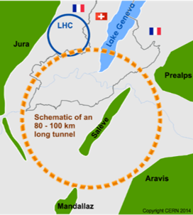
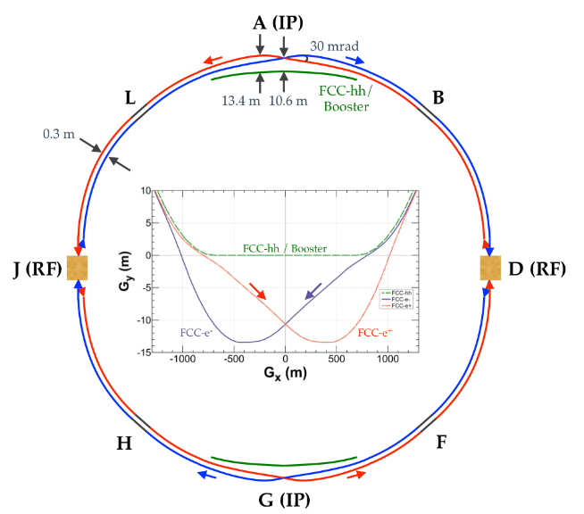
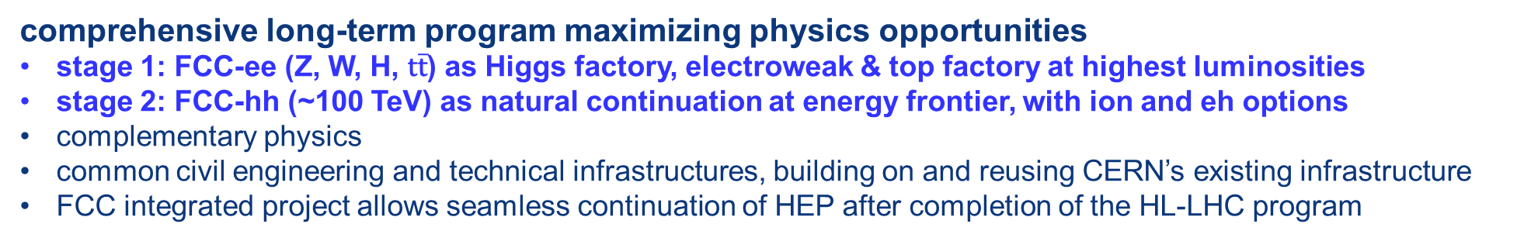
FCC integrated project: inspired by LEP- LHC
comprehensive long-term program maximizing physics opportunities
stage 1: FCC-ee (Z, W, H, $\text{t}\overline{\text{t}}$) as Higgs factory, electroweak & top factory at highest luminosities
stage 2: FCC-hh (~100 TeV) as natural continuation at energy frontier, with ion and eh options
complementary physics
common civil engineering and technical infrastructures, building on and reusing CERN’s existing infrastructure
FCC integrated project allows seamless continuation of HEP after completion of the HL-LHC program
FCC-hh
FCC-ee
2020 - 2045
2045 - 2060
2070 – 2090++
Notes:
The FCC study and program comprises of two accelerators: the Lepton Collider FCC-ee and the Hadron Collider FCC-hh.
The aim of this setup is devise a comprehensive, cost-effective program to maximizing the physics opportunities.

Slide 3
FCC-ee collider parameters (stage 1)
Parameter (for 97.75 km circumference) | Z | WW | H (ZH) | ttbar
beam energy [GeV] | 45 | 80 | 120 | 182.5
beam current [mA] | 1390 | 147 | 29 | 5.4
no. bunches/beam | 16640 | 2000 | 393 | 48
bunch intensity [10¹¹] | 1.7 | 1.5 | 1.5 | 2.3
SR energy loss / turn [GeV] | 0.036 | 0.34 | 1.72 | 9.21
total RF voltage [GV] | 0.1 | 0.44 | 2.0 | 10.9
long. damping time [turns] | 1281 | 235 | 70 | 20
horizontal beta* [m] | 0.15 | 0.2 | 0.3 | 1
vertical beta* [mm] | 0.8 | 1 | 1 | 1.6
horiz. geometric emittance [nm] | 0.27 | 0.28 | 0.63 | 1.46
vert. geom. emittance [pm] | 1.0 | 1.7 | 1.3 | 2.9
bunch length with SR / BS [mm] | 3.5 / 12.1 | 3.0 / 6.0 | 3.3 / 5.3 | 2.0 / 2.5
luminosity per IP [10³⁴ cm⁻²s⁻¹] | 230 | 28 | 8.5 | 1.55
beam lifetime rad Bhabha / BS [min] | 68 / >200 | 49 / >1000 | 38 / 18 | 40 / 18
Update ongoing for FCCWeek Paris

Slide 4

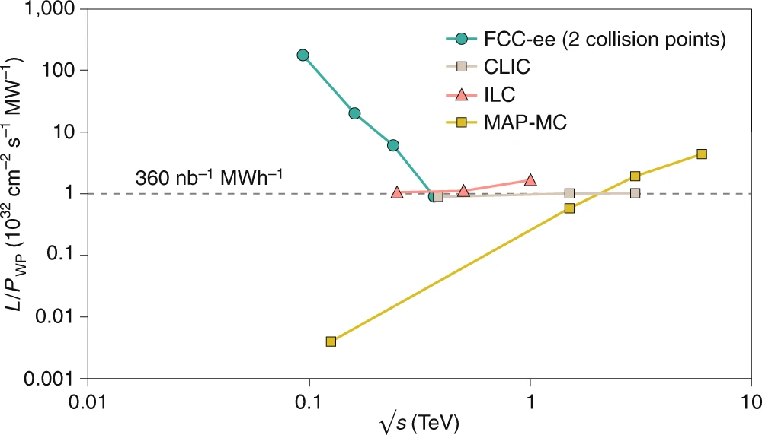
FCC-ee figures of merit
Luminosity vs. capital cost
for the H running, with 5 ab⁻¹ accumulated over 3 years and 10⁶ H produced, the total investment cost (~10 BCHF) corresponds to → 10 kCHF per produced Higgs boson
for the Z running with 150 ab⁻¹ accumulated over 4 years and 5x10¹² Z produced, the total investment cost corresponds to → 10 kCHF per 5×10⁶ Z bosons
This is the number of Z bosons collected by each experiment during the entire LEP programme !
Luminosity vs. electricity consumption
Due to twin-aperture magnets,
thin-film SRF, efficient RF power
sources, top-up injection
Capital cost per luminosity dramatically
decreased compared with LEP !
Highest lumi/power of all H fact proposals
Electricity cost ~200 CHF per Higgs boson

Slide 5
FCC-hh (pp) collider parameters (stage 2)
parameter | FCC-hh |  | HL-LHC | LHC
collision energy cms [TeV] | 100 |  | 14 | 14
dipole field [T] | 16 () |  | 8.33 | 8.33
circumference [km] | 97.75 |  | 26.7 | 26.7
beam current [A] | 0.5 |  | 1.1 | 0.58
bunch intensity [10¹¹] | 1 | 1 | 2.2 | 1.15
bunch spacing [ns] | 25 | 25 | 25 | 25
synchr. rad. power / ring [kW] | 2400 |  | 7.3 | 3.6
SR power / length [W/m/ap.] | 28.4 |  | 0.33 | 0.17
long. emit. damping time [h] | 0.54 |  | 12.9 | 12.9
beta* [m] | 1.1 | 0.3 | 0.15 (min.) | 0.55
normalized emittance [μm] | 2.2 |  | 2.5 | 3.75
peak luminosity [10³⁴ cm⁻²s⁻¹] | 5 | 30 | 5 (lev.) | 1
events/bunch crossing | 170 | 1000 | 132 | 27
stored energy/beam [GJ] | 8.4 |  | 0.7 | 0.36
Update ongoing for FCCWeek Paris

Slide 6
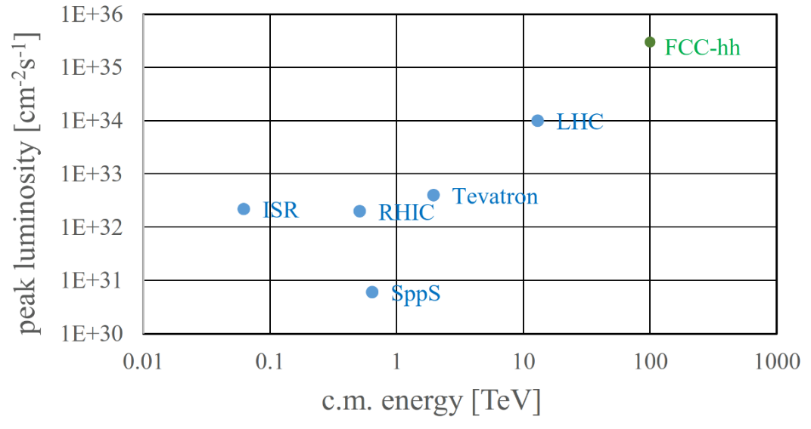
FCC-hh: performance
order of magnitude performance increase in energy & luminosity
100 TeV cm collision energy (vs 14 TeV for LHC)
20 ab⁻¹ per experiment collected over 25 years of operation (vs 3 ab⁻¹ for LHC)
similar performance increase as from Tevatron to LHC
key technology: high-field magnets

Slide 7
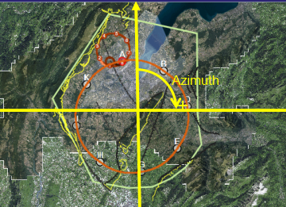
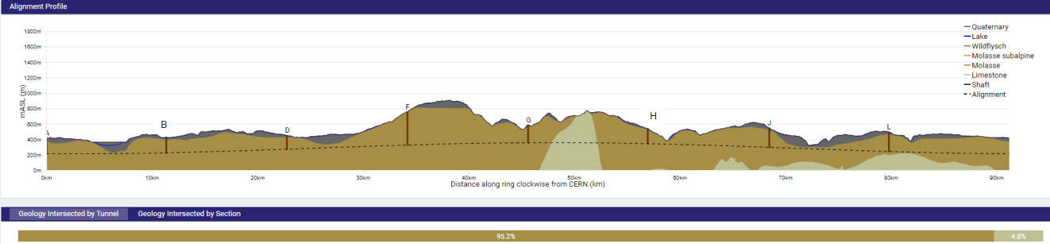
FCC implementation - footprint baseline
Present implementation variant was established considering:
Geological 3D model and tunnelling risks
Territorial aspects from previous studies, also with Host States
No site visits, no interactions with land owners have taken place yet
Further work requires close interaction with Host State services.
91.2 km circumference
8 surface sites with ~5 ha area each.

Slide 8
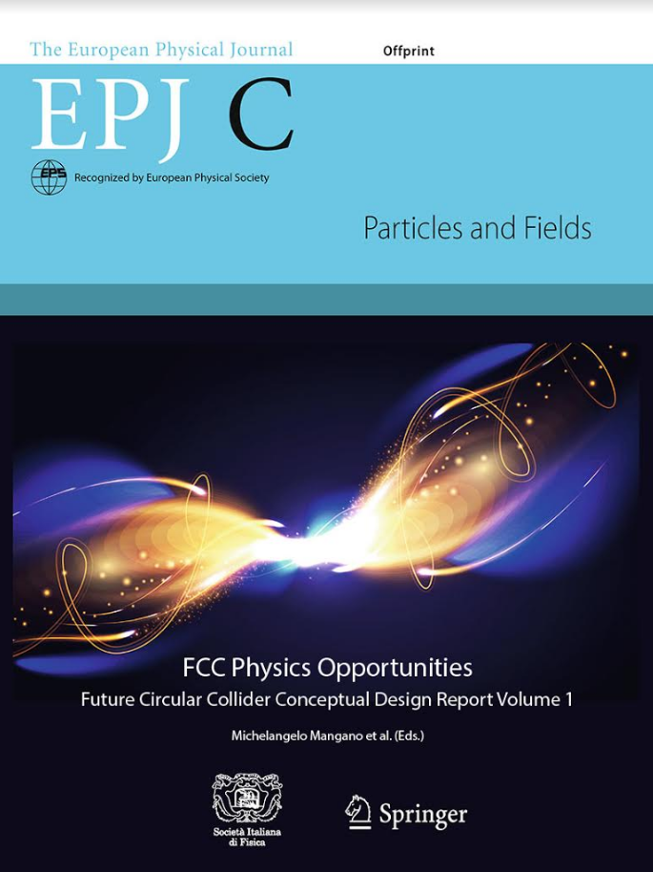
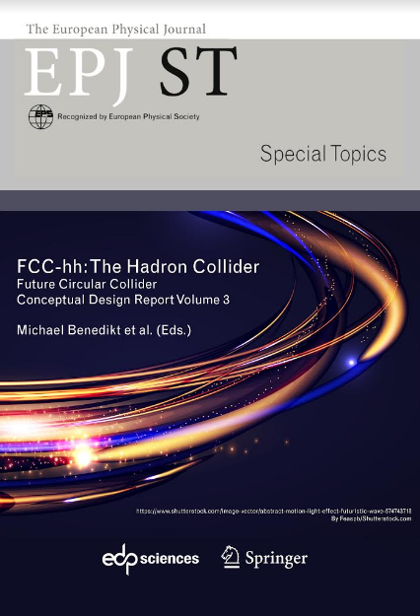
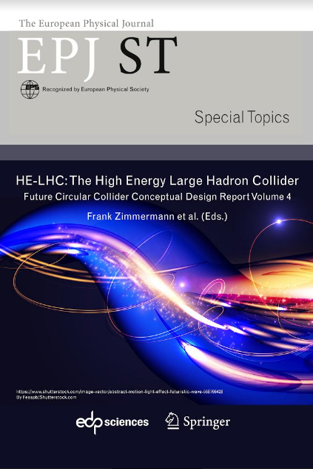
FCC CDR & Study Documentation
FCC-Conceptual Design Reports:
  Vol 1 Physics, Vol 2 FCC-ee, Vol 3 FCC-hh, Vol 4 HE-LHC
  CDRs published in European Physical Journal C (Vol 1) and ST (Vol 2 – 4) [Springer]
  EPJ C 79, 6 (2019) 474 , EPJ ST 228, 2 (2019) 261-623 ,
  EPJ ST 228, 4 (2019) 755-1107 , EPJ ST 228, 5 (2019) 1109-1382
EPJ is a merger and continuation of Acta Physica Hungarica, Anales de Fisica, Czechoslovak Journal of Physics, Fizika A, Il Nuovo Cimento, Journal de Physique, Portugaliae Physica and Zeitschrift für Physik. 25 European Physical Societies are represented in EPJ, including the DPG.
Summary documents provided to EPPSU 2019/20
  FCC-integral, FCC-ee, FCC-hh, HE-LHC
  Accessible on http://fcc-cdr.web.cern.ch/
>1350 contributors from > 350 institutes,
a truly global effort as suggested by EPPSU 2013

Slide 9
from ESPP Update 2020
      High-priority future initiatives:
      An electron-positron Higgs factory is the highest-priority next collider. For the longer term, the European particle physics community has the ambition to operate a proton-proton collider at the highest achievable energy.
      “Europe, together with its international partners, should investigate the technical and financial feasibility of a future hadron collider at CERN with a centre-of-mass energy of at least 100 TeV and with an electron-positron Higgs and electroweak factory as a possible first stage.
      Such a feasibility study of the colliders and related infrastructure should be established as a global endeavour and be completed on the timescale of the next Strategy update..”

Slide 10
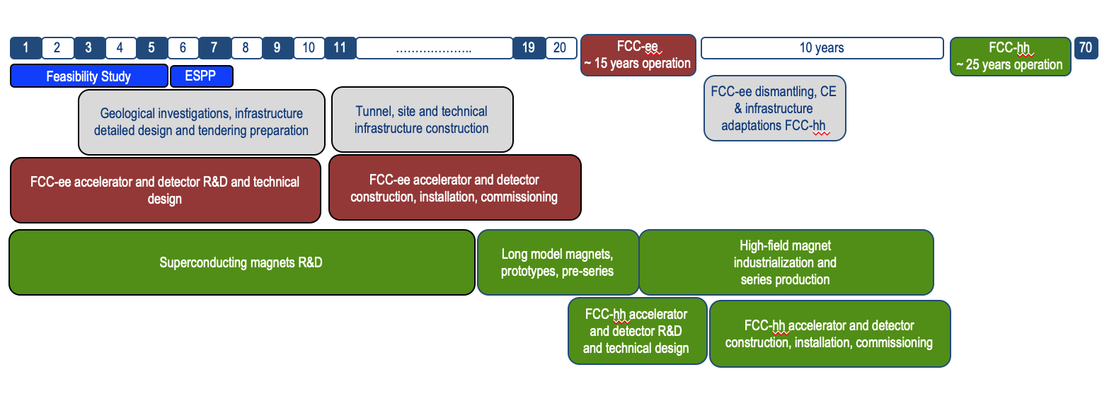
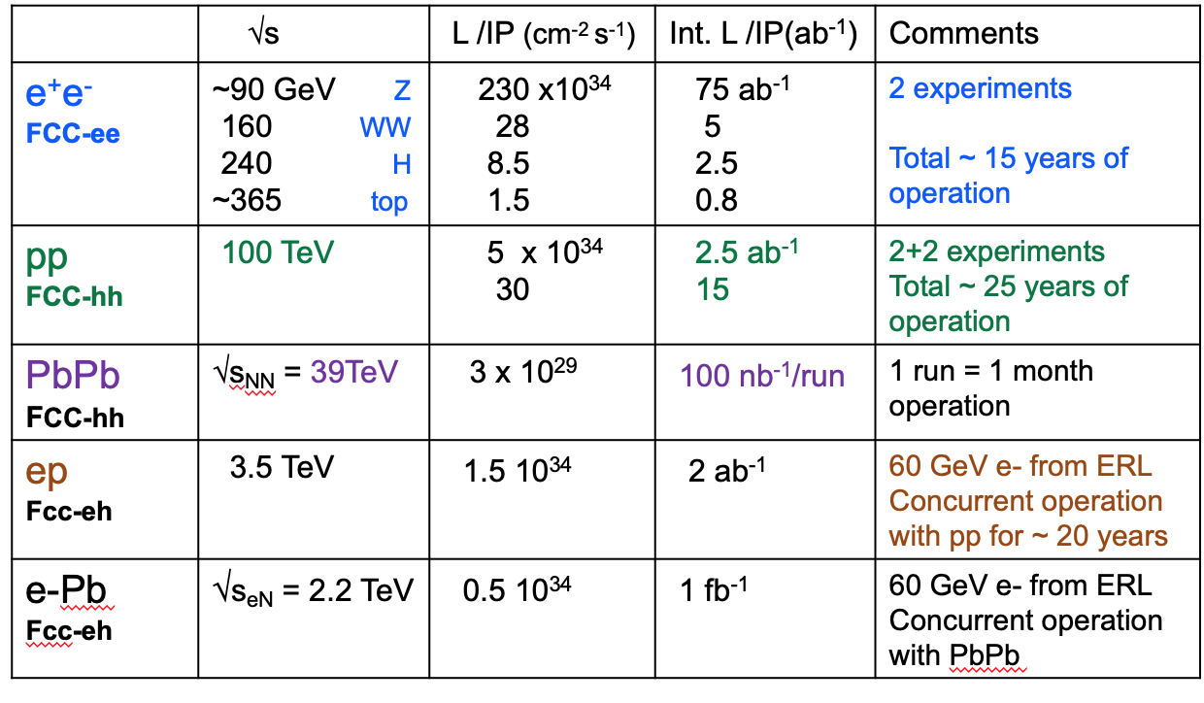
Timeline of the FCC integrated programme
Technical
schedule
2-4 experiments
20-30
Feasibility Study: 2021-2025
If project approved before end of
decade → construction can start
beginning 2030s
FCC-ee operation ~2045-2060
FCC-hh operation 2070-2090++
F. Gianotti

Slide 11
FCC feasibility study 2021 – 25 & roadmap
Highest priority goals:
Financial feasibility
Technical and administrative feasibility of tunnel: no show-stopper for ~100 km tunnel
\
Technologies of machine and experiments: magnets; minimised environmental impact; energy efficiency & recovery
Gathering scientific, political, societal and other support
>2040 first
ee collisions
Fabiola Gianotti: “CERN vision and goals until next strategy update” FCCIS Kick-Off, 9 Nov. 2020
>2030
start tunnel
construction
>2036
machine
installation
2028 approval
2026/7
ESPPU
>2030 - 37
element production
2025/26
Feasibility proof
>2026 - 30 full
technical design
2014 FCC
study kickoff
2020
ESPPU
2020 FCCIS
kickoff
2025/26
Financing model
Operation concept
2013
ESPPU
2018 FCC CDR
2020-25
FCC Feasibility Study
FCCIS H2020 DS
today
2012 Higgs discovery announced
2011 circular Higgs factory proposal

Slide 12
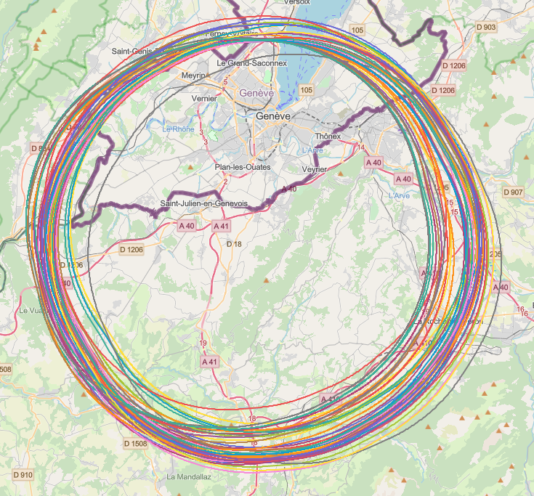
Implementation studies with host states
layout & placement optimisation across both host states, Switzerland and France;
following "avoid-reduce-compensate" directive of European & French regulatory frameworks;
diverse requirements and constraints:
  technical feasibility of civil engineering and subsurface geological constraints
  territorial constraints on surface and subsurface
  nature, accessibility, technical infrastructure, resource needs & constraints
  optimum machine performance and efficiency
  economic factors including benefits for, and synergies, with the regional developments
  …
collaborative effort: FCC technical experts, consulting companies, government-notified bodies

Slide 13
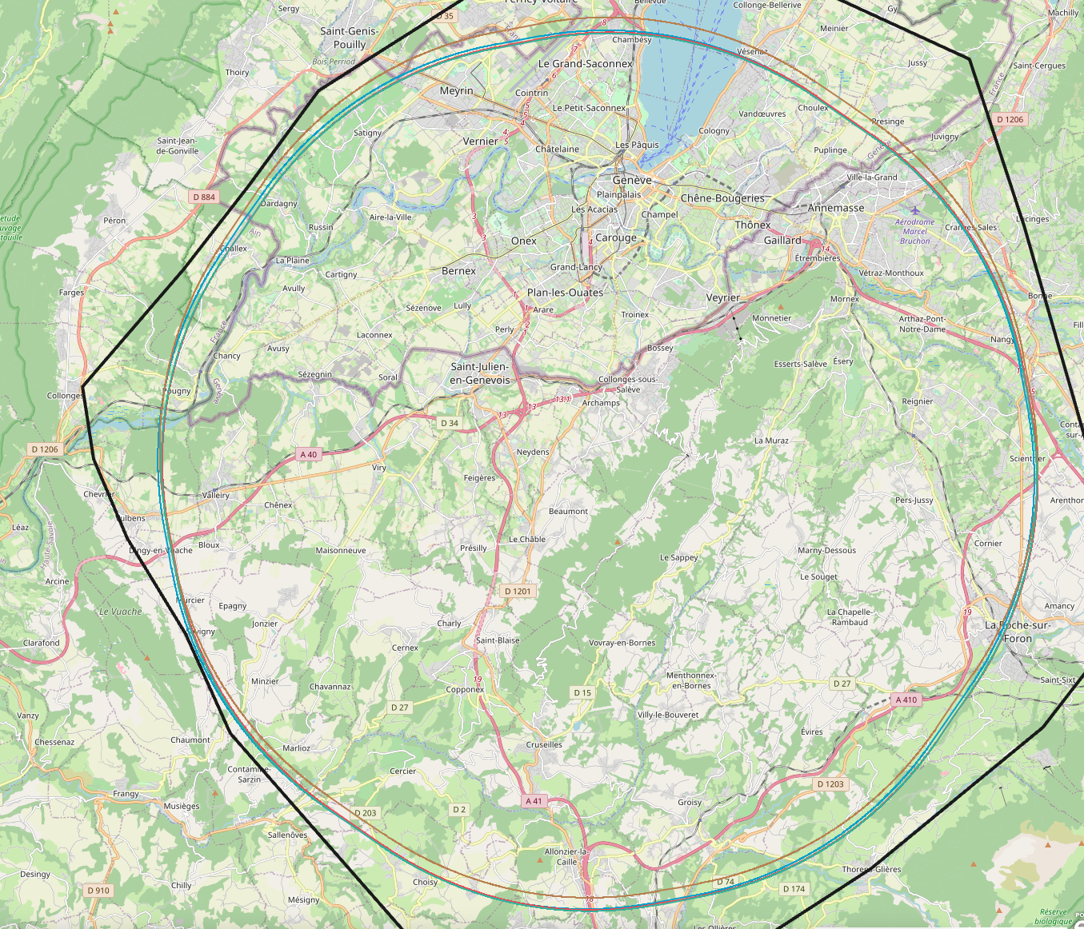
Detailed implementation studies
Analysis of baseline scenario from review PA31-1.0 with automated search tool with enlarged perimeters around target areas for surface sites.
More than 3’000’000 iterations on PA31-1.0 with different starting conditions revealed no better ranked scenarios in geological boundary area.
Presently three scenarios maintained, optimised fallback scenarios 1.1 and 1.6 in addition to a baseline 1.0 scenario that will only be considered if 1.0 turns out to be incompatible from a territorial point of view.

Slide 14
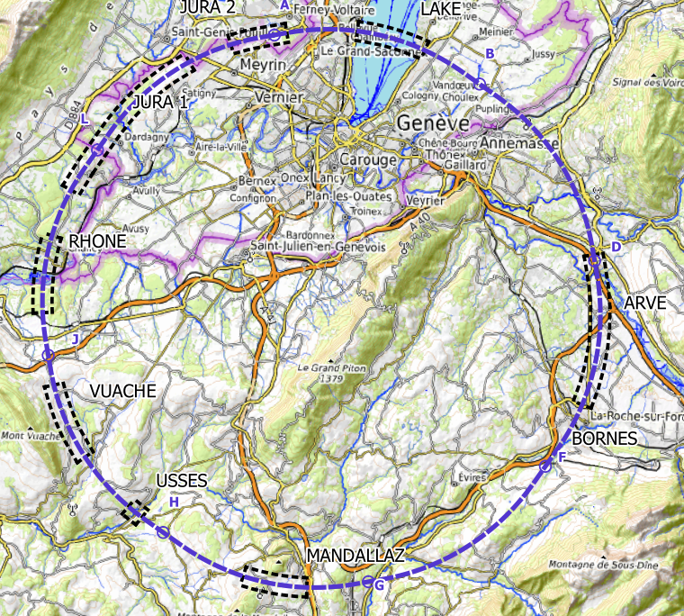
Plans for high-risk area site investigations
  Jura, Vuache (3 Areas)
  Top of limestone
  Karstification and filling-in at the tunnel depth
  Water pressure
  Lake, Rhône, Arve and Usses Valley (4 Areas)
  Top of the molasse
  Quaternary soft grounds, water bearing layers
  Mandallaz (1 Areas)
  Water pressure at the tunnel level
  Karstification
  Bornes (1 Area)
  High overburden molasse properties
  Thrust zones
  Site investigations planned for mid 2023 – mid 2025:
  ~40-50 drillings, 100 km of seismic lines

Slide 15
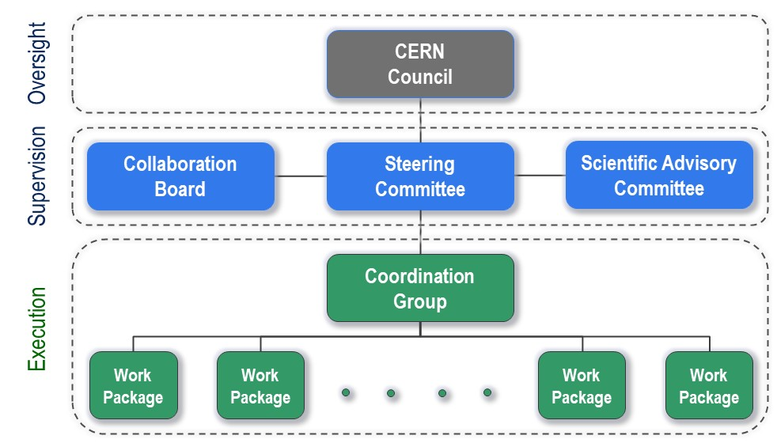
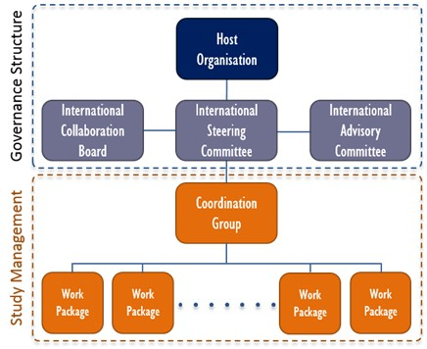
FCC Feasibility Study - organisational structure
  New structure very similar to the first phase of the FCC Study (2014-2020), leading to the Conceptual Design Report as input to the ESPPU.
  Classical structure common to CERN projects.

Slide 16
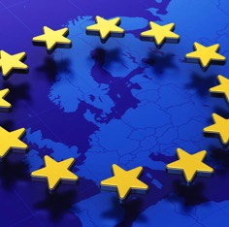
Status of Global FCC Collaboration
Increasing international collaboration as a prerequisite for success:
links with science, research & development and high-tech industry will be essential to further advance and prepare the implementation of FCC
147
Institutes
30
Companies
34
Countries
EC
H2020

Slide 17

FCC Feasibility Study – coordination team and contact persons
EU Projects
NN
Study Support Unit
IT: Sylvain Girod
Procurement: Adam Horridge
Quality control: NN
Resources: Sylvie Prodon
Scheduling, quality mangement: NN
Secretariat: Julie Hadre
Collaboration building
Emmanuel Tsesmelis
Study Support and Coordination
Study Leader: Michael Benedikt
Deputy Study Leader: Frank Zimmermann
Communications
Panagiotis Charitos, James Gillies
Physics, Experiments and Detectors
Christophe Grojean
Patrick Janot
Physics programme
Matthew McCullough, Frank Simon
Accelerators
Tor Raubenheimer
Frank Zimmermann
Project organisation model
Technical Infrastructures
Klaus Hanke
Host State processes and civil engineering
Timothy Watson
Organisation and financing models
Paul Collier (interim)
FCC-ee collider design
Katsunobu Oide
FCC-hh design
Massimo Giovannozzi
Technology R&D
Roberto Losito
FCC-ee booster design
Antoine Chancé
FCC-ee injector
Paolo Craievich, Alexej Grudiev
FCC-ee energy calibration polarization
Alain Blondel, Jorg Wenninger
FCC-ee MDI
Manuela Boscolo, Mike Sullivan
Integration
Jean-Pierre Corso
Geodesy & survey
Hélène Mainaud Durand
Electricity and energy management
Jean-Paul Burnet
Cooling and ventilation
Guillermo Peon
Cryogenics systems
Laurent Delprat
Computing and controls infrastructure, communication and network
Dirk Duellmann
Safety
Thomas Otto
Operation, maintenance, availability, reliability
Jesper Nielsen
Transport, installation concepts
Cristiana Colloca
Administrative processes
Friedemann Eder
Placement studies
Johannes Gutleber, Volker Mertens
Environmental evaluation
Johannes Gutleber
Tunnel, subsurface design
John Osborne
Surface sites layout, access and building design
Detector concepts
Mogens Dam, Felix Sefkow, Philipp Roloff
Physics performance
Patrizia Azzi, Emmanuel Perez
Software and computing
Gerardo Ganis, Clément Helsens
Financing model
Florian Sonnemann
Procurement strategy and rules
In-kind contributions
Operation model
Paul Collier, Jorg Wenninger

Slide 18
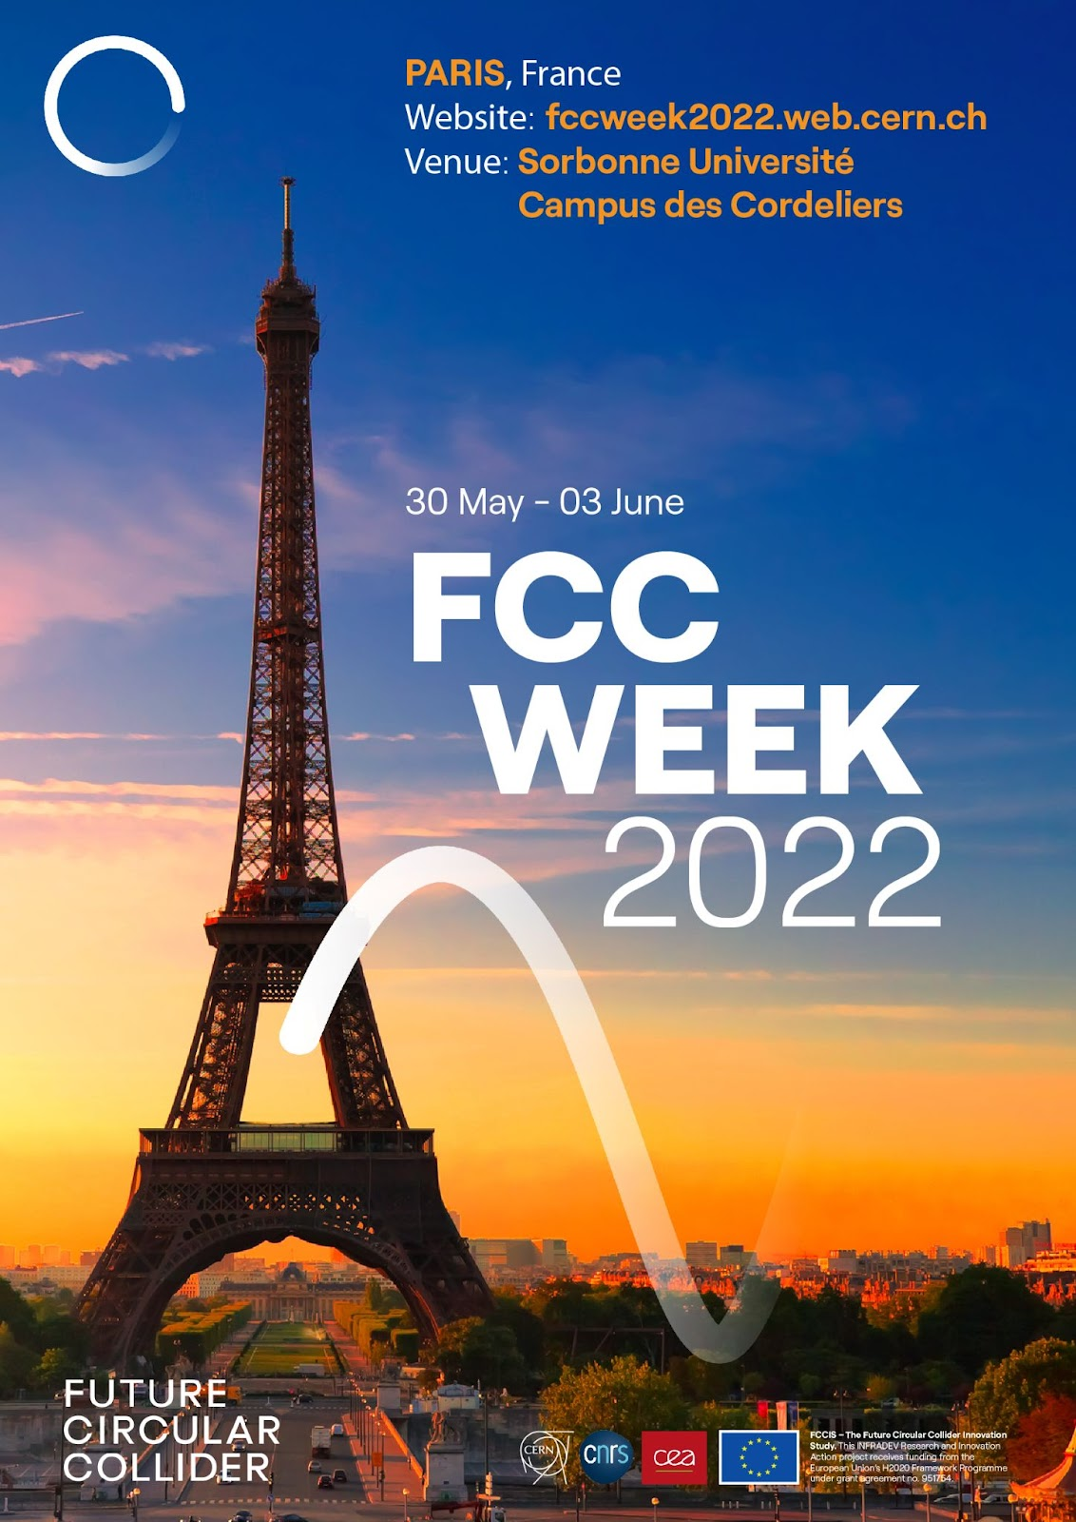
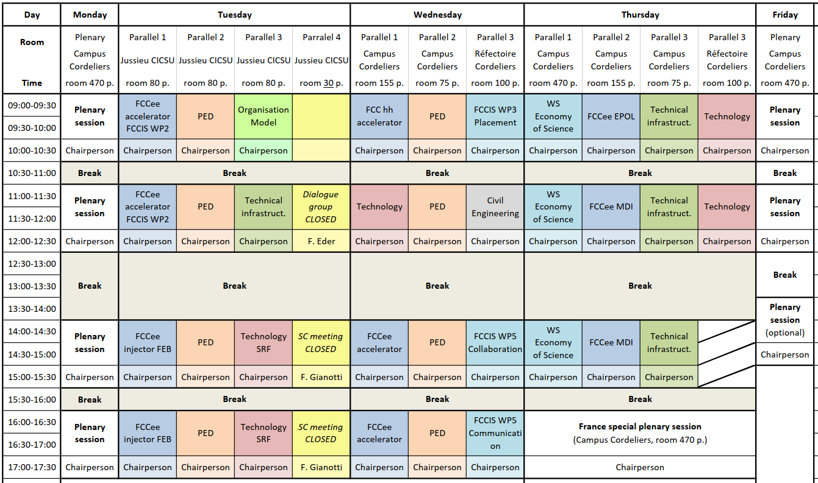
FCC Week 2022
In Paris 30 May to 3 June 2022, planning for a hybrid event.
We are looking forward to seeing you there !

Slide 19
Summary
The European Strategy Update 2019/20 issued the request for a feasibility study of the FCC integrated programme to be delivered by end 2025.
The main activities of the FCC Feasibility Study are:
  concrete local/regional implementation scenario in collaboration with host state authorities,
  accompanied by machine optimization, physics studies and technology R&D,
  performed via global collaboration and supported by EC H2020 Design Study FCCIS,
  in parallel High Field Magnet R&D program as separate line, to prepare for FCC-hh.
Long term goal: world-leading HEP infrastructure for 21st century to push the particle-physics precision and energy frontiers far beyond present limits.
Success of FCC relies on strong global participation. Everybody interested is warmly welcome to join the effort!

