Slide 1








Status Report on FCC Accelerator Science and Technology
Frank Zimmermann, CERN
Estonia, Engagement Meeting,
2 March 2022
LHC
PS
SPS
FCC
http://cern.ch/fcc
Work supported by the European Commission under the HORIZON 2020 projects EuroCirCol, grant agreement 654305; EASITrain, grant agreement no. 764879; ARIES, grant agreement 730871, FCCIS, grant agreement 951754, and I.FAST, grant agreement 101004730.
photo: J. Wenninger

Slide 2

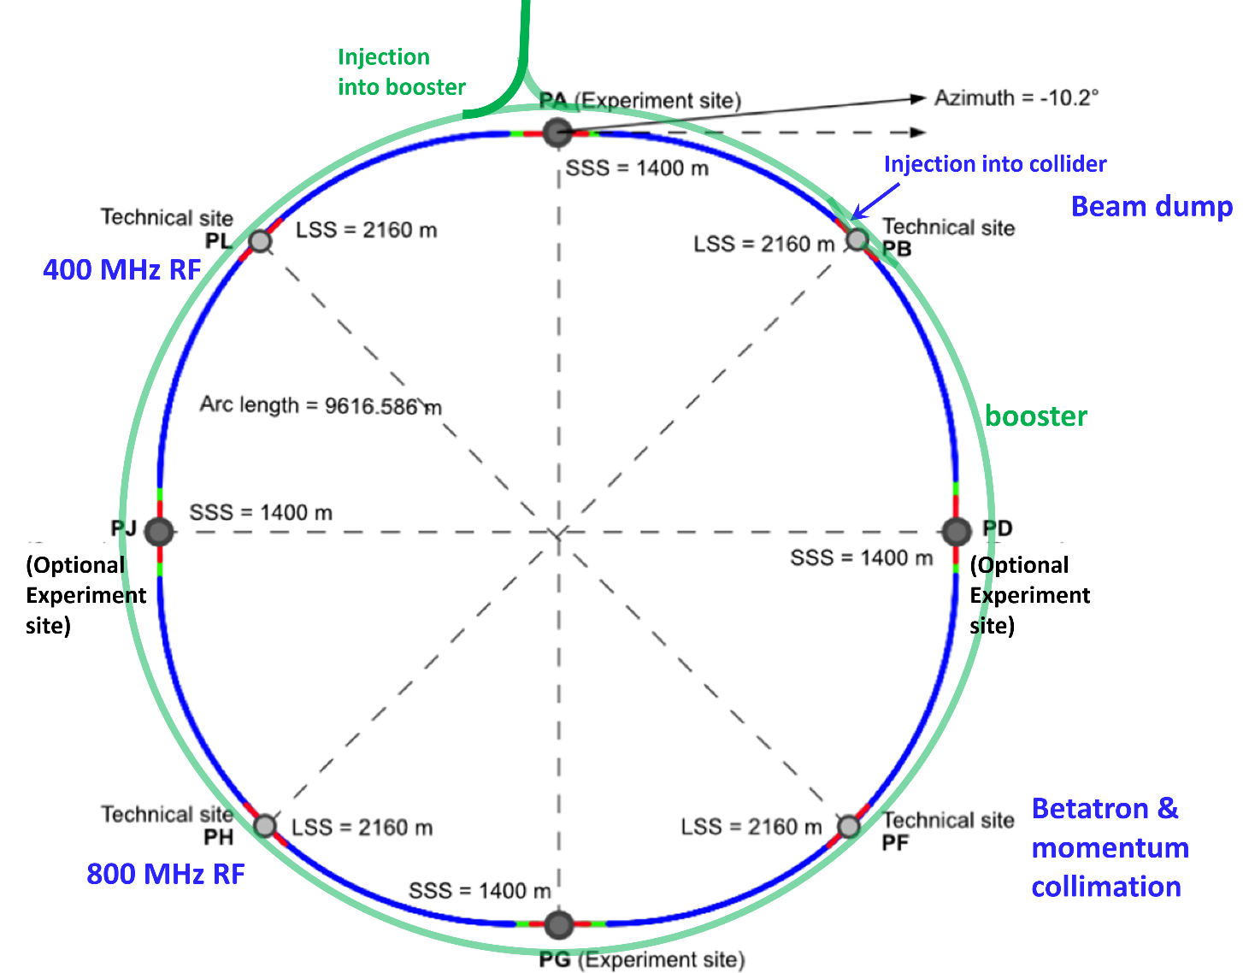
ee design choices & new “lowest risk” layout
Double ring e+ e- collider
Common footprint with FCC-hh, except around IPs
Asymmetric IR layout and optics to limit synchrotron radiation towards the detector
2 IPs, large horizontal crossing angle 30 mrad, crab-waist collision optics (alternative layouts with 4 IPs under study now)
Synchrotron radiation power 50 MW/beam at all beam energies
Top-up injection scheme for high luminosity Requires booster synchrotron in collider tunnel

Slide 3
FCC-ee collider parameters (stage 1)
Parameter [4 IPs, 91.2 km circumference] | Z | WW | H (ZH) | ttbar
beam energy [GeV] | 45 | 80 | 120 | 182.5
beam current [mA] | 1400 | 135 | 26.7 | 5.0
no. bunches/beam | 8800 | 1120 | 336 | 42
bunch intensity [10¹¹] | 2.76 | 2.29 | 1.51 | 2.26
SR energy loss / turn [GeV] | 0.0391 | 0.37 | 1.869 | 10.0
total RF voltage 400/800 MHz [GV] | 0.120/0 | 1.0/0 | 2.48/0 | 4.0/7.67
long. damping time [turns] | 1170 | 216 | 64.5 | 18.5
horizontal beta* [m] | 0.15 | 0.2 | 0.3 | 1
vertical beta* [mm] | 0.8 | 1 | 1 | 1.6
horiz. geometric emittance [nm] | 0.71 | 0.28 | 0.64 | 1.49
vert. geom. emittance [pm] | 1.42 | 4.34 | 1.29 | 2.98
bunch length with SR / BS [mm] | 4.32 / 15.2 | 3.55 / 7.02 | 2.5 / 4.45 | 1.67 / 2.54
luminosity per IP [10³⁴ cm⁻²s⁻¹] | 181 | 17.3 | 7.2 | 1.25
beam lifetime rad Bhabha / BS [min] | 19 / - | 20 / - | 10 / 19 | 12 / 46
preliminary - for new layout & with 4 IPs

Slide 4
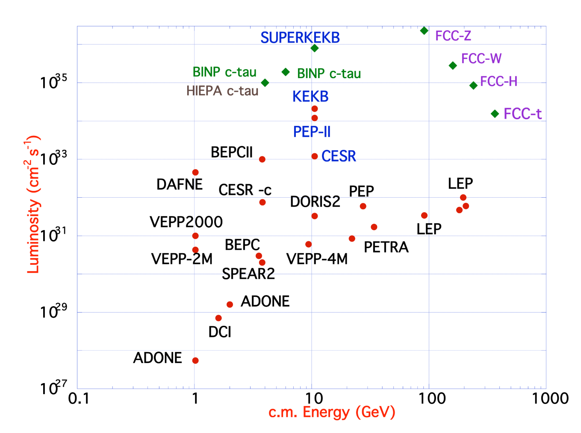
FCC-ee design concept
based on lessons and techniques from past colliders (last 40 years)
B-factories: KEKB & PEP-II:
double-ring lepton colliders,
high beam currents,
top-up injection
DAFNE: crab waist, double ring
S-KEKB: low β_{y}*, crab waist
LEP: high energy, SR effects
VEPP-4M, LEP: precision E calibration
KEKB: e⁺ source
HERA, LEP, RHIC: spin gymnastics
Marica Biagini
Marica Biagini
combining successful ingredients of several recent colliders → highest luminosities & energies

Slide 5
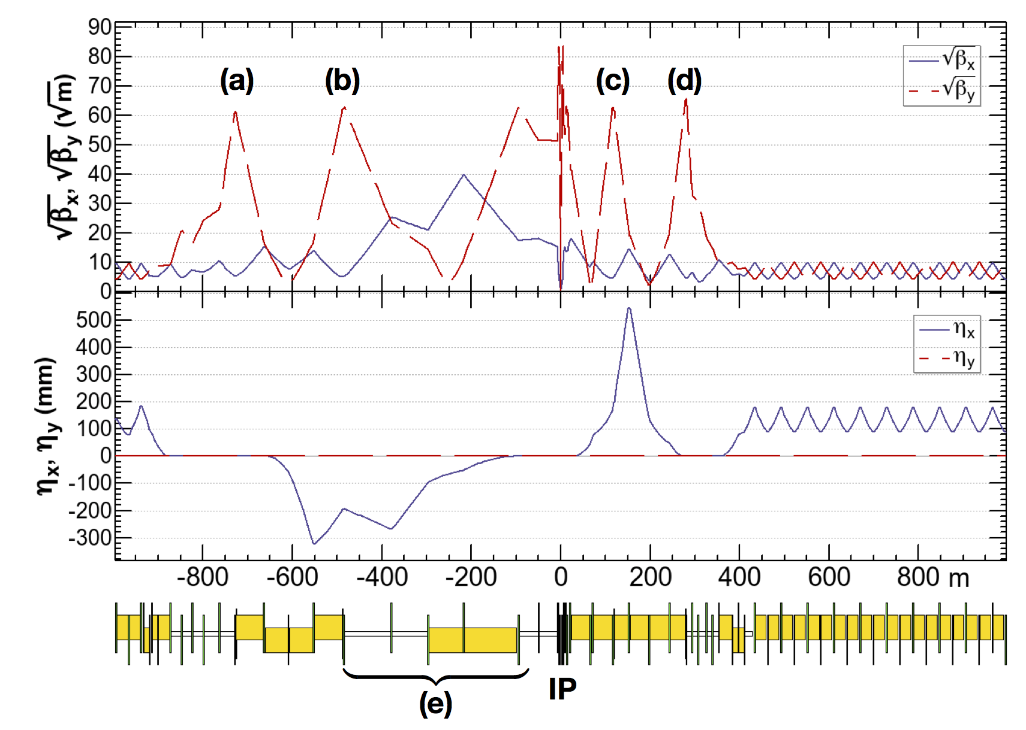
new: FCC-ee asymmetric crab-waist IR optics
Novel asymmetric IR optics to suppress synchrotron radiation toward the IP, E_{critical} <100 keV from 450 m from IP (e) – lesson from LEP
4 sextupoles (a – d) for local vertical chromaticity correction combined with crab waist, optimized for each working point – novel “virtual crab waist”, standard crab waist demonstrated at DAFNE
low incident SR,
minimum nonlinearities
ttbar 182.5 GeV
K. Oide et al., Design of beam optics for the future circular collider e⁺e⁻ collider rings, Phys. Rev. Accel. Beams 19, 111005 (2016).
yellow boxes:
dipole magnets
H. Burkhardt, K. Oide, et al.

Slide 6
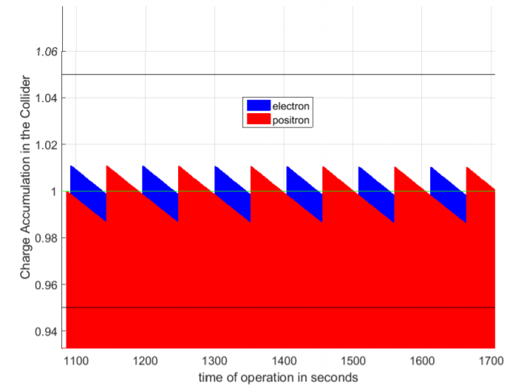
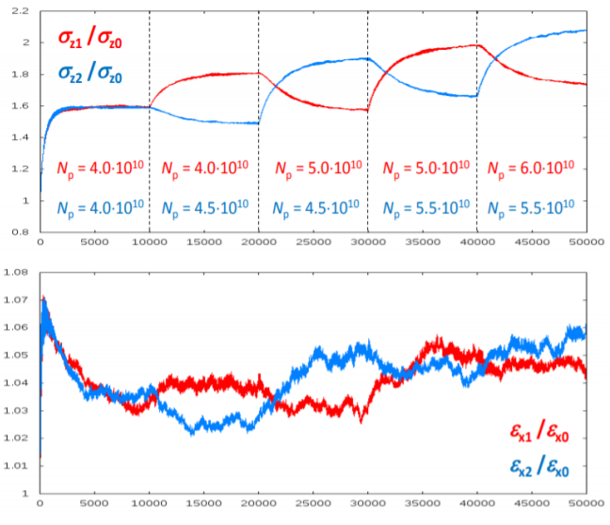
new: “bootstrapping” & top-up injection
injection from zero, alternating between beams to avoid beam-beam flip-flop effect
alternating replenishment of the two colliding beams, keeping beam currents stable within a few per cent
D. Shatilov
S. Ogur
average luminosity ~ peak luminosity

Slide 7

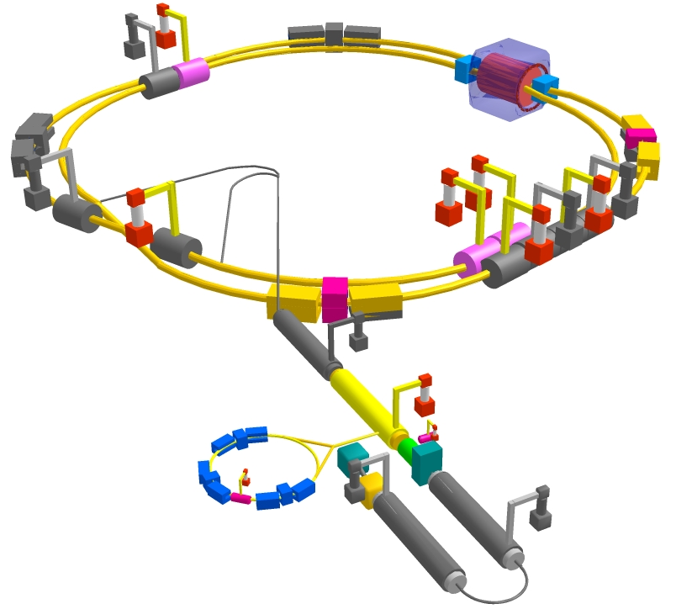
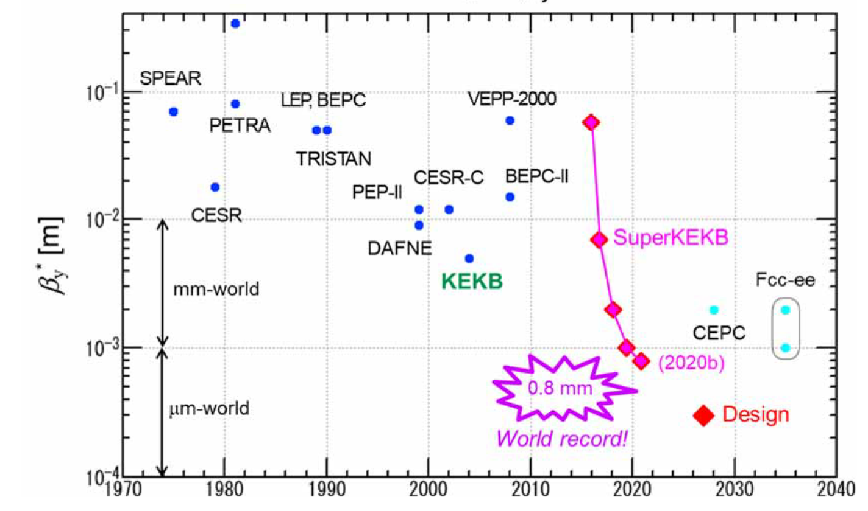
SuperKEKB – pushing luminosity and β*
Design: double ring e⁺e⁻ collider as B-factory at 7(e⁻) & 4(e⁺) GeV; design luminosity $\sim$8 x 10³⁵ cm⁻²s⁻¹; β_{y}* $\sim$0.3 mm;
nano-beam – large crossing angle collision scheme (crab waist w/o sextupoles); beam lifetime$\sim$5 minutes; top-up injection;
e⁺ rate up to $\sim$ 2.5 10¹² /s ; under commissioning
M. Tobiyama, K. Oide
SuperKEKB is demonstrating FCC-ee key concepts
β_{y}* = 0.8 mm achieved in both rings – using the
FCC-ee-style “virtual” crab-waist collision scheme
Y. Funakoshi, Y. Ohnishi, K. Oide
new world record L = 3.81 x 10³⁴ cm⁻²s⁻¹ on 23 December ‘21

Slide 8
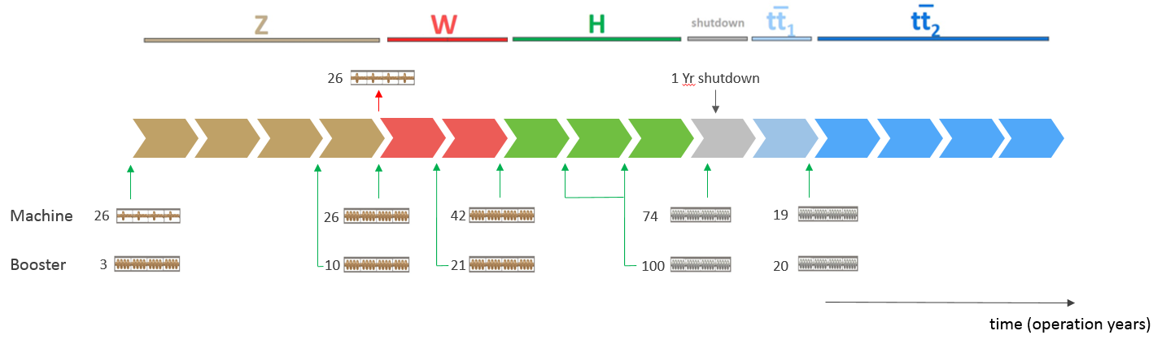
FCC-ee RF staging scenario
“Ampere-class” machine
three sets of RF cavities to cover all options for FCC-ee & booster:
high intensity (Z, FCC-hh): 400 MHz mono-cell cavities (4/cryom.)
higher energy (W, H, t): 400 MHz four-cell cavities (4/cryomodule)
ttbar machine complement: 800 MHz five-cell cavities (4/cryom.)
installation sequence comparable to LEP ( ≈ 30 CM/shutdown)
WP | V_{rf} [GV] | #bunches | I_{beam} [mA]
Z | 0.1 | 16640 | 1390
W | 0.44 | 2000 | 147
H | 2.0 | 393 | 29
ttbar | 10.9 | 48 | 5.4
“high-gradient” machine
RF development: SC cavities, SRF material & coating techniques, cavity fabrication,
cryomodules, FPC & HOM couplers, RF power sources, …

Slide 9
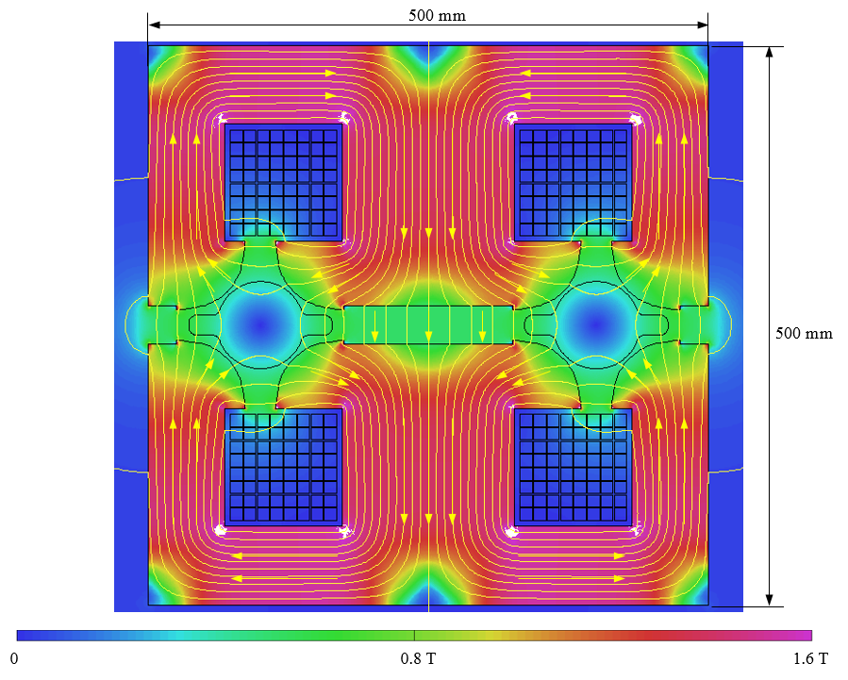
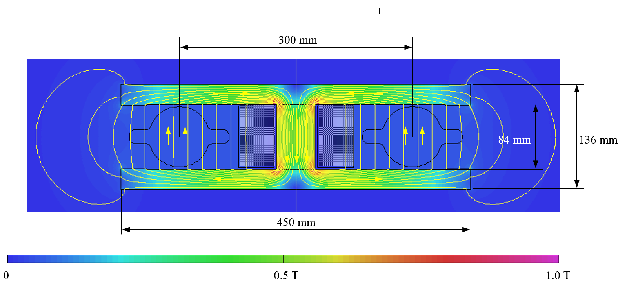
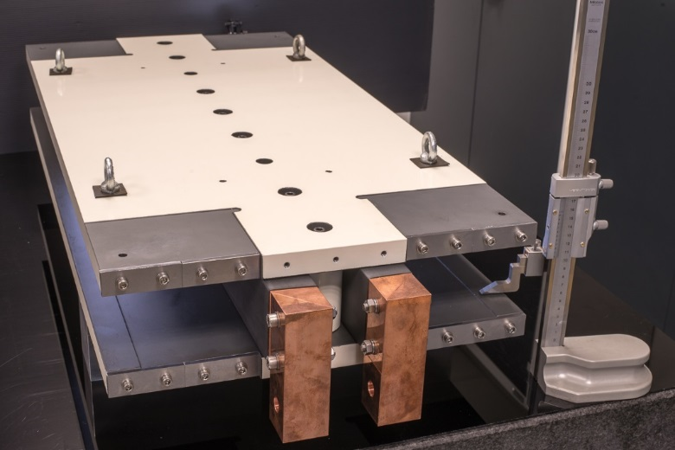
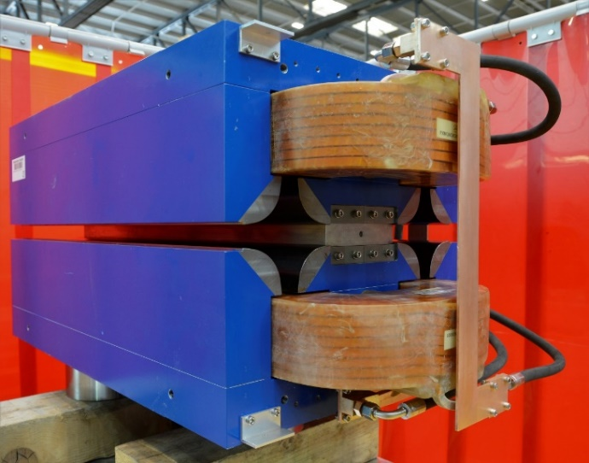
prototypes of FCC-ee low-power magnets
Twin-dipole design with 2× power saving
16 MW (at 175 GeV), with Al busbars
Twin F/D arc quad design with 2× power saving
25 MW (at 175 GeV), with Cu conductor
A. Milanese
Phys. Rev. Accel. Beams 19, 112401 (2016)
prototype
prototype
even more efficient alternative magnet designs are being explored

Slide 10
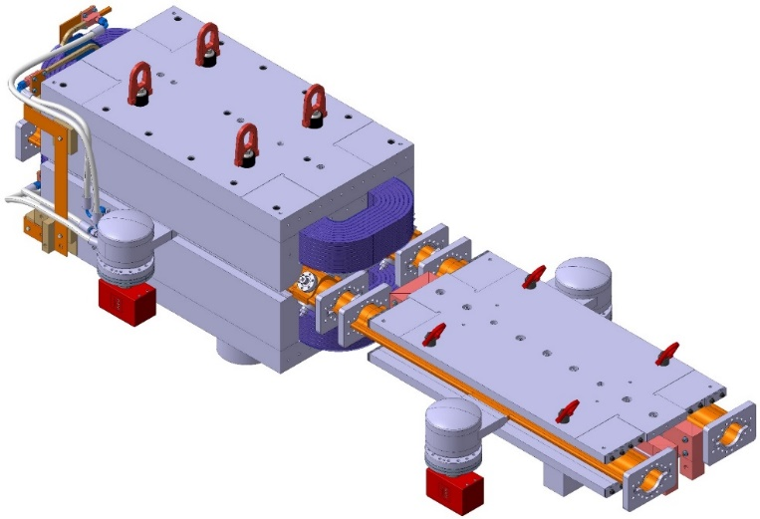
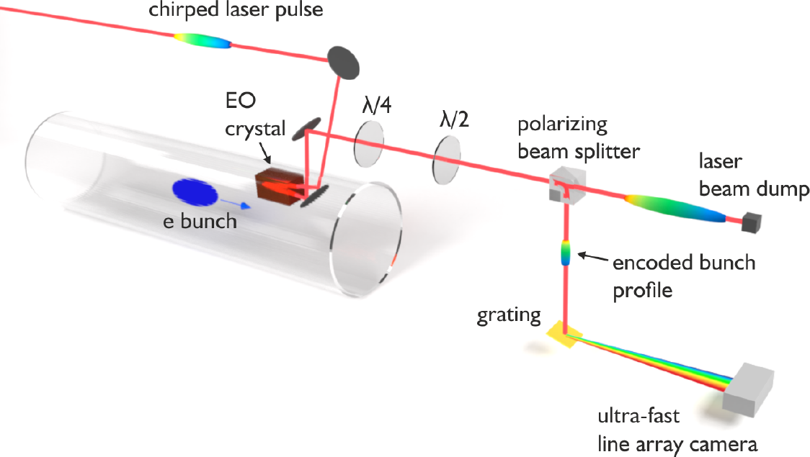
FCC-ee R&D: prototypes by 2025
FCC-ee complete arc half-cell mock up
including girder, vacuum system with antechamber + pumps, dipole, quadrupole + sext. magnets, BPMs, cooling + alignment systems, technical infrastructure interfaces.
R. Kersevan et al
key beam diagnostics elements
bunch-by-bunch turn-by-turn longitudinal charge density profiles based on electro-optical spectral decoding (beam tests at KIT/KARA) ; ultra-low emittance measurement (X-ray interferometer tests at SuperKEKB, ALBA) ; beam-loss monitors (IJCLab/KEK?) ;
beamstrahlung monitor (KEK); polarimeter ; luminometer
A.-S. Müller et al, KIT
bunch electric field at the crystal
changes the laser pulse polarization

Slide 11
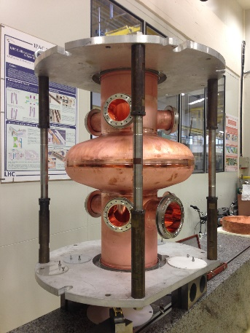
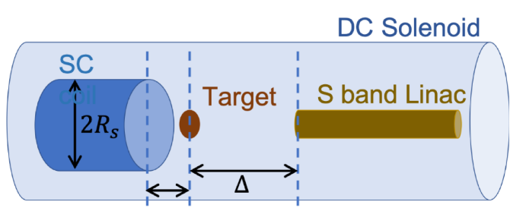
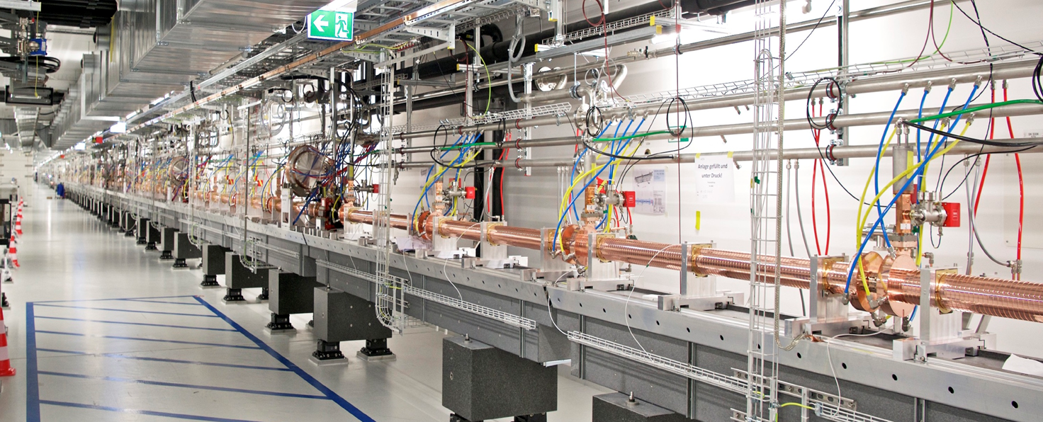
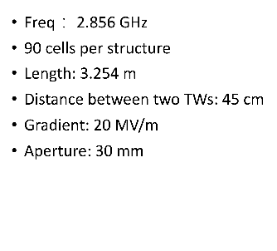
FCC-ee R&D: prototypes by 2025
400 MHz SRF cryomodule,
+ prototype multi-cell cavities for FCC ZH operation
High-efficiency RF power sources
high-yield positron source
target with DC SC solenoid or flux
concentrator
positron capture linac
large aperture S-band linac
beam test of e⁺ source & capture linac at SwissFEL – yield measurement
SwissFEL linac
strong support from Switzerland via CHART II program 2019 – 2024 for FCC-ee injector, HFM, beam optics developments, geology and geodesy activities.
P. Craievich, H. Braun,
A. Grudiev, I. Chaikovska

Slide 12
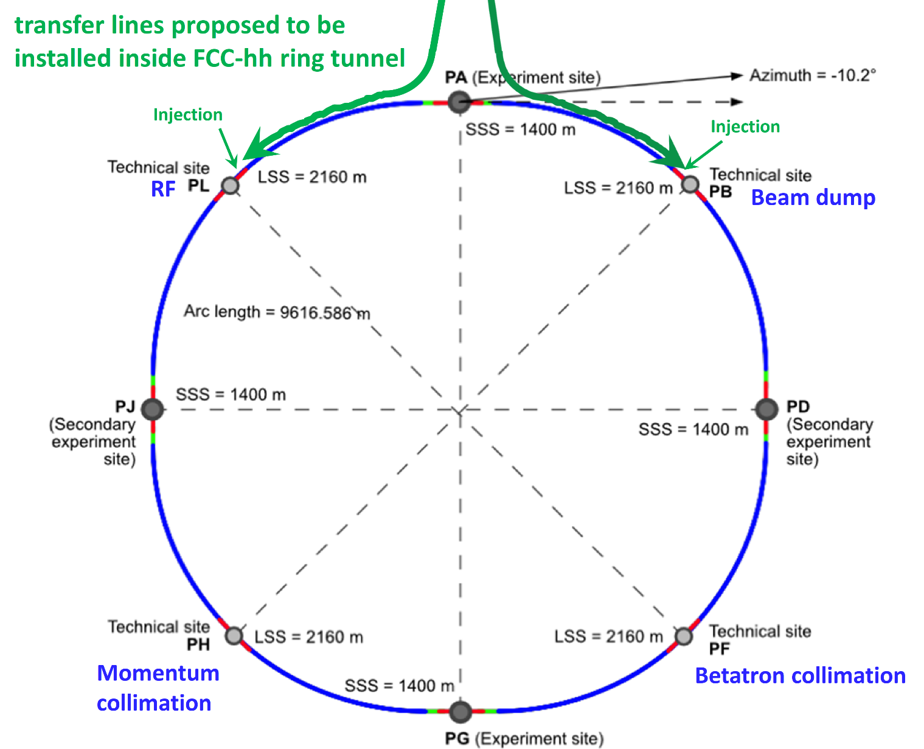
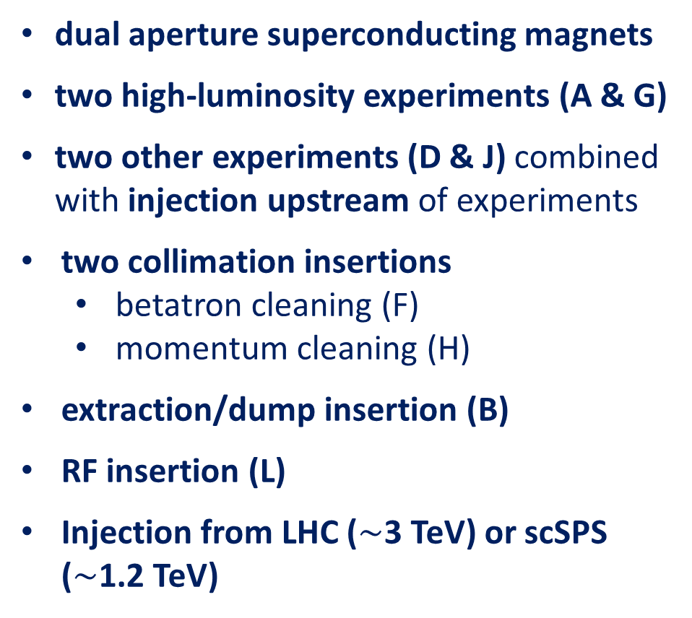
FCC hh basic design choices
dual aperture superconducting magnets
two high-luminosity experiments (A & G)
two other experiments (D & J) combined with injection upstream of experiments
two collimation insertions
  betatron cleaning (F)
  momentum cleaning (H)
extraction/dump insertion (B)
RF insertion (L)
Injection from LHC ($\sim$3 TeV) or scSPS ($\sim$1.2 TeV)

Slide 13
FCC-hh (pp) collider parameters (stage 2)
parameter | FCC-hh |  | HL-LHC | LHC
collision energy cms [TeV] | 100 |  | 14 | 14
dipole field [T] | 16-17 |  | 8.33 | 8.33
circumference [km] | 91.2 |  | 26.7 | 26.7
beam current [A] | 0.5 |  | 1.1 | 0.58
bunch intensity [10¹¹] | 1 | 1 | 2.2 | 1.15
bunch spacing [ns] | 25 | 25 | 25 | 25
synchr. rad. power / ring [kW] | 2700 |  | 7.3 | 3.6
SR power / length [W/m/ap.] | 32.1 |  | 0.33 | 0.17
long. emit. damping time [h] | 0.45 |  | 12.9 | 12.9
beta* [m] | 1.1 | 0.3 | 0.15 (min.) | 0.55
normalized emittance [μm] | 2.2 |  | 2.5 | 3.75
peak luminosity [10³⁴ cm⁻²s⁻¹] | 5 | 30 | 5 (lev.) | 1
events/bunch crossing | 170 | 1000 | 132 | 27
stored energy/beam [GJ] | 7.8 |  | 0.7 | 0.36
preliminary - for new layout

Slide 14
worldwide FCC Nb₃Sn program
Main development goal is wire performance increase:
J_{c} (16T, 4.2K) > 1500 A/mm² →50% increase wrt HL-LHC wire
Reduction of coil & magnet cross-section
5400 mm²
3150 mm²
~1.7 times less SC
After 1-2 years development, prototype Nb₃Sn wires from several new industrial FCC partners already achieve HL-LHC J_{c} performance
~10% margin
HL-LHC
~10% margin
FCC ultimate
FCC conductor development collaboration:
Bochvar Institute (production at TVEL), Russia
Bruker, Germany, Luvata Pori, Finland
KEK (Jastec and Furukawa), Japan
KAT, Korea, Columbus, Italy
University of Geneva, Switzerland
Technical University of Vienna, Austria
SPIN, Italy, University of Freiberg, Germany
2019/20 results from US, meeting FCC J_{c} specs:
Florida State University: high-J_{c} Nb₃Sn via Hf addition
Hyper Tech /Ohio SU/FNAL: high-J_{c} Nb₃Sn via artificial pinning centres based on Zr oxide.

Slide 15

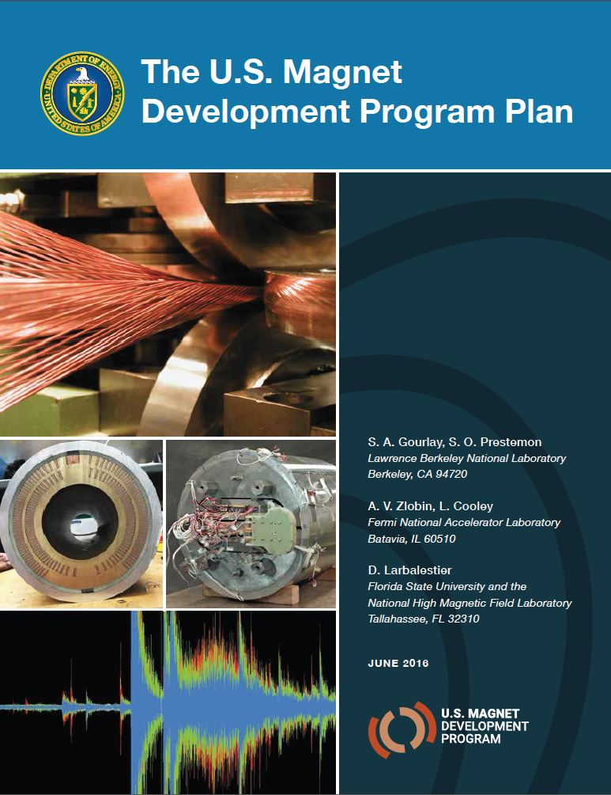
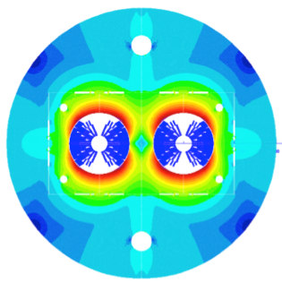
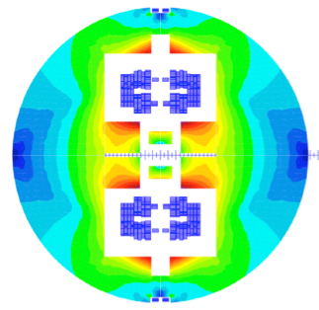

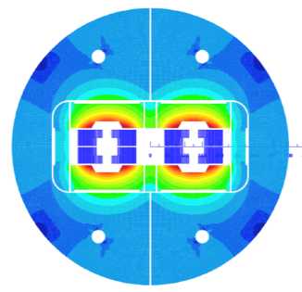
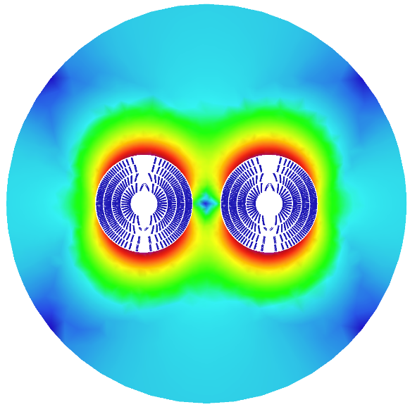
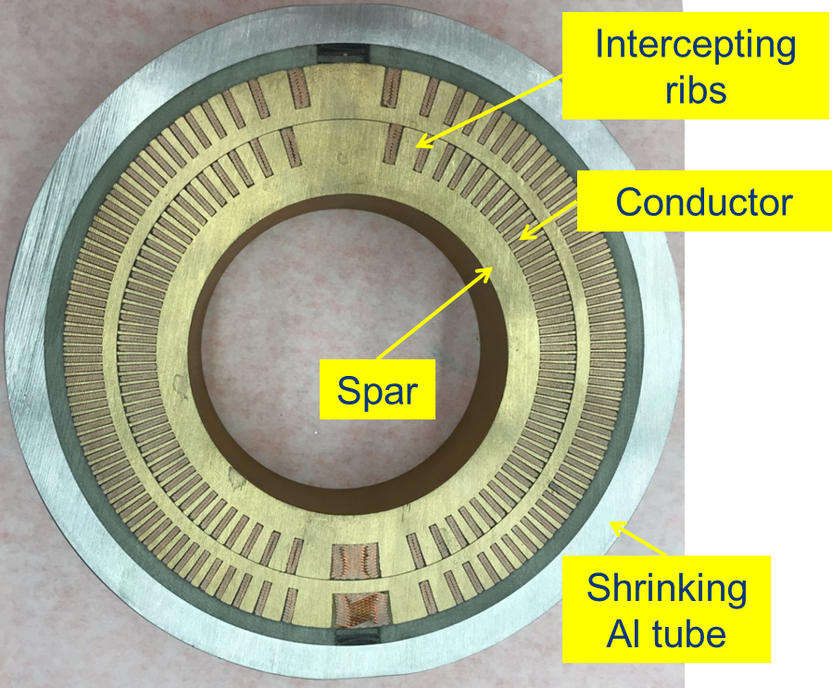
16 T dipole design activities and options
H2020
Swiss contribution
Cos-theta
Common coils
Canted
Cos-theta
Blocks
INFN
CIEMAT
LBNL
CEA
PSI
FNAL
Short model magnets (1.5 m lengths) will be built until 2025

Slide 16
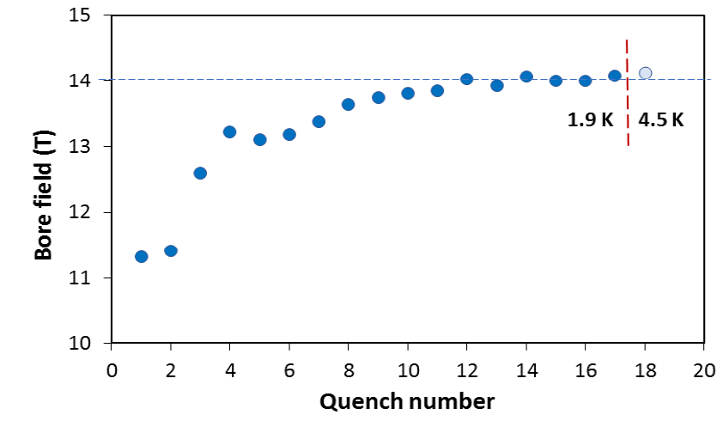
US – MDP: 14.5 T magnet tested at FNAL
84% on the laodline at 1.9 K
92% on the loadline at 4.2 K
60-mm aperture
4-layer graded coil
15 T dipole demonstrator
Staged approach: In first step pre-stressed for 14 T
Second test in June 2020 with additional pre-stress reached 14.5 T

Slide 17
Take home messages
FCC-ee is first stage of FCC integrated programme; 1st physics ~2045
FCC-ee design incorporates many lessons from recent & present e⁺e⁻ colliders, and goes further! SuperKEKB demonstrates key concepts
FCC-ee = efficient and sustainable collider at the e⁺e⁻ energy frontier: highest luminosity per input power, highest luminosity per construction cost, most precise energy calibration, and ultimate upgrade potentials (100 TeV FCC-hh, FCC based muon collider …)
Prototypes of FCC-ee key components by 2025
Superconducting cable & high-field magnet programme prepares for 100 TeV proton-proton collider, FCC-hh, in the same tunnel, to begin operation around ~2065/70

