Slide 1
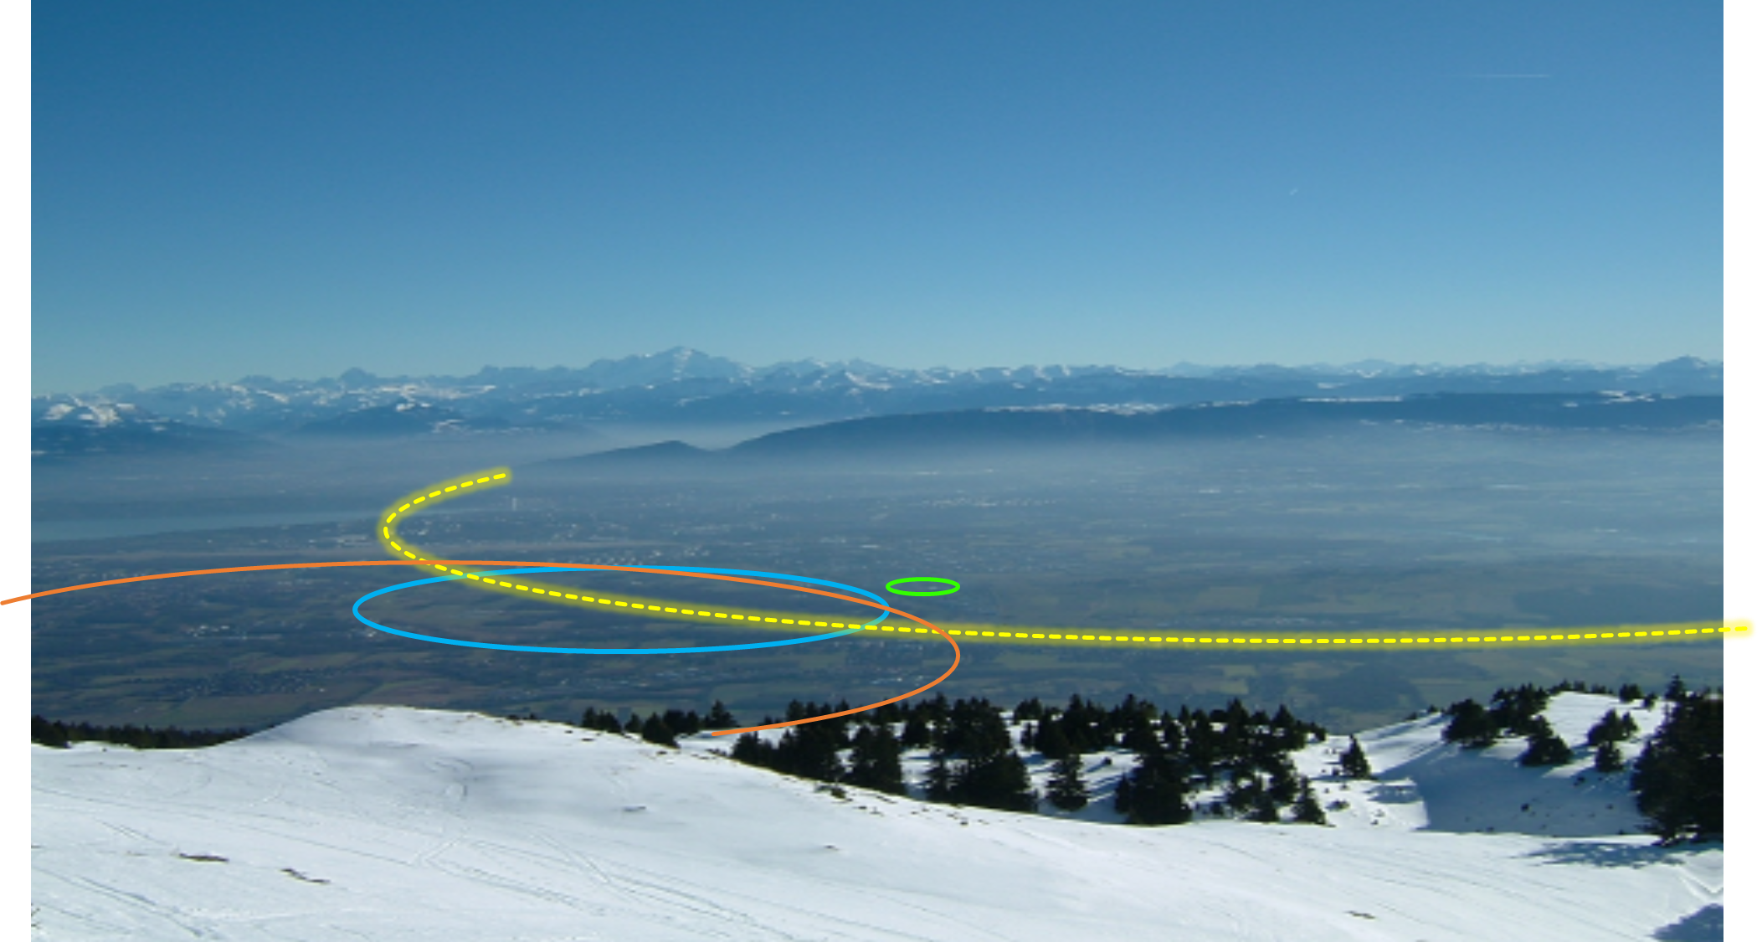
The FCC Feasibility Study and Global Collaboration
Emmanuel Tsesmelis
CERN
Head of Associate Member State and Non-Member State Relations
Convenor of FCC Global Collaboration Working Group
FCC Engagement Meeting – Estonia
2 March 2022
PS
LHC
FCC
SPS
Work supported by the European Commission under the HORIZON 2020 projects EuroCirCol, grant agreement 654305; EASITrain, grant agreement no. 764879; ARIES, grant agreement 730871, FCCIS, grant agreement 951754, and E-JADE, contract no. 645479
Photo: J. Wenninger

Slide 2

FCC Global Collaboration Working Group
Engage with countries with mature communities, a long-standing participation in CERN’s programmes and the potential to contribute substantially to the Organization’s long-term scientific objectives, to facilitate opportunities for national participation in the FCC Feasibility Study.
Work with national laboratories, institutes and universities as well as industry in the MS, AMS and NMS - to carry out the following mandate:
  Encourage an expanded membership.
  Explore opportunities for future prospective participants.
  Support new participants in application process.
  Assist the new participants in defining areas of collaboration.
  Conclude relevant agreements.
  Facilitate the integration process.
  Facilitate interest in CERN non-core areas - geology, geodesy, logistics, materials science.
  Prepare the foundations for research and contributions by industry.
  Liaise with national contact persons and forums.
Convened by Emmanuel Tsesmelis (CERN International Relations)

Slide 3


Status of Global FCC Collaboration
Increasing international collaboration as a prerequisite for success:
links with science, research & development and high-tech industry will be essential to further advance and prepare the implementation of FCC
147
Institutes
30
Companies
34
Countries
EC
H2020

Slide 4


FCC Engagement Meetings (Online)
Overview
  Recently-launched extended forums with interested countries to discuss collaboration with FCC.
  Topics:
    Introduction to FCC Feasibility Study.
    Presentation of FCC physics, experiment, detector, accelerator and global collaboration.
    Presentations from the country scientific community.
Meetings
  Mexico (mini meeting on accelerator)
    21 June 2021
  Republic of Korea
    3 September 2021
  Pakistan
    14 September 2021
  Portugal
    26 November 2021
  Estonia
    2 March 2022
Much interest expressed by participating countries and the FCC looks forward to stronger / deeper involvement in the follow-up.

Slide 5
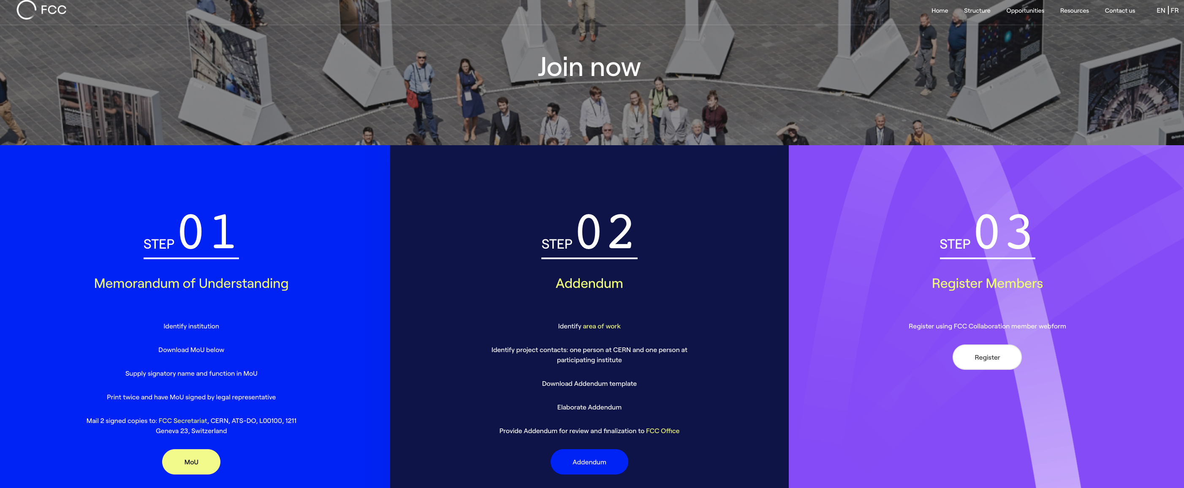
FCC Feasibility Study Collaboration Membership
Participation in FCC through MoU and Addenda.
The FCC MoU for the first phase of the study is being updated to cover the Feasibility Study.
The current participating institutes who wish to take part in the Feasibility Study can continue to participate on the basis of the previously signed MoU until the updated MoU is signed.
https://fccis.web.cern.ch/join-now

Slide 6

Thank you

