Slide 1
WP8 – Innovative Superconducting Magnets
I.FAST – 1st Annual Meeting
04 .May.2022 – Globe conference room
Lucio Rossi, Ernesto De Matteis, – INFN-MILANO-LASA
and all WP8 collaborators

Slide 2











I.FAST WP8 -magnets members
(WP8 comprise also a task on special SC cable for fast ramping led by GSI)
I.FAST
HITRI & I.FAST

Slide 3
WP8 Listing
INFN-LASA
Gabriele.Ceruti@mail.polimi.it

Slide 4
WP8 duration: from M1 to M48 !!
Scope of our WP8
Here we want to develop technologies supporting the EU Industry that wish to learn about the CCT developed by CERN.
We aim to verify if CCT and HTS can be the way to go for advanced HadronTherapy (CNAO, MedAustron,…SEEIIST), in particular for SC Gantry and – possibly- for SC synchrotrons.
The big picture → talk Ernesto De Matteis Thursday h14.45
Transpose HEP collider technology for medical accelerators…
  Trying to fill the gap with Japan that has a strong leadership in SC Gantry…
  A companion program based on classical costheta NbTi – but curved! – is going on (CERN-CNAO-INFN-MedAustron)
  A twin program HITRIplus has a WP dedicated to CCT curved in Nb-Ti
Here the SC technology advance and the direct involvement of 3 important accelerator industries in EU.

Slide 5
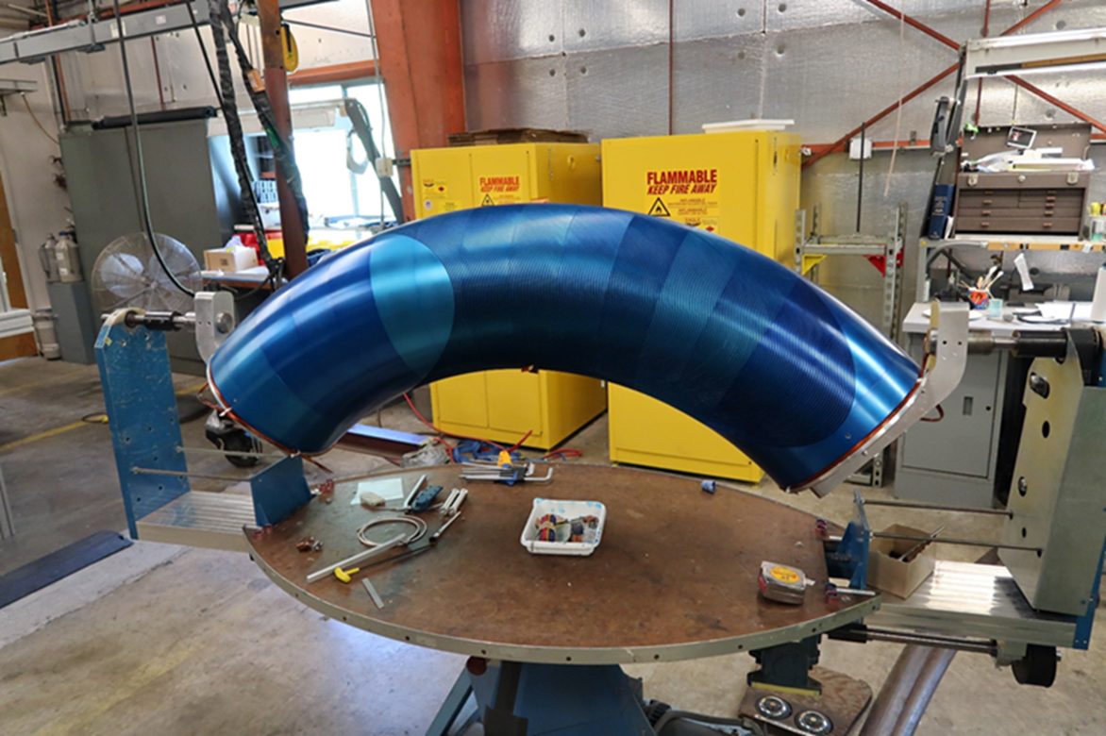
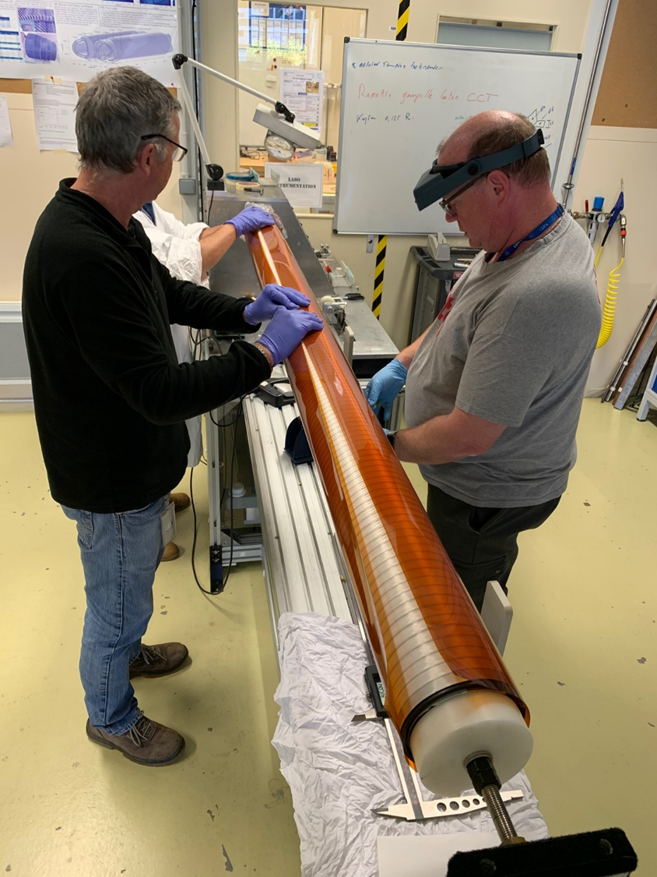
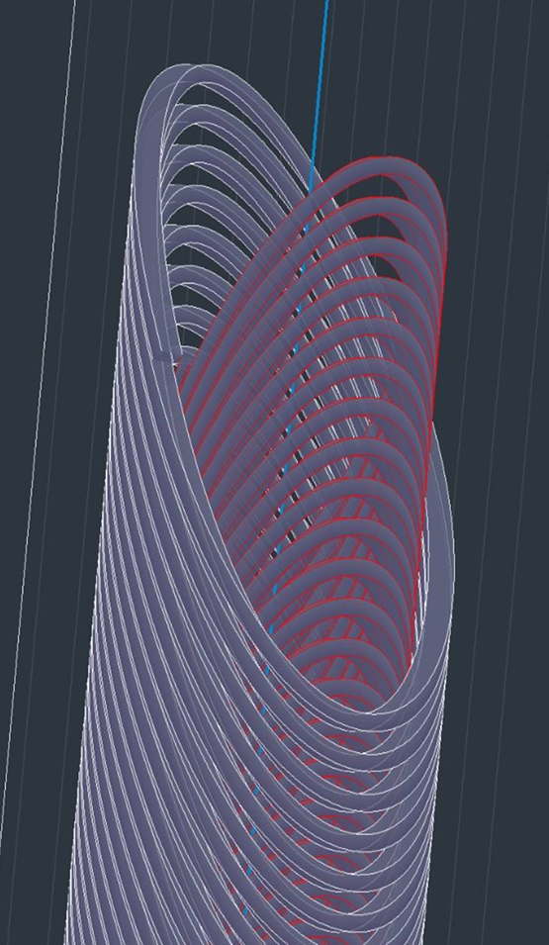
Nb-Ti CCT: p-gantry and HiLumi LHC
LBNL: CCT coil prototype for large acceptance proton gantry ∅ = 400 mm: Successfully tested to 3.5 T stady state; segmented former.
HiLumi LHC: CERN has designed, built and tested a dual 3 T, 2 m long - ∅ = 105 mm, straight CCT. Now IHEP Beijing producing 2x13 units
Short circuit at 3.5T!!
Proto 2m 2.9 T 105 mm very successful at CERN. However, learning and transfer not easy (China…, SE…)

Slide 6
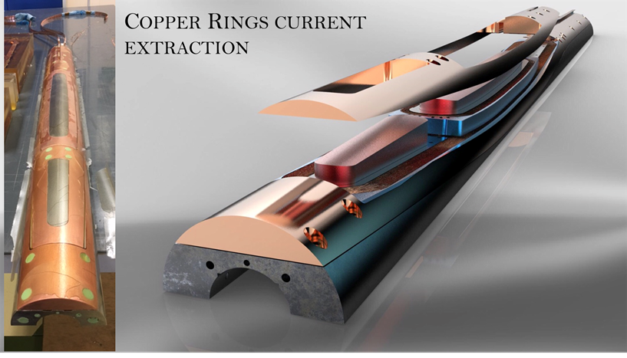
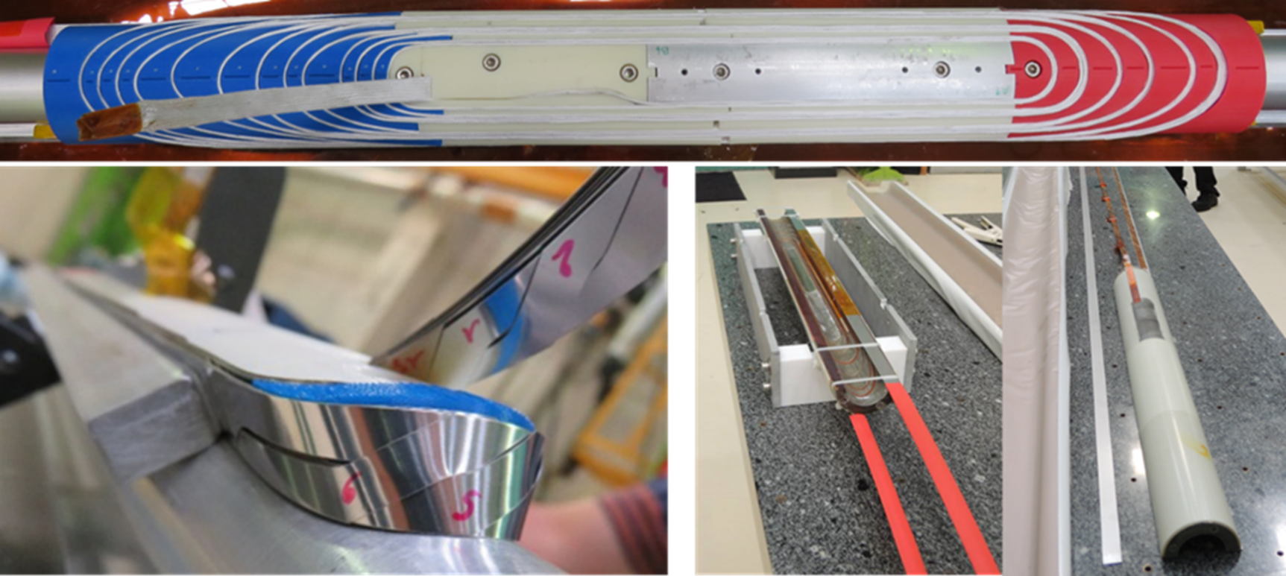



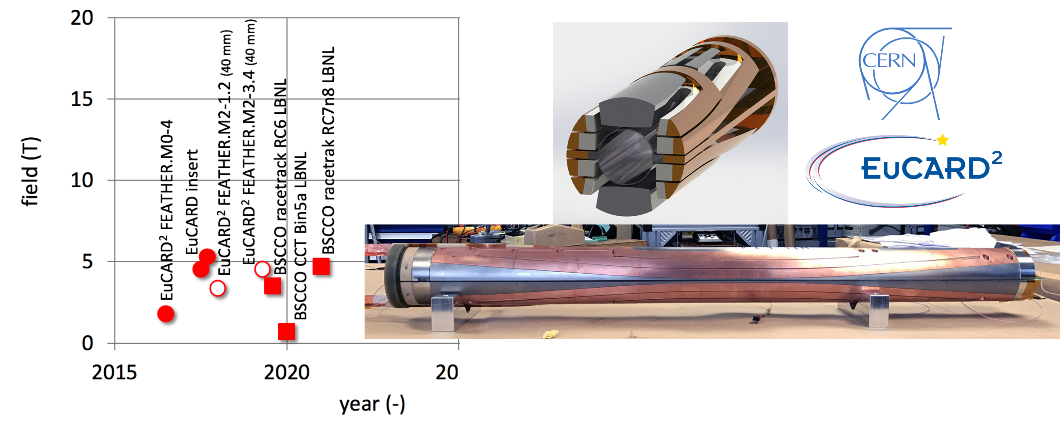
We build on HTS in FP7-Eucard2 – H2020-ARIES programs
Courtesy of Glyn Kirby

Slide 7
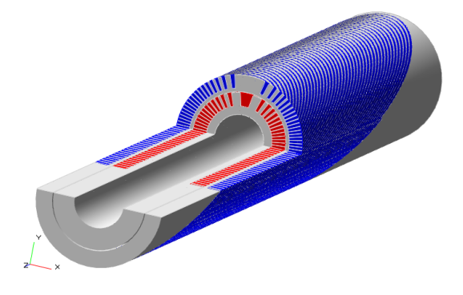

Scope of our WP8 – cont.
Additional difficulty: the magnets is RAMPED : 0.4 T/s
The field quality has not yet demonstrated in HTS
CCT seems a technology suitable for 3-5 T:
  Simple tooling
  Little number of pieces
→ 1 HTS CCT preceeded by 1 Nb-Ti of same dimension as “gauge”
  2 HTS CCT ideal: need additional effort for budget (HTS tapes -> CERN; or MgB2, but conductor procurement is also a cost issue… apart for field low)
We would like to stay “near” the parameter of HITRI+
Straight! We consider that HTS is already difficult enough!
CCT dipole
4 T target
Ø =80 mm;
L <= 1000 mm

Slide 8
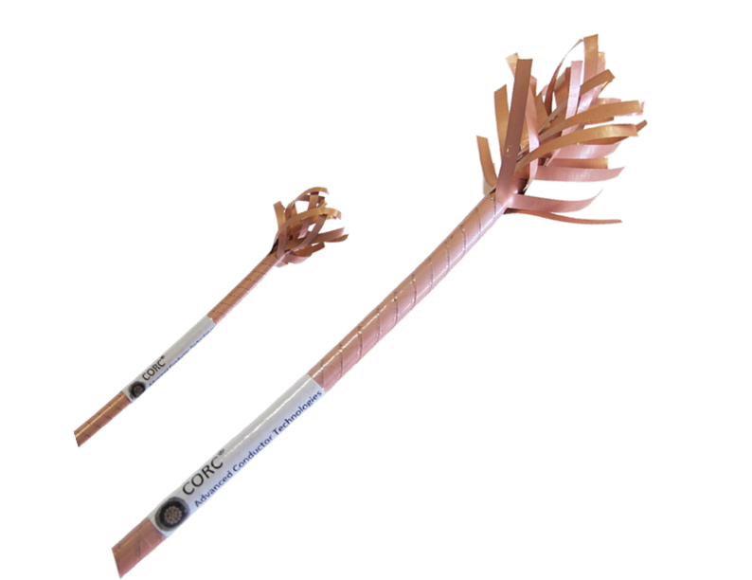

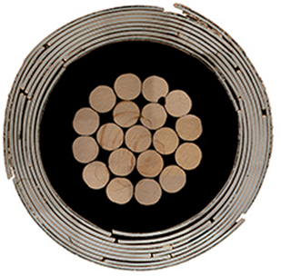

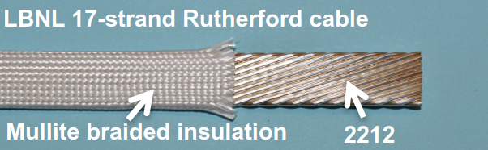
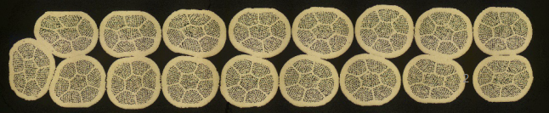
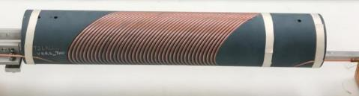
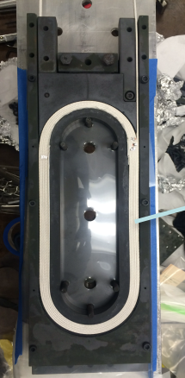
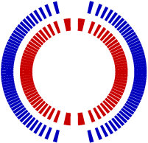
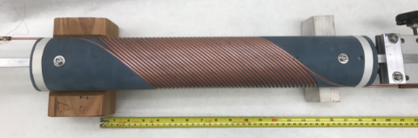
LBNL effort on HTS accelerator magnets mainly based on CCT
Program based on CORC and CCT layout led by X. Wang & S. Prestemon
Program on use of Bi-2212 Rutherford cable with race track and CCT layout
led by T. Shen and S. Prestremon
By Advanced Conductor
Technologies
Outer layer
Courtesy of Xiaorong Wang
Inner layer
Courtesy of Tengming Shen

Slide 9
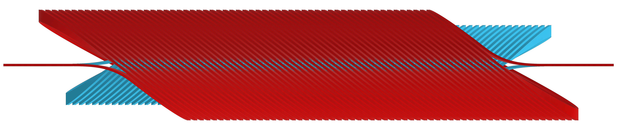
Canted-Cosine-Theta (CCT) Magnet (1)
The CCT design is based on pairs of canted conductor layers:
I
I
G. Ceruti – INFN-Milano-LASA
Current I flows in the two conductors so that the transverse magnetic field components sum and axial field components cancel each other.
Total magnetic field
of the inner layer
Total magnetic field
of the external layer
+
=

Slide 10
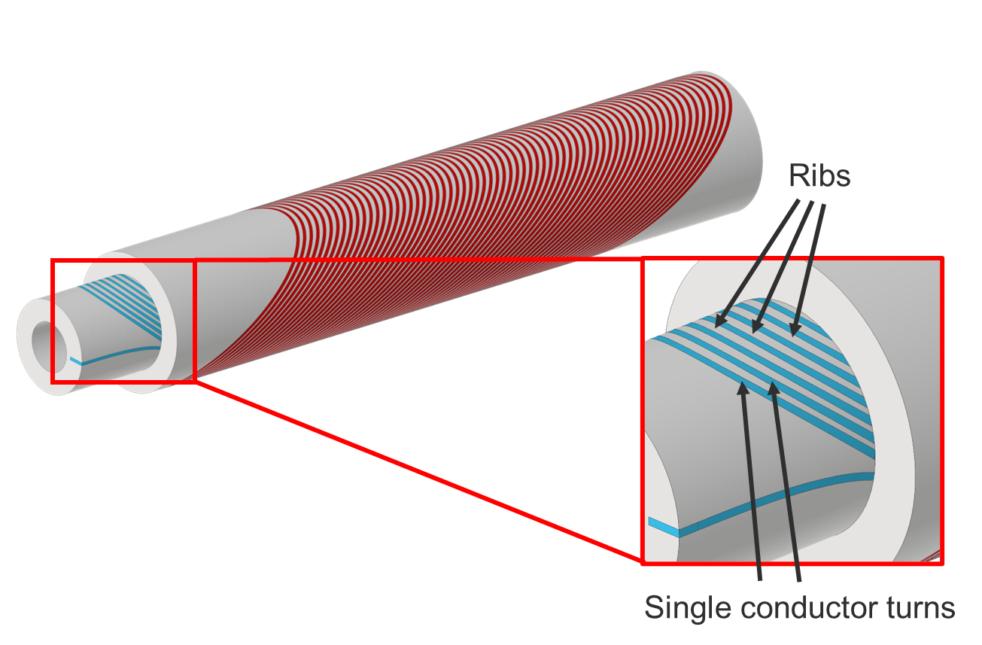

CCT schematics
G. Ceruti – INFN-Milano-LASA

Slide 11
IFAST-WP8 (CCT magnets part) meetings
Kick off meeting : 29 April 2021
We had n.9 meetings (Last meeting : 21 April 2022)
Regular meeting each third Thursday of each MONTH at 9h00.
(we invite also HITRIplus members as observer)
First Decision: change in the layout of the first CCT
  We have proceeded mainly with design work in this 1st year
Set up HTS European Strategy Group:
  deliverable 8.1 deadline shift to 04/2022 to synchronize with LDG roadmap implementation for Accelerator R&D (ESUPP 2020)
MLS and DLVs updates
CCT Computation and Design Workshop

Slide 12
First decision: change in the layout of the first CCT (in LTS)
We devised to design a curved CCT in LTS as precursor of the HTS straight CCT.
However, a curved CCT is already foreseen in HITRIplus (that is more oriented to design for gantry and less to technology R&D.
All community thinks a that a combined function (dipole + quadrupole winding, superimposed) is maybe more interesting step.
Demonstrated in Cosϑ but not in CCT, yet.
In addition, we may use low losses SC wire to address the ramp rate
  So straight , combined function, with low losses design (wires + former) is better that a simple curved CCT
  Change in DLV scope (and of preceeding MS) has been accepted by Project Coordination and GB.

Slide 13
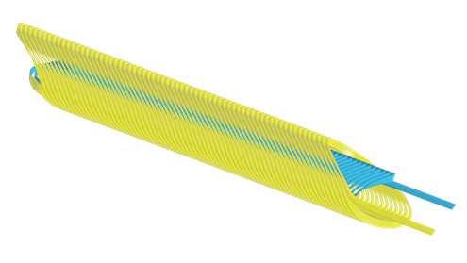
Preliminary design combined function
Considered two options:
High current (two Rutherford cables in //)
Low current : 2x10 ropes (6+1)
Other possibility is to go toward 4 layers, i.e., → 4 formers design
G. Ceruti – INFN-Milano-LASA

Slide 14
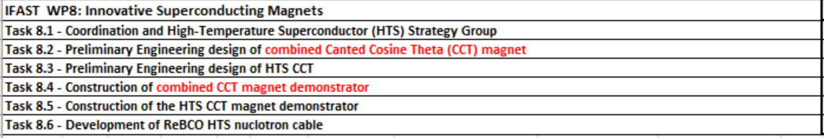
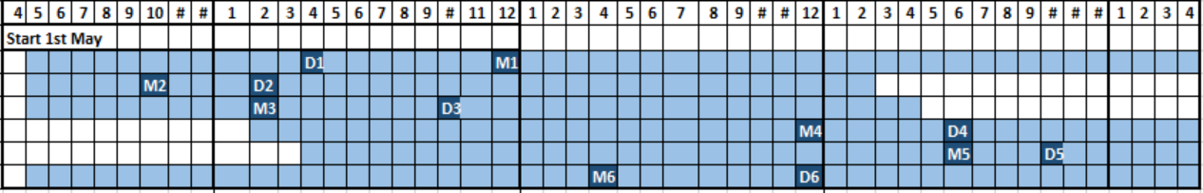
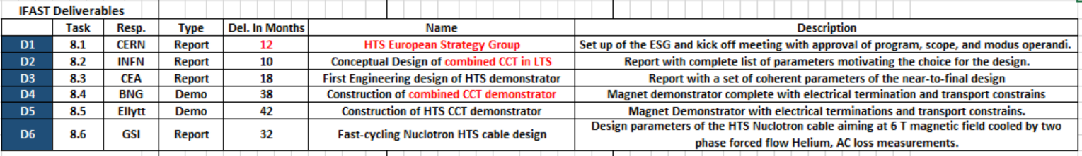
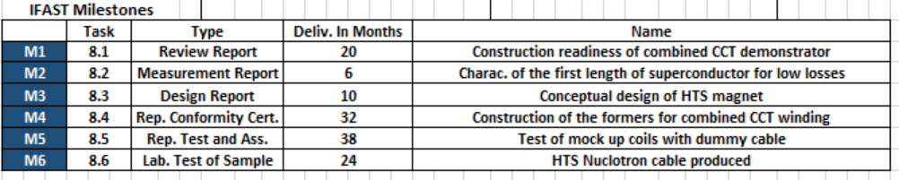
Timeline
Change: design of a straight combined function, low loss CCT magnet
HTS European Strategy Group 8.1 DONE (deadline shift)
Task 8.1
Task 8.2
Task 8.3
Task 8.4
Task 8.5
Task 8.6
Milestone Report done by INFN
Milestone Report done by INFN CERN, and UNIGE

Slide 15
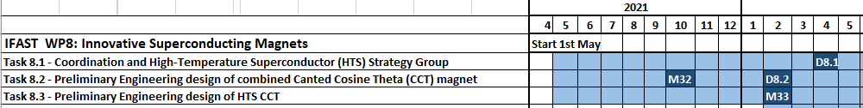
IFAST WP8 – MLS and DLVs
Deliverables
  D8.1 (04/2022): HTS European Strategy Group (DONE) https://zenodo.org/record/6384239#.Ym-95NpBw2y
  D8.2 (02/2022): Conceptual Design of combined CCT in LTS (DONE) https://zenodo.org/record/6389851#.YmwhA9pByUl
Milestones:
  M32 (10/2021) : Charac. of the first length of superconductor for low losses (DONE) https://zenodo.org/record/5901601#.YmrIvNpByUl
  M33 (02/2022) : Conceptual design of HTS magnet (work in progress- delay 3-4 months)
  → will entail a delay of at least 2 months on D5 (engineering design), hopefully not on the construction of the magnet (however procurement of materials is a hurdle these days…)

Slide 16
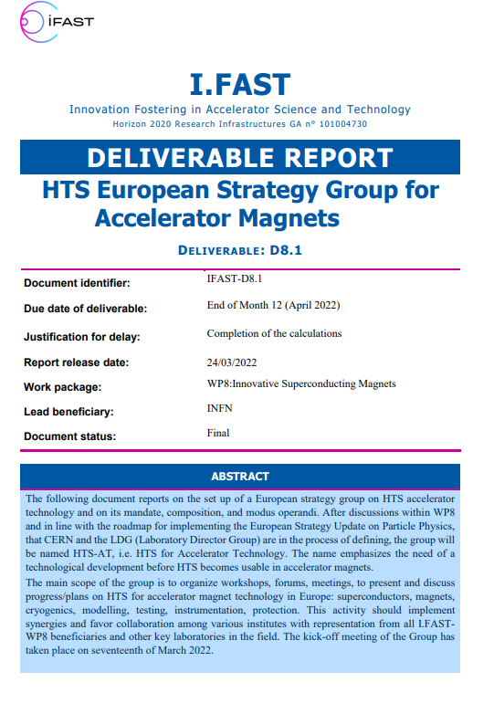
Deliverable 8.1 : HTS European Strategy Group
Task 8.1 – A. Ballarino, L. Rossi
Set up of a European strategy group on HTS accelerator technology and on its mandate, composition, and modus operandi.
Roadmap for implementing the European Strategy Update on Particle Physics;
Group name : HTS-AT (HTS for Accelerator Technology);
Main scope of the group is to organize workshops, forums, meetings, to present and discuss progress/plans on HTS for accelerator magnet technology in Europe: superconductors, magnets, cryogenics, modelling, testing, instrumentation, protection;
Favoring synergies and collaboration among various institutes;
kick-off meeting of the Group was 17th of March 2022.
https://zenodo.org/record/6384239#.Ym-95NpBw2y

Slide 17
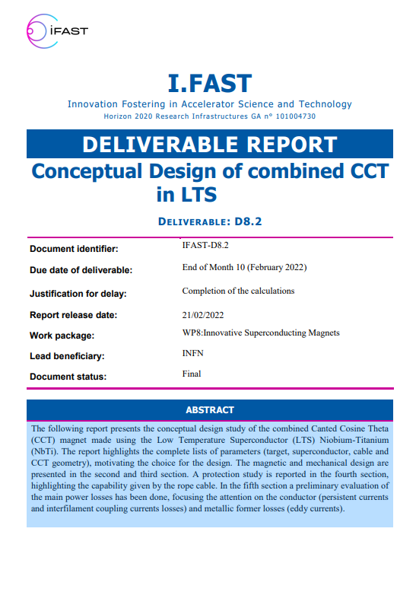
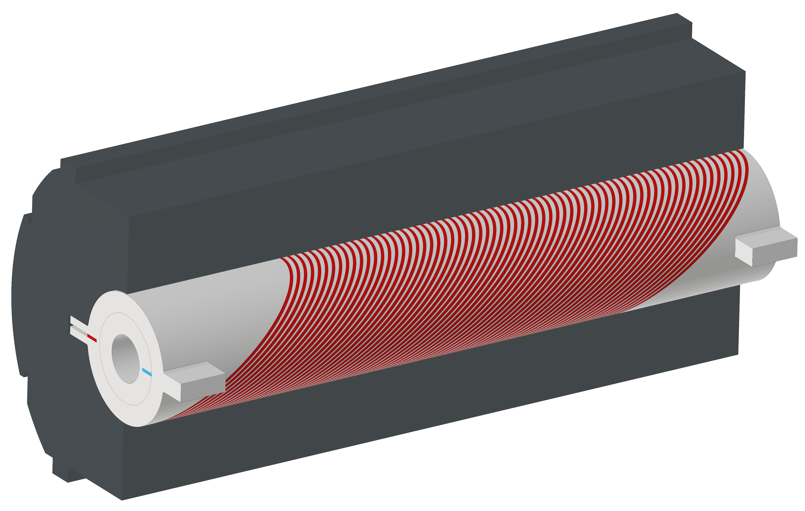
Deliverable 8.2 : Conceptual Design of combined CCT in LTS
Task 8.2 – E. De Matteis, task leader
Report on the conceptual design study of the combined Canted Cosine Theta (CCT) magnet made using the Low Temperature Superconductor (LTS) Niobium-Titanium (NbTi).
Complete lists of parameters (target, superconductor, cable and CCT geometry)
4 T dipole + 5 T/m gradient
Magnetic and mechanical design, protection study, evaluation of the main power losses.
CCT magnet based on NbTi

Slide 18

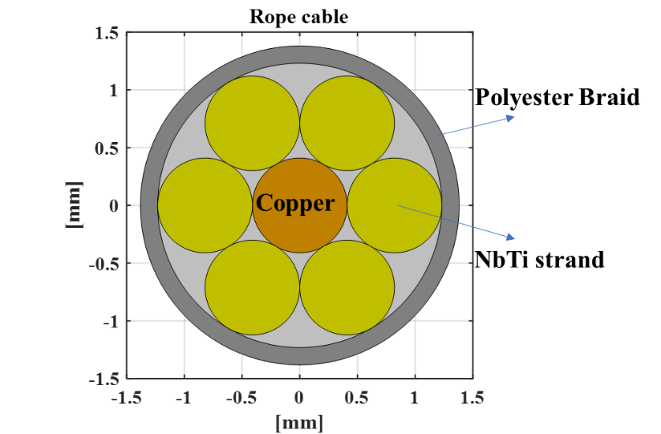
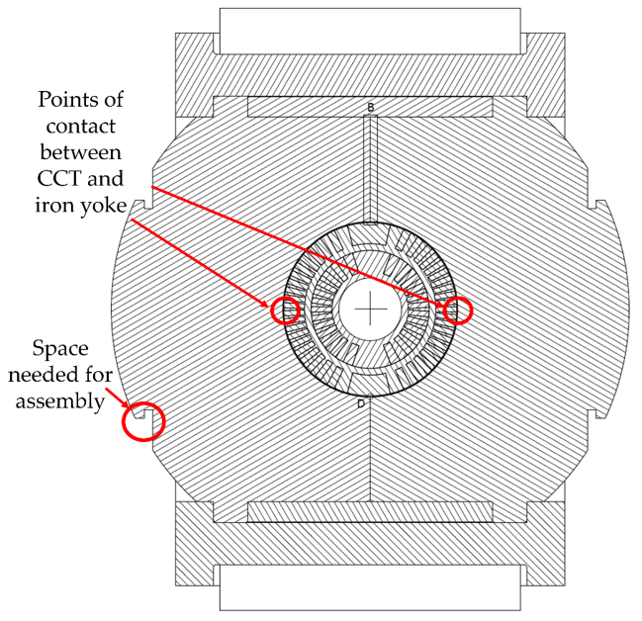
Deliverable D8.2 – Combined CCT magnet based on NbTi
Conceptual design of the Combined CCT magnet based on NbTi:
Magnetic design:
  Combined fields (4 T dipole + 5 T/m of quad. @4.7 K, 28.7% LL margin, magnetic length of 0.73 m; 2 x 8 ropes (1300 A each)
Mechanical design:
  Full mechanical structure (Former+ Iron yoke+ Assembly);
  Materials for the former (Al Br and PEEK);
Stability and Protection:
  Large time margin of 0.325 s for a rope 6 NbTi+1 copper strands.
Power Losses:
  Conductor Losses and eddy current losses for metal formers (0.4 T/s of ramped field) → St Steel good but difficult to machine, AlBronze good but sufficient for 0.25-0.3 T/s and difficult to rpocure
  → solution PEEK (or polymer former);
Deliverable 8.2 https://zenodo.org/record/6389851#.YmwhA9pByUl
Iron yoke as shield and collar

Slide 19
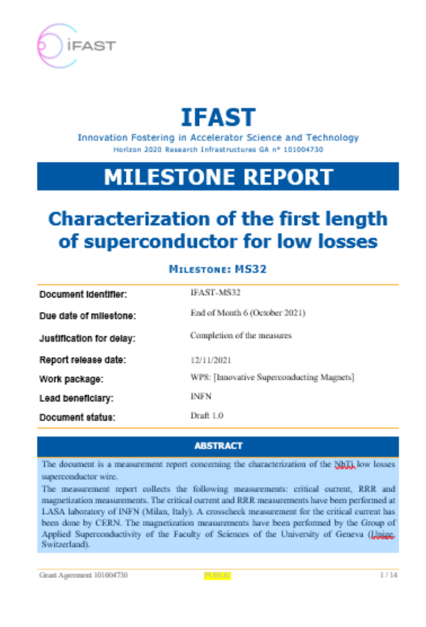
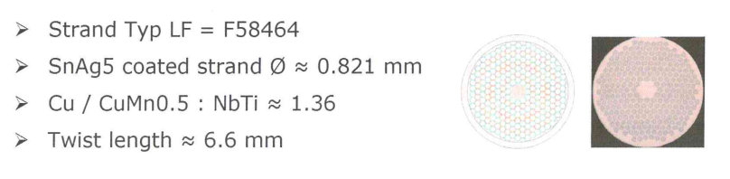
Milestone MS32: Characterization of the first length of superconductor for low losses
Task 8.2 – E. De Matteis, task leader
NbTi superconductor wire (originally designed according to the specifications for the DISCORAP project), produced by Bruker
Critical current measurements (INFN and CERN)
RRR measurements (INFN)
Magnetization measurements (Univ, of Geneva)
https://zenodo.org/record/5901601#.YmrIvNpByUl

Slide 20
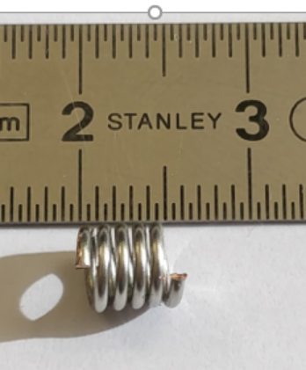
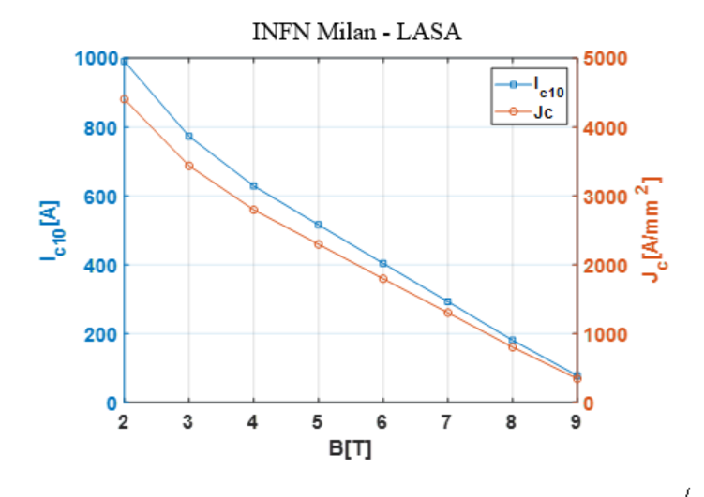
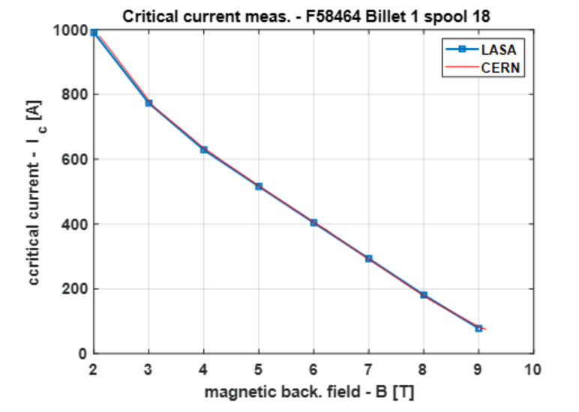
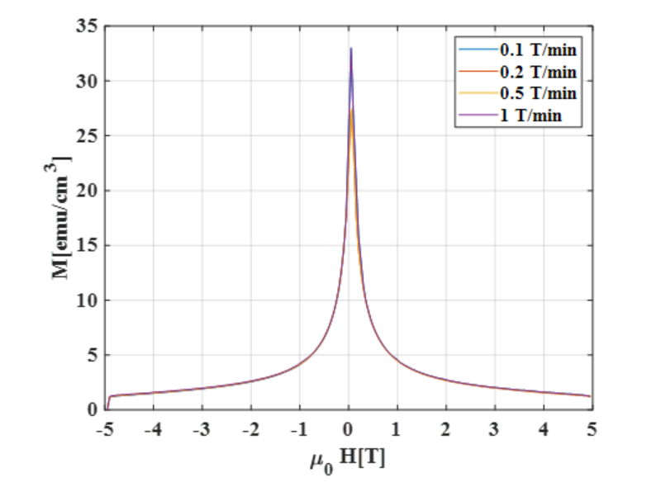
Milestone MS32: Characterization of the first length of superconductor for low losses
Minicoil
for Magnetization meas.
1. Critical current (Jc= 2297 A/mm2 @ 5T, 4.2 K), about 20% less LHC02 outer layer strand.
2. Nb-Ti filaments of the order of 2.6 µm
3. RRR>130 as expected

Slide 21
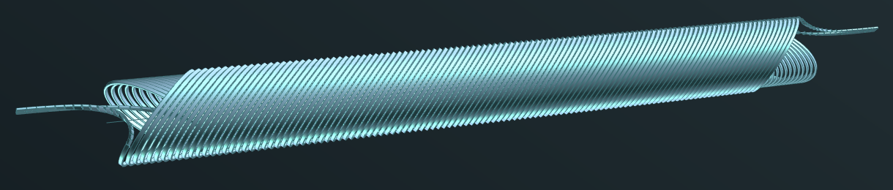
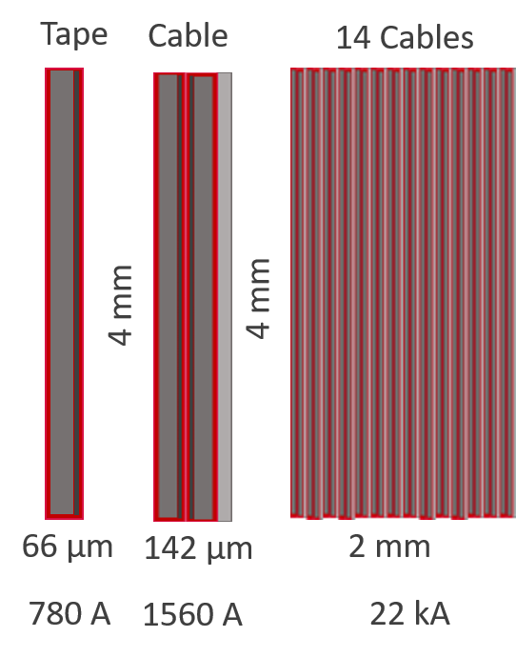
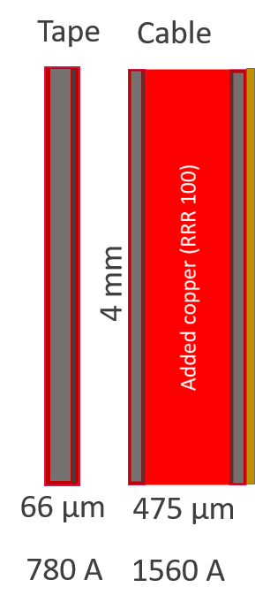
Milestone MS33– Conceptual Design of HTS CCT magnet
The main goal of the WP8
Baseline (4 T dipole @ 10 K, > 15 K of margin);
Superconductor ReBCO (Tapes);
Two preliminary designs (No iron):
“Metal Insulation-like” design with 2 layers cable (780 A x 2 tapes x 14 cables)
“Insulated-like” design (added copper to conductor);
Protection aspect is the critical point for both:
No classical protection for the MI-like;
Use fo cable like for EuCard2: too big current → high losses in th Current Leads
10-50 µV threshold and 10 ms delay (Insulated-like) adding more than 320 µm of copper;
Working in progress (MS Report in preparation)
Task 8.3 - T. Lecrevisse (CEA) Task leader
“MI-like” design
Insulated-like
X 14

Slide 22
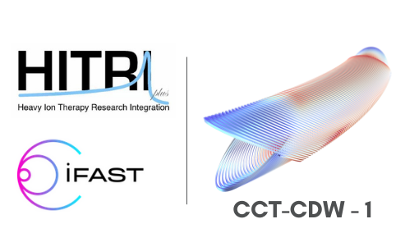
CCT Computation Design Workshop:
Scope: the strong interest of magnet design according to the Canted Cosine Theta (CCT) concept, pursued in both European H2020-HITRIPlus and H2020-I.FAST programs, HITRIPlus-WP8 (Superconducting Magnet Design) and H2020-I.FAST-WP8 (Innovative Superconducting Magnet)
The workshop was held in remote and on 21 and 22 September afternoon (3.00 pm - 7.00 pm)
Attendees: I-FAST and HITRIplus partners but also other groups, as LBNL and CERN
Chair: Lucio Rossi, INFN-Milano LASA lab (HITRIPlus-W8 and IFAST-WP8 coordinator), lucio.rossi@cern.ch
Scientific Program Committee:
- Berhard Auchmann, PSI/CERN, Bernhard.Auchmann@cern.ch
- Thibaut Lecrevisse, CEA, thibault.lecrevisse@cea.fr
- Soren Prestemon, LBNL, soprestemon@lbl.gov
- Davide Tommasini, CERN, Davide.Tommasini@cern.ch
Workshop Scientific Secretary: Ernesto De Matteis (INFN-LASA Milano), ernesto.dematteis@mi.infn.it
Workshop Assistant: Sara Sabatini (INFN-Milano), sara.sabatini@mi.infn.it
https://indico.cern.ch/event/1065779/

Slide 23

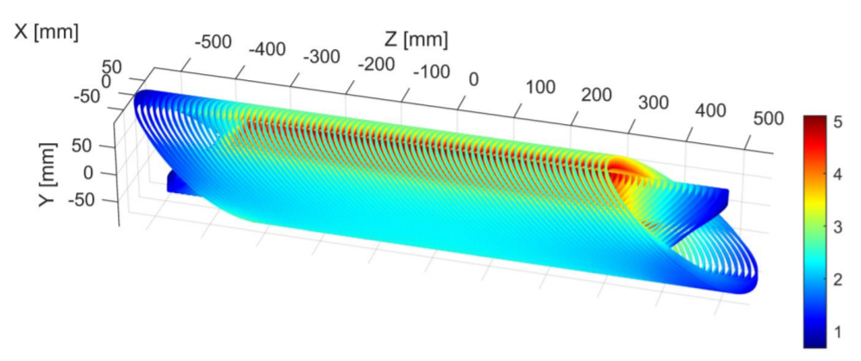
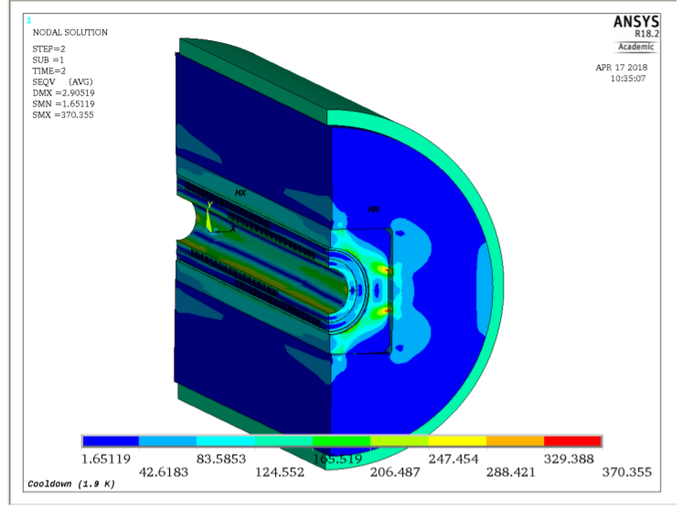
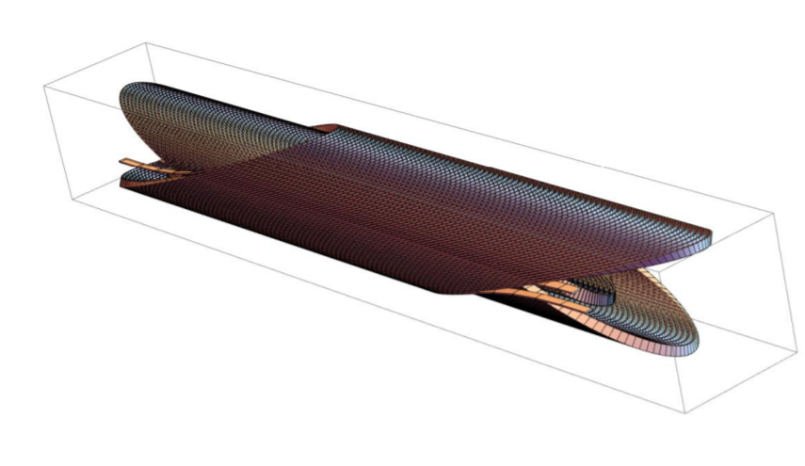
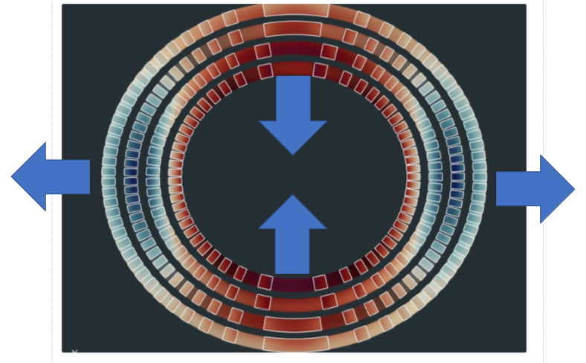
CCT-CD Workshop: Outcomes
Design and Computation Tools

Slide 24
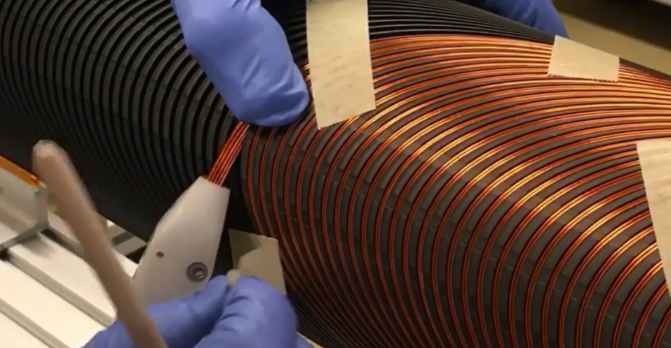
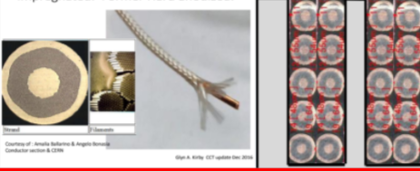
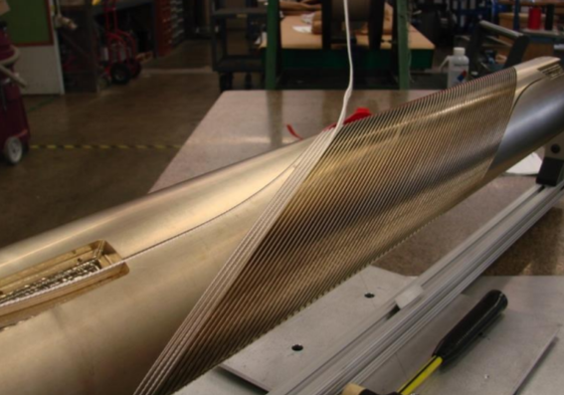
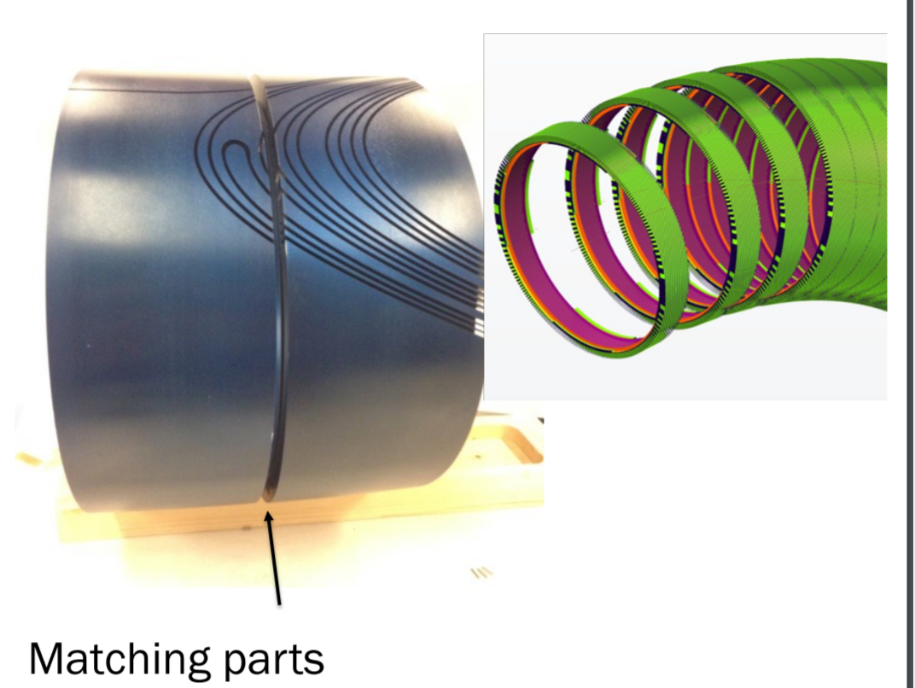
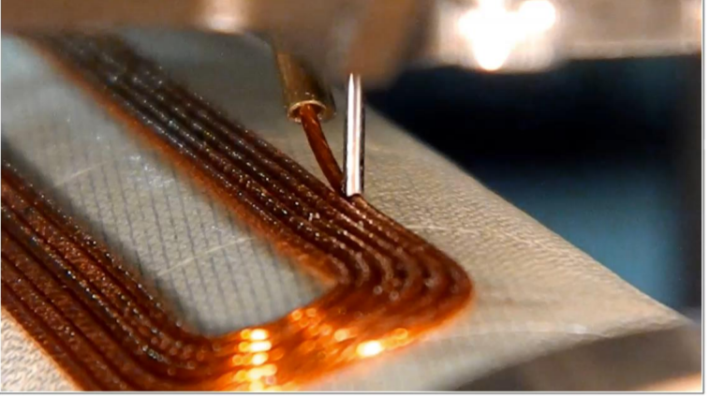
CCT-CD Workshop: Outcomes
Technology for CCT

Slide 25
Next steps
HTS workshop planned in February 6-10, 2023, hosted by CERN
(A. Ballarino chair).
Finalization of the Conceptual Design of HTS CCT magnet.
  CEA → INFN
  Define conductor and protection;
  Prepare the Engineering Design (Deliverable 8.3 – 10/2022 → 12/2022??).
Engineering Design of the Combined CCT magnet based on NbTi:
  Former tests: polymer or metal – Aluminum Bronze materials;
  → keep an eye on the WP10 on Additive manufacturing…
  Winding tests: dummy rope and tools for tests;
  Industries will be more involved and slowly take the lead of the construction.

Slide 26
Thanks for the attention!!!

Slide 27
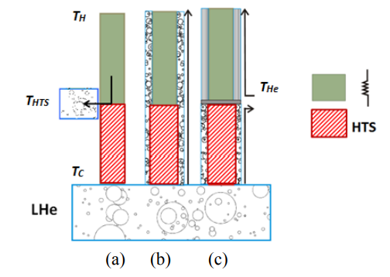
Focus on Power consumption of Current leads (Last IFAST/HITRIplus meetings)
HTS current leads : cooling scheme¹
HTS conduction-cooled current lead;
HTS self-cooled current lead;
HTS gas-cooled current lead.
T_{HTS} is the temperature at the top end of the HTS part
¹Amalia Ballarino, ‘‘Current Leads, Links and Buses’’, CAS-CERN Accelerator School: Superconductivity for Accelerators, Erice, Italy, 24 April - 4 May 2013

Slide 28
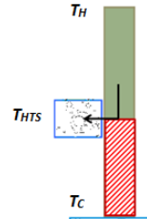
CCT configuration: HTS conduction-cooled current lead
300 K
Copper
The CLs consist of a copper resistive part between room temperature and 60 K, and an HTS part between 60 K and 4.7 K.
60 K
The 60 K temperature should be provided by a cryo-cooler, which acts as heat-sink for the upper resistive part of the leads
HTS
4.7 K

Slide 29



CCT configurations: current leads power consumption
300 K
Resistive part between 300 K and 60 K:
Copper
$$\frac{Q_{c,min}}{I}=46\left[\frac{W}{kA}\right]$$
60 K
2 x Rutherford cables (I ̴ 10 kA)
$$Q_{c,min}\sim 460 W$$
For each CL
HTS
$$Q_{c,min}\sim 70 W$$
2 x 10 ropes (I ̴ 1.5 kA)
4.7 K
Are there available cryocoolers?
Current Limitations for NbTi and Nb3Sn supercondutors
The same CL at zero current absorbs the 50% of the nominal power (nominal current) if made by phosphorus deoxidized copper (much more if made by pure copper).

