Slide 1
Task 10.5:
Nonevaporable getter (NEG) coating under synchrotron radiation (SR)
1st I.FAST Annual Meeting 2-6 May 2022
Oleg B. Malyshev (UKRI)
Task 10.5 leader

Slide 2
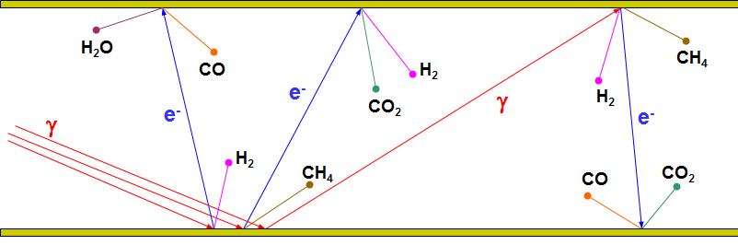
Vacuum in particle accelerators
All particle accelerators need vacuum. The main reason is beam-gas interaction leading to a beam quality degradation:
  Increases beam size (emittance)
  Reduces beam lifetime
  Increases radiation hazard
  Encourages recombination
Photon stimulated desorption (PSD) is one of the most important sources of gas in the presence of synchrotron radiation (SR) or any photons with E > 5-10 eV.
PSD can be considered as a two-step process:
first, photons with energy >5-10 eV cause the photoelectron emission,
then the photoelectron stimulate gas desorption.

Slide 3
Two concepts of the ideal vacuum chamber
Traditional:
‘New’ (C. Benvenuti, CERN, ~1998):
surface which outgasses as little as possible (‘nil’ ideally)
surface which does not pump otherwise that surface is contaminated over time
Results in
Surface cleaning, conditioning, coatings
Vacuum firing, ex-situ baking
Baking in-situ to up to 300°C
Separate pumps
surface which outgasses as little as possible (‘nil’ ideally)
a surface which does pump, however, will not be contaminated due to a very low outgassing rate
Results in
NEG coated surface
There should be no un-coated parts
Activating (baking) in-situ at 150-180°C
Small pumps for C_{x}H_{y} and noble gases
NEG coating
NEG pump

Slide 4
What non-evaporable getter (NEG) coating does?
Reduces gas desorption:
  A pure metal or metal alloy (Ti, Zr, V, Hf, etc.) film 0.5-3-μm thick without contaminants.
  A barrier for molecules from the bulk of vacuum chamber.
Increases distributed pumping speed, S:
  A sorbing surface on whole vacuum chamber surface
  providing a pumping speed of S = α⋅A⋅v/4;
where α – sticking probability, A – surface area, v – mean molecular velocity
Vacuum NEG Bulk
Coating
Main benefits of NEG coating:
Can be activated at low temperature of 150-160 °C
Meeting challenging vacuum specification at UHV or XHV
Lower cost of vacuum system
  Less number of pumps, thus less controllers and cables
  Smaller size of the pumps, thus lower cost per unit
The only solution for narrow vacuum chambers

Slide 5
What is really need for vacuum system design
There are not enough PSD data for various NEG coatings.
  A future machine vacuum deign can't be done properly without these data.
What information have to be obtained:
Experimentally measured PSD yields, η, and sticking probabilities, α, for H₂, CH₄, CO, CO₂ (for modelling future machines)
  for various types of NEG coatings (composition and structure),
  as a function of photon dose,
  as a function of activation temperature and duration,
  as a function of film thickness,
  for shapes similar to vacuum chamber of future machines,
  etc.
Practical knowledge and experience on what happens in case of various operation issues:
  SR induced activation, recovery rate after a vacuum accident,
  SR induced pumping,
  a leak during NEG activation,
  SR beam alignment fluctuation,
  non-uniform temperature during activation: overheated NEG, underheated NEG,
  not uniformly coated and partially coated chambers (a chamber with an antechamber),
  effect of storage in vacuum, in nitrogen, in argon, in air, ...,
  NEG lifetime,
  other questions from machine operation experience.

Slide 6
Task 10.5 objectives
Building facilities for photon stimulated desorption (PSD) yield measurement on beamlines.
Obtaining and analysing the photon stimulated gas desorption (PSD) experimental data from Non-Evaporable Getter (NEG) coated prototypes under conditions similar to future light sources.
 | Milestone/Deliverable name | Delivery date (in months) | Content
Milestone | First NEG coated sample are installed on SR beamline at DLS and Soleil | 12 | Report - Completed
Deliverable | First PSD data from NEG coating | 36 | Report

Slide 7
Task 10.5 partners (vacuum experts from 4 HEI)
Partner | Main capability relevant to the project | Future machine
UKRI/STFC/ASTeC | NEG deposition and characterisation Pumping property and ESD evaluation Gas dynamics modelling, data analysis, large vacuum system design | UK-XFEL
Diamond LS | PSD facility at a SR beamline on Diamond Pumping property and ESD evaluation Large vacuum system design and operation | Diamond-2
Soleil | PSD facility at a SR beamline on Soleil Pumping property and ESD evaluation Large vacuum system design and operation | Soleil-2
DESY | NEG deposition and characterisation Pumping property and ESD evaluation Large vacuum system design and operation | PETRA-IV
Notes:
All capabilities exist at least at two partners

Slide 8
Common interest of all partners
Vacuum chambers made of either pure copper or copper alloy
  Surface preparation before deposition (cleaning, etching…)
  Preparation on the deposition facility (bakeout)
Small inner aperture (~20 mm)
Interest to
  New types of NEG coatings such as Zr, Ti-Zr-Hf-V
  Alloy targets for NEG deposition
  Low activation temperature
  SR induced activation
  Effect of film thickness
  Comparison of results (on PSD, pumping properties, aging, etc.) obtained in different labs
  Key knowledge and experience for future projects.

Slide 9
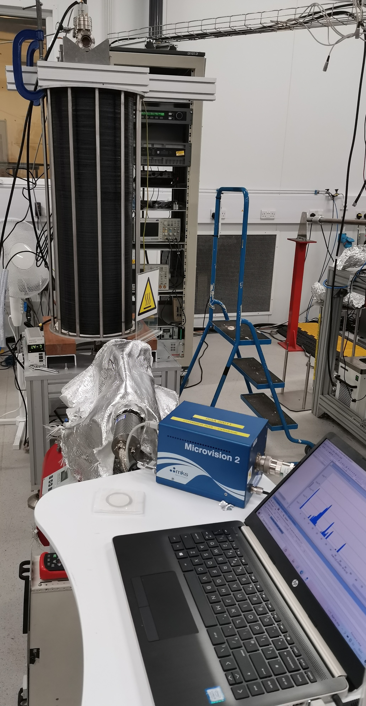
NEG deposition facility at UKRI (Daresbury Laboratory)
The facility is used for a routine coating of tubes with
  a length of 0.5 m
  Inner diameter 5-40 mm
  CF16-CF40 flanges
It has been updated with a new coil to deposit thin films on
  tubes with length of 1 m
  Inner diameter 5-100 mm
  CF16-CF150 flanges.

Slide 10
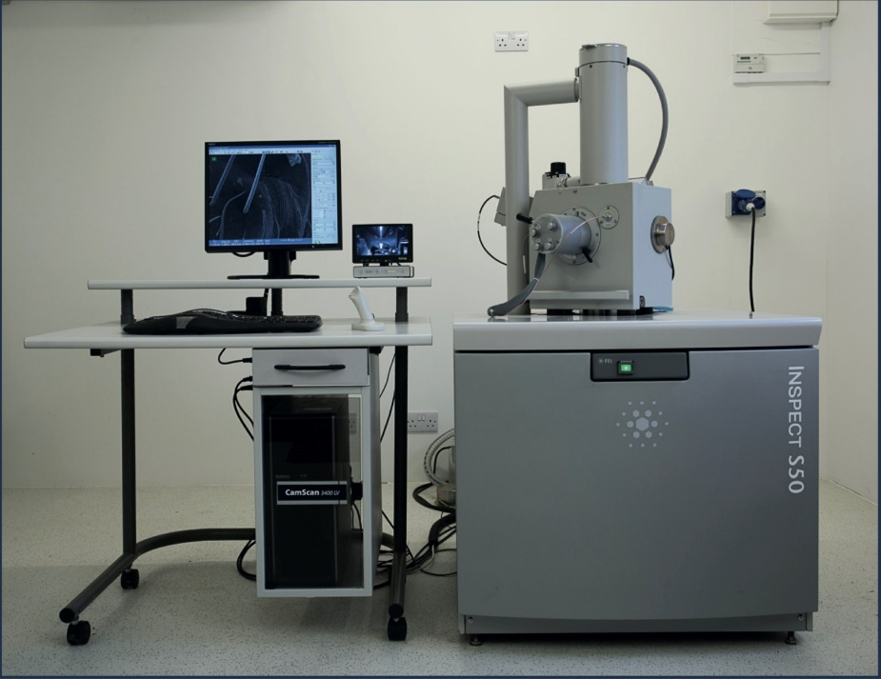
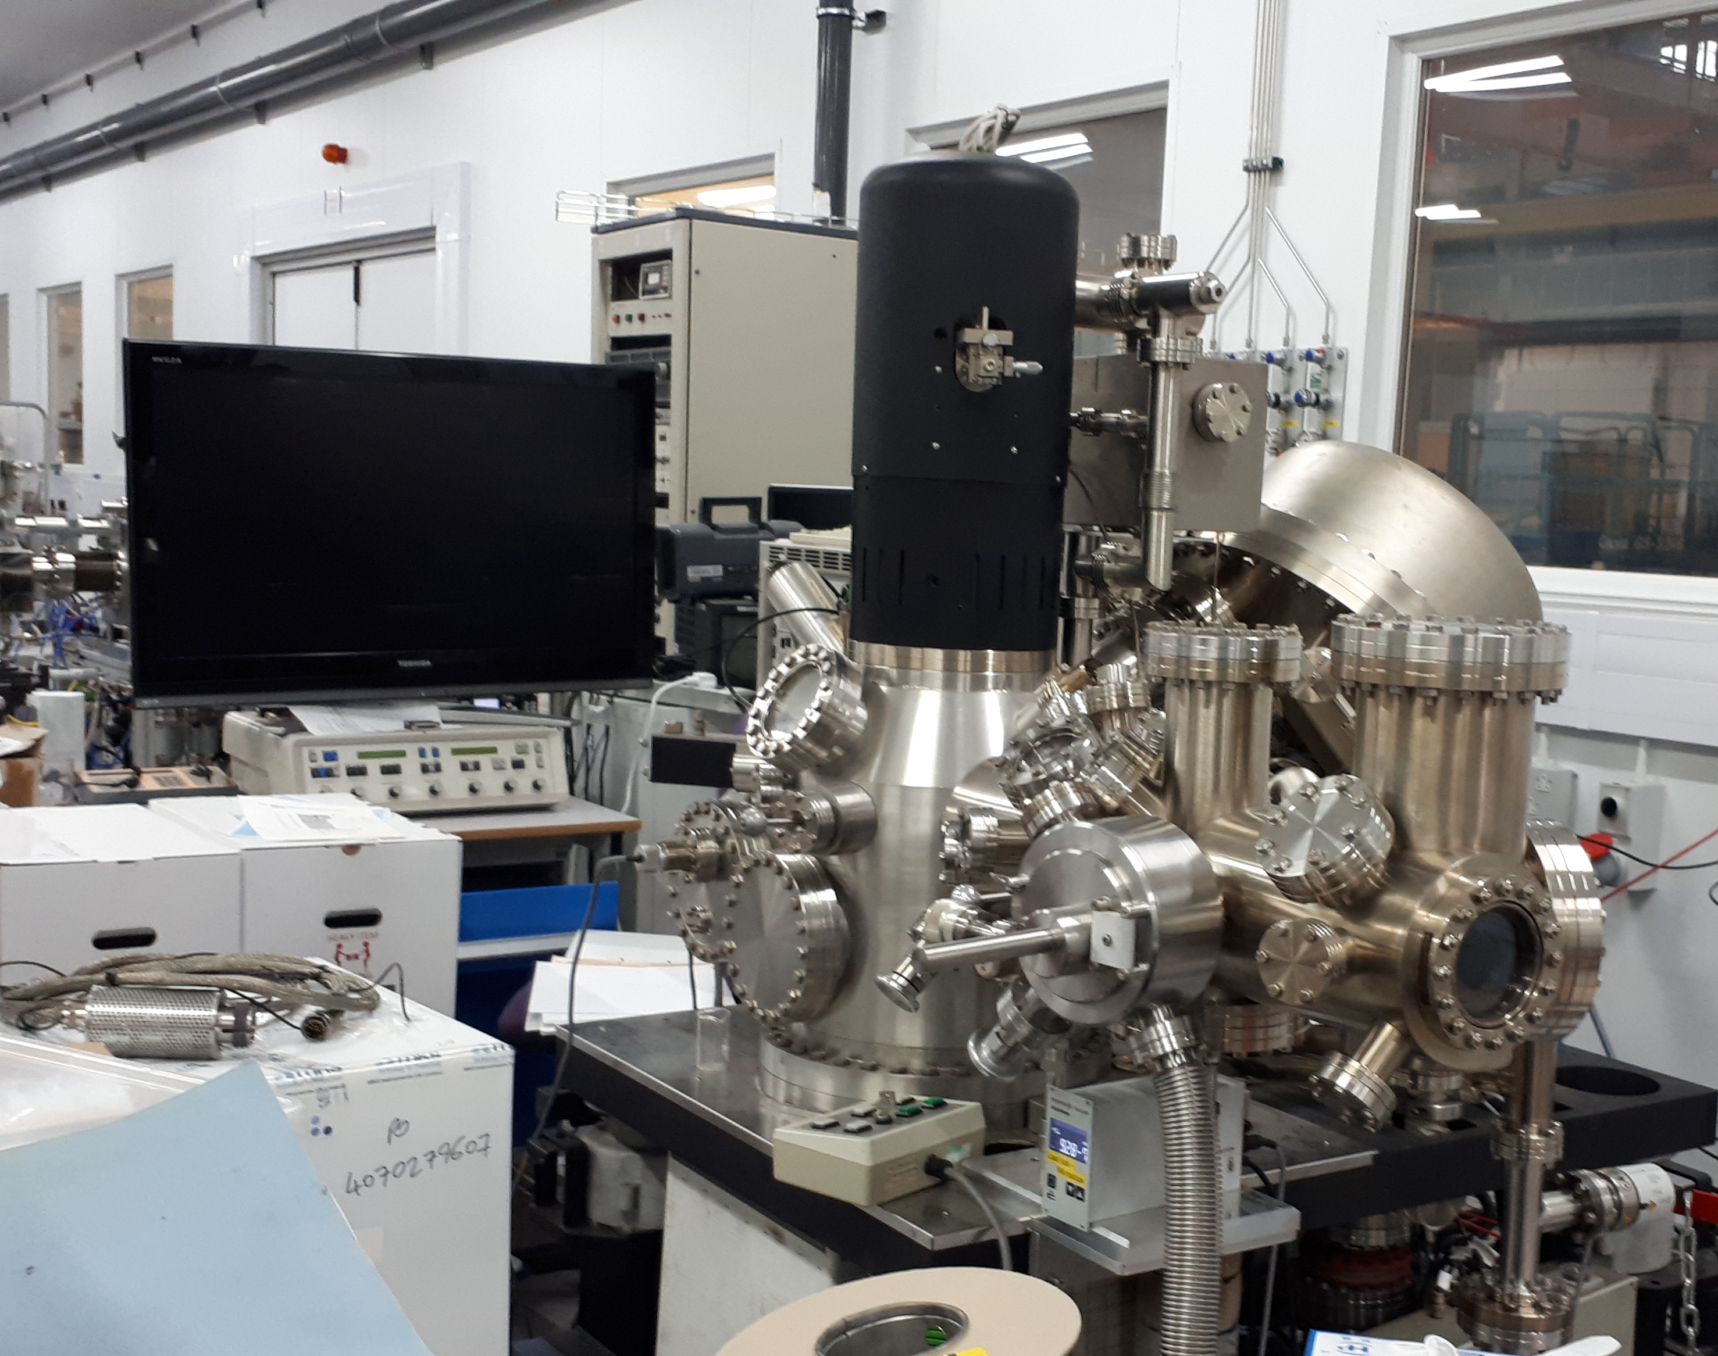
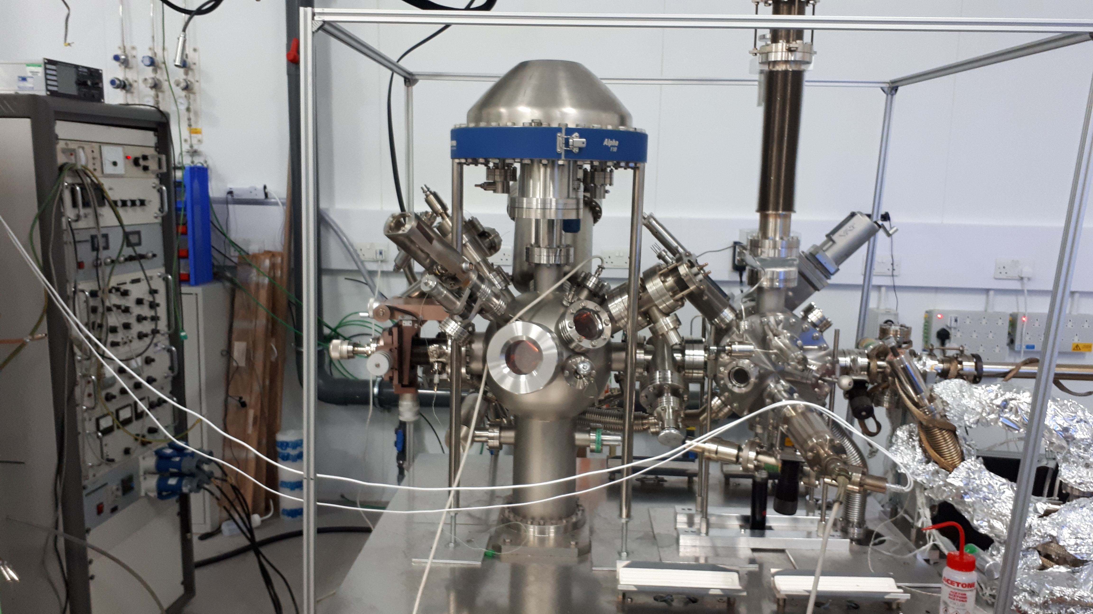
NEG Thin Film Characterisation at UKRI (DL)
Auger, XPS
FEI inspect S50 SEM
Auger
More characterisation facilities are available through collaborations with
The Materials Characterisation Laboratory at ISIS (RAL)
CI universities
Other UK universities
International collaborations
Courtesy of R. Valizadeh

Slide 11
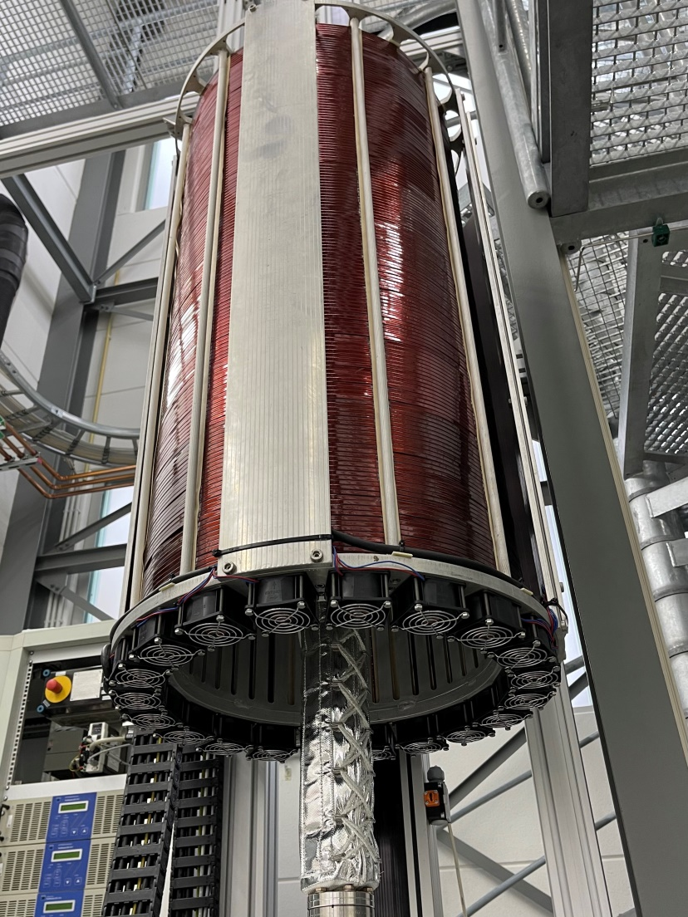
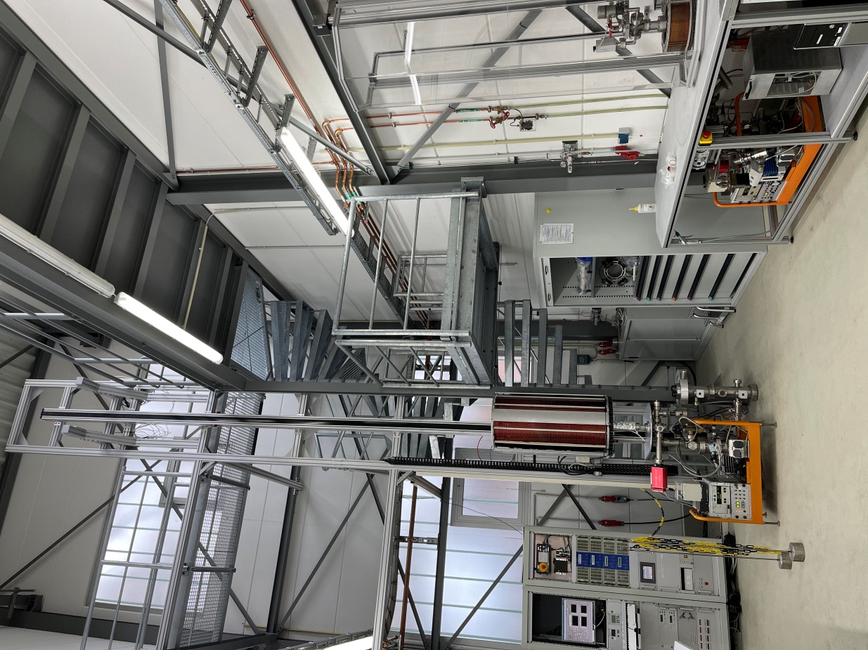
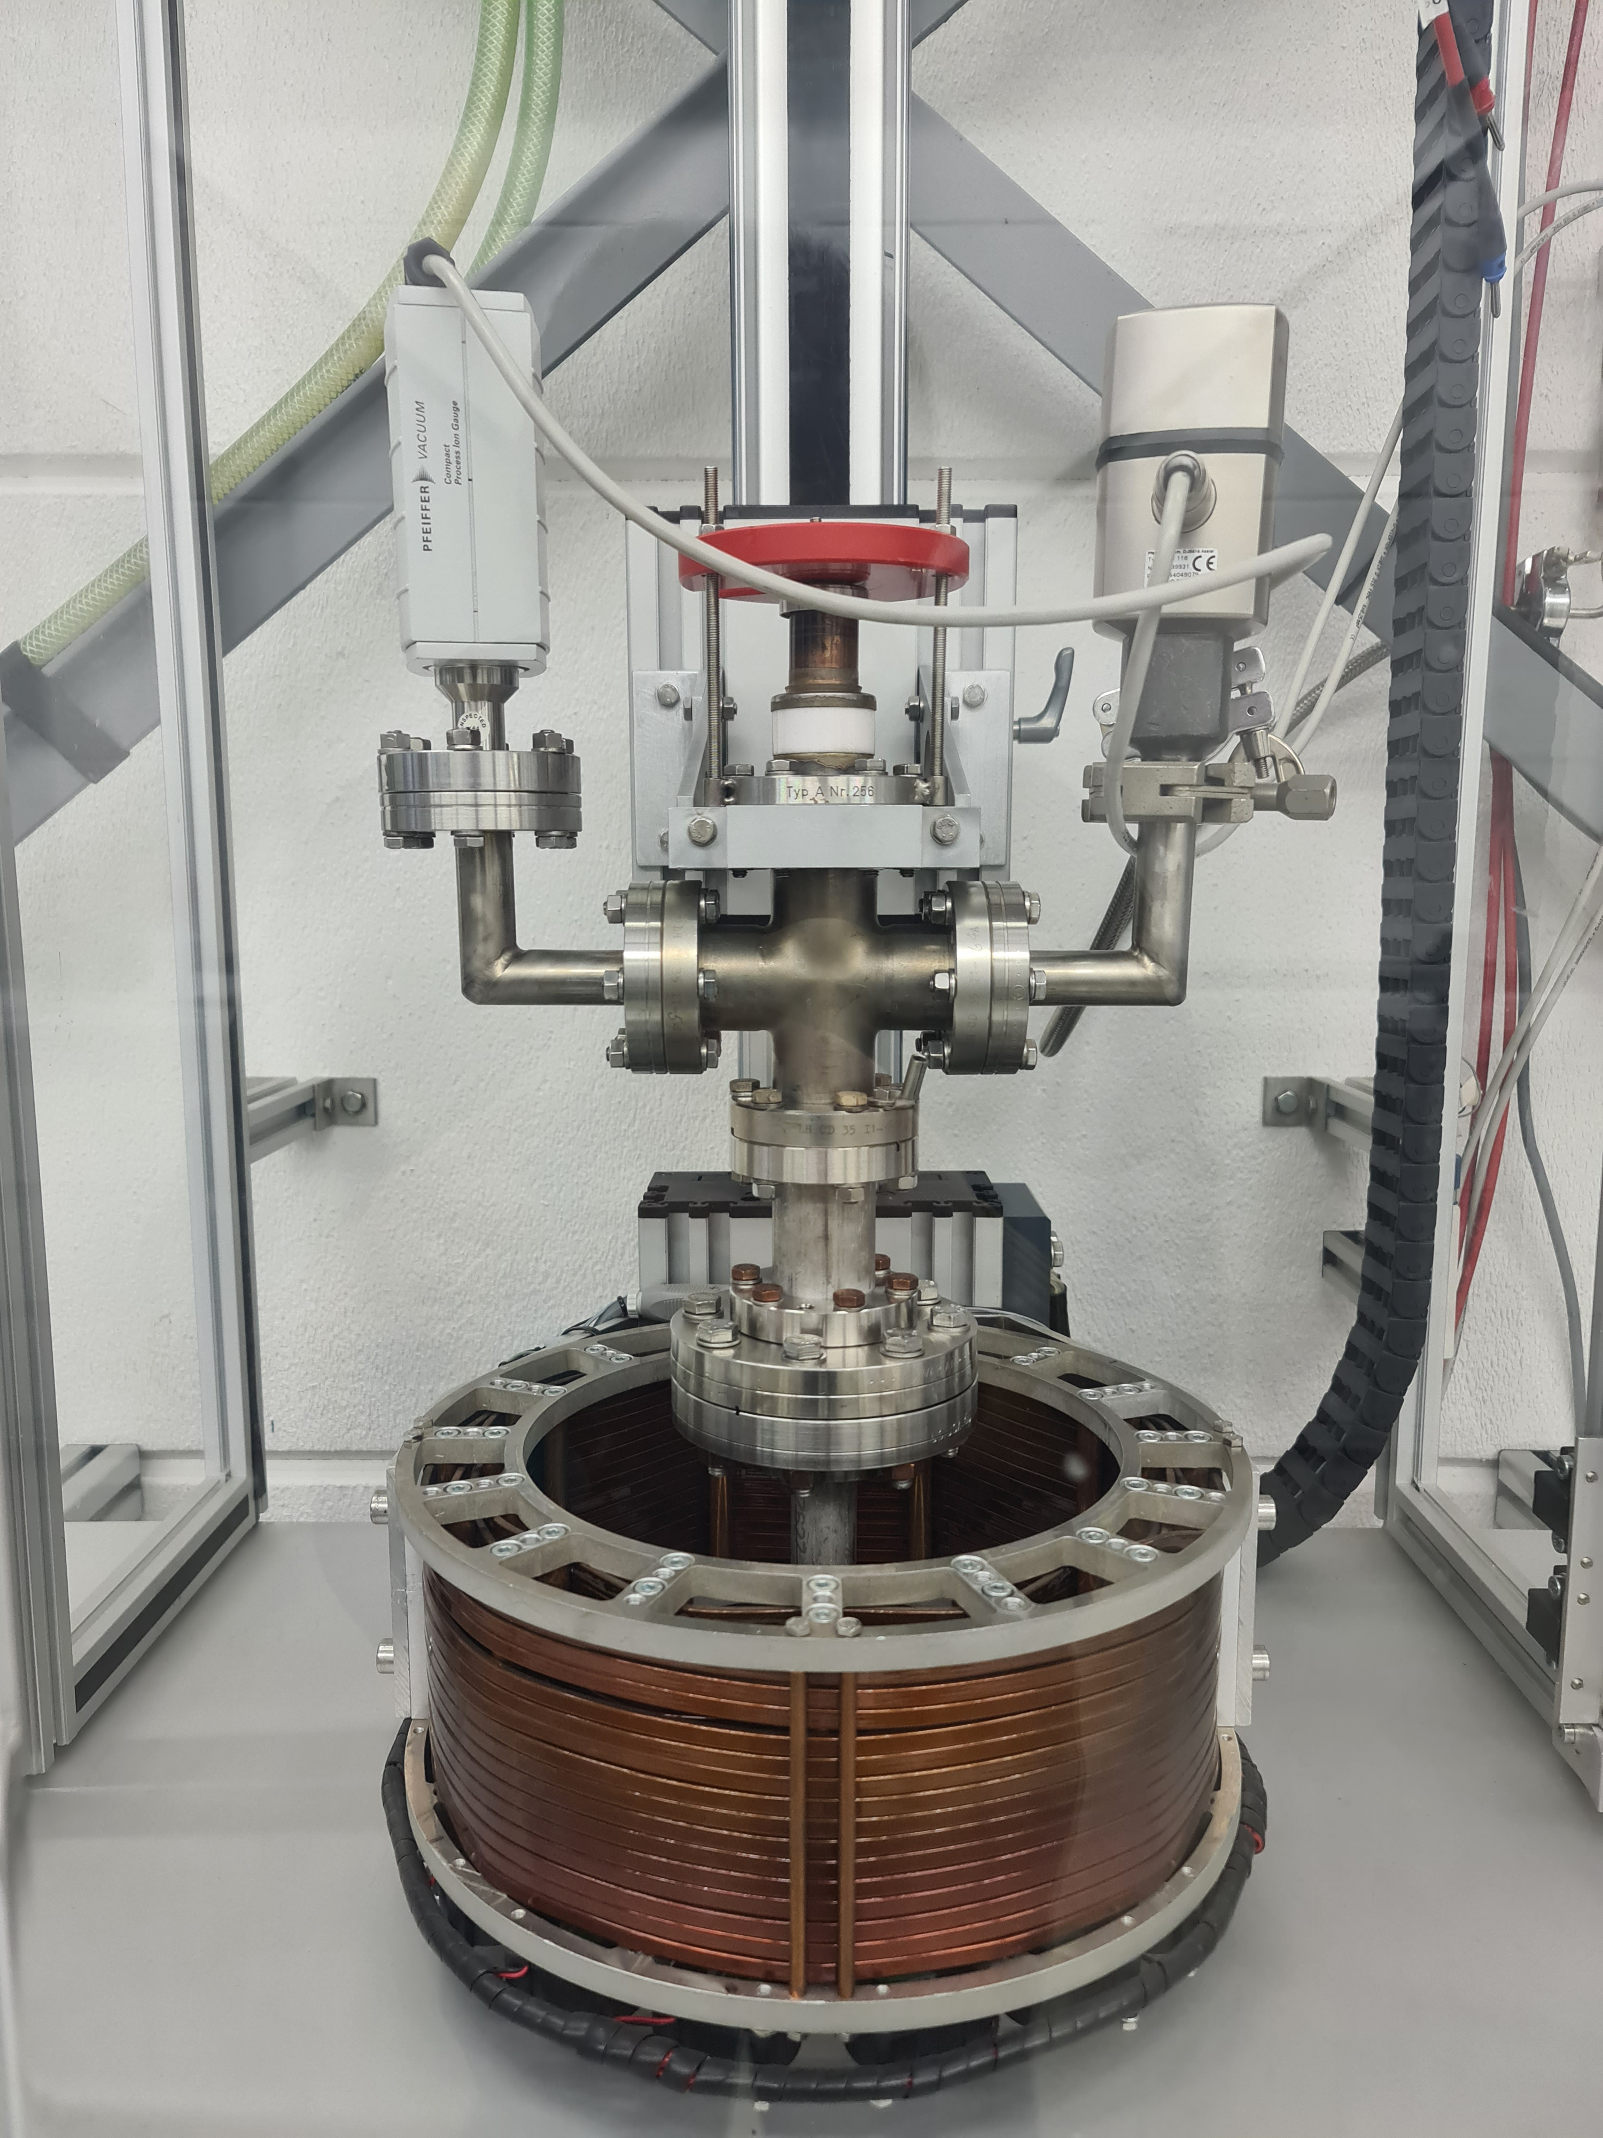
NEG deposition facility at DESY
Support by main future project of DESY
1 sputtering setup for long chambers (up to 5 m)
1 deposition system for short chambers
Courtesy of L. Lilje and R. Sirvinskaite (DESY)

Slide 12
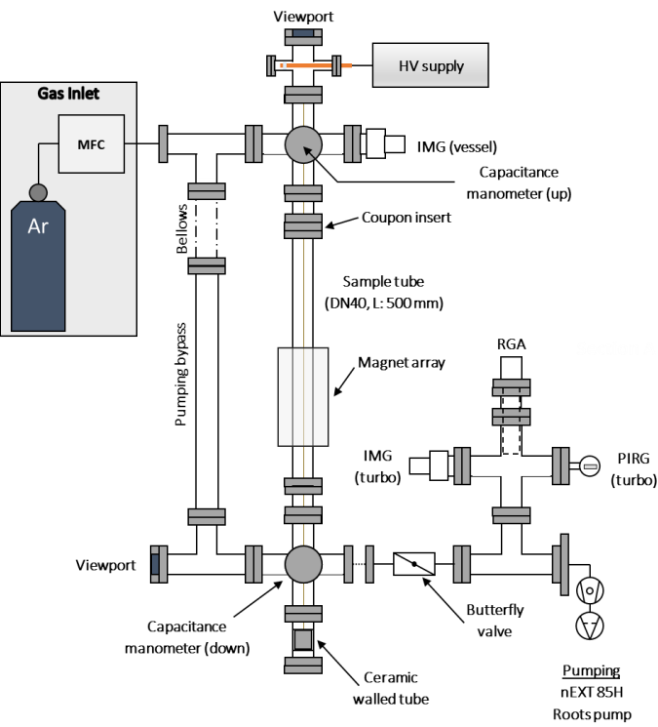
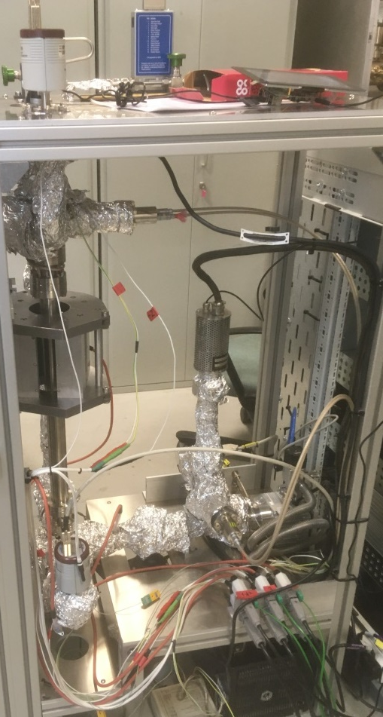
NEG deposition facility at DLS
Overview
DC magnetron sputtering rig, DN40 vessels up to 0.5 m
Base pressure around low 10⁻⁹ mbar range (unbaked)
Ar sputtering gas operating between 3×10⁻³ and 1 mbar
Moving permanent magnet (≈600 G) on rail
Static and pulsed DC HV modes
Twisted wire(s) tensioned by 0.5 kg mass in vacuum
System controlled using PLC
Status:
Increased operating pressure limit to 1 mbar
Several short (1 hour) coating runs with Zr wire, operating at low plasma power (<4 W)
Next steps:
Increase plasma power to approx. 15 W and perform longer coating run
Thickness and composition determination on Si coupons
Courtesy of C. Burrows (DSL)

Slide 13
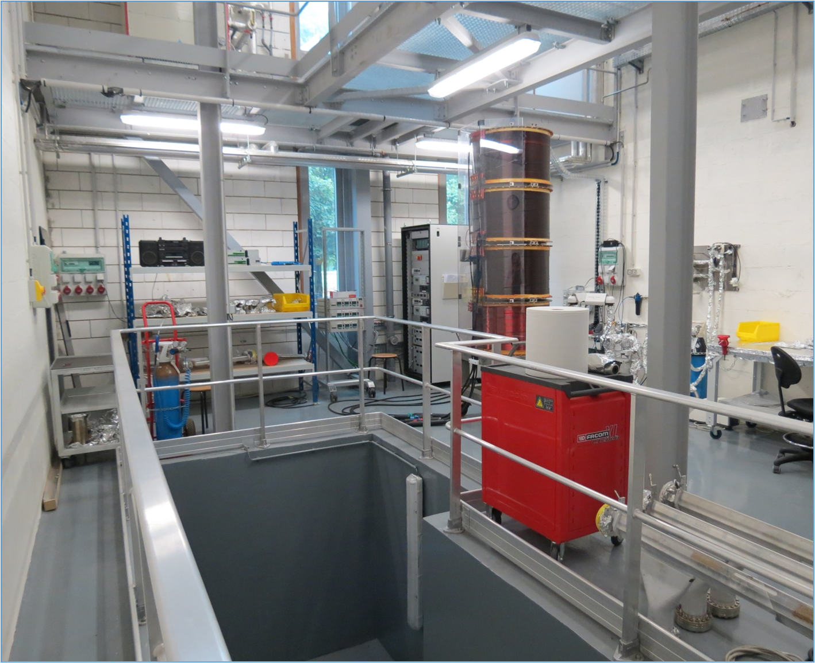
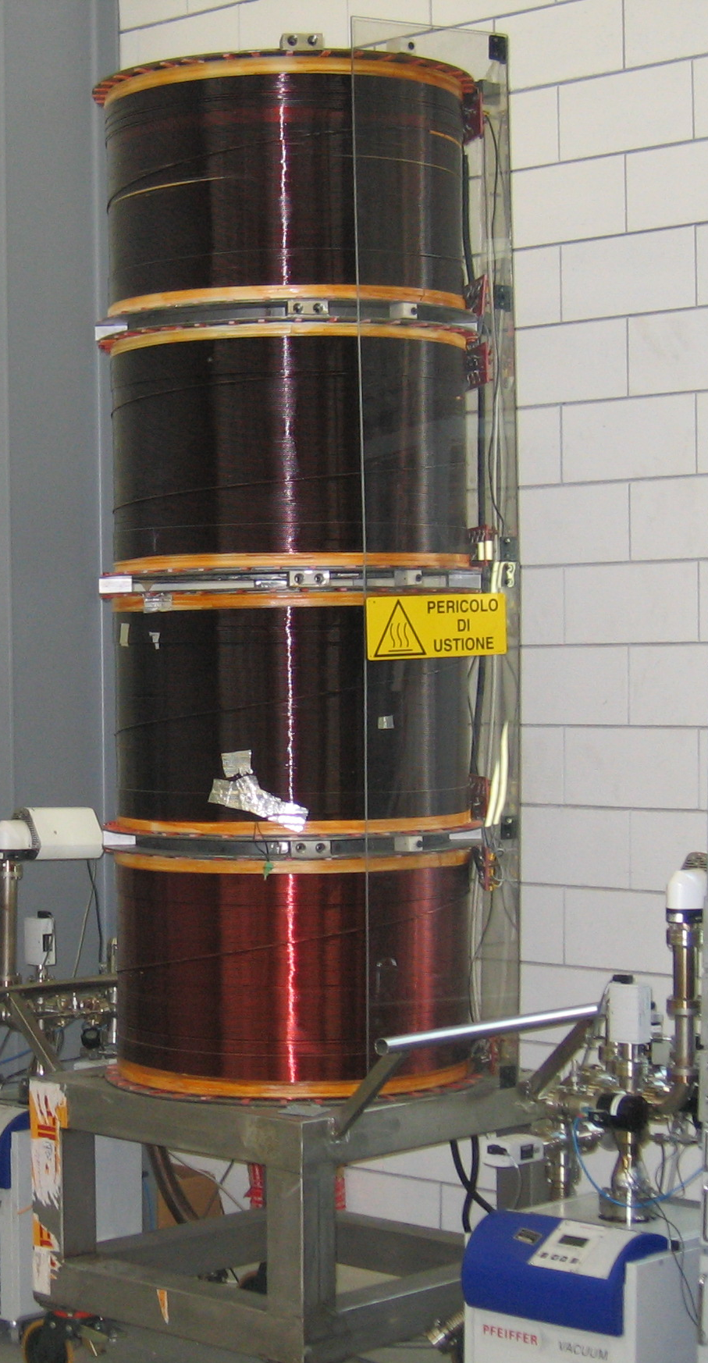
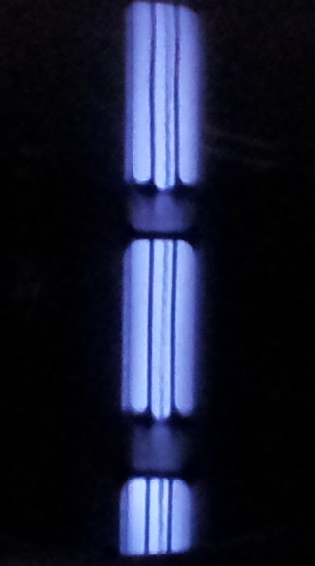
NEG deposition facility at Soleil
There is a deposition facility at Soleil
It could be used for a small number of samples in a future
Courtesy of Nicolas Béchu (Soleil)

Slide 14
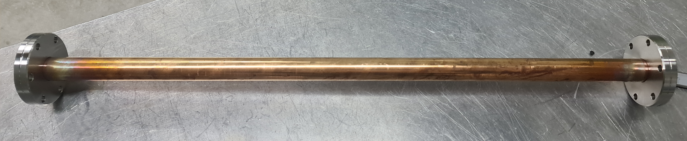
Samples for pumping properties evaluation
It was agreed that a project standard sample for pumping properties evaluation is
  made of OFHC or OFS copper samples
  ID = 20 mm
  L = 500 mm
  equipped with two CF40 flanges
Courtesy of L. Lilje and R. Sirvinskaite (DESY)

Slide 15
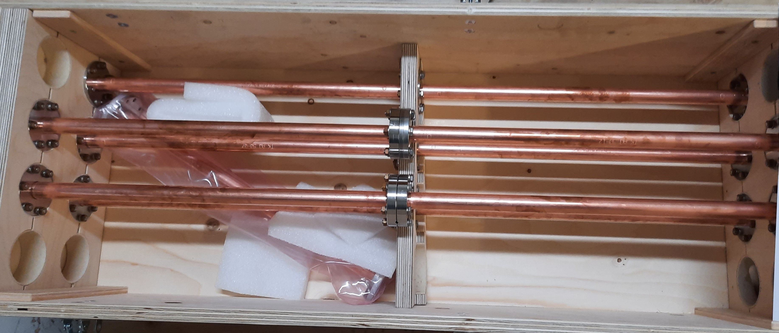
Samples for pumping properties evaluation
11 samples have been provided by DESY in March 2022.
  10 Samples have been etched with ammonium persulfate and cleaned with Elma Clean at DESY
    following a procedure being developed in ongoing research
  One sample have been cleaned with Elma Clean
    but not etched with ammonium persulfate
More samples can be produced in a future.
3 samples will be used for comparison of cleaning/etching procedures
  by thermal outgassing measurements
  by ESD measurements
8 samples to be coated at UKRI (DL):
  4 samples will be coated with Zr
  4 samples will be coated with Ti-Zr-V
so identical samples will be tested in 4 labs for comparing (cross-verifying) the results obtained on different facilities

Slide 16
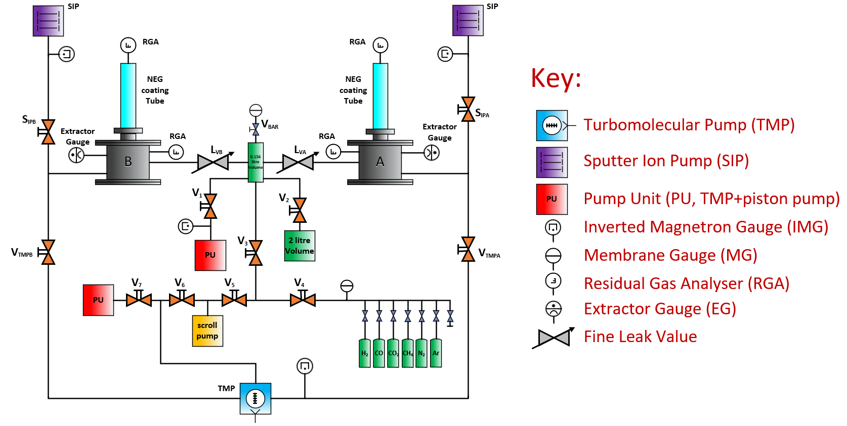
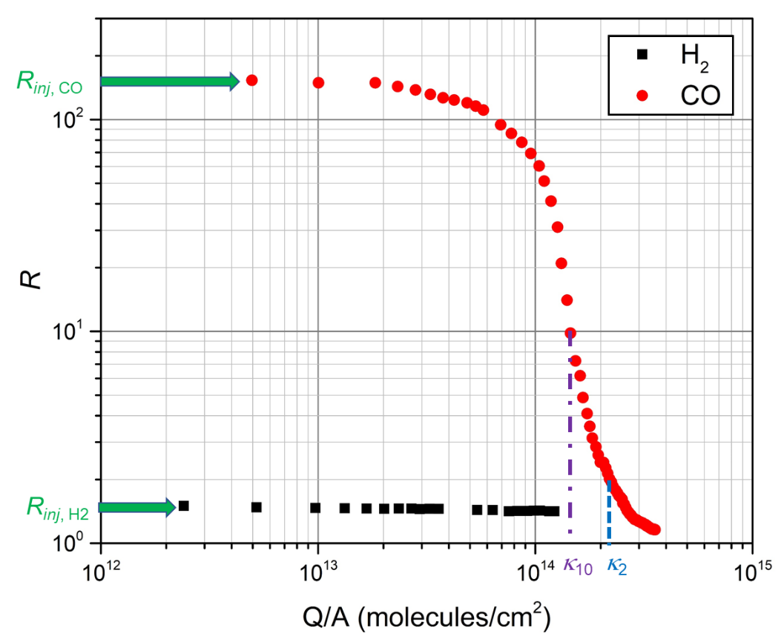
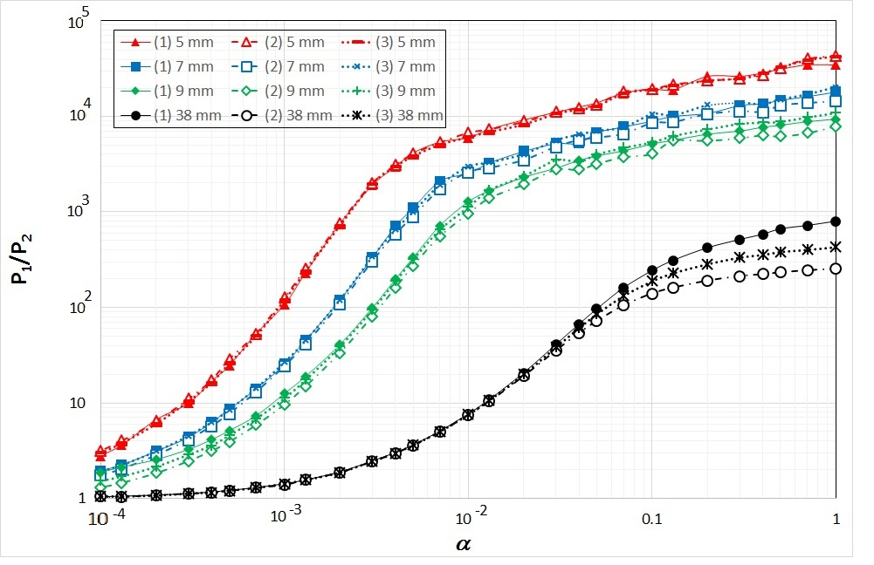
Facilities for pumping properties evaluation at UKRI (DL)
The pumping properties evaluation facilities are used for a routine measurements of initial sticking probability α and sorption capacity κ.
Up to 4 samples can be tested at the same time.
Pressure ratio R = P_{bot}/P_{top} as a function of
sticking probability α obtained with TPMC modelling
Typical result:
R = P_{bot}/P_{top}

Slide 17
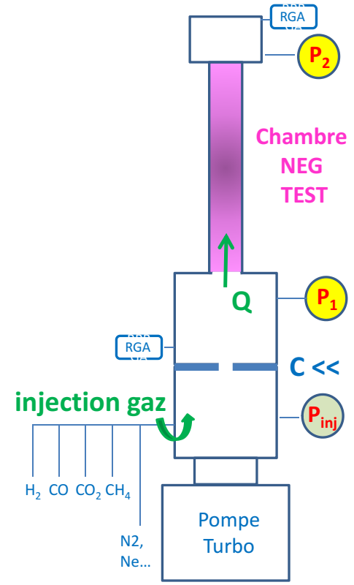

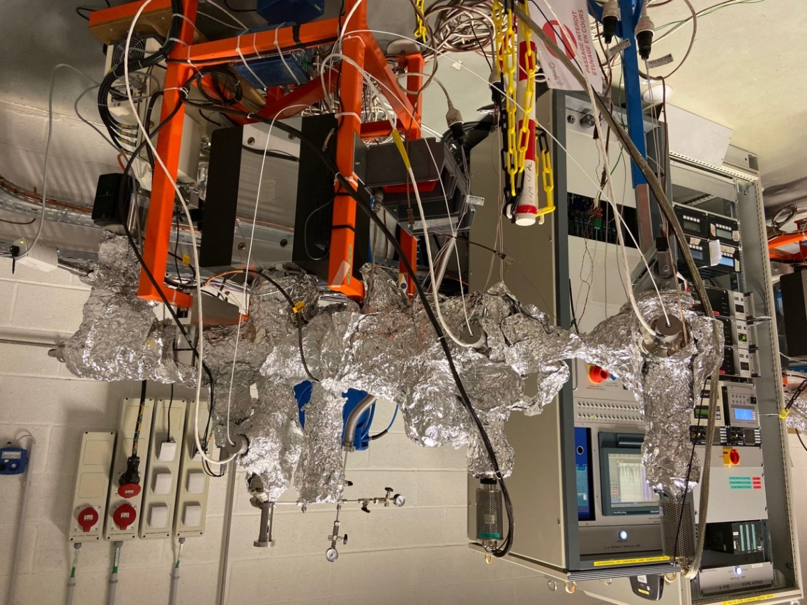

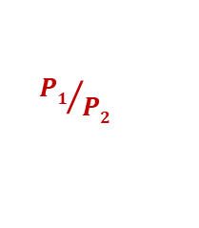
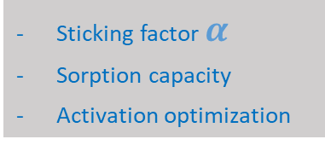
Facilities for pumping properties evaluation at Soleil
@ Vacuum LAB
2 Transmission Method Test Benches for NEG coating characterization
Sticking factor $α$
Sorption capacity
Activation optimization
Gas inlet
P_{inj}
C <<
Turbo
P₂
P₁
P. Costa Pinto, P. Chiggiato, A. Sapountzis, T. Sinkovits, M. Taborelli,
CERN
80th IUVSTA Workshop, NSRRC, Hsinchu, Taiwan (2016)
Courtesy of C. Herbeaux (Soleil)
Transmission Method
${P1}/{P2}$
is calibrated with MOLFLOW+ to find $α$

Slide 18
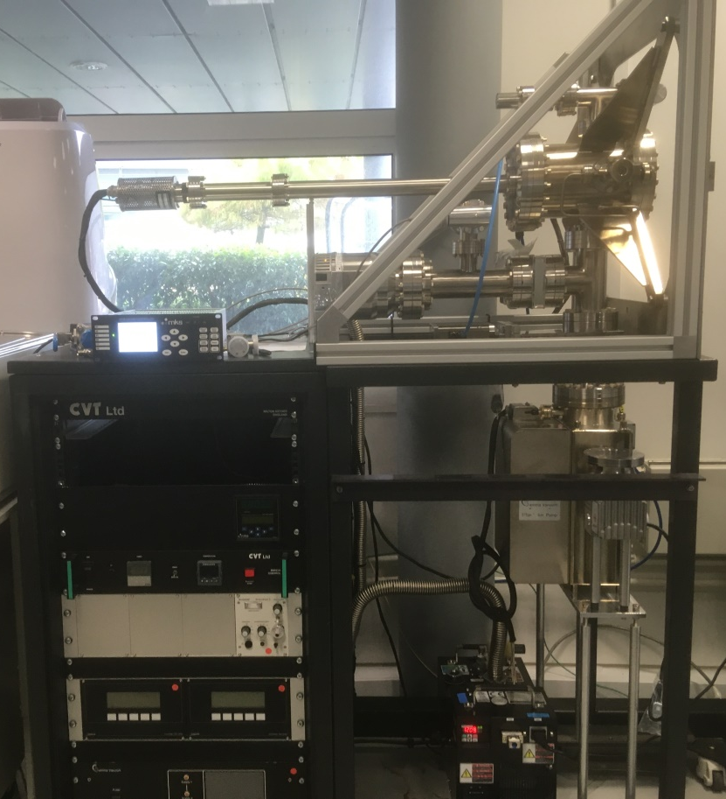
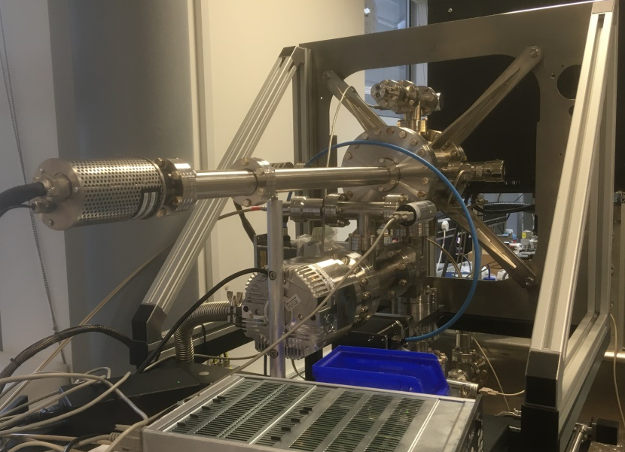
Facility for pumping properties evaluation at DSL
Overview
RGA-based or extractor gauge pressure ratio method to estimate sticking probability
Pumping provided by a 300 l/s TMP and a 150 l/s SIP
Gas injection through dedicated system based on expansion volumes
Four gases (H₂, CO, CO₂, CH₄) let through regulated leak valve, expected operating pressures up to 10⁻⁵ mbar
System to be controlled by PLC
Status:
System currently in commissioning (to be ready for samples by end of July 2022)
Courtesy of C. Burrows (DSL)

Slide 19
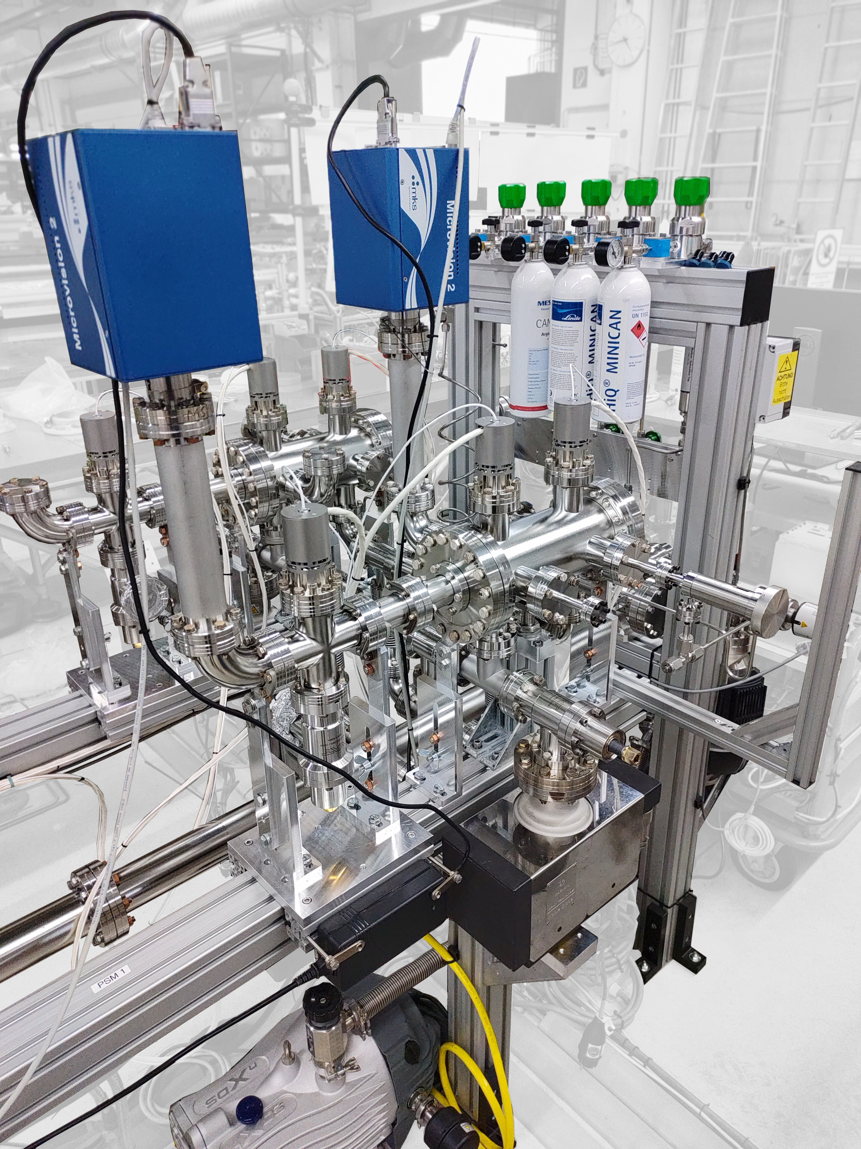
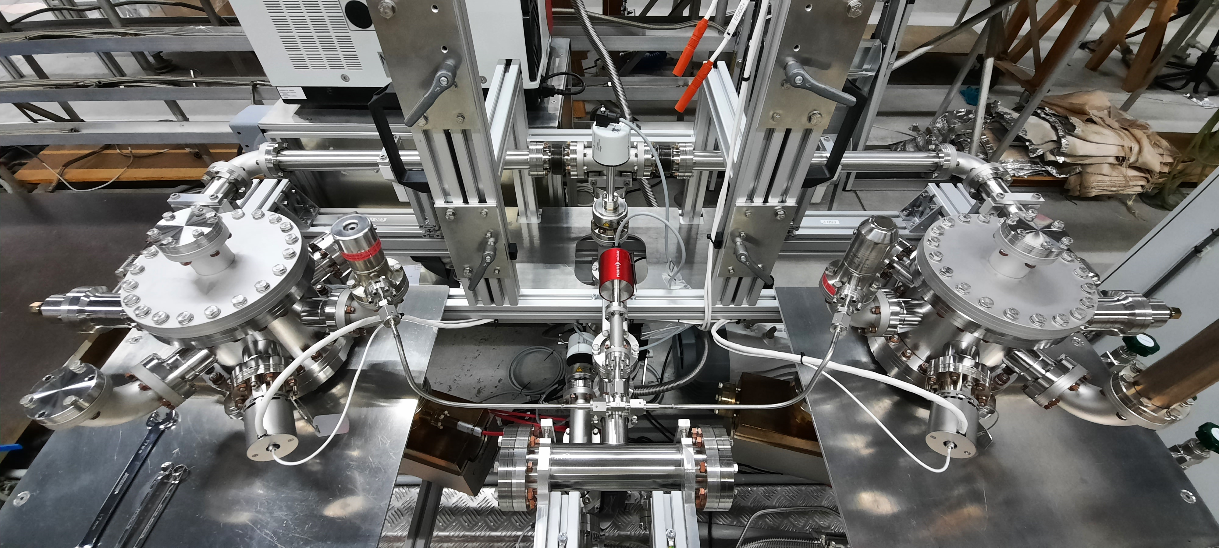
Facility for pumping properties evaluation at DESY
Pumping test setup is running now after redesigning
RGA or extractor gauge-based pressure ratio measurements
Another mirroring system is lacking RGAs
ESD setup (one of the two mirroring chambers) is ready for commissioning and pumping tests
Courtesy of R. Sirvinskaite (DESY)

Slide 20
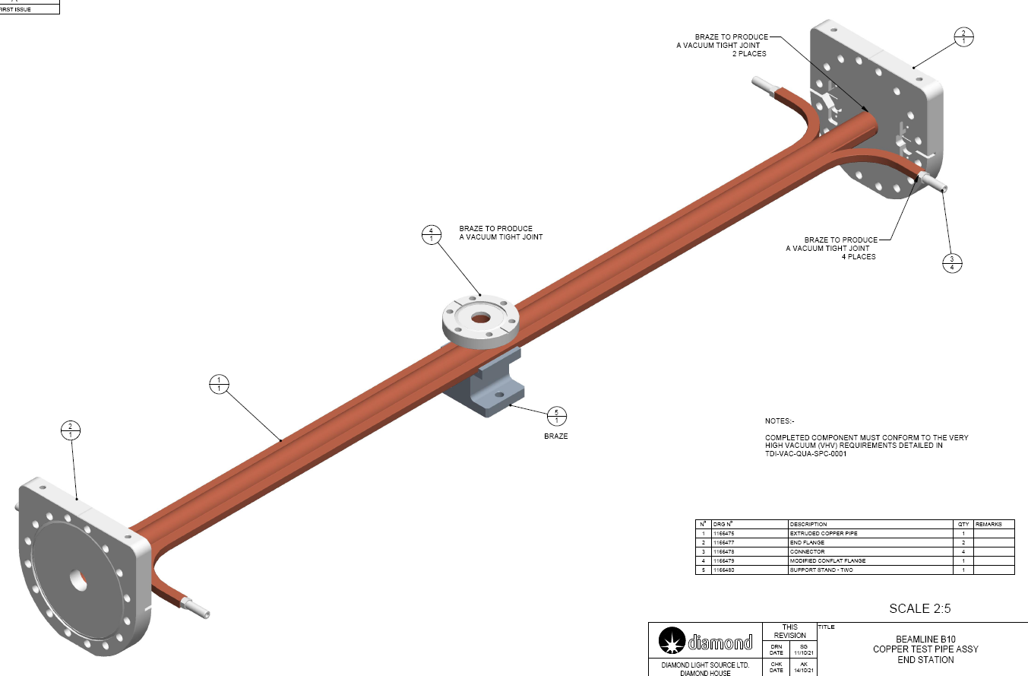
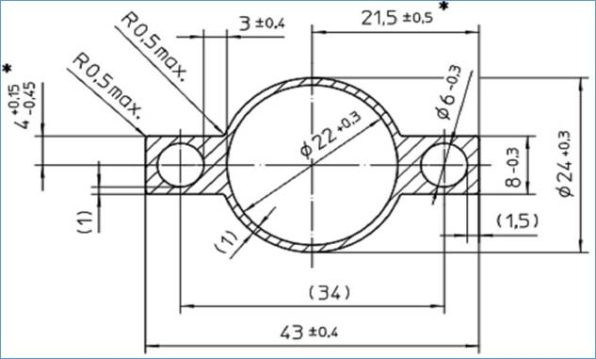
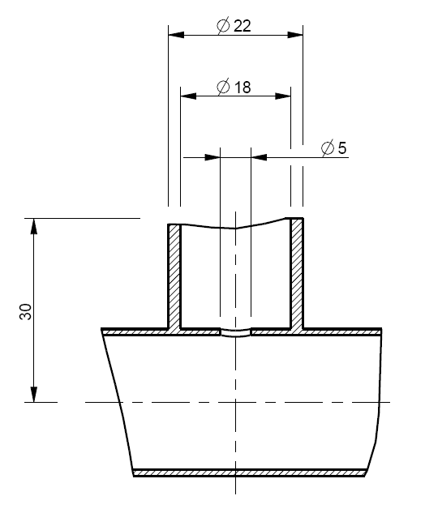
Sample for PSD measurements
Samples jointly designed by Soleil and DLS
9 samples can be provided by Soleil by June 2022. (More samples can be produced in a future).
  Initially, samples will be cleaned by a manufacturer
  Later, samples will be cleaned at DESY following a procedure being developed in an ongoing research
  Initially two samples will be coated with Zr at UKRI (DL),
    so identical samples will be initially tested in DLS and Soleil for comparing (cross-verifying) the results obtained on different facilities
  Central port is circular with ID = 18 mm and with 5-mm hole to vessel body
  Central and end flanges are brazed
Courtesy of C. Burrows (DSL)

Slide 21
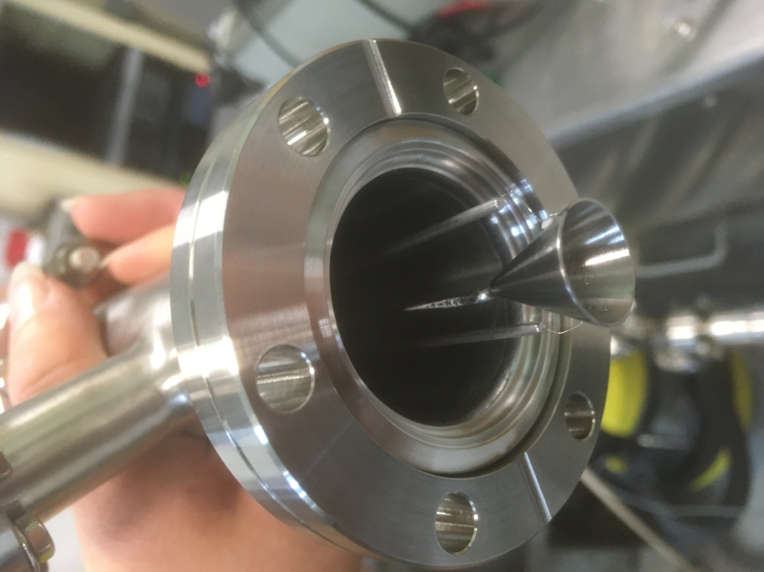
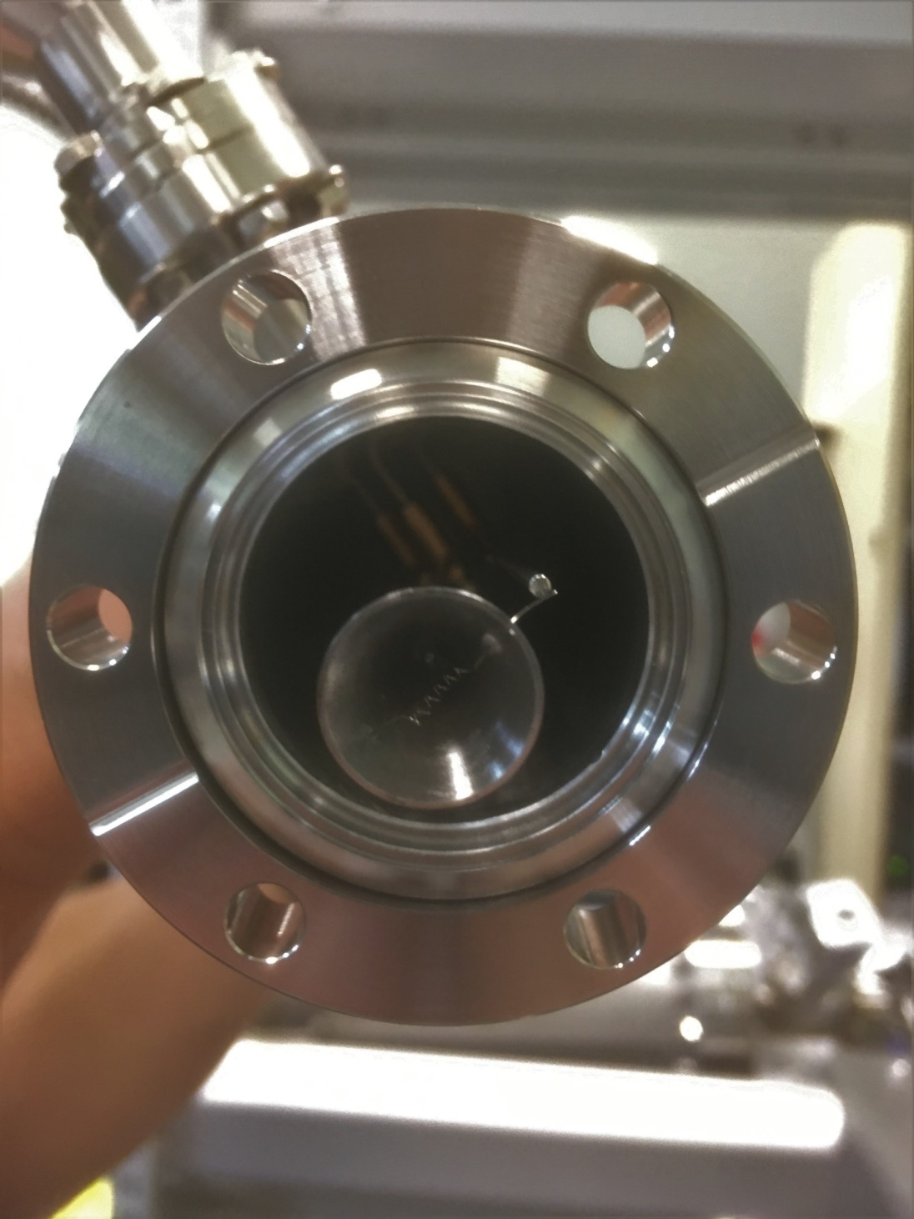
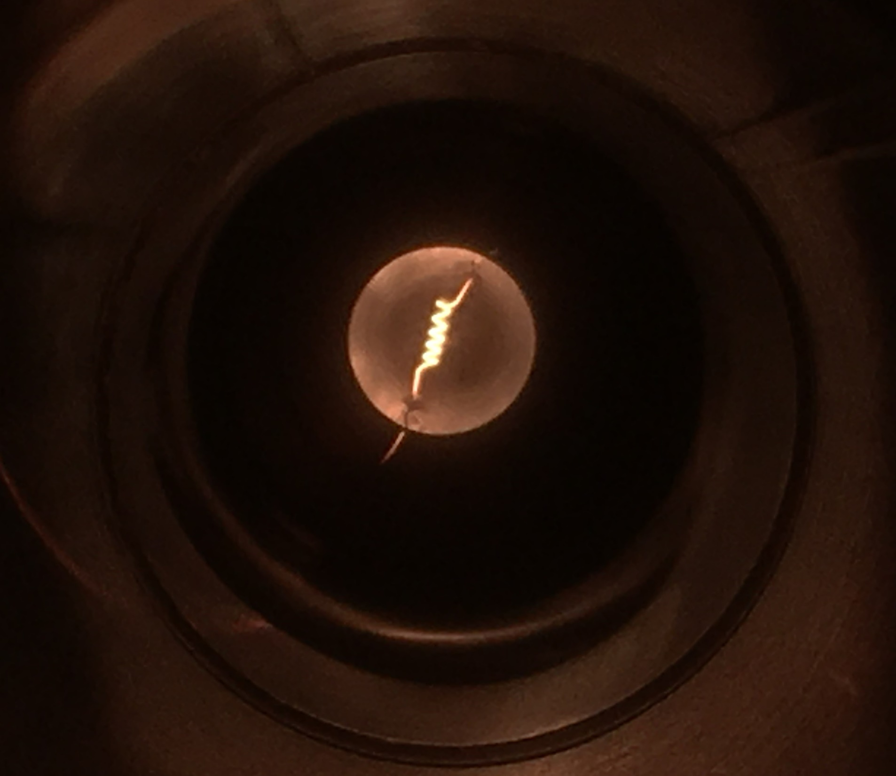
Central port
Central RGA port
Photoelectrons
Photons
(diffused or reflected)
A great attention was paid to the central port design as it should allow an accurate measurements of pressure inside NEG coated chamber irradiated by SR photon:
  Low thermal outgassing
  Low PSD and ESD inside the port
Solution:
  Small entrance hole
  Covered by stainless steel cone:
    15 mm diameter, 0.5 mm wall thickness,
    3.4 mm clearance to wall
  Filament to condition the cone with electrons
    operated up to 3 A at ±300 V
Beam SR photons
e⁻
γ
γ
Stainless steel
supports
0.125 mm
W filament
Filament glow at 1.5 A
Courtesy of C. Burrows (DSL)

Slide 22
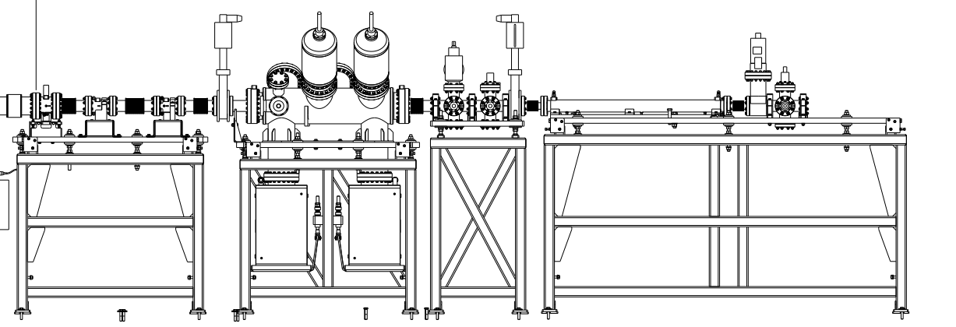
An updated facility for PSD studies on SR beamline at Soleil
gauge+RGA
Overview
Typical Soleil dipole front-end:
  Photon flux: 3.4 × 10¹⁴ photon/(s·mrad·mA)
  Critical energy: 8.379 keV
Beam width at test piece 1-50 mm
Test vessel angular range of up to 30 mrad (1.8º)
Status
Front-end section: reconditioned during 2020
Experimental end-station: currently under operation with samples coated with NEG at SAES getters
New OFHC copper samples for SR studies designed and procured (9 pcs). Delivery expected in June 2022.
The samples will be NEG coated at UKRI (DL) and installed during a Soleil shutdown in August 2022
P_{T} [mbar]
S [l.s⁻¹]
C [l.s⁻¹]
S.R
Q [mbar.l.s⁻¹]
beam collimation
(gas load)
TEST Chamber
SIP
SIP
Turbo molecular pump
+ gauge+RGA
Turbo molecular pump
+ gauge+RGA
Courtesy of C. Herbeaux (Soleil)

Slide 23
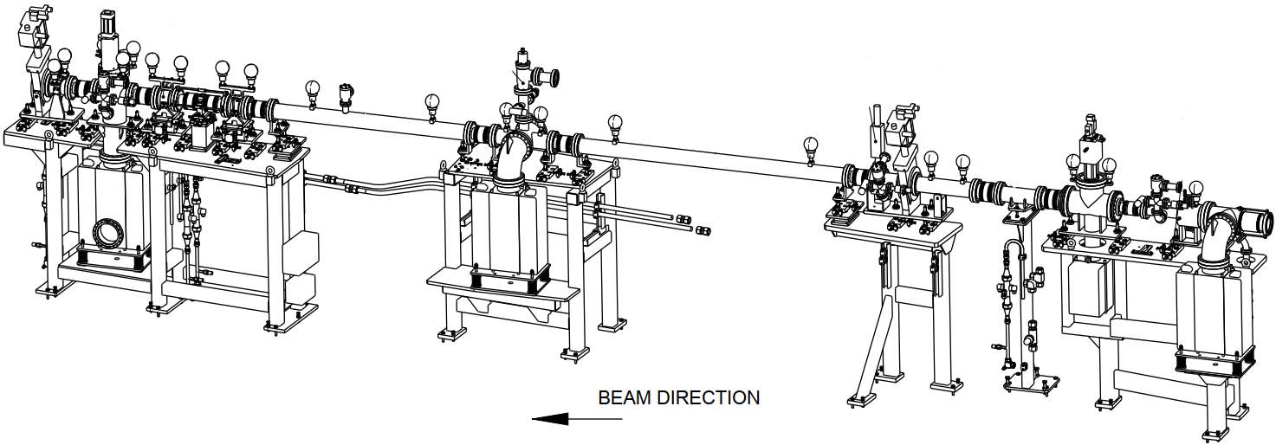
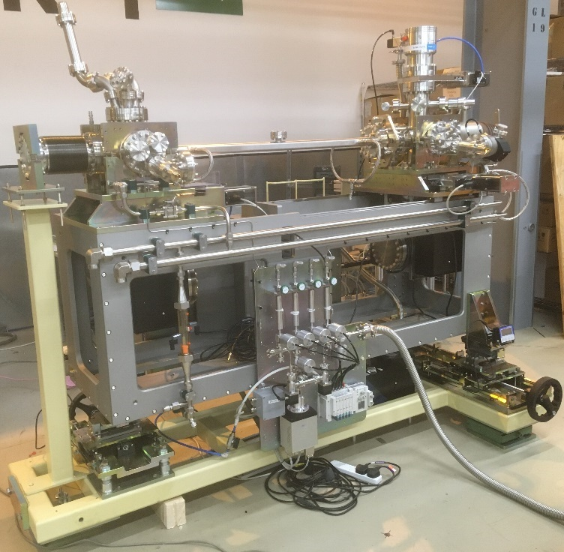
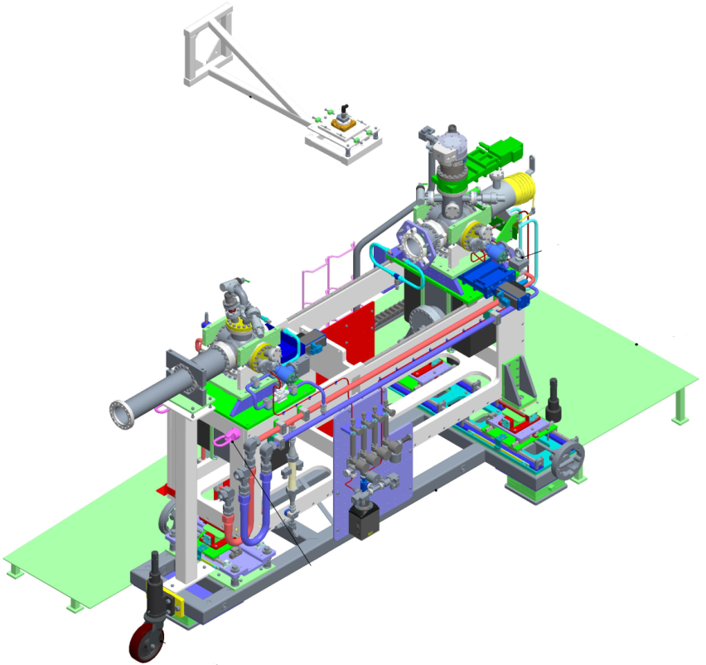
A facility for PSD studies on SR beamline at DSL
Overview
Typical DLS dipole front-end (FE10B):
  Photon flux: 3.86 x 10¹⁴ photon/(s·mrad·mA)
  Critical energy: 8.379 keV
Beam width at test piece up to 20 mm
Test vessel angular range of up to 60 mrad (3.5º)
Two 300 l/s SIPs and a 300 l/s TMPs for gas injection or coating saturation measurements
Status
Front-end section: installed November 2020
Experimental end-station: currently under post-installation conditioning with a stainless steel DN40 DLS type sample vessel (uncoated)
Stainless steel DN40 DLS type sample NEG coated at UKRI (DL) was be installed during a DLS shutdown:
  In March 2022
1st copper sample coated with NEG could be installed during a following DLS shutdown
  In August 2022
Courtesy of C. Burrows (DSL)

Slide 24
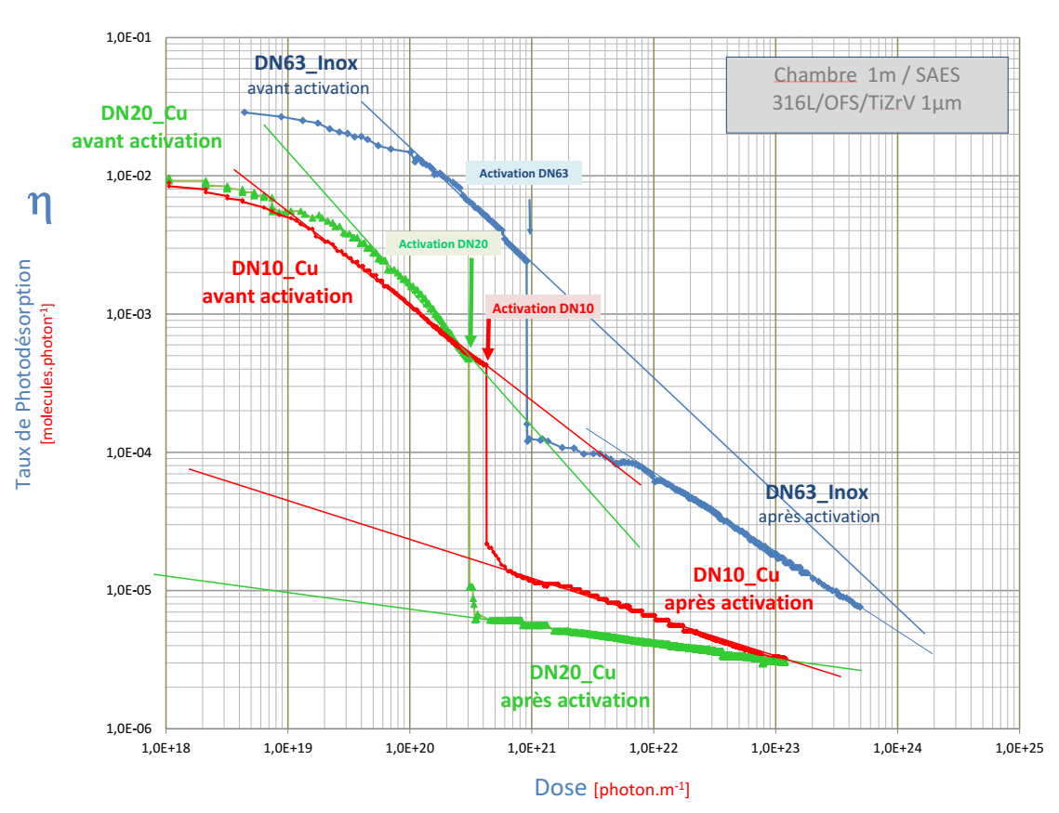
Results of PSD testing at Soleil
Three 1-m long, water cooled vacuum chambers with ID = 63, 20 mm and 10 mm were installed on the PSD beamline.
The chambers were previously NEG coated at SAES with a 1-µm thick TiZrV film.
Total PSD yields calculated for initial SR irradiation before NEG activation, followed by activation to 200 °C for 24 h and continuing with SR irradiation.

Slide 25
Task 10.5 coordination activities
Task 10.5 has started with two preparatory meetings:
  on 2nd March and 7th April 2021
Task 10.5 meeting take place every month:
  1st Task 10.5 (kick-off) meeting on 12th May 2021
  2nd Task 10.5 meeting on 15th Sep 2021
  3rd Task 10.5 meeting is scheduled on 12th May 2022
  Monthly briefing Task 10.5 meeting
Deposition and testing facilities are operational at UKRI and DESY
SR beamlines have been design, built and are already in operation at DLS and Soleil
Milestone Report MS47 has been submitted on 1/4/2022

Slide 26
Summary
Task 10.5 team works in full capacity according its plan
All necessary capabilities exist at least with two partners
  Deposition facilities are operational at UKRI and DESY, in conditioning at DSL, can be used at Soleil
  Pumping property evaluation facilities are operational at UKRI, DESY and Soleil, in conditioning at DSL.
SR beamlines
  Reconditioned and is in operation in Soleil
    tested with a sample coated with NEG at SAES Getters
  Have been design, built and are already in operation at DLS
    A stainless steel sample coated with NEG at UKRI has been installed for PSD measurements
Samples:
  11 samples for pumping property measurements have been produced and delivered to UKRI:
    8 samples are ready for NEG coating and testing in 4 labs
    3 samples are used for comparing copper cleaning procedures by TD and ESD measurements
  9 samples for PSD measurement have been designed and are under production
    to be delivered for NEG coating in June and
    to be installed on SR beamlines in August 2022
Milestone MS48 report submitted on time

Slide 27
Acknowledgment (Task 10.5 team)
DLS
Matthew Cox
Chris Burrows
Hugo Shiers
DESY
Lutz Lilje
Ruta Sirvinskaite
Nils Plambeck
Ralph Böspflug
Sven Lederer
Soleil
Christian Herbeaux
Nicolas Béchu
Vincent Le Roux
UKRI (STFC/DL/ASTeC)
Oleg Malyshev
Reza Valizadeh
Eleni Marshall
Adrian Hannah
James Conlon

Slide 28
Thanks for your attention

