Slide 1
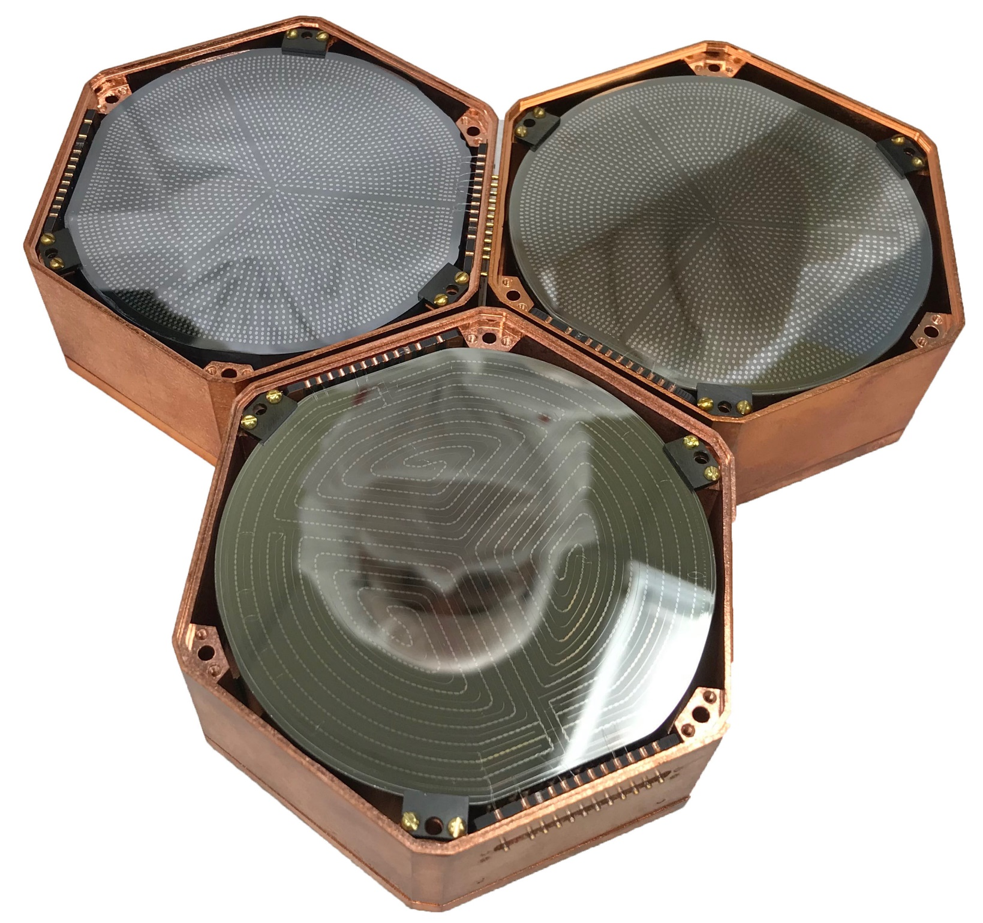
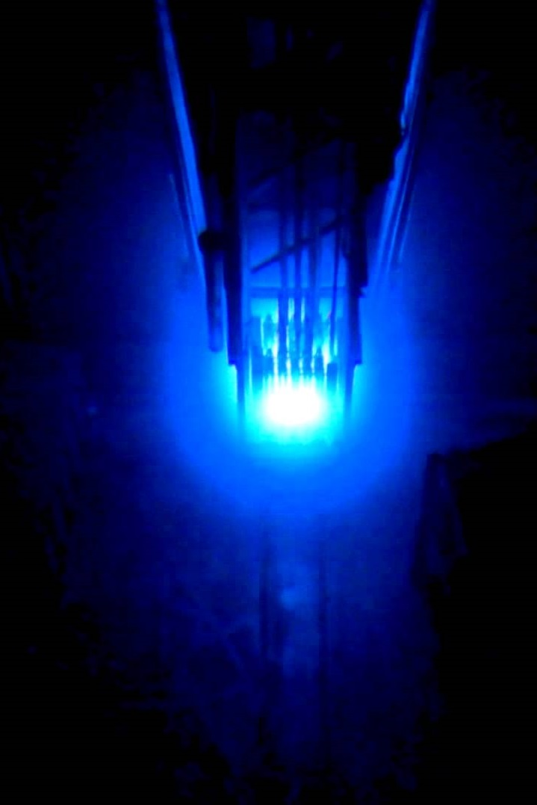

Search for Axions on the MIνER CEνNS Experiment
Rupak Mahapatra, Texas A&M

Slide 2
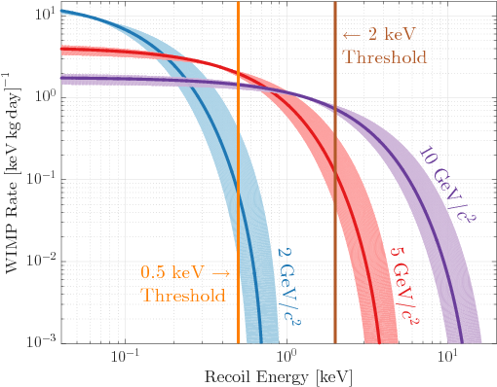
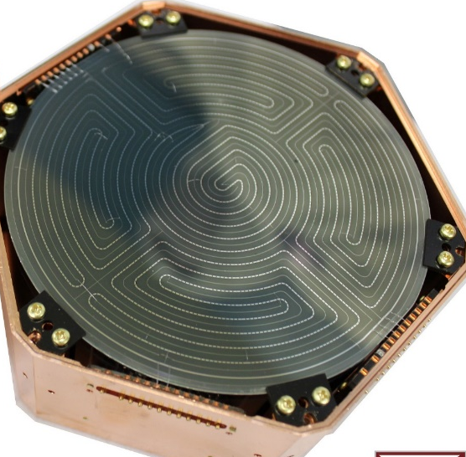
Coherent Neutrino Scattering: Connection to WIMPs
Requirements: Low Threshold Detectors combined with Low-background achieved through reduction and rejection
Integrated rate/kg-year
Background
CEνNS observed at SNS (~50 MeV ν), thus accessible by many detector technologies: E_{max}∝E _{ν}²
CEνNS process is yet to be discovered at a reactor! E_{ν}~MeV hence need low threshold detectors
Recoil energy in eV

Slide 3
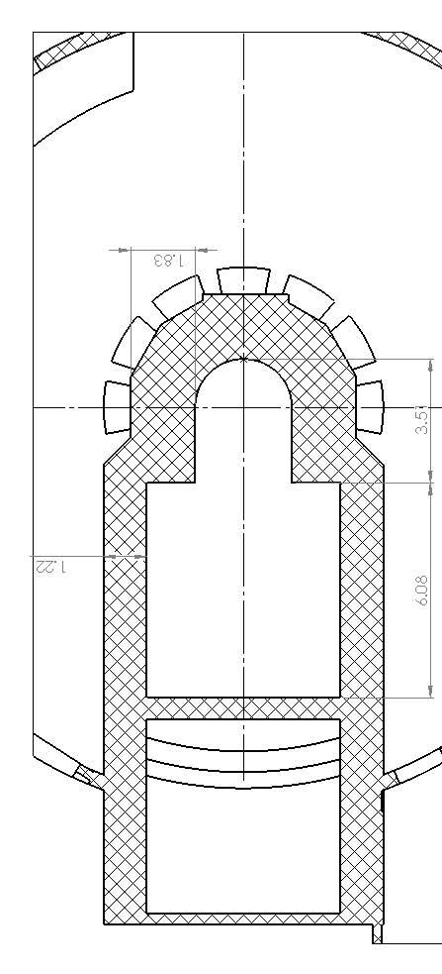
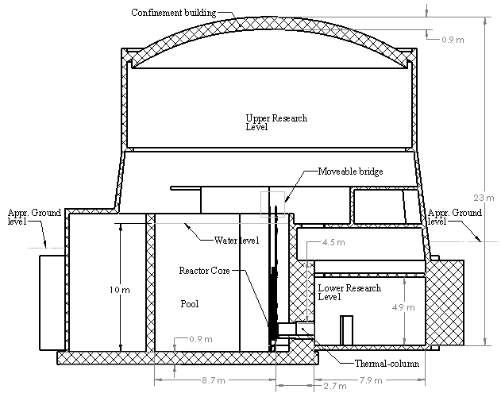
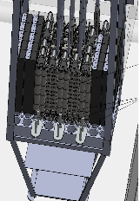

Experiment Plans
Key Features
Low-threshold (<100 eV) with sensitivity to CNS
2-10 m proximity to core (rate enhancement)
Moveable Core tests short baseline oscillation
4 kg (max=30) payload with CNS sens. in 4 months
High gamma flux is about 9.0×10¹¹ cm⁻² s ⁻¹ for ALP
Top View
Side View
Movable Bridge
Precisely Movable Core to Probe m-scale oscillation

Slide 4
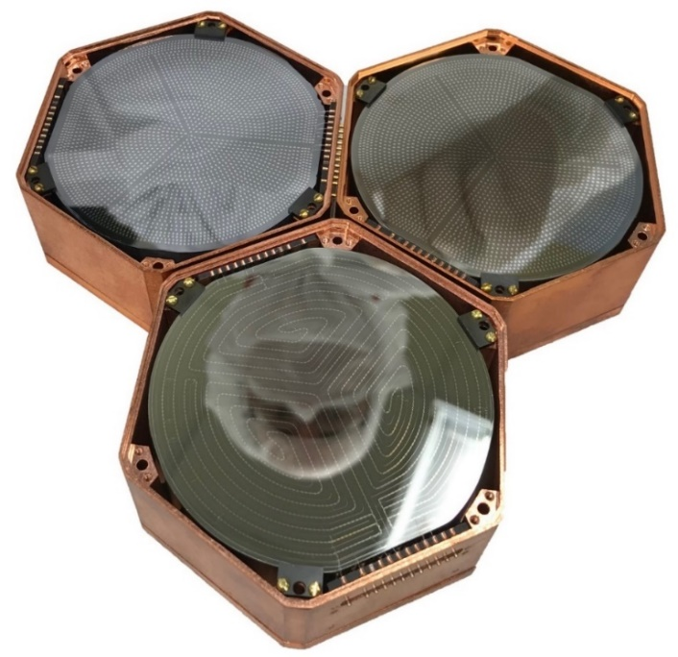
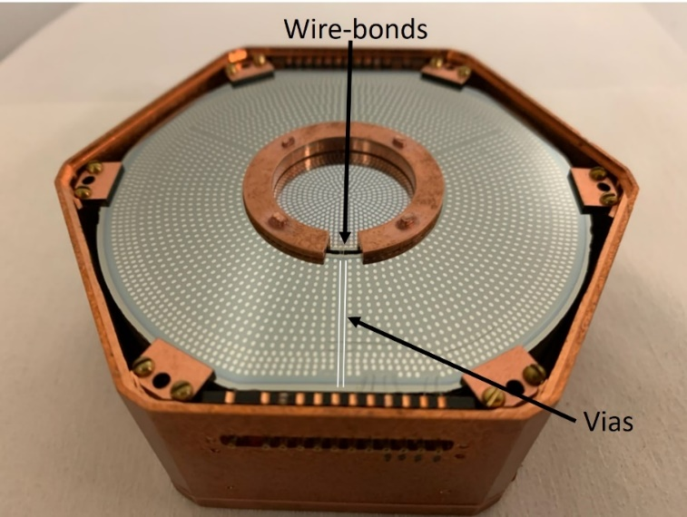
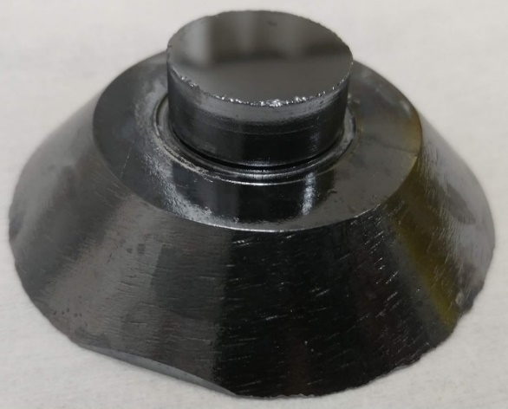
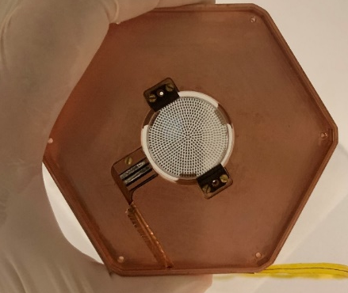
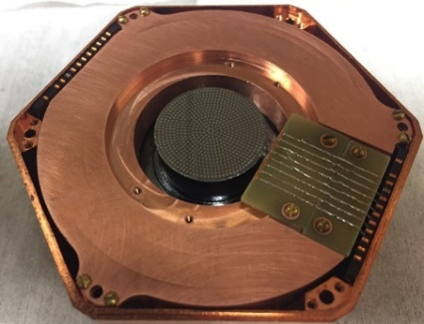
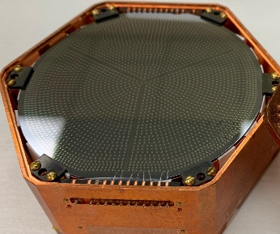
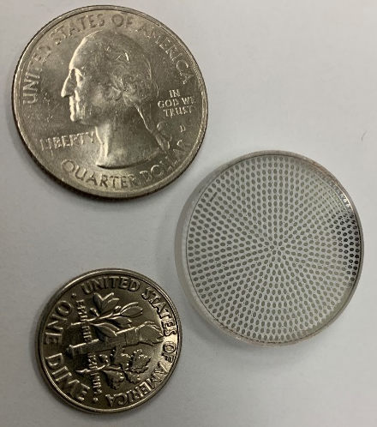
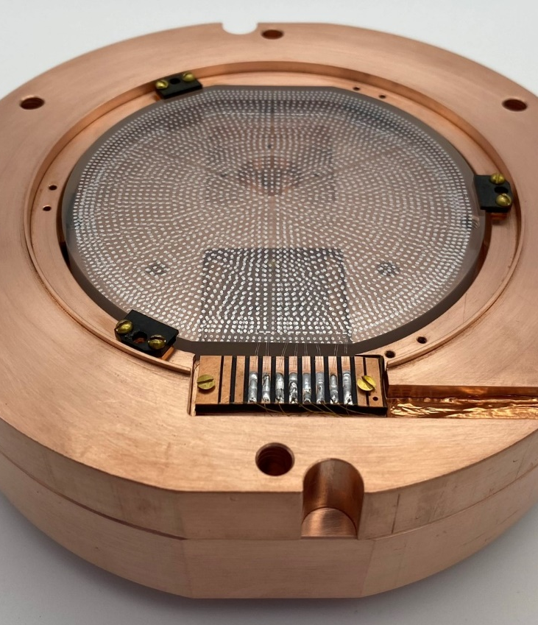
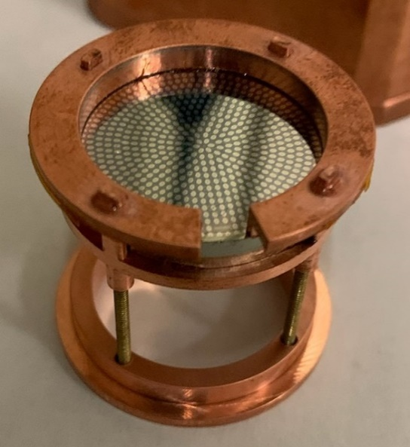
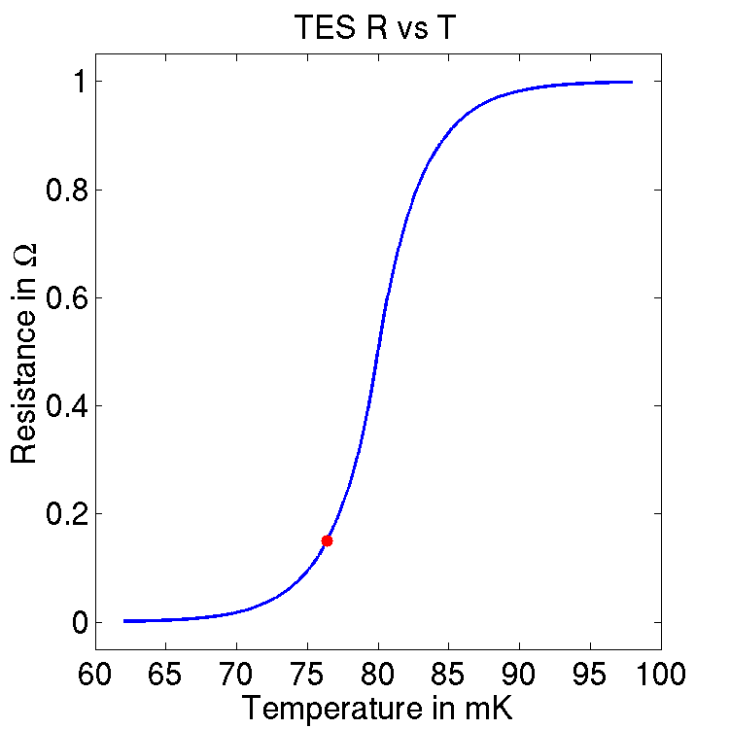
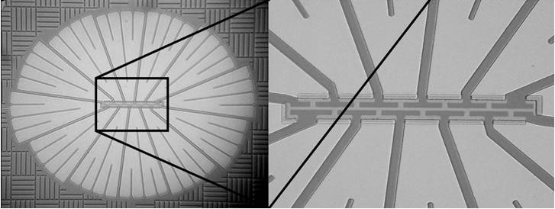
gm-kg scale MINER Detectors
Ge, Si, Al2O3
0V, LV (few V), HV (400V)
Smallest – 10 gm Si
Largest – 1.5 kg Ge
ΔR
R₀
T₀
ΔT

Slide 5
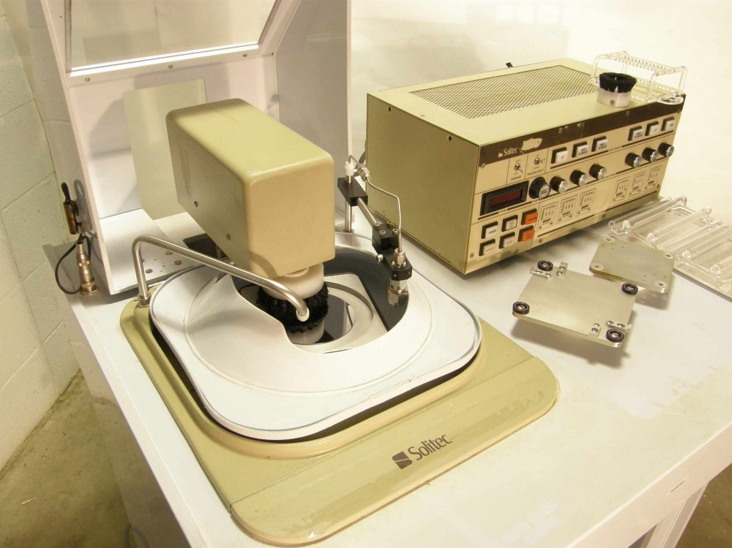
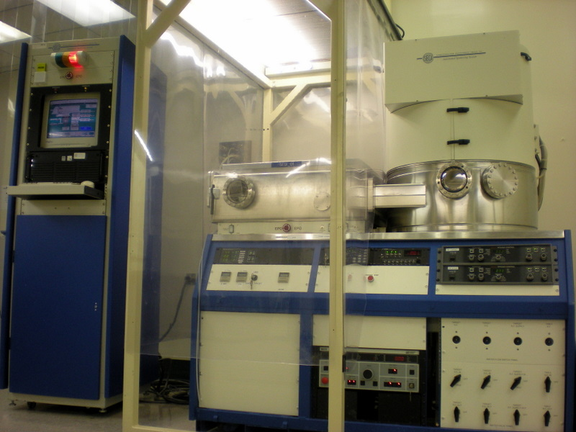
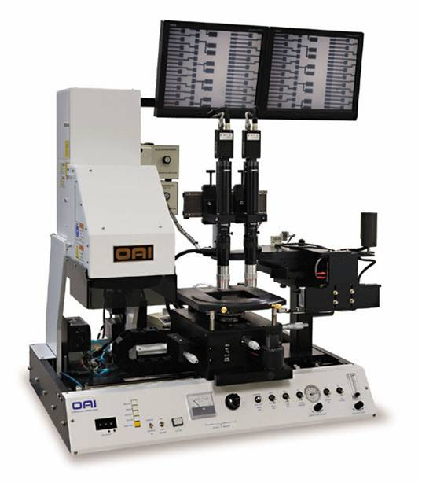
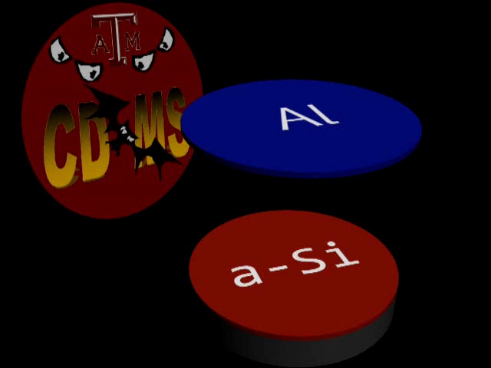
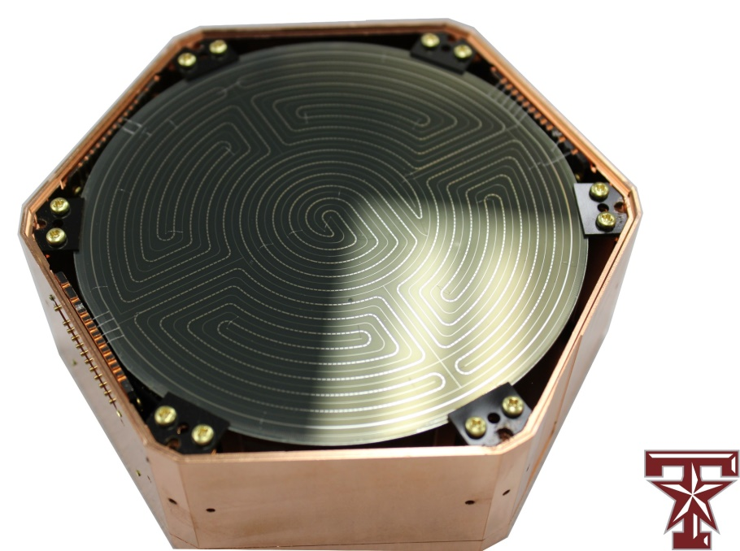
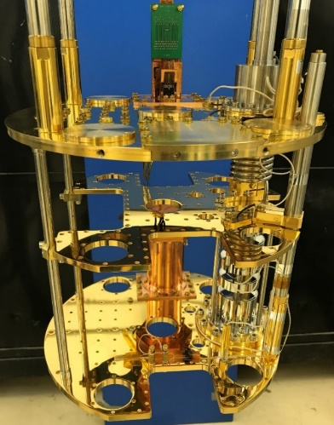
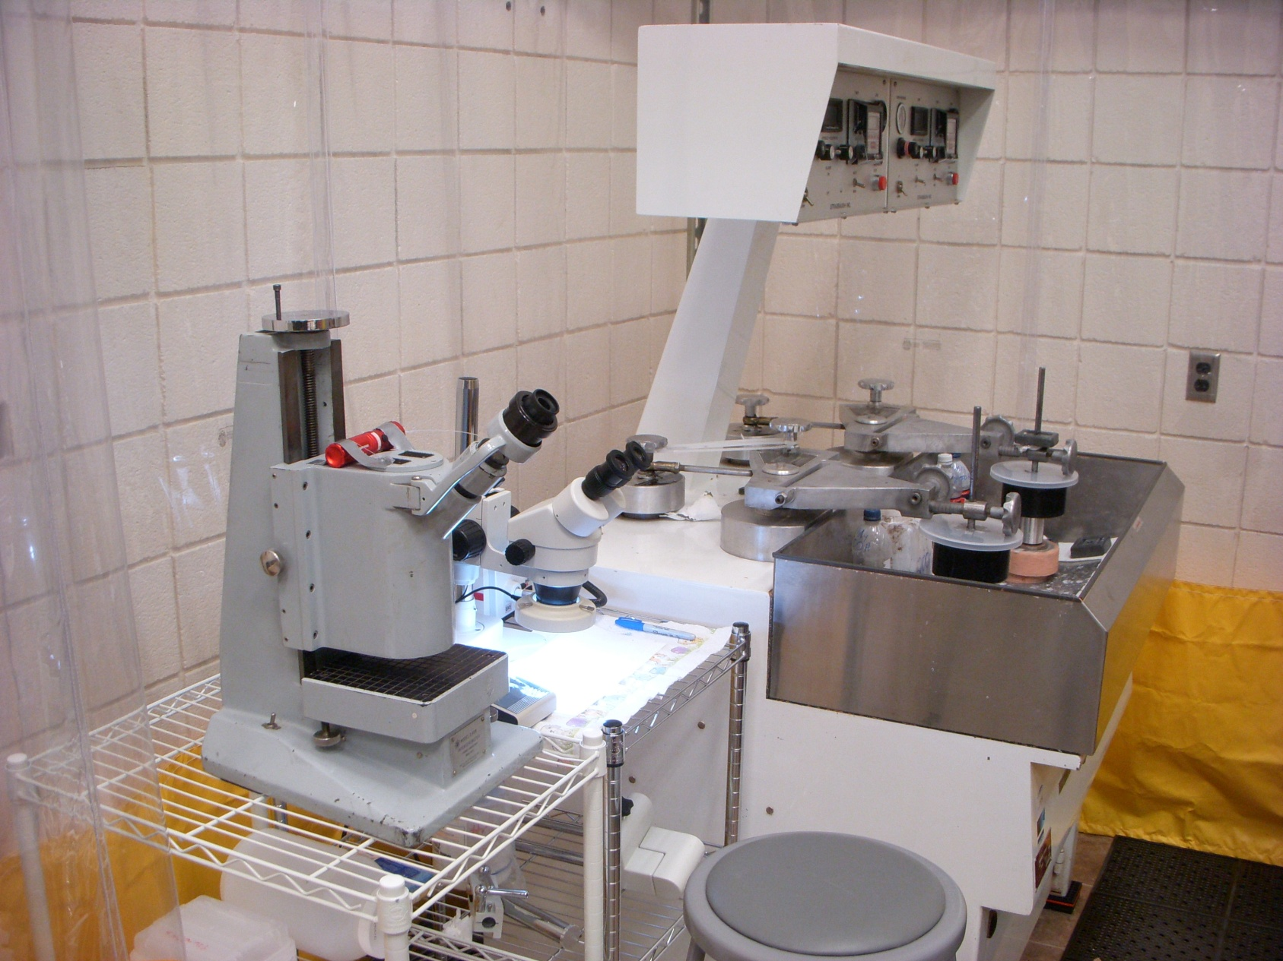
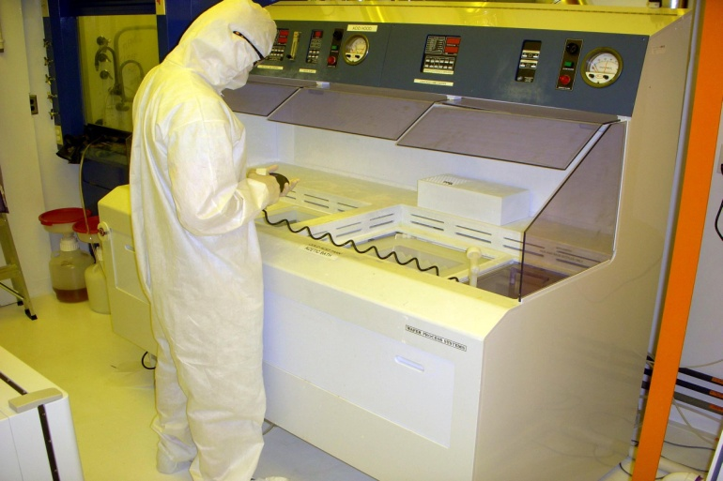
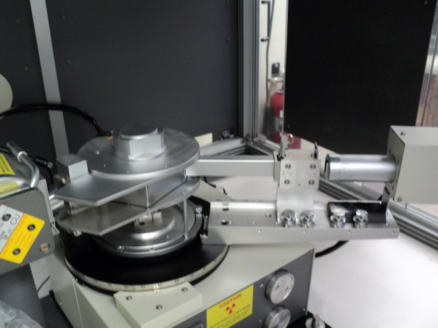
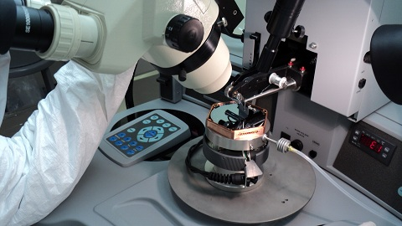

$5M Dedicated Fab @ TAMU
1st SNOLAB Tower Completed!
Multi-step process repeatable for high quality detectors
Photo Coat
Deposition
Circuit Mask Exposure
Polish
XRD
Inspect and Package
Chemical Etch

Slide 6
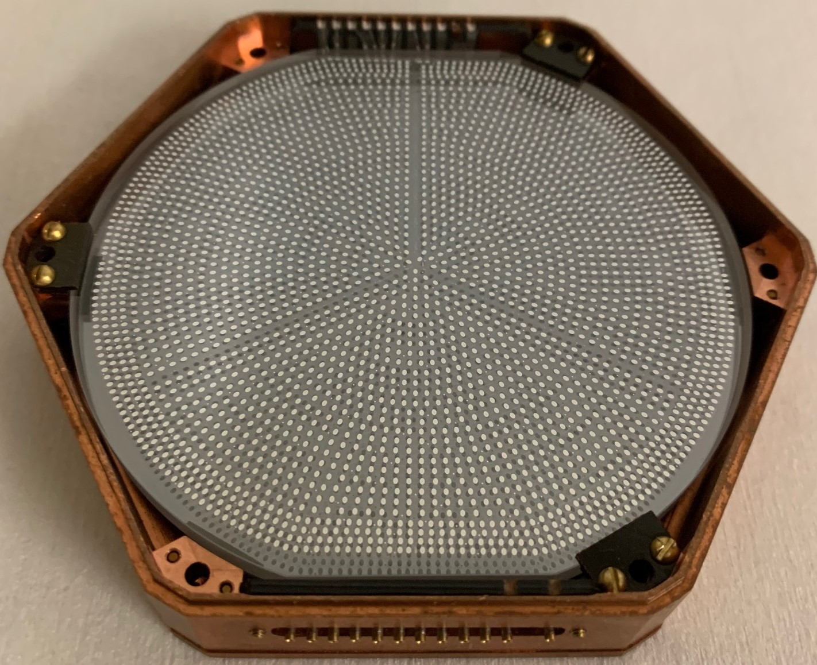
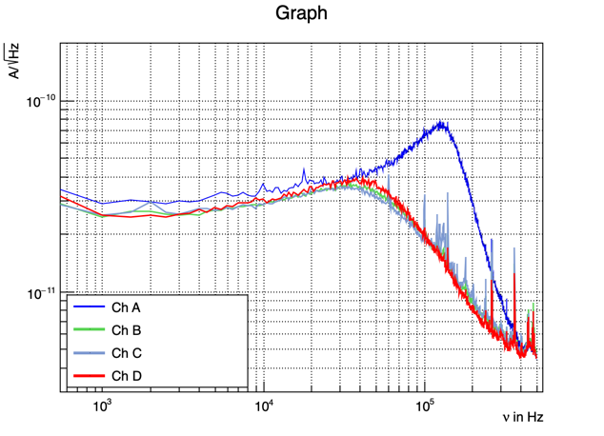
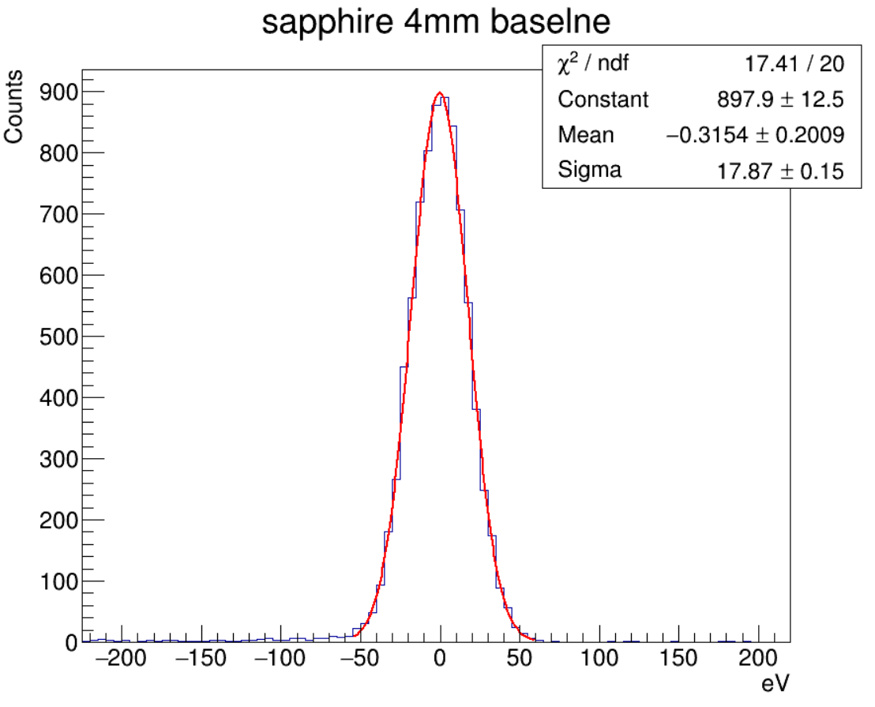
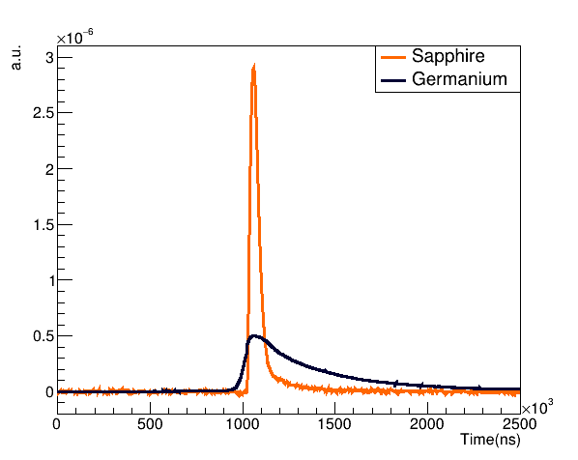
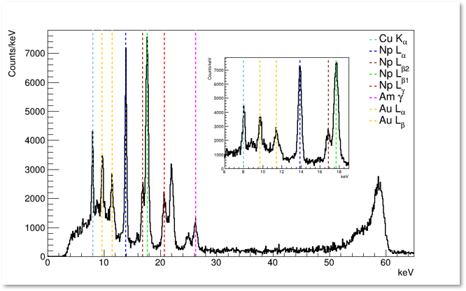
~100gm sapphire detector with ~15 eV σ baseline resolution
Calibrated based on 13.9KeV line. Exact value is within 15-18 eV, based on peak
~100 gm 3”x 4mm sapphire detector shown
~200 gm 3”x1cm sapphire detector tested
Faster phonon pulses provide better position information, background rejection
Calibration: Internal ⁵⁵Fe, ²⁴¹Am and external ⁵⁷Co, ²⁵²Cf, AmBe.

Slide 7
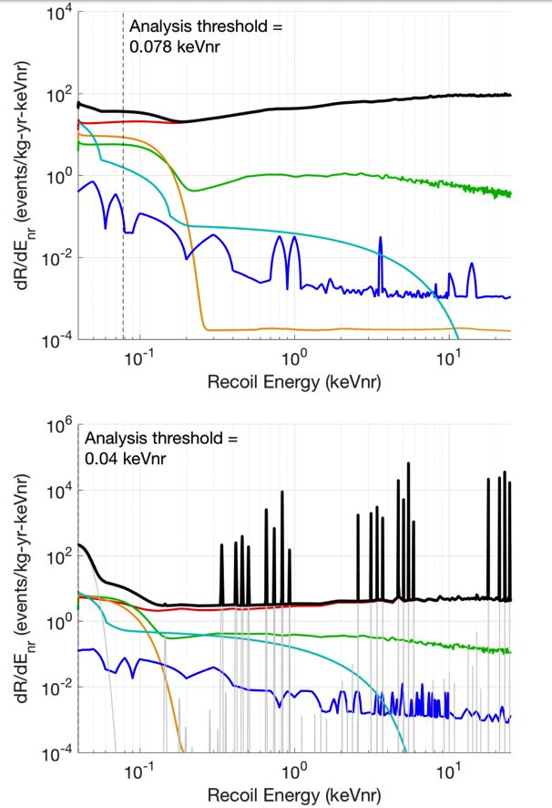

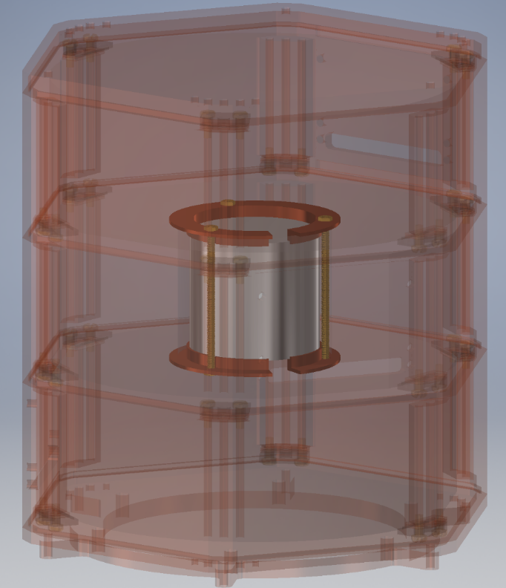
Low-Threshold Ge Detector inside Fully Hermetic Ge Shielding
  3He + 32Si (β-decay in bulk)
Ge Activation
Surface Betas
Surface 206Pb
Neutrons
CNS
Inner Ge detector shielded by 1” active Ge veto for background rejection
Ge 3”x1” G15
Ge donut 3”x1”
Ge 3”x1” G22
Inner copper shielding to for additional hermetic shielding being designed. Capable of hosting gm-kg scale detector

Slide 8
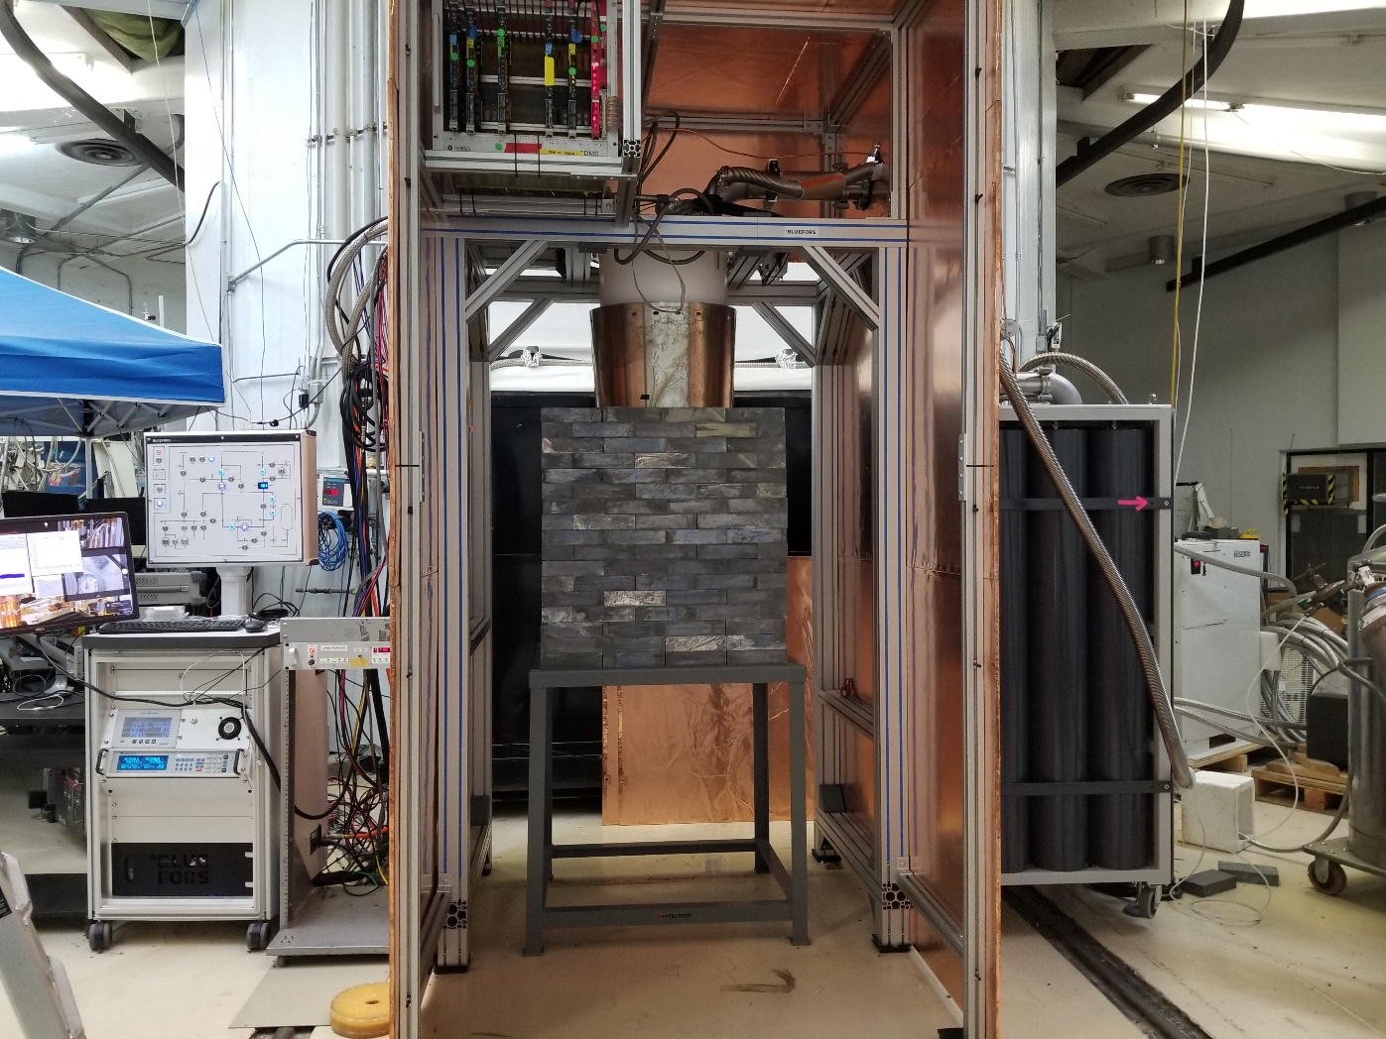
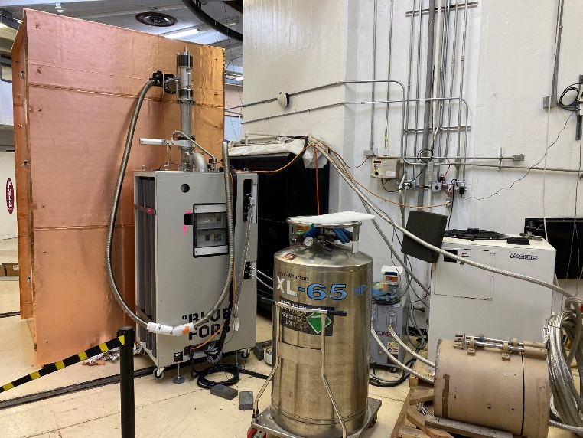
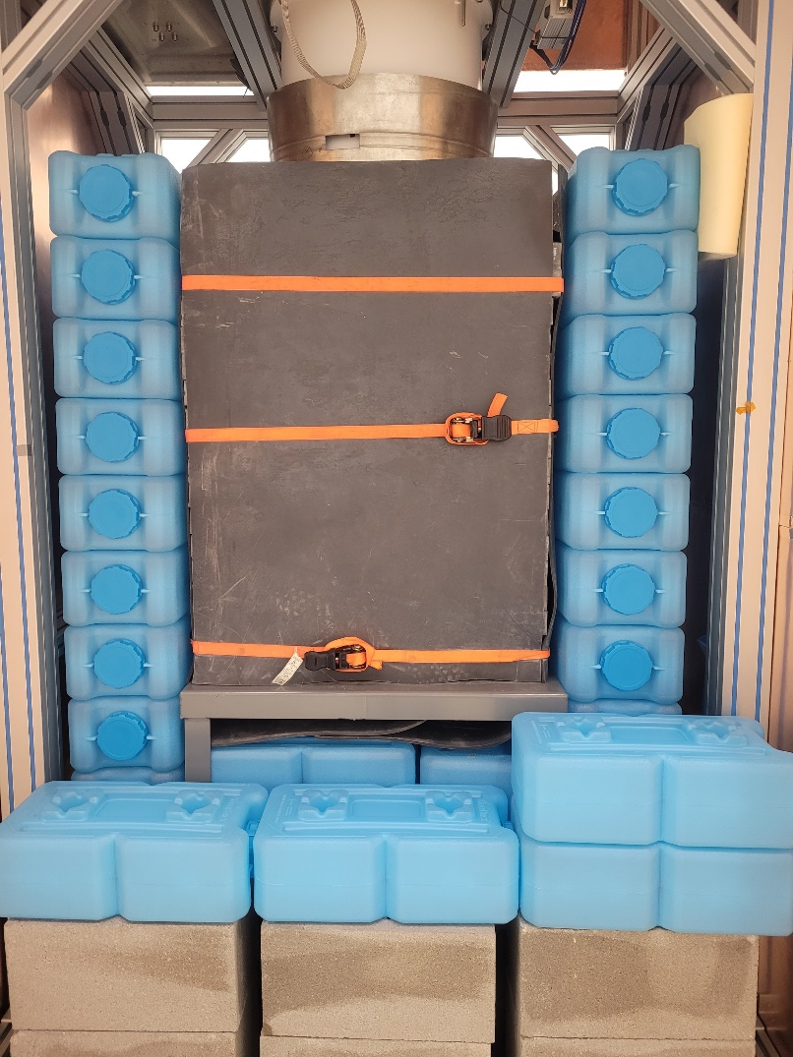
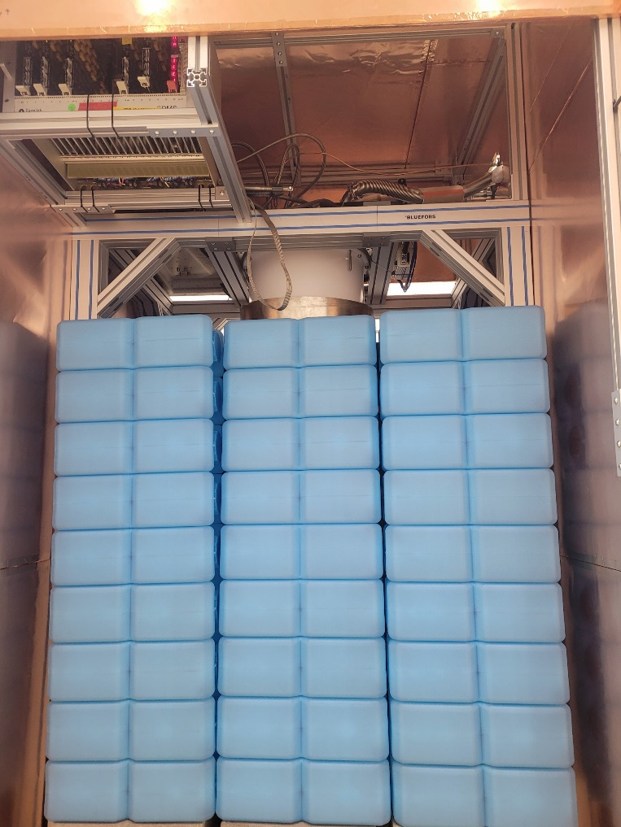
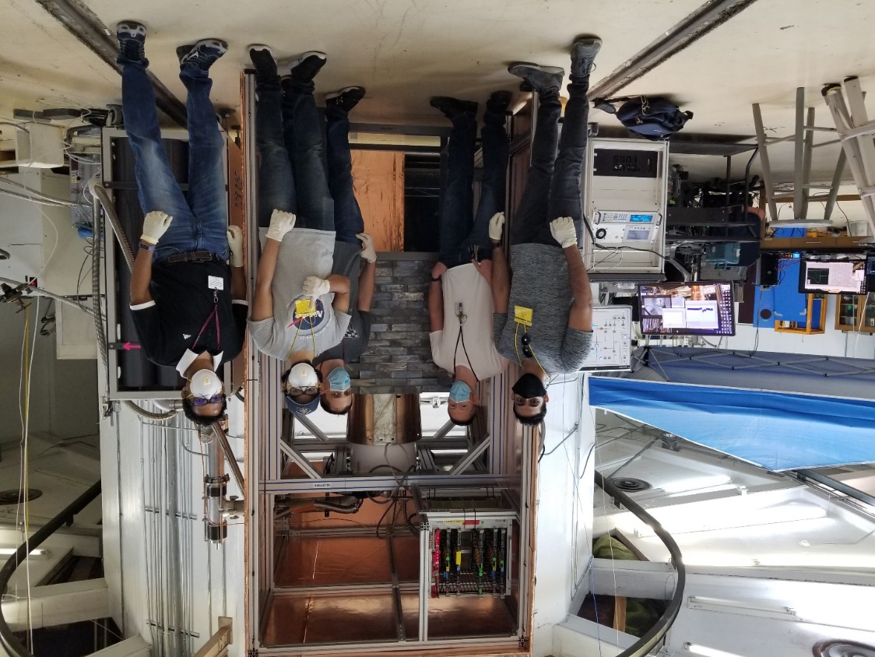
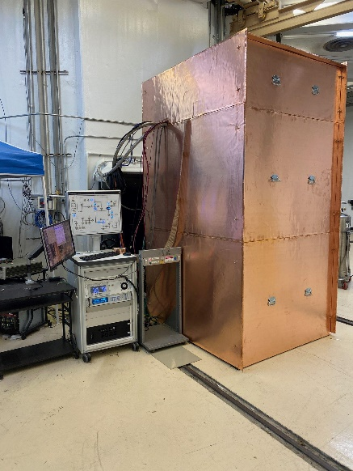
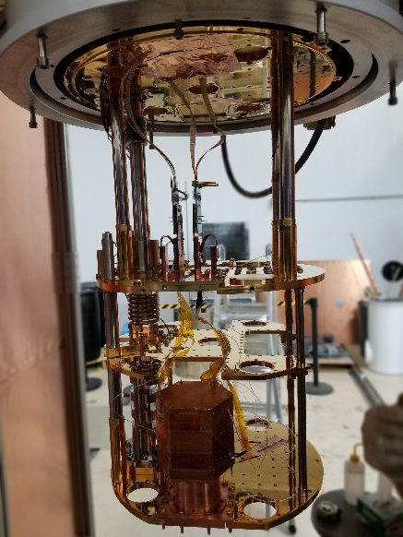

Slide 9
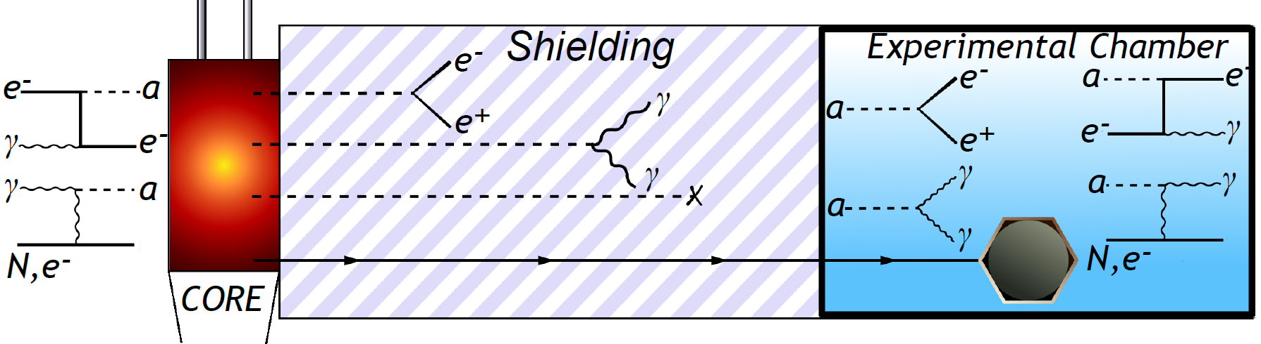
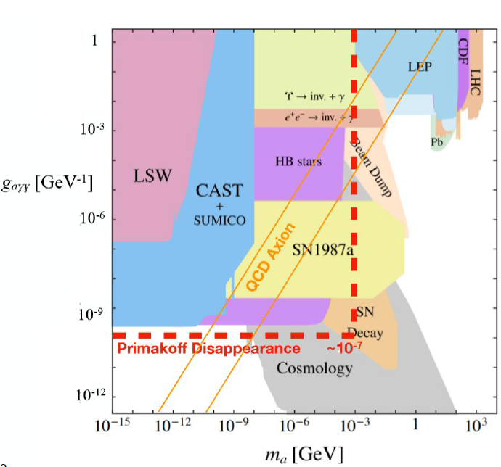
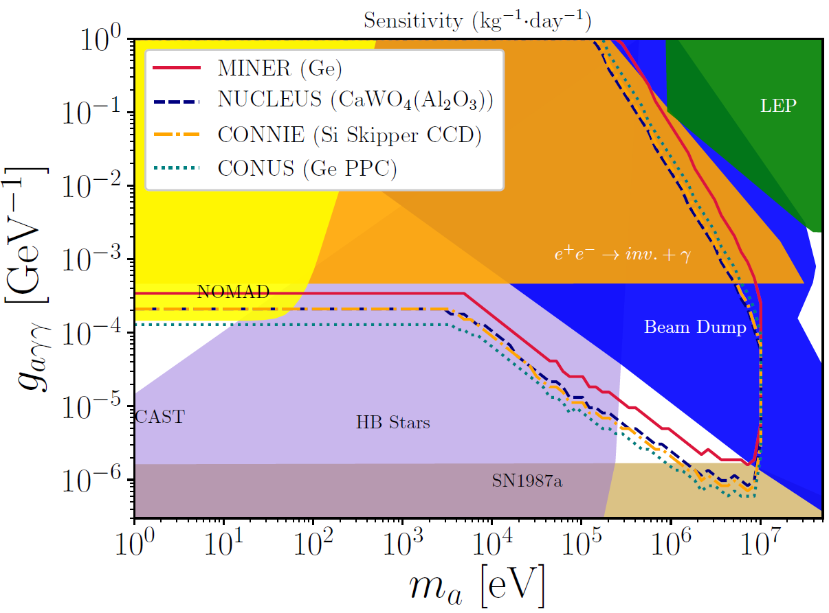
Axion Search on MINER from Reactor γ

Slide 10
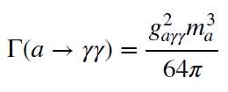
Survival probability

Slide 11
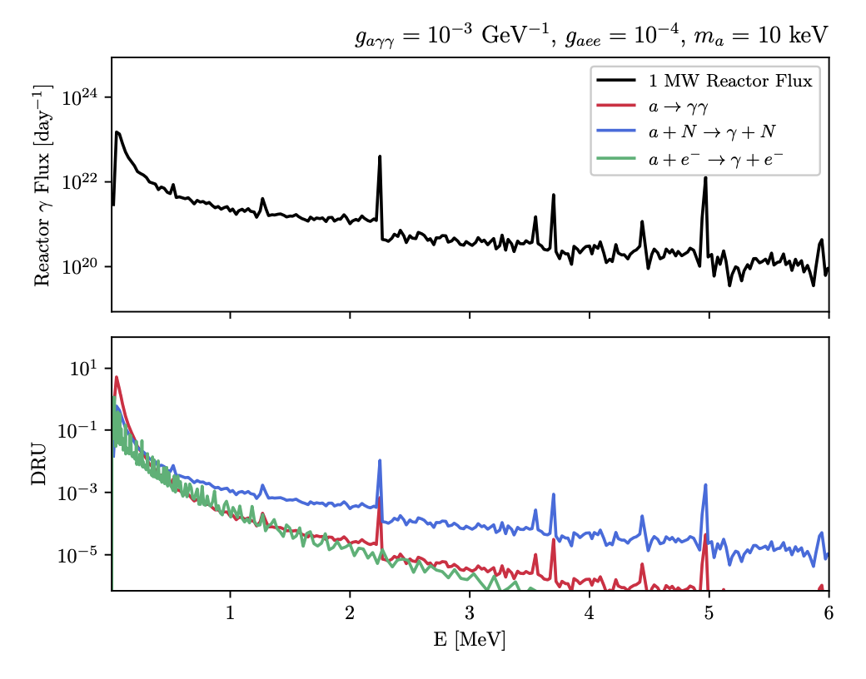
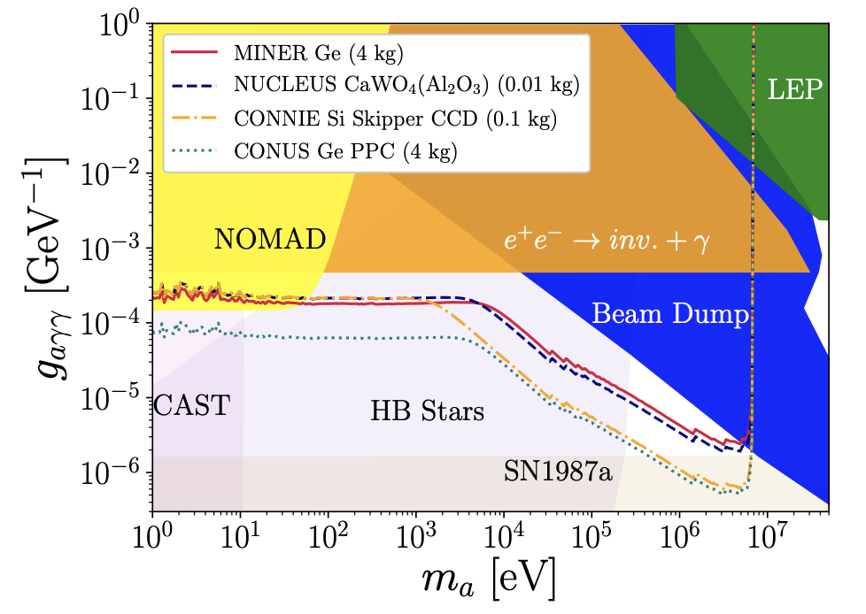
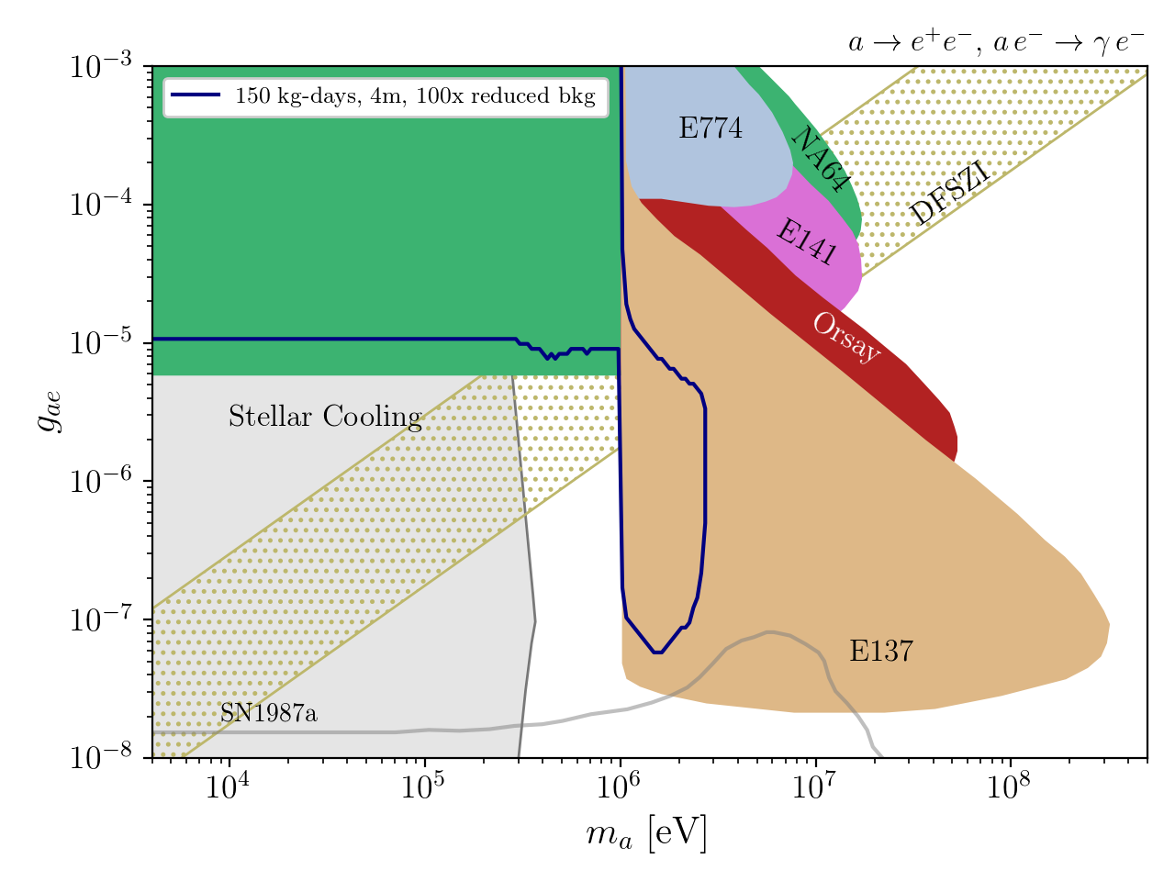
Bounds on couplings to photons

Slide 12


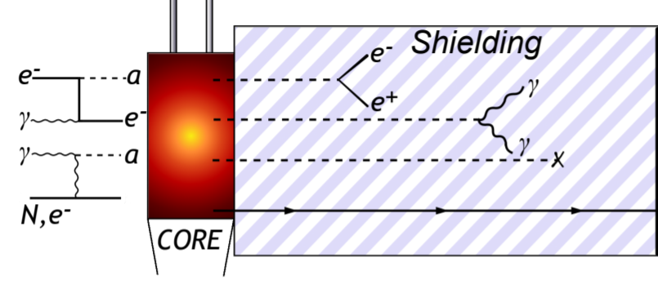


CsI(Tl) 100-kg prototype (room temp)
CsI(Tl)
CsI(Tl)
CsI(Tl)
γ
CsI(Tl)
CsI(Tl)
CsI(Tl)
a
CsI(Tl)
CsI(Tl)
CsI(Tl)
True Event: Single Scatter event inside the inner CsI(Tl) crystal, without any of the surrounding crystals vetoing it.

Slide 13




5x5 CsI(Tl) prototype setup is kept at a distance of approximately 4 meters from the reactor core at the MINER experiment.

Slide 14

Shielding And Background Control (Passive Veto)
Shielding Across 3x3 CsI(Tl) Setup
4” lead is used as gamma shielding.
1/4th inch copper housing to stop lower energy x-rays.
Water bricks for neutron control.
PMT
CsI(Tl)

Slide 15




Ar-41 Reduction Using Air Purge
Reduction in Ar-41 1.29 MeV gamma using air-purge system
Dry air is 0.93% Ar, Ar is 99.6% Ar-40
Reactor ON with and without airpurge comparison.
Ar-41 Decay
Shubham Verma (Texas A&M University)
Detection of Axions/ALPs using CsI(Tl) Scintillator Detectors

Slide 16

Background performance

Slide 17

Experimental Reach
Promising ALP Sensitivities (new 5x5 setup):
Work is in progress to scale up (have 2 tons of CsI) and reduce background by more shielding

Slide 18
Missing Energy Searches
JBD, B. Dutta, D. Kim, A. Kubik, R. Mahapatra, S. Rajendran, H. Ramani, A. Thompson, and S. Verma, PRD (2021)

Slide 19

ALP Search via Missing Gamma in Nuclear Decays
Disappearance signal from ALP processes with nucleon and photon couplings

Slide 20


Slide 21


E2
not E2

Slide 22


Slide 23
Summary
Reactor searches for ALPs carving out new parameter space due to high reactor flux
Missing gamma search – nuclear couplings competitive with astro limits, include Primakoff effect for disappearance

