Slide 1
Machine learning techniques for calorimetry
Rajdeep M Chatterjee (rchatter@cern.ch)**
On behalf of the CMS Collaboration
University of Minnesota
XI International Conference on New Frontiers in Physics
30 Aug - 11 Sept 2022
**A Zoom/Vidyo/Skype meeting can be setup on request

Slide 2
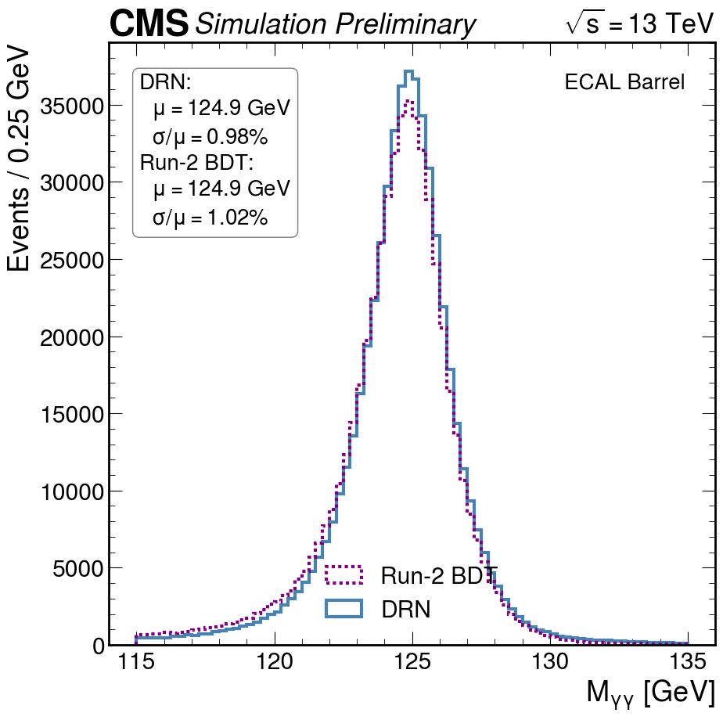
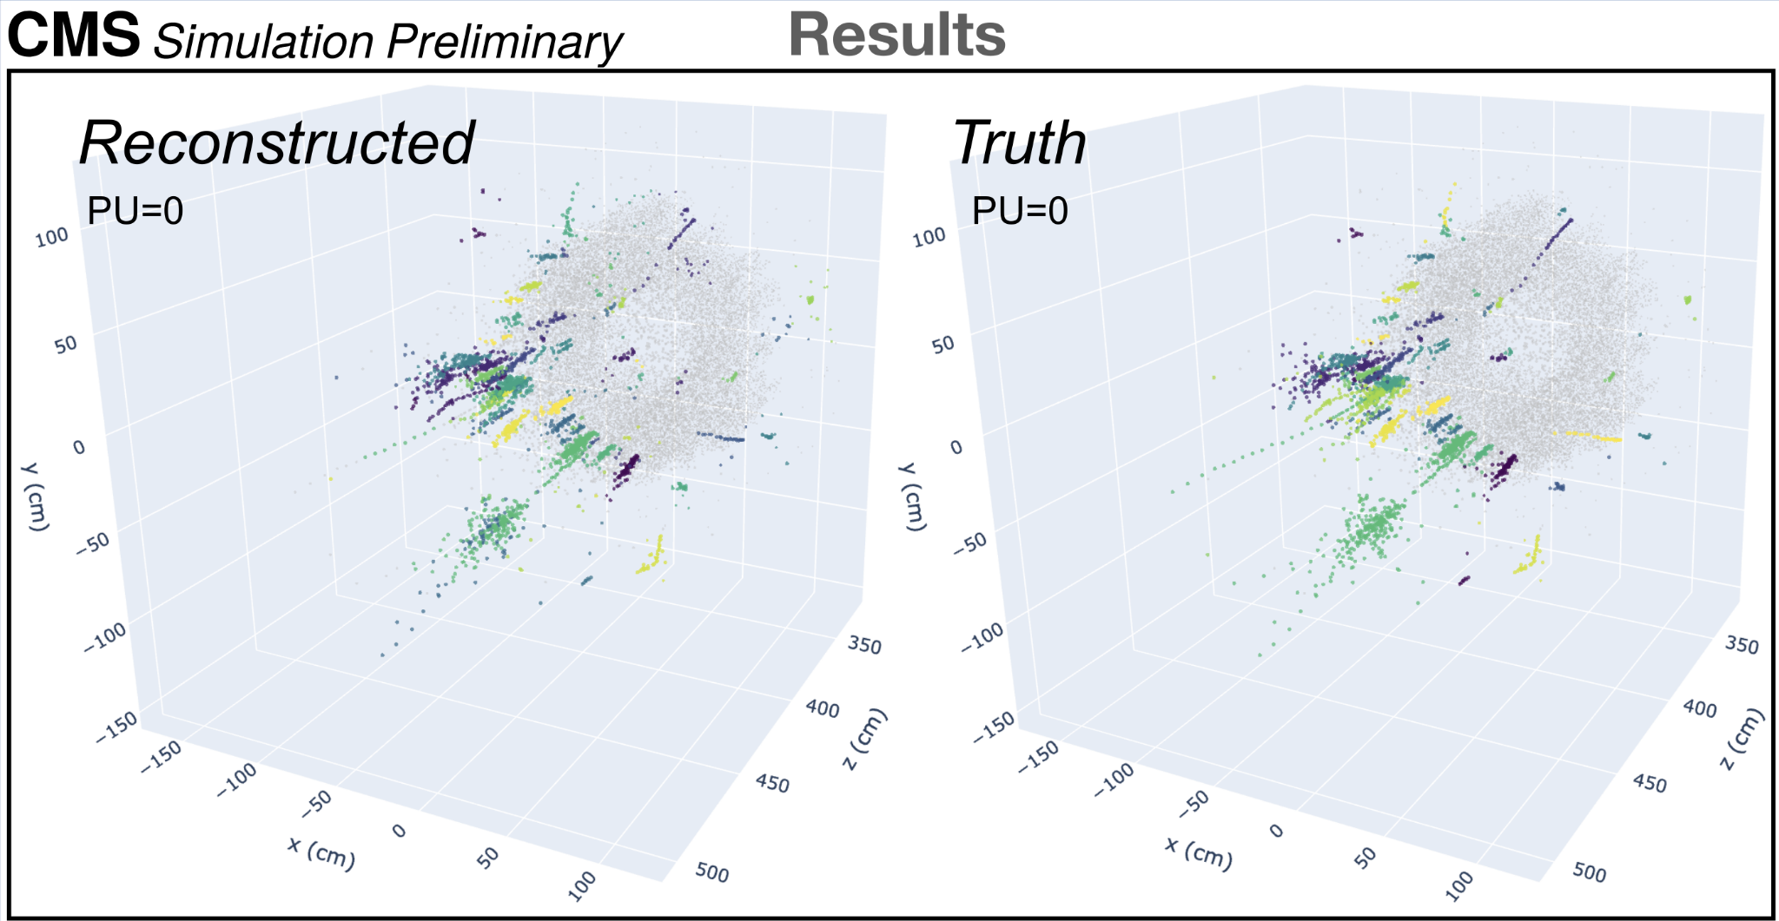
Outline
Calorimetry in CMS
Why use Graph Neural Networks (GNNs)?
How do GNNs work?
Four examples:
  Clustering energy deposits in the CMS electromagnetic calorimeter (ECAL)
  Electron/photon energy reconstruction in the CMS ECAL
  Pion energy reconstruction in the prototype HGCAL testbeam
  Hit-to-particle reconstruction in the CMS HGCAL
Conclusions
GNN
GNN

Slide 3
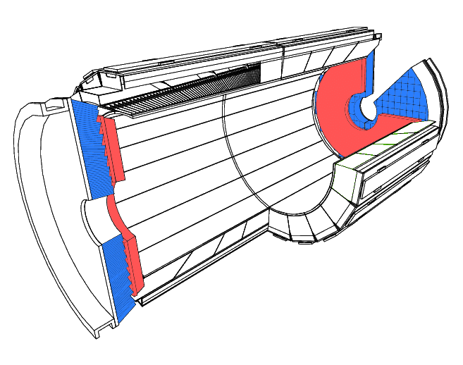
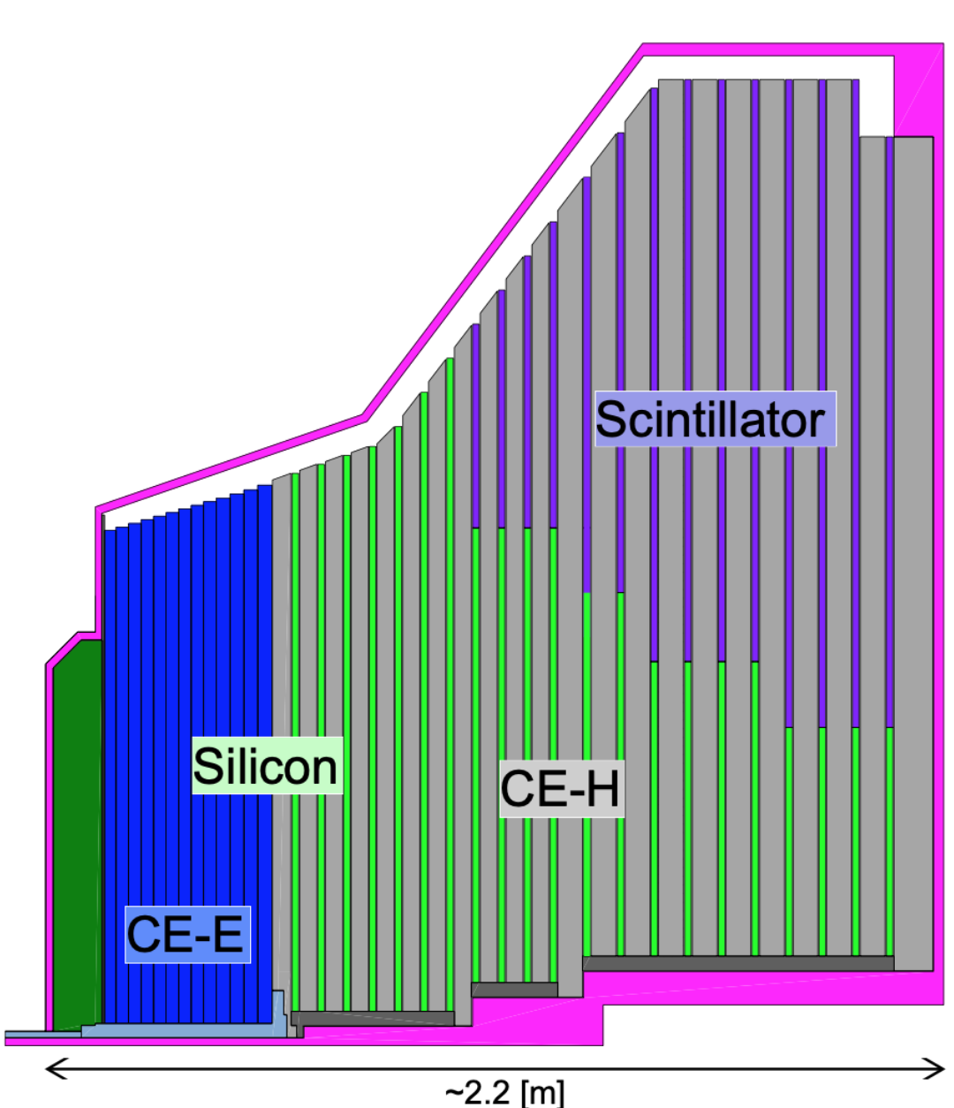
Calorimetry in CMS
Phase 1 detector:
  Crystal ECAL: homogeneous calorimeter composed of ~75k scintillating PbWO₄ crystals
  Preshower: Si based sampling calorimeter, in front of ECAL endcaps
  HCAL: Sampling plastic scintillator based hadronic calorimeter situated just outside ECAL
Phase 2 detector:
  Add HGCAL: Replaces endcap calorimeters (both ECAL and HCAL). Silicon and scintillator tile sampling calorimeter with unprecedented granularity (~6 million readout channels)
Today focus on ECAL and HGCAL reconstruction
  Similar work also in progress in HCAL
Performance of energy measurements from the calorimeters are critical for nearly all physics in CMS

Slide 4
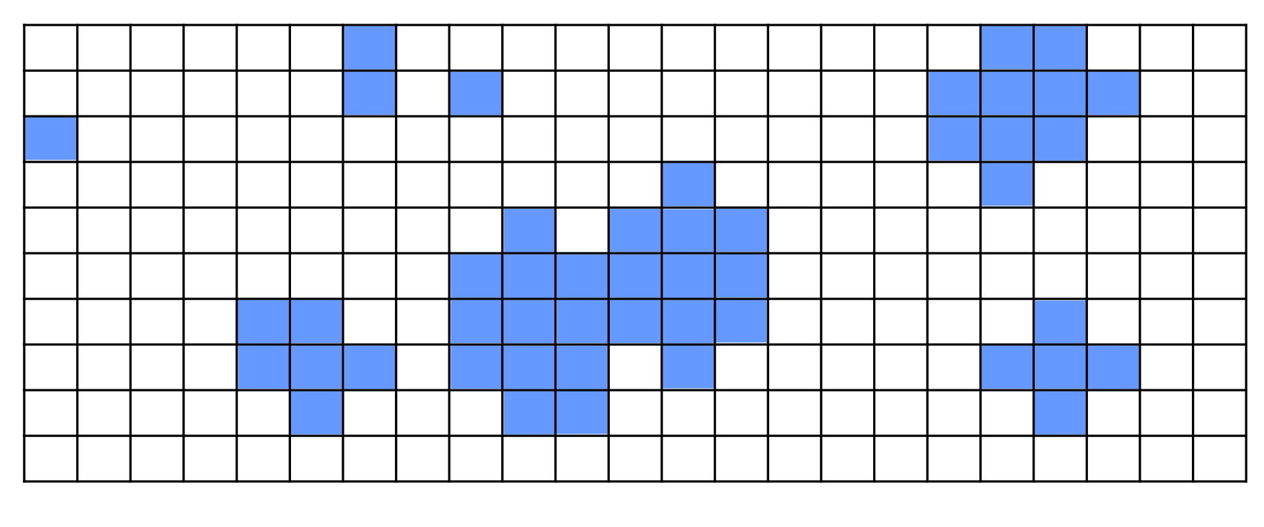
Reconstruction of physics objects from calorimeter hits
Start with pattern of detector hits
Two main tasks:

Slide 5
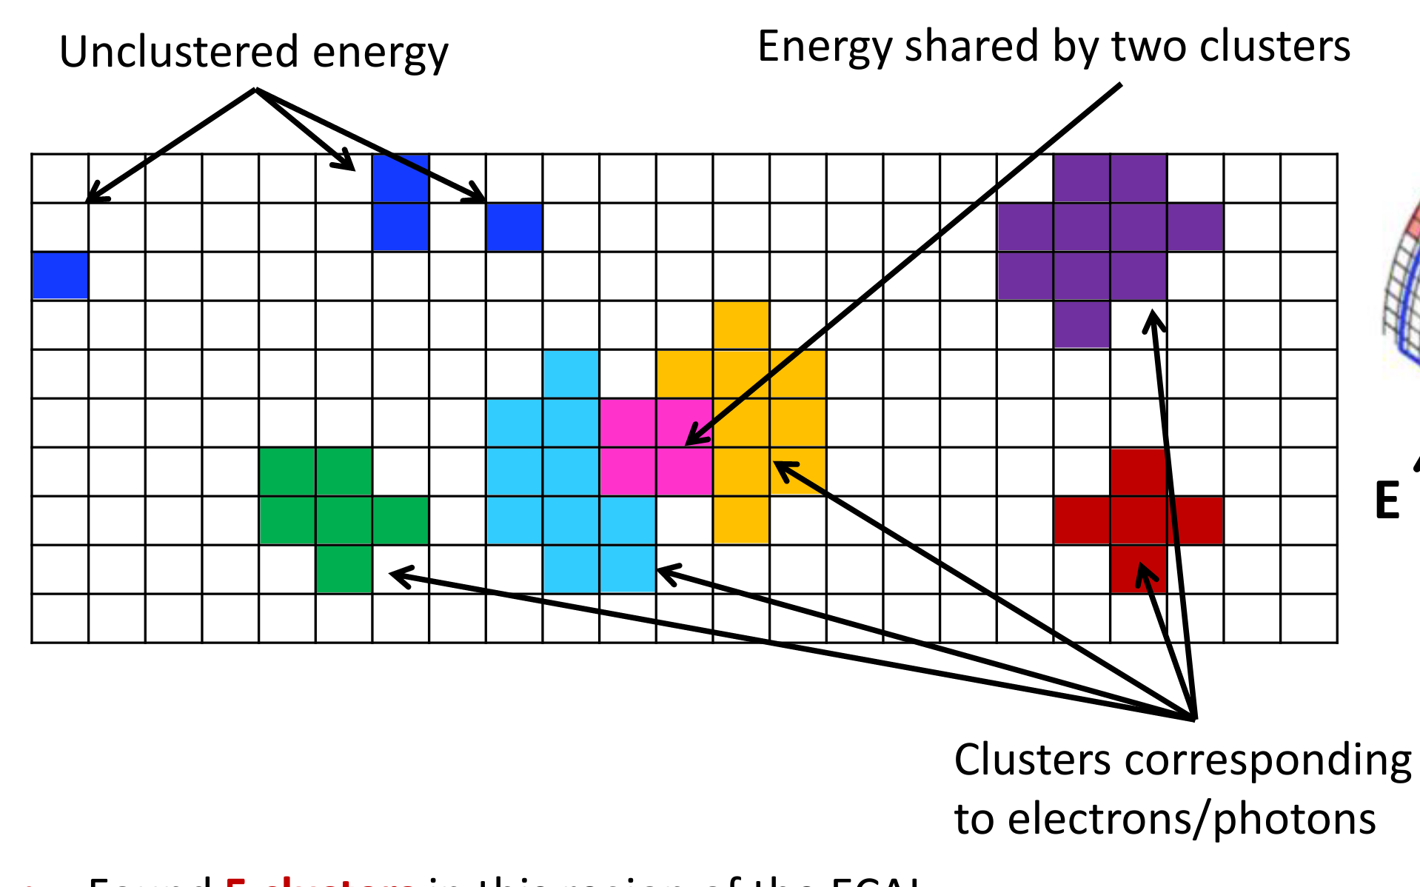
Reconstruction of physics objects from calorimeter hits
Unclustered energy
Energy shared between particles
Clusters corresponding to individual incident particles
Start with pattern of detector hits
Two main tasks:
  Associate each incident particle with a collection of hits using a clustering algorithm
    Hits are gathered together around the crystal with highest energy to form clusters
    In the case of EM particles bremsstrahlung and photon conversion before the ECAL, clusters have to be combined together to form a SuperCluster (SC)

Slide 6
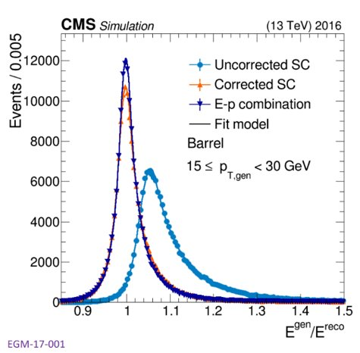
Reconstruction of physics objects from calorimeter hits
Unclustered energy
Energy shared between particles
JINST 16 (2021) P05014​
Clusters corresponding to individual incident particles
Start with pattern of detector hits
Two main tasks:
  Associate each incident particle with a collection of hits using a clustering algorithm
    Hits are gathered together around the crystal with highest energy to form clusters
    In the case of EM particles Bremsstrahlung and photon conversion before the ECAL, clusters have to be combined together to form a SuperCluster (SC)
  Compensate for losses and energy mismeasurement
Both typically done by rule-based algorithms or boosted decision trees (BDTs) --> Rely on high-level human-engineered inputs

Slide 7
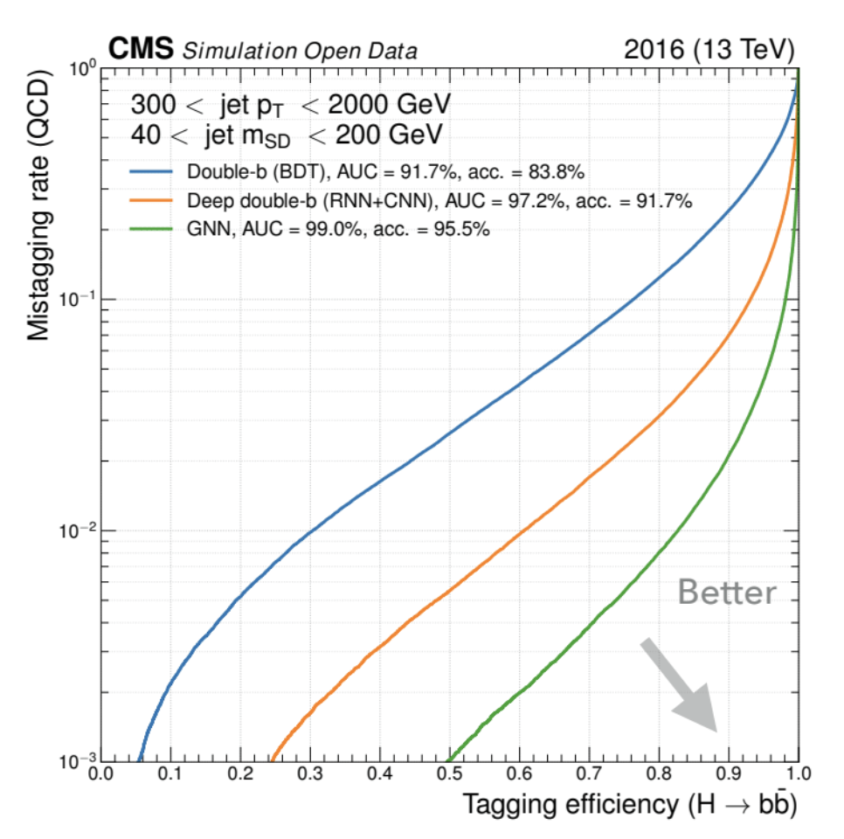
The machine learning approach
ML is most powerful when applied on low-level inputs and has recently evolved in efficiently using them
  Gives model access to full information content of every event
  Avoids potential for biases from human feature engineering
This has been demonstrated already in CMS e.g. jet tagging*
  Train on jet constituents rather than high-level variables
Hence we would like to use low-level calorimeter inputs, the detector hits, as input features
arXiv:1909.12285
*First with deepJet: arXiv:2008.10519

Slide 8
Different ML architectures : pros and cons
Inputs can be challenging for most architectures
  There can be any number of hits (detector is zero-suppressed, so not all channels are active)
  They can be distributed across multiple very different detector components
  They are naturally represented in at least 4 dimensions (x, y, z, energy), more recent 5 dimensional hits (x, y, z, energy, time) are in use
  They are in no particular order
GNNs are the best option for input types
Can it (easily) handle… | BDT | MLP | CNN | RNN | GNN
Variable-size input | 🇽 | 🇽 | ✅ | ✅ | ✅
Complicated geometries | ✅ | ✅ | 🇽* | ✅ | ✅
4D or 5D inputs | ✅ | ✅ | 🇽* | ✅ | ✅
Unordered inputs | 🇽 | 🇽 | ✅ | 🇽 | ✅
*CNNs work best with rectangular input spaces

Slide 9
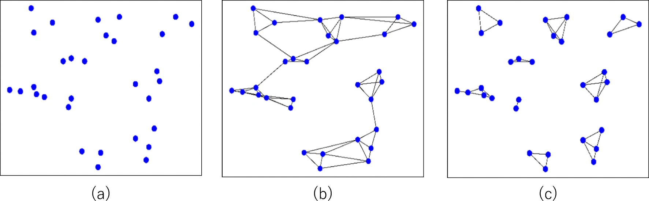
How do GNNs work
Collection of hits is represented as a point cloud

Slide 10
How do GNNs work
Collection of hits is represented as a point cloud
Generate graph by drawing edges between k nearest neighbors of each hit

Slide 11
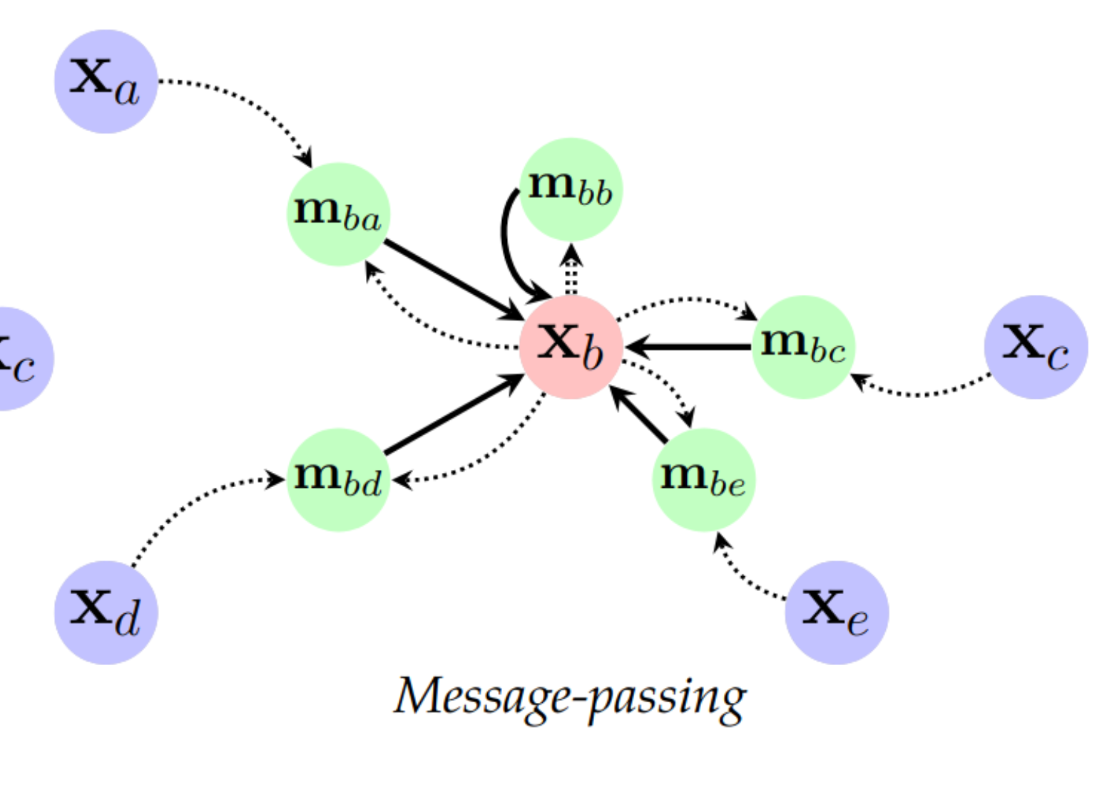
How do GNNs work
Collection of hits is represented as a point cloud
Generate graph by drawing edges between k nearest neighbors of each hit
Perform “message passing” to allow information to flow along graph edges (analogous to image convolutions in CNNs)

Slide 12
ECAL clustering

Slide 13
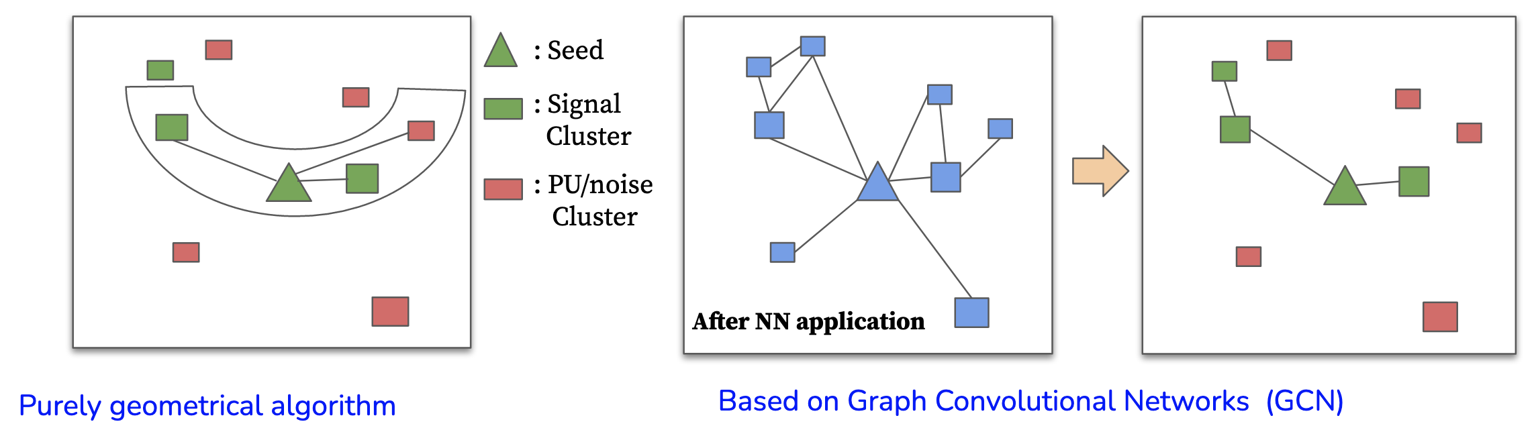
Improving the ECAL SC algorithm
Mustache SC (currently used)
GNN based DeepSC (proposed)
After NN application
Evaluated on one cluster at a time.
Large efficiency for signal, but also large pileup and noise contamination.
Evaluated on all the clusters together in a region around the seed.
Noise an pileup are filtered for each cluster :
  → For the same signal efficiency as the current algorithm provides clusters with higher purity.

Slide 14
GNN based DeepSC algorithm for the ECAL
Windows of variable dimensions along η are opened around all clusters with E_{T} > 1 GeV (seeds)
Input features
  -- Cluster information : E, E_{T}, η, φ, z, #crystals; relative to the seed : ΔE, ΔE_{T}, Δη, Δφ
  -- List of Rechits for each cluster
  -- Summary of window features : min, max , mean of the crystal variables (E, E_{T}, ΔE, ΔE_{T}, Δη, Δφ)
Outputs : Cluster classification (whether in/out of SC), window classification (electron/photon/jet)
Training and testing :
  -- Electron and photon guns uniform in pT in the range 1-100 GeV; Pileup uniformly distributed between 55-75 interactions.

Slide 15
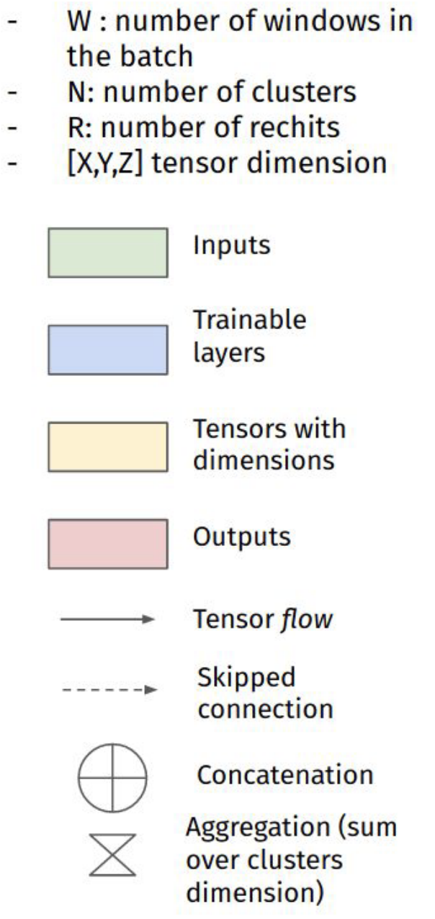
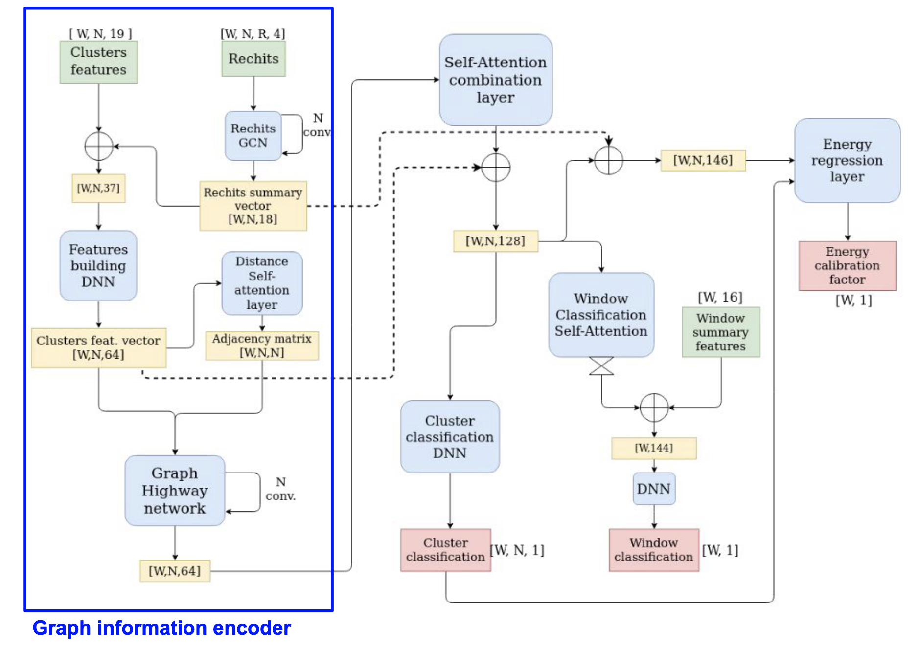
GNN network architecture
ç√
ç√
Additional correction
Graph decoder : classification/ID outputs

Slide 16
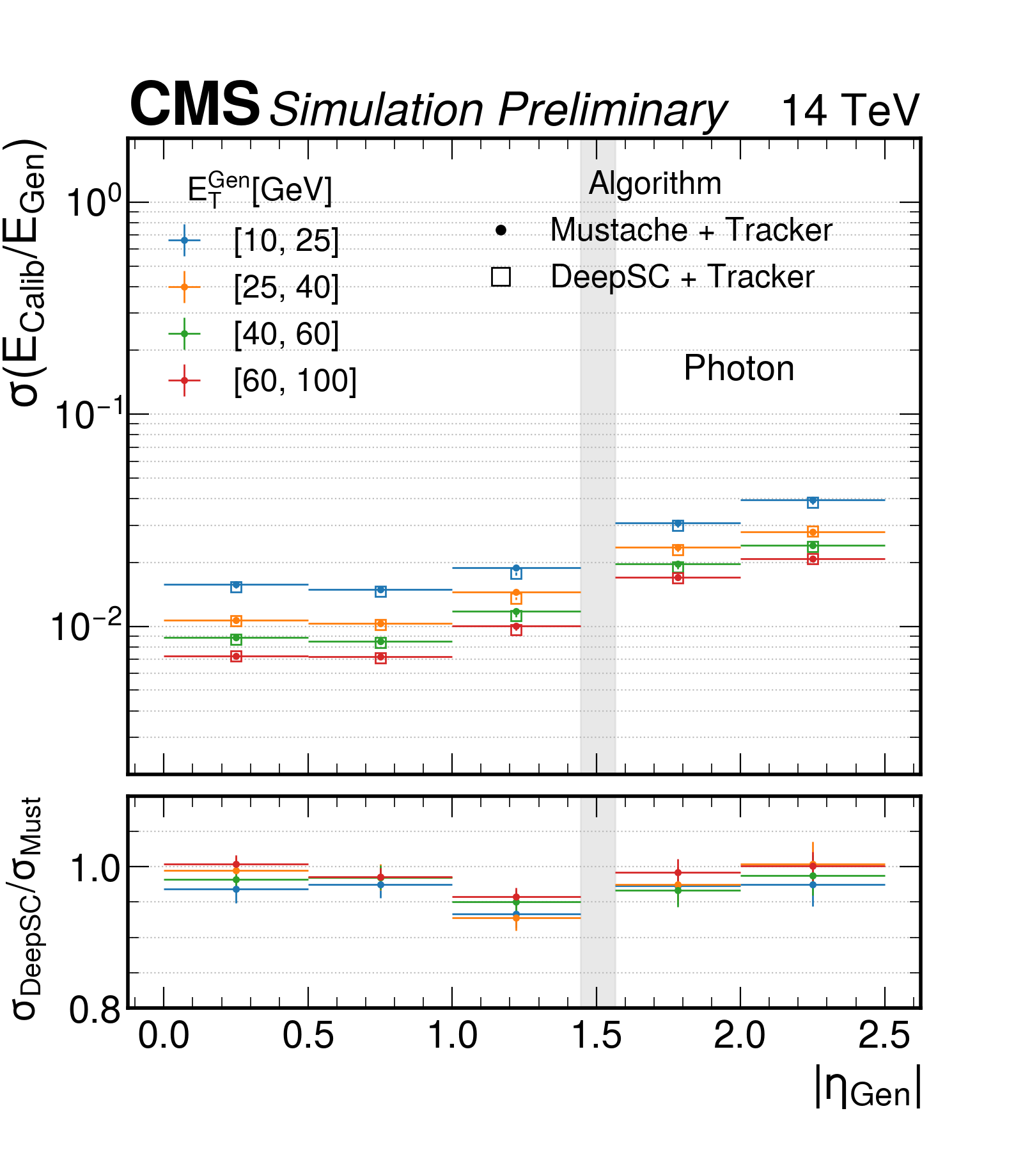
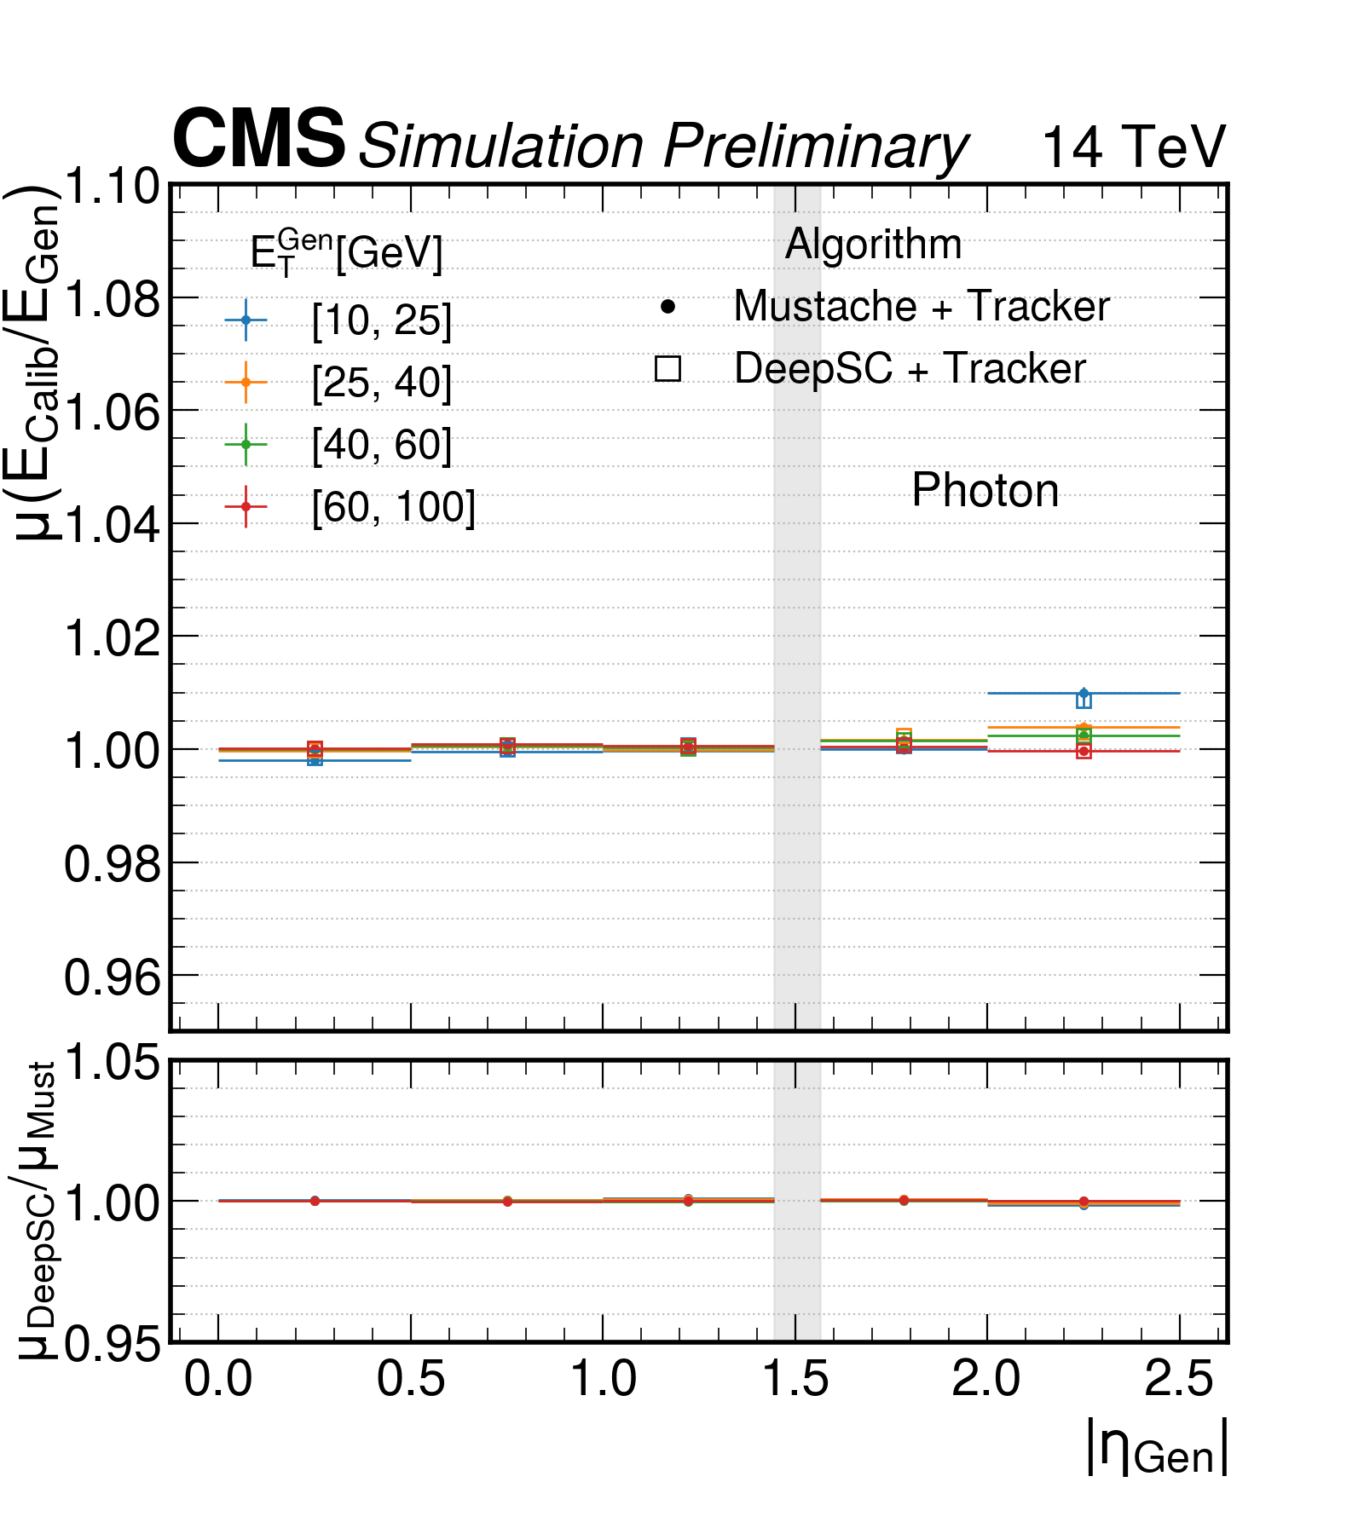
Energy scale and resolution performance: Photons
CMS-DP-2022/032
The energy response of photons is estimated by fitting the calibrated photon energy divided by the true energy with a Cruijff function.
The energy scale is found to be stable for all energies and the resolution either comparable or better compared to the current Mustache algorithm

Slide 17
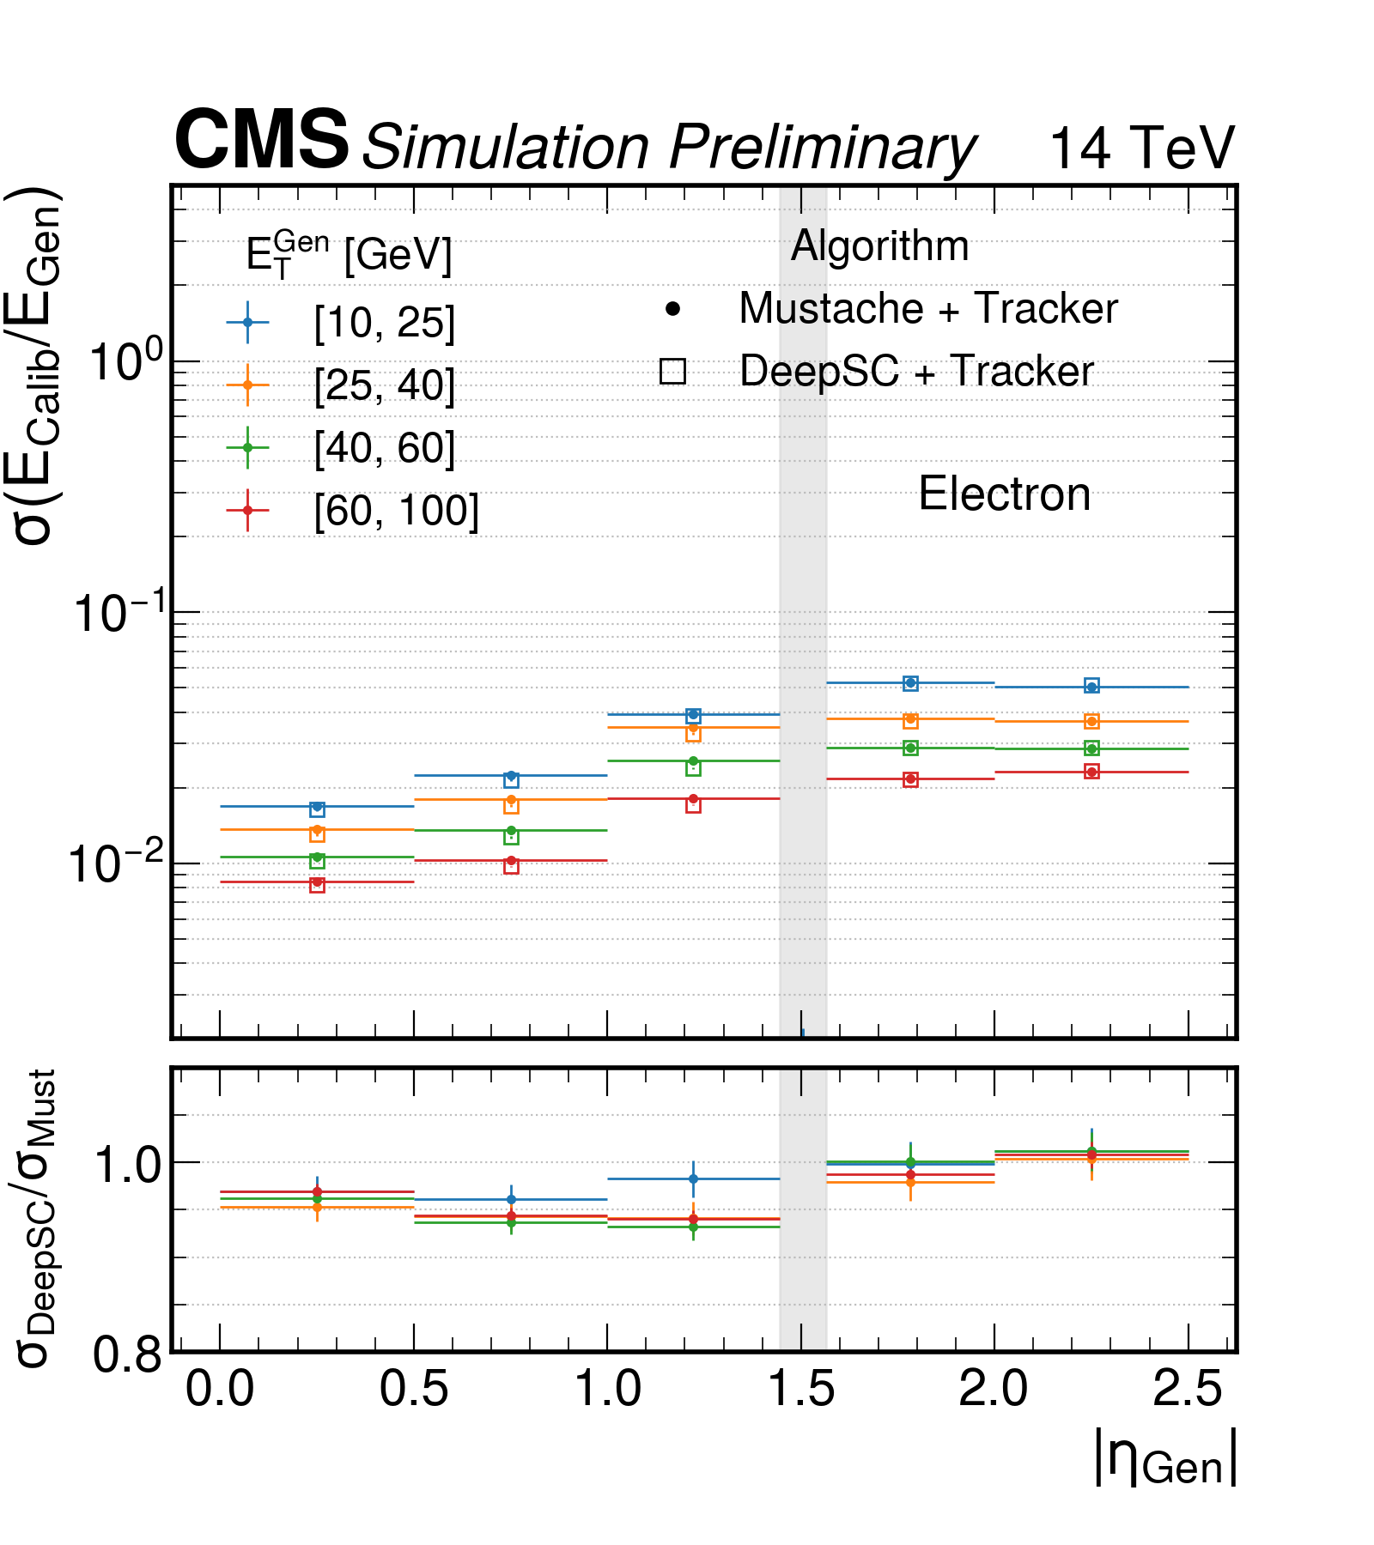
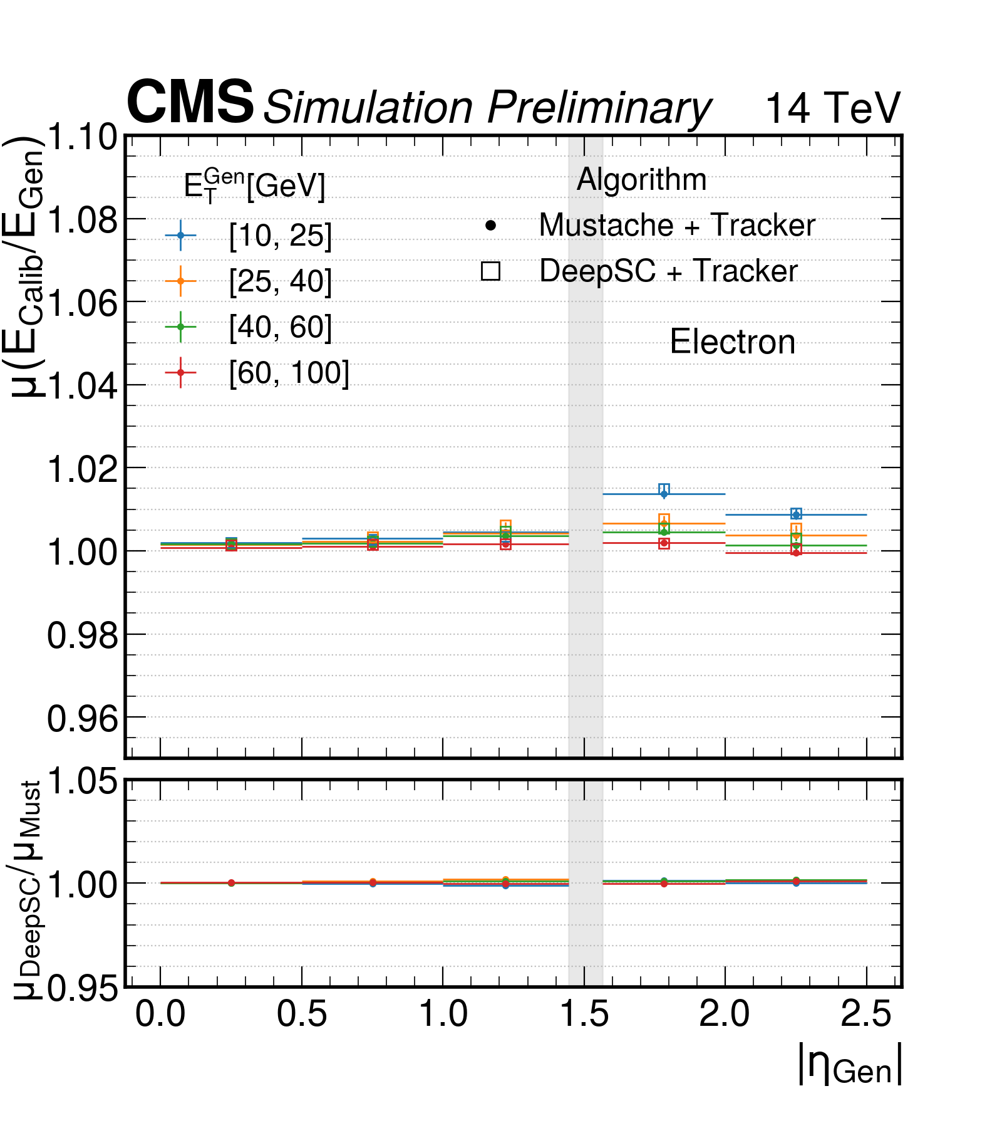
Energy scale and resolution performance: Electrons
CMS-DP-2022/032
The energy response of photons is estimated by fitting the calibrated electron energy divided by the true energy with a Cruijff function.
The energy scale is found to be stable for all energies and the resolution either comparable or better compared to the current Mustache algorithm

Slide 18
A regression to correct electron and photon energies

Slide 19
Why do we need this regression
Electron/photon energies measured from the ECAL supercluster are subject to losses:
  Energy lost in gaps and upstream material
  Longitudinal energy leakage
  Finite thresholds to suppress noise
  pileup and noise contamination
Compensated per-particle using a ML regression
Run-2 corrections implemented as a BDT
  Uses ~30 high-level input features to describe EM shower
BDT corrections first developed for Higgs discovery in 2012
BDT energy corrections have supported all physics analyses using electrons/photons in CMS during LHC Run 2
Can we do better using a GNN?

Slide 20
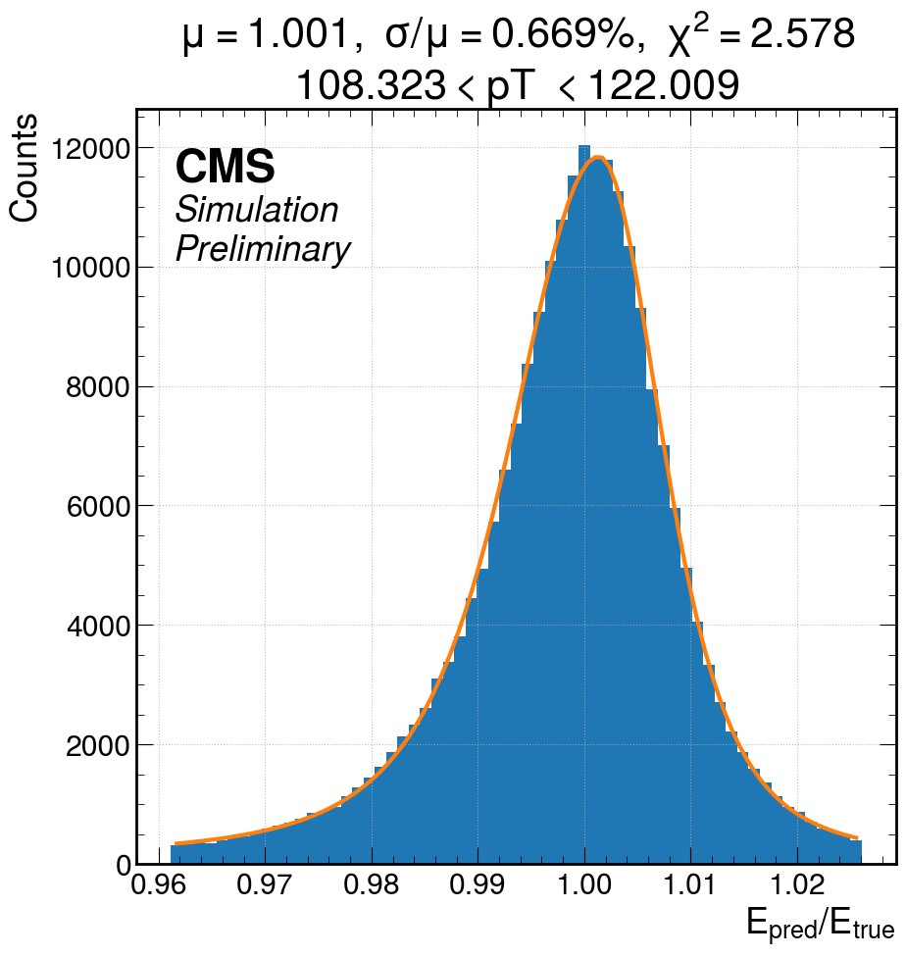
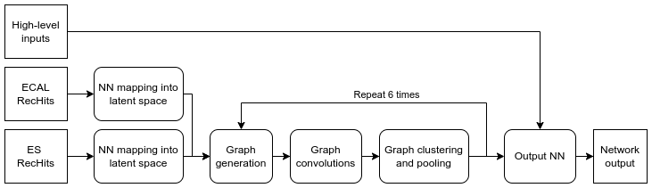
The Dynamic Reduction Network
New architecture: Dynamic Reduction Network (DRN)^{[1]}, based on dynamic GNNs
  Graph operations take place in a high-dimensional latent space
  Added clustering and pooling step to aggregate information across the graph
Input includes hits from both ECAL and ECAL preshower, as well as additional features to describe information not encoded in the hit collection (pileup, leakage into HCAL)
Outputs parametrization of double-sided crystal ball probability density for energy correction factor.
  → Thus obtain in addition to the energy correction factor the uncertainty associated with the correction
[1]: arXiv:2003.08013

Slide 21
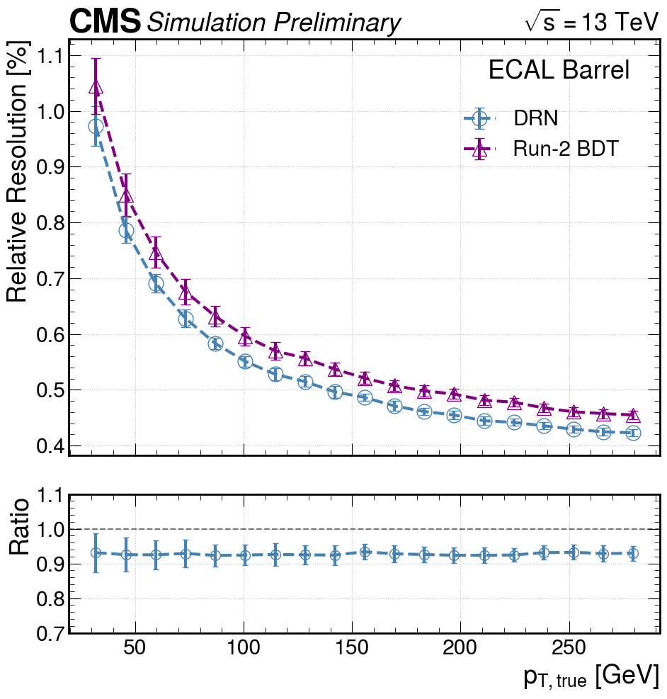
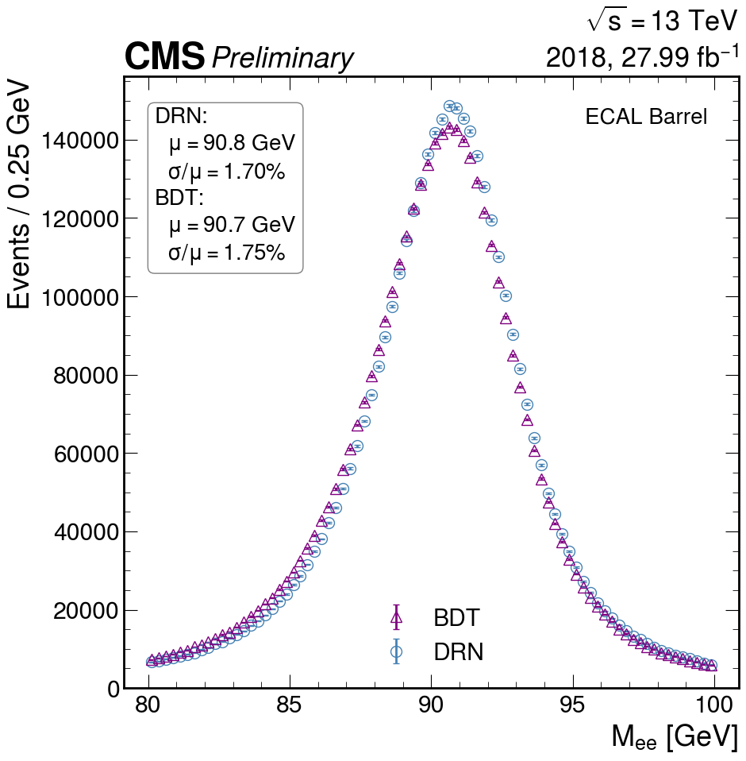
Performance with the DRN
CMS-DP-2022/009
Photon gun Simulation
ggH→γγ
Simulation
DY Z→ee
2018 DATA
Improved per-object energy resolution by ~10% for both electrons and photons
Translates to improved invariant mass resolution by ~5%, confirmed in Run 2 data.
First major change to energy regression algorithm since 2012
  In process of being deployed for Run 3

Slide 22
Pion reconstruction with the HGCAL beam test prototype

Slide 23
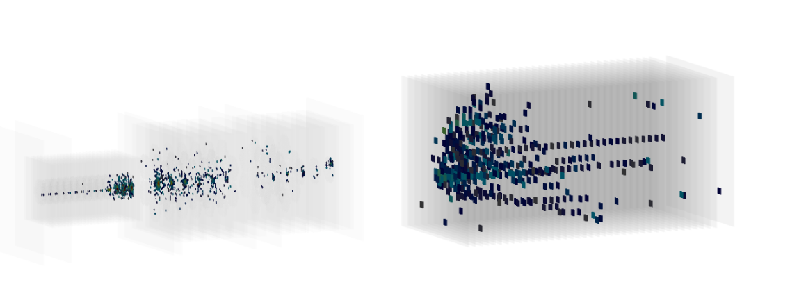
A pion event display
AHCAL
CE-H
CE-E
300 GeV π⁻
Pion shower in HGCAL prototype testbeam. Each square is a detector hit

Slide 24
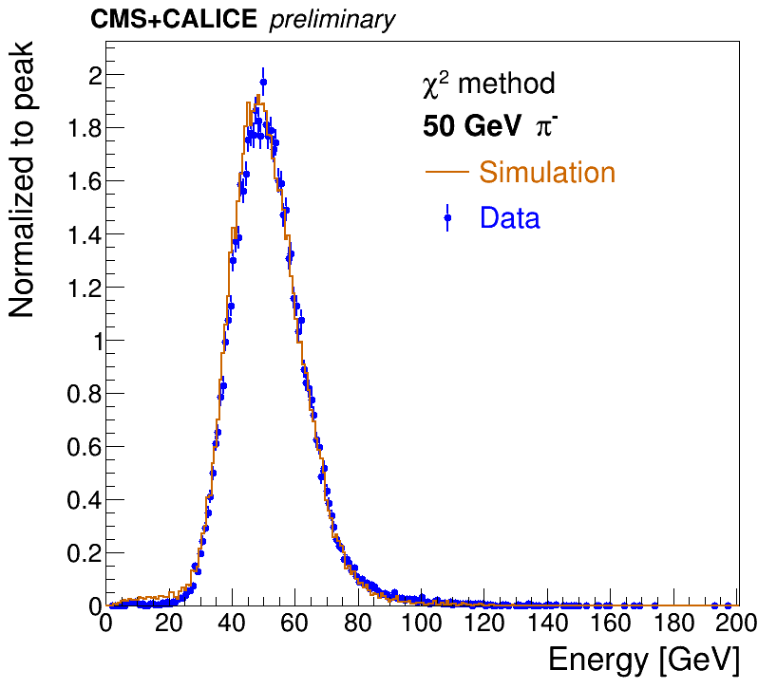
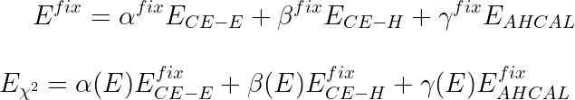
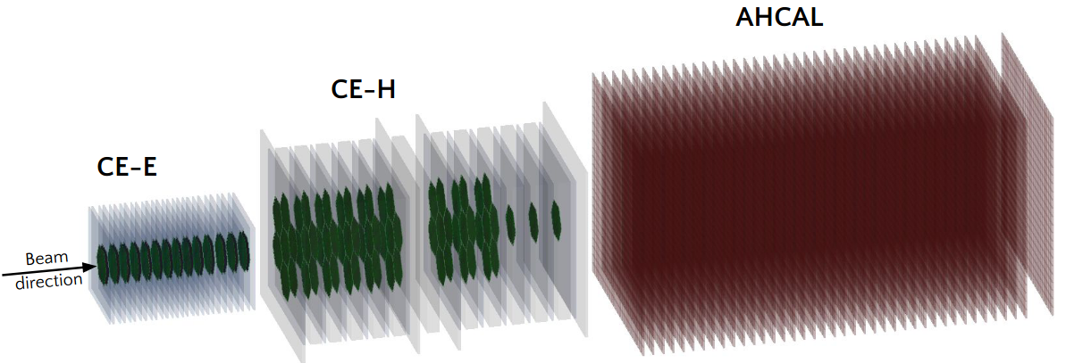
Baseline energy reconstruction
Prototype detector with 3 different sections
  Si CE-E, CE-H, scintillator-tile CALICE AHCAL
Detector-level calibration:
  CE-E (CE-H+AHCAL) calibrated with 50 GeV e⁺ (π–) beam
χ²-method :
  CE-E, CE-H, AHCAL combined with energy-dependent weights
    MIP-like in CE-E optimized separately
  Very simple baseline
    No corrections for event-by-event fluctuations, leakage, etc
    Doesn’t exploit the high granularity of the detector
modules
modules
Passive material

Slide 25
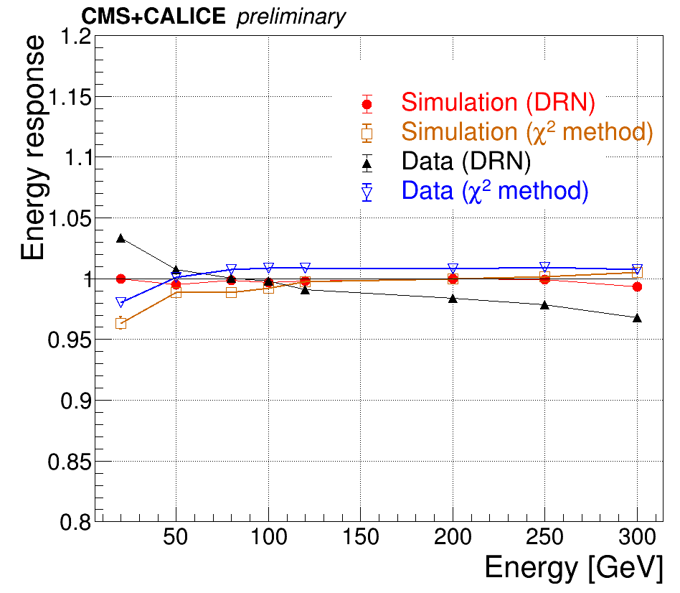
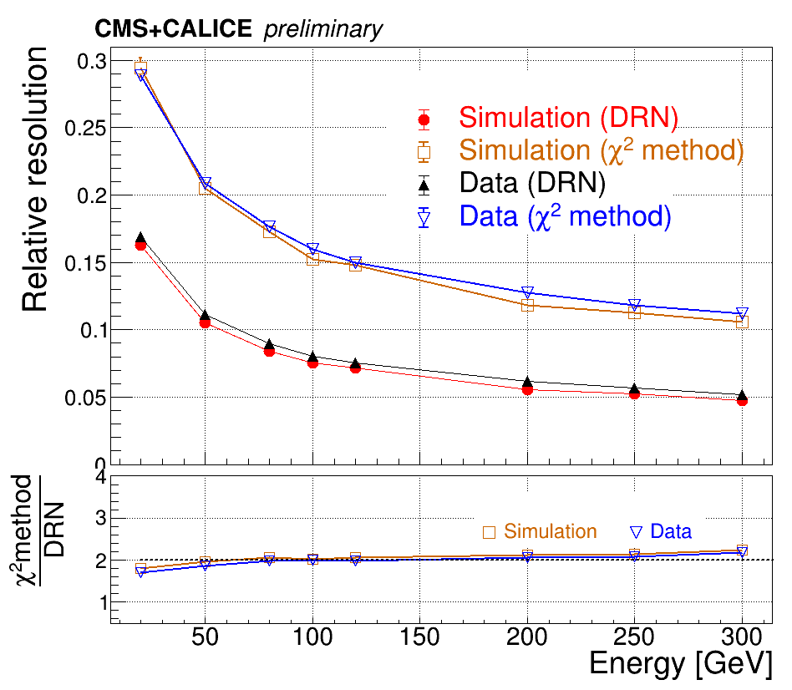
Energy resolution & response of charged pions
CMS-DP-2022/022
Use same Dynamic Reduction Network as in ECAL regressions
Dramatic improvement in energy resolution w.r.t. χ² method
Good agreement between the DRN predictions of the energy response and the relative resolution between beam test data and simulation

Slide 26
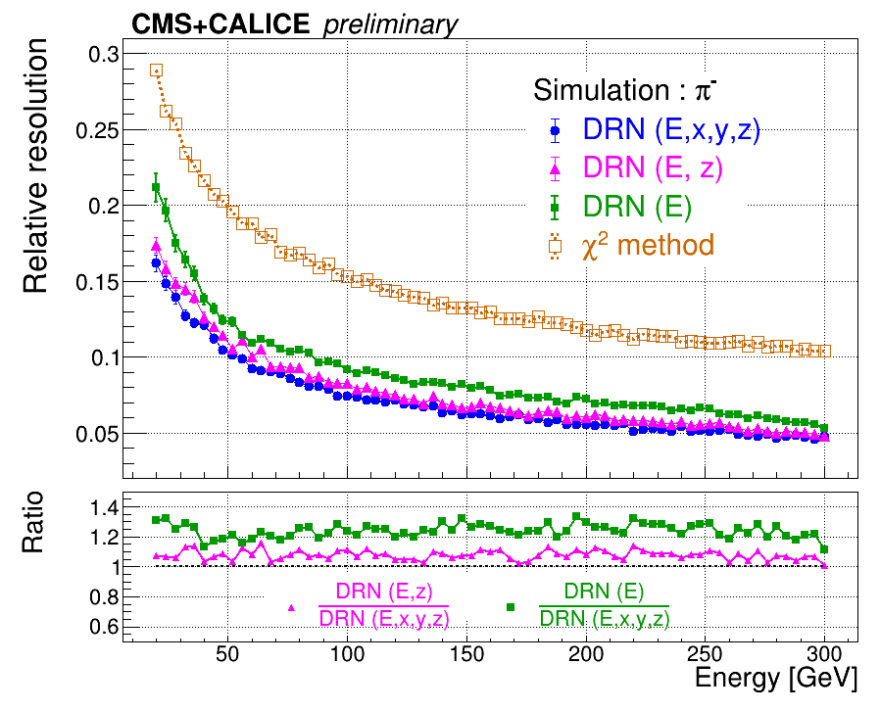
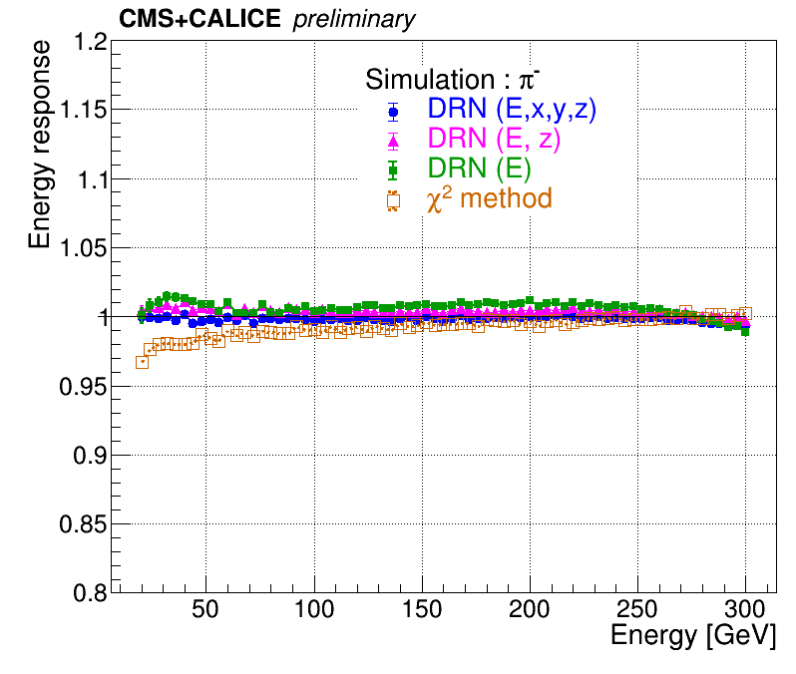
Training DRN with different input features
CMS-DP-2022/022
To understand the massive improvement in energy resolution with the DRN additional trainings were performed with different input features.
The improvement from χ² method to DRN (E) comes from learning event-by-event fluctuations in EM fraction.
Adding the spatial coordinates gives the DRN information about the spatial development of the shower.
  → Helps the DRN to better compensate for per event fluctuations and also learn about transverse leakage along with longitudinal leakage.

Slide 27
CMS HGCAL hits → particle reconstruction

Slide 28
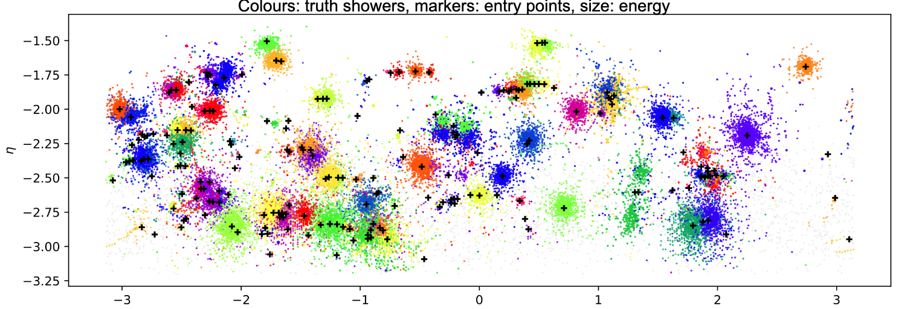
Complexity of the problem
HGCAL detector poses challenging problems for event reconstruction
  ~3 million readout channels per endcap
  ~200,000 hits per event in HL-LHC conditions
Need to perform “particle tracking” for showers
  Not simple helical trajectories
How do we go from these >100,000 hits to collection of particles and their properties?
  No viable pre-existing algorithm for this task
Truth-level particle associations
η
ɸ

Slide 29
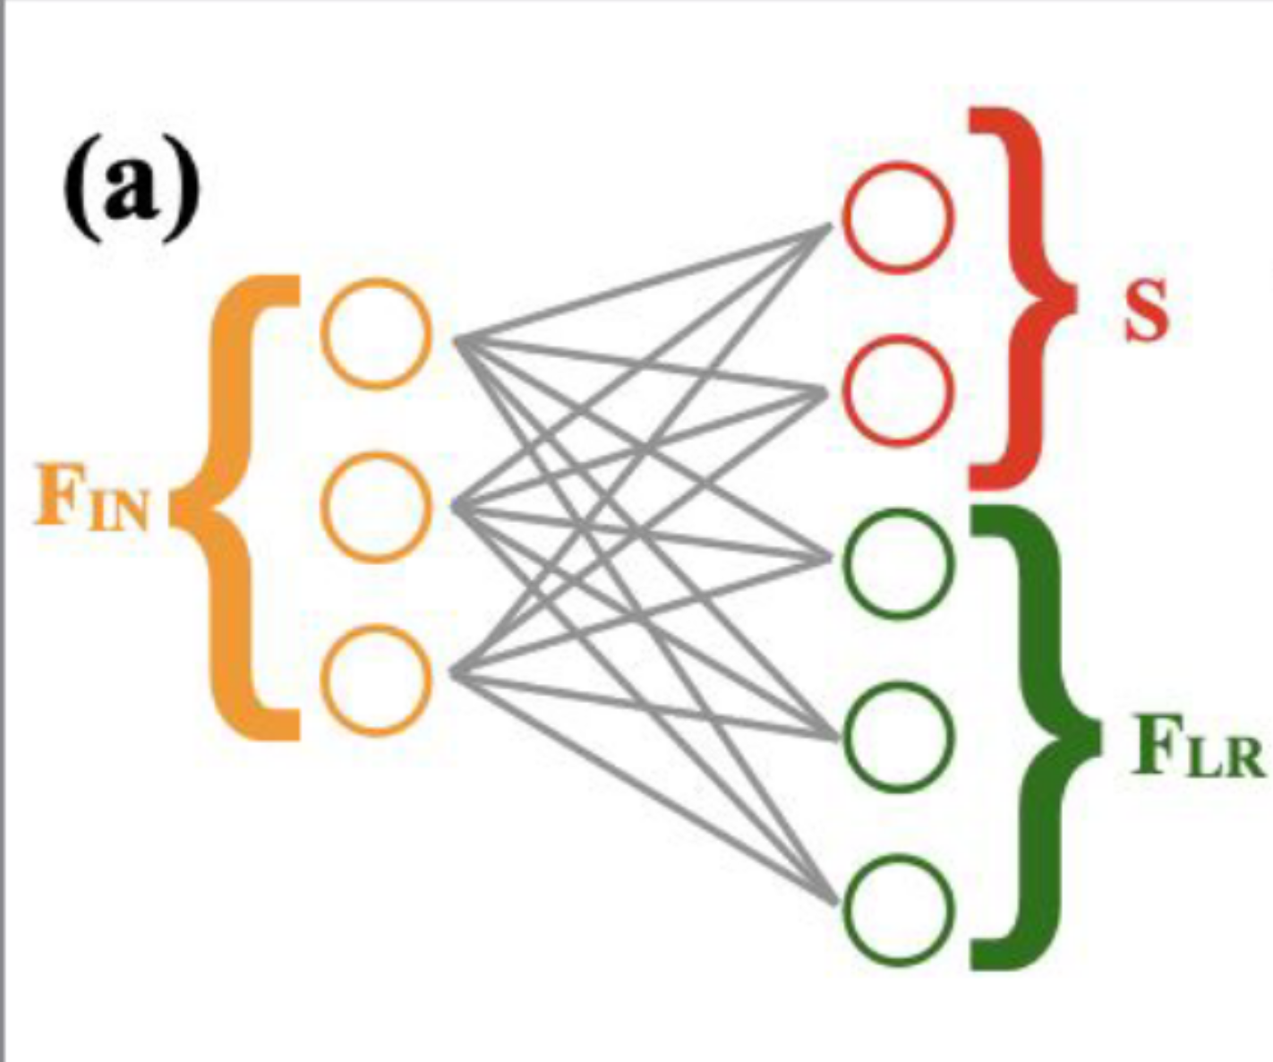
Graph-based approach
Huge number of channels requires novel computational techniques
Modified graph architecture^{[1]}
  High-dimensional information is projected into low-dimensional space for graph generation
  Add distance weighting to graph message passing
Novel loss function allows identification of arbitrary number of particles and reconstruction of their energies^{[2]}
Input: all 5D HGCAL hits (x, y, z, energy, time) in a given event
Output: clustering of hits into particles with corrected energies
  Alternatively could apply separate dedicated corrections with e.g. DRN
Low-dimensional clustering space
Input features
Additional high-dimensional features
d_{ba}
d_{bc}
d_{bd}
d_{be}
Distance-weighted message passing
[1]: arXiv:2204.01681
[2]: arXiv:2002.03605

Slide 30
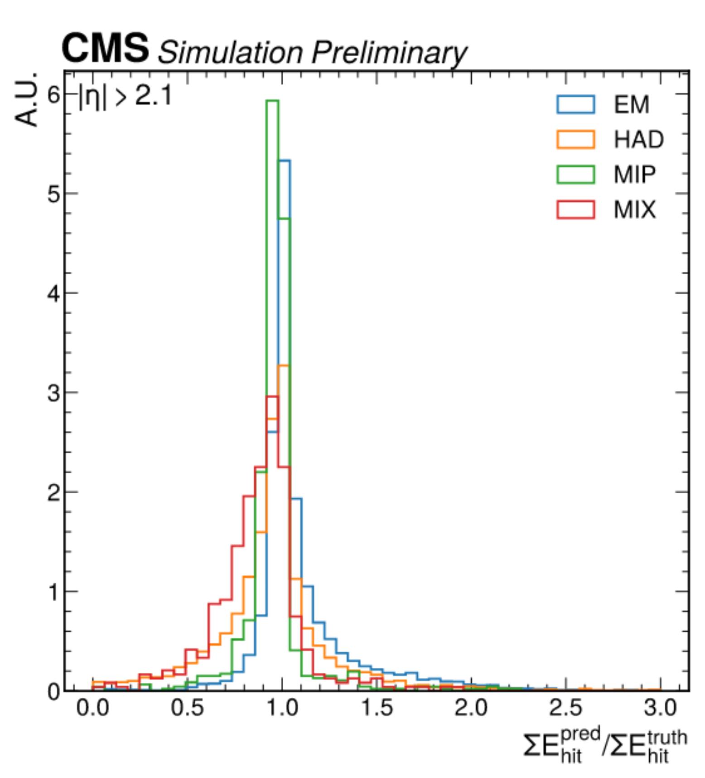
Performance
CMS-DP-2022/004
ττ gun
Gray hits are noise
Colored hits are due to individual incident particles
Efficiently recovers hadronic and EM energy deposits
Clear (qualitative) separation between particles
Performance very good even in dense areas;
  Expected to work well for pileup, substructure, etc

Slide 31
Summary
The performance of physics analyses in any experiment is intimately linked to the performance of the underlying detectors and the reconstruction of physics objects.
In order to extract more from a given amount of data it is imperative that we update our detector reconstruction using state-of-the-art tools.
One of the promising approaches underway in CMS in this regard is to incorporate low level calorimeter hits as input features into GNNs, that are uniquely suited for high energy physics problems.
Today we have seen a few examples amongst the many being used CMS wide.
These methods being developed are general and applicable to any detector.

Slide 32
BACKUP

Slide 33
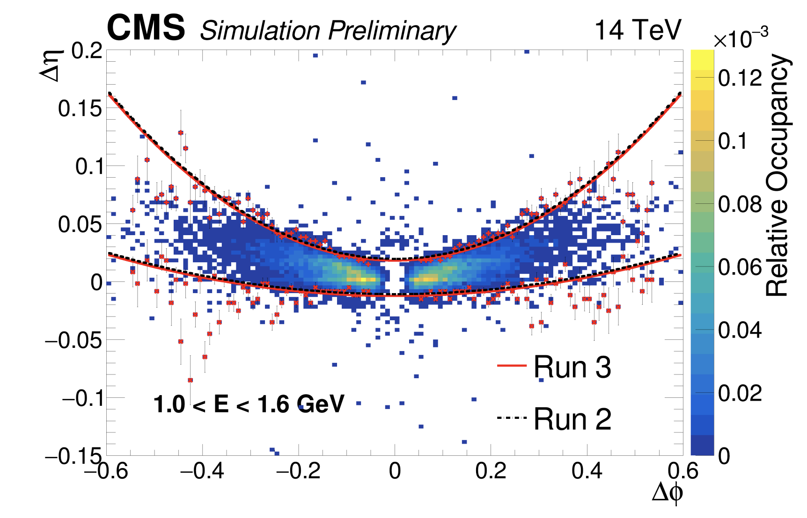
Mustache SC algorithm

Slide 34
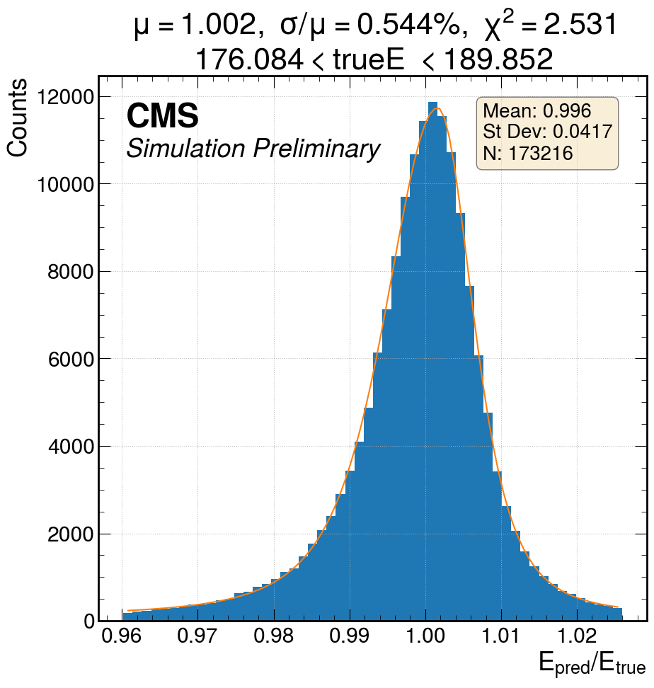
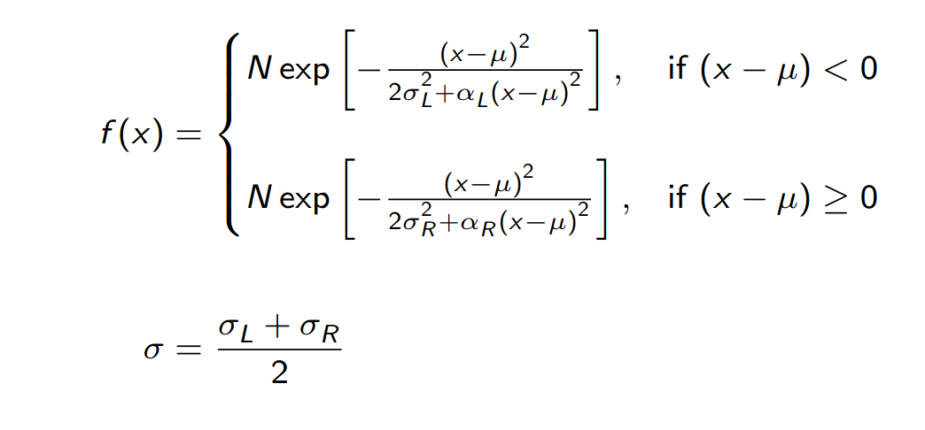
cruijff function for fitting calorimeter response
The response (E_{pred}/E_{true}) is fitted with a cruijff function :
Mean is extracted as Cruijff μ
Relative resolution extracted as σ/μ

Slide 35
Material budget upstream of ECAL

Slide 36
HGCAL beam test
CE-E
Si sensors
Cu/CuW & Pb absorbers
28 sampling layers
CE-H
Si sensors
Cu/CuW & Steel absorbers
12 sampling layers
CALICE AHCAL
Scintillator tiles on SIPMs
Steel absorbers
39 sampling layers
  Downsample to only every fourth layer to match final HGCAL geom
Total of ~17k readout channels (after downsampling AHCAL)
Testbeam Oct. 2018
  At H2 Beamline, CERN
Exposed to e⁺ and π– beams with energies ranging from 20–300 GeV
modules
modules
Passive material

Slide 37
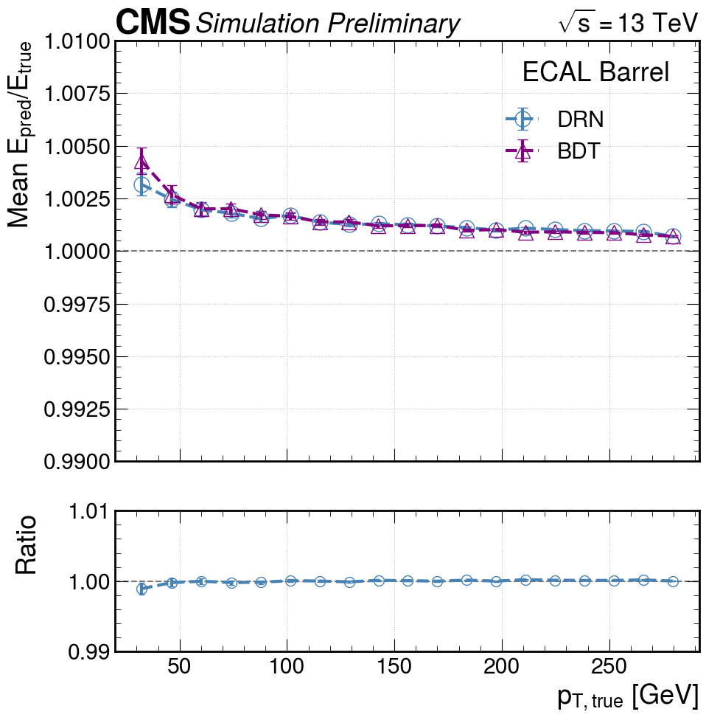
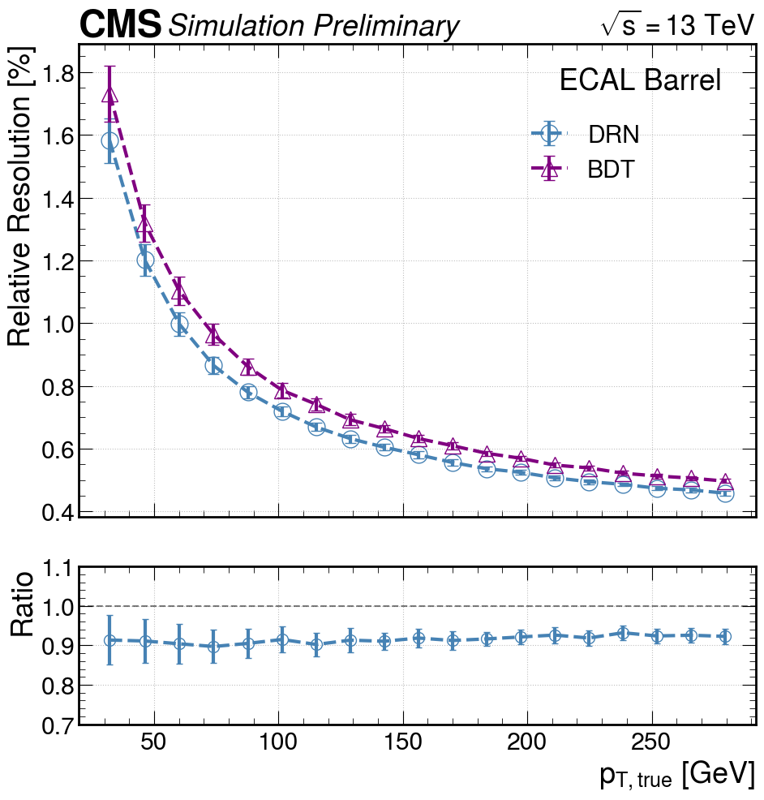
DRN electron regression (EB)
Dynamic Reduction Network (DRN) and Boosted Decision Tree (BDT) performance in the ECAL barrel as a function of generated transverse momentum. Performance is evaluated on electron gun simulation with ideal detector calibration. Error bars represent fitting uncertainties. Left: Mean response E_{Pred}/E_{True}. Regression response is stable to within better than 0.5%. Right: Relative resolution. The DRN obtains a better resolution than the BDT by ≈ 10% at all values of p_{T}.

Slide 38
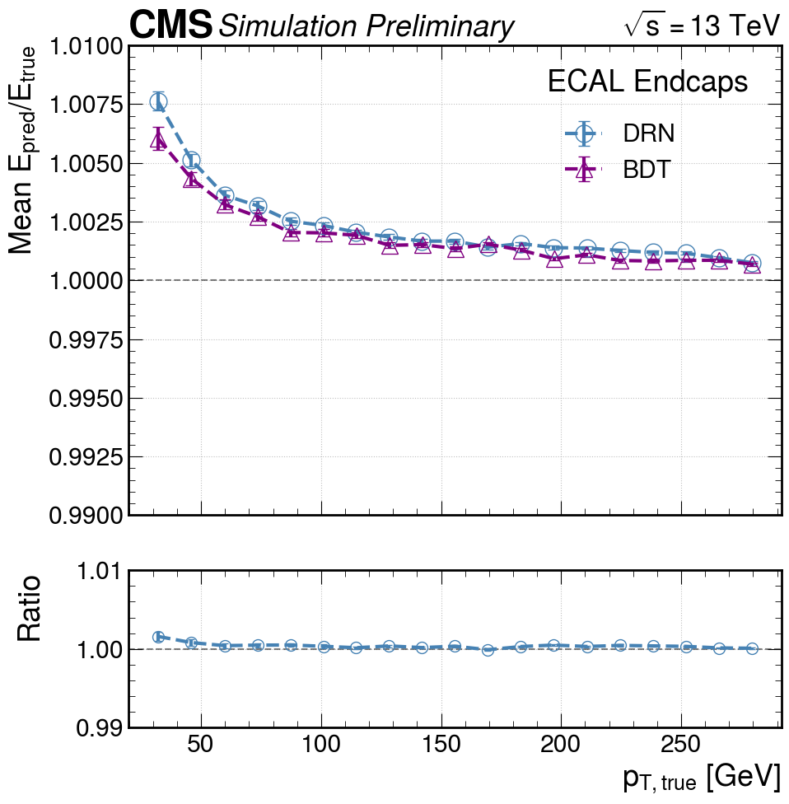
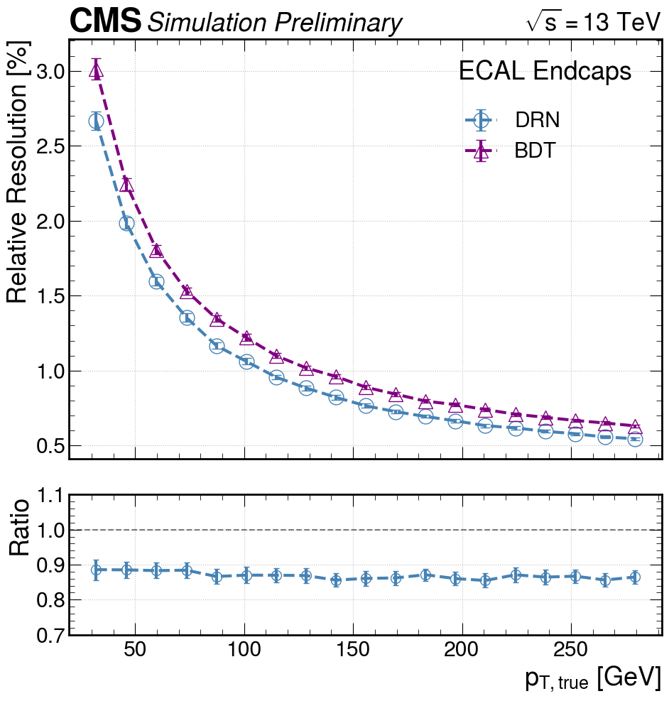
DRN electron regression (EE)
Dynamic Reduction Network (DRN) and Boosted Decision Tree (BDT) performance in the ECAL endcaps as a function of generated transverse momentum. Performance is evaluated on electron gun simulation with ideal detector calibration. Error bars represent fitting uncertainties. Left: Mean response E_{Pred}/E_{True}. Regression response is stable to within better than 0.75%. Right: Relative resolution. The DRN obtains a better resolution than the BDT by ≈ 10% at all values of p_{T}.

Slide 39
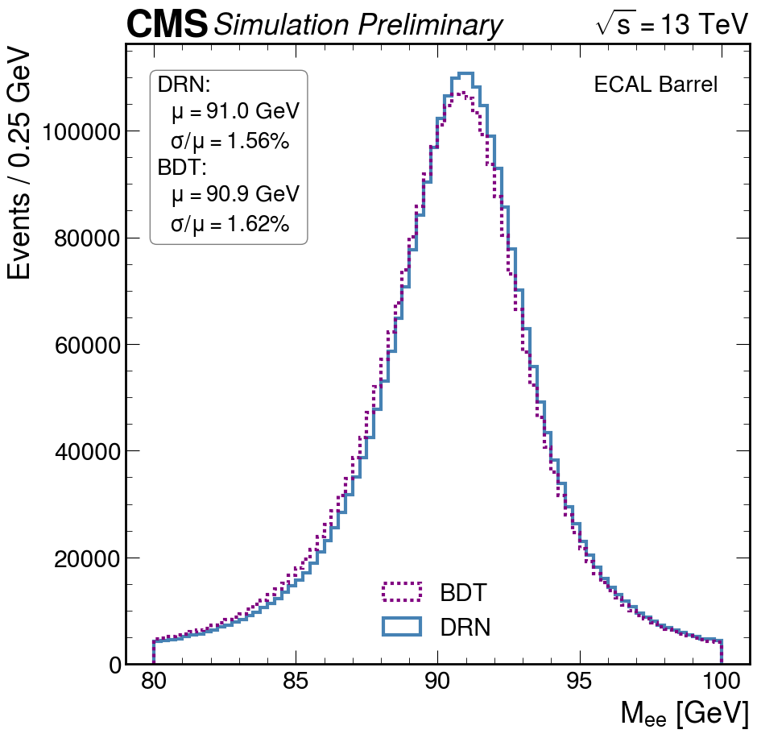
DRN regression Z boson reco (EB)
Di-electron invariant mass distributions of Z→ee events in 2018 Legacy simulation (left) and 2018 Legacy data (right) for both the Dynamic Reduction Network (DRN) and Boosted Decision Tree (BDT) architectures. The DRN obtains an improved resolution with respect to the BDT by about 5% in both data and simulation.

Slide 40
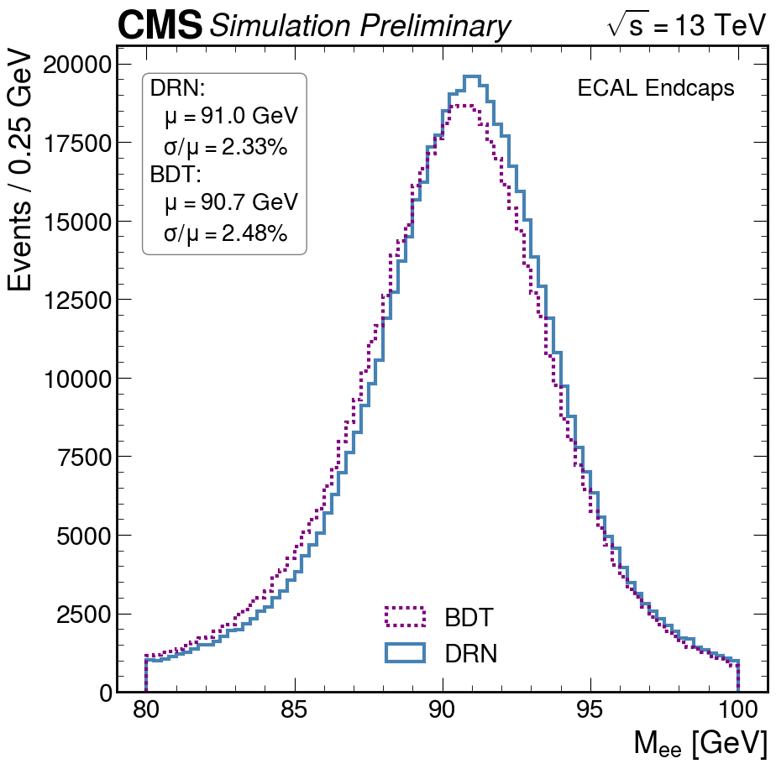
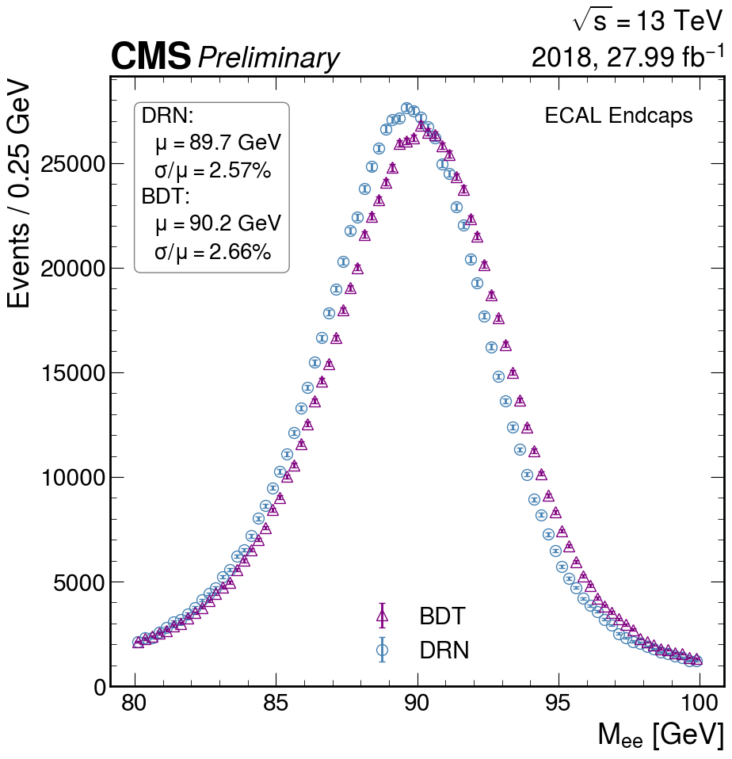
DRN regression Z boson reco (EE)
Di-electron invariant mass distributions of Z→ee events in 2018 Legacy simulation (left) and 2018 Legacy data (right) for both the Dynamic Reduction Network (DRN) and Boosted Decision Tree (BDT) architectures. The DRN obtains an improved resolution with respect to the BDT by about 5% in both data and simulation.

Slide 41
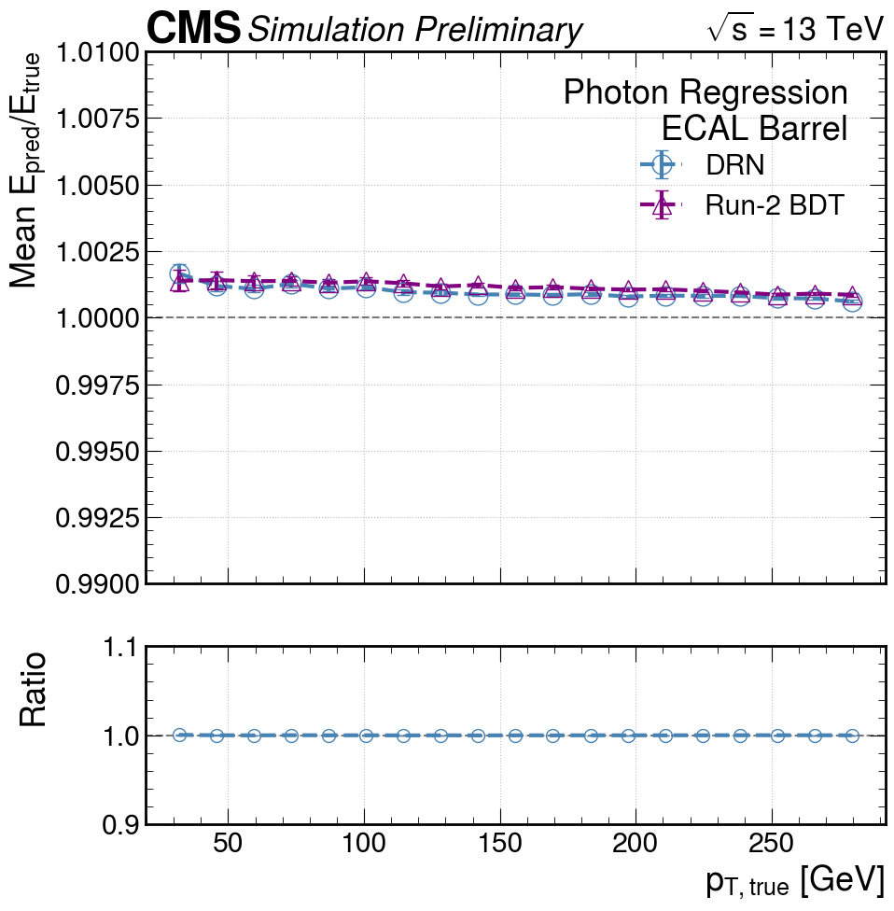
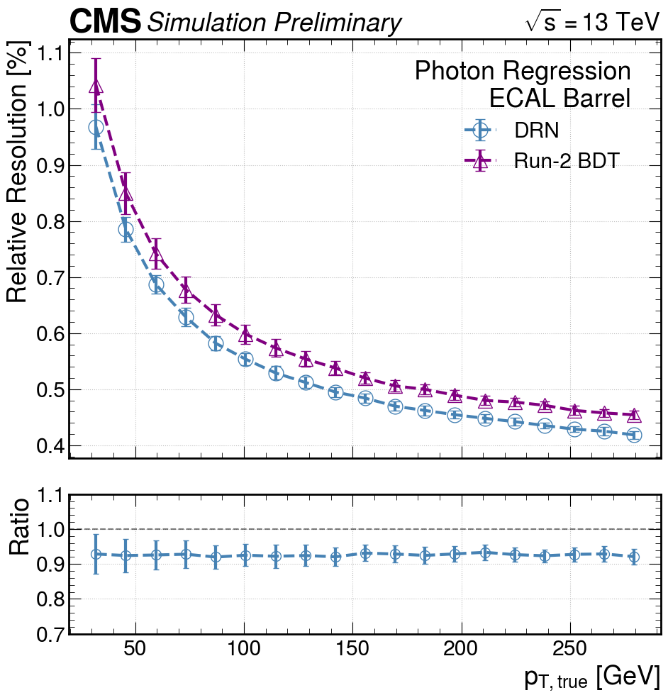
DRN photon regression (EB)
Dynamic Reduction Network (DRN) and Boosted Decision Tree (BDT) performance in the ECAL barrel as a function of generated transverse momentum. Performance is evaluated on photon gun simulation with ideal detector calibration. Error bars represent fitting uncertainties. Left: Mean response E_{Pred}/E_{True}. Regression response is stable to within better than 0.2%. Right: Relative resolution. The DRN obtains a better resolution than the BDT by ≈ 10% at all values of p_{T}.

Slide 42
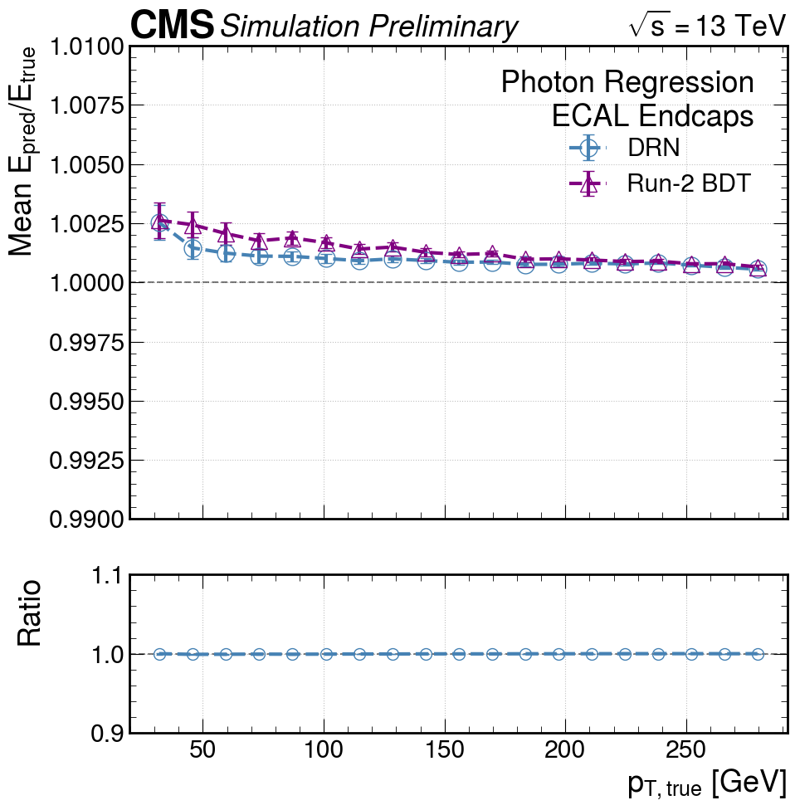
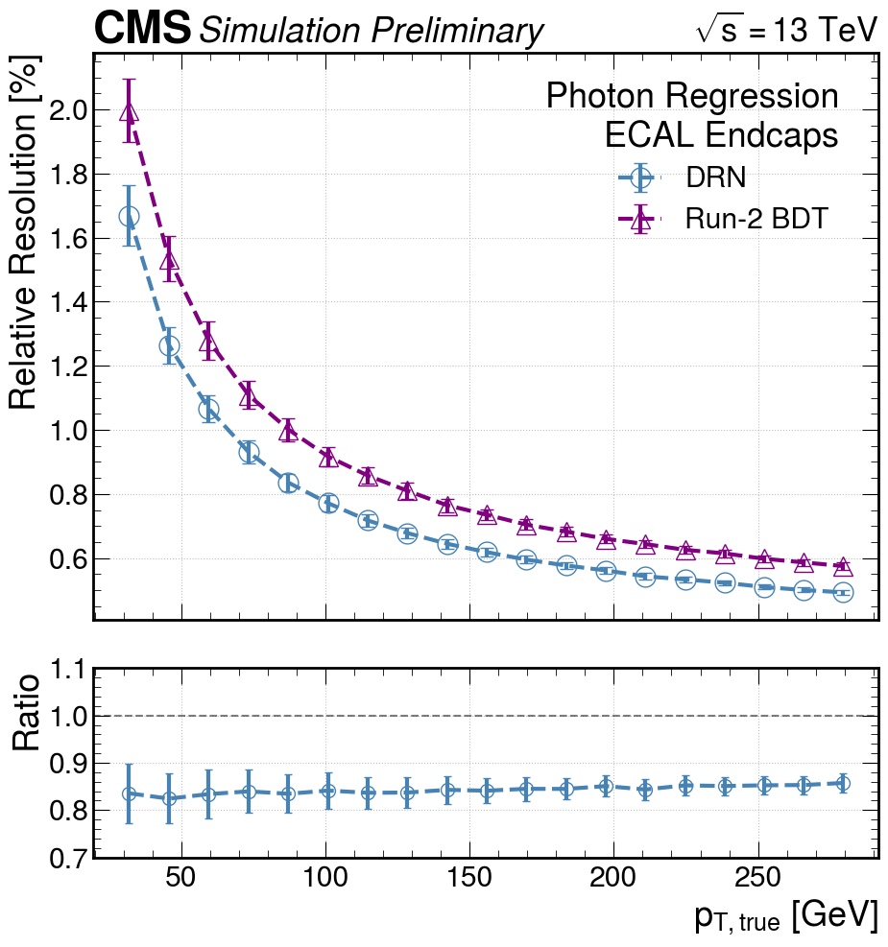
DRN photon regression (EE)
Dynamic Reduction Network (DRN) and Boosted Decision Tree (BDT) performance in the ECAL endcaps as a function of generated transverse momentum. Performance is evaluated on photon gun simulation with ideal detector calibration. Error bars represent fitting uncertainties. Left: Mean response E_{Pred}/E_{True}. Regression response is stable to within better than 0.4%. Right: Relative resolution. The DRN obtains a better resolution than the BDT by ≈ 15% at all values of p_{T}

Slide 43
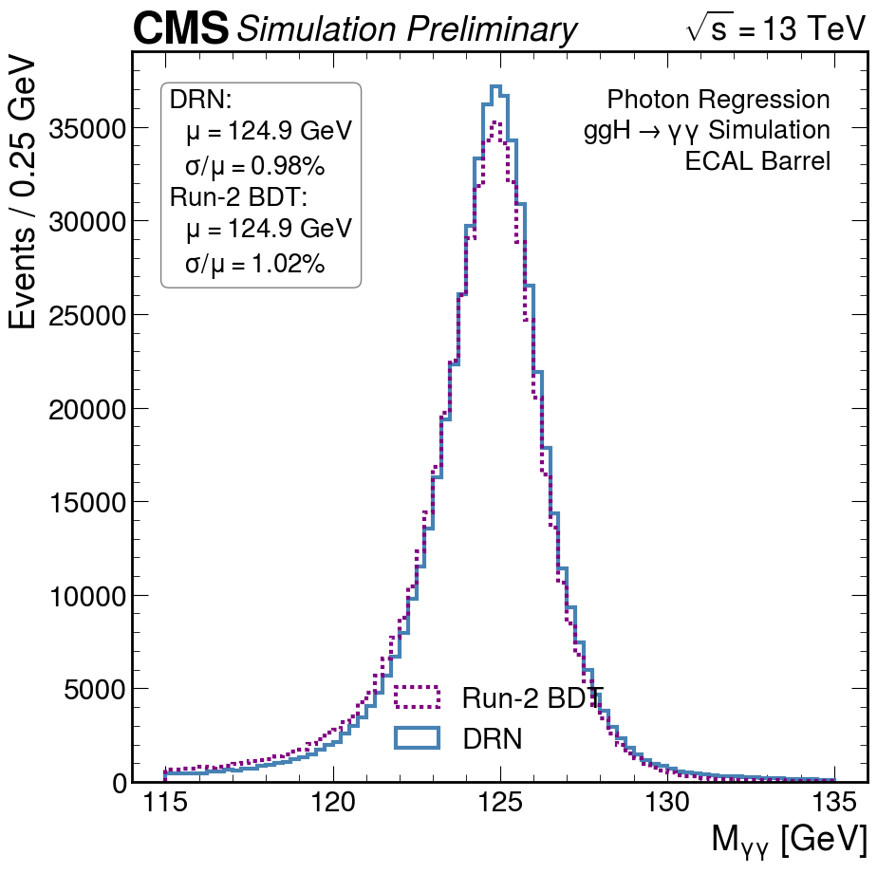
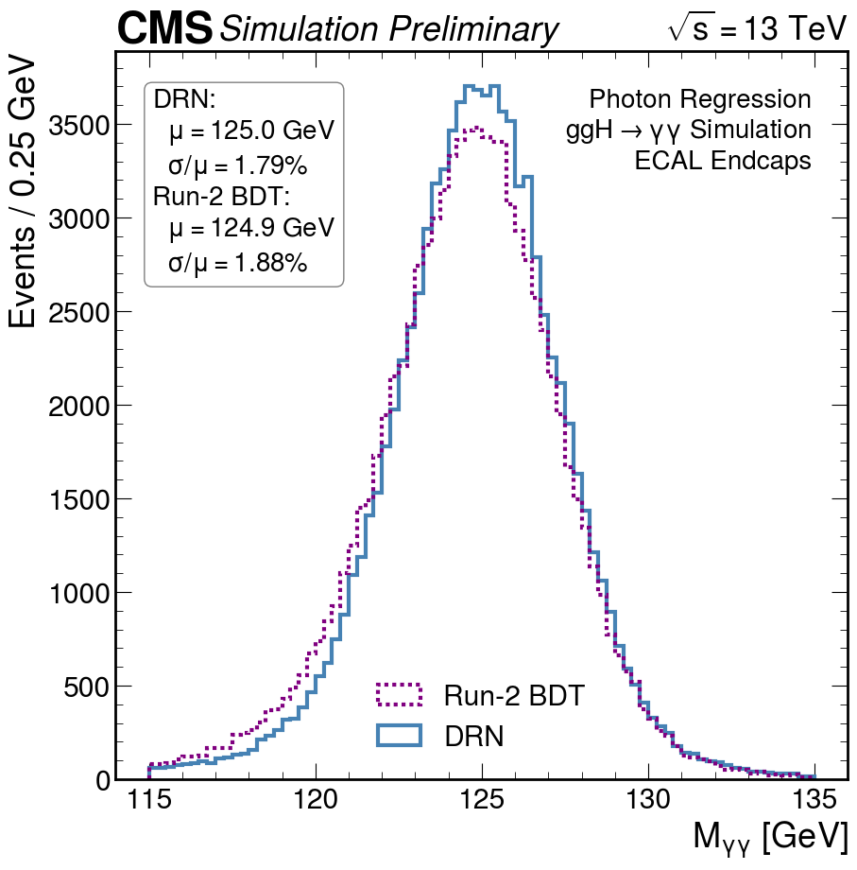
DRN photon regression Higgs reco (ggH→γγ)
Di-photon invariant mass distributions of H→γγ events in 2018 Legacy simulation for both the Dynamic Reduction Network (DRN) and Boosted Decision Tree (BDT) architectures. The Higgs peak is fit with a Cruijff function to parameterize the detector response and resolution. Left: events in which both photons are detected in the barrel region of the ECAL. Right: events in which both photons are detected in the ECAL endcaps. The DRN obtains an improved resolution with respect to the BDT by about 5% in both detector regions.

