Slide 1
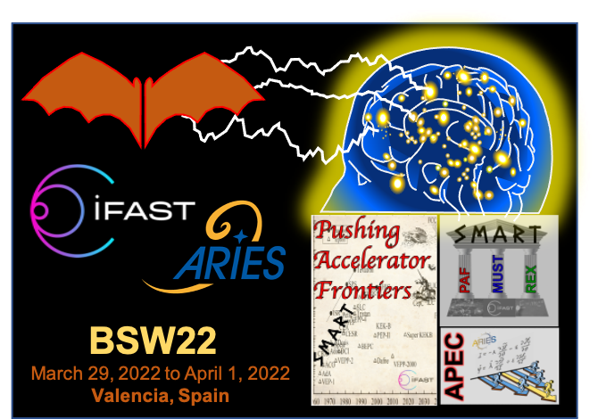
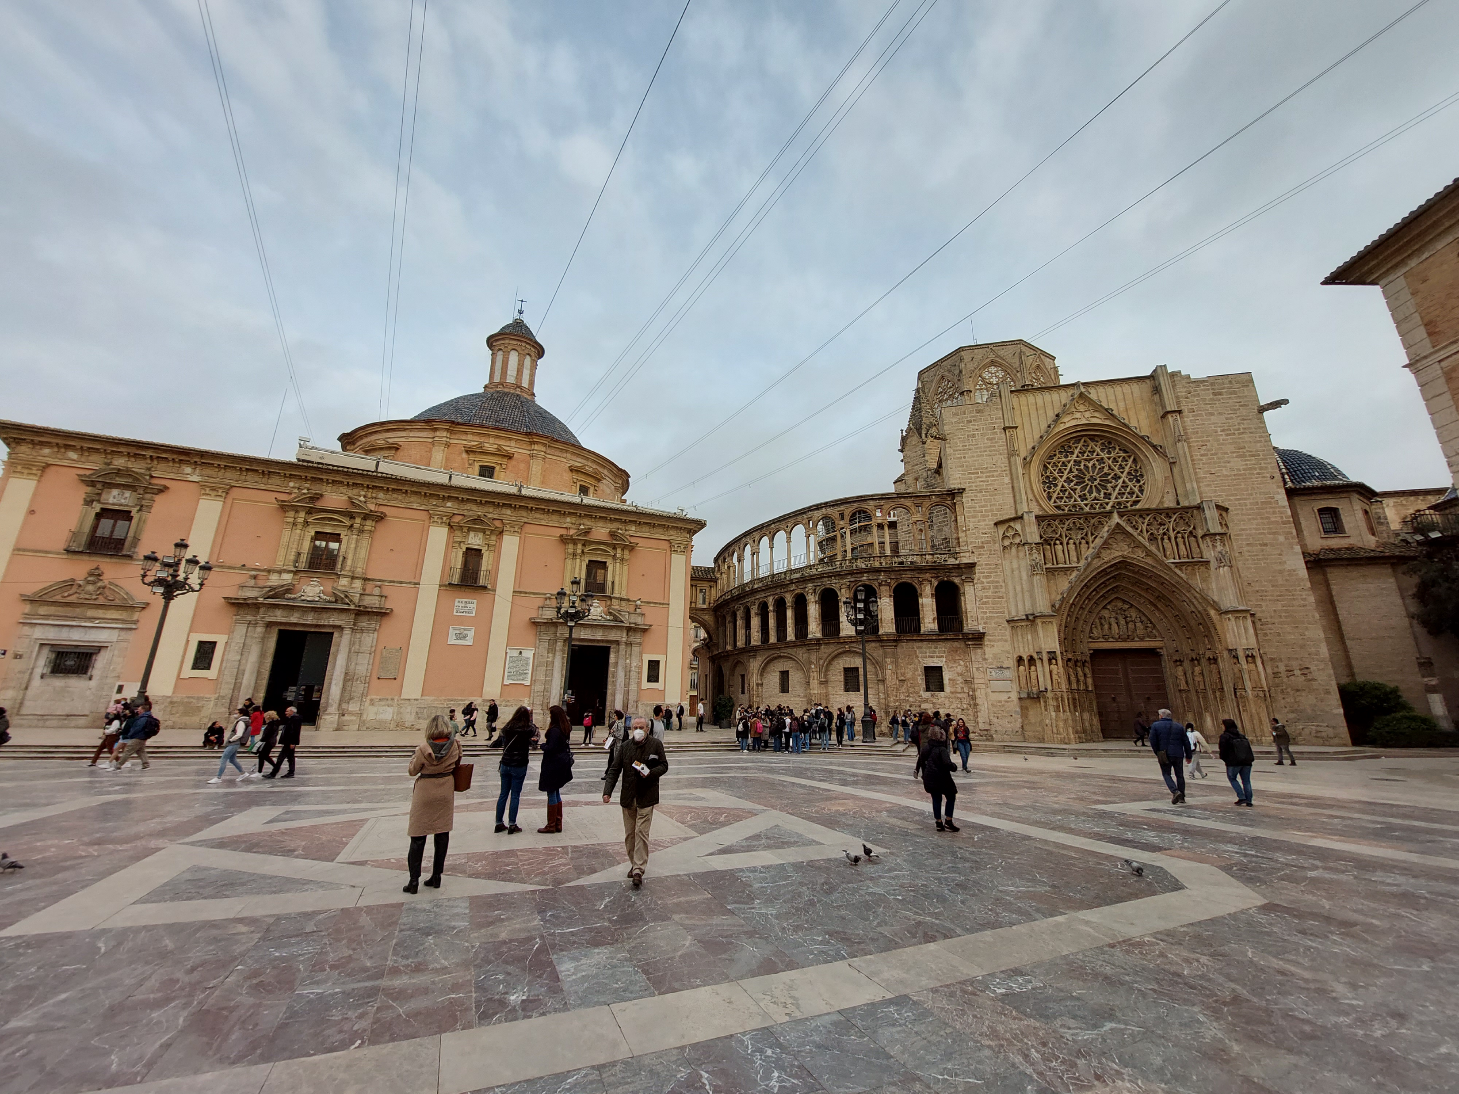
Welcome to BSW22 Valencia !
ARIES WP6 APEC & iFAST WP5.2 SMART PAF brainstorming & strategy in-person non-virtual meeting
29 March – 1 April 2022
organizers: Angeles Faus Golfe (IJCLab), Giuliano Franchetti (GSI), Frank Zimmermann (CERN)

Slide 2

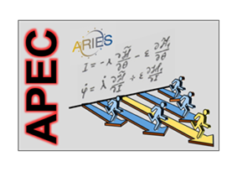

what is/was ARIES WP6 ?
Accelerator Performance and Concepts (APEC)
2017-2021
http://aries.web.cern.ch/content/wp6
coordinators: Alessandro Drago (INFN-LNF), Giuliano Franchetti (GSI & GUF), Johannes Gutleber (CERN), Klaus Höppner (HIT), Florian Hug (JGU), Mauro Migliorati (Sapienza), Marco Zanetti (Padua) and Frank Zimmermann (CERN)
HORIZON 2020
This project has received funding from the European Union’s Horizon 2020 Research and Innovation programme under Grant Agreement No 730871.

Slide 3

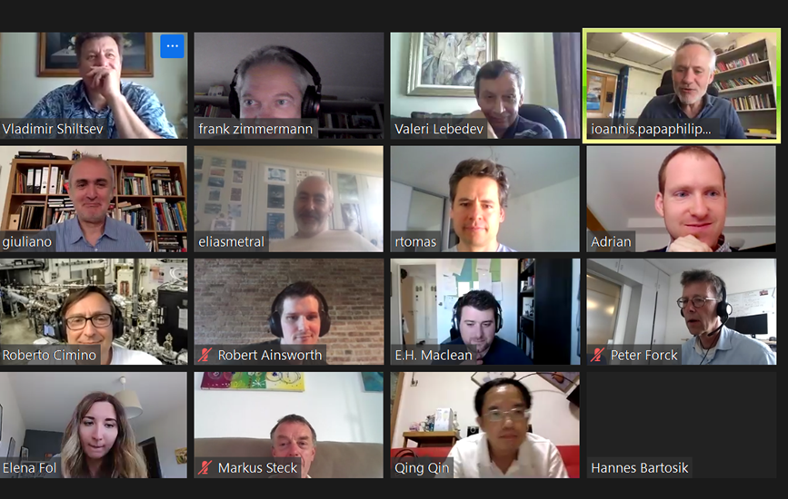
ARIES-APEC workshop on “Mitigation Approaches for Hadron Storage Rings and Synchrotrons” (Mitigations2020) was held, during the covid-19 pandemic, from 22 June to 1 July in a safe virtual space; chaired by G. Franchetti and F. Zimmermann
summary report from scientific secretaries (Alexander Engeda, Elena Fol, Michael Hofer, Annemarie Lauterbach, Giulia Russo, Tirsi Prebiba) + survey on SC mitigation
118 participants

Slide 4
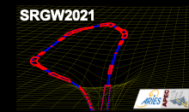
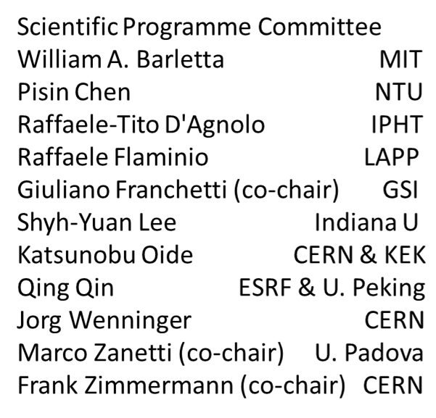
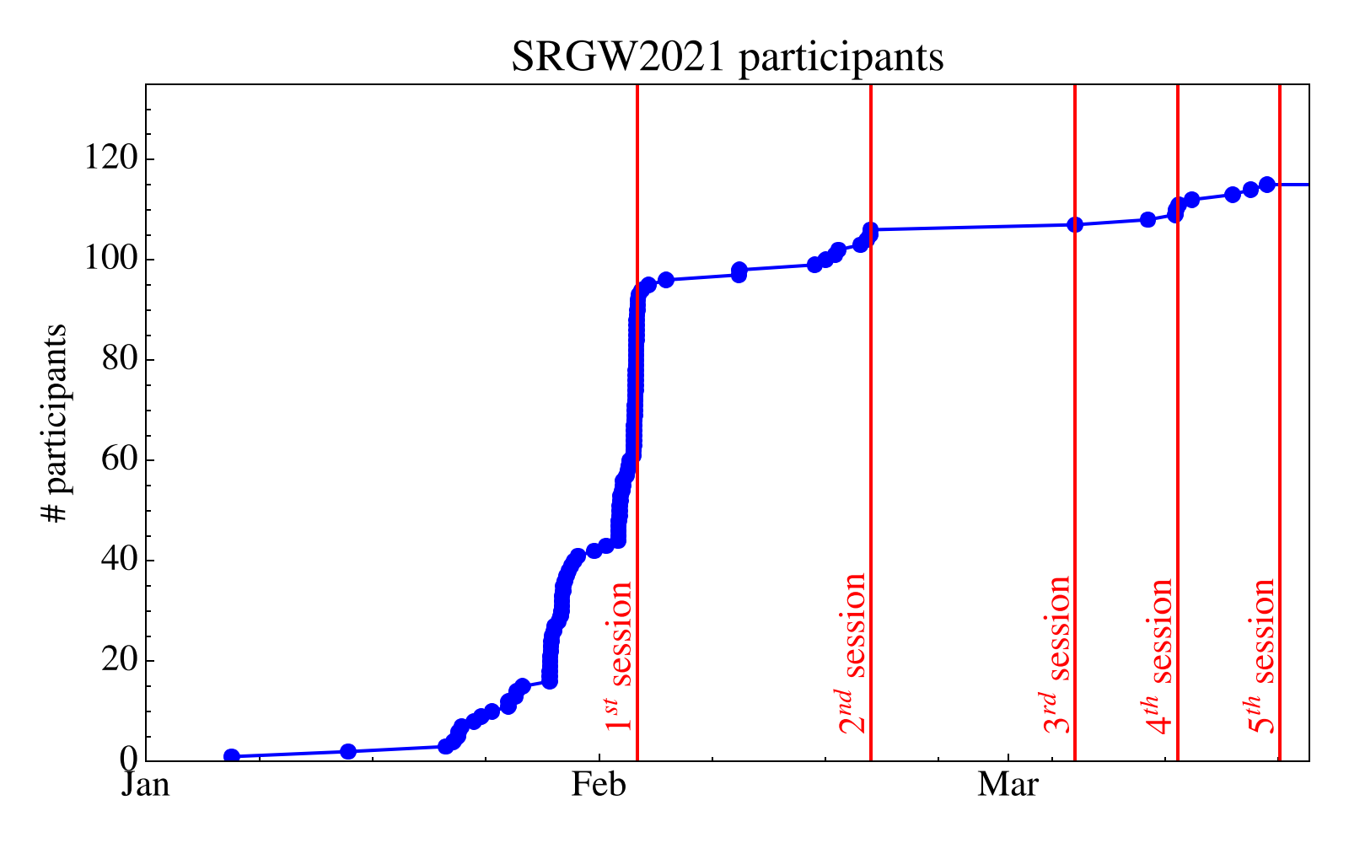
ARIES Workshop on Storage Rings and Gravitational Waves (SRGW2021), virtual space, 2 February -18 March 2021 ; chaired by G. Franchetti, Marco Zanetti, and F. Zimmermann
115 registered participants
main focus: detection and/or generation of gravitational waves or other gravity effects using storage rings & accelerator technologies
Sessions:
2/2/2021, Introduction to Gravitational Waves and their effects, chair: Pisin Chen / NTU Taiwan
18/2/2021, Measurements and sensitivity, chair: Shyh-Yuan Lee / Indiana U
4/3/2021, Proposals and Schemes, chair: Jörg Wenninger / CERN
11/3/2021, Gravitational wave generation and detection, chair: Frank Zimmermann / CERN
18/3/2021, Ground motion and final discussion, chairs: Giuliano Franchetti/GSI; John Ellis/CERN

Slide 5
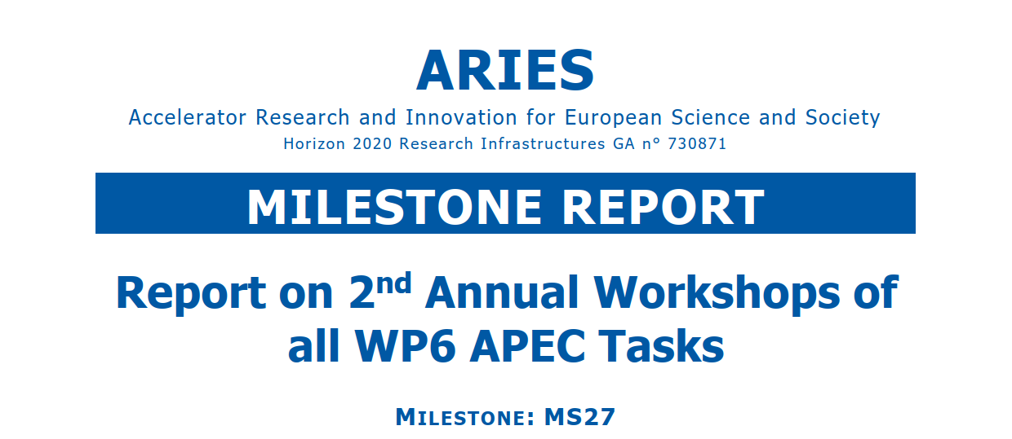
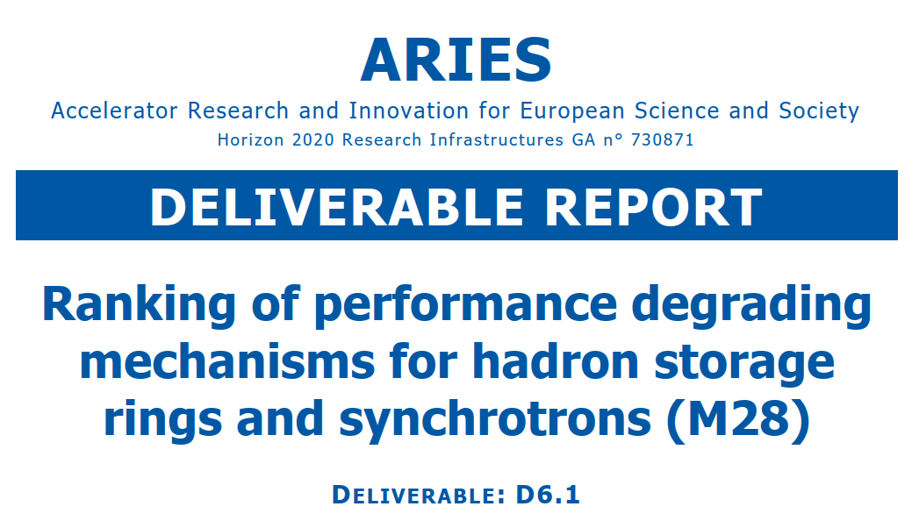
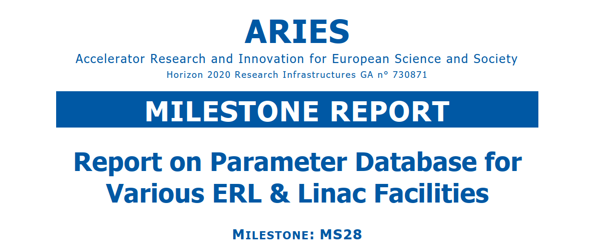
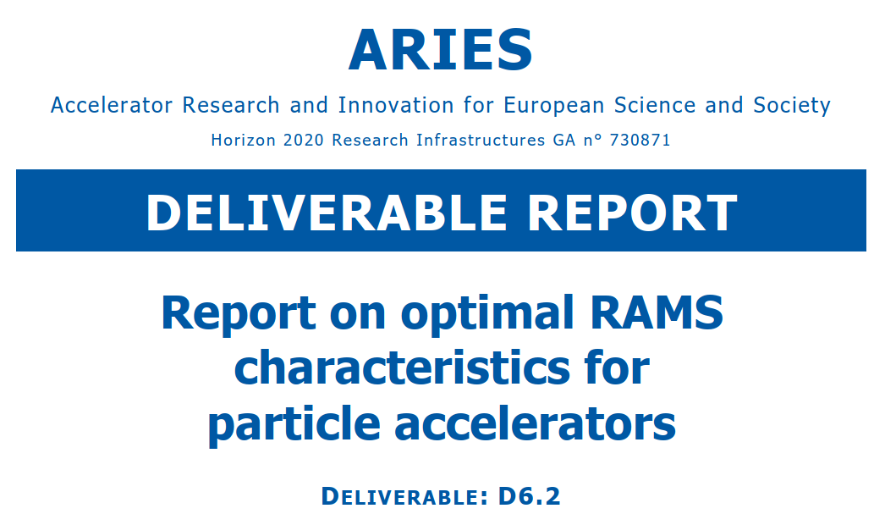
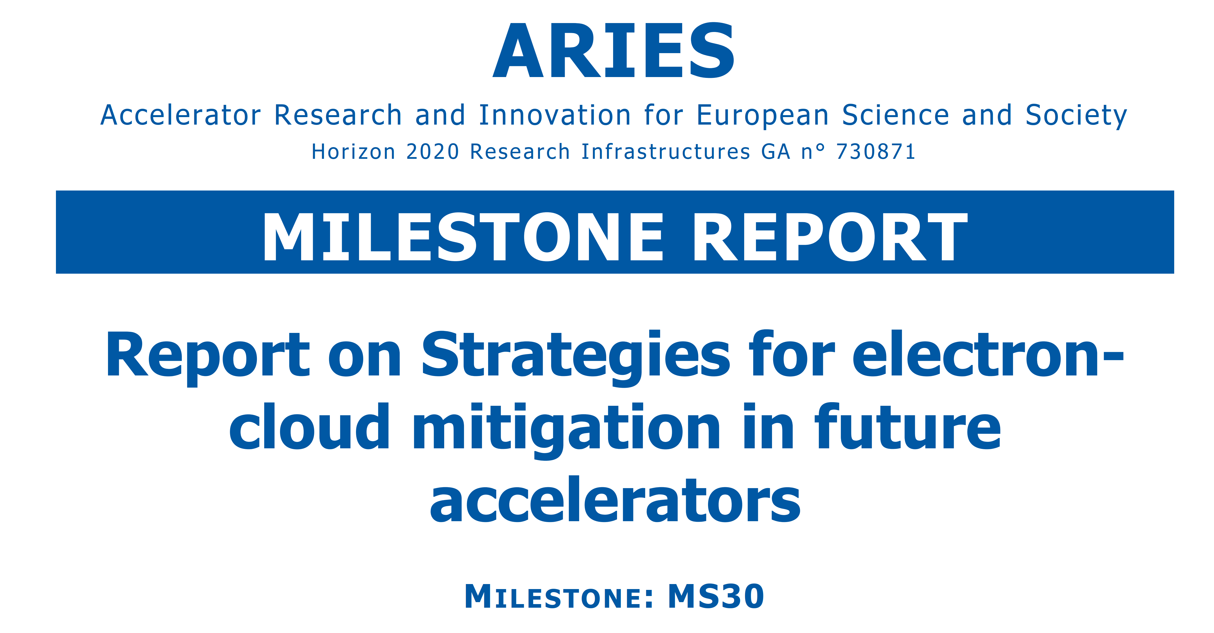

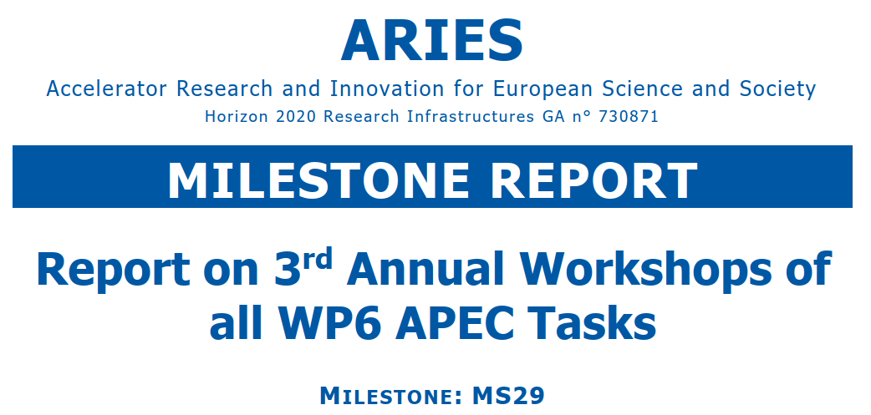
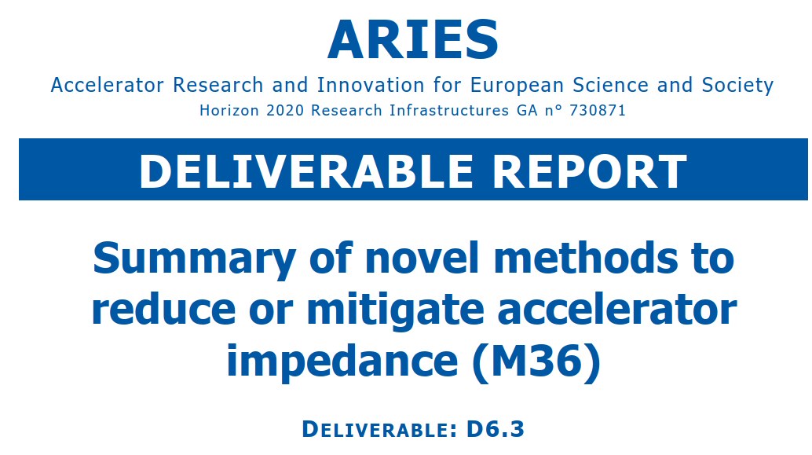
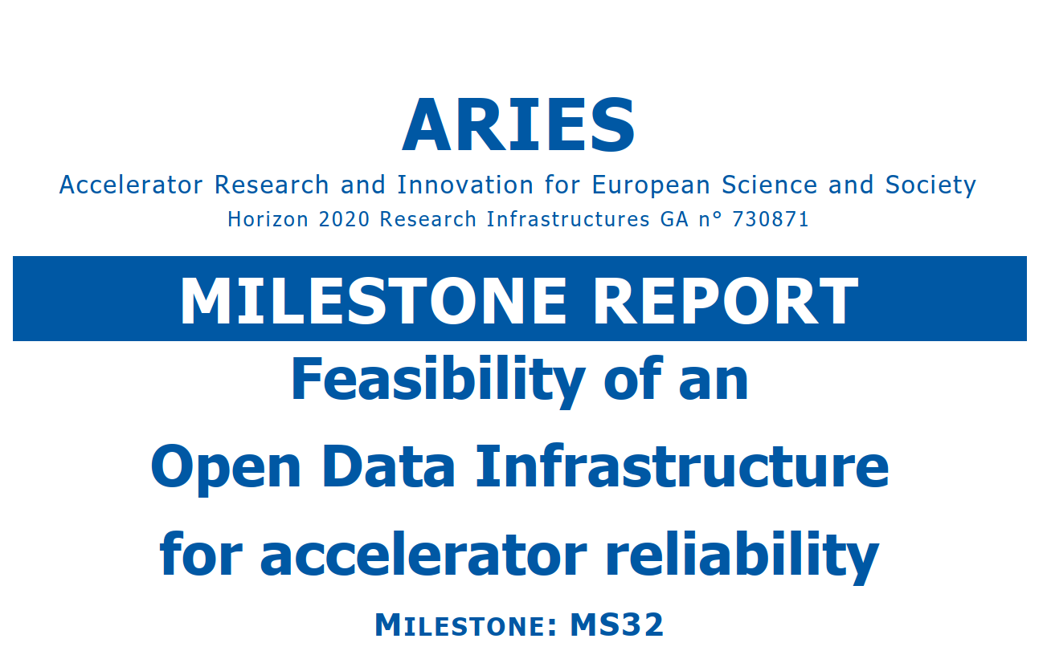
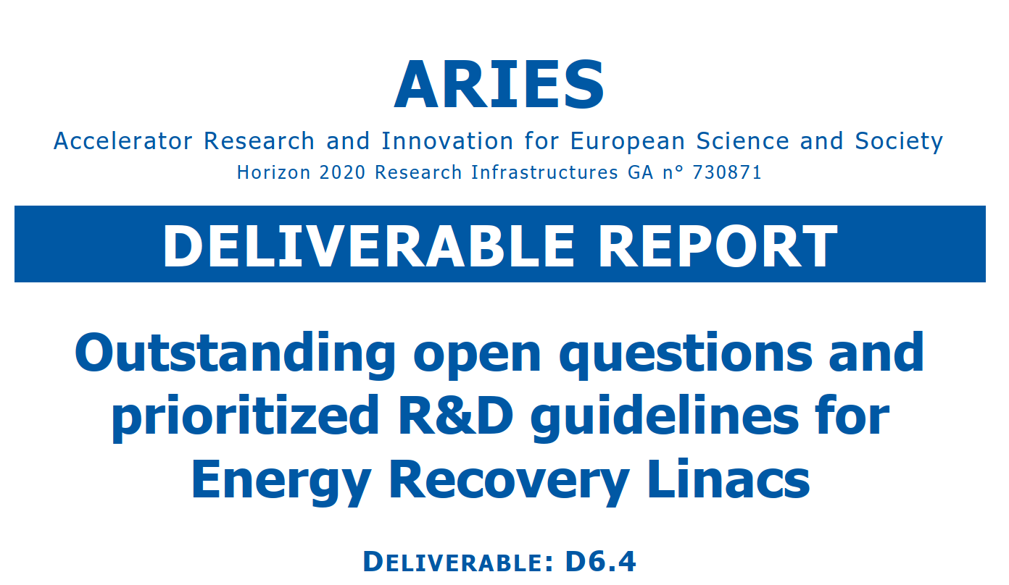
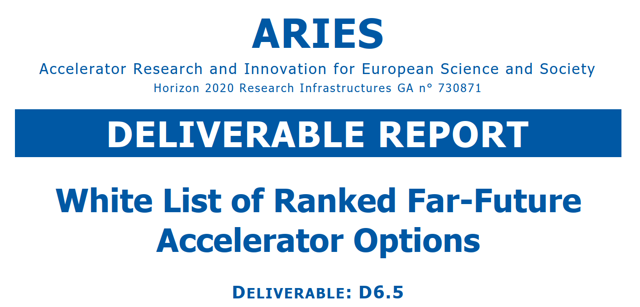
ARIES WP6 milestones and deliverables
approved
approved
approved
approved
approved
approved
approved
approved
approved
approved
approved
a job well done

Slide 6
White List of Ranked Far-Future Accelerator Options
April 2021
ARIES D6.5
Time scale | Priority and focus
10-15 years | Energy recovery Crystal bending Gamma Factory
15-30 years | Proton based muon collider Plasma acceleration Positron based muon collider Crystal and nanostructure acceleration Gravitational wave detection using storage rings
 | Low or no priority
 | Photon collider Crystalline beams “Moessbauer acceleration” using photon entanglement Gravitational wave generation using accelerators Non-electromagnetic acceleration or focusing mechanisms

Slide 7
key results from WP6 APEC
ERL R&D guidelines [D6.4]
(1) test facilities, (2) beam dynamics & diagnostics, (3) electron sources & injectors, (4) SRF: high loaded Q cavity operation; HOMs, HOM damping & high current operation; high Q₀ cavity performance
optimal RAMS characteristics for accelerators [D6.2]
availability critical systems and availability model (FCC-ee); measures to improve reliability of power converters, RF system, and electrical distribution (lead causes of unavailability for CERN’s normal conducting machines); operations modelling platform (FCC-hh) for allocating availability goals to different sub-machines, fault-tolerant system design
performance limitations in hadron synchrotrons [D6.1]
beam loss, single-bunch instabilities, & nonlinearities prominent
mitigation measures [MS31, D6.3]
Landau octupoles, bunch-by-bunch feedback, optimised tunes, and tailored slippage factor; novel techniques emerging ; for Space Charge: reduced the peak intensity (CERN, PSB, JPARC),resonance compensation, optimized lattice & working point; future e-lenses ; Impedance: mechanical design optimization, feedback systems, advanced coatings (HTS,…)
ranking of (far-)future accelerator options [D6.5]
(1) energy recovery linacs, crystal bending, Gamma Factory
(2) muon collider(s), plasma & crystal & nanostr. acceleration, gravitational wave detection

Slide 8


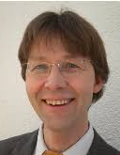
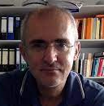
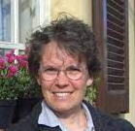
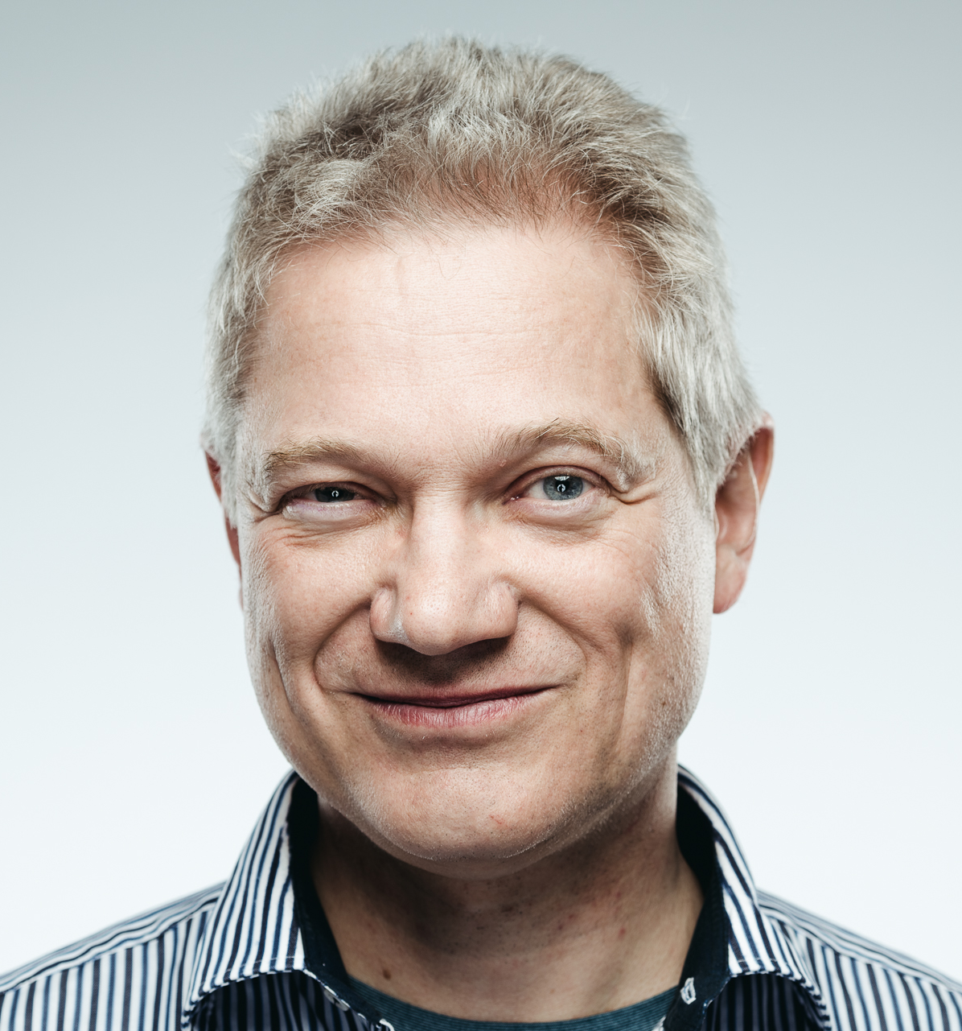

what is iFAST WP5?
WP5: Strategies and Milestones for Accelerator Research and Technologies (SMART)
Peter Forck (GSI), Giuliano Franchetti (GSI), Nadia Pastrone (INFN),
Frank Zimmermann (CERN)
Participating Institutes:
INFN, CERN, CEA, CNRS, KIT, PSI, United Kingdom Research and Innovation, GSI, Bergoz Instrumentation, Barthel HF-Technik GmbH, HIT Heidelberg + JGU Mainz
This project receives funding from the European Union’s Horizon 2020 Research and Innovation programme under GA No 101004730.

Slide 9
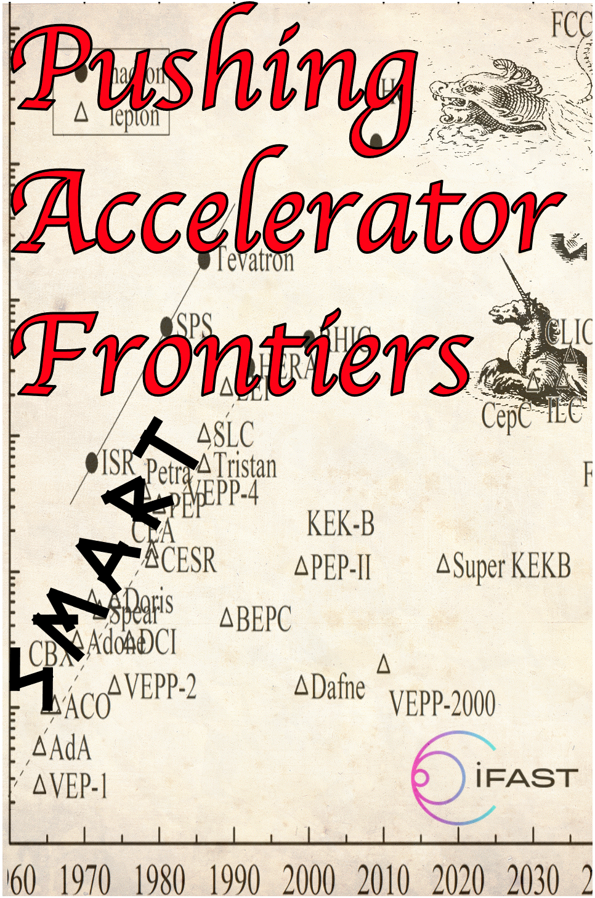
the three SMART pillars
Task 5.2 Pushing Accelerator Frontiers (PAF)
Task 5.1 MUon colliders STrategy network (MUST) | Task 5.2 Pushing Accelerator Frontiers (PAF) | Task 5.3 Improvement of Resonant slow EXtraction spill quality (REX)
Coord.: Nadia Pastrone (INFN) | Coord.: Frank Zimmermann (CERN), Giuliano Franchetti (GSI) | Coord.: Peter Forck (GSI)
INFN, CERN, CEA, CNRS, KIT, PSI, UKRI | CERN, GSI, CNRS, PSI + JGU Mainz | GSI, BI, BT, CERN, HIT
Support the effort to design a muon collider and to project and plan the required R&D. | Significantly improve the performance of lepton and hadron accelerators | Mitigate intensity fluctuations of slowly extracted beam from synchrotrons by means of detailed parameter simulations, related experimental verifications, and active beam control
Consolidate the community devoted to developing an international future facility. | Identify novel accelerator opportunities and possible implementations | Produce a prototype of improved hardware for power supply control to achieve a current stability in the range of ∆I /I < 10⁻⁶.
Prepare the platform to disseminate the information | Define a roadmap for long-term accelerator R&D | Design and produce a high-performance RF-amplifier with versatile control for knock-out extraction.

Slide 10

Task 5.2 Pushing Accelerator Frontiers (PAF)
Main tools: topical workshops and dedicated prospective studies
Overriding goal: survey frontiers of classical accelerators and develop long-term strategies for boosting the performance of future facilities and for overcoming limitations
Thrust 1: networking on novel intense positron sources, providing a “condensation point” for the worldwide positron-source community (CNRS – Iryna Chaikovska)
- different methods of e⁺ production, both classical techniques & especially novel/exotic ones
Thrust 2: survey extreme beams and ultimate limits, and examine approaches to overcome the present limits on beam brightness (CERN – Frank Zimmermann, GSI – Giuliano Franchetti)
- space-charge compensation or cooling, crystalline beams,..
- review the ultimate limits on high-gradient acceleration,
high-field bending, beam size, beam density, and luminosity
F. Zimmermann, R. Assmann, M. Bai, G. Franchetti, Review of Accelerator Limitations and Routes to Ultimate Beams, IPAC’21
- IPAC’21 paper

Slide 11
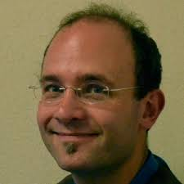
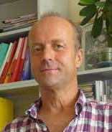
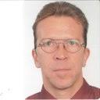
Task 5.2 Pushing Accelerator Frontiers (PAF) – cont’d
Thrust 3: artificial intelligence for accelerators, exploring applications of machine learning, deep learning, advanced optimization algorithms and neural networks, for accelerator control and design (PSI – Rasmus Ischebeck)
Thrust 4: accelerators for “dark sector”& precision physics
(CERN – Christian Carli, GSI – Bernd Lorentz)
- accelerator/beam requirements for dark-sector searches in fixed-target experiments
- investigating current precision frontier accelerator developments, such as EDM ring designs
focus of the Valencia meeting !

Slide 12
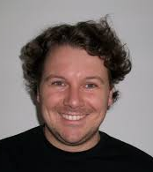
Task 5.2 Pushing Accelerator Frontiers (PAF) – cont’d
Thrust 5: green accelerators, sustainable accelerator concepts, e.g. energy recovery, energy efficiency, and possibly particle (e.g. positron) recycling (CERN, GSI, CNRS, PSI, + JGU – Florian Hug)
WP5 - Task 5.2 PAF synergies:
with Task 5.1 MUST: positron sources, ultimate limits, and particle recycling ..
with the Task 5.3 REX: dark sector fixed-target experiments and machine learning …
→ PAF will develop a coherent landscape for future accelerators and issue targeted R&D recommendations

Slide 13
PAF workshops so far
Extreme Storage Rings Workshop (ESRW22) – virtual – 31 January to 8 February 2022, see next page

Slide 14
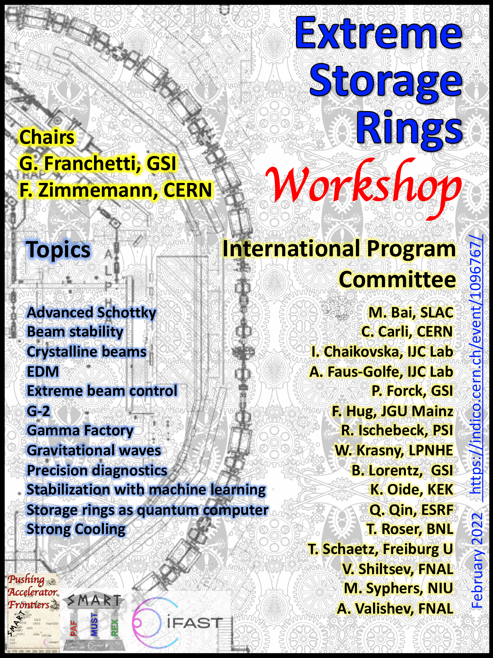


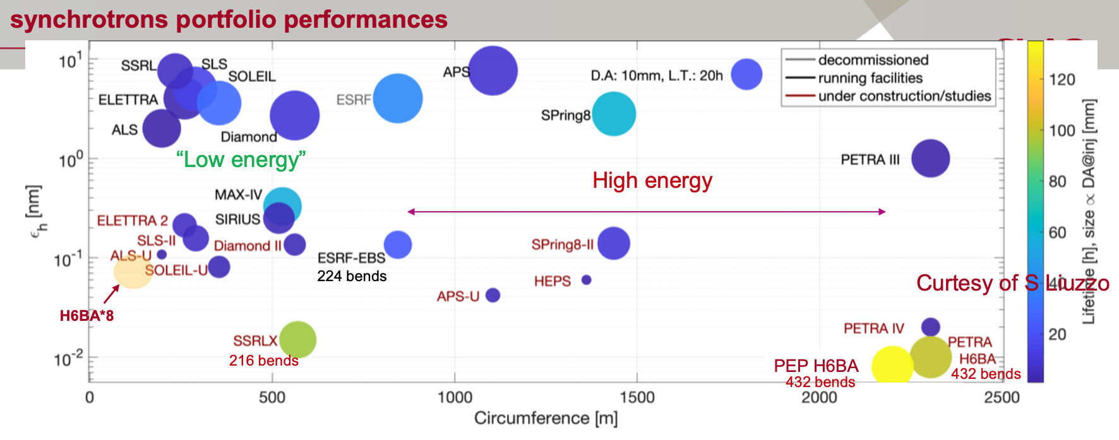
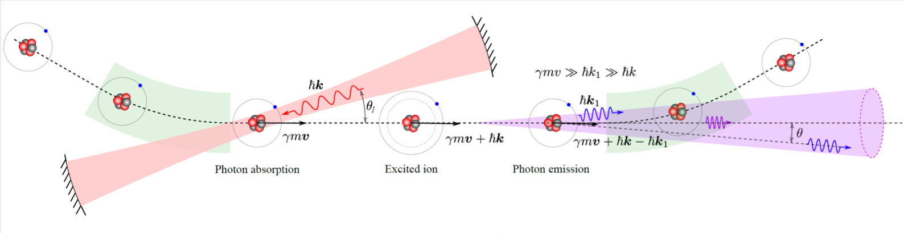
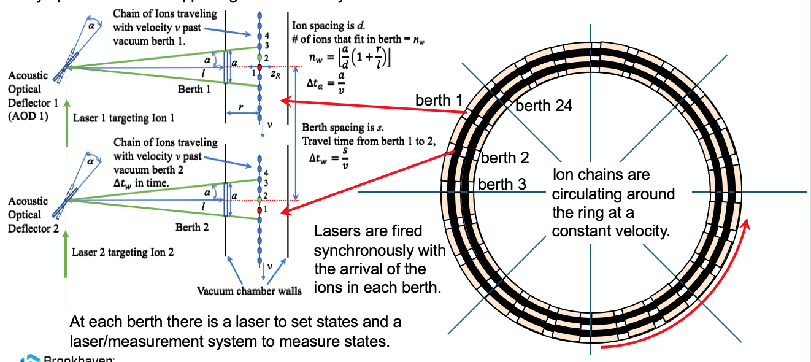
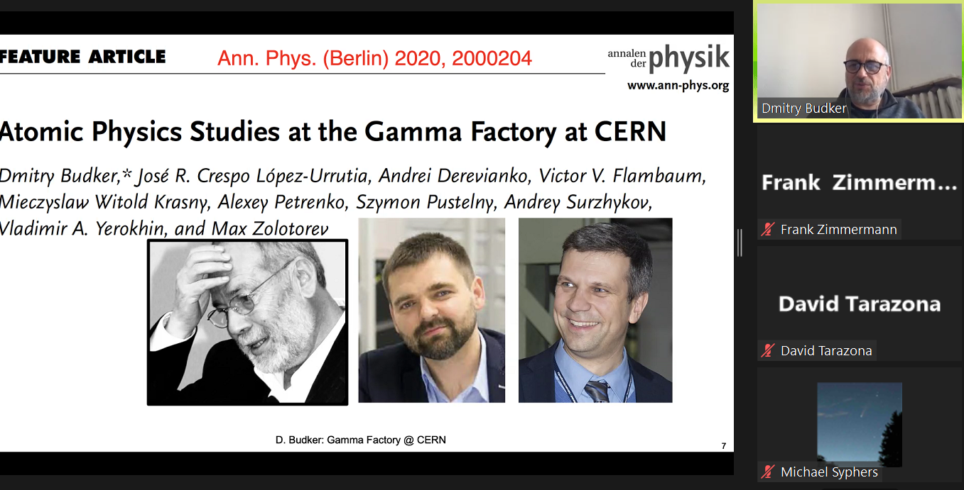
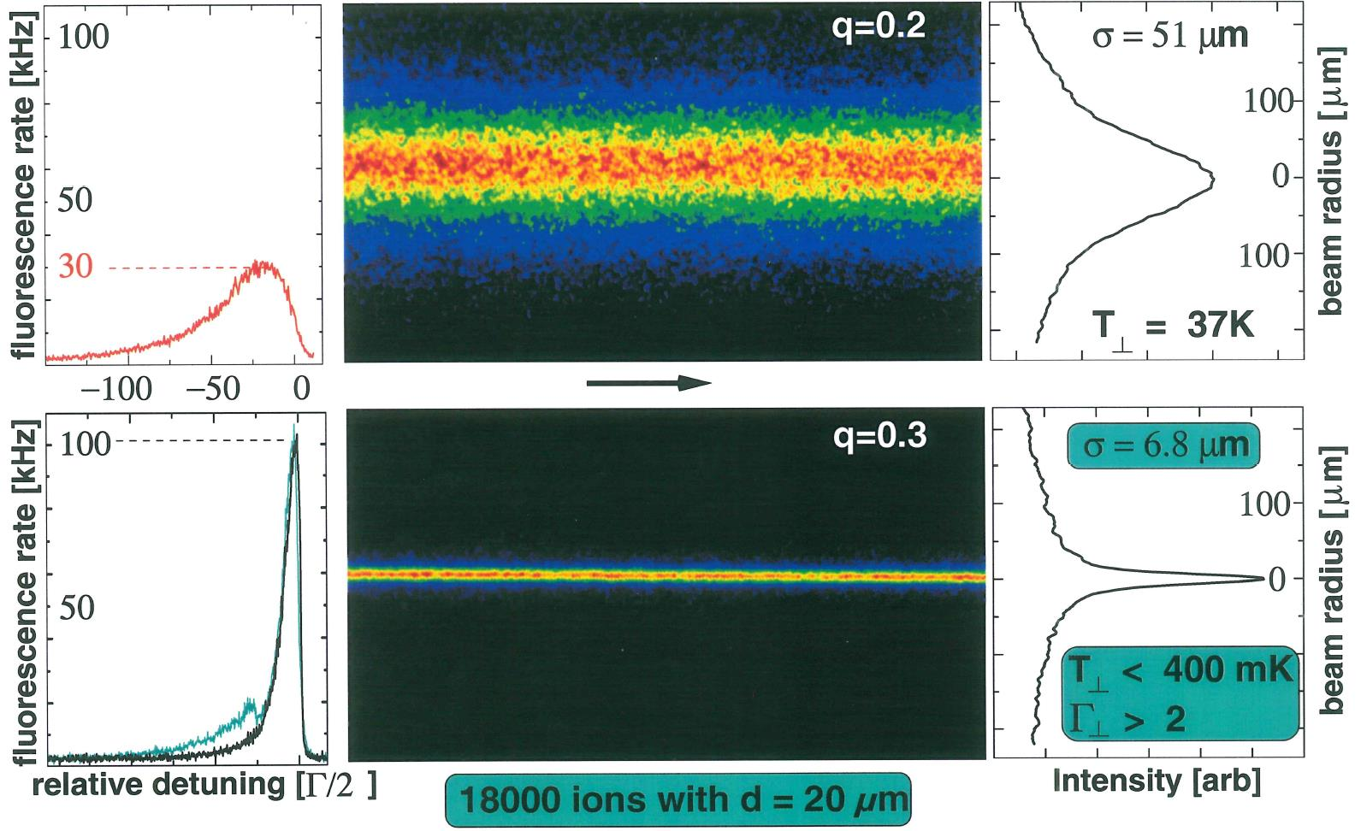
Cross-boundary subjects with added value from collaboration and sharing of resources.
Collaborative schemes involving laboratories, university and industry.
Priority to longer-term high-risk high-gain R&D.
https://indico.cern.ch/event/1096767/
Pantaleo Raimondi
Maurizio Vretenar
Danyal Winters
Kevin Brown
Tobias Schaetz
Dima Budker

Slide 15
WP5 deliverables
D5.1: International collaboration plans towards a multi-TeV muon collider Report on established collaboration and results disseminated by the action [MUST] | M46
D5.2: Roadmap for future accelerators Strategy for intense positron sources; R&D plan towards ultimate beams; State of the art and possible directions for crystalline beams; Strategy and requirements for EDM ring or other precision experiments; Roadmap for accelerator AI; State of the art and future roadmap for green accelerators [PAF] | M42
D5.3: Ripple mitigation for slow extraction beam quality improvement Simulation results for improvements including their experimental verifications, and design considerations of the accelerator control with related hardware. [REX] | M46

Slide 16
WP5 milestones
MS15 | International workshop on muon source design | 5.1 | M18
MS17 | Beam requirements for dark-sector searches | 5.2 | M18 Oct. 22
MS18 | Present and future AI accelerator applications | 5.2 | M24 May 23
MS20 | Engineering design of improved power supply current measurement and RF-amplifier layout | 5.3 | M24
MS16 | International workshop to define R&D plans | 5.1 | M36
MS19 | Ultimate hadron-beam brightness | 5.2 | M48

Slide 17
PAF workshops so far
Extreme Storage Rings Workshop (ESRW22) – virtual – 31 January to 8 February 2022, see next page
PAF brainstorming & strategy workshop, in 30 March – 1 April, 2022 (departure 2 April) – this event !!
    topics:
      (1) present and future AI accelerator applications
      (2) beam requirements and accelerators for the dark sector

Slide 18
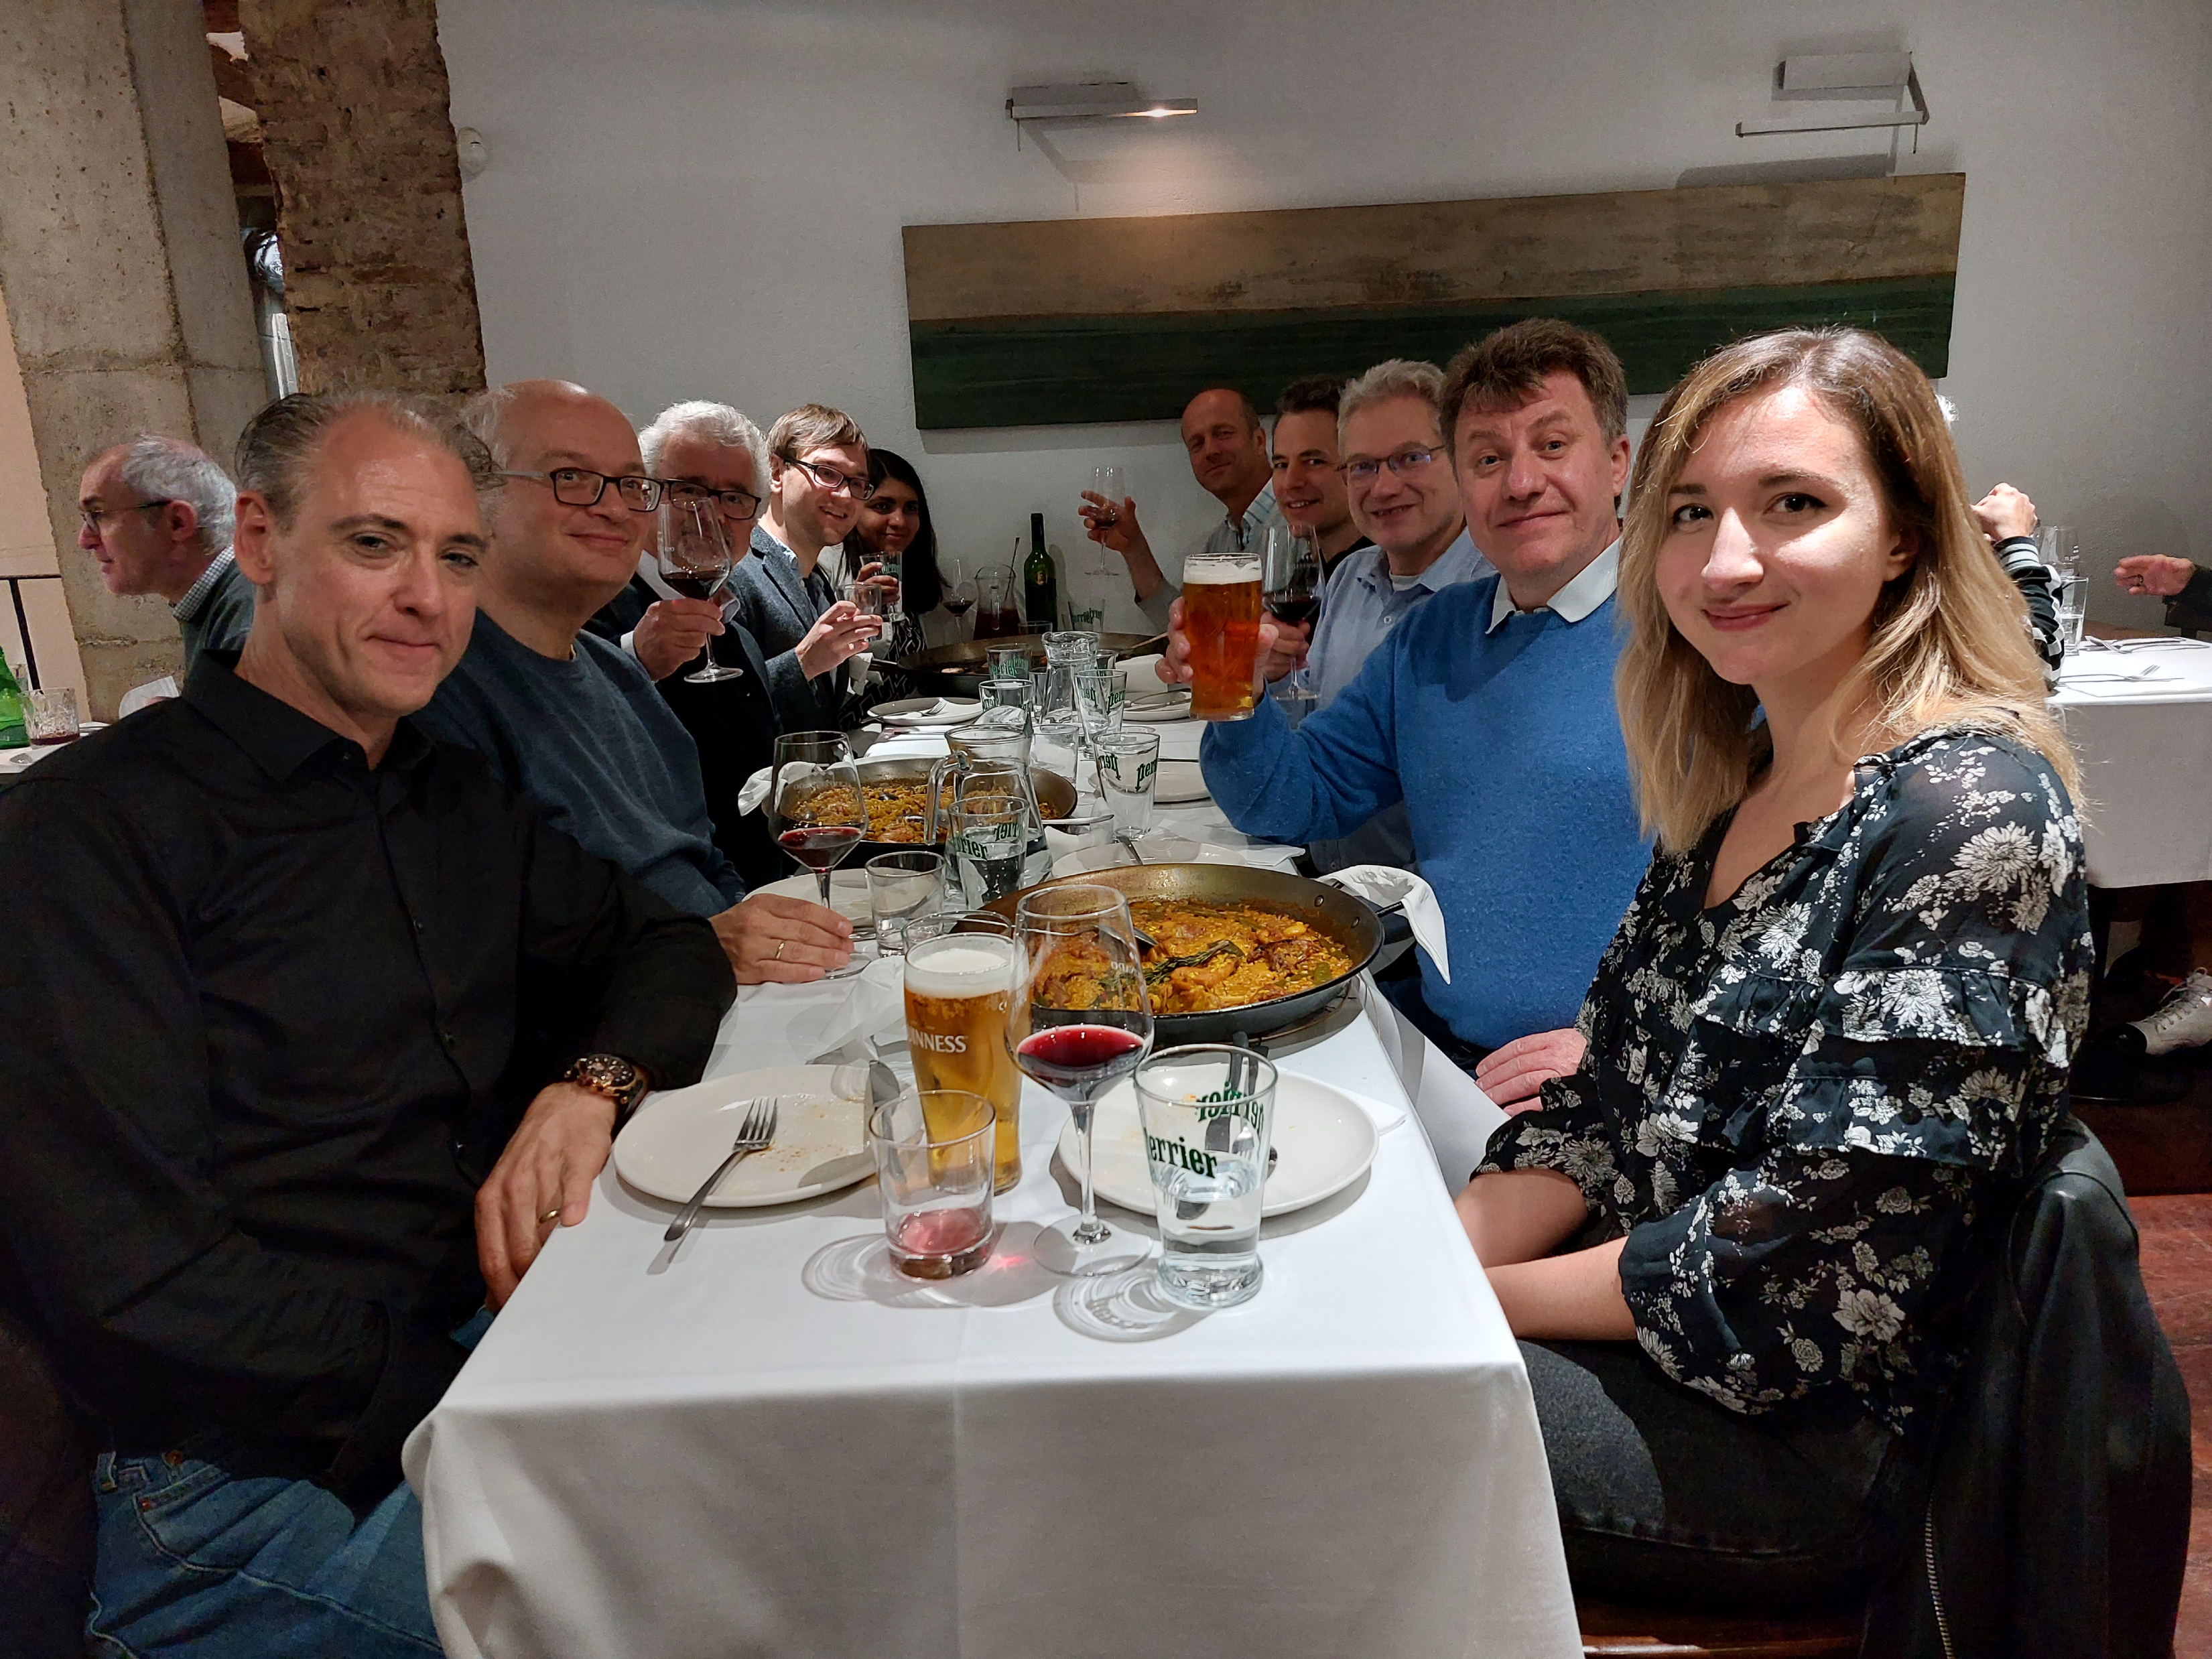
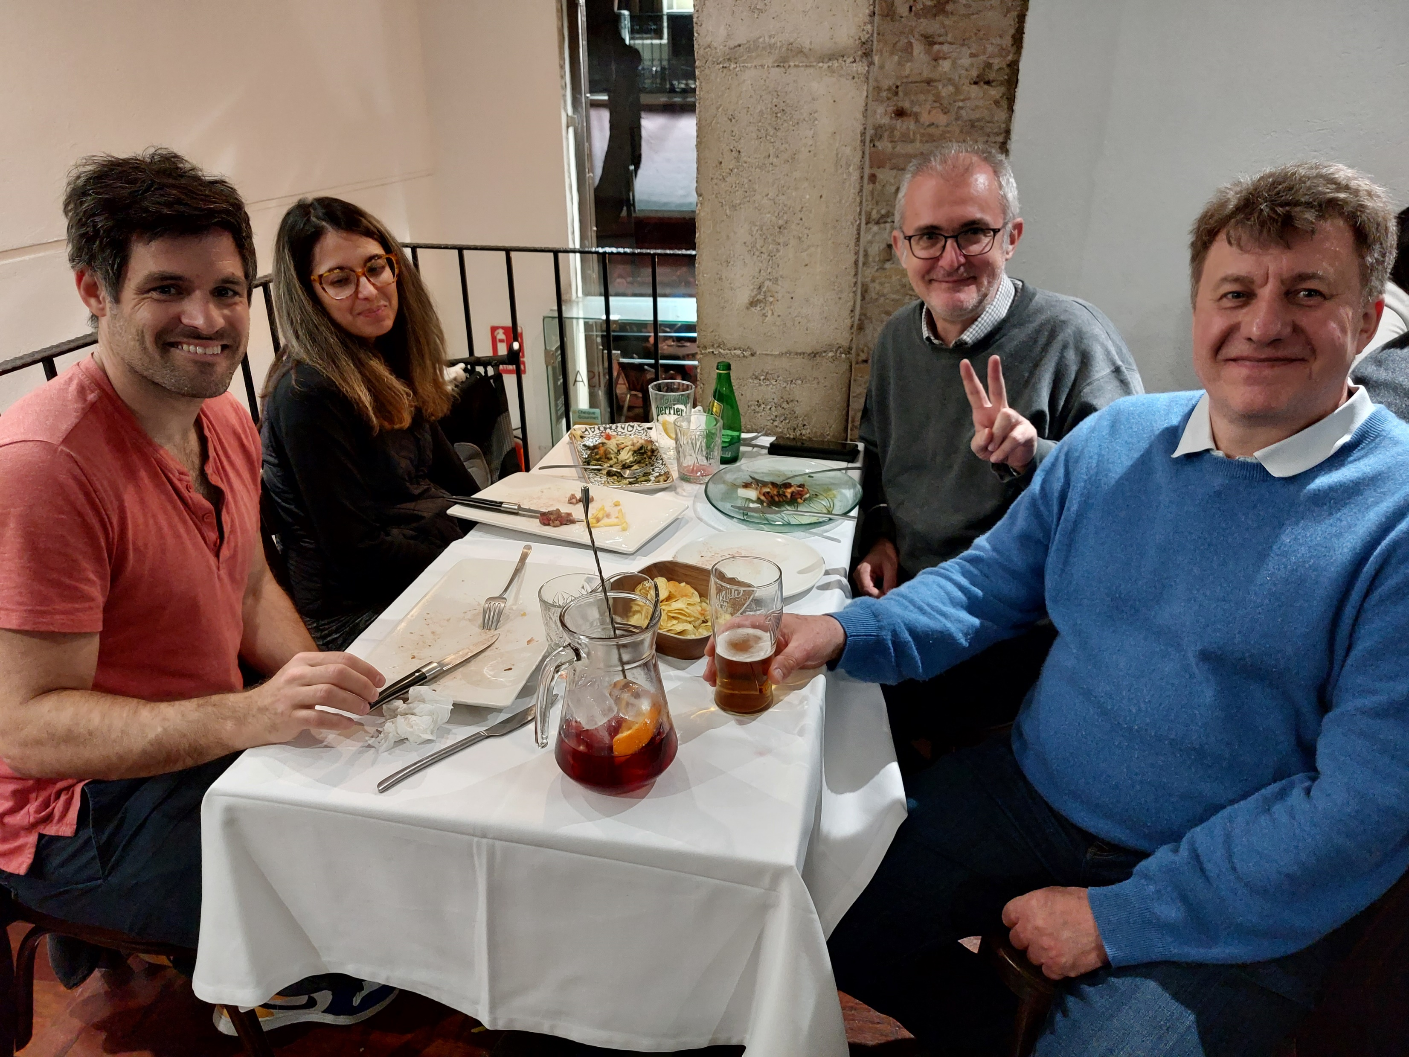
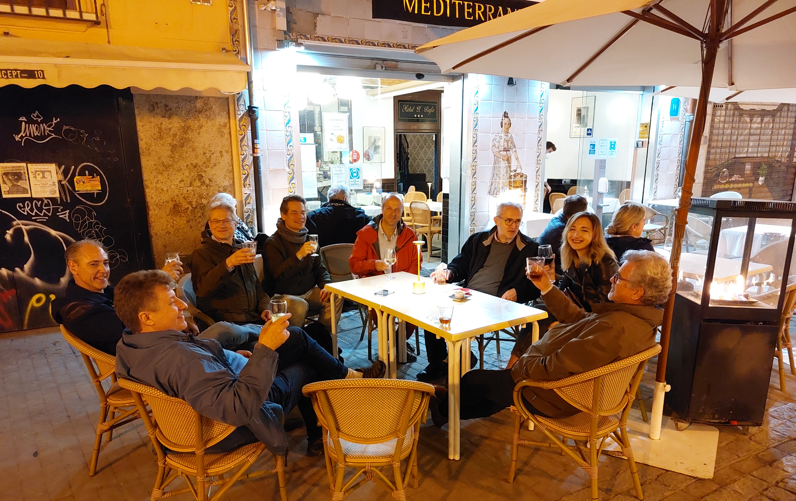
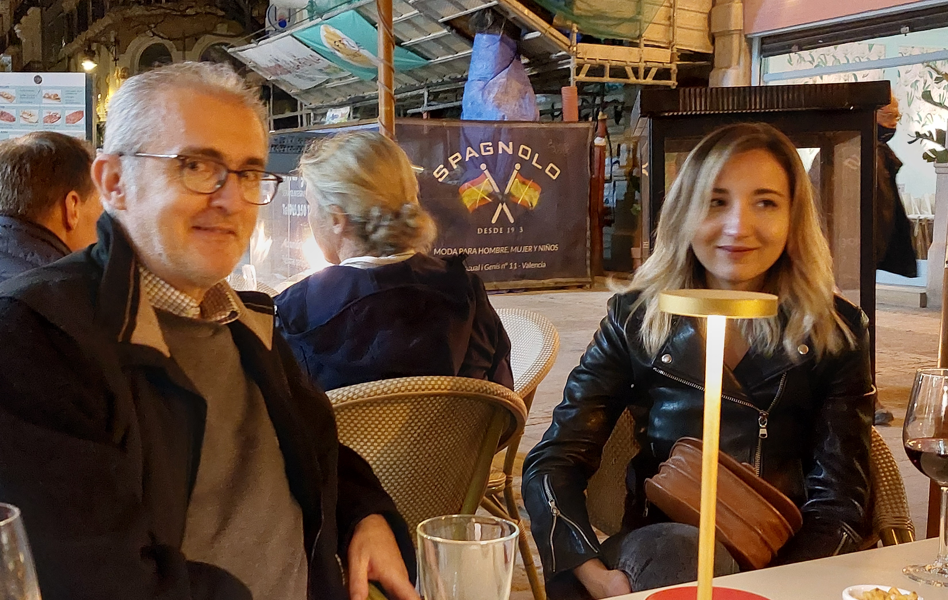
different from a zoom meeting
but be careful in shady streets (brazen thefts ! )

Slide 19
already three results from last night
Gamma Factory inevitable
question marks on AWAKE and LHeC
solution for powering the FCC

Slide 20
today we will start with the dark sector
in recent years more and more ideas and proposals :
SHIP, FASER,… subsequent generations, … g-2, EDM…
DASEL, eSPS,… what exactly is needed ?
can advanced accelerator concepts find a purpose here?
intra-workshop theme :
might machine learning help the dark sector accelerator searches?

