Slide 1
Hybrid EDM Ring and Axions
Christian Carli iFAST BSW22, 29th March to 1st April 2022
Recap of standard fully electric charged particle Electric Dipole Moment (cpEDM) ring
Hybrid Ring Concept
Hybrid Ring with high Periodicity
Search for oscillating EDMs
Summary and Conclusions

Slide 2
Recap of standard fully electric charged particle Electric Dipole Moment (cpEDM) ring
“Frozen spin” concept (for MDM, neglecting EDM)
  Initial longitudinal polarization is maintained
“Magic energy” – ideal case
  “Frozen spin” with radial electric field only choosing
  rel. factors and
  with describing the proton EDM
  (average) fields and with
  and the proton mass and charge and the circumf.
Imperfect machine with average radial magnetic field
  Vertical electric field from quadrupoles compensates resulting vertical deflection
Rotation of spin vector in machine with additional radial magnetic field
  Described by Thomas-BMT equation (NO subtraction of angular frequency for rotation of direction)
  Gives
  with describing the rotation of the direction
  corresponding to an EDM of or give both
e_{y}
B_{y}
e_{x}
Polarimeter
spin
E_{x} (<0)
ω_{s} = ω_{p}
for η = 0
Sketch of a CP-EDM Ring
Gravity neglected
For “magic energy” keep only E_{x}

Slide 3
Recap of standard fully electric charged particle Electric Dipole Moment (cpEDM) ring
Orbit difference measurement to assess average radial magnetic field
With low vertical tune , a field of
(corresponding to an EDM of -10⁻²⁹ e.cm) and
smooth focusing
  Orbit
  separation
  (less than 1% of typical radii of atoms!)
  Measured with SQUID orbit difference Pick-ups
  In addition tune modulation
    to alleviate requirements on number and precise
    spacing of pick-ups with varying around circumf.
    to measure at a finite frequency with lower
    background noise
  On imperfections of orbit difference measurements
    E.g., 10⁻⁶ relative difference of beam currents and
    common of both beams
    => gives same signal than orbit separation
    Ensure that signal sufficiently low with one beam only?
CW beam
B_{x} generated
by beam(s)
PU coil to measure B_{x}
CCW beam
Beam separation and B_{x} generated
Note:
1) Separation enhances magnetic field
2) With beam parameters and lattice
proposed, beams are not round
(very large vertical beam size!)
cf. analysis by V. Lebedev of this scheme and other potential limitation in:
    http://collaborations.fz-juelich.de/ikp/jedi/public_files/usual_event/AccPhysLimitationsOnEDMring.pdf)

Slide 4
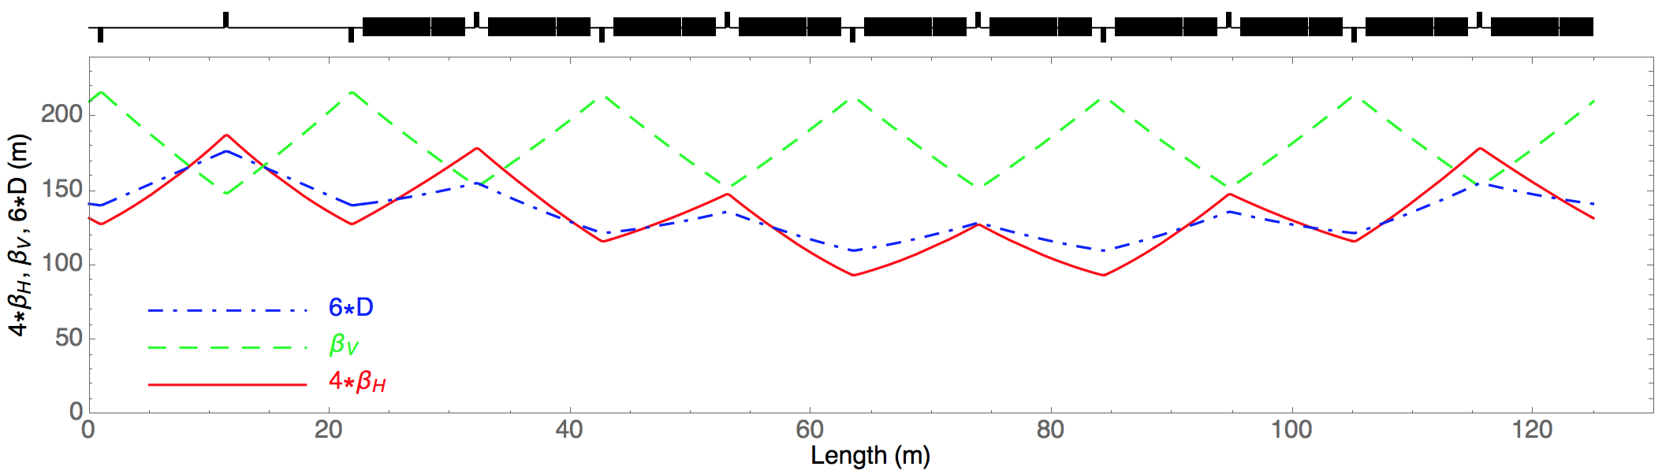
Recap of standard fully electric charged particle Electric Dipole Moment (cpEDM) ring – limitation of orbit difference measurement
Twiss parameters for one out of four periods of the “strong focusing” pEDM lattice proposal
Orbit separation at position in a real machine with Twiss betatron function varying with position
with the betatron phase
Effect of magnetic field on orbit difference weighted with
  Possible to have finite average separation of beams with vanishing average
    Say positive (negative) at positions with large (small)
Situation similar, somewhat more complicated, in case of tune modulation
Horizontal separation of beams due to vertical magnetic field and skew quadrupoles (tilted electrodes of bends) yield similar effects

Slide 5
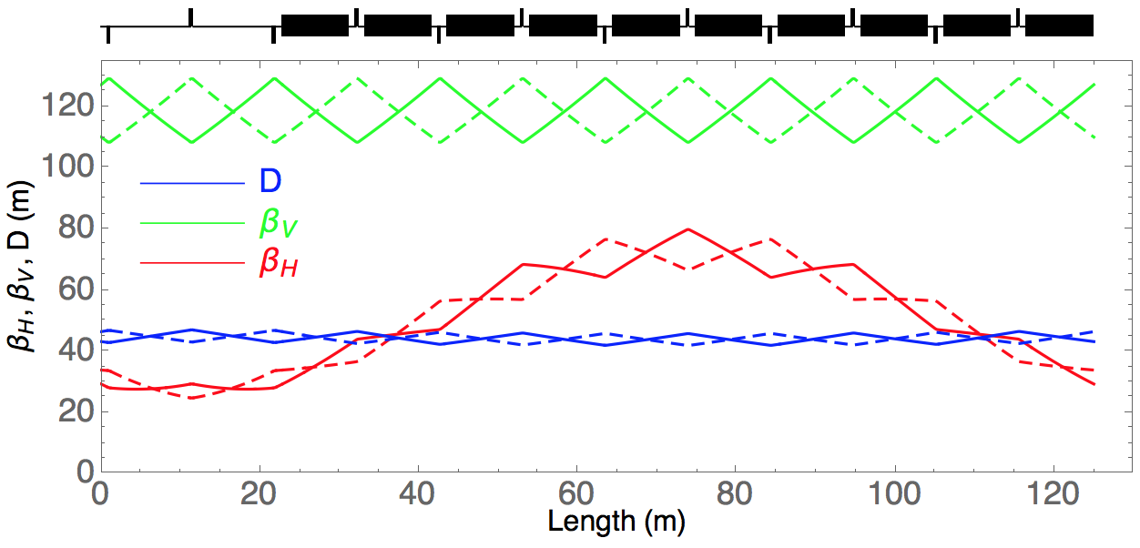
Hybrid Ring Concept - Proposal
Hybrid ring proposed by
S. Haciomeroglu and Y.K. Semertzidis
(see PRAB 22, 034001 (2019)
and arXiv:1806.09319)
Ring operated at “magic energy” with electro-static bends without gradient (field index )
  Geometry taken from strong focusing “magic energy” electric ring
  Quadrupoles magnetic with strength and (length )
    Operation with two counter-rotating beams
    Thus, quadrupole polarity opposite for CW and CCW beam
  Working point Q_{H} = 1.754, Q_{V} = 0.673 almost identical for two beams
  Significant variations of horizontal betatron functions with periodicity four and larger dispersion
    Impact on IBS to be evaluated
  Tuning of machine for both
  beams more delicate
    Closed orbit
    Working point
    Chromaticity and 2nd order
    dispersion for spin coherence
  Note some analogies with,
  e.g., “doubly magic” proposal
  (superposition of electric and
  magnetic fields)
Twiss parameters for one out of four periods for the
CW (solid lines) and the CCW (dashed lines) beam

Slide 6
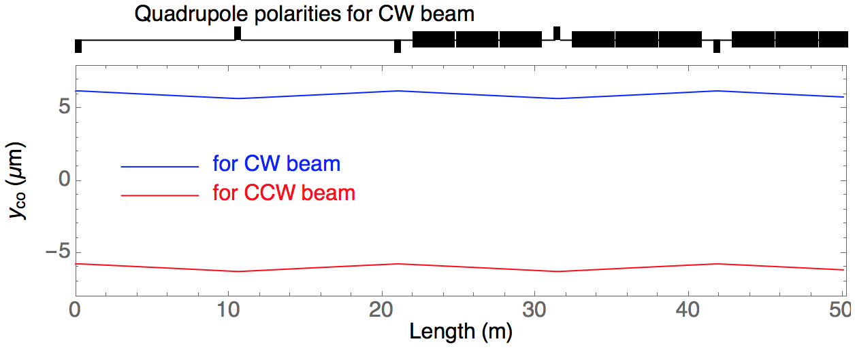
Hybrid Ring Concept - average radial magnetic field
Average radial magnetic field (in addition to magnetic field from quadrupoles)
  Again, the vertical acceleration over one turn vanishes (for closed orbit, in average for many turns)
  With perfect electric bends (field index set to ), no vertical electric fields
    Closed orbit such that average radial magnetic field along closed orbit vanishes
    For particles executing transverse betatron oscillations, radial magnetic field vanishes in average
    only (as is the case for perfects hybrid ring)
Average radial magnetic field does not lead to a 1st order effect mimicking EDM
(vertical spin build up proportional to the average radial magnetic field)
Vertical closed orbits for a constant radial magnetic field B_{r} = 1 nT

Slide 7
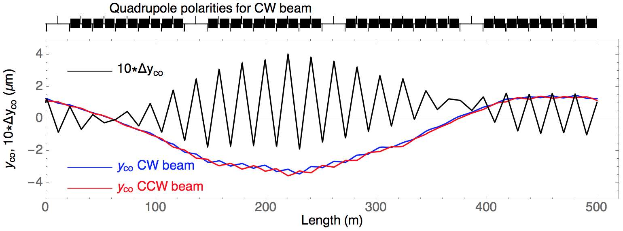
Hybrid Ring Concept - average vertical electric field
Vertical electric generated typically by tilted (rotated around longitudinal axis) bendings
  E.g. one out of bends tilted by in ring generates
  deflection and average electric field
  Again compensation by
  average radial magnetic field
  Resulting spin rotation
  around radial axis
  Vertical spin build-up proportional to vertical electric field – 1st order effect!
  Can be disentangled from EDM observing CW and CCW beams
  =>does not mimic EDM
Vertical closed orbit due to random tilts (rms 0.1 mrad) of bendings
Sign and direction of B_{x}
for CCW beam?!
Fast spin rotations not mimicking EDM
a feature of proposals combining
electric and magnetic fields for large G
Separation of CW and CCW
orbits (by a few 100 um under
the assumptions made)

Slide 8
Hybrid Ring Concept -
Splitting of counter-rotating beams and electric gradients
Small field indices say difficult to control
  For and ,
  Corresponding
  gradient
One single bending (length ) with gradient and orbit separation
  Difference of electric field seen
  by CW and CCW beam
  Compensated by difference of magnetic
  field seen by CW and CCW beam
  Resulting spin rotation cannot be disentangled from EDM
  Effects mimics EDM!
    For (due to 1 nT radial magnetic field):
    For (0.1 mrad rms tilts of bends):
  => Control of closed orbit and unwanted electric gradients!
Similar effect from horizontal orbit separation and skew quadrupolar
components (inner and outer plate of bend not perfectly parallel)
Cross section of deflectors
with finite field index m
Subtlety with the meaning of ΔB_{x}
and Δω_{x} (radial axis pointing
inwards for CCW beam)

Slide 9
Hybrid Ring Concept –
Quadrupole polarity swaps & geometric phase effects
Runs with opposite (magnetic) quadrupole polarities
  Important ingredient of concept!
  Analogy with inversion of all magnetic fields for “frozen spin” rings with electric and magnetic fields
    Time reversal argument applies to CW beam with one polarity and CCW beam with other polarity
    …. but in addition operation with counter-rotating beams
    Imperfection of magnetic field inversion limit to sensitivity
  Quadrupolar fields generated with currents only (no yoke) inside state-of-the-art shielding?
    General reproducibility (between fills and longer term) of machine
    Achievable average magnetic field of the two polarities
    Orbit difference (both transverse planes) measurements?
Geometric phase effects
  Magnetic field due to quadrupole with strength , length and offset
  averaged over half-cell length :
    Expect enhanced geometric phase effects – beam based alignment to mitigate?
  Again cancellations combining results with different quadrupole polarities and with counter-rotating beams

Slide 10
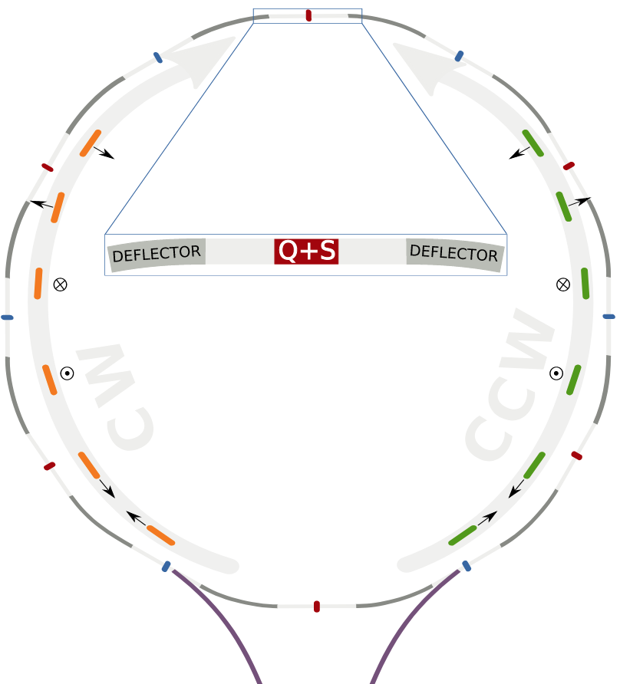
Hybrid Ring Concept –
Recent proposal for high periodicity lattice
Z. Omarov et al.,
Comprehensive symmetric-hybrid ring design
for a proton EDM experiment at below 10⁻²⁹ e.cm,
Phys. Rev. D 105, 032001 (2022)
“Symmetric-Hybrid” ring
  Each quadrupole is symmetry point
  “Vertical velocity effect” due to vertical
  quadrupole misalignments disappear
    Vertical velocity effect is transfer of radial
    spin component into vertical direction
    Proportional to average slope inside
    bending elements
    (Kind of) rotation around longitudinal axis
    Misaligned quadrupole at symmetry point
    gives vanishing average slope and effect
  Beam based methods for mitigation of
  systematic effects
    Intentional quad movement to
  Many other possible effects not (yet) studied
  (see list below with some possible effects)
Schematic of the Symmetric-Hybrid ring

Slide 11
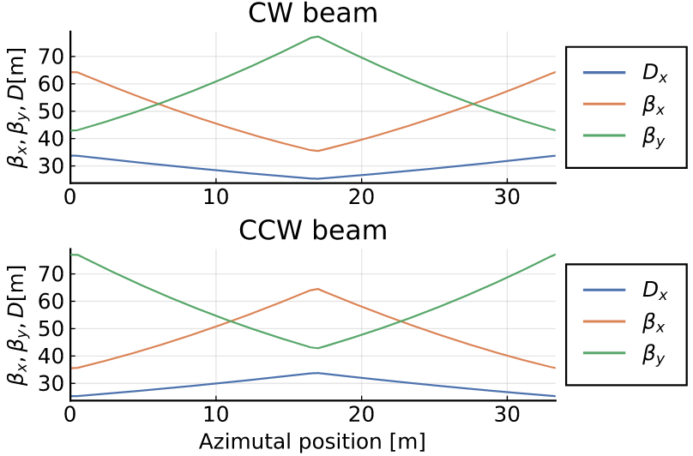
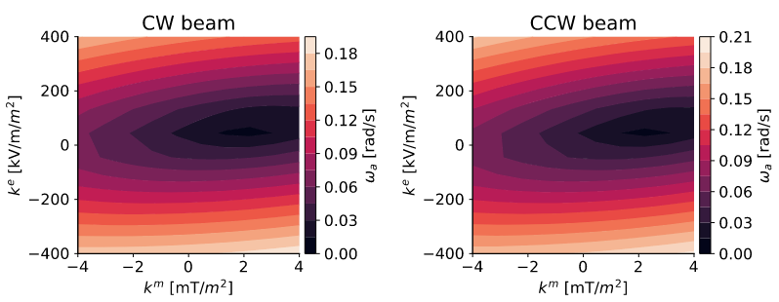
Hybrid Ring Concept –
Recent proposal for high periodicity lattice
  Spin coherence optimization with combined
  magnetic and electric sextupoles
    Polarity of quadrupoles swapped between
    CW and CCW beam
    Sextupoles with combined electric and
    magnetic components
    => Electric part average strength between
    CW and CCW beam
    => Magnetic part generating a difference
    Correction of transverse oscillations to
    spin de-coherence only?

Slide 12
Hybrid Ring Concept –
Recent proposal for high periodicity lattice
Potential systematic effects – some ideas, not an exhaustive list!
  Bending elements with (simultaneous) horizontal offset and tilt (around longitudinal axis)
    Offset shifts energy from magic one, vertical field from tilt generates spin rotation with
    respect to tangential
  “Vertical velocity effect” from radial magnetic fields not caused by quadrupole offsets
  (residual fields even with state-of-the-art shielding)
  Geometric phase effects due to bending elements with horizontal offset and
  longitudinal magnetic fields
    Offset shifts energy from magic one and generates radial spin component
    Rotation around longitudinal axis from magnetic field generates vertical spin component
  Offset of sextupole and beam separation from magnetic fields
    Sextupole offset generates quadrupolar and skew quadrupolar components
    (proportional to offset whereas deflection is proportional to square of offset)
    With beam separation leads to systematic effects (mimicking EDM)
  Spin coherence time optimisation with two sextupole families
    Oscillations in three phase spaces (and emittances), each contributing to spin de-coherence
    Expect to need three sextupole families for optimisation

Slide 13
Search for oscillating EDMs –
Signature of coupling from axions
y
y
x
x
Polarimeter
B_{y}
Polarimeter
spin
B_{y}
spin
EDM
E_{x} (<0)
EDM
E_{x} (<0)
ω_{s} ≠ ω_{p}
ω_{s} ≠ ω_{p}
Initial situation
Spin and EDM parallel
Half an oscillation period later
Spin and EDM antiparallel
Spin rotation w.r.t. particle direction with frequency equal to EDM oscillation
  Oscillating EDM means that ratio between EDM and spin oscillates
    Frequency range and stability?
    Resonance condition !
    Long-term build up of vertical spin component
  Many systematic effects strongly mitigated!
  Severely limited by statistics (need for runs with different possible spin oscillation frequencies)?
    Say frequencies fixed over one 1000 s store
    Build-up of vertical polarization over full duration for below 1 mHz frequency range!

Slide 14
Summary, Conclusion and Outlook
“Hybrid ring” proposal triggered by limitations of scheme to asses average radial field with standard fully electric cpEDM ring
  Focusing using magnetic quadrupoles
    Different optics for counter-rotating beams
    Tuning simultaneously for both beams delicate
  Average radial magnetic field not leading in first order to systematic effect mimicking EDM
  Average vertical electrical fields (tilted bends) generate fast spin rotations around radial axis
    Can be disentangled from EDM combining observations with CW and CCW beam
  Recent proposal for high periodicity and symmetry lattice
  Still many systematic effects to be understood and evaluated
Proposal to search for oscillating EDM from axion coupling
  Systematic effects strongly mitigated
  Expect statistical limit orders of magnitudes larger than for static EDMs
Conclusion and Outlook
  Careful assessment of different proposals to be done to come realistic sensitivity
  estimates and choose best one

