Slide 1

Machine Learning in Particle Accelerators
Rasmus Ischebeck

Slide 2

Machine Learning Landscape
Before we start, a bit of context
Artificial
Intelligence
Machine
Learning
Deep
Learning
Rasmus Ischebeck

Slide 3
Machine Learning Landscape
8 9
What is an “eight”?
Rasmus Ischebeck

Slide 4
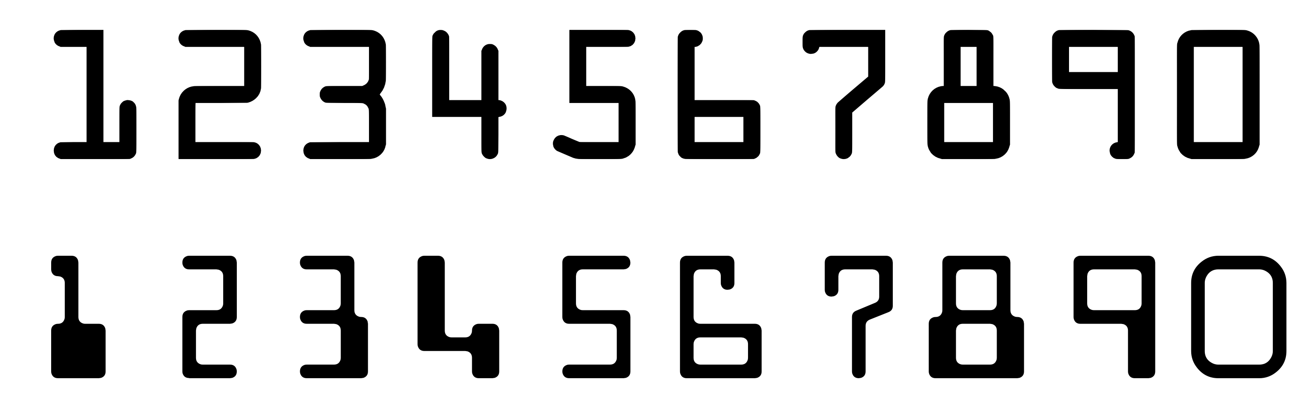
Machine Learning Landscape
Rasmus Ischebeck

Slide 5
1234567890

Slide 6
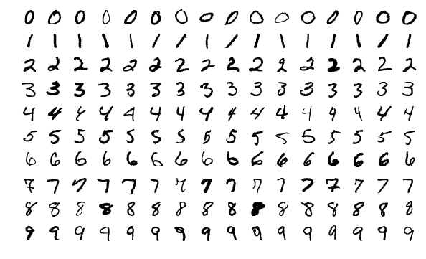

Slide 7
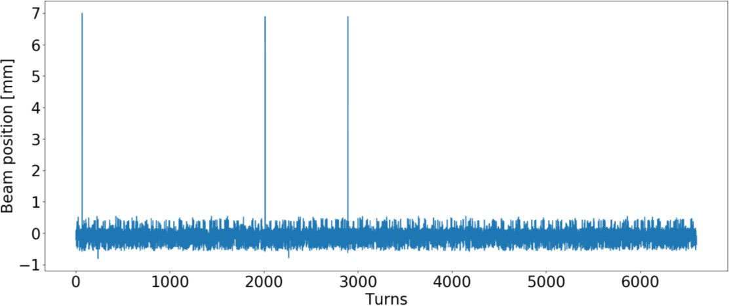
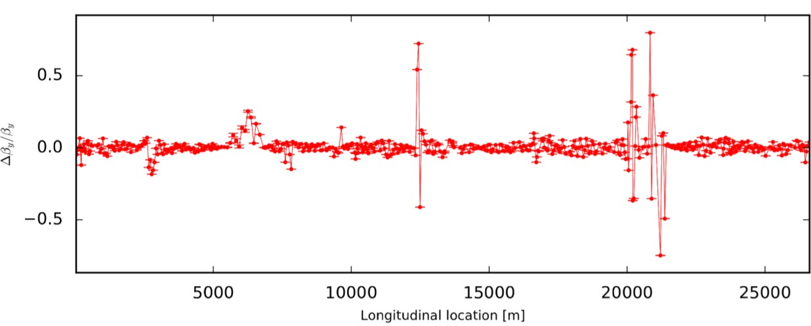
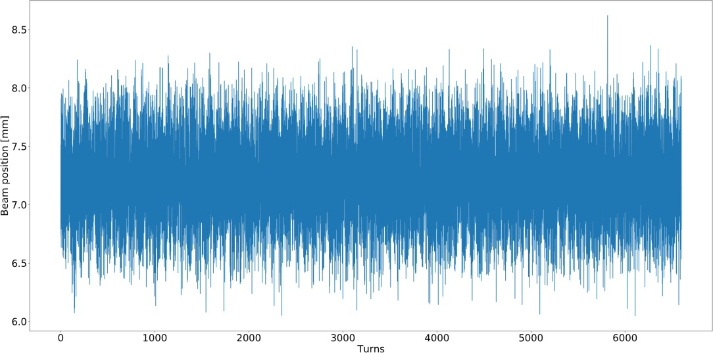

Applications to Accelerators
What is a “faulty BPM”?
Causes a spike, obviously, a bad BPM
Causes a spike, but how to detect before computing the optics?
Local outliers while global beta- beating is expected to be uniform
Rasmus Ischebeck
Elena Fol

Slide 8
Anomaly Detection
“An observation which deviates so much from other observations as to arouse suspicions that it was generated by a different mechanism."
Stephen Hawking

Slide 9
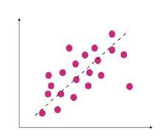
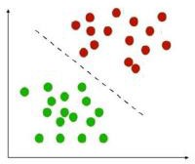
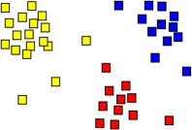
Relevant ML concepts and definitions
Supervised Learning
Regression
Input/output pairs available
Learn a mapping function,
generalizing for all provided data
Predict from unseen data
Classification
Clustering
Unsupervised Learning
Only input data is given
Discover structures and patterns
What is “Learning”?
Elena Fol

Slide 10
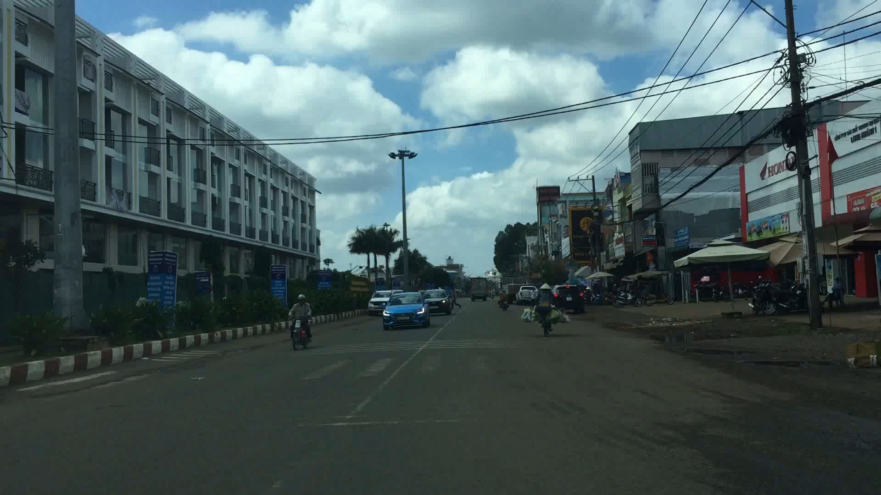
Machine Learning Outside the Accelerator World
Image recognition
Rasmus Ischebeck
Thắng Phùng Đình

Slide 11

Machine Learning Outside the Accelerator World
Social media
Rasmus Ischebeck
Photo by Amanda Vick on Unsplash

Slide 12
Machine Learning Outside the Accelerator World
Marketing
Rasmus Ischebeck

Slide 13
Use of Machine Learning for Accelerators
Optimization
Fault Detection
Artificial Intelligence
Machine Learning
Deep Learning
Instrumentation
Surrogate Diagnostics
Data Acquisition
Data Reduction
Data Analysis
Modeling
Surrogate Models
Accelerator Design
Rasmus Ischebeck

Slide 14
Examples of Applications of AI/ML/DL
Cases of problems that could be solved only with AI/ML/DL
  … ?
Applications enabled by AI/ML/DL that took less effort than manual coding
  Safe optimization of accelerators
  Virtual diagnostics
  Detection of faulty diagnostics
  Use of ML for accelerator design
  Use for data analysis
Rasmus Ischebeck

Slide 15
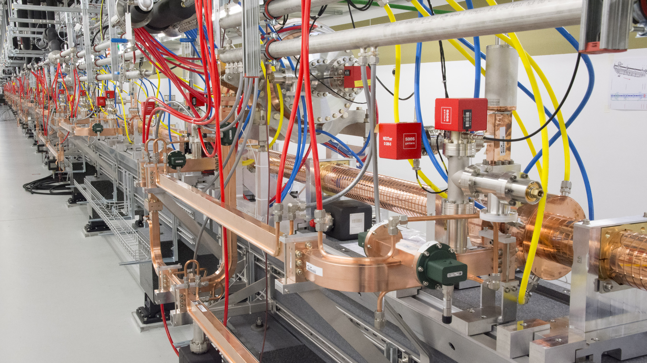

Applications of ML to Accelerator Operation
Rasmus Ischebeck

Slide 16
Safe Optimization of Accelerator Performance
Two examples from PSI:
  SwissFEL: optimization of the pulse energy while keeping losses in the undulators low
  HIPA: optimization of an accelerator that is limited by beam loss
One example from Elettra
  Optimization of the FEL by straightening the trajectory
Rasmus Ischebeck

Slide 17
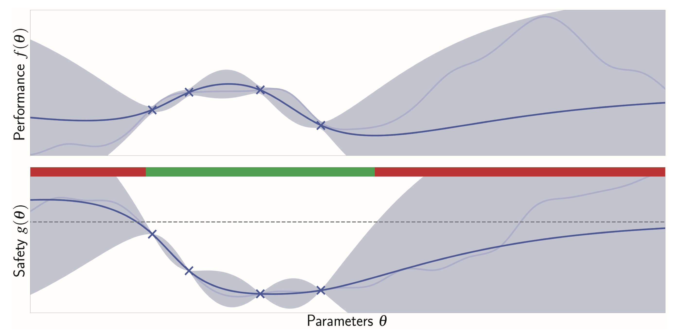
How does Safe Bayesian Optimization work?
Figure courtesy of J. Kirschner

Slide 18
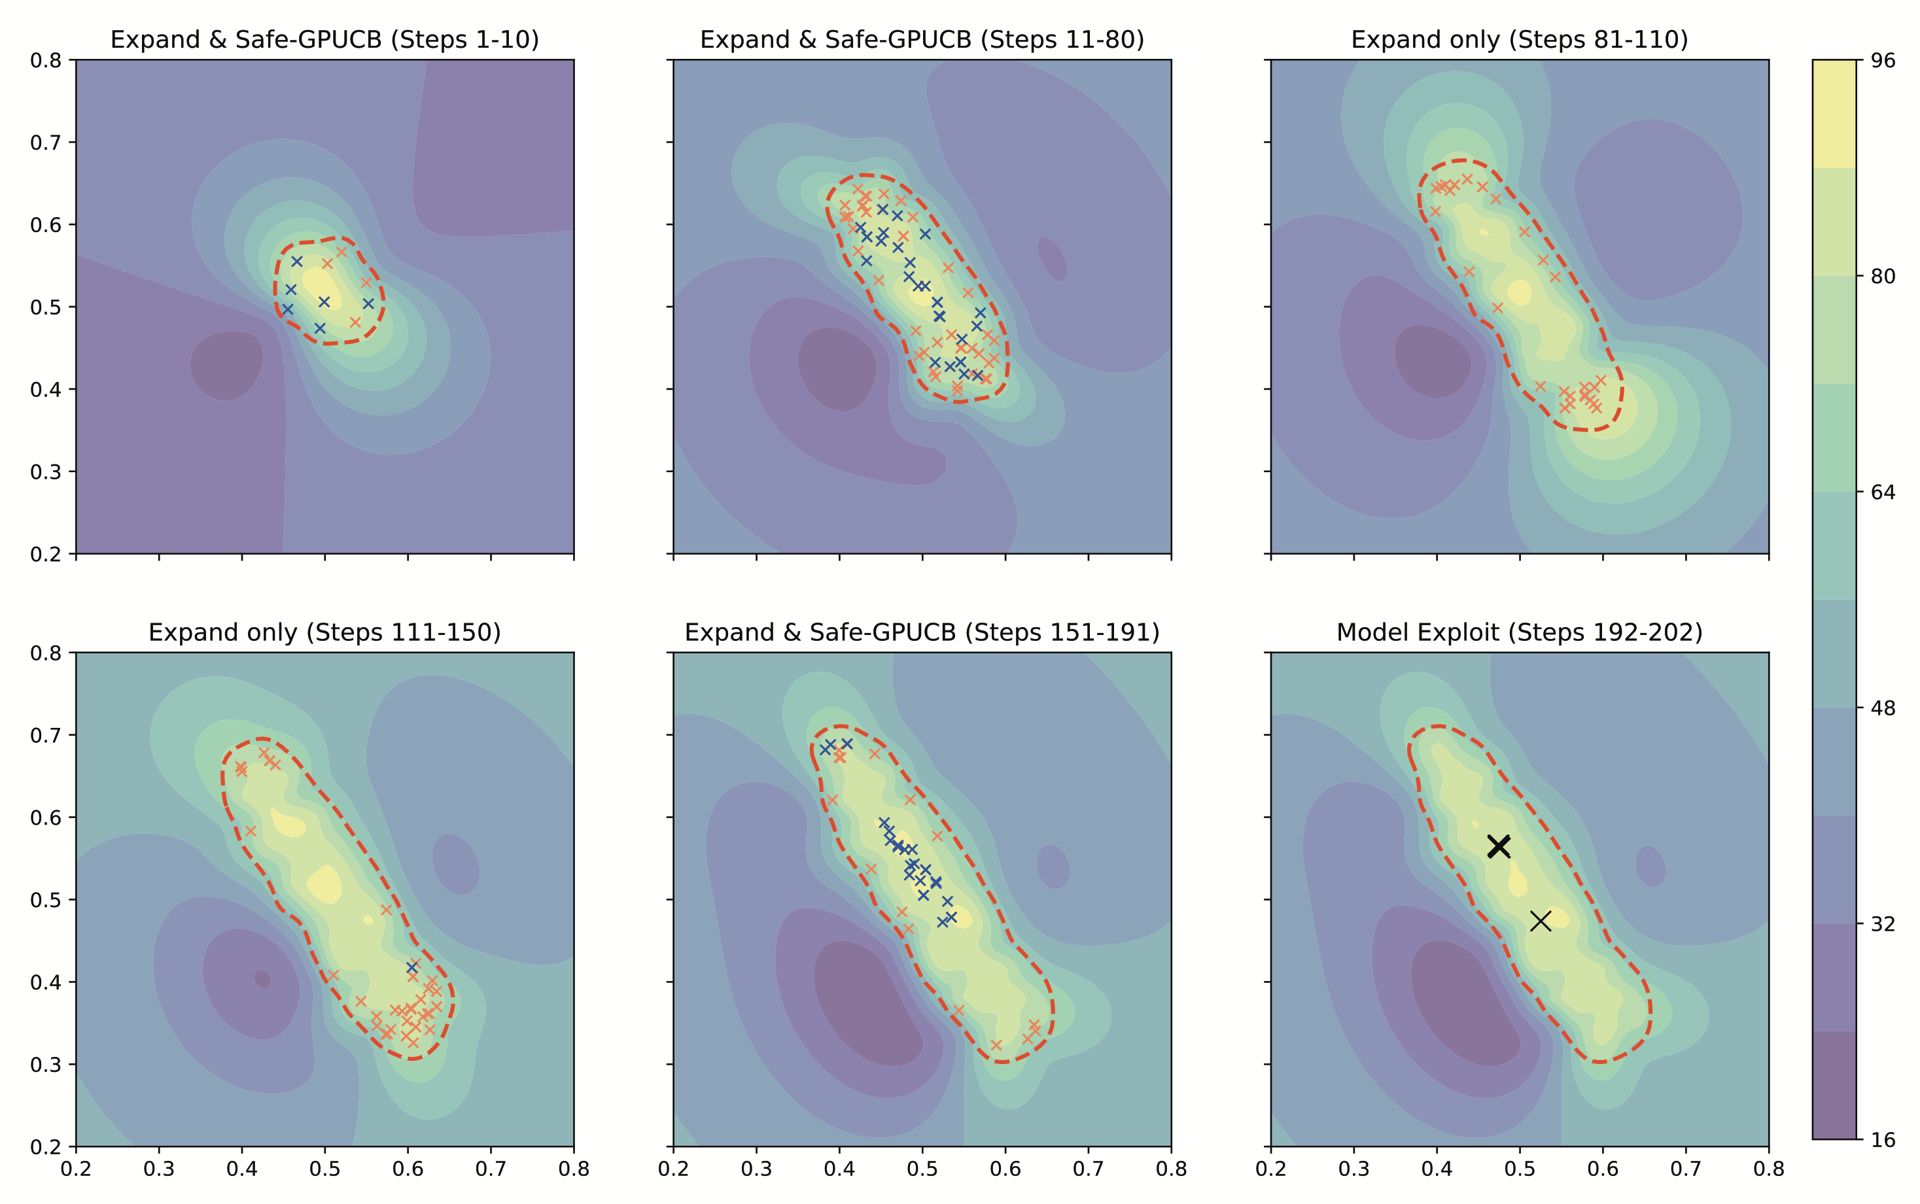
First Results
Figure courtesy of J. Kirschner

Slide 19
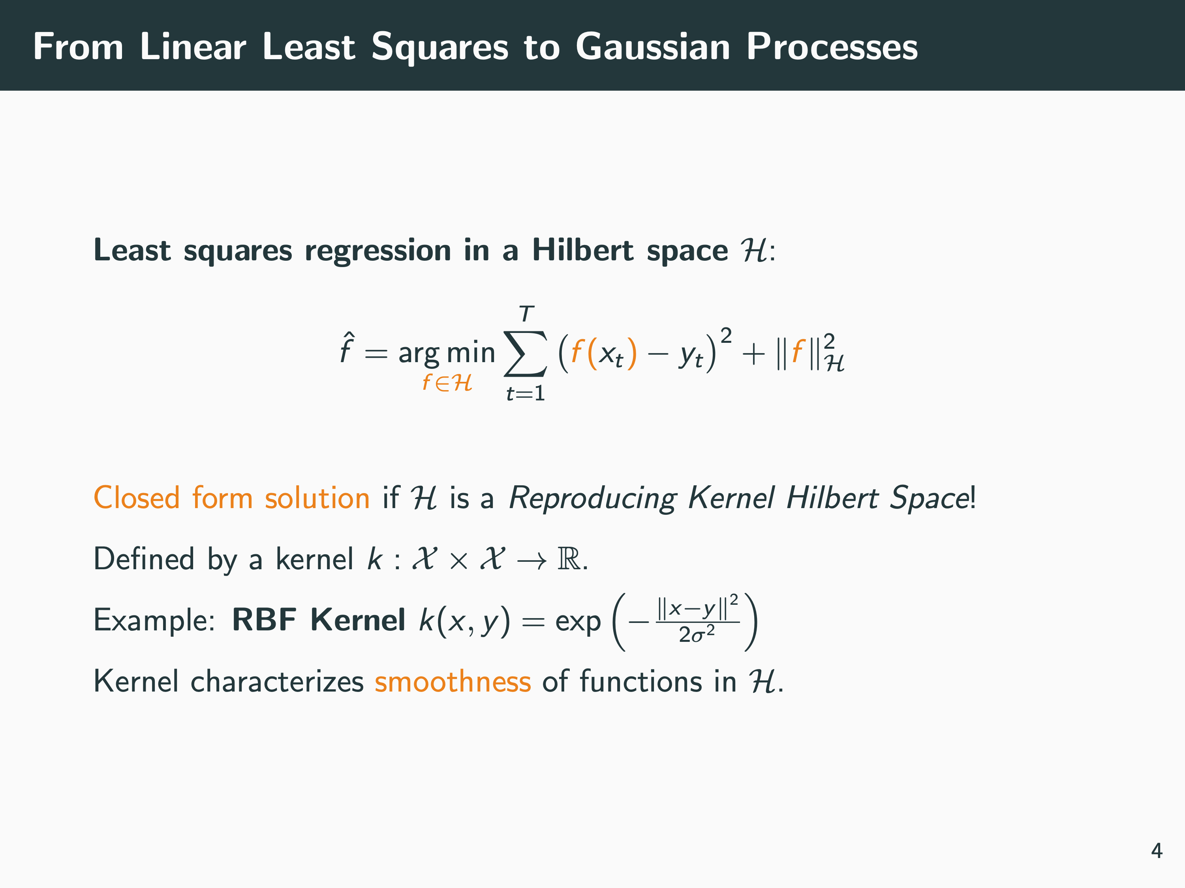
Johannes Kirschner

Slide 20
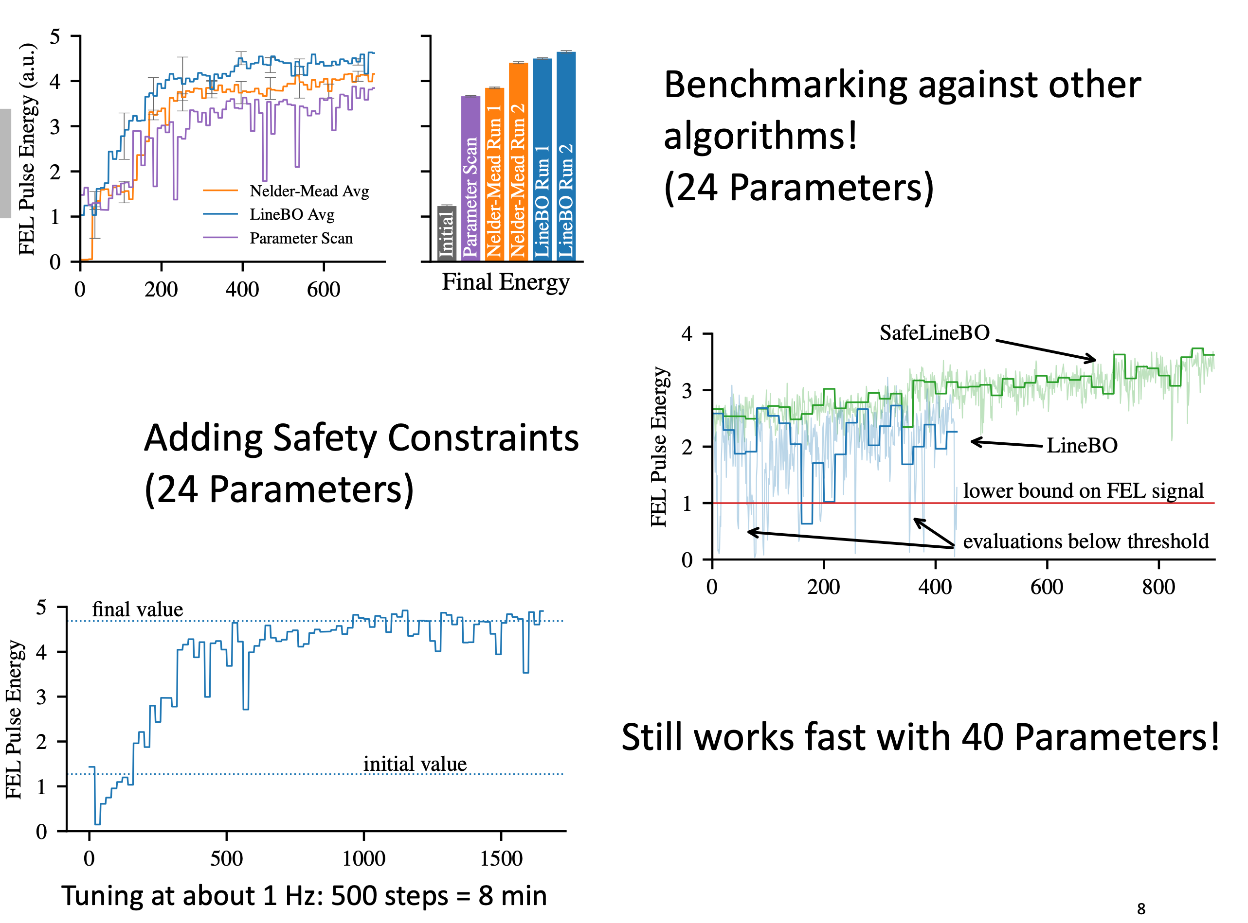
Comparison of Optimization Algorithms
Rasmus Ischebeck
Nicole Hiller

Slide 21
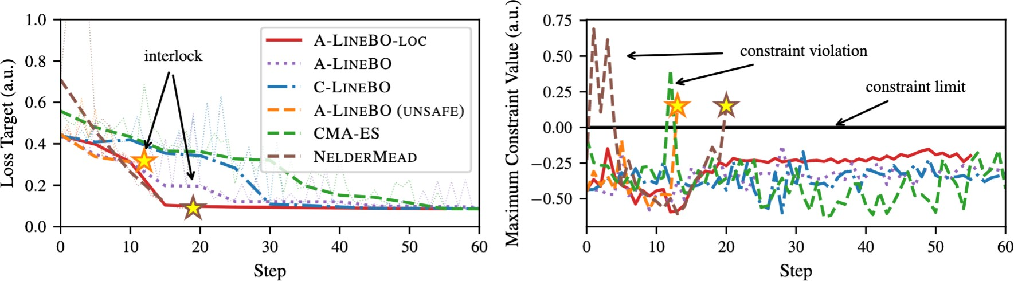
HIPA results
safe variants competitive
non-safe methods create interlocks (violate constraints)
  proves constraints are working
Rasmus Ischebeck
Jochem Snuverink

Slide 22
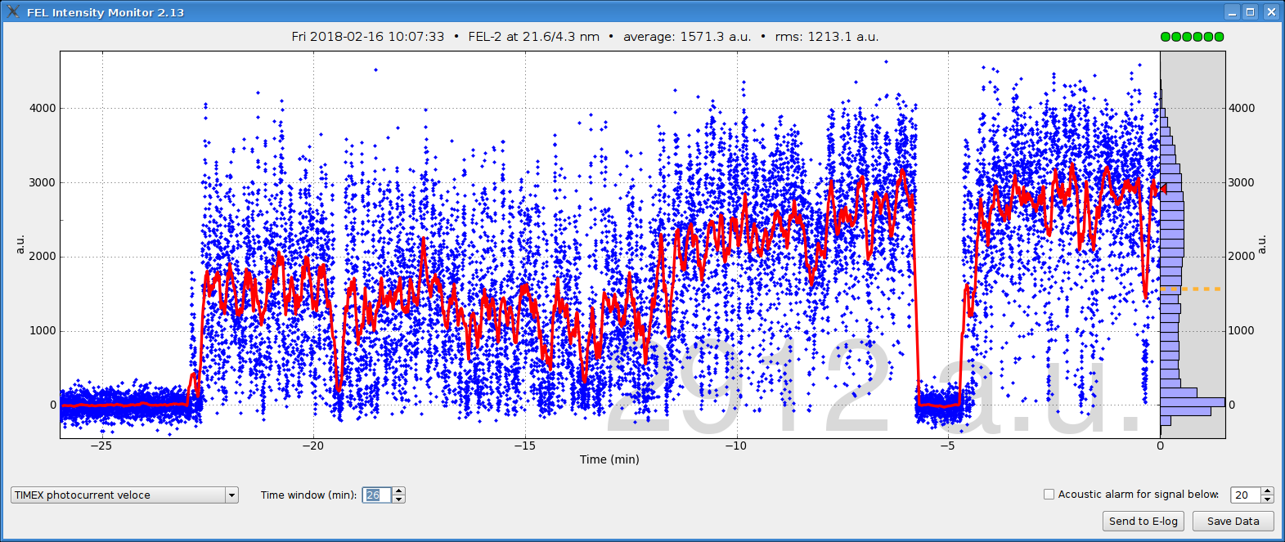
Statistical Optimization of the electron beam trajectory in the undulators
13 Beam Position Monitors (26 variables)
Objective function: FEL-2 intensity estimated by a photocurrent of a mirror installed in front of the experimental chamber
Passive mode (no excitation)
3X average FEL energy
8 min – 10Hz – 8 iterations

Slide 23
Detection of Faulty Diagnostics
One example from CERN:
  Detection of faulty beam position monitors
One example from DESY:
  Detection of faults in the superconducting RF system
Rasmus Ischebeck

Slide 24
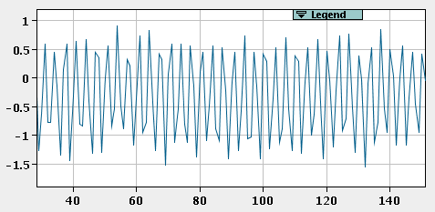
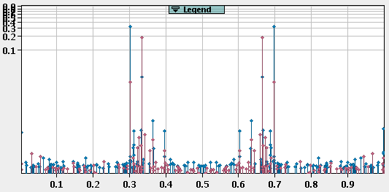
Measuring the optics
Turn-by-turn beam position
Spectrum
Optics
Position [mm]
Amplitude
Δ𝛽/ 𝛽
Turn no.
Excite the beam to perform transverse oscillations.
Frequency
Harmonic analysis using Fast Fourier Transform (FFT)
Compute beta-beating and other optics functions
➔ Beam Position Monitors (BPMs) to measure the beam centroid turn-by-turn
Semi-automatic and manual cleaning of outliers
Unphysical values still can be observed
Denoising (SVD) Signal cuts
What are the limitations of traditional techniques?
Elena Fol

Slide 25
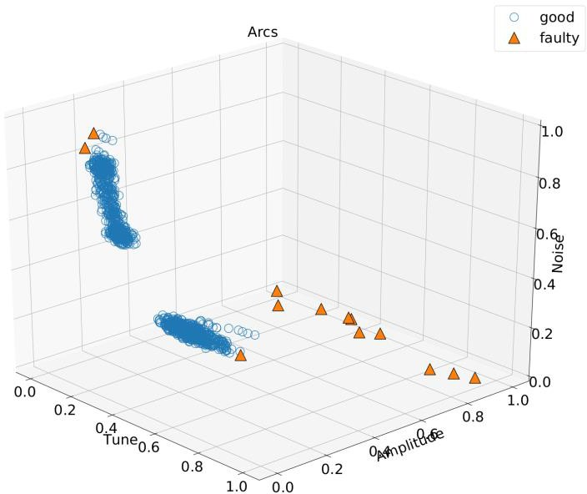
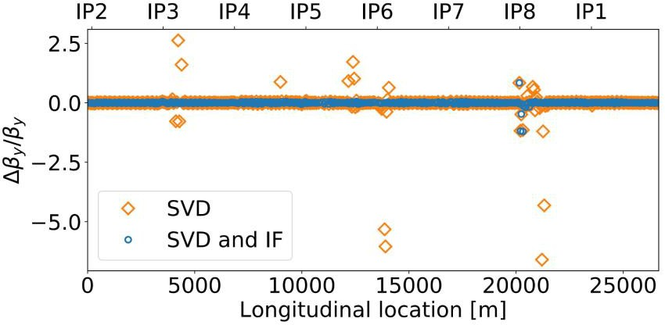
Detection of faulty Beam Position Monitors
Faulty BPMs are a-priori unknown: no ground truth ➔ Unsupervised Learning
Applied clustering algorithms: DBSCAN[1], Local Outlier Factor[2],
anomaly detection using Isolation Forest[3] implemented with Scikit-Learn.
Avoid the appearance of erroneous optics computation
Harmonic analysis of all BPMs
Detection of faulty signal
prior to optics computation
Outlier detection based on
combination of several signal properties
Immediate results
1. “A Density-Based Algorithm for Discovering Clusters in Large Spatial Databases with Noise” Ester, M., H. P. Kriegel, J. Sander
Breunig, M. M., Kriegel, H. P., Ng, R. T., & Sander, J. (2000, May)., LOF: identifying density-based local outliers
Liu, Fei Tony, Ting, Kai Ming and Zhou, Zhi-Hua. “Isolation forest.” Data Mining, 2008. ICDM‘08.
Instrumentation faults detection
17
Elena Fol

Slide 26
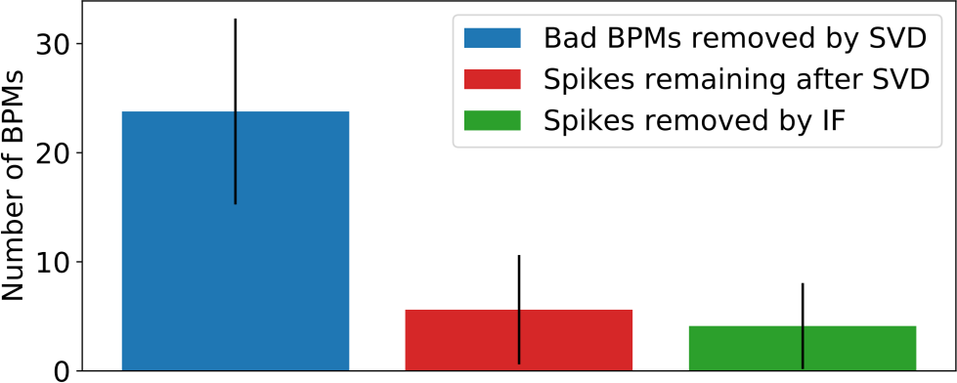
Detection of faulty Beam Position Monitors
Reduction of non-physical outliers in beta-beating: Averaged cleaning results, optics measurements in 2018.
Instant faults detection instead of offline diagnostics.
Observed outliers
IF-identified bad BPMs
Full optics analysis is possible directly during dedicated measurements session instead of iterative procedure of cleaning and analysis.
Fully integrated into optics measurements at LHC
Successfully used in operation under different optics settings.
Published in: Physical Review Accelerators and Beams:
“Detection of faulty beam position monitors using unsupervised learning”, Phys. Rev. Accel. Beams 23, 102805.
Instrumentation faults detection
19
Elena Fol

Slide 27
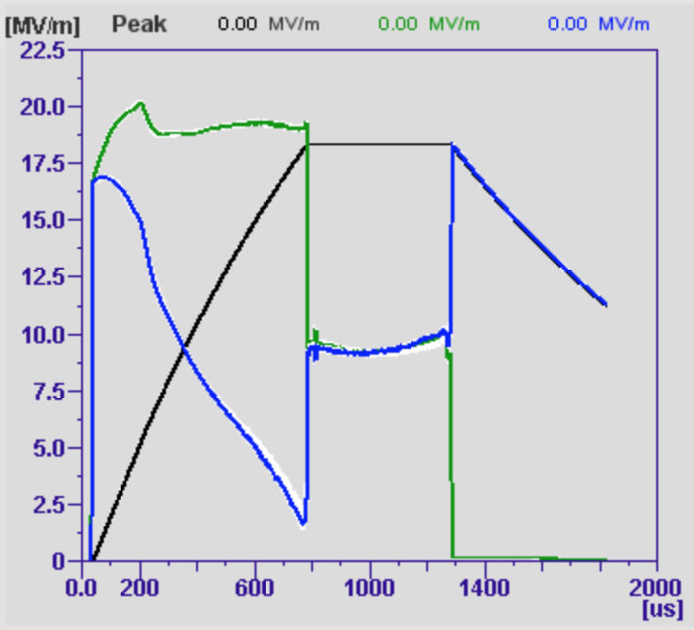
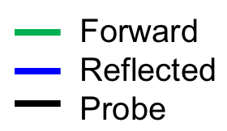
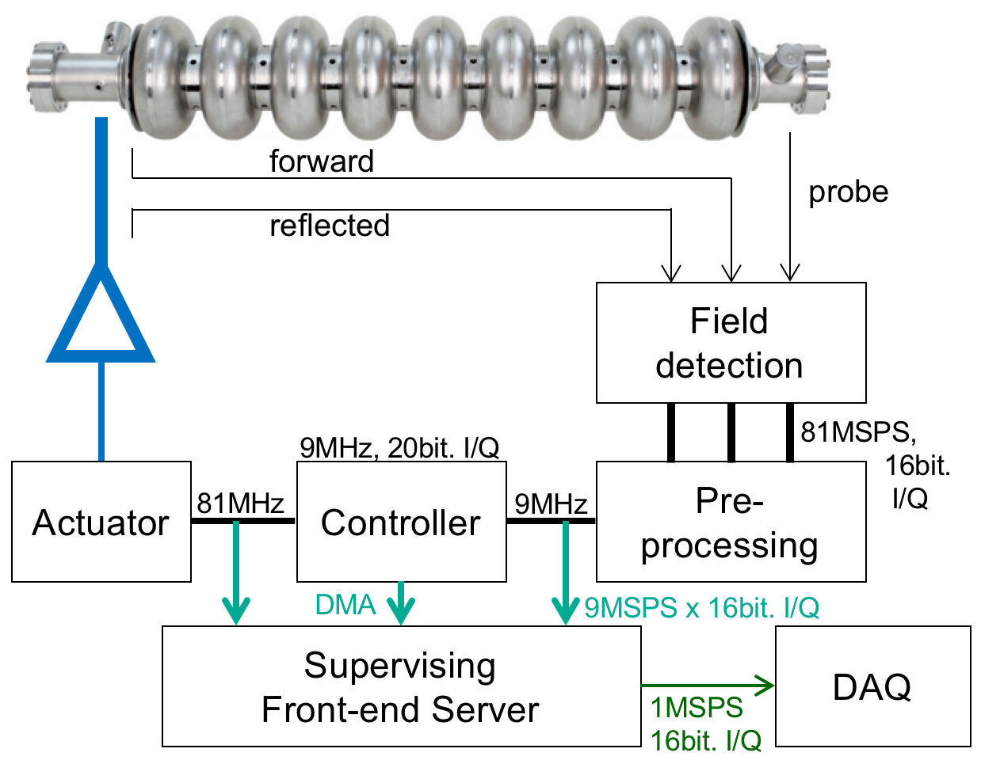
Areas for potential ML applications – Anomaly detection for the cavity signals
Cavity fault detection requires: U_{for}, U_{ref}, U_{probe}
Data rates to DAQ per cavity per pulse:
  2048 x 2 x 3 x 16bit = 24.6kB
  Pulses per Day = 864000
  700 cavities → 604 Mio events/day
  Total data/day = 14.8 TB
Good statistics (ensemble & events)
Questions we like to address:
  How many cav./pulses behave normally
  Cav/Pulses out of nominal operation range
  Reliably quench detection and reaction
  Anomalies: due to parameter changes
  Anomalies: due to digital / communication/ readout

Slide 28
Virtual Diagnostics
Use ML to predict the response of an instrument
  Invasive instruments (e.g. spectrometers, screens…)
  Fragile instruments
  Broken instruments
Rasmus Ischebeck

Slide 29
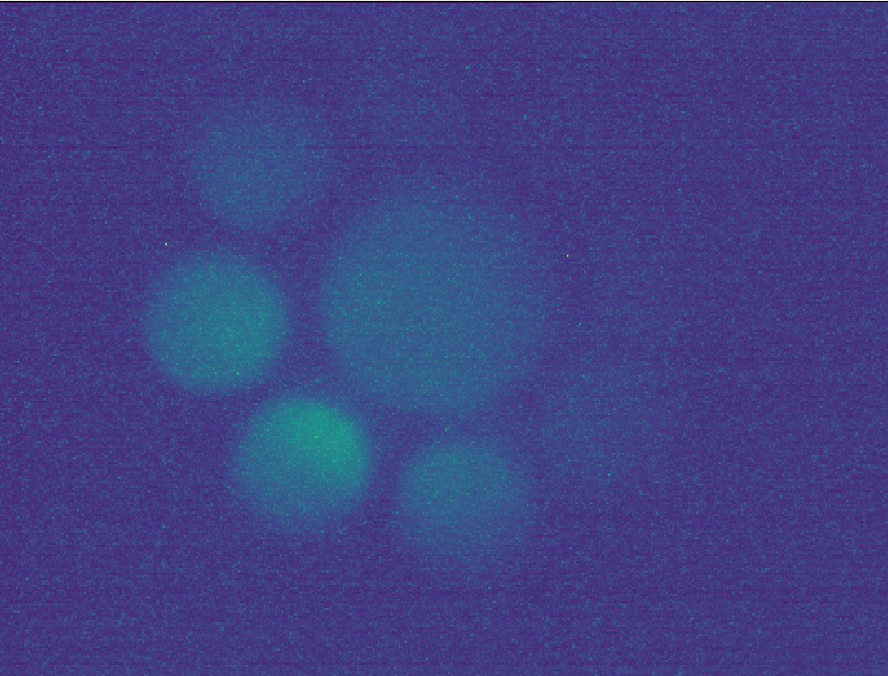
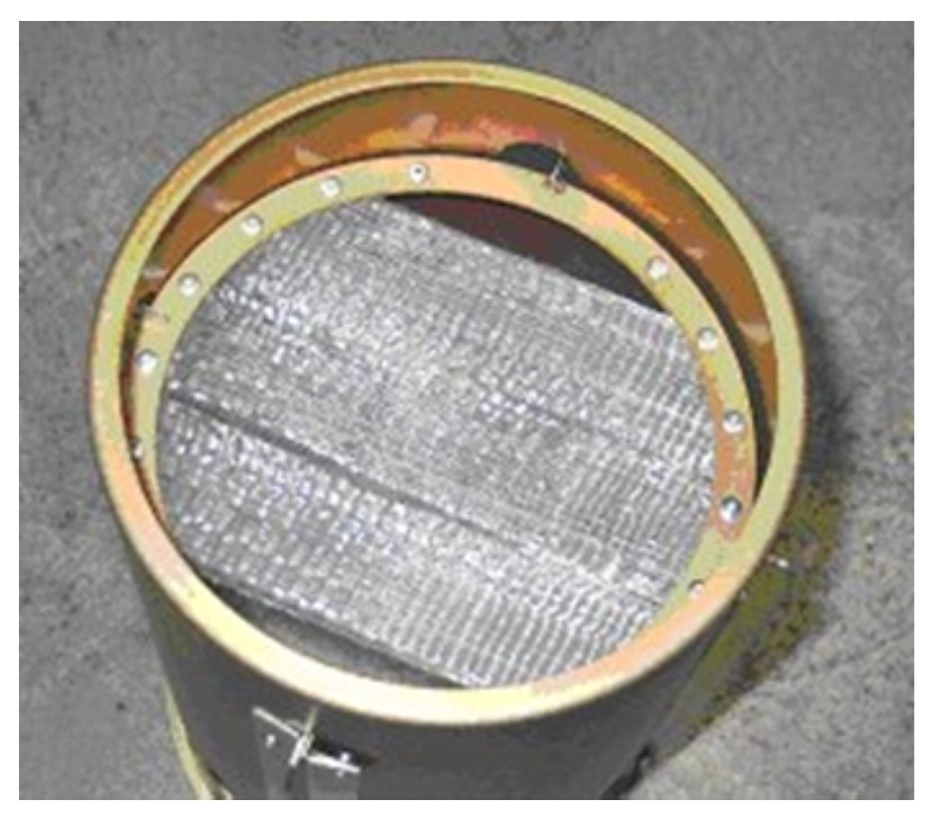
Virtual Diagnostics at SINQ
The VIMOS system monitors the SINQ target beam spot with a metal grid.
If the beam is focussed too much or changes too fast interlocks are triggered.
This grid is degrading over time and cannot be replaced
Can we use other sensors to predict the images?
Targets
Machine Learning Model
Position monitor s
Loss monitor s
Current monitor s
Features
Rasmus Ischebeck
Jaime Coello de Portugal

Slide 30
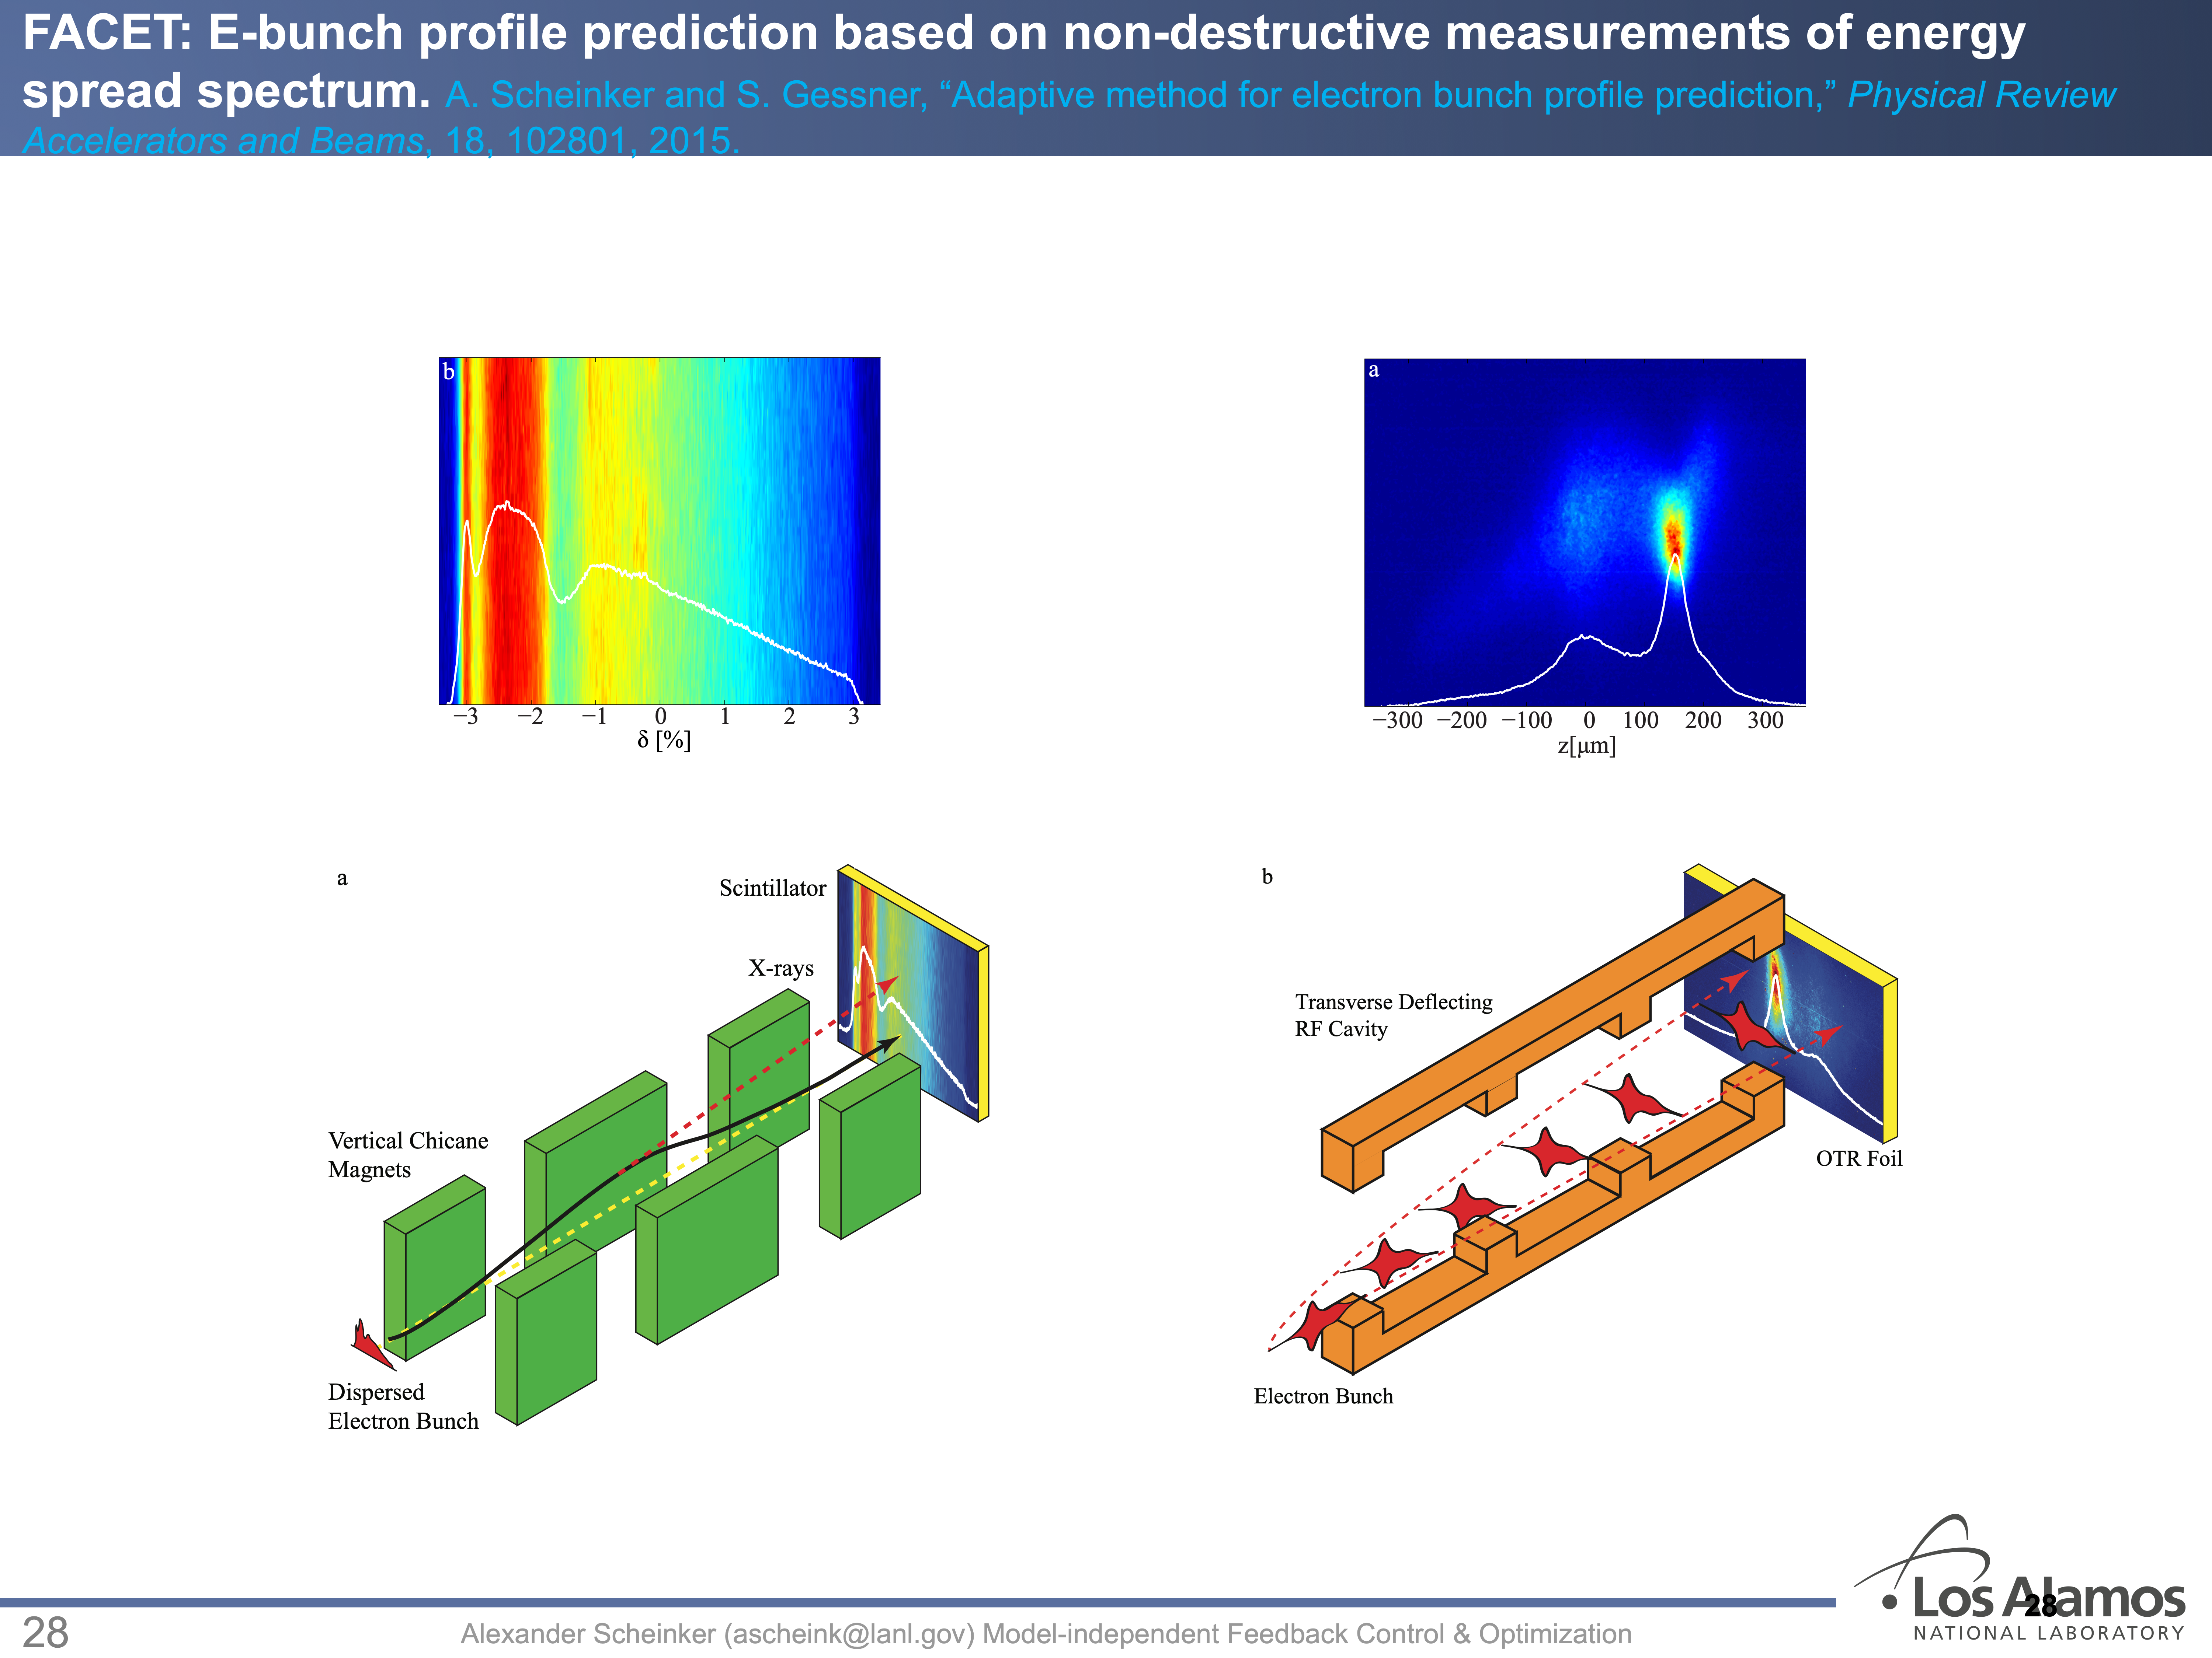

Slide 31

Applications of ML to Accelerator Simulation
Rasmus Ischebeck
Photo by Caspar Camille Rubin on Unsplash

Slide 32
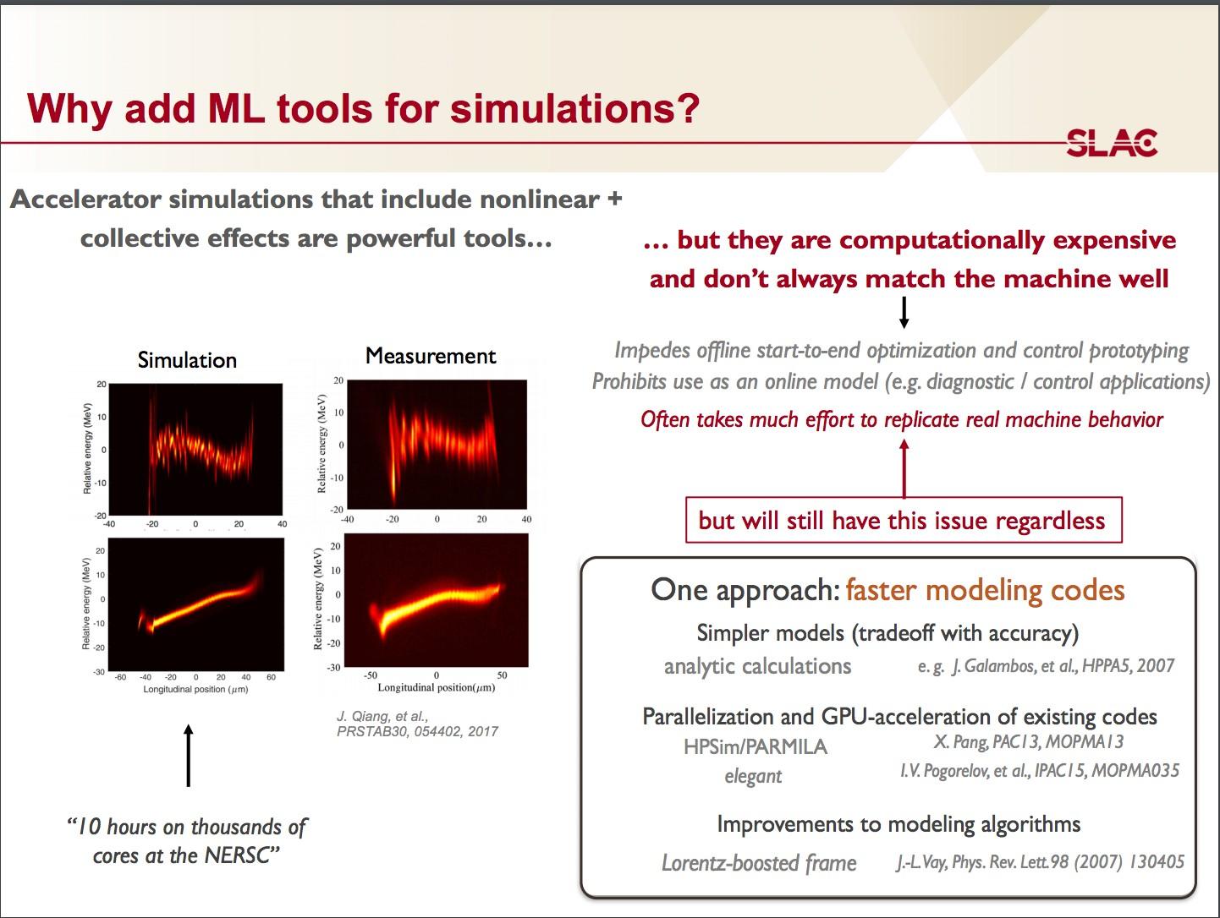
a

Slide 33
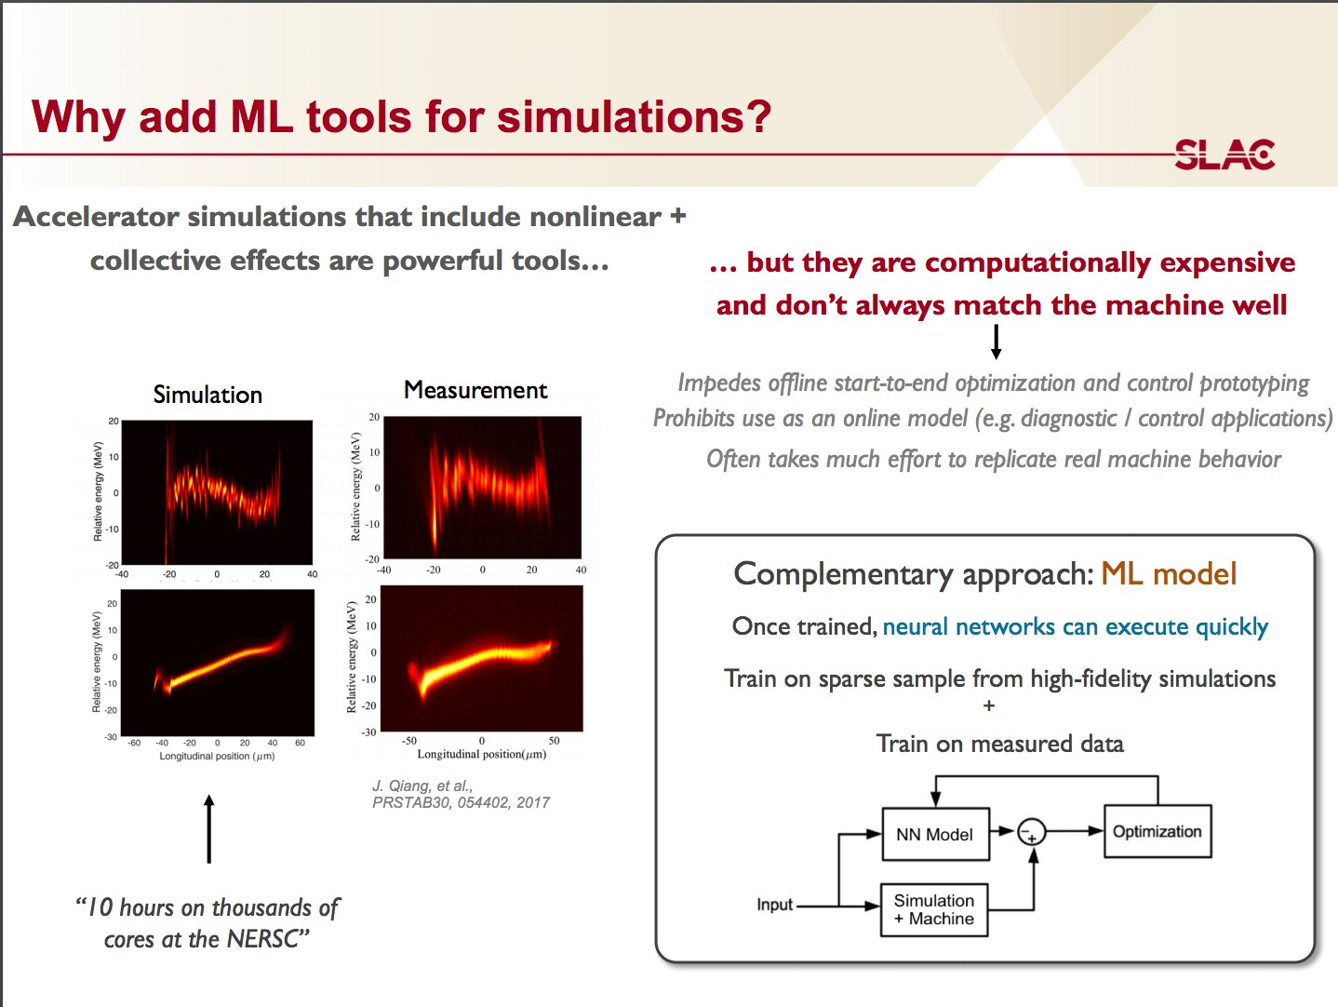
a

Slide 34
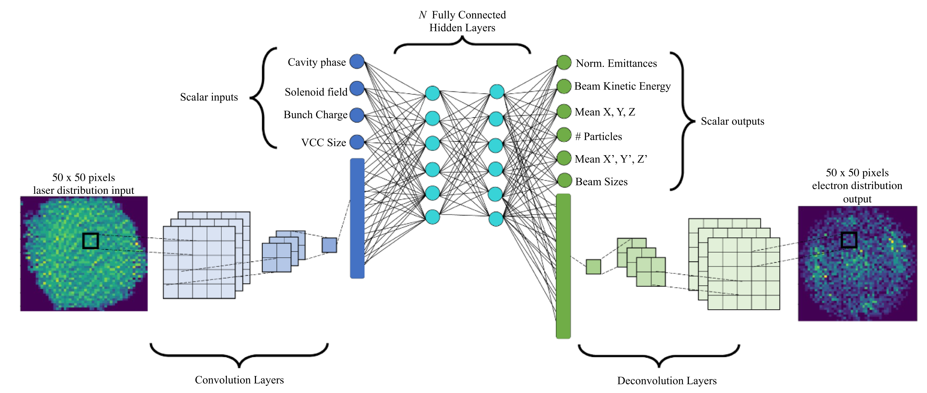
Optimization of the LCLS-II Injector
Rasmus Ischebeck
Lipi Gupta et al 2021 Mach. Learn.: Sci. Technol. 2 045025

Slide 35
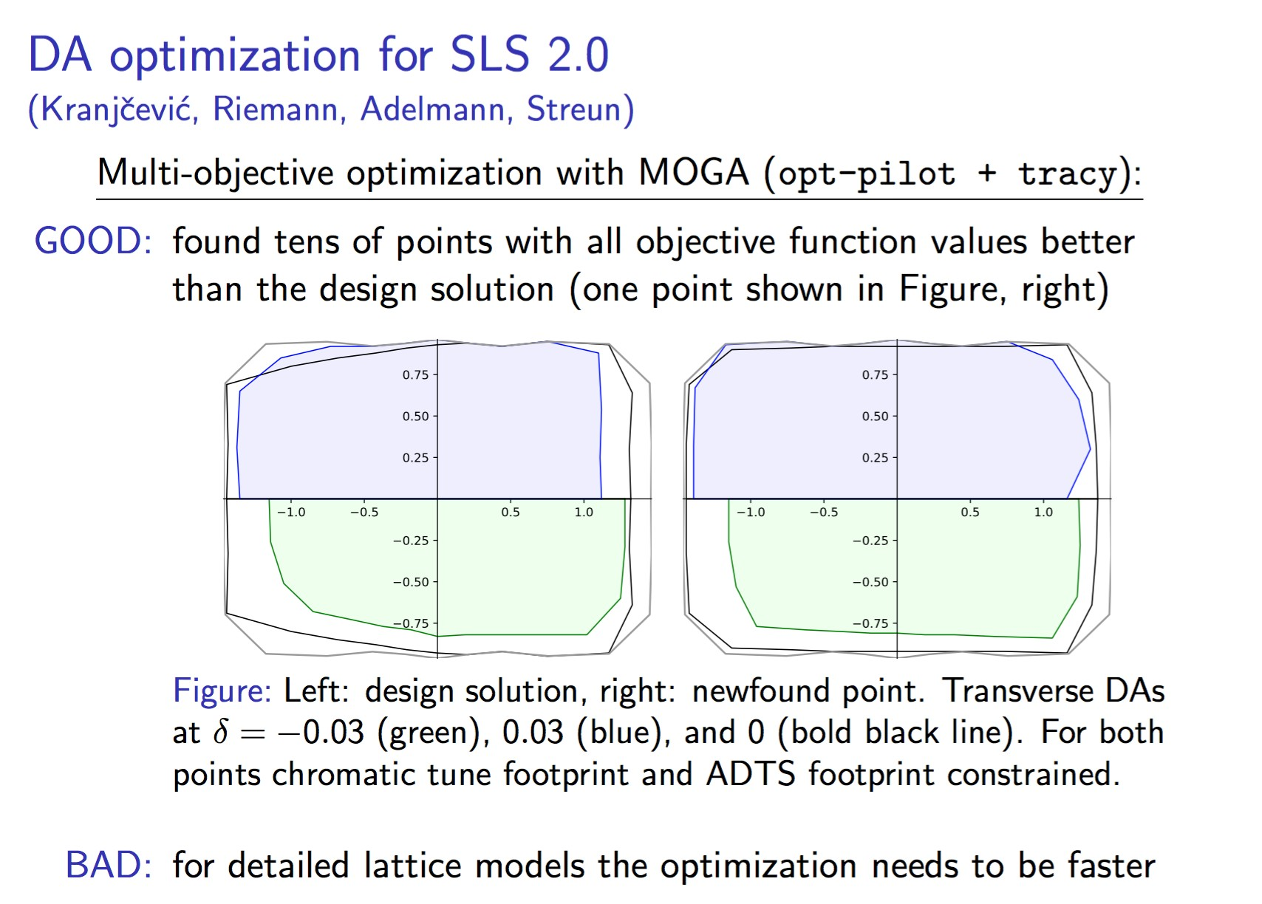
a

Slide 36
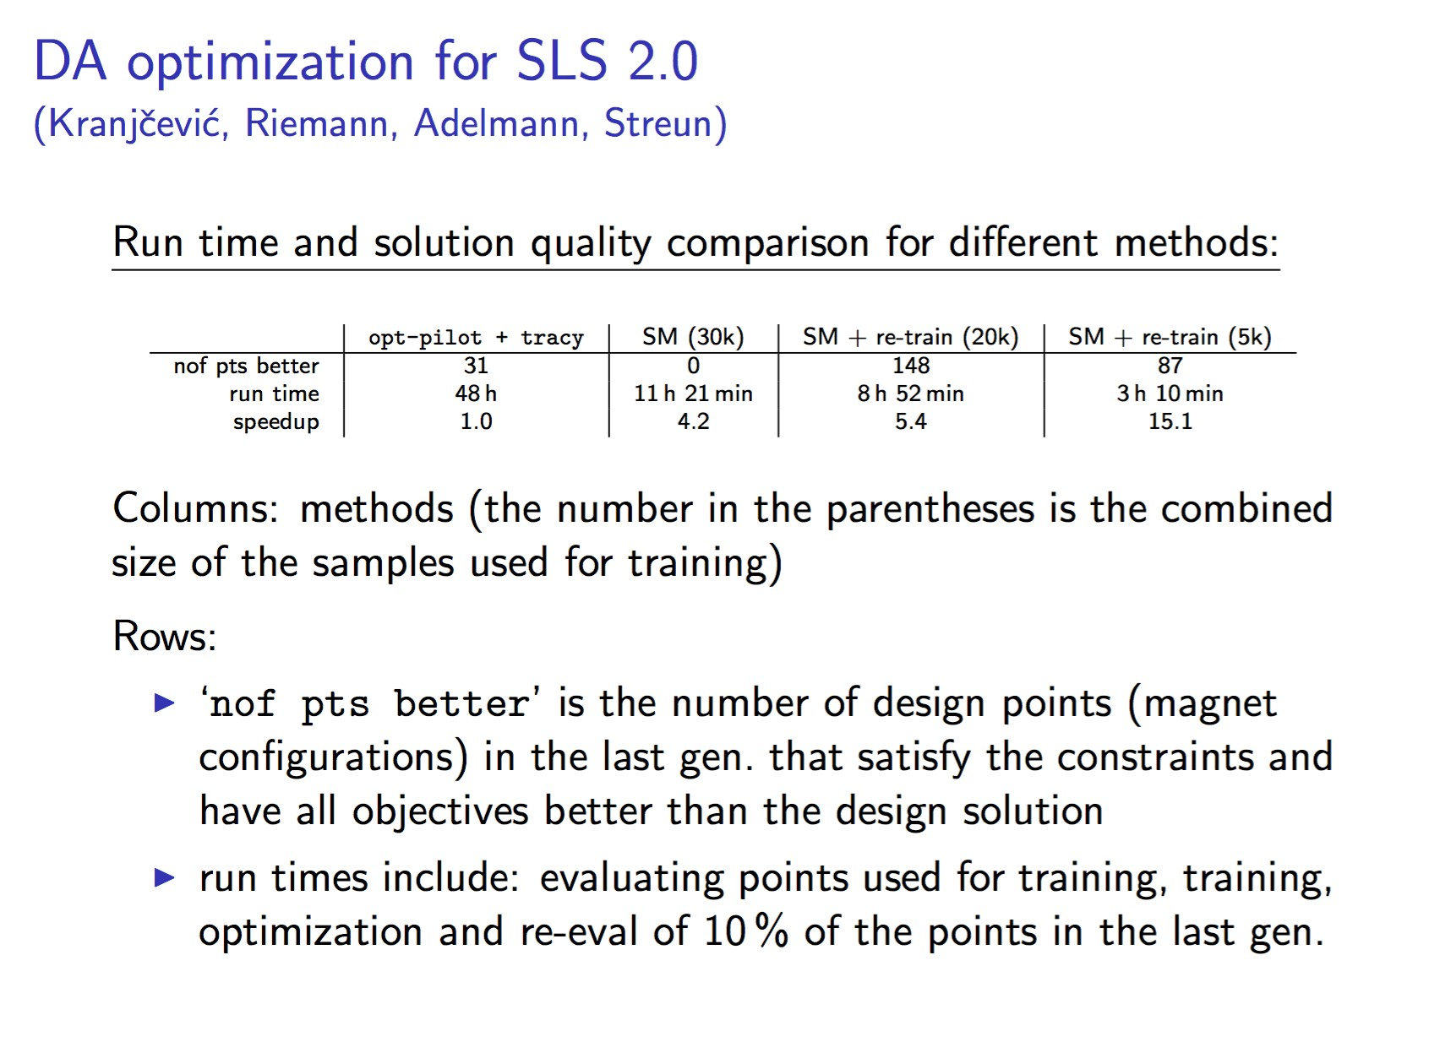
• a
https://arxiv.org/abs/2008.04151

Slide 37
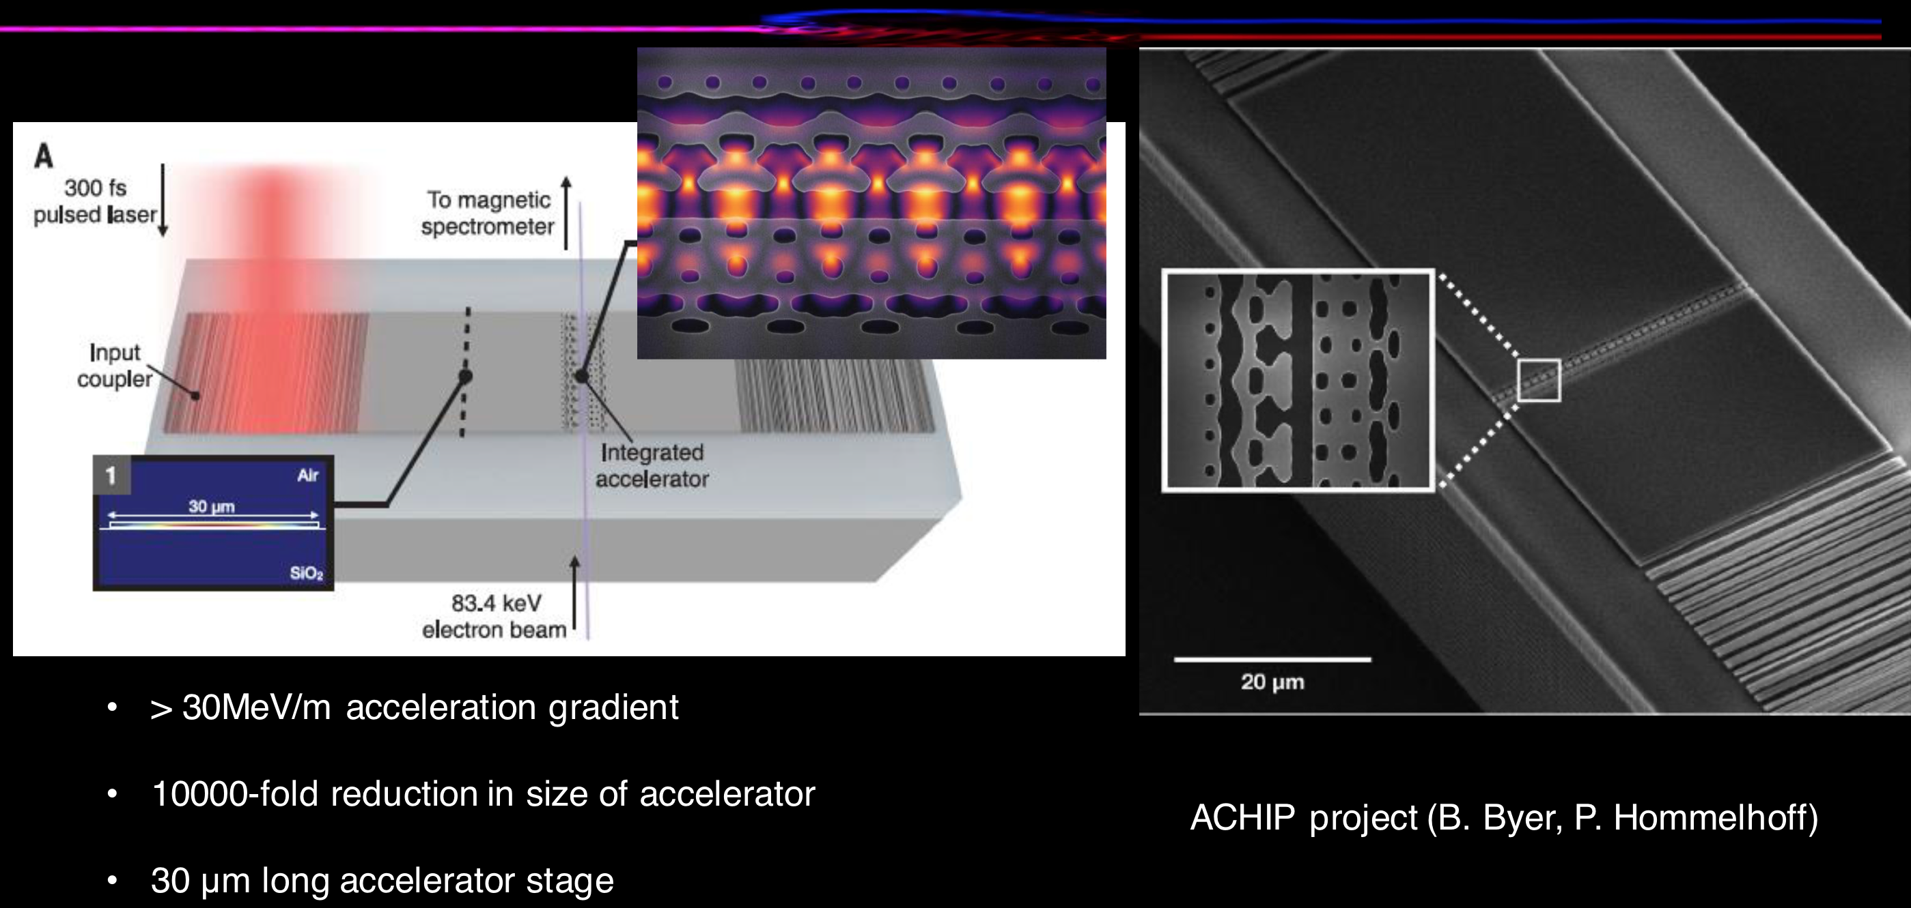
Inverse Design of Accelerating Structures
Rasmus Ischebeck
Jelena Vučković, Neil Sapra: Science 367, 79–83 (2020)

Slide 38
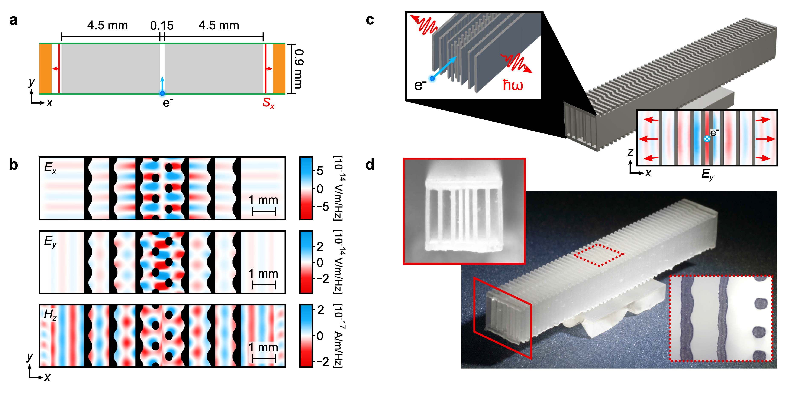
Inverse Design of THz Structures
Rasmus Ischebeck
Benedikt Hermann

Slide 39
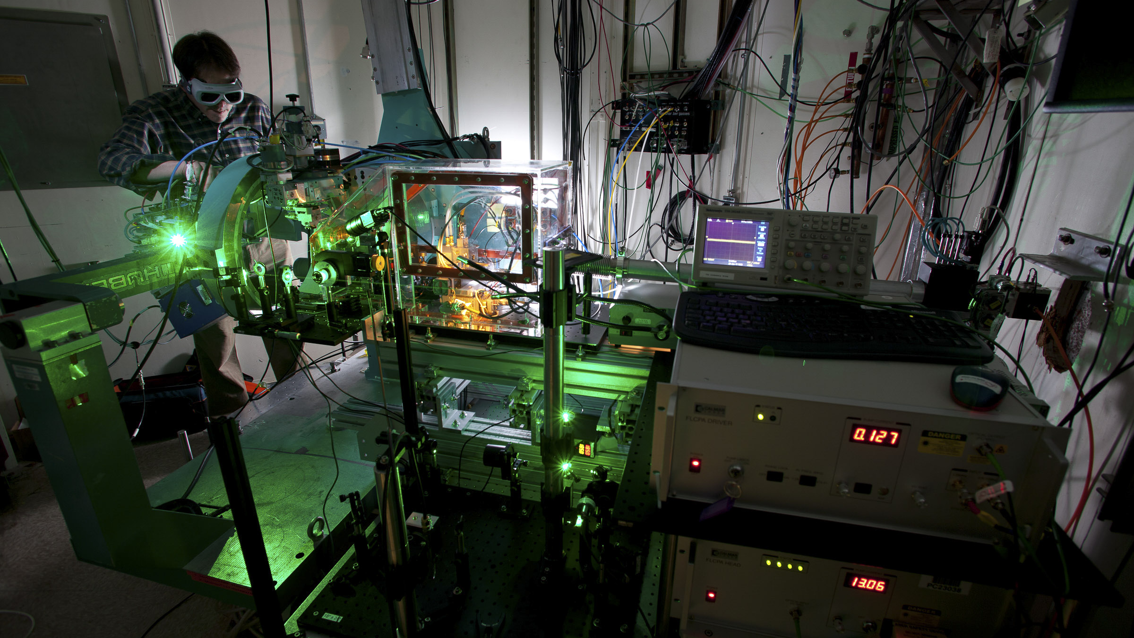
Data Acquisition and Analysis
Rasmus Ischebeck

Slide 40
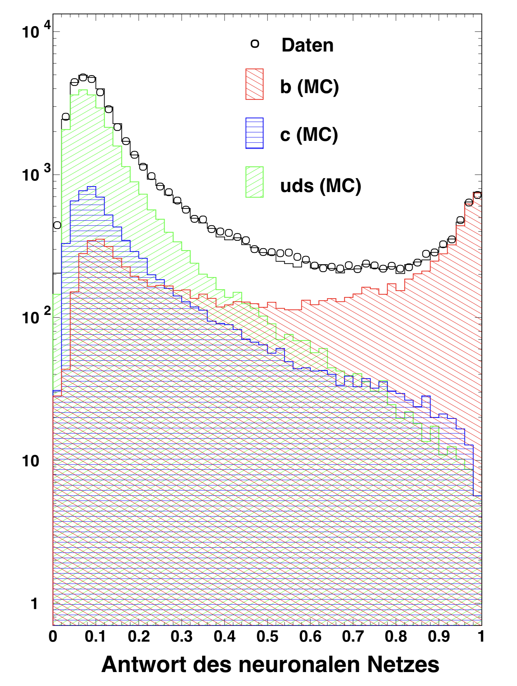
Machine Learning for HEP Data Analysis
Improving interpretation of detector data (2002)
Rasmus Ischebeck
Peter Wienemann

Slide 41
We have a Problem…
Rasmus Ischebeck

Slide 42


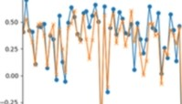
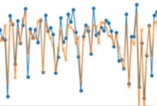
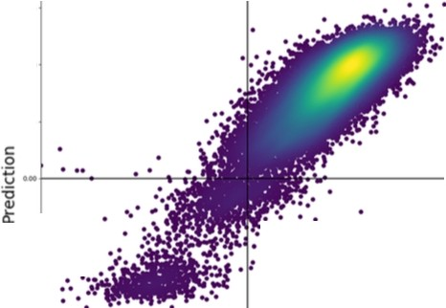

'4Ul l(K(RREI INIIITUI
SwissFEL Pump-Probe Delay Prediction using ML
Sven Augustin - PSI Fellow (LSF)
Trends are followed with tiny residual:
.,,
Input and output nicely correlated
,..
.,,
...
.,,
7
.. ,.
.. ,,
Data Pred1ct1on
-- Residual
"' .".'·w• vJIN1-{¥,
•
-------
Feature Im ortance
2.4
.
.
2.2
.,_BAM 070
....
....
..,,
• •
•
2.0
BAM 070 humidity, pressures, temperatures
•
1.8
1.6
-r• --
Laser labhumidities
1.4
BPMs (and pressures, temperatures)
.,...._ _
•■--• - ....
1.2
..,. ,,
◄M ◄2) HO on
Data
.,.
.,,
u,
0
50
100
150
200
250
300
350
In collaboration with A.Adelmann (LSM) and C. Bostedt (LSF)

Slide 43
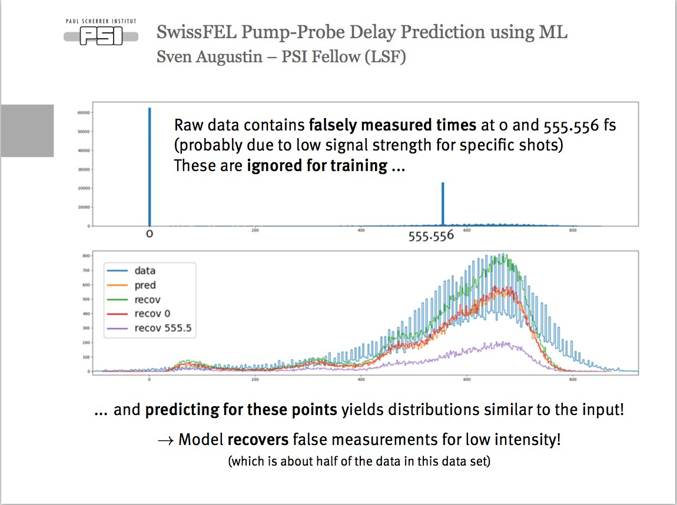
a

Slide 44
Summary
Use machine learning…
  …when you have lots of data, and the algorithm to analyze it is not obvious
  …when you have pre-classified cases (be it from simulations, from other detectors, or from manual classification)
  …when speed matters
  …when other methods are more effort, or more expensive
ML is easy and cheap
Rasmus Ischebeck

Slide 45
Large Variety of Open Source Libraries
Rasmus Ischebeck

Slide 46
Thank You
Andreas Adelmann
Andreas Krause
Andreas Streun
Auralee Edelen
Benedikt Hermann
Elena Fol
Giulio Gaio
Jelena Vučković
Jochem Snuverink
Johannes Kirschner
Neil Sapra
Nicole Hiller
Peter Wienemann
Raimund Kammering
Sven Augustin
Rasmus Ischebeck

