Slide 1
General information
G. Iadarola
ABP Computing Meeting

Slide 2
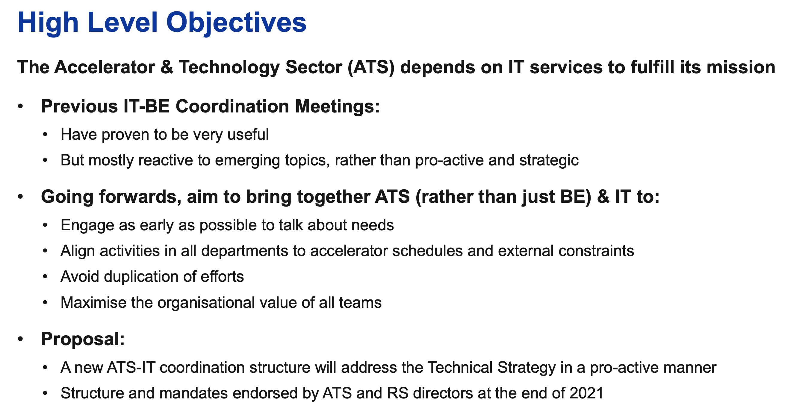
New ATS-IT collaboration structure
ATS-IT Technical Committee kick-off meeting
  https://indico.cern.ch/event/1112774/
2

Slide 3
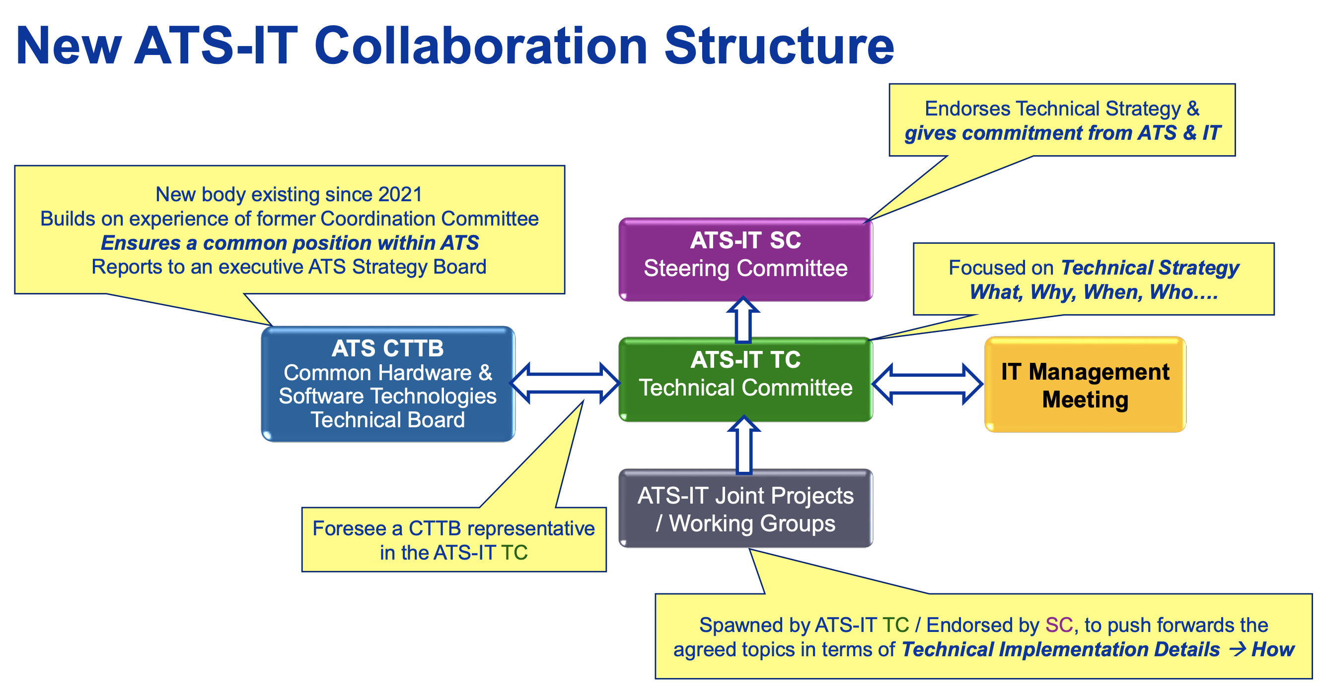
New ATS-IT collaboration structure

Slide 4
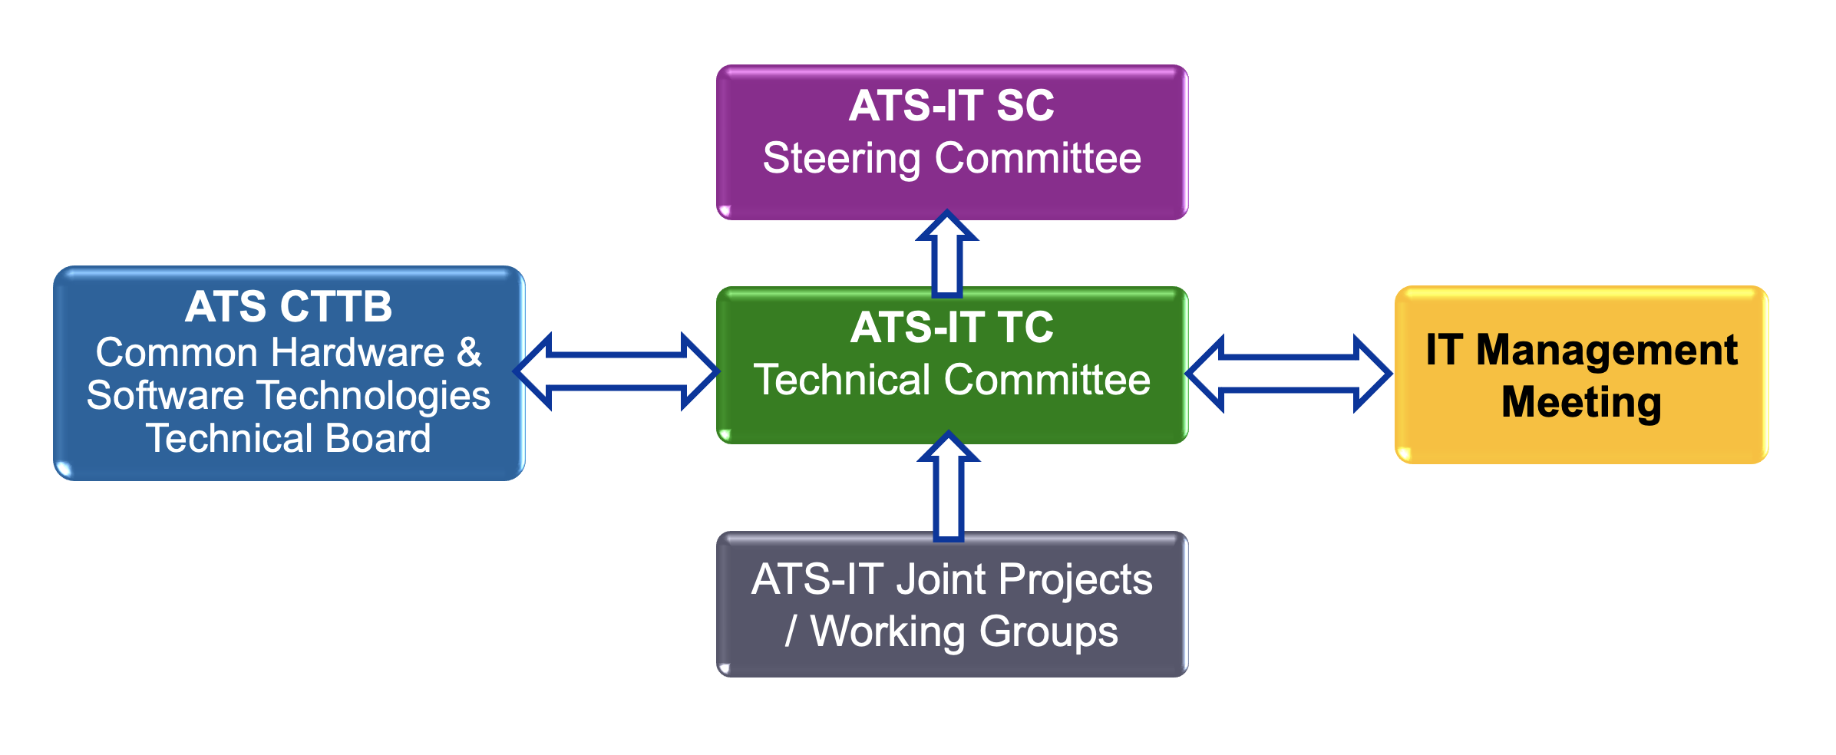
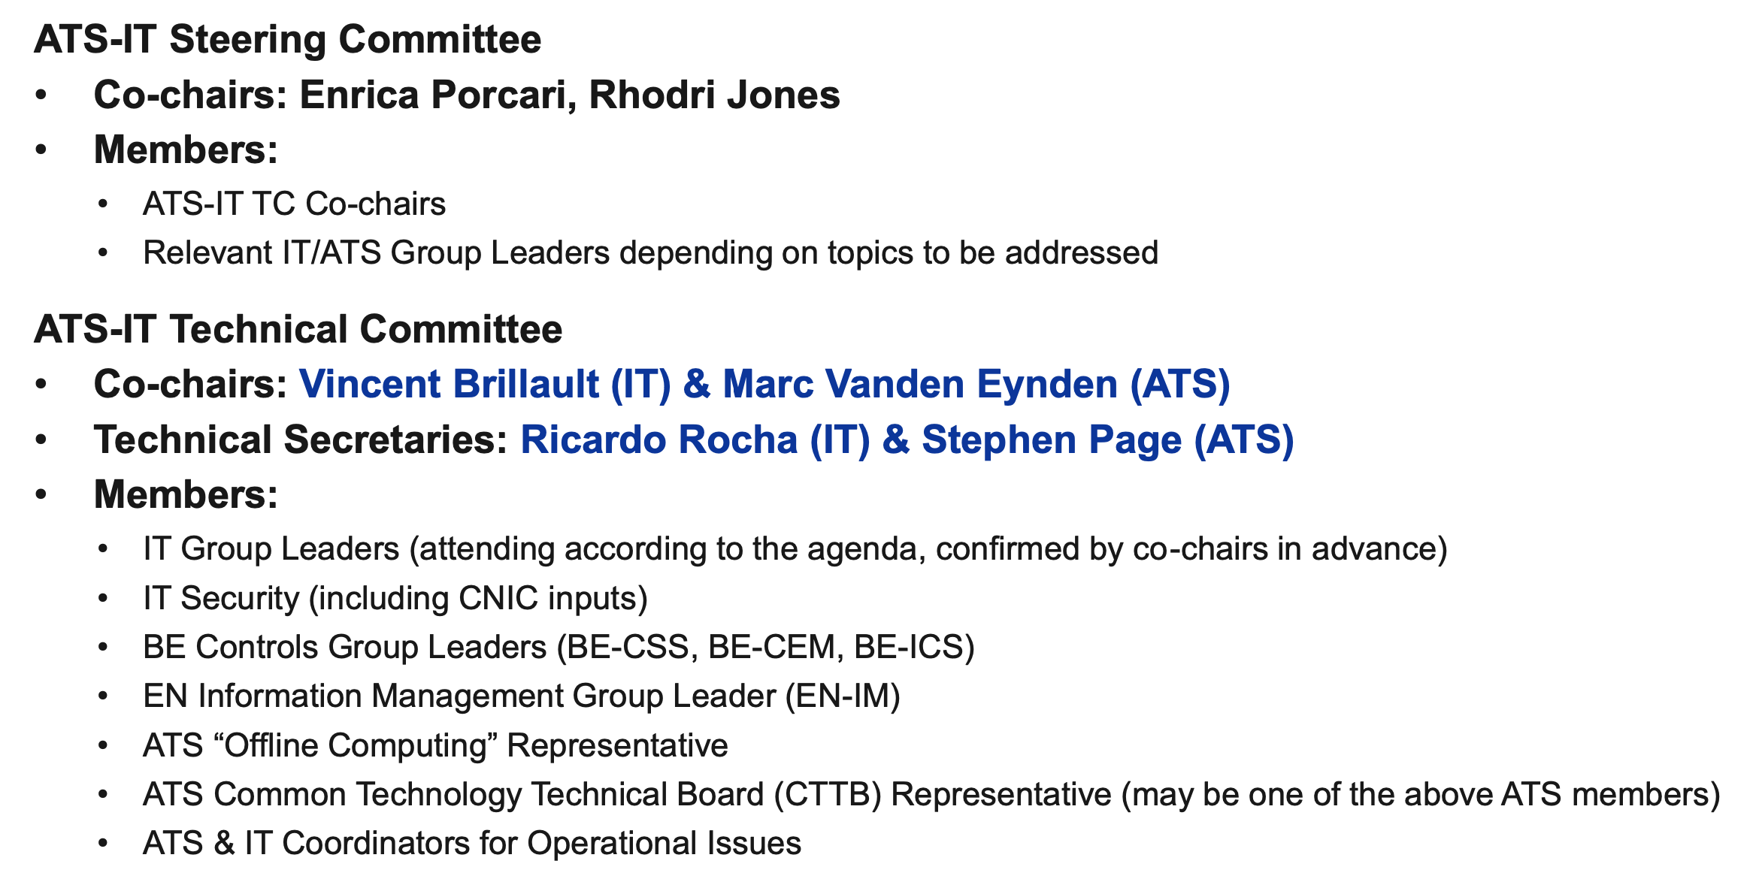
New ATS-IT collaboration structure

Slide 5
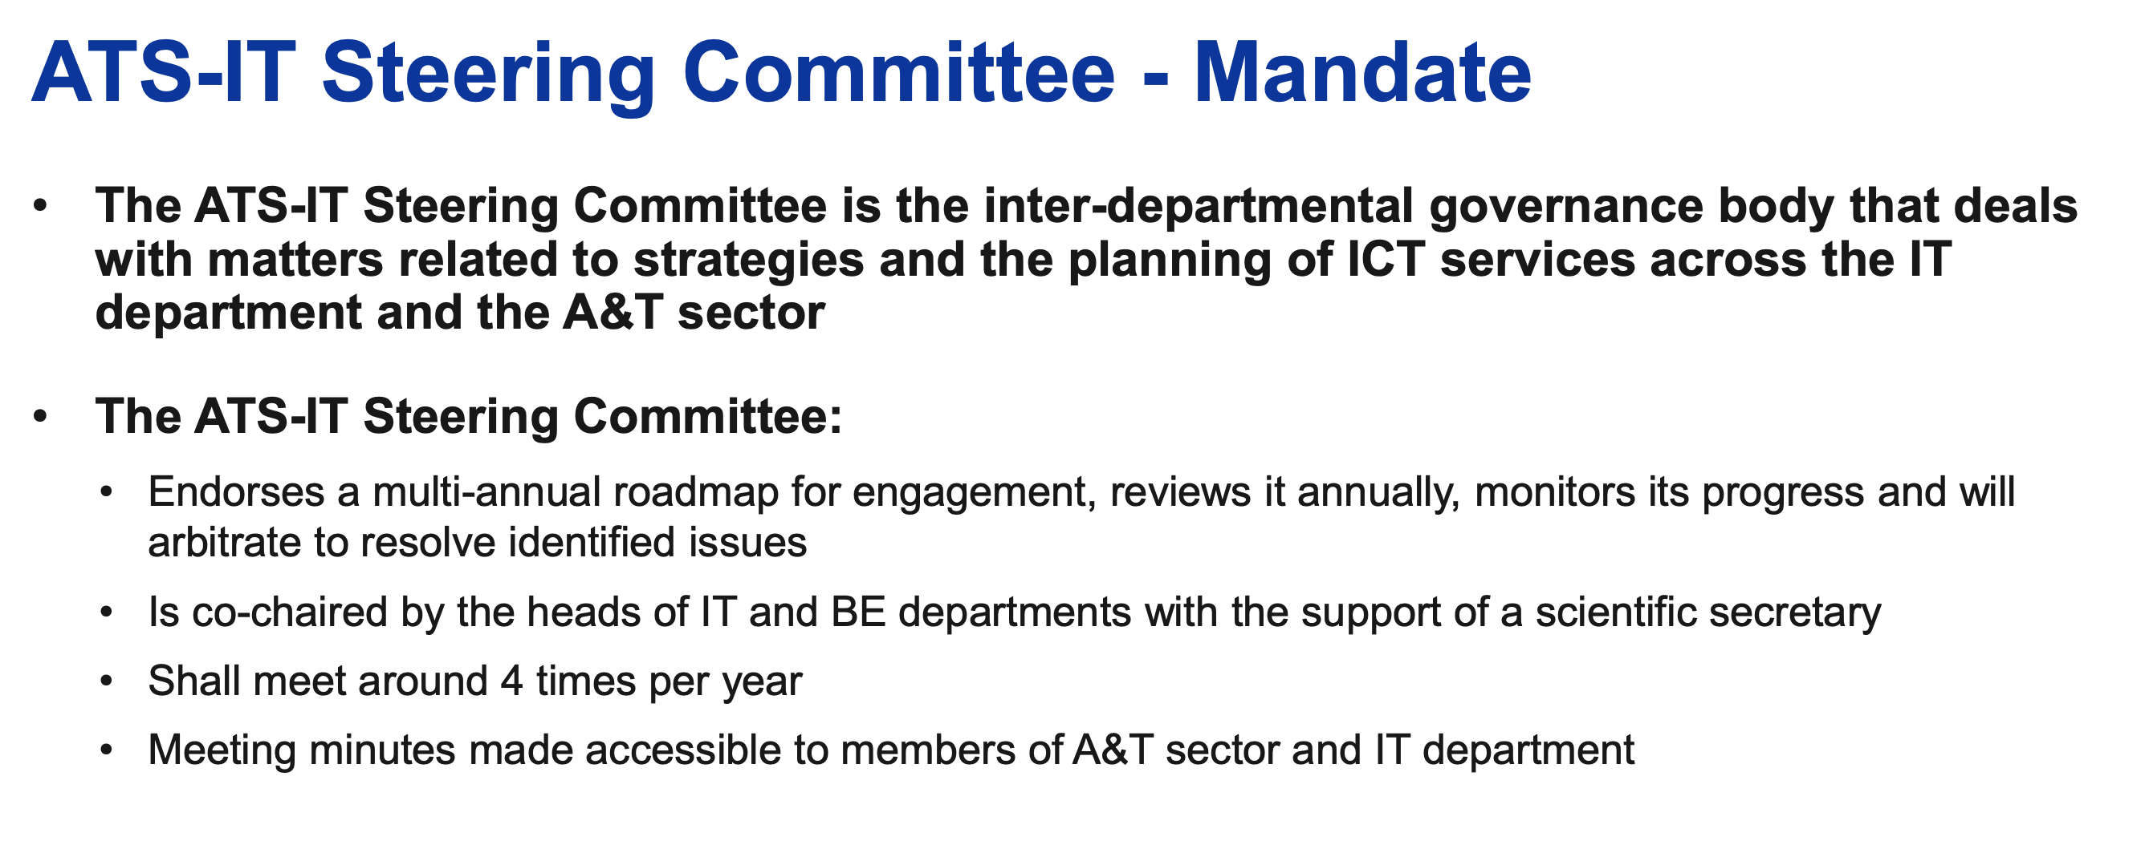
New ATS-IT collaboration structure

Slide 6
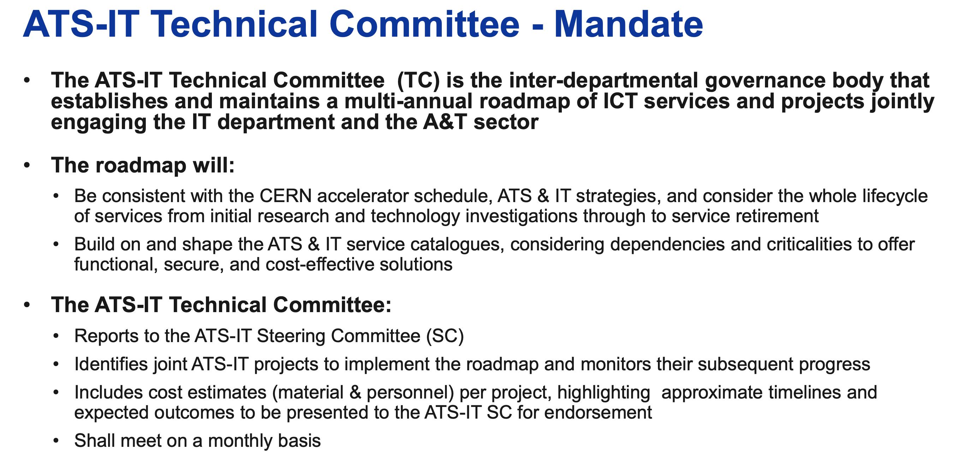
New ATS-IT collaboration structure

Slide 7
Input on simulations and data analysis
On scientific computing for numerical modelling, data analysis and simulations we need to build a global view on plans and needs across the ATS departments (BE, EN, SY, TE)
  Launching ATS community forum on scientific computing (simulations and data analysis) reporting to ATS-CTTB
    Place to share experience, needs and identify synergies and areas of collaboration these topics across ATS (notably software design and development)
    Forum to prepare coordinated requests and projects to be proposed and follow-up with IT through the ATS-IT technical committee
    Participation will be open to anybody from ATS sector (anybody can propose a topic for discussion).
    Contact persons to be identified in all groups invested in simulation and analysis activities (example of key players, BE-ABP, BE-EA, EN-STI, SY-RF, SY-STI, SY-ABT, TE-MSC, TE-MPE, etc…) to define a mandate and identify first topics for discussion.
Input on mandate, topics to be addressed, people that should be involved is very welcome!

Slide 8
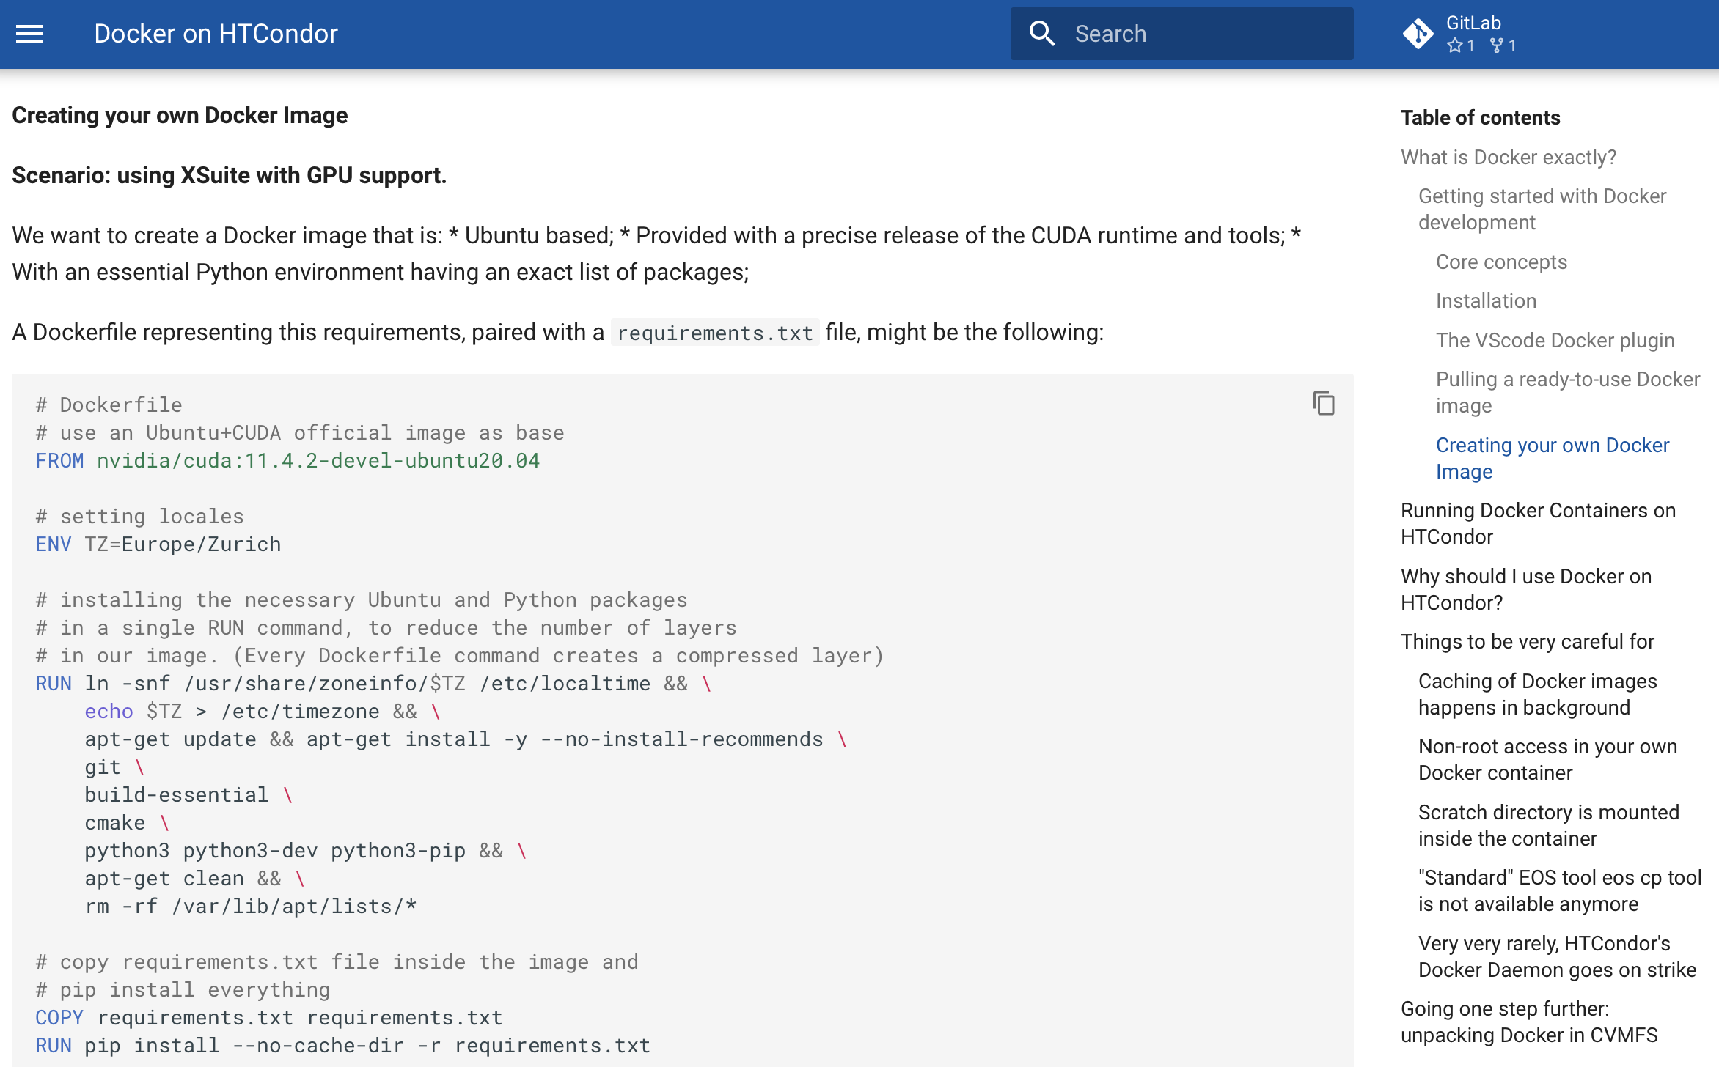
New docker guide from C. Montanari:
https://abpcomputing.web.cern.ch/guides/docker_on_htcondor/

Slide 9
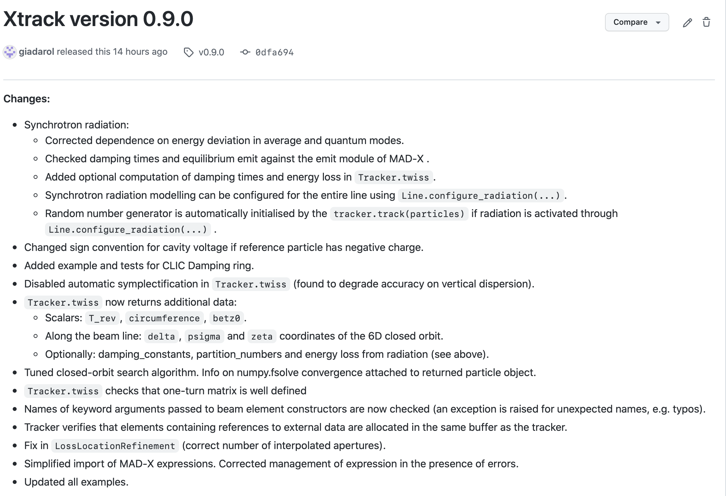

Slide 10
Thanks for your attention!

