Slide 1
CI Experimental results and plan
BGC CI team

Slide 2
Section I: Summary from v2 setup
OTR verification
Development of a hybrid simulation code
New configuration for 20 mm long uniform gas jet

Slide 3
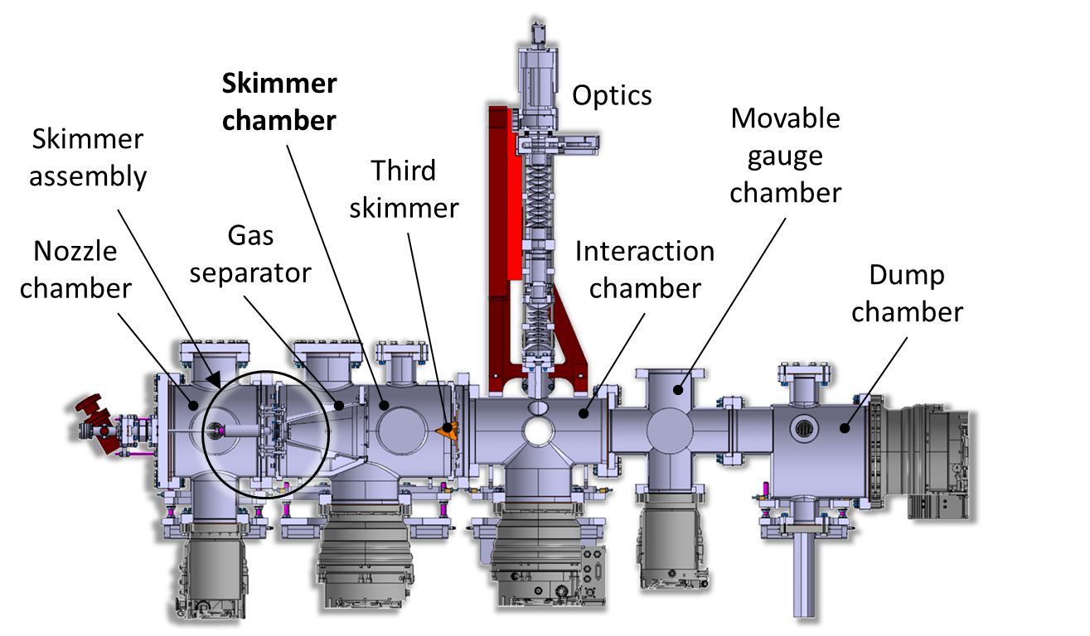
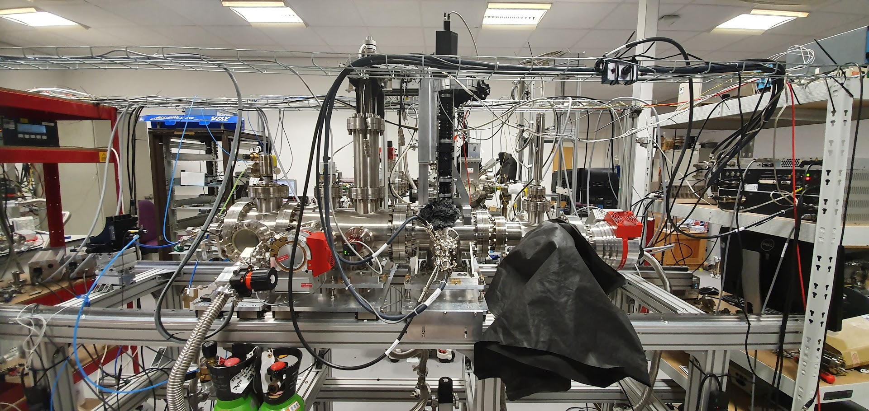
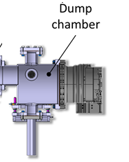
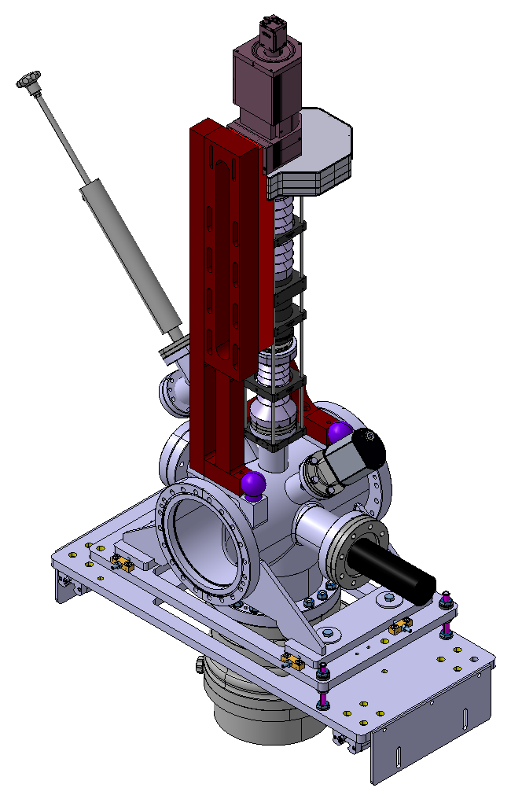
V2 gas jet monitor at the Cockcroft Institute
Moveable gauge 282 mm from nozzle
Imaging System
Skimmer Chamber
Skimmer Assembly
Third Skimmer
Gas Separator
Interaction Chamber
Nozzle Chamber
Dump Chamber
HIPACE 300L/S
Turbo-molecular pump
HIPACE 700L/S
Turbo-molecular pump

Slide 4
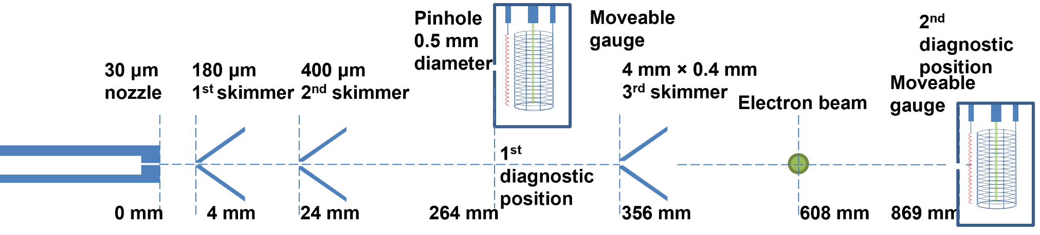
Geometry used for V2

Slide 5
Gas jet monitor Vs OTR
Y
X
Y
X
X (mm)
Y (mm)

Slide 6
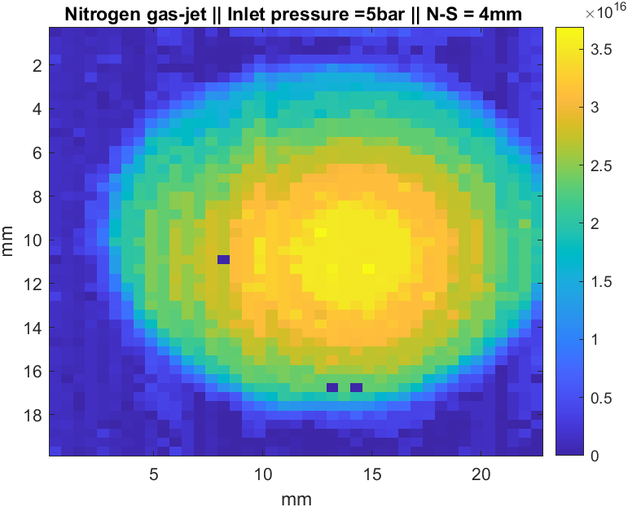
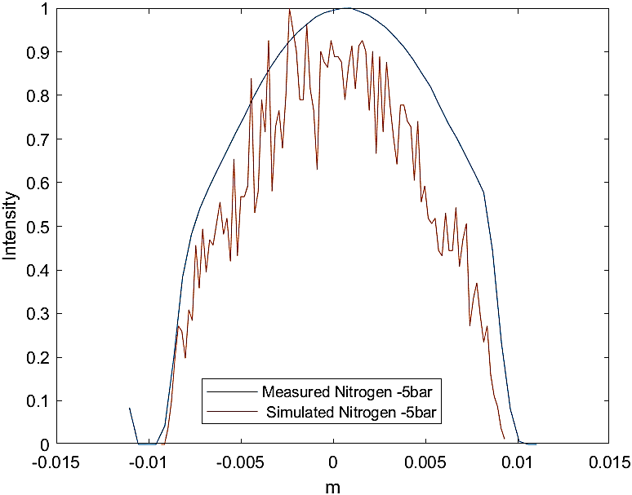
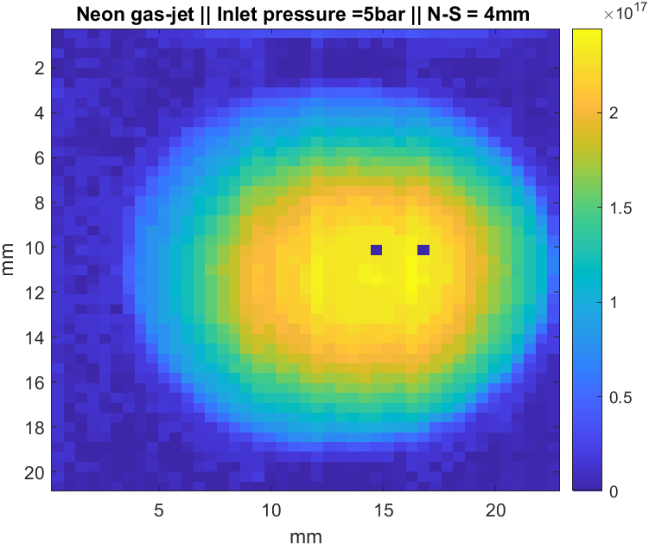
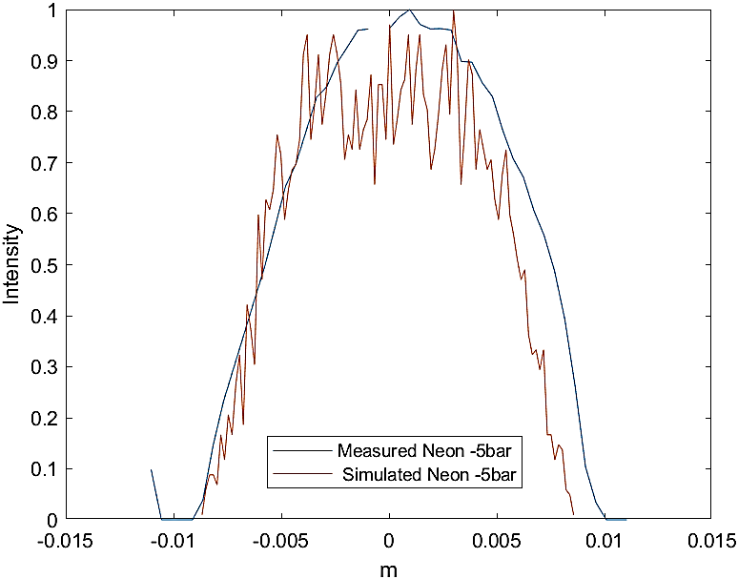
Hybrid gas jet code from continuous flow to molecular tracking
Gas jet density distribution verified with old configuration at 264 mm from nozzle:
    Nozzle : 30micron; Skimmer I : 180 micron; Skimmer II: 2mm
FWHM = 13.6 mm
FWHM = 15.8 mm
Nitrogen
Y
X
FWHM = 12.5 mm
FWHM = 13.3 mm
Neon
Experiment
Simulation

Slide 7
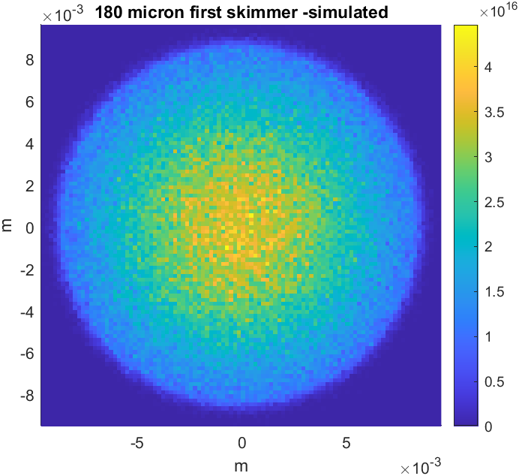
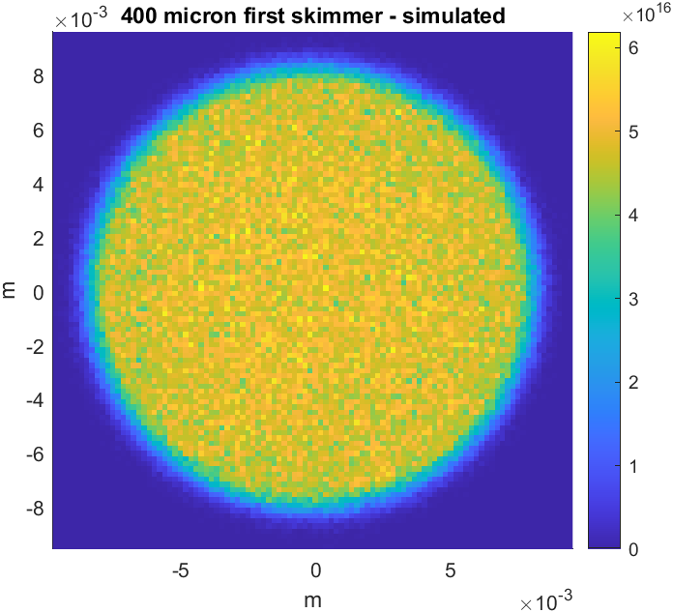
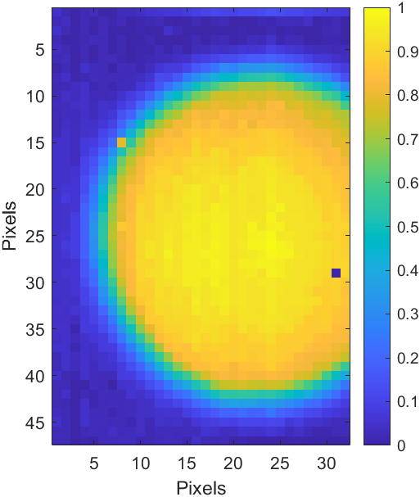
Configuration suggested by simulation to generate a uniform distribution gas jet for ~20 mm
Simulation suggest: uniform distribution after 2nd skimmer at 264 mm from nozzle.
It is verified by the experiment.
Simulation
Simulation
Experiment
Nitrogen
Y
X
Old configuration
  30 micron nozzle
  180 micron first skimmer
  2mm second skimmer
New configuration
  30 micron nozzle
  400 micron first skimmer
  2mm second skimmer

Slide 8
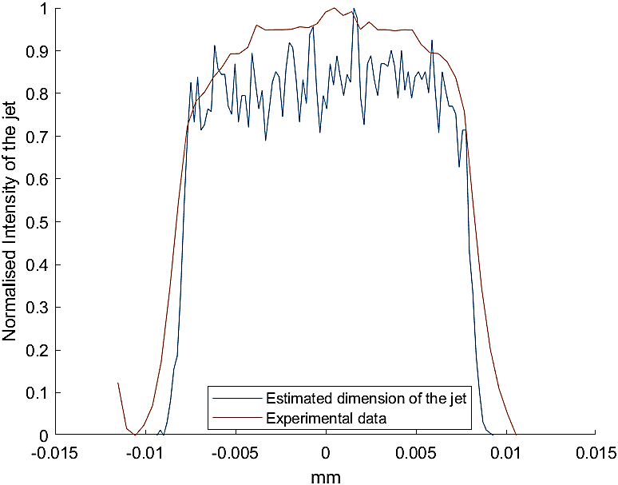
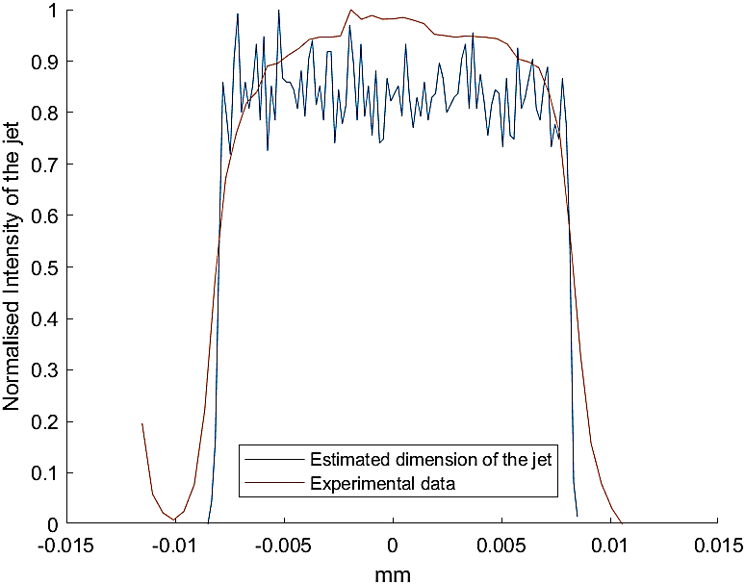
Gas jet density with new configuration
Experiment agree with simulation very well.
Nitrogen
Neon
Decision: New configuration will be used for future V3 test.

Slide 9
Pressure in each chamber (v3)
Configuration | Nozzle chamber | Skimmer chamber I | Skimmer chamber II | Interaction chamber
Nozzle :30µm 1st skimmer: 180µm 2nd skimmer: 400µm | 6.03e-3 | 1.69e-05 | 5.33e-07 | <5e-9
Nozzle :30µm 1st skimmer: 180µm 2nd skimmer: 2mm | 5.9e-3 | 7.91e-6 | 8.03e-7 | <5e-9
Nozzle :30µm 1st skimmer: 400µm 2nd skimmer: 2mm | 5.56e-3 | 1.13e-5 | 1.52e-6 | <5e-9
Pressure in each chamber given in (mbar) at the specified configuration.
The last configuration offered the highest gas-curtain density(tested at two locations- before and after third skimmer), as well as a more uniform jet.

Slide 10
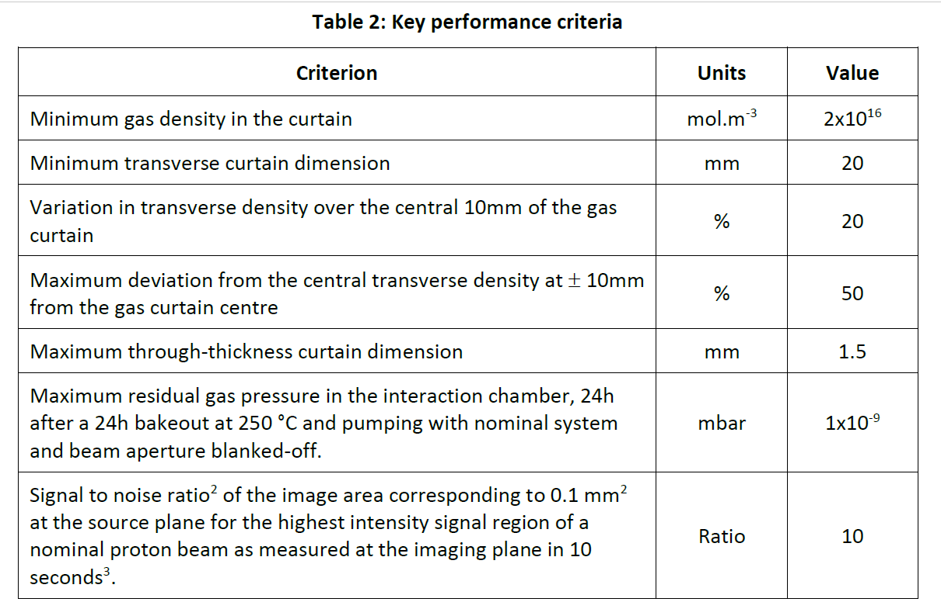
Summary for section I
Gas jet image was verified with OTR.
Developed a reliable gas jet density distribution measurement tool.
Developed a hybrid simulation code can simulate gas jet from continuous flow to molecular flow with a good agreement with experiments.
Gas jet curtain criteria could be met by new configuration.
for v4

Slide 11
Commissioning of v3 gas jet monitor
Setup description
Gas jet beam profile measurement
Gas jet density distribution simulation and experiment

Slide 12
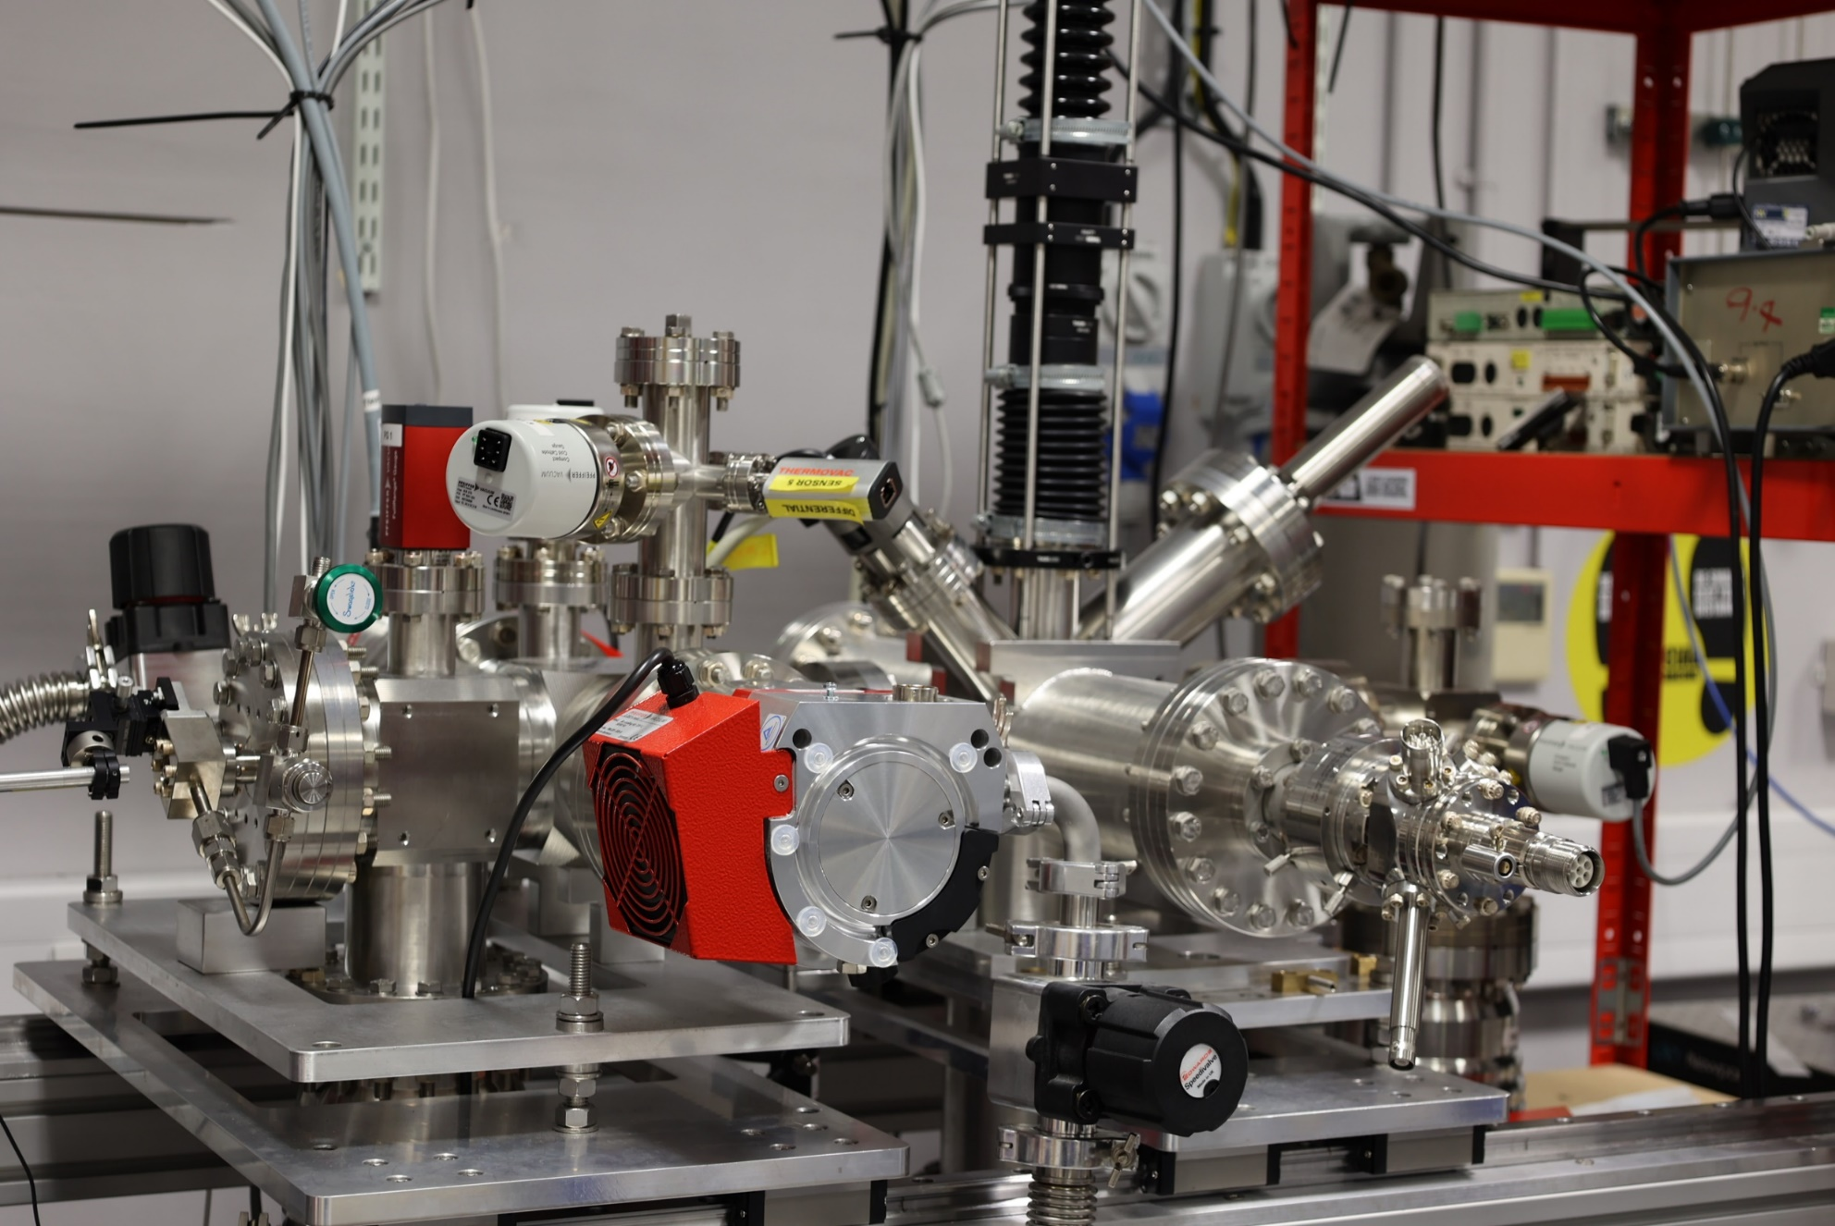
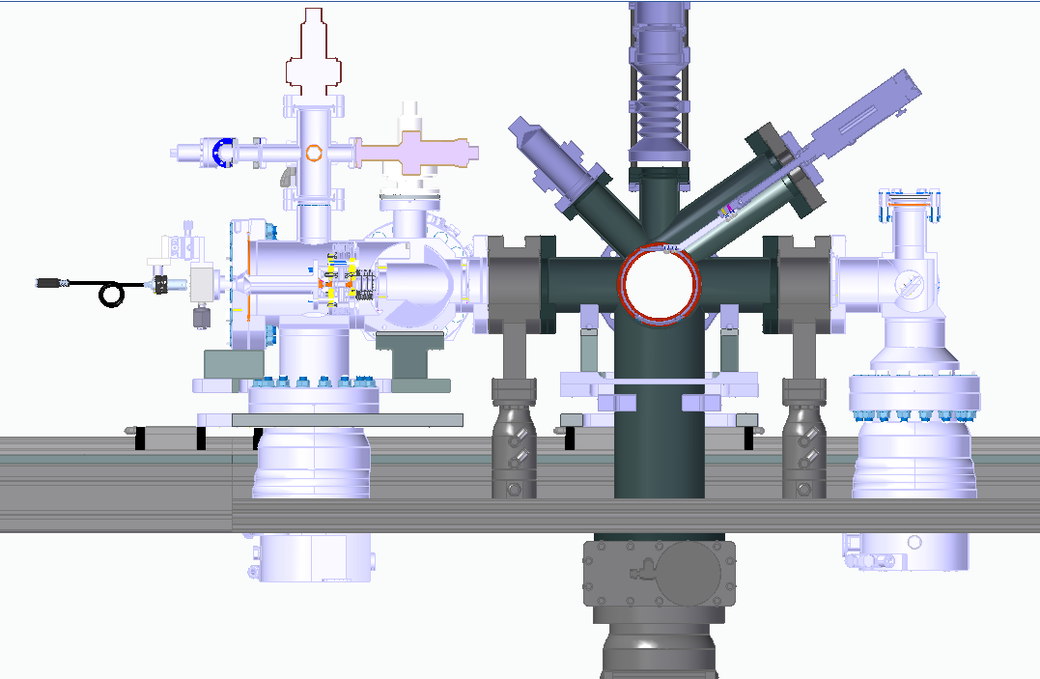
V3 gas jet monitor at CI
 | Nozzle (0 mm) | 1st skimmer (4.49 mm) | 2nd skimmer (33.59 mm) | 3rd skimmer (168.2mm) | Interaction (393.7 mm)
1 | 30 um | 400 um | 2 mm | 0.7 * 9 mm² or 0.3 * 9 mm²
New configuration used

Slide 13
Vacuum control system
Normally closed
power outrage
Rough pump
Electrical valve
TMP
Normally closed
RS485 protocol
Pressure Gauge
Gauge
Controller
Solenoid valve (48V control)
Pneumatic
PC
Gate valve
RS232 protocol
USB/Arduino
USB/Arduino
Status

Slide 14
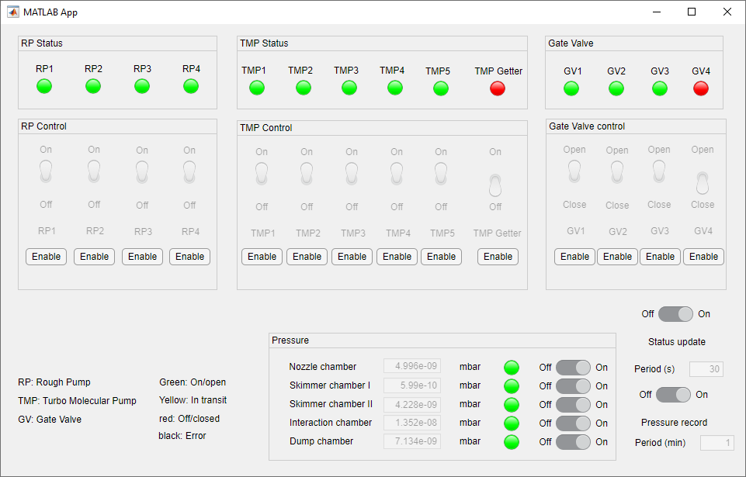
Main control GUI

Slide 15
NEG VS TMP installed in interaction chamber (Nitrogen)
Condition | CH1 | CH2 | CH3 | CH4 | CH5
E-gun & Jet off TMP | 3.8e-7 | 1.2e-8 | 3.1e-8 | 3.2e-8 | 1.3e-8
E-gun off Jet on TMP | 4.9e-3 | 1.03E-05 | 1.16E-06 | 3.97E-08 | 1.37E-07
E-gun & Jet on TMP | 5.5e-3 | 5.3e-6 | 1.6e-6 | 4.58e-8 | 1.2e-7
3rd skimmer
0.7 x 9mm

Slide 16
NEG VS TMP installed in interaction chamber (Nitrogen)
Condition | CH1 | CH2 | CH3 | CH4 | CH5
E-gun & Jet off TMP | 6.90E-09 | 1.90E-10 | 3.70E-09 | 1.66E-09 | 3.20E-09
E-gun off Jet on TMP | 5.5e-3 | 1.2e-5 | 1.9e-6 | 1.14e-8 | 3.2e-8
E-gun & Jet on TMP | 5.5e-3 | 1.2e-5 | 1.9e-6 | 3.66e-8 | 3.1e-8
3rd skimmer
0.3 x 9mm

Slide 17
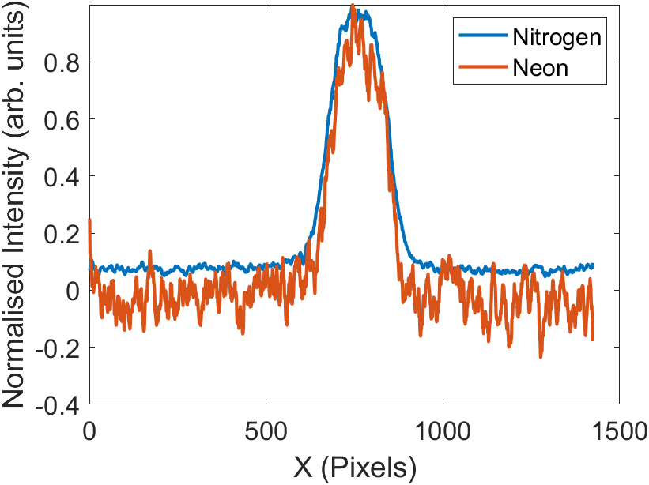
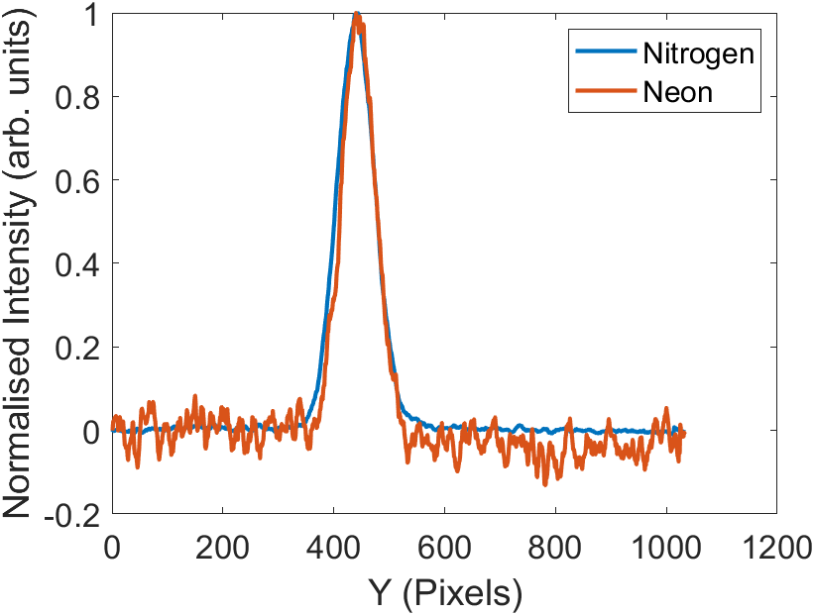
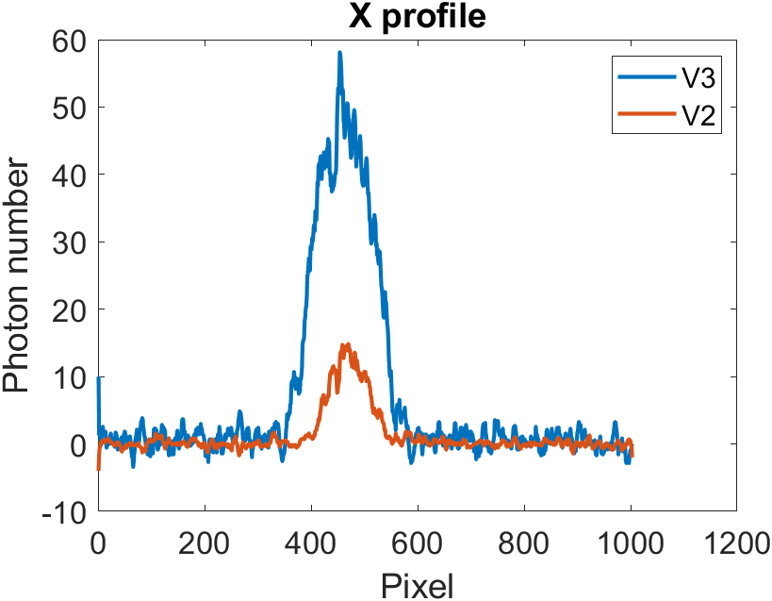
Gas jet measured beam profile
Condition:
0.7 mm *9 mm 3rd skimmer
E-beam conditions: 0.63mA at 5keV
Exposure time per picture : 0.1s
Total integration time :
  Neon: 2000s
  Nitrogen: 200s
Photon number per second: Neon: ~22s Nitrogen: ~300s
The ratio between Nitrogen and Neon signal level consistent with V2, but is at least 5 times higher
Improvement for S/N ratio from V2 to V3

Slide 18
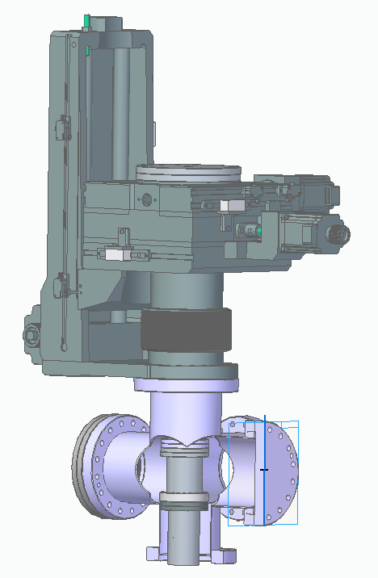
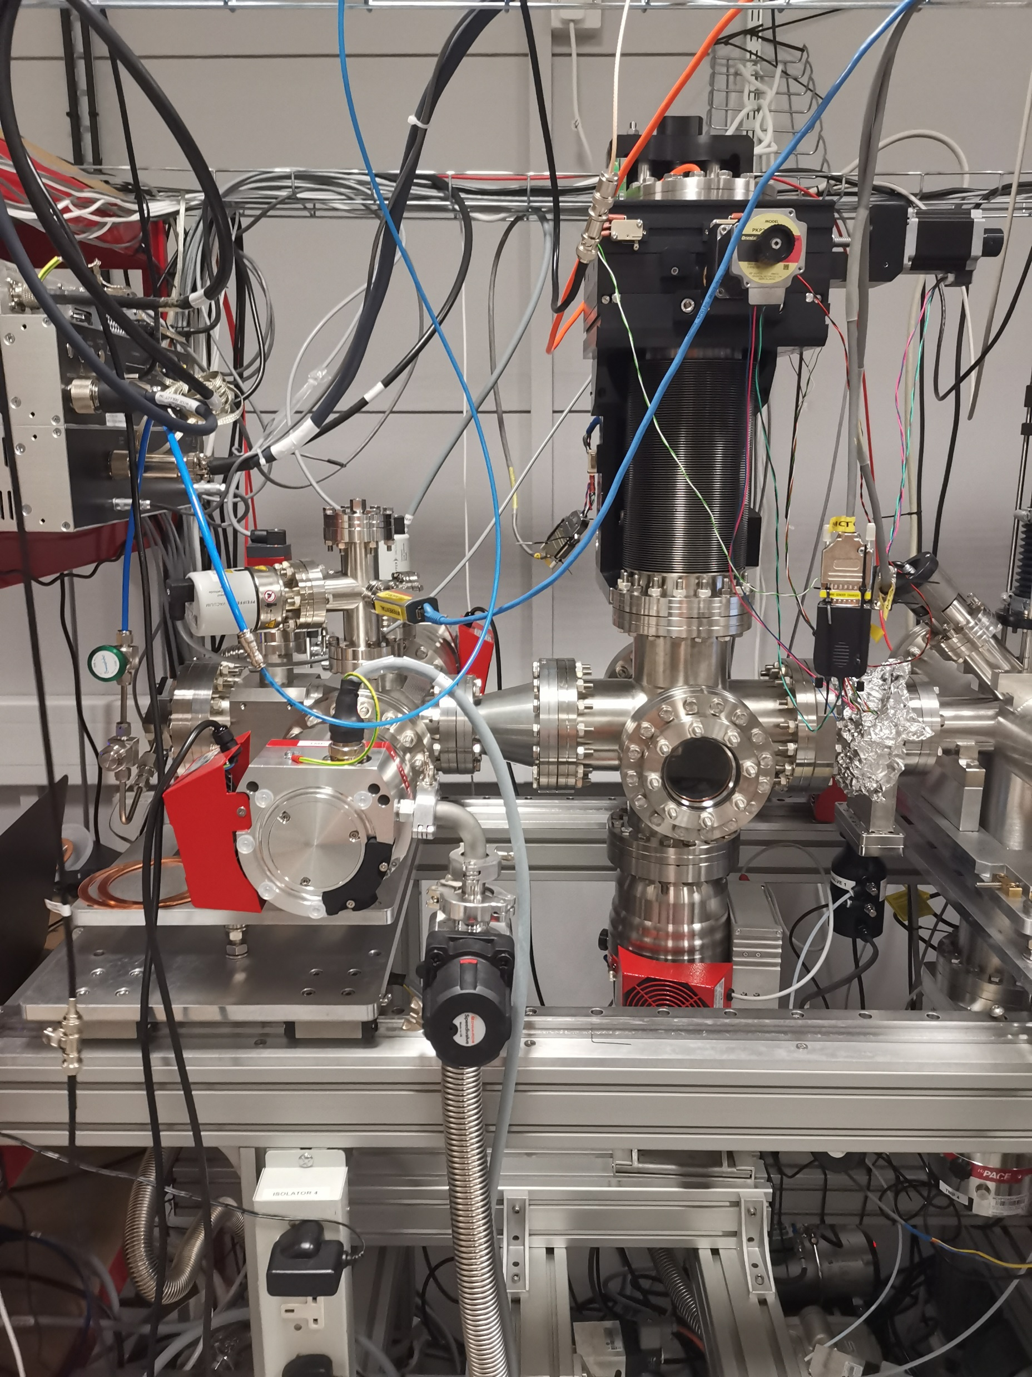
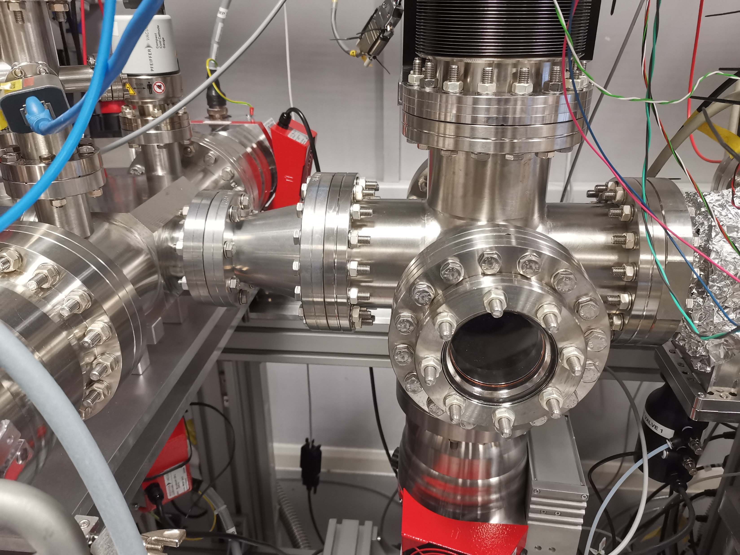
New Movable gauge system
Y
X
Pinhole = 1 mm

Slide 19
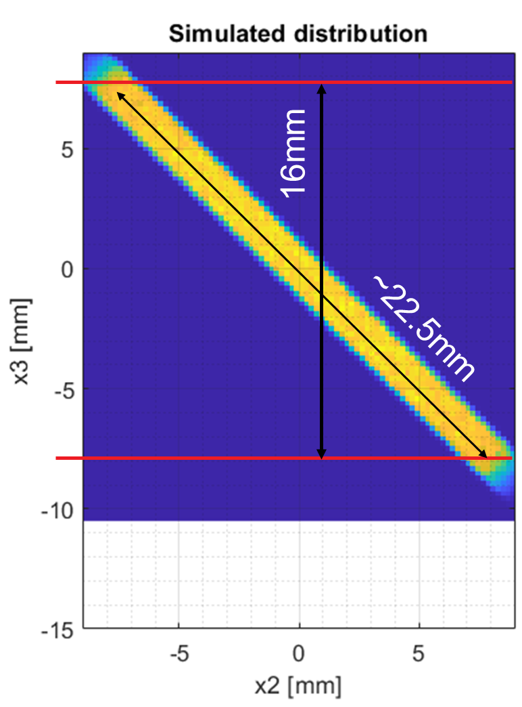
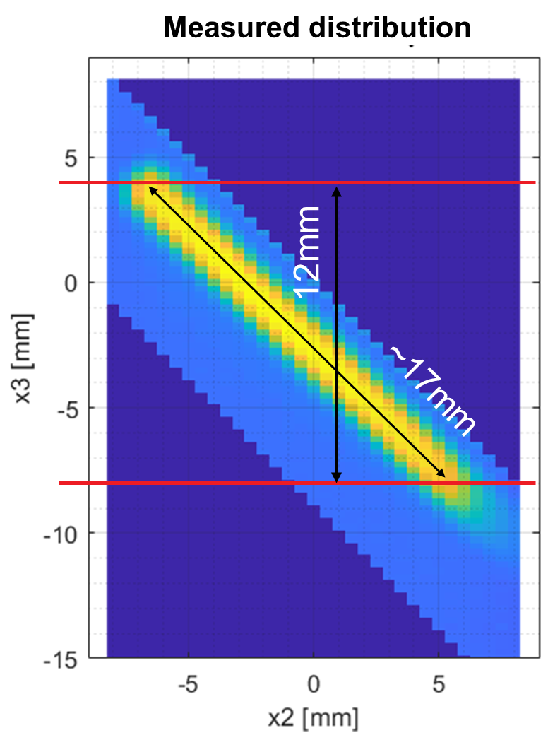
 | Nozzle (0 mm) | 1st skimmer (4.49 mm) | 2nd skimmer (33.59 mm) | 3rd skimmer (168.2mm) | Interaction (393.7 mm)
1 | 30 um | 400 um | 2 mm | 0.7mm*9mm
3rd skimmer

Slide 20
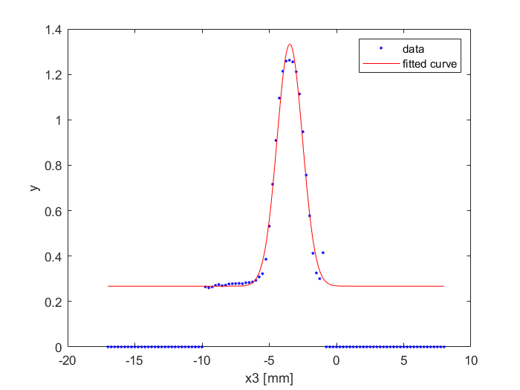
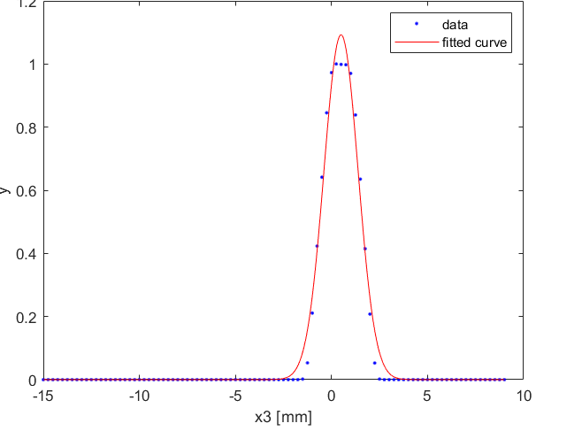
Convoluting simulation with pinhole Vs Measurement (large skimmer)
Simulation (convoluted)
Measurement
Flat top
Gaussian fit
Sigma = 0.87 ± 0.07 mm
FWHM = 2.1 ± 0.2 mm
Sigma = 0.95 ± 0.05 mm
FWHM = 2.2 ± 0.1 mm

Slide 21
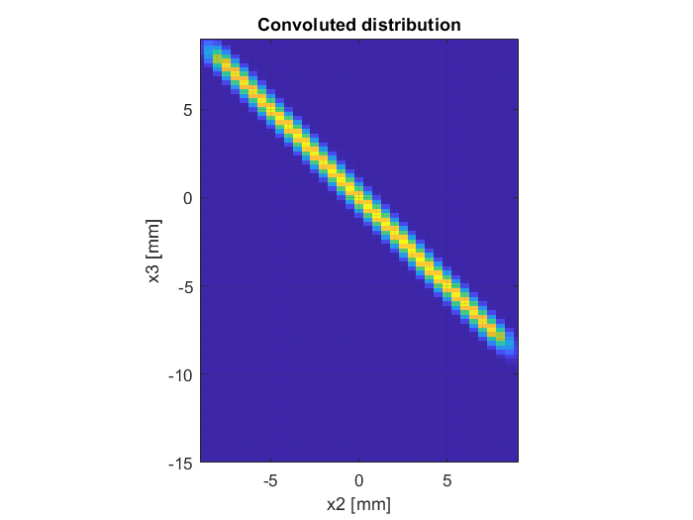
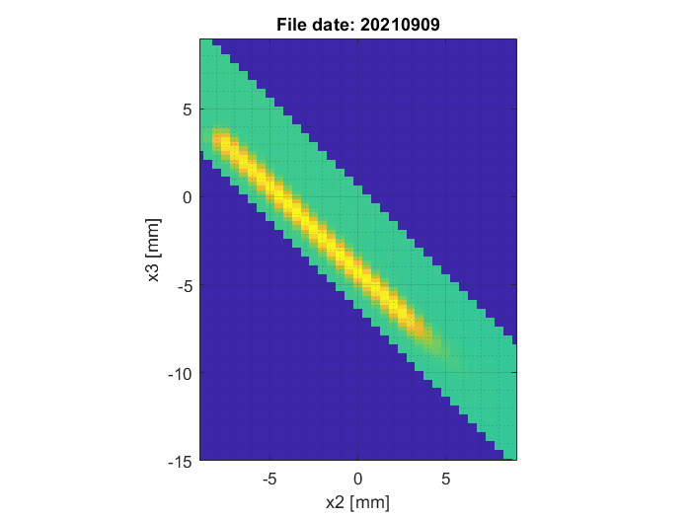
3rd skimmmer
 | Nozzle (0 mm) | 1st skimmer (4.49 mm) | 2nd skimmer (33.59 mm) | 3rd skimmer (168.2mm) | Interaction (393.7 mm)
1 | 30 um | 400 um | 2 mm | 0.3mm*9mm
Measured distribution

Slide 22

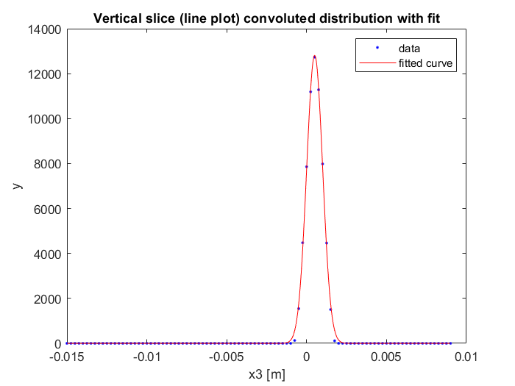
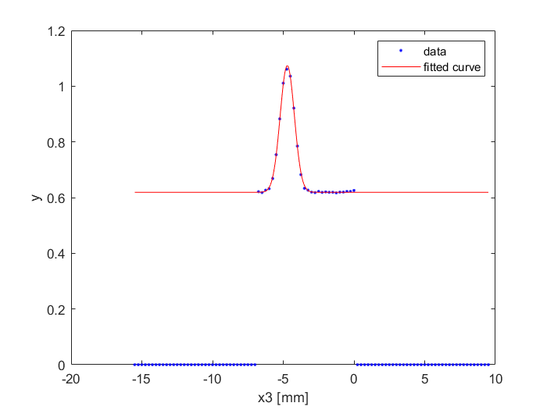
Simulation (convoluted)
Measurement
No Flat top
Gaussian fit
Sigma = 0.50 ± 0.02 mm
FWHM = 1.18 ± 0.05 mm
Sigma = 0.497 ± 0.009 mm
FWHM = 1.17 ± 0.02 mm

Slide 23
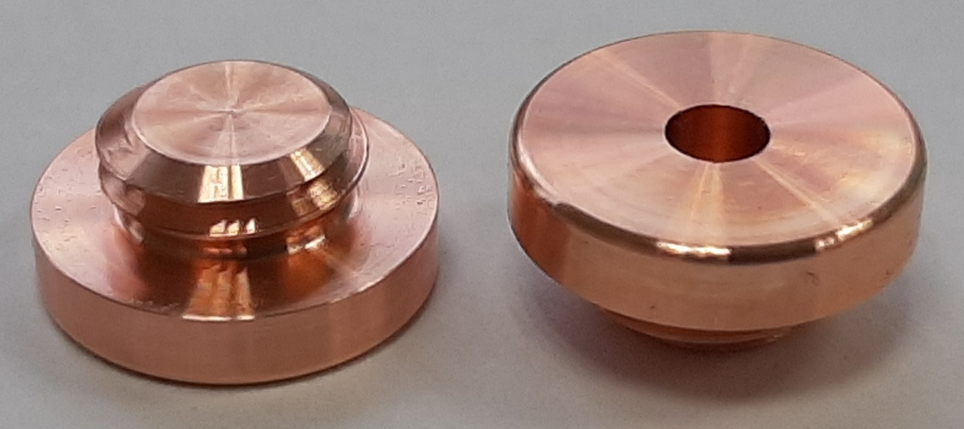
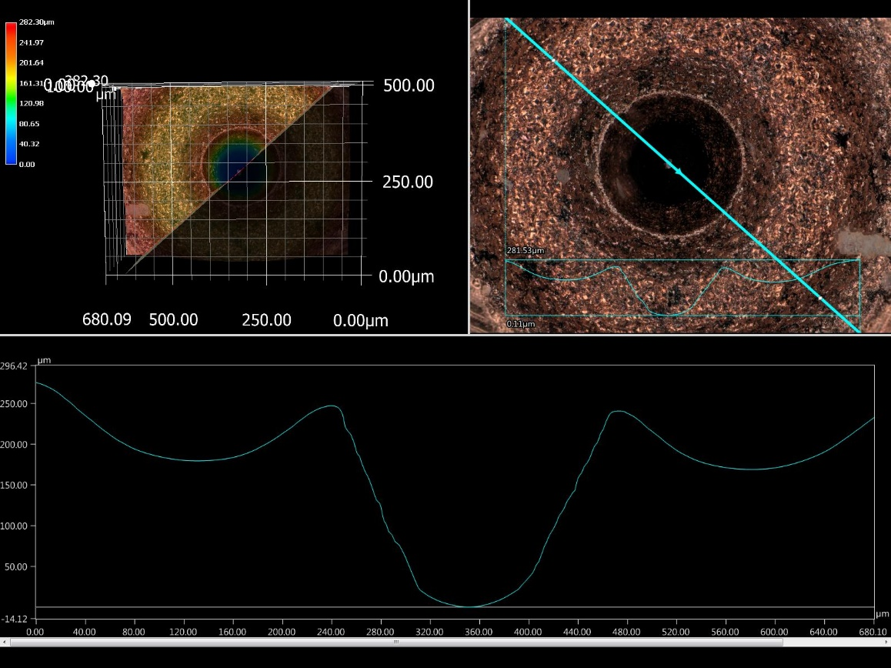
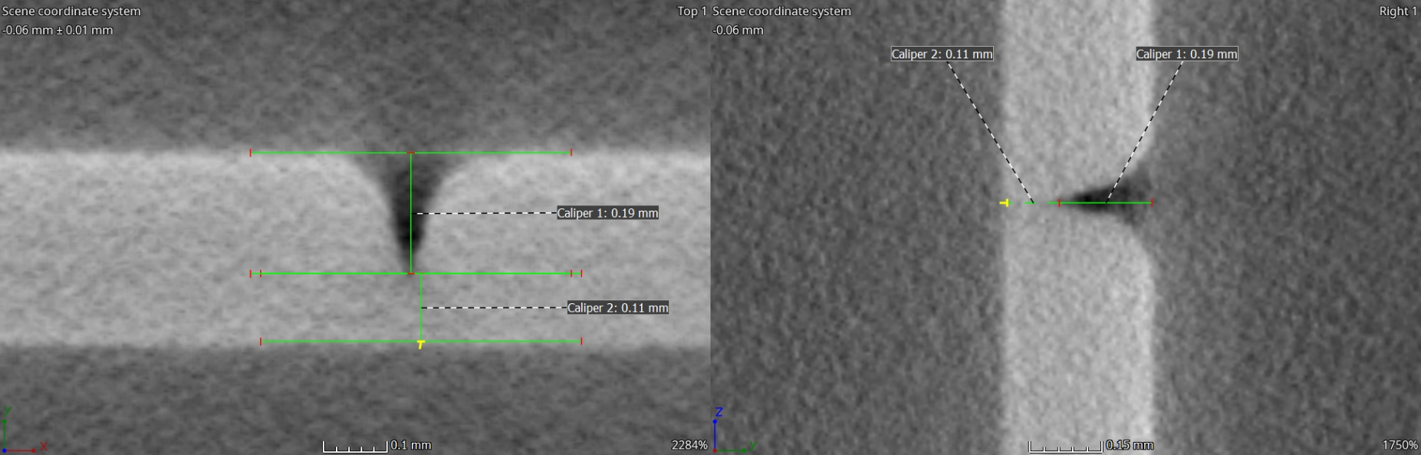
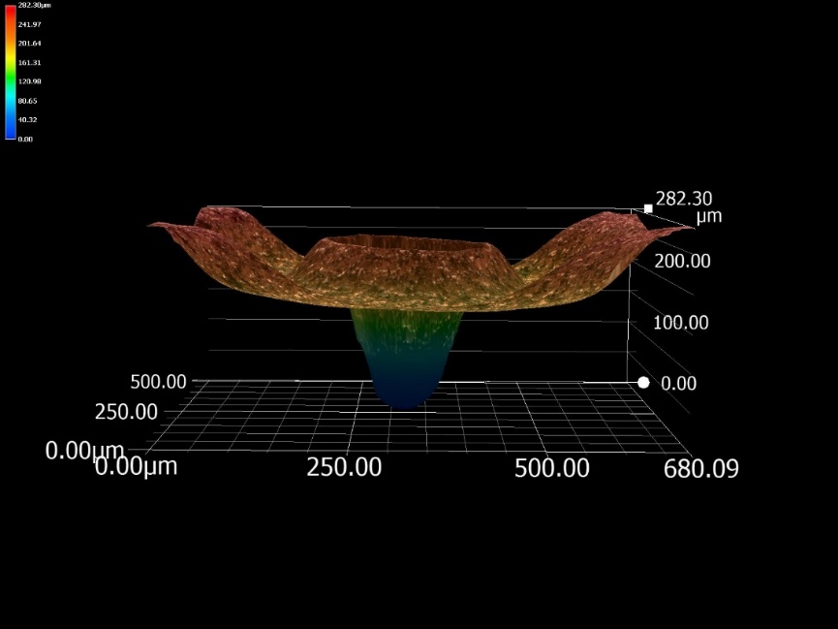
Convergent-Divergent (CD) Nozzles
CERN workshop EDM and Focused Ion Beam (FIB) divergent nozzle development
FIB nozzle now with Cockcroft institute for tests
Pictures Courtesy A. Cherif

Slide 24
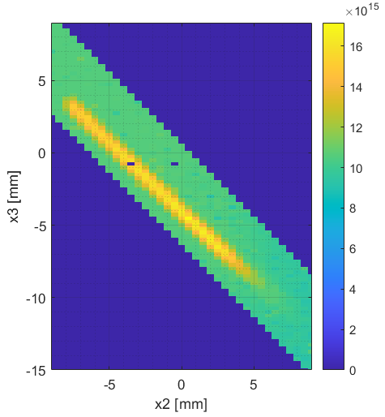
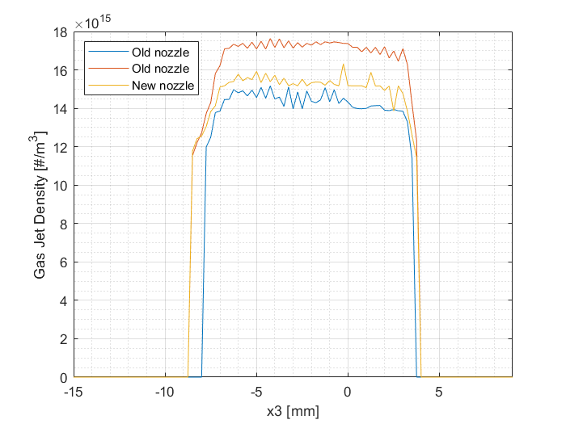
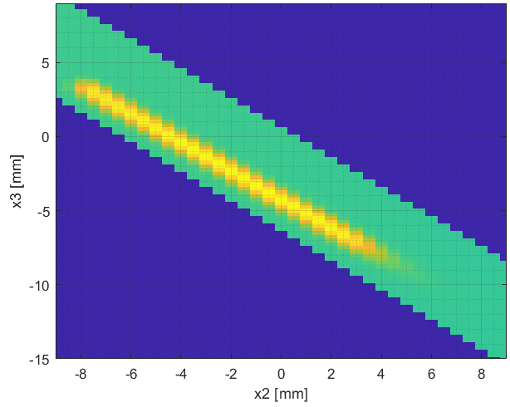
Old vs New nozzle

Slide 25
Summary for section II
Design, procurement and commissioning of V3 gas jet monitor
Demonstrated a beam profile measurement with much higher SNR than v2.
New configuration of nozzle-skimmer assembly shows a good gas jet property and easy of alignment.
The difference of CD nozzle and flat nozzle shows little difference.

Slide 26
Section III: NEG Experiments

Slide 27
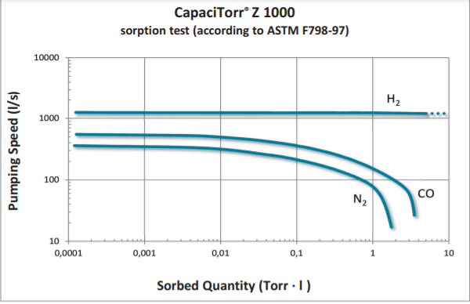
NEG Pump Introduction
CapaciTorr Z1000 installed in the Dump chamber and later re-located to the Interaction chamber, replacing the TMP’s installed in each chamber.
Once activated, the NEG pumps at 360L/s but slows as the getter material becomes coated with the sorbed molecules. Once fully saturated, all pumping will stop.
When reactivated, sorbed molecules are released or diffused into the bulk of the getter.

Slide 28
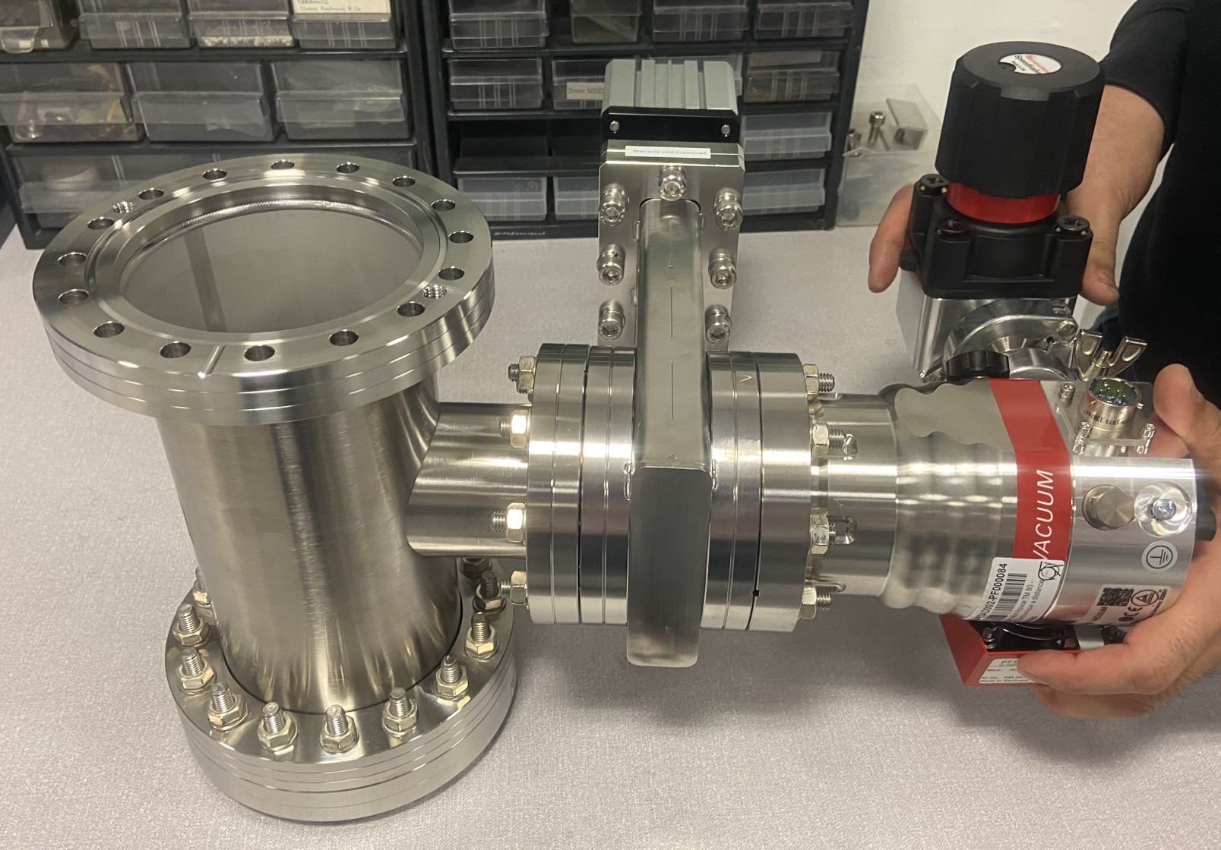
NEG Subsystem
Gate valve to isolate TMP from NEG during normal operation
100mm
NEG inside DN100 pipe
TMP used to reach activation pressure and pump released molecules during activation.

Slide 29
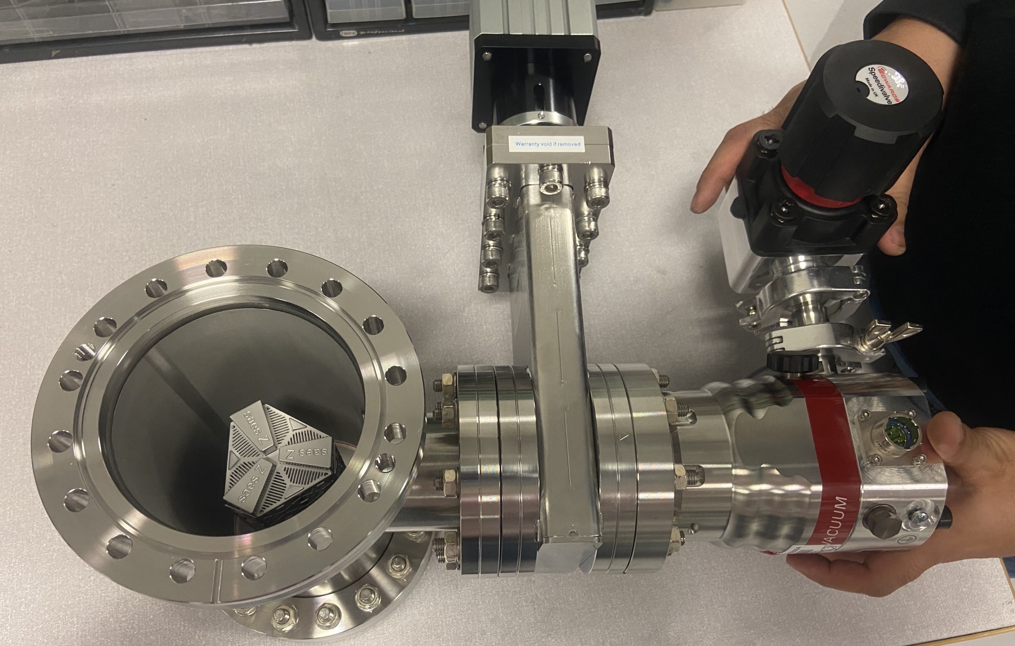
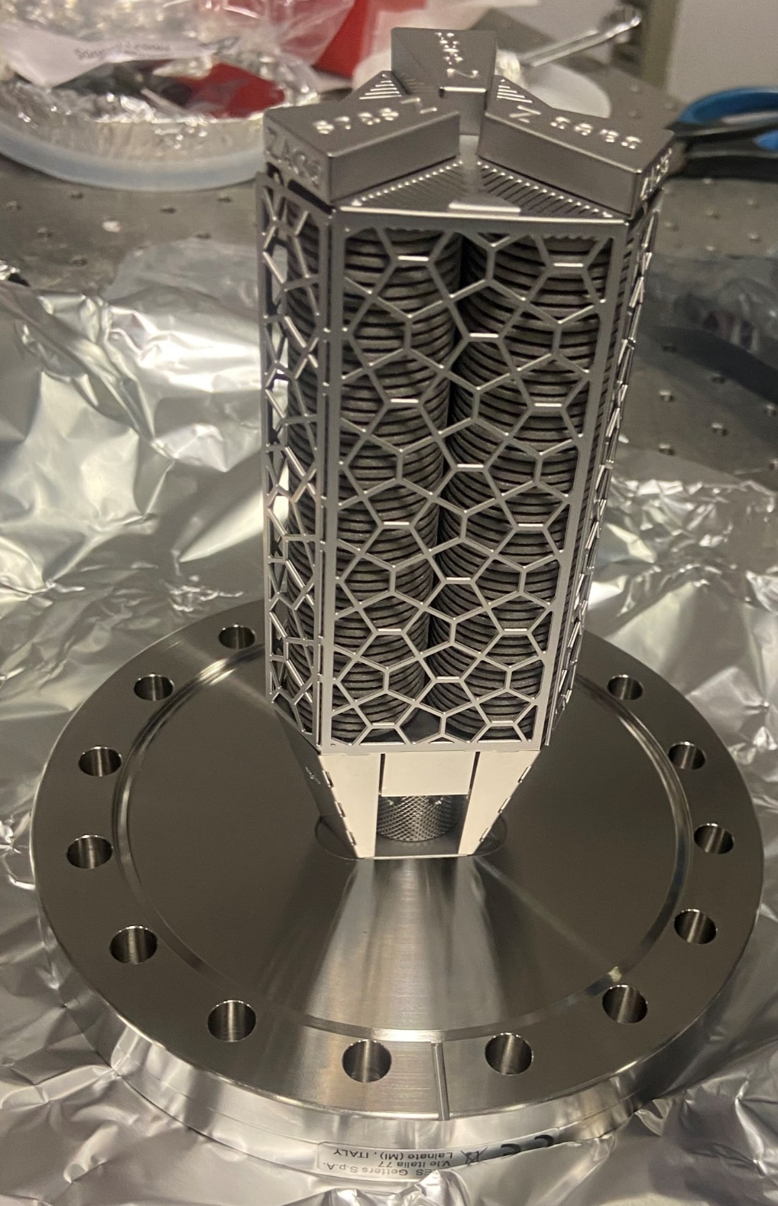
NEG Subsystem
100mm

Slide 30
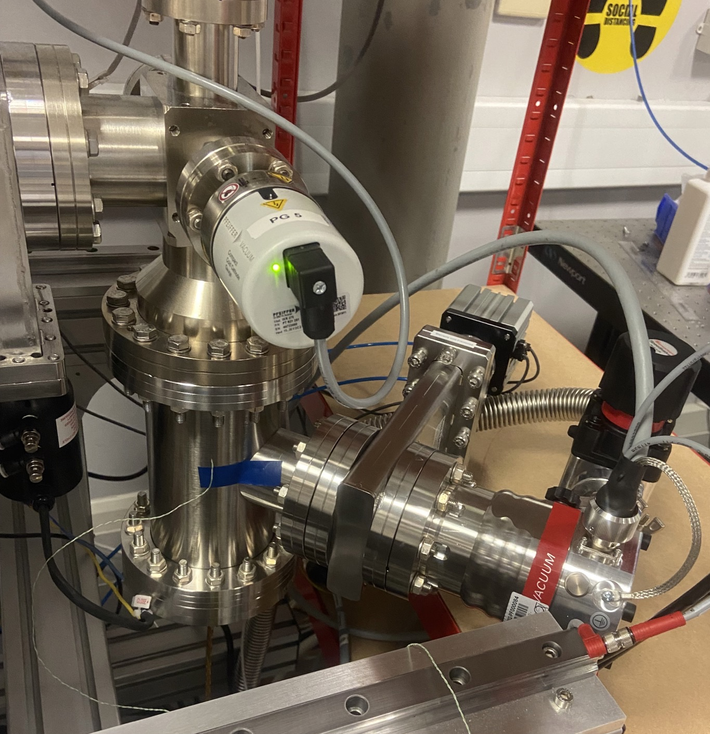
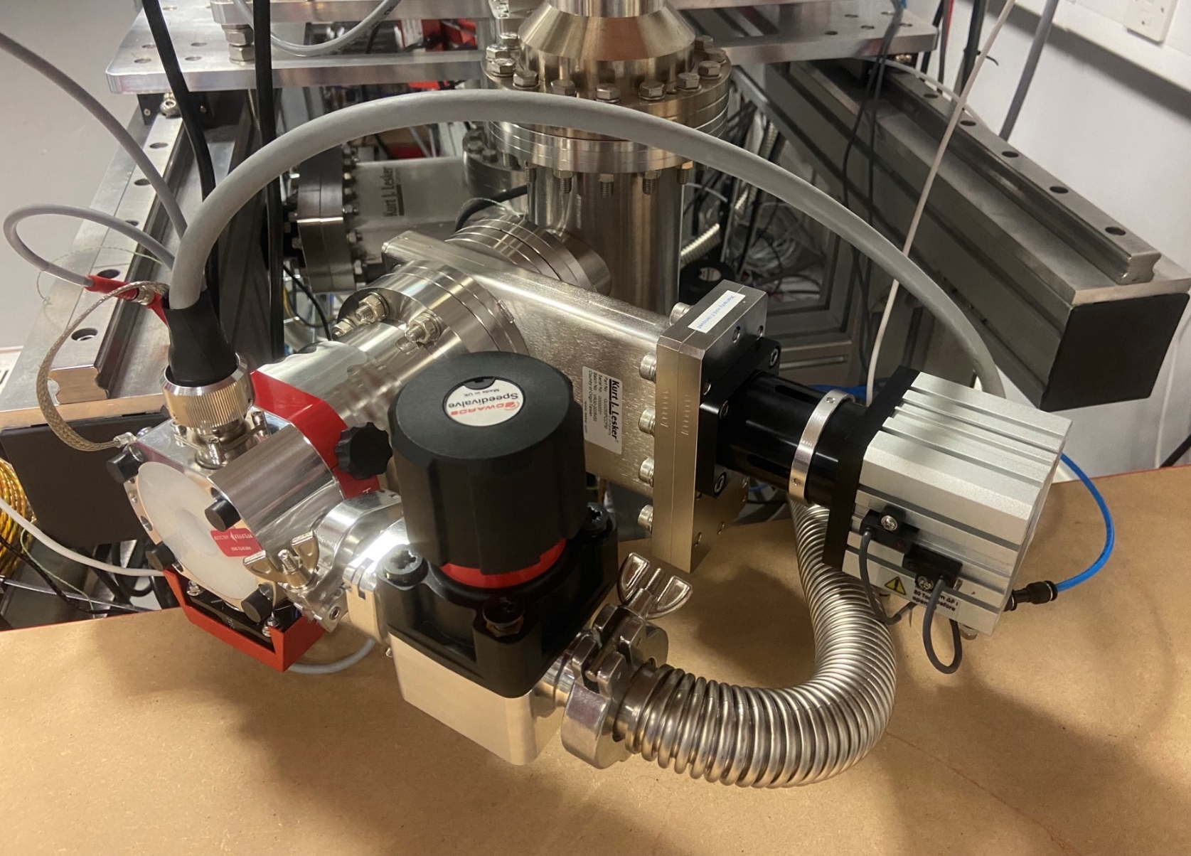
NEG Pump Installed in the Dump Chamber
All Jet tests use N2 at 5 bar

Slide 31
Dump Chamber Pressure
0.7x9mm skimmer saturates much quicker than 0.3x9mm skimmer due to increased volumetric flowrate to dump chamber.
  NEG pumping at max 360L/s
  NEG pumping speed reduced as getter surface becomes coated
  Pumping tends towards an equilibrium as NEG saturates and pumping is provided from diffusion effect through the 4th skimmer.
  Using the saturation curve from the larger skimmer, It is predicted that the smaller skimmer will reach an equivalent saturation after 13 days of continuous jet.
3
2
1
Data failed to save over weekend. Problem fixed.

Slide 32
Interaction Chamber Pressure
Interaction chamber follows a similar pressure curve to the Dump chamber.
There is a clear dependency between the interaction and dump chambers as a result of the diffusion effects through the 4th skimmer.
A maximum pressure of 1.75E-8 mbar is seen compared to the dump chamber maximum pressure of 5.73E-7 mbar.

Slide 33
Skimmer Chambers I and II Pressure
Near constant skimmer II chamber suggests NEG effects are independent of pressure data from nozzle to skimmer II chamber.
The skimmer I chamber is also near-constant with an increase in noise experienced.

Slide 34
Nozzle Chamber Pressure
Drop in nozzle chamber pressure of approximately 50% from initial jet.
Anticipated not a function of NEG saturation as nozzle chamber should be fully independent from NEG located in the dump chamber.
Likewise, pressure decrease between different 3rd skimmers should be relatively similar in the nozzle chamber. However, we see a discrepancy of 5 days.
Further testing required.

Slide 35
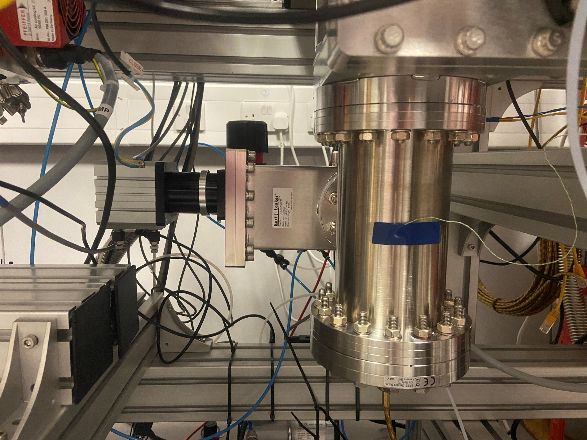
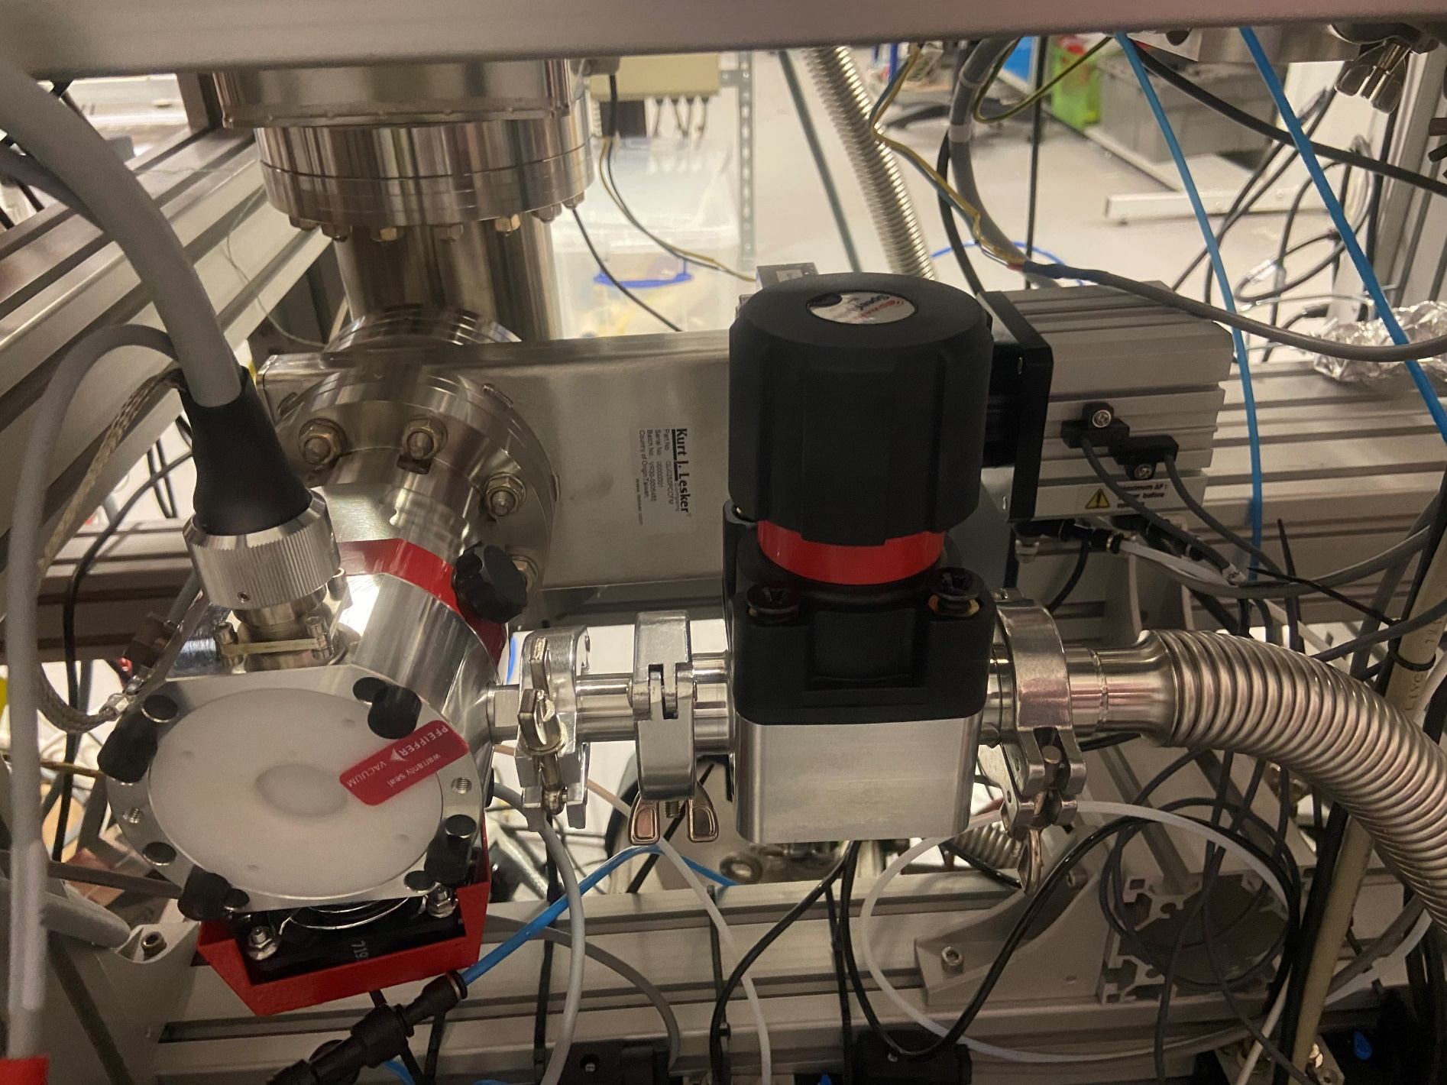
NEG Pump Installed in Interaction Chamber

Slide 36
Pump Down Pressure Data
E-7 mbar reached within 15 minutes of gauge on.
Full activation and NEG cooldown takes 3 hours and reaches E-9 mbar.
Anticipated minimum pump down from 1 bar & NEG activation should take 4 hours total to reach E-9 mbar.
NEG activation and TMP gate valve closed.
Left pumping over weekend. Maximum pressure required to activate NEG is E-4 mbar.

Slide 37
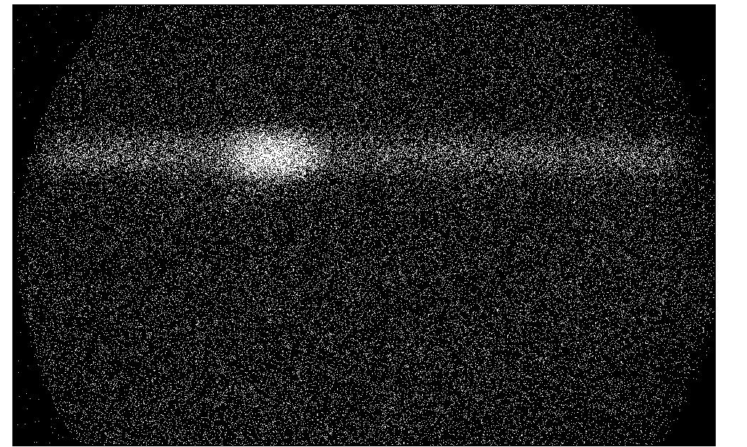
NEG Initial Results
0.7x9mm 3rd skimmer
100s integration time
0.60mA E-gun Emission
N2 @ 5bar
1mm

Slide 38
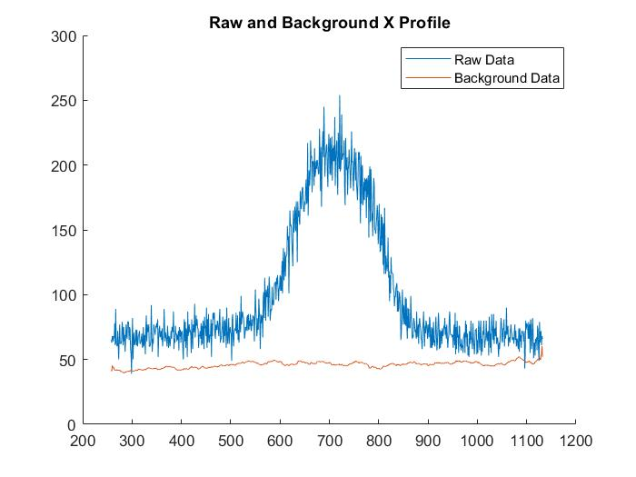
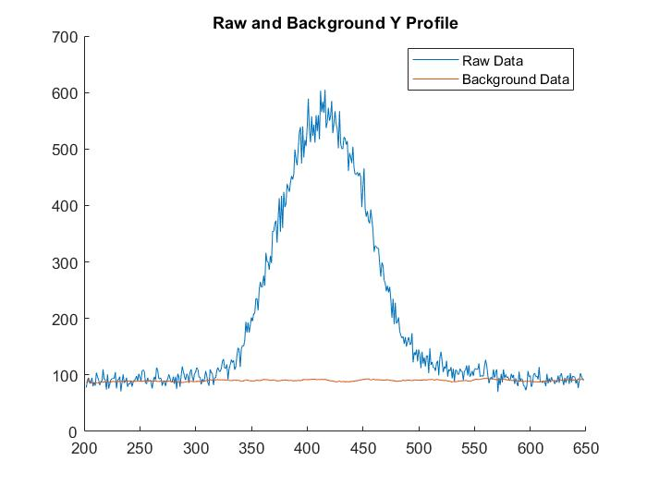
NEG Beam Measurement
 | NEG | TMP
Photon Rate / s⁻¹ | 290 | ~300

Slide 39
Dump, Interaction and Nozzle Chamber Pressures
Only 54 Hour Jet Time due to shipping time constraints.
Little to no noticeable change in Interaction and Dump chamber pressures over such a small time.
As with previous measurements, the Nozzle chamber appears to reduce again. Further evidence of a NEG independent trend.

Slide 40
Future Pressure Tests
Jet will be ran until pressure reaches a steady state and NEG can clearly be defined as saturated.
More pressure data collected for NEG located in the interaction chamber.
Pressure will be recorded with Jet for exclusively TMP pumping to observe nozzle chamber without a NEG installed.

