Slide 1

Electron Beam Test Stand (EBTS)
A. Rossi for the EBTS team
BGC Collaboration meeting
30/03/2022
CERN

Slide 2
EBTS current team
Sameed Muhammed– Senior physicist fellow (2y) and Fredrik Wenander – Senior physicists and expert in beam sources (strong support from BE-ABP-HSL for first phase)
Wilfried Devauchelle- electrical technician + student (interlocks)
Alexandre Frassier- electrical engineer (HV)
Ashley Churchmann mechanical technician and Jean Cenede mechanical engineer (design EBTS + integration)
Students George Bantemits (BI motor control and BPM) + Lukas Golino (readout)
Manfred Wendt – Senior electrical engineer, expert in BI & BPM
Technical support from industrial support for cabling and similar
Acknowledging the work of Sergey Sadovich

Slide 3
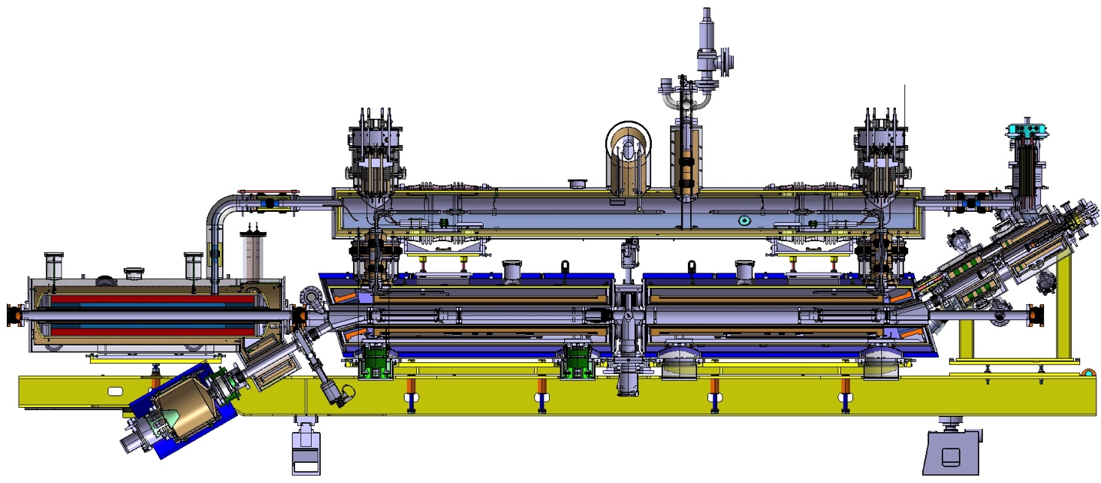
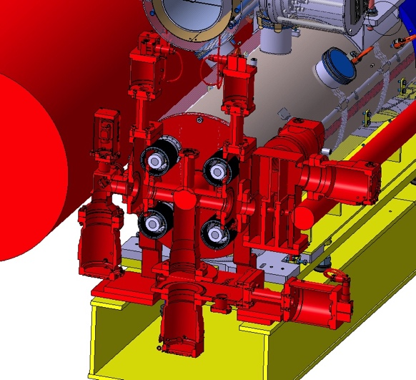
Latest design of the Hollow Electron Lens
Ioannis Papazoglou
Antti Kolehmainen

Slide 4
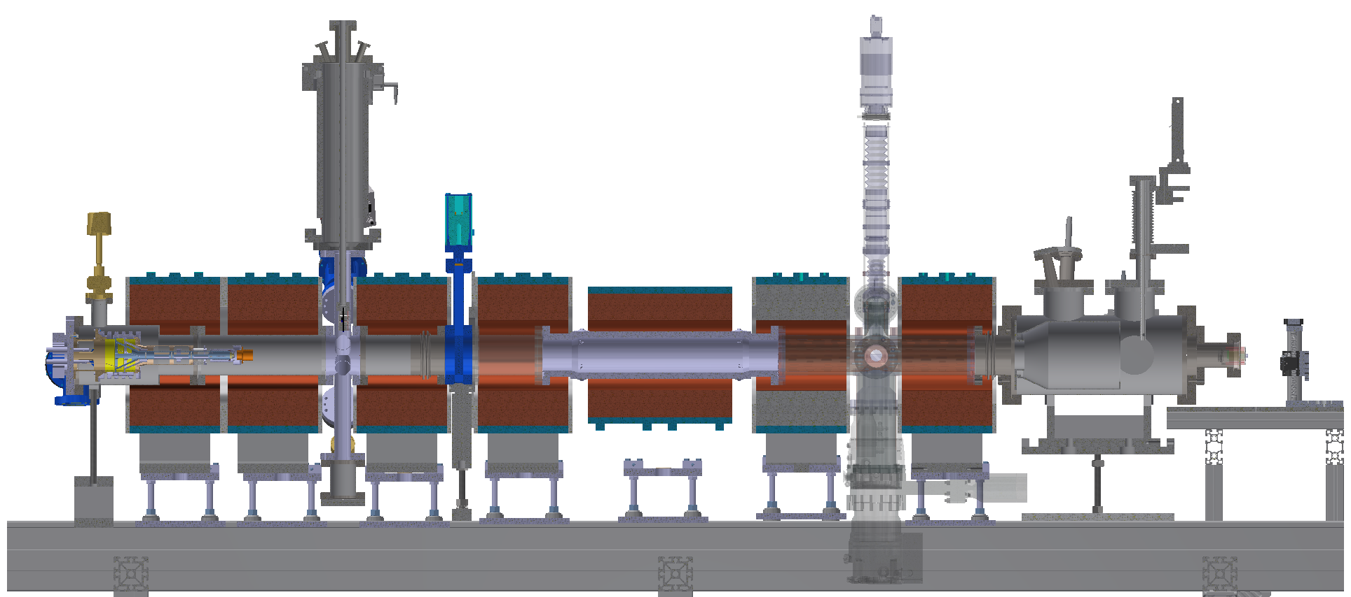
Electron Beam Test Stand
Beam Diagnostics Box
Sector Valve
BGC
Collector
BPM
E-Gun
Sergey Sadovich

Slide 5
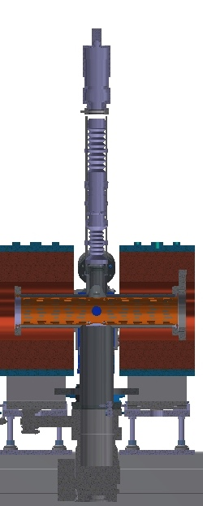
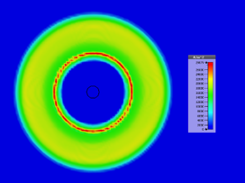
EBTS scope and experimental programme: BGC
BGC prototype for LHC measurements:
  Validation of prototype with HEL beam type
See Ashley’s for EBTS layout and installation
Hollow Beam D_{ext} ~16 – 30 mm
Steering ± 5mm
Energy ≥ 10 keV
Pulsed mode: 100us at 5A at 10Hz ≈ 5mA average
  Presently limited by passively cooled collector
  Repetition rate can be increased using water-cooled collector up to HEL nominal parameters (Anode Modulator is also needed), or DC beam

Slide 6
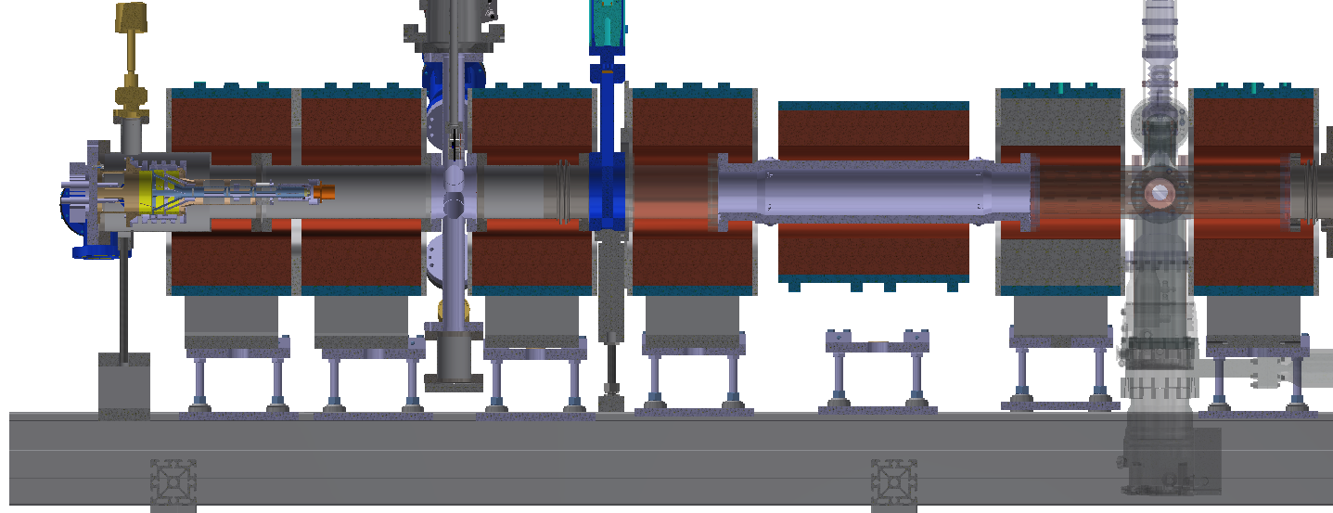
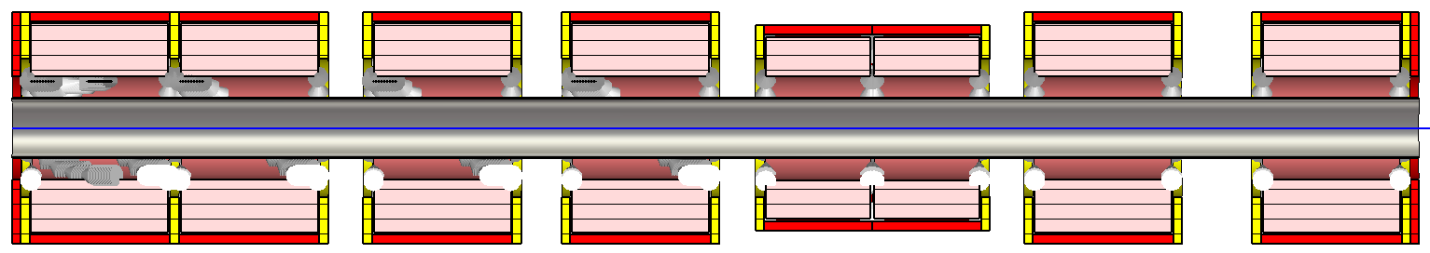
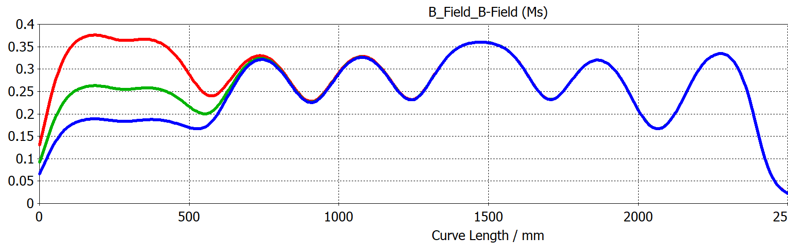
EBTS: Beam Size.
BGC
120mm
800A
560A
400A
* Current at Gun Solenoid
16 – 30 mm at 5A
Offset: ±5mm H/V
Sergey Sadovich

Slide 7
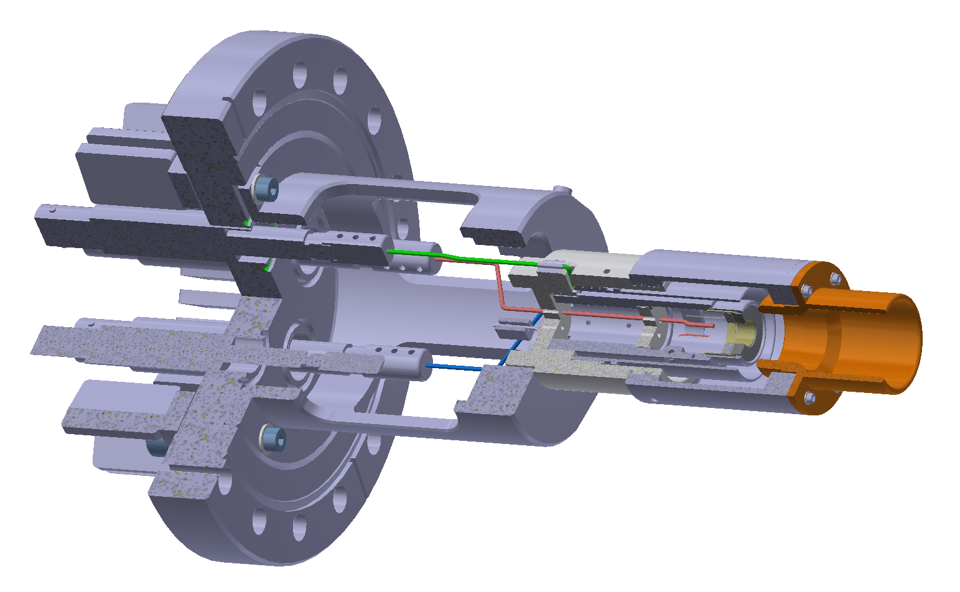
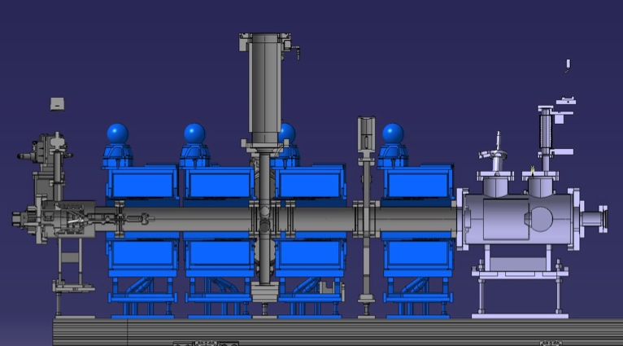
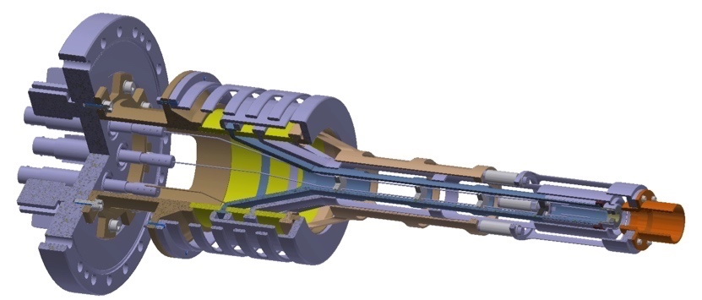
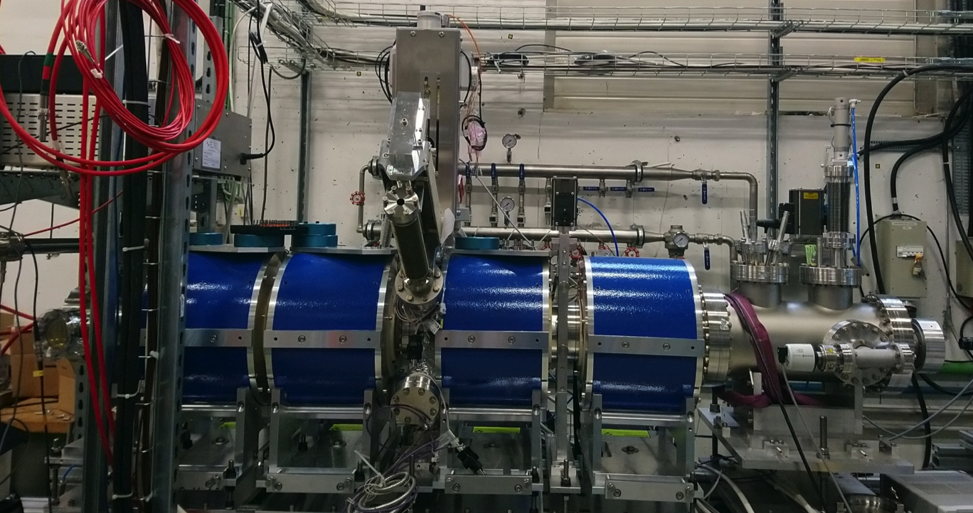
EBTS scope and experimental programme: e-GUN
Characterisation of HEL e-gun prototype II: full scan I(T,V)
First prototype 2019
Second prototype
  Tested: small current due to old cathode
  New cathode being activated
A. Churchman
D.Perini, A.Kolehmainen CERN

Slide 8
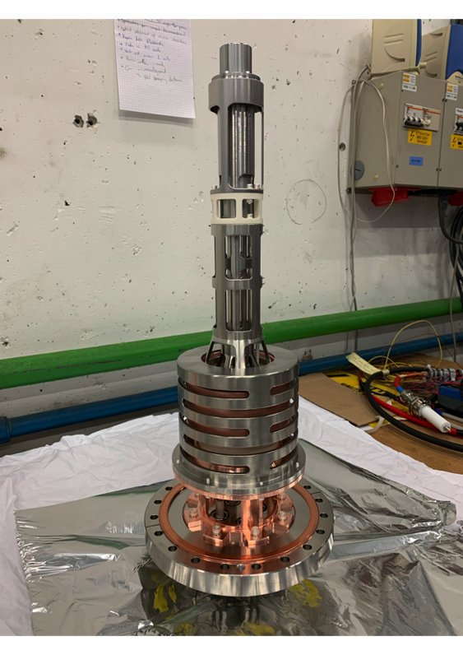
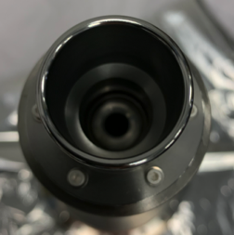
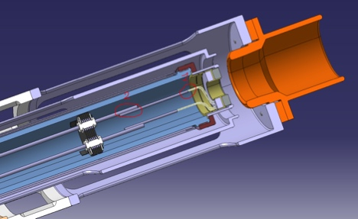
EBTS scope and experimental programme: e-GUN
A. Kolehmainen

Slide 9
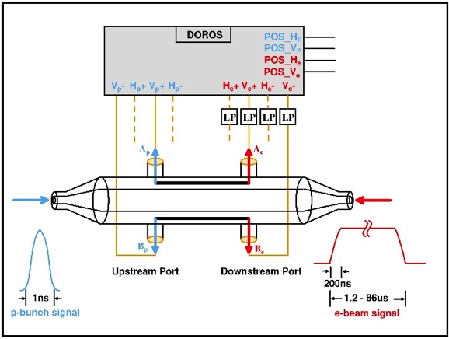
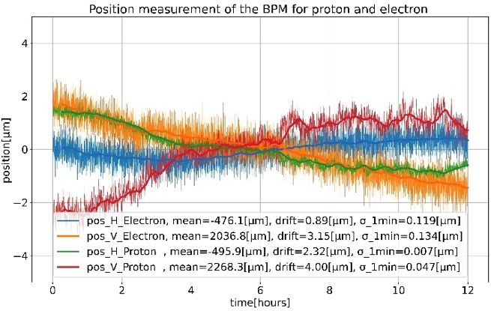
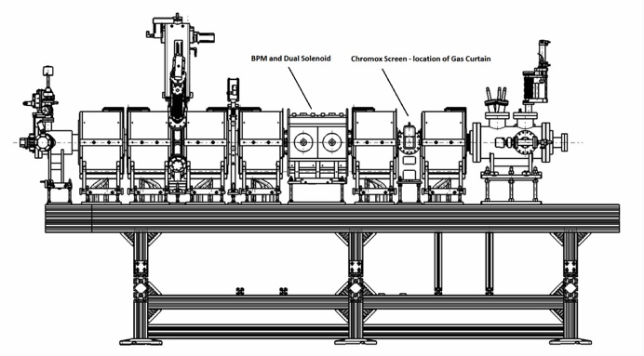
EBTS scope and experimental programme: BPM
Strip-line BPM: experimental confirmation of e-beam measurements with HEL type beam
Numerical simulations and laboratory measurements demonstrate the feasibility of measuring both ~ DC e-beam and bunched LHC beam, with < 2um difference
G. Bantemits et at. IBIC2021
Planned to be mounted ~ May 2022
See A. Churchman’s

Slide 10
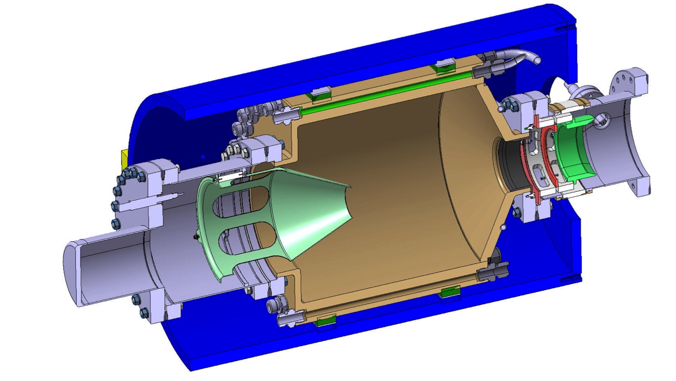
EBTS scope and experimental programme
Collector prototype & powering:
  High Voltage behaviour
  Thermomechanical resistance
  Efficiency for electron collection and vacuum
  HV powering: coping with
  large power pulsed
Material procurement (1/2 done)
and construction planned

Slide 11
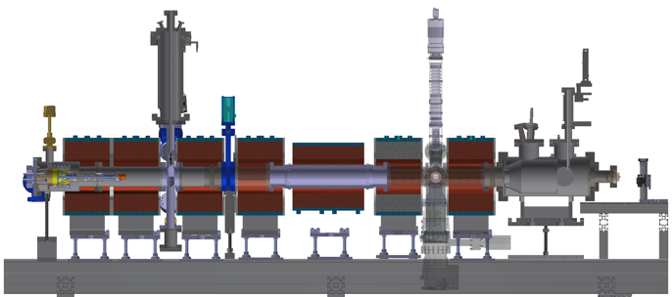
Planning 2022
Jan
Feb
Mar
Apr
May
Jun
Jul
Aug
Sep
Oct
Nov
Dec
Stage 1
Stage 2
Stage 3
Gun characterisation
BPM
BTV
BGC
BDB (FC and YAG Commissioning)
Interlocks
Corrector magnets

Slide 12
Thank you for your attention.
Notes:
Merci encore pour tout le travaille a faire aar Adirana et Frederik.

