Slide 1
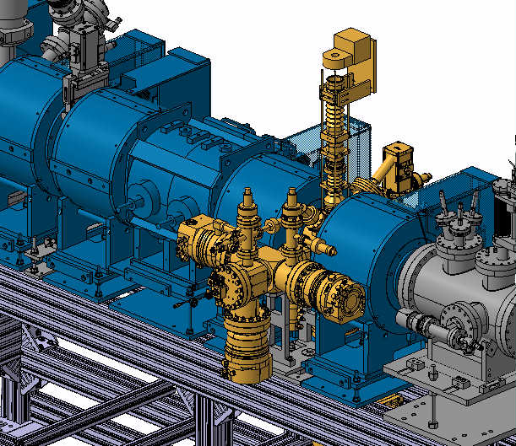

Beam Gas Curtain V3 (BGC) on the Electron Beam Test Stand (EBTS)
Ashley Churchman – SY-BI-ML, CERN
BGC Collaboration meeting
30/03/2022
CERN

Slide 2
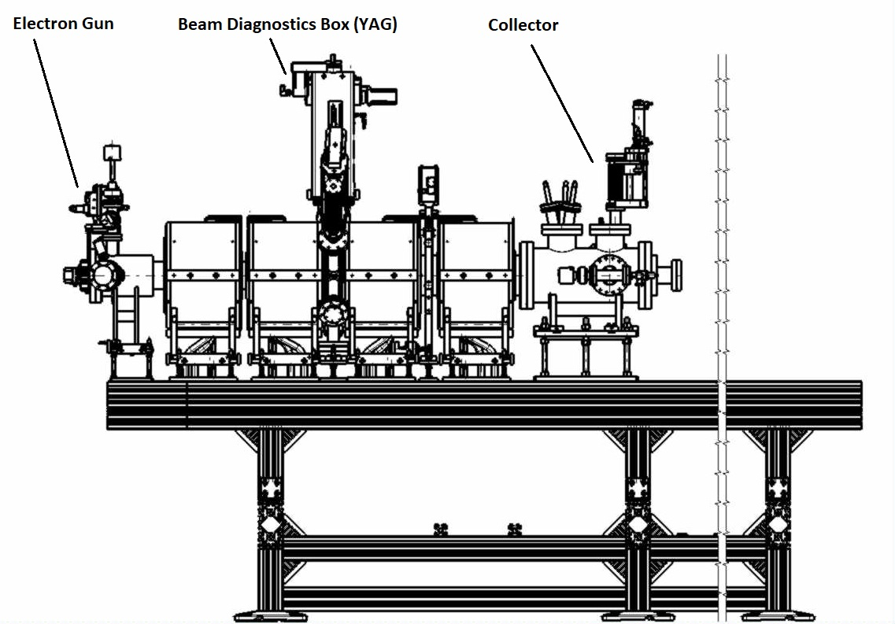
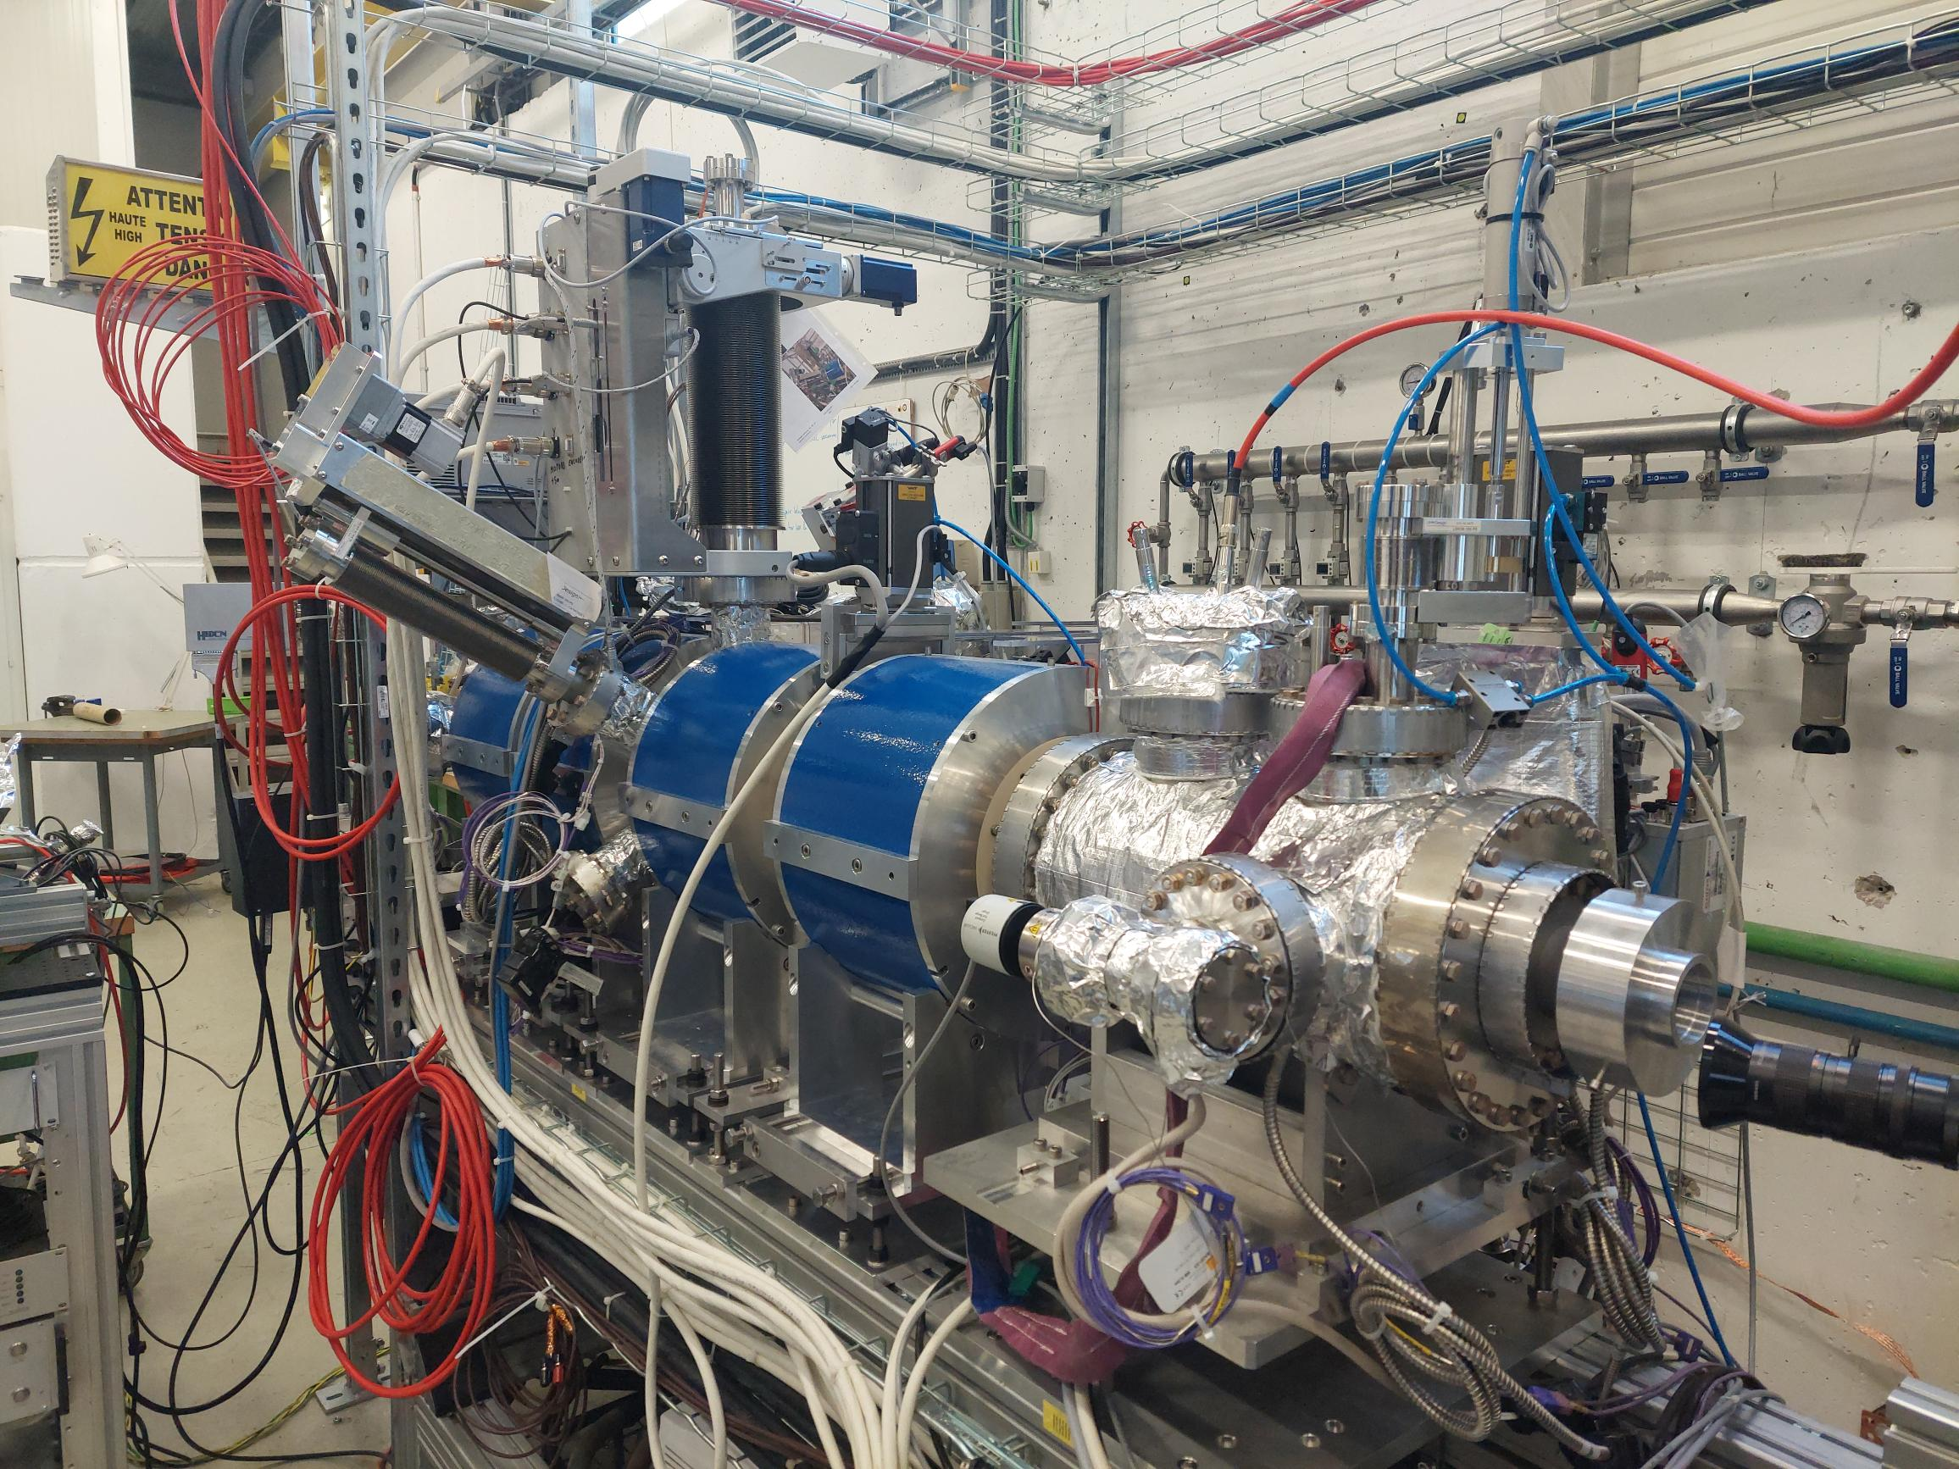
EBTS – Phase 1; Electron Gun & Collector.
Current situation
Notes:
Current phase of the EBTS.
Primary assets are the Electron Gun, BDB and Collector.
There is also a Sector Valve and x4 Solenoid magnets.

Slide 3
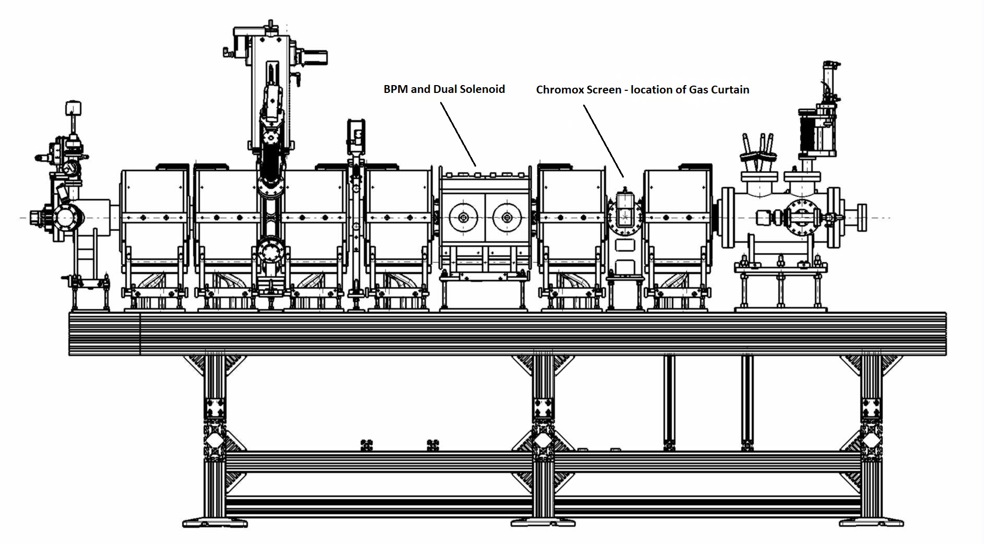
EBTS – Phase 2; BPM & Chromox Screen
Notes:
Once the Electron gun has been commissioned, we will progress to Phase 2.
This includes the addition of the BPM, Chromox ‘BTV’ and an additional 3 Solenoid Magnets.

Slide 4
EBTS – Phase 2; Chromox Screen details
65x45x0.3mm.
Magnetically coupled & pneumatically actuated ‘push/pull’ mechanics.
Housed within DN100 ‘cross’ (270x270mm).
Notes:
At the nominal position of the Gas Curtain.
With tolerance for some slight Beam Steering – Magnets.
In respect to planning – the Screen is due to arrive at CERN in mid-April.
The additional mechanical pieces are being manufactured by the SY-BI workshop.

Slide 5
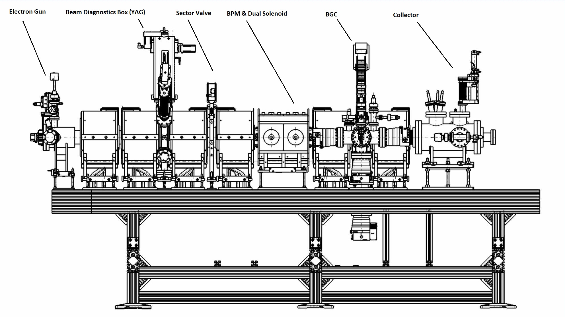
EBTS – Phase 3; BGC installation.
Notes:
Quick re-cap of all pieces of instrumentation on EBTS.

Slide 6
EBTS – Phase 3 installation procedure (1)
Step 1 – Remove Gas Injection, Dump Chamber and interaction Pump.
Step 2 – Mount BGC onto Support.
Step 3 – Assemble DN100 Beam-pipes and BPM onto BGC.
Notes:
Step by Step process to install the Beam Gas Curtain onto the EBTS.
The BGC assembly will be handled using the overhead crane of B236.
Additional Aluminium supports will be used. This is for critical additional support.

Slide 7
EBTS – Phase 3 installation procedure (2)
Step 4 – Slide BGC/BPM assembly through each Solenoid.
Notes:
The sub-assembly will be DELICATELY slid through the Solenoids.
The support will be transitionally used between the Solenoids.

Slide 8
EBTS – Phase 3 installation procedure (3)
Step 5 – Mount BGC assembly to Sector Valve, using silver coated studs.
Step 6 – Re-mount Gas Injection, Dump chamber and Interaction Pump.
Step 7 – Mount DN100 Spacer and Bellow.
Notes:
Mounting of Sub assembly to Sector Valve is achieved via x8 M6 Silver coated Studs.

Slide 9
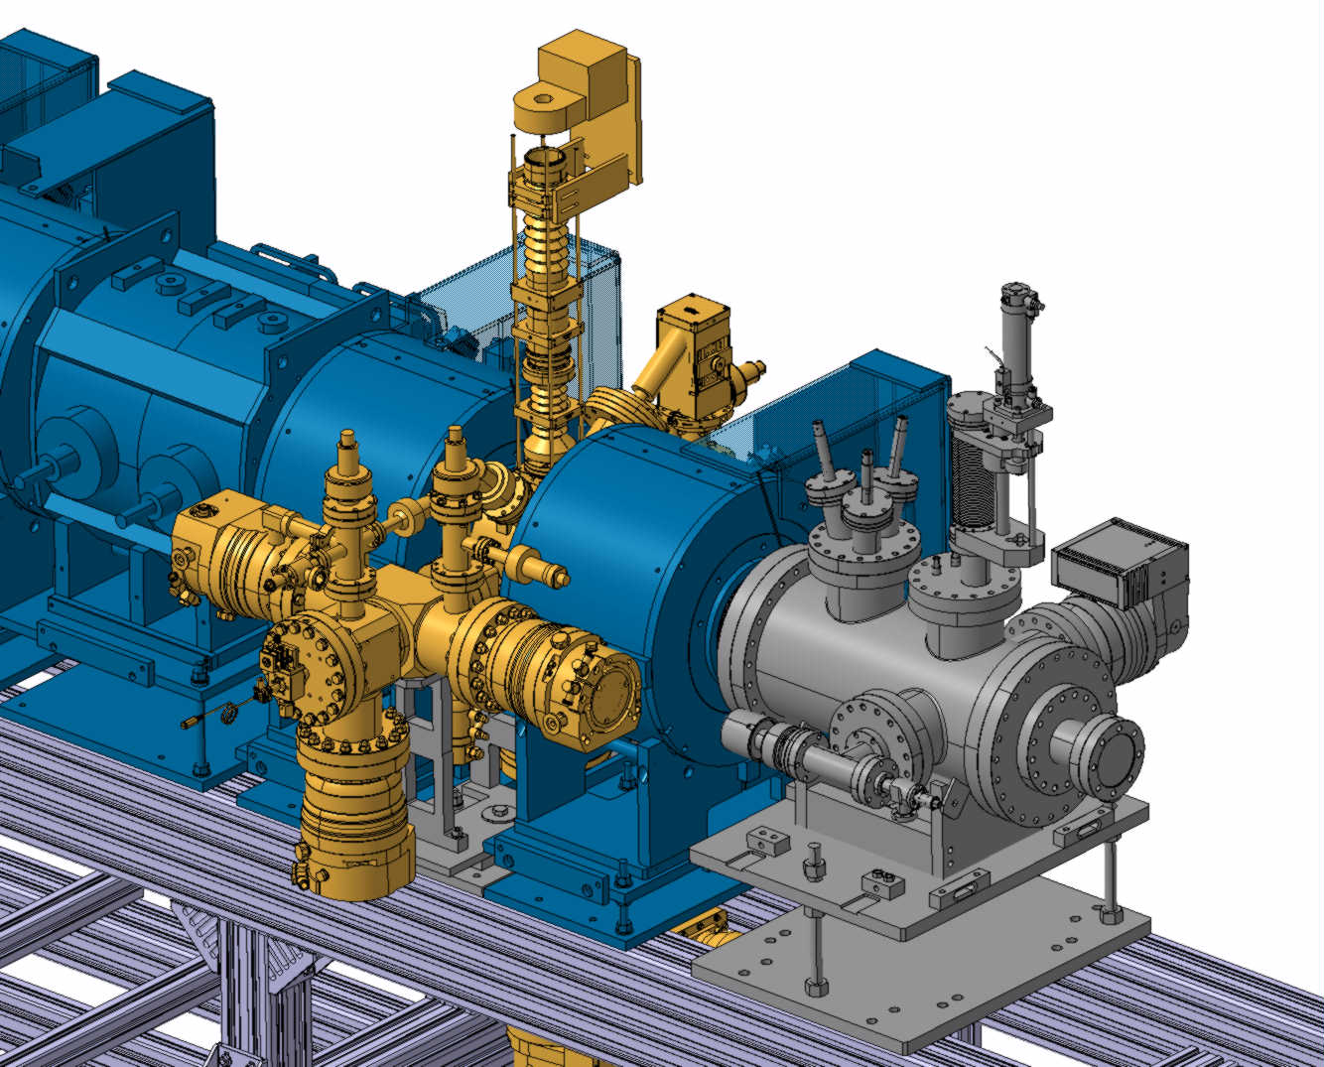
EBTS – Phase 3
Step 8 – Align Solenoids to Vacuum assembly, using existing positions for reference.
Step 9 - Slide final Solenoid over the BGC/DN100 pieces.
Step 10 – Mount Collector to EBTS and connect to DN100 Bellow.

Slide 10
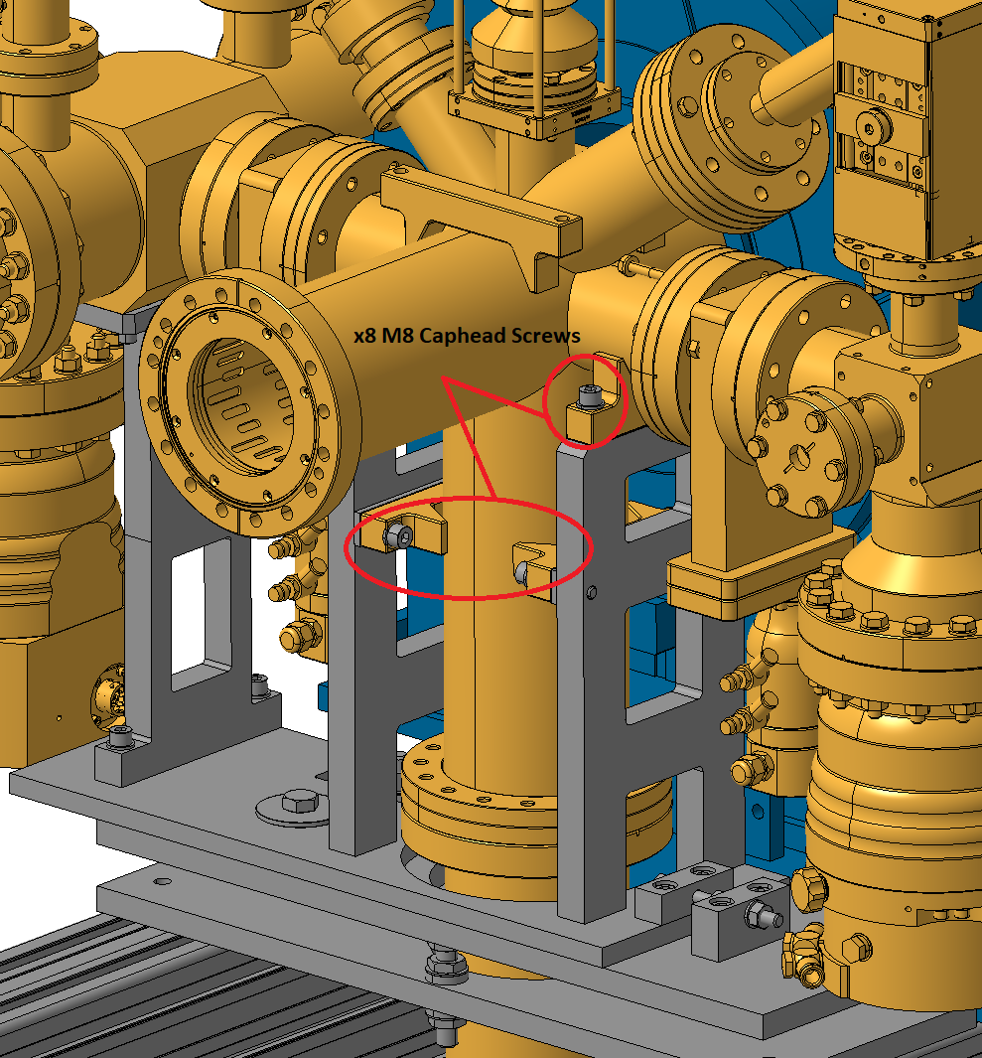
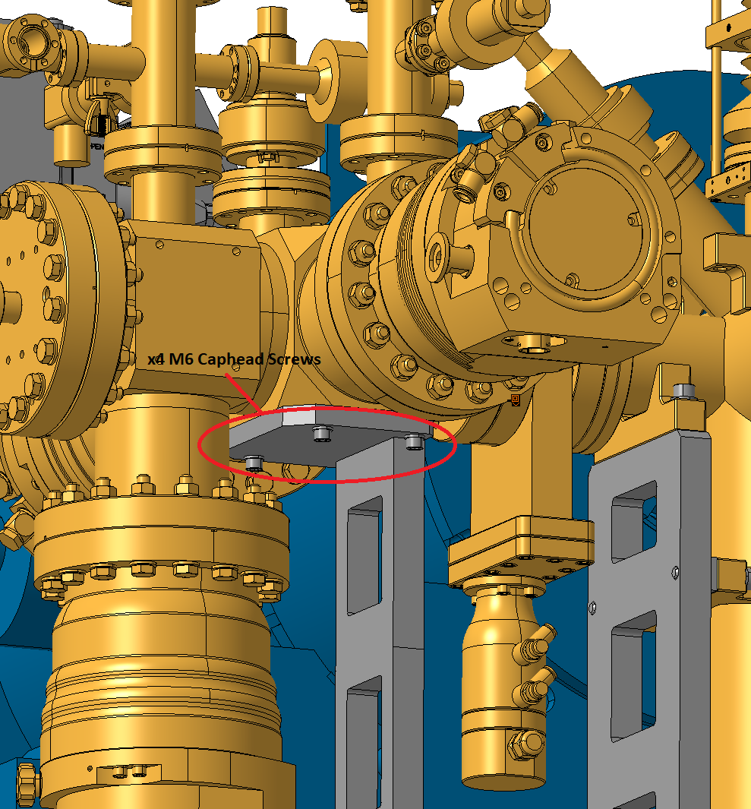
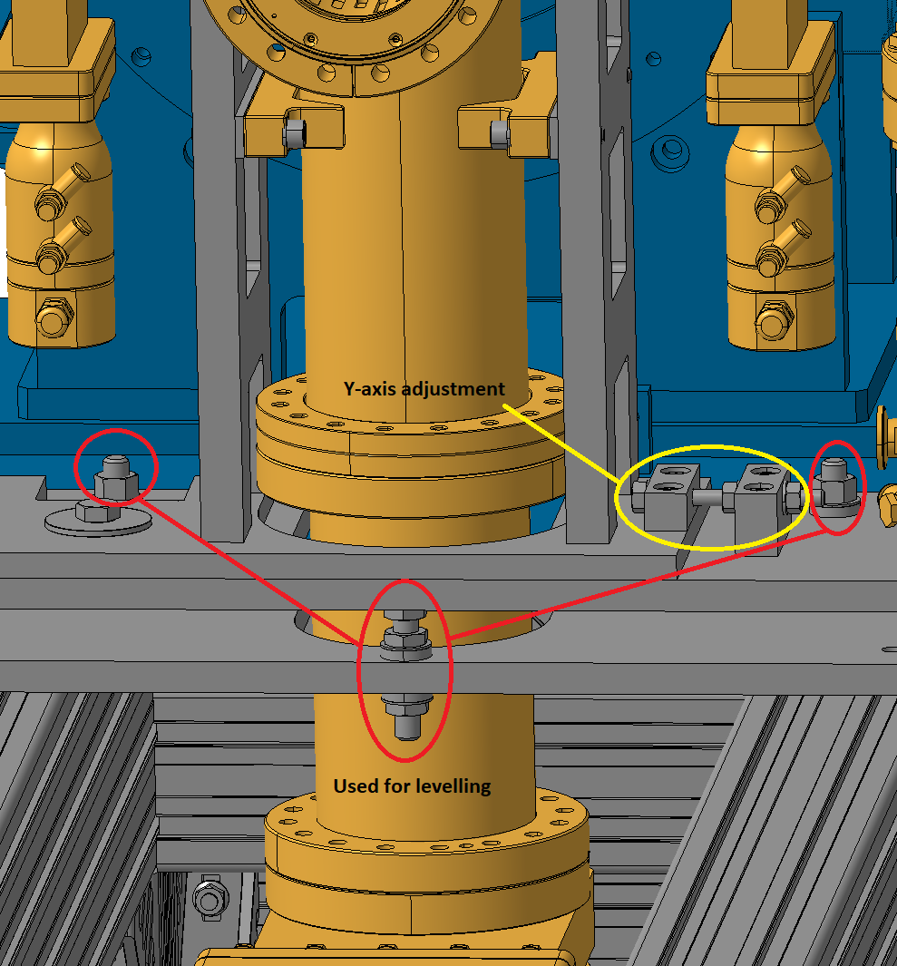
EBTS – Phase 3
BGC Support
Notes:
The BGC is mounted to the support via x8 M8 & x4 M6 Caphead Screws.

Slide 11
Thank you for your attention.

