Slide 1
BGC Version 3 at CERN
O. Sedlacek, H. Zhang, O. Stringer, S. Mazzoni
30.03.2022

Slide 2
Outline
Arrival
Current Installation
Future plans
Experimental plans for EBTS

Slide 3

Journey of V3 at CERN
Arrival of V3 to CERN
Future development as a stand-alone
Installation and commissioning of V3 on EBTS
17th of March!
Installation of V3 at LHC
1
3
5
V3 transport from Cockcroft to CERN
2
4
6
Installation and commissioning as a stand-alone
Scintillating screen tests at EBTS
Experiments of V3 on EBTS

Slide 4

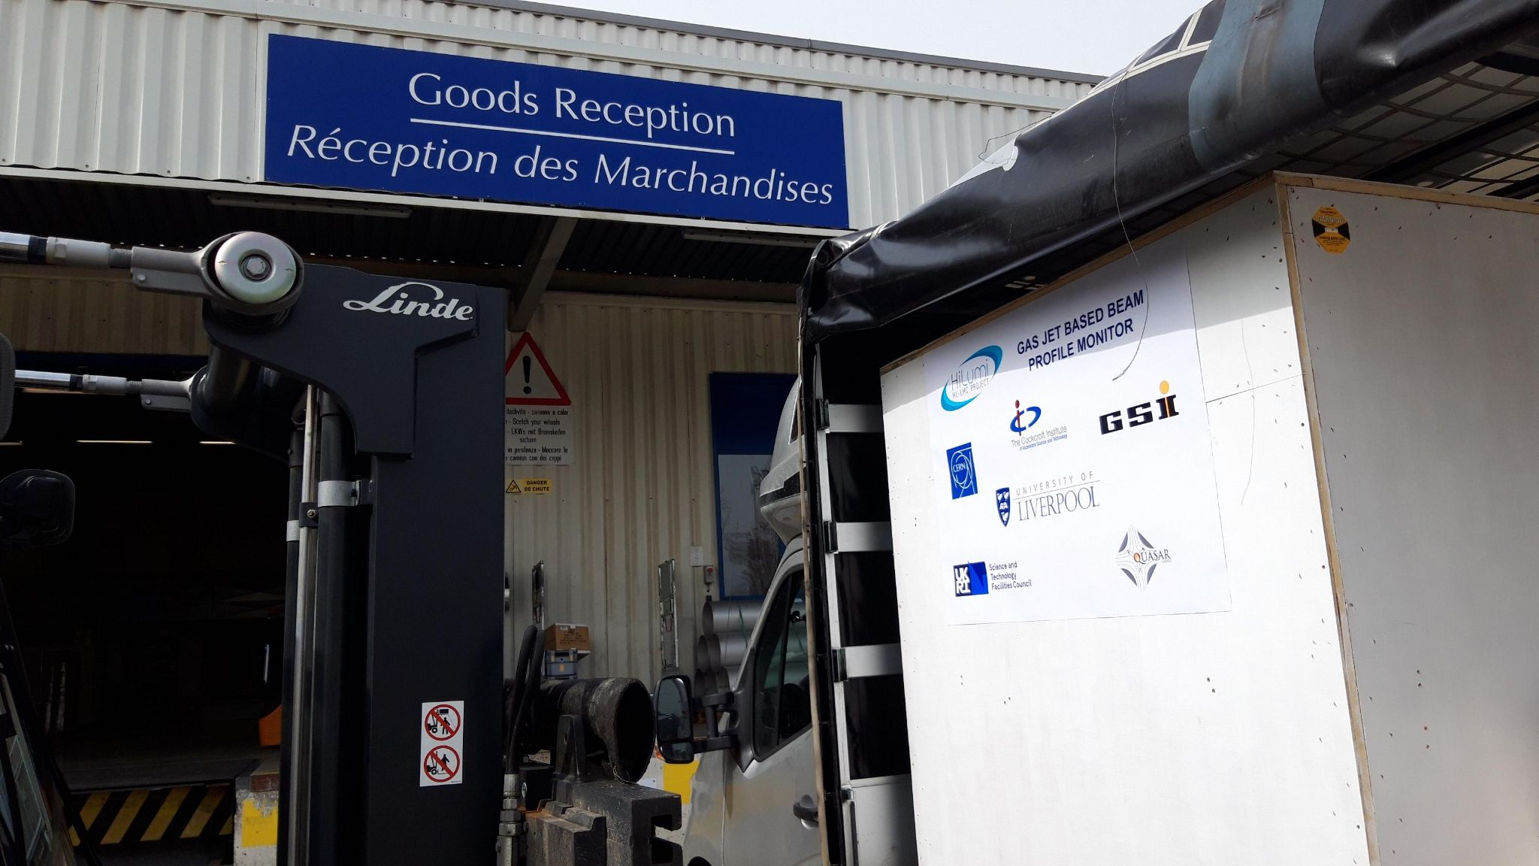

Want big impact? Use big image.
Version 3 of Gas Jet monitor installed at CERN!
O.Sedlacek, H. Zhang, O. Stringer, S. Mazzoni BGC collaboration meeting - 30.03.2022

Slide 5
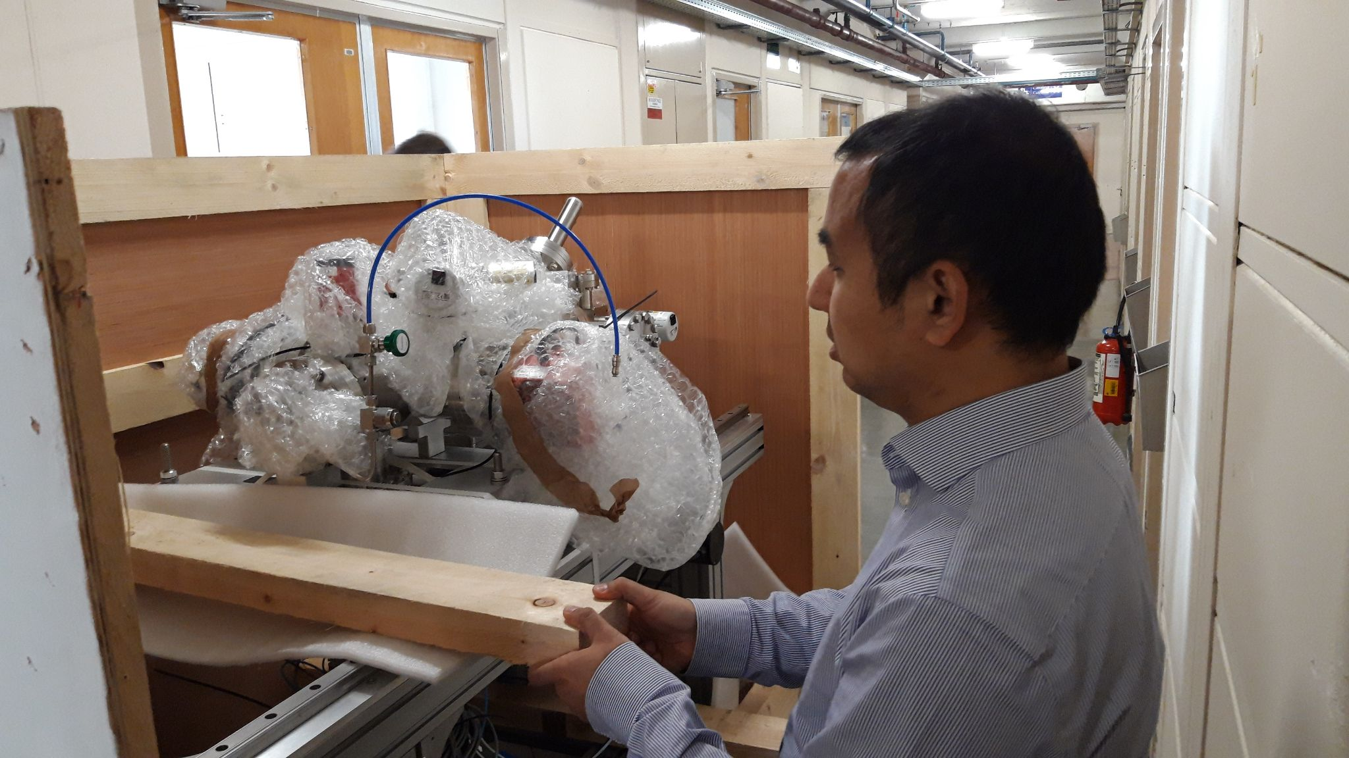

Want big impact? Use big image.
Version 3 of Gas Jet monitor installed at CERN!
O.Sedlacek, H. Zhang, O. Stringer, S. Mazzoni BGC collaboration meeting - 30.03.2022

Slide 6

Journey of V3 at CERN
Arrival of V3 to CERN
Future development as a stand-alone
Installation and commissioning of V3 on EBTS
Installation of V3 at LHC
1
3
5
V3 transport from Cockcroft to CERN
Currently!
4
6
2
Scintillating screen tests at EBTS
Experiments of V3 on EBTS
Installation and commissioning as a stand-alone

Slide 7
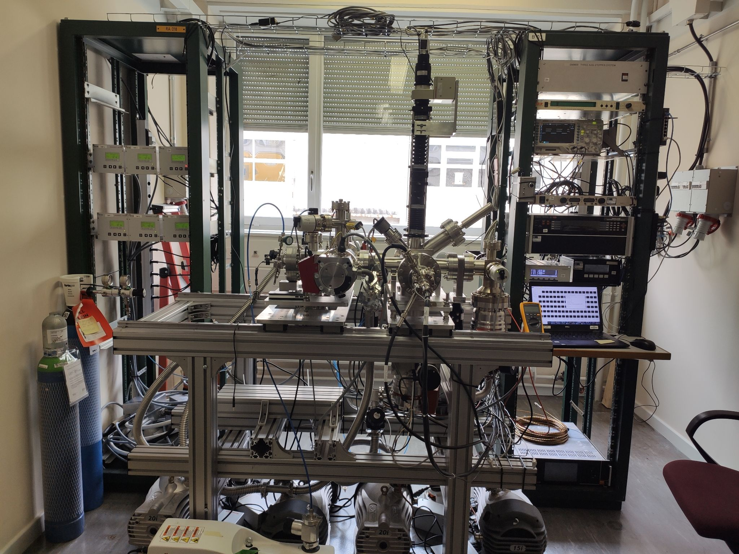
Want big impact? Use big image.
Version 3 of Gas Jet monitor installed at CERN!
Notes:
Get a new picture

Slide 8
Current status of V3 at CERN
Nozzle-Skimmer assembly realigned
  Alignment setup in lab 865/1-A04
  Alignment laser on V3 check successful!
System closed
  Last Friday (25.3.) pumping started
  After cca 25min - pressures ~ 10⁻⁷ mbar
  After cca 70h - pressures: 10⁻⁸-10⁻⁹ mbar
-> Successful system pump down!

Slide 9
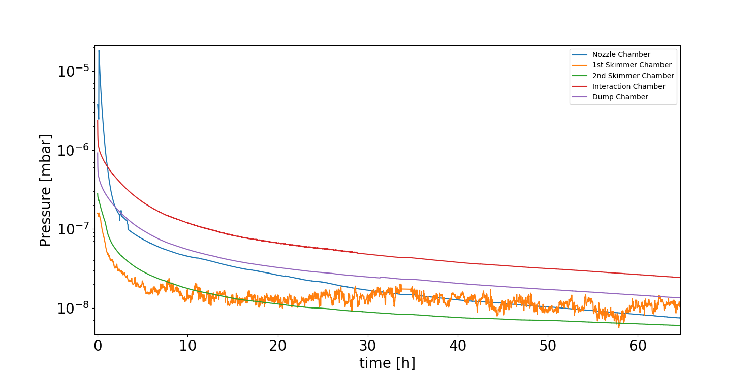
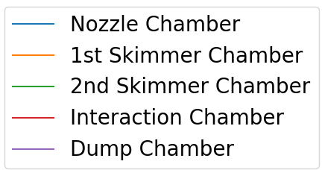
Pressures during pump down

Slide 10
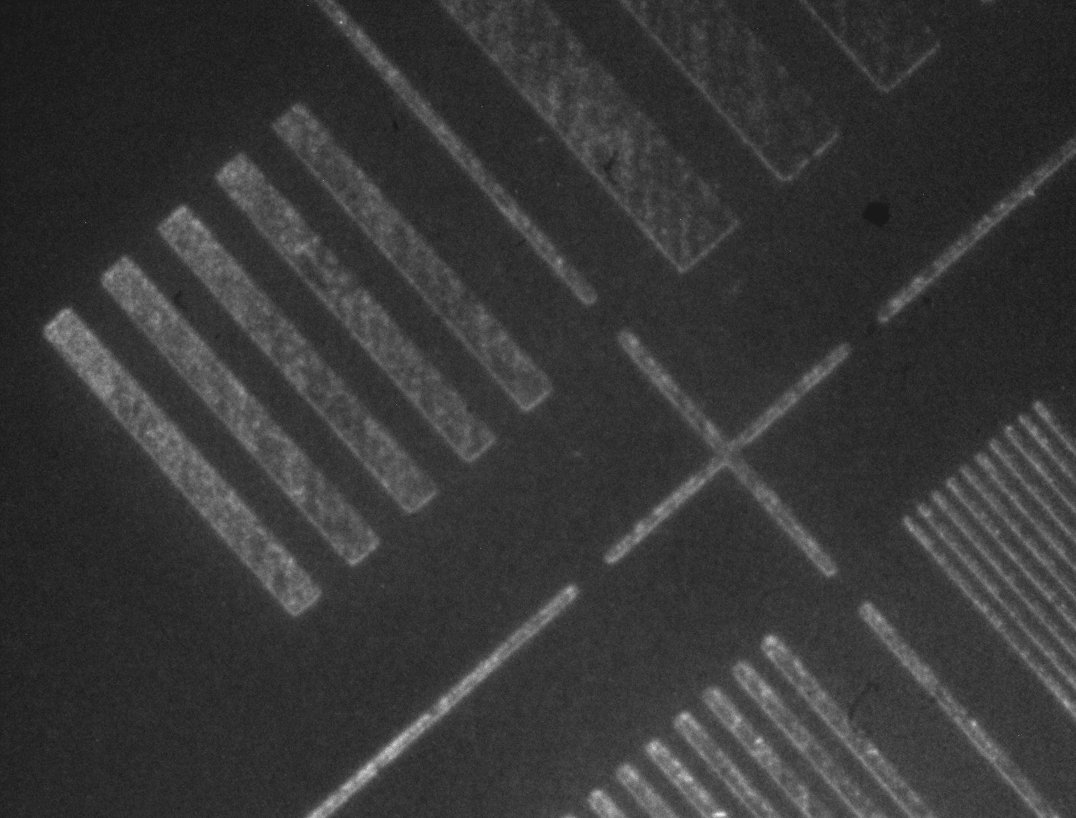
Current status of V3 at CERN
Intensified camera
  Hamamatsu camera installed
  Custom mount
  Focused on the target
Gas Jet tested - Successful!
Electron gun
  Tested and ready
-> System ready for gas jet measurements!

Slide 11
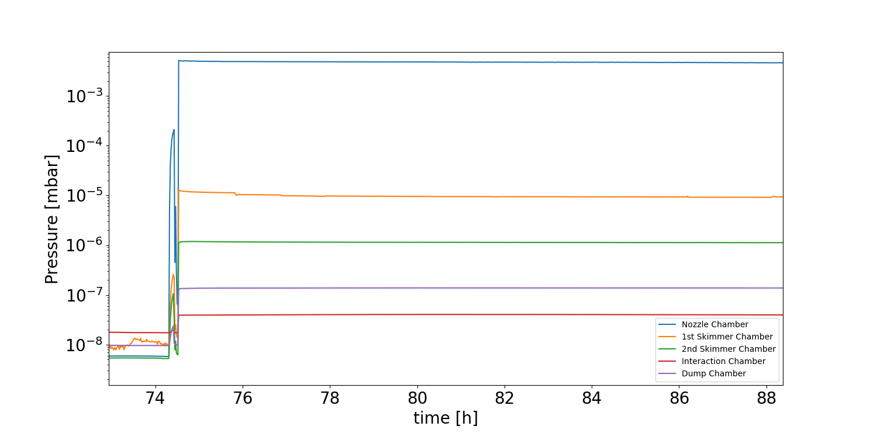
Pressures with Gas jet

Slide 12
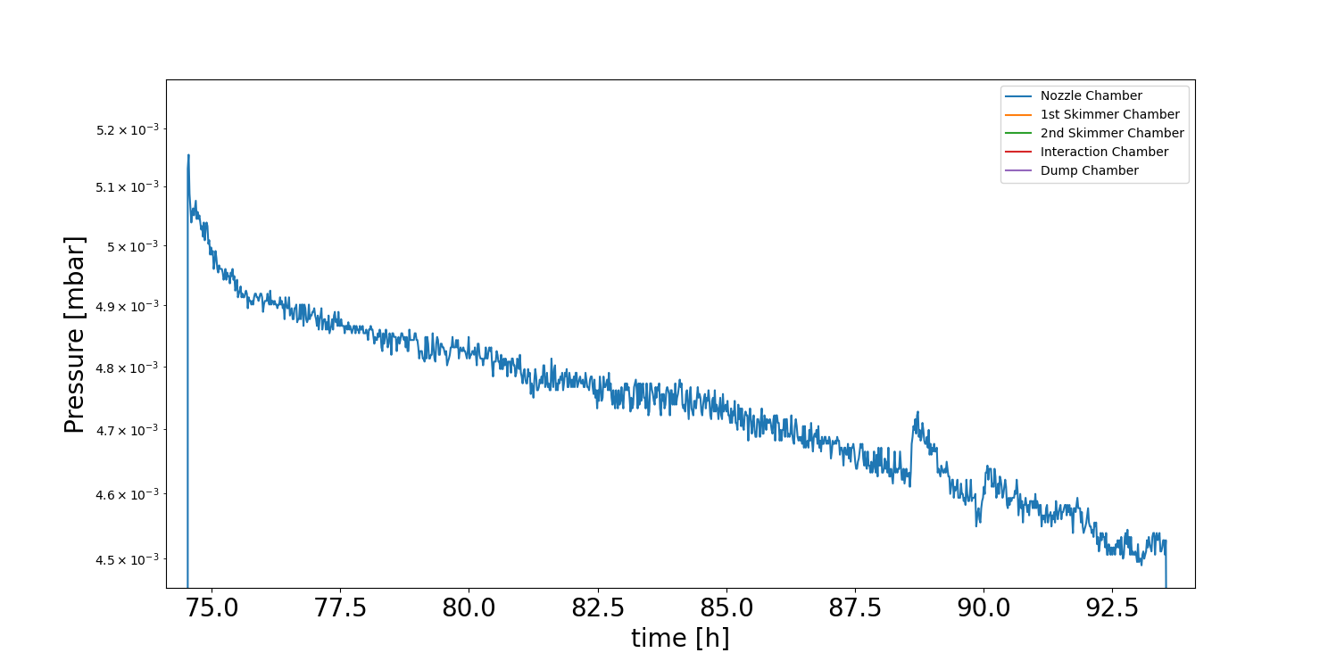
Pressures with Gas jet - Nozzle Chamber
Consistent with Observations at CI!

Slide 13
Journey of V3 at CERN
Arrival of V3 to CERN
Future development as a stand-alone
Installation and commissioning of V3 on EBTS
Installation of V3 at LHC
1
3
5
V3 transport from Cockcroft to CERN
2
4
6
Installation and commissioning as a stand-alone
Scintillating screen tests at EBTS
Experiments of V3 on EBTS

Slide 14

Future plans - Stand-alone
Stability of the gas jet
  Different 3rd skimmer effects
  Profile stability
Vacuum scenarios
  Preparation for LHC
Further studies of the divergent-convergent nozzle
  Alignment
NEG pump tests
  Saturation, pressure equilibrium afterwards

Slide 15
Journey of V3 at CERN
Arrival of V3 to CERN
Future development as a stand-alone
Installation and commissioning of V3 on EBTS
Installation of V3 at LHC
1
3
Summer 2022
5
End of 2022
(or 2023)
V3 transport from Cockcroft to CERN
Spring 2022
-> end of 2022
2
4
6
Installation and commissioning as a stand-alone
Scintillating screen tests at EBTS
Experiments of V3 on EBTS

Slide 16
Experimental plan at EBTS
CHROMOX screen tests
  Hollow electron beam profile at BGC position
  Before BGC installation
BGC installation and commissioning on EBTS
Cathode light background
Gas Jet measurements of Hollow electron beam profile
  Matching the CHROMOX conditions
  Studying different beam settings
  Different gases (N₂, Ne, Ar)

Slide 17
Thank you for your attention
Any questions?
ondrej.sedlacek@cern.ch
Thank you for your attention
Any questions?
ondrej.sedlacek@cern.ch

