Slide 1


Fluorescence Monitors at GSI
--- Lessons learned ---
Collaboration Meeting the 30th of March 2022
Peter Forck & Serban Udrea, GSI
Goal: Preparation of experiments at HEL-test-bench and LHC
Experiences from single pass ion beams:
University München TANDEM: 3 MeV/u < E_{kin} < 5 MeV/u
GSI LINAC: 5 MeV/u < E_{kin} < 11 MeV/u
GSI synchrotron: 100 MeV/u < E_{kin} < 800 MeV/u
For peace
and freedom
Violence must
be rejected

Slide 2
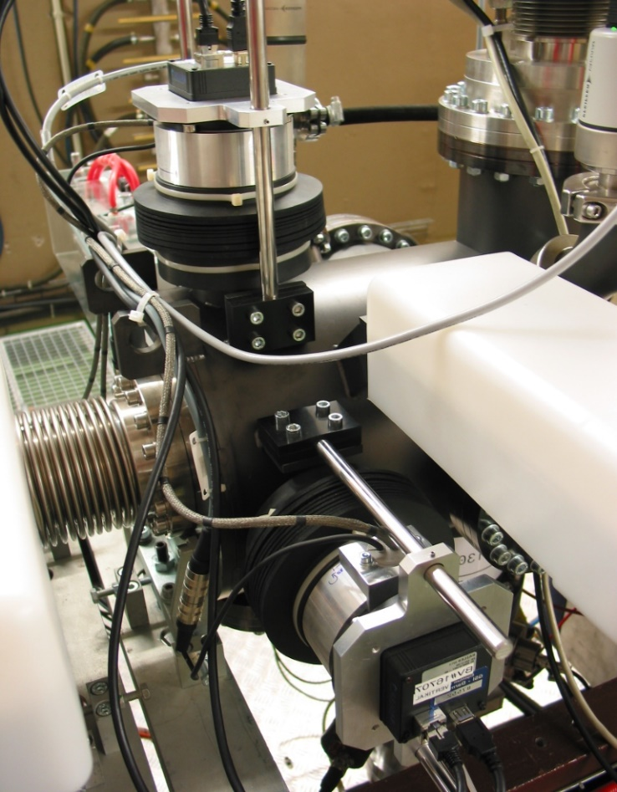
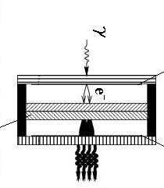
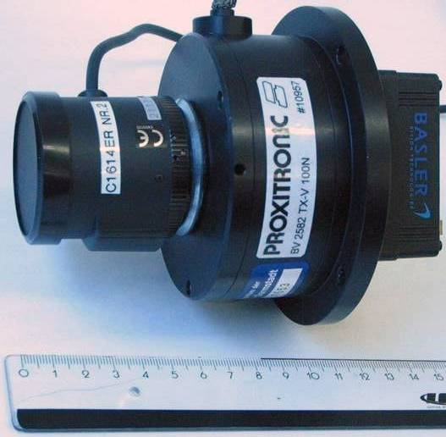
BIF-Monitor: Technical Realization at UNILAC@GSI
Horizontal BIF
Example: BIF station at GSI UNILAC:
Using transition with N₂
N₂ + Ion → (N₂⁺)*+ e⁻ + Ion → N₂⁺ + γ + e⁻ + Ion
Insertion length 25 cm
2 x image intensified CCD cameras
Optics with reproduction scale typ. 0.2 mm/pixel
Gas inlet + gauge, pneumatic actuator for calibration
Advantage: Compact insertion, resolution adaptable
of-the-shelf components
Image Int. CCD
Vertical BIF
Beam
Image intensifier
for single photons
Photocathode
γ
e⁻
double
MCP
∅ 15 cm
Phosphor
many γ
C. Andre (GSI) et al., Proc. IBIC 2014
Beam: Ar¹⁰⁺@4.7 MeV/u, I=2.5 mA⇔10¹¹ ppp, p=10⁻⁵mbar

Slide 3
BIF-Monitor: N₂ Fluorescence Spectra for different Ions
For N₂ working gas the spectra for different ion impact is measured:
Fluorescent transitions:
N₂ + ion→(N₂⁺)* +e⁻+ ion→N₂⁺+ γ + e⁻ + ion
N₂⁺ : B²Σ_{u}⁺ (v’’) → X²Σ_{g}⁺ (v’),
λ = 391, 427 & 471 nm,
life time τ ≈ 60 ns
GSI UNIAC: ion energy ≈ 5 MeV/u
Results:
Comparable spectra for all ions
Small modification due to N₂⁺
dissociation by heavy ion impact
⇒ Stable operation with
constant spectrum for highly ionized ions
vib. 0 → 0
vib. 0 → 1
vib. 0 → 2
1→ 0
N⁺ trans.
N⁺ trans.
C. Andre (GSI) et al., Proc. IBIC 2014

Slide 4
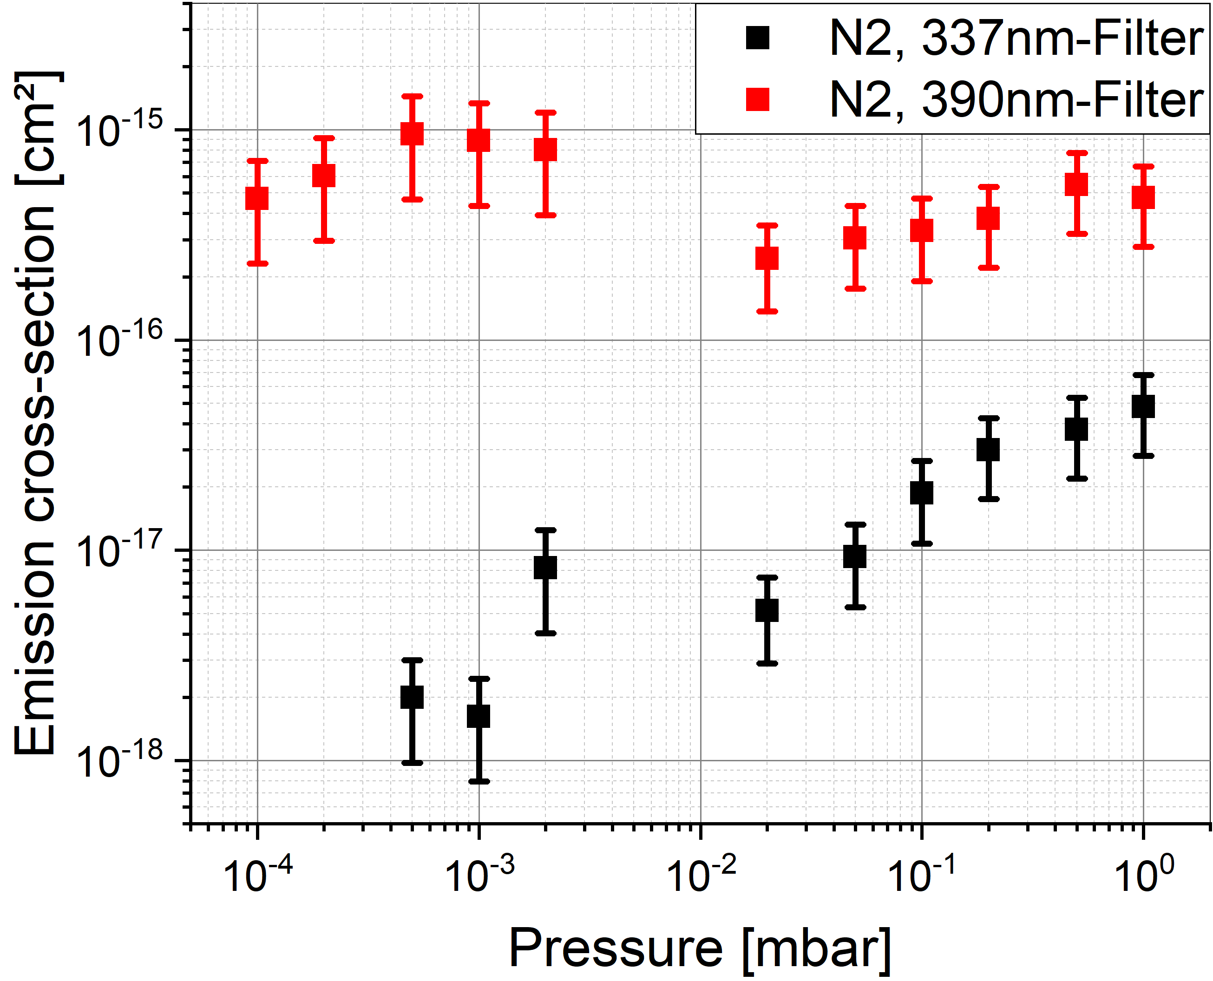
Nitrogen Molecule Spectra with Ion Impact: Cross Section
N₂ as working gas for process:
N₂ + ion → (N₂⁺)*+ e⁻ + ion
→ N₂⁺ + γ + e⁻ + ion
Result for cross section:
Ionic lines: B²Σ_{u}⁺ (v’’=0) → X²Σ_{g}⁺ (v’=0)
⇒ Constant σ over entire range
Neutral lines: C³Π_{u}(v’’=0) → B³Π_{g}(v’=0)
Increasing σ
as generated by secondary electrons only
(spin forbidden by proton impact)
Estimation of cross section:
Ionic: σ_{S}(2.7 MeV/u) = 4 ⋅ 10⁻¹⁶ cm²
⇒ Proton σ_{p}(2.7MeV/u) = σ_{S}(2.7MeV/u) / q² = 6.3 ⋅ 10⁻¹⁸ cm²
⇒ Bethe-Bloch scaling σ_{p}(7TeV) = 0.03 ⋅ σ_{p}(2.7MeV) = 1.8 ⋅ 10⁻¹⁹ cm²
Serban’s estimation: σ_{p}(7TeV) = 3.7⋅10⁻²⁰ cm² ⇒ factor 5 too large
Neutral: Can not be excited by proton & ion impact!

Slide 5
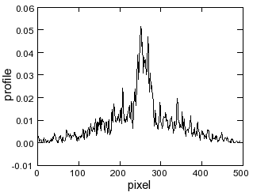
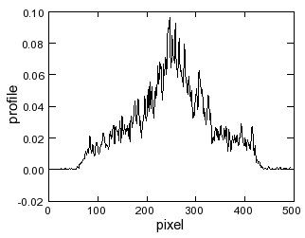
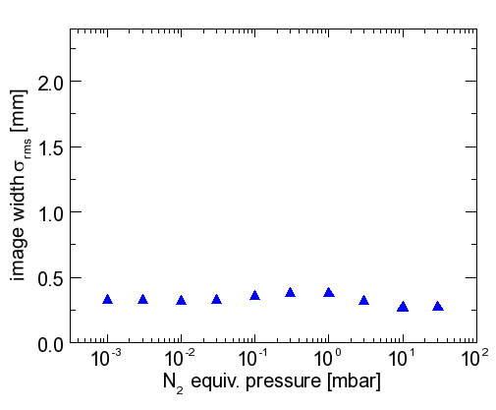
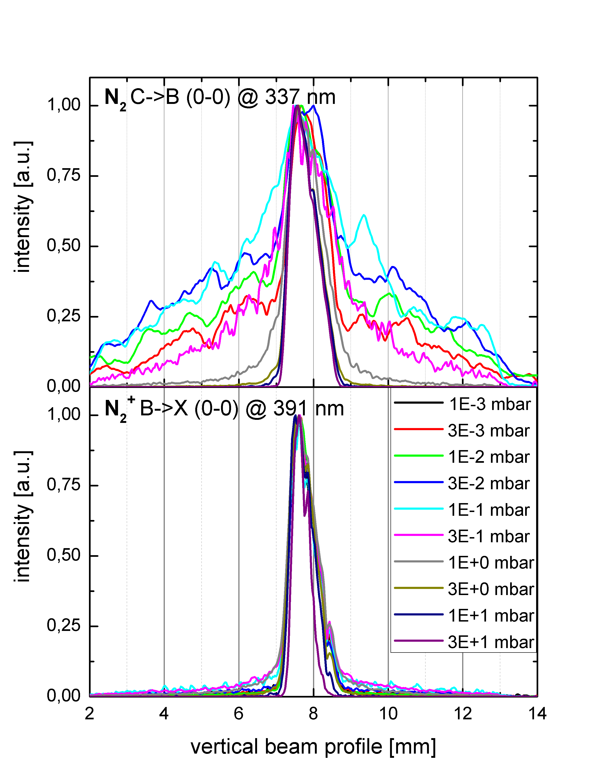
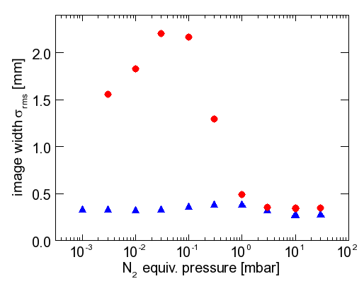
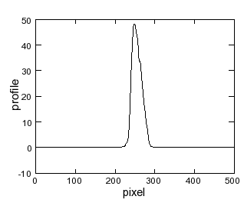
BIF Monitor: Different Gas Pressures and Profile Width
Observation: Trans. of ionic states e.g. N₂⁺ → profile width independent on pressure
Trans. of neutral states e.g. N₂ → width strongly dependent on pressure!
Ionic transitions λ=391 nm:
N₂ + ion→(N₂⁺)* +e⁻+ ion→N₂⁺+ γ+e⁻ + ion
N₂⁺ @391nm: B²Σ⁺_{u}(v’’=0) → X²Σ⁺_{g}(v’=0)
large σ for ion-excitation, low for e⁻
N₂
N₂
p = 0.003 mbar
p = 0.1 mbar
N₂
N₂ trans.
@337 nm
Neutral transitions λ=337 nm:
N₂ + e⁻ → (N₂)* + e⁻ → N₂ + γ + e⁻
N₂ @337nm: C³Π_{u}(v’’=0) → B³Π_{g}(v’=0)
large σ of e⁻ excitation., low for ions
at p ≈ 0.1 mbar→ free mean path ≈1 cm!
p = 30 mbar
N₂⁺ trans.@391 nm
Result: Save operation if p < 10⁻³ mbar
F. Becker et al., IPAC’12 &HB’12

Slide 6
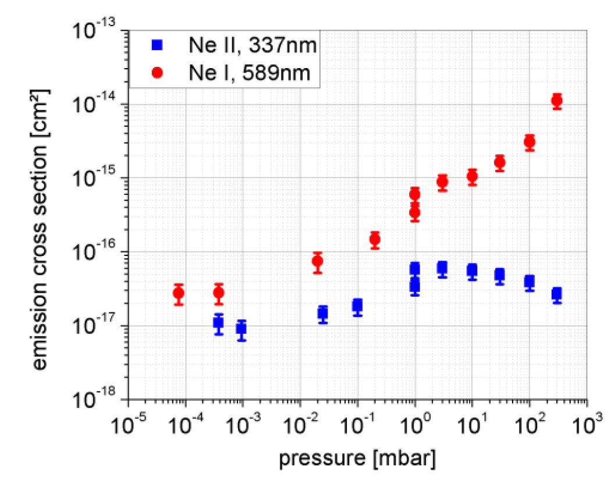
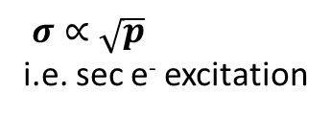
Neon Spectra with Sulfur Ion Impact at 3.1 MeV/u
Result for cross section:
Ne⁺ : σ is independent on pressure
Ne & high pressure p > 10⁻² mbar:
caused be secondary electrons
Ne & low pressure p < 10⁻³ mbar:
σ is constant
i.e. reflects correct beam profile
Absolute systematic error Δσ _{sys} = 50 %
$σ∝\sqrt{p}$
i.e. sec e⁻ excitation
foil
Estimation of cross section for neutral Ne:
Sulfur ₁₆S⁸⁺ no Titanium foil
σ_{S}(2.7MeV/u) = 2.5 ⋅ 10⁻¹⁷ cm²
dE/dx ∝ q² scaling with charge state q = 8 (Bethe-Bloch scaling)
⇒ Proton σ_{p}(2.7MeV) = σ_{S}(2.7MeV/u) / q² = 3.9 ⋅ 10⁻¹⁹ cm²
Energy loss from 2.7 MeV to 7 TeV by factor 0.03, but non Bethe-Bloch scaling for neutrals
⇒ Bethe-Bloch scaling σ_{p}(7TeV) = 0.03 ⋅ σ_{p}(2.7MeV) = 1.2 ⋅ 10⁻²⁰ cm²
⇒ Bethe-Born scaling σ_{p}(7TeV) = 0.007 ⋅ σ_{p}(2.7MeV) = 2.8 ⋅ 10⁻²¹ cm²
Serban’s estimation: σ_{p}(7TeV) = 4.7⋅10⁻²² cm² ⇒ factor 6 too large (25 for B-Bloch)

Slide 7
Pressure dependent Profile Reading
Task: To which pressure the methods delivers
a correct profile reproduction?
Process:
1. Direct excitation e.g.: N₂ + ion → (N₂⁺)*+ e⁻ + ion
2. Indirect processes e.g.: N₂ + e⁻ → (N₂)*+ e⁻ → N₂ + γ + e⁻
⇒ No all spectral lines are correct
Results: Possible misreading for neutral lines
avoid 10⁻² mbar < p < 10 mbar ⇔
chose either r_{mfp} >> r_{beam} or r_{mfp}<< r_{beam}
use transition of the charged specious
Beam: S at 3 MeV/u at TU-München TANDEM
all transitions
okay p< 10⁻³mbar
effect for Ne
10⁻² mbar
r_{mfp}~30 mm
10⁻¹ mbar
r_{mfp}~ 3 mm
∅30mm
10⁺¹ mbar
r_{mfp}~ 30 μm
∅100mm
F. Becker et al. (GSI) , IPAC’12 and HB’12

Slide 8
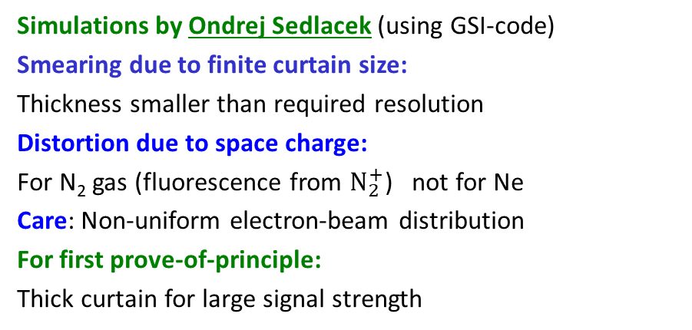
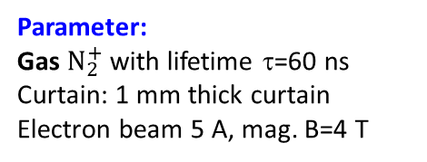
Distortions by Depth-of-focus, Space Charge and Curtain Thickness
Task: The depth-of-focus must fit to the beam size
Method: Determination of beam size
Care: Radial beam density distribution
Additionally: Vignetting → increase for open iris
GSI UNILAC:
Ar¹⁰⁺@4.7 MeV/u,
2.5 mA
P. Forck, A. Bank (GSI), EPAC 2002
Simulations by Ondrej Sedlacek (using GSI-code)
Smearing due to finite curtain size:
Thickness smaller than required resolution
Distortion due to space charge:
For N₂ gas (fluorescence from $N_{2}^{+}$) not for Ne
Care: Non-uniform electron-beam distribution
For first prove-of-principle:
Thick curtain for large signal strength
Hollow electron beam:
Start distribution
Space charge distortion
Curtain smearing
Smearing & distortion
Parameter:
Gas $N_{2}^{+}$ with lifetime τ=60 ns
Curtain: 1 mm thick curtain
Electron beam 5 A, mag. B=4 T
O. Sedlacek et al, IPAC2021

Slide 9
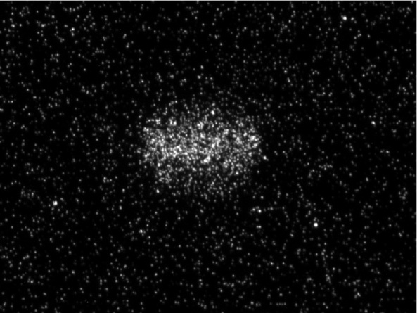
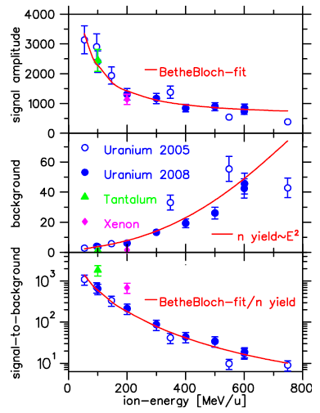
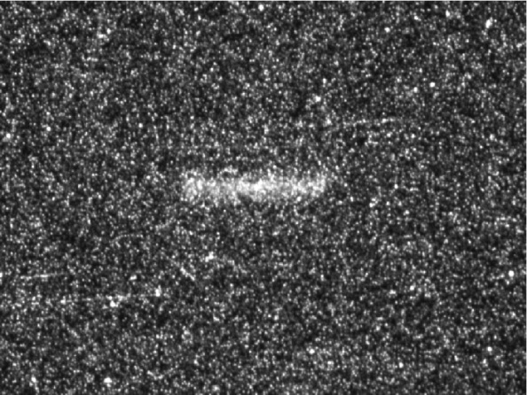
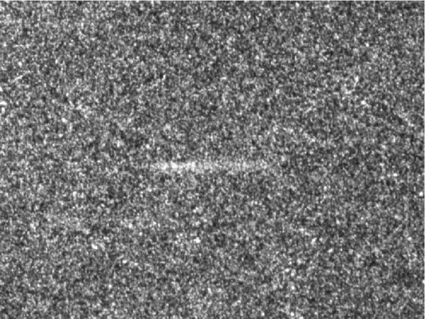
Energy Scaling for N₂ Fluorescence and Background
60 MeV/u
E_{kin} dependence for signal
& background close to beam-dump:
Image from 1·10⁹ U
p= 2·10⁻³ mbar,
mounted ≈ 2 m
before beam-dump:
viewport
350 MeV/u
750 MeV/u
Signal proportional to energy loss
Suited for single pass with ≥ 10¹⁰ ions/pulse
Background prop. E_{kin}² ⇒ shielding required
Background outside of viewport ⇒ not optical photons
F. Becker (GSI) et al., Proc. DIPAC’07

Slide 10
Neutron induced Background
Neutron creation by nuclear interactions
Refection at concrete wall, i.e. ‘bouncing around’
Long ‘detention’ in tunnel; here ≈ 1 ms
Mitigation:
Image intensifier gate only during beam
However, at LHC not applicable
Neutron flux by PHITS:
Beam: Xe⁴⁸⁺ @200MeV/u stopped in dump
Concrete wall
Beam
dump
beam
Comparison PHITS & plastic scintillator:
(II comparable background decay):
Beam: Xe⁴⁸⁺ @200MeV/u stopped in dump
PHITS:
Particle and Heavy Ion Transport code System
(comparable to FLUKA)
Only relevant at LHC; no neutrons at HEL
O. Sedlacek et al, IPAC2021

Slide 11
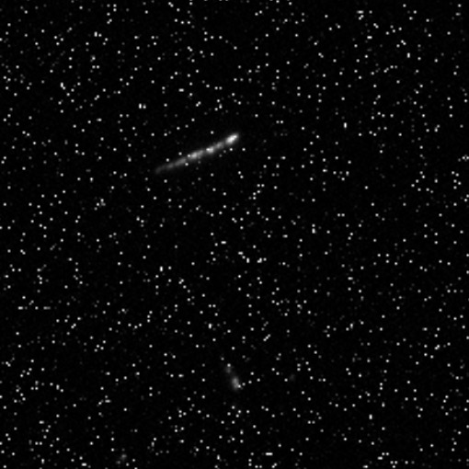
Fast Proton induced Background (LHC only)
Proton creation by nuclear spallation reaction:
Fast proton emitted in beam direction
Image Intensifier window with photo cathode
Cherencov radiation in glass
Sometimes ‘comets’ appeared
for parallel orientation of Image Intensifier
Mitigation:
Shielding by lead between vacuum window
Image Intensifier 90⁰ rotation of II plane
Neutron flux by PHITS:
Beam: Xe⁴⁸⁺ @200MeV/u stopped in dump
Concrete wall
Beam
dump
beam
100µm
stainless steel
vacuum window
90⁰ II orientation
→ No ‘comets’
Parallel II orientation
→ ‘comets’
‘Comet’ due to fast proton
passage inside glass
with photo cathode
Only relevant at LHC; no fast protons at HEL

Slide 12
Some experimental ‘Lessons learned’
Image Intensifier gate:
Voltage photo cathode ↔ MCP follows gate TTL-gate,
input ≈ 1 MΩ impedance
Maximum trigger rate 10 kHz
For long cable > 20 m (at LHC):
External 50 Ω termination via T-piece required & 50 Ω TTL driver electronics
Test: Background contribution must scale with gate length
Image Intensifier gate and camera exposure
II gate only if beam is present (HEL is pulsed, LHC quasi cw operation)
Camera exposure only slightly longer than II gate
Image Intensifier operation:
Avoid high illumination
Amplification by MCP voltage: Start with low value increase only to required voltage
Background:
Optical photons though viewport (→ blackening methods detailed investigated by CERN)
Homogeneous distributed background by ionizing radiation (i.e. also outside of viewport)

Slide 13
Conclusion
Working gas:
N₂ and Ne properties fairly well investigated (more light from N₂)
experimental knowledge for low electron currents at CI
Scaling with one order of magnitude for LHC beams
Proposal: If possible, start with N₂ at HEL and large skimmer (‘first we have to see a signal…’)
Image intensifier, optics and camera:
Robust and well designed system, remote controlled at LHC, accessible at HEL test-bench
Proposal: Image Intensifier gate and camera exposure only during beam presence
LHC test operation:
Background measurement urgently required, dependence on optical filters
HEL test bench:
High beam current, high magnetic field, ‘exotic’ beam shape ⇒ surprises possible
High magnetic field and space charge: ⇒ surprises due to captured residual gas electrons or ion
Thank you for your attention!
Questions and comments?

Slide 14
Backup slide

Slide 15
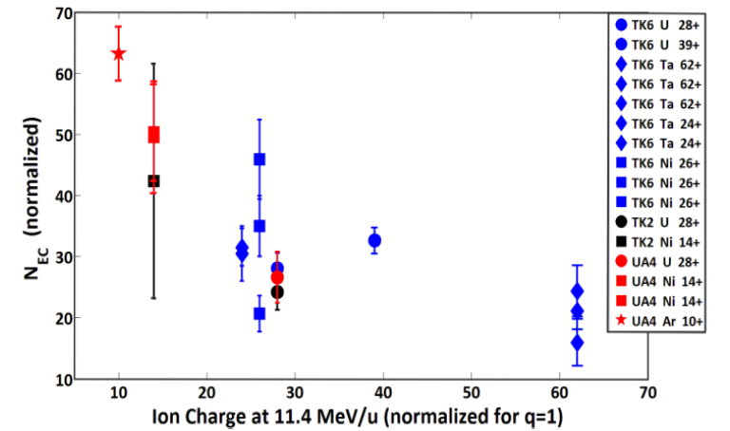
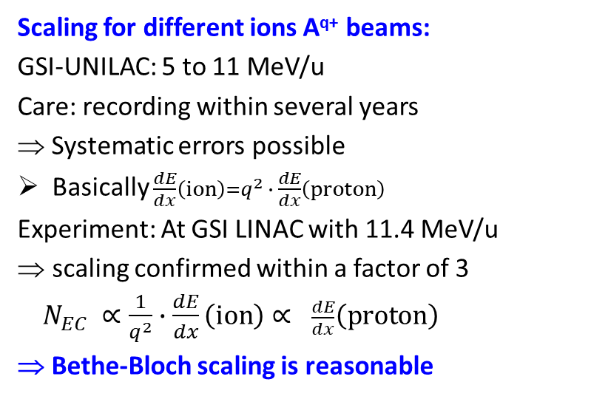
BIF-Monitor: N₂ Scaling for different Ions
For N₂ working gas the spectra for different ion impact is measured:
Scaling for different ions A^{q+} beams:
GSI-UNILAC: 5 to 11 MeV/u
Care: recording within several years
⇒ Systematic errors possible
Basically $\frac{dE}{dx}\left(ion\right)=q^{2} ∙ \frac{dE}{dx}\left(proton\right)$
Experiment: At GSI LINAC with 11.4 MeV/u
scaling confirmed within a factor of 3
$N_{EC} ∝\frac{1}{q^{2}}∙\frac{dE}{dx}\left(ion\right)∝ \frac{dE}{dx}\left(proton\right)$
⇒ Bethe-Bloch scaling is reasonable
Ideally: constant
Result: Variation by factor 3
C. Andre (GSI) et al., Proc. IBIC 2014

Slide 16
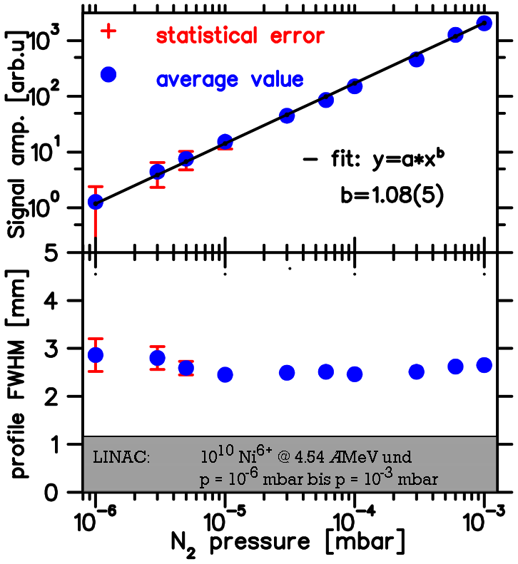
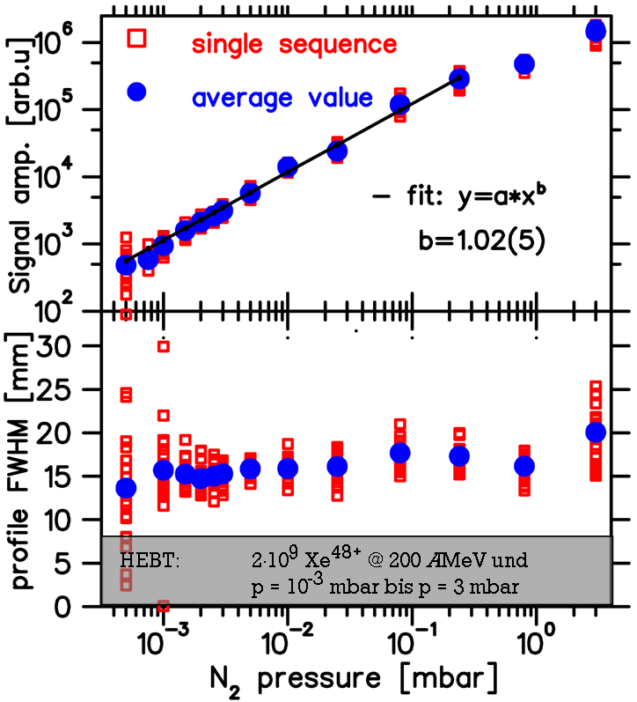
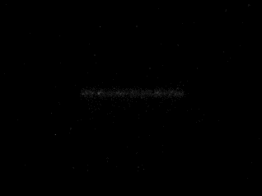
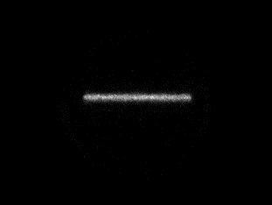

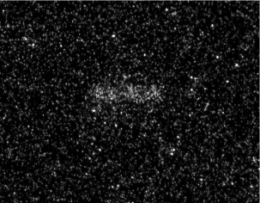
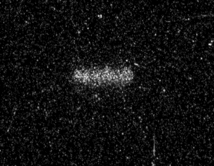
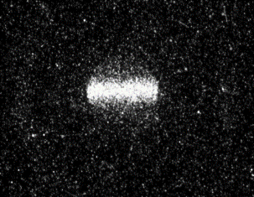
Pressure -Variation by 6 Orders of Magnituden
UNILAC (4,5 MeV/u)
SIS-18 (200 MeV/u)
Notes:
Original images show the signal increase
-> Energy variation – about the conversion factor

Slide 17
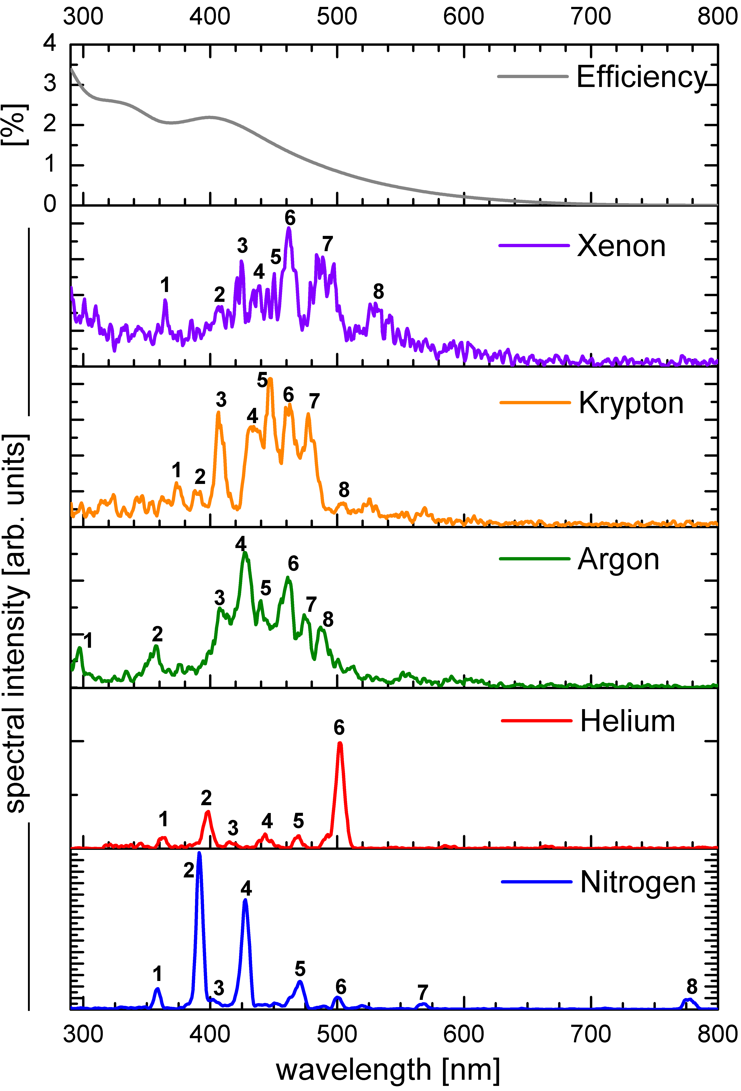
BIF-Monitor: Spectroscopy & Fluorescence Yield
Results of detailed investigations:
Rare gases and N₂: green to near-UV
Compact wavelength interval for N₂
Fluorescence yield: N₂ ≈ 4x higher as rare gases
⇒ N₂ and Xe are well suited !
Beam: S⁶⁺ at 5.16 MeV/u, p_{N2} =10⁻³ mbar
Photo-cathode:
low noise bialkali
Relative fluorescence yield Y (all wavelength):
gas | Y for p | Y for p/n_{e}
Xe | 86 % | 22 %
Kr | 63 % | 25 %
Ar | 38 % | 30 %
He | 4 % | 26 %
N₂ | 100 % | 100 %
n_{e}: gas electron density ∝ energy loss ⇔ beam influence
F. Becker et al. (GSI, TU-München), IPAC’12 and HB’12

Slide 18
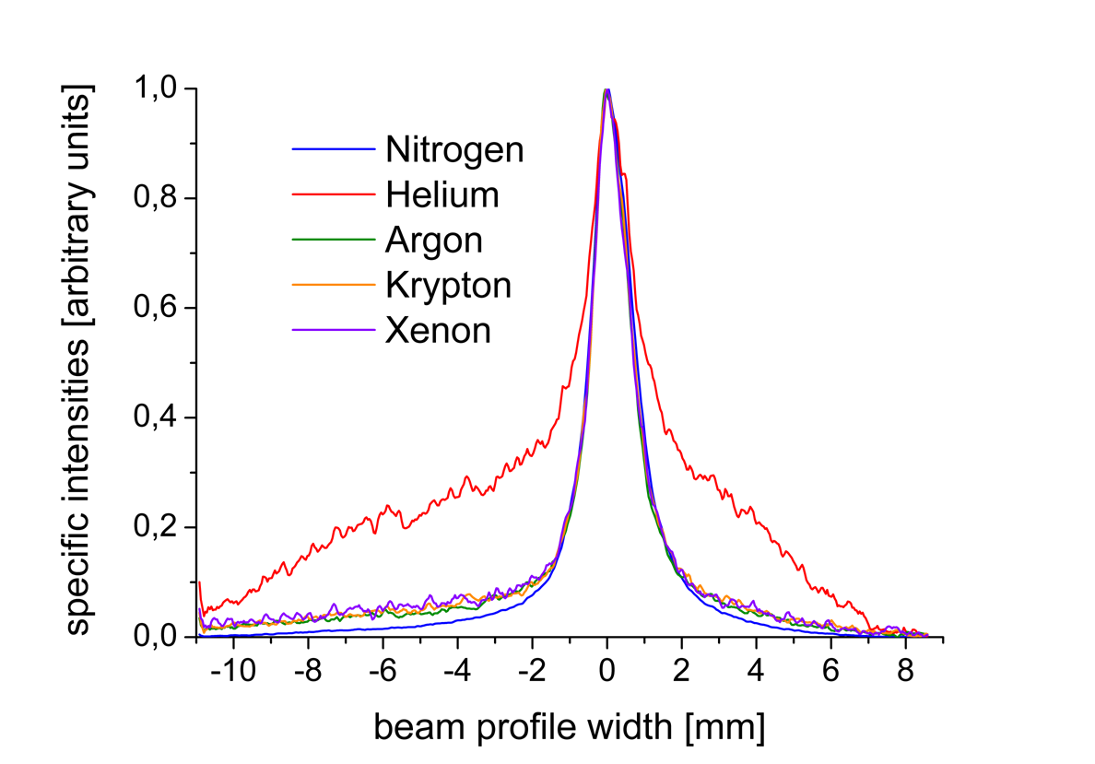
BIF-Monitor: Spectroscopy & Profile Reading
Results of detailed investigations:
Rare gases and N₂: green to near-UV
Compact wavelength interval for N₂
Fluorescence yield: N₂ ≈ 4x higher as rare gases
Same profile reading for all gas except He
⇒ N₂ and Xe are well suited !
Beam: S⁶⁺ at 5.16 MeV/u, p_{N2} =10⁻³ mbar
Photo-cathode:
low noise bialkali
Normalized profile reading for all λ:
Profile reading equal
for all gases except He
F. Becker et al. (GSI, TU-München), IPAC’12 and HB’12

