Slide 1

BGC collaboration meeting – March 2022
Thibaut Lefevre (SY-BI)

Slide 2
LHC schedule as of today
LHC 3 years SPS 2 years
PS 19mo PSB 18mo

Slide 3
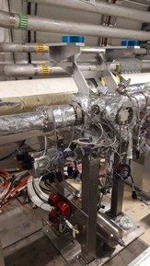
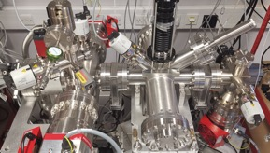
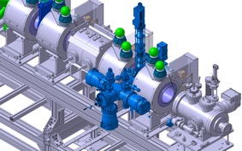
BGC today and tomorrow
Very exciting times ahead of us
both scientifically and technically
Characterising the BGC performance on the e-test stand
Characterising the shape and the homogeneity of the Hollow electron beam
Measuring fluorescence cross sections with protons at highest energies
Measuring the LHC beam profiles during run 3 (understand spatial resolution)

Slide 4
BGC beyond Hilumi
Establishing a novel technology for non-invasive imaging systems
Possible applications in other machines than LHC
  Playing with gas densities and gas types to assess its potential at CERN accelerators in general

Slide 5
Looking forward a productive meeting !

