Slide 1
BGC v3 Tunnel Installation
Gerhard Schneider, Krystian Sidorowski, Giannis Papazoglou, Ray Veness
Beam Gas Curtain (BGC):
baseline instrument for on-line monitoring of the overlap between proton and electron beams in the hollow e-lens and as a general non-invasive profile measurement diagnostic
BGC collaboration meeting 30th March 2022

Slide 2
Content
BGC v3 installation as today, v3 Phase 1 with distributed gas
BGC v3 finalisation for LHC gas curtain operation, Phase 2

Slide 3
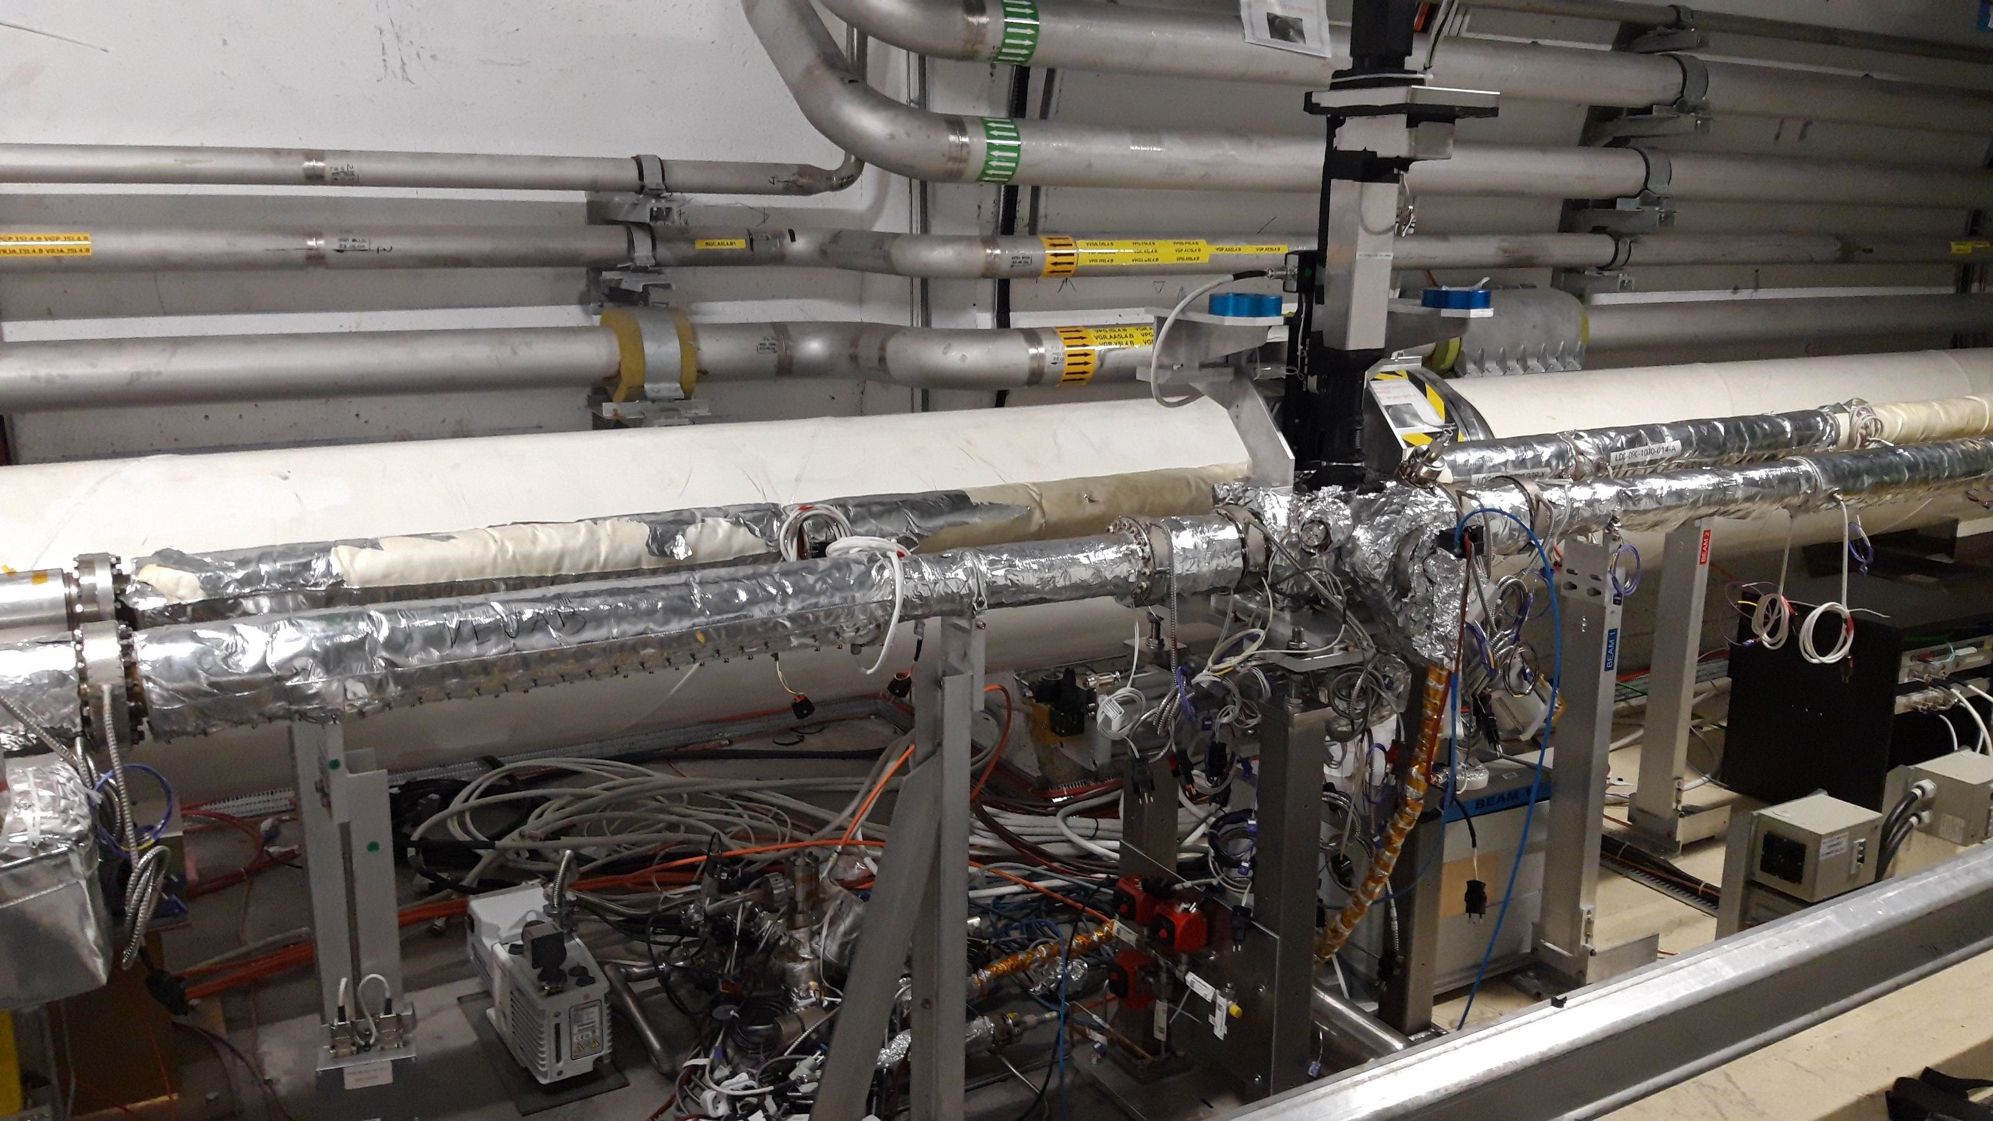
BGC tunnel installation March 2022 (Phase 1)
Optical system
Local BGI Penning
3x Gate valves
Local Racks
BGC cables for Phase 2
Gas injection for distributed gas
Phase 2 gas injection valves
BGI gas injection system

Slide 4
Summary LHC tunnel installations (Phase 1) resulting from approved ECRs
Done in LS2 and YETS 21/22
BGC Installed in the LHC
Gas line is pulled from the gas bottle to the BGC (for phase 2)
Gas line valves installed
Compressed air for the valves pulled
Power cables pulled
Fibre optics cable pulled and rack installed
BGI gas system and control rack now operational on BGC, Test injection made
Optical system installed and operational
ECR 2025553 + ECR 2363497 = LS2 + YETS 21/22

Slide 5
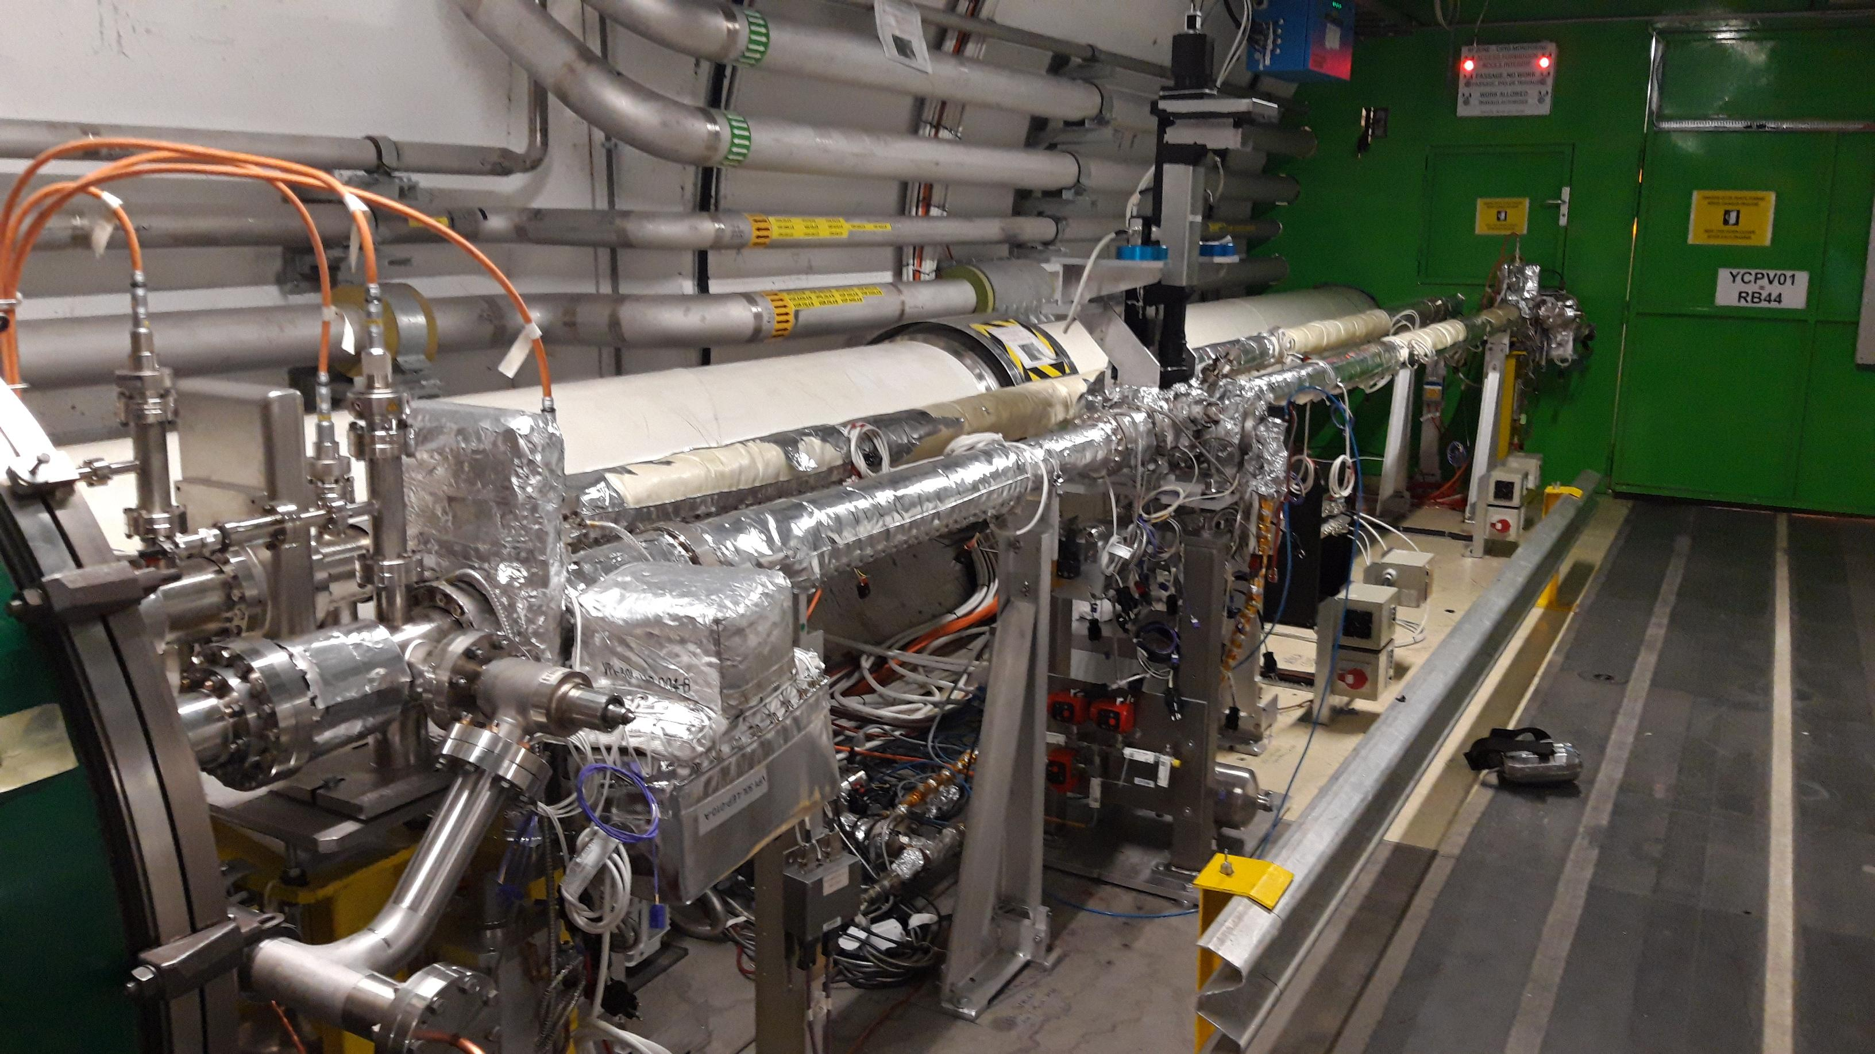
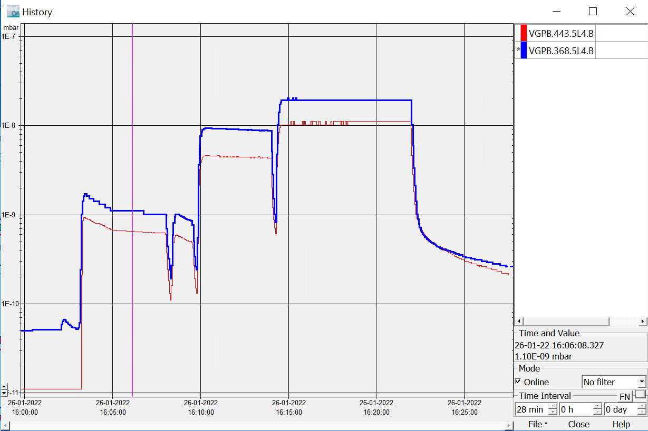
Ready for gas injection, here with sector valves closed
Penning VGPB.368.5L4.B | Penning BGC | Penning VGPB.443.5L4.B
1.1E-9 mbar | 1.5E-9 mbar | 6.2E-10 mbar
9.0E-9 mbar | 1.0E-8 mbar | 4.4E-9 mbar
2.0E-8 mbar | 2.2E-8 mbar | 1.0E-8 mbar

Slide 6
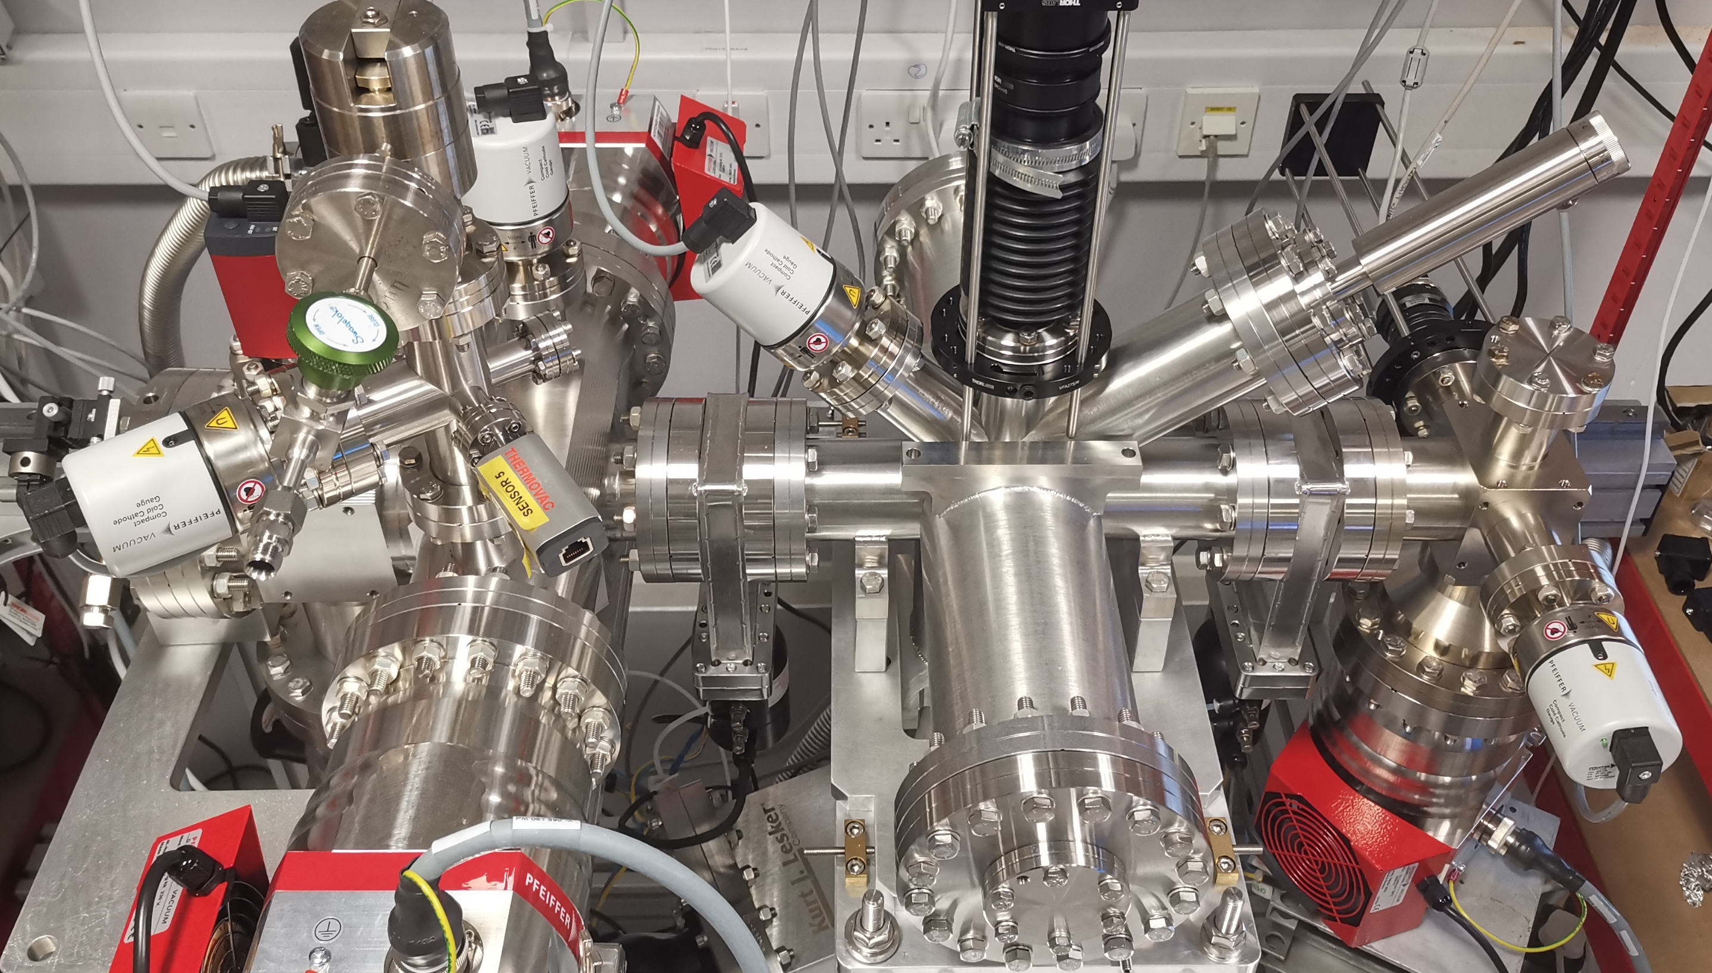
Phase 2 instrument with Gas Curtain
Add BGC injection, dump and central TMP in tunnel
Transfer to LHC compatible vacuum system
Picture courtesy CI

Slide 7
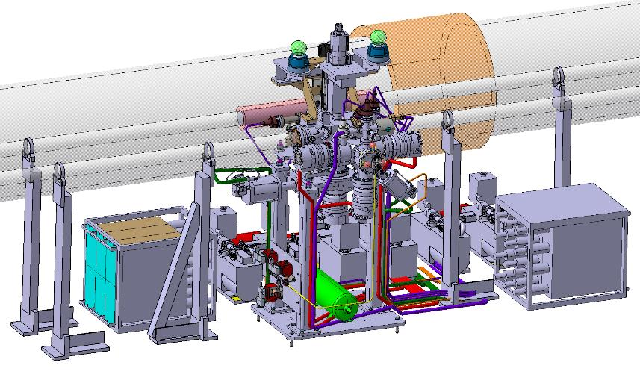
Phase 2 Installation in LHC
Remove:
  BGI gas system
  BGI control rack
Install:
  6 primary pumping units
  Gas injection system
  Gas dump chamber
  5 TMPs:
    Gas injection system with 3 TMPs
    Gas dump chamber with 1 TMP
    1 TMP directly on the interaction chamber
  Compressed air line to the valves
  3 solenoids for the gas injection valves
  Add independent compressed air supply for BGC vacuum pumping system?
Connect everything to power and controls

Slide 8
Summary
Phase 1 BGC installation objectives for distributed gas fully achieved, ready for LHC beam
Phase 2 BGC installation underway
  EBTS test required prior to installation
  Change to LHC compatible vacuum system
  Approval by LHC management after proof of vacuum comatibiltiy
  Additional compressed air connection in tunnel?

Slide 9
Questions?

Slide 10
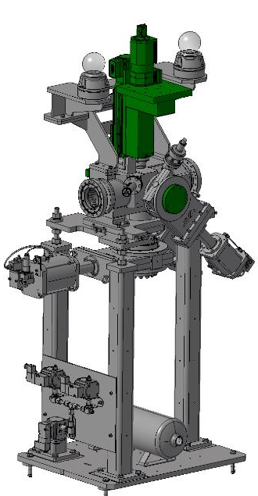
BGC Phase 1 2021in YETS

Slide 11
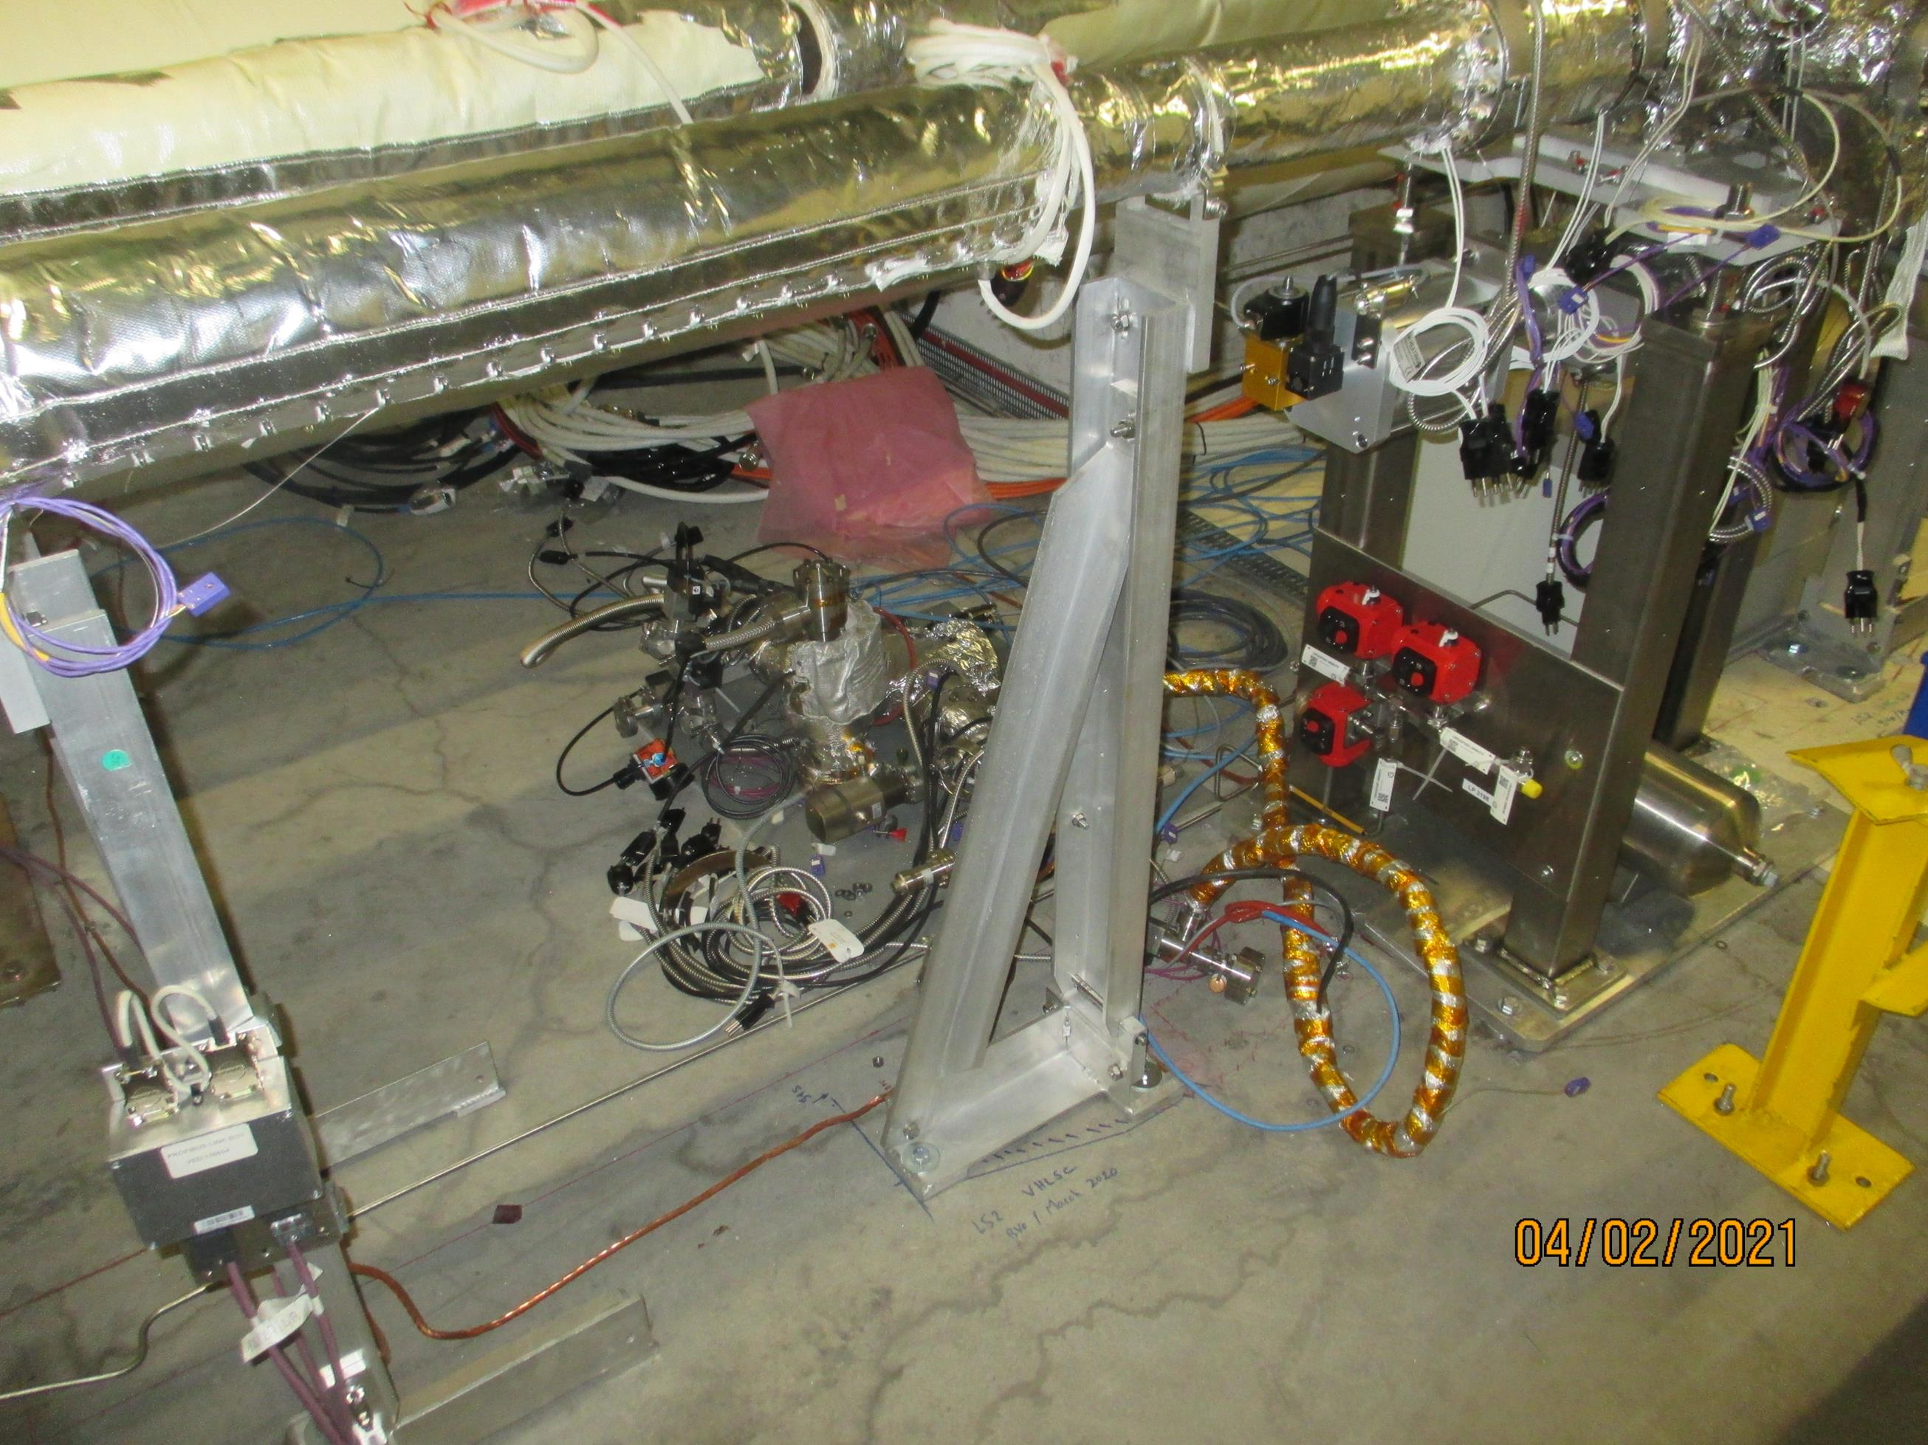
BGI Gas injection system next to BGC

Slide 12
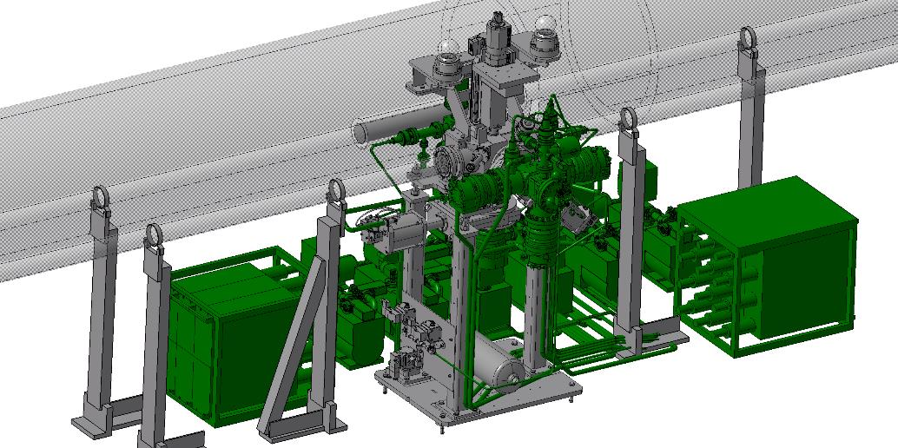
Phase 2 to be installed

Slide 13
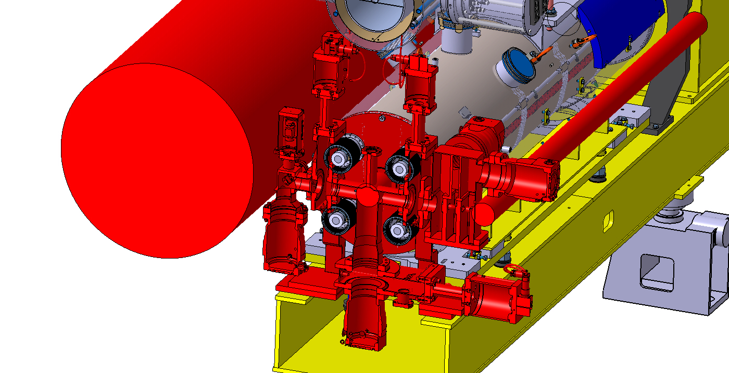
Final BGC version (V4) in HEL, here 4R

Slide 14
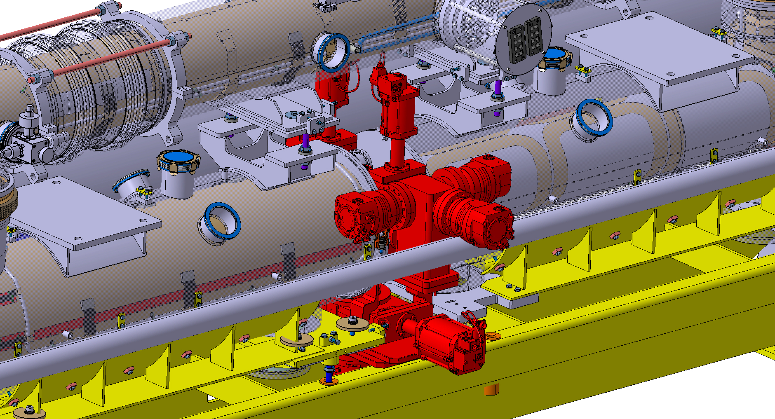
Design of final instrument (V4) for HEL well in Progress
Challenge: Space

