Slide 1


Slide 2
‘Spreading the CERN spirit of scientific curiosity, for the inspiration and benefit of society’
Education & Outreach
Innovation & Knowledge Exchange
Culture & Creativity
WITH A FOCUS ON EDUCATION AND YOUTH
Our projects are generously supported by individuals, foundations and corporates

Slide 3
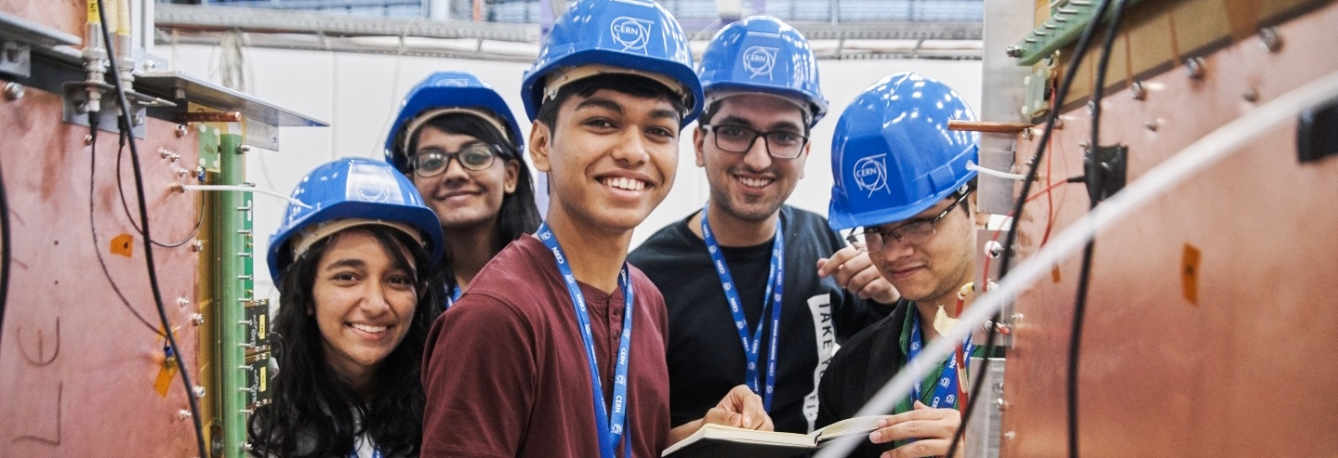
Goals of the Education and Outreach projects
Encourage, inspire & support young peoples’ interests in STEM
Promote public understanding of science and how it affects daily life
Enable equal access to scientific education, regardless of gender, race, religion & background

Slide 4
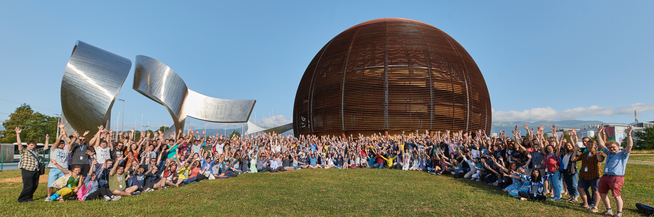
Examples of Education and Outreach projects
Non-Member State Summer Student Programme
ATLAS PhD Grant Scheme
Beamline for Schools

Slide 5
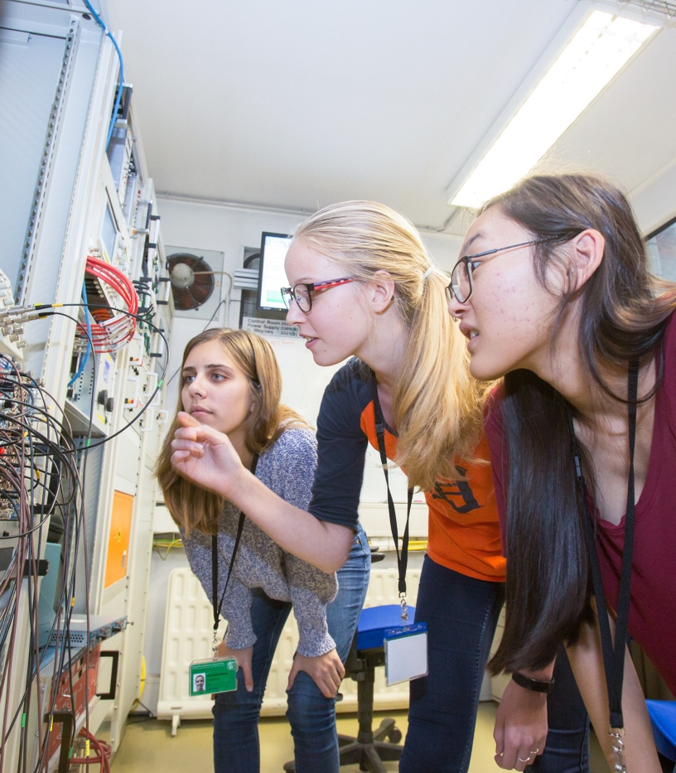
Advantages for sponsors
Support the next generation of scientists, support social mobility, promote diversity and inclusion
Recruitment opportunities
Brand association
Communication / Visibility

Slide 6

P&G history with CERN :
From 2008 to 2011, P&G sponsored the CERN Summer Student Programme with a contribution of CHF 12.800/year

Slide 7




Follow us:
cernandsocietyfoundation.cern
Contact:
Pascale Goy
pascale.goy@cern.ch
CERNandSocietyFoundation
cern-society-foundation

Slide 8

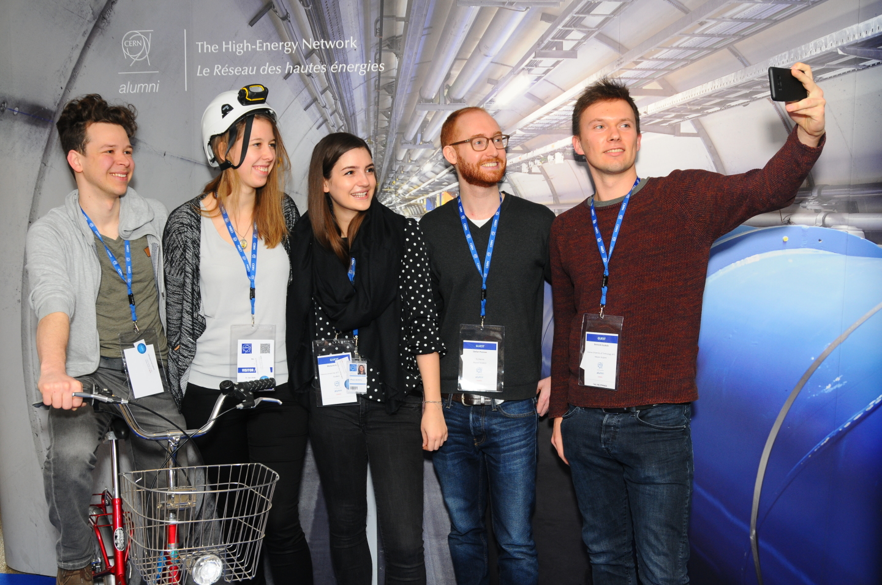
Goals of the CERN Alumni Programme:
Demonstrate impact
Stay connected
Network of ambassadors
Support early careers
Launched June 2017
>7,500 active members

Slide 9
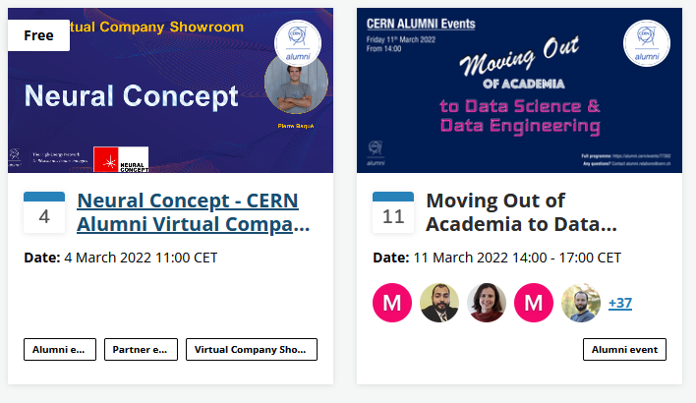
CERN Alumni Talent pool:
Jobs board
Virtual Company Showroom
Alumni spotlights

Slide 10
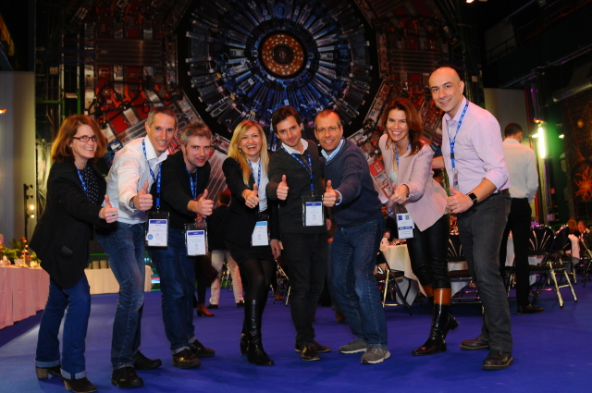
Thank you!
Contact:
Rachel Bray
Head of CERN Alumni Relations
CERN – International Relations Sector
Rachel.Bray@cern.ch
alumni.relations@cern.ch

