Slide 1
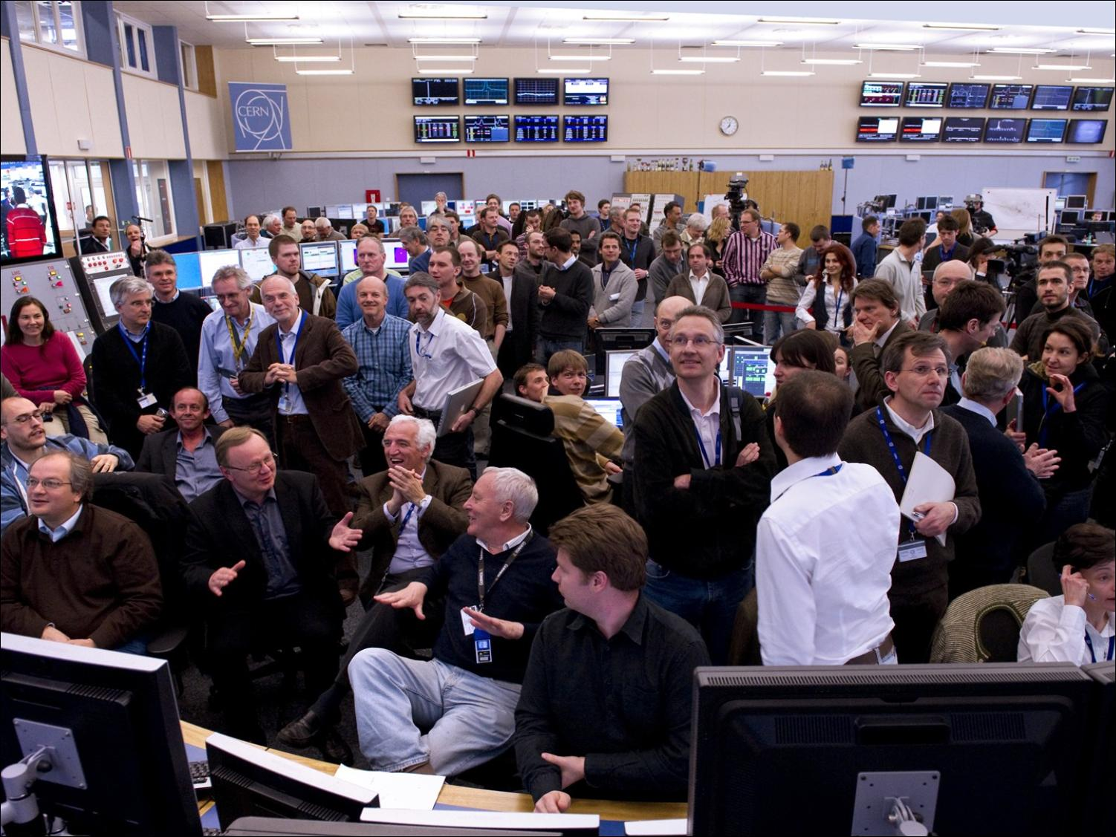

The Large Hadron Collider
A marvel of technology
Lyn Evans
10th Anniversary of the discovery of the Higgs boson, 4th July 2022

Slide 2
In December 1993, a plan was presented to the CERN Council to build the machine over a ten-year period by reducing the other experimental program of CERN to the absolute minimum, with the exception of the full exploitation of the LEP collider. An external expert panel chaired by Robert Aymar endorsed the design.

Slide 3
Although the plan was generally well received, it became clear that two of the largest contributors, Germany and the United Kingdom, were very unlikely to agree to the budget increase required. They also managed to get Council voting procedures changed from a simple majority to a double majority, where much more weight was given to the large contributors so that they could keep control.

Slide 4
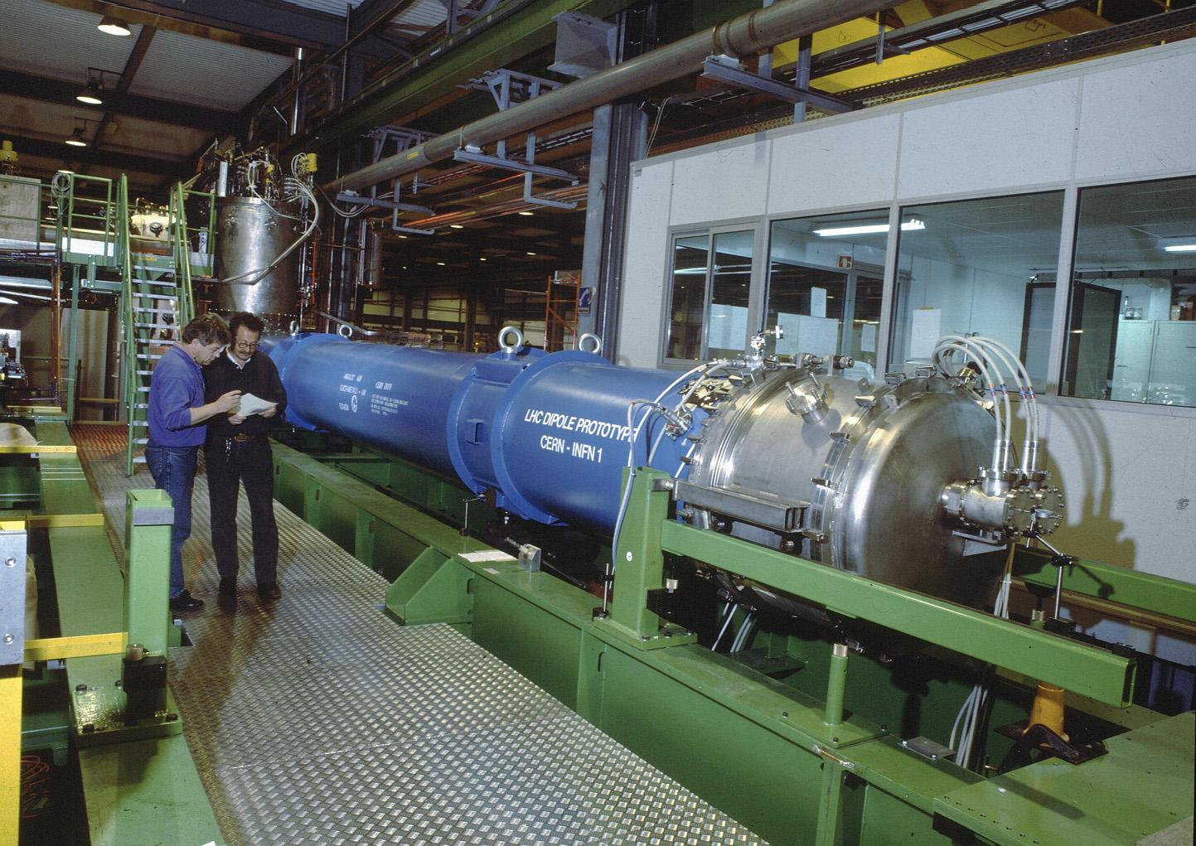
The 10 metre long prototype bending magnet for LHC, which has reached a field of 8,73 Tesla on 14 April 1994

Slide 5
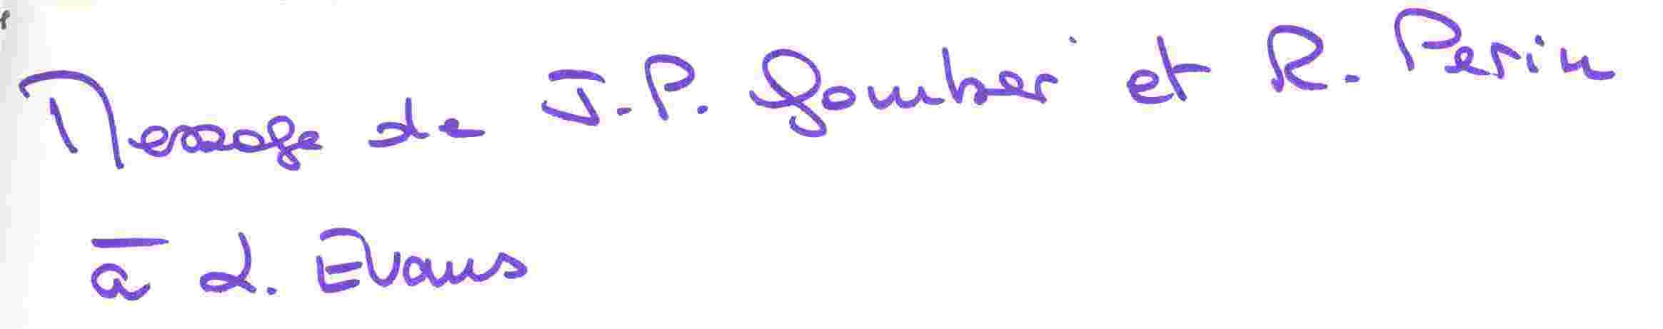
Finance Committee April 1994
Notes:
5

Slide 6
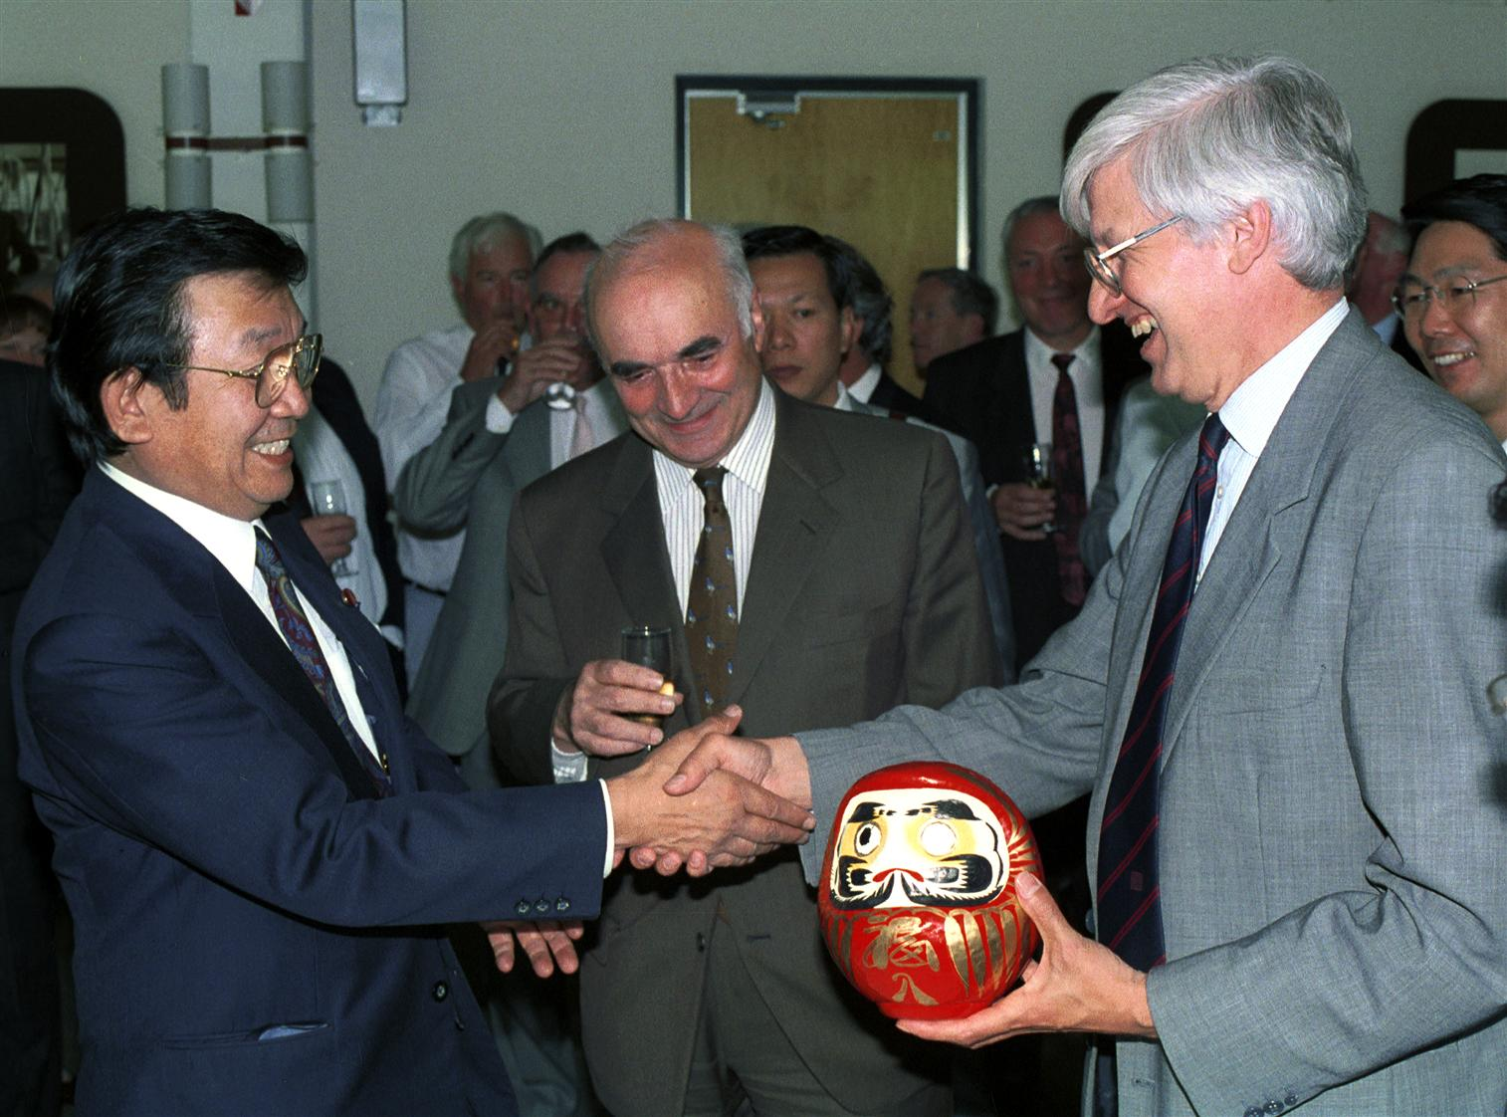
Japan becomes an Observer
June 1995
Japan becomes an Observer of CERN and announces a financial contribution to the LHC.
The Japanese Minister for Education, Sciences and Culture offers a Daruma doll to CERN’s Director-General. According to Japanese tradition, an eye is painted on the doll to mark the beginning of the LHC project and the second eye must be drawn at the time of its completion.
Japan makes two other major financial contributions to the LHC project in 1996 and 1998.
Notes:
6

Slide 7
1996
March
  India makes a financial contribution to the construction of the LHC.
  And in June, Russia announces a financial contribution to the project.
December
  Canada announces a financial contribution for the LHC, while a protocol of co-operation is defined for participation of the United States.
  In December 1997, the US declares a contribution.
Notes:
7

Slide 8
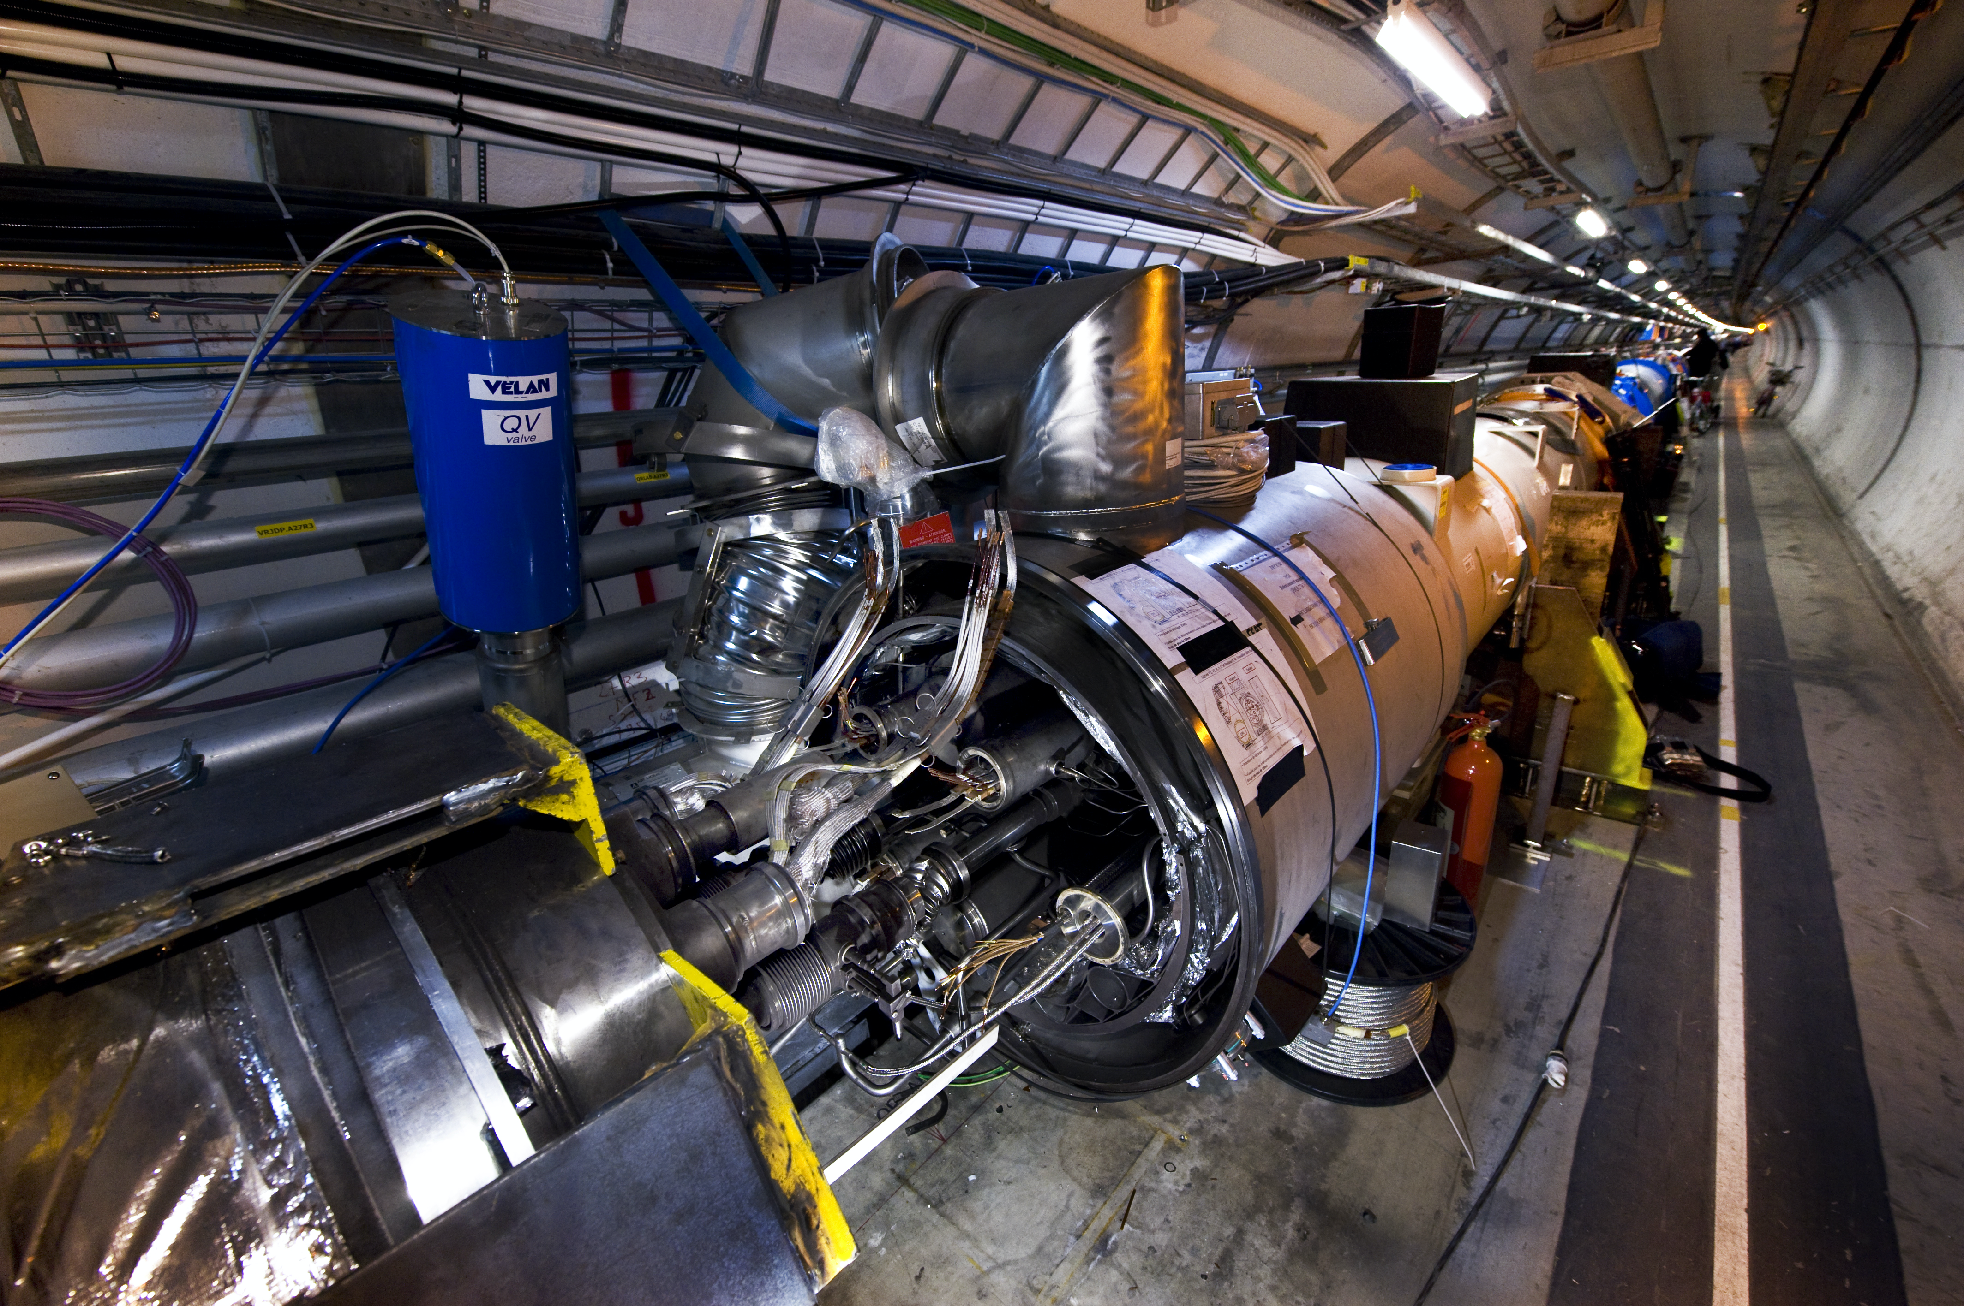
19th September 2008

Slide 9
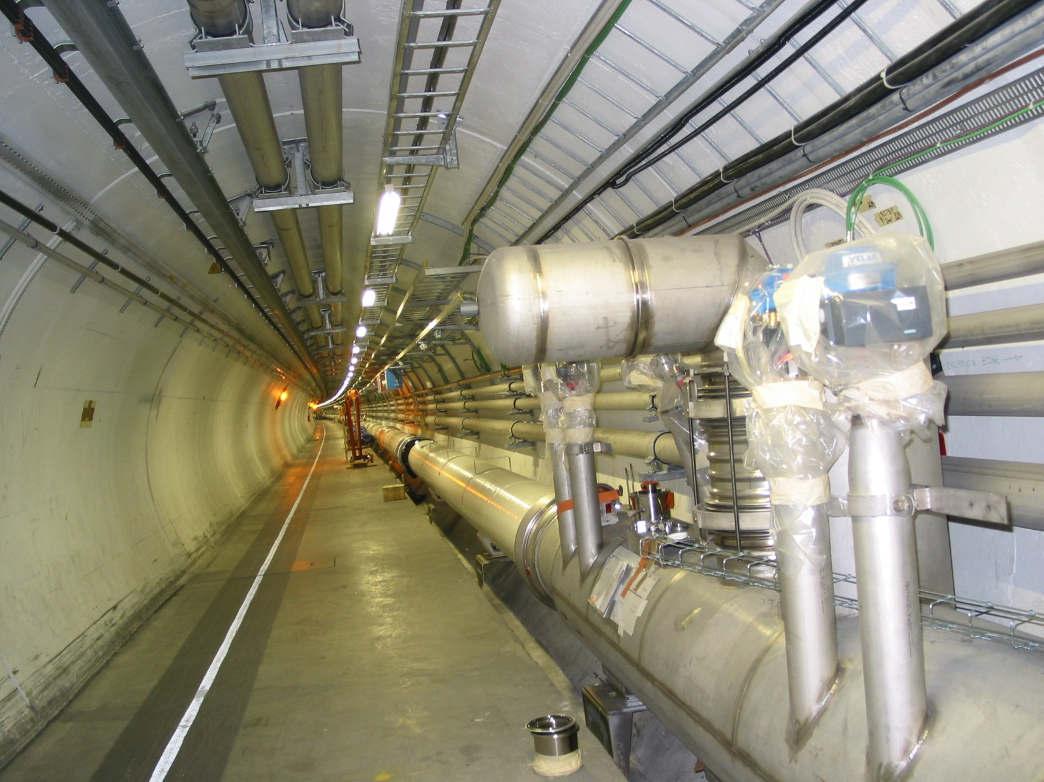
QRL crisis June 2004

Slide 10
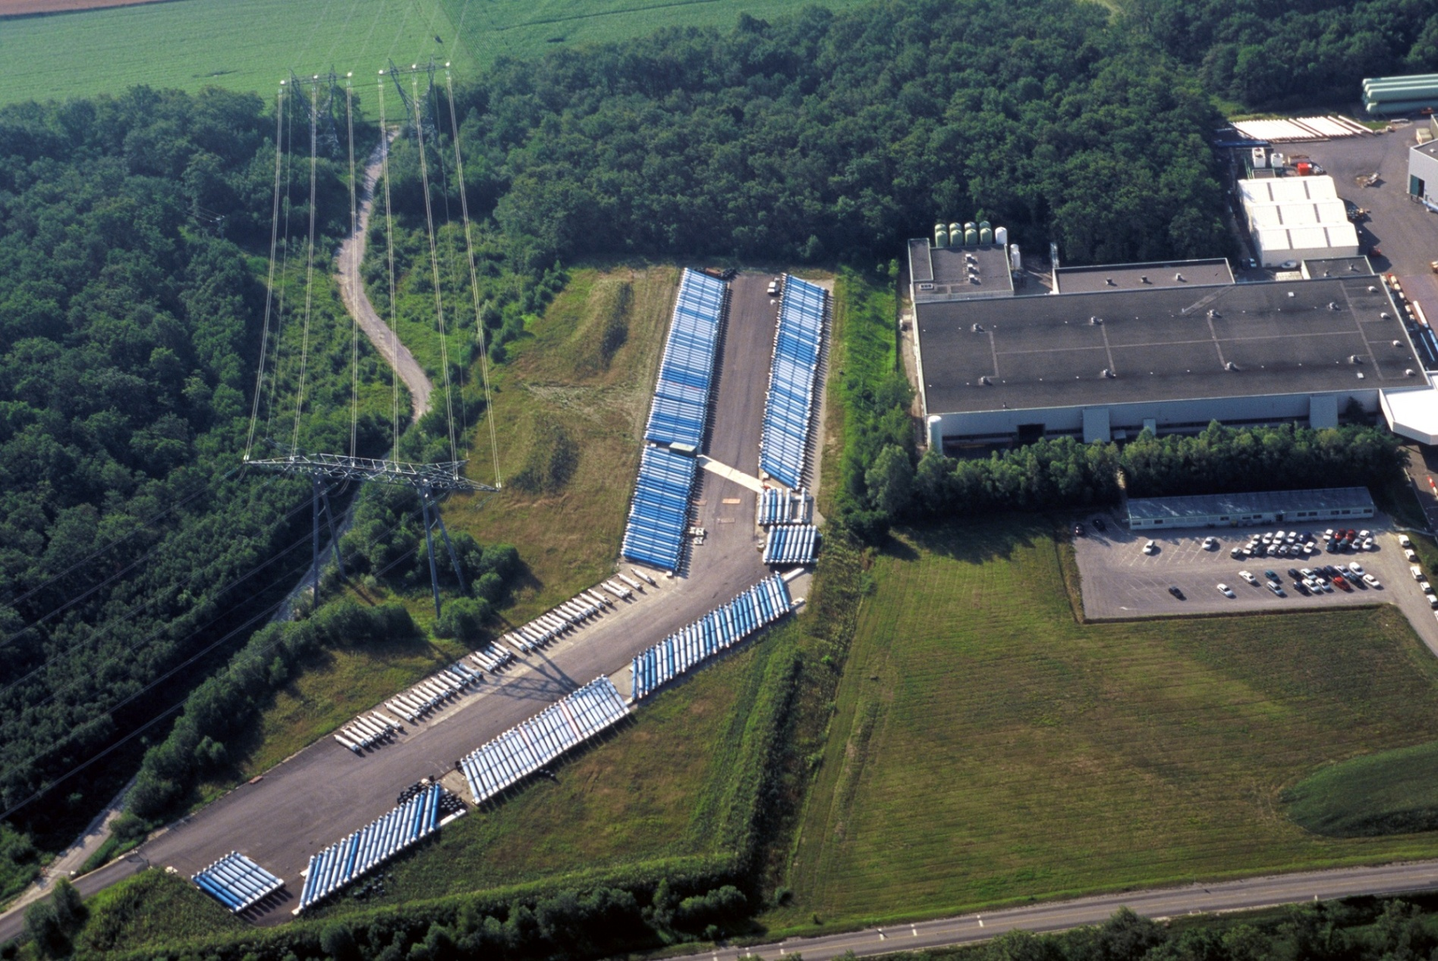
Magnet rows
Notes:
10

Slide 11
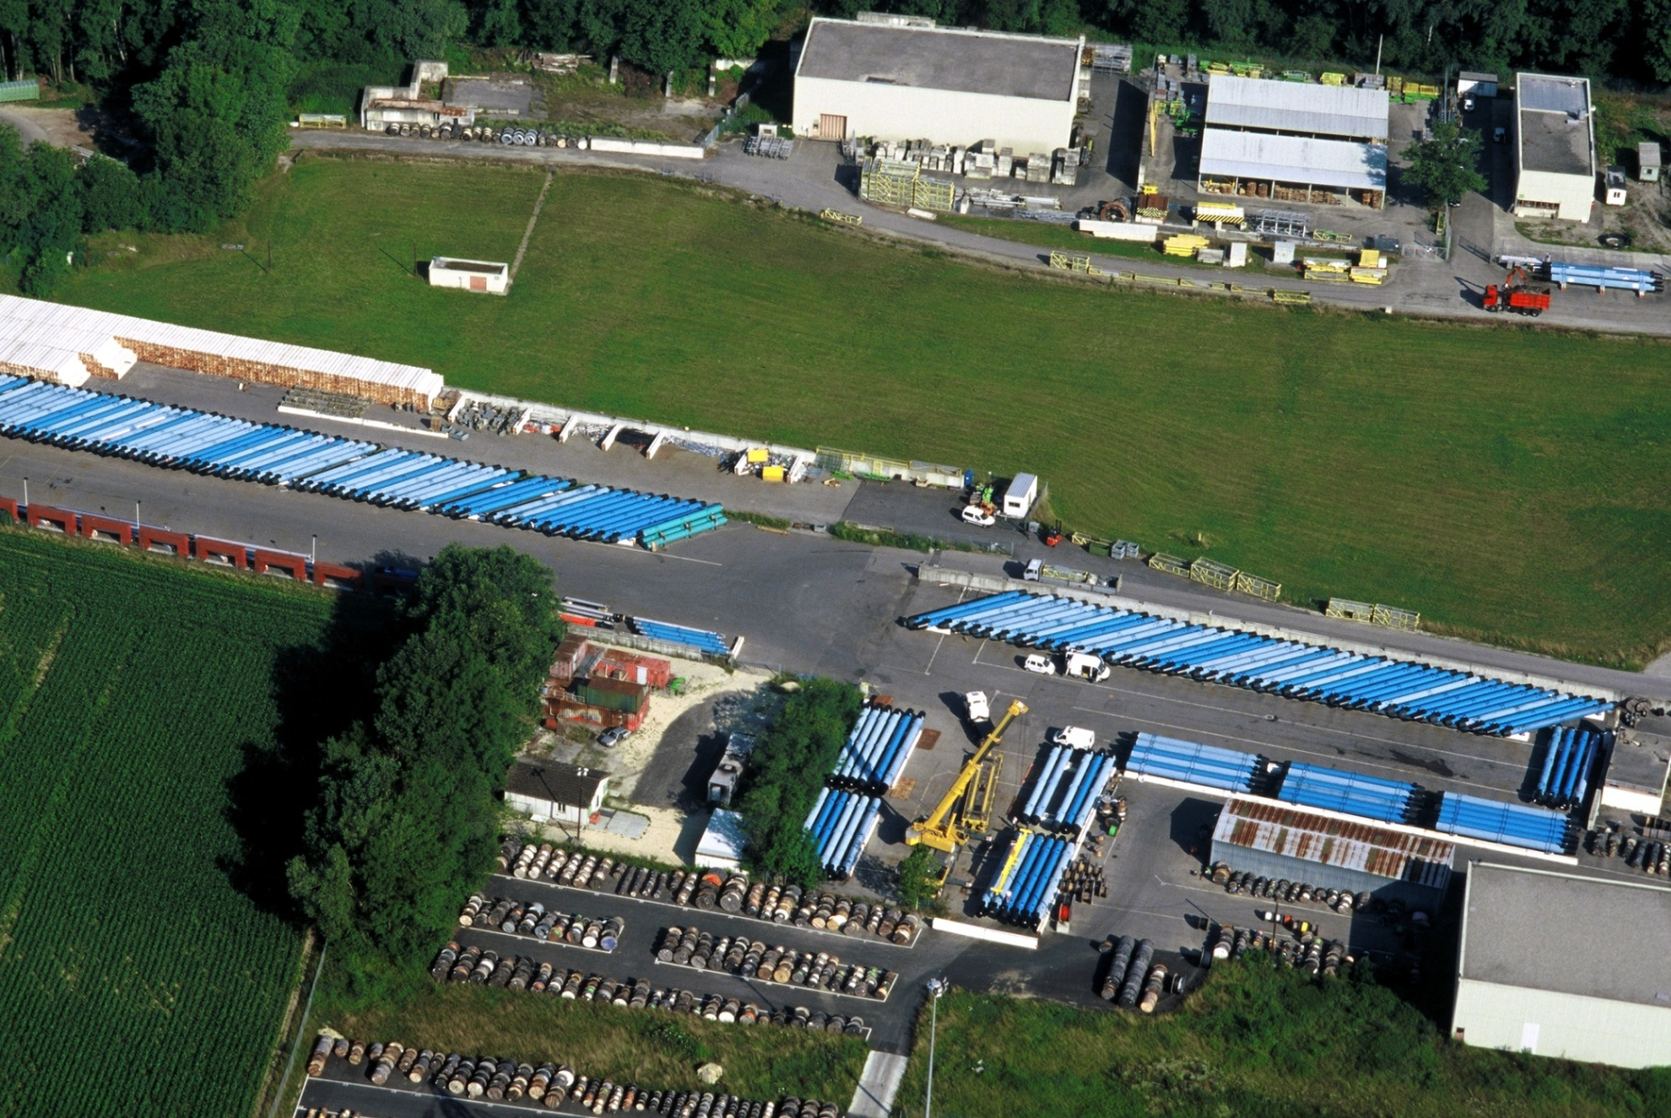
Magnet rows
Notes:
11

Slide 12
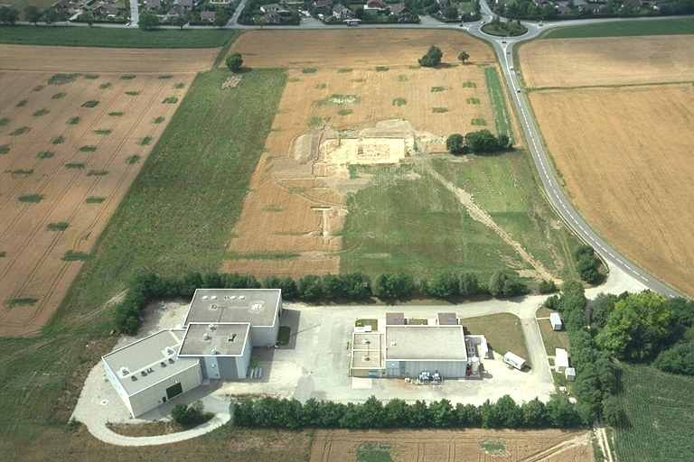
Aerial view of Point 5
Gallo-roman vestiges 1998
Notes:
12

Slide 13
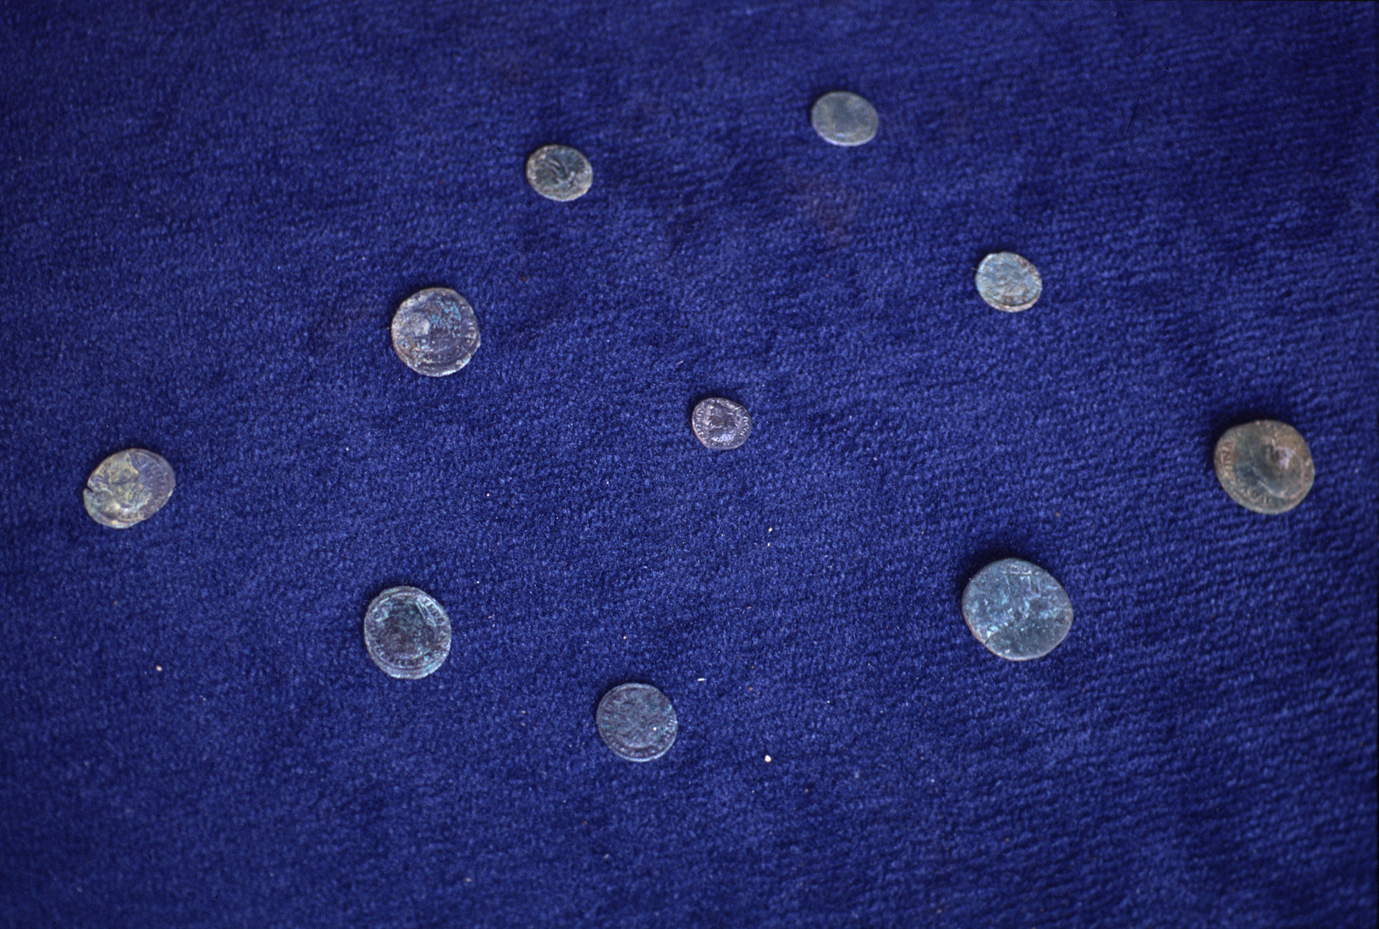
Roman coins found during archeological excavations at Point 5
Notes:
13

Slide 14
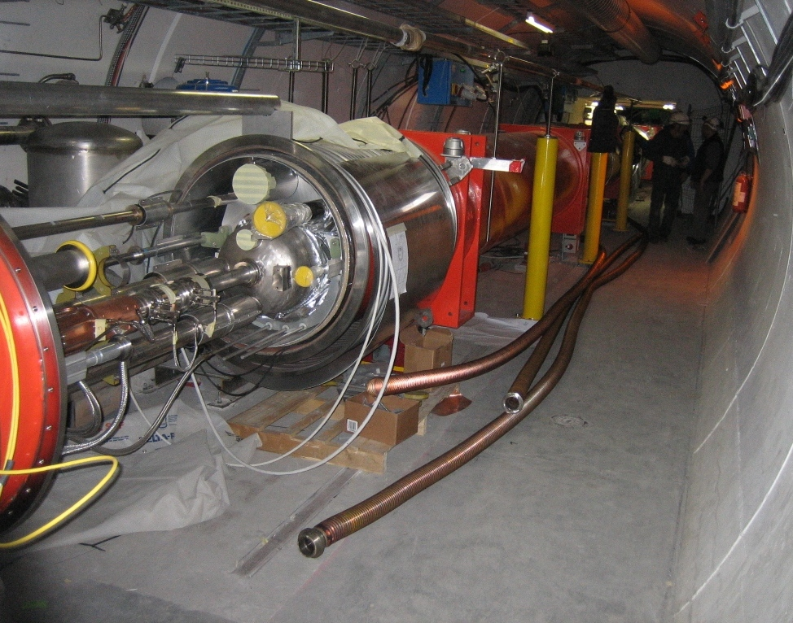
Inner triplet crisis Feb 2005

Slide 15
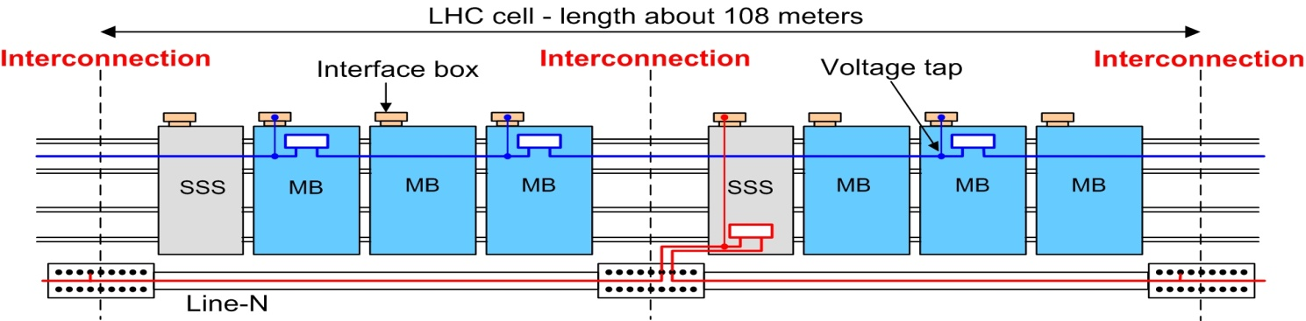
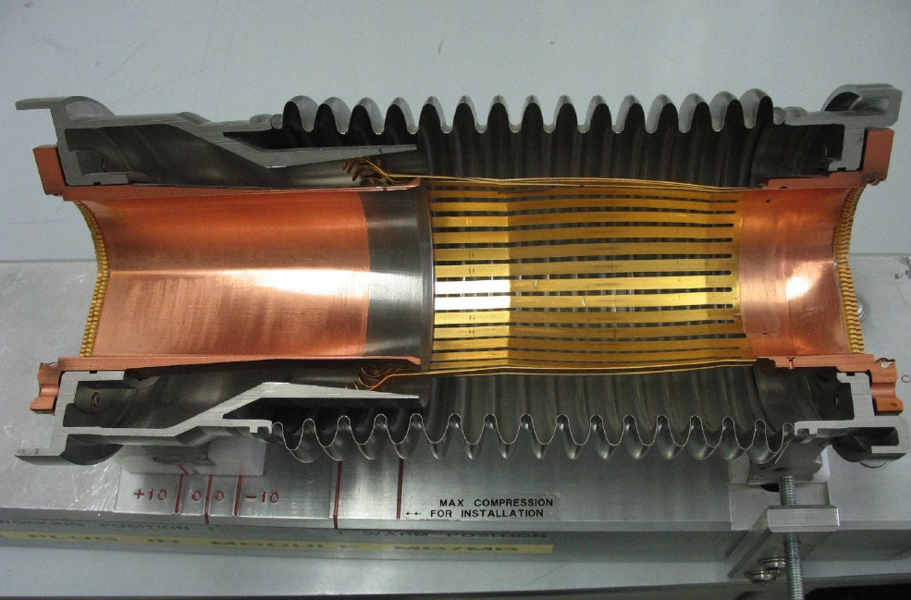
The crisis of the PIM’s

Slide 16
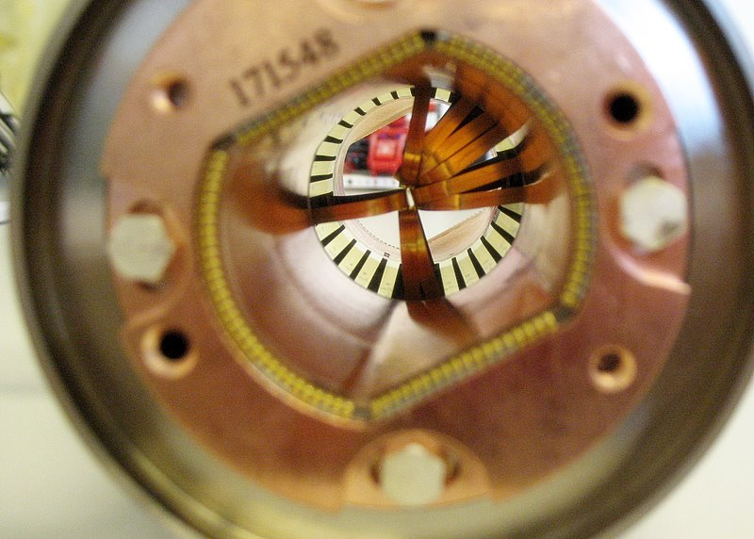
Arc plug-in module with damaged fingers

Slide 17
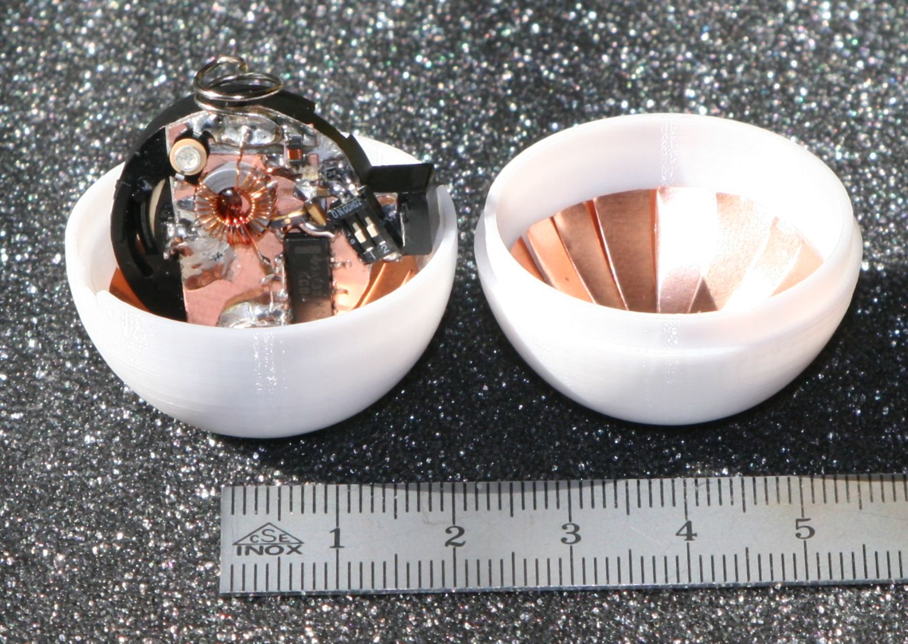
Transmitter ball

Slide 18
Quarks and Photons: The Strangest Little Things in Nature
FOX NEWS.COM, THURSDAY, NOVEMBER 09, 2006

Slide 19
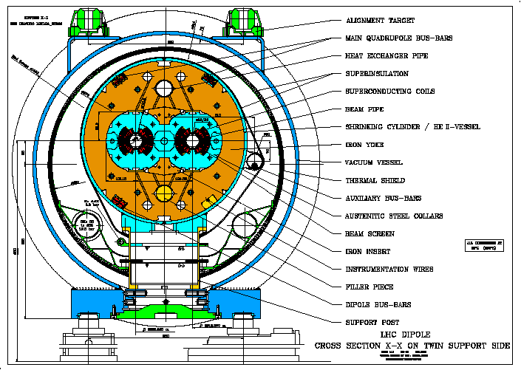
Cross-section of LHC cryodipole

Slide 20
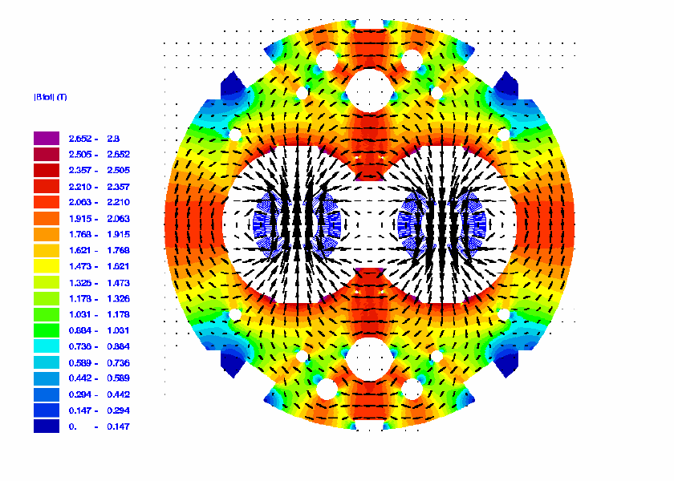
Dipole magnetic flux plot

Slide 21
LHC beam screen

Slide 22
Warm Vacuum System
For roughly 3 km of the 27 km circumference, mainly in the long straight sections, the vacuum chambers are at room temperature, requiring a low residual pressure without the benefit of the distributed cryopumping. As a spin-off of the development of sputtering technology for superconducting cavities a new getter material (TiZrV) has been developed which can be sputtered on the internal surface of the copper vacuum chambers and can be activated at the very low temperature of 200 degrees (conventional getters require activation at 600 degrees).
When activated, the chamber wall itself becomes a distributed pump, producing very low residual pressure and at the same time a very low secondary emission yield, preventing the buildup of an electron cloud.
All warm chambers, including those inside the detectors, are treated in this way.

Slide 23
Critical current density of technical superconductors

Slide 24
Cross-section of LHC cryodipole

Slide 25
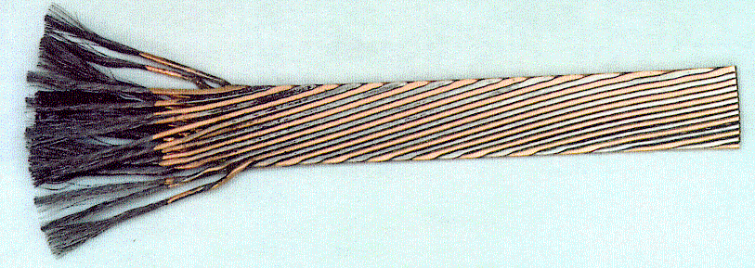
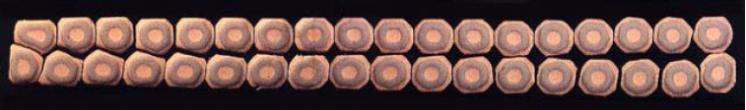

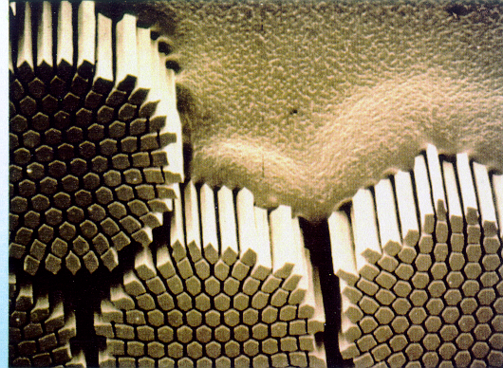
7000 km of superconducting cable Nb-Ti

Slide 27
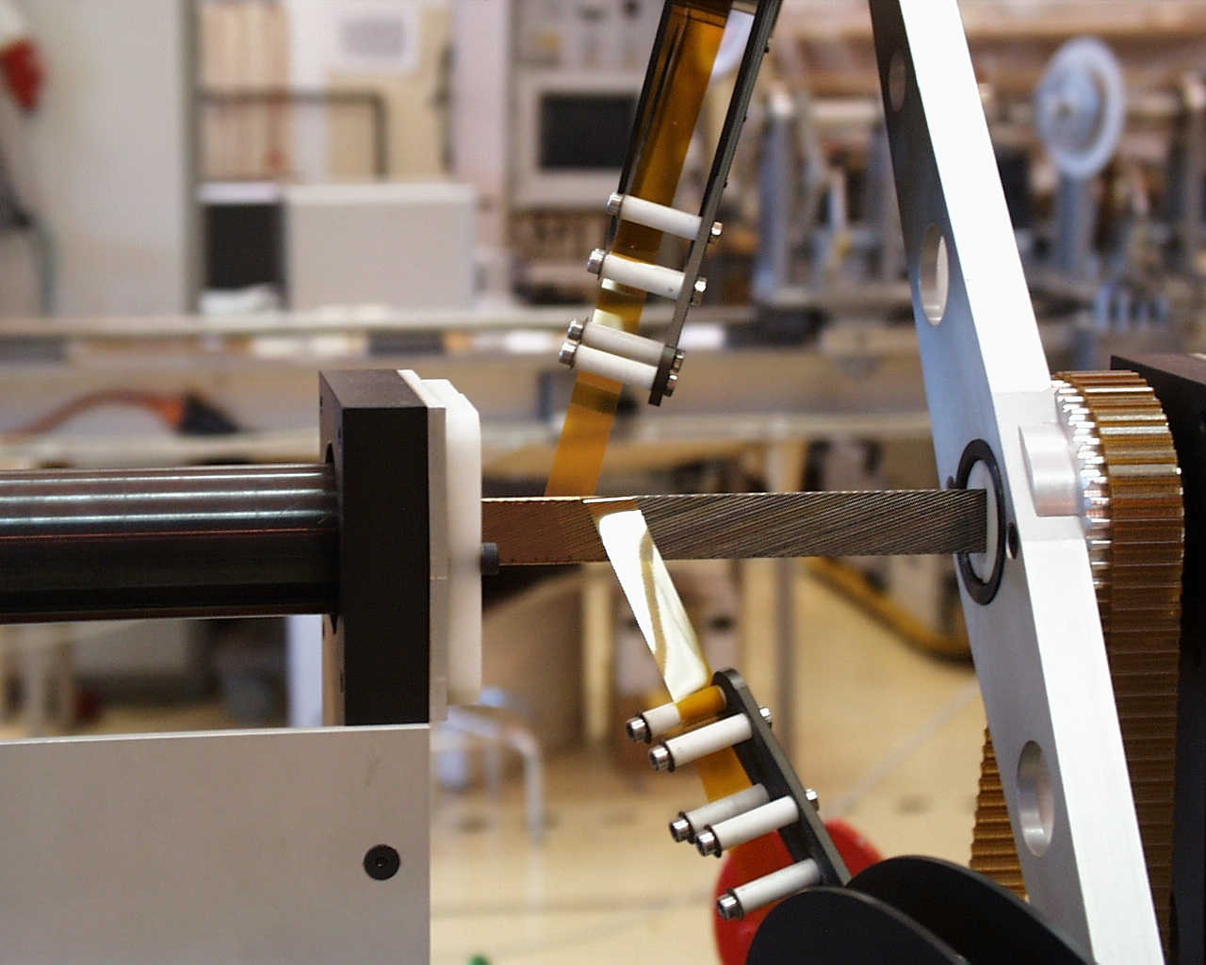
Cable insulation by double polyimide wrap

Slide 28
specific heat of LHe and Cu

Slide 29
equivalent thermal conductivity of He II
Helium II
OFHC copper

Slide 30
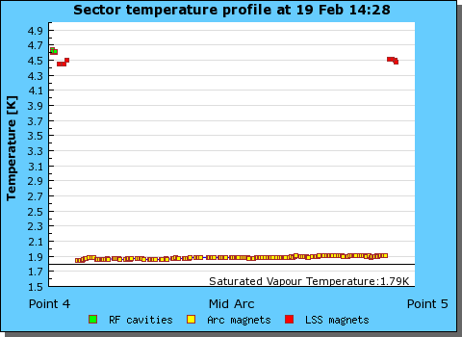
Cryogenic operation of LHC sector
3.3 km

