Slide 1
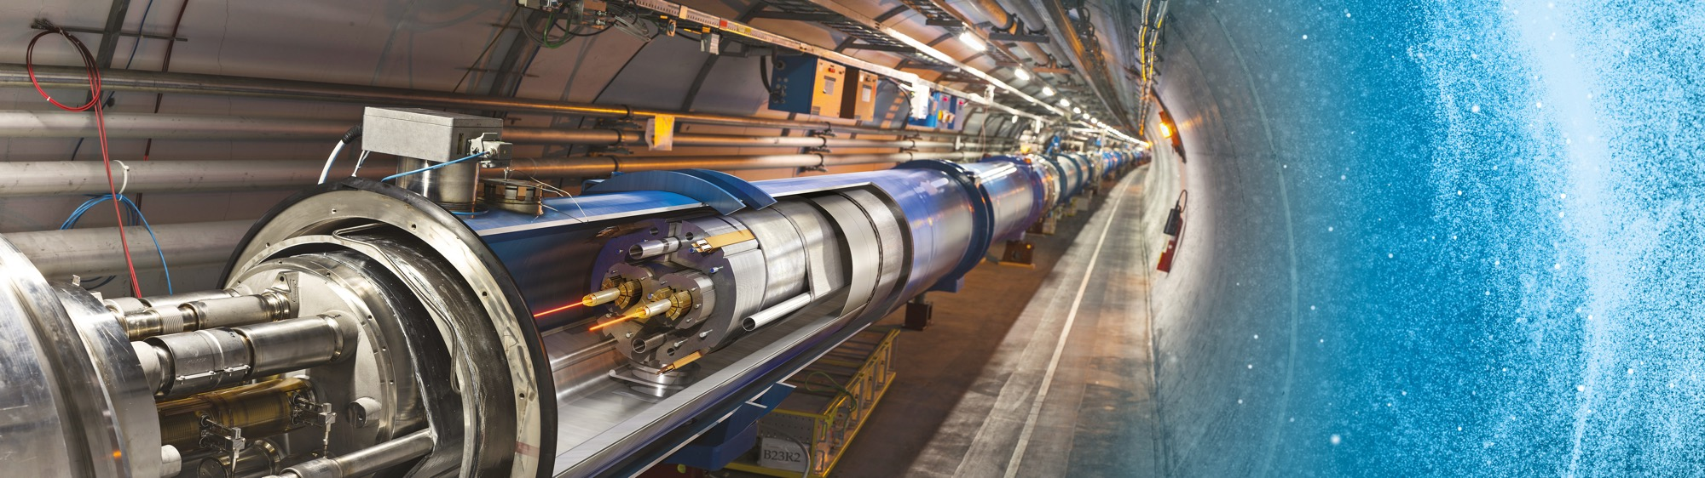
Business Opportunities at CERN
Daniel Schoerling
22/03/2022

Slide 2
Supplies (229 MCHF spent in 2021 – CERN budget only)

Slide 3
Table 1, Supplies
01 | Civil engineering, building and technical services
02 | Electrical engineering and magnets
03 | Electronics and radio frequency
04 | Information technology
05 | Mechanical engineering and raw materials
06 | Vacuum and low temperature
07 | Particle and photon detectors
08 | Optics and photonics
09 | Gases, chemicals, radiation and waste equipment
10 | Health, safety and environment
11 | Transport, handling and vehicles
12 | Office supply, furniture, communication and training
13 | Miscellaneous
WBMS: Austria, Switzerland, Czech Republic, France, Hungary, Italy, Slovakia
VPBMS: Bulgaria. Denmark, Estonia, UK, Israel, India, Latvia, Norway, Serbia

Slide 4
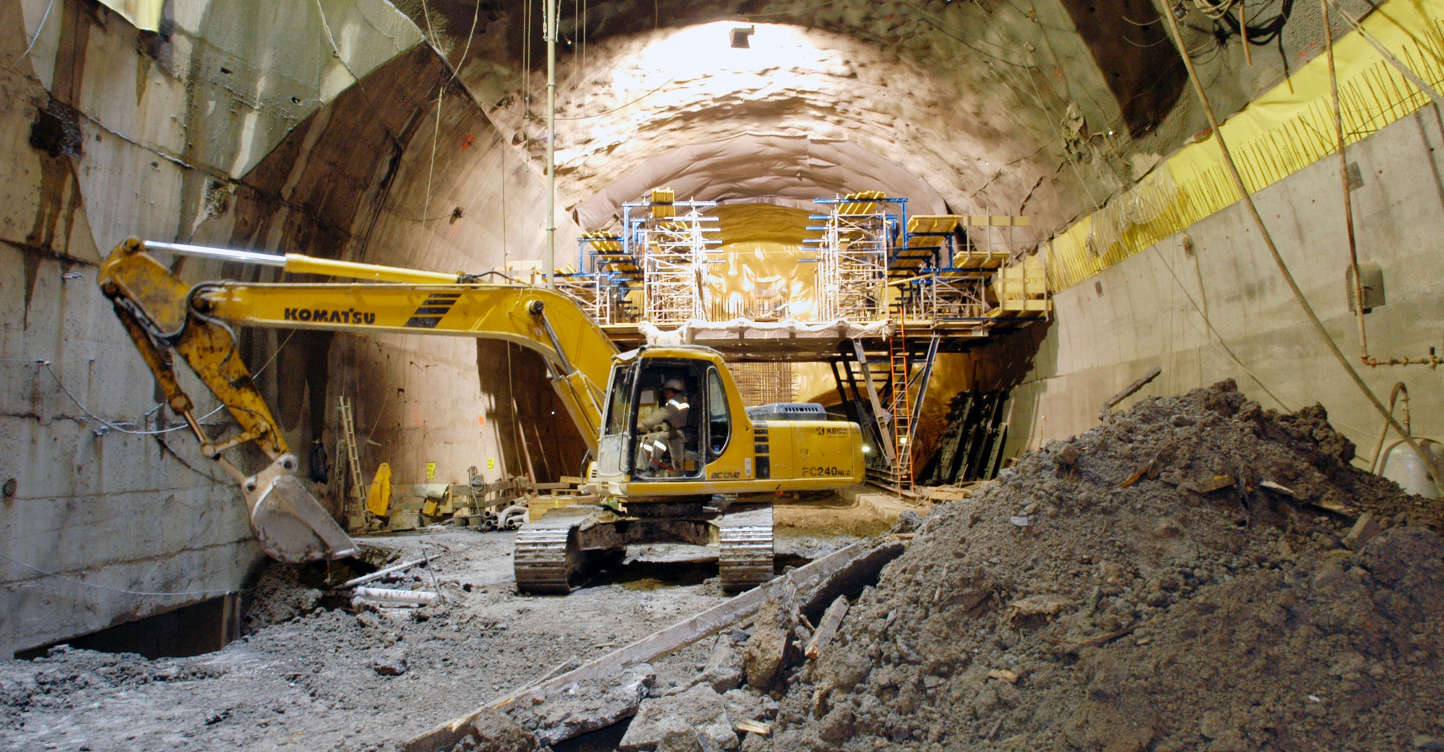
What do we buy?
Civil engineering:
  Construction
  Renovation of buildings
  Metallic structures
  Earthworks
  Roads
Cooling and ventilation
equipment

Slide 5
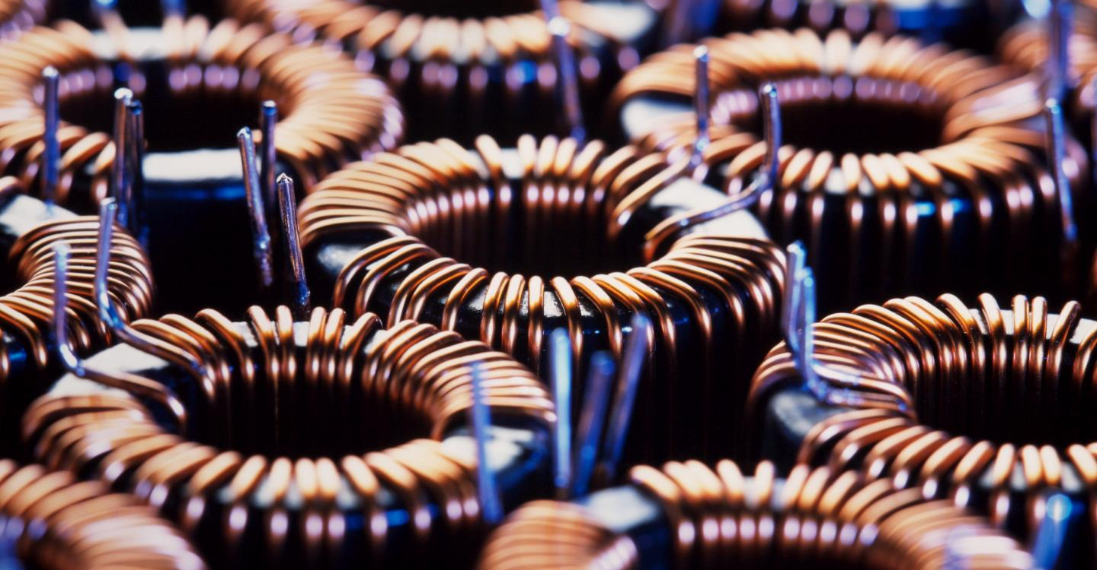
What do we buy?
Electronics
Sensors
Power Supplies
Electronics and radiofrequency:
  Electronic components (active, passive)
  PCBs and assembled boards
  LV and HV power supplies
  Radiofrequency plants
  Amplifiers

Slide 6
Spending profile

Slide 7
Examples of forthcoming projects
In the next 6 months several Market Survey will take place for qualifying companies to supply components for the power converters of the North Area. The total estimated contract volume is >30 MCHF (different contract sizes).
Companies in the following areas are required:
Integration/cabling
Power stacks
Magnetics low and medium voltage
Energy storage (capacitor banks)
Power resistors
Constant need in the following areas:
UPS and batteries
Transformers
Switchboards and switchgear
Cables
Automation
Electronic components (active, passive)
PCBs and assembled boards
Radiofrequency plants
Amplifiers

Slide 8
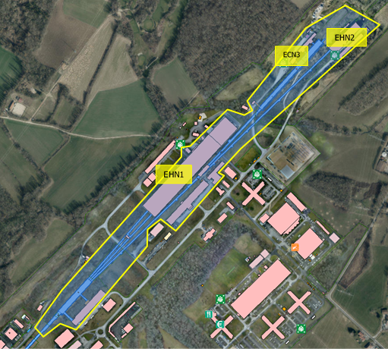
North Area Consolidation
Renovation of the Fixed Target Experimetal Area at the CERN Prevessin site, after 45 years of wear-and-tear + fantastic physics
Recover the availability and reliability of the beam- facility
Correct safety concerns and non-conformities
Be prepared for new projects and test beams in next decades

Slide 9
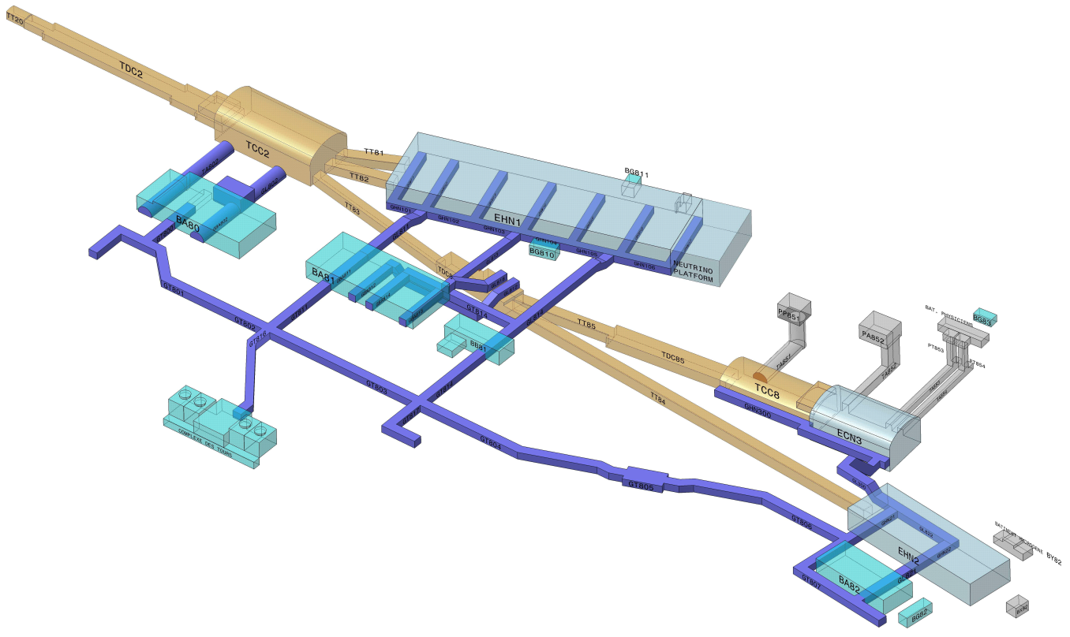
Schematic view of the North Area
A few numbers:
Overall surface 60000 m²:
  underground 16600m²,
  experimental halls 31000 m²,
  service buildings: 12000 m²
6 beam lines, ~ 6.3 km cumulated
~ 1500 visitors / year
300 m
Secondary beam area
1250 m
Primary beam area
Underground
beam tunnels,
caverns
Underground
Technical galleries
Service
buildings
Exp. Halls

Slide 10
Cumulated budget
Nota: without EL-CONS (~ 20 MCHF)

Slide 11
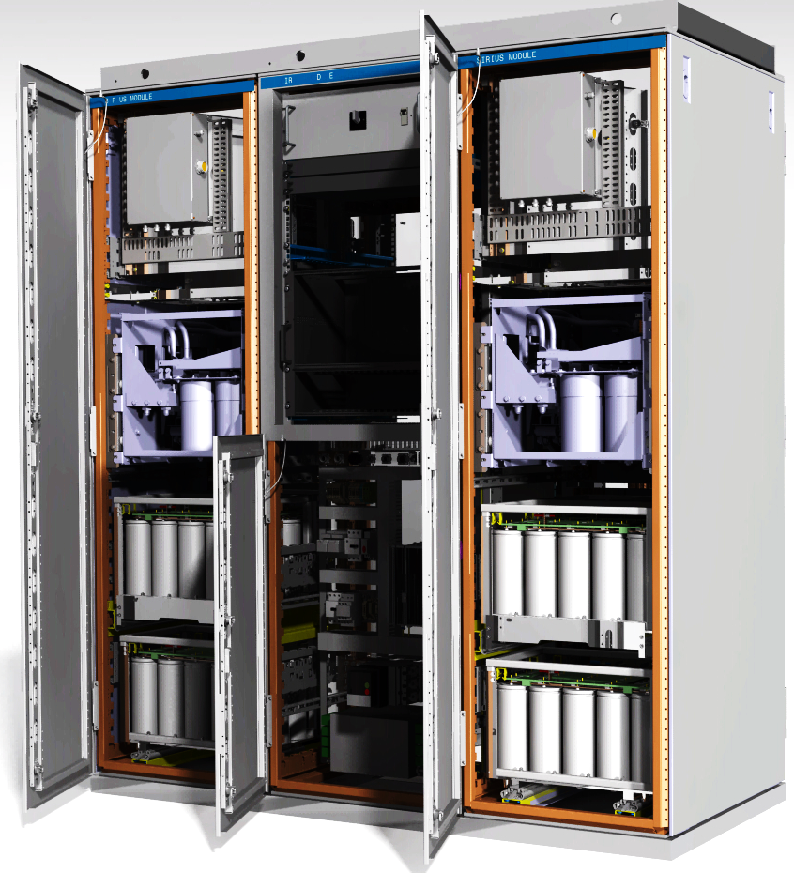

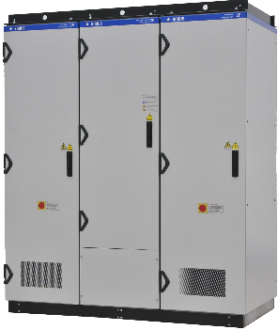
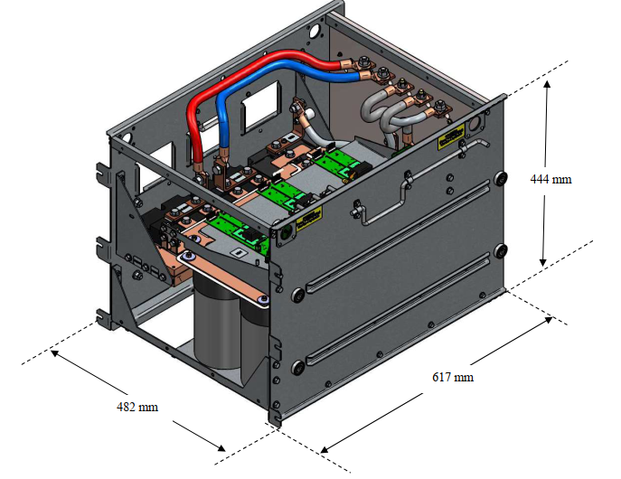
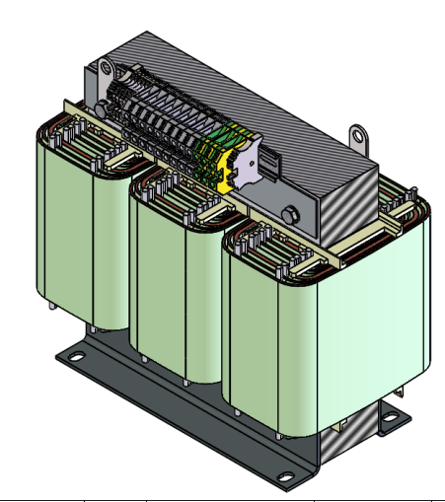
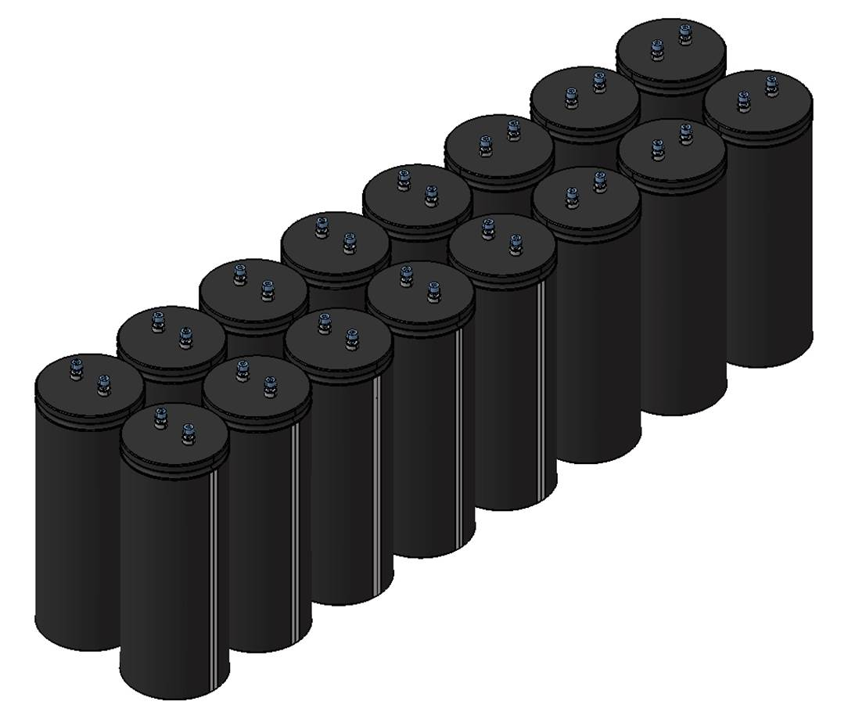
POLARIS Highlights
PHASE I – LS3: commit for qty / contracts in 2022/23
396 POLARIS to deliver
PHASE II – LS4: use optional qty / re-order in 2027/28
188 units
All new IT contracts
Contracts: 5 years (+2)
208 units
IT Manufacturing
IT Power Stacks
IT Magnetics
IT ELCO Capacitors
188 units
Cat. C
438 units
Cat. B
438 units
Cat. B
13 400 units
Cat. B
200 units
Cat. C
496 units
Cat. B
496 units
Cat. B
14 000 units
Cat. B
360 V / 2000 Apk
CONTRACT 1
CONTRACT 2
CONTRACT 4
CONTRACT 7
Standard off-the-shelf capacitors

Slide 12
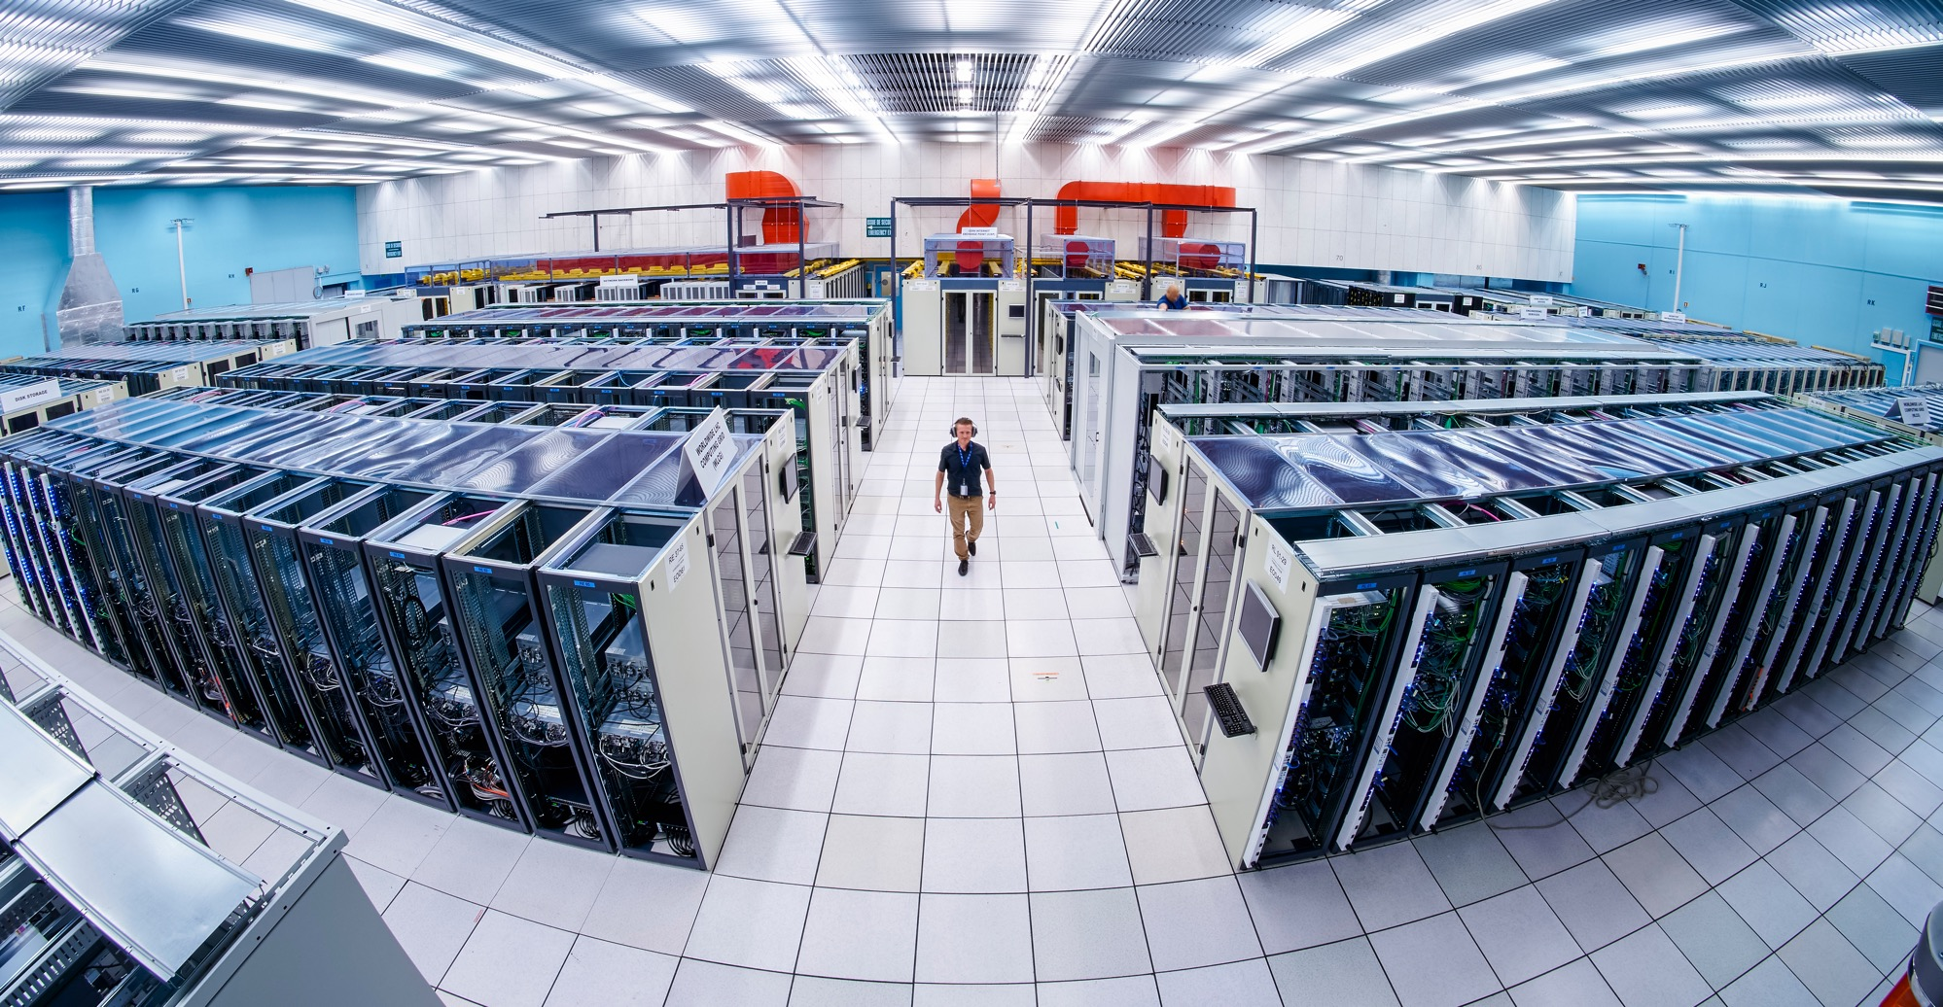
What do we buy?
Electronics and radiofrequency:
  Electronic components (active, passive)
  PCBs and assembled boards
  LV and HV power supplies
  Radiofrequency plants
  Amplifiers
Session 8:
Safety,
Radiation Protection, ICT
Session 4: Electronics
Sensors
Power Supplies

Slide 13
Spending profile

Slide 14
Upcoming opportunities
Several blanket purchase contracts for the supply of Servers and Storage for Physics Data Processing, Acquisition and Control (above 10 MCHF)
Fairly regular opportunities for circuit testing and wafer processing.
For PCBs and electronic card assembly there is very regular requirements in support of the HL-LHC upgrade, for example:
MS-4742 for the supply of low-density hexagonal printed circuit boards for CMS
MS-4737 for the supply of PCBs, mainly for ATS
MS-4726 for the supply of wafer probe testing services for CMS.
MS-4750 for the design of custom made rad-hard cables (375MRad) for the ATLAS pixel detector (to be published)
See https://found-java-ext.cern.ch/java-ext/found/CFTSearch.do for forthcoming Market Surveys

Slide 15
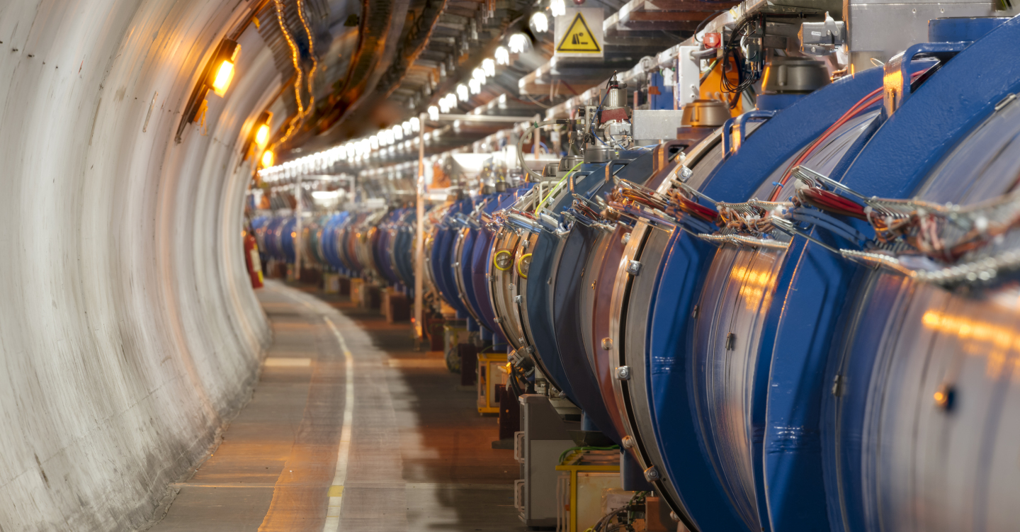
What do we buy?
Magnets, Superconductors, Mechanical Engineering & Materials
Electronics and radiofrequency:
  Electronic components (active, passive)
  PCBs and assembled boards
  LV and HV power supplies
  Radiofrequency plants
  Amplifiers
Session 4: Electronics
Sensors
Power Supplies

Slide 16
Spending profile

Slide 17
Examples of forthcoming projects
Normal conducting magnets: constant need for spare coils and magnet yokes
Mechanical engineering: machining of parts, welding, metallic construction, special fabrication techniques
Raw materials, finished and semi-finished products (plates, pipes, etc.)
Wood products for engineering and construction applications

Slide 18
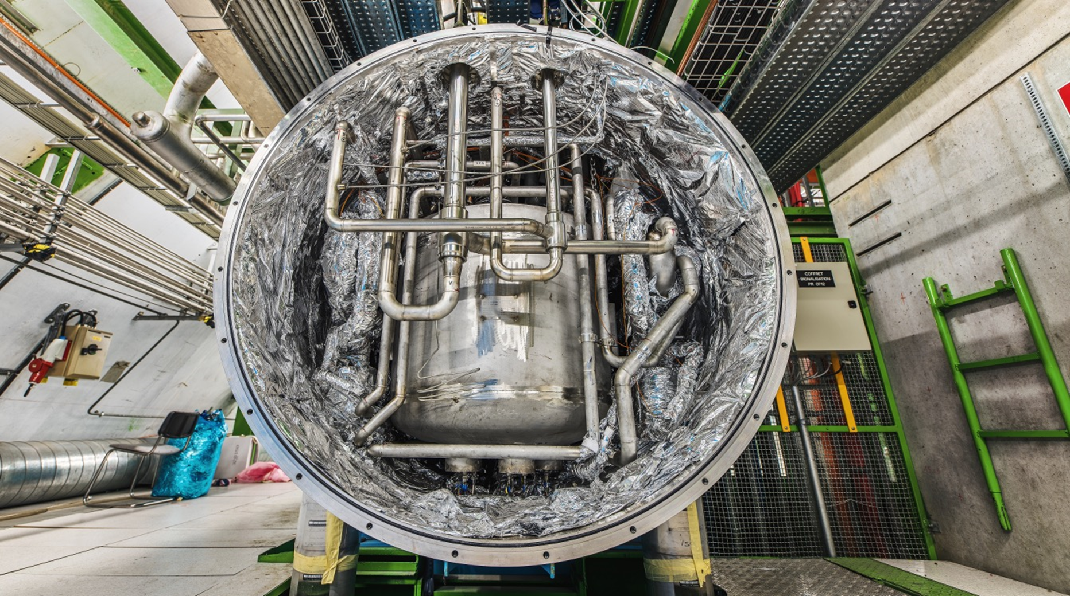
What do we buy?
Cryogenics,
Cooling,
Vacuum Technology
Electronics and radiofrequency:
  Electronic components (active, passive)
  PCBs and assembled boards
  LV and HV power supplies
  Radiofrequency plants
  Amplifiers
Session 7:
Cryogenics,
Cooling,
Vacuum Technology
Session 4: Electronics
Sensors
Power Supplies

Slide 19
Spending profile

Slide 20
Dune/Darkside
• Warm structure material
• Warm structure components manufacturing
• Warm structure membrane manufacturing
• Warm structure underground assembly
• Cold structure material procurement
• Cold structure underground assembly

Slide 21
Summary
The procurement service has the aim to achieve balanced return to all member states.
To achieve this goal we need your help!
For any further question please feel free to contact:
daniel.schoerling@cern.ch
Procurement.Service@cern.ch

