Slide 1
Goals of the 12 T robust programme:
One short model, assembly technique with key and bladders.
One short model, with collars.
One long (~ 6 m) model.
Develop winding tool, reaction and impregnation moulds.
Design, build and cool to LN instrumented assembly mock-ups.
The design must be made keeping in mind that one day it may be a double aperture, 10-15 m long dipole.
This project has not a specific father or mother but it is the effort of our group.
It must be the project of the young generation.

Slide 2
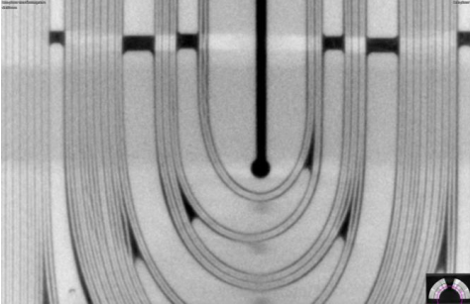
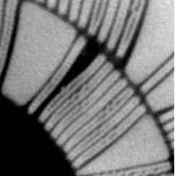
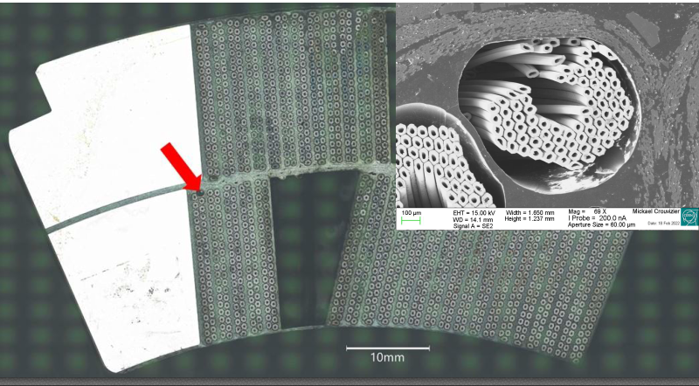
From the previous, important experience on Nb₃Sn magnets, two axes of work:
  Quality of coils – Winding, thermal treatment tools. Handling.
  Stress management in the structure – limit stresses in the coils.
Take the time to carry out winding tests. – Check if tools can be improved.
Design ‘intrinsically safe’ structures. Identify and manage effect of tolerances on coil compression and bending.

Slide 3
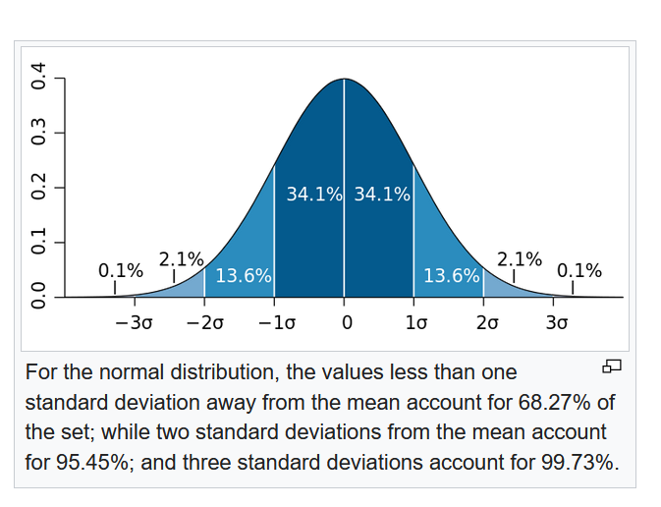


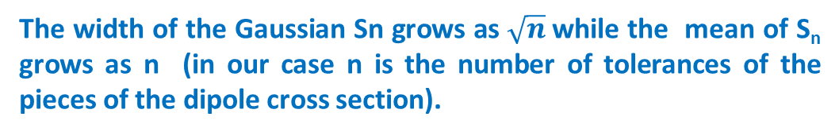
A Sum of Gaussian Random Variables is a Gaussian Random Variable
S_{n} sum of n statistically independent random variables x_{i}
The mean value of the sum is the sum of the individual means.
The variance of the sum is the sum of the individual variances.
If all the individuals x_{i} have the same probability density we have:
The width of the Gaussian Sn grows as $\sqrt{n}$while the mean of S_{n} grows as n (in our case n is the number of tolerances of the pieces of the dipole cross section).
Reduce the number of pieces to be less sensitive to tolerances

Slide 4
Intrinsically safe structure
Work with closed cavities (whenever possible)
  To protect the coils from over stresses.
  To control unbalanced stresses. The alignment precision of long presses or long ‘force’ tools is limited.
Rigid material. Collars or paddles.
Soft material. Coils.

Slide 5
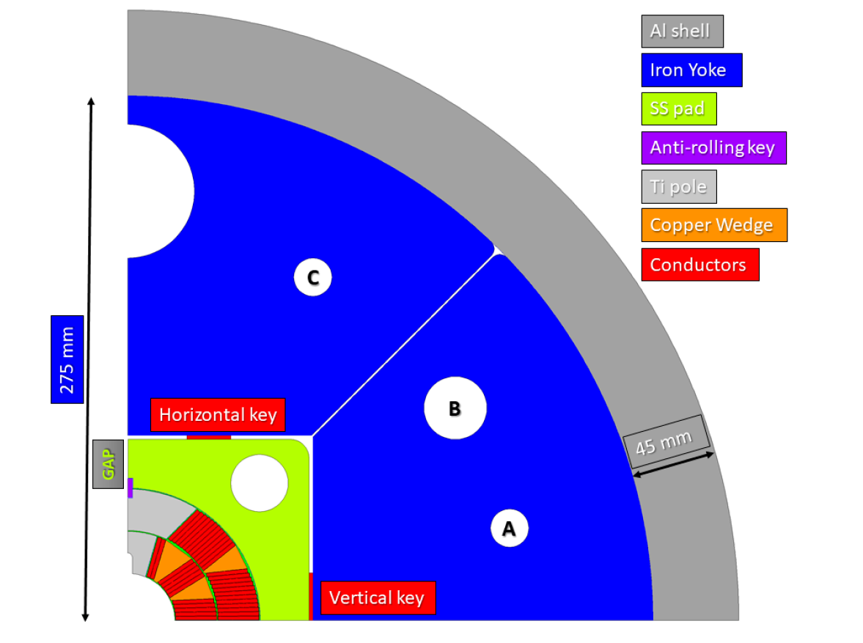
Cross section of the FalconD
The limit to cable compression, tells us that 12 T – 13 T are at the edge of what we can realize with the configuration cos-theta coils and with ‘traditional’ structures.
This limit is practically given by the electromagnetic forces.
What can we do? In the long term think differently. In the short term pay attention to all the margins that one can include in the design. Every 1% counts!
12 T, cable with 40 strands, strand diameter 1 mm.

Slide 6
We can shift ‘a little bit’ the limiting curve toward right.
Iron as close as possible to the coils. Limited by:
  Iron saturation
  Stresses in the collars / pads.
No miracles, but a few per cent. Stresses due to EM forces are proportional to the current.
Iterations between magnetic and mechanical optimizations.

Slide 7
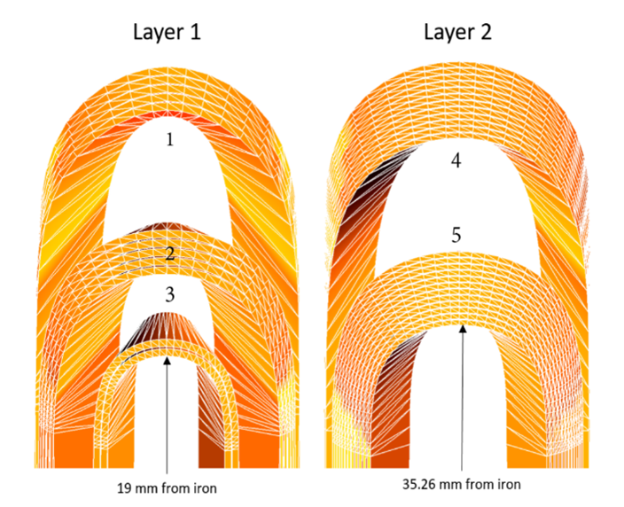
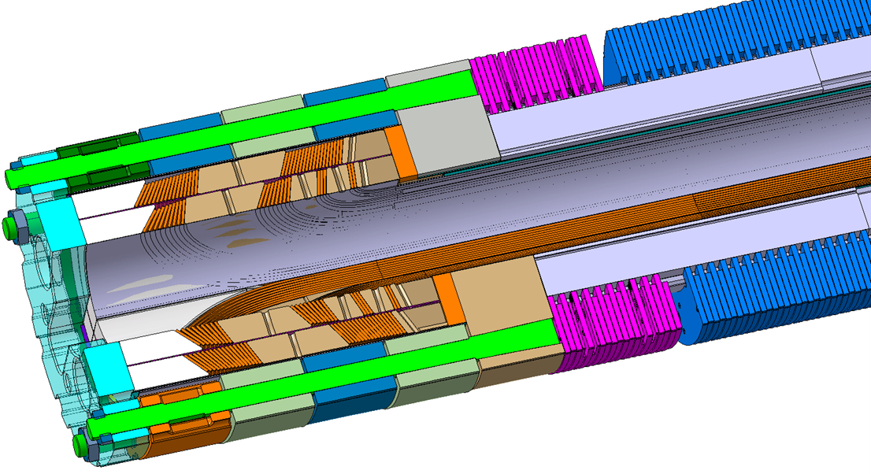
Traditionally a magnet design starts with cable definition and magnetic design.
The iteration magnetic design – mechanical design – reasonable construction constraints is not always done from the beginning.
Then we find ourselves with cross section coil angles not so favourable to reach the right prestress or with coil ends difficult to wind or with high local stress concentrations (high local field).
Here as well, we can find a few per cent of margin and save our neck.

Slide 8
Some (starting) numbers and some questions:
Bore diameter: 50 mm (winding on a larger bore would be better but ..)
Beam – beam distance: 200 – 210 mm
Paddle external size (radius): 90 mm (?) in FalconD it is 97 mm
Collar thickness (midplane): 20-23 mm (there will be a rod)
Cable
40 strands (Can we reduce them if we go closer with the iron? Do we gain in winding if we do this?)
strand diameter 1 mm
Low prestress in the coils during assembly (collaring at 30-40 MPa average). Increase pre-stress during cool down to 70-80 MPa average (horizontal gap in the collared coils structure). Maximum compression in the coils < 120 MPa in all load cases.

Slide 9
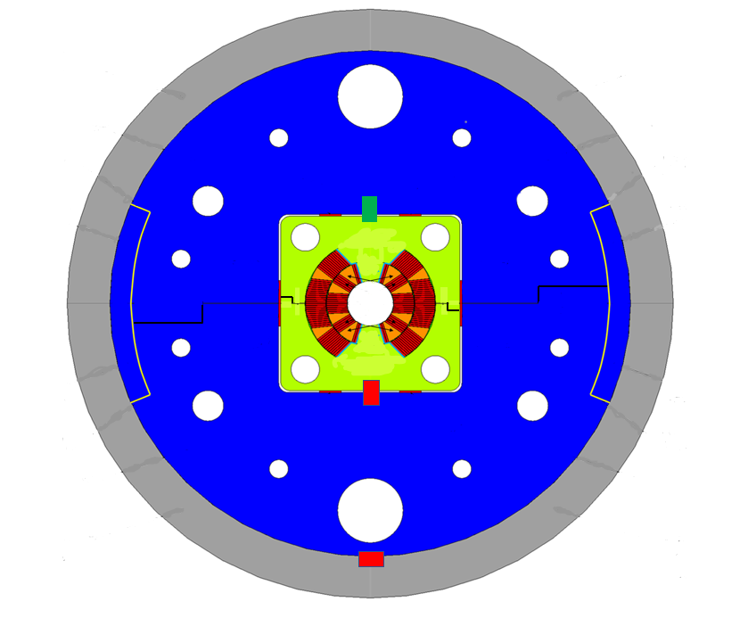
Key and bladders, one aperture cross section
Separate the functions and directions of forces
Horizontal gap closed after cool down. Closed cavity.
Tight tolerances for the cavity but coil shims. Angles are important.
Pushing key. Large horizontal clearance (0.2 – 0.3 mm)
Horizontal gap always open.
Large tolerances.
Aluminium insert. Longer than in the picture. Just to easy the assembly. Aluminium cylinder heated and slightly forced on the two half yokes kept at the right position by the inserts.
Horizontal alignment of the iron yoke halves. 0.0 – 0.1 mm clearance of undeformed parts for assembly.
Clearance absorbed by the horizontal pushing key.
Horizontal alignment of the paddles. 0.0 – 0.1 mm clearance of undeformed parts for assembly.
Clearance absorbed by the horizontal pushing key.
Fix line. Longitudinally free key. Horizontal clearance just to insert it (0.05 – 0.1 mm).
Pushing key. Horizontal clearance just to insert it (0.05 – 0.1 mm)
Moderate coil prestress at room temperature (50-60 MPa). Higher compression at the end of cool down (70-80 MPa).

Slide 10

Nb₃Sn magnets, easy are not.
  Forgive, they do not.
    Nothing, neglected has to be. Under the carpet a problem hidden, back will come.

