Slide 1
12 T Robust CERN Models:
Nb₃Sn Wire and Cable
Simon C. Hopkins

Slide 2
Similar Cable/Strand Experience (1)
Baseline: 40-strand cable of 1 mm diameter strands
  FalconD Cable Spec: EDMS 2663170
  cf. HL-LHC, 108/127
Ref | Name | Keystone | Width (mm)* | Strand Types
C01 | FalconD | 0.5° | 20.95 | 162/169, R&D (TVEL, KAT)
H11 | FRESCA2 | 0° | 20.95 | 132/169, PIT
H19 | ERMC | 0° | 20.95 | 150/169, 120/127
* width spec for FalconD set to 20.95 mm to match production experience for ERMC, FRESCA2

Slide 3
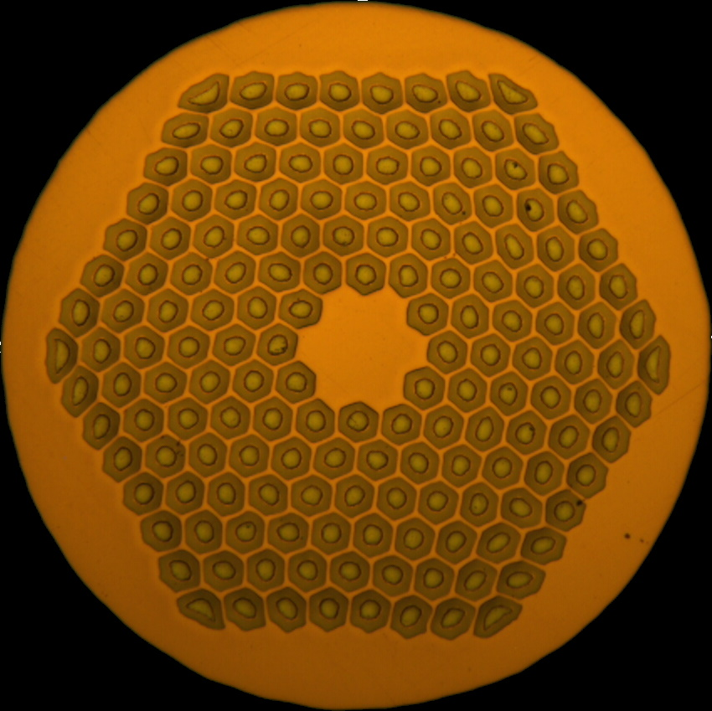
Similar Cable/Strand Experience (2)
RRP layouts with relevant cabling experience at CERN:
 | 108/127 | 132/169 | 150/169 | 162/169
Layout
Cu/non-Cu | 1.15-1.2 | 1.25 | 1 | 0.9
d_{eff} (µm) | 60 | 52 | 52 | 52

Slide 4
Current Density
For strand, can anticipate:
  specified non-Cu J_{c} 2450 A/mm² (4.2 K, 12 T)
  typical non-Cu J_{c} ~2800 A/mm² (4.2 K, 12 T), and
  J_{e} ~ 1250–1400 A/mm², depending on chosen Cu/non-Cu, Sn stoichiometry and heat treatment
    Conservative optimisation might suggest reduced Sn (cf. HL-LHC), d_{eff} < 60 µm, Cu/non-Cu > 1, RRR >> 100 as cabled; but available data (axial strain, transverse stress, stability…) to be reviewed

Slide 5
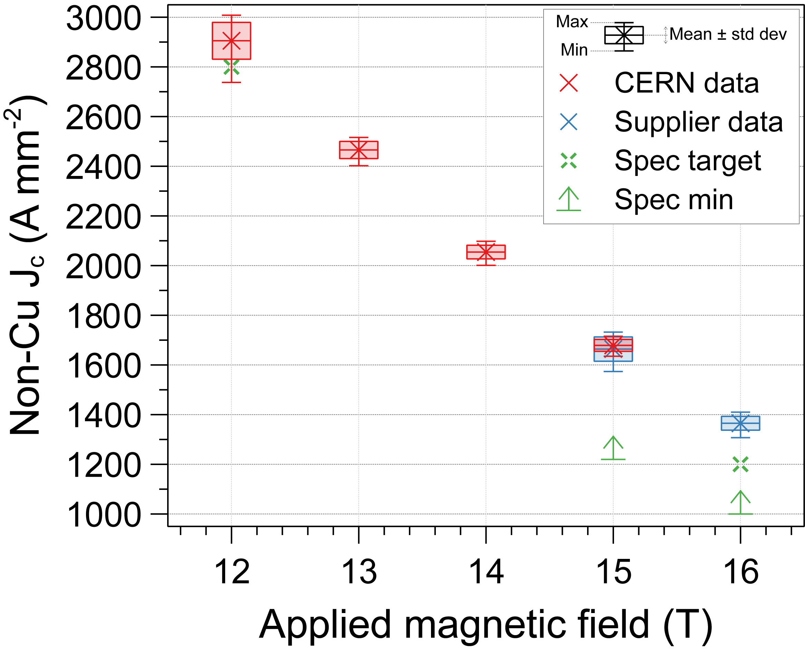
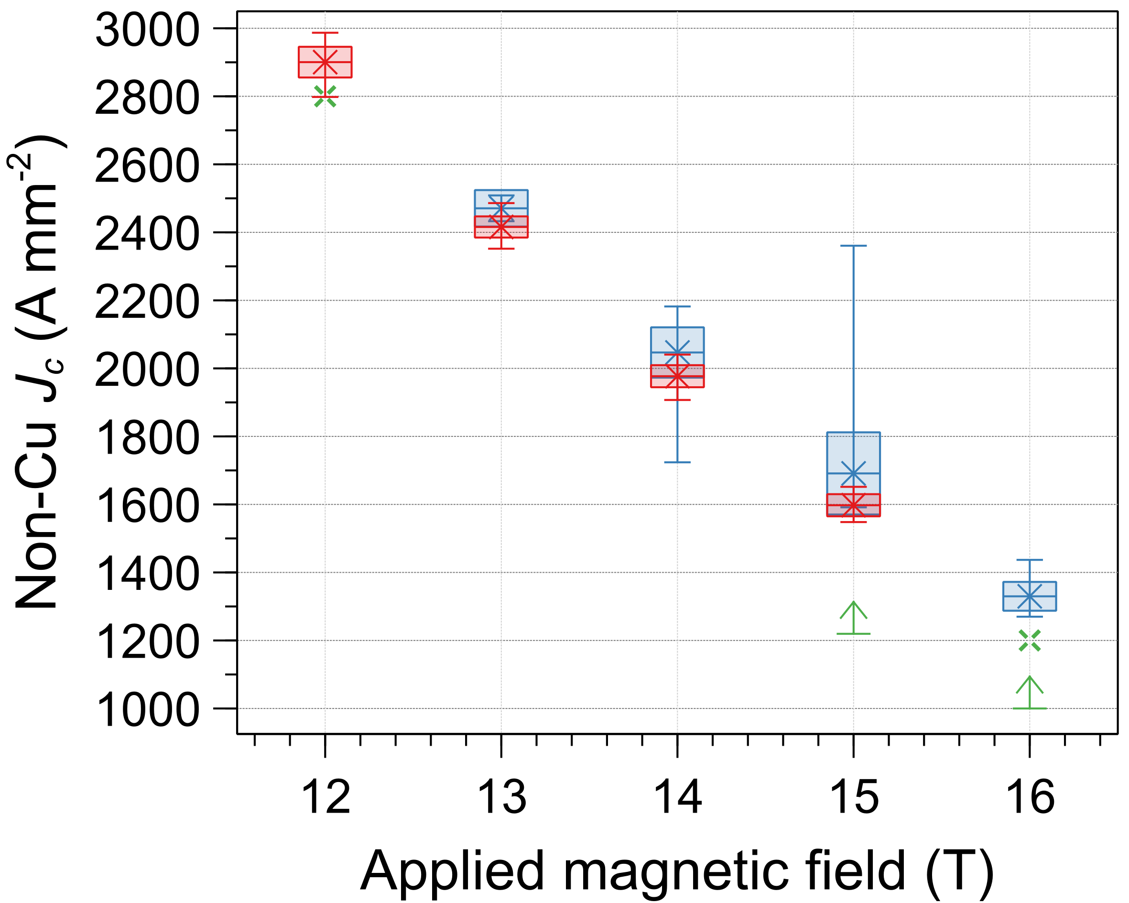
J_{c} (DEM-1.1 & ERMC-1)
DEM-1.1
665 °C
ERMC-1
650 °C
J_{c} distribution as measured by the supplier (nominally 4.2 K) and CERN (mean 4.26 K)
Standard heat treatment; supplier Cu/non-Cu values used for consistency.

