Slide 1

Interplay between equilibrated and non-equilibrated components with dynamical initialization framework
Y. Kanakubo et al., Phys. Rev. C 105 (2022) 2, 024905
Y. Kanakubo et al., Phys. Rev. C 106 (2022) 5, 054908
Yuuka Kanakubo^{1,2}
¹ University of Jyväskylä, Centre of Excellence in Quark Matter
Collaborators: Yasuki Tachibana³, Tetsufumi Hirano²
² Sophia University, ³Akita International University

Slide 2
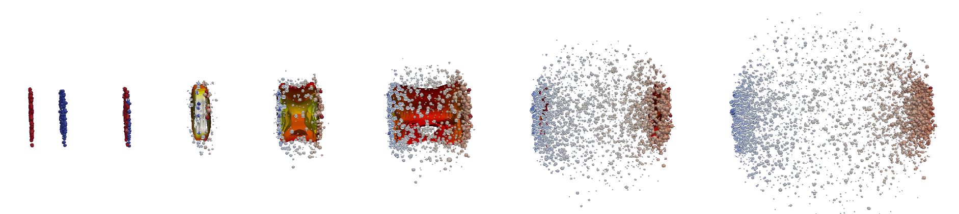

Hydro-based multi-stage dynamical model
Standard model in HIC
Extraction of QGP properties from direct comparisons with data
QGP
Hadrons
J. E. Bernhard, 1804.06469
Initial state
Evolution of QGP
Hadronic afterburner
Relativistic hydrodynamics
Fluids to particles
Hadronic transport
Initial condition
$$P=P\left(e\right), η/s,ζ/s$$

Slide 3
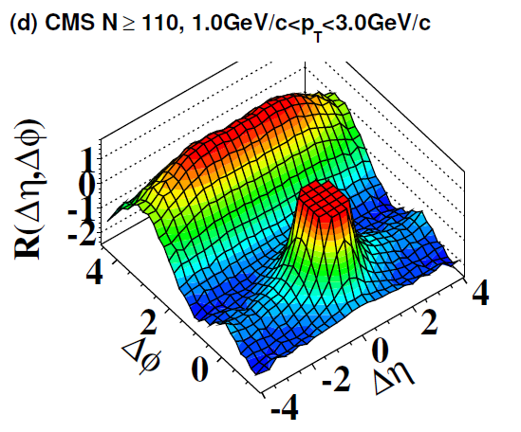
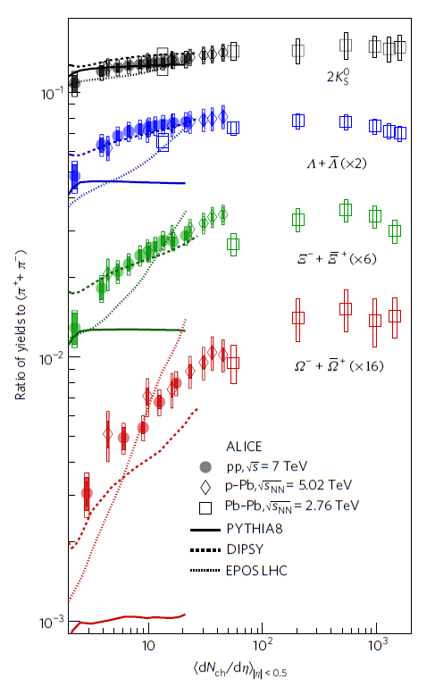


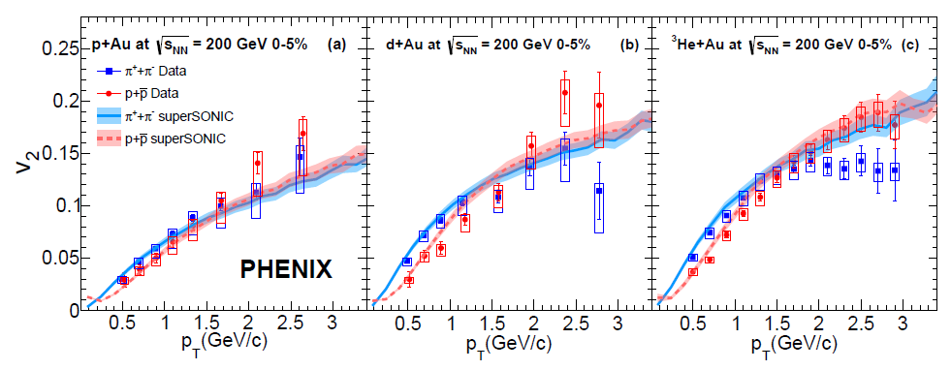
QGP signals in small colliding systems
In high-multiplicity small systems (pp, pA)…
Thermal strange hadron productions
Hydro-like collectivity
Long range correlation
Strangeness enhancement
CMS Collaboration, JHEP 09 091 (2010)
Challenge to interpret the universal behavior from pp to AA
ALICE Collaboration, Nature Phys. 13 535-539 (2017)
… within a hydro based dynamical framework?
Flow harmonics
PHENIX Collaboration, Phys. Rev. C 97, 064904 (2018)

Slide 4

Dynamical Core-Corona Initialization framework
pp
AA
Y. Kanakubo et al., PTEP 2018 12, 121D01 (2018);
Y. Kanakubo et al., Phys. Rev. C 101 2, 024912 (2020);
Y. Kanakubo et al., Phys. Rev. C 105 (2022) 2, 024905
Core: fluids (equilibrated matter)
➔ Hydrodynamics
Corona: non-equilibrated partons
➔ String fragmentation
Core-corona: K. Werner, Phys. Rev. Lett. 98 (2007) 152301
Does universal behavior originate from QGP formation?
…How much of system is equilibrated?

Slide 5
Dynamical Core-Corona Initialization model
2
Y. Kanakubo et al., Phys. Rev. C 105 (2022) 2, 024905

Slide 6

Model flowchart of DCCI2
Y. Kanakubo et al., Phys. Rev. C 105 (2022) 2, 024905
Initial partons:
PYTHIA8/PYTHIA8 Angantyr
T. Sjöstrand et al., Comput. Phys. Commun. 191, 159 (2015)
C. Bierlich et al., JHEP 1610 139 (2016)
Dynamical initialization of QGP fluids based on core-corona
Equilibrated matter (core)
(3+1)-D hydro with source terms
Non-equilibrated partons (corona)
Y. Tachibana et al., Phys. Rev. C 90, 021902 (2014)
PYTHIA8 (string fragmentation)
iS3D (thermal hadron sampling)
M. McNelis et al., Comput. Phys.Commun.258, 107604 (2021)
Hadronic afterburner: JAM
Y. Nara et al., Phys. Rev. C61, 024901 (2000)

Slide 7

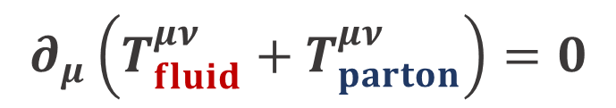
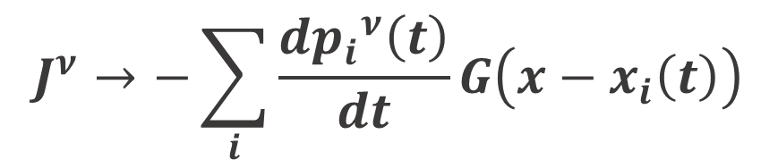
Dynamical initialization framework
New framework to dynamically generate initial condition
M. Okai et al., Phys.Rev.C 95 (2017) 5, 054914
C. Shen and B. Schenke, Phys.Rev.C 97 (2018) 2, 024907
Continuum eq. for fluids + partons
Energy-momentum conservation in
fluid + parton
$$∂_{μ}\left(T_{fluid}^{μν}+T_{parton}^{μν}\right)=0$$
Hydrodynamic eq. with source term
$∂_{μ}T_{fluid}^{μν}=J^{ν}$
$$J^{ν}→−\sum_{i}{\frac{d{p_{i}}^{ν}\left(t\right)}{dt}}G\left(x−x_{i}\left(t\right)\right)$$
“Sources of fluids”
= “energy-momentum of partons”

Slide 8

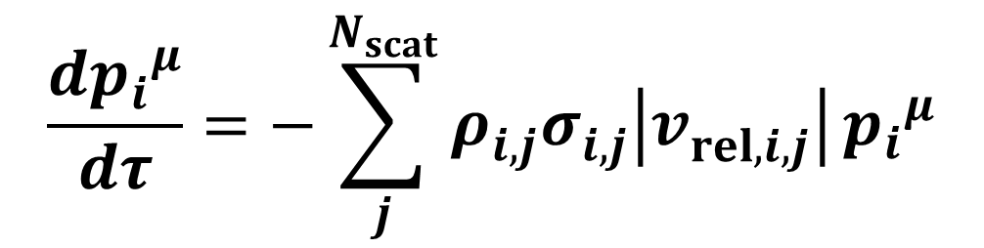


Dynamical core-corona picture
Multiple scatterings among partons ➔ partial equilibration
$$\frac{d{p_{i}}^{μ}}{dτ}=−\sum_{j}^{N_{scat}}{ρ_{i,j}^{}σ_{i,j}^{}\left|v_{rel, i,j}^{}\right|}{p_{i}}^{μ}$$
Defined at a co-moving frame with $η_{s, i}$
Energy-momentum deposition
➔ # of scatterings with partons (non-equilibrated and equilibrated)
Low $p_{T}$ and/or dense region
Core (fluids)
High $p_{T}$ and/or dilute region
Corona (partons)

Slide 9
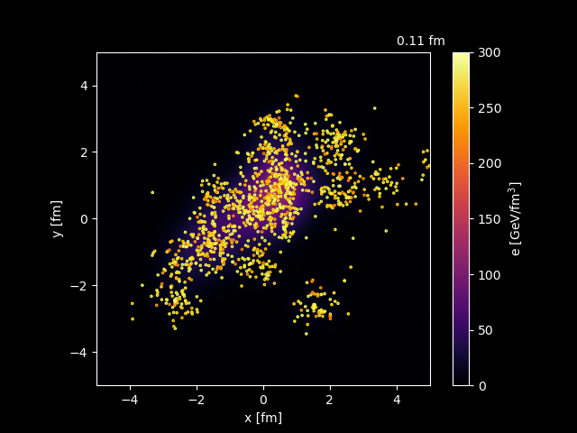
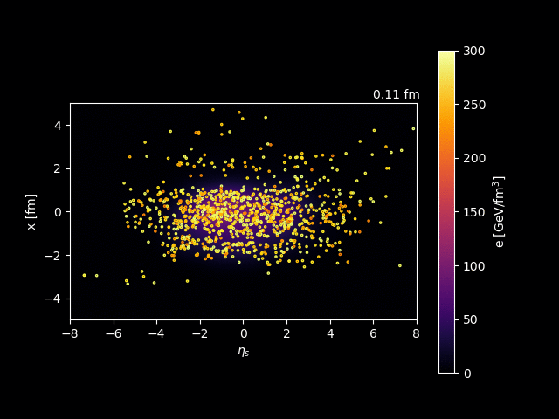
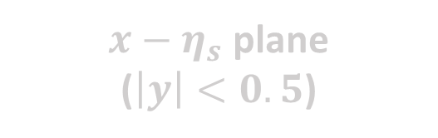
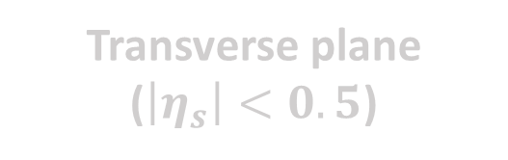
Dynamical core-corona initialization
PbPb 2.76 TeV
Transverse plane
($\left|η_{s}\right|<0.5$)
$x−η_{s}$ plane
($\left|y\right|<0.5$)
Dynamical “equilibration” in jet-quenching like picture

Slide 10


Result
Exploring origin of QGP-like signals in pp and pA…
Description of
Multiplicity
Particle yield ratios

Slide 11
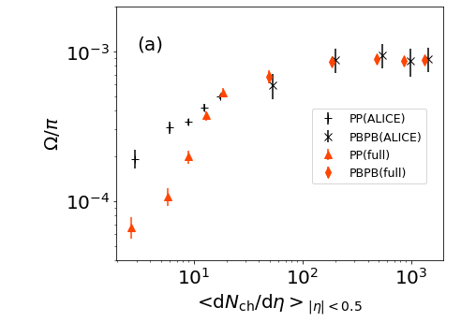

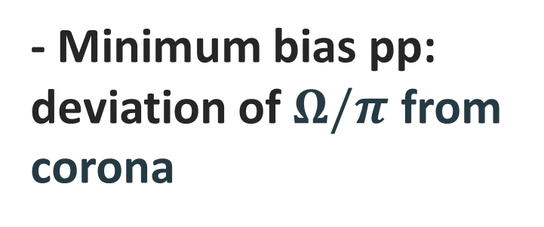
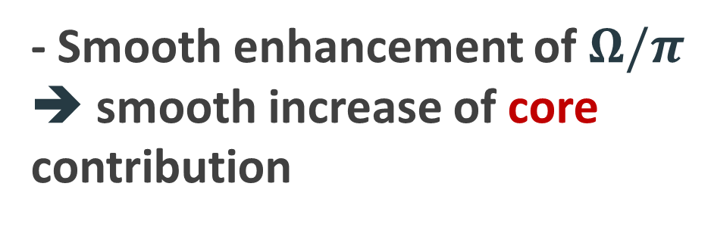
$Ω/π$ ratio from pp to PbPb
Hadron chemistry ➔ components of the matter
Core
- Smooth enhancement of $Ω/π$
➔ smooth increase of core contribution
B. Abelev et al. (ALICE Collaboration), Phys. Lett. B 728, 216-227 (2014); erratum 734, 409-410 (2014)
J. Adam et al., (ALICE Collaboration), Nature Phys. 13 535-539 (2017)
- Minimum bias pp: deviation of $Ω/π$ from corona
Corona

Slide 12
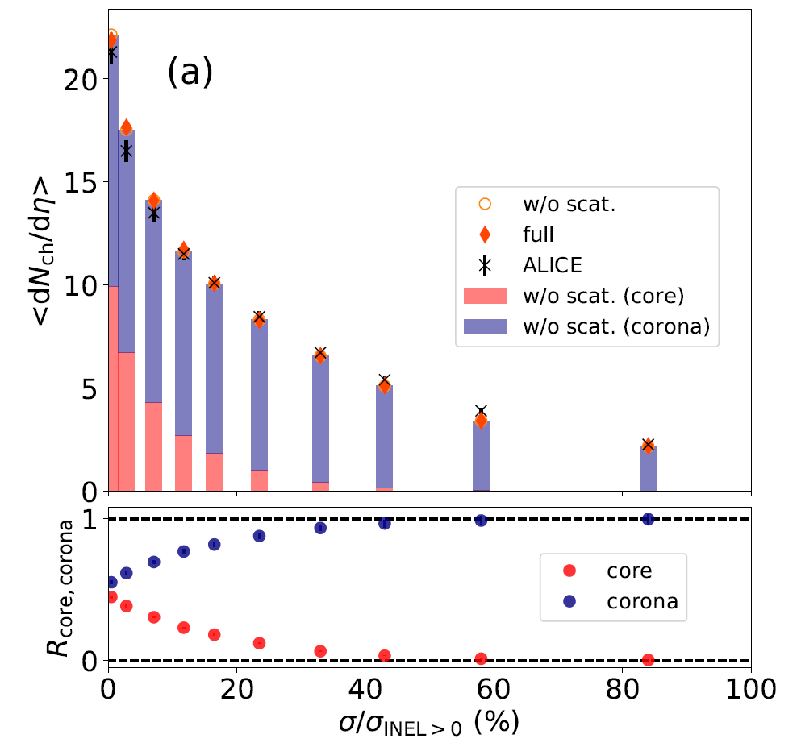
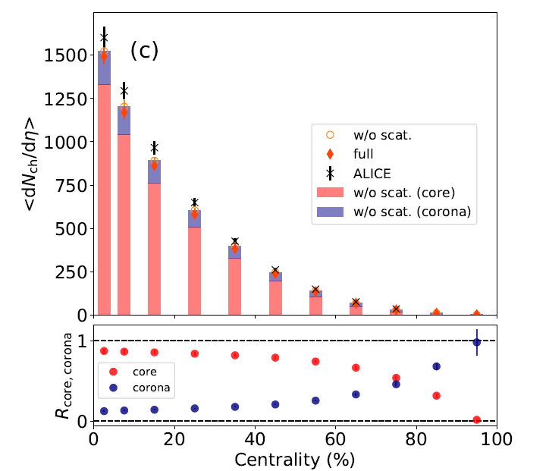
Fraction of core and corona in pp and PbPb
pp 7 TeV
PbPb 2.76 TeV
Corona
J. Adam et al., (ALICE Collaboration), Nature Phys. 13 535-539 (2017)
Core
K. Aamodt et al., (ALICE Collaboration), Phys. Rev. Lett. 106 032301 (2011)
pp: core/corona $∼50\%$ at the highest multiplicity class (0-0.95%)
PbPb: corona $∼20\%$ at intermediate centralities (40-60%)

Slide 13
Fraction of core and corona in pp and PbPb
pp 7 TeV
PbPb 2.76 TeV
Corona
J. Adam et al., (ALICE Collaboration), Nature Phys. 13 535-539 (2017)
Core
K. Aamodt et al., (ALICE Collaboration), Phys. Rev. Lett. 106 032301 (2011)
Need both equilibrated and non-equilibrated matter
in both pp and AA

Slide 14
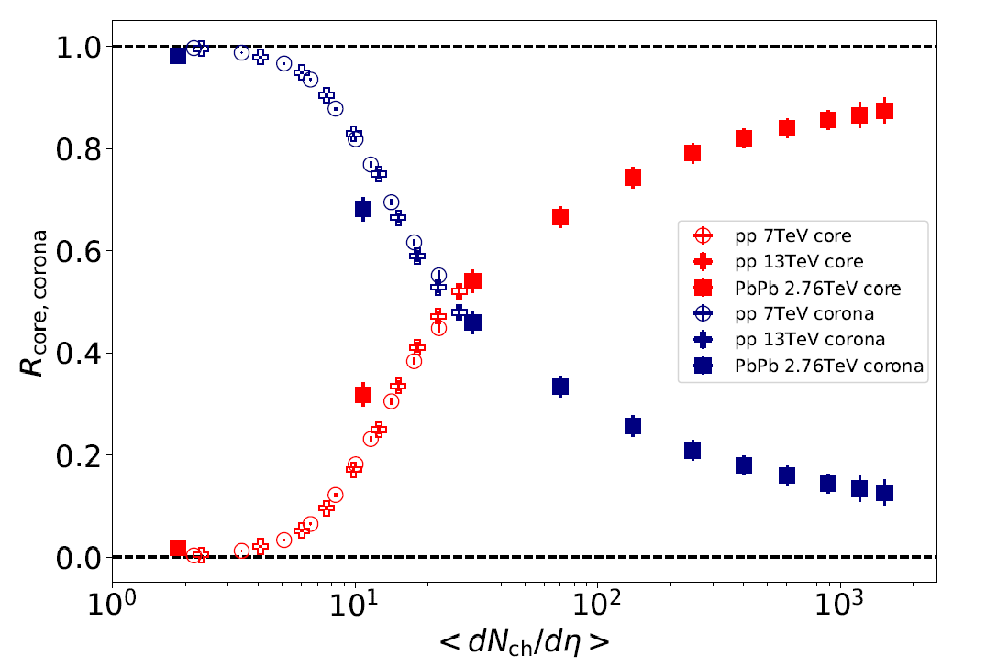

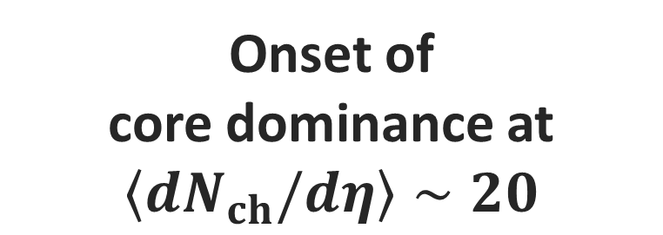
Onset $\left\langle dN_{ch}/dη\right\rangle$ of core dominance
Core
Clear scaling with multiplicity
Onset of
core dominance at $\left\langle dN_{ch}/dη\right\rangle ∼20$
Corona
PbPb
pp

Slide 15
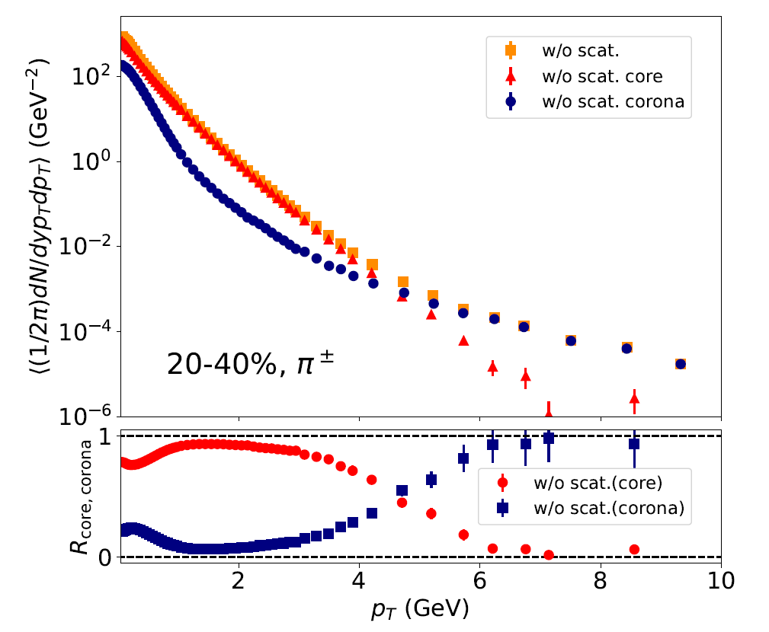





Fraction of core and corona vs. $p_{T}$
Charged $π$, PbPb 2.76 TeV, 20-40%
Core
Low $p_{T}$: core dominance
high$p_{T}$: corona dominance
Corona
Core-corona picture
➔ From low to high $p_{T}$ within one framework
$$p_{T} (GeV)$$

Slide 16
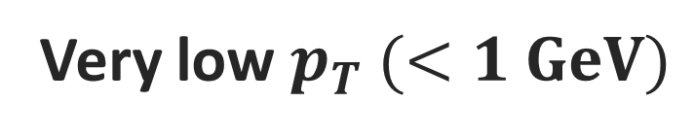
Fraction of core and corona vs. $p_{T}$
Charged $π$, PbPb 2.76 TeV, 20-40%
Core
Very low $p_{T} (<1 GeV)$
Slight enhancement of corona components
Corona
Non-equilibrium corrections to core (equilibrium)
$$p_{T} (GeV)$$

Slide 17
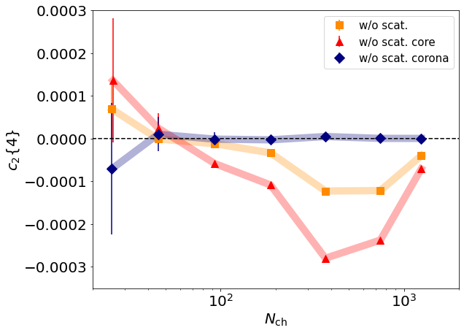
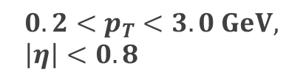
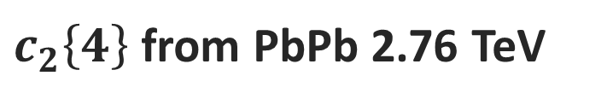



Corona corrections to flow
$c_{2}\left\{4\right\}$ from PbPb 2.76 TeV
$$c_{2}{\left\{4\right\}}_{core}≠c_{2}{\left\{4\right\}}_{tot}$$
$$0.2<p_{T}<3.0 GeV, \left|η\right|<0.8$$
➔ Diluted by corona
Conventional Hydro model
$c_{2}\left\{4\right\}$
Comparison
Experiment
Be careful with
corona correction even in AA!
$$N_{ch}$$

Slide 18
Summary
Understanding from pp to AA from model-data comparisons?
Dynamical core-corona initialization (DCCI2)
Dynamical description of QGP fluid generation from partons
Simple combination of hydro + PYTHIA
Multiplicity
Particle yield ratios
Proper extraction of QGP properties?
Need both equilibrated and non-equilibrated matter in both pp and AA

Slide 19
Thank you!

Slide 20
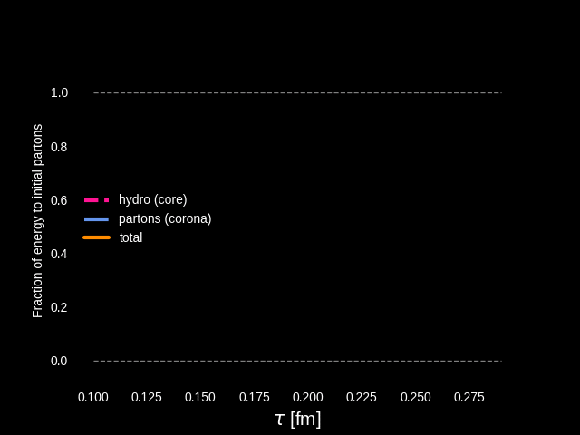
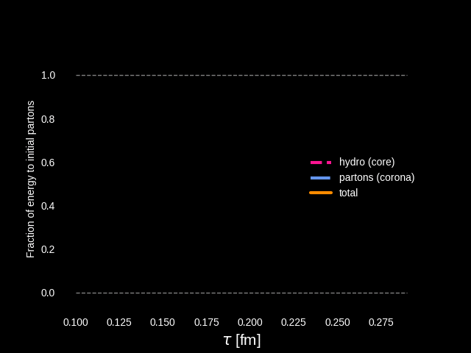

Energy budget in dynamical core-corona initialization
Dynamical energy conversion from initial partons (corona) to fluids (core)
PbPb
pp
Starting from vacuum $T^{μν}=0$ for fluids
Energy & momentum conservation as total system
Conservation of incoming beam energy in QGP generation event-by-event

Slide 21
Problems in DCCI2

Slide 22
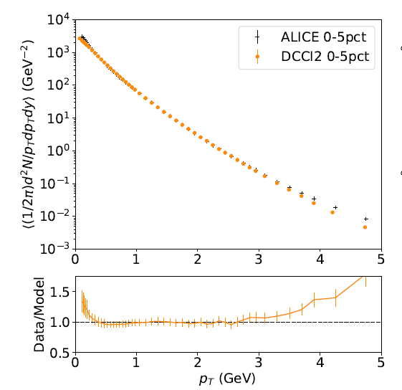
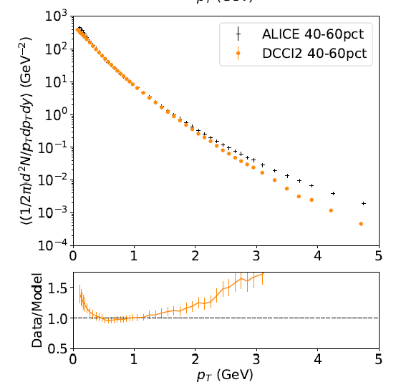

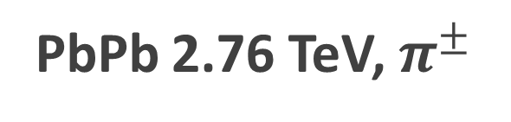
1. Yields at high $p_{T}$
PbPb 2.76 TeV, $π^{±}$
0-5%
40-60%
ALICE Collaboration, Phys. Rev. C 93 (2016) 3, 034913
Need to sophisticate jet quenching in DCCI2
Deviation from exp. data above $p_{T}∼3 GeV$. Lack of high $p_{T}$ yields (corona)
+ Need $N_{coll}$ scaling at high $p_{T}$?

Slide 23
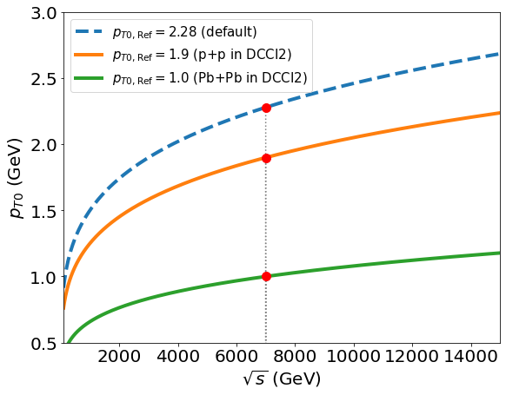
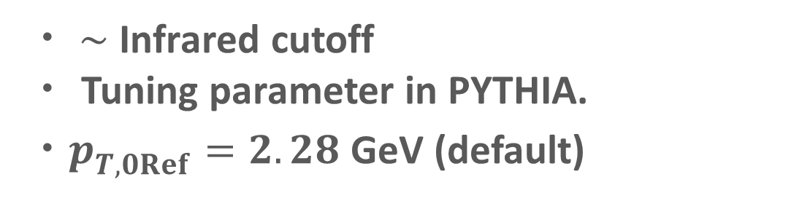
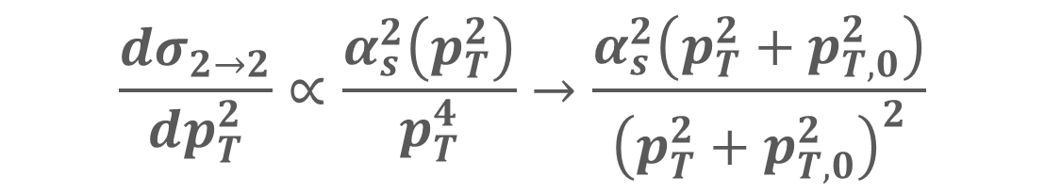

2. Multiplicity distribution in pPB
Multiplicity in DCCI2 ➔ controlled at initial parton generations
$$\frac{dσ_{2→2}}{dp_{T}^{2}}∝\frac{α_{s}^{2}\left(p_{T}^{2}\right)}{p_{T}^{4}}→\frac{α_{s}^{2}\left(p_{T}^{2}+p_{T,0}^{2}\right)}{{\left(p_{T}^{2}+p_{T,0}^{2}\right)}^{2}}$$
pPb?
・ $∼$ Infrared cutoff
・ Tuning parameter in PYTHIA.
・$p_{T,0Ref}^{}=2.28$ GeV (default)
Smaller $p_{T,0Ref}^{}$ ➔ More MPI ➔ More partonic productions at mid-rapidity

Slide 24
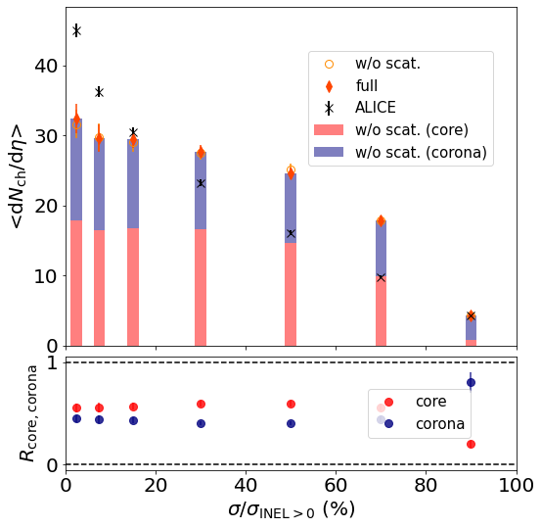
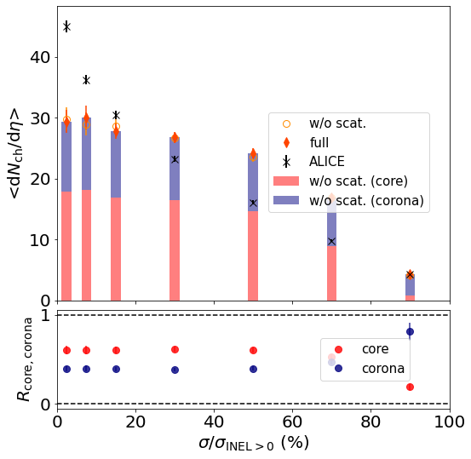
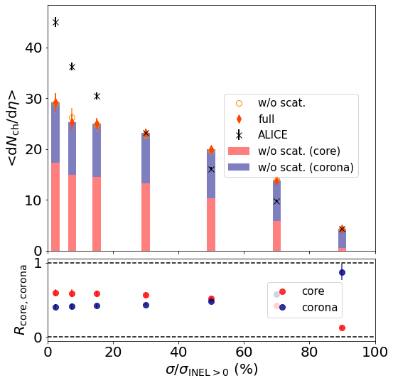



Parameter $p_{T0Ref}$dependence in DCCI2
$$p_{T0Ref}=0.8 GeV$$
$$p_{T0Ref}=1.0 GeV$$
$p_{T0Ref}=1.4 GeV$
Insensitive to the parameter…
Difficult to describe event distribution
Difficulty ➔ interplay of two different particle production mechanisms within a given total collision energy

Slide 25
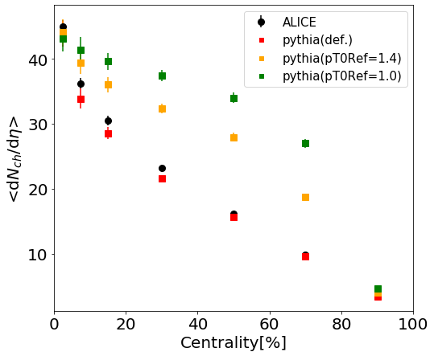
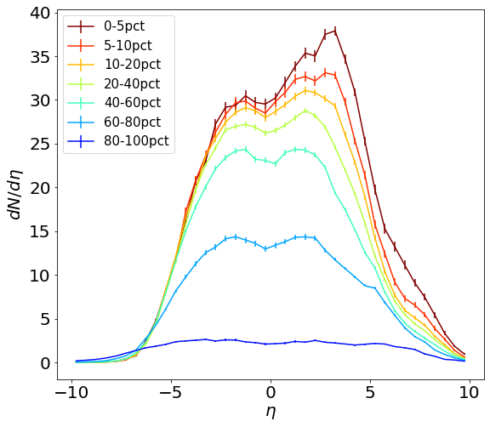
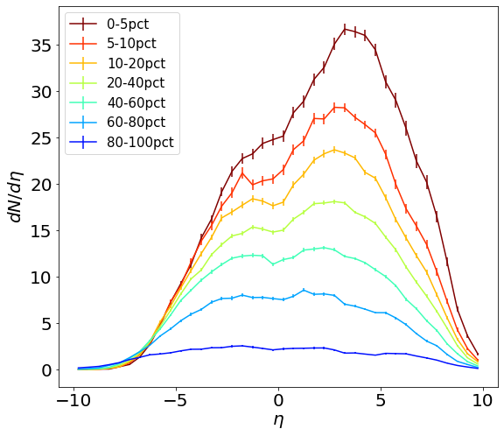
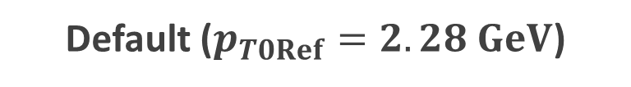

Parameter $p_{T0Ref}$dependence in default PYTHIA
$$p_{T0Ref}=1.0 GeV$$
Default ($p_{T0Ref}=2.28 GeV$)
Maximum multiplicity ➔ saturated

Slide 26
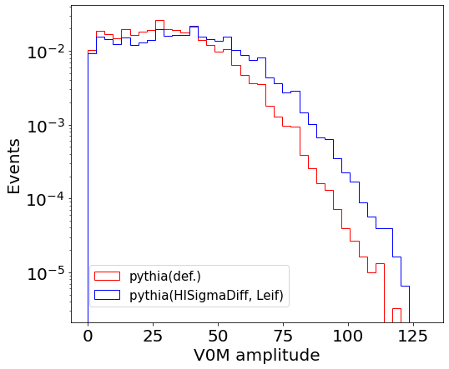
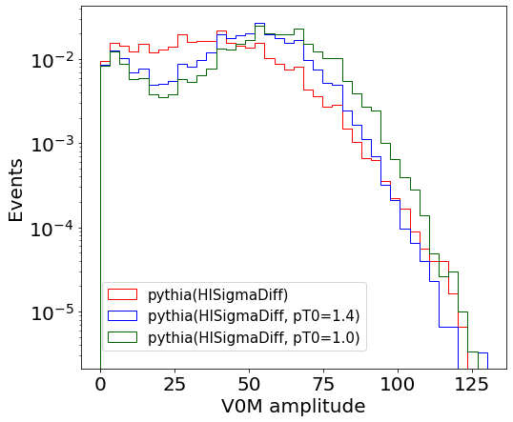

Multiplicity distribution in pPB default PYTHIA
Any dependence on some parameters related to 2nd absorptive collisions?
pPB 5020 GeV
$$σ_{diff} σ_{abs}$$
➔ No significant enhancement?
Difficulty: reproduction of multiplicity distribution given a fixed collision energy

Slide 27
Backup

Slide 28
QGP study via relativistic heavy-ion collisions
Only possible research method based on observation on the earth
QGP
Hadrons
J. E. Bernhard, 1804.06469
Initial state
Evolution of QGP
Hadronic afterburner
Description of the multi-stage process
➔ Rewinding the process to “see” QGP

Slide 29
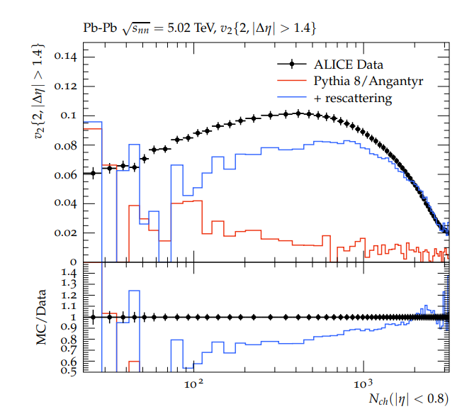
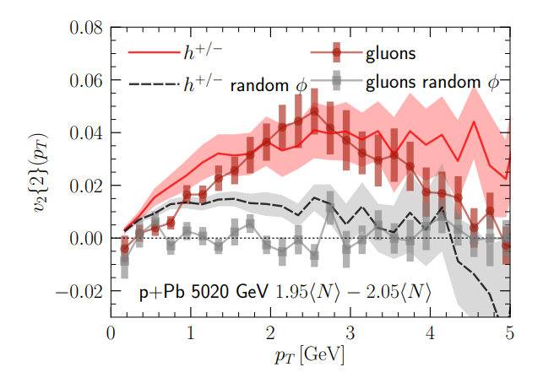
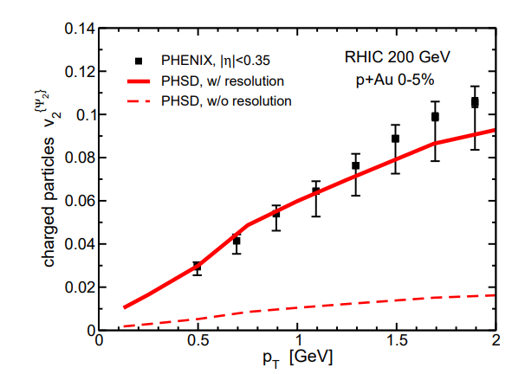
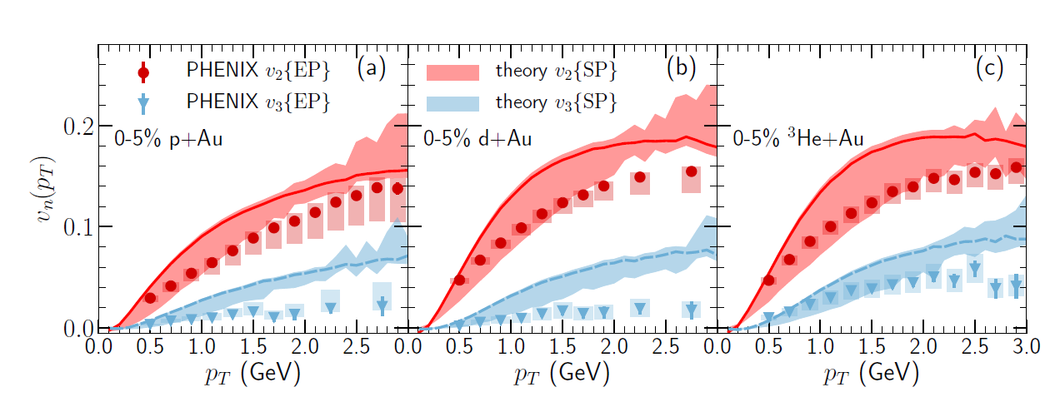
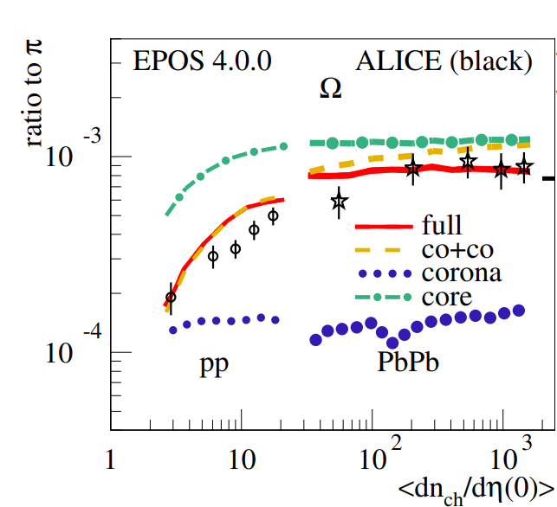
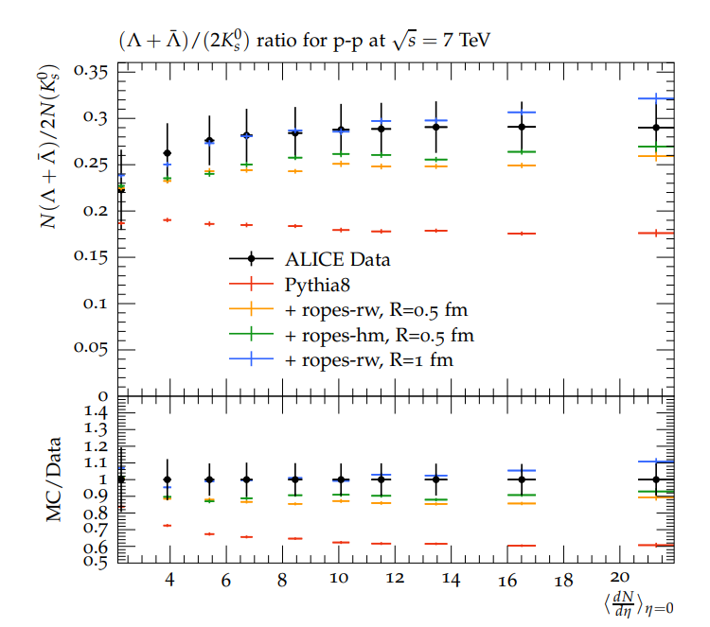
Discussion on origin of “QGP” signals
Moritz Greif et al., Phys. Rev. D 103 (2021) 5, 054011
L. Oliva et al., Phys. Rev. C 101 (2020) 1, 014917
C. Bierlich et al., Eur. Phys. J. A 57 (2021) 7, 227
C. Bierlich et al., Phys. Lett. B 835 (2022) 137571
B. Schenke et al., Phys. Lett. B 803 (2020) 135322
K. Werner, arXiv: 2301.12517

Slide 30




Discussion on origin of “QGP” signals
6
Moritz Greif et al., Phys.Rev.D 103 (2021) 5, 054011
L. Oliva et al., Phys.Rev.C 101 (2020) 1, 014917
8
Color fields
Transport
C. Bierlich et al., Eur.Phys.J.A 57 (2021) 7, 227
C. Bierlich et al., Phys.Lett.B 835 (2022) 137571
String interactions
B. Schenke et al., Phys.Lett.B 803 (2020) 135322
Hydrodynamics
etc.
K. Werner, arXiv: 2301.12517
Comparisons with various experimental data
➔ Requires dynamical model building

Slide 31
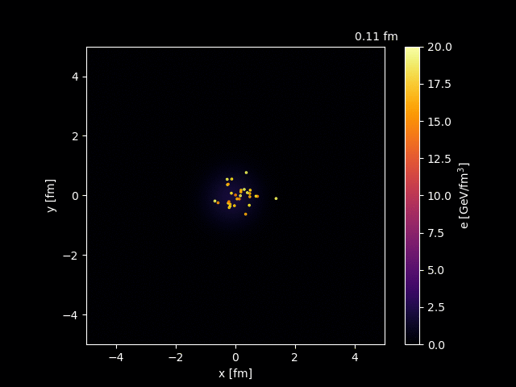
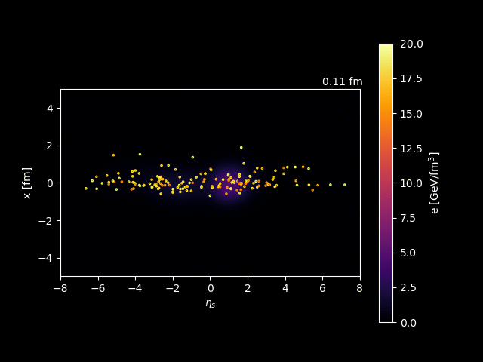
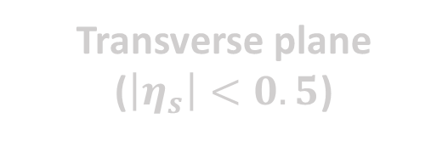
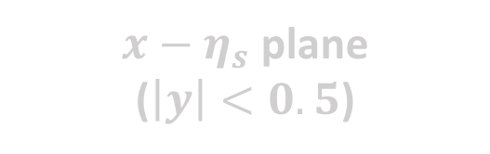

Dynamical core-corona initialization
pp 7 TeV
Transverse plane
($\left|η_{s}\right|<0.5$)
$x−η_{s}$ plane
($\left|y\right|<0.5$)
$x−η_{s}$ plane ($y∼0$)

Slide 32




Longstanding problem in hydro
$p_{T}$ spectra
Lack of very low $p_{T}$ hadron yields from hydro
G. Nijs et al., Phys. Rev. C 103 (2021) 5, 054909
J. Zimanyi et al., Phys. Rev. Lett. 43, 1705 (1979);
M. Kataja and P. V. Ruuskanen, Phys. Lett. B 243, 181 (1990);
J. Sollfrank et al., Z. Phys. C 52, 593 (1991);
U. Ornik and R. M. Weiner, Phys. Lett. B 263, 503 (1991);
V. Begun et al., Phys. Rev. C 90, 014906 (2014); Phys. Rev. C 90, 054912 (2014); Phys. Rev. C 91, 054909 (2015);
P. Huovinen et al., Phys. Lett. B 769, 509 (2017);
E. Grossi et al., Phys. Rev. D 104, 034025 (2021)
$$p_{T} (GeV)$$
➔ Non-hydro components？

Slide 33


Where doesn’t hydro work?
1. In peripheral AA, small systems
2. At high $p_{T}$ (and very low $p_{T}$)
Trajectum
Phys. Rev. C 103 (2021) 5, 054909
ALICE Collaboration, Nature Phys. 13 535-539 (2017)
hydro
X Picture of local equilibrium
Need to extend applicability of dynamical frameworks

Slide 34
Model flowchart of DCCI2
Y. Kanakubo et al., Phys. Rev. C 105 (2022) 2, 024905
Initial partons:
PYTHIA8/PYTHIA8 Angantyr
T. Sjöstrand et al., Comput. Phys. Commun. 191, 159 (2015)
C. Bierlich et al., JHEP 1610 139 (2016)
Dynamical initialization of QGP fluids based on core-corona
Equilibrated matter (core)
(3+1)-D hydro with source terms
Non-equilibrated partons (corona)
Y. Tachibana et al., Phys. Rev. C 90, 021902 (2014)
PYTHIA8 (string fragmentation)
iS3D (thermal hadron sampling)
M. McNelis et al., Comput. Phys.Commun.258, 107604 (2021)
Hadronic afterburner: JAM
Y. Nara et al.,Phys. Rev. C61, 024901 (2000)

Slide 35
DCCI2: combination of hydro and PYTHIA
DCCI2
Hydro (and hadronic) afterburner on PYTHIA
From HIC community’s point of view
From high-energy physics community’s point of view
Corona (non-equilibrium) correction on hydro

Slide 36
Parameter fixing in DCCI2

Slide 37





Parameter set for PYTHIA part: almost Monash Tune
How far can we go as a naive combination of hydro and PYTHIA
PYTHIA
…with simple starting point
Default parameter values except $p_{T0Ref}$ in initial parton generation
Hydro with dynamical core-corona
$$\frac{dσ_{2→2}}{dp_{T}^{2}}∝\frac{α_{s}^{2}\left(p_{T}^{2}\right)}{p_{T}^{4}}→\frac{α_{s}^{2}\left(p_{T}^{2}+p_{T,0}^{2}\right)}{{\left(p_{T}^{2}+p_{T,0}^{2}\right)}^{2}}$$
$p_{T0}∼$ Infrared cutoff for 2→2 cross section

Slide 38




Difference of $E_{T}$ evolution between hydro and string frag.
PbPb (MB)
Hydro: $E_{T}$ decrease due to $pdV$ work in longitudinal direction
String fragmentation:
$E_{T}$ enhance
More multi-parton interaction is required in DCCI compared to PYTHIA
(with smaller $p_{T0}$ to enhance partonic productions at midrapidity)
Different dynamics in later stage
➔ Require different initial energy profile

Slide 39




Hadron vertices model in PYTHIA
S. Ferreres-Solé and T. Sjöstrand, Eur. Phys. J., vol. C78, no. 11, p. 983, 2018.
The production vertex of the hadron is taken to be the average of the two break-up vertices producing it.
t
z
The vertex of the hadron with mass $m_{i}$
Option
flag Fragmentation:setVertices = on
Information of production vertices
event[i].xProd(), event[i].yProd(), event[i].zProd(), event[i].tProd()

Slide 40





Space-time distribution of direct hadrons
PbPb 2.76 TeV
1 sampled event
Probability distribution ($\left|η\right|<0.5$)
$$P(r)$$
$$P(t)$$
Double peaks of hadron vertices from core and corona before hadronic rescatterings

Slide 41



Space-time distribution of direct hadrons
pp 7 TeV
1 sampled event
Probability distribution ($\left|η\right|<0.5$)
$$P(r)$$
$$P(t)$$
Short lifetime of hydro ($∼1 fm$) in pp
Direct hadrons from core and corona
➔ closely produced in space-time coordinate

Slide 42






Fraction of core and corona vs. $p_{T}$ with PID
Core
$$π$$
$$p$$
Corona
$$p_{T} (GeV)$$
$$p_{T} (GeV)$$
Core dominance up to higher $p_{T}$ for heavier hadrons
T. Hirano and Y. Nara, Phys. Rev. C 69, 034908 (2004).
Core/corona fraction $∼50\%$ at $p_{T}→0$ GeV in proton spectra

Slide 43





Comparison with exp. data
PbPb 2.76 TeV, $π^{±}$
0-5%
10-20%
40-50%
ALICE Collaboration, Phys. Rev. C 93 (2016) 3, 034913
Corona at very low $p_{T}$: possible compensation of yield

Slide 44




Comparison with exp. data
PbPb 2.76 TeV, $p+\overline{p}$
0-5%
10-20%
40-50%
ALICE Collaboration, Phys. Rev. C 93 (2016) 3, 034913
Corona at very low $p_{T}$: possible compensation of yield

Slide 45
















Corona components from string modification
$$τ_{s}=0.3 fm$$
$$τ_{s}<τ<τ_{fo}$$
String cutting
Parton-pairing
String modification caused by ..
Discard dead partons
Find hypersurface boundaries $T_{sw}$
Sample partons & boost with $v_{fluid}$ at the boundary (recreation of color singlet )
・Spatial overlap of strings and medium
・Completely fluidized partons

Slide 46


Corona components from string modification (cont’d)
$$τ_{s}=0.3 fm$$
$$τ_{s}<τ<τ_{fo}$$
String cutting
Parton-pairing
4. Surviving partons traverse medium
5. Make a pair for a parton coming out from medium
Non-thermal & thermal
➔ Contributes as corona components
*$p_{T, cut}$: threshold to/not to modify a string

Slide 47


Hydro-based multi-stage dynamical model
$$t$$
Detector
Hadronic transport
Hadron gas
Fluids ➔ particles
Relativistic hydrodynamics
QGP
Collision
Initial condition
$$z$$
Standard model in HIC
Powerful tool to extract QGP info from experimental observation
Space-time evolution of HIC

Slide 48


Corona corrections to flow
$c_{2}\left\{4\right\}$ from PbPb 2.76 TeV
$$0.2<p_{T}<3.0 GeV, \left|η\right|<0.8$$
$c_{2}\left\{4\right\}$
$$N_{ch}$$

Slide 49



$Ω$ yields from $e^{+}e^{−}$ with Monash Tune
P. Skands et al., Eur.Phys.J.C 74 (2014) 8, 3024

Slide 50



QGP study with relativistic hydrodynamics
Many body system of quarks and gluons under local equilibrium
$$∂_{μ}T^{μν}=0$$
$$P=P\left(e\right)$$
Energy-momentum conservation
Equation of state (EoS)
$η/s(T)$ $, ζ/s(T)$…
-- Basic information of matter --
A lots of developments on hydro theory…
How should we apply them on QGP study?

Slide 51
Dynamical core-corona picture
$∼$ EoM with a drag force due to secondary scatterings
$$\frac{d{p_{i}}^{μ}}{dτ}=−\sum_{j}^{N_{scat}}{ρ_{i,j}^{}σ_{i,j}^{}\left|v_{rel, i,j}^{}\right|}{p_{i}}^{μ}$$
Defined at a co-moving frame with $η_{s, i}$
*Note: Instant equilibration of deposited energy and momentum
- Collision criterion
- Parametrized cross-section
- Density of partons
$$b_{i,j}≤\sqrt{\frac{σ_{i,j}}{π}}$$
$σ_{i,j}=\frac{σ_{0}}{s_{i,j}/[GeV^{2}]}$
$$ρ_{i,j}=G(x_{i}−x_{j})$$
$G$: Gaussian
# of (non-equilibrated and equilibrated) partons scattered with ith parton
Low $p_{T}$ and/or dense region
Core (fluids)
High $p_{T}$ and/or dilute region
Corona (non-equilibrated partons)

Slide 52

Effects of hadronic rescatterings
Significant suppression of yield ratios at central PbPb
✓Captured with dissociation/annihilation of hadrons in late stage
Visible hadronic rescattering effects even in pp collisions

Slide 53





Corona correction in PbPb
$$∼5−11 \%$$
$$∼15−38 \%$$
- Mean $p_{T}$ and momentum anisotropy
➔ non-negligible effect of corona
- Pure hydro calculation can bring misinterpretation of exp. data even in PBPB

Slide 54

Origin of corona contribution
PbPb 2.76 TeV

Slide 55


Collision with constituent partons of QGP fluids
$$\frac{d{p_{i}}^{μ}}{dτ}=−\sum_{j}^{N_{scat}}{ρ_{i,j}^{}σ_{i,j}^{}\left|v_{rel, i,j}^{}\right|}{p_{i}}^{μ}$$
➔ Applied to both core (QGP fluids) and corona (non-equilibrated partons)
Sampling of equilibrated partons at each time step
*with mass-less ideal gas approximation

Slide 56


Quark gluon plasma (QGP)
A state of quarks and gluons under thermal & chemical equilibrium
Gluon
Quark
- Extremely high temperature ($T∼2 \text{trillion} \text{degrees}$)
$$T$$
- Early universe
Hadron
QGP
Goal: Revealing the properties of the primordial matter
Only way to create QGP on the earth…
High energy heavy-ion collisions

Slide 57

High-energy heavy-ion collisions
QGP
Hadrons
J. E. Bernhard, 1804.06469
How can we access the properties of QGP from HIC experimental data?
Dynamics of locally equilibrated matter
Relativistic hydrodynamics
Press release on 2005/04/18
https://www.bnl.gov/newsroom/news.php?a=110303

Slide 58




QGP study with relativistic hydrodynamics
Energy-momentum tensor $T^{μν}$ ➔decomposed with
four velocity of fluids $u^{μ}\left(x\right)$
Energy-momentum conservation
$$∂_{μ}T^{μν}=0$$
Lattice EoS (high T)
Hadronic resonance gas EoS (low T)
Equation of state (EoS)
$$P=P\left(e\right)$$
Many-body system of quarks and gluons
$$u^{μ}\left(x\right)$$
Dynamics of locally-equilibrated patches
➔ Local equilibration

