Slide 1
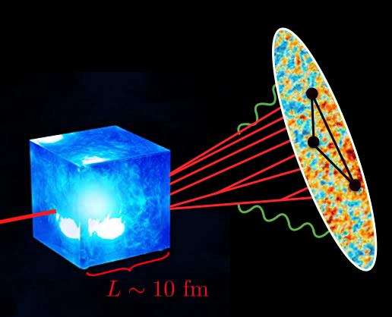



A Coherent View of Jet Quenching from Energy Correlators
Jack Holguin
In collaboration with Carlota Andres, Fabio Dominguez, Cyrille Marquet, Ian Moult

Slide 2
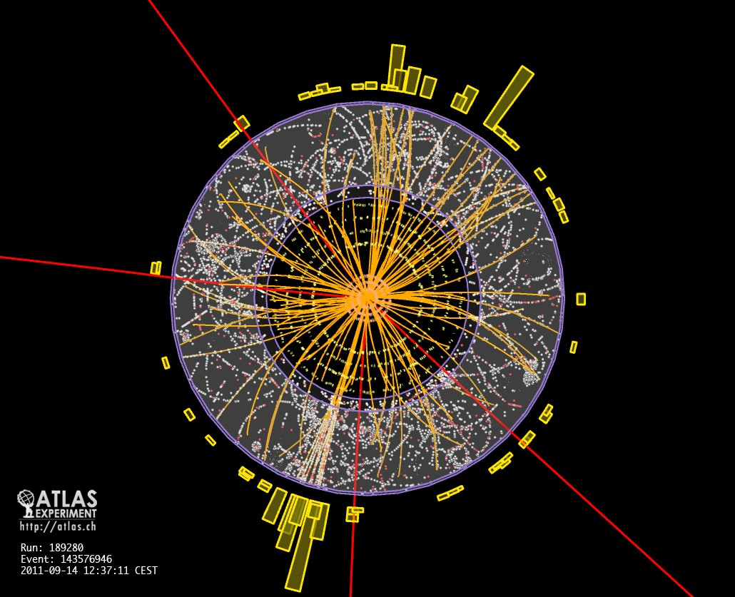
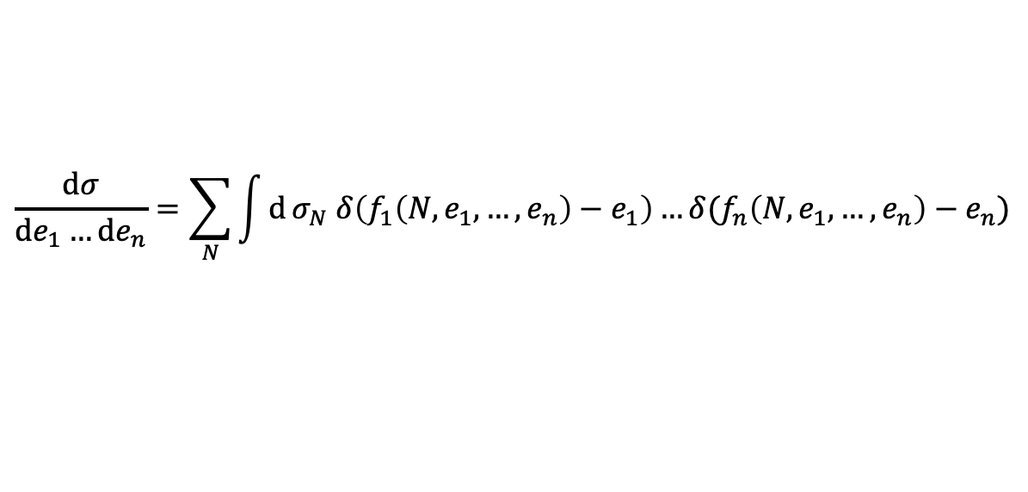

Introduction
Context:
There has been an exceptionally successful program of studying QCD in vacuum and medium with event shape observables and algorithmic substructure.
$$\frac{dσ}{de_{1}…de_{n}}=\sum_{N}{\int{d}σ_{N} δ\left(f_{1}\left(N,e_{1},…,e_{n}\right)−e_{1}\right)…δ(f_{n}\left(N,e_{1},…,e_{n}\right)−e_{n})}$$
$$\{e_{1},e_{2},…,e_{n}\}$$

Slide 3
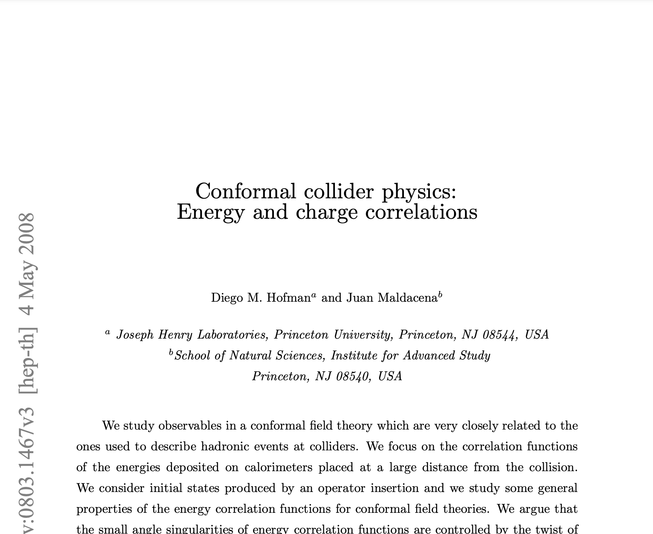
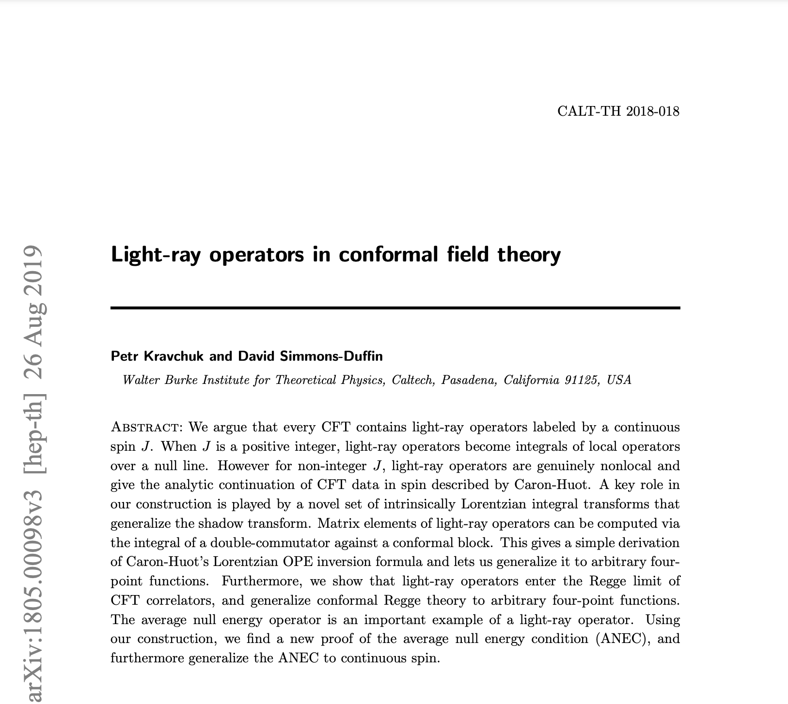
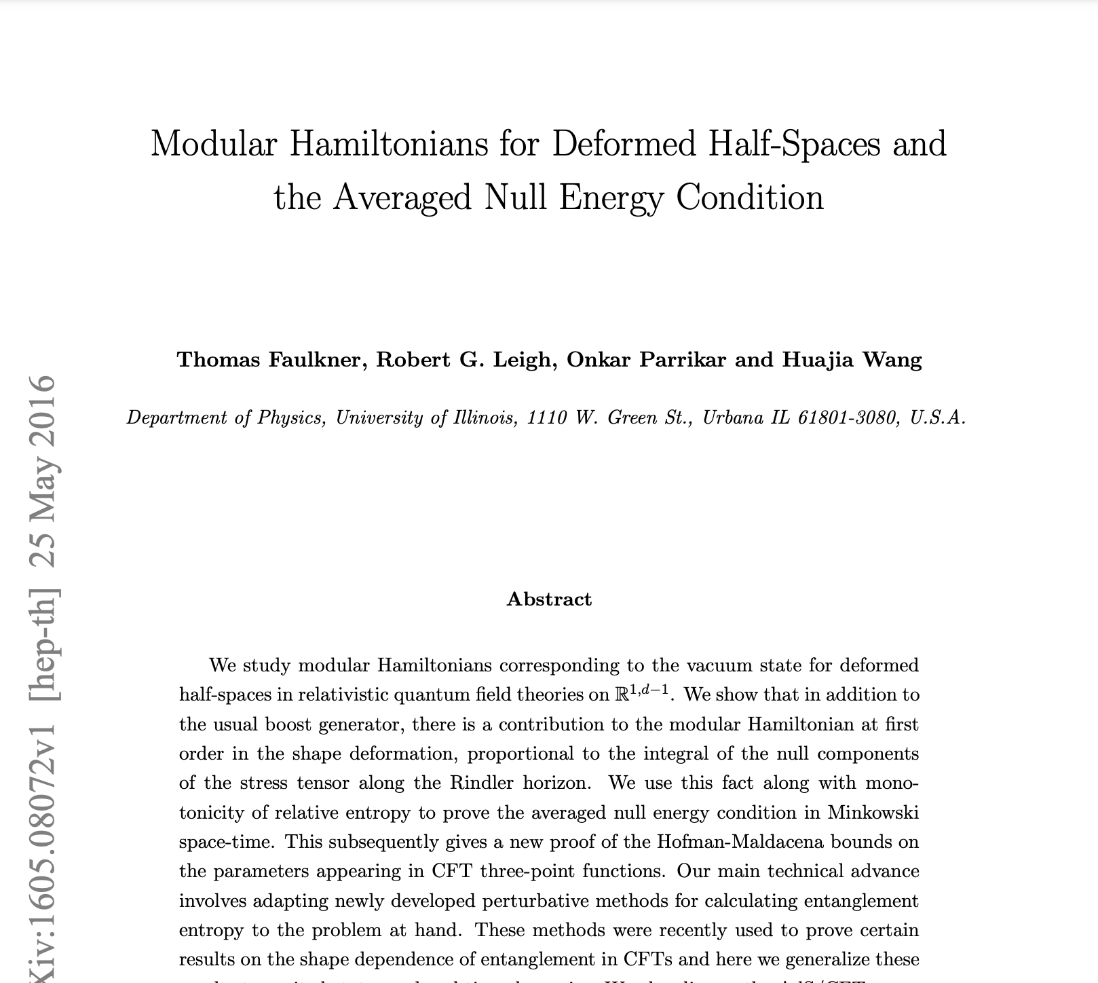
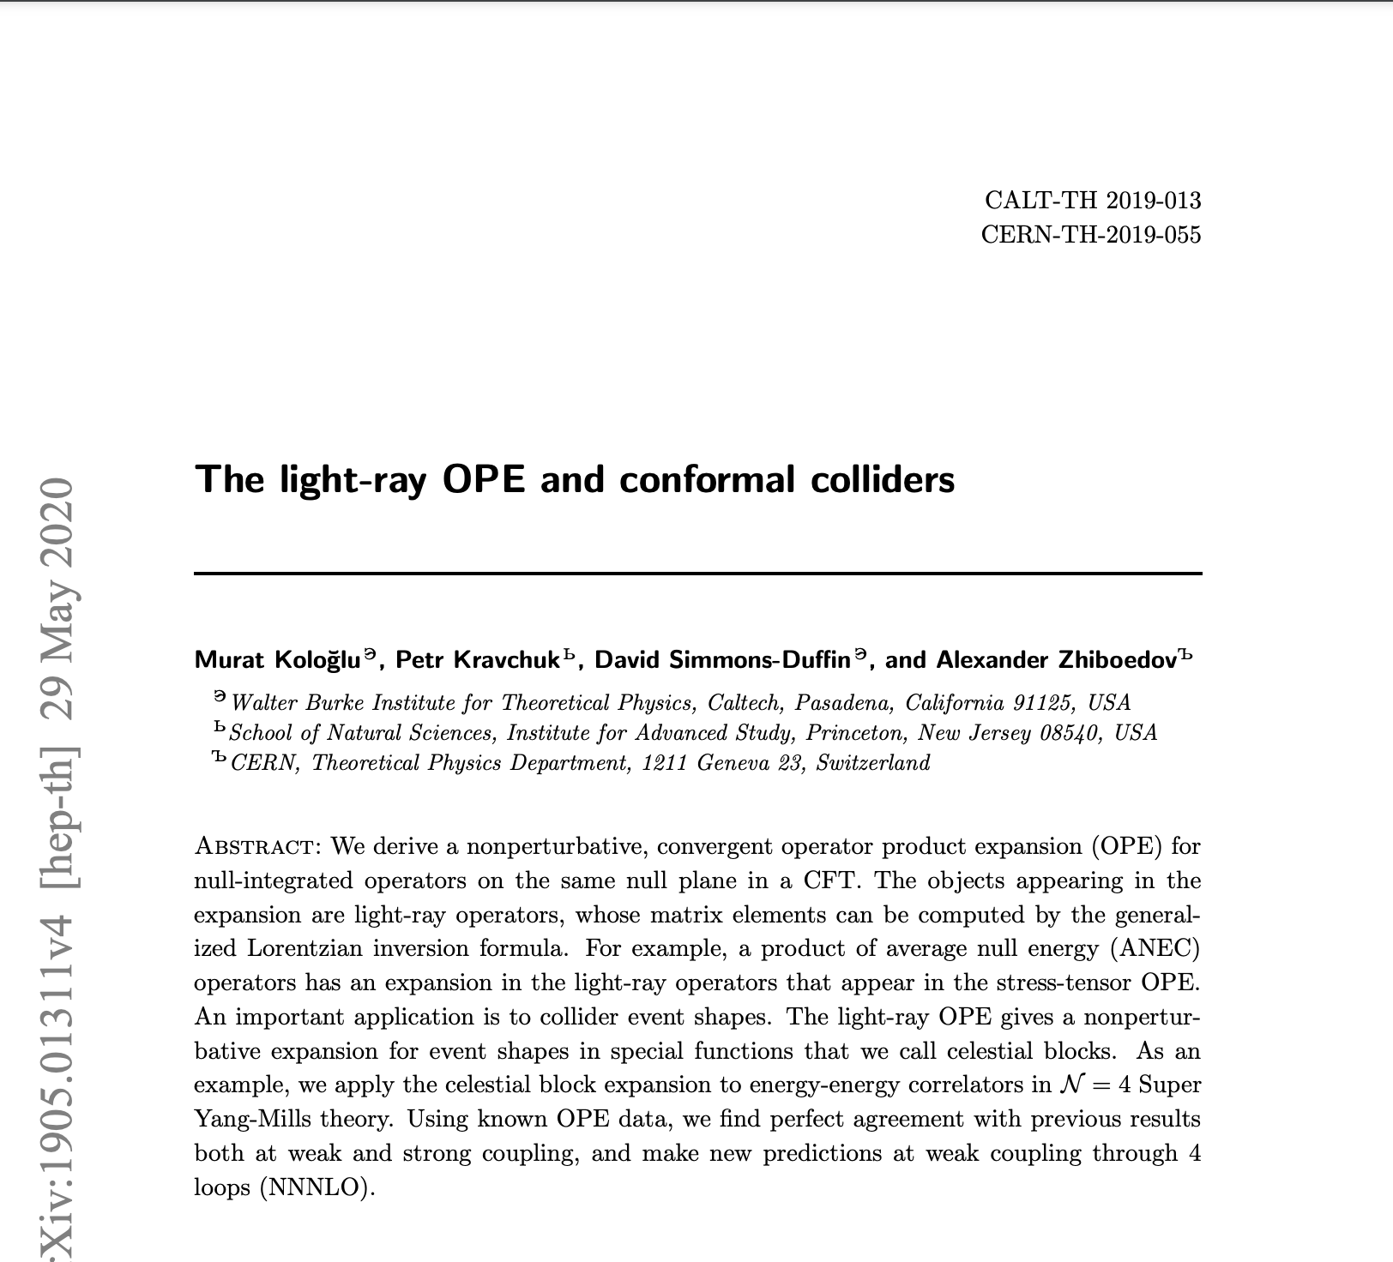
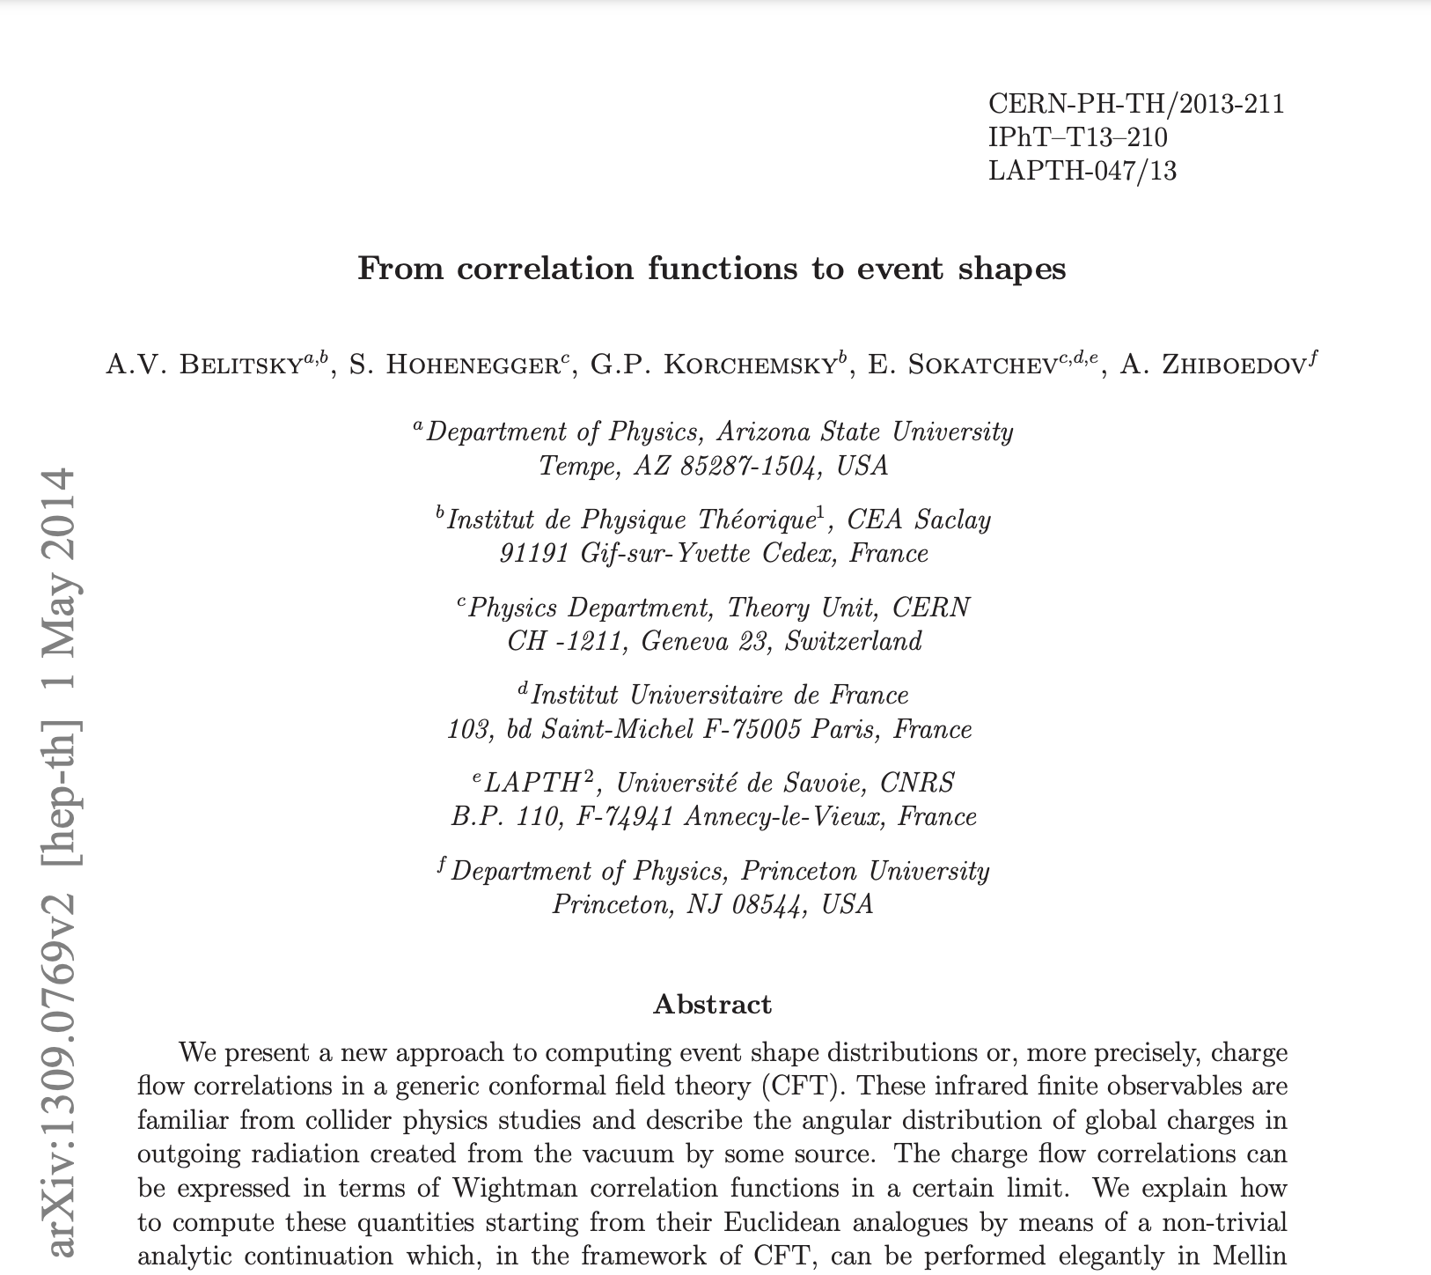
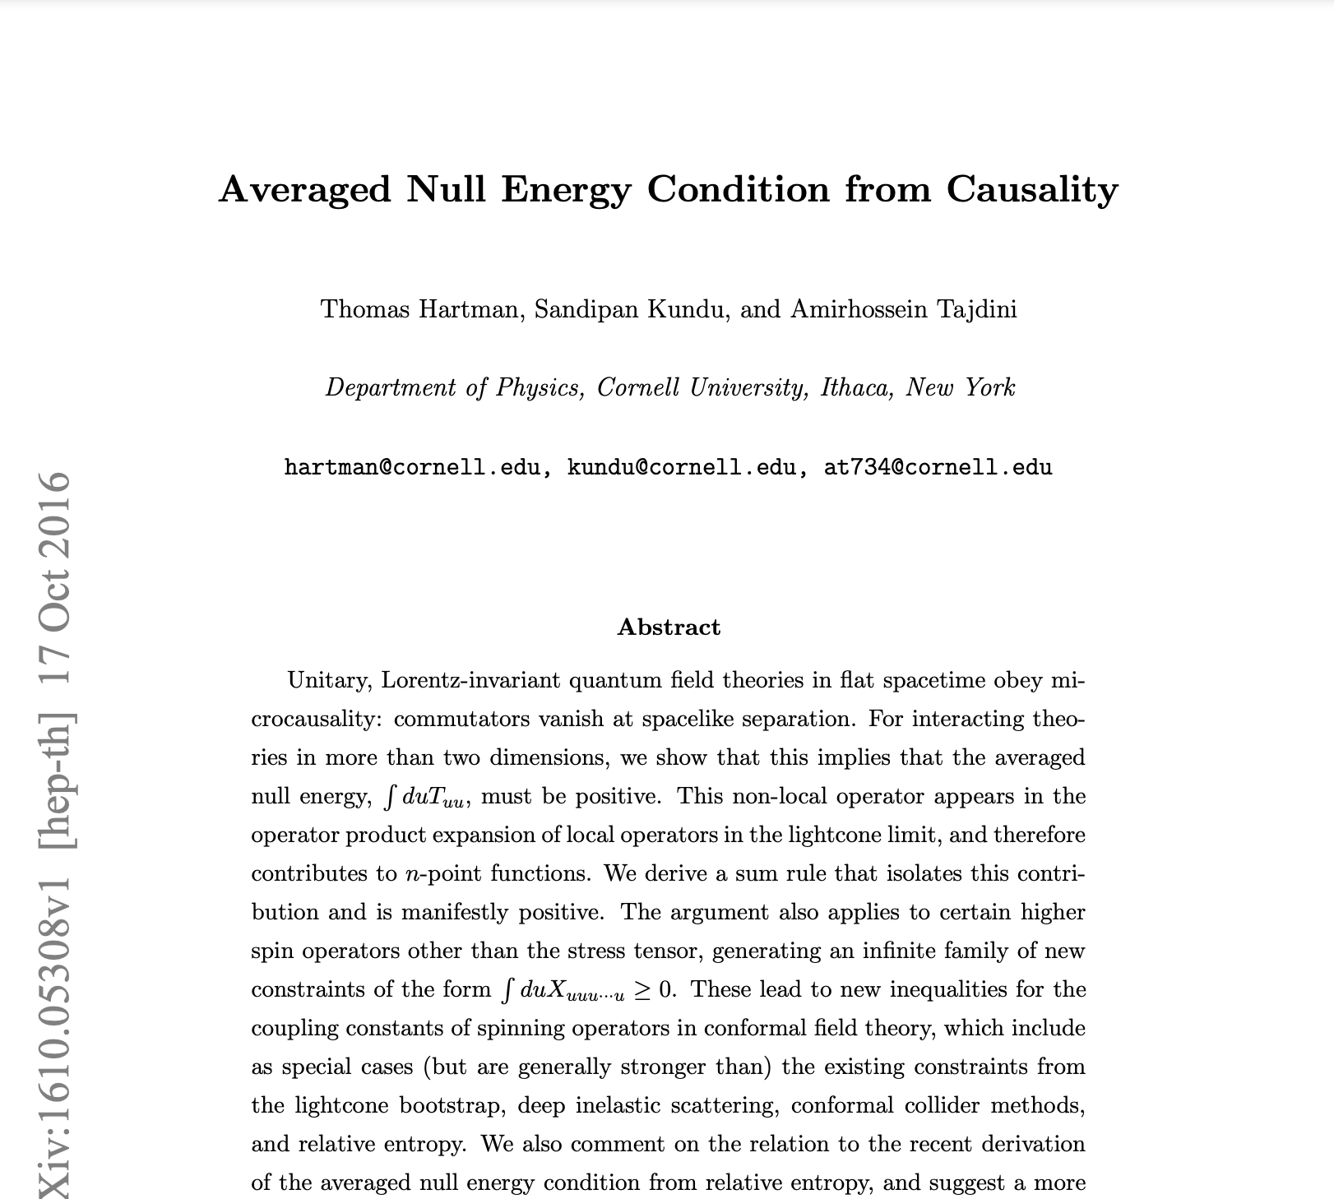
Introduction
Context:
However, there is an interesting disconnect between much of the developments in collider QCD phenomenology and formal theory.

Slide 4
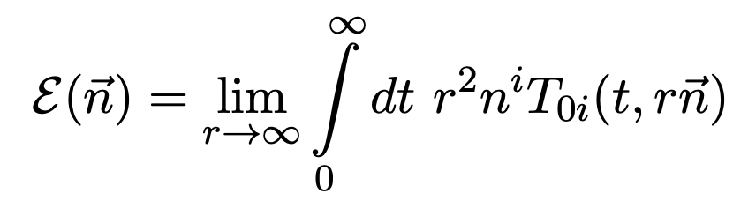
Introduction
What’s the middle ground?
The energy flow operator is an ANEC operator, it can be computed directly in CFTs admitting many new computational techniques.
Its correlation functions are also directly collider observables – Energy Correlators.
We want to apply these to HI collisions to study jet quenching.

Slide 5
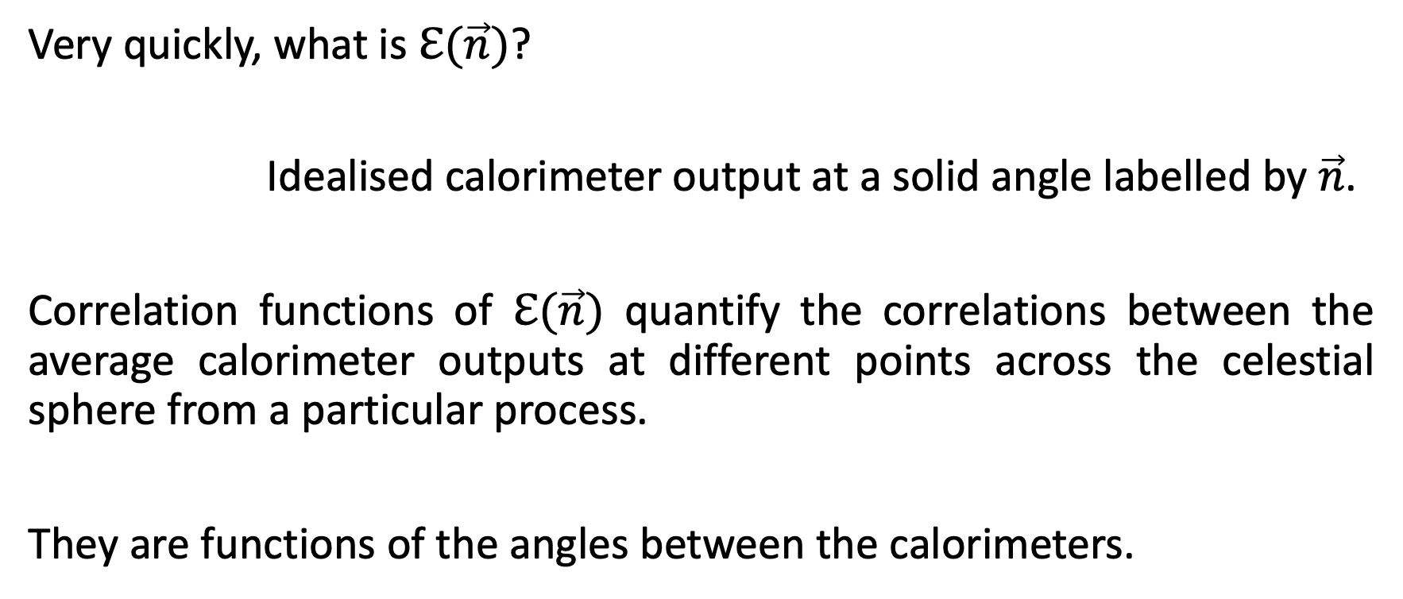
Introduction
Very quickly, what is $ℇ(\vec{n})$?
Idealised calorimeter output at a solid angle labelled by $\vec{n}$.
Correlation functions of $ℇ(\vec{n})$ quantify the correlations between the average calorimeter outputs at different points across the celestial sphere from a particular process.
They are functions of the angles between the calorimeters.

Slide 6
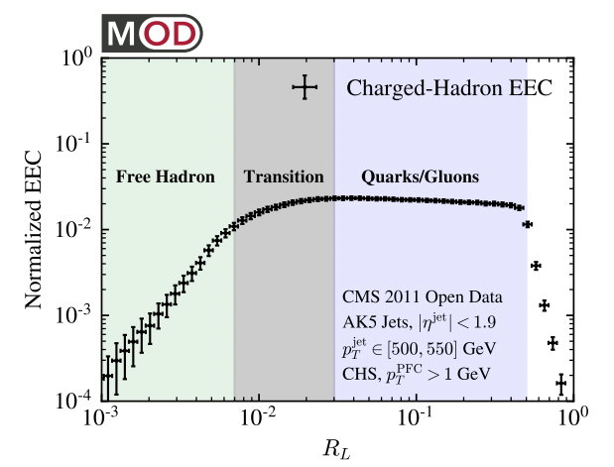
Introduction
Important difference between correlators and more ‘typical’ observables.

Slide 7
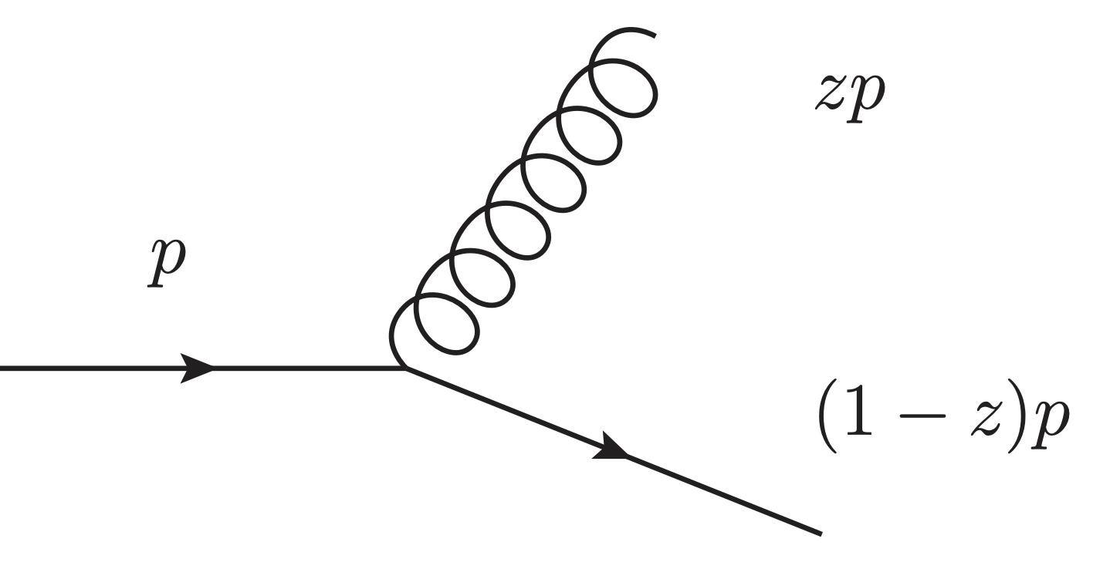

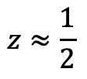
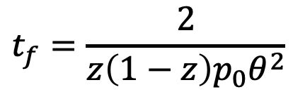
Introduction
Additional to the computational benefits from formal theory, phenomenologically energy correlators are very good at isolating parts of multiscale dynamics.
The angular size of a correlation often can be interpreted as a time parameter for the physics inducing the correlations.
$$z≈\frac{1}{2}$$
$$t_{f}=\frac{2}{z\left(1−z\right)p_{0}θ^{2}}$$
$$θ^{2}∼t_{f}^{−1}\sim p_{exchanged}^{2}$$

Slide 8
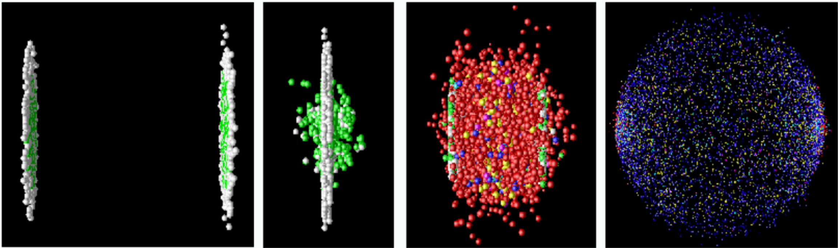
Introduction
Time
t=0 to 1 fm/c
t=1 to 10 fm/c
t>10 fm/c
The QGP in heavy ion collisions (HIC):
– 20 years of HIC at RHIC, 10 years of HIC at the LHC, sPHENIX coming soon.

Slide 9
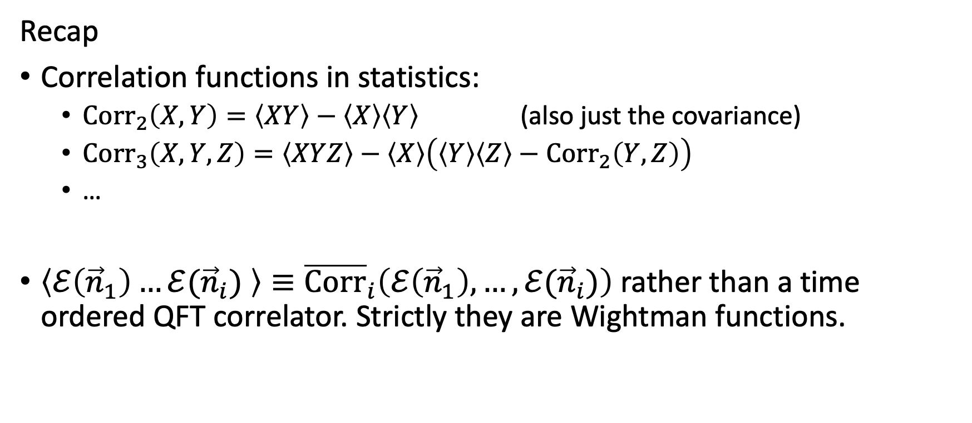

Computing Correlation Functions of $ℰ(\vec{n})$
Recap
Correlation functions in statistics:
  ${Corr}_{2}\left(X,Y\right)=\left\langle XY\right\rangle −\left\langle X\right\rangle \left\langle Y\right\rangle$ (also just the covariance)
  ${Corr}_{3}\left(X,Y,Z\right)=\left\langle XYZ\right\rangle −\left\langle X\right\rangle \left(\left\langle Y\right\rangle \left\langle Z\right\rangle −{Corr}_{2}\left(Y,Z\right)\right)$
  …
$\left\langle ℰ\left({\vec{n}}_{1}\right)…ℰ({\vec{n}}_{i}) \right\rangle ≡{\overline{Corr}}_{i}\left(ℰ\left({\vec{n}}_{1}\right),…,ℰ({\vec{n}}_{i})\right)$ rather than a time ordered QFT correlator. Strictly they are Wightman functions.

Slide 10
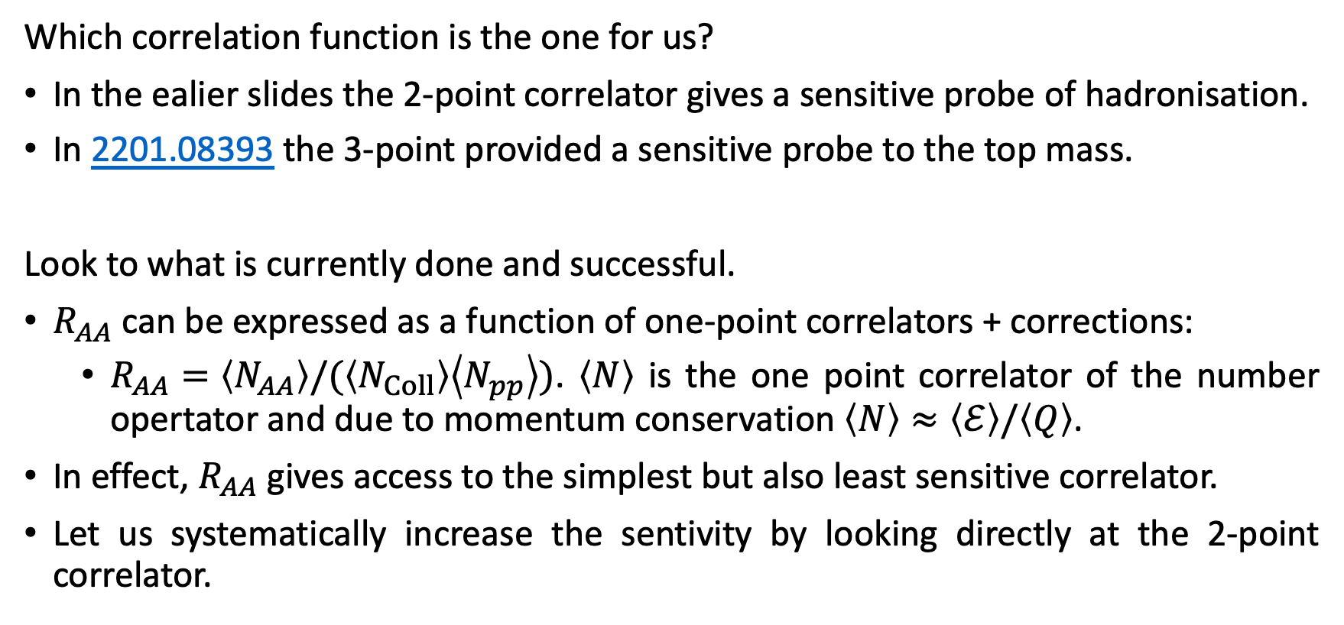
Computing Correlation Functions of $ℰ(\vec{n})$
Which correlation function is the one for us?
In the ealier slides the 2-point correlator gives a sensitive probe of hadronisation.
In 2201.08393 the 3-point provided a sensitive probe to the top mass.
Look to what is currently done and successful.
$R_{AA}$ can be expressed as a function of one-point correlators + corrections:
  $R_{AA}=\left\langle N_{AA}\right\rangle /(\left\langle N_{Coll}\right\rangle \left\langle N_{pp}\right\rangle )$. $\left\langle N\right\rangle$ is the one point correlator of the number opertator and due to momentum conservation $\left\langle N\right\rangle ≈\left\langle ℰ\right\rangle /\left\langle Q\right\rangle$.
In effect, $R_{AA}$ gives access to the simplest but also least sensitive correlator.
Let us systematically increase the sentivity by looking directly at the 2-point correlator.

Slide 11
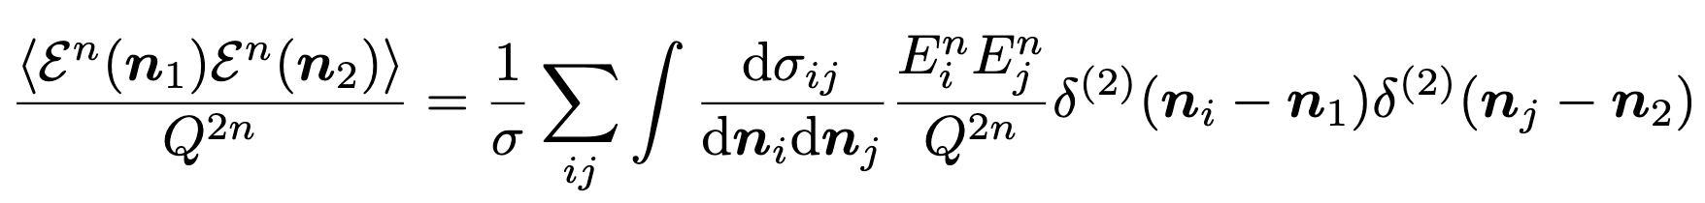
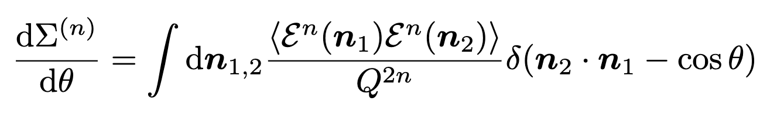
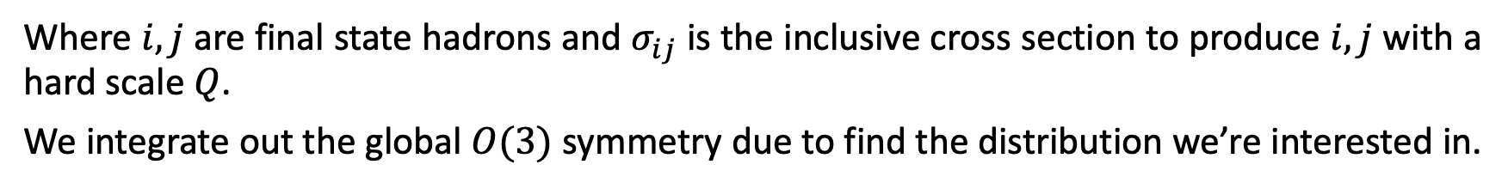
Computing Correlation Functions of $ℰ(\vec{n})$
Where $i,j$ are final state hadrons and $σ_{ij}$ is the inclusive cross section to produce $i,j$ with a hard scale $Q$.
We integrate out the global $O(3)$ symmetry due to find the distribution we’re interested in.
Let me now set up the perturbative calculation we perform.

Slide 12
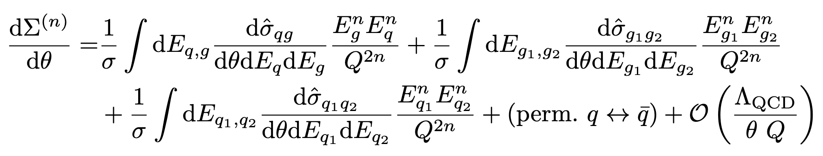
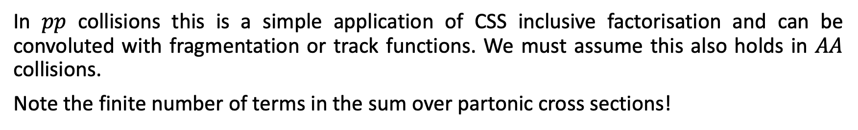
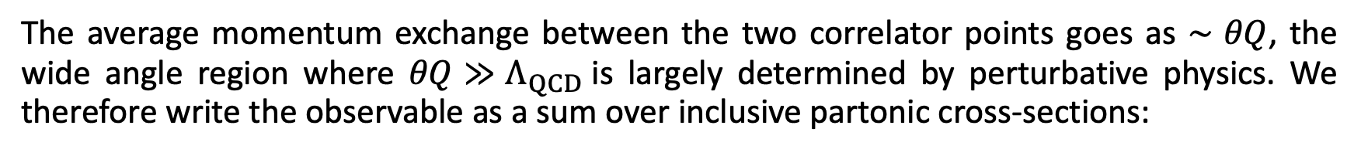
Computing Correlation Functions of $ℰ(\vec{n})$
The average momentum exchange between the two correlator points goes as $∼θQ$, the wide angle region where $θQ≫Λ_{QCD}$is largely determined by perturbative physics. We therefore write the observable as a sum over inclusive partonic cross-sections:
In $pp$ collisions this is a simple application of CSS inclusive factorisation and can be convoluted with fragmentation or track functions. We must assume this also holds in $AA$ collisions.
Note the finite number of terms in the sum over partonic cross sections!

Slide 13
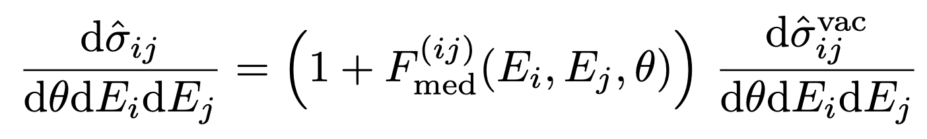
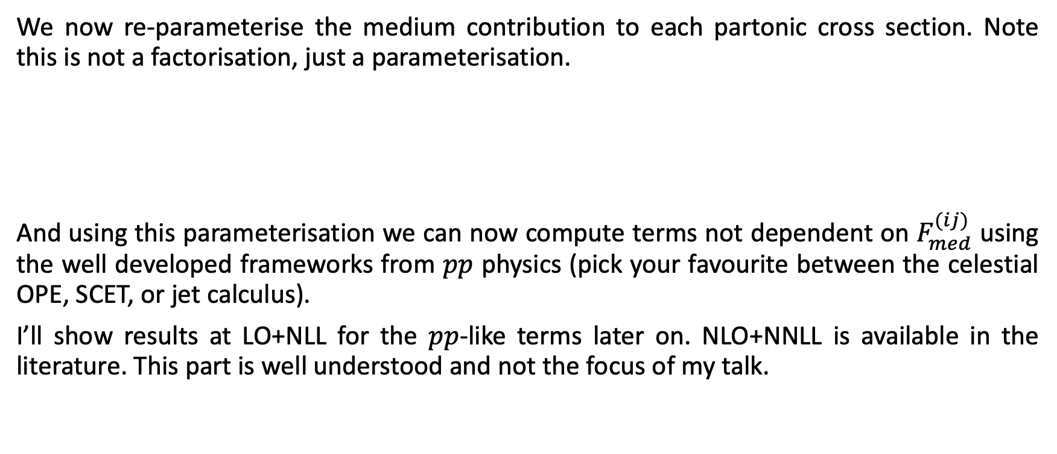
Computing Correlation Functions of $ℰ(\vec{n})$
We now re-parameterise the medium contribution to each partonic cross section. Note this is not a factorisation, just a parameterisation.
And using this parameterisation we can now compute terms not dependent on $F_{med}^{(ij)}$ using the well developed frameworks from $pp$ physics (pick your favourite between the celestial OPE, SCET, or jet calculus).
I’ll show results at LO+NLL for the $pp$-like terms later on. NLO+NNLL is available in the literature. This part is well understood and not the focus of my talk.

Slide 14
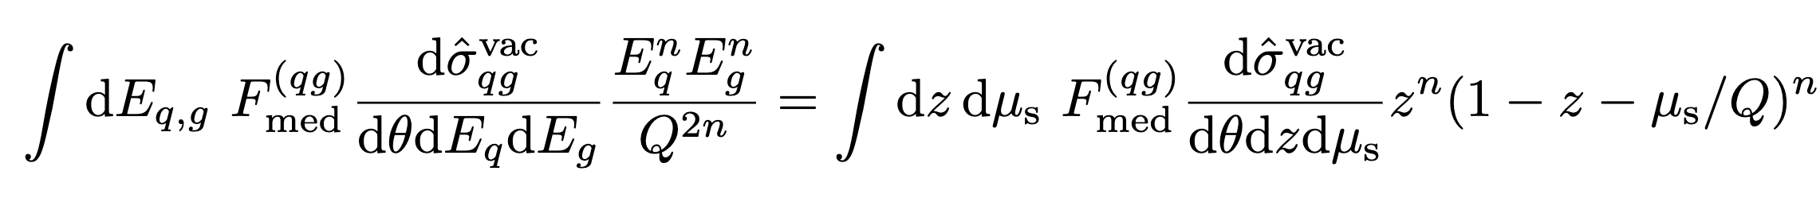
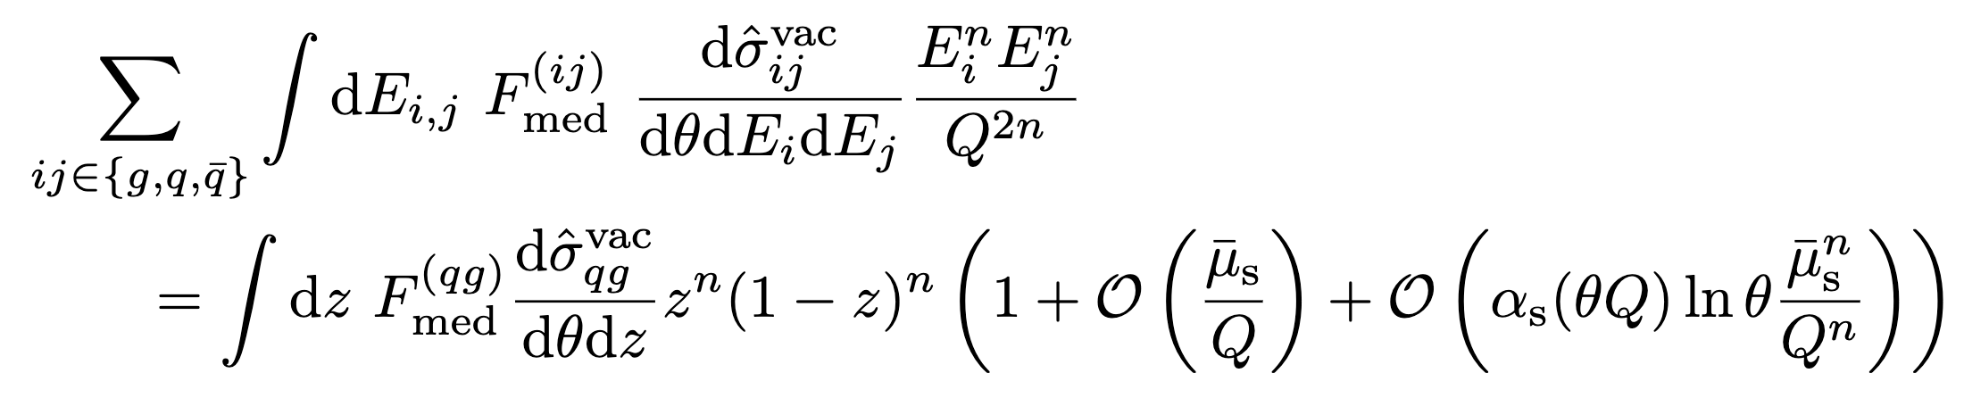


Computing Correlation Functions of $ℰ(\vec{n})$
Now we must focus on the ‘medium’ terms that contain the physics intrinsic to HI collisions. So far we’ve not approximated anything other than assuming perturbative factorisation. Let’s introduce some new helpful variables:
where $z=E_{q}/Q$ and $μ_{s}=Q−E_{q}−E_{g}>0$ is the energy scale of the radiation over which the perturbative cross sections are inclusive.
With this parameterisation and assuming we are measuring quark jets:

Slide 15
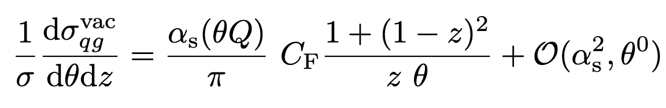
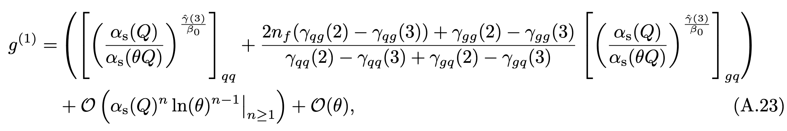
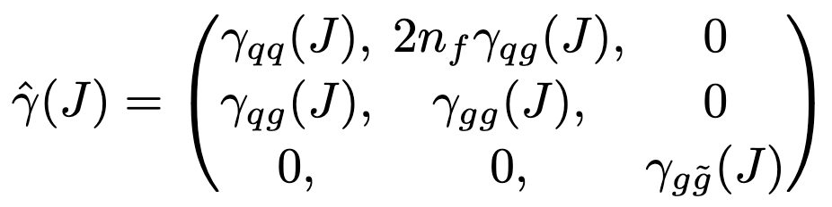
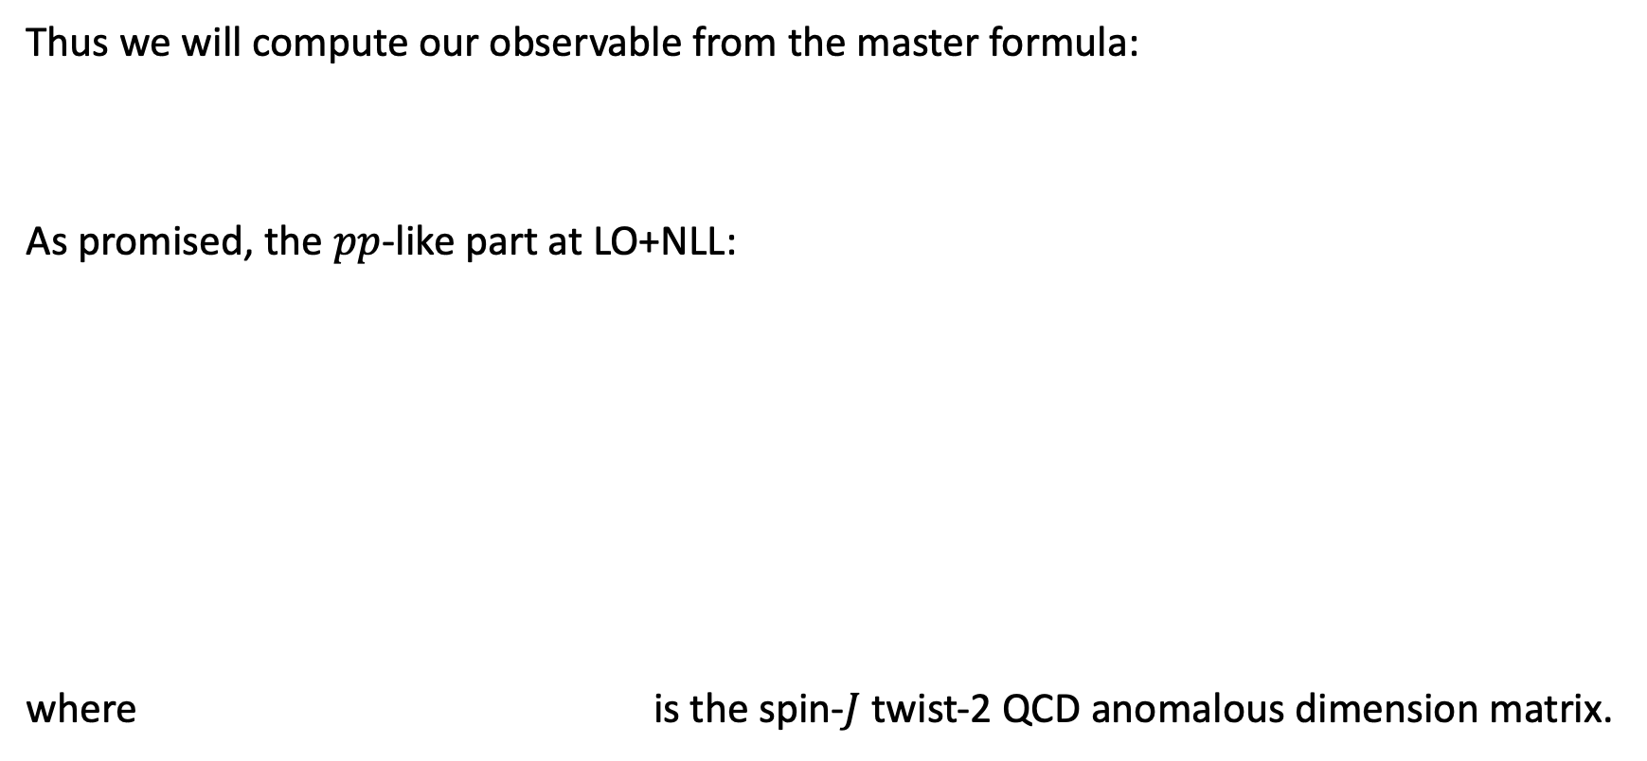
Computing Correlation Functions of $ℰ(\vec{n})$
Thus we will compute our observable from the master formula:
As promised, the $pp$-like part at LO+NLL:
where is the spin-$J$ twist-2 QCD anomalous dimension matrix.

Slide 16
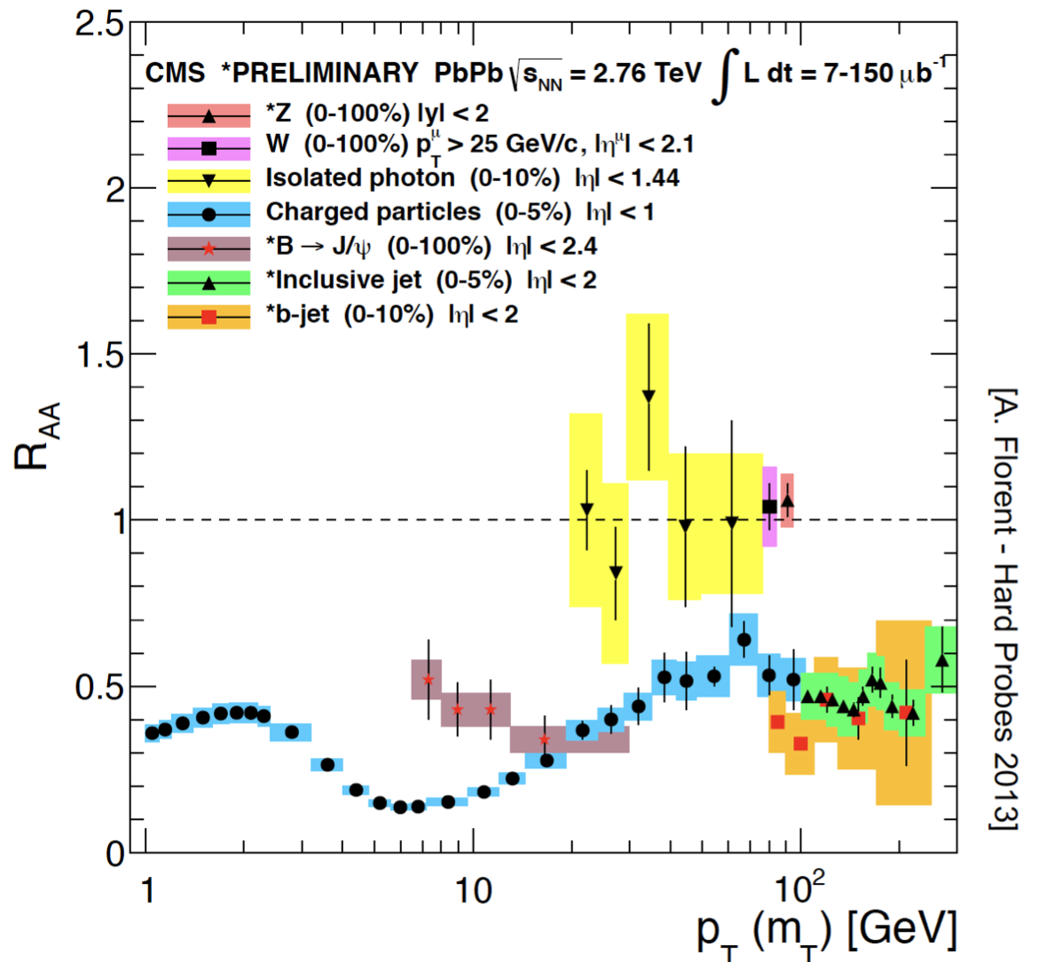



Computing $F_{med}$
This is what we’re interested in. To progress further we will have to input models for the interaction between a jet and a medium. We will rely on the BDMPS-Z approach and use various approximations to solve for $F_{med}^{(ij)}$.
Jet modification in HIC key points which we must consider:
Energy loss through medium-induced radiation
Widely studied in terms of suppression of jets and high-$p_{T}$ hadrons.
Colour coherence effects – what we want to study!
Breaking of angular ordering.
Expected to modify jet inner structure.
Often understood in terms of simplified calculations, but not yet unequivocally seen in observables.
We wont yet consider medium response – this will likely need Monte Carlo.
arXiv:1512.08107, 1710.03237, 1812.05111, 2010.00028, 2210.07901 and more

Slide 17
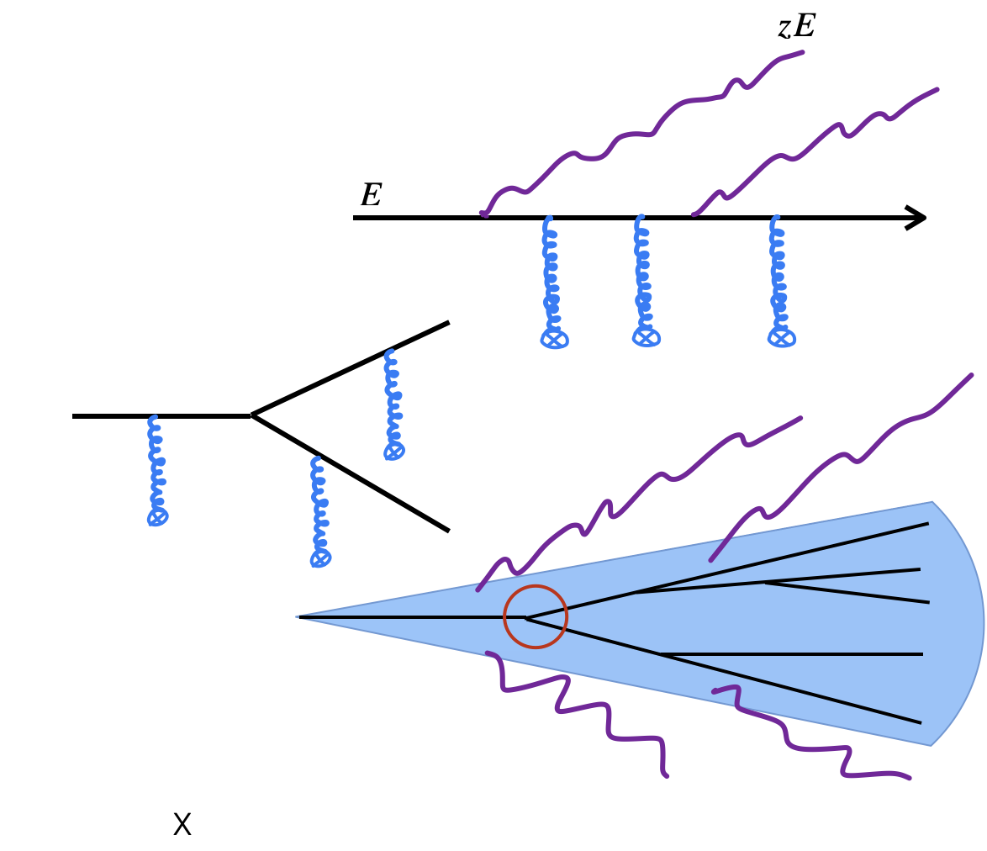
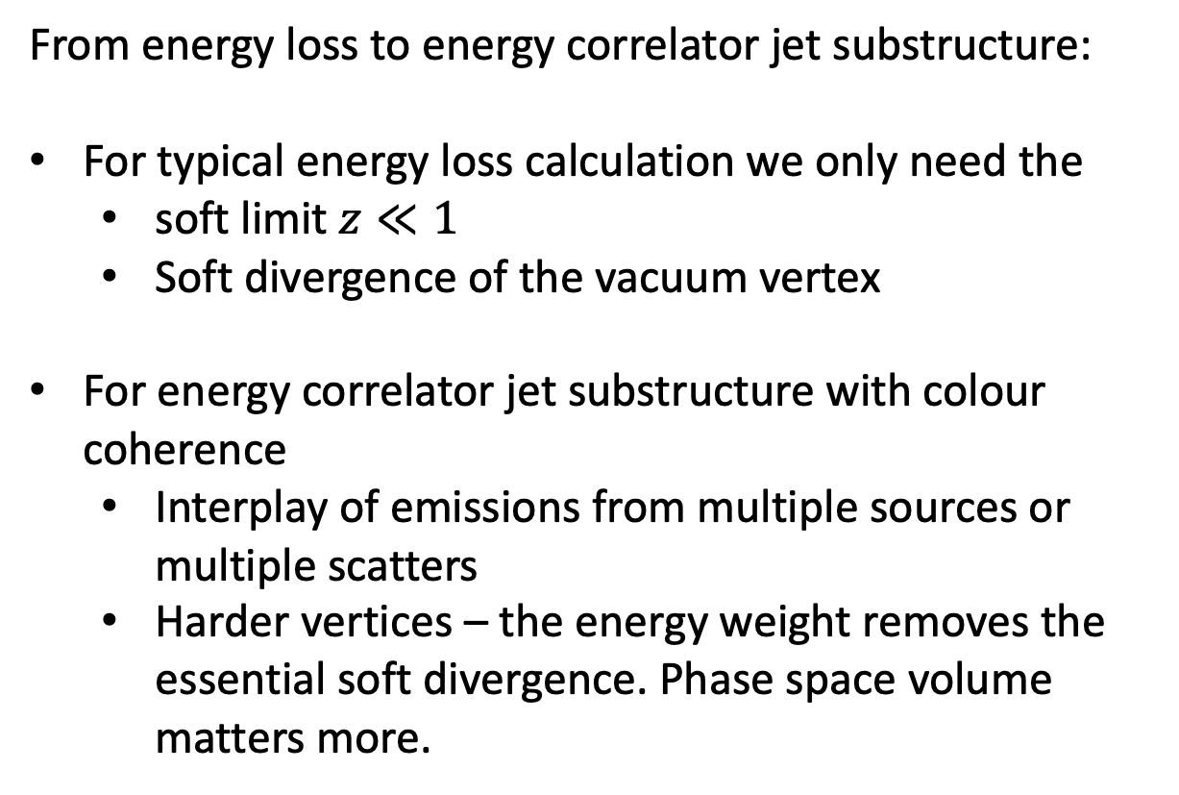
Computing $F_{med}$
From energy loss to energy correlator jet substructure:
For typical energy loss calculation we only need the
  soft limit $z≪1$
  Soft divergence of the vacuum vertex
For energy correlator jet substructure with colour coherence
  Interplay of emissions from multiple sources or multiple scatters
  Harder vertices – the energy weight removes the essential soft divergence. Phase space volume matters more.

Slide 18
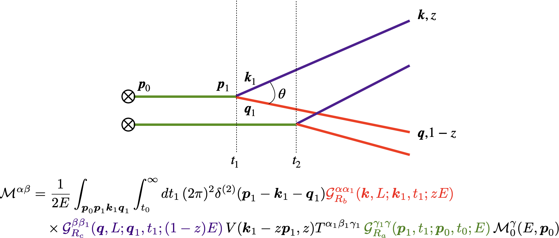
Computing $F_{med}$
Leading structure to study is a (quark) jet fragmenting into a jet and a subjet in the presence of a medium.

Slide 19
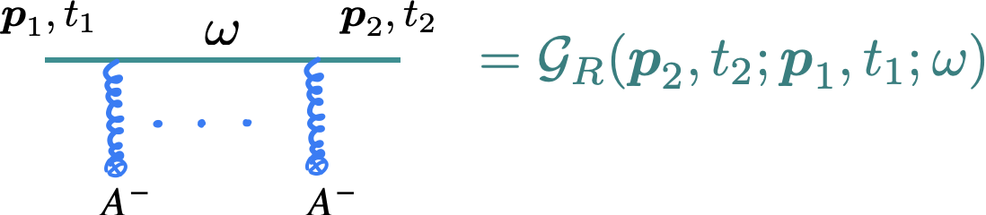
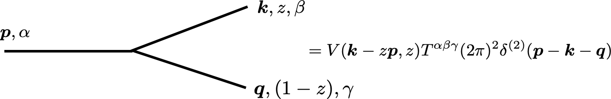
Computing $F_{med}$
The formalism we use, based in BDMPS-Z:
All particles have a large longitudinal momentum compared to their transverse momenta and therefore there is a decoupling between transverse and longitudinal dynamics
We work in a mixed representation with momentum coordinates in the transverse direction and “time” (+ coordinate) in the longitudinal direction.
Multiple scatterings resumed through propagators in a background field
Vacuum vertices
Background field averaged at the level of the cross section

Slide 20
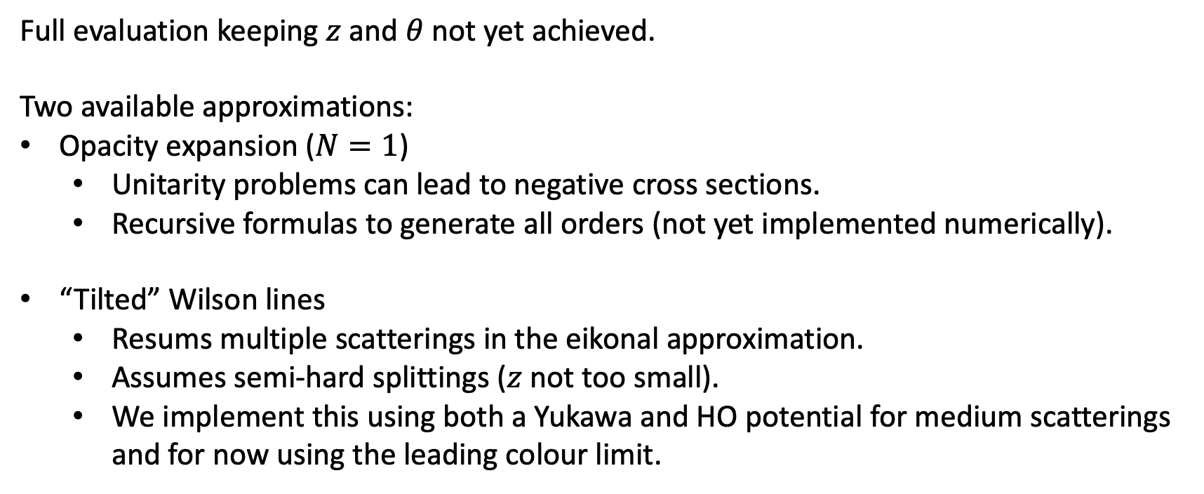
Computing $F_{med}$
Full evaluation keeping $z$ and $θ$ not yet achieved.
Two available approximations:
Opacity expansion ($N=1$)
  Unitarity problems can lead to negative cross sections.
  Recursive formulas to generate all orders (not yet implemented numerically).
“Tilted” Wilson lines
  Resums multiple scatterings in the eikonal approximation.
  Assumes semi-hard splittings ($z$ not too small).
  We implement this using both a Yukawa and HO potential for medium scatterings and for now using the leading colour limit.
arXiv:1807.03799
arXiv:1907.03653
arXiv:2107.02542

Slide 21
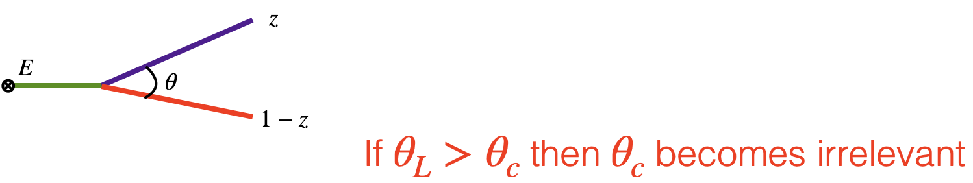
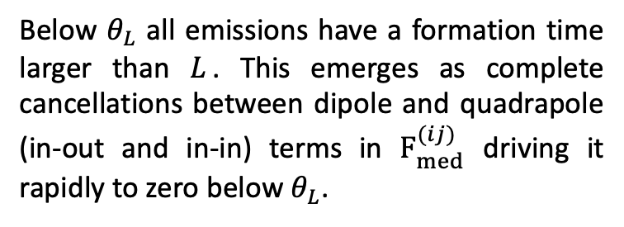

Computing $F_{med}$
For intuition, focus on HO for a bit.
For a static medium of length within the harmonic approximation one can read off the relevant scales directly from the formulas
  (Vacuum) formation time:
  Decoherence time:
arXiv:1907.03653
Below $θ_{L}$ all emissions have a formation time larger than $L$. This emerges as complete cancellations between dipole and quadrapole (in-out and in-in) terms in $F_{med}^{(ij)}$ driving it rapidly to zero below $θ_{L}$.
Below $θ_{c}$ emissions do not colour decohere and the medium does not independently resolve them. This emerges as an exponential suppression in the factorisable dipole terms within $F_{med}^{(ij)}$ forcing it to become small below $θ_{c}$.

Slide 22




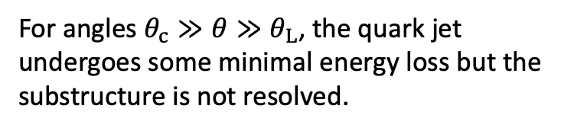
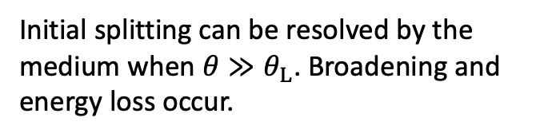

Interpretation for $F_{med}$
$$E≫ \hat{q}L^{2}$$
$$E≪ \hat{q}L^{2}$$
For angles $θ_{c}≫θ≫θ_{L}$, the quark jet undergoes some minimal energy loss but the substructure is not resolved.
Initial splitting can be resolved by the medium when $θ≫θ_{L}$. Broadening and energy loss occur.
22

Slide 23
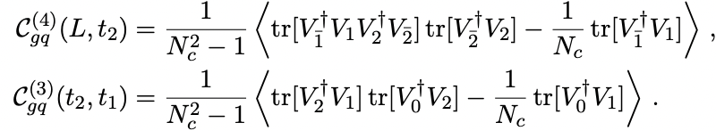

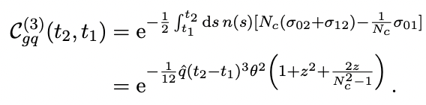
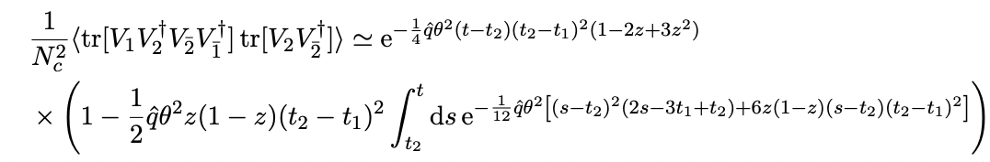

Numerical evaluation of $F_{med}$
Numerical integration is needed

Slide 24



Numerical evaluation of $F_{med}$
General features: an enhancement which begins above $θ_{L}$, at $θ≫θ_{L}$ the enhancement peaks and then settles into a new medium dependent scaling law.
Amplitudes appear model dependent.

Slide 25

Numerical evaluation of $F_{med}$
Whilst amplitudes are very model dependent, the differences can be fairly well absorbed into variation of the model parameters (not so much the wide angle though).

Slide 26


Numerical evaluation of $F_{med}$

Slide 27


Numerical evaluation of $F_{med}$

Slide 28



Numerical evaluation of $F_{med}$
Controlled by $θ_{L}$
Controlled by $(θ_{c}−θ_{L})$
Controlled by number of large scatters limit. Behaves as if medium is infinitely long and so always decoherent.
Provided $E≫E_{c}∼\hat{q}L^{2}$

Slide 29

Questions and observations
Coherence is a feature independent of the approach we take to evaluating the BDMPS-Z framework.
It doesn’t seem clearly associated with a particular crisp angle or energy. Analytically, harsh boundaries on the phase-space of radiation emerge from approximations of emission kernels and medium interactions. In more complete numerical evaluations these boundaries are fuzzy.
Energy correlators provide a nice window into coherence and general features of jet quenching. Other models can be readily input – if you can compute $F_{med}$, you can compute this observable.
How does the observable change with a more realistic medium?
What other information can we extract? Can we access the 3-point correlator?

Slide 30

Conclusions
Energy Correlators are cool and fun!
The simple and inclusive nature of energy correlators perhaps provides a window into degrees of theoretical control than can be very hard to otherwise achieve in jet substructure within HI physics.
We’ve shown that (within the BDMPS-Z) framework, coherence can be accessed in a model independent way through energy correlator spectra.
There are several steps that needed to be taken to produce less idealised predictions that can be compared with experiment. Also, the novelty of these observables possibly introduces several experimental challenges. However, they show great promise and so I think it is worth the effort!

Slide 31
Part N/A: Supplemental Material

Slide 32

Jet Quenching
Where each of the in-medium propagators is of the form:

Slide 33

Jet Quenching

Slide 34

Jet Quenching
BDMPS-Z

Slide 35





Part N/A: Supplemental Material

Slide 36

Part N/A: Supplemental Material

