Slide 1
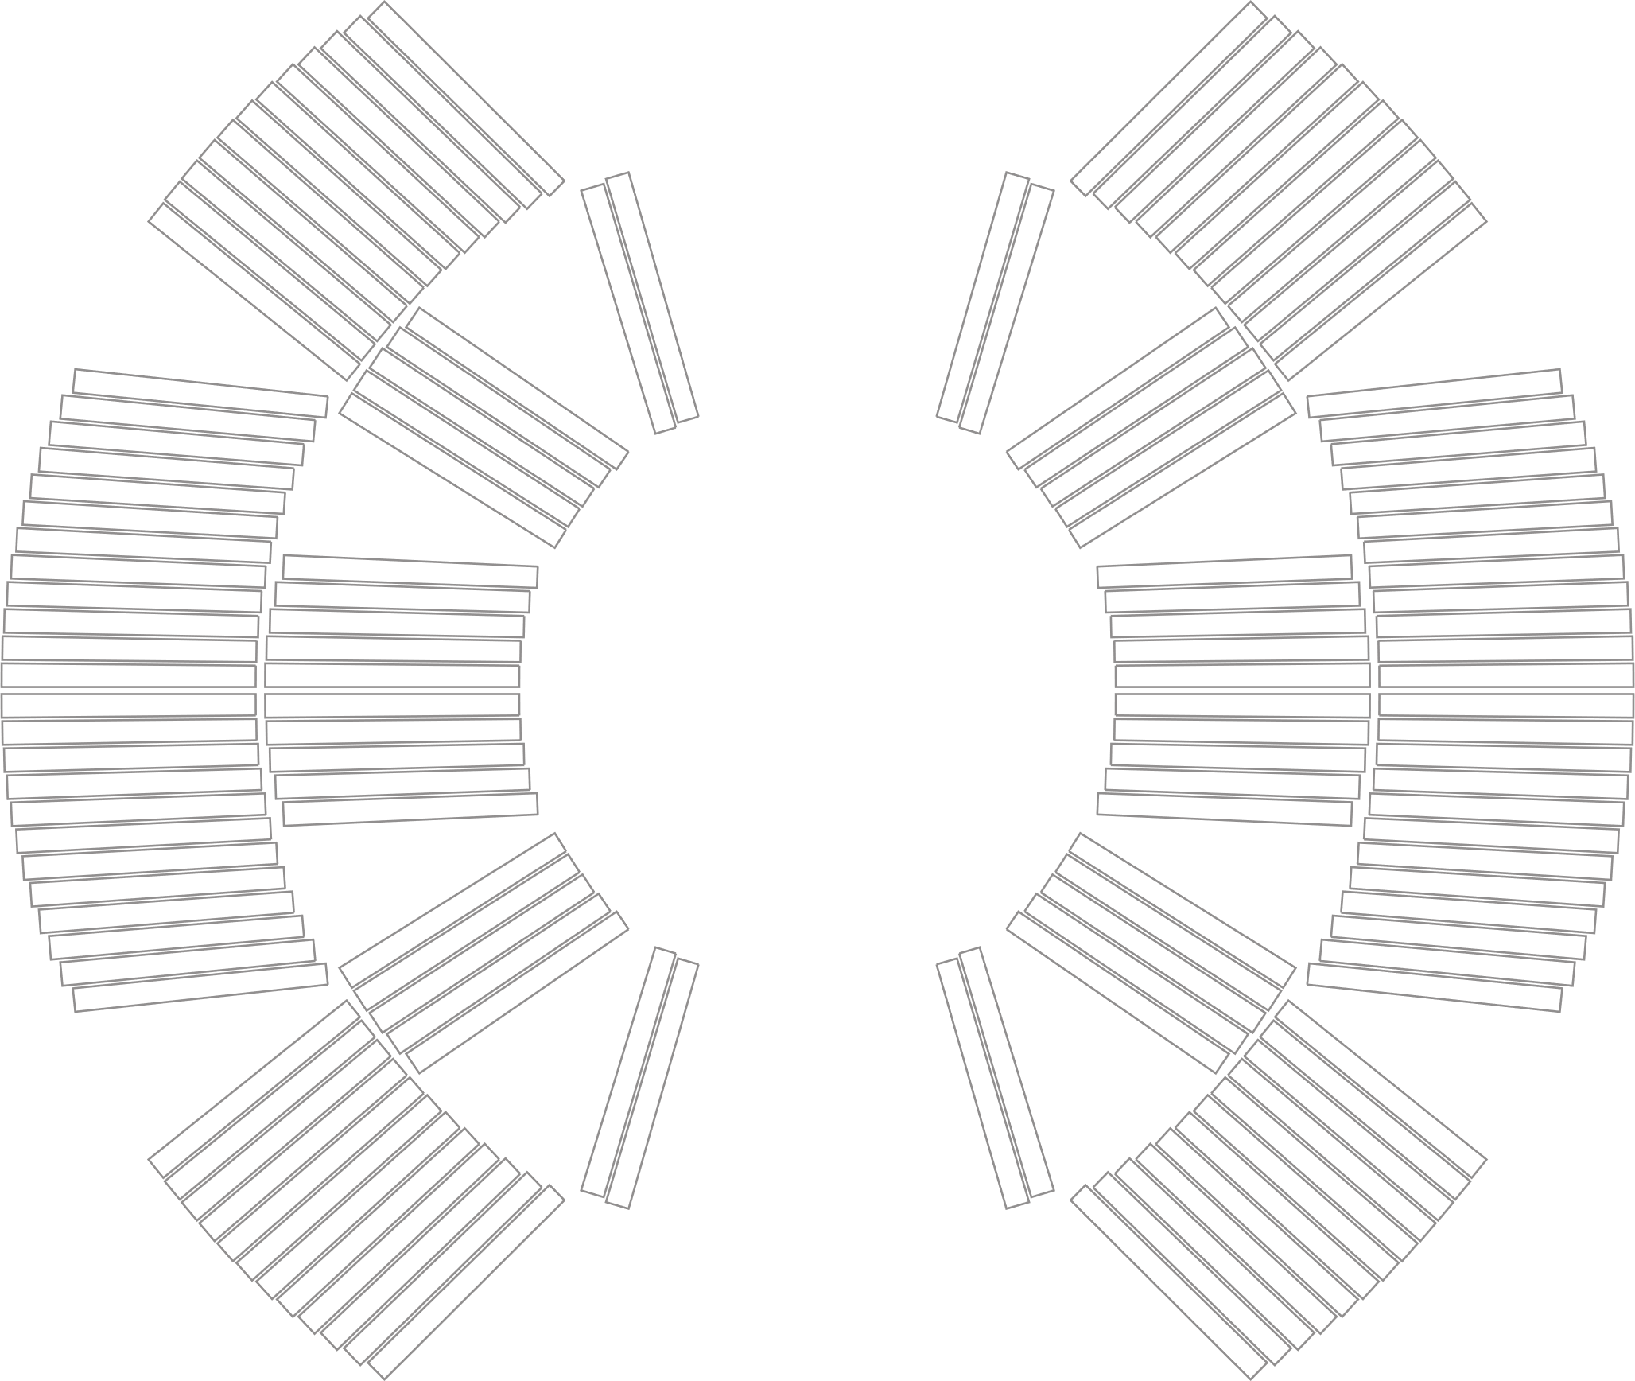

Falcon Dipole
Iron Pad Study
INFN LASA
Superconducting Magnet Group
Milan, Italy
&
INFN Genova

Slide 2
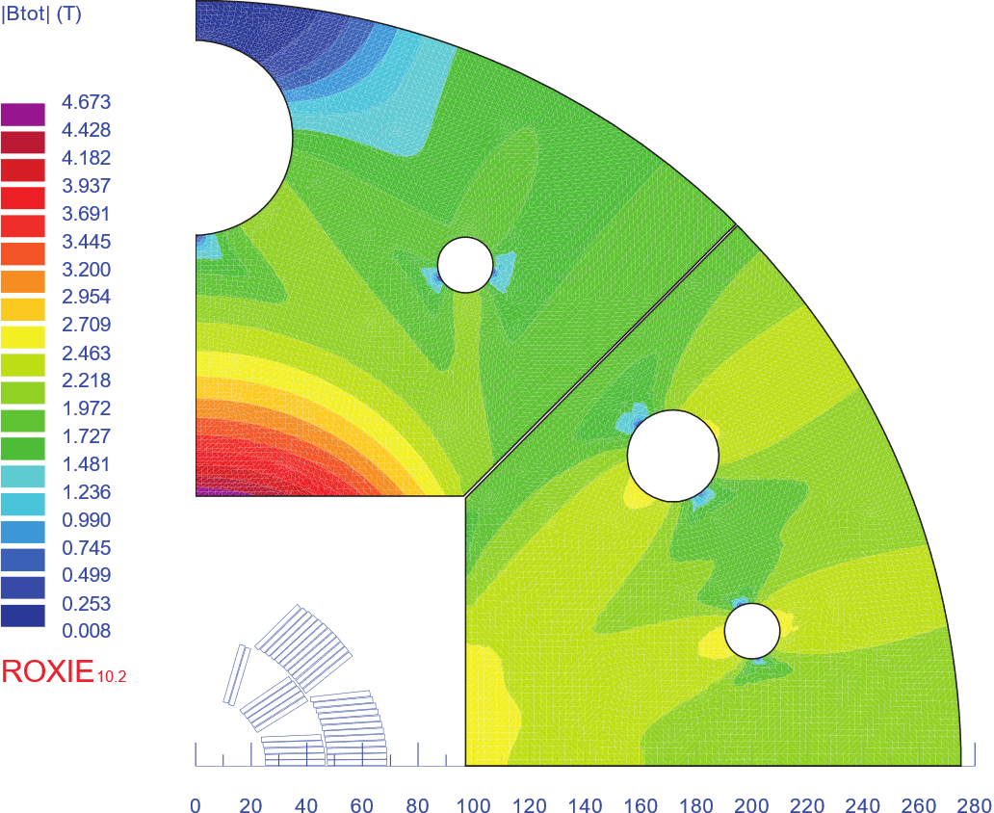
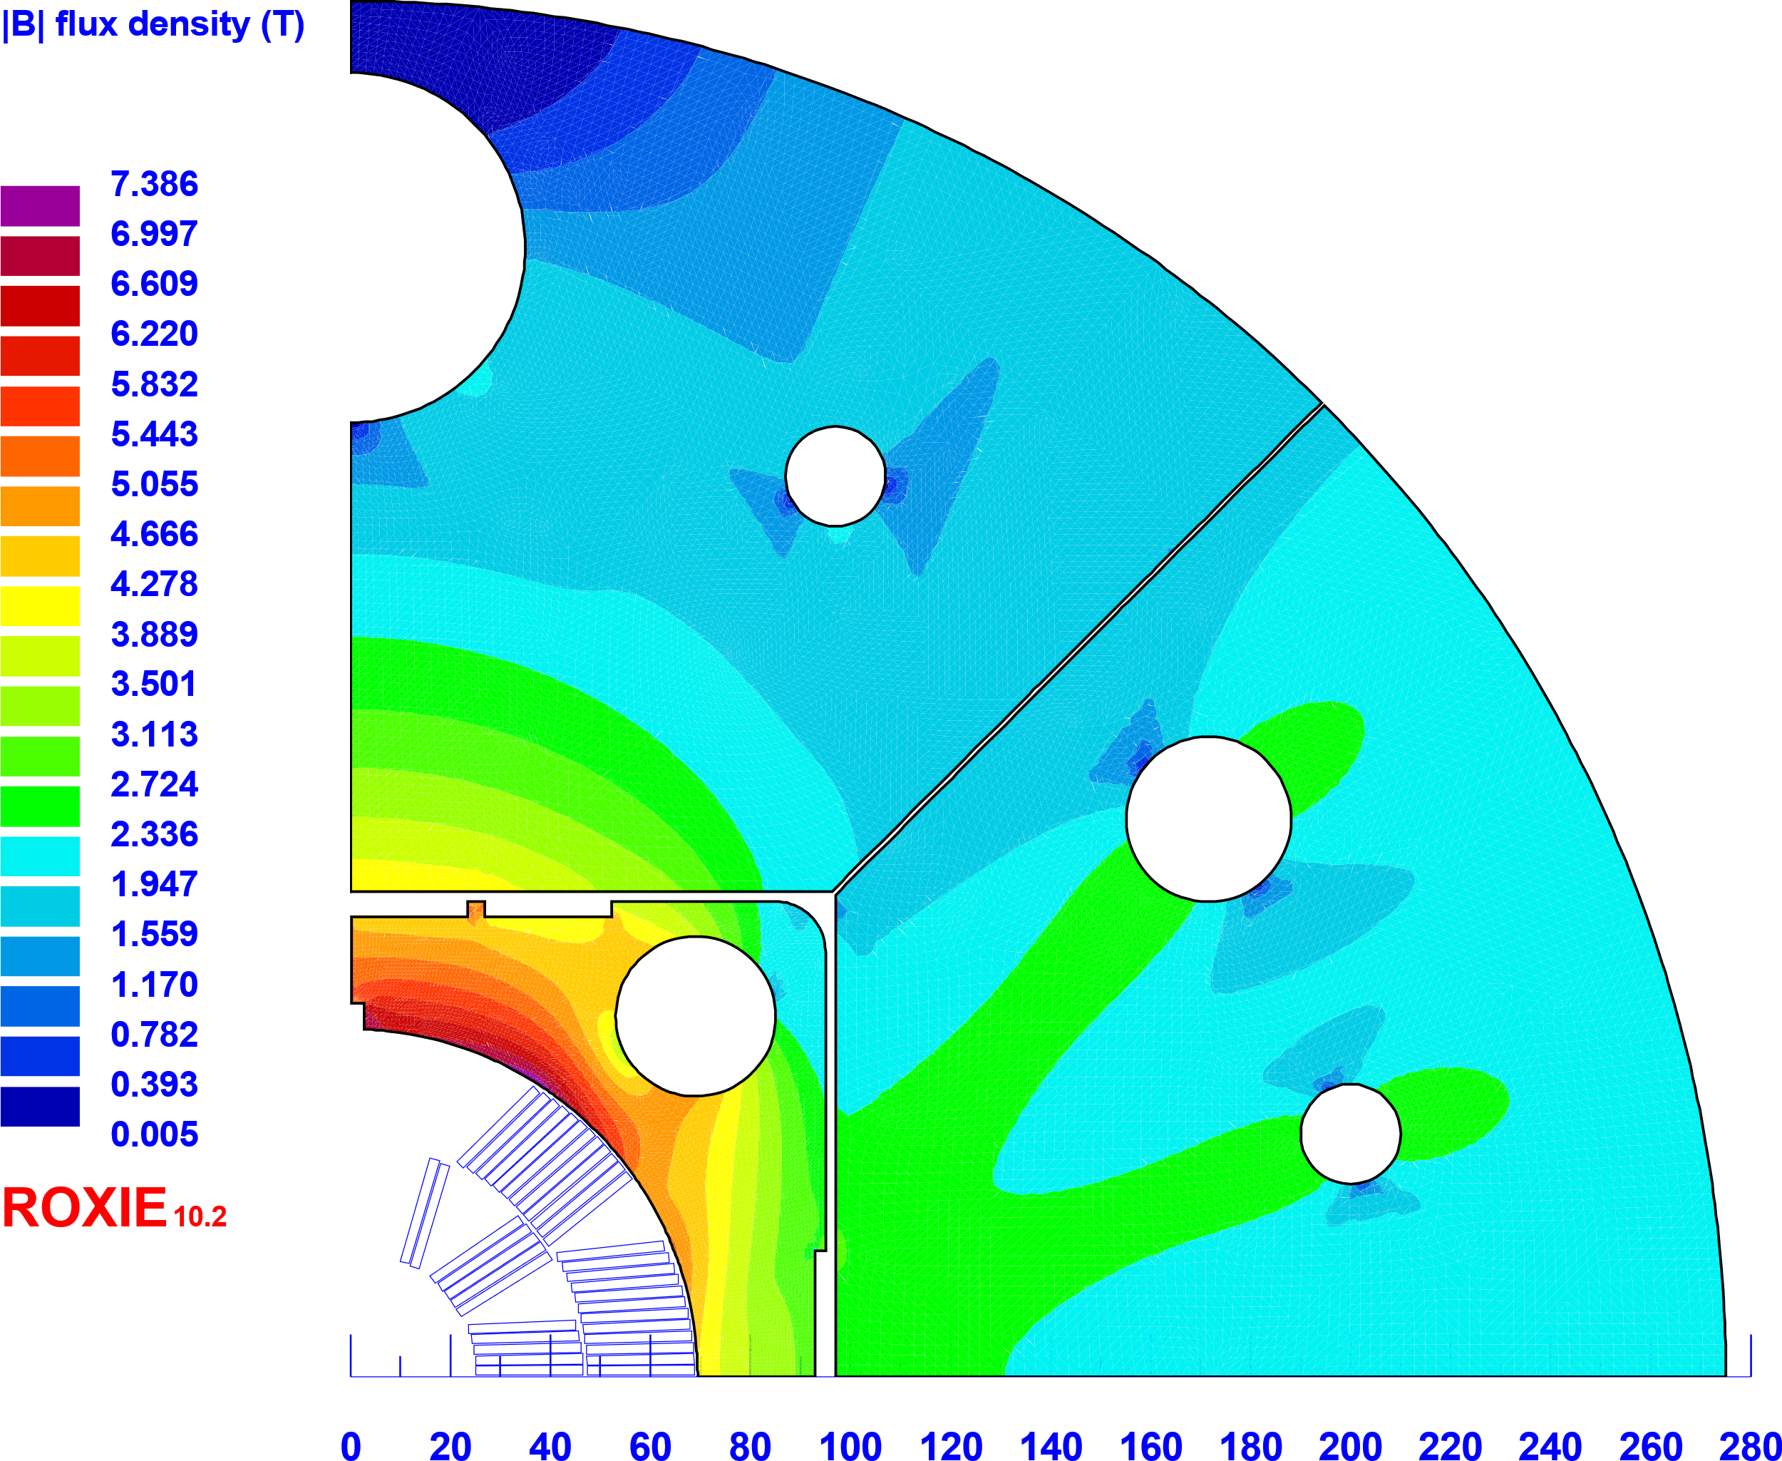
TDR version
Iron pad
Parameter | TDR version | Iron pad
Operating current [A] | 20991 | 19565
Peak field [T] | 12.53 | 12.46
Peak and bore field ratio | 1.044 | 1.038
Margin on loadline [%] | 23.58 | 25.12
Temperature margin [K] | 5.11 | 5.35
Field quality [units] | TDR version | Iron pad
b₃ | -0.28 | 14.75
b₅ | -5.30 | -4.77
b₇ | 12.63 | 11.80
b₉ | 2.85 | 2.66
b₁₁ | 1.31 | 1.22

