Slide 2
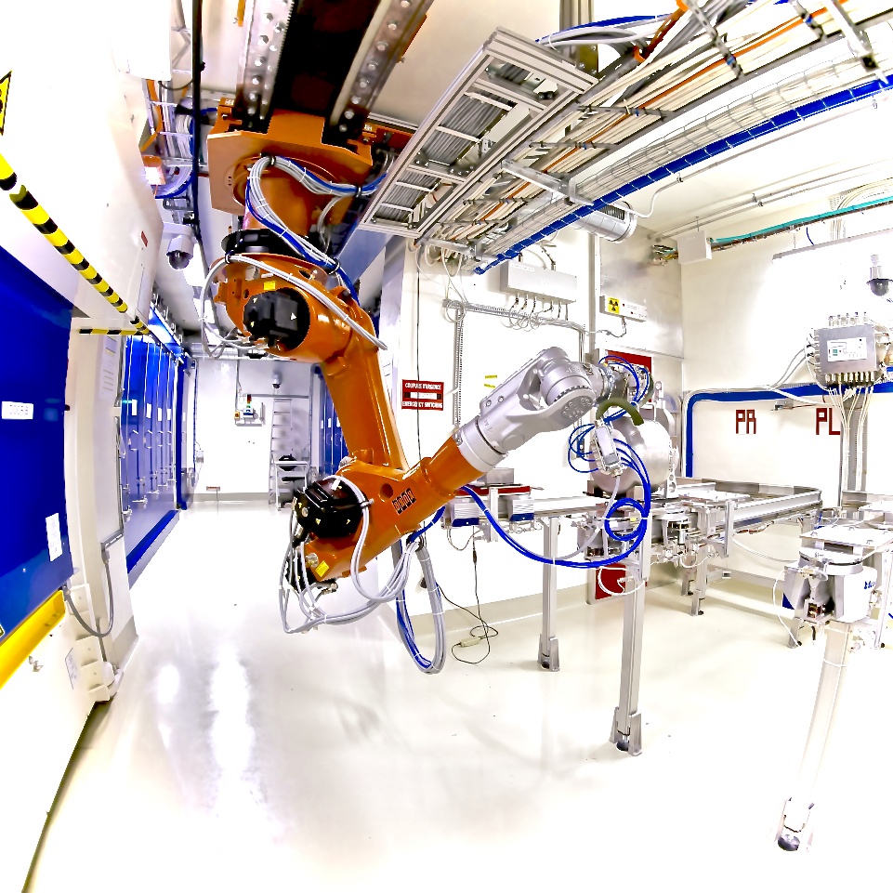
CERN-MEDICIS
2021 Operation operation miniworkshop review
https://cern.medicis/

Slide 3
Welcome & Thank you
Program of today at https://indico.cern.ch/event/1136123/
External board review members:
Valentin Fedoseev SY-STI
Jose Alberto Rodriguez BE-OP
Markus Widorski HSE-RP
Presentations:
Thierry Stora SY-STI
Laura Lambert SY-STI
Elodie Aubert, Alex Dorsival HSE-RP
Philippe Bertreix, Maxime Munos, Nabil Menaa HSE-RP

Slide 4
The MEDICIS program is driven with input from the collaboration
Last Coll. Board : 10th Nov 2022
https://medicis.cern/approved-projects
Program defined by run coordinator with input
from external partners and possibilities (eg target
Materials, shipping to end user, etc)
Goal maximize output (both technical and medical) for 2022
With available resources
Streamline development
Objectives for the miniworkshop :
- SWOT: Strength Weaknesses (from 2021) Improvement Threats ( for 2022)
- Implement Key Performance Indicators
- Towards Medical Isotope : Good Lab Practices

Slide 5
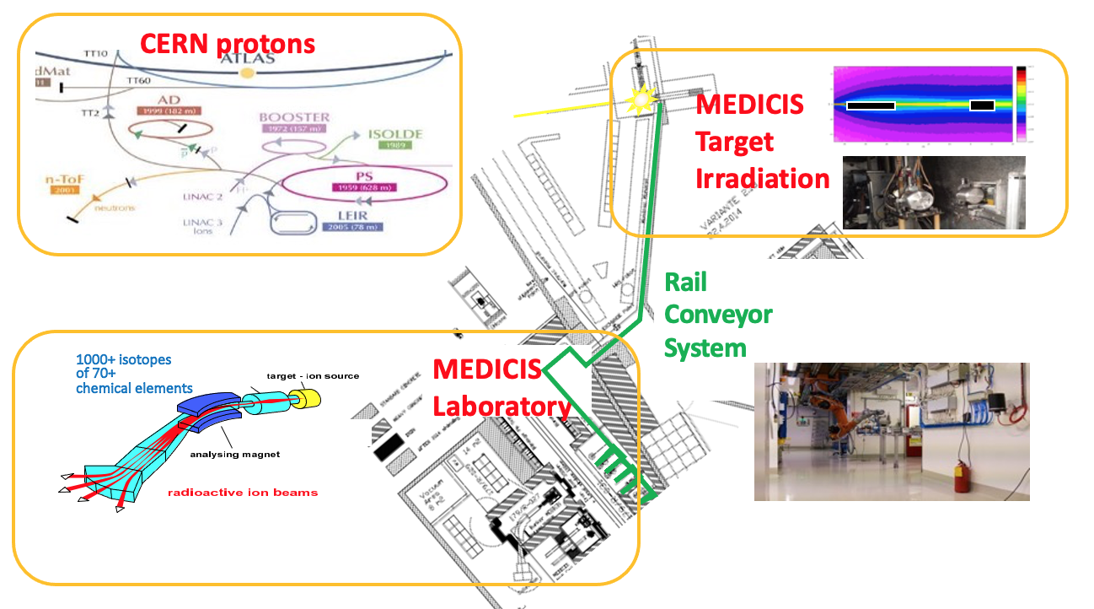
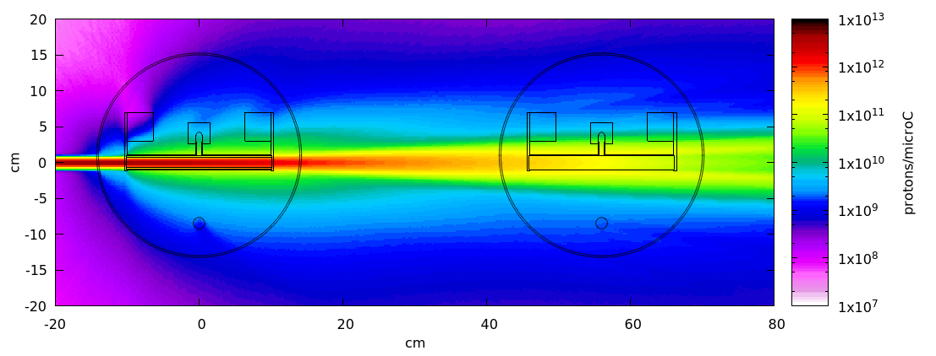
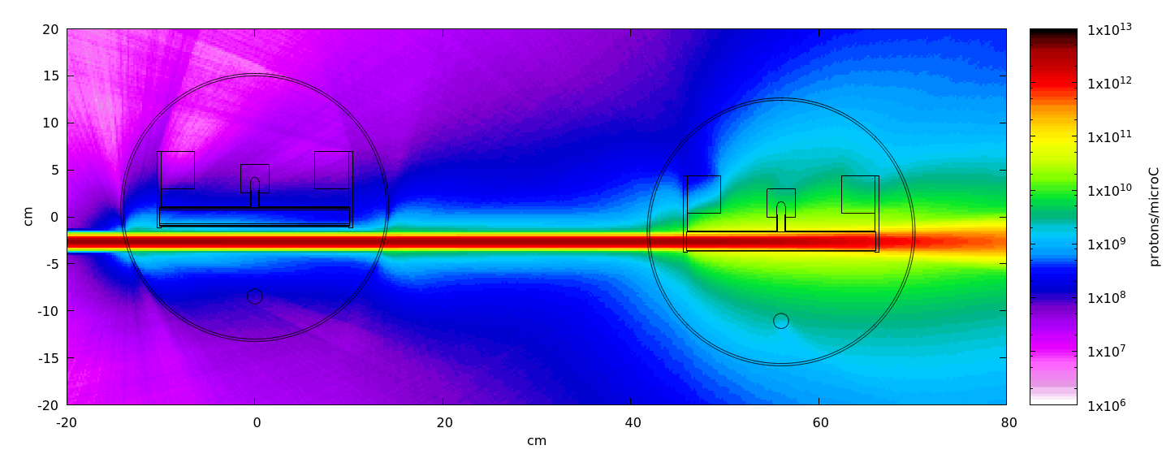
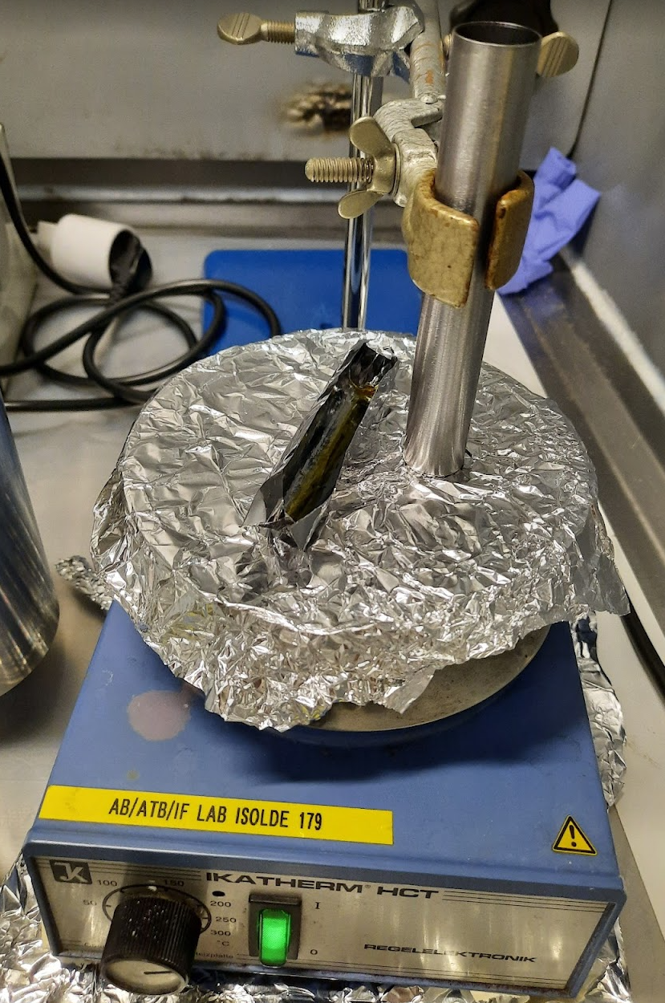
From CERN- MEDICIS to the laboratory/Hospital
3 modes of operation in 2021
Protons (“direct/indirect”) +
sources

Slide 6
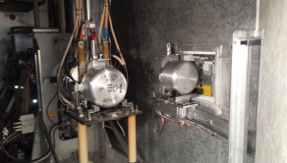
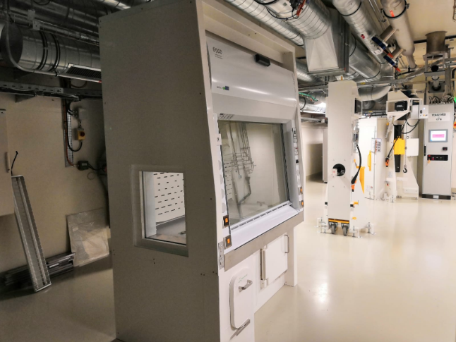
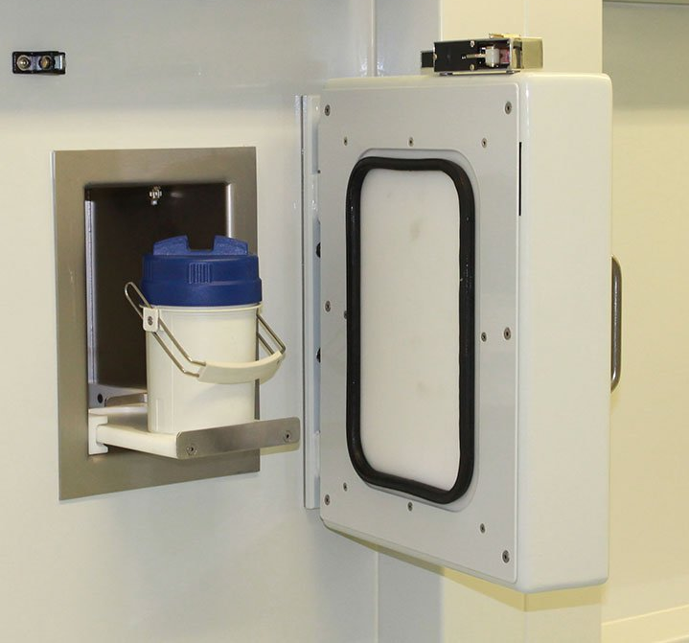
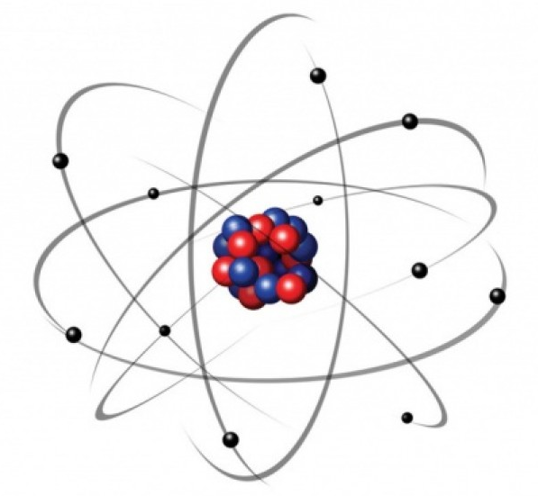
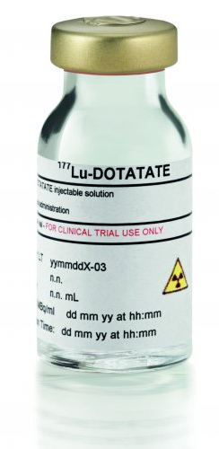
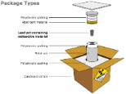
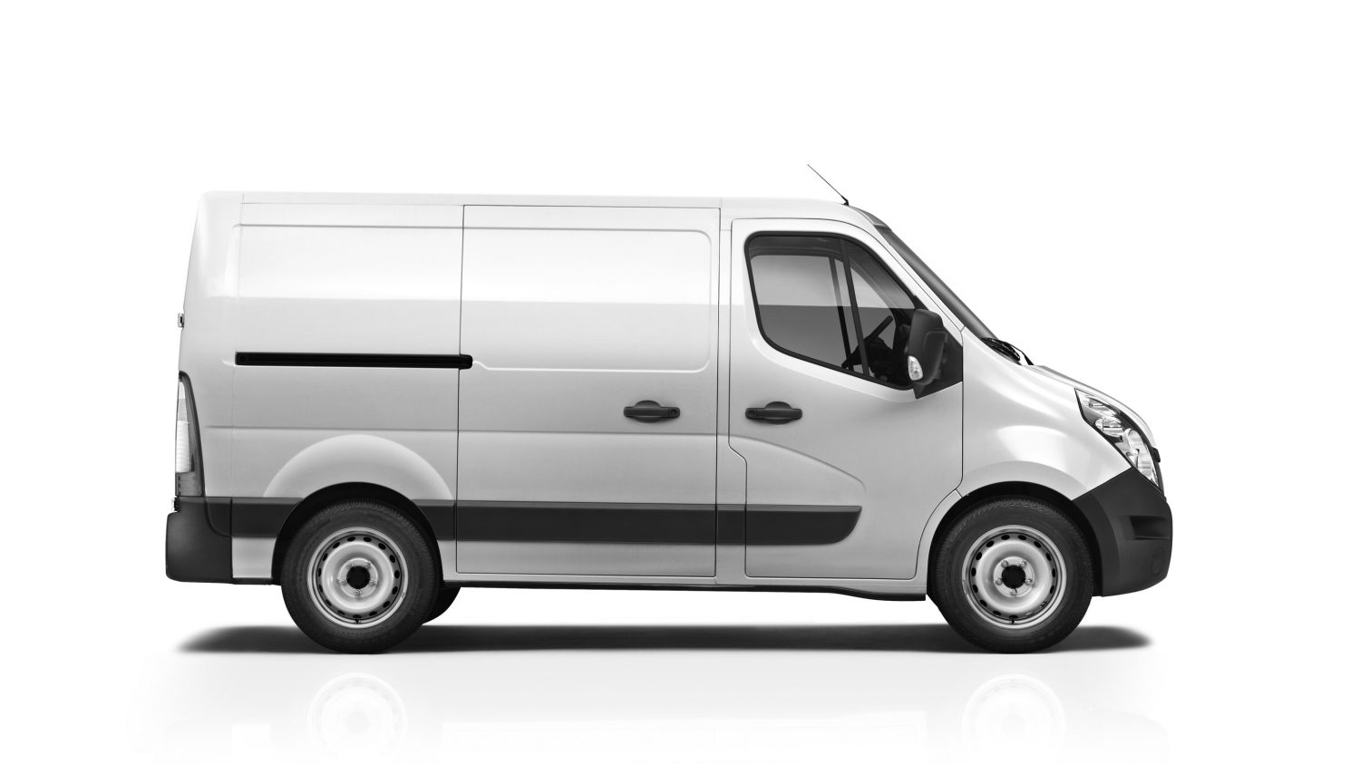
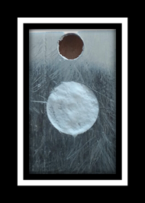
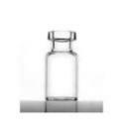
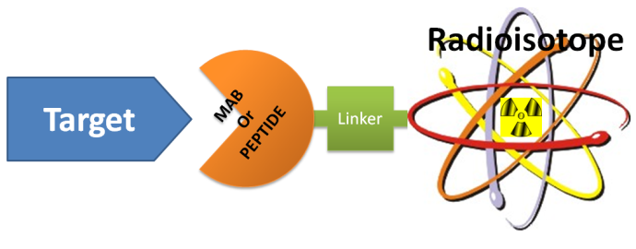
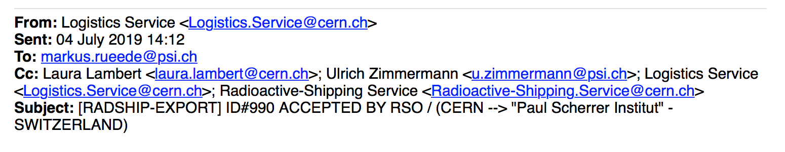
From CERN- MEDICIS to the laboratory/Hospital
120MBq Auger ¹⁶⁵Tm >99%
Produced/delivered in 24hr

Slide 7
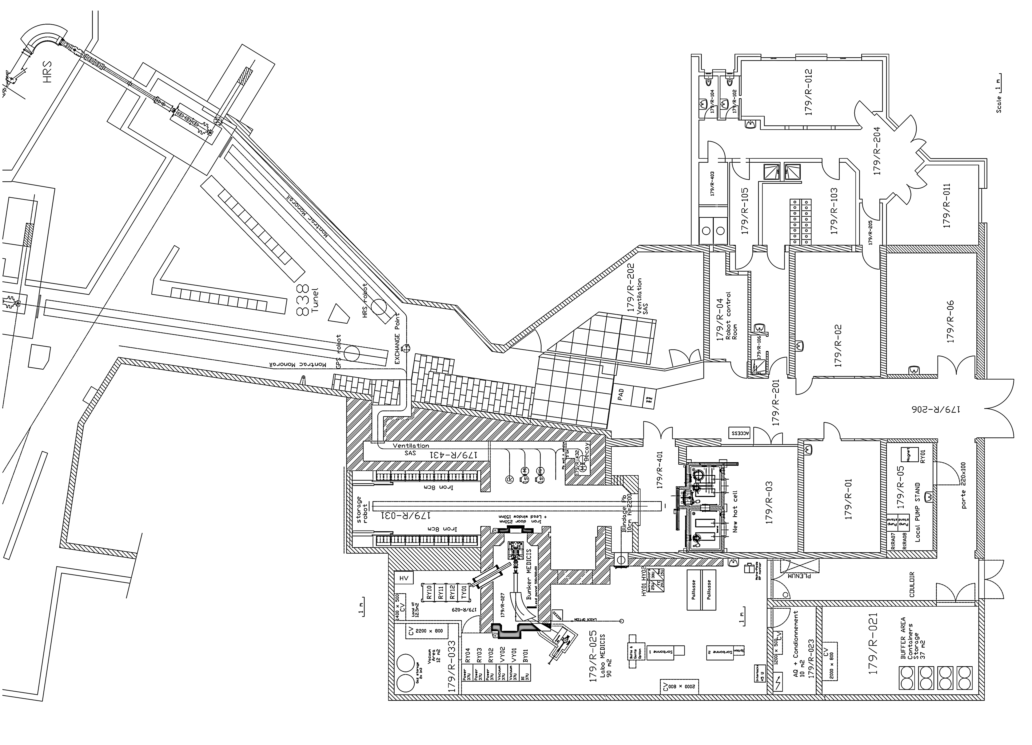
Operation
1.4 GeV Protons
HRS
Irradiation Point
Insert target
12 min – protons stopped (at HRS until 2021)
Target Area
Irradiation
Transparent to ISOLDE
Class A lab
GPS
Retrieve target
12 min – protons stopped (only at HRS)
EoB+12min
Decay
Until target reaches <1Sv/h (at 26 cm)
Decay Point
Target storage
MEDICIS/ISOLDE
Install in Frontend
Isotope Extraction
EoB+4h
MEDICIS Frontend, Separator and Collection chamber
MEDICIS
From JP Ramos

Slide 8
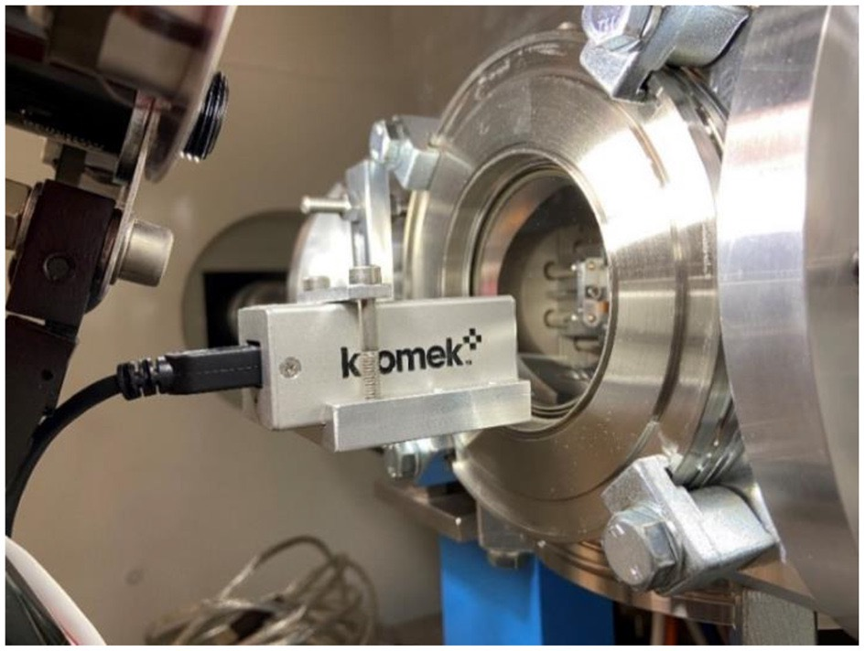
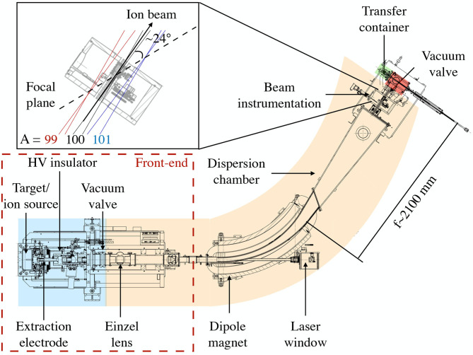
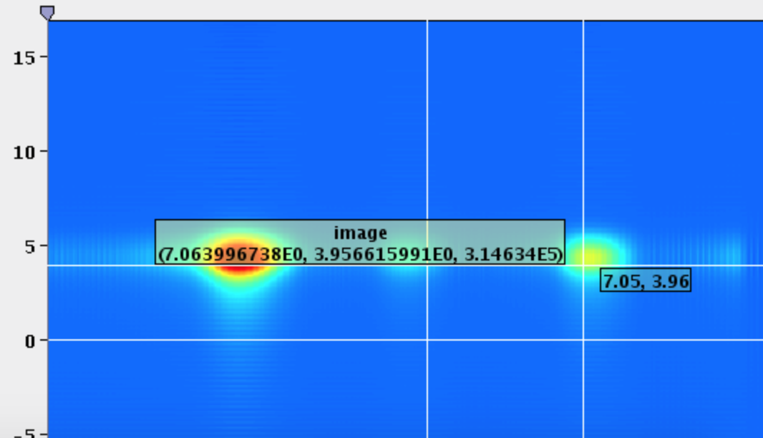
MEDICIS Isotope separator beam line
Online monitoring of
implantation
Beam profile + integrated
Ion current implantation
Mass Resolving Power ∼ 500
Y Martinez et al
10.3389/fmed.2021.689281

Slide 9
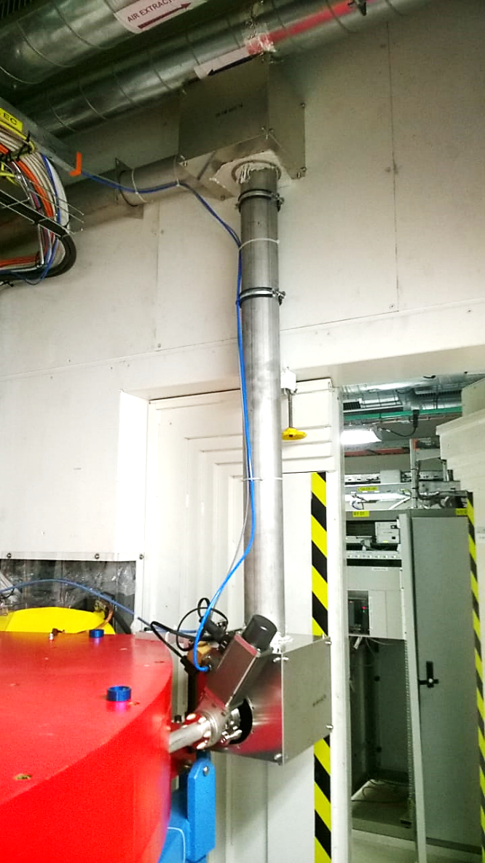
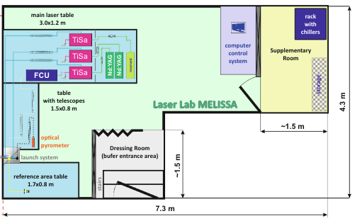
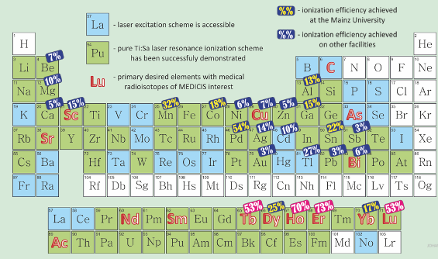

MELISSA | MEDICIS Laser Ion Source for Separator Assembly
Beam Transport
Laser Lab
Гадельшин В.М. | Лазеры-2019, Москва (03.10.2019)
Gadelshin et al,
https://doi.org/10.3389/fmed.2021.727557

Slide 10
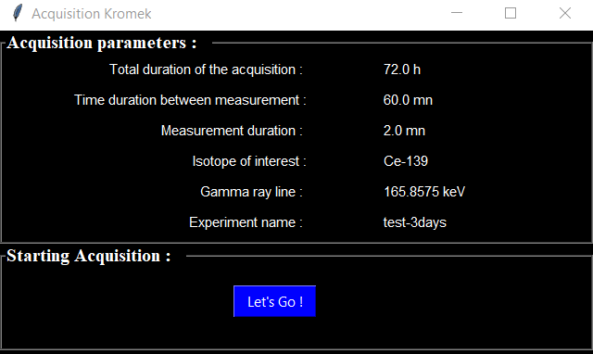
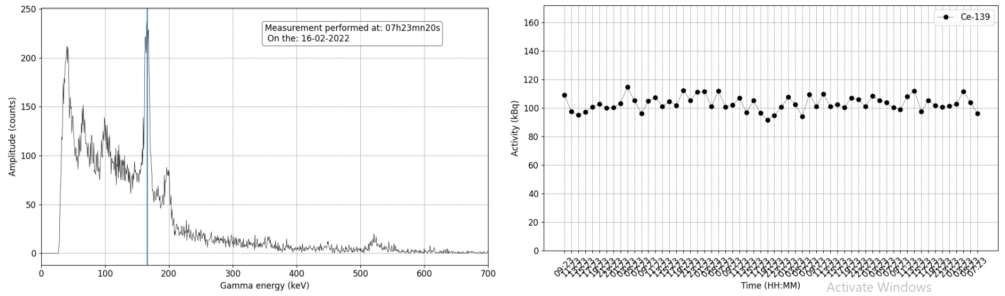
Automated activity measurement in the collection chamber with Kromek gamma-detector
Python program :
- Spectrum saving
- Activity measurement saving
- Display of spectrum and evolution
on MELISSA-status website https://melissa-status.web.cern.ch
9:30
21:30
9:30
21:30
9:30
21:30
9:30
21:30
9:30
21:30

Slide 11
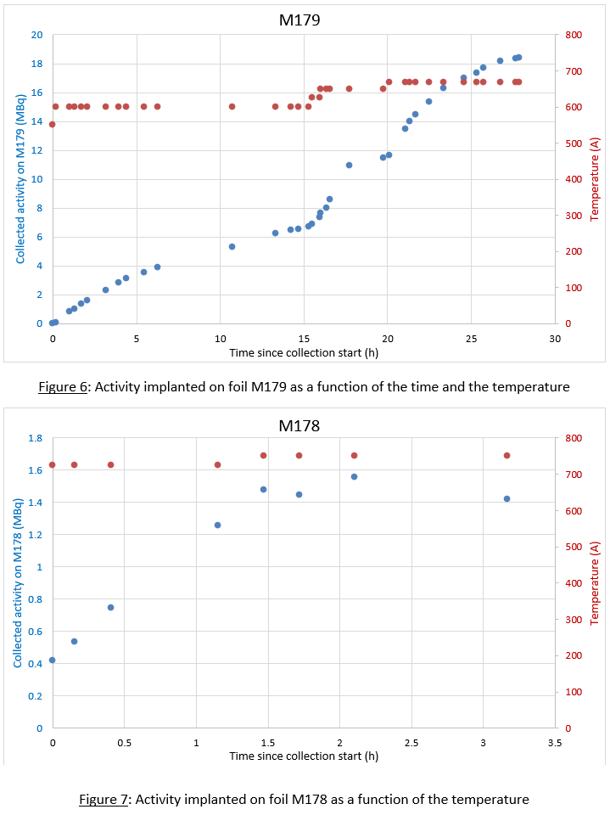
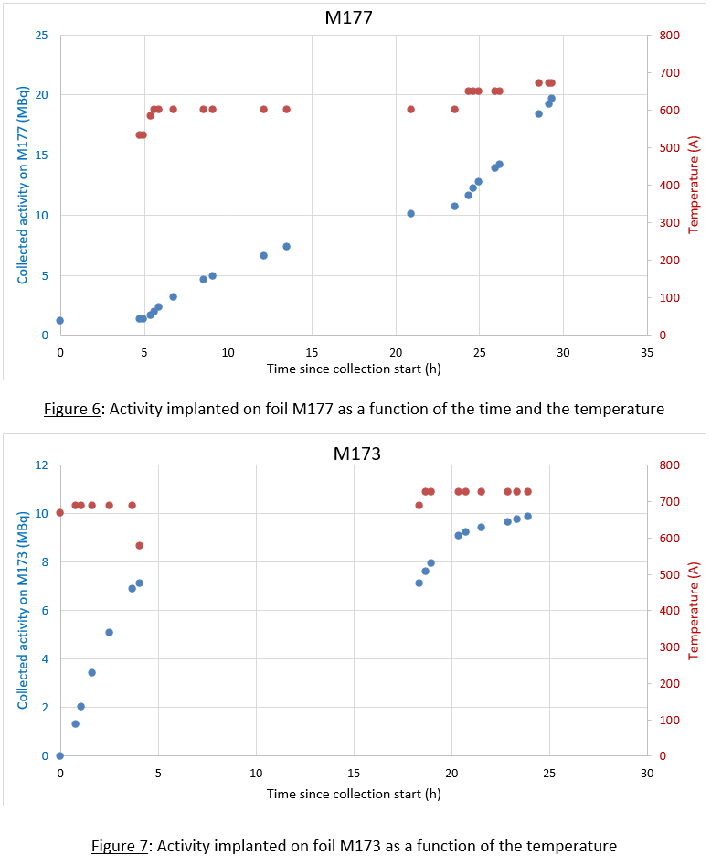



Tm-167

Slide 12



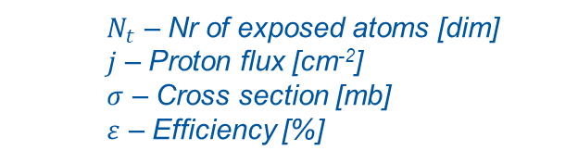
ISOLDE: Isotope Separation
Adapted from
1.4GeV Protons
Extraction electrode
Extraction optics
Mass separator
Proton
Ion Source
Target unit
+/- 8V
Transfer line
500 A
(pulsed)
Protons
20 cm
up to 2300 °C
+/- 9 V
Target heating (1 – 2kW), <~10% beam power
1000 A
1. Production
4. Ionization
$$Beam Intensity=σ.j.Νt.ε$$
$N_{t}$ – Nr of exposed atoms [dim]
$j$ – Proton flux [cm⁻²]
$σ$ – Cross section [mb]
$ε$ – Efficiency [%]
2. Diffusion
5. Mass Separation
3. Effusion
6. Transport
$$ε={ε_{diff}ε}_{eff}{ε_{is}ε_{sep}ε}_{trans}$$

Slide 13
People involved in Operation (as at start last year)

Slide 14
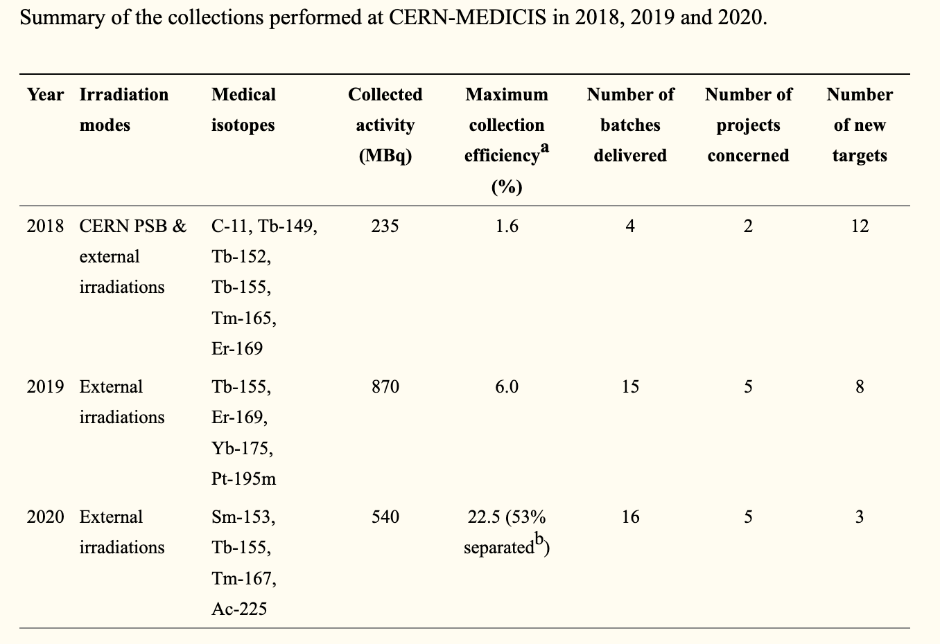
Cases of Tb-155 and Yb-175
In 2020:
Tb-155 separation efficiency reached 6%
From cyclotron-produced nat-Gd target
Tb-155/156>99.95% (Activity)
In 2021, >500MBq single batch collection,
>35% collection efficiency for Yb-175
For Ta foil target irradiated Tb-155
not high sep efficiencies reached in 2021
C. Duchemin et al., 10.3389/fmed.2021.693682

Slide 15
Overview of collections performed in 2021

Slide 16
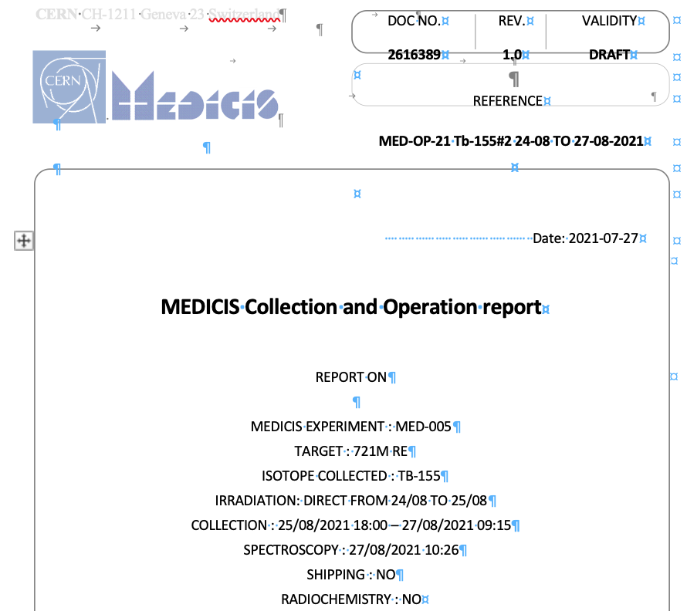
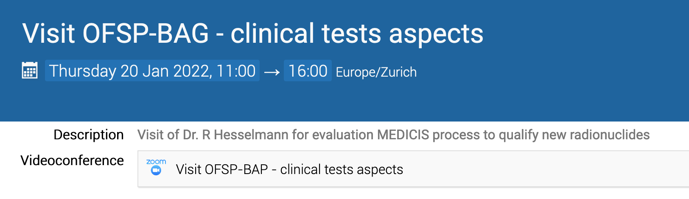
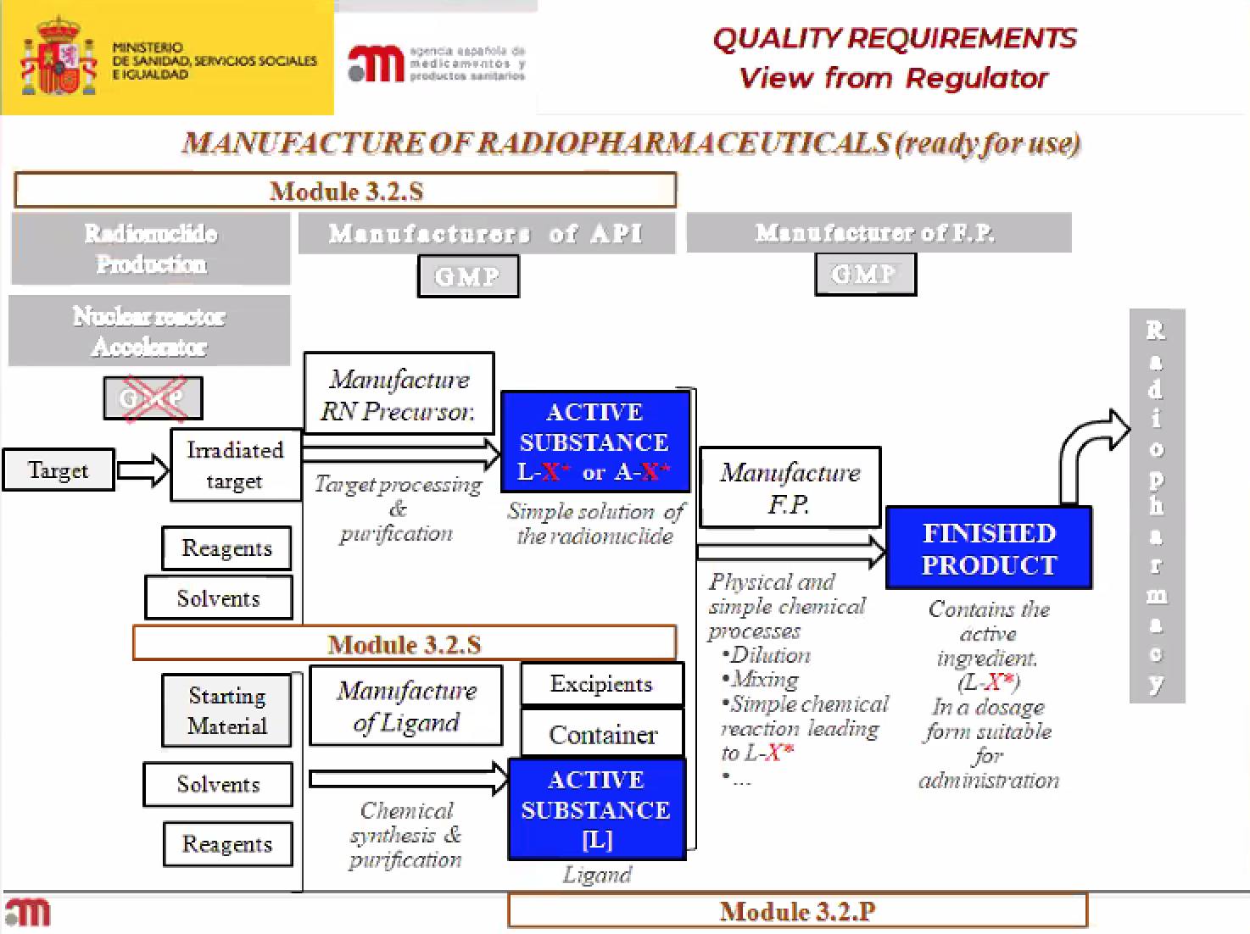
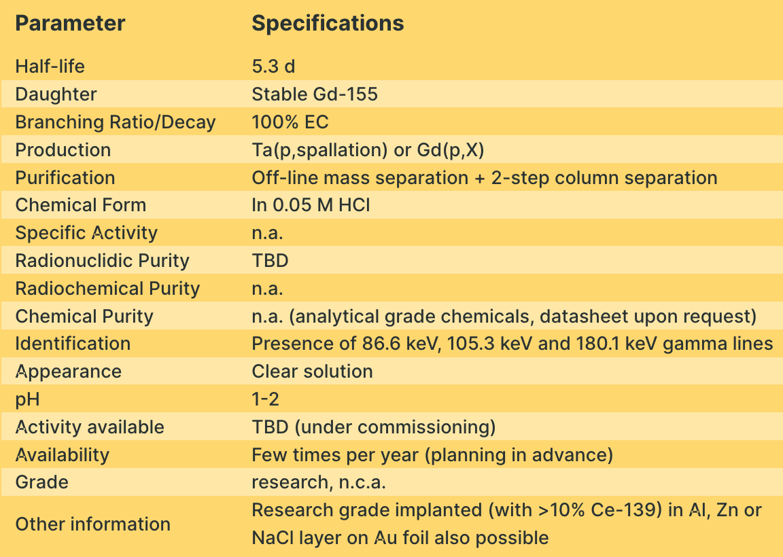
Status of traceability in 2021
Could we use this for Monitoring
& Towards qualification for medical isotope provision

Slide 17
Parameters followed to monitor the facility
Towards
Key performance
Indicators
To be completed
With ALARA
optimization
Radioisotopes have finite T1/2
(hours → days) !!

Slide 18
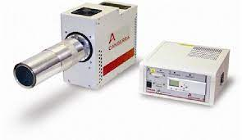
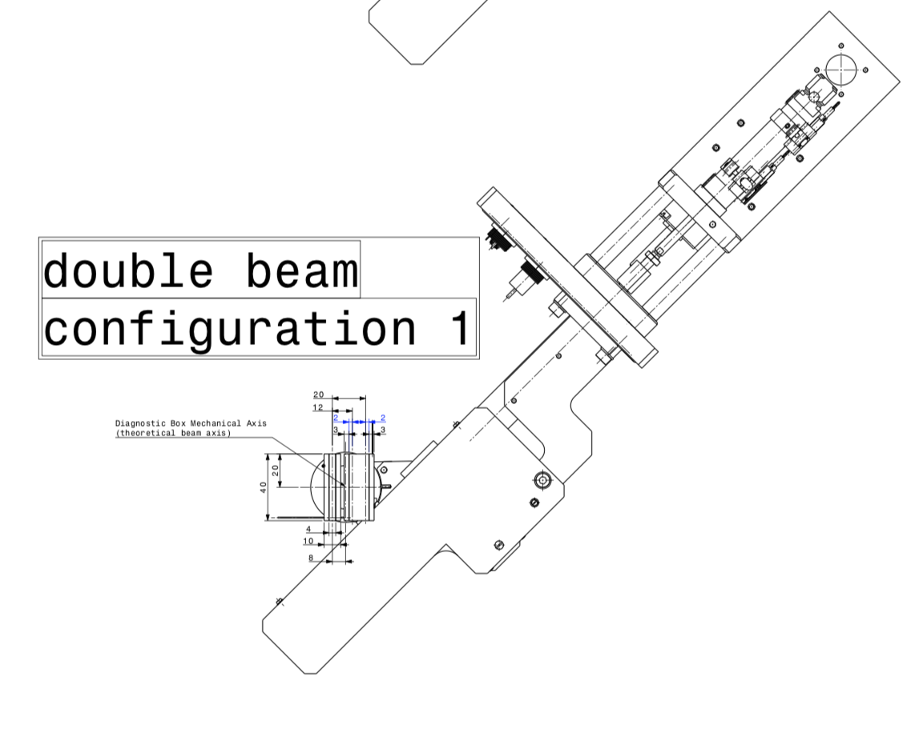
Already in the pipeline for 2022 – March is for commissioning/tests
Gamma detector for spectro
Work on some simple modelling of release
From existing data @ MEDICIS
Compare with experimental data
(J-Parc/ G Beyer)
theoretical data from Eichler
Not fully with Kromek online
Monitoring
Reduced sputerring
Not ready before summer

