Slide 1
Quench Antenna Developments at Fermilab
J. DiMarco
28Apr2022

Slide 2
Introduction – Quench Antennas at Fermilab:
A quench developing in a superconducting magnet causes distortion in the local magnetic field from current redistributions and/or motions in the cable.
These small changes in field can be detected by a stationary inductive pick-up loop of suitable sensitivity.
Technique to detect quenches using pick-up coils first realized at CERN (D. Leroy, J. Krzywinski, V. Remondino, L. Walckiers, and R. Wolf, “Quench observation in LHC superconducting one meter long dipole models by field perturbation measurements”, IEEE Trans. Appl. Sup., Vol. 3 No. 1, 1993.)
“Quench Antennas” were designated as such, and the analysis/localization technique further developed, at the SSC Laboratory (T. Ogitsu, A. Devred, and Kim, K. Quench antenna for superconducting particle accelerator magnets. United States: N. p., 1993. Web. doi:10.2172/91952.)
Fermilab used Quench Antennas in the series production of quadrupole magnets for the LHC IR in 2001, where voltage tap instrumentation was limited to avoid cost and complication. These were of the same type as developed for SSC dipoles, but appropriate to quadrupoles. (M. A. Tartaglia et al., “Quench Antenna Studies of Mechanical and Quench Performance in Fermilab Interaction Region Quadrupoles for LHC”, IEEE Trans. Appl. Supercond., 16:441-444, 2006.)
Thin, credit-card-sized, PCBs designed as magnetic measurement probes were used as quench antennas during various model magnet developments from 2007 to 2015. (e.g. R. Bossert, et al., "Fabrication and Test of 4m Long Nb3Sn Quadrupole Coil made of RRP-114/127 strand," (LQM01), Published in AIP Conf. Proc. 1434 (2011) 869-876.)

Slide 3
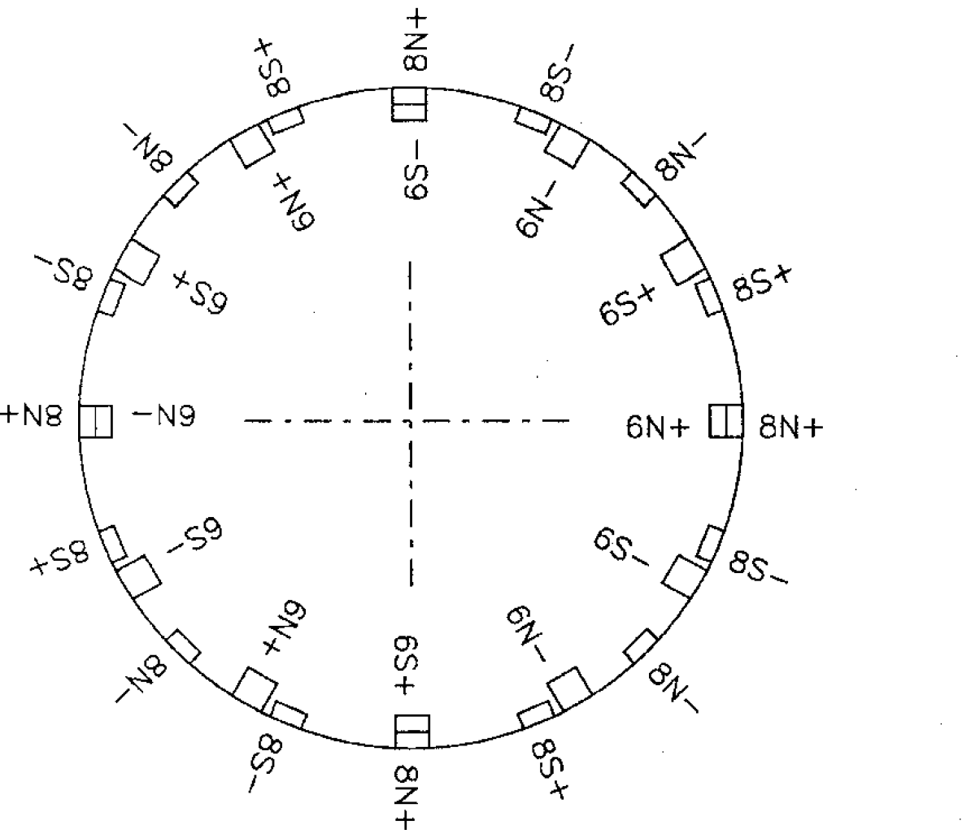
Besides the quench induced changes, power supply ripple or fluctuations can cause substantial field changes which can obscure the QA signal - the effects of these field fluctuations need to be suppressed, or ‘bucked’ as much as possible (as for magnetic measurement probes), by using a combination of loops that yield a net low sensitivity to quadrupole and dipole fields (DQ-bucked antennas).
Combination of normal and skew sextupole and octupole windings shown at right, buck the quadrupole field and allow for localization of quench (this same arrangement was used for the 2001 LHC IR quads fabricated at Fermilab)
(Ogitsu, et al., Quench Observation Using Quench Antennas on RHIC IR Quadrupole Magnets, IEEE Trans. Magnetics, Vol. 32 No. 4, July 1996)

Slide 4
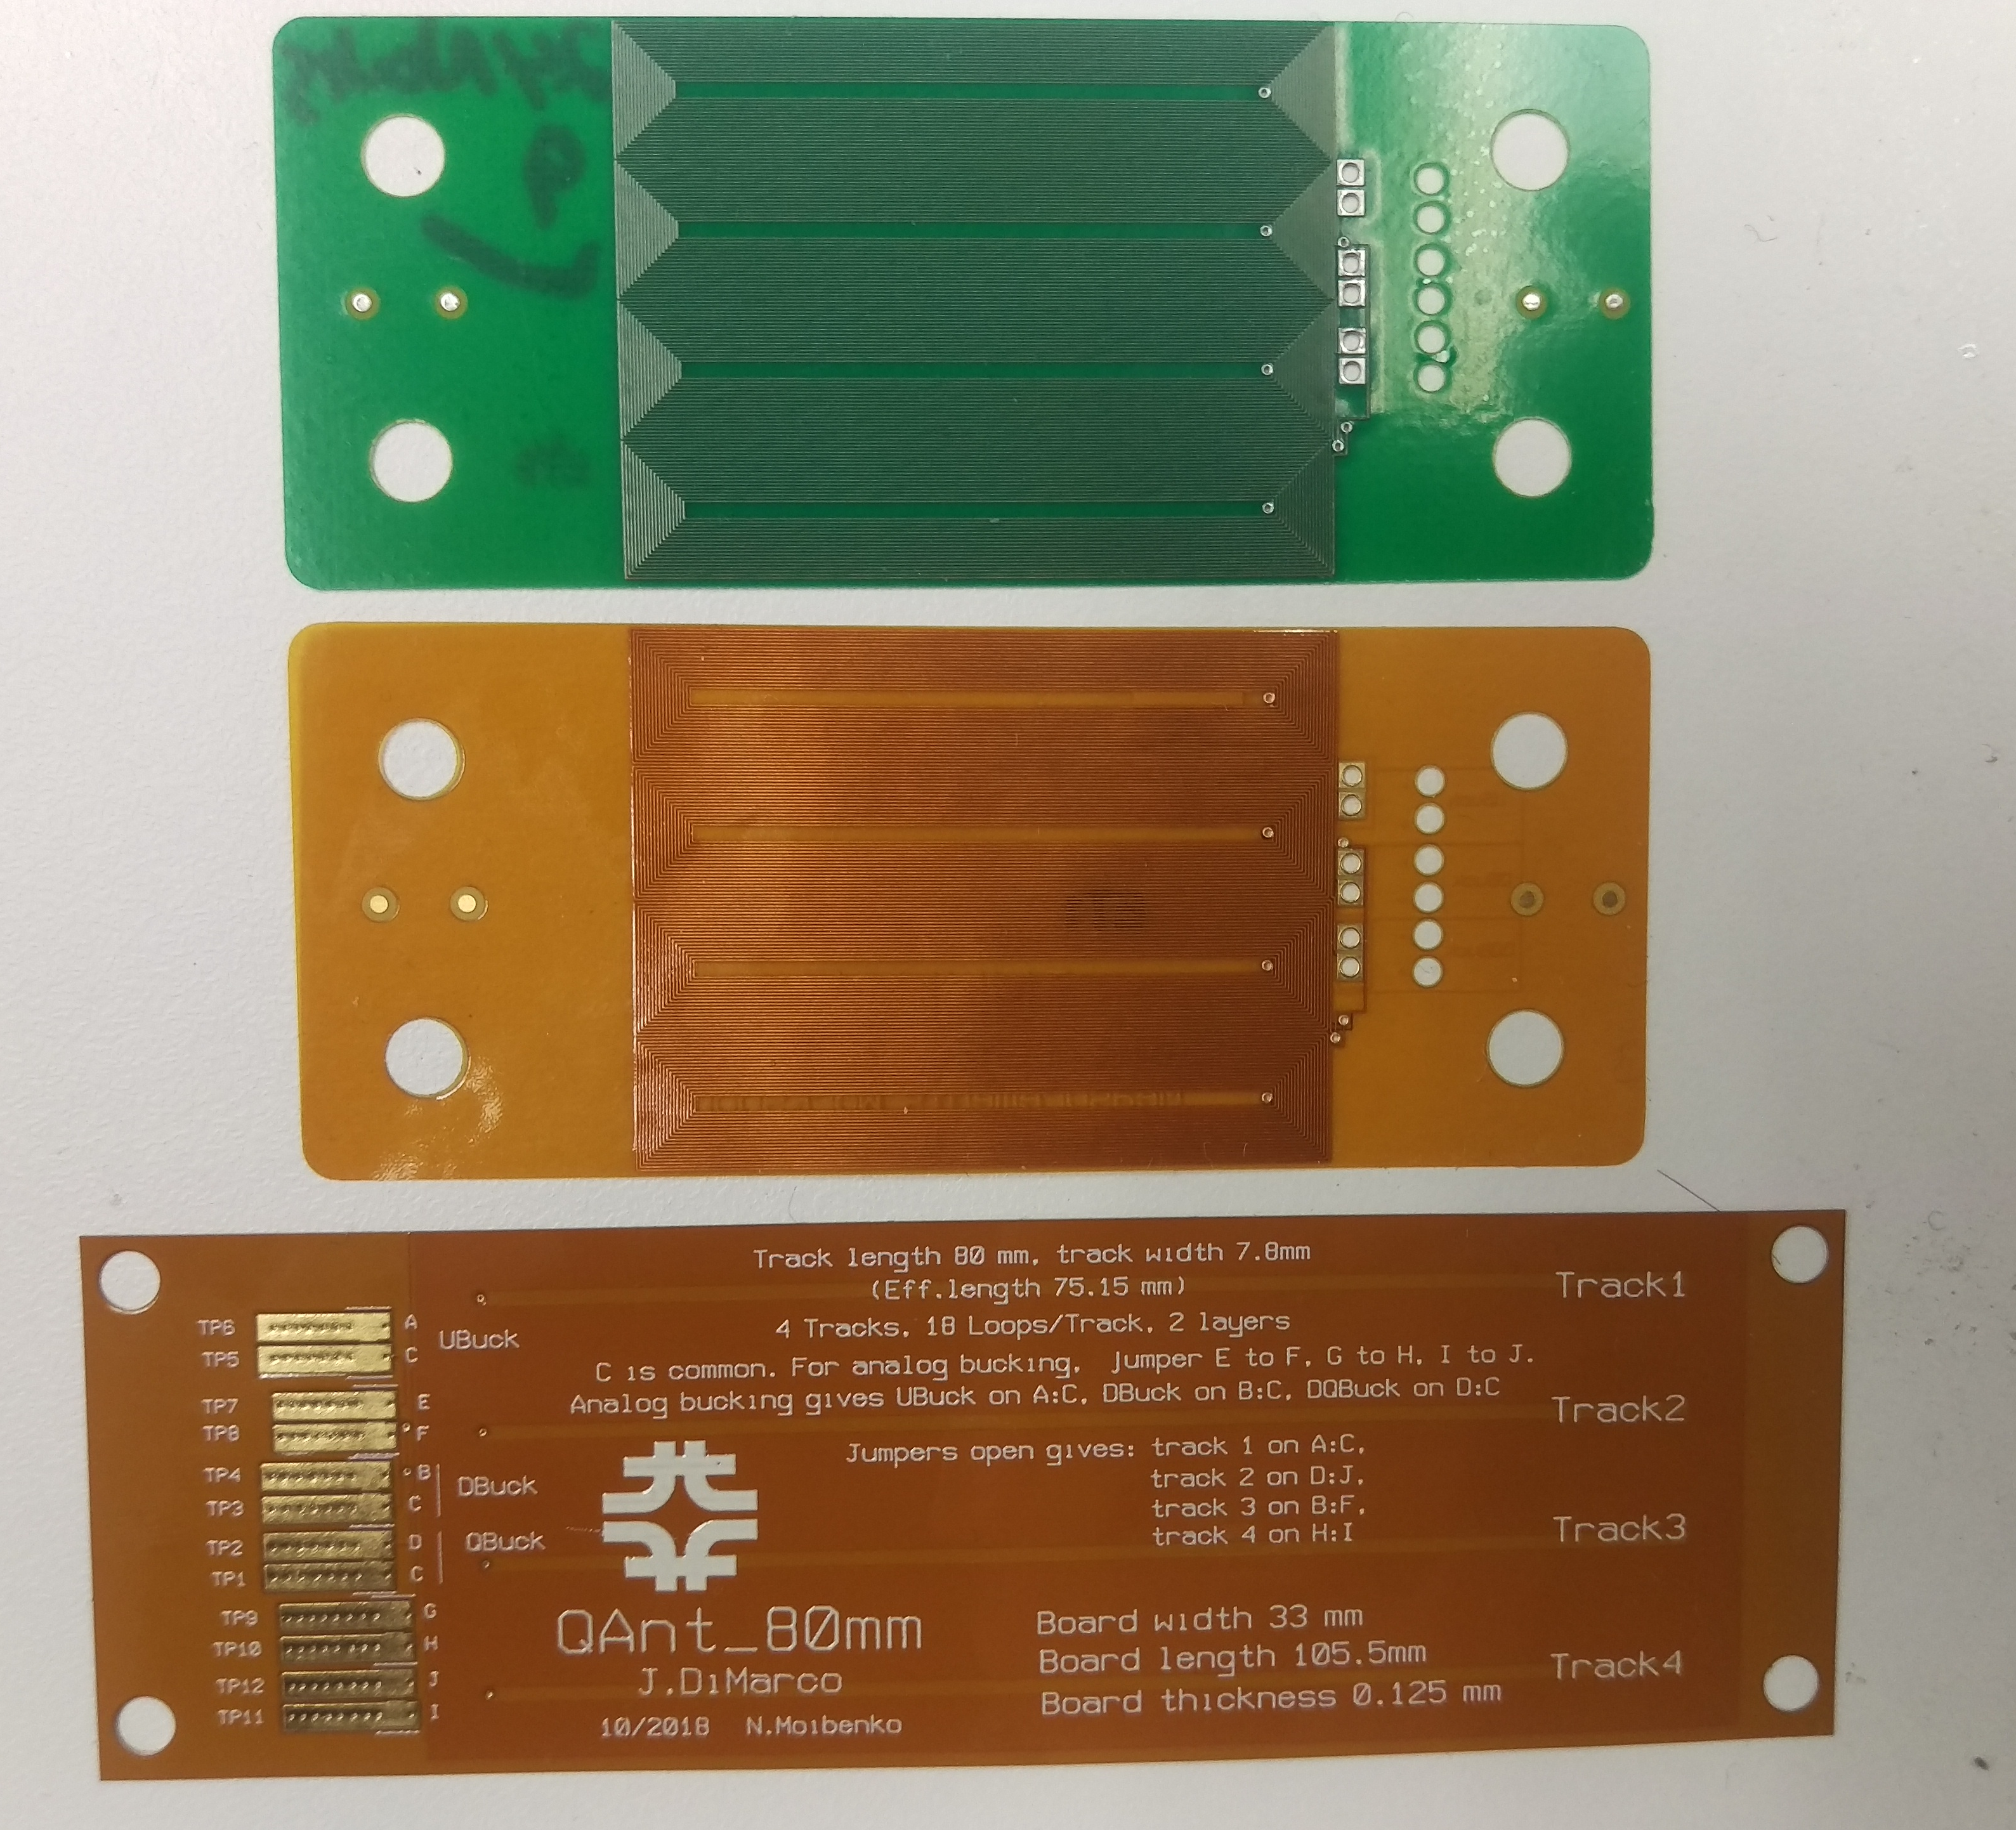
After IR quads program, and successful use of PCB-style magnetic measurement probes, started developing flex circuits with the idea of eventually building them into magnets, even between layers (less invasive, less risk than installing voltage taps)
Worked together with Stoyan Stoynev for new tests/ideas.
Tests in MQXFS1 and with the QA wrapped around the cold OD of the anticryostat gave encouraging results with low noise.
Pressure tests – 200MPa, no problem!
But the DQ bucking present on the PCB board was designed to be used in a plane - what was the best way to apply flex PCB to QA development?
But first - new quench antenna needed for Nb3Sn full-length quads for LHC IR quads built by US HiLumi AUP
Original rigid version
Original flex version
2018 flex version
80 mm track length (105 mm overall)
Track width 7.8 mm, overall width 33 mm
Thickness 0.2 mm
4 loops of 18 turns, 2 layers
Can be used as 4 individual tracks, or ‘Jumpers’ can be connected to combine loops so that signals ‘buck’ dipole or dipole + quadrupole main fields.
Quench detection trigger

Slide 5
In Fall of 2019, a Quench Antenna for MQXF production measurements with the following capabilities was proposed to be built at Fermilab with the following design criteria:
Full coverage of magnet, including ends
No ‘dead zones’
50mm nominal axial resolution (finer in some limited areas)
Ability to determine azimuthal location of quenches
The completed QA was delivered to BNL in early August 2020 in time for the MQXFA04 testing

Slide 6
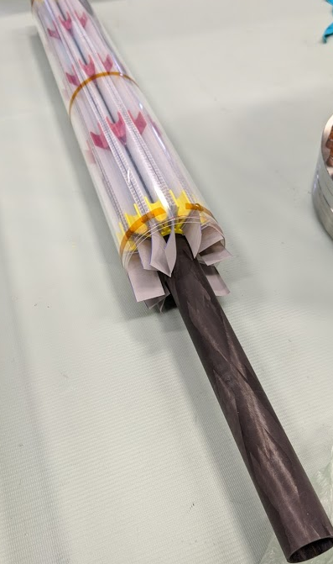
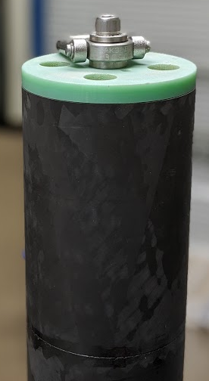
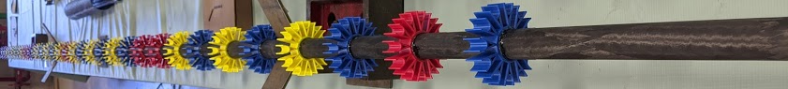
5m-long MQXFA quench antenna:
Features:
Inner carbon fiber core with ‘spider’ support assembly for radial DQ-bucked “theta antennas”
Theta antennas have corrugated plastic supports for ribbon cable
100mm-long overlapping sextupole(DQ-bucked) flex circuits overwrap the radial antennas to make up “Z-antennas”
~110 of the Z-antennas over 5m length
Outer carbon fiber shell full 5m length

Slide 7
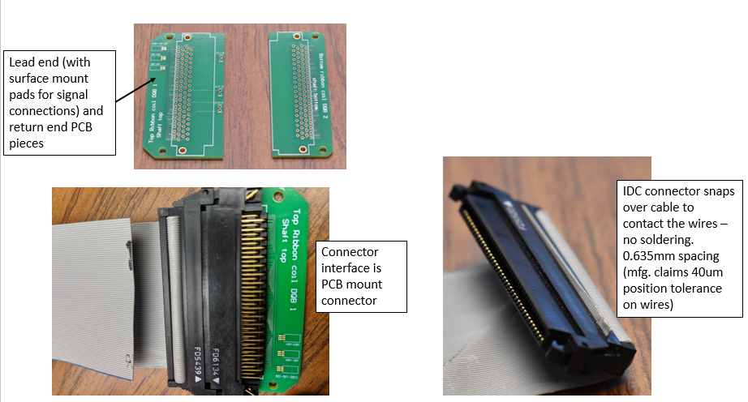
Theta (radial) antennas -
12 channels for radial probes - brought out on single 24wire, individually shielded twisted pair cable
40 wire, 25mm wide ribbon cable (3M 3756/40)
PCBs at each end create DQ-bucked loops from the ribbon cable

Slide 8
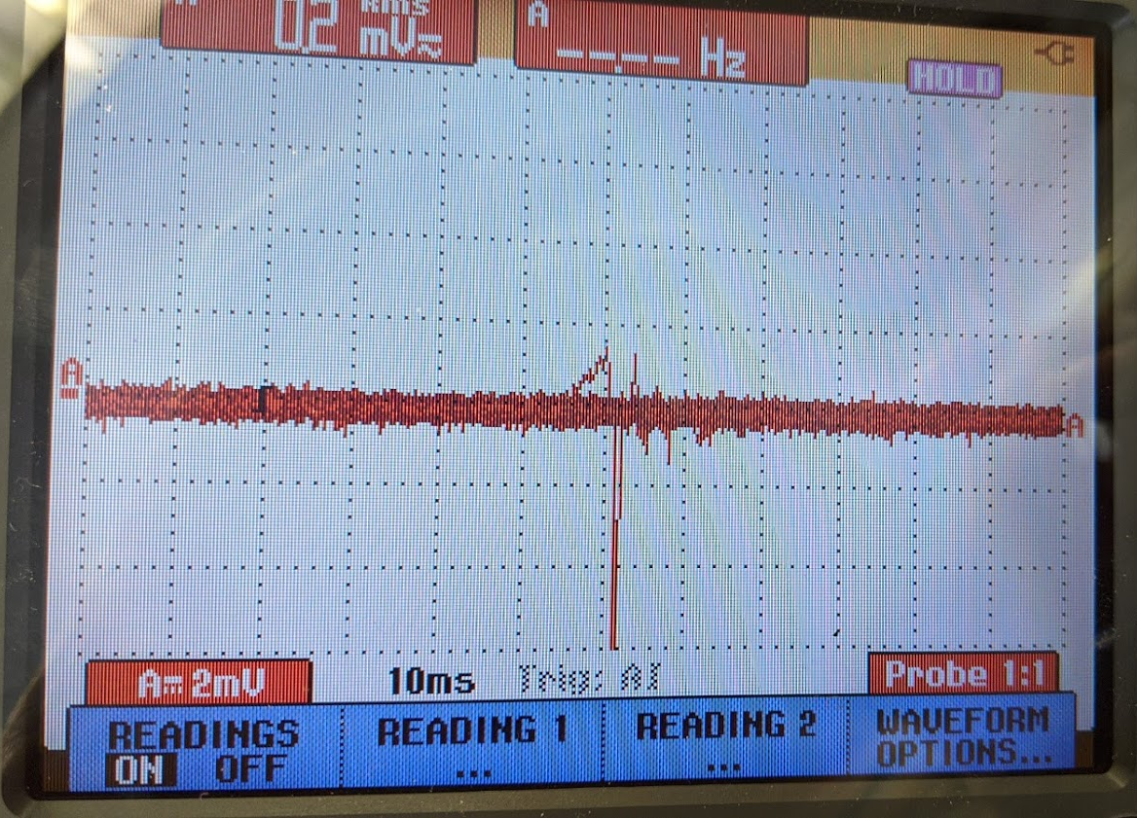
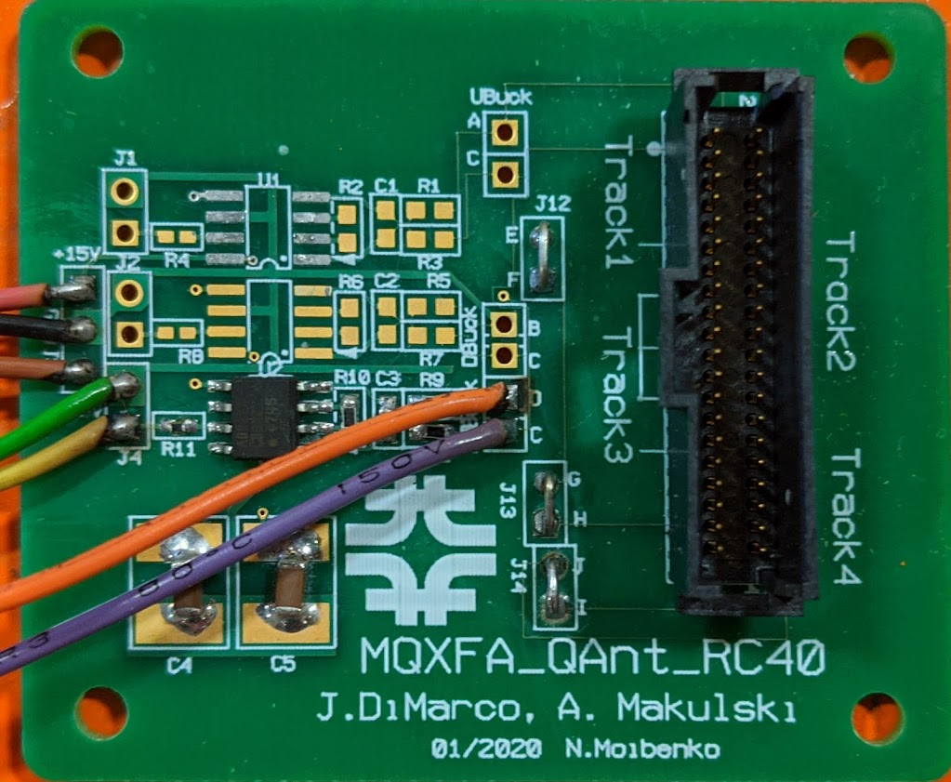
Theta antennas (cont.):
To compensate for the weak sensitivity of few (5) turns available from ribbon cable, the TQA channels are outfitted with 1000x gain amplifiers (based on AD8221BR)
Test for circuit functionality with dB/dt from permanent magnet ➔

Slide 9
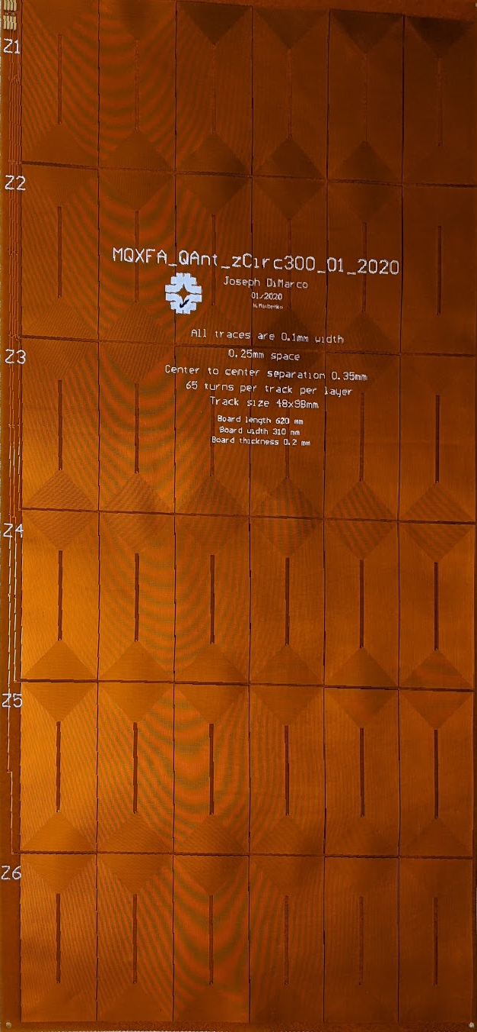
Z antennas:
Single panel has 6 ‘sextupole’ circuits Z1-Z6 – wrapped around the theta antennas and ‘spider’ supports
Each ‘ZQA’ is composed of a 6-fold set of ‘racetrack’ windings, with each winding connected in series and alternating in chirality with its neighbor, to form a single circuit (shown going left to right in photo)
Each racetrack has 132 turns (66 per layer) and is 100 mm long and 50 mm wide.

Slide 10
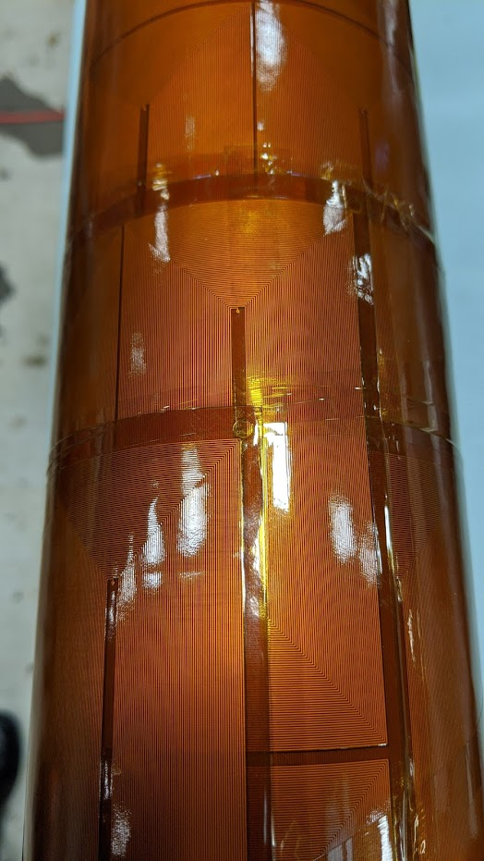
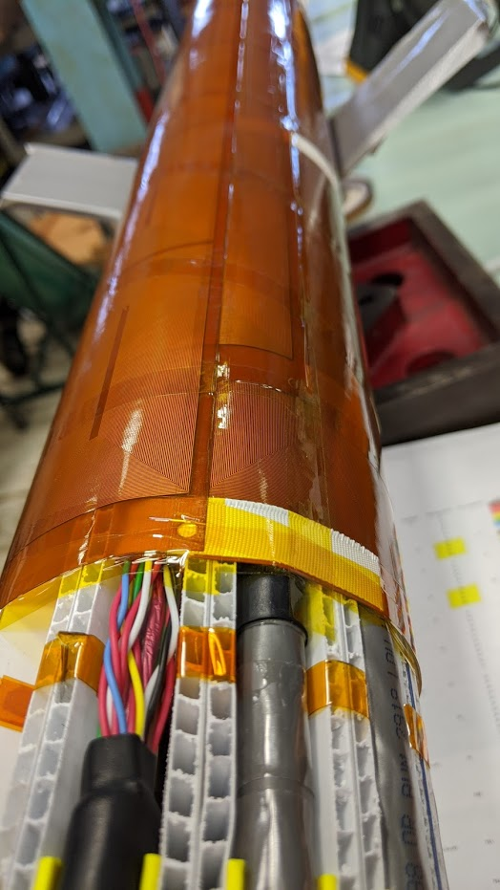
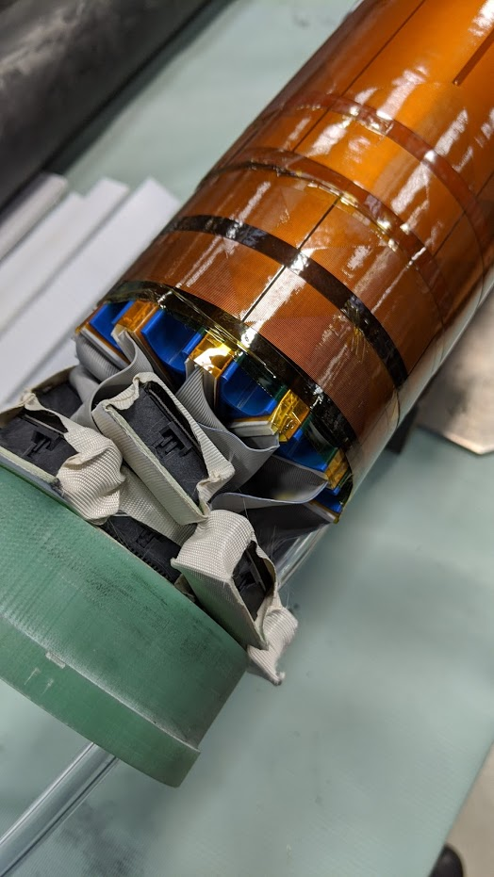
Overlapping, dipole and quadrupole bucked (DQBuck) circuits, staggered so there are no ‘dead zones’ in Z or angle
High density overlap region at ends for 25mm resolution
DQBuck radial circuits, sandwiched in plastic supports every 30 degrees.
NLE theta antenna terminations
Signal cables for 122 channels

Slide 11
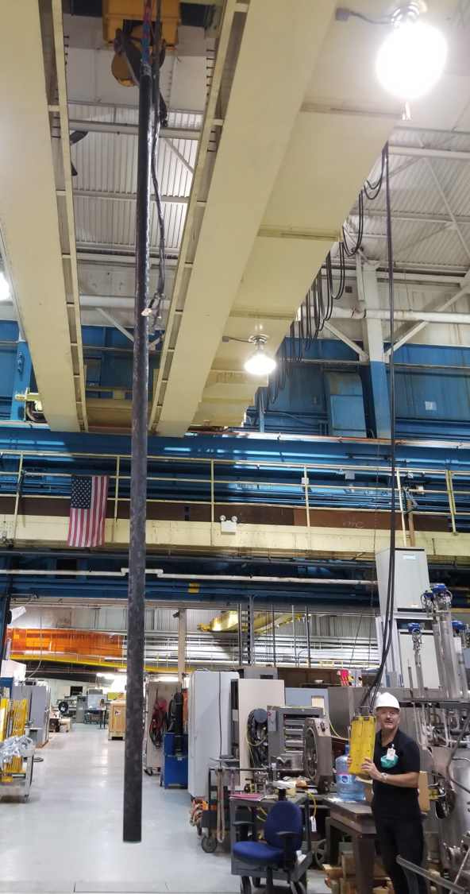
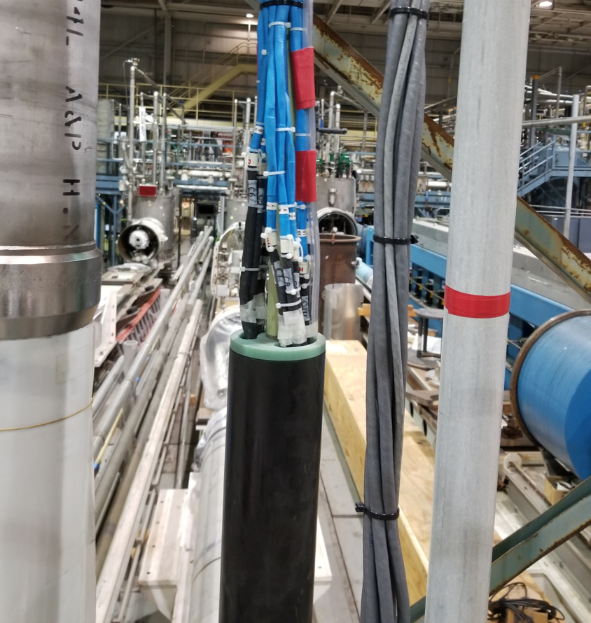
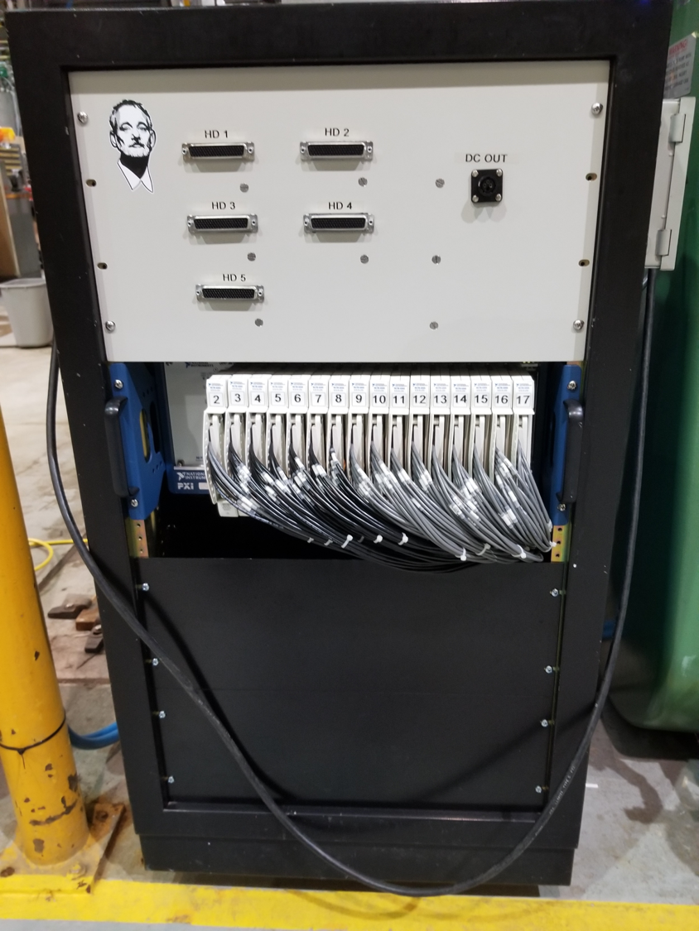
Quench antenna ready for use at BNL
Data acq. 16 bit ADCs

Slide 12
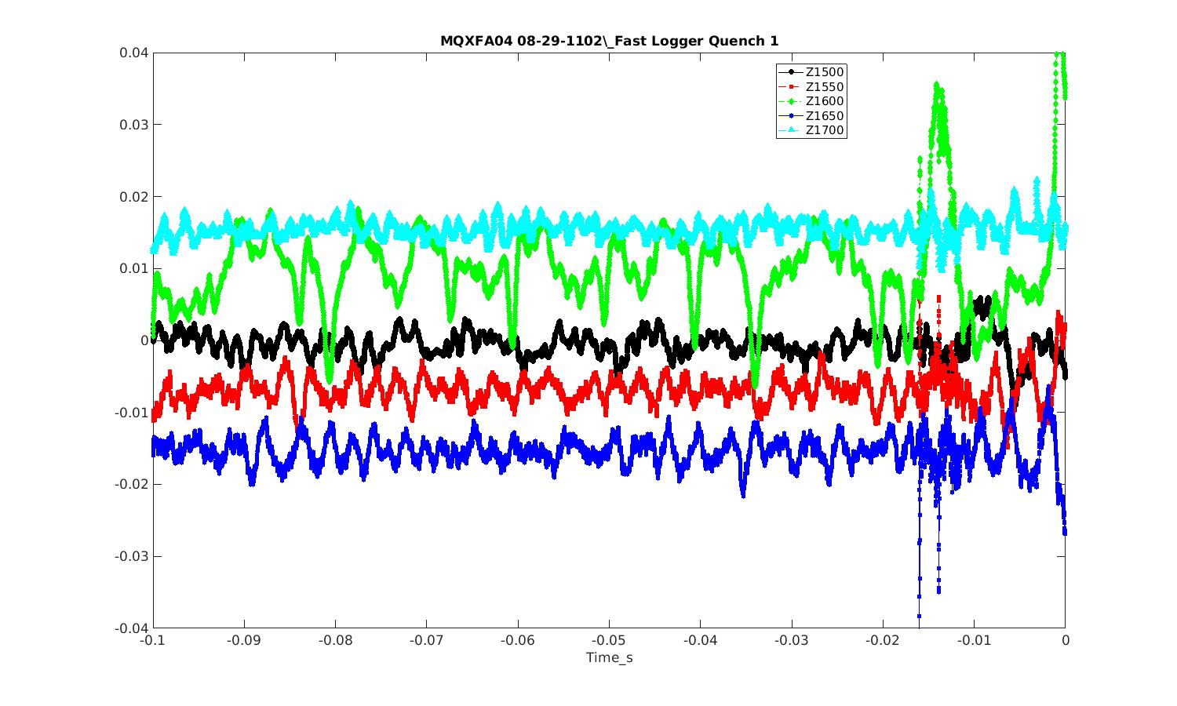
Quench location analysis usually starts with
‘raw’ voltages near quenching segment

Slide 13
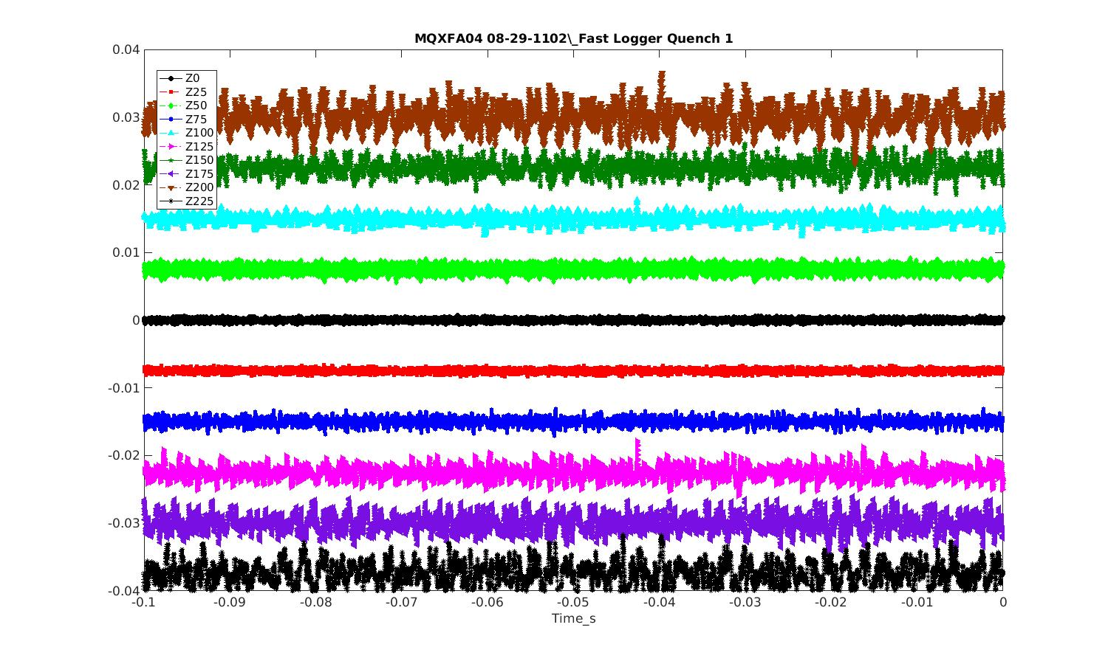
Signals look ‘noisy’, but in fact, the noise is actually low.
The qant segments that extend past the end of the magnet (Z0, Z25, etc) show very little noise.
These should be the worst case, being the channels with longest cable lengths in the antenna (non-lead end).
This suggests that the ‘noise’ seen on other channels is actually signal!

Slide 14
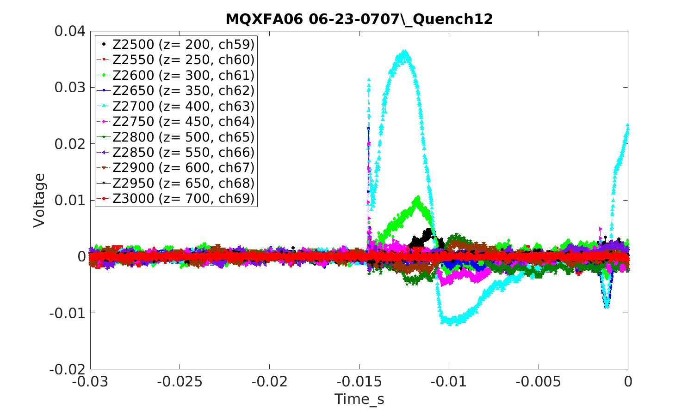
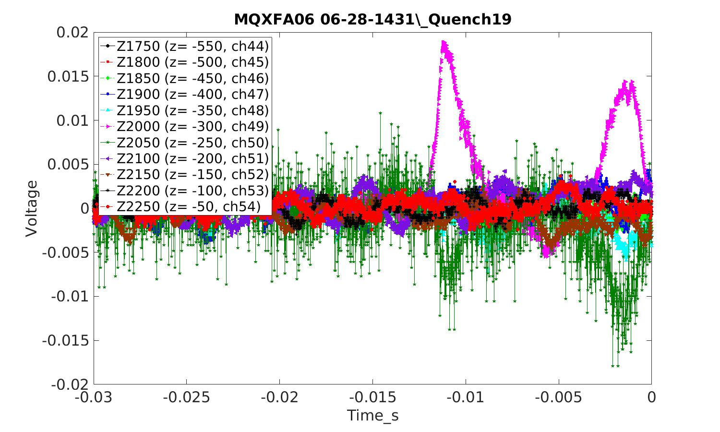
About 75% of quenches had some level of spike event at start
Some quenches had little spike activity

Slide 15
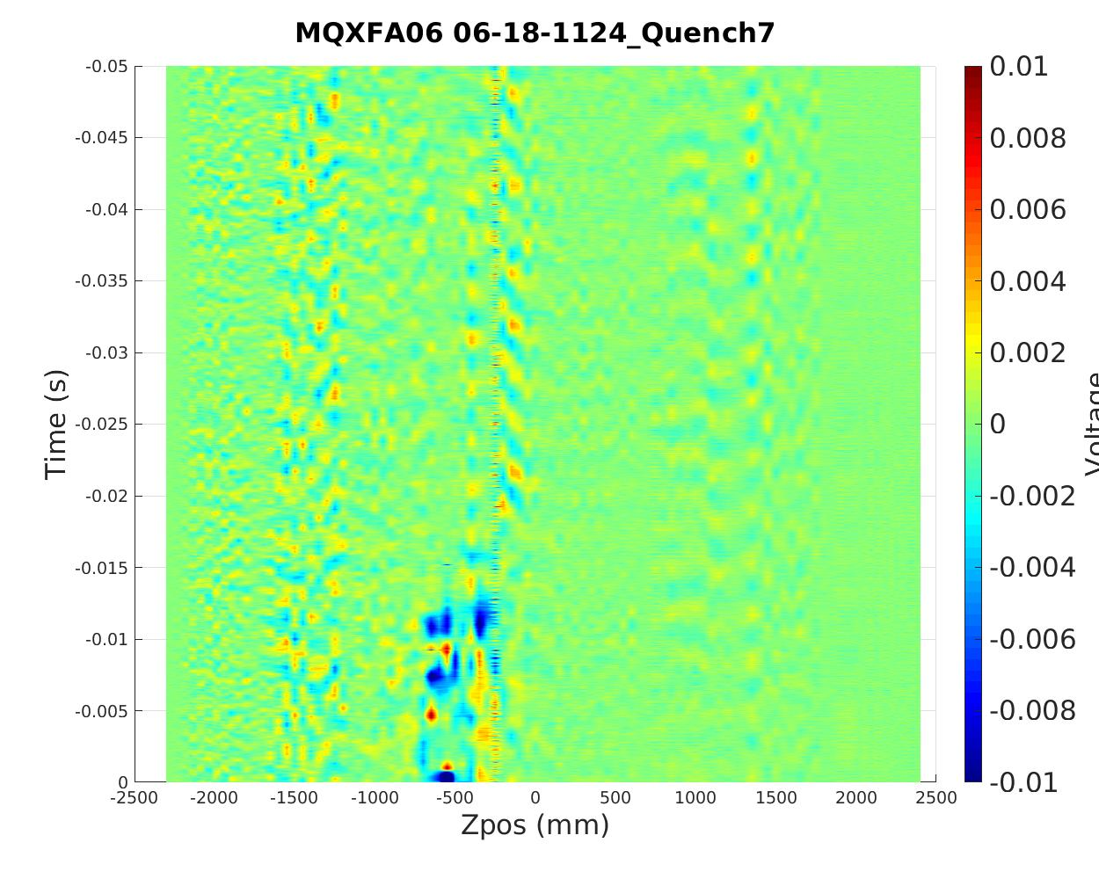
Example of antenna signals from apparent multiple quench starts near each other (within about 300mm)
Some quenches seem to show additional activity elsewhere in the magnet

Slide 16
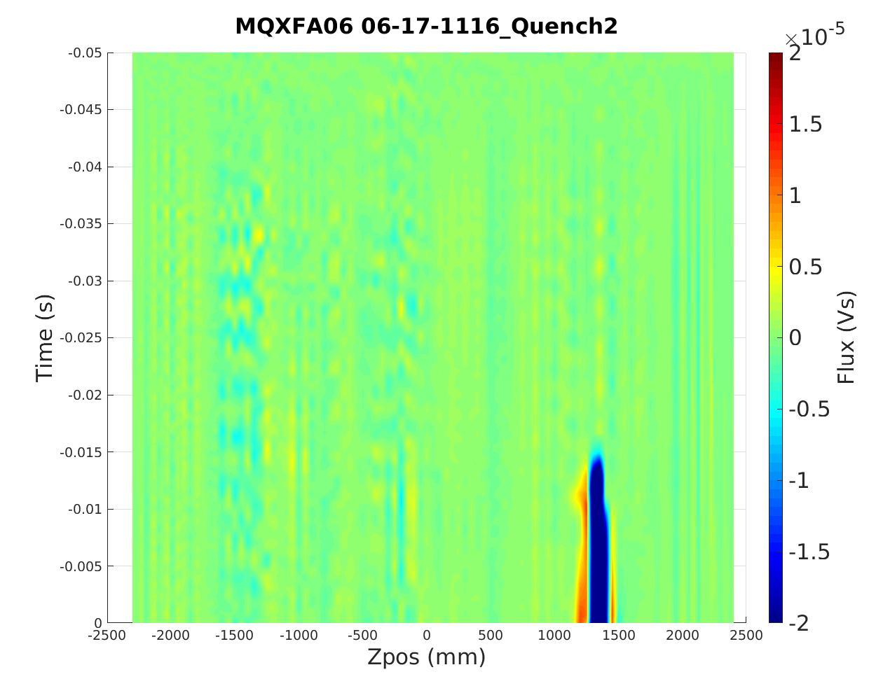
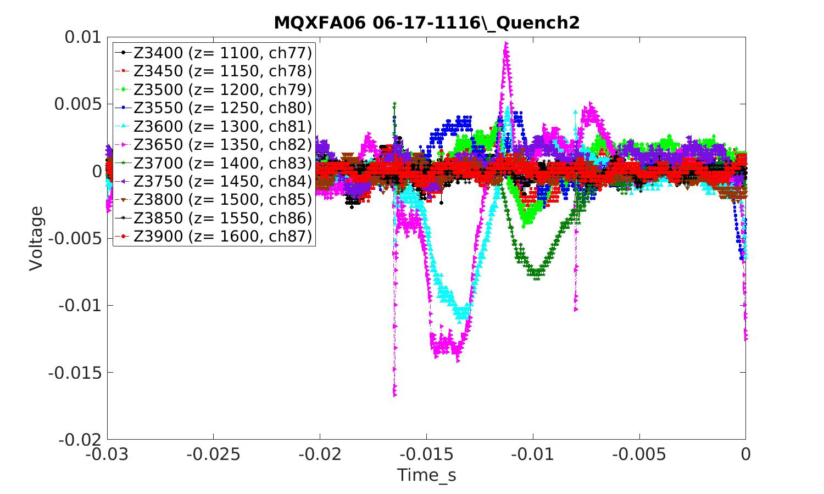
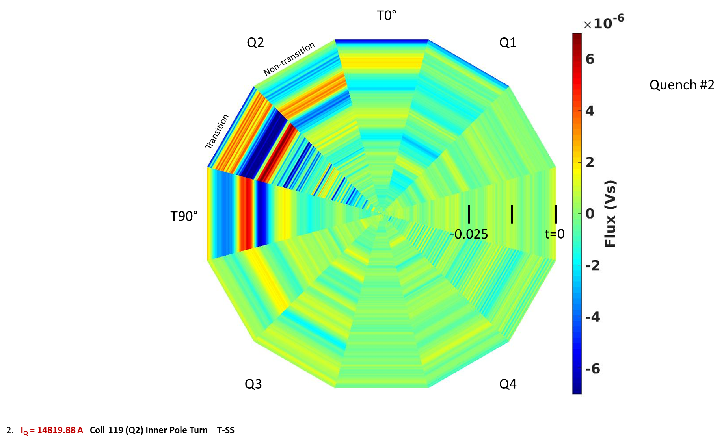
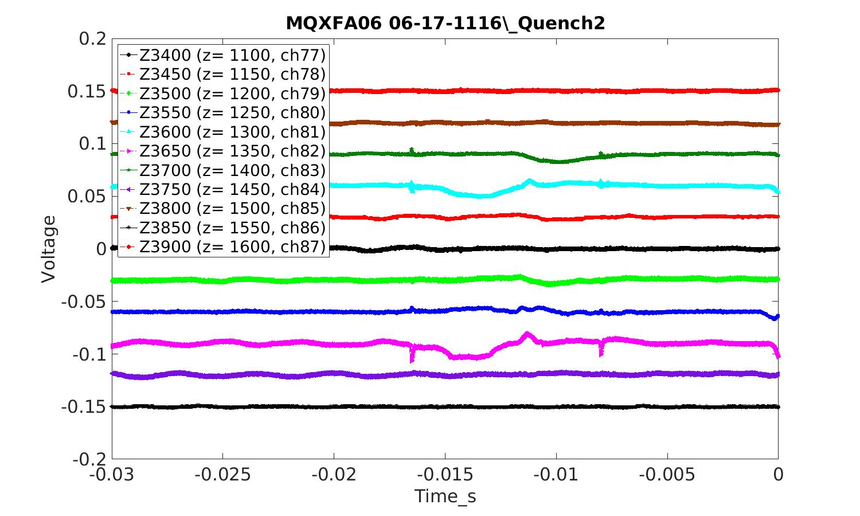
Q#2

Slide 17
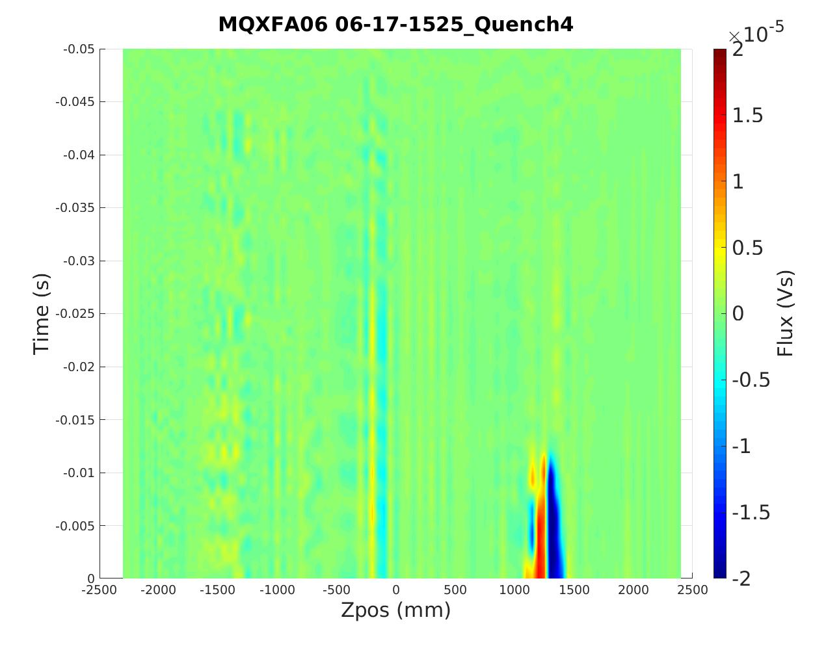
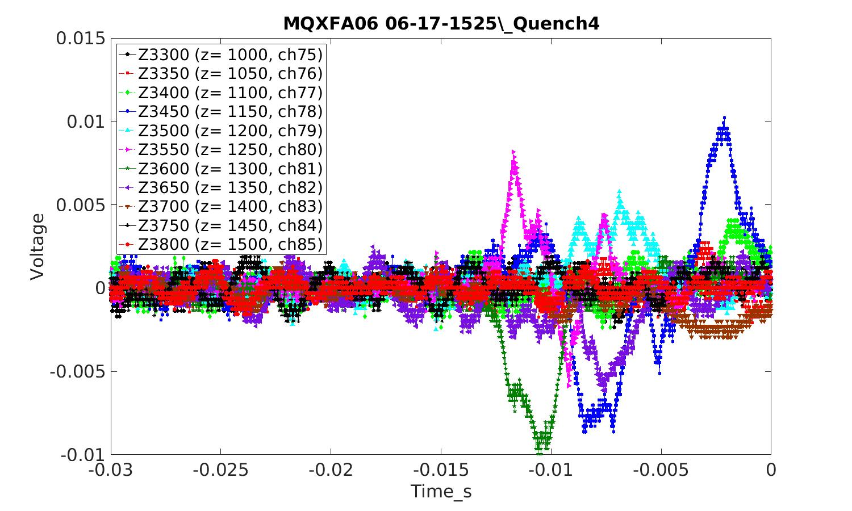
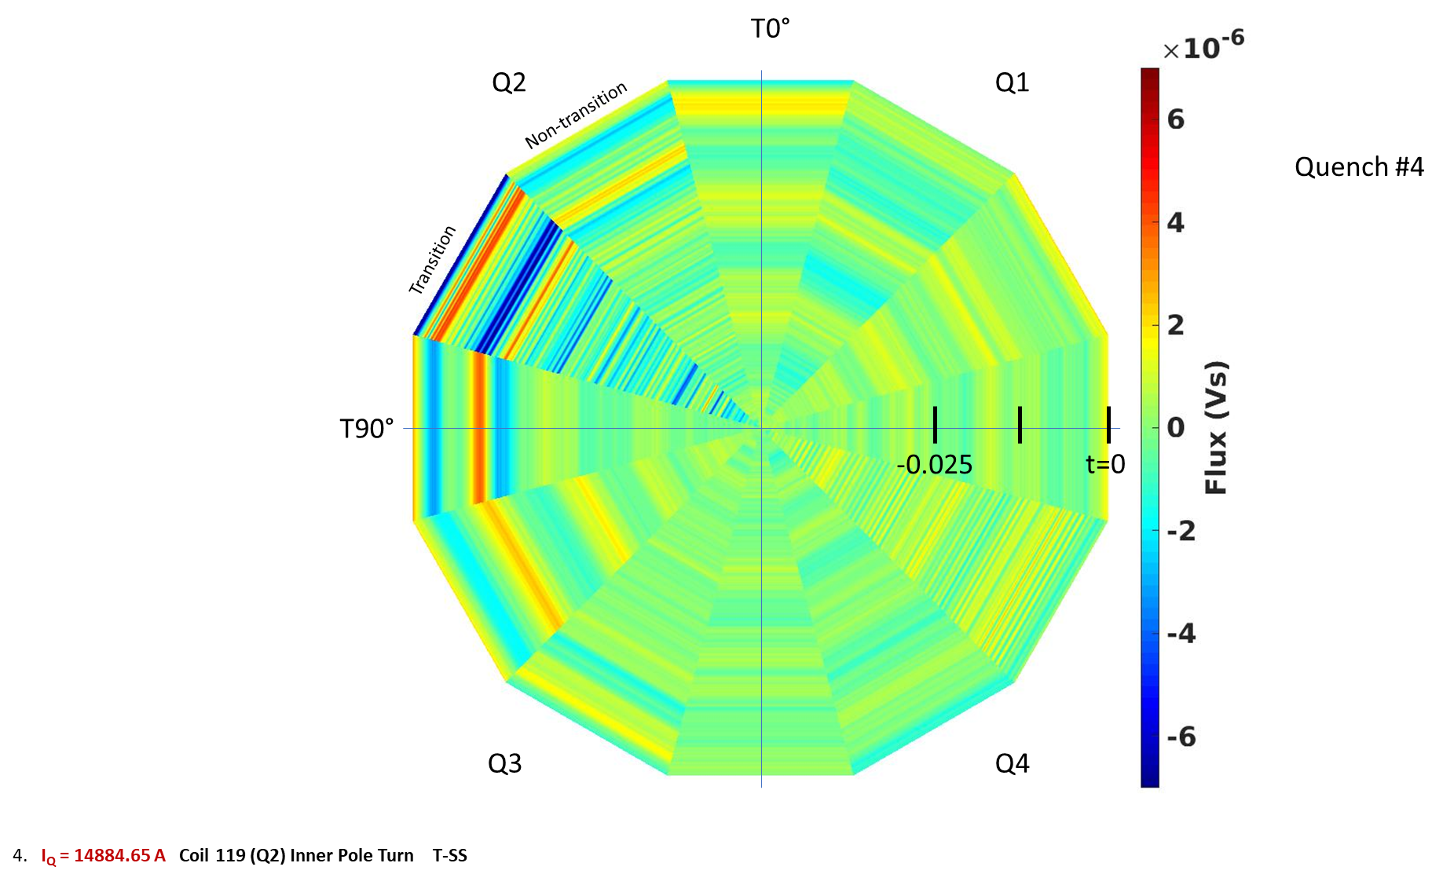
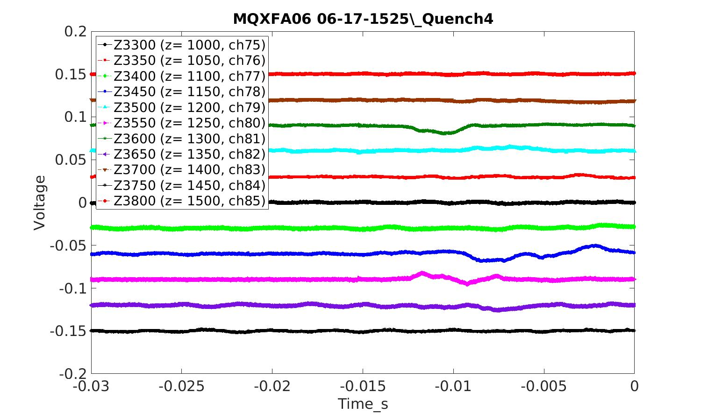
Q#4

Slide 18
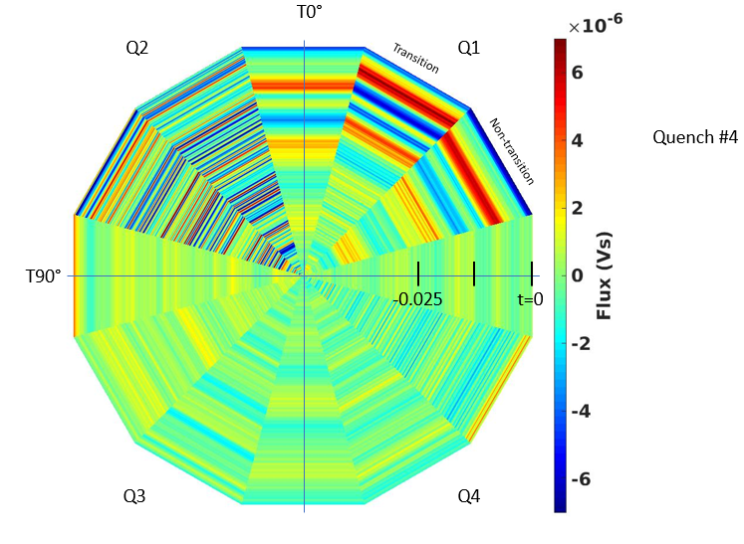
Outer coil quench example
Detected without problem
Quench #4:
This is an outer coil quench and is observed by the ZQA to be starting at Z = 450mm (note that the amplitude is fairly small).
TQA T330 in Q1 has the largest flux signals which show large amplitude at about t = -15ms. This seems a clear indication of the azimuthal location of the quench, even though this is in the Outer Coil. The location is consistent with that indicated by voltage taps - pole turn transition side of Q1. Note that the striated regions in the flux map vs time in Q2 may correspond to activity in other Z-locations, such as Z = -1500mm, and these tend to decrease in later quenches.

Slide 19
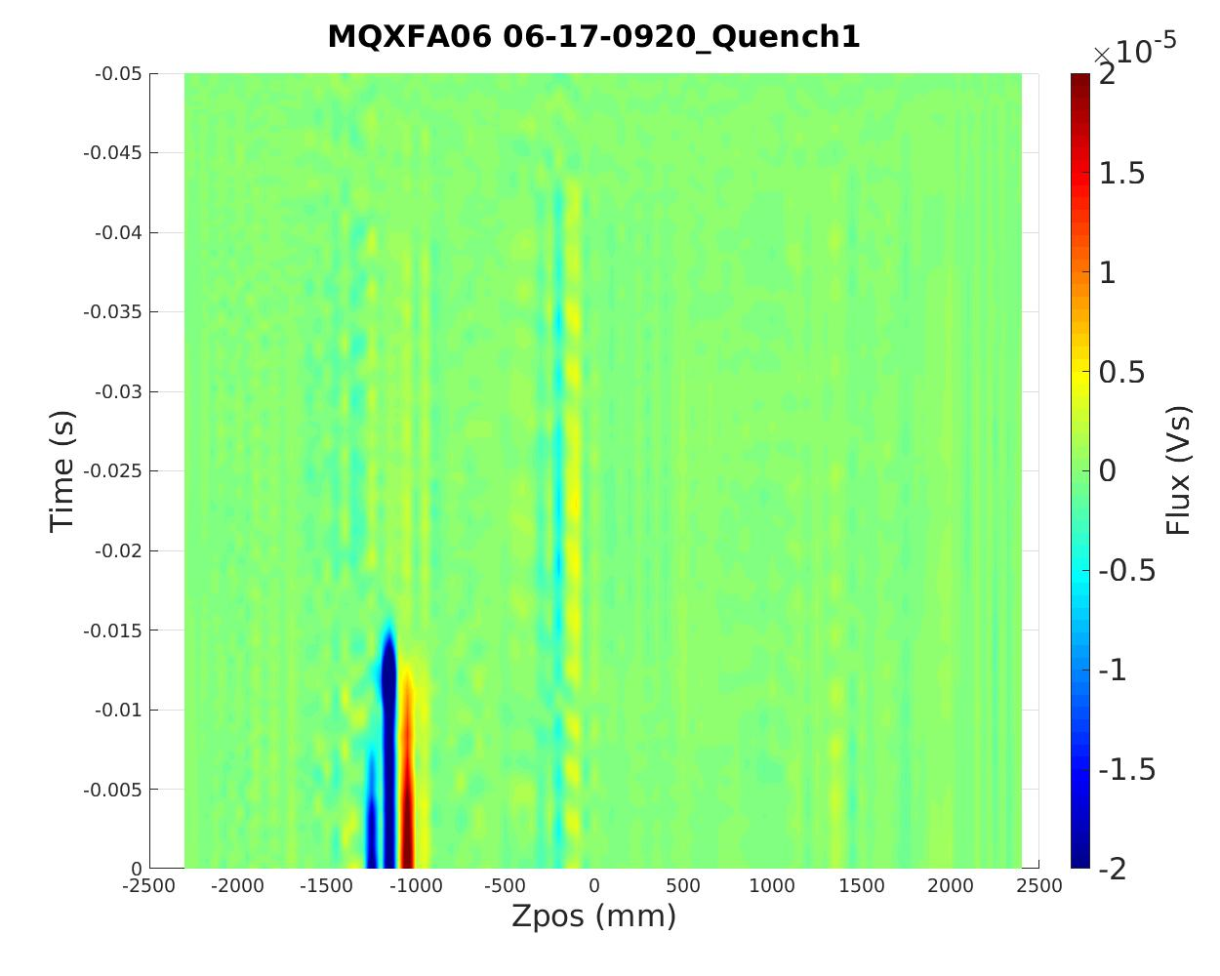
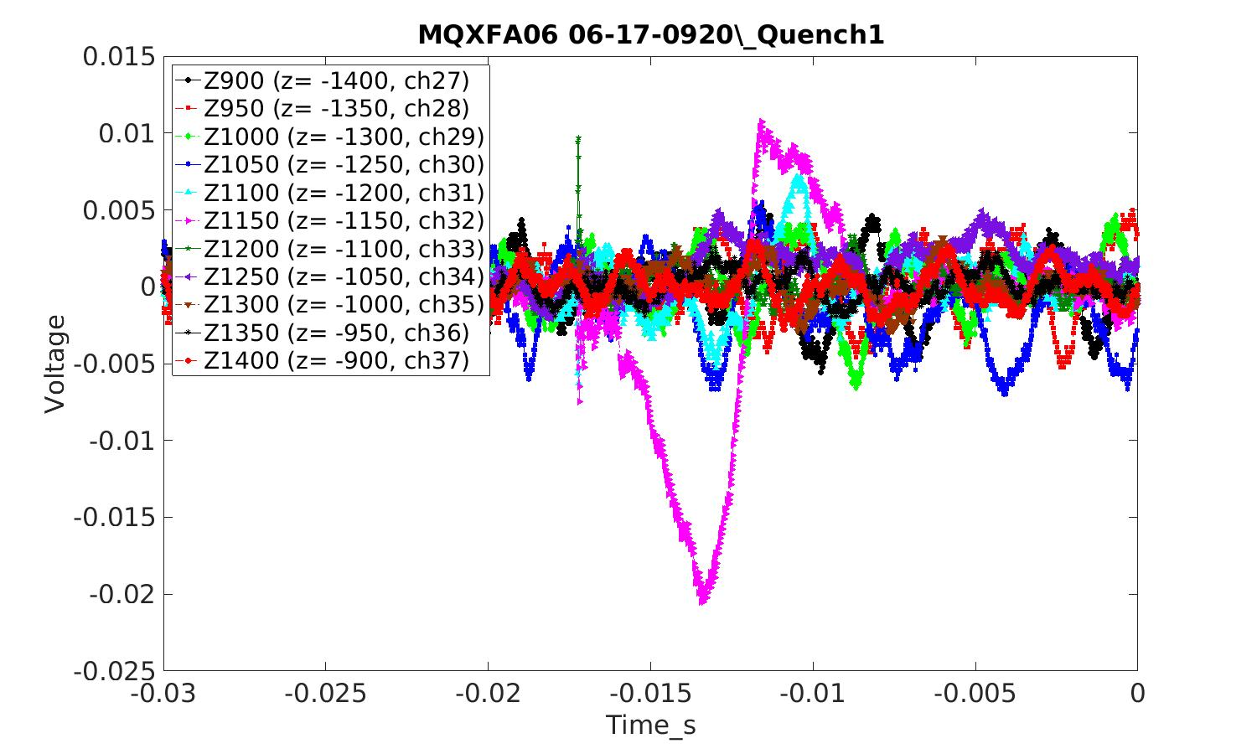
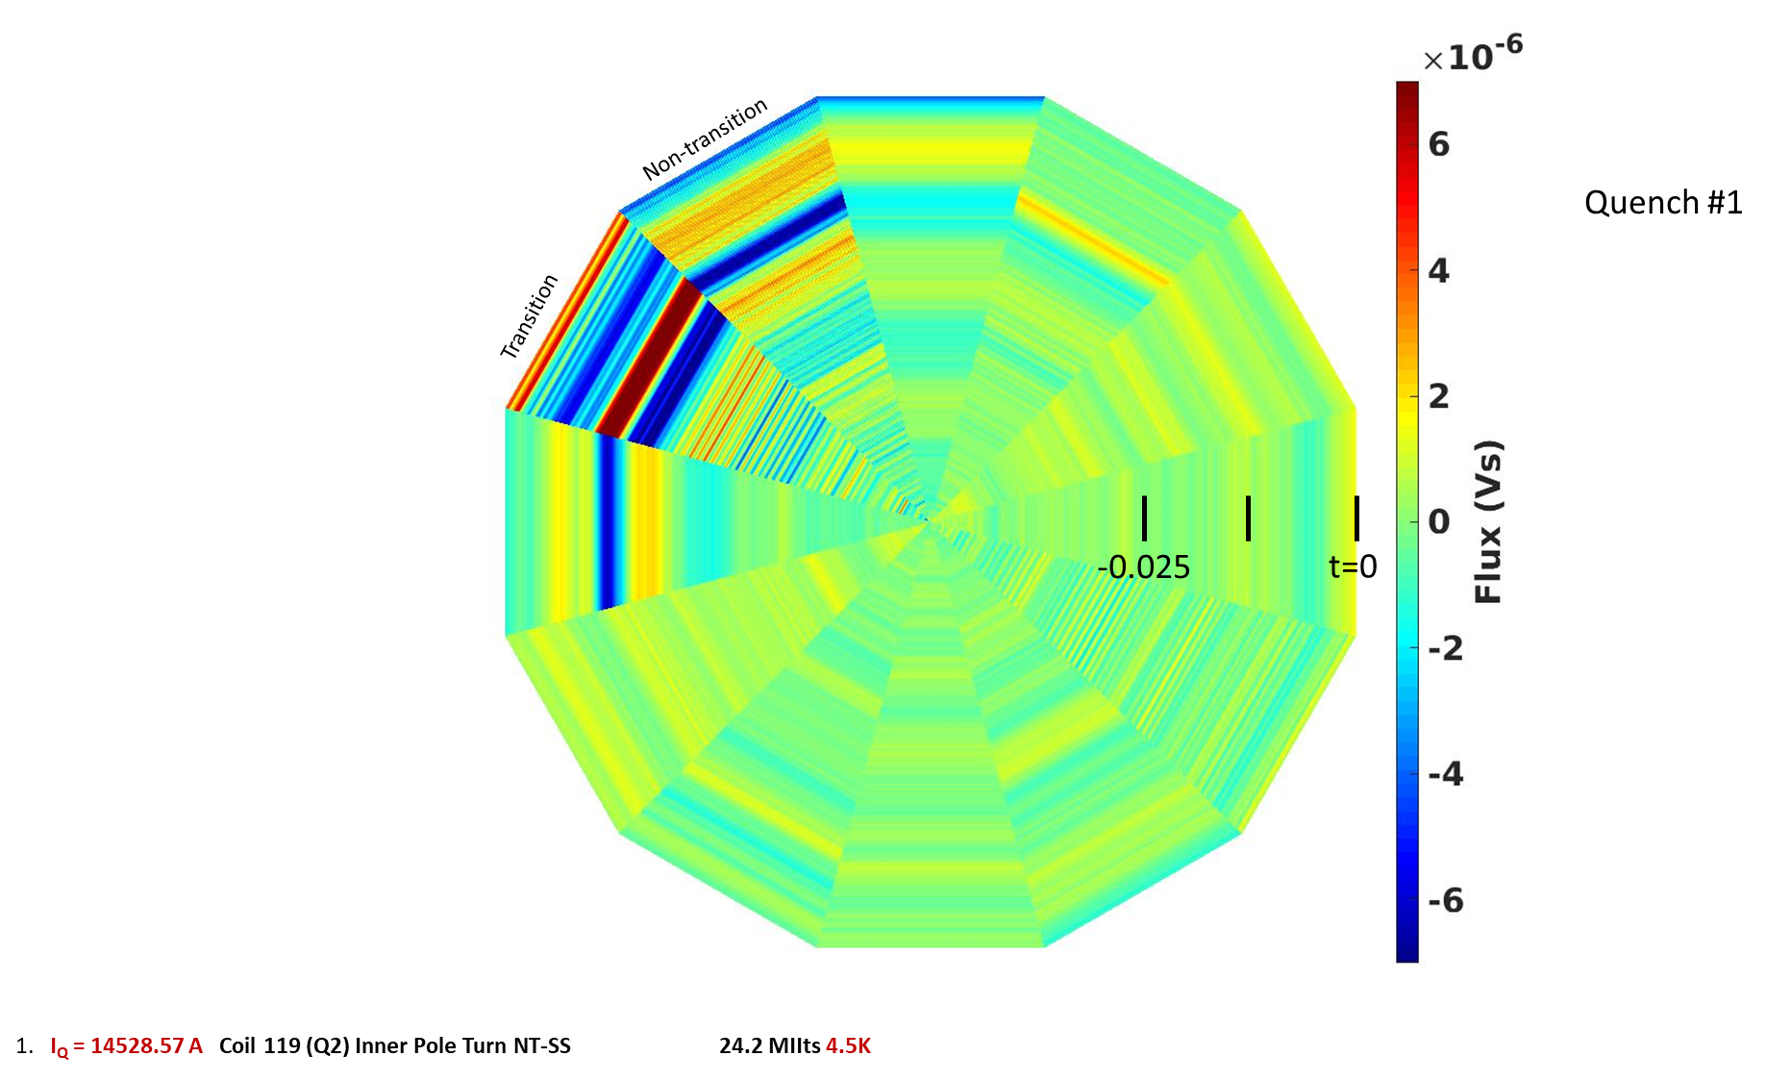
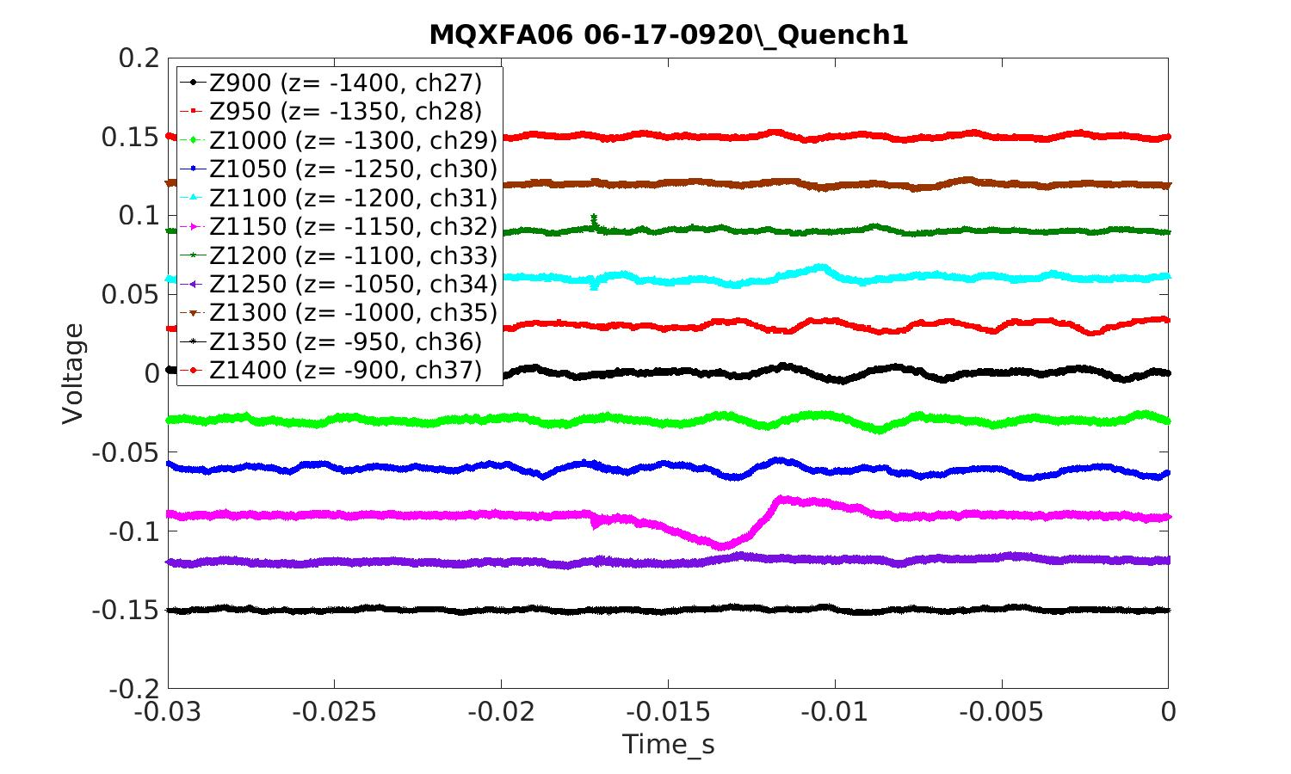
Q#1
Example where angular antennas gave wrong location (indicates ‘transition side’ when voltage taps indicate ‘non-transition side’)

Slide 20
Unfortunately, angular localization can not be determined reliably at the level of the angular array (30 degrees)
Weak signals
Full-length antennas
Amplifiers noise/balance

Slide 21
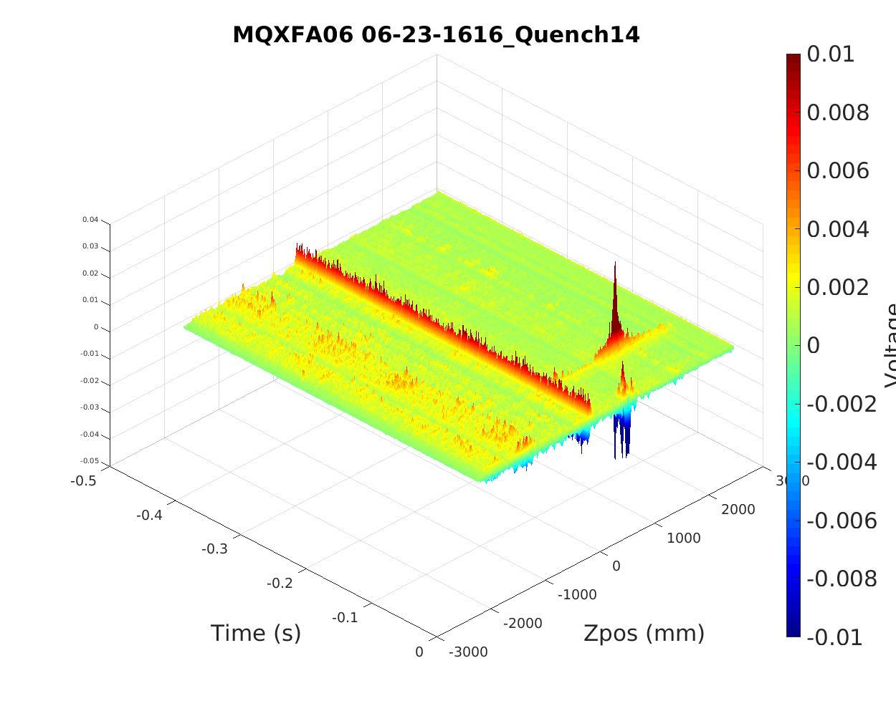
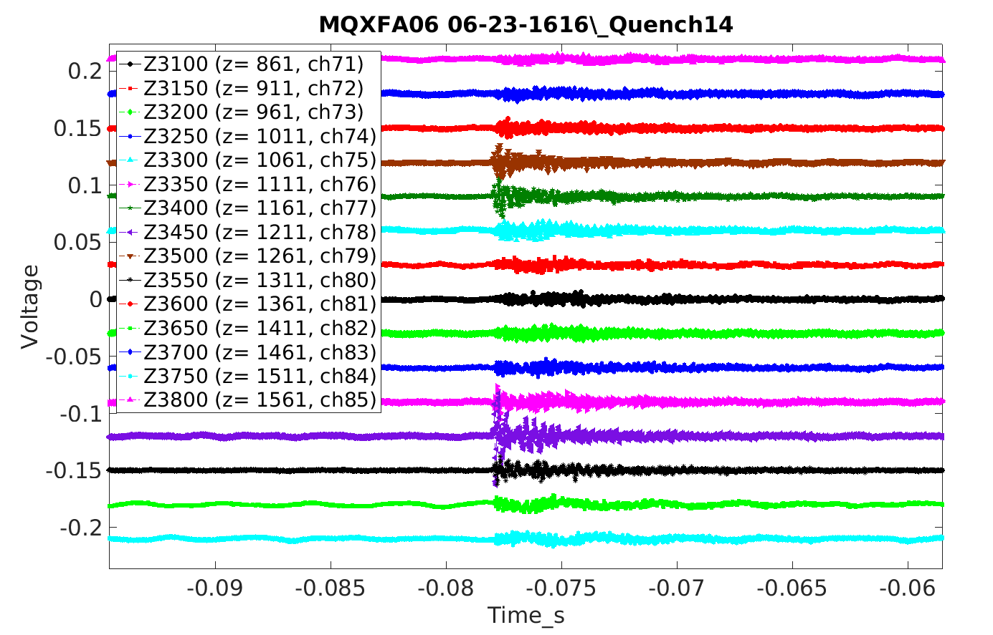
Have observed some events that spread over some distance in the magnet
Event at ~ t=-78ms
Quench

Slide 22
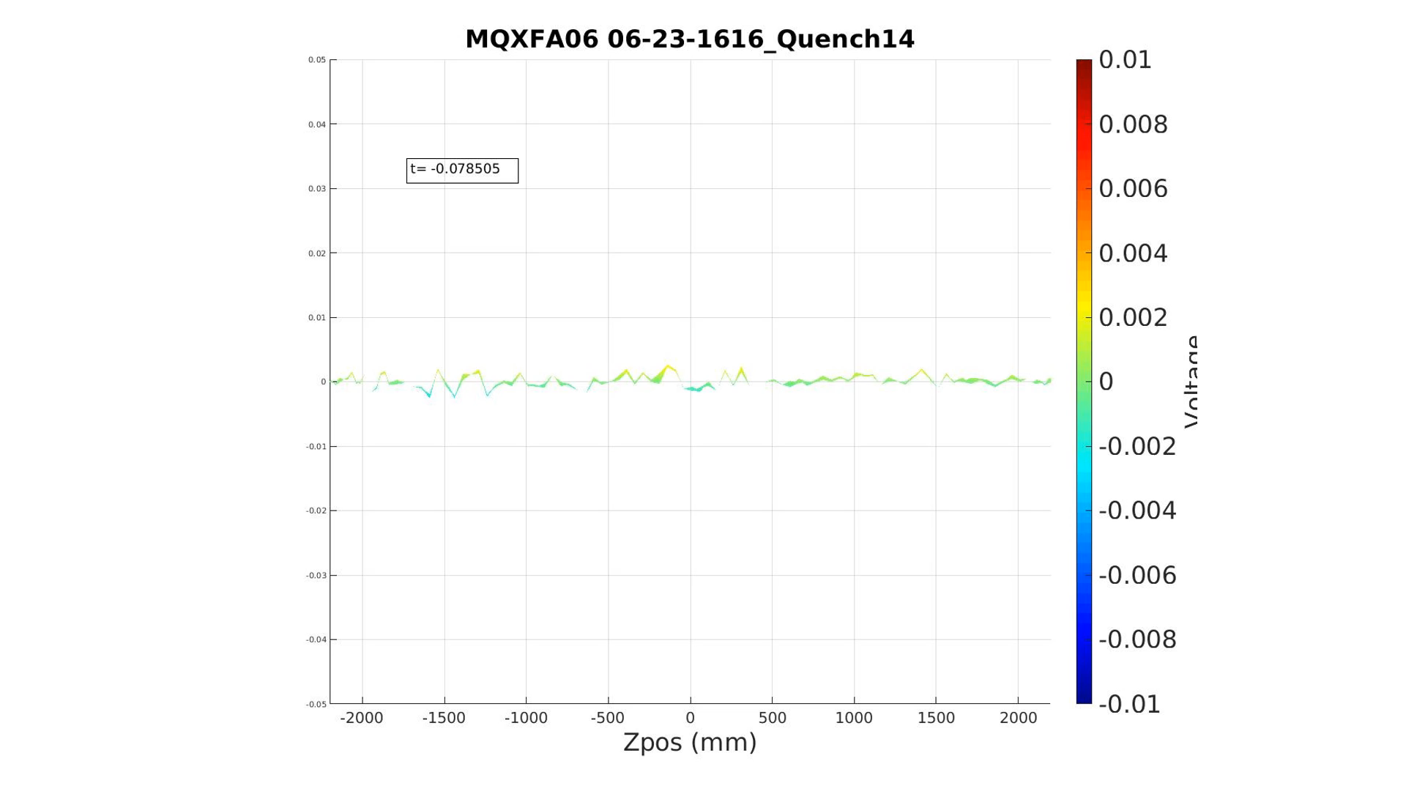
Consecutive time slices of event at t=-78ms
This event has a bipolar voltage swing – perhaps a local mechanical event

Slide 23
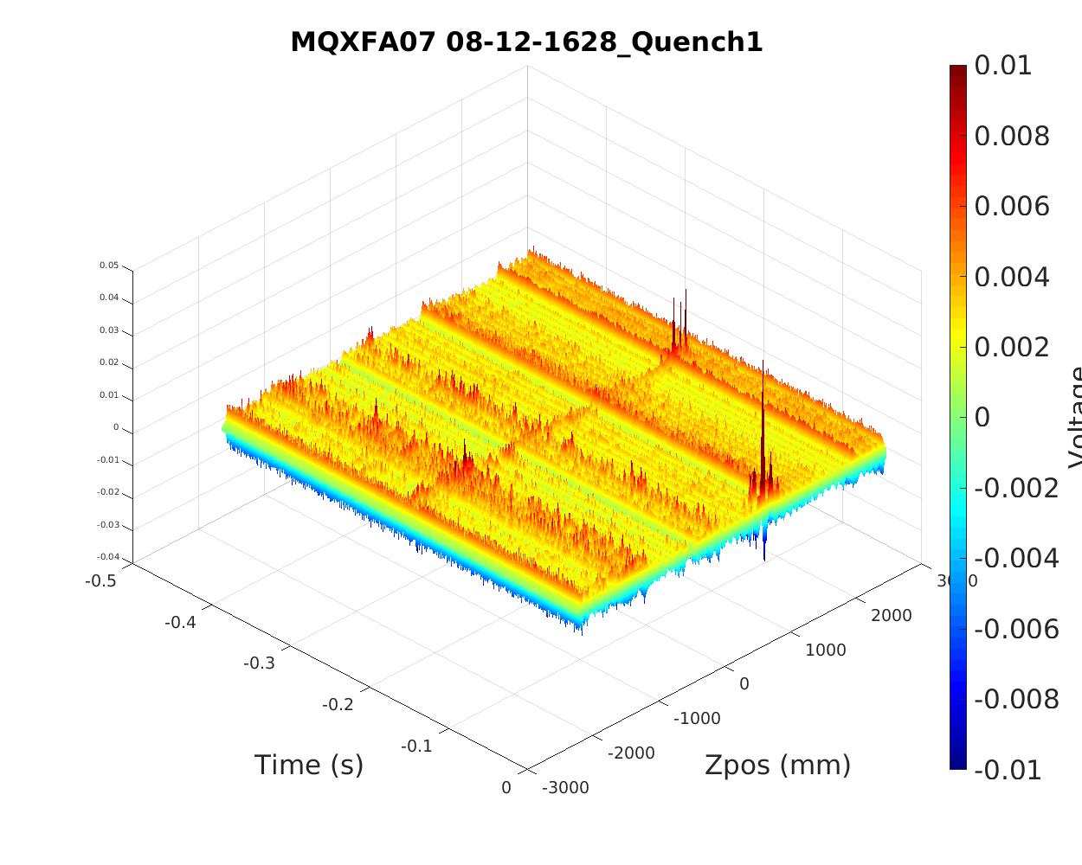
This event in MQXFA07 traveled across whole magnet

Slide 24
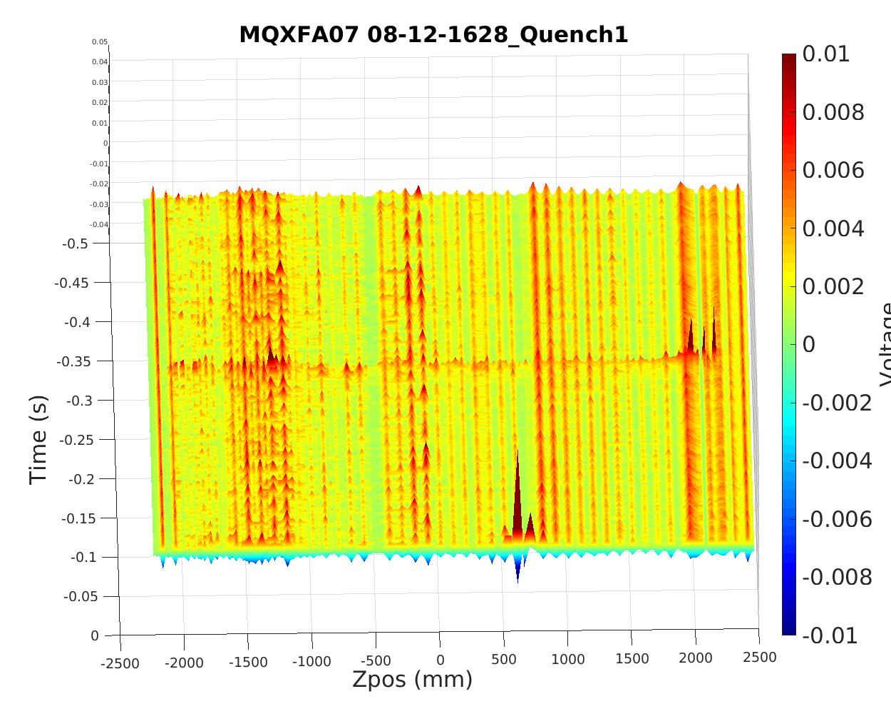
Signal travelled length of magnet in a few ms – indicates speed on the order of 1000 m/s

Slide 25
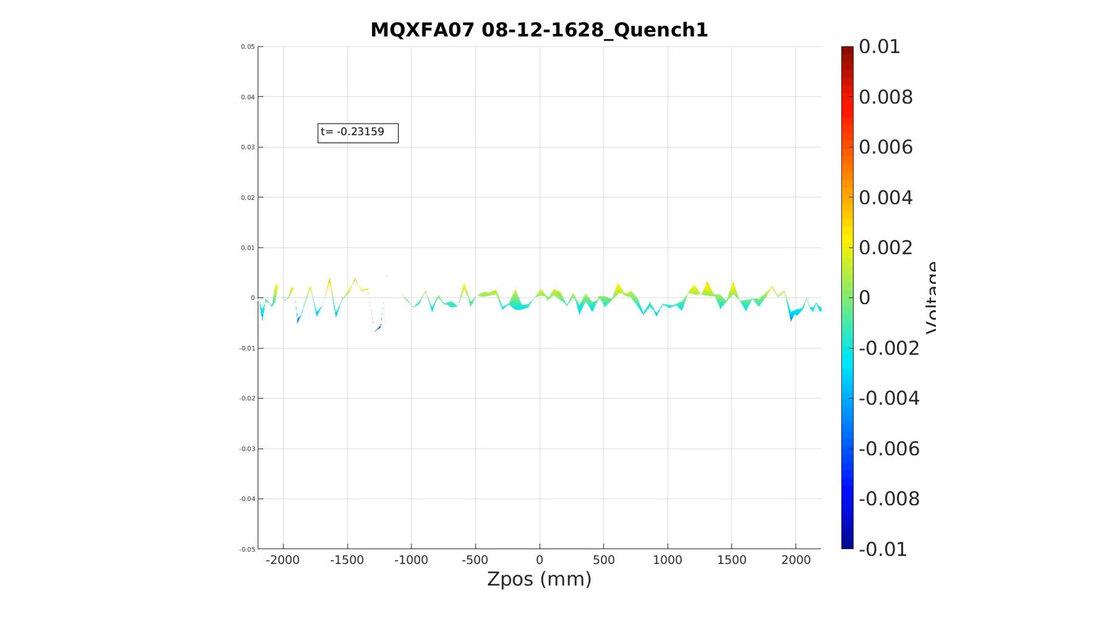
Event seems to be only ‘unipolar’ – perhaps just flux redistribution event that propagates at some level.

Slide 26
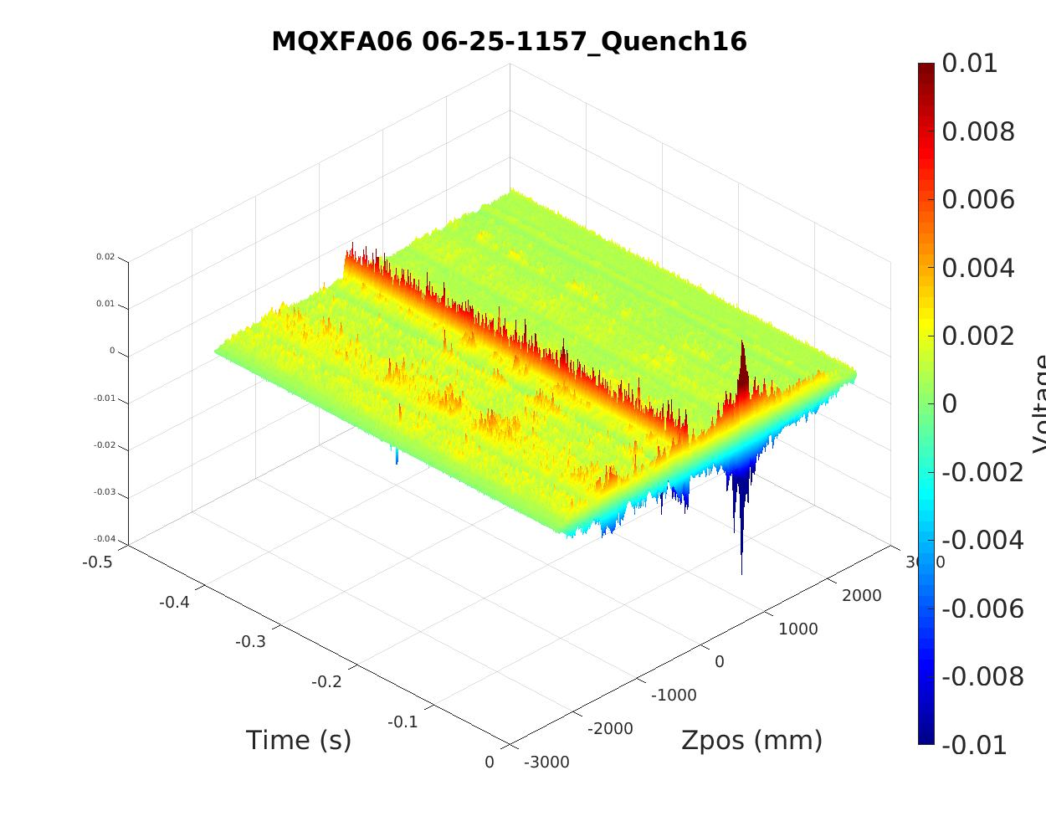
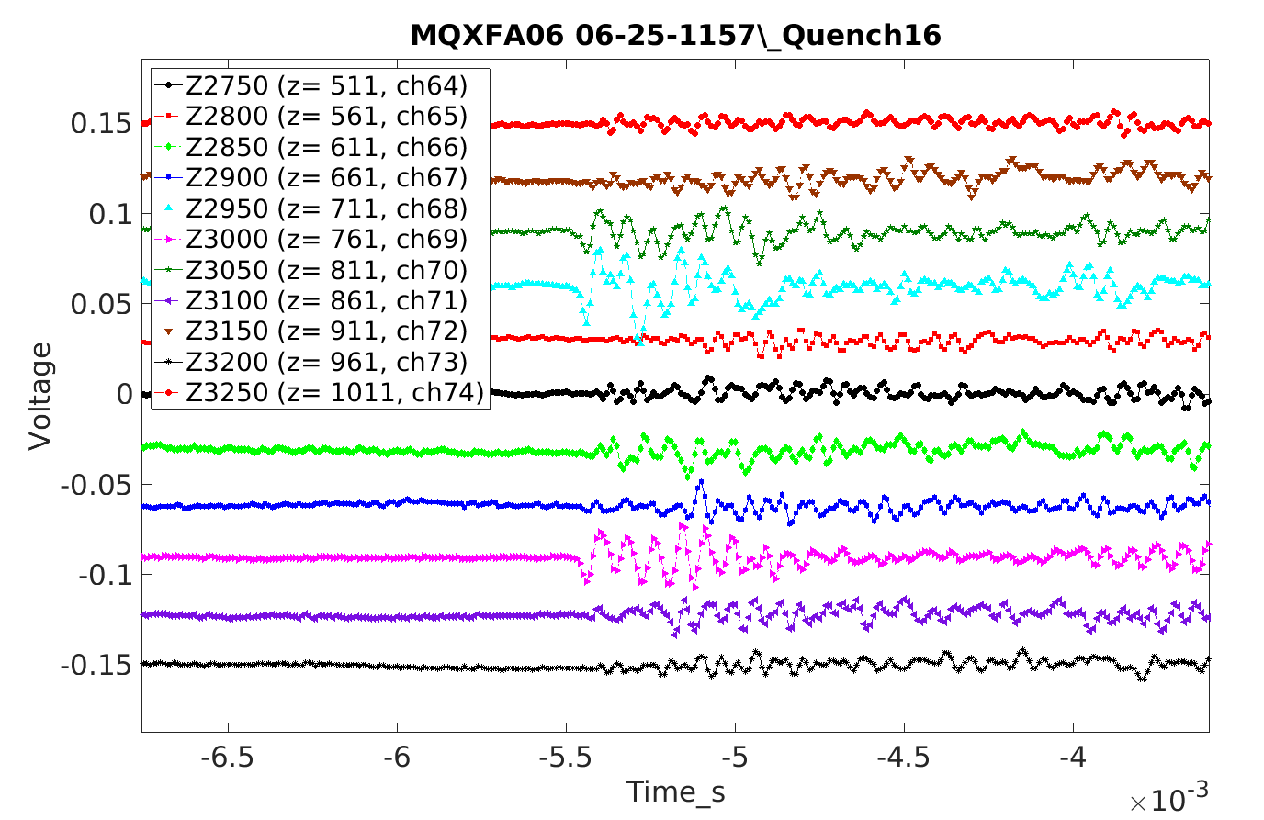
This was a mechanical event seen after quench centered on the quench location

Slide 27
After MQXFA, we have tried to develop some further ideas:
Intersecting slant loops
Triangle antenna pairs
Pixel arrays
Also,
Fabricated test structure to be used in our anti-cryostats (warm bore tubes (WBTs))
Mapping facility for warm tests – ability to check response of QA as a function of signal source/position without cryo tests

Slide 28
Our recent QA developments have been moving in the direction of local detection of flux change, instead of localization coming from interpretation of magnetic measurement windings.
As such, number of channels is an important component of high resolution localization. Have tried to keep this down in some designs, but have also explored antennas which could take advantage if the ability to monitor large number of channels is available.
In general, the QA being developed can be used in an anticryostat, or in the cold aperture of the magnet, or even between layers during magnet fabrication.

Slide 29
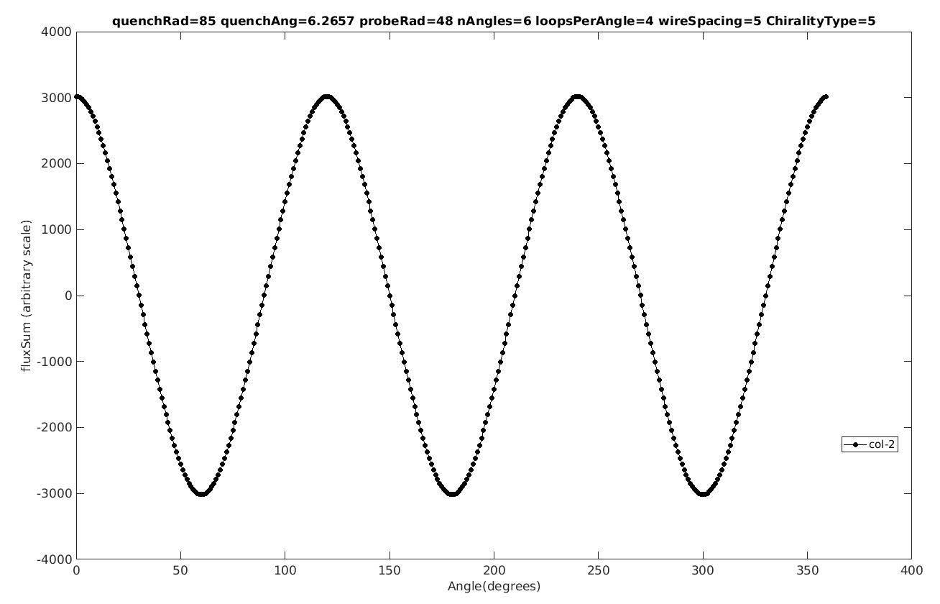
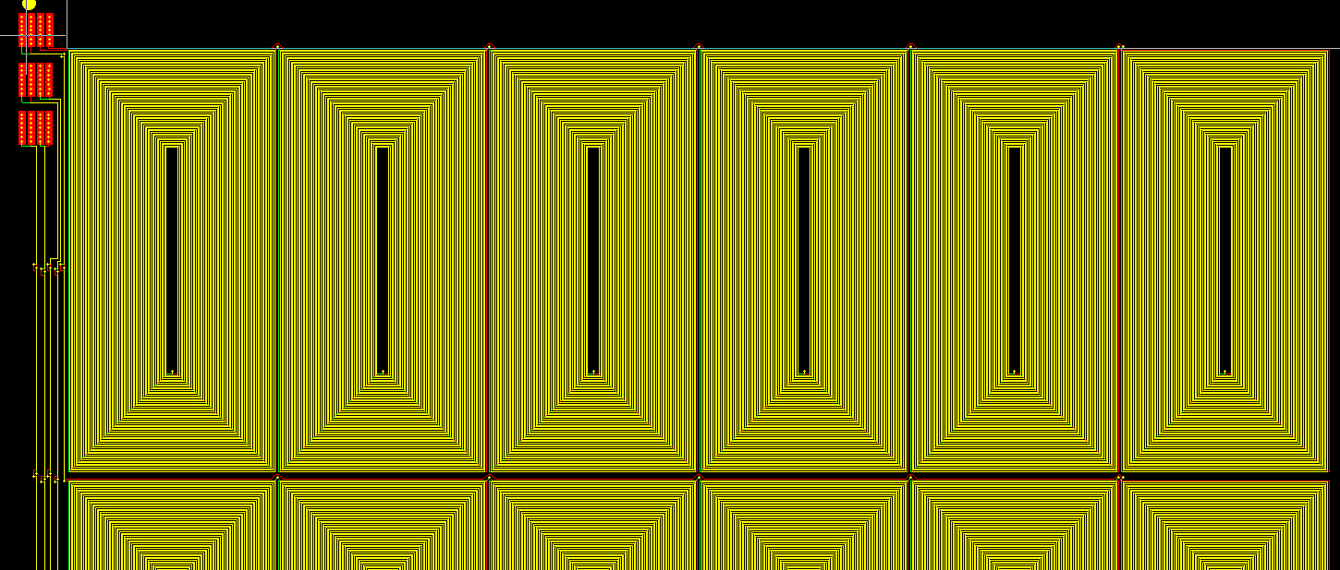
Tried to design more asymmetric windings so that there were no ‘dead-zones’ in angle
Sensitivity of QA changes as function of quench angle because of symmetries
Flux
Example of low sensitivity regions at some quench angles when using symmetric windings
Angle

Slide 30
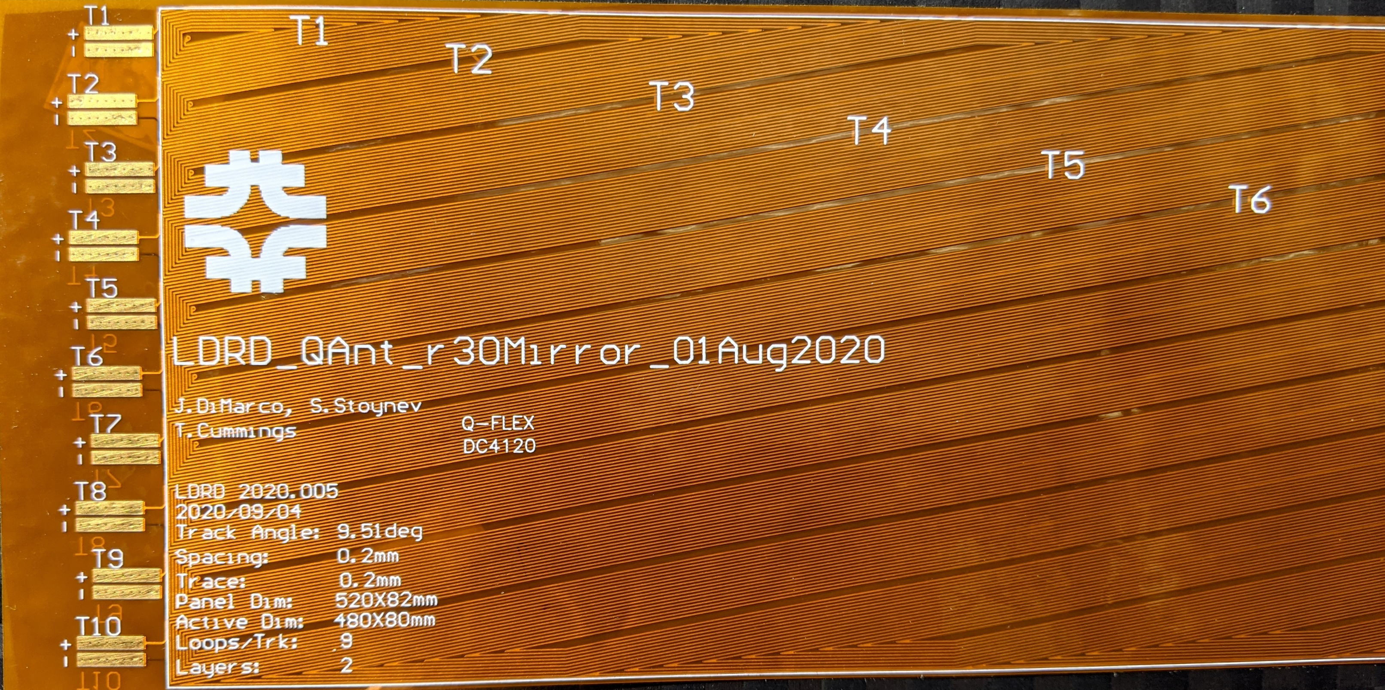
Slant Antenna
Slant QA on straight conductor avoids ‘dead zones’ present with symmetrical windings
0.5m long
20 channels
(10 read from each end, with even division about diagonal)
Reversing and crossing pair of these allows for localization in z and angle within some range determined by angle, etc.

Slide 31
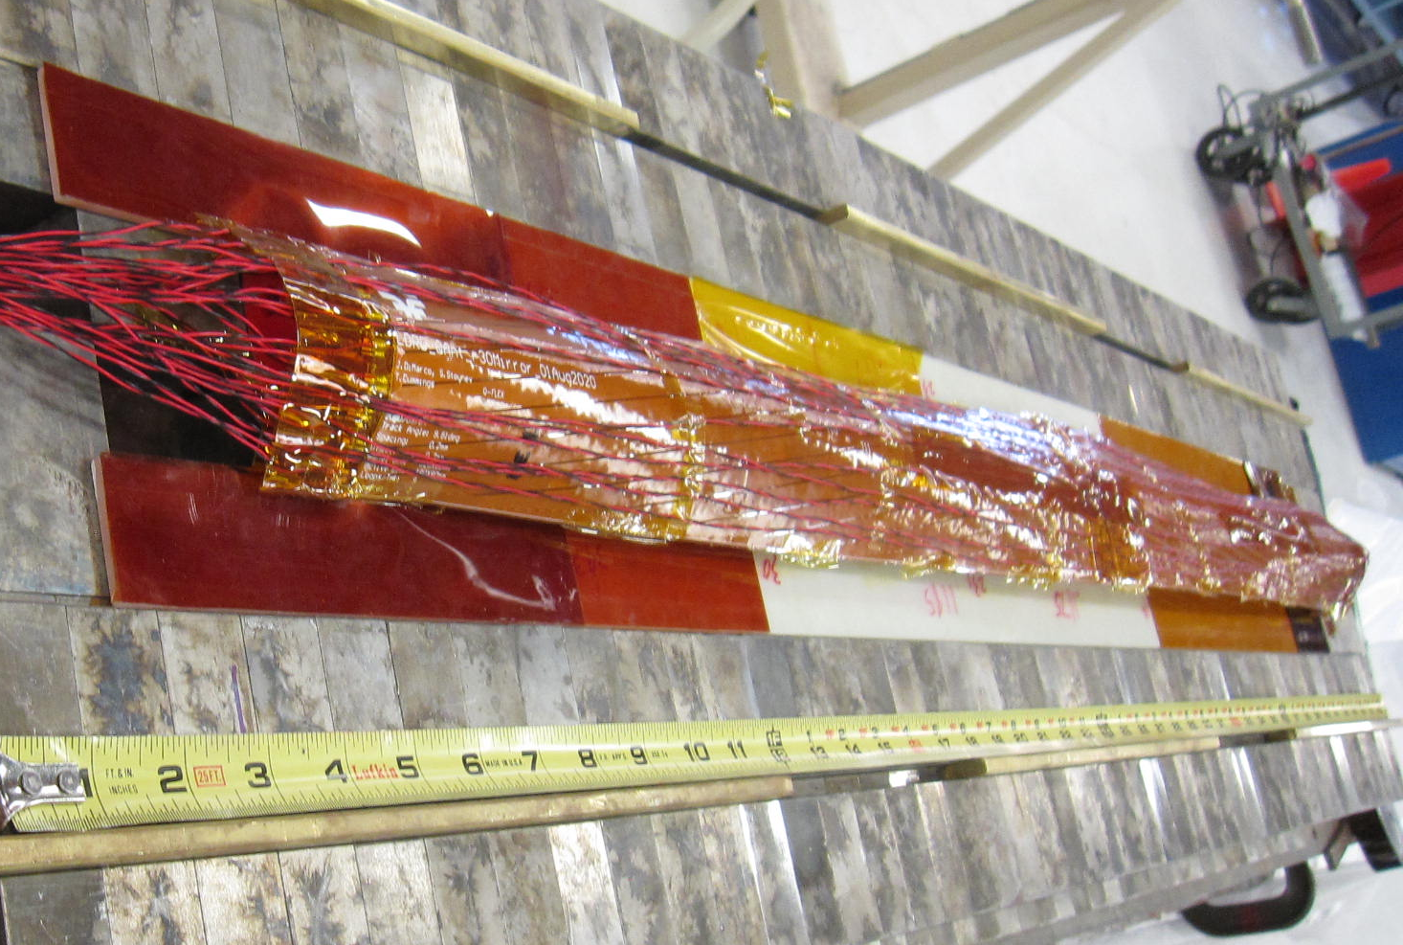
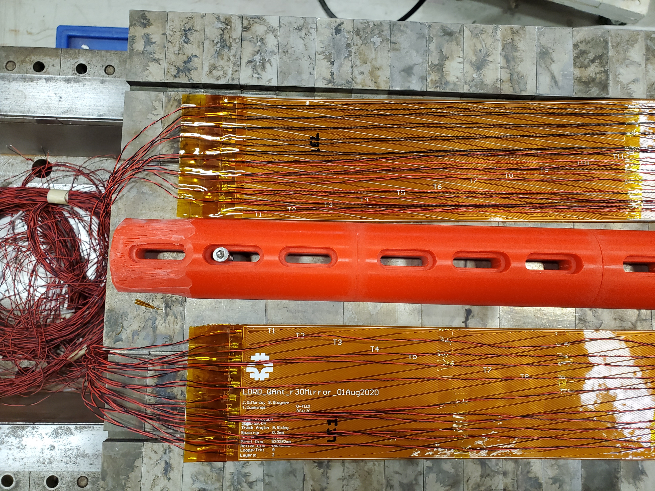
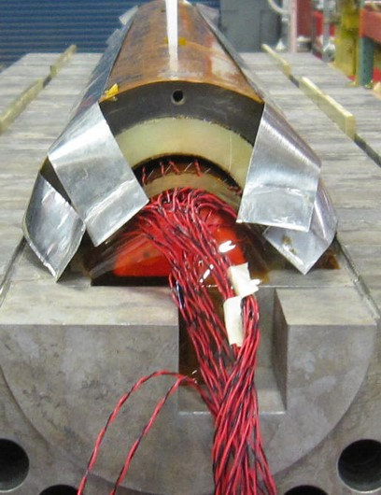
Slant QAntennas wired for mirror magnet (currently under test)
Full 1m coverage with 2*0.5m slant QA back-to-back.
Second set with opposite slant as well ➔ 4 * 20 signals (160 wires)

Slide 32
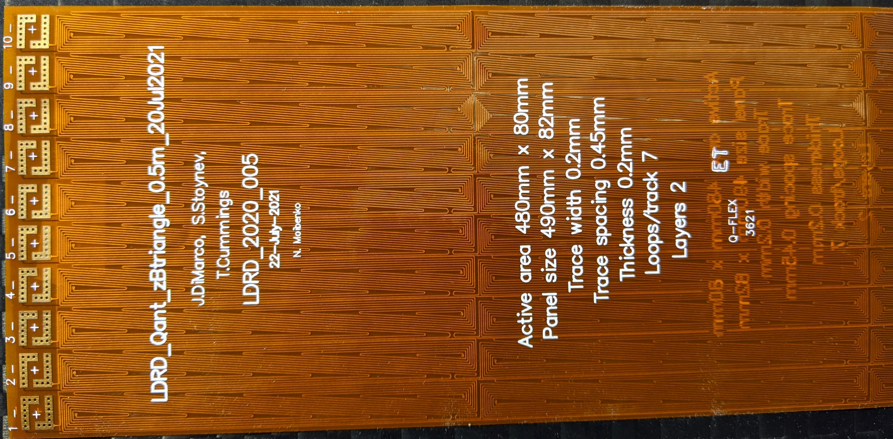
Triangle-pair QAntenna
The triangle-pair QA tries to keep the nice asymmetry properties of the slant antenna while also incorporating bucking – the two triangles have opposite chirality and are connected in series
The triangle pairs are 8mm x 80mm, and 6 are serially connected in length so that the panel has 480mm Z coverage. There are 10 such groups of 8mm width for total panel width of 80 mm.

Slide 33
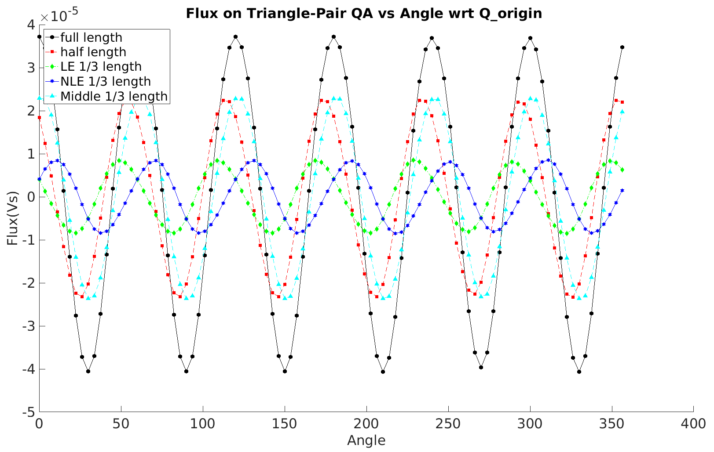
Angular sensitivity of triangle-pair QA (simulation)
There is still symmetry which causes insensitivity at some angles, but that is very local, and as quench moves, the sensitivity also changes.
Advantages:
No dead-zones
Local bucking
Disadvantages:
May be harder to interpret since sensitivity changes as quench propagates (but may be able to find utility in this, e.g. quench velocity determination, or enable more precise localization)
e.g. if quench extent is exactly full length of pair (black circle symbol), there will be minimal sensitivity at particular angle, but as quench moves into another 1/3 of QA (green symbol), the sensitivity is significant again.

Slide 34
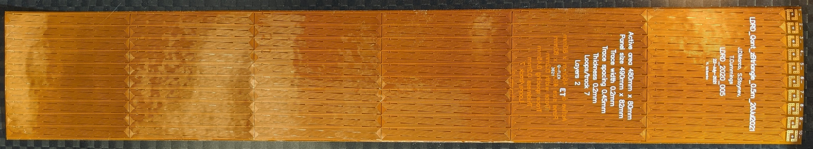

Slant Antenna
Triangle-pair QAntenna

Slide 35



50mm
5x5 pixel antenna
Small sensor array that could give fine resolution. Number of turns is 14 and loops are small but could be used interlayer and have sufficient sensitivity from proximity.
Very channel intensive!
Wiring panels have been fabricated which have 50 wires (25 pair) and are 0.5m long, to transfer signals from 5x5 pixel QA.
The wire pairs travel front/back of the panel to be low noise.
The 5x5 QA would be aligned using the matching holes on both flex circuits and soldered after tinning the surfaces.
The wiring panels can be chained to extend the signals as needed; or truncated to simply provide easier wiring to the 25 circuits.
100mm
The two triangles have opposite chirality to buck local field

Slide 36

Structure for Warm Bore Tube (WBT) QA
Channels to contain wiring from the antennas to the data acquisition
WBT QA would be wrapped around the small or large structures, which nest together.
Matches size of two of our WBTs that are most frequently used

Slide 37



QAntennas for small WBT structure
85mm x 400mm comprised of 10 triangle pair QA, each 85mm x 40mm.
This will wrap around circumference of small WBT structure (diameter 27mm, C= 85mm).

Slide 38


Mapper table
3- axis motion on rails
dB/dt signal on probe tip (current pulse from WF generator)
Mapper will allow us to make automated scans and test QA without cryogenic test stand time. Goal is to better understand QA response to AC disturbance.
Scan probe tip in volume so panel can be tested flat (as shown) or wrapped on cylinder, etc.

Slide 39

FNAL QA collaboration with LBNL
Future QA that would help provide intersecting coverage to current QA’s on CCT magnets

Slide 40

First tests of intersecting slant antennas…
Test of MBHSM03 ‘Mirror Magnet’ (single coil test with iron blocks to complete symmetry)
Outfitted with slanted, intersecting, flexible quench antennas for quench detection
60 channels, 8mm x 48mm ‘pixel’ size
100 kHz sampling (10 $μ$s / measurement)

Slide 41

Loops for these two antennas wired in series (cryo channel limitations)
20 channels
“series”
20 channels
“RE”
20 channels
“LE”
Loops for other two QA brought out with individual signals
Note that the top two series QA lie on top of the bottom two to form intersecting areas of coverage with ~8mm x 48mm pixel size.

Slide 42

The sort of variations seen here in the individual QA arrays are absent from the ‘series’ channels – the series combination appears to bucks this ‘noise’ out
LE channels
RE channels
series channels

Slide 43

Zoomed View
Onset of quench clearly indicated

Slide 44




5.9”
The diagonals of the rhombus formed
are 8.1 mm and 48 mm
(its side is 24.6 mm).
43 ¼ ’’
c
37 3/8 ’’
C= 5.9”
Approximate shape
a/b = 0.45
Q1
Quench
location
37 3/8 ’’
We could be few mm off in any direction (to be improved by cross-checks)
Courtesy Stoyan Stoynev

Slide 45




To visualize the quench location, can plot the channels with emphasis on the intersection of channels that both have high magnitude.
$S_{pix}=\sqrt{\left(\left|S_{1}\right|∗\left|S_{2}\right|\right)}$
This can be done for each time slice
Time stamp of slice shown here
Quench location

Slide 46
Overlay with coil photo to show location in end pack

Slide 47

Quench appears to be at this end block

Slide 48

Can try to look at quench activity across sequence of time slices
Video shows 200$μ$s around quench in 10 $μ$s steps

Slide 49

Here look at flux change over first 8ms of quench (sampled every 0.1ms)

Slide 50

Note that this kind of analysis has the ability to produce spurious results; e.g the two ‘hot’ regions nearer the edges are each formed by two active intersecting lines – which then form other intersections…

Slide 51

Outer coil quench
quench effects seen in regular voltage signals of quench antenna

Slide 52

Q#2 - Slow, low field, outer coil quench – tq = -67 ms
Even more clearly visible when normalize to noise s.d.

Slide 53

First activity actually happening here

Slide 54




Slide 56

Outer coil quench is at this end block
Q#2
Q#1
Transition side

Slide 57


Slide 58
Closing comments:
The various quench antennas tested so far all appear to be reasonably sensitive to quench events and other events during magnet ramping.
All quenches were detected during magnet tests.
Outer coil quenches do not seem to cause particular difficulty, and were also always detected.
Lots of variety and room for new ideas. Have been working with several new layouts that could even be incorporated into magnet fabrication. These have tended to be more ‘local flux detection’ techniques than ‘magnetic measurement’ techniques, but I’d like to push again on the latter as well.
Interpretation of details of quench development/propagation more generally remains difficult – perhaps good simulation tools could help that understanding.

