Slide 1
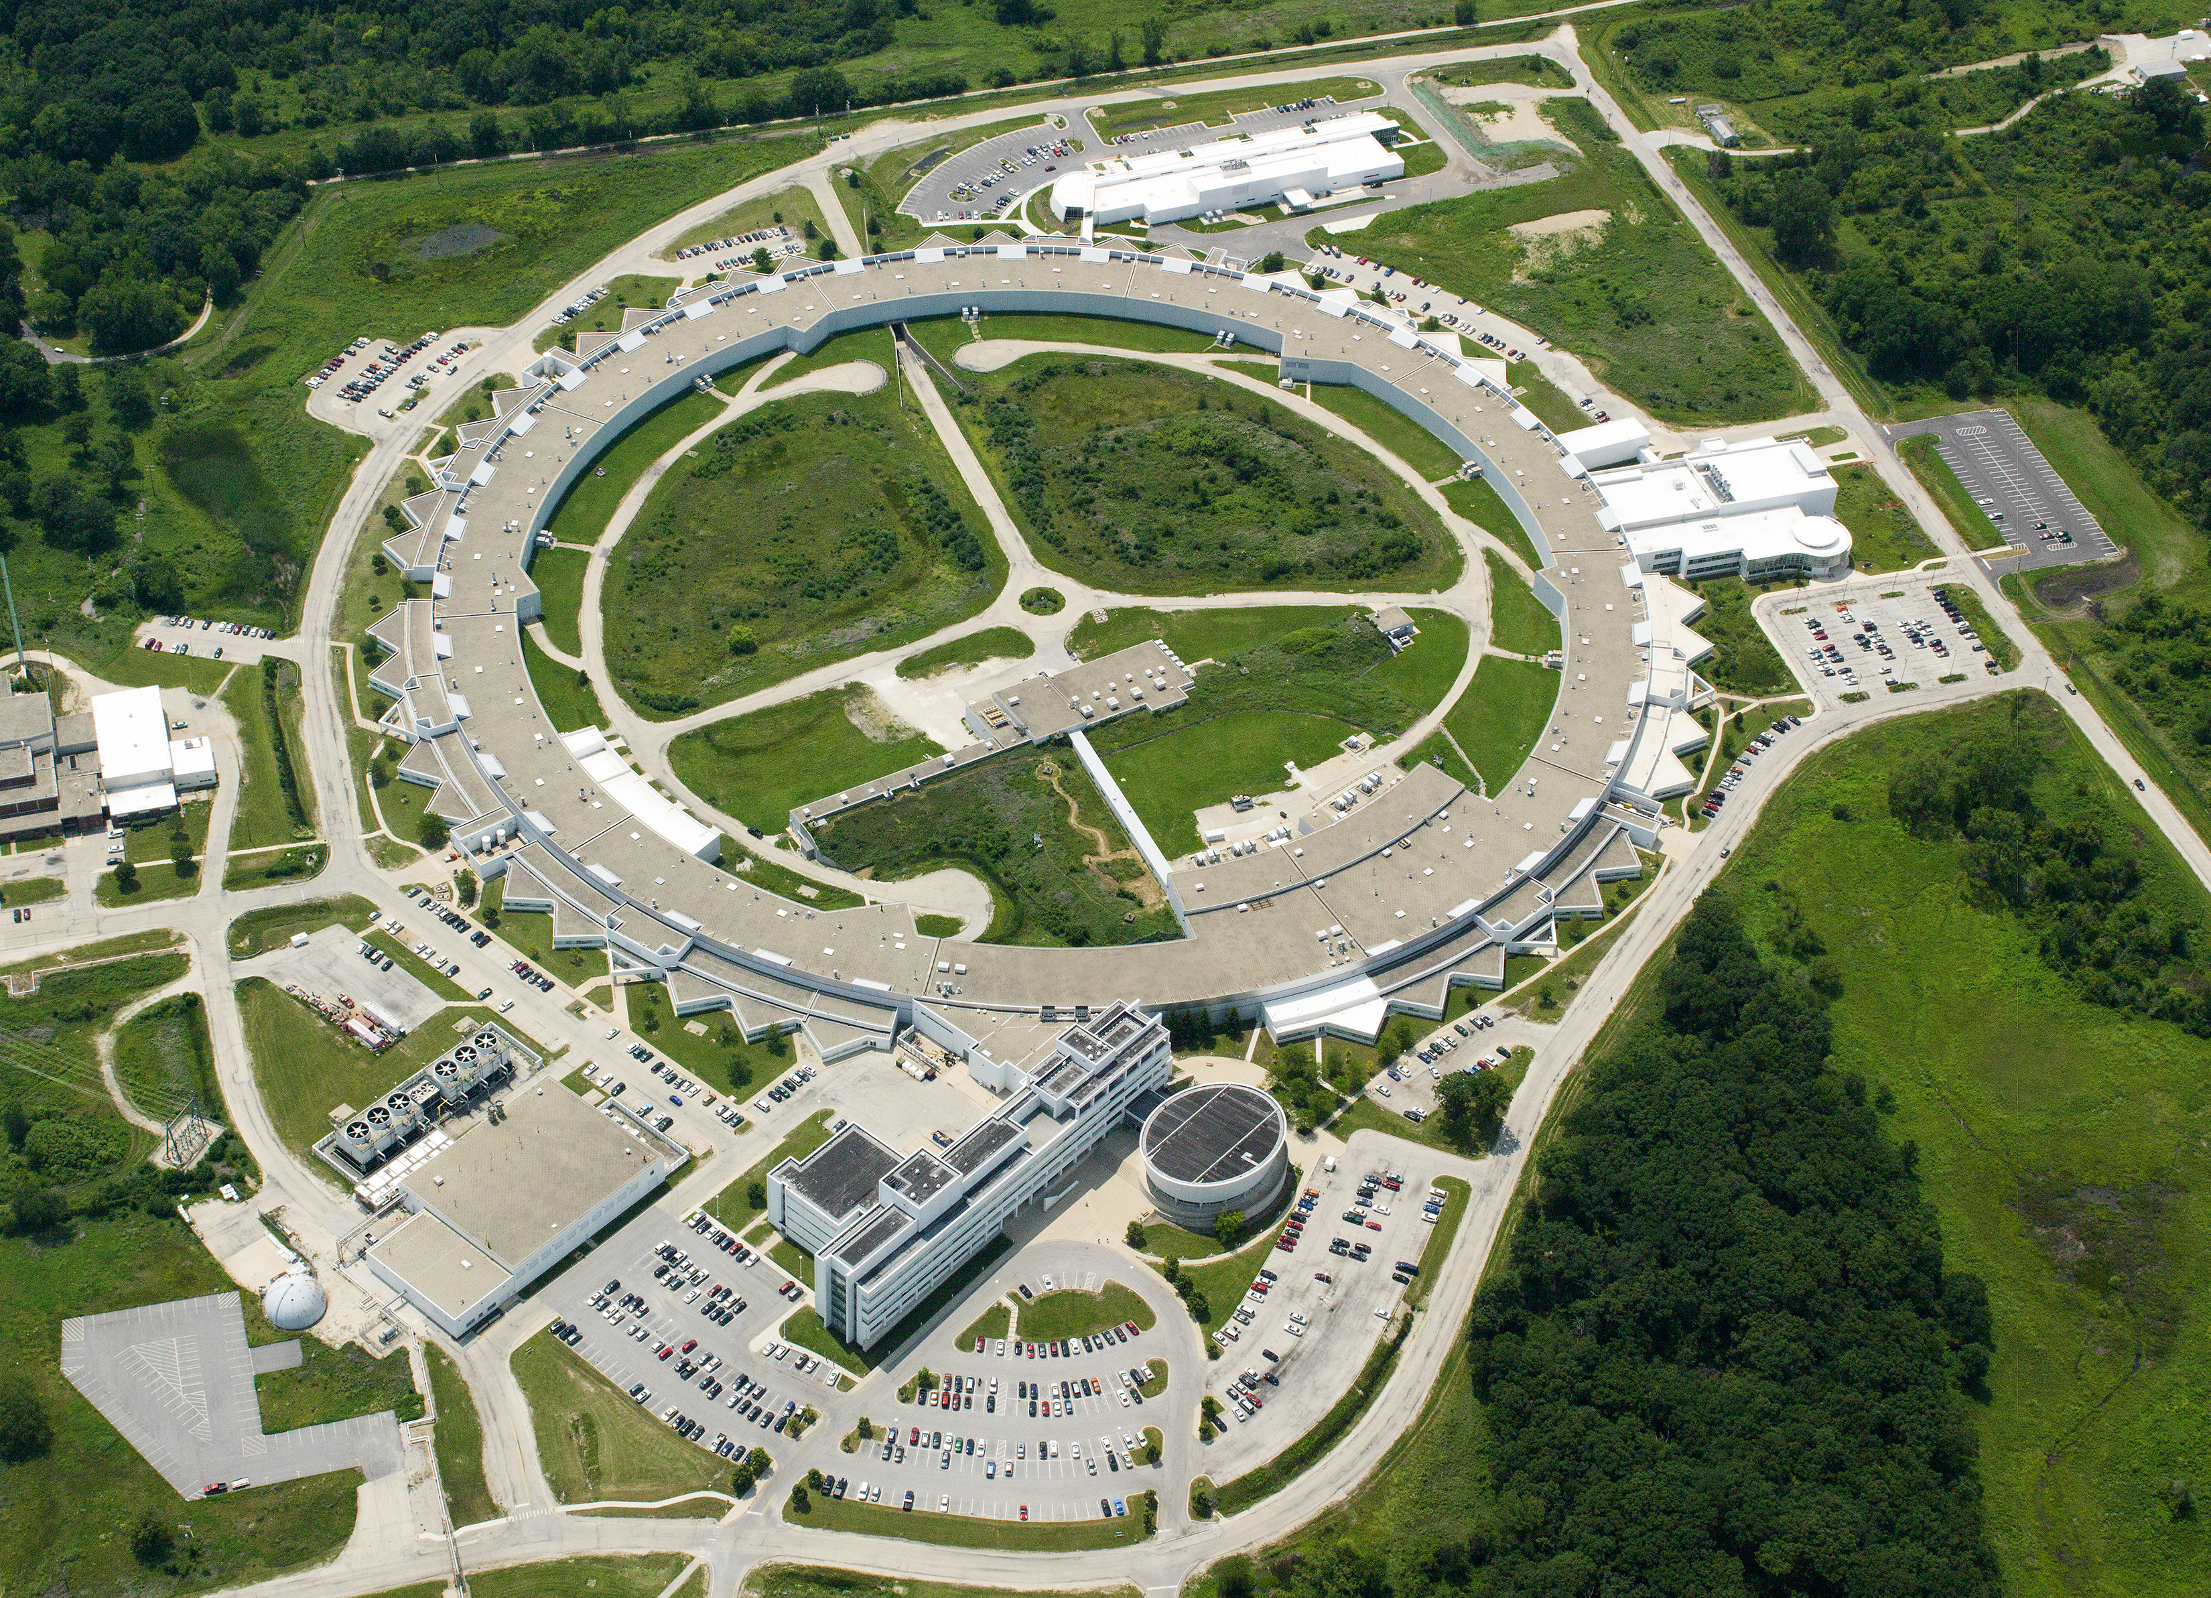


Progress Report for the
Advanced Photon Source
Upgrade Project
William. G. Jansma, Charles Doose, Animesh Jain, Samuel P. Jarvis, Jeremy Nudell
Argonne National Laboratory
IWAA 2022
31 Oct – 04 Nov 2022
CERN, Geneva, Switzerland
Notes:
Univ of Chicago Review, Aug. 30, 2010
1

Slide 2
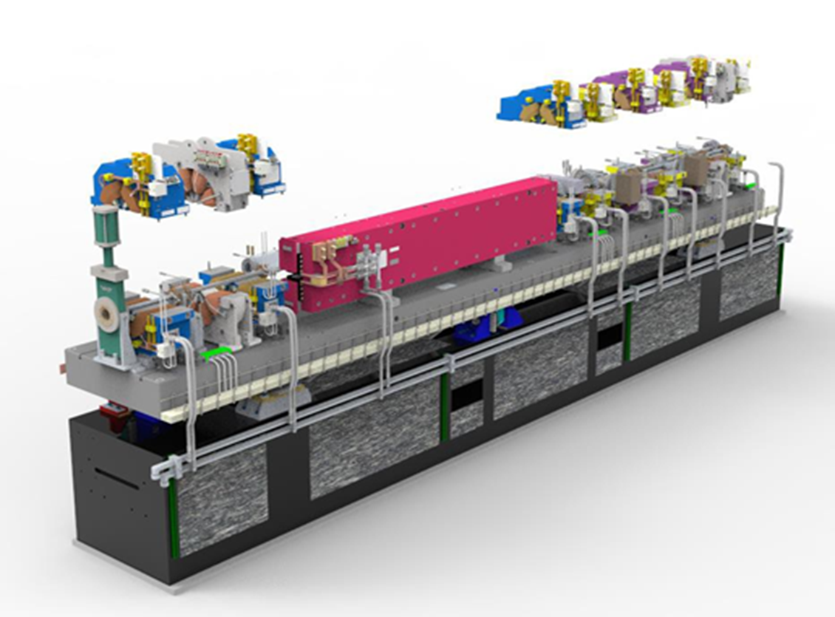
OUTLINE
Background
Alignment Requirements
Magnet Fiducialization
Module Assembly
Superconducting Undulators
Beamlines
Survey Control Network
Module Installation Planning

Slide 3
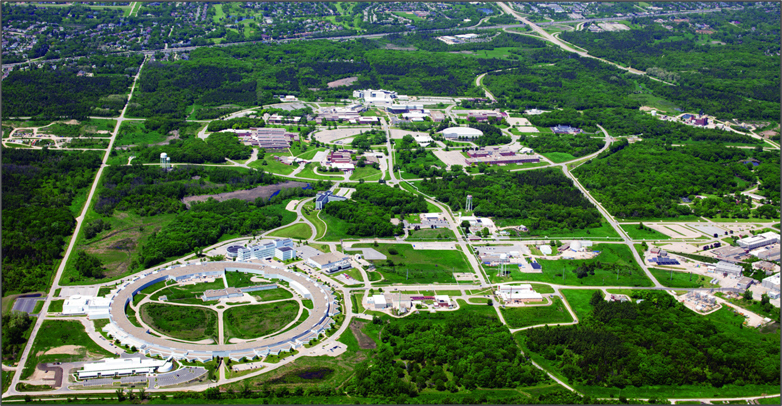
Argonne National Laboratory
The first US National Laboratory - a multi-disciplinary facility operated by UC-Argonne, LLC for the U.S. Department of Energy.
Focus on basic science research, energy storage and renewable energy, environmental sustainability, and national security.

Slide 4
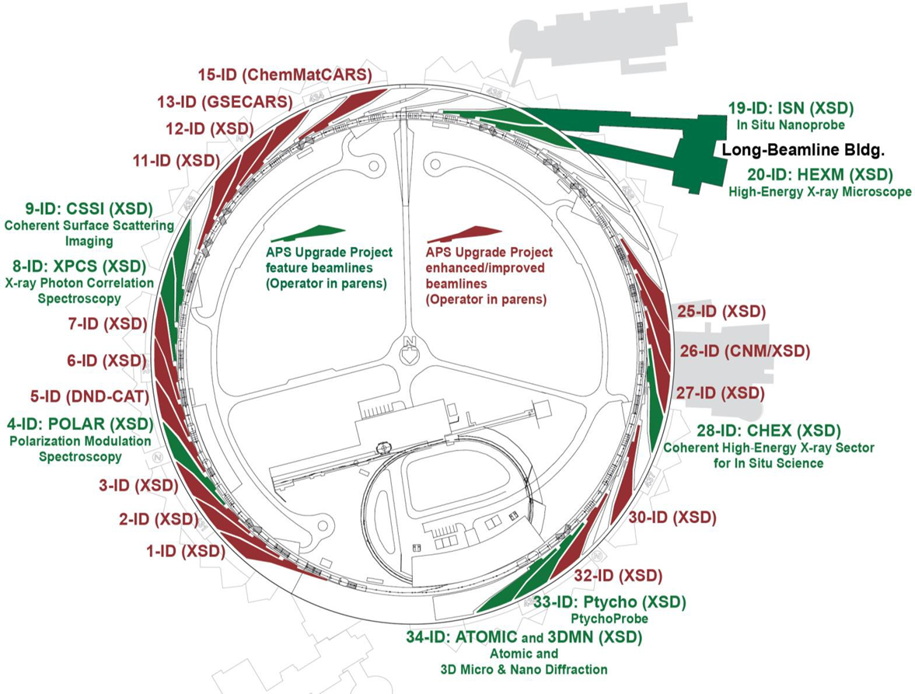
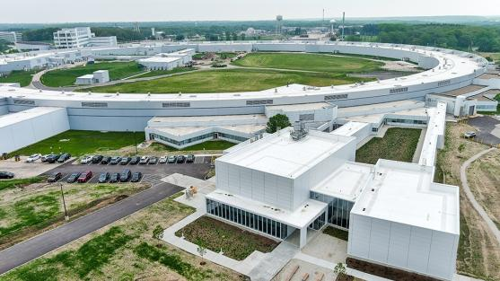
Advanced Photon Source Upgrade Project
$ 815M upgrade replaces the existing APS electron storage ring, already a premier international synchrotron radiation facility, with a new array of magnets, a multi-bend acromat lattice.
Upgrade will reduce electron beam emittance by a factor of 70, and double stored beam current from 100 mA to 200 mA, resulting in a brightness increase of up to 500x
High performance insertion devices (some superconducting), will make the resulting X-ray beams two to three orders of magnitude brighter.
A suite of featured, enhanced and improved beamlines

Slide 5
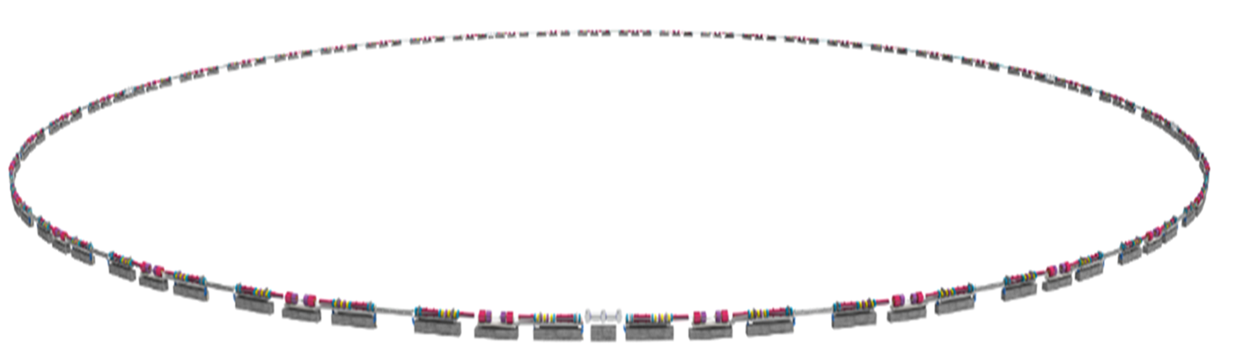
Advanced Photon Source
Upgrade Project
Higher brightness means X-rays can be focused onto a smaller, laser-like spot, allowing researchers to gather more data in greater detail in less time.
Higher energy X-rays penetrate deeper inside materials to reveal crucial information about a material’s structure and function.
High brightness and high energy allow observation and imaging — in real time — of fast and ultrafast technologically important processes, including fuel sprays, magnetic switching, and in vivo biological processes occurring in living organisms. Scientists will be able to see matter at the atomic level.

Slide 6
Storage Ring | Insertion Devices | Front Ends | Beamlines
1,321 Magnets | 11 Phase Shifters/Supports | 470 Tables/Supports | 36 Enclosures
4,640 Vacuum Components | 48 Canted Magnets/Supports | 162 Shutters | 55 Mirrors
2,245 Power Supplies | 33 Corrector Magnets | 108 BPMs | 20 Instruments
400 Power Supply Controllers | 800 Vacuum Components | 162 Masks | 19 Monochromators
560 RF BPM Electronics | 68 Power Supplies | 116 Collimators | 9 Transports
200 Module Assemblies | 57 Insertion Devices | 35 High Heat Load and Canted Front Ends | 21 Compound Refractive Lens

Slide 7
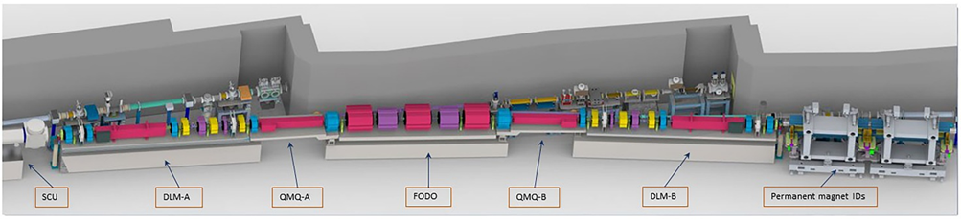
APS-U Storage Ring Alignment Requirements
Parameter |  |  |  |  |  | Value | Units
Storage ring
Circumference |  |  |  |  |  | 30 | mm
Girders
Girder-to-Girder Alignment (DLM to FODO; 1 sigma cutoff) |  |  |  |  |  | 100 | μm rms
Girder-to-Girder Alignment (QMQ to DLM or FODO; 1.5 sigma cutoff) |  |  |  |  |  | 50 | μm rms
Elements within a girder
Magnet to magnet (2 sigma cutoff) |  |  |  |  |  | 30 | μm rms
Dipole roll |  |  |  |  |  | 0.4 | mrad
Quadrupole roll |  |  |  |  |  | 0.4 | mrad
Sextupole roll |  |  |  |  |  | 0.4 | mrad
BPM centroid mechanical offset allowance |  |  |  |  |  | 250 | μm rms
Fast corrector magnet longitudinal alignment allowance |  |  |  |  |  | +/- 1 | mm (peak-peak)
Standard MPE for Vacuum and Diagnostic component alignment is +/- 250 mm

Slide 8
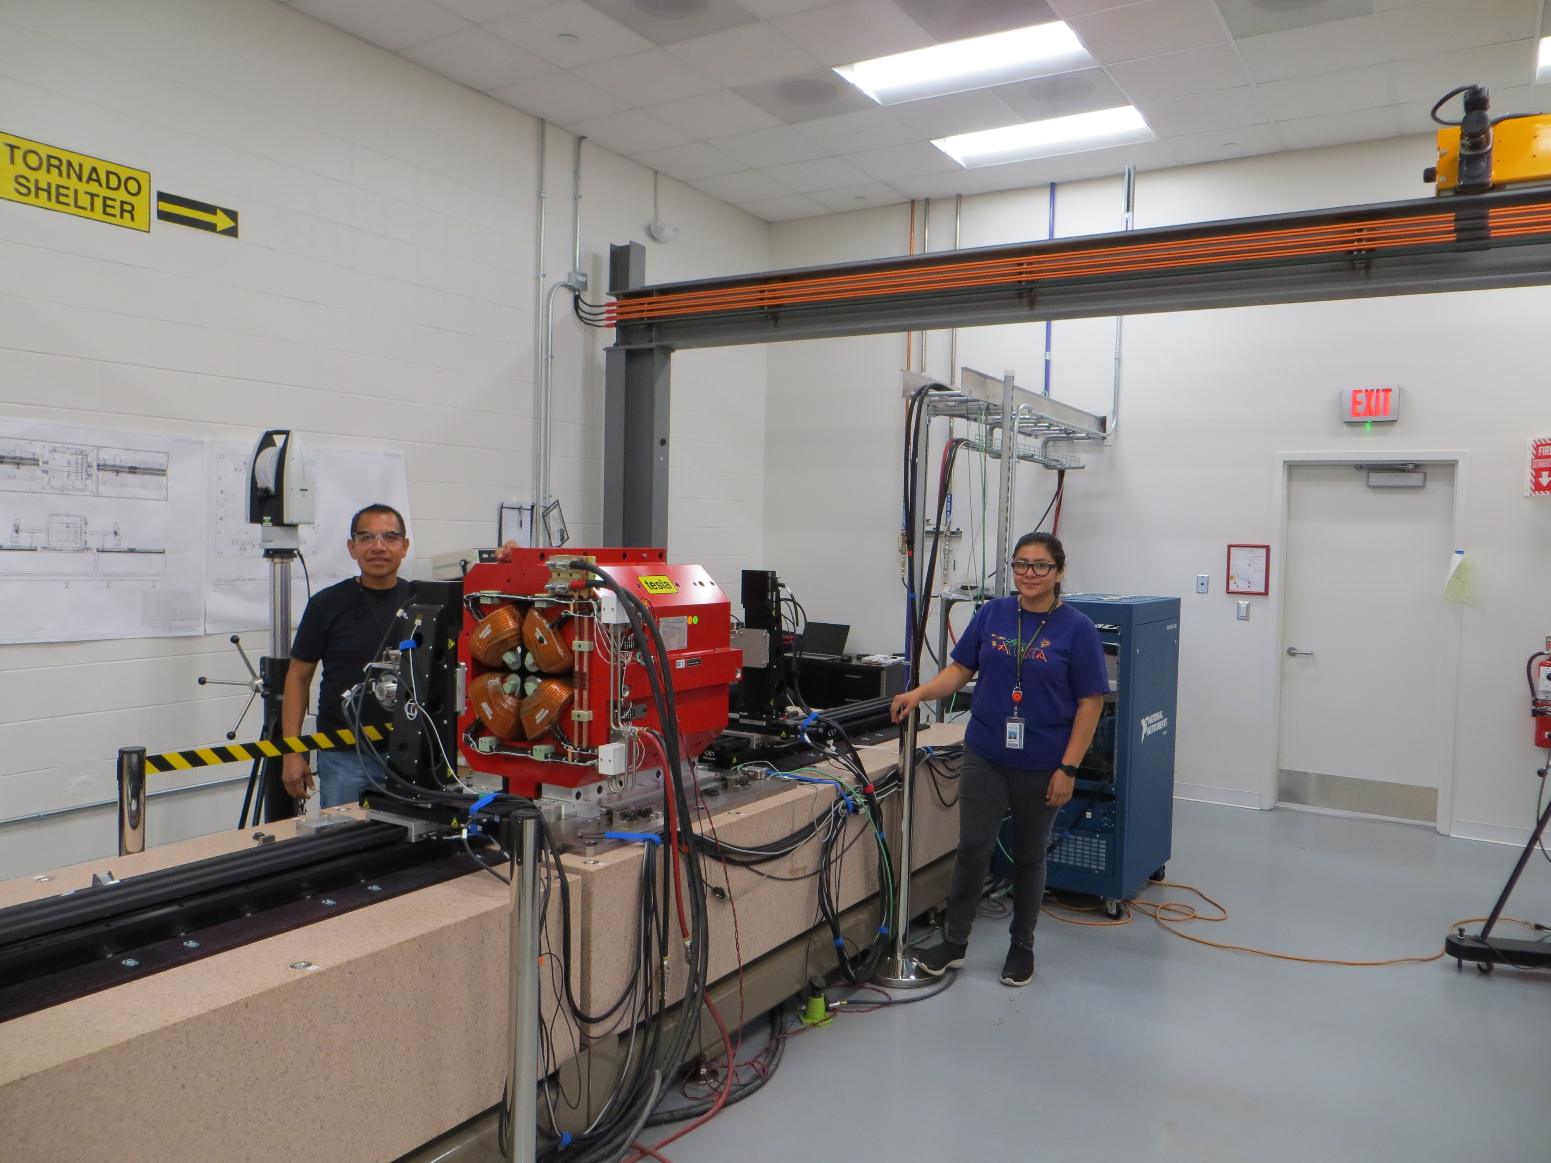
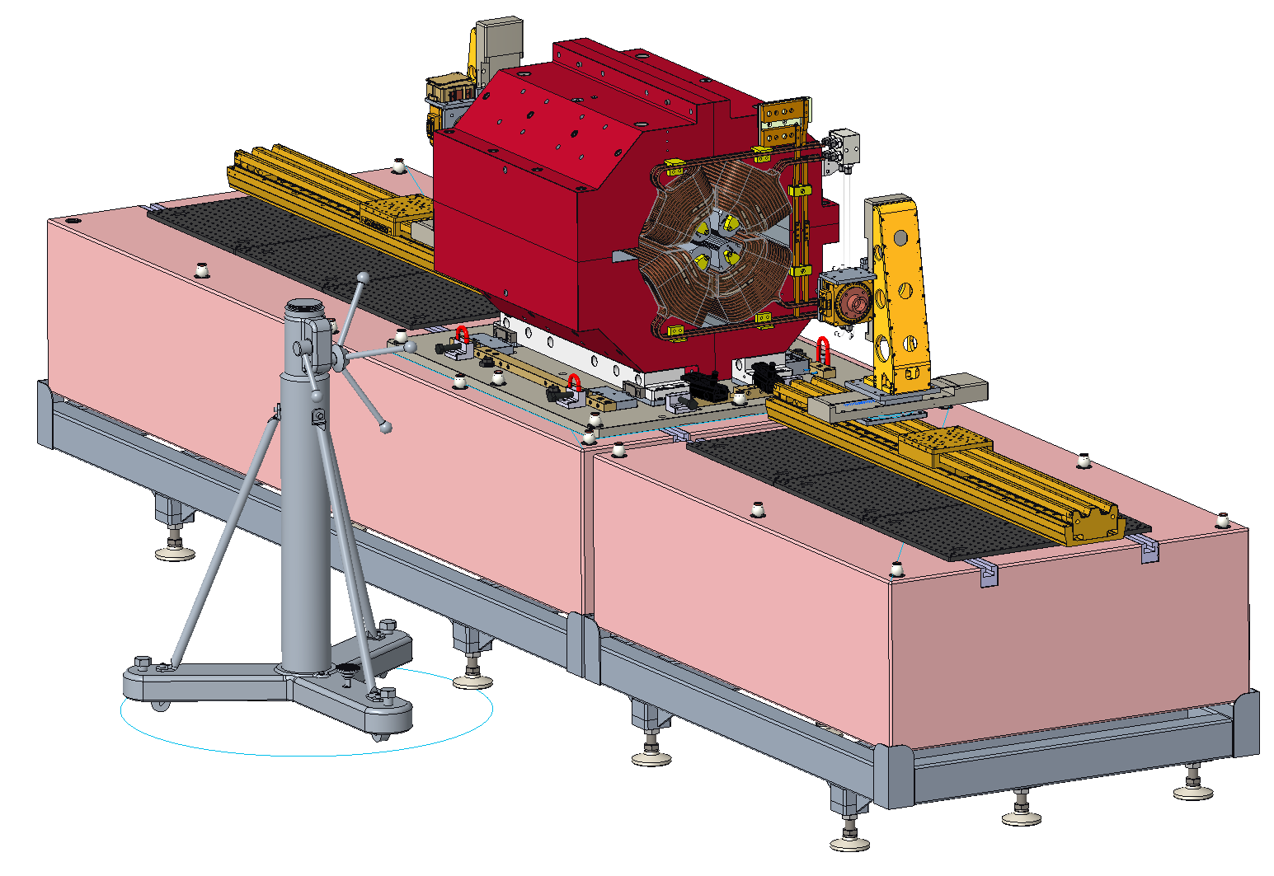
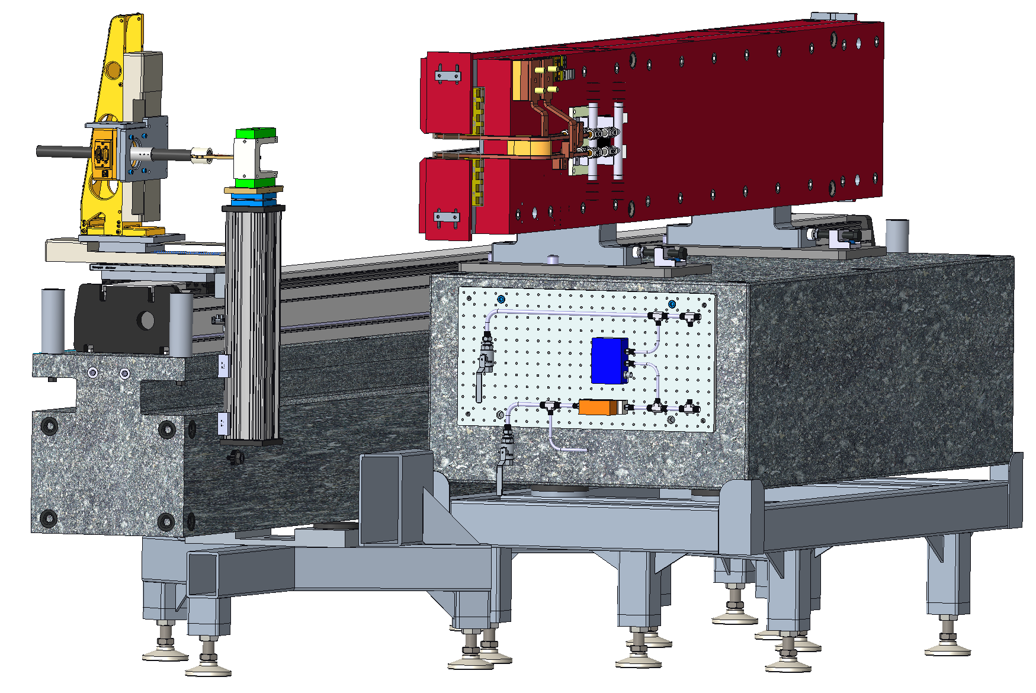
Magnet Fiducialization
1321 magnets to be assembled on 200 modules (plus 5 spares)
Fiducialization required for 1190 magnets
2 rotating wire benches for multipole measurement
1 Hall probe bench for dipole measurement
6 μm RMS fiducialization uncertainty for multipoles
COMPLETED FIDUCIALIZATIONS
Updated: | Friday, October 21, 2022
Magnet Type | Total | Completed | %
Q1 | 82 | 82 | 100
Q2 | 81 | 81 | 100
Q3 | 83 | 83 | 100
Q4 | 82 | 82 | 100
Q5 | 82 | 82 | 100
Q6 | 82 | 82 | 100
Q7 | 82 | 82 | 100
Q8 | 82 | 40 | 49
S1 / S3 | 164 | 164 | 100
S2 | 82 | 82 | 100
M1 | 82 | 82 | 100
M2 | 82 | 82 | 100
M3 | 82 | 82 | 100
M4 | 42 | 42 | 100
 | 1190 | 1148 | 96.5

Slide 9
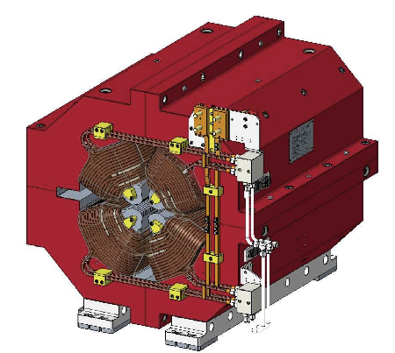
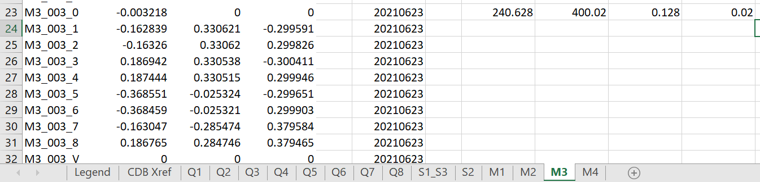
Magnet Fiducialization
Fiducial information is uploaded to the CDB…
Individual reports include comprehensive measurement records for each magnet
Compilation file includes fiducial and reference plane information for all APS-U multipole and dipole magnets in a single location for use during assembly

Slide 10
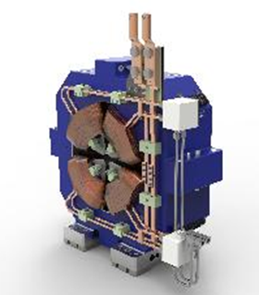
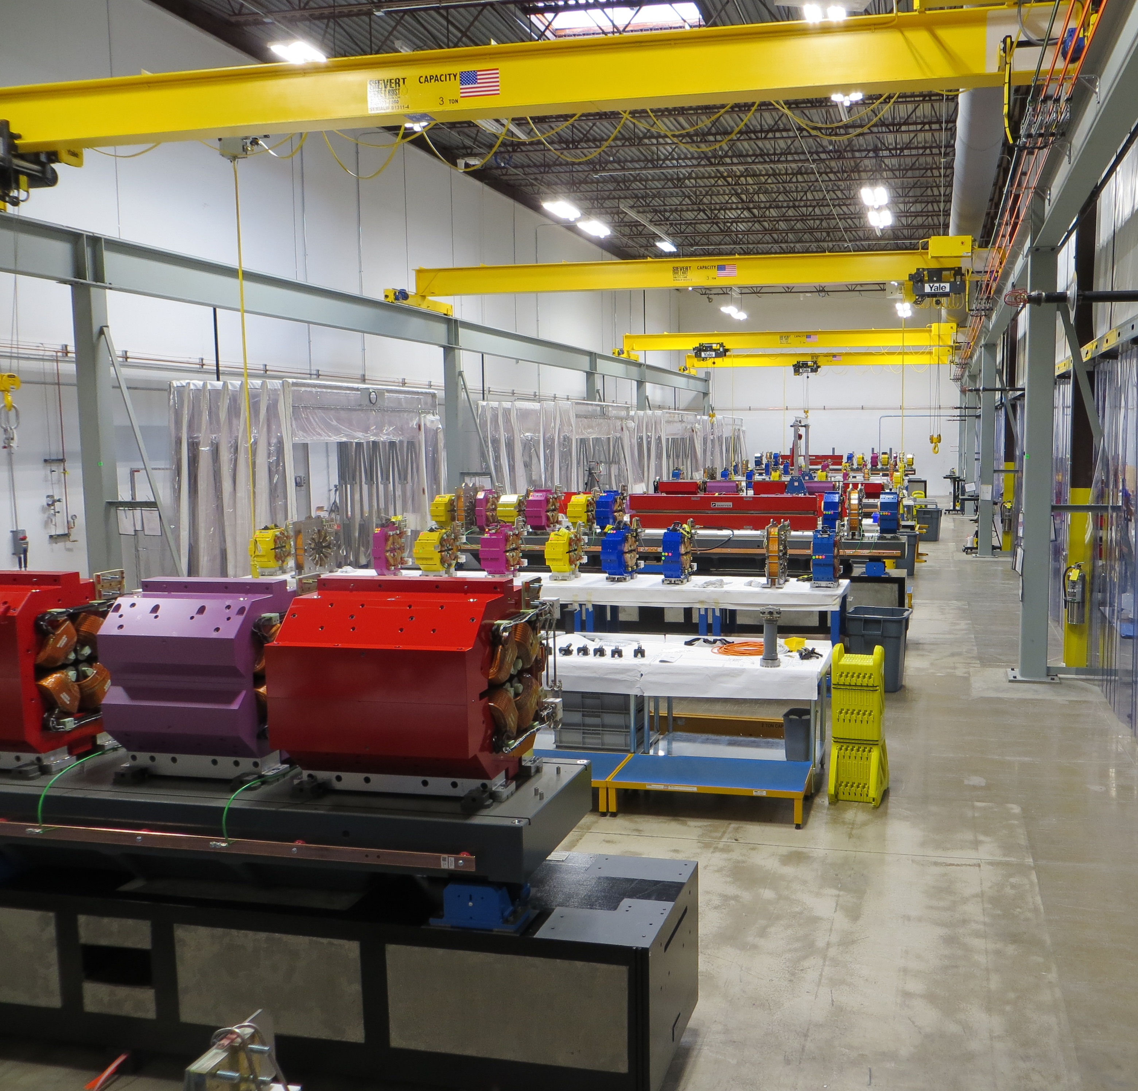
MODULE ALIGNMENT
Magnet alignment procedure developed; Module assembly underway
Vacuum system alignment process in development; component deliveries will ramp up in 2022
Automation of measurement steps to prevent errors and increase efficiency
Custom program calculates optimal shim placement
Extraordinary results achieved; well within the APS-U specification
DLMA-1160 | X (m) | Y (m) | Z (m) | Pitch (mr) | Yaw (mr) | Roll (mr)
DA16_AQ1_0 | 0.000004 | -0.000002 | -0.000204 | -0.020 | 0.075 | -0.001
DA16_AQ2_0 | 0.000008 | 0.000008 | -0.000067 | 0.017 | -0.001 | -0.025
DA16_AQ3_0 | -0.000009 | 0.000004 | 0.000063 | -0.162 | 0.065 | 0.035
DA16_AS1_0 | -0.000005 | -0.000016 | -0.000046 | -0.132 | 0.046 | -0.031
DA16_AQ4_V | -0.000003 | -0.000002 | -0.000016 | -0.010 | 0.015 | 0.000
DA16_AS2_0 | -0.000002 | -0.000003 | 0.000076 | 0.238 | 0.032 | -0.045
DA16_AQ5_V | -0.000010 | 0.000002 | 0.000057 | -0.013 | 0.057 | -0.017
DA16_AS3_0 | -0.000002 | -0.000004 | 0.000131 | -0.123 | 0.182 | 0.008
Average | -0.000002 | -0.000002 | -0.000001 | -0.026 | 0.059 | -0.010
RMS | 0.000006 | 0.000007 | 0.000099 | 0.121 | 0.079 | 0.026
ABS Max | 0.000010 | 0.000016 | 0.000204 | 0.238 | 0.182 | 0.045

Slide 11
PROCESS AUTOMATION
Multiple software tools utilized to streamline the module alignment process
Spatial Analyzer
  Primary software tool for module alignment
  Sophisticated measurement plan tool automates multiple processing steps – substantial savings in effort and reduction of errors
Leica Tracker Pilot
  Automatically turns on laser tracker at desired time – laser is on and warmed-up when technicians arrive for work.
  Calibration checks and compensation
APS-U Component Database (CDB)
  Interfaces with Jupyter Lab to extract a list of magnets installed on any module
  List from CDB used for optimal shim calculations and coordinate transformations
  Module survey results are uploaded to CDB
Excel
  Source of fiducial and reference data for Jupyter Lab shim calculations and coordinate transformations
Python / Jupyter Lab
  Custom programs developed to execute calculation of optimal shims and coordinate transformations

Slide 12
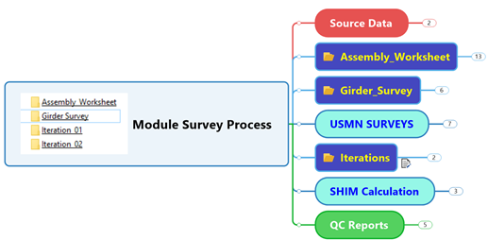
MODULE ALIGNMENT PROCEDURE
General Order of Module Assembly and Alignment
Pre-survey
Run shim calculation
Install magnets on girder plate with shims
Run coordinate transformation program
Survey magnet array
USMN uncertainty analysis
Magnet transformations
Revise shim packs (Typically 2 iterations)
Split magnets; install vacuum & diagnostics
Align vacuum system
Re-assemble magnets
Re-survey magnet array; Vacuum components not measured after reassembly.
Record appropriate documentation in CDB
Place module in storage

Slide 13
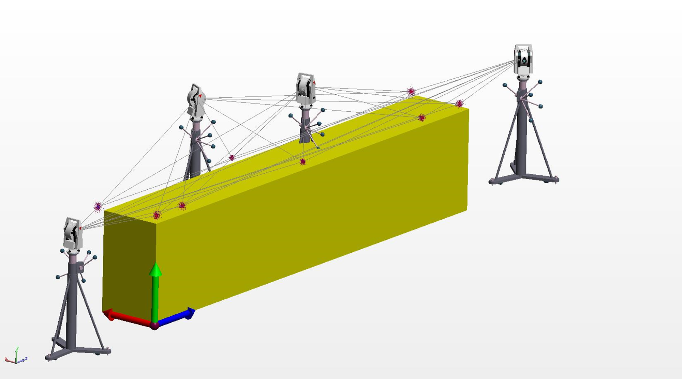
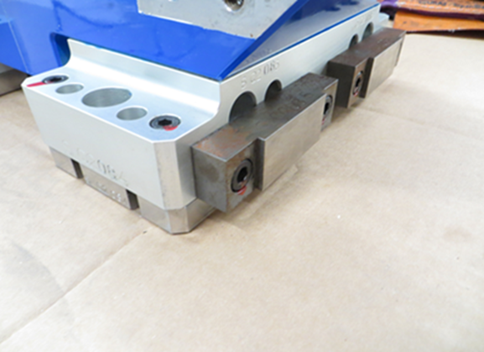
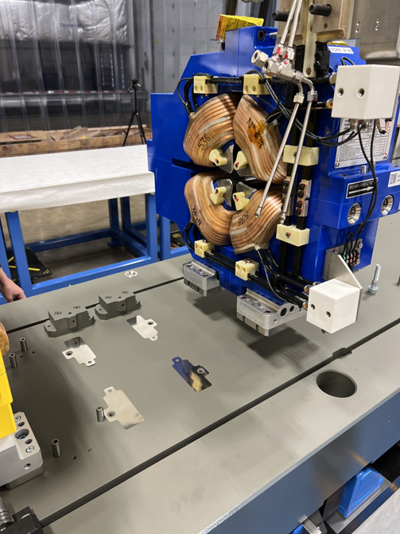
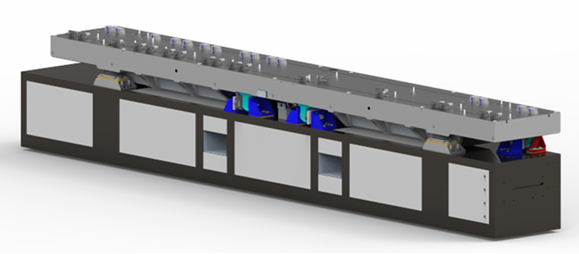

Pre-Survey
Records relationships between girder fiducials - impossible to measure after magnet installation
Pre-survey measurements are utilized in all subsequent surveys
Reduces uncertainty and increases confidence
Shim Calculation
No adjustment is provided – alignment corrections accomplished using shims
Python / Jupyter program extracts magnet serial number from CDB and fiducial records from a network drive
Automatically calculates optimum shim placement through multiple linear regression permutations
Extraordinary results achieved
Horizontal Reference
Vertical Reference
Plate Surface
Alignment X Stop
IWAA 2022 CERN - Geneva - Switzerland 29 Oct - 04 Nov 2022

Slide 14
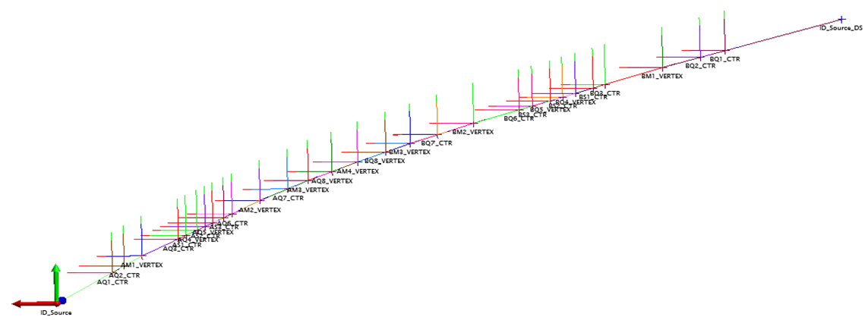
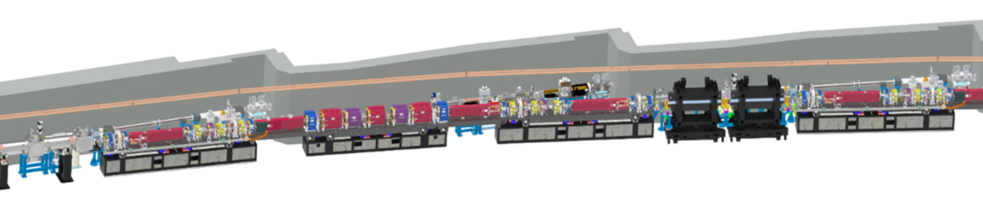
Coordinate Transformation
Python / Jupyter program extracts magnet serial number from CDB and fiducial records from network drive
Automatically transforms each magnet from its local CS into the generic lattice CS
Multiple transformations – overall array and individual magnets
Module installation fiducials expressed in the generic lattice CS
IWAA 2022 CERN - Geneva - Switzerland 29 Oct - 04 Nov 2022

Slide 15
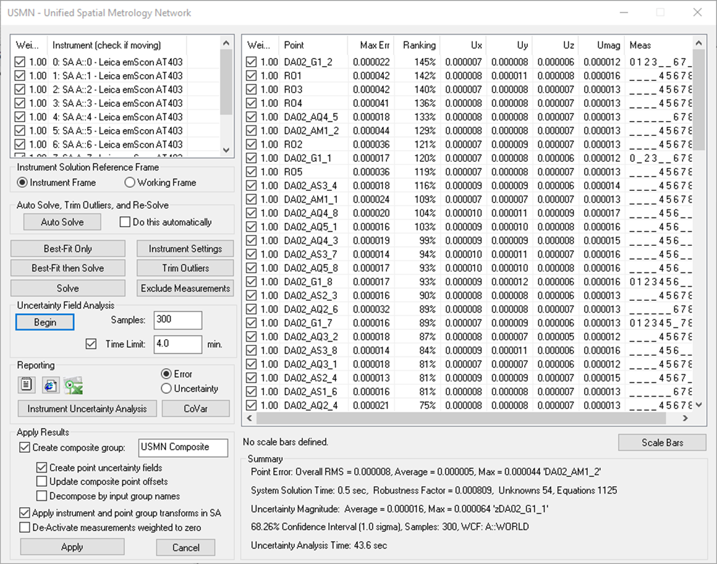
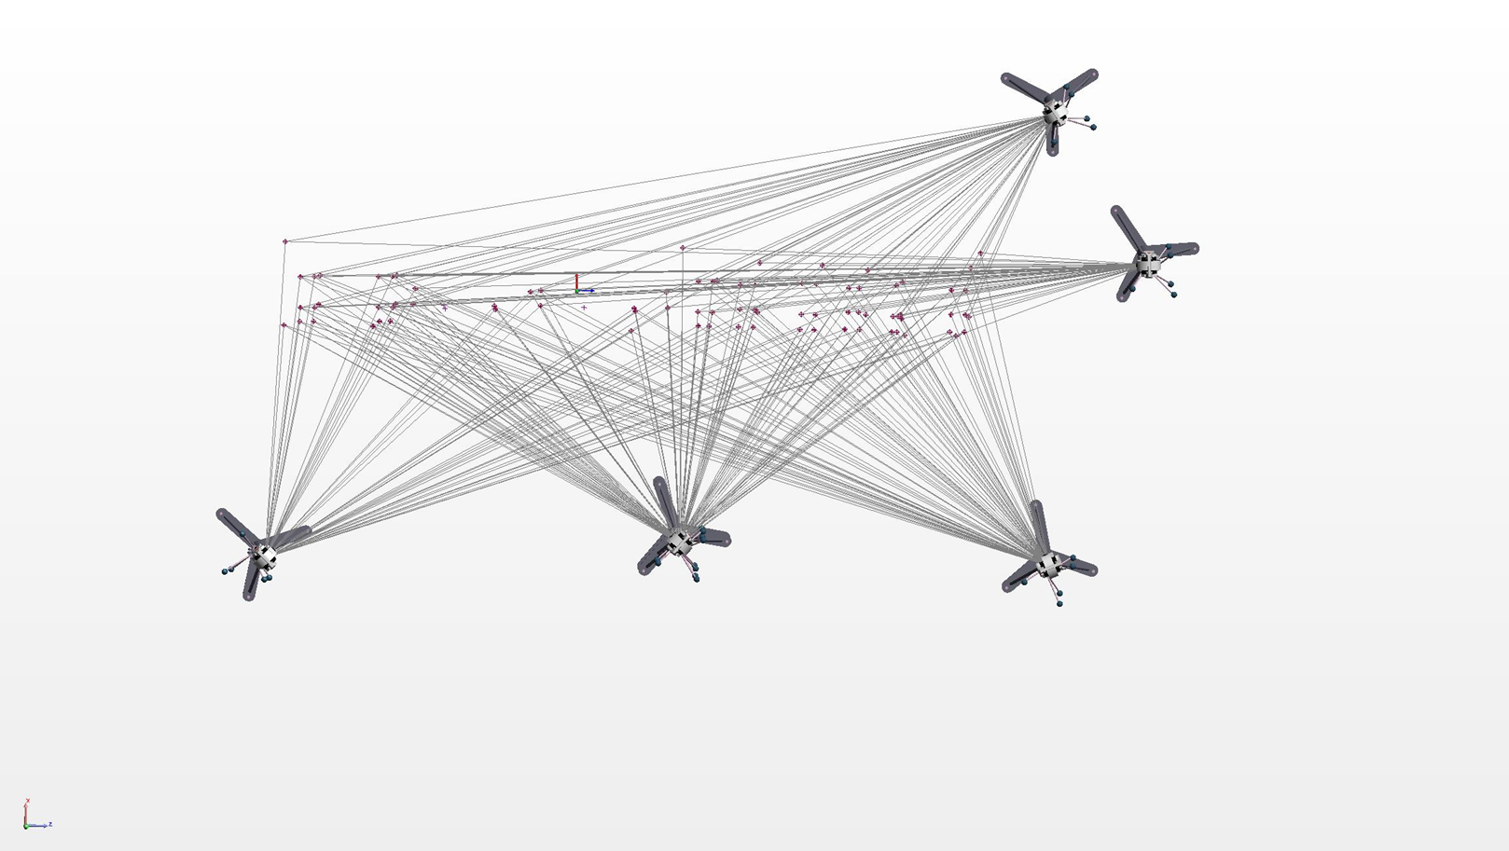
Module Survey
Survey of all fiducial references
Perform Unified Spatial Metrology Network (USMN) uncertainty analysis of measurement set
Transformation files generated in earlier step undergo least-squares best-fit transformations to determine magnet positions within the assembly.
IWAA 2022 CERN - Geneva - Switzerland 29 Oct - 04 Nov 2022

Slide 16
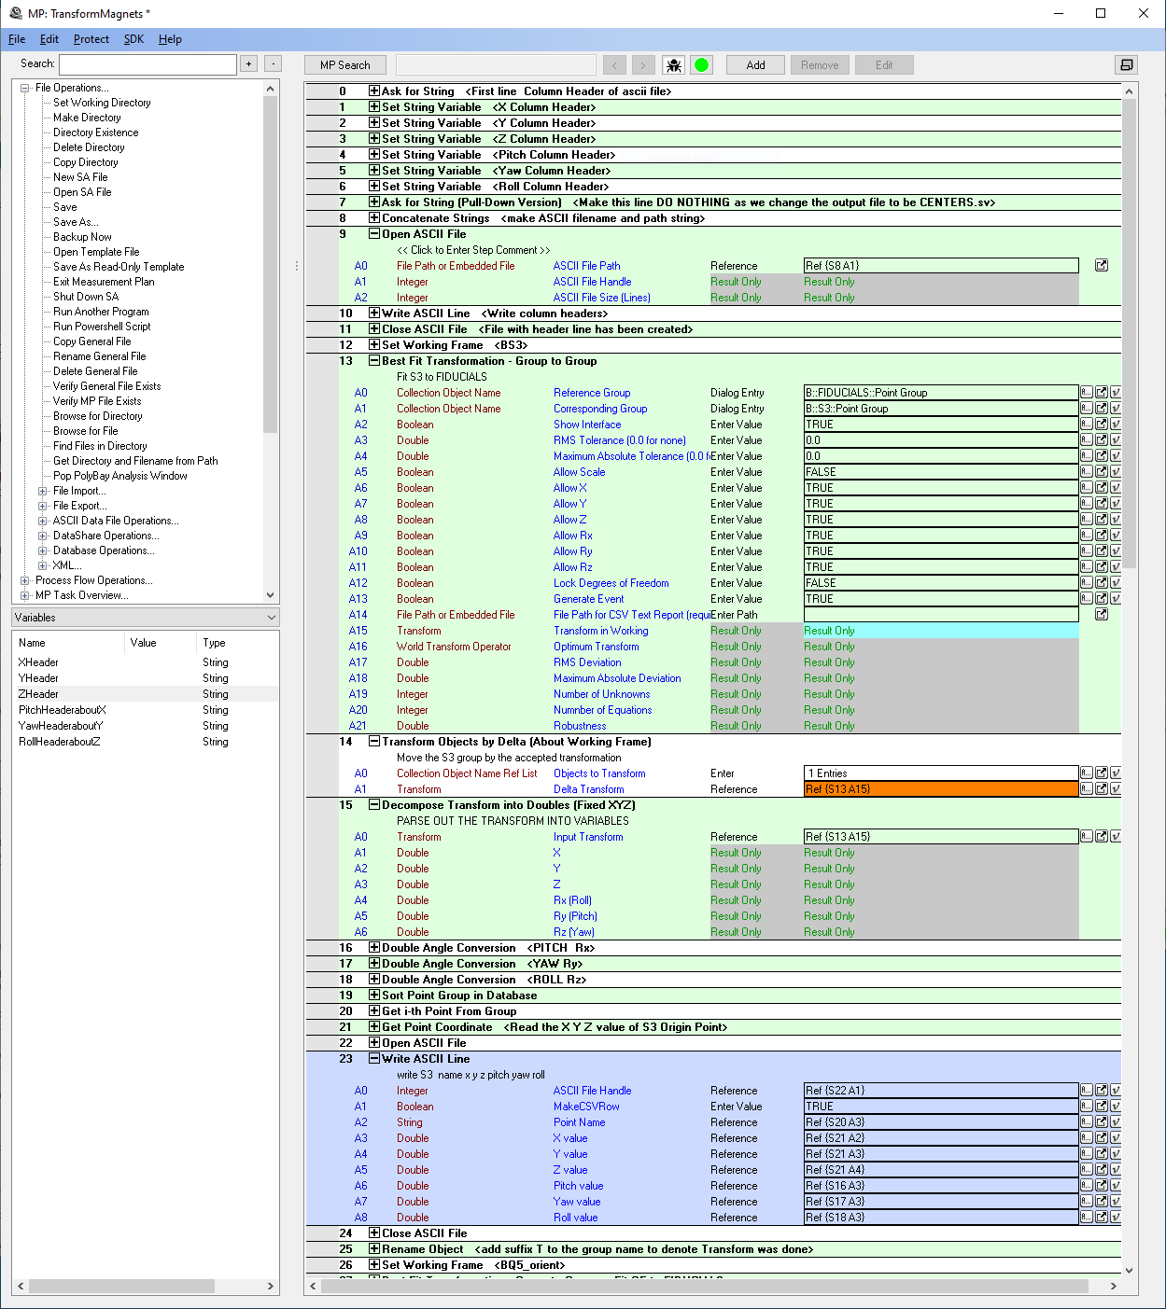

Automated Measurement Plans *
Spatial Analyzer software operates on scripts to automate measurement and analysis steps, reducing the possibility of errors and saving significant time and effort
Arguments and Parameters coordination
Multiple coordinate transformations between measured values and ideal positions
File input paths and output paths
ASCII file construction line by line
Unit conversions
* Contributed by Sam Jarvis

Slide 18
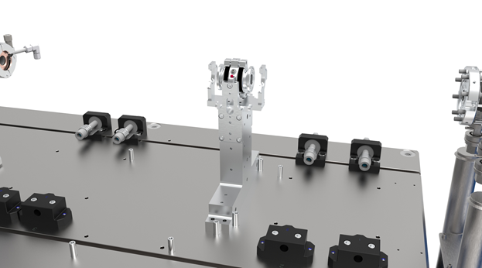
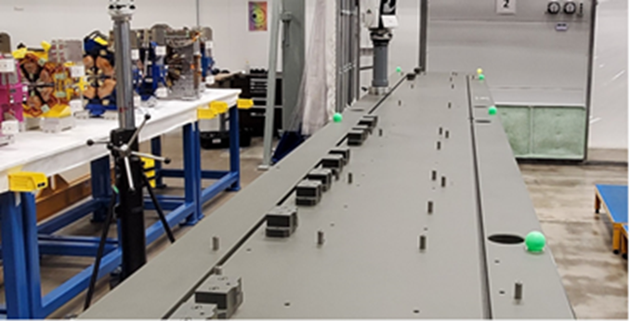
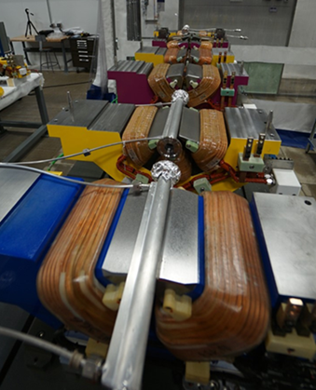
Vacuum & Diagnostic Systems
Multiple vacuum and diagnostic segments
Tolerance is +/- 0.250 mm; uncertainty spec needed
Magnet alignment tolerance is 0.030 mm RMS;
Pole tips serve as precision locating gauges.
Features in the assembly simplify alignment:
  BPM mount and chamber yokes are precision machined to be self-aligning against locating pins in the girder plate surface. Inspections show BPM position error is < 100 μm in X and Y
  Vacuum chamber segments will self-align to the magnet pole tips; Mylar shim strips 0.5 mm thick will locate chamber segments at the multipole magnet centers. Shims will be removed after vacuum connections are made up.
  Flange circumferences and chamber surfaces are excellent reference features
IWAA 2022 CERN - Geneva - Switzerland 29 Oct - 04 Nov 2022

Slide 19
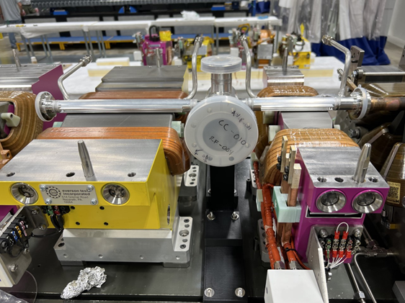
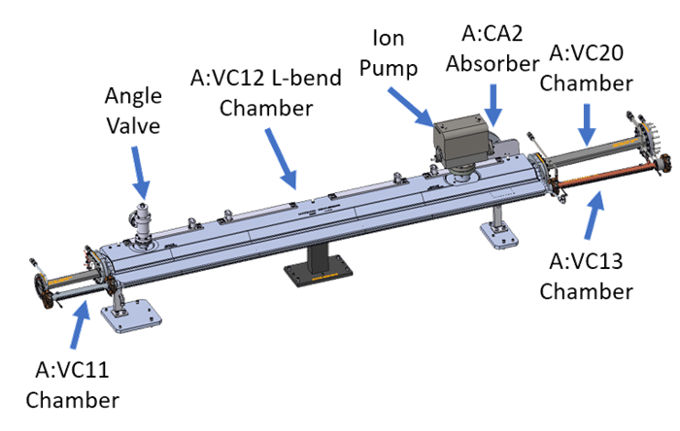
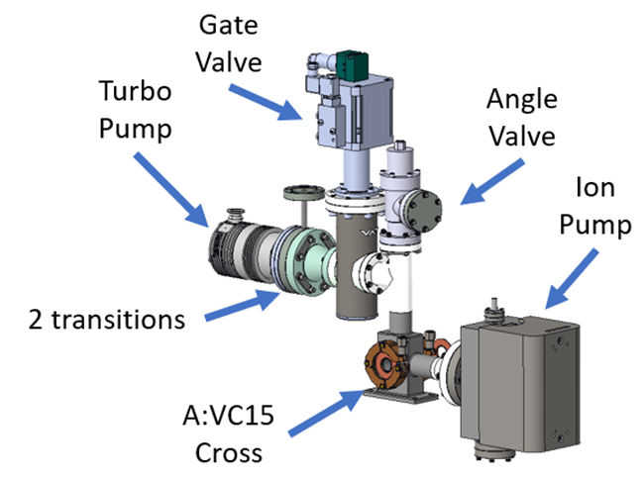
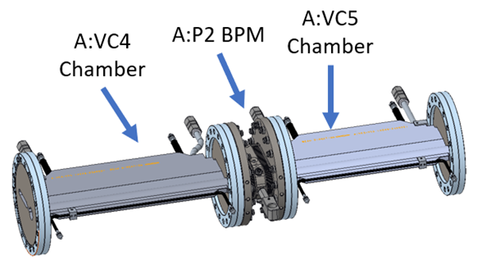
Vacuum System Sub-Assemblies
Sub-assemblies of multiple components will be pre-aligned both to minimize exposure to atmosphere, and to increase efficiency in assembly.
Many vacuum connections are easier to make up on a bench than in-situ within the module assembly where there is a tight fit.
19

Slide 20
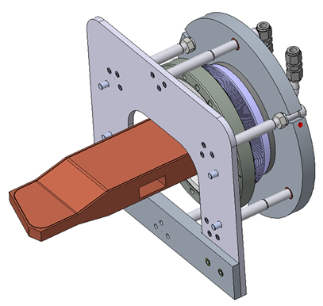
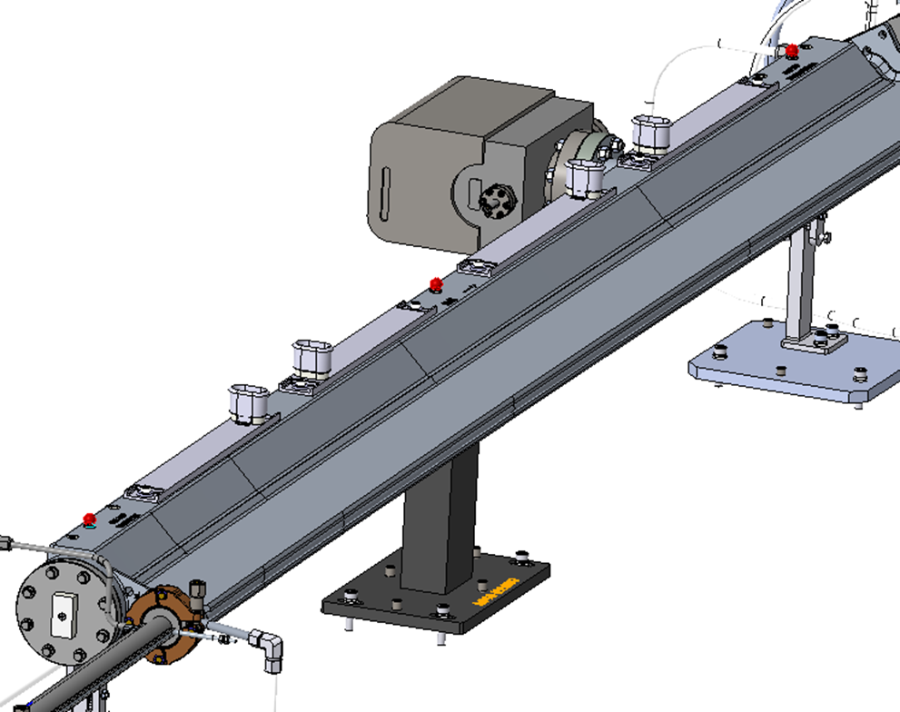
L-Bend Chambers
ConFlat flanges welded in-house. First few chambers will undergo dimensional inspection of flange position and orientation.
Whether all 160 chambers will need inspection to be determined
Absorbers at downstream end will require alignment
Absorbers
Fiducials provided by vendor
Alignment procedure under development – will be done in module assembly area
PCMM arm and optics will be employed
IWAA 2022 CERN - Geneva - Switzerland 29 Oct - 04 Nov 2022

Slide 21
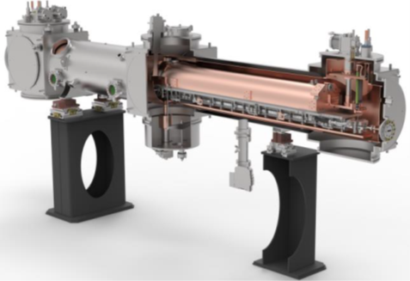
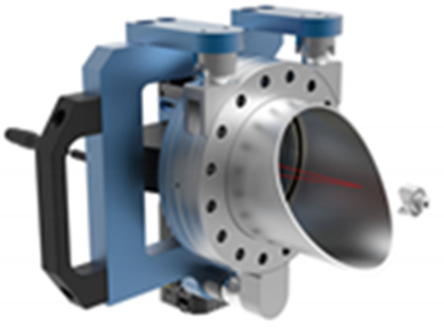
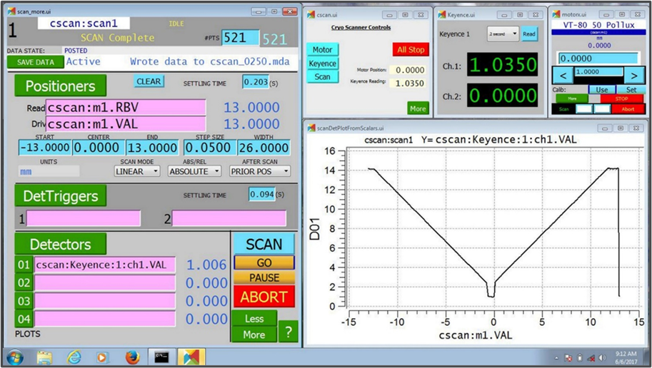
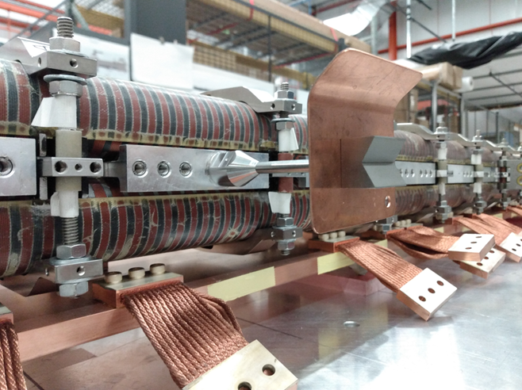
Superconducting Undulators
APS is a world leader in the development of superconducting undulator insertion devices for synchrotron light sources and free electron lasers
Three SCUs currently operating at the APS.
APS Upgrade features two advanced SCUs: each 4.8-m-long cryostat will contain two SC undulator magnets up to 1.9 m in length; both in-line and canted configurations will be built.
Cryostat Internal Measurement
Cold mass displacement is measured using a 2D laser scanning method developed at APS – presented at IWAA 2018
Cryoscanner measures X and Y thermal shift displacements of the cold mass assembly with <10 μm resolution.
Kinematic couple - EPICS GUI - Low-cost solution

Slide 22
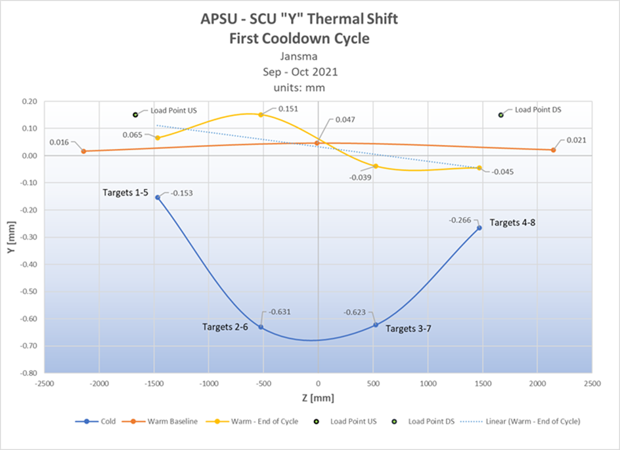
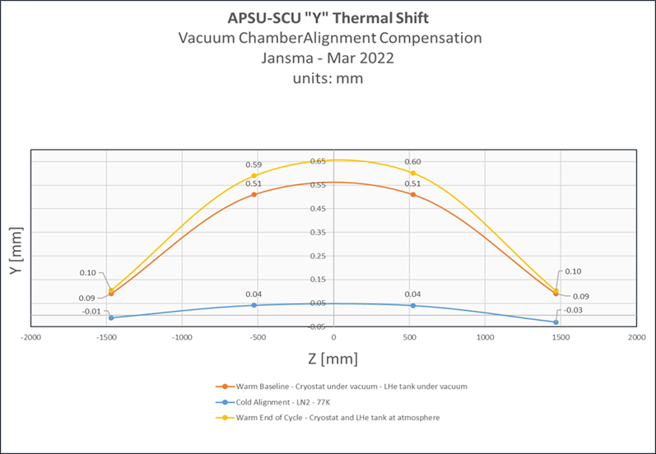
Superconducting Undulators
First engineering cooldown of the new SCU design performed in September 2021.
Measurement result revealed a 0.8-mm sag in the vacuum chamber position upon cooldown to LHe temperature
Sag is compensated in the warm alignment of the chamber and magnet cores.
Middle of the chamber set 0.8-mm higher than the ends to introduce an inverse vertical profile, opposite to the profile observed at cooldown.
Second engineering cooldown performed to test the compensation strategy.
Compensation strategy was successful.
Final assembly of the first article APS-U SCU under-way as of this writing. Compensation applied in warm alignment of the cold mass; cold mass position within the cryostat will be verified upon cooldown
IWAA 2022 CERN - Geneva - Switzerland 29 Oct - 04 Nov 2022

Slide 23
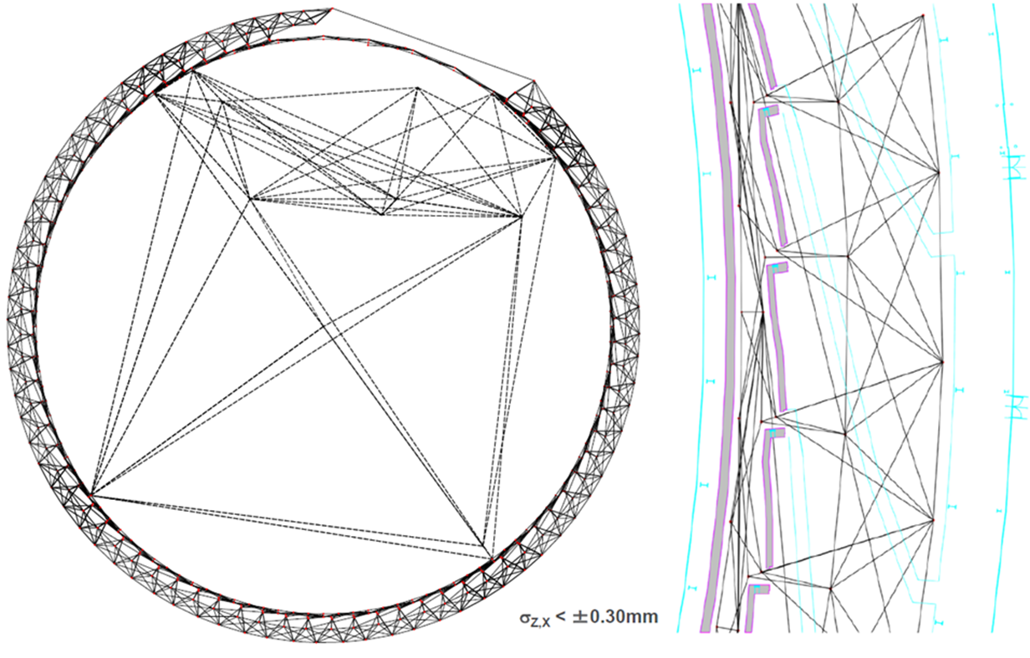
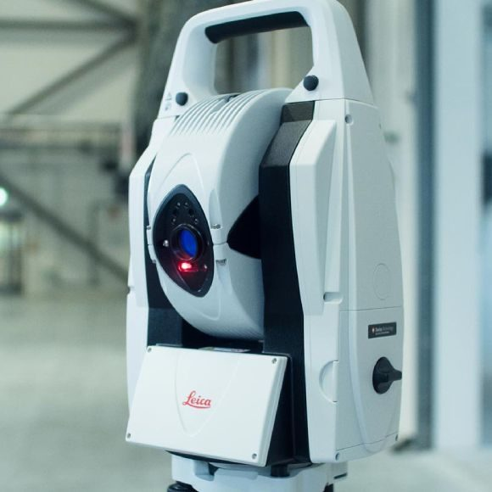
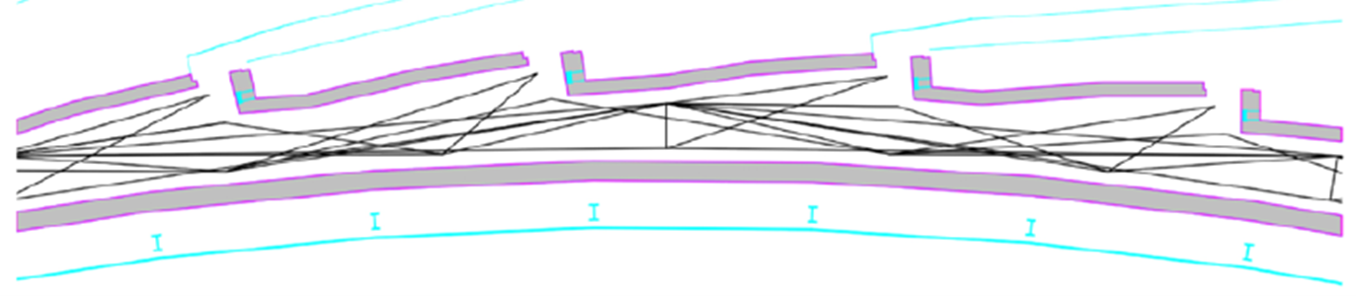
Survey Control Network
Final survey of the existing APS storage ring completed in 2021
Existing beamline source locations and smoothing curve for the machine documented.
Control network to be densified and resurveyed in 2023, immediately upon removal of the existing storage ring. Monuments obstructed by existing machines will be included in the APS-U control network survey, as well as local beamline optical control targets
Network adjustment is accomplished using NETOBS, software developed at the Facility for Rare Isotope Beams (FRIB) at Michigan State University Analysis revealed a 22-ppm scaling error in the existing control network—this will be re-solved in the development of the final alignment strategy for the new ring.
IWAA 2022 CERN - Geneva - Switzerland 29 Oct - 04 Nov 2022

Slide 24
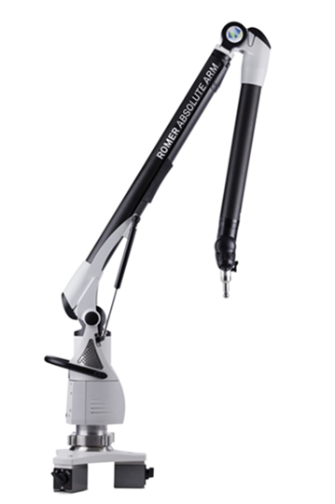
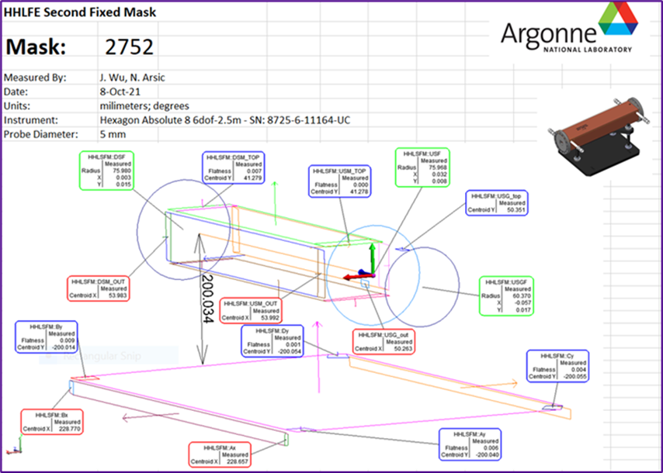
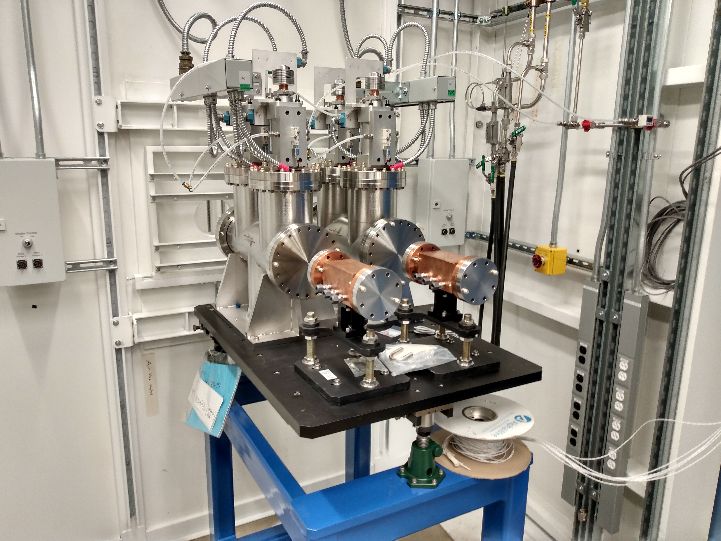
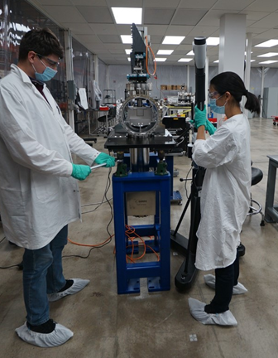
Beamlines
Inspection and fiducialization of APS-U front-end and beamline components underway.
Traditionally, APS survey and alignment utilized precision optical tooling methods to perform this work. We are now using PCMM arms and metrology software to increase efficiency.
A remarkable increase in productivity over the traditional fiducialization method realized; new methods are up to 4x more efficient and provide higher quality, detailed reporting for the components.
IWAA 2022 CERN - Geneva - Switzerland 29 Oct - 04 Nov 2022

Slide 25
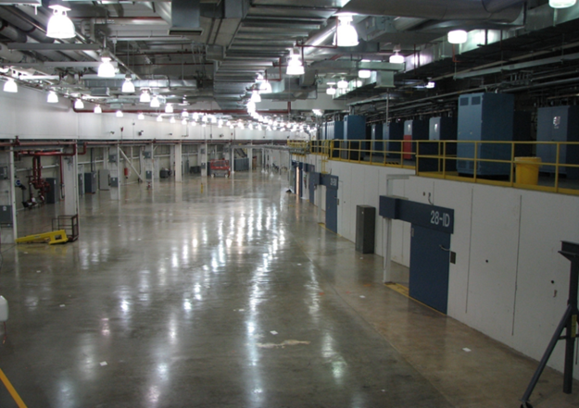
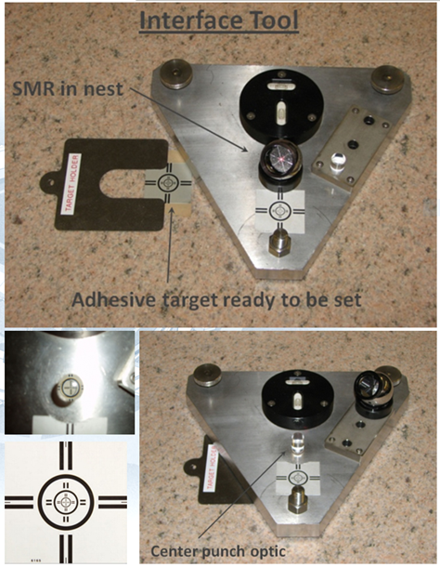
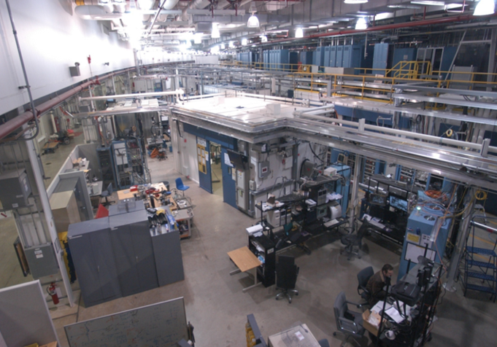
Beamlines
Original beamline optical control targets were placed before the APS experiment hall was built out and the entire line was visible.
Experiment hall now populated infrastructure - impossible to reproduce original control. Special tooling enables optical control targets to be measured using a laser tracker.
SMR nests placed throughout beamline hutches and surrounding areas to establish USMN adjusted laser tracker network.
Optical control targets measured within the network. Beamline CS established based on the original optical control.
Existing control robust; 5-m segment of known X-ray beam position extrapolated 30-m indicated original optical targets within 100-μm
Control accurately references APS X-ray beams. Local control to be integrated with the APS primary control network to inform the storage ring alignment strategy to meet existing beamline trajectories.
IWAA 2022 CERN - Geneva - Switzerland 29 Oct - 04 Nov 2022

Slide 26
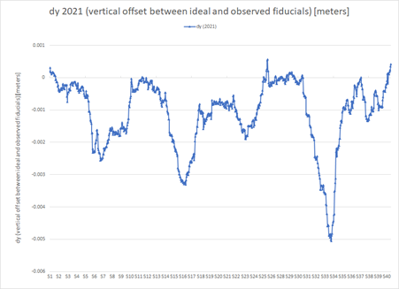

Module Installation Planning
Original goal to align the new ring to meet existing beamline infrastructure modified
The vertical component (Y) of the machine will be aligned fit the ideal orbit plane.
Decision driven by the fact that all beamline front ends and wall collimators are being removed and replaced; this is the most challenging aspect of realigning a beamline.
Opportunity reset the vertical smoothing and eliminate large excursions in Y due to decades of floor settlement.
Beamlines will be adjusted vertically to meet the new elevation.
We are working with APS Physics to determine the best course of action with respect to radial deviation in establishing the final alignment lattice for module installation.

Slide 27

Module Installation Planning
We have assembled a mockup of a full sector to evaluate installation procedures and to train personnel. The mockup exercise will provide valuable information as we prepare for installation of the new storage ring machine.

Slide 28
CONCLUSION
The preceding provides a snapshot of the status of sur-vey and alignment activities for the APS Upgrade project as of October 2022. Our primary focus over the past two years has been the mechanical inspection and alignment of components and assemblies, and development of pro-cusses to streamline the production of fully assembled storage ring modules. In the coming months, the focus will shift to installation strategies and the development of a sound alignment plan for installation of the newly assembled modules.

Slide 29
Acknowledgement
The authors sincerely thank all who contributed to this work.
APS-U Survey & Alignment team: Jimmy Alba, Venus Appendence, Nemanja Aric, Mike Bose, Dino Cinchona, Will Evans, Brian Gericke, Roberto Lopez, Tommy Parched, Rex Green;
The following APS personnel: Ethan Anliker, Ned Arnold, Ralph Bechtold, Josh Downey, Mark Erdmann, Rolando Greco, Ran Hong, Scott Izzo, Yuri Ivanyushenkov, Keith Knight, John Quintana, Spiro Skiadopoulos, and many others.
Thanks to Peter Manwiller of FRIB, Michigan State University.
This research used resources of the Advanced Photon Source, a U.S. Department of Energy (DOE) Office of Science user facility at Argonne National Laboratory and is based on research supported by the U.S. DOE Office of Science-Basic Energy Sciences, under Contract No. DE-AC02-06CH11357.
IWAA 2022 CERN - Geneva - Switzerland 29 Oct - 04 No 2022

Slide 30


Slide 31


Thank You!
Questions?
“Surveyors” - Gwynn Wilson building, University of Southern California photographed by Ruth Wallach
IWAA 2022 CERN - Geneva - Switzerland 29 Oct - 04 Nov 2022

