Slide 2
Max IV High Precision Self-positioning Robot
Alina Andersson, Max IV Laboratory
Abdullah Shahin, The Faculty of Engineering, Lund University

Slide 3
Robot B.O.R.I.S. at MaxIV

Slide 4
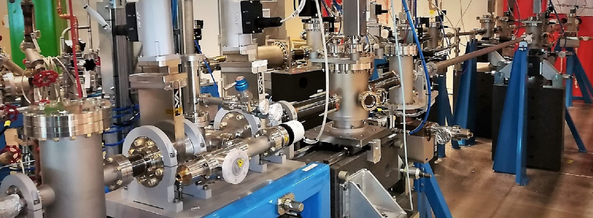
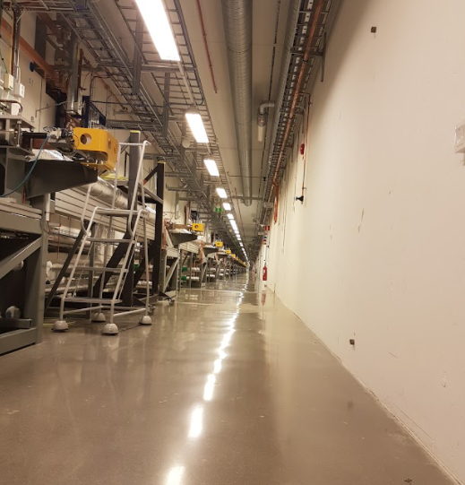
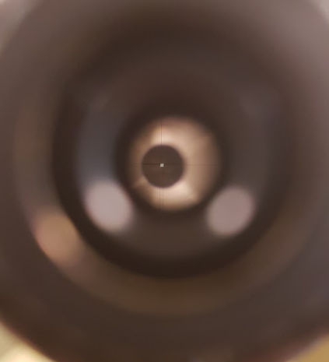
Introduction

Slide 5
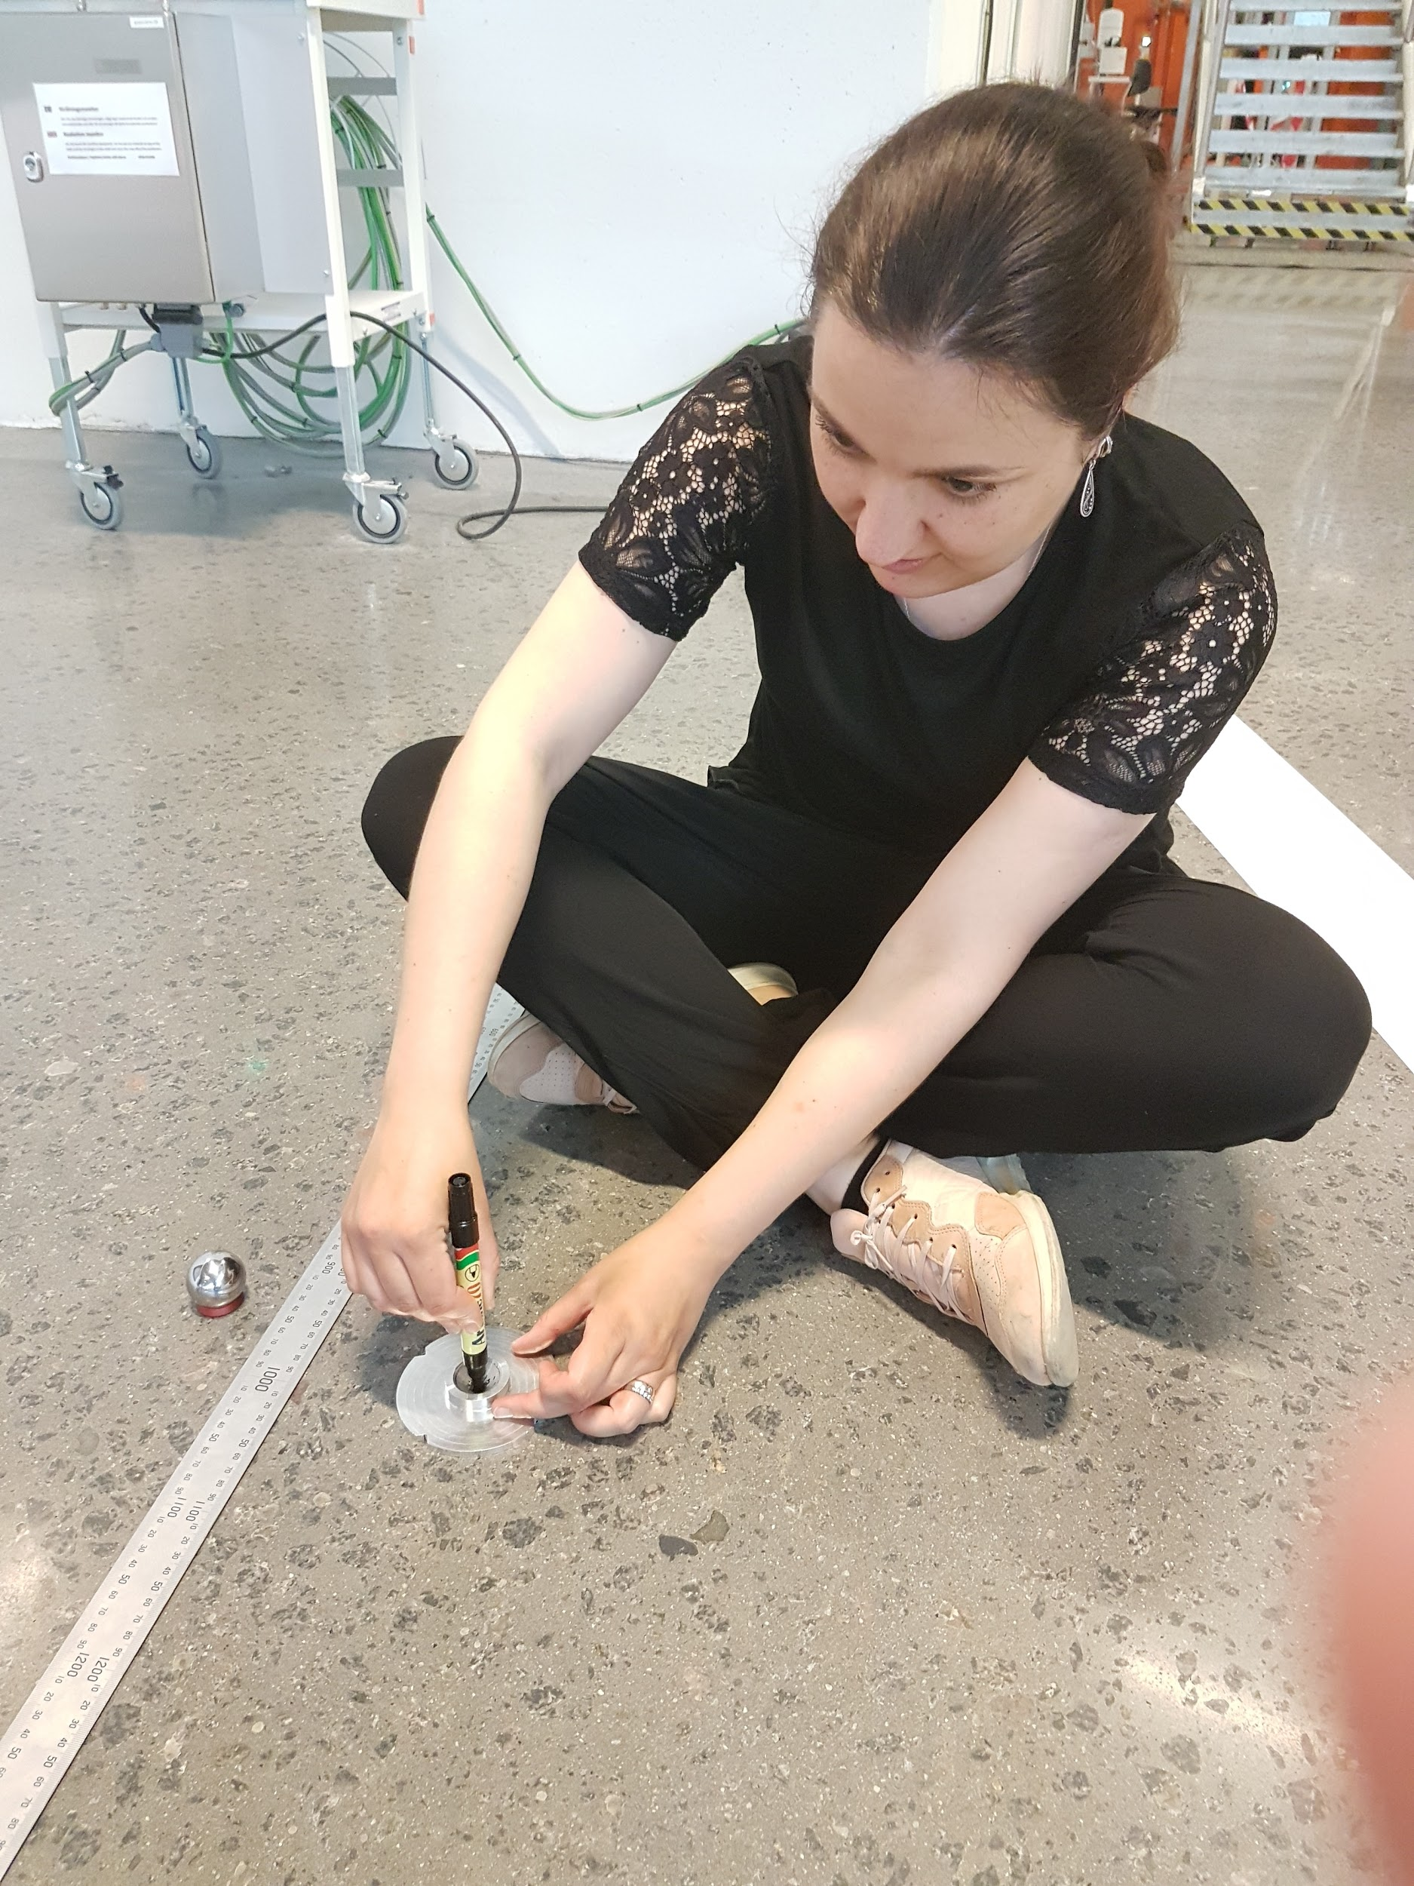
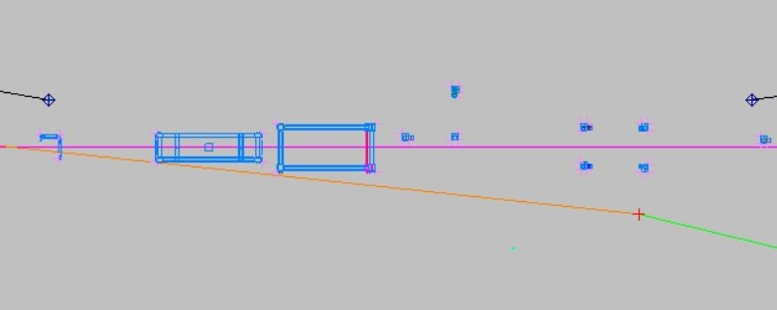
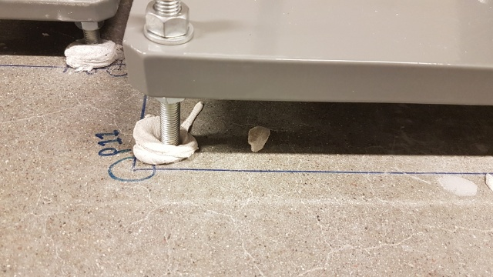
Introduction
Bluelining is a technique of transferring a three-dimensional (3D) computer model into real space.

Slide 6
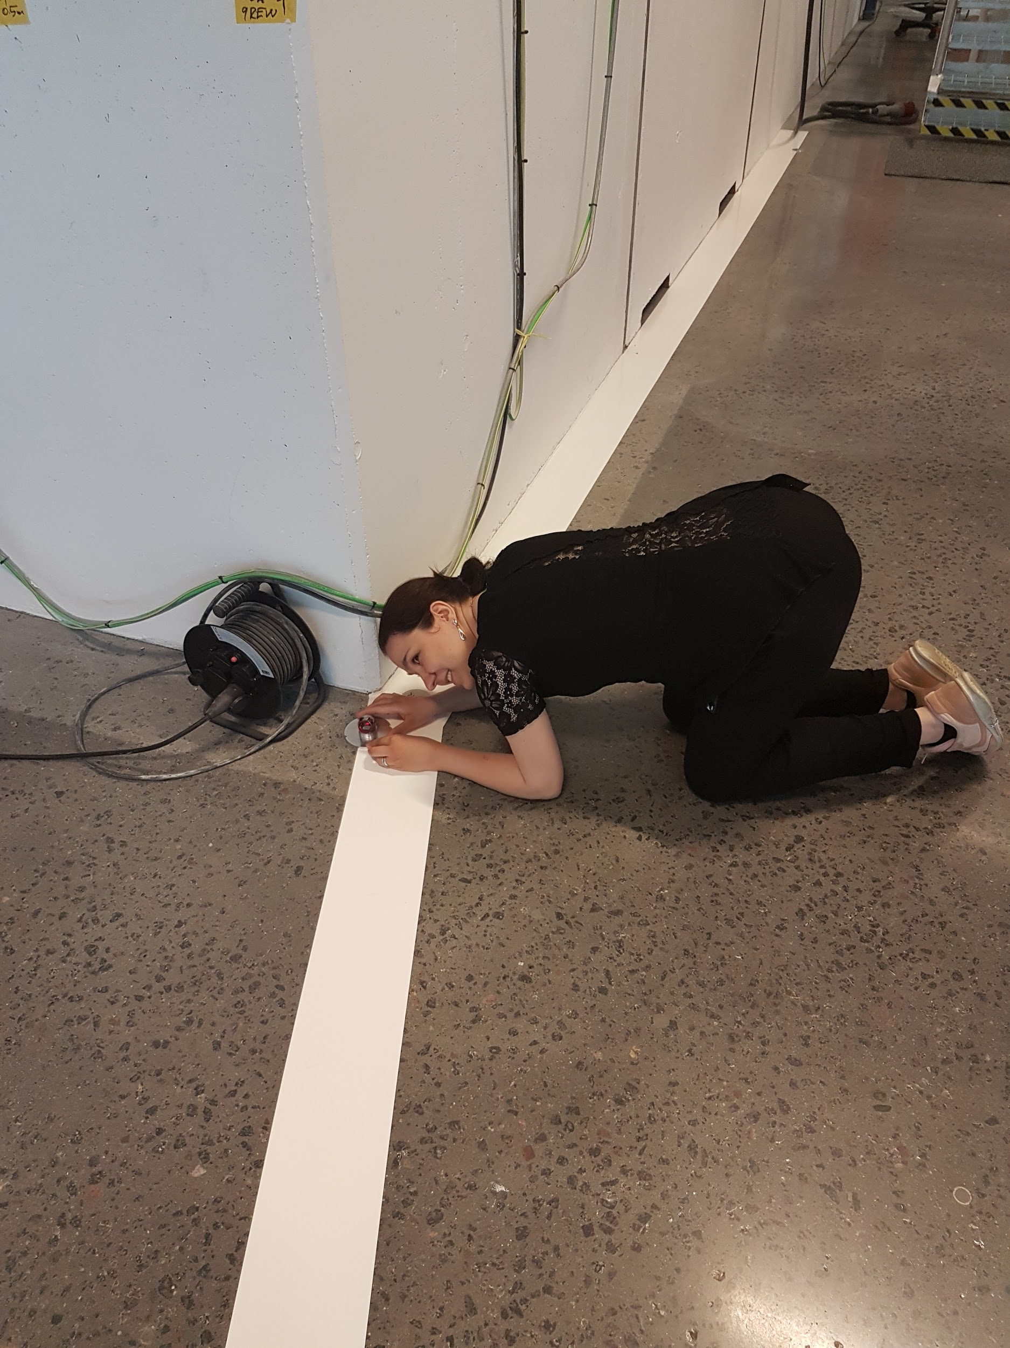
Introduction
The current manual bluelining process for such machines has some disadvantages that need to be improved:
Precision can be around 2-5 mm
The process is relatively slow; since each point has to be treated individually and manually.
The working process might be uncomfortable for a worker
Sometimes the working environment can be unhealthy for humans (construction dust) or not accessible for a long time

Slide 7
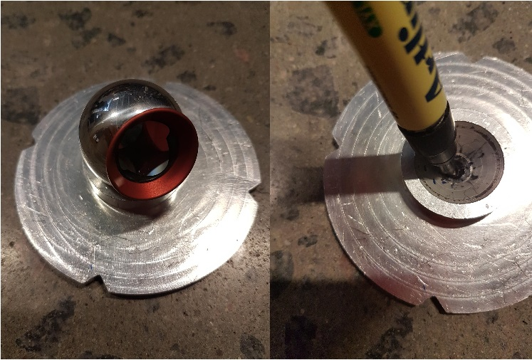
Solution
A bluelining robot would improve the existing bluelining method significantly.
We developed a high-precision self-positioning robot that simplifies the work by automatically driving to the location specified by a computer and marking that position with a dot and lines.

Slide 8
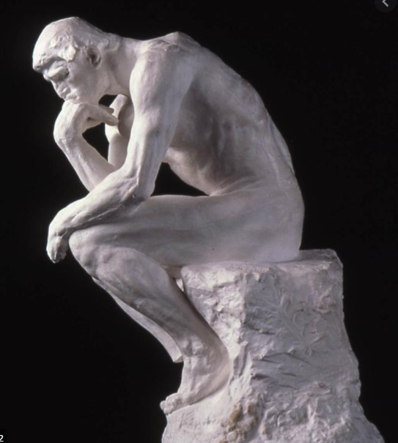
Projects.
Concept design -> Prototyping-> Tests
The primary prototype is divided into two main parts:
a manipulator and a so-called "taxi"
The mobile platform “taxi” is transporting the robot and the manipulator, who will actually perform the job.
B.O.R.I.S.

Slide 9
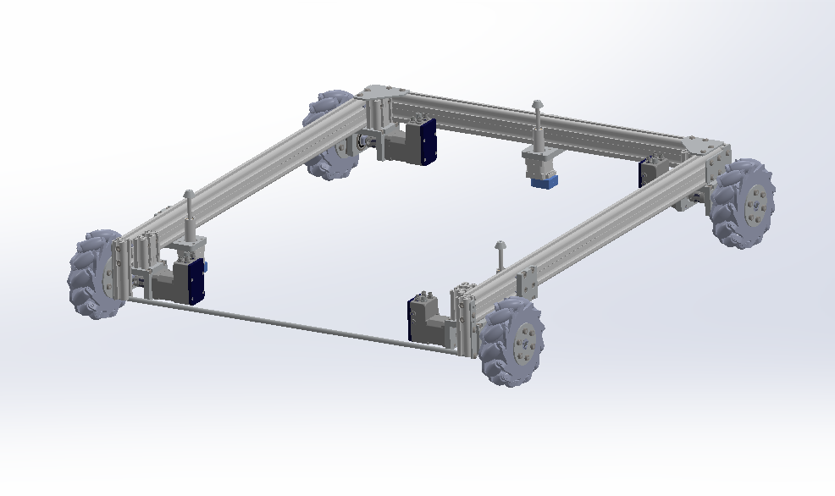
Delivery platform (Taxi)
First stage of positioning

Slide 10
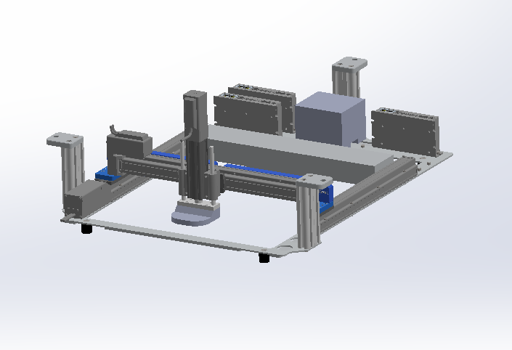
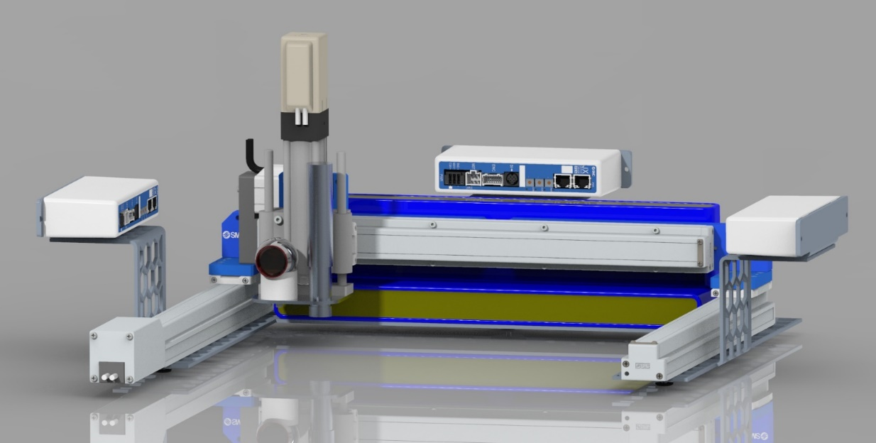
Manipulator
The manipulator is the most accurate and precise sub-
robot.

Slide 11
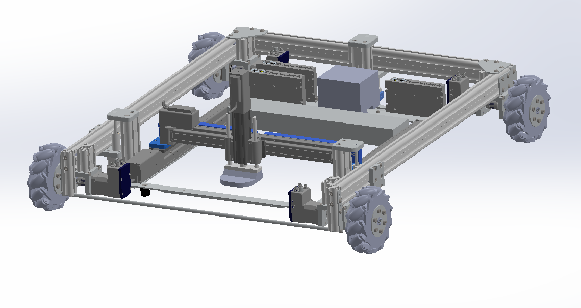
B.O.R.I.S.

Slide 12
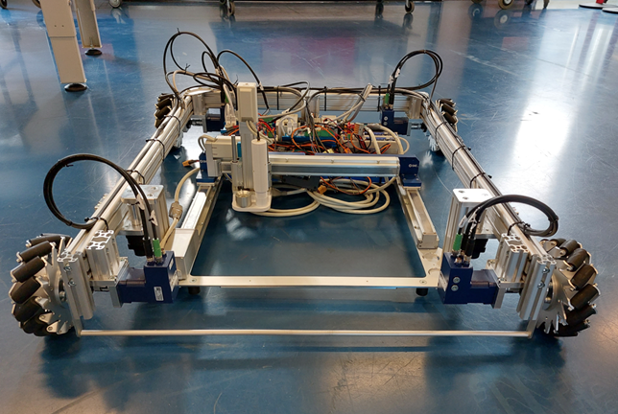
B.O.R.I.S.

Slide 13
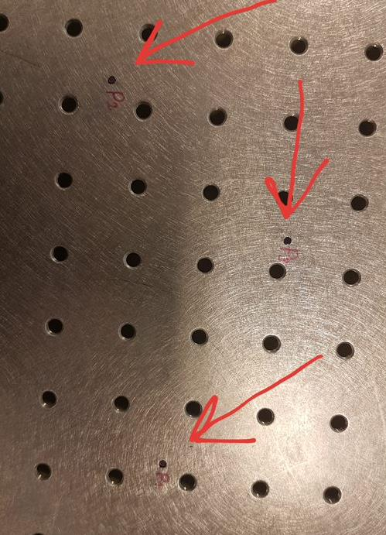
Test results

Slide 14
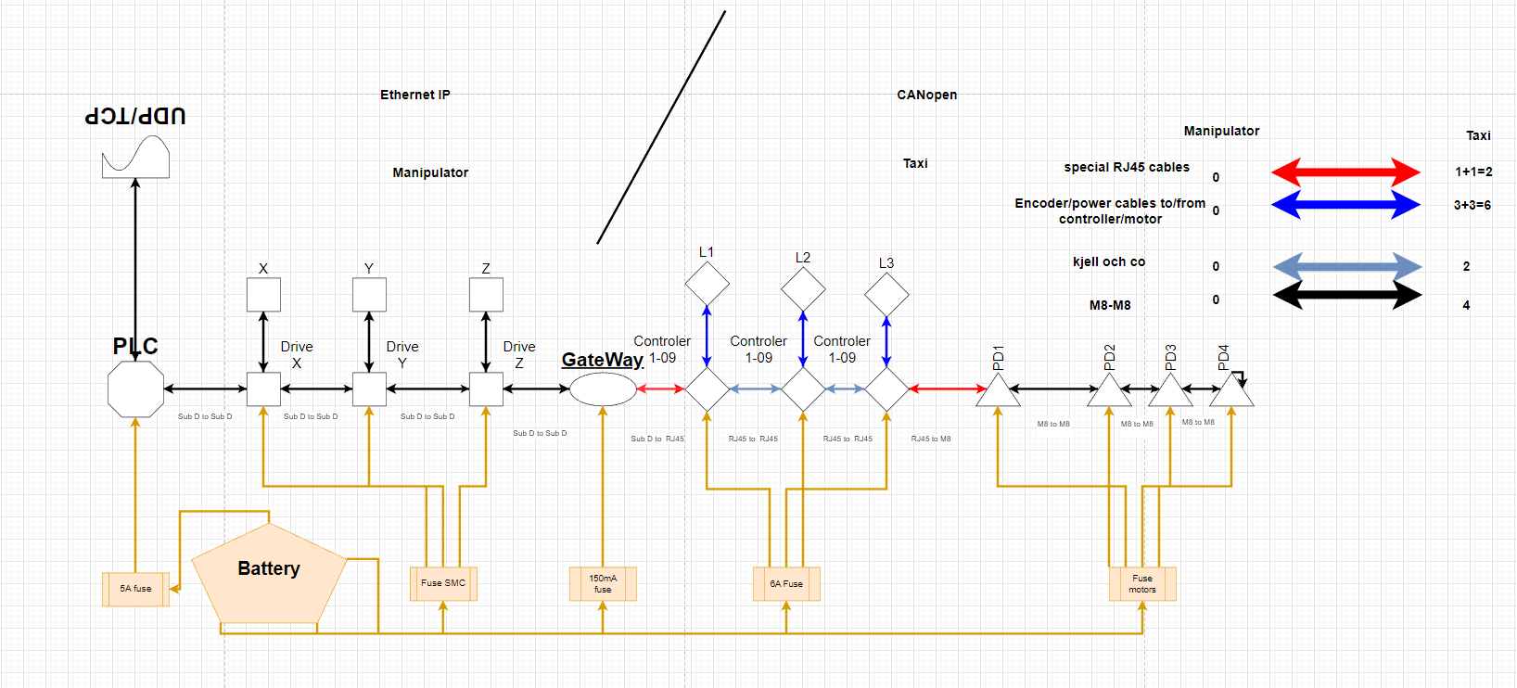
B.O.R.I.S.

Slide 15
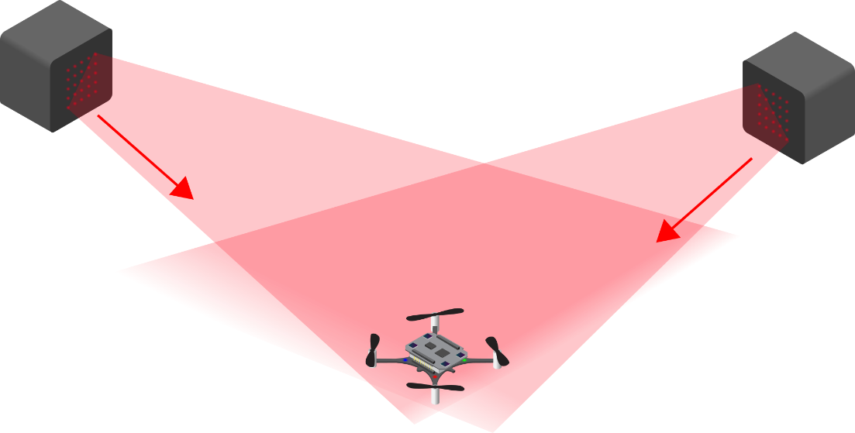
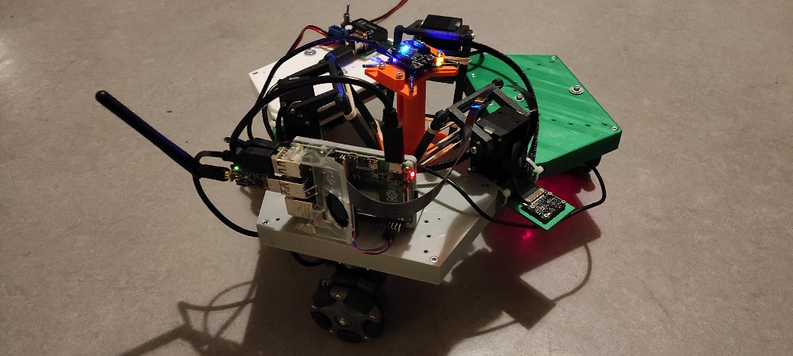
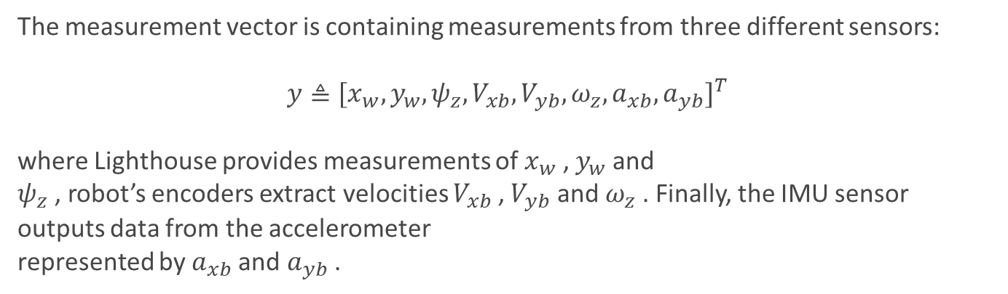
Positioning sensors and sensor fusion
The measurement vector is containing measurements from three different sensors:
$${y≜[x_{w}, y_{w}, ψ_{z}, V_{xb}, V_{yb}, ω_{z}, a_{xb},a_{yb}]}^{T}$$
where Lighthouse provides measurements of $x_{w}$ , $y_{w}$ and
$ψ_{z}$ , robot’s encoders extract velocities $V_{xb}$ , $V_{yb}$ and $ω_{z}$ . Finally, the IMU sensor outputs data from the accelerometer
represented by $a_{xb}$and $a_{yb}$ .

Slide 16
Filters
The filters in focus are the Particle filter (PF), the extended
Kalman filter (EKF) and the unscented Kalman filter (UKF).
Algorithm 1: Extended Kalman Filter Algorithm
while currentSimulationTime < simulationTime do
Calculate the state estimate with the control
commands from the previous time step;
Calculate the error covariance with the Jacobian
of the model;
Calculate the measurement residual;
Calculate the Kalman gain;
Correct the state estimate with the Kalman gain;
Correct the error covariance;
end

Slide 17

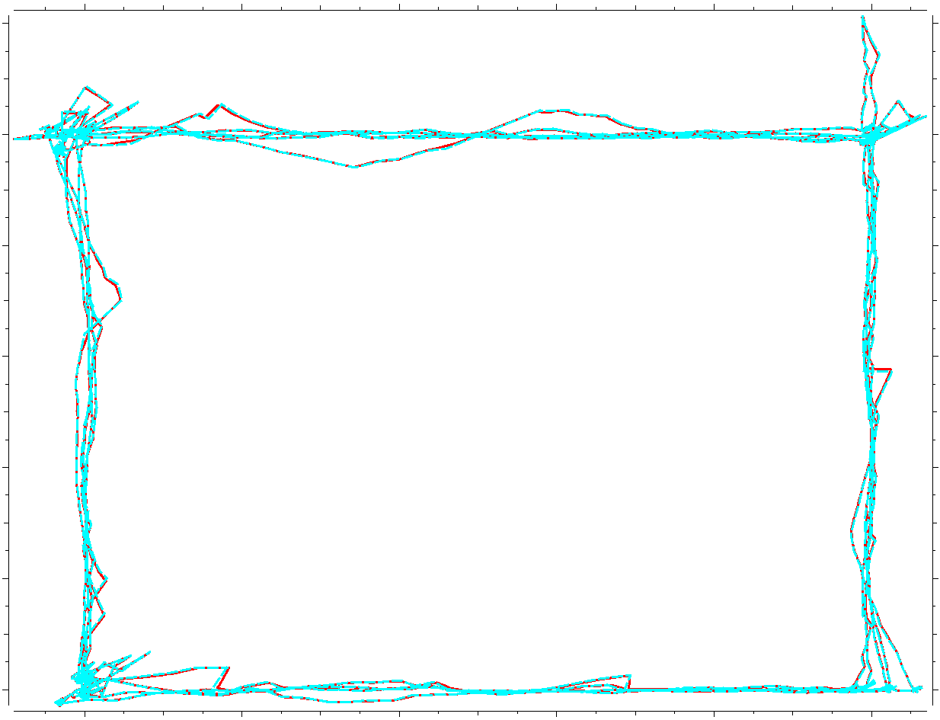

Filters

Slide 18
Thank you !
References:
The Thinker https://en.wikipedia.org/wiki/The_Thinker
Lighthouse https://www.bitcraze.io/images/documentation/overview/lighthouse.png

