Slide 1

Challenges for mobile Hydrostatic Levelling Systems applied in accelerator environments
P. Bestmann
01.11.2022

Slide 2
Outline
  Scope & Motivation
  The new Train project
  Challenges & limitations
  mHLS developments
  Modifications
  Automation & Reliability
  Outlook
Maintenance
Autonomy
Precision
Alignment
Speed
Automatisation
Realtime
Time
Physics
Budget
Reliability
Accuracy

Slide 3
Scope & Motivation
Survey & Alignment
Increasing radiation levels
Time constraints
Precision & Accuracy
Machine- dimension
  We can draw one very clear conclusion from the studies for future accelerators & upgrades:
  We will need to find new ways to measure and align the machines!

Slide 4
The new Train Project
Needs
Constraints
Studies
Solutions
  The aim of the studies is to find, develop & qualify methods with a high automation potential
  Concentrating on our core competencies
  4 main tasks to cover
    Roll angle measurements
    Radial measurements
    Vertical measurements
    Full alignment

Slide 5
The new Train Project – vertical measurements
Direct levelling
Digital or optical
Indirect levelling
Total Stations or Laser Trackers
Hydrostatic levelling
Permanent installation
  Our options are limited
    By external constraints
    By the measurement process
    By the automation potential
    By the materialization of references
  Permanent signalization
    Radiation hard
    180° visibility
    Clear identification

Slide 6
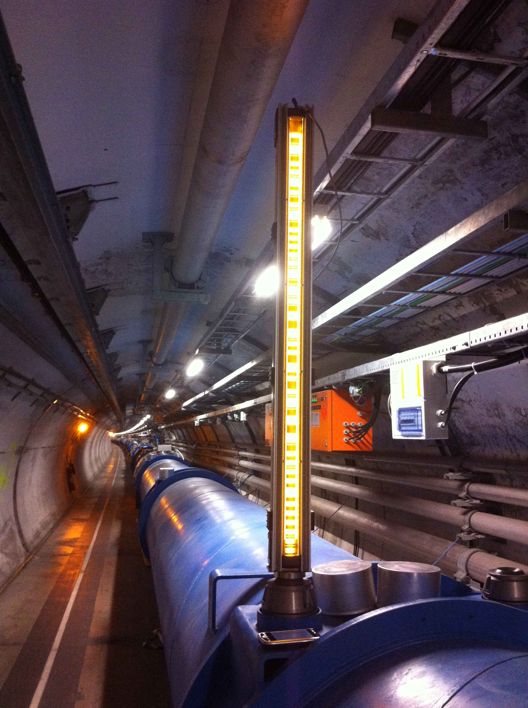
Highly automated vertical measurements
Our aim is to gain physics time
  Shutdown planning is very tight
  Measurements in shadow of warm-up or electrical tests
  Opening of sectors for direct alignment
Key is signalization and identification of the targets
  Can we install a levelling staff or reflector on the go?
  How failsafe could that be?
  Can we install them permanently in the machine?

Slide 7
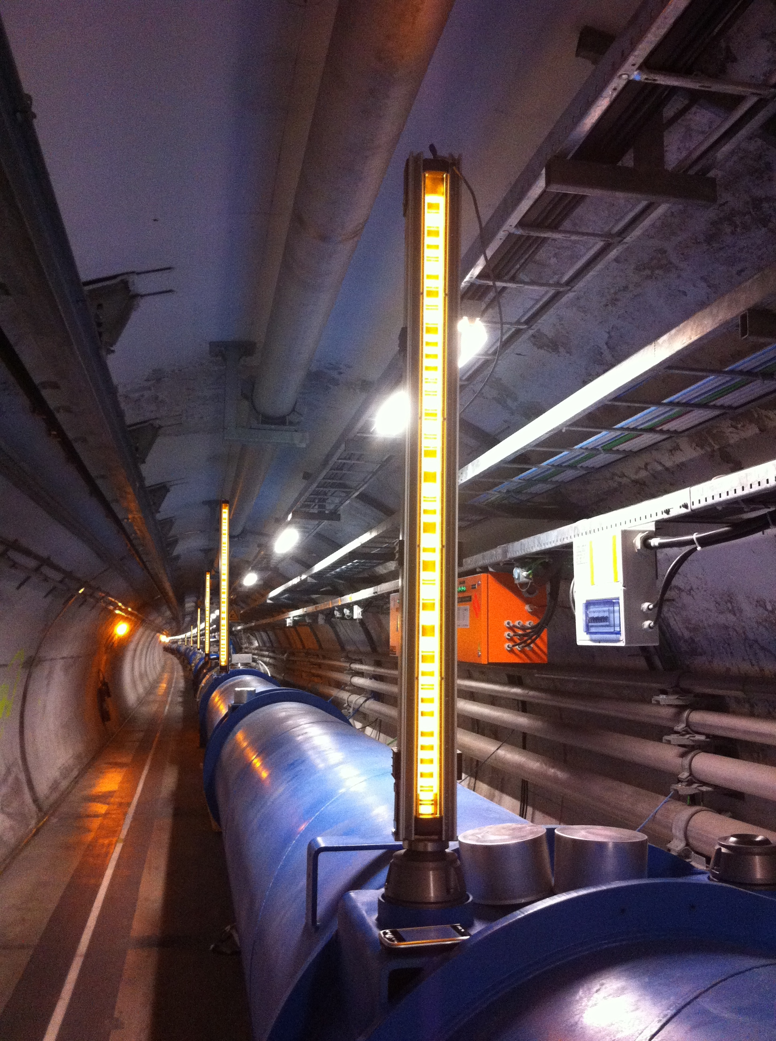
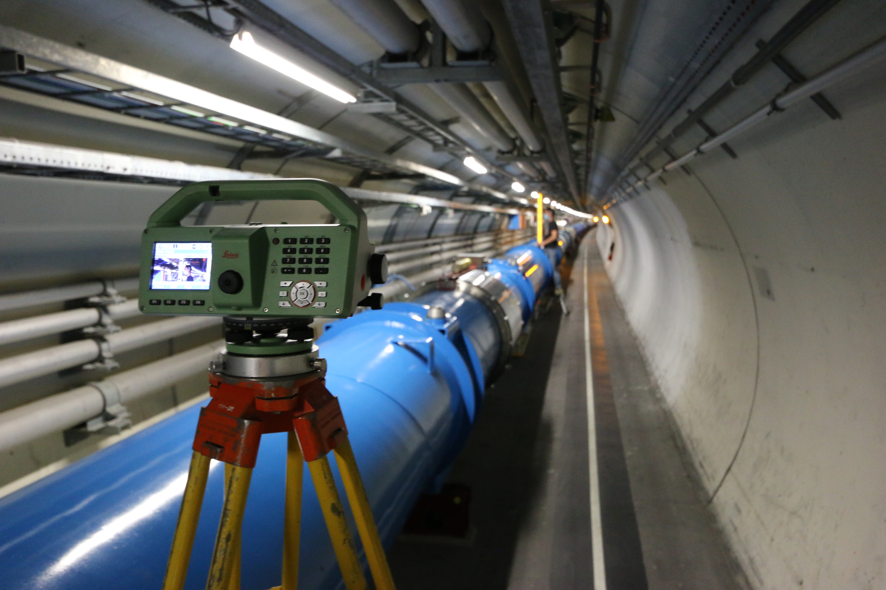
Direct levelling
Can we automate direct digital levelling?
  Instrument control
  Verticalization
  Movement

Slide 8
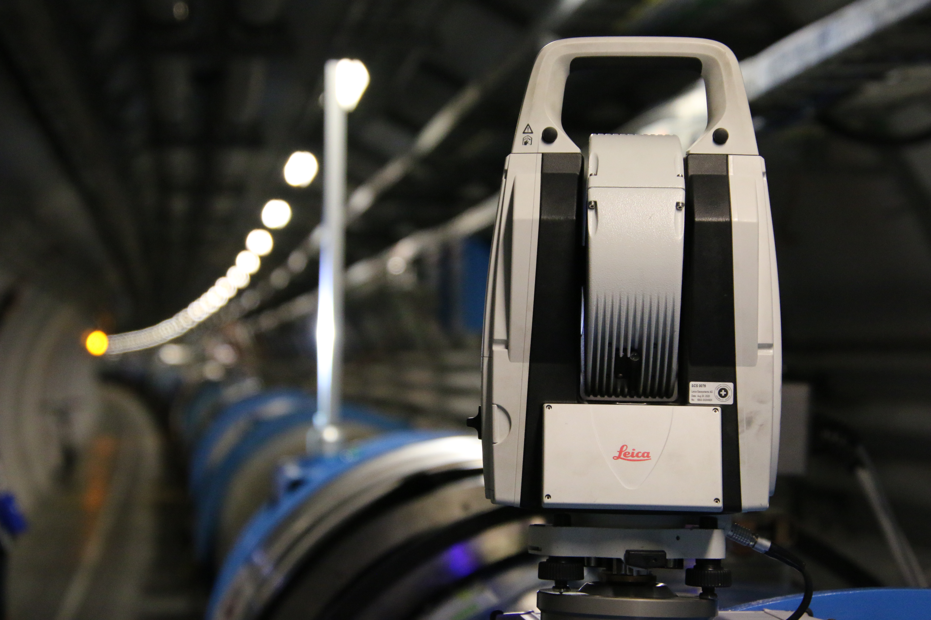
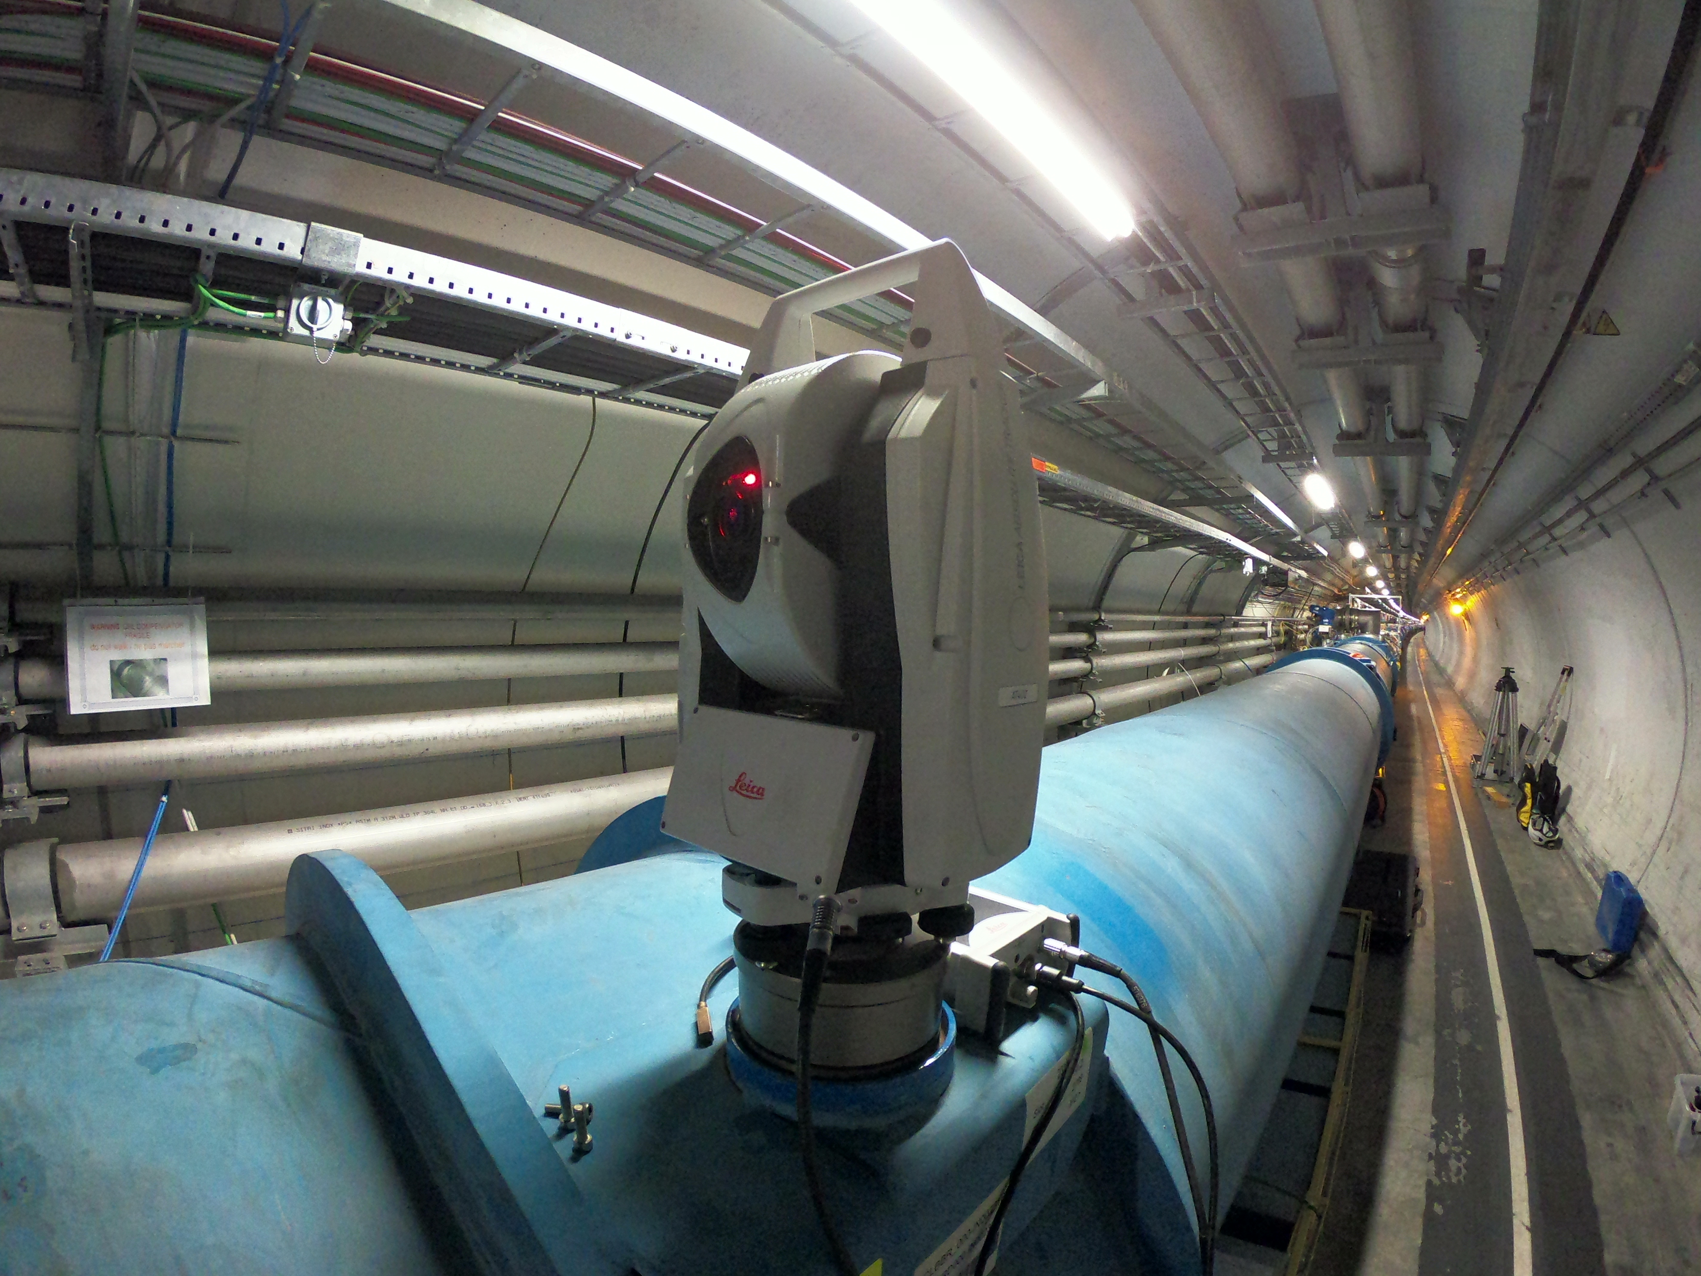
Indirect levelling
Can we automate indirect levelling?
  Using a AT403 Type Laser Tracker
  Automatic verticalization
  Target orientations

Slide 9
Why mHLS measurements
High automation potential
Advantages in precision and error propagation
No physical contact of the mHLS and the magnet
  Avoiding interference and reliability problems
The link is made by close range photogrammetry
  Permanent radiation hard targets
  Almost free to choose our measurement configuration
The biggest challenge is on the infrastructure around, not the measurement itself

Slide 10
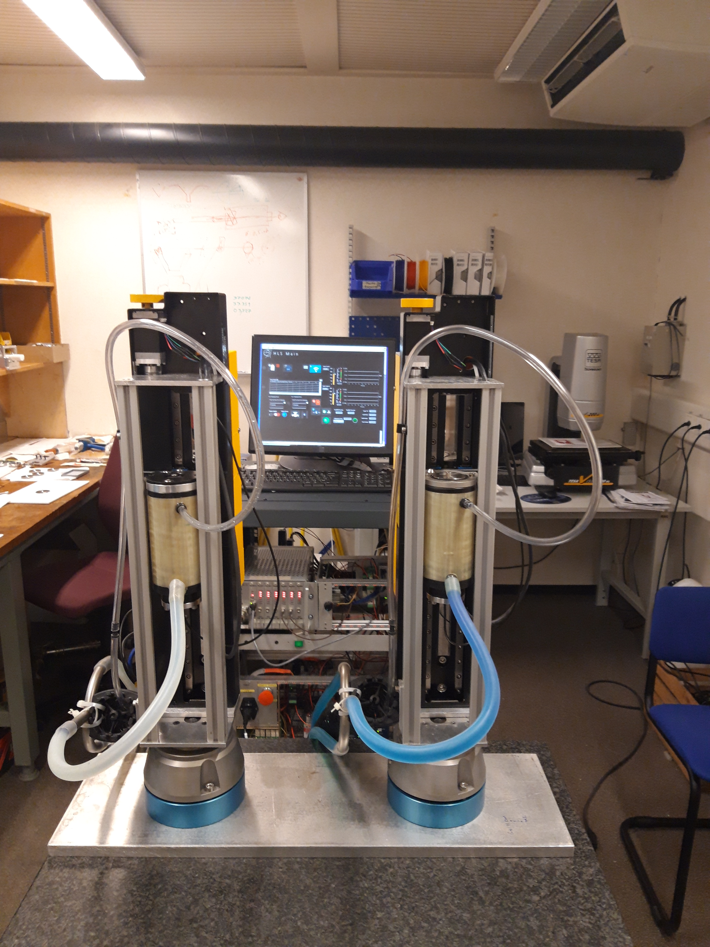
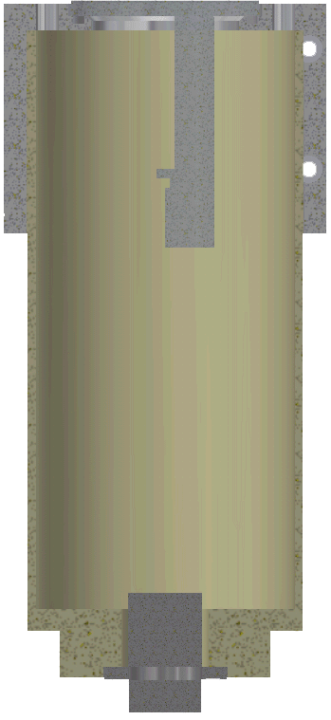

mHLS concept
Based on Ultrasonic system designed by DESY
  Transducer already submerged in water
  Not affected by splash water during transport
  Temperature compensated
  Central valve to cutoff pipe during transport
  Electronics based in mobile Rack
  10h energy autonomy
D2
D1
WS
R2
R1
$$H=D_{2}−D_{1}\frac{WS−R_{1}}{R_{2}−R_{1}}$$

Slide 11
mHLS measurements
The Hydrostatic Levelling System is designed to be static
  A mobile use is introducing some additional aspects to be addressed
  The range of precision has been shown and proven in the past
  Remaining issues have been:
    Range limitations
    Ventilation issues
    Gradient issues
    Reliability issues

Slide 12
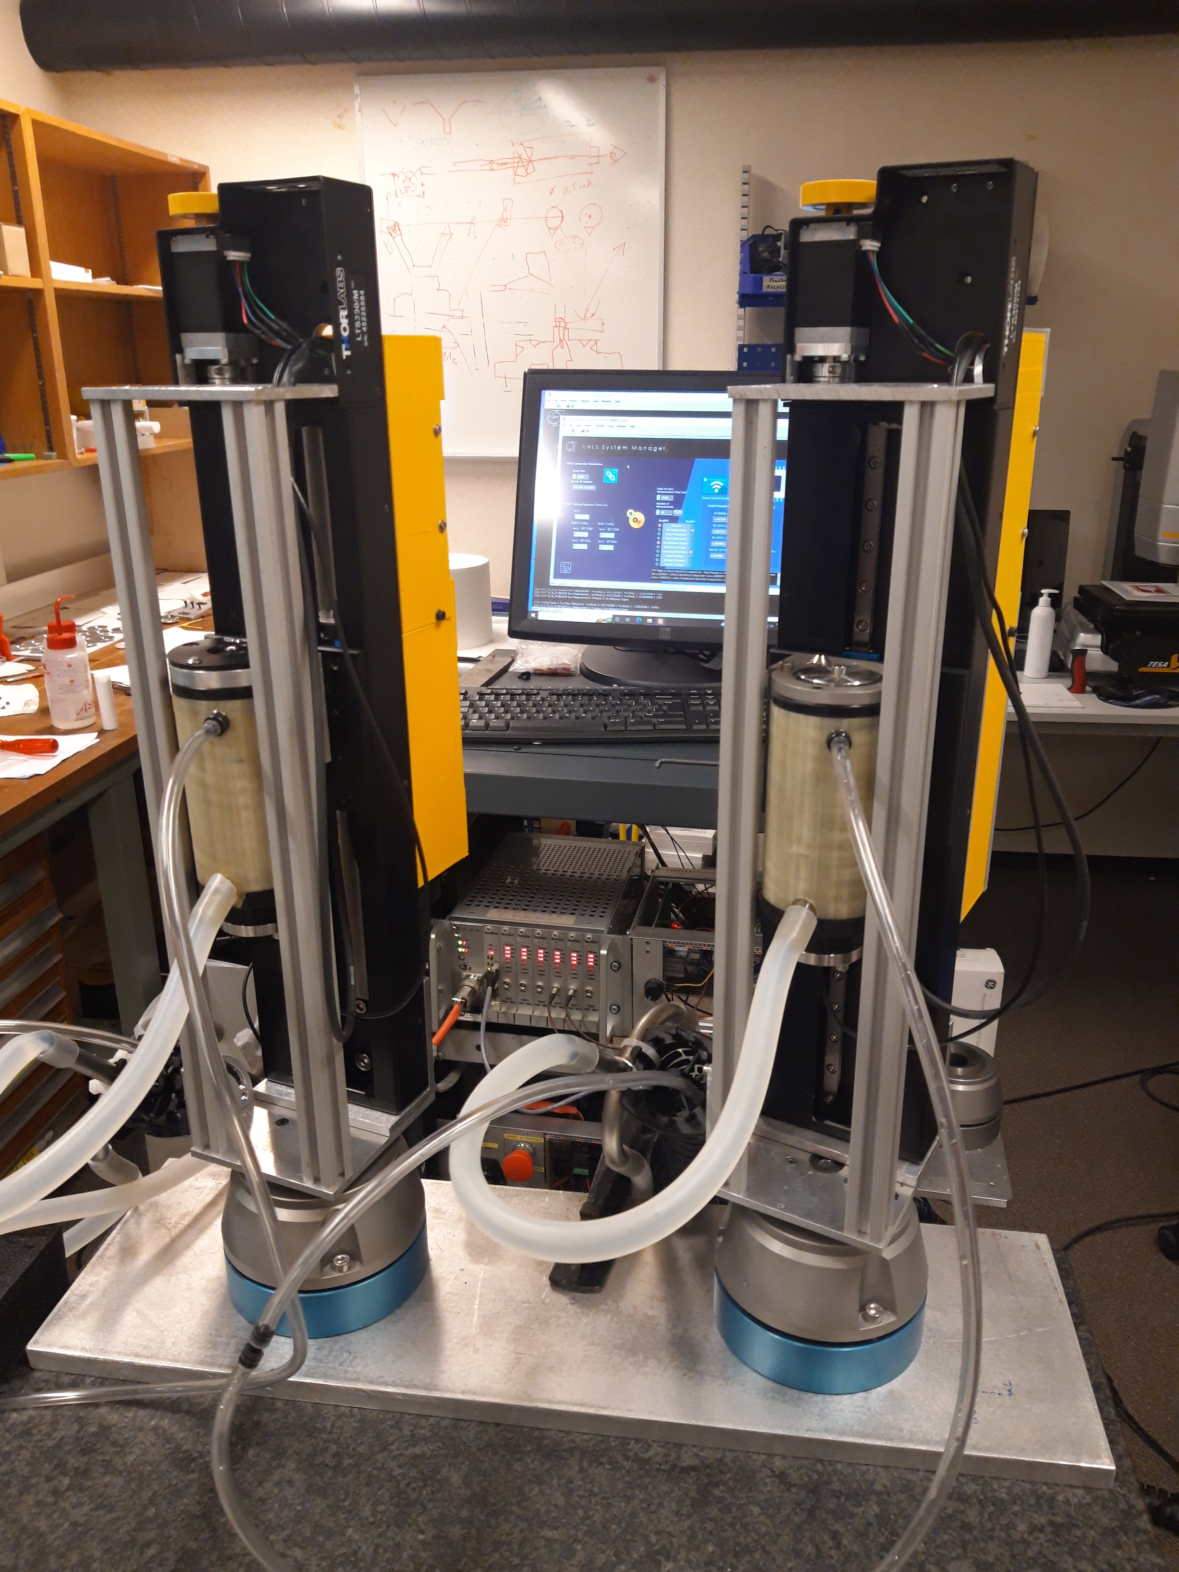
mHLS measurements
Vertical measurement range
  Solved by translation stage
  Preserving the initial precision
Horizontal range
  Can be extended with minimal influence on precision
  Communication and power supply optimized
  30m Cables are transparent in Laboratory tests

Slide 13
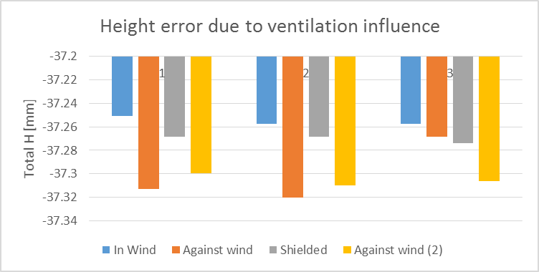
Ventilation effects
Tunnel ventilation is clearly visible in tests
Fully mitigated by air tube and central air-intake
Spill water & condensation is a concern
Careful manipulation and validation before each measurement in mandatory

Slide 14
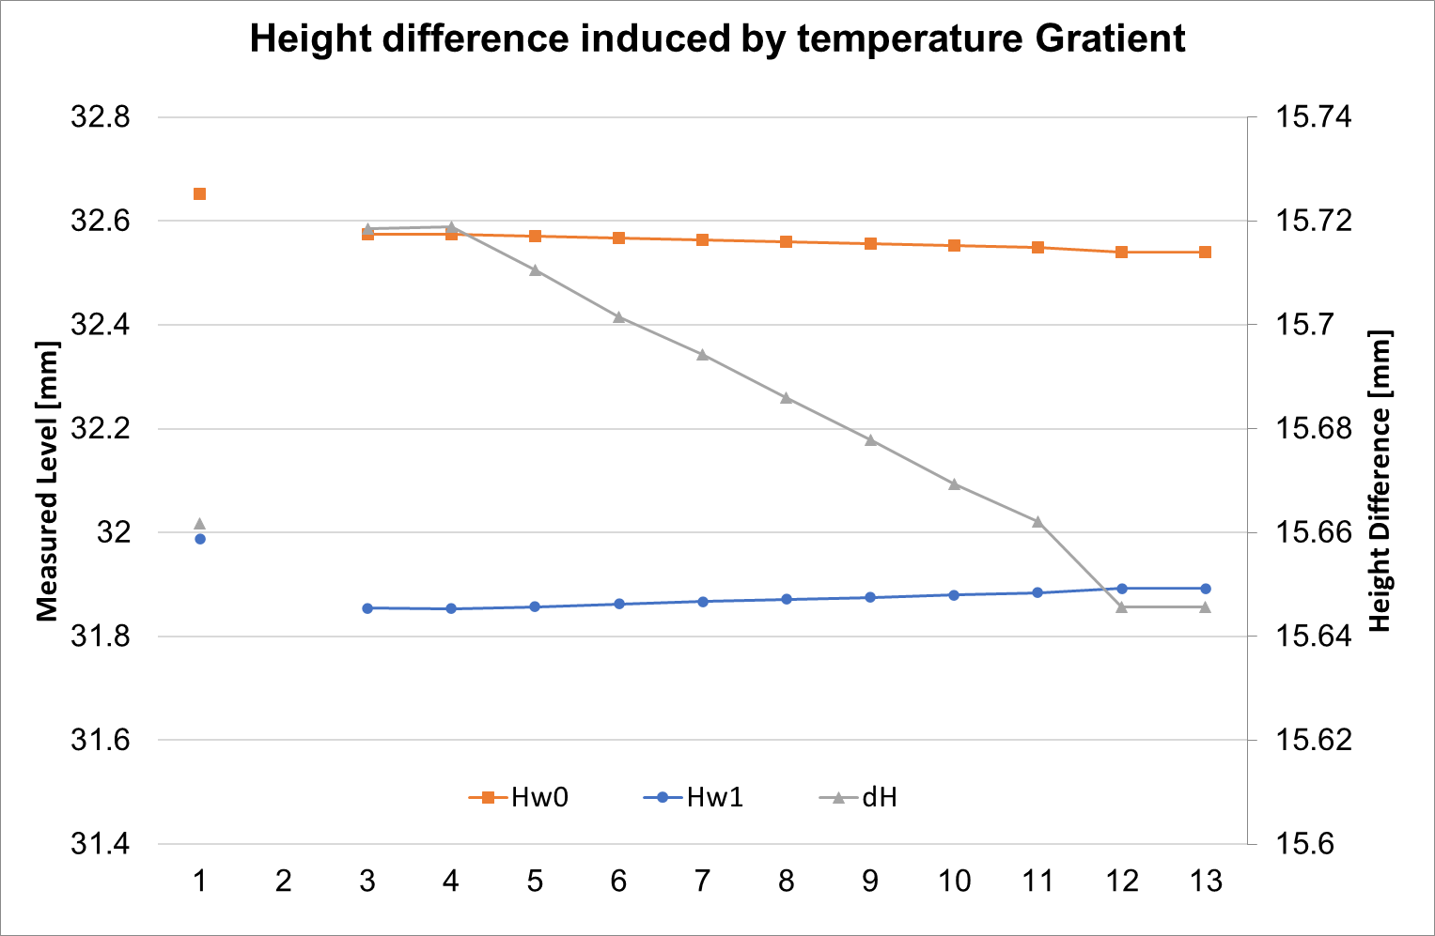
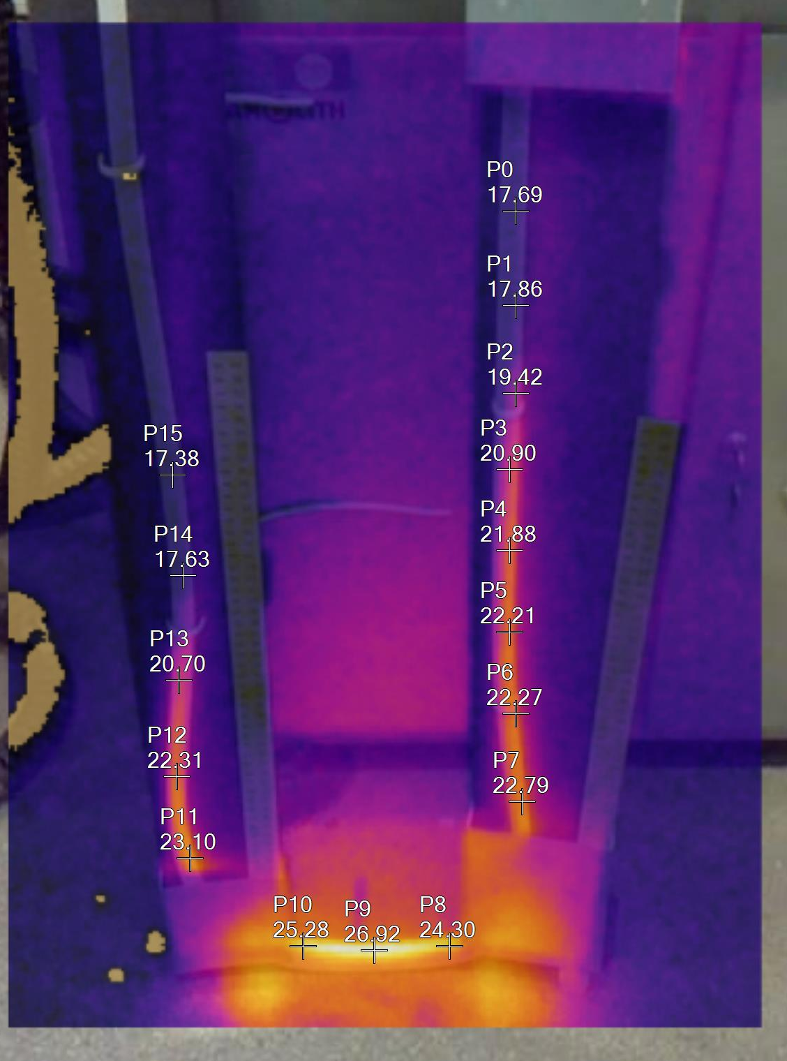
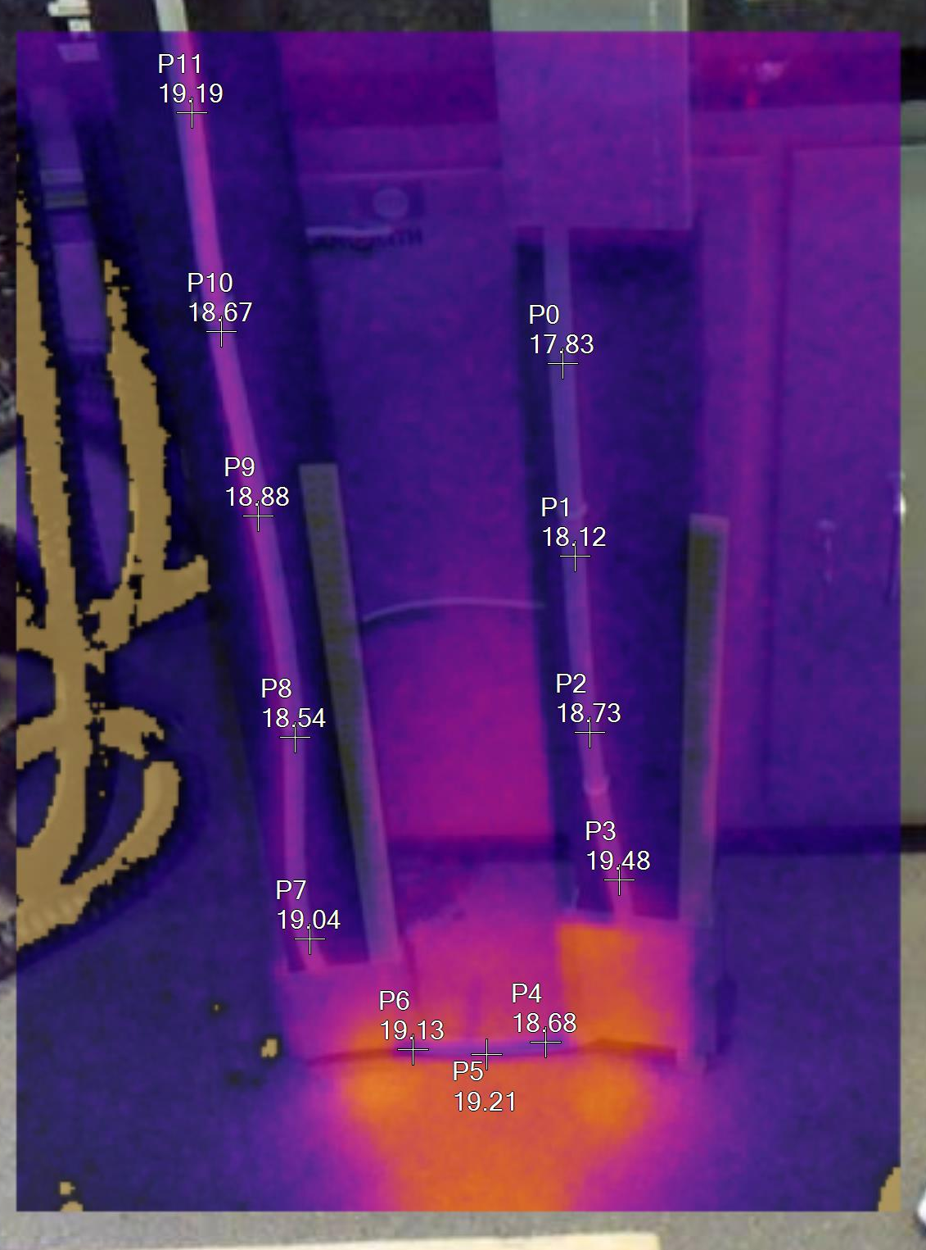
Temperature Gradient
The reference piece only accounts for the temperature inside the vessels
Volumetric expansion coefficient of water is around 21ppm/K
With 10°C gradient the theoretical influence is 2‰
Silicon tubes are expanding as well
40s interval with 250ml/min

Slide 15
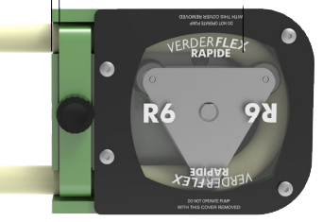
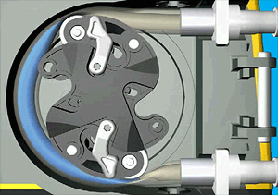
Temperature Gradient
Risk of significant systematic effects is too big
A permanent circulation with an adjustable peristaltic pump in standby mode
  avoids the buildup of gradients
  helps to avoid creation of air pockets
Vessel
Vessel
Pump
Valve
Von Njmcca - Eigenes WerkPreviously published: http://www.watson-marlow.com/

Slide 16
Automation & Reliability
The system is becoming bigger and heavier
  50mm protection duct
  Two water tubes
  1 air tube
  1 CAT6 Communication Cable
  1 Power cable
  1 Sensor Cable
Handling of 2x30m duct in an automated way is quite challenging
  Changing distances between measurement points
  Need to change leading system in the sequence

Slide 17
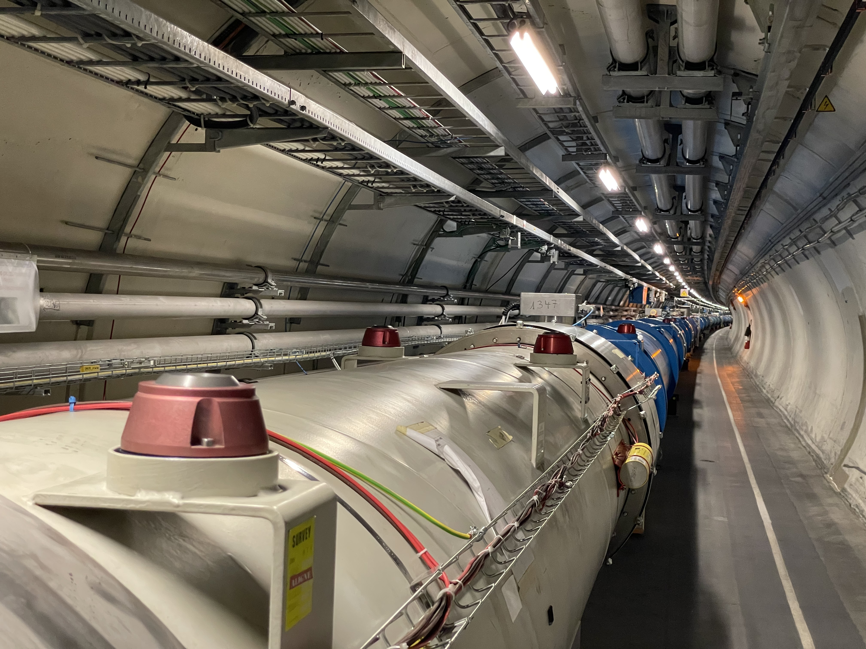
Automation & Reliability
The system remains very sensitive to external influences
  Validation routines are from extreme importance
  Vessel communication
    Pinched tube or air-pockets
    Splash water or condensation in air-tube
  Movement response tests will validate the communication
Photogrammetric link depends on a precise determination of the local vertical
  Next study will be on how to directly link the photogrammetry to the gravity

Slide 18
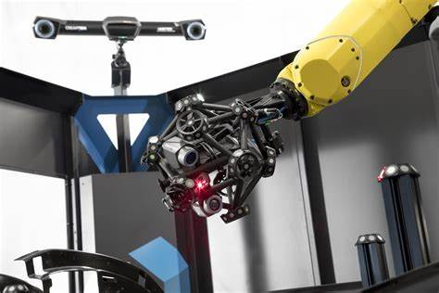
Outlook
Can we really measure between two magnets without any physical contact?
Industrial scanning/projection solutions are existing
If we use photogrammetry and add the external orientation by mHLS?
Picture: Ametek GmbH Division Creaform

Slide 19

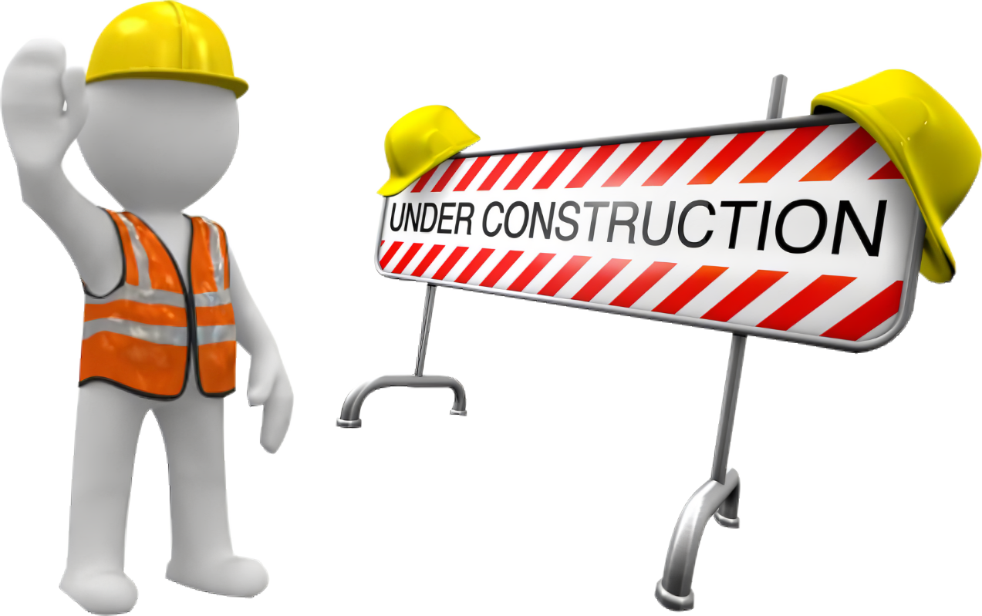
Outlook
The new Train project just started
  Direct wire offset measurements by photogrammetry
  To be fully qualified in 2024
Further studies for vertical measurements will start soon
Studies for handling & infrastructure will follow

