Slide 1
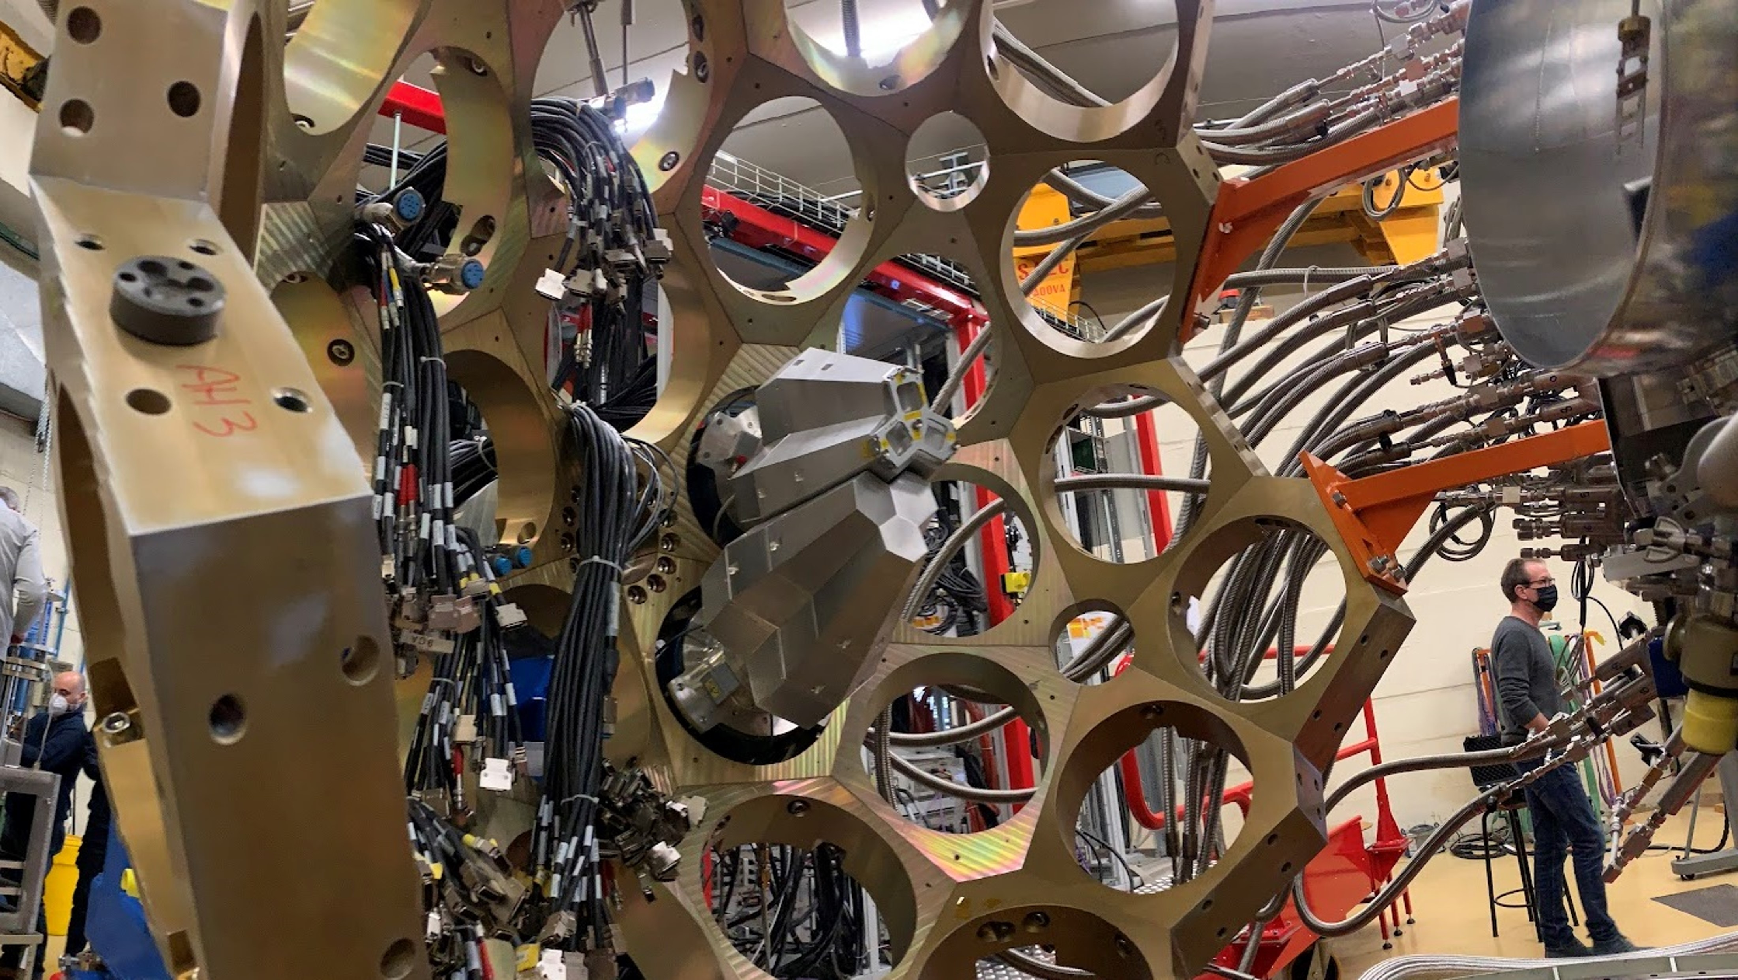

Utilising Modern Metrology Techniques to Improve Efficiency for the AGATA Experimental Installation
Ryan Cash Richard Smith Mike Liptrot
Notes:
To edit the background image, select ‘Format’ from the PowerPoint menu and ‘Slide Backgound’ from the drop-down menu. Within the new list of options that appears on the right of the screen, select the ‘File’ button under ‘Insert picture from’ and select your image from your file browser.

Slide 2
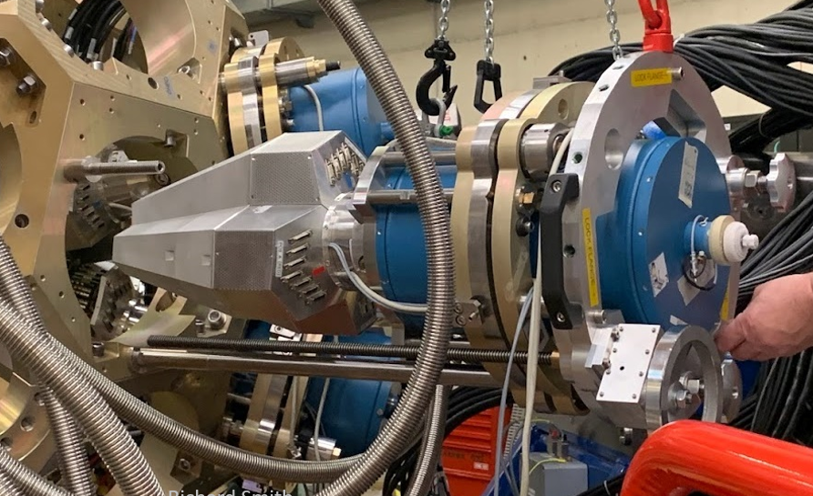
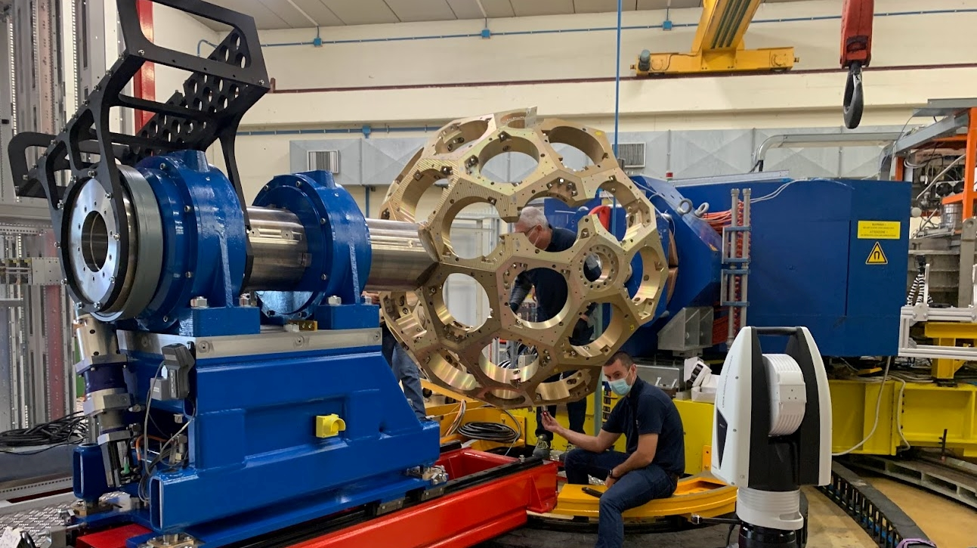
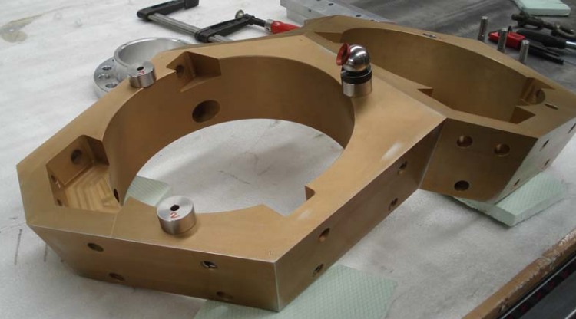
What is AGATA?
AGATA (Advanced Gamma Tracking Array) is a European research project with the aim of developing and building a 4pi gamma-ray spectrometer of the next generation.
AGATA detector with X,Y,Z and RX,RY,RZ adjustment system
Honeycomb (30 flanges)
2 flanges during assembly, using a laser tracker
Rotation stage
Laser tracker tooling

Slide 3
History of Alignment for AGATA
Metrology Arm
Laser Tracker
Laser tracker dedicated tooling
Now
Laser tracker and 3D scanning
Future
Image © STFC Alan Ford future
Notes:
Delete boxes as required

Slide 4
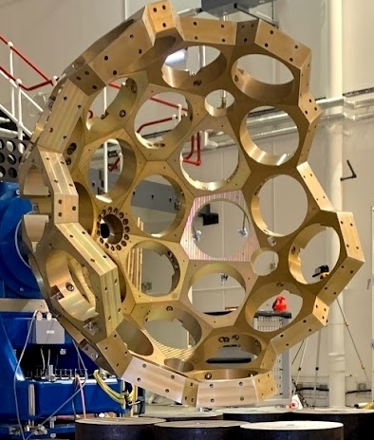
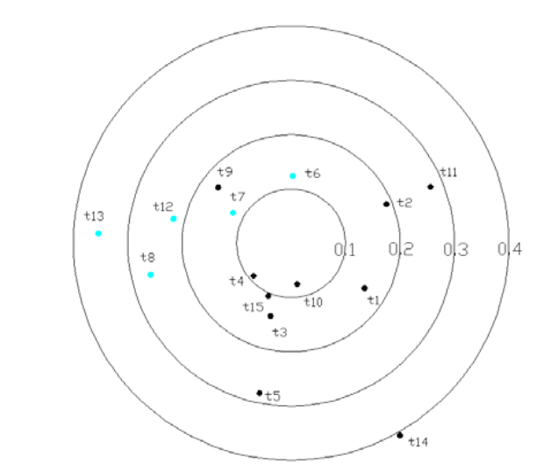
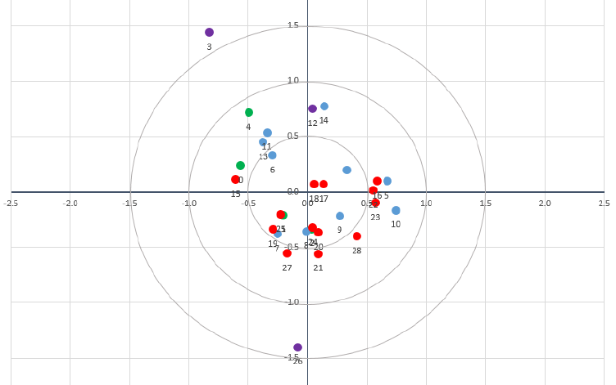
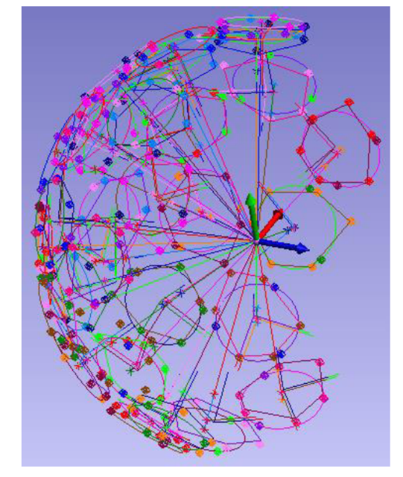
Flange Alignment and Survey Results
Projection on the target plane of the focussing point of each flange
Results from 2008 for 15 flanges
Results from 2022 for 30 flanges
#3 Unused split flange
All points bellow 0.4mm
Average error converging on the target point was 0.492mm
(excluding split flanges)
Agreed tolerance for 2022 installation was all points bellow 0.4mm this was not achievable with extra 15 flanges

Slide 5
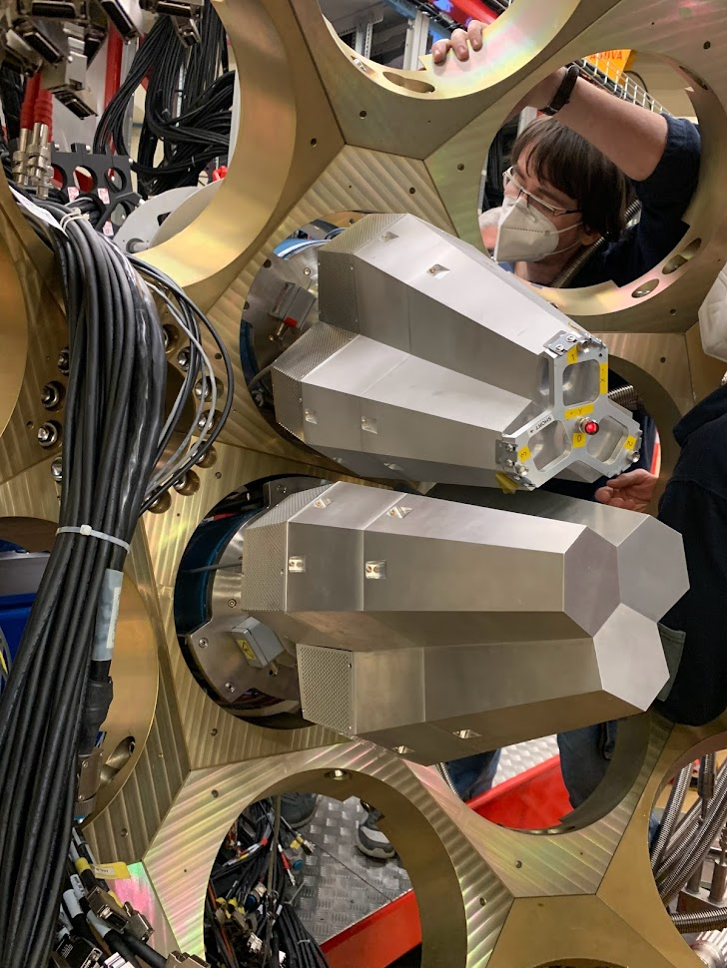
Why Change?
Improved positioning of detectors
Reduced risk of crashing detectors on installation (30 detectors @ £500k each)
Live position monitoring when detector is installed
Reduced installation times due to single point measurements
Reduced cost due to time savings
Repeatable point positon measurements
Honeycomb alignment tolerance was not achievable

Slide 6
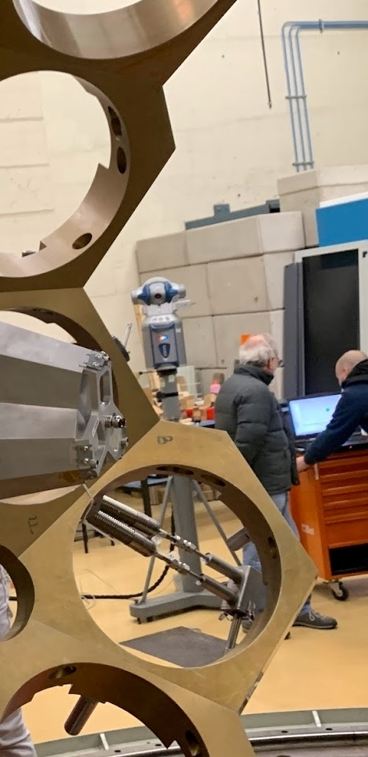
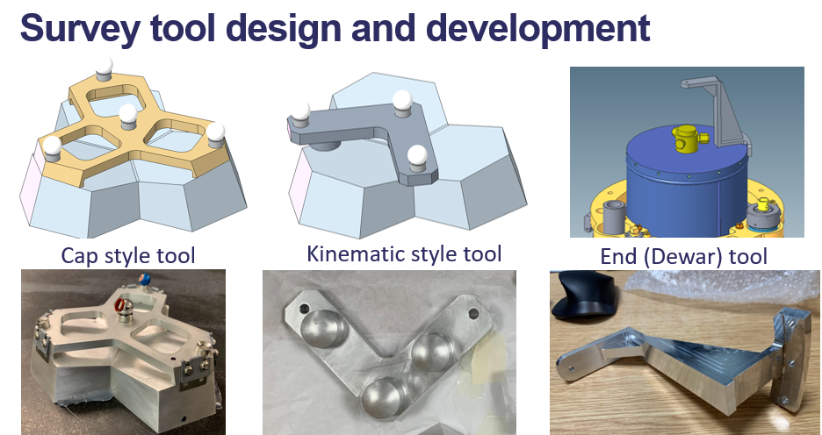
Detector Alignment and Survey
New ideas that take advantage of latest laser tracking technology
Develop tooling that exploits new methods
Generate detailed survey models of the full array

Slide 7
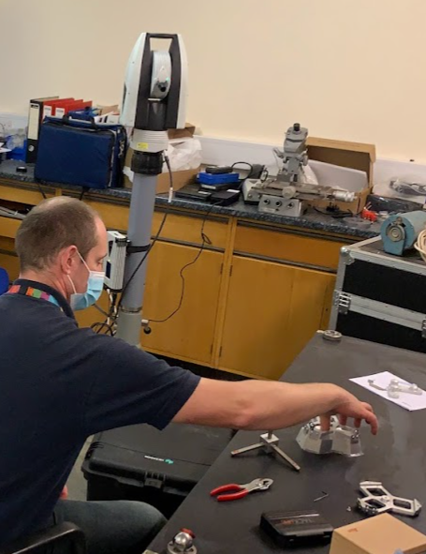
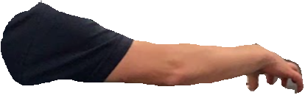

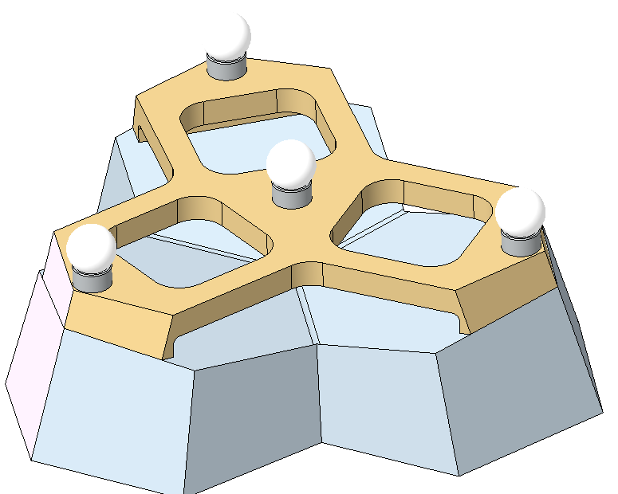
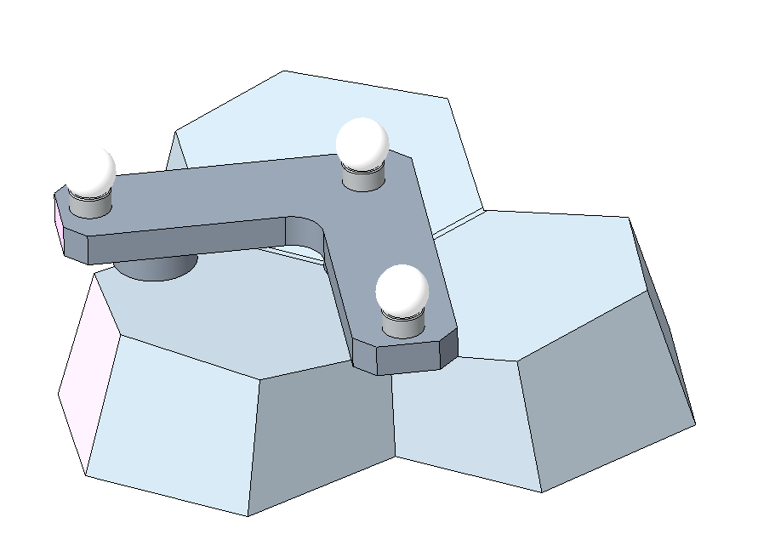

Survey Tooling Test
Tooling mounted/unmounted 100+ times
Multiple data points recorded
Provided information on repeatability
Average error 0.022mm
Inc. tracker error ~0.050mm accuracy
Tooling errors removed by updating survey model with measured points not CAD points

Slide 8
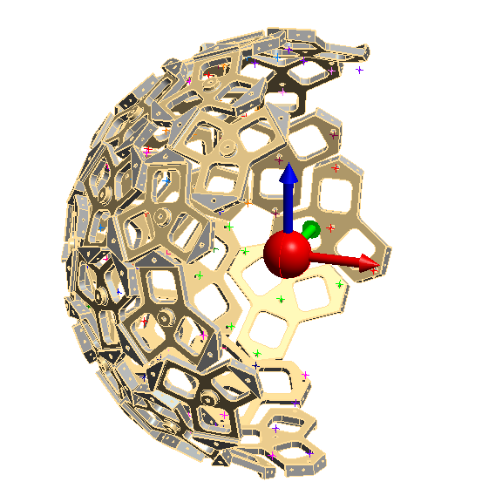
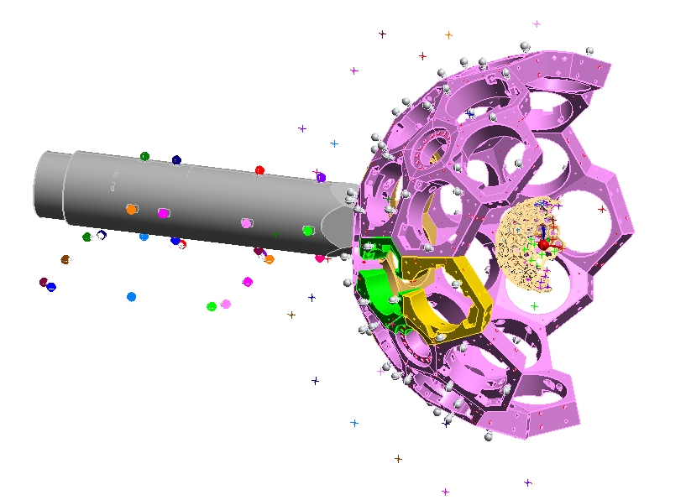
Detector Positions in SA
Dewar tool points
AGATA Zero point
Cap style tool pints

Slide 9
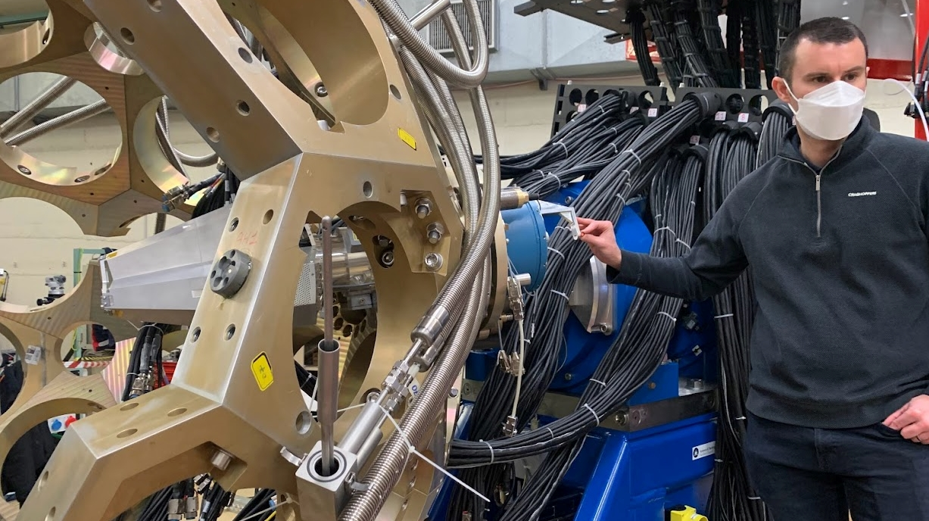
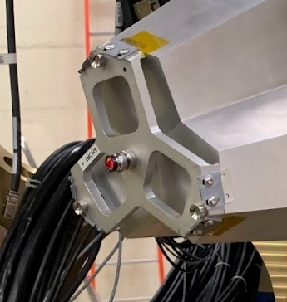

Detector Survey Tooling Setup
Cap Style Tool
Dewar tool
Capable of surveying detectors to ~0.1mm (incorporating manufacturing errors)

Slide 10
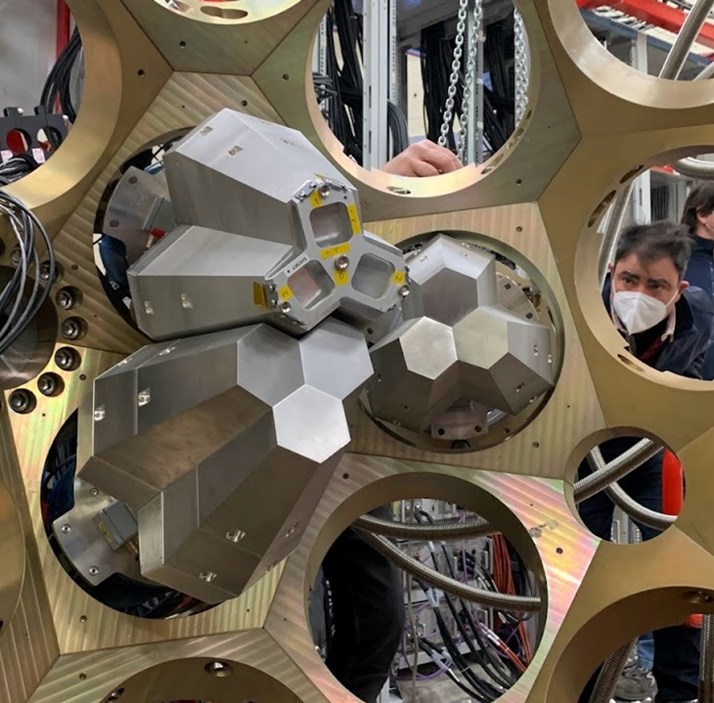
2nd Detector
3rd Detector

Slide 11
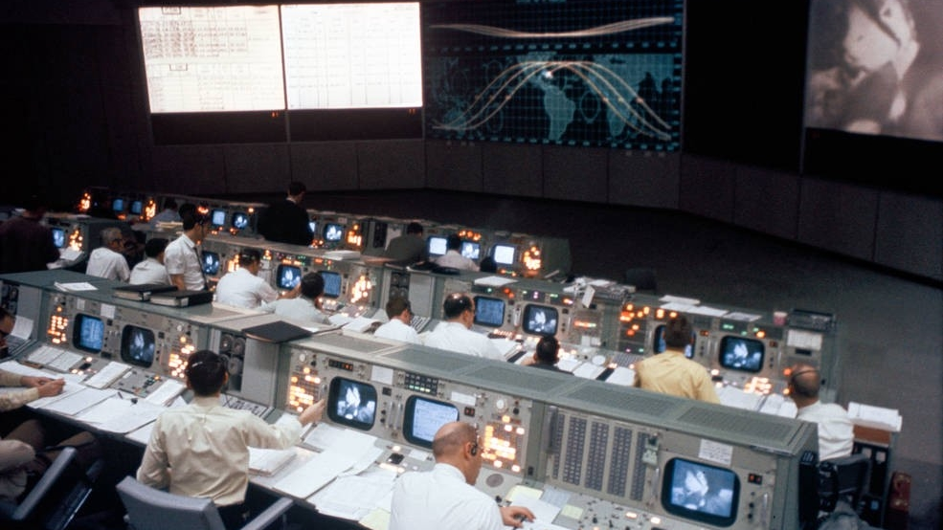
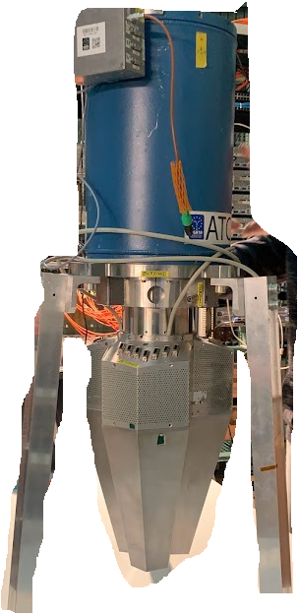
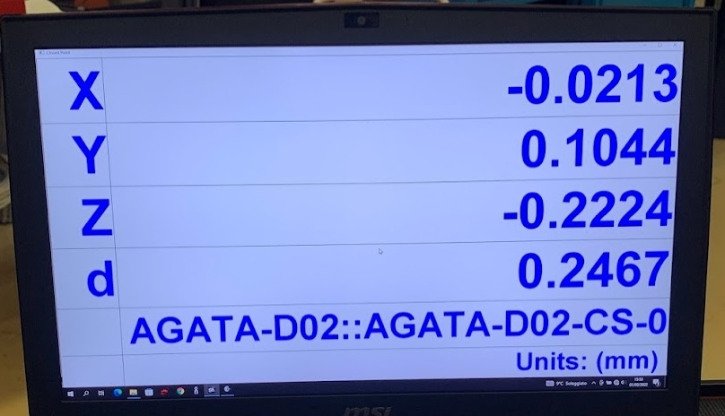
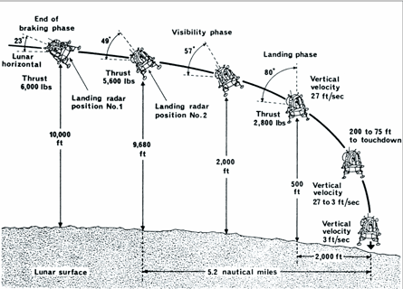
Detectors Tracked into Position

Slide 12
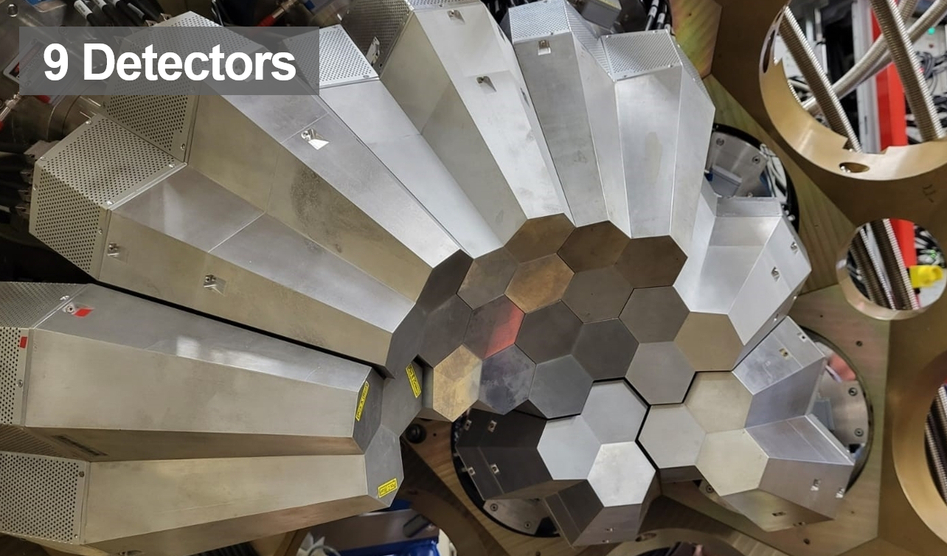
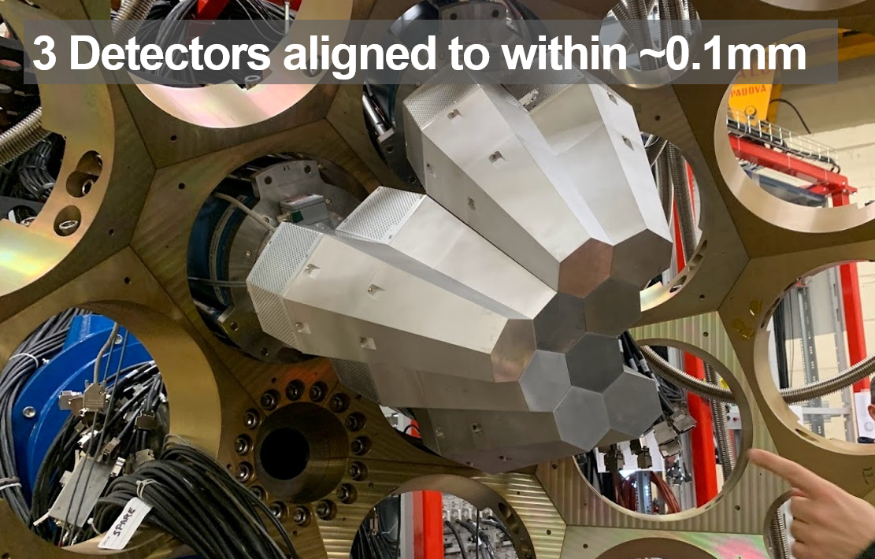
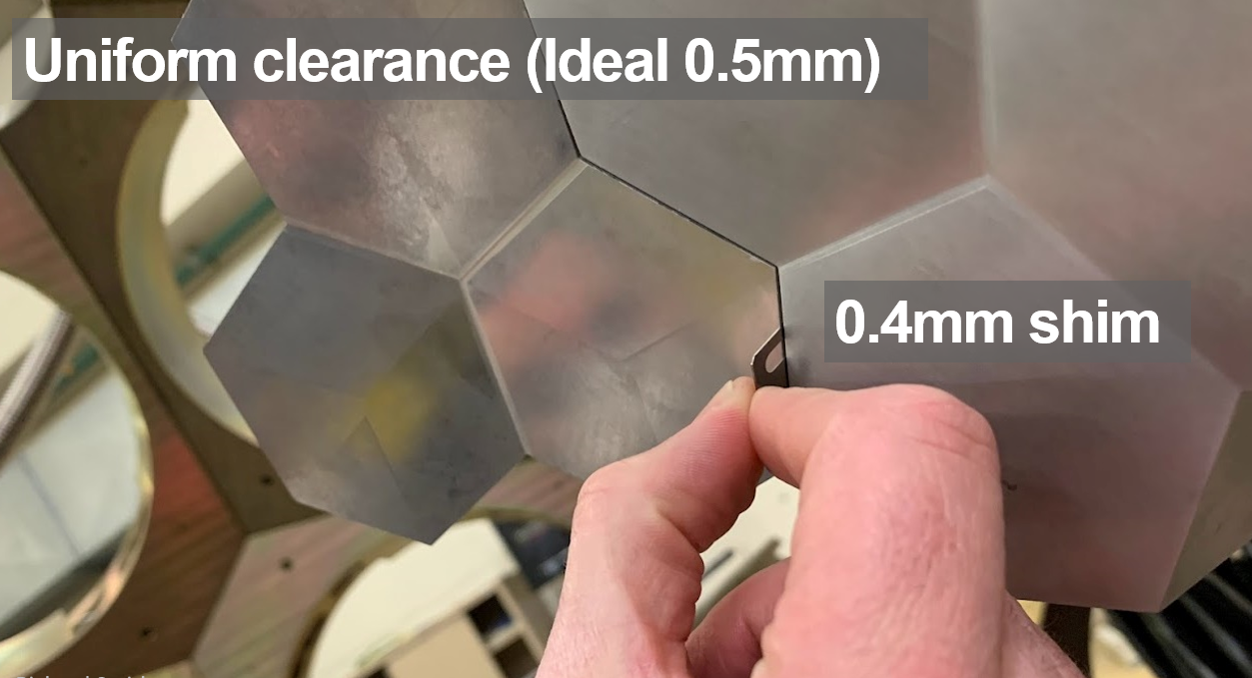
Results

Slide 13
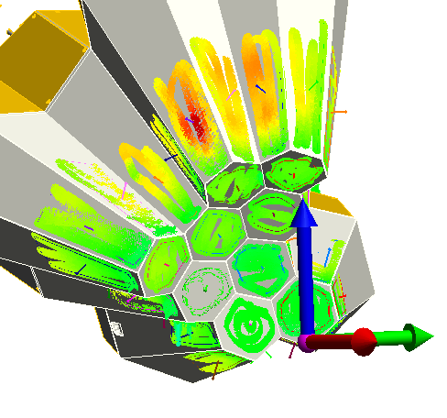
How Can We Improve?
Individually fiducialise each detector using laser tracker?
3D scan each detector nose and reference to fiducials. This would add an extra quality control step in the process and improve their position relative to the AGATA nominal zero position.
Contact surface map generated after detectors had been set to validate new tooling and confirm detector’s final location

Slide 14
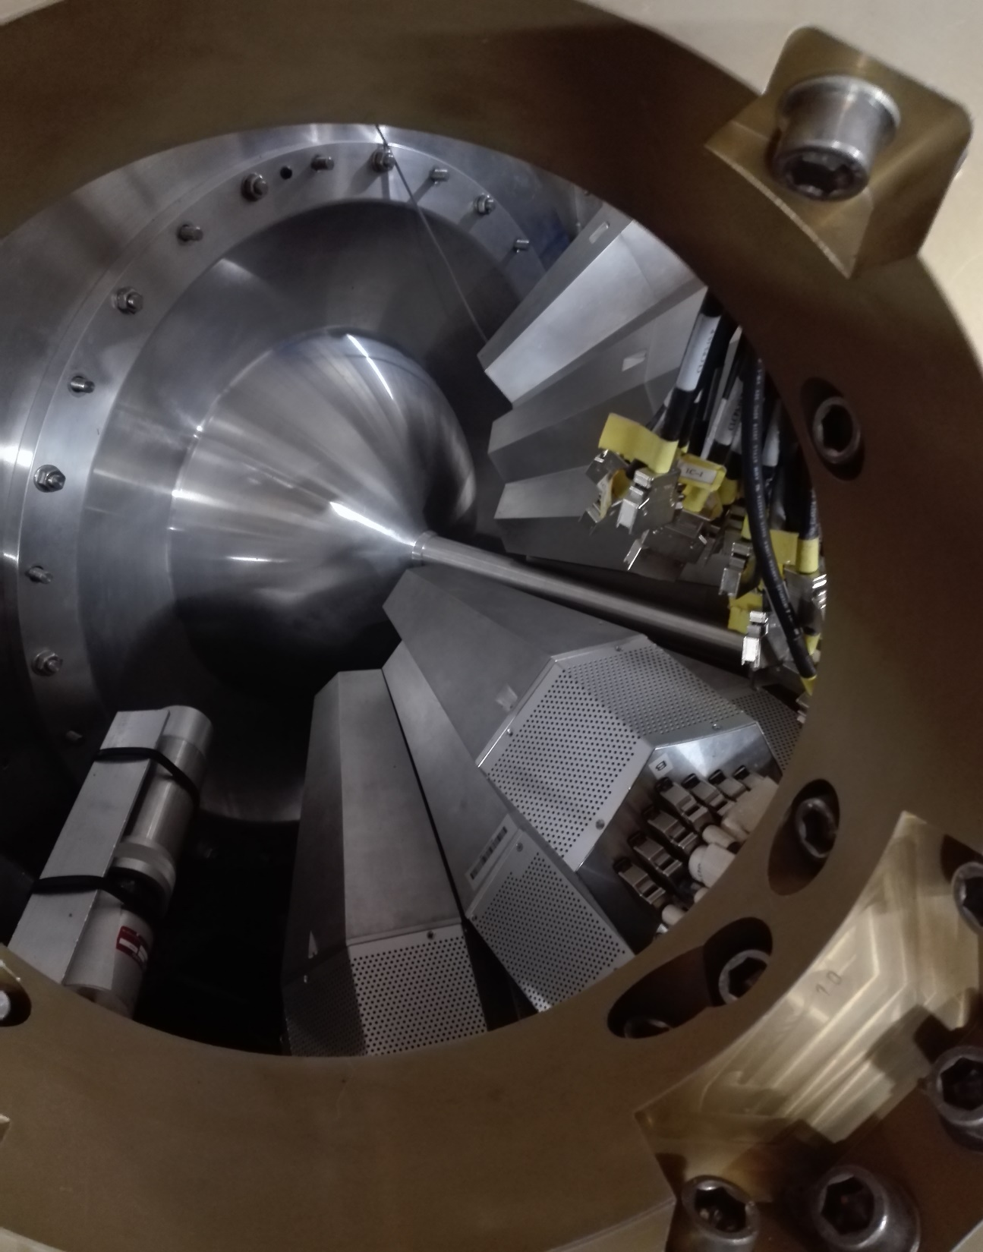
Questions

