Slide 1
Analysis of Earthquake Effects on Belle II Detector and SuperKEKB Accelerator
KEK
Hiroshi Yamaoka
yamaokah@post.kek.jp

Slide 2
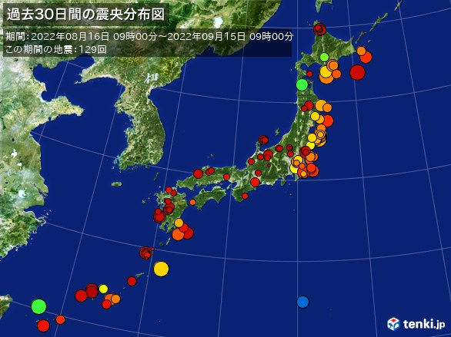
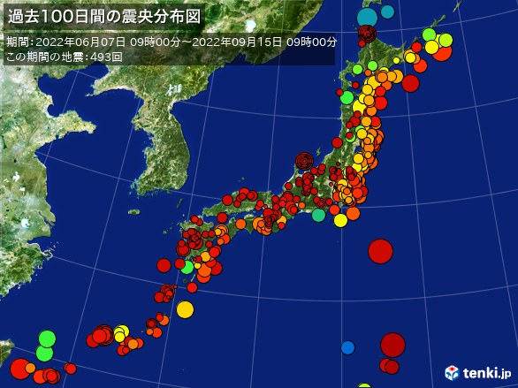
Distribution of earthquake in Japan
https://earthquake.tenki.jp/bousai/earthquake/seismicity-map/100days/
In 30 days,
129 times
Each color: Depth
Circle size: Magnitude
KEK
KEK
In 100 days,
493 times
➔ In Japan, we experience a lot of earthquakes!

Slide 3
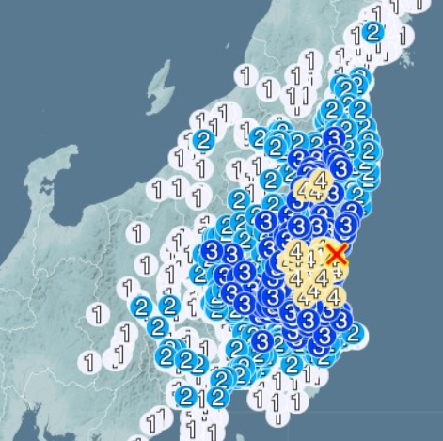
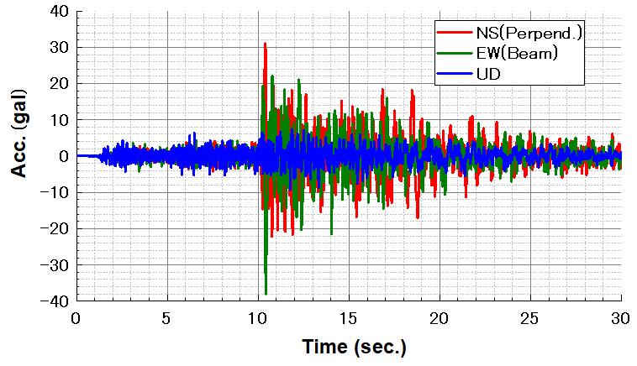
Motivation
Nov. 1st, 2021
gal = 1 cm/s² = 1/100 m/s²
Intensity: 3.50
KEK
Tokyo
Superconducting quadrupole magnet (QCS) for SuperKEKB was quenched.
This was second time quench from the earthquake on Mar. 20, 2021.
Induced voltage exceeded the trigger level which was 1.5V.
Why this was happend??

Slide 4
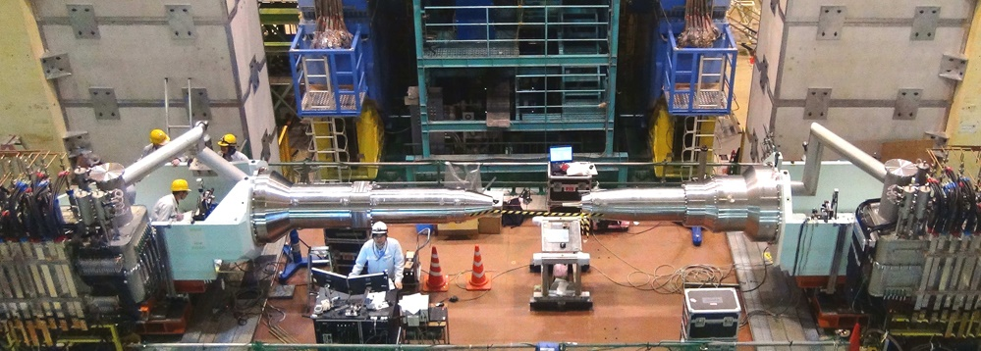
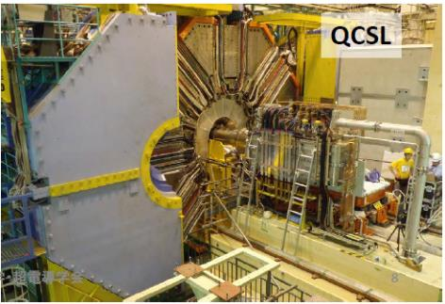
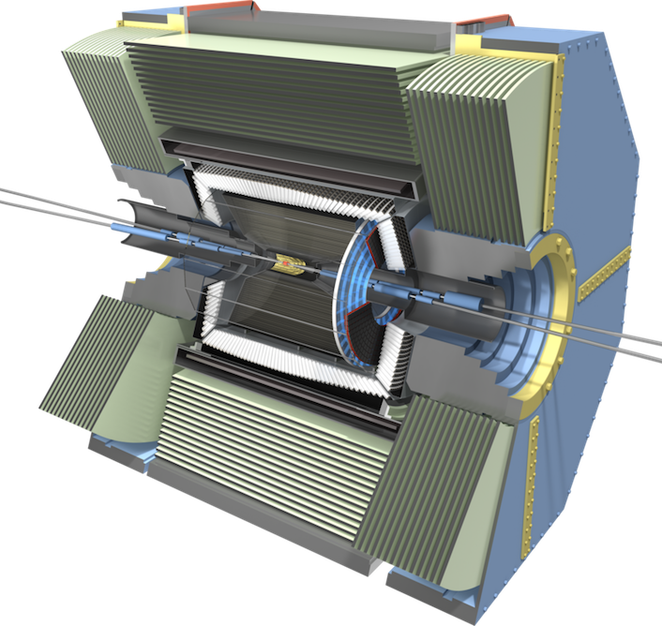
SuperKEKB Interaction Region
Belle II Detector(1400ton)
Superconducting quadrupole magnet (QCS)
Belle solenoid
QCS
QCS
QCS
➔ There are three superconducting magnets.

Slide 5
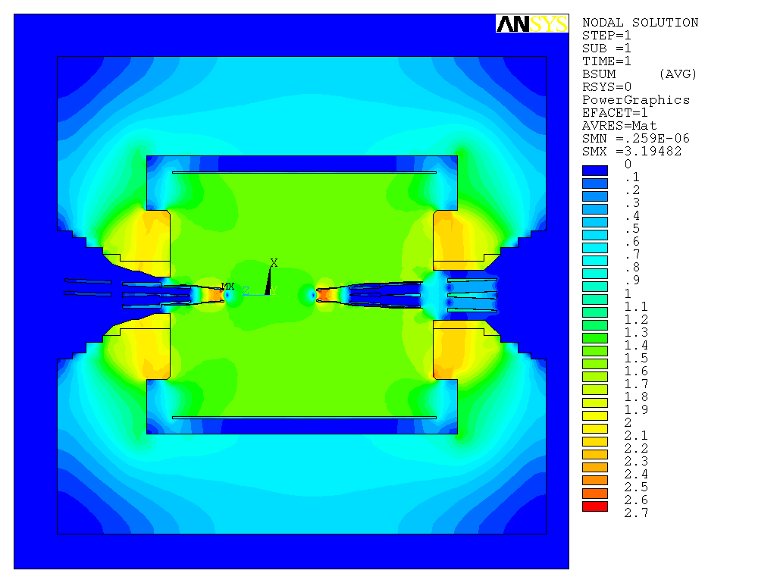
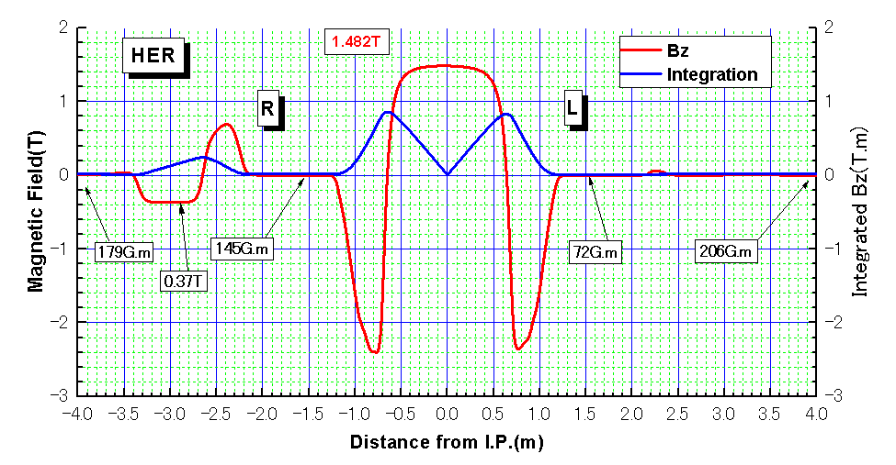
Distribution of combined magnetic field
Process to the magnet quench
Earthquake!
Iron yoke
Coil1
Disturb magnetic field
Air
Coil2
Coil3
Generate induced voltage
Exceed trigger level
Power shutdown
Quench!
How much is the relative displacement when shaking?
Large relative displacement causes damage to B.P, etc.

Slide 6
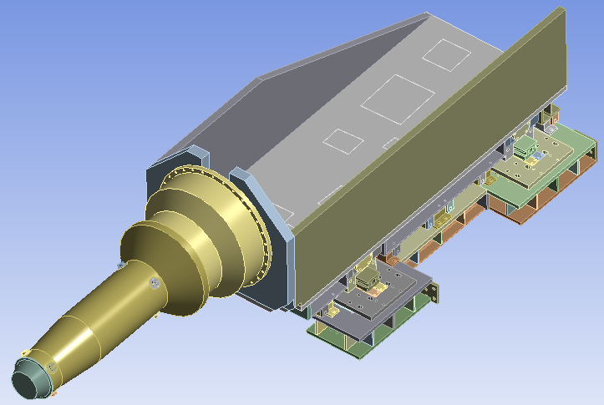
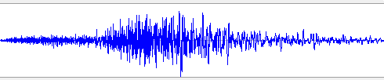
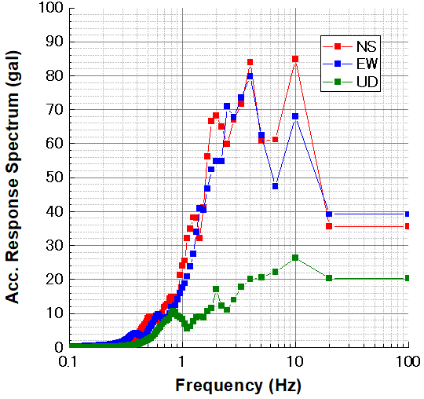

Investigation of relative displacement of QCS
Response Spectrum analysis (RSA/FEM)
Time history
Conversion
(Input data)
Response Spectrum
Damping
ζ = 5%
Extrapolate until 100Hz
Data is input to the constraint points
Get relative displacement

Slide 7
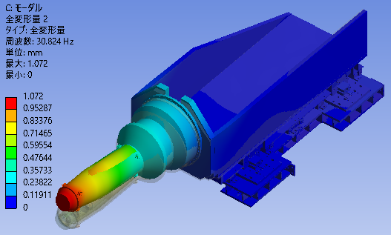
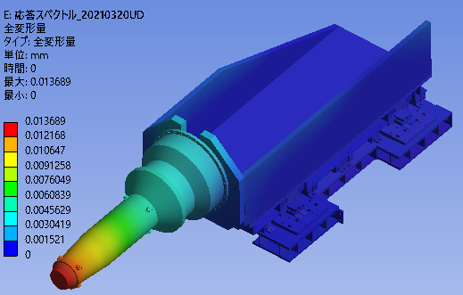
Result(QCS)
- Displacement of QCS is the same as that of floor until reaching 1st mode.
→ No relative displacement
- After Passing 1st mode, generates the relative displacement.
Modal analysis is done before spectrum analysis
Modal analysis
Response Spectrum Analysis (RSA/FEM)
f₁= 31Hz
(Result)
Relative displacement = 14μm
(Summary of RSA/FEM of QCS)
QCS shakes with floor with the same phase → Very small relative displacement.
- First mode of natural frequency is out of the earthquake effect.
- Displacement is decreasing according to increase frequency.
➔
- How much is the relative displacement of Belle II detector?

Slide 8
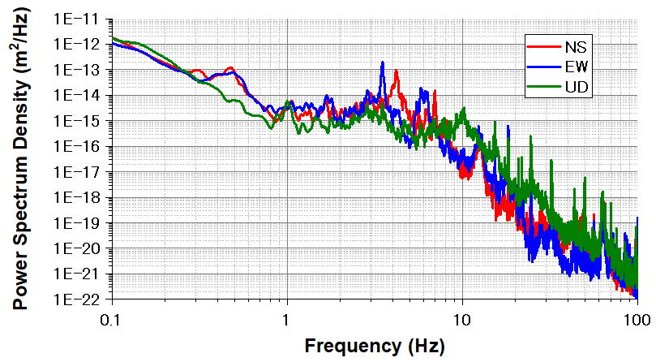
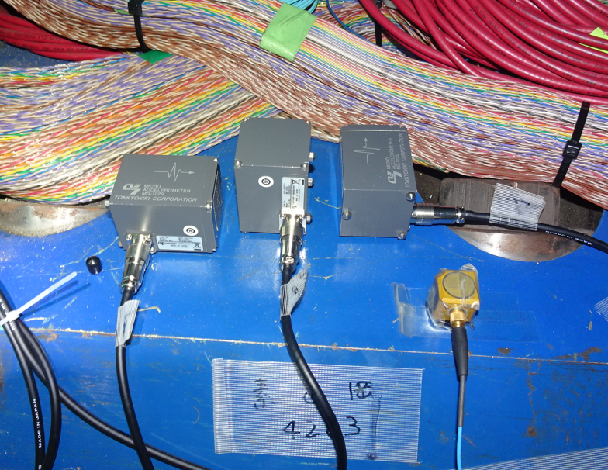
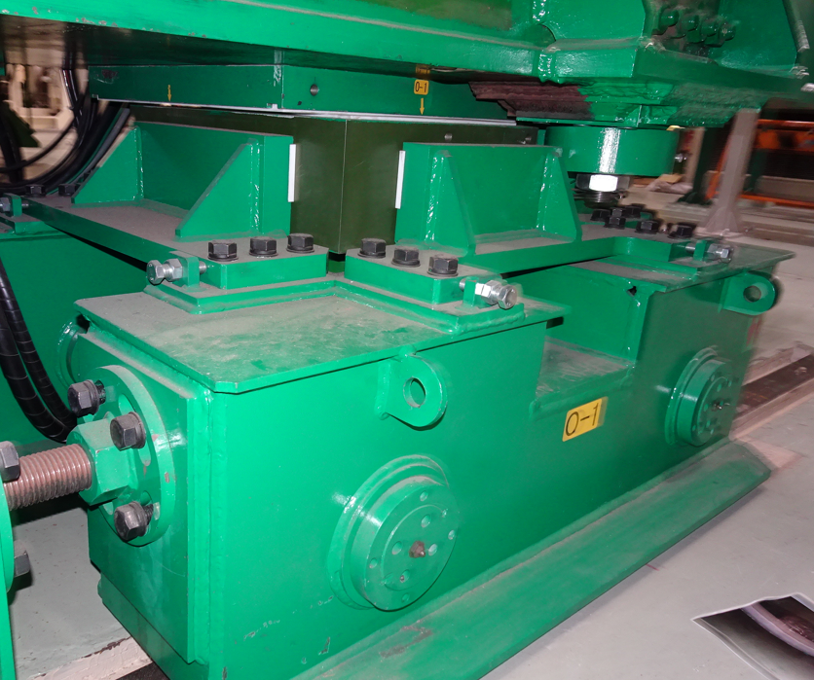
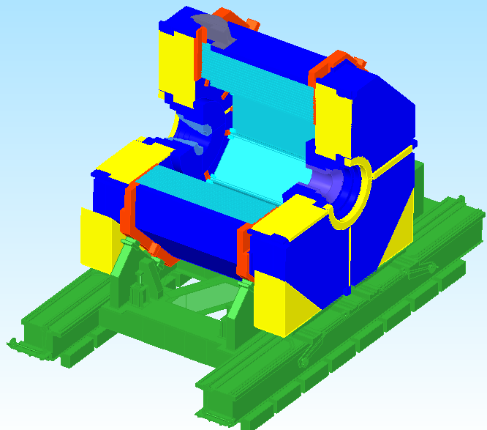
Natural frequency of Belle II detector
Natural frequencies in the horizontal direction was measured around 4Hz.
Mode shape of the Belle II detector.
➔ Rigid body mode at 4- 5Hz. Because,
- Belle II detector is not fixed on the floor.
- Belle II detector is placed on the Teflon sheet.
➔ Make a FEM model for Belle II detector.
Here

Slide 9
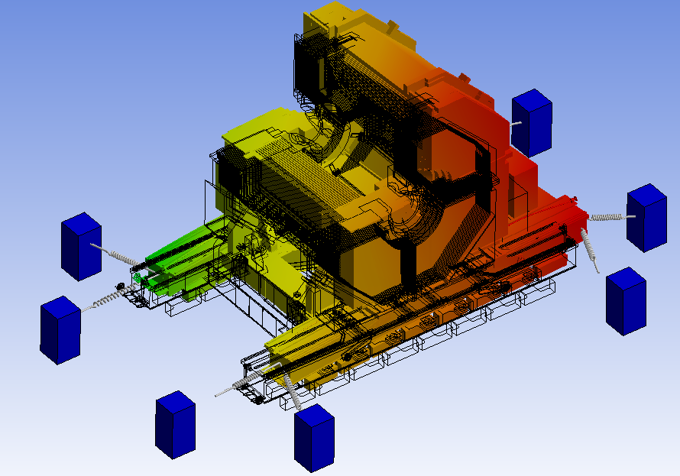
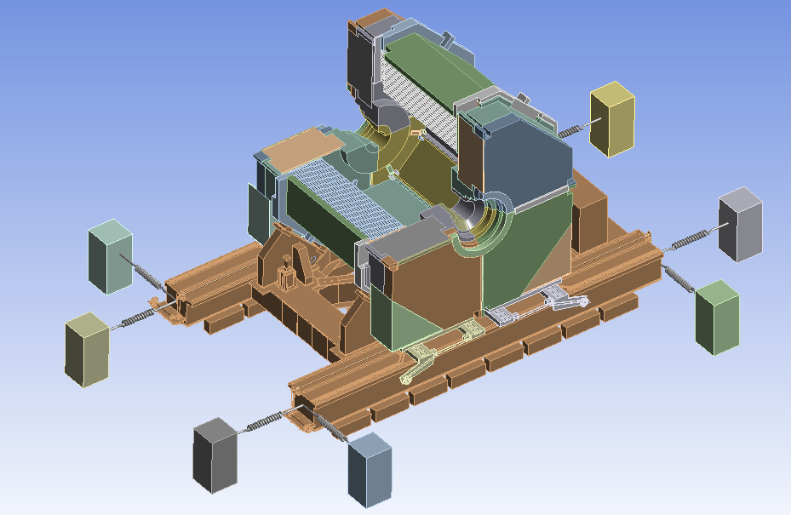
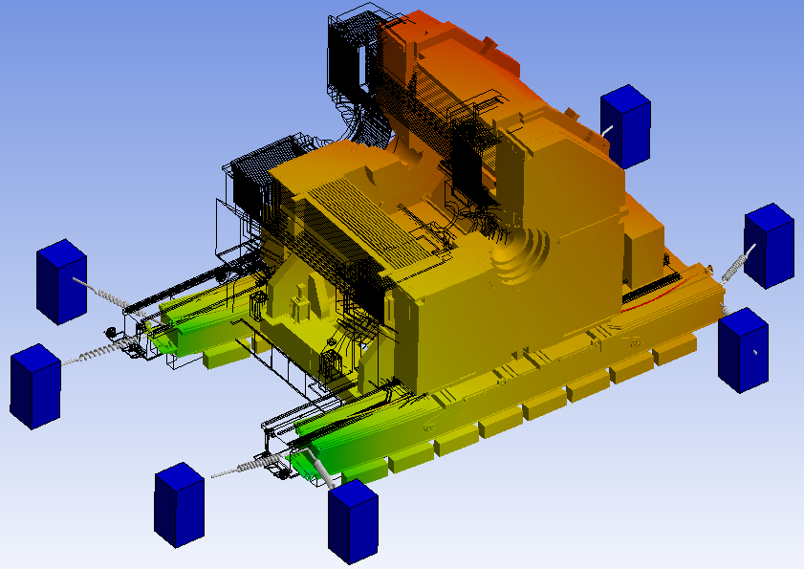
Belle II detector FEM model
Results of modal analysis
4.6Hz
8e5 N/mm
4e5 N/mm
4.7Hz
(Assumptions)
- Make columns around the Belle II.
- Connect springs between column and the Belle II.
- Adjusted spring constant which to be around 4 - 5Hz.
Belle II can move horizontal direction freely.
But it fixed to the vertical direction.

Slide 10
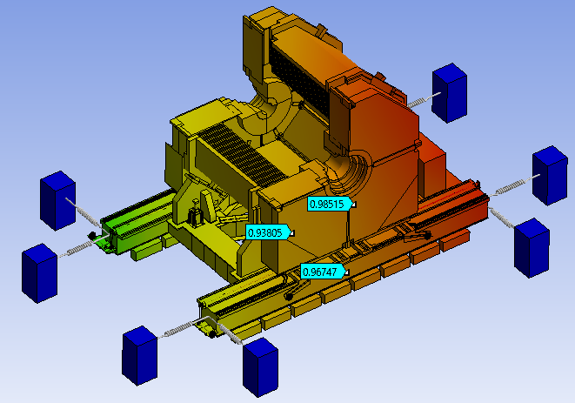
Response Spectrum Analysis (RSA/FEM)
(Input data)
Response spectrum
Nov. 1st, 2021
Displacement
Damping
ζ = 5%
~1.0mm
(Results)
→ Displacement = 14μm (QCS), 1.0mm (Belle II)
As the cause of magnet quench, Belle II would be shaken not QCS.
Other comparison of RSA/FEM
Date | Intensity | QCS | BelleII
Apr. 12th, 2020 | 3.5 | 0.065mm | 2.1mm
Mar. 20th, 2021 | 3.5 | 0.017mm | 0.7mm
Mar. 16th, 2022 | 4.3 | 0.023mm | 3.4mm
If these calculations are true, we need to take account;
- Damage of bellows of beam pipe.
- Disappearing gap btwn. sub-detectors.

Slide 11
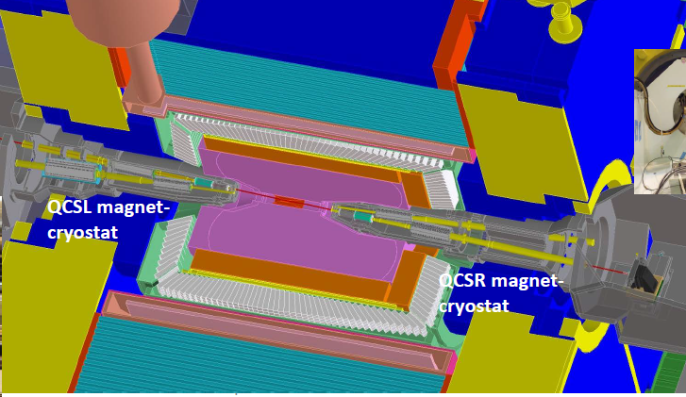
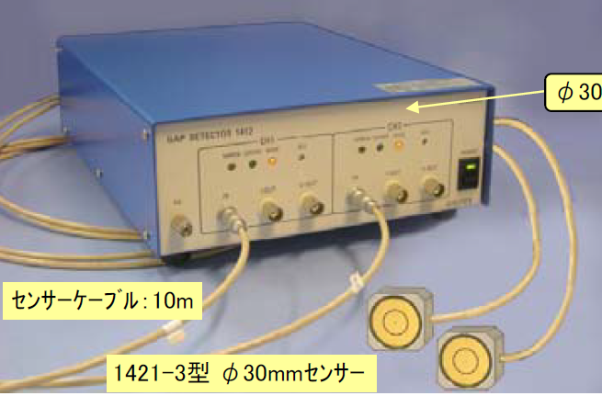
Comparison of RSA/FEM and measurement
Gap sensor
Specifications (Gap sensors)
Type | Capacitive
Company | Digi-tex lab
Scale | 0.1 – 8.5mm
Precision | < 0.6μm
Range | DC -100Hz
Size | φ30 x 35 (D) mm
Comparisons
Date | Intensity | FEM | Gap sensor
Apr. 19, 22 | 2.5 | 0.52mm | 0.3mm
May 3rd, 22 | 1.3 | 0.13mm | 0.035mm
May 5th, 22 | 2.4 | 0.40mm | 0.10mm
May 8th, 22 | 0.8 | 0.05mm | 0.019mm
May 9th, 22 | 1.0 | 0.05mm | 0.03mm
May 22, 22 | 2.4 | 0.12mm | 0.10mm
Difference between FEM and measurement might be difference of response spectrum at ground level and underground (GL-16m).

Slide 12
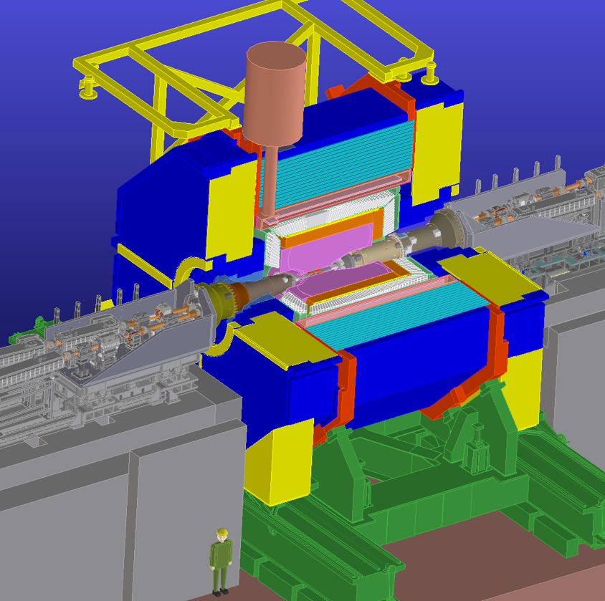
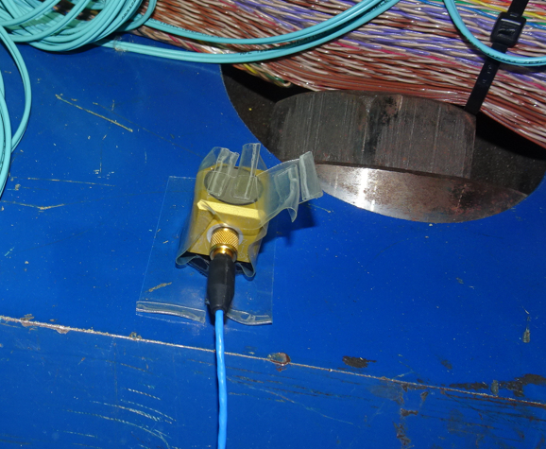
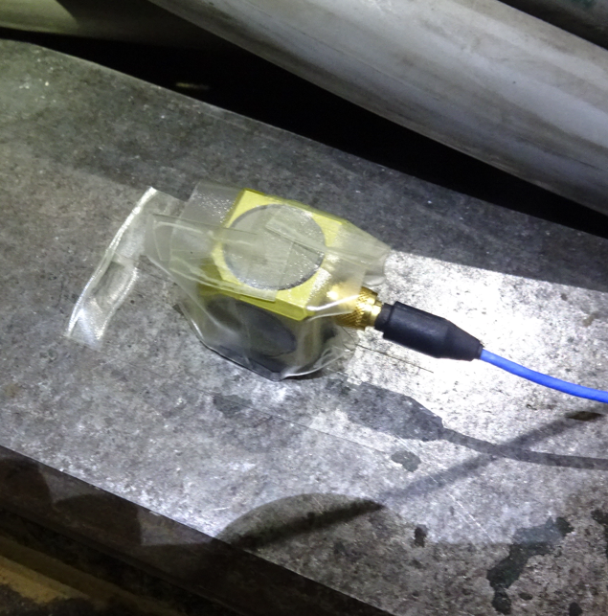
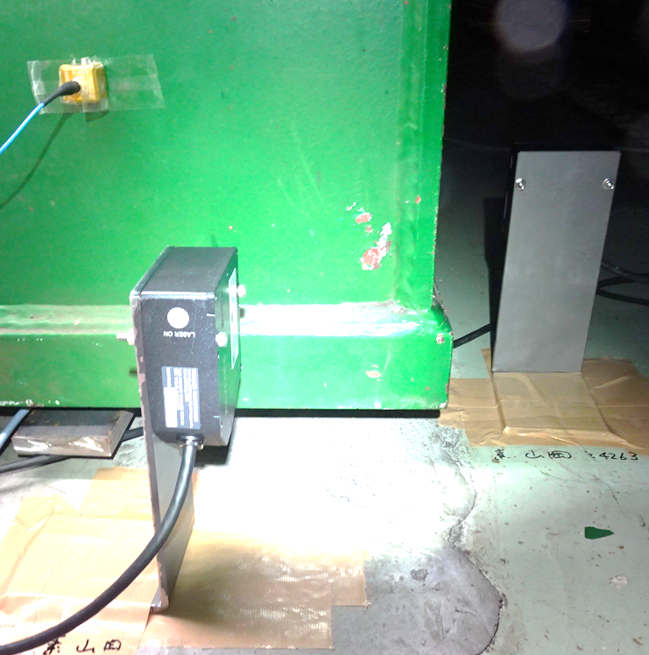
Earthquake measurement system
Accelerometer (Belle TOP)
Accelerometer (Floor: GL-16m)
Laser distance sensors
Specifications of each sensor
Detection | Acc. | Disp.
Type | Piezo | Laser
I.D. | 356B18 | LK-80
Range | 0.5 - 3kHz | DC – 10kHz
Sensitivity | 1mV/gal | 0.5mm/V
Precision | 0.05 gal | 0.2 μm
Trigger level: 5 gal

Slide 13
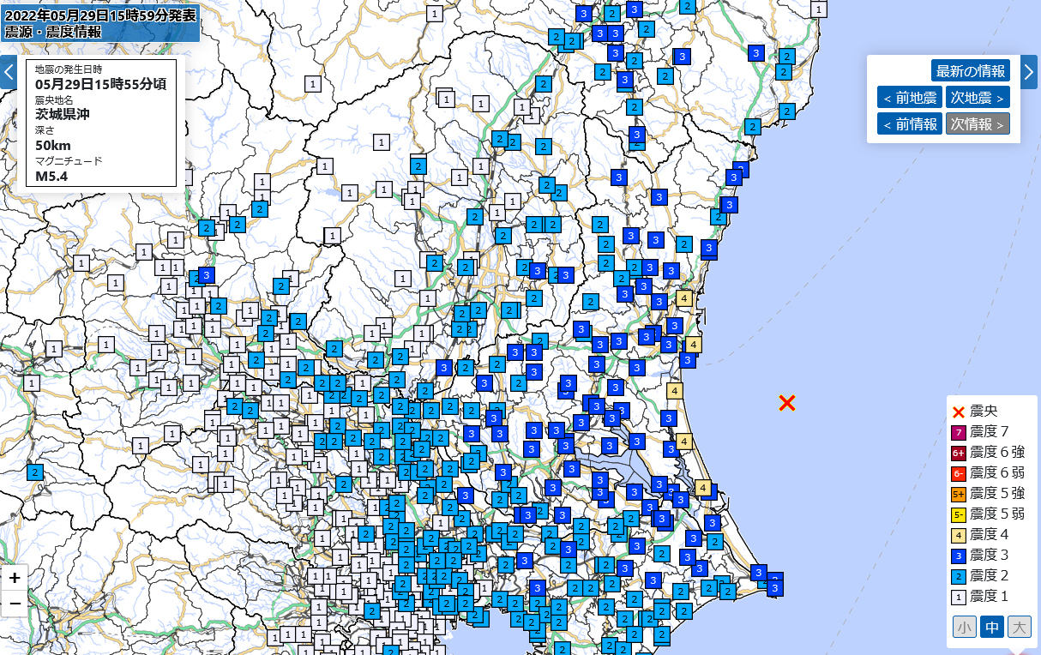
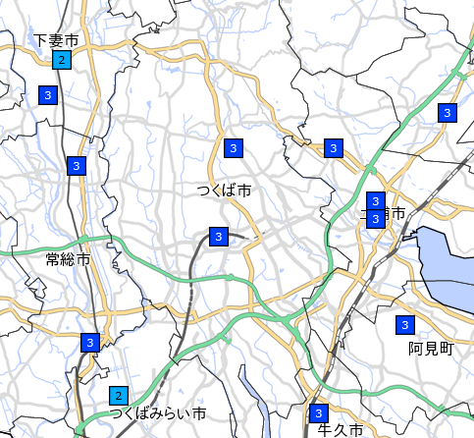
Earthquake on May 29, 2022
Intensity: 3
KEK
KEK
Tokyo
We have caught an earthquake!

Slide 14
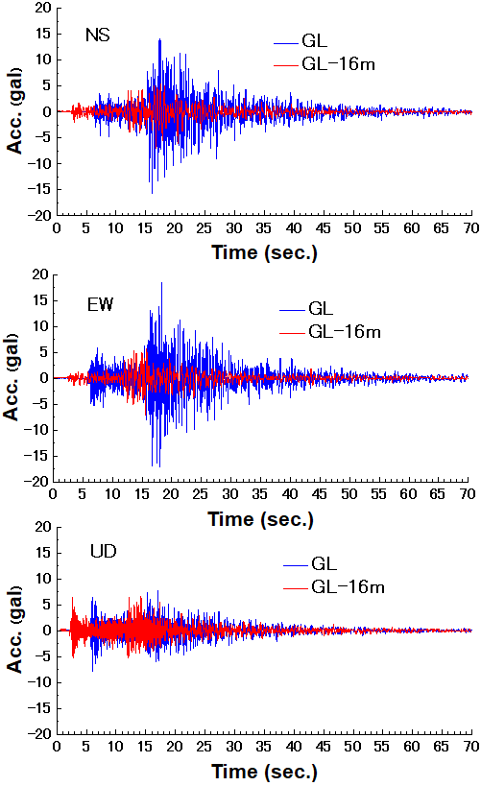
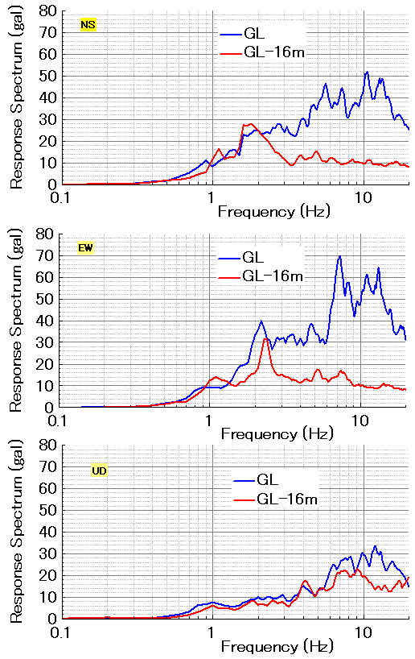
Time history
Response Spectrum
Smaller
Getting larger
Same
Getting larger
Smaller
Same
Same
Same

Slide 15
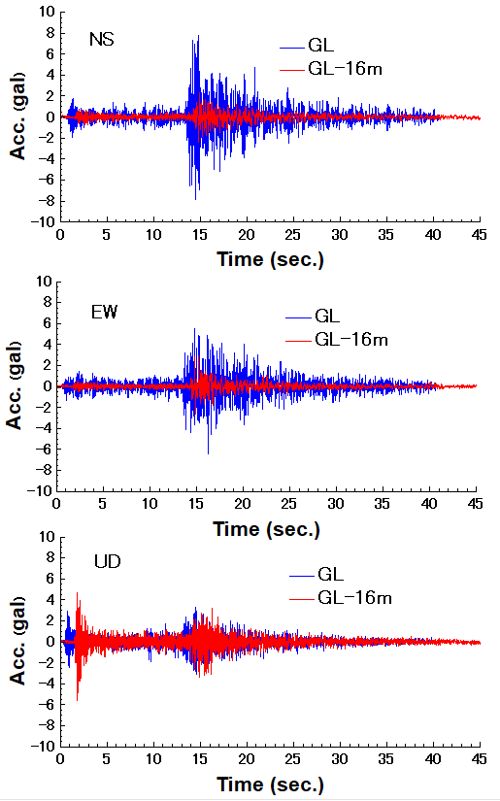
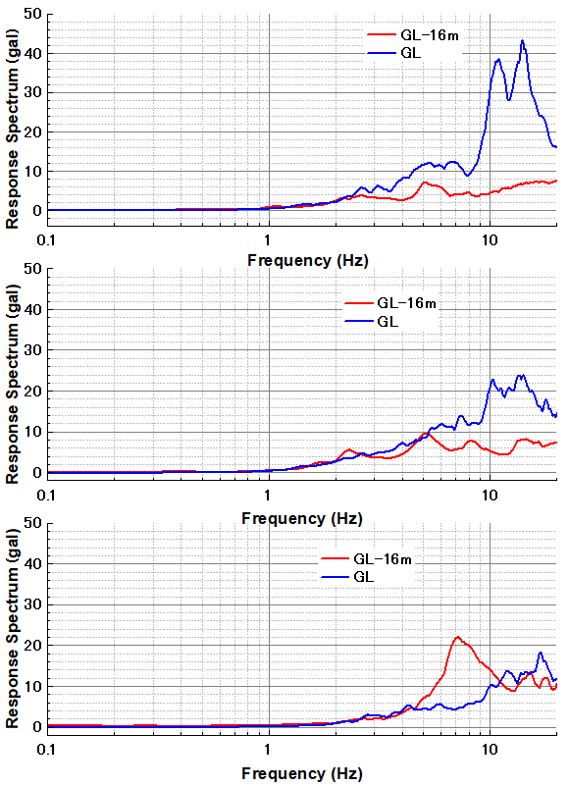
Earthquake on Jun. 12, 2022
Time data
Response Spectrum
NS
EW
UD
➔ Similar situation as that of May 29.

Slide 16
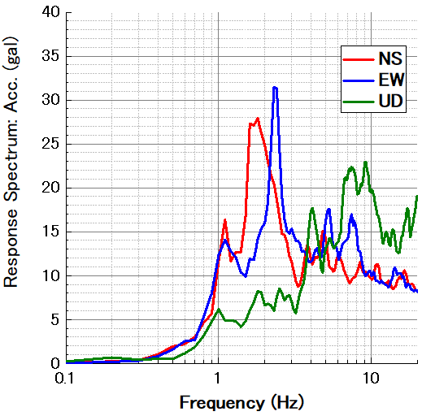
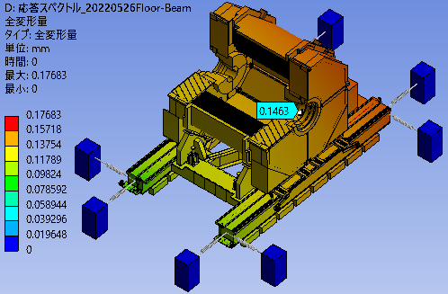
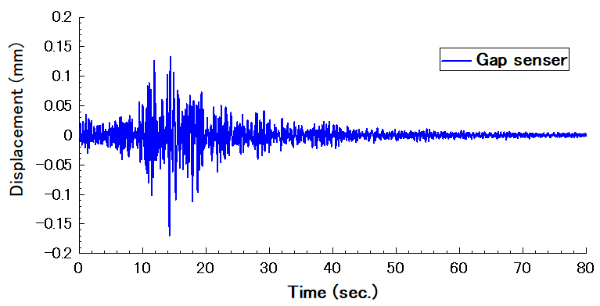
RSA/FEM with GL-16m data of earthquake on May 29.
Response spectrum (GL-16m)
FEM
Damping= 5%
Gap sensor
Displacement= 0.15mm
Displacement= 0.17mm
Good agreement!

Slide 17
Correlation between QCS-L and QCS-R
Gap sensor
QCS-L(31Hz)
If two QCS’s don’t recieve earthquake effect, displacement of both sensors must be almost same and small.
Gap sensor
QCS-R(24Hz)
Result:
- Small displacement. - Almost same value.
Summary of displacement measured by the gap sensors at several earthquakes
Date | Intensity | L-side (mm) | R-side (mm) | Difference (mm)
May 3rd, 22 | 1.3 | 0.0359 | 0.0364 | 0.0005
May 5, 22 | 2.4 | 0.099 | 0.104 | 0.0053
May 8th, 22 | 0.8 | 0.0189 | 0.0194 | 0.0005
May 9th, 22 | 1.0 | 0.0371 | 0.0353 | 0.0017
May 22, 22 | 2.4 | 0.091 | 0.083 | 0.0084
Evidence:
➔ Belle II shakes not QCS
Quench:
➔ Belle II shakes not QCS

Slide 18
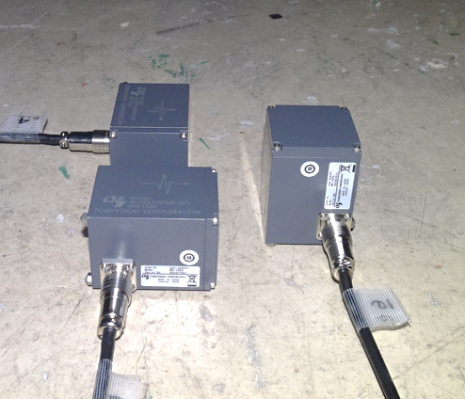
Measurement of relative displacement
Detect. | Acceleration
Type | Servo
Company | Tokkyo-kiki
Range | 0.1 – 400Hz
Sensitivity | 32.6gal/1V
Precision | 10⁻⁶ gal
High precision acceleration sensors are set.
Displacement can be get from two times integration of acceleration time history.

Slide 19
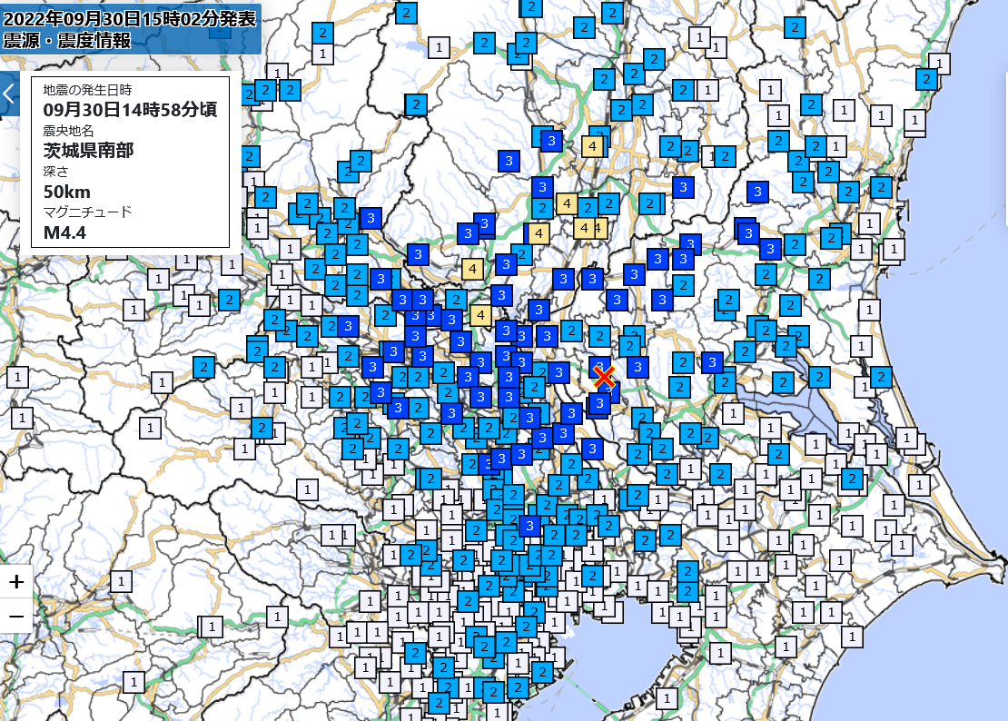
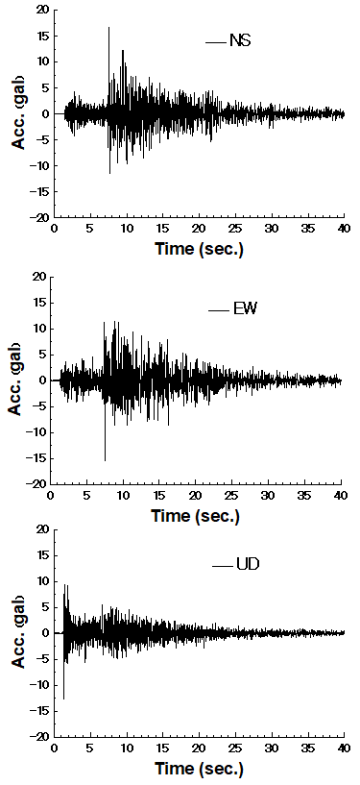
Earthquake on Sep. 30th, 2022
Intensity:
2.1
KEK
Tokyo

Slide 20
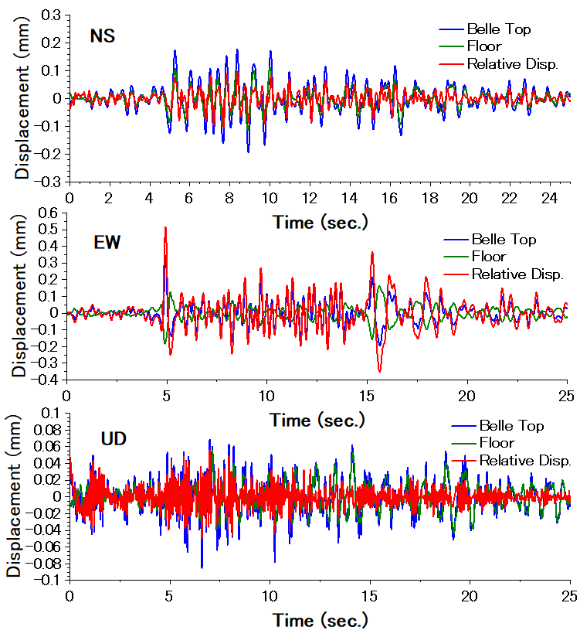
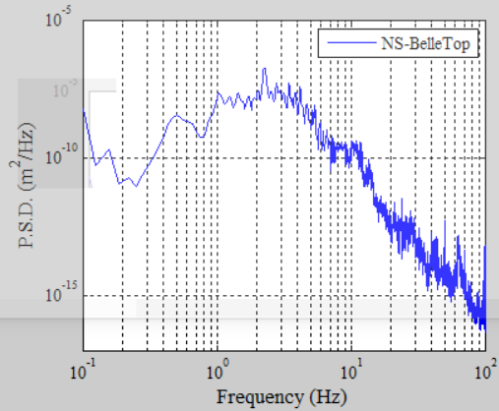
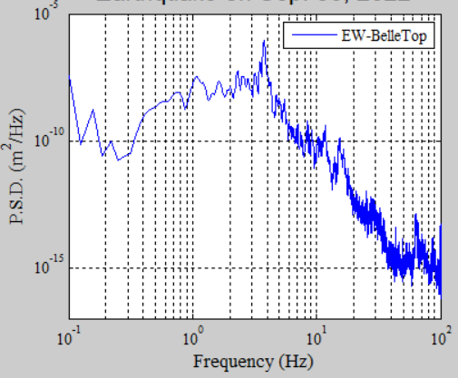
Displacement
EW
NS
NS
Relative displacement is larger than that of Belle II top!
EW
Resonance
Data is still insufficient...

Slide 21
Summary
- QCS was quenched due to an earthquake.
Response spectrum analysis (RSA/FEM) has been done.
QCS was shaken? Belle II was shaken?
Answer: Belle II, not QCS.
True?
- We decided to confirm FEM results.
- We have to think about other effects. Bellows, Gap, etc.
Let’s measure earthquake at Belle II and QCS!
From compare gap sensors → Belle was shaken.
Results of RSA/FEM is consistent with measurement.
Earthquakes is not damped at underground (GL-16m) until 2Hz.
Relative displacement becomes larger than absolute displacement.
Rel. disp. < Abs. disp. ➔ Rel. disp. > Abs. disp.

Slide 22
Thank you!

Slide 23
JMA (Japan Meteorological Agency) |  |  |  | http://www.jma.go.jp/jma/kishou/know/shindo/explane.html
Scale: I | JMA | Acc.(cm/s2): acc=0.45x10^(0.5I) | People | Indoor Situations | Outdoor Situations
0 |  |  | Imperceptible to people.
1 | 0.8 | 1.4 | Felt by only some people in the building.
2 | 2.5 | 4.5 | Felt by most people in the building. Some people awake. | Hanging objects such as lamps swing slightly.
3 | 25 | 14 | Felt by most people in the building. Some people are frightened. | Dishes in a cupboard rattle occasionally. | Electric wires swing slightly.
4 | 80 | 45 | Many people are frightened. Some people try to escape from danger. Most sleeping people awake. | Hanging objects swing considerably and dishes in a cupboard rattle. Unstable ornaments fall occasionally. | Electric wires swing considerably. People walking on a street and some people driving automobiles notice the tremor.
5-Lower | 250 | 142 | Most people try to escape from a danger. Some people find it difficult to move. | Hanging objects swing violently. Most Unstable ornaments fall. Occasionally, dishes in a cupboard and books on a bookshelf fall and furniture moves. | People notice electric-light poles swing. occasionally, windowpanes are broken and fall, un-reinforced concrete-block walls collapse, and roads suffer damage.
5-Upper |  | 253 | Many people are considerably frightened and find it difficult to move. | Most dishes in a cupboard and most books on a bookshelf fall. Occasionally, a TV set on a rack falls, heavy furniture such as a chest of drawers falls, sliding doors slip out of their groove and the deformation of a door frame makes it impossible to open the door. | In many cases , un-reinforced concrete-block walls collapse and tombstones overturn. Many automobiles stop because it becomes difficult to drive. Occasionally, poorly-installed vending machines fall.
6-Lower | 400 | 450 | Difficult to keep standing. | A lot of heavy and unfixed furniture moves and falls. It is impossible to open the door in many cases. | In some buildings, wall tiles and windowpanes are damaged and fall.
6-Upper |  | 800 | Impossible to keep standing and to move without crawling. | Most heavy and unfixed furniture moves and falls. Occasionally, sliding doors are thrown from their groove. | In many buildings, wall tiles and windowpanes are damaged and fall. Most un-reinforced concrete-block walls collapse.
7 |  | 1423 | Thrown by the shaking and impossible to move at will. | Most furniture moves to a large extent and some jumps up. | In most buildings, wall tiles and windowpanes are damaged and fall. In some cases, reinforced concrete-block walls collapse.

Slide 24
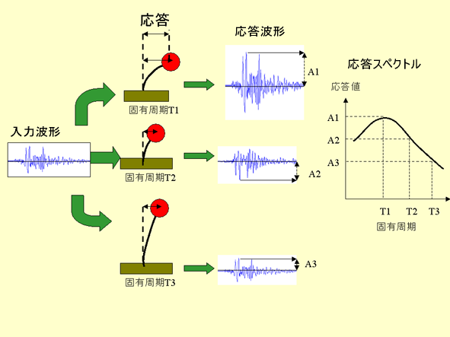
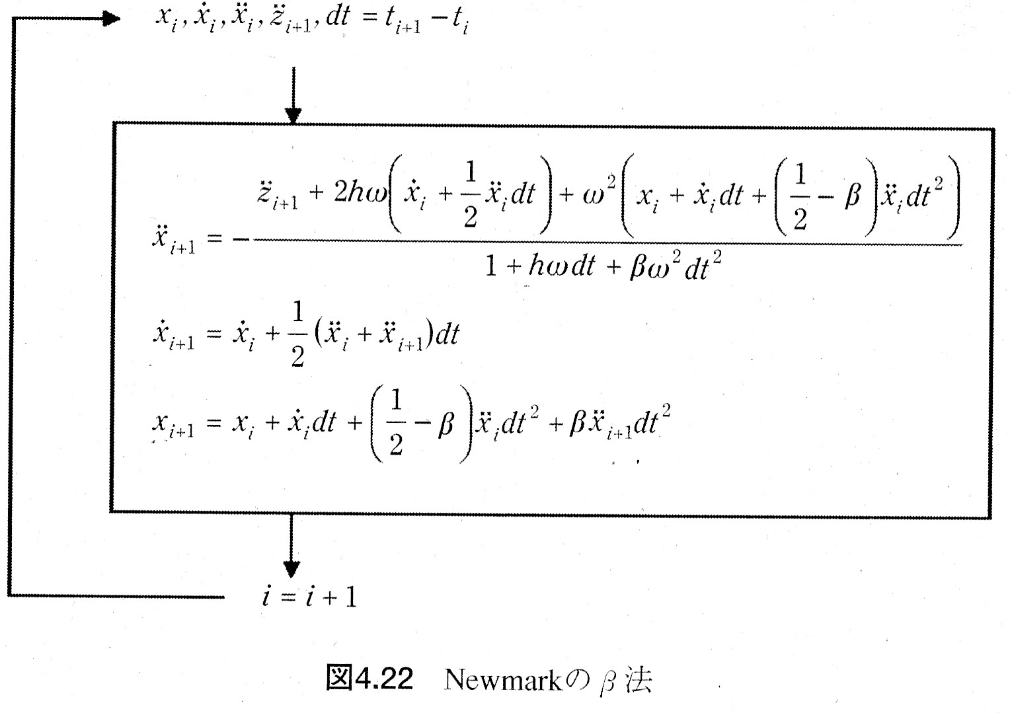
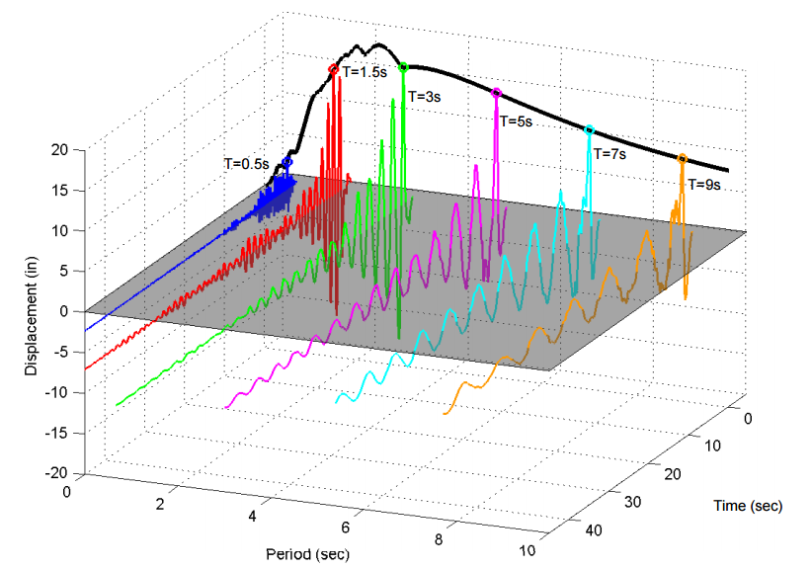

Response Spectrum
A response spectrum is a function of frequency or period, showing the peak response of a simple harmonic oscillator that is subjected to a transient event. The response spectrum is a function of the natural frequency of the oscillator and of its damping. Thus, it is not a direct representation of the frequency content of the excitation (as in a Fourier transform), but rather of the effect that the signal has on a postulated system with a single degree of freedom (SDOF).
$$m{\ddot{x}}_{i}+c{\dot{x}}_{i}+kx_{i}=−m{\ddot{z}}_{i}$$
Response
Output
Response Spectrum
Input

Slide 25
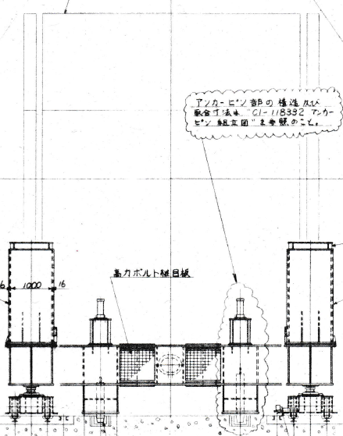
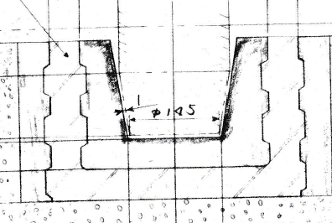
➔ If a big earthquake is struck such as intensity of 5 or 6, the Belle II would be shaken 10mm or 20mm??
Maybe no??
There are four anchors.
But those have to be have enough rigidness.
以上

Slide 26
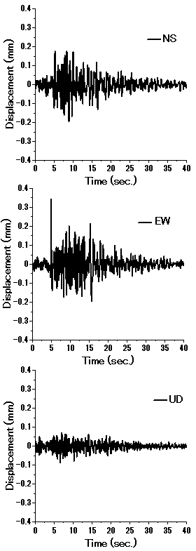
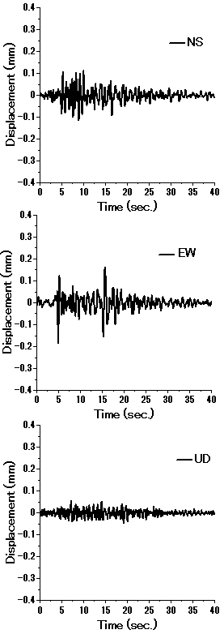

Displacement on Sep. 30. 2022
Ground (GL)
Belle-Top
Floor(GL-16m)

Slide 27




Natural frequency of Belle when the magnet is excited.
UD
NS
EW
EW
NS
UD
1st mode natural frequency : 4 – 5 Hz

