Slide 1
3D calculation for the alignment of LHC low-beta quadrupoles
RUDE Vivien
1st November 2022 – IWAA 2022
On behalf : GM group

Slide 2
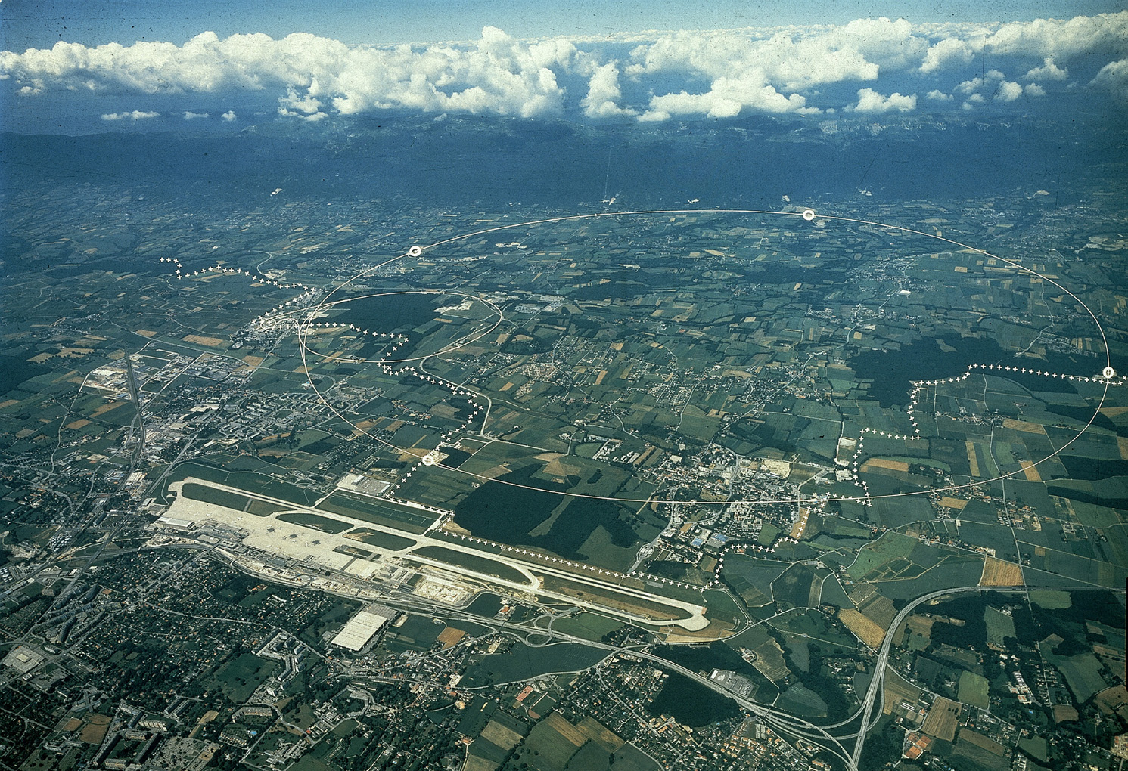
Outline
LHC Low Beta Quadrupoles
Alignment requirement
3D calculations
Results
Perspective : HL-LHC

Slide 3
LHC
Meyrin
site
ALICE
Prevessin
site
CMS
ATLAS
Appart’ City Hotel
Ferney-Voltaire
LHCb

Slide 4
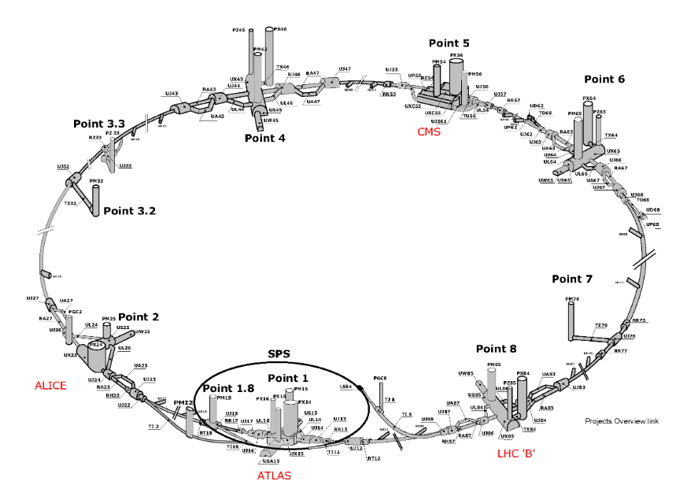
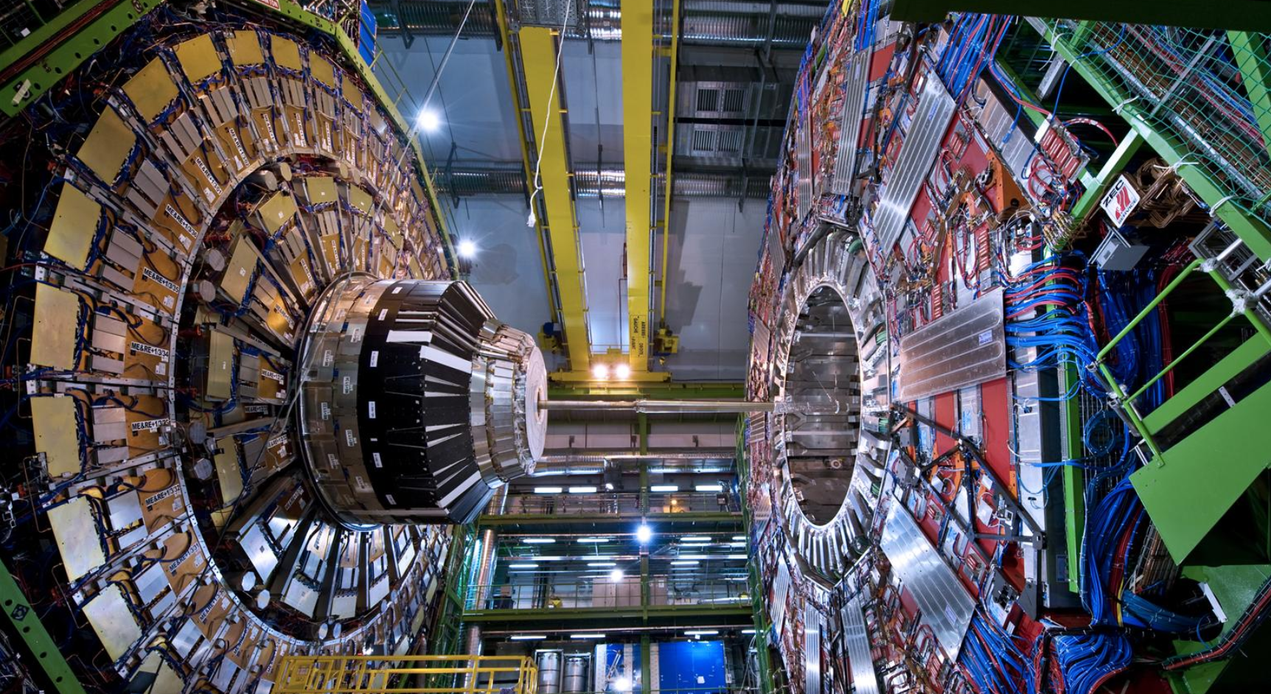
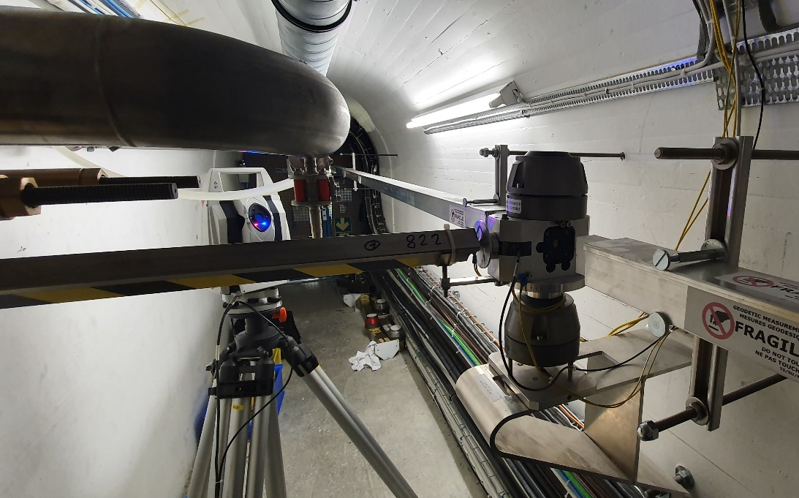
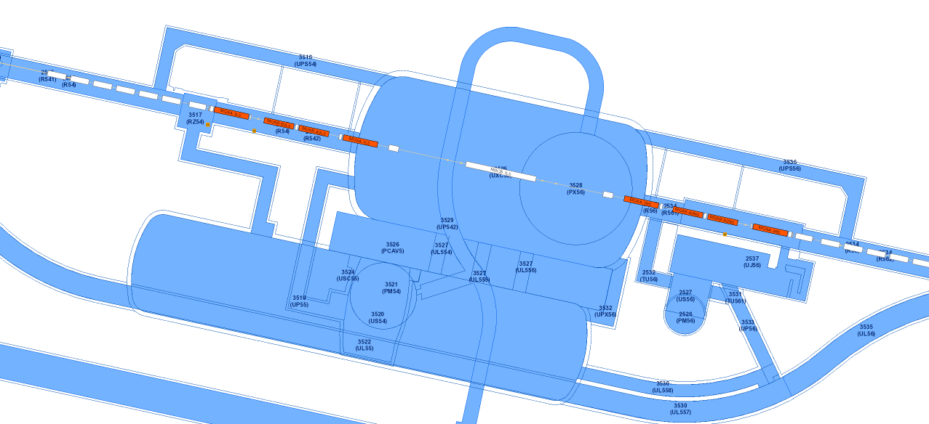
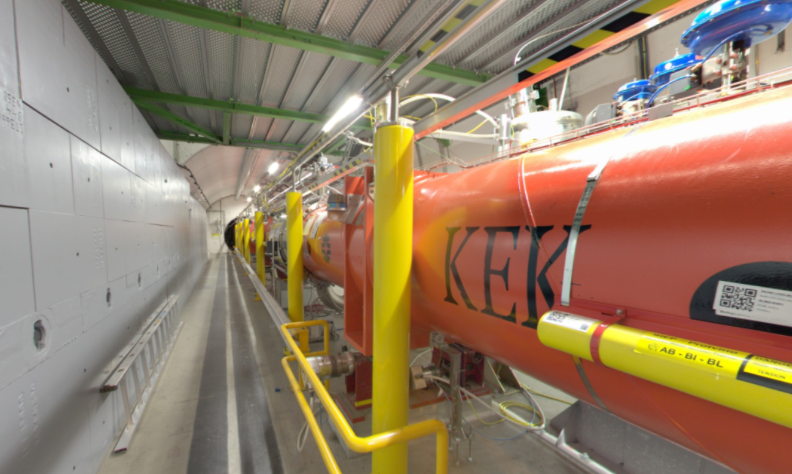
LHC

Slide 5
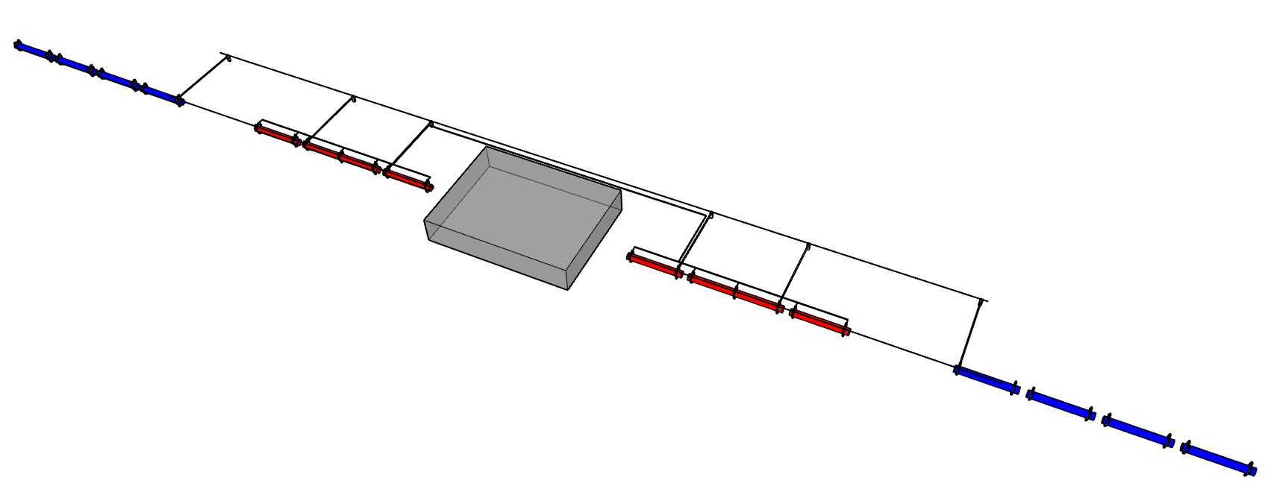
Low Beta alignment requirement
140 m
Alignment tolerances :
±0.15 mm at 1σ
Experiment
Common points
“Stable” points
Experiment
Left
Right
Q3
Q2
Q1
Q1
Q2
Q3
Nominal axis
Radius : 0.15 mm at 1σ

Slide 6


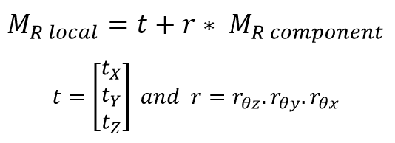
3D transformations
R-ccs (cern)
140 m
Experiment
R-local
R-component

Slide 7
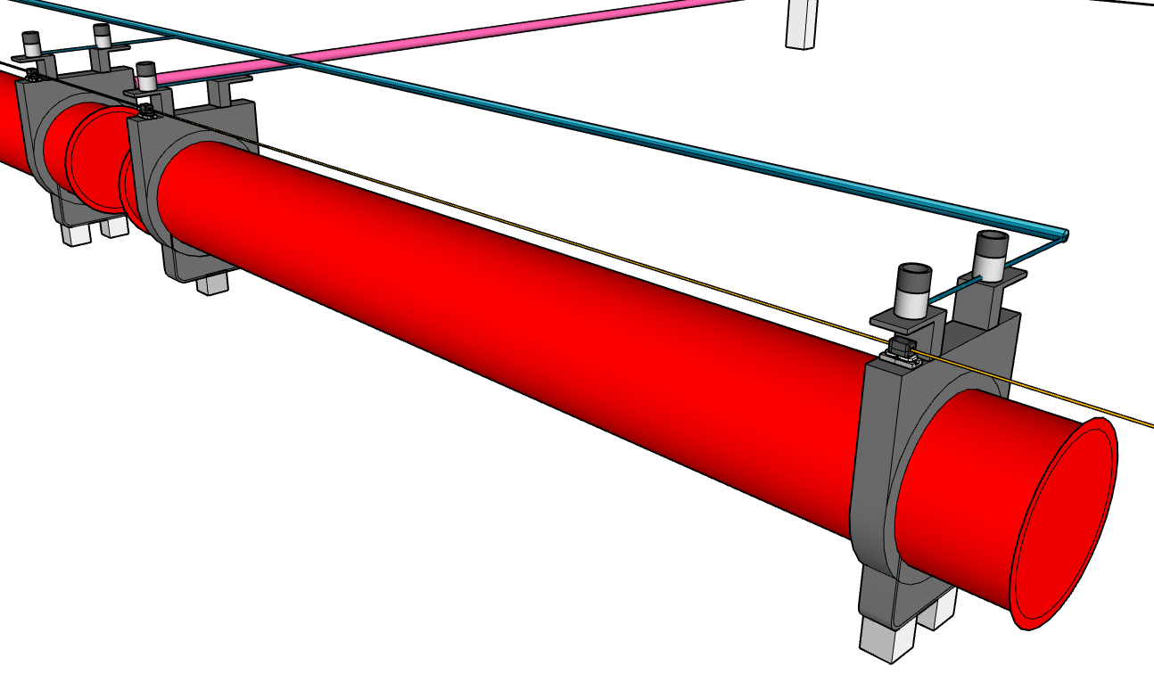
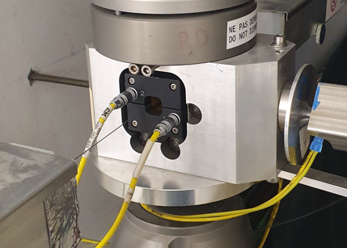
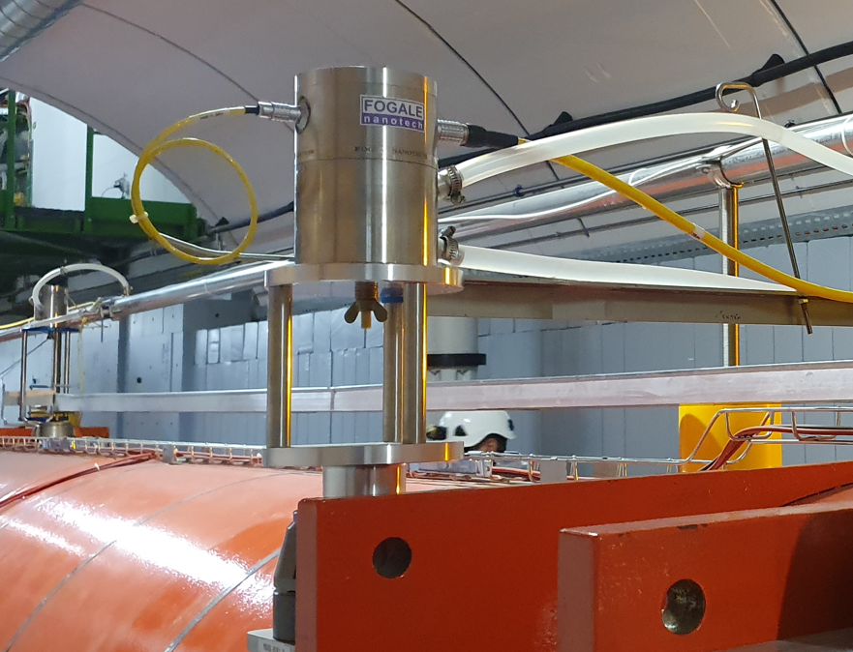
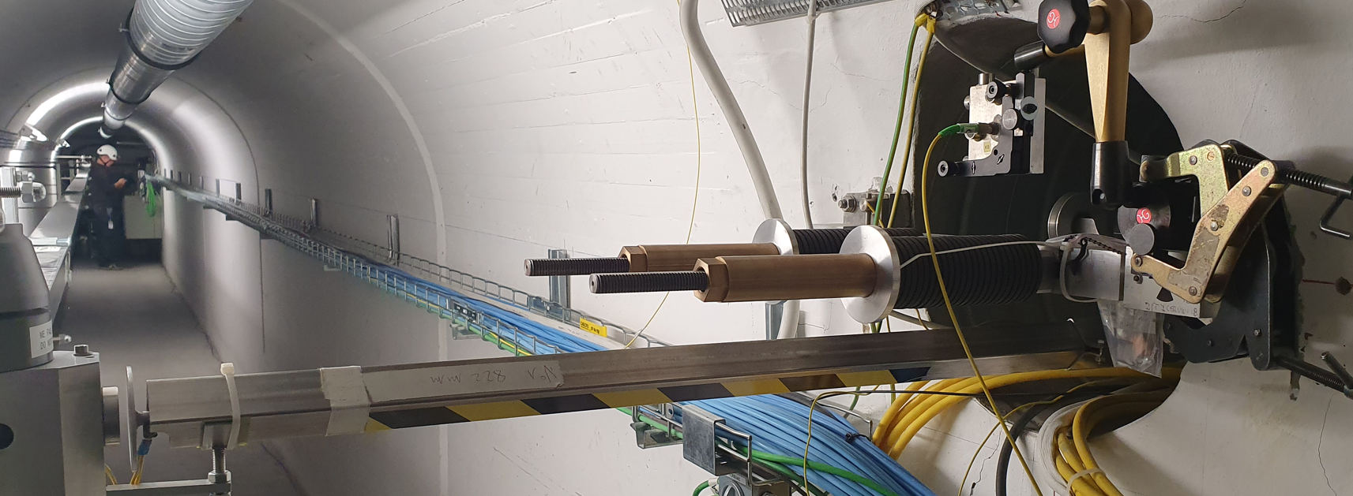
Alignment sensors
Wire sensor : WPS
electrode
wire
Water sensor : HLS
Distance sensor : DOMS + Invar rod
DOMS
electrode
DOMS
Invar rod
electrode

Slide 8

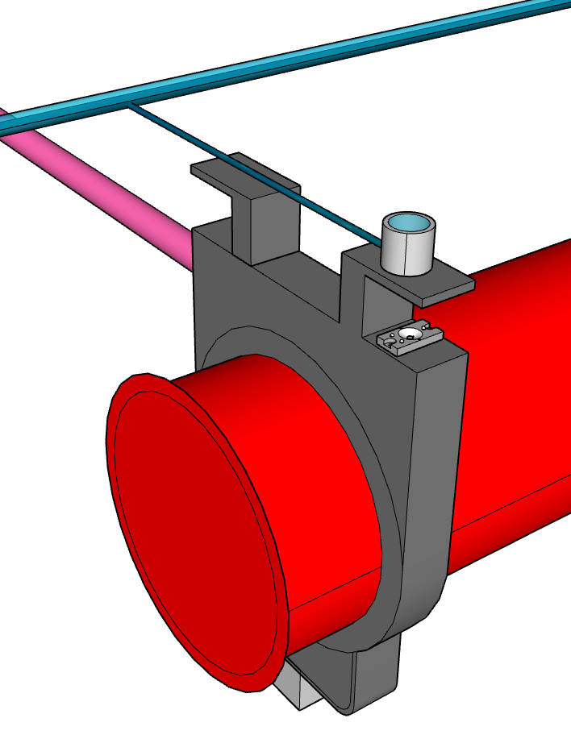
Fiducialisation process
A priori sigma : 20 μm per axis (1σ)
R-interface-HLS
R-interface-DOMS
R-interface-WPS
R-component

Slide 9
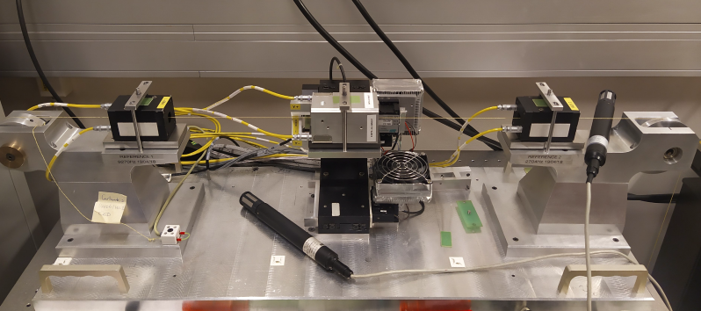
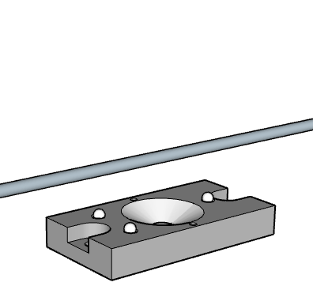
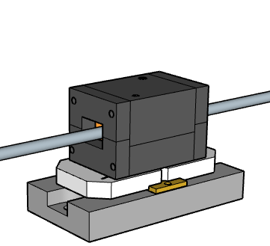

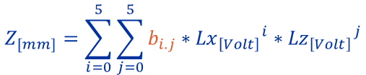
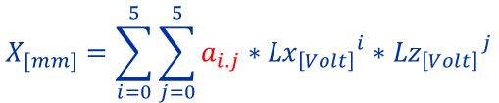
$$X_{[mm]}=\sum_{i=0}^{5}{\sum_{j=0}^{5}{a_{i.j}∗{{Lx}_{\left[Volt\right]}}^{i}∗{{Lz}_{\left[Volt\right]}}^{j}}}$$
Calibration process
electrod
A priori sigma : 5 μm per axis (1σ)
wire
$$Y_{[mm]}=−35 mm$$
$$Z_{[mm]}=\sum_{i=0}^{5}{\sum_{j=0}^{5}{b_{i.j}∗{{Lx}_{\left[Volt\right]}}^{i}∗{{Lz}_{\left[Volt\right]}}^{j}}}$$

Slide 10
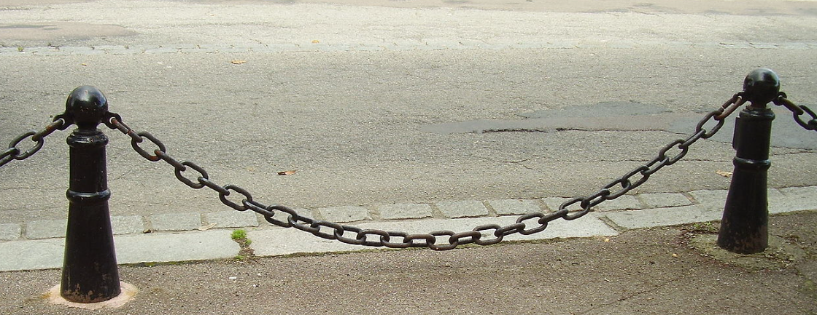
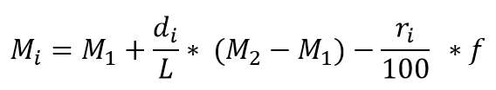



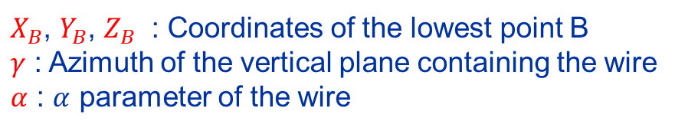
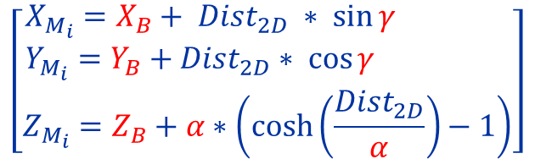
3D model : Wire
$$M_{1}$$
$$M_{2}$$
A priori sigma : 10 μm per axis (1σ)
Z
Y
$$B$$
Hyperbolic cosine
Approximation : Second order polynomial
CERN α ∼ 60 000
$$\left[\begin{matrix}X_{M_{i}}=X_{B}+ {Dist}_{2D} ∗ \sin{γ} \\ Y_{M_{i}}=Y_{B}+{Dist}_{2D}∗ \cos{γ } \\ Z_{M_{i}}=Z_{B}+α∗\left(\cosh\left(\frac{{Dist}_{2D}}{α}\right)−1\right)\end{matrix}\right]$$
$X_{B}$, $Y_{B}$, $Z_{B}$ : Coordinates of the lowest point B
$γ$ : Azimuth of the vertical plane containing the wire
$α$ : $α$ parameter of the wire

Slide 11

3D model : Water
Hydrostatic equilibrium
→ Equipotential surface of the Earth’s gravity
Geoid Model : CERN Geoid 1985

Slide 12
Least square adjustment
LEAST SQUARE ADJUSTMENT
3D transformation
Fiducialisation
Calibration
3D model
Water
3D model
Wire
3D model
Distance
Observations :
WPS : A priori sigma → 30 μm
HLS : A priori sigma → 30 μm
DOMS : A priori sigma → 100 μm
Main Parameters :
3D positions of the components
Sags of the wires
Heights of the water networks
Accuracy (in R-local):
Radial position of the components : [74 μm : 100 μm]
Vertical position of the components : [45 μm : 67 μm]
Sag (absolute accuracy) : 40 μm
Height (absolute accuracy) : 30 μm

Slide 13
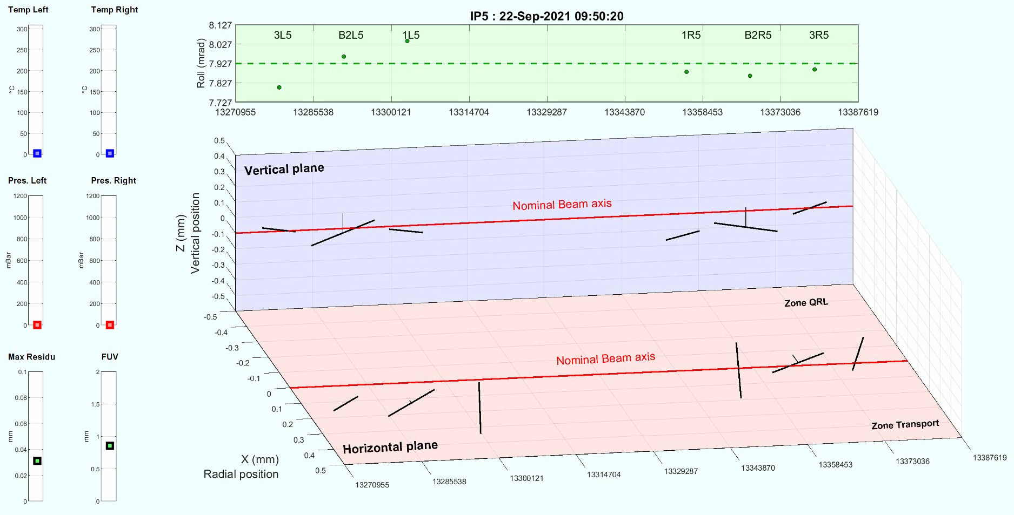
Result : Alignment

Slide 14
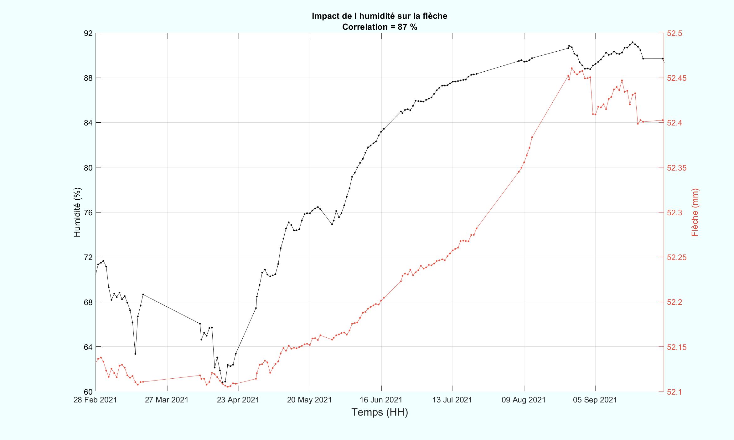
Result : Sag versus Humidity
Carbon Kevlar wire
L = 140 m
92
52.50
88
52.45
84
52.40
80
52.35
Δ = 28%
Δ = 350 μm
Humidity [ % ]
Sag [ mm ]
76
52.30
72
52.25
68
52.20
64
52.15
60
52.10
28 Feb
27 Mar
23 Apr
20 May
16 Jun
13 Jul
09 Aug
05 Sep
Time

Slide 15
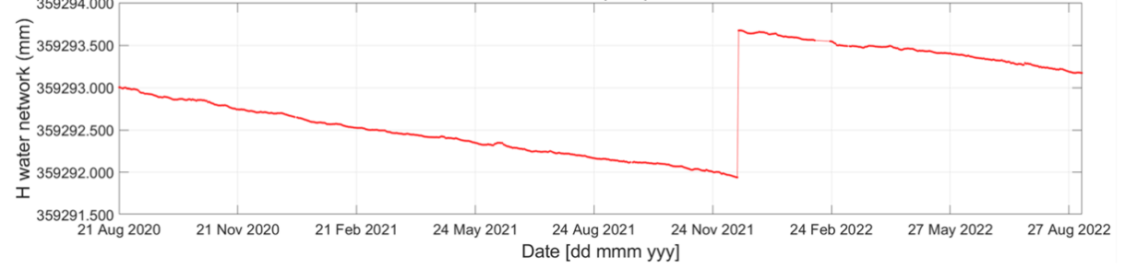
Result : Height of water network
359294.000
Δ = 16 months
359293.500
359293.000
Height [ mm ]
359292.500
Δ = 1 mm
359292.000
359291.500
21 Aug 2020
21 Nov 2020
21 Feb 2021
24 May 2021
24 Aug 2021
24 Nov 2021
24 Feb 2022
27 May 2022
27 Aug 2022
Time

Slide 16
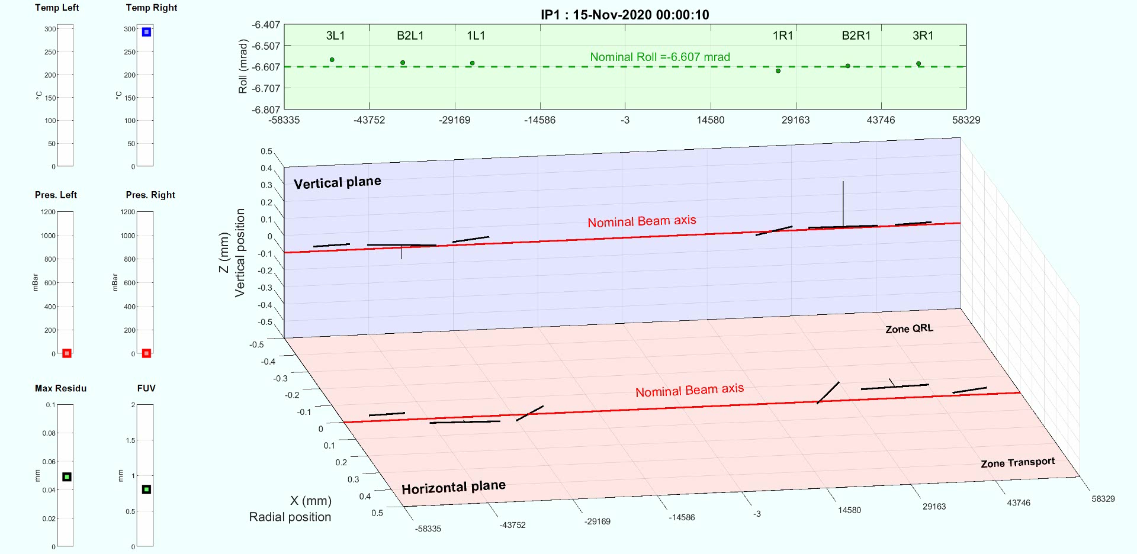
Result : Cooling Down
400 μm
Q1
Q2
2.5 mm
1 mm
Warm position
Cold position

Slide 17
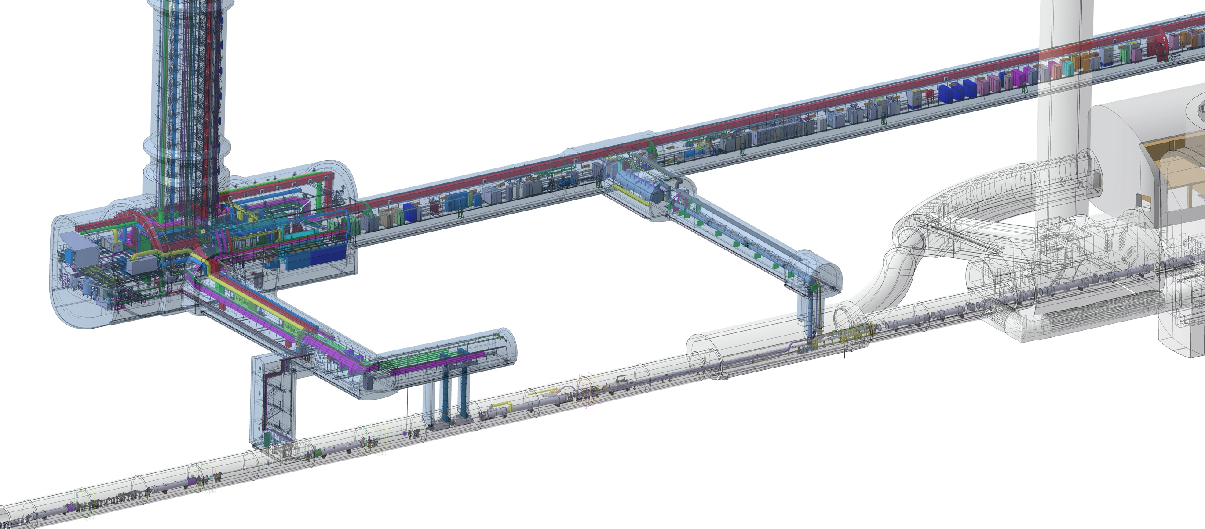
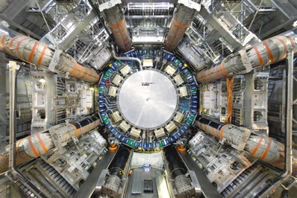
Perspective : HL-LHC
UR55
Courtesy
M. Modena and M. Mendes
US57
UW57
UL57
UA57
D1
CP
Q3
Q2B
Q2A
Q1
UPR57
LHC
TAXN
50 m
D2
HL-LHC
DQHDS
Crab
Cavities
Q4
210 m
Q5

Slide 18
Perspective : HL-LHC Alignment requirement
  Position of the components cryostat along one side of the tunnel : +/- 0.1 mm *
  Position of the components cryostat along one side of the tunnel w.r.t the other side : +/- 0.15 mm *
* On main component
UPS gallery
P1
P2
P3
P4
P5
P6
Alignment between Q1 and Q5 :
TDR limits : σ (1 sigma) < 0.1 mm
Alignment between Q5-left and Q5-right :
TDR limits : σ (1 sigma) < 0.15 mm
EXP.
Q5
Q4
CC2
CC1
D2
TCLX
TCTPH
TCTPV
TAXN
D1
CP
Q3
Q2b
Q2a
Q1
Q1
Q2a
Q2b
Q3
CP
D1
TAXN
TCTPV
TVTPH
TCLX
D2
CC1
CC2
Q4
Q5
Left
Right
R = 0.1 mm
R = 0.15 mm
R = 0.1 mm

Slide 19
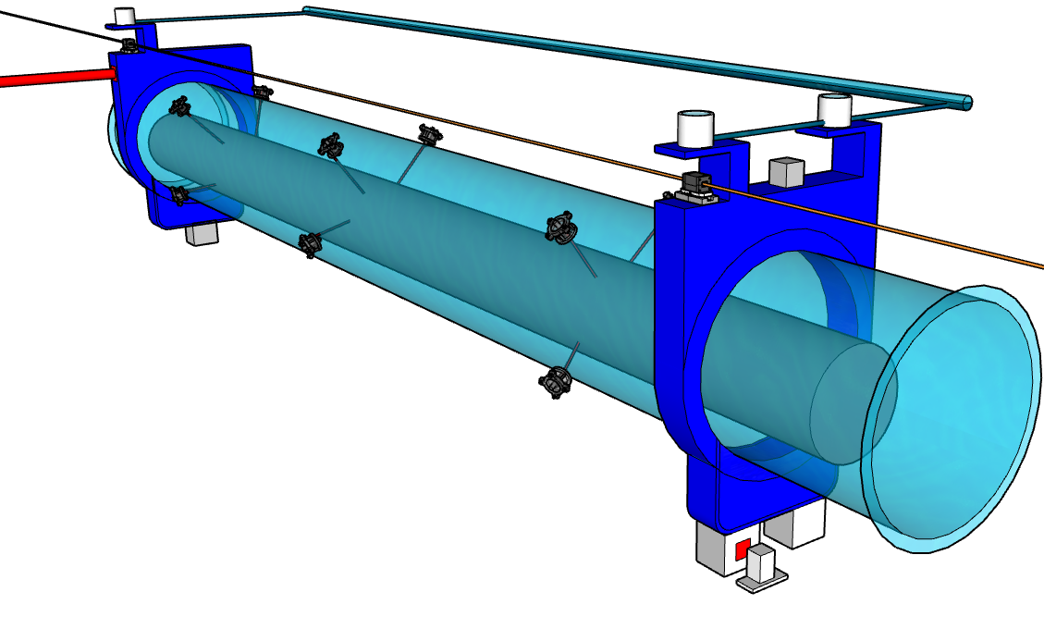
Perspective : Accuracy of the sensors
 | LHC | HL-LHC
WPS | 30 μm | 20 μm
HLS | 30 μm | 20 μm
Long range Distance Link UPS-tunnel | 100 μm | 40 μm
Inclinometer | No | 100 μrad
Internal monitoring | No | 20 μm
Wire to wire
Long range
FSI
HLS
Inclinometer
WPS
wire

Slide 20

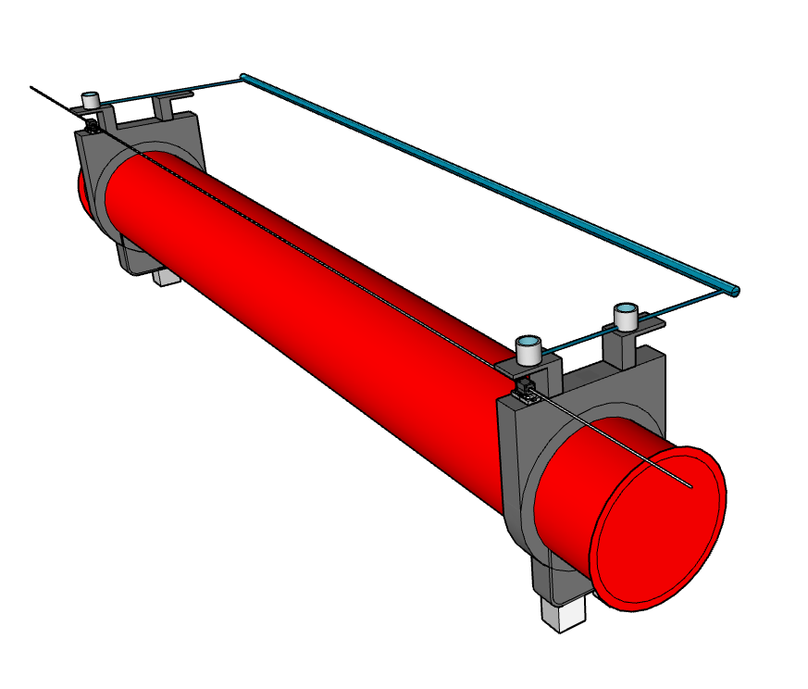
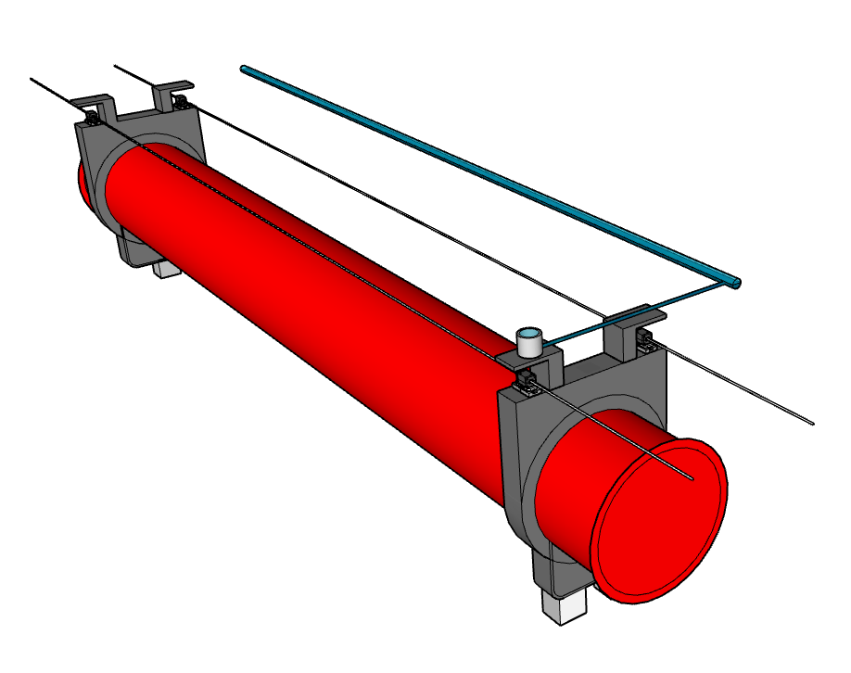
Perspective : LHC → HL-LHC
Accuracy
Reliability
Improve accuracy and reliability
Cost / scope / time
LHC configuration
“ Q1 “
HL-LHC configuration
“ Q1 “

Slide 21
Perspective : LHC → HL-LHC
Number of sensors
Per IP | LHC | HL-LHC
WPS | 22 | ∼140
HLS | 25 | ∼90
Long range Distance Link UPS-tunnel | 6 | 12
Inclinometer | -- | ∼50
Internal monitoring | -- | 160
SUM :
53
∼450
6 components
34 components

Slide 22
Conclusion
Per IP | LHC | HL-LHC
Distance from IP | 50 m | 210 m
Number of sensors | 53 | ∼450
Number of components | 6 | 34
Internal monitoring | no | YES
Reliability | no | YES
Alignment tolerance | 0.15 mm [Q3-Q3] | 0.15 mm [Q5-Q5]
LHC Low Beta alignment requirement
→ +/-0.15 mm (1σ)
Results
→ Accuracy below 0.1 mm (1σ)
3D versus 2D
→ Difference up to 0.1 mm
LHC → HL-LHC
P1
P2
P3
P4
P5
P6
R = 150 μm
R < 40 μm
Q5
Q4
D2
TCLX
TAXN
D1
CP
Q3
Q2b
Q2a
Q1
Q1
Q2a
Q2b
Q3
CP
D1
TAXN
TCLX
D2
Q4
Q5
TCTPV
TCTPH
TCTPV
TCLMB
CRAB1
TCTPH
TCLMC
CRABL
CRAB1
TCLMC
CRAB2
TCLMB
-220
-200
180
-160
-140
-120
-100
-80
-60
-40
-20
0
20
40
60
80
100
120
140
160
180
200
220

Slide 23
Thank you
for your attention

Slide 24
SPARE

Slide 25
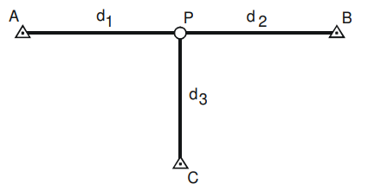
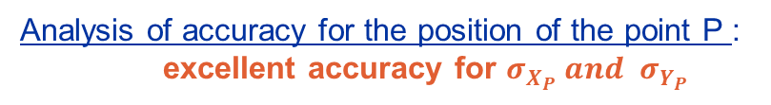
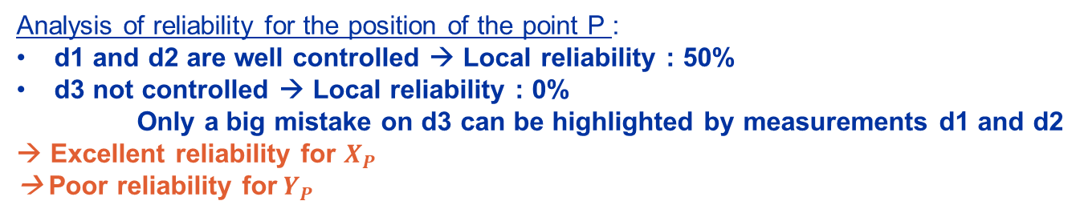
Reliability from GM group point of view
Analysis of
accuracy
The a priori hypotheses are considered as true without any mistakes on the observations
Least Square Adjustment
Stochastic model which contain
the probabilistic of the observations
Analysis of
Reliability
The analysis of reliability includes the notion of auto-control. That means the possibility to detect the mistakes on the observations
A priori hypothesis :
→ Distances d1, d2, d3 → accurate (micrometric level)
Analysis of accuracy for the position of the point P :
excellent accuracy for $σ_{X_{P}} and{ σ}_{Y_{P}}$
y
Analysis of reliability for the position of the point P :
d1 and d2 are well controlled → Local reliability : 50%
d3 not controlled → Local reliability : 0%
Only a big mistake on d3 can be highlighted by measurements d1 and d2
→ Excellent reliability for $X_{P}$
→ Poor reliability for$Y_{P}$
x

Slide 26
Accuracy of the proposition
General coordinate system
P1
P2
P3
P4
P5
P6
Wire Q1-D1
Wire Q1-D1
Q5
Q4
CC2
CC1
D2
TAXN
D1
CP
Q3
Q2b
Q2a
Q1
Q1
Q2a
Q2b
Q3
CP
D1
TAXN
D2
CC1
CC2
Q4
Q5
Baseline
Proposition
HL-LHC limits (2) : (1σ) < 0.15 mm
Q5
Q4
CC2
CC1
D2
TAXN
D1
CP
Q3
Q2b
Q2a
Q1
Q1
Q2a
Q2b
Q3
CP
D1
TAXN
D2
CC1
CC2
Q4
Q5

Slide 27
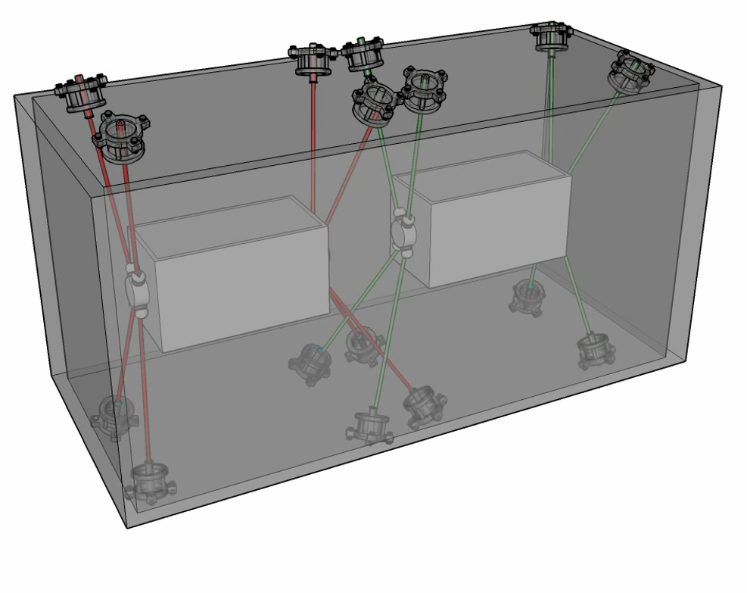
Internal monitoring
Wire to wire
HLS
Inclinometer
WPS
wire

Slide 28
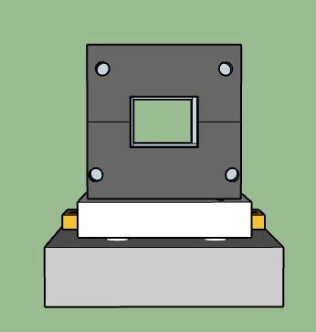
Difference 2D versus 3D
θ = 2 mrad
Δ rad = 70 μm
Difference up to 0.1 mm
for LHC configuration
34.5 mm

