Slide 1
Stability Studies of High-Quality Concrete
Slab Floors at the ESRF
IWAA2022 CERN
David Martin ESRF

Slide 2
Outline
The ESRF
ESRF site movement signatures
Behavior of concrete slabs

Slide 3






















The ESRF
13 Member states:
France 27.5 %
Germany 24 %
Italy 13.2 %
United Kingdom 10,5 %
Russia 6 %
Benesync 5,8 %
(Belgium, The Netherlands)
Nordsync 5 %
(Denmark, Finland, Norway, Sweden)
Spain 4 %
Switzerland 4 %
8 Associate countries:
Austria 1.75 %
Israel 1.75 %
Poland 1 %
Portugal 1 %
India 0.66 %
Czech Republic 0.6 %
South Africa 0.3 %
Hungary 0.25 %
Contribution to the budget in %
21 partner nations
Annual budget: ~115 million euros
Members of staff: 630 of 40 different nationalities
Legal status: Private civil company subject to French law

Slide 4
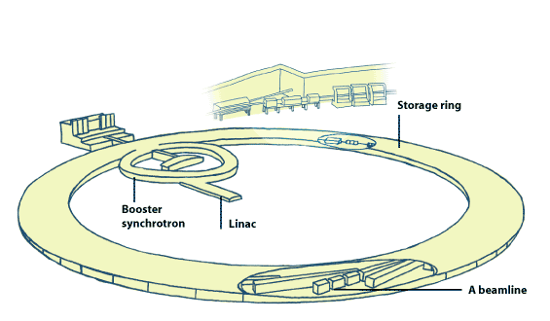
The ESRF
The linear accelerator (linac) accelerates the electrons from rest mass to 100 MeV
The booster accelerates the electrons from 100MeV to 6GeV
The storage ring keeps the electrons circulating at 6GeV for many hours
The 6GeV electrons produce synchrotron radiation in a tangential direction to the beam travel
A ESRF is composed of two main elements:
A particle accelerator that generates synchrotron radiation – the source,
Beamline(s) that use the synchrotron radiation generated by the accelerator to study matter.

Slide 5
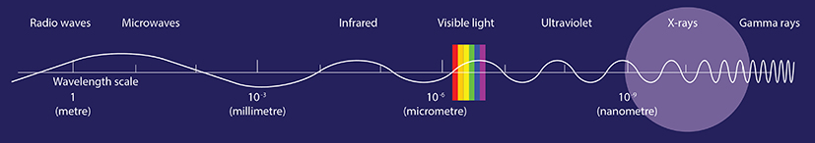
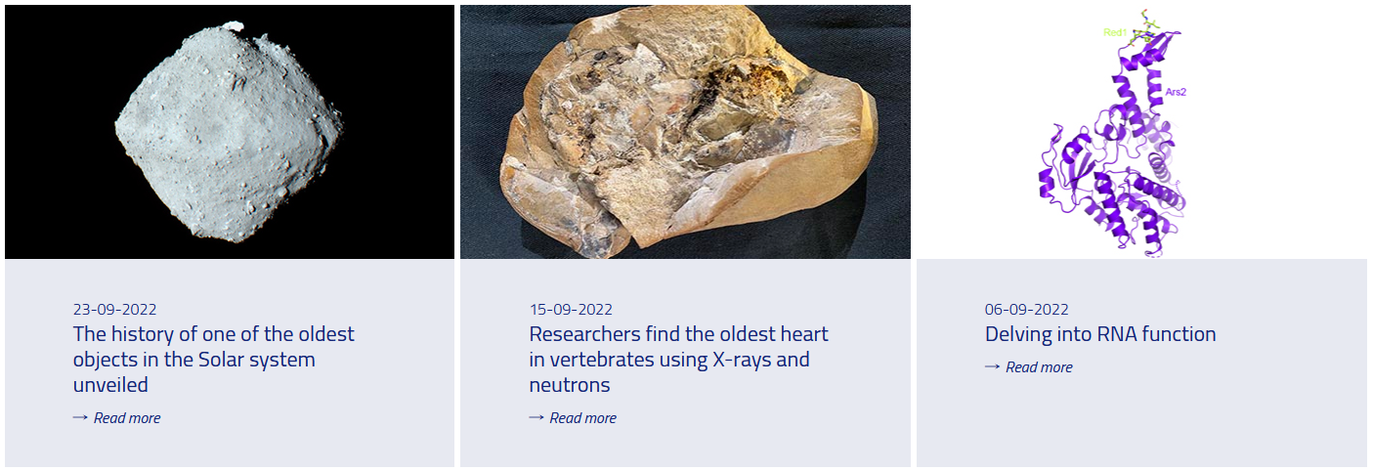

The ESRF X-rays for science
Scientists use the ESRF to explore everything from exotic states of matter to snake fossils to the reason why chocolate sometimes develops a white film when it melts …

Slide 6
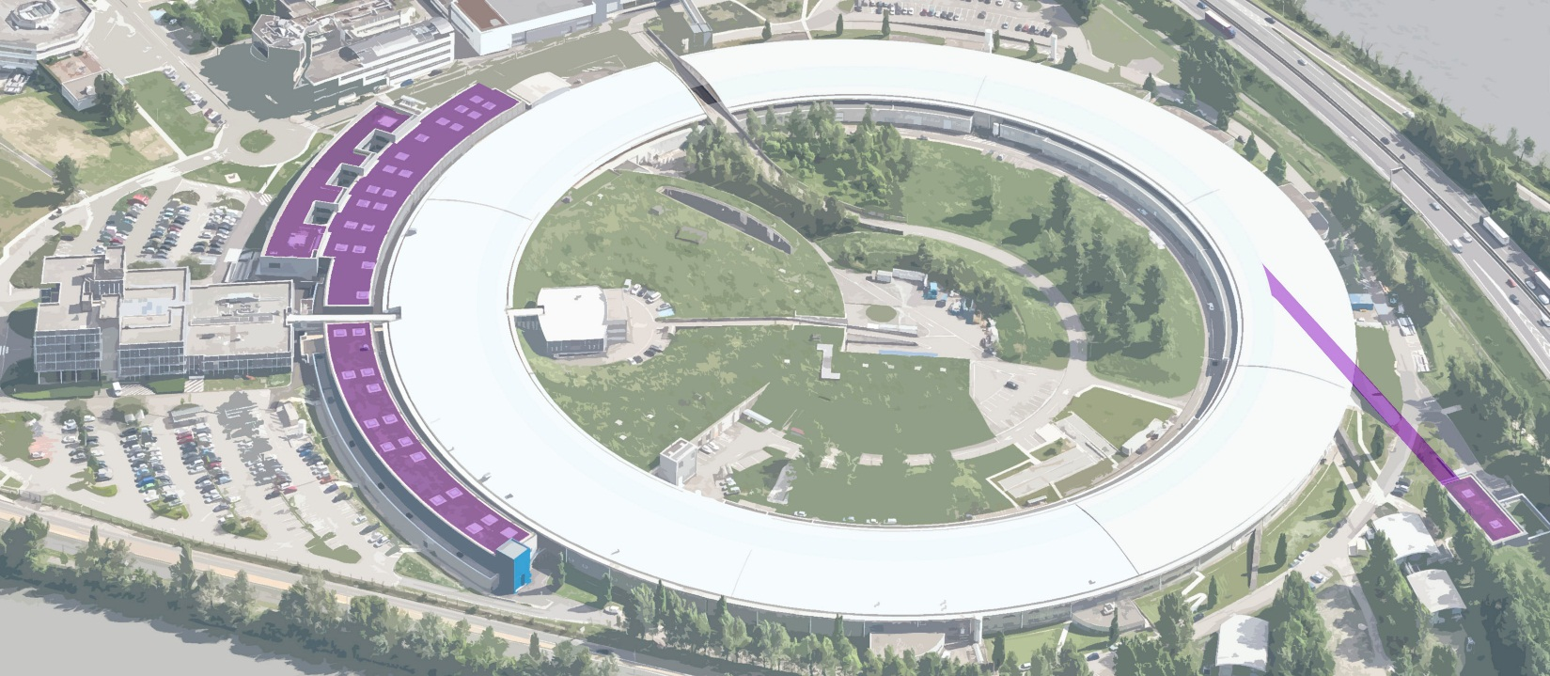
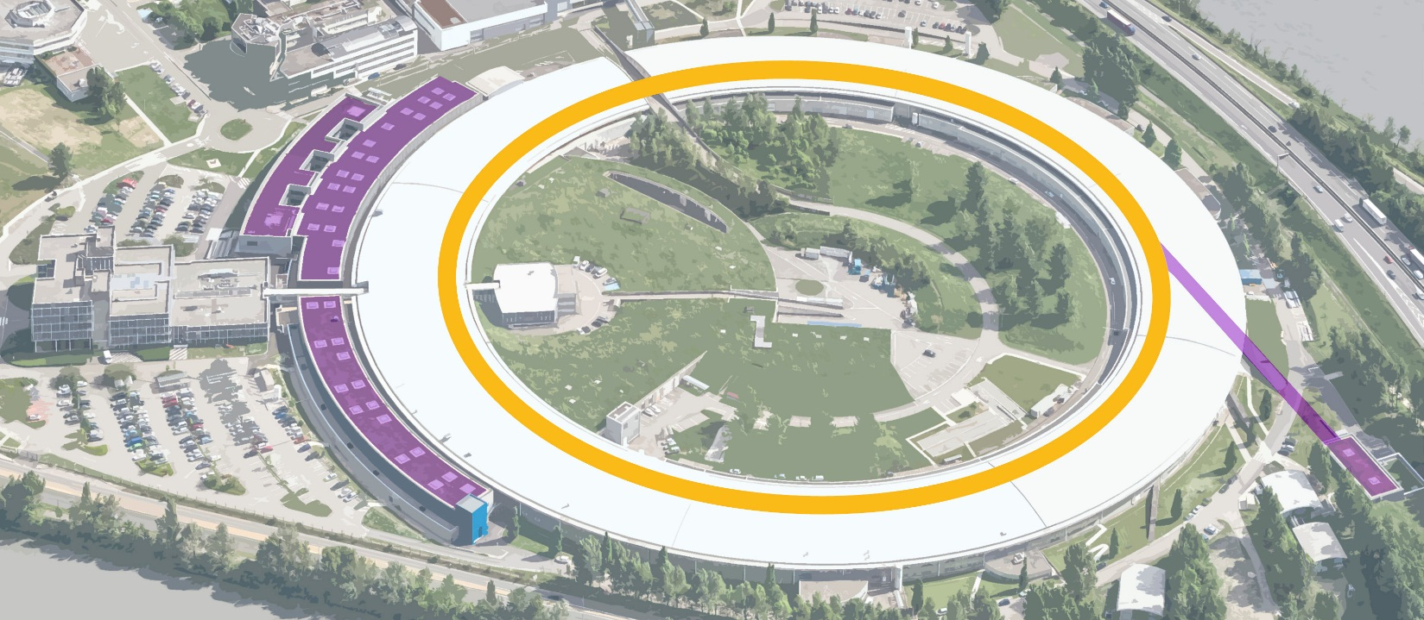
ESRF Upgrade programme
2009
2015
Upgrade PHASE I – 160 M€
In time and within budget
2015
2022
ESRF-EBS – 150 M€
Launched in June 2015
- Construction of 19 new-generation experimental stations to explore the nanoworld
- Creation of a new ultra-stable experimental hall
- Improvement and refurbishment of most of the cutting-edge scientific equipment and accelerator infrastructure
- Construction of a new storage ring –the EBS, inside the existing structure, with performance increased by a factor of 100
- Construction of new state-of-the-art beamlines
- Ambitious instrumentation programme (optics, high-performance detectors)
- Intensified big data strategy

Slide 7


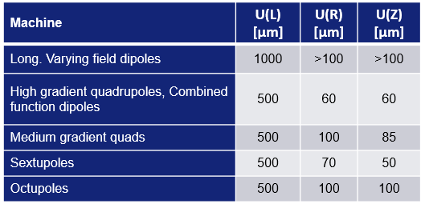
Alignment – one of the defining characteristics of the UP1 and EBS
Upgrade Programme Phase I
EBS - UP Phase II
Note EBS will be discussed in detail :
03 November 2022, 09:45 AM (Machine)
04 November 2022, 11:05 AM (Beamlines)
Loading case of long term movements | Response performance to loading
Slab thermal stability with respect to the inside hall temperature set point and the external temperature variation over a 12 hour period | Anywhere within a solid disk of 5 metres radius over a 12 h period ▪ Vertical deflections < 2 µm ▪ Rotation angle < 200 nrad
Daily external ambient temperature changes ΔT=20 C | Anywhere within a solid disk of 5 metres radius over a 24 h period vertical differential movement of ▪ < 1 µm ▪ < 100 nrad Anywhere on the Golden Slab except at distances closer than 1.5 m from the edge.
Vertical deformation due to medium term settlement | ≤ 250 µm peak to peak displacements anywhere in a disk of 60 diameter over a period of 12 months starting one year after building completion.
Golden Slab deformation due to settlement: Long term | Differential movement ≤ 5 mm peak-to-peak anywhere in a circle of 200 m diameter, measured on the EXPH2 slabs over a period of 10 years

Slide 8
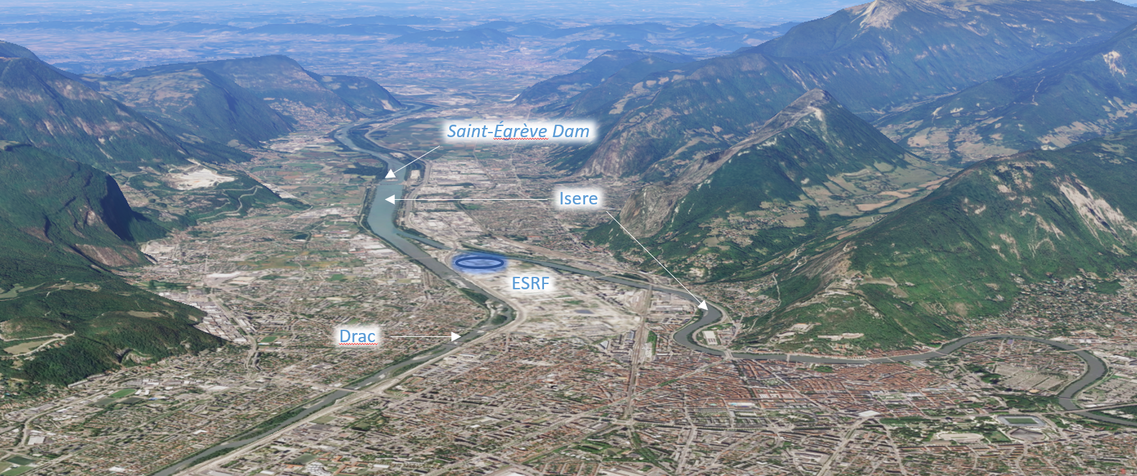
Context - ESRF Site Movement signatures
At the ESRF, there are several well known site movement signatures …
The ESRF is located:
between the Chartreuse and Vercors mountain ranges so there are geological influences.
between the Drac and Isère rivers so there are geomorphological influences.
upriver of the Saint-Égrève dam which is emptied periodically changing the level of water in the rivers and ground water.
on an old glacial lake bed – the underlying soil profile is relatively homogeneous clay overlaid by alluvial material.

Slide 9
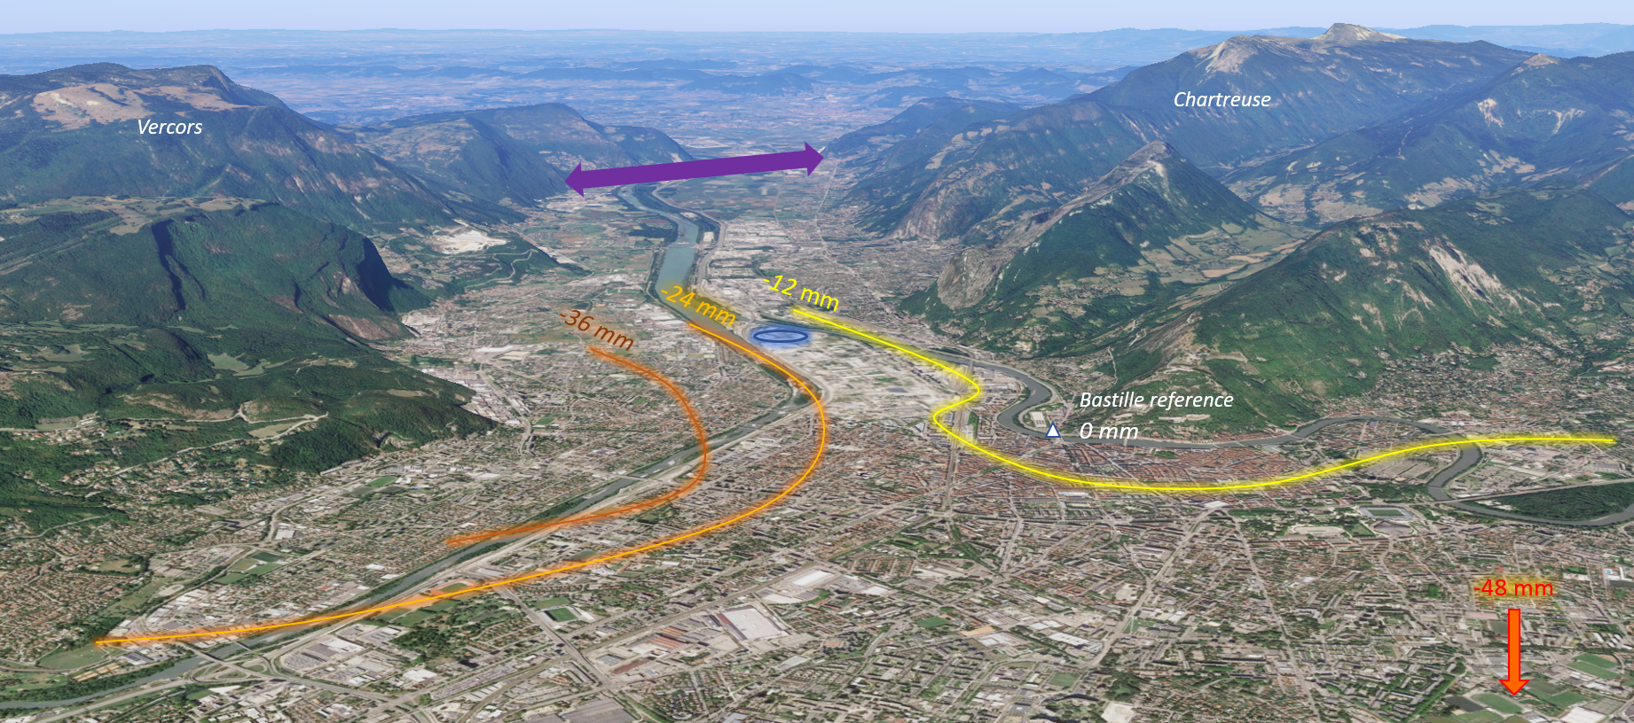
Grenoble Basin
A study based on levelling of the Grenoble basin between 1880 and 2001 shows …
Movements 1989 to 2001*
Several things appear to be happening:
The center of the Grenoble basin is sinking (48 mm between 1989 and 2001, > 40cm since 1880).
The Chartreuse range is slowly separating from the Vercors.
These observations indicate the ESRF has tilted ~ 5 mm towards the Vercors over 11 years or so.
*Mesure de l’affaissement actuel de la cuvette grenobloise par comparaisons de nivellements, Menard G., Pôle Grenoblois Risques Naturels

Slide 10
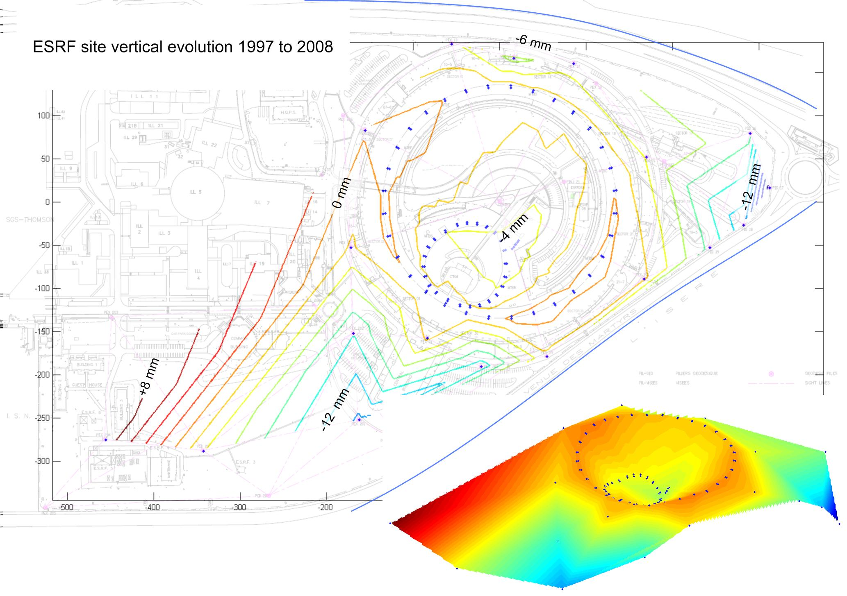
ESRF vertical movements in the Grenoble basin context
It is difficult to confirm this tilt across the site with our observations.
However, several things are happening:
The center of the site is sinking,
The area at the confluence of and along the two rivers is sinking,
The central office building is sinking,
The SR is relatively stable.
b)
a)
d)
c)
If the whole site is sinking it is not very important…

Slide 11
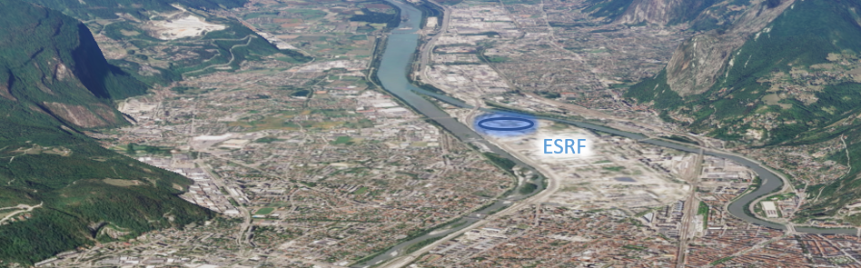
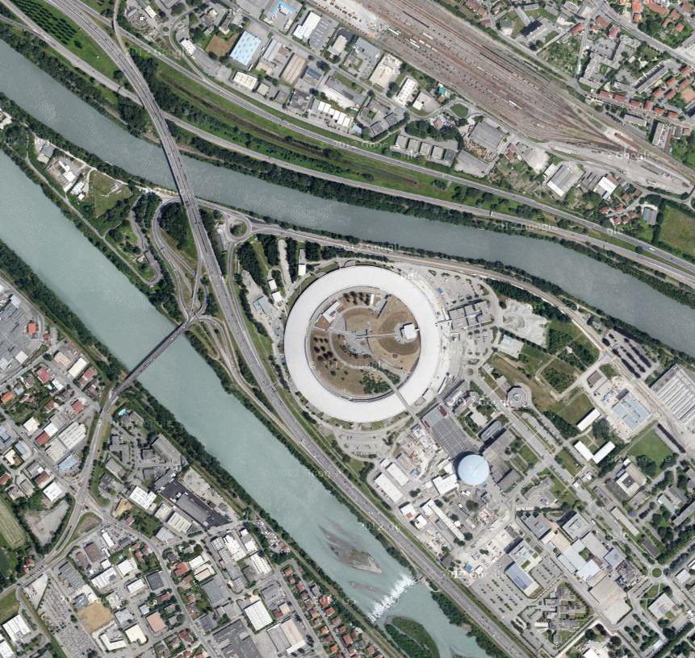
Long term horizontal deformation
The ESRF site, and machine are stretching along the valley and river axes…
+2.5 mm
0 mm
-3.5 mm
C01
C17

Slide 12
Long term Vertical deformation
The ESRF site, and machine are tilting across the valley as we have already observed…
+2.5 mm
0 mm
-3.5 mm
C01
C17

Slide 13
Deformation due to dam purging
The ESRF site, and machine bend up towards the adjacent rivers…
+0.4 mm
0 mm
-0.4 mm
C01
C17

Slide 14
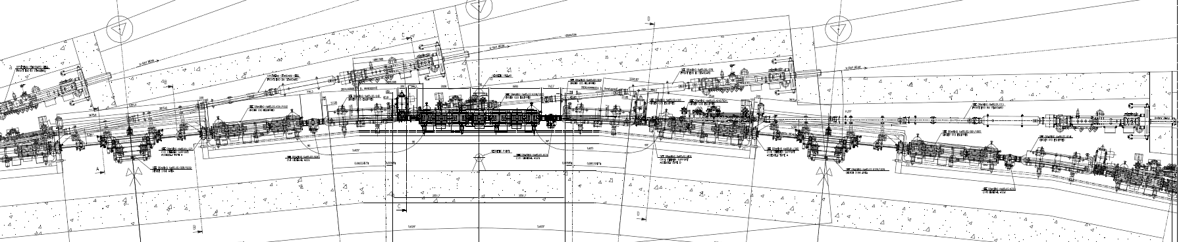
Movements at the slab joints
Joint
Crack
There are movements between girders of the old SR of ±150 µm per year.
August to January
January to August

Slide 15
Horizontal Movements at the slab joints
Interestingly WPS observations show even larger horizontal movements across the slabs joints …

Slide 16
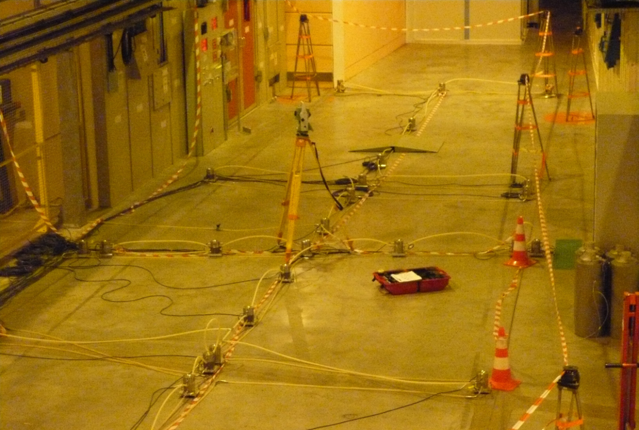
BM18 tests July 2009 to September 2011
This HLS was installed to determine the deformation of the slab under a charge of 5T.
However, it was also observed that the slab was bending – apparently as a function of temperature change

Slide 17
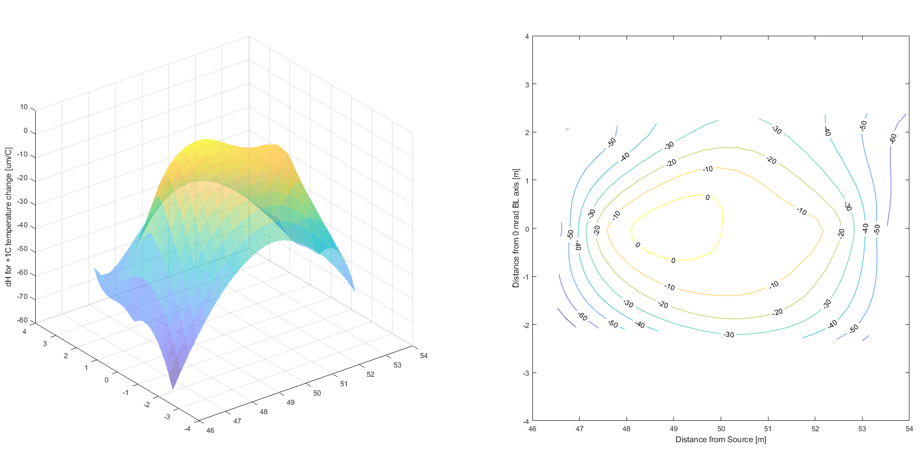
BM18 slab bending as a function of temperature change
This discovery was made at the start of the Upgrade Programme High Quality Slab (HQS) study. It led to more detailed studies of slab bending…

Slide 18
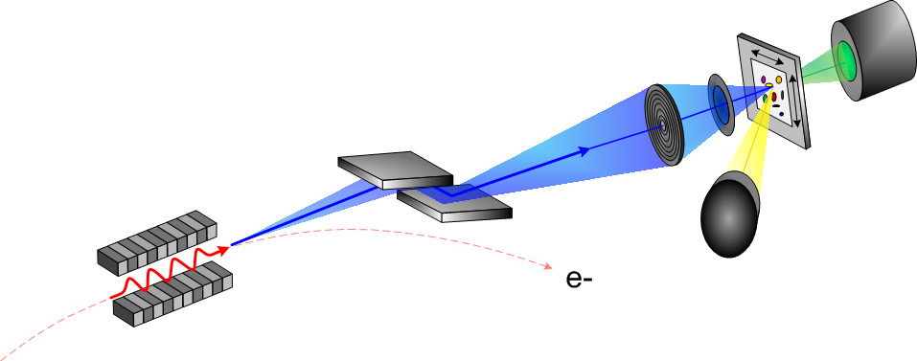
Briefly what is a beamline?
A beamline can be thought of in three ways:
  It’s a physical space within the experimental hall.
  It’s also a set of equipment that brings the X-ray beam to the material being studied and records what happens.
  And most importantly, it’s a dynamic meeting place, where scientists and staff collaborate to answer leading-edge research questions.
Sample and detector
X-ray optics
X-ray source

Slide 19
Alignment – one of the defining characteristics of the UP1 and EBS
Loading case of long term movements | Response performance to loading
Slab thermal stability with respect to the inside hall temperature set point and the external temperature variation over a 12 hour period | Anywhere within a solid disk of 5 metres radius over a 12 h period ▪ Vertical deflections < 2 µm ▪ Rotation angle < 200 nrad
Daily external ambient temperature changes ΔT=20 C | Anywhere within a solid disk of 5 metres radius over a 24 h period vertical differential movement of ▪ < 1 µm ▪ < 100 nrad Anywhere on the Golden Slab except at distances closer than 1.5 m from the edge.
Vertical deformation due to medium term settlement | ≤ 250 µm peak to peak displacements anywhere in a disk of 60 diameter over a period of 12 months starting one year after building completion.
Golden Slab deformation due to settlement: Long term | Differential movement ≤ 5 mm peak-to-peak anywhere in a circle of 200 m diameter, measured on the EXPH2 slabs over a period of 10 years

Slide 20
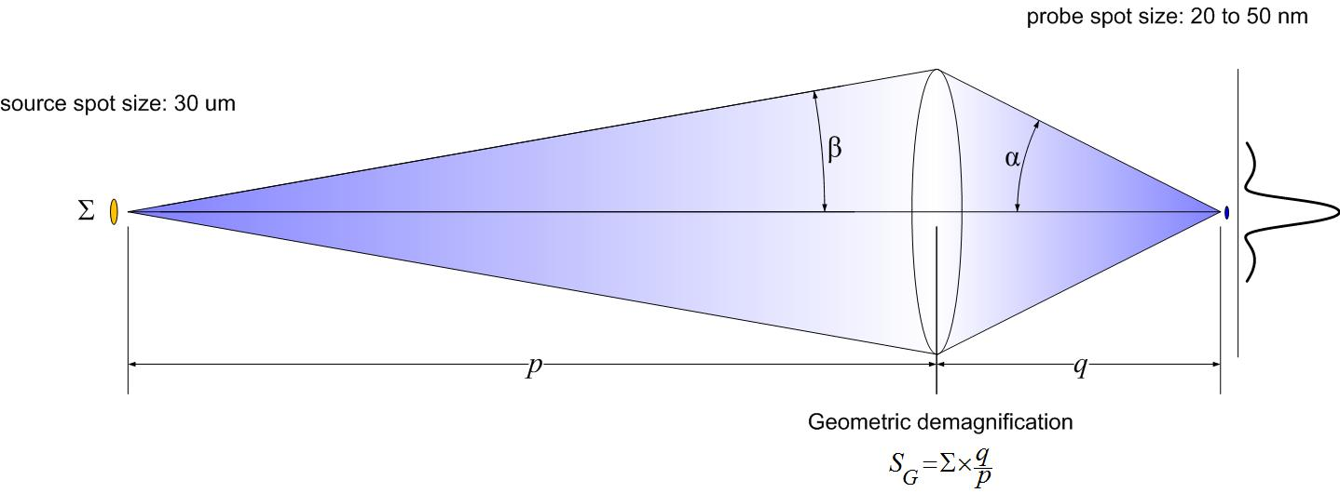
ESRF long beamlines alignment tolerances
To respect tolerances we must know the stability characteristics of the ground and the floor that everything is built on - and influence they have.
The size of the focused x-ray probe spot depends on:
  the source size,
  the distance between the source and the focusing optics p, and
  the working distance between optics and the experimental sample q.
  At the ESRF p=150 m and q=0.05 m so q/p=3000⁻¹ → theoretical probe size ~10 nm

Slide 21
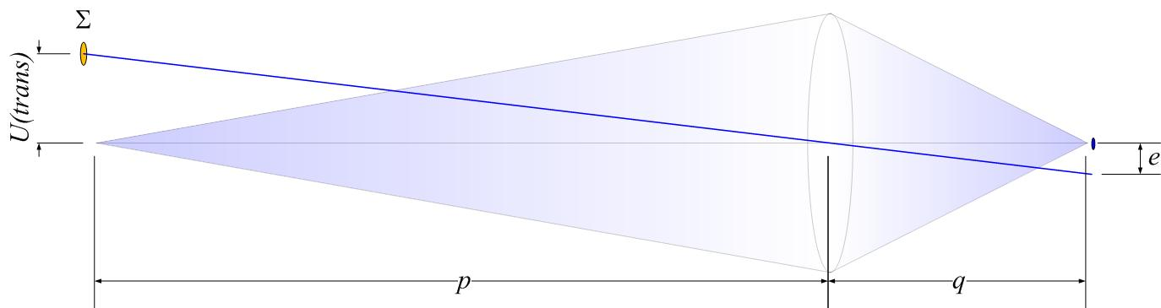

Long Beamline Translation tolerance
Tolerance is 10% of 50 nm probe size e = 5 nm
$U\left(trans\right)=\frac{p}{q}×e=\frac{150 m}{0.05 m}$ $×5 nm=15μm$

Slide 22
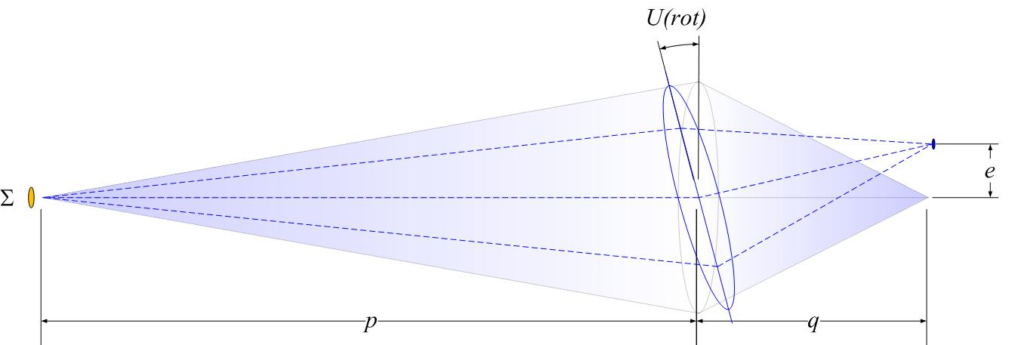

Long Beamline Rotation tolerance
Tolerance is 10% of 50 nm probe size e = 5 nm
$U\left(rot\right)=\frac{e}{q}=\frac{5 nm}{0.05 m}$ $=100 nrad$

Slide 23
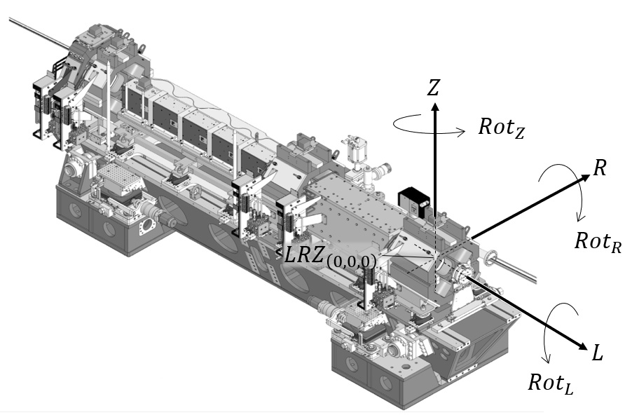
Alignment – one of the defining characteristics of the UP1 and EBS
There were two key constraints for EBS
first respect the magnet (and other) alignment tolerances
Machine | U(L) [μm] | U(R) [μm] | U(Z) [μm]
Long. Varying field dipoles | 1000 | >100 | >100
High gradient quadrupoles, Combined function dipoles | 500 | 60 | 60
Medium gradient quads | 500 | 100 | 85
Sextupoles | 500 | 70 | 50
Octupoles | 500 | 100 | 100
Maximum permissible error 2.5σ
… and second ensure the new machine was in the same place as the old machine to minimize disturbance to the functioning beamlines.

Slide 24
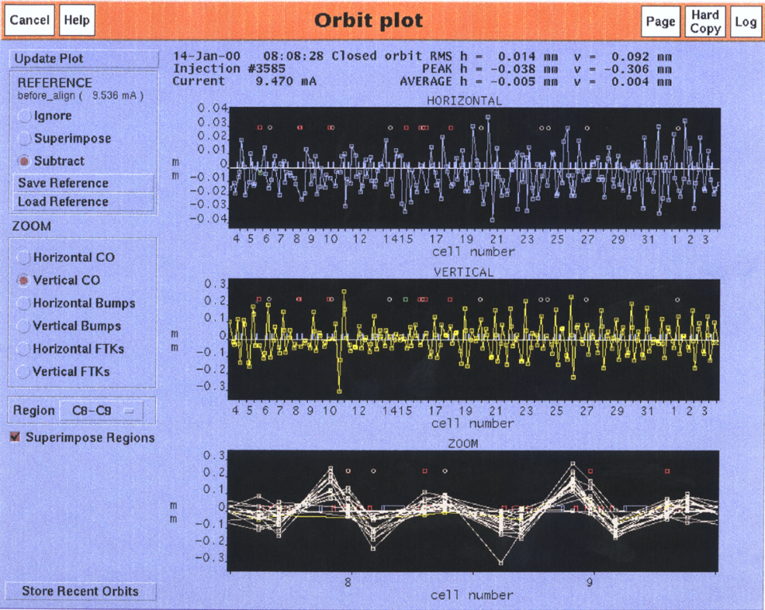
Movements at the slab joints
Movements at the slab joints were directly observed in the orbit of the old SR machine.
Joint
Crack

Slide 25
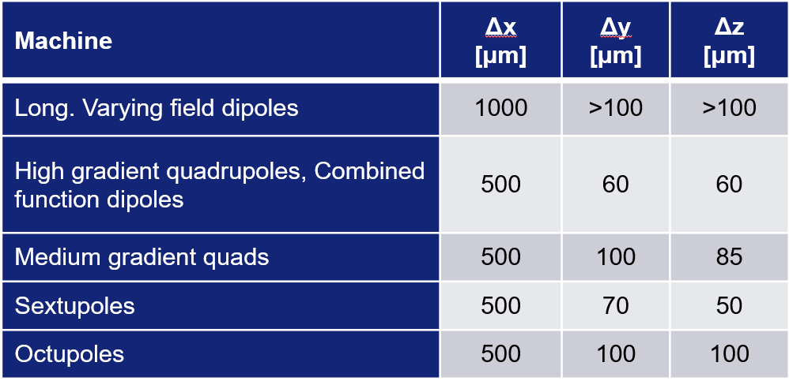
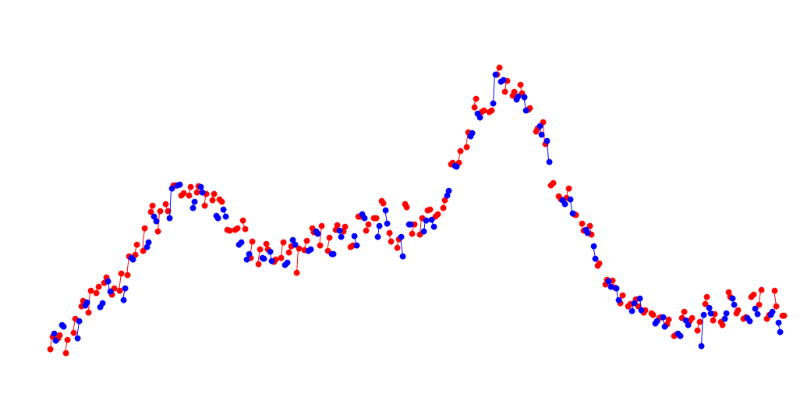
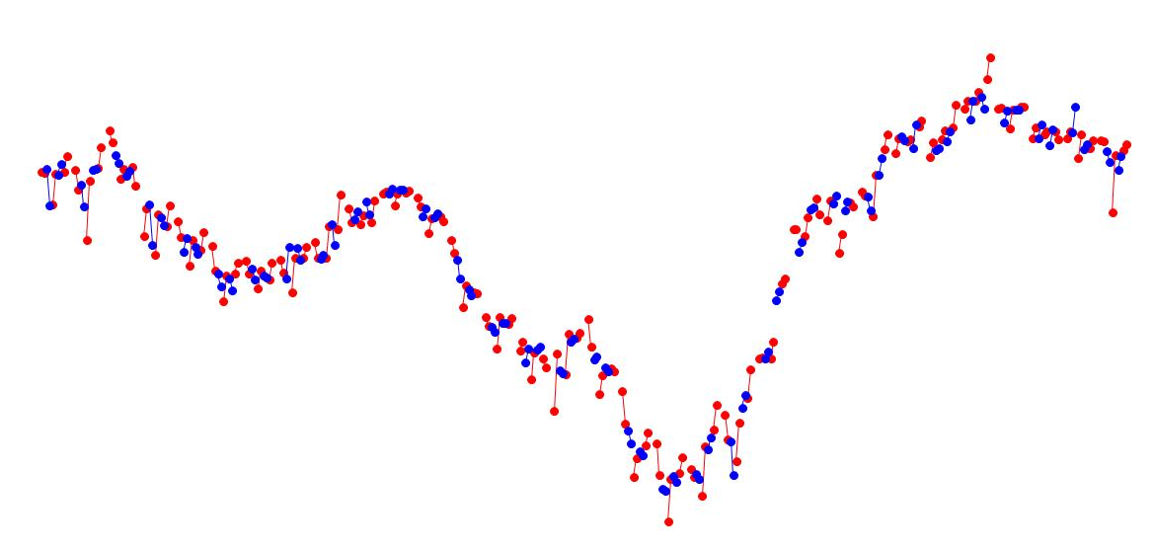
EBS machine tolerances
Before the construction of EBS we discussed extensively what these tolerances mean and how they could be interpreted to the machine as a whole.
Error “waves” applied to the lattice: DX, DY, Rotations for quad and sext.
Correction performed for each frequency and amplitude.
This is an exercise to verify large errors at long wavelengths are unimportant (next slide).
Simulations were made based on the old SR measured position (below).
Real survey data was used to define the tolerances interpolated to the new EBS machine positions.
Random Gaussian DX DY to represent fiducialisation and local alignment errors in quadrupoles and sextupoles were added on top of the survey errors.
In the definition of tolerances girders are unnecessary – they are replaced by the simulated machine survey.
Horizontal
Vertical
+1.1 mm
+0.8 mm
Nominal Position
Nominal Position
-2.1mm
-1.2 mm
Alignment meeting | SOLEIL-ESRF Zoom | April 2022 | S.M.Liuzzo

Slide 26
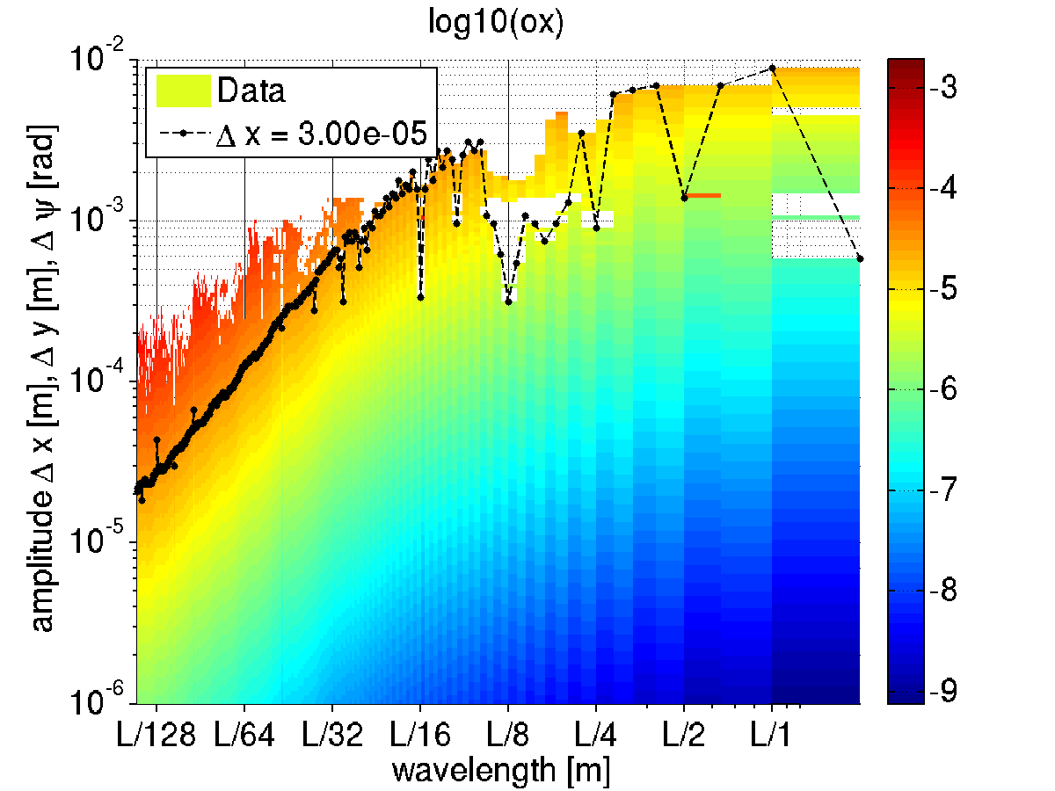
Long range errors: error envelope function
Residual orbit after closed orbit correction
Impact of error “waves” on horizontal orbit
At a wavelength of L/128~6m 30 um errors amplitude give 30 um residual orbit distortion.
At a wavelength of L/2~422m 7mm errors amplitude give 30 um residual orbit distortion.
Slow, large variations have limited impact on the optics!
Alignment meeting | SOLEIL-ESRF Zoom | April 2022 | S.M.Liuzzo

Slide 27
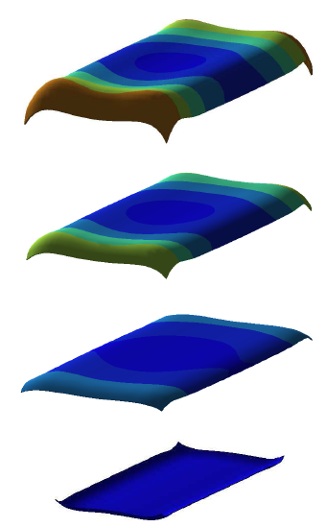
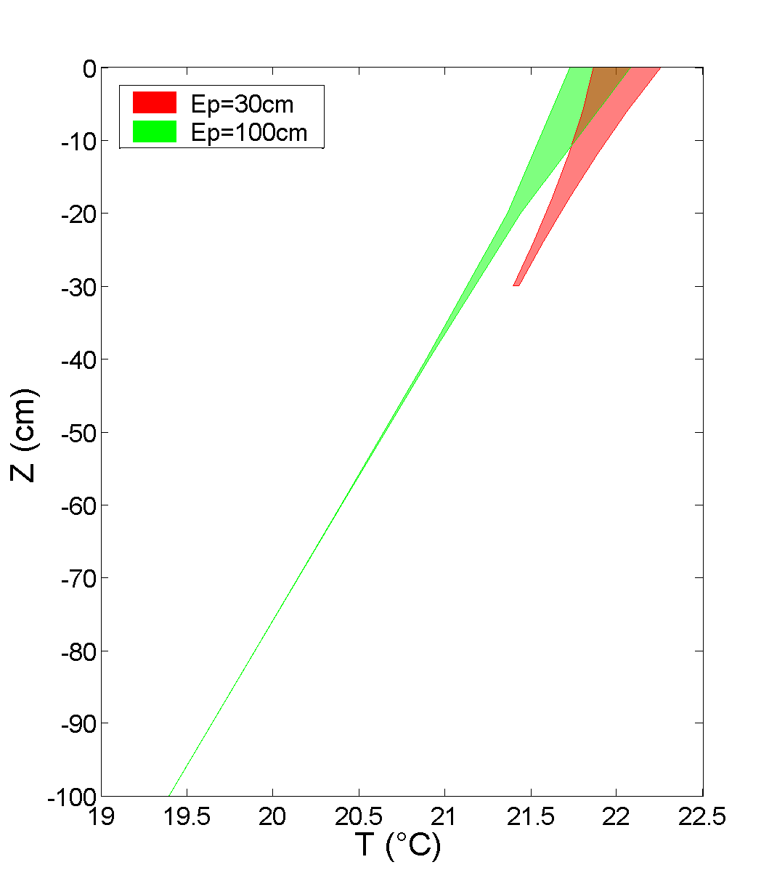
Characteristic Thermally induced slab bending
It is assumed bending results from thermal gradient variations through the slab.
NECS (Numerical Engineering & Consulting Services SAS), “«Etudes de Stabilité du Golden Slab»- Comportement Thermomécanique Tenant Compte des Charges Statiques, et des Déformations Différées Dues au Séchage du Béton, Note Technique - Rapport d’Etudes Paramétriques”, N001_A143_2010_ESRF_A,26 May 2010

Slide 28
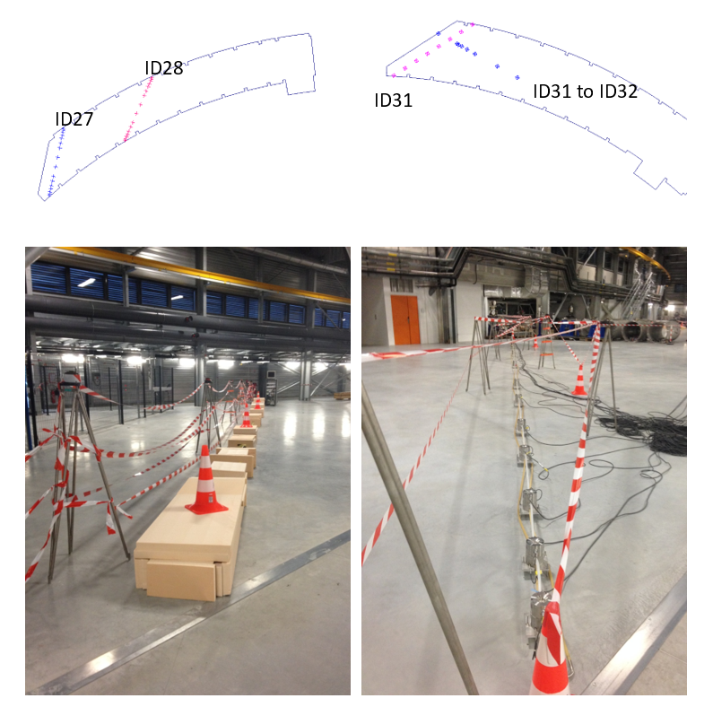
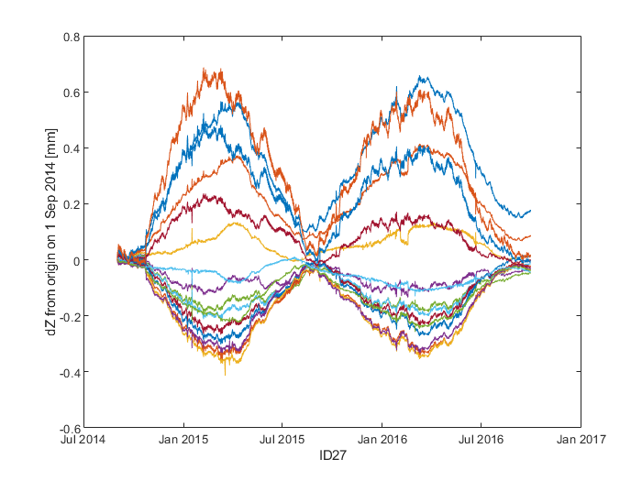
Chartreuse (Belledonne, ID16) HQS HLS studies
ID27
ID28

Slide 29
Id27 AND id28 MAX AND MIN BENDING OVER TWO YEARS

Slide 30
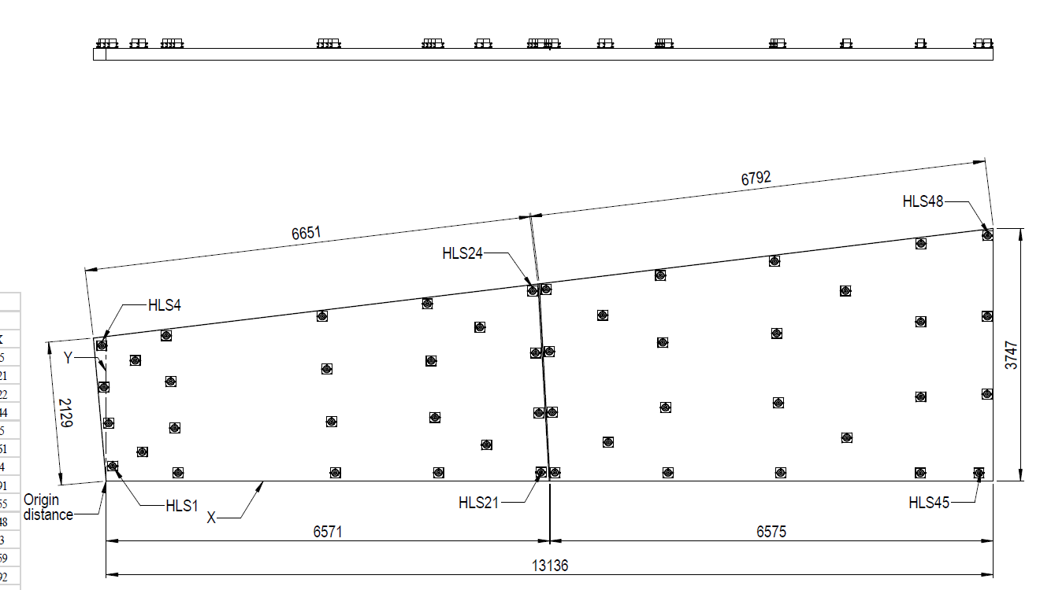
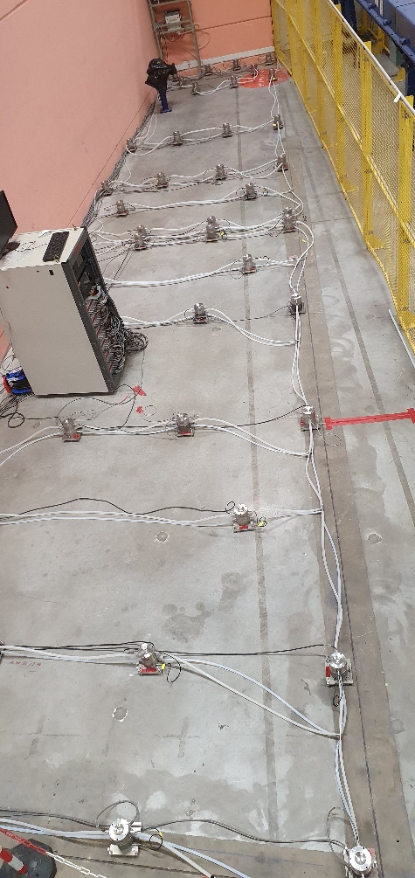
BM19 HLS
To study carefully slab thermal bending an extensive HLS was installed on BM19 Slab1a and Slab1b in November 2021.
Recall, when the EXPH floor was build in 1990-91, four steel reinforced slabs were poured along each beamline from the port end to the freeway. A surface joint was then cut at the middle of each slab. In reality, these surface joints run through the depth of the slab, and despite reinforcement between slab parts, they act independently. So there are actually 8 slabs along a given beamline between the port end and the freeway.

Slide 31
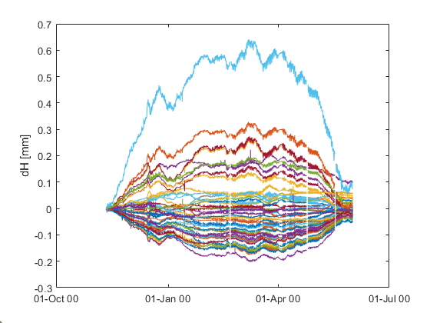
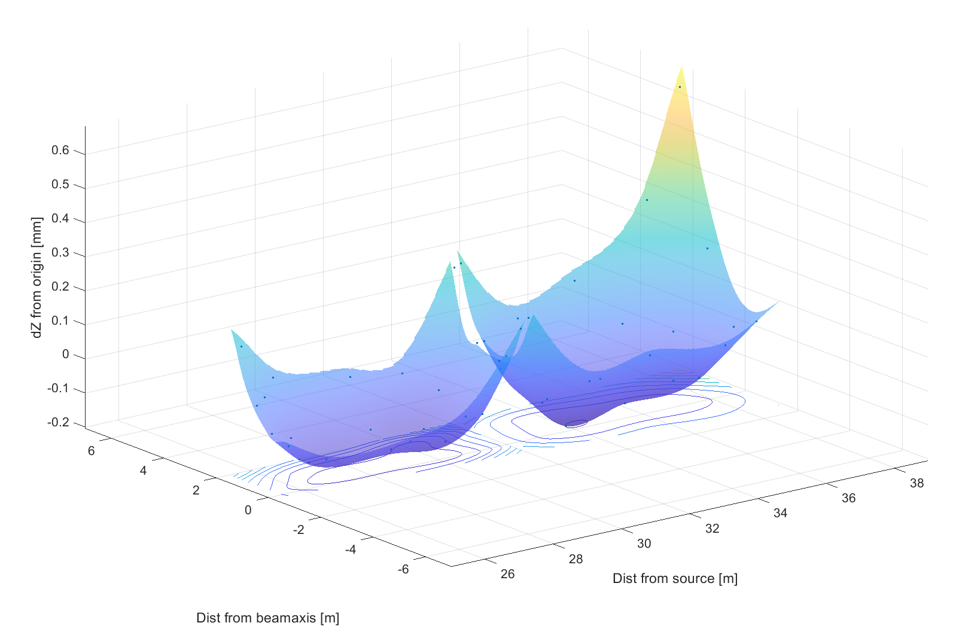
BM19 HLS
maximum
Observations on BM19 for roughly 6 months between November 2021 and May 2022 show movements that are qualitatively similar to those observed on ID27 in 2014-15.
The bending between the start and the maximum in March is highly characteristic.
Recall ID27
11/2014 to 05/2015 6 months

Slide 32
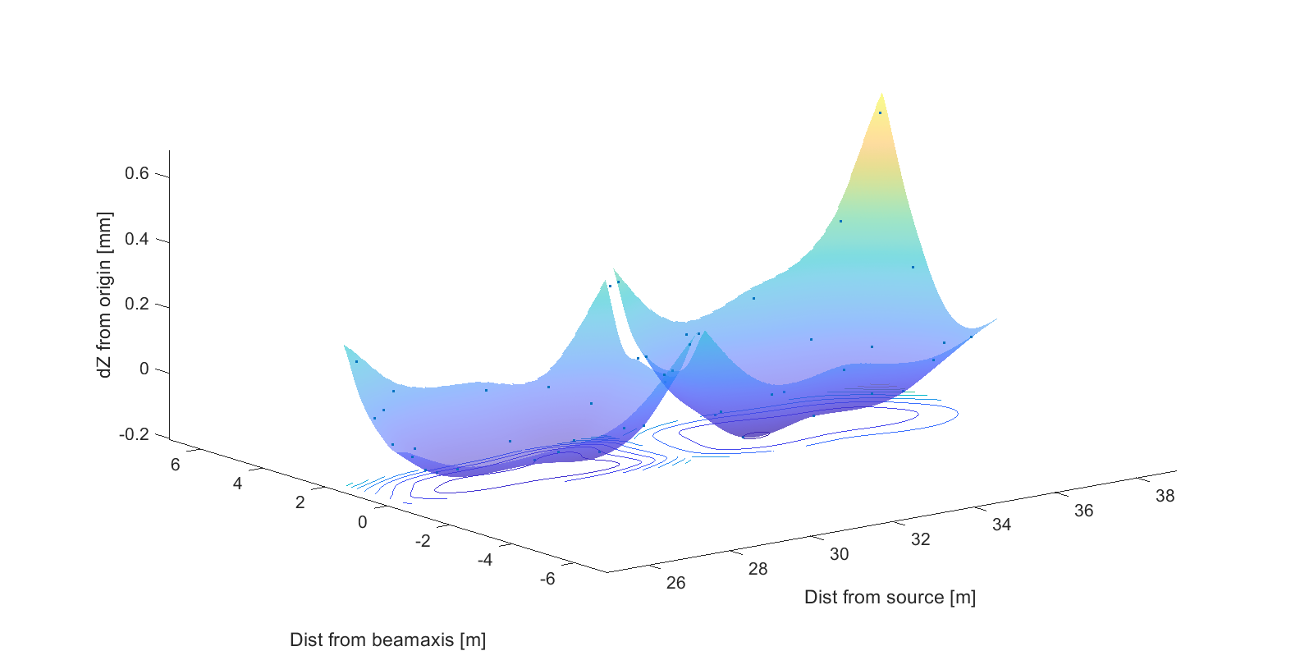
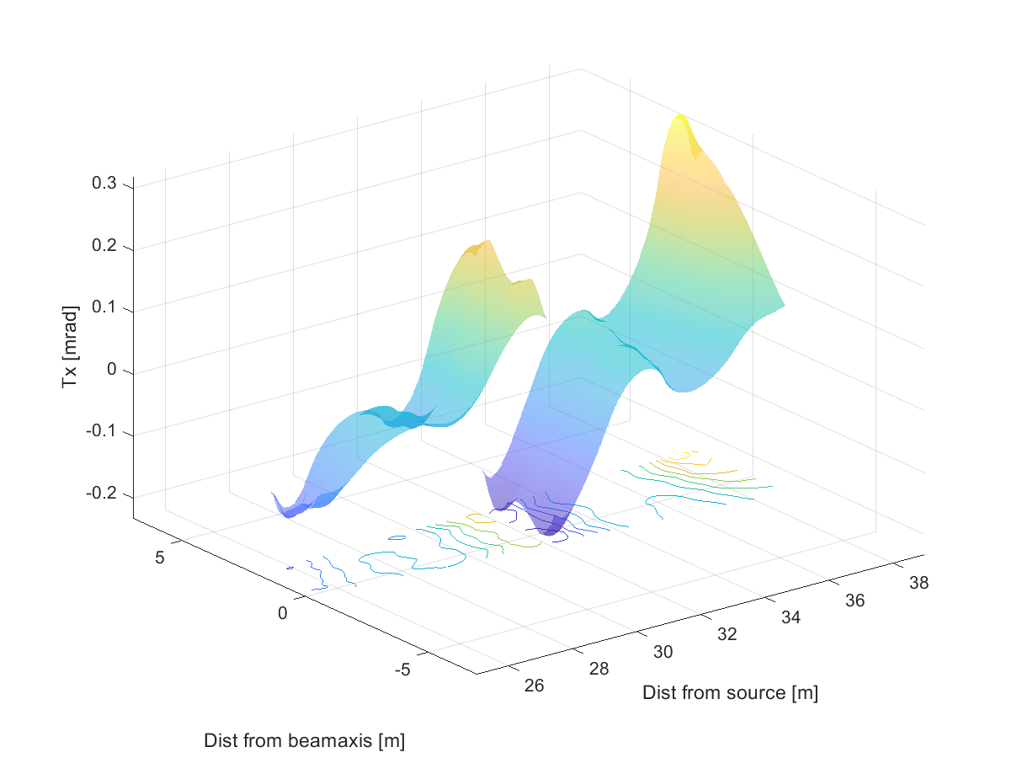
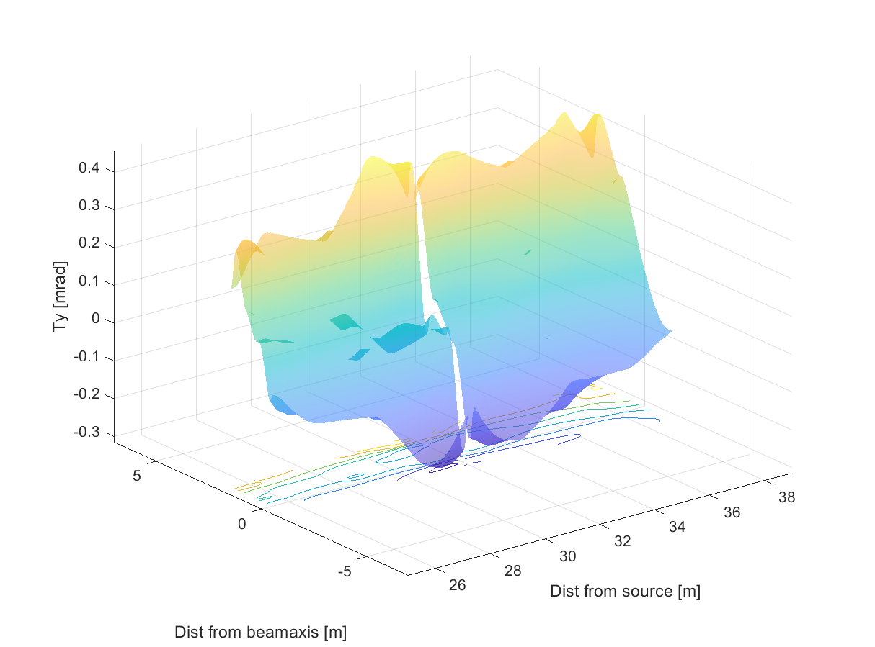
BM19 HLS floor Tilt
Tilt along the beam
Tilt across the beam

Slide 33
BM19 HLS floor Movements as a function of time
Standard Deviation of movement
Range of movement
Some key points:
  Peak at 8 to 12 hours,
  SD greater than 10 um after 24 hours, and greater than 100 um after 4 weeks,
  Range greater than 10 um after 2 hours, and greater than 100 um after 2 to 3 days.
Note these graphs are created using 1000 samples of each specified period (e.g. 24 hours) over the entire period November 2021 to May 2022

Slide 34
BM19 HLS floor Tilt on beam axis for different time periods
A key point:
  Tilts near and on the beam axis are less variable on slab1b than slab1a. This is because the beam axis is much closer to the edge of the slab1a.
Note these graphs are created using 1000 samples of each specified period (e.g. 24 hours) over the entire period November 2021 to May 2022

Slide 35
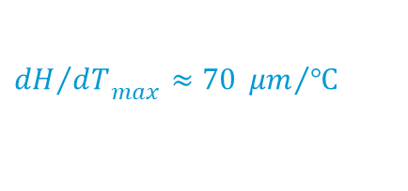

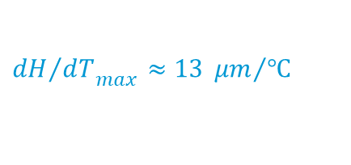
Variable Movements for a change in temperature of 1°C
ID03
ID14
BM18
$${{dH}/{dT}}_{max}≈13 {μm}/℃$$
$${{dH}/{dT}}_{max}≈27 {μm}/℃$$
$${{dH}/{dT}}_{max}≈70 {μm}/℃$$
A study was made that shows variations in thermally induced movements between different parts of the EXPH.
ESRF-TS-ALGE/2202DM, Final ID03 HLS slab study and a detailed slab thermal bending study for ID03, ID14 and BM18, 23/09/2021

Slide 36
Conclusion
In summary and ignoring vibration:
  Dam purging and associated ground water variations produce a smooth deformation over the entire ESRF site. Movements typically last less than a week.
  Movements due to the adjacent rivers, geomorphology and geology are also smooth but take place over years to decades.
  Slab movements occur on 12 hour and 6 month cycles. They can produce sharp discontinuities at the joints between adjacent slabs.
  Slab bending produces both vertical and horizontal displacements and tilts that can have an adverse effect on both machine and beamline performance.
All slabs bend, and their movements can impose an
upper limit on alignment if their behavior
is not properly considered!
Geologic
Geomorphologic - Rivers
Slab Semi-annual
Magnitude
Dam Purging/Ground Water
Slab Diurnal
Vibration
< 1 second
12 hours
Days
6 months
Years
Decades

