Slide 2
Welcome to the 16th International Workshop on Accelerator Alignment (IWAA)
Malika Meddahi

Slide 3
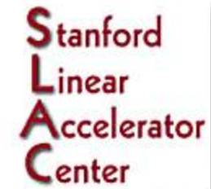
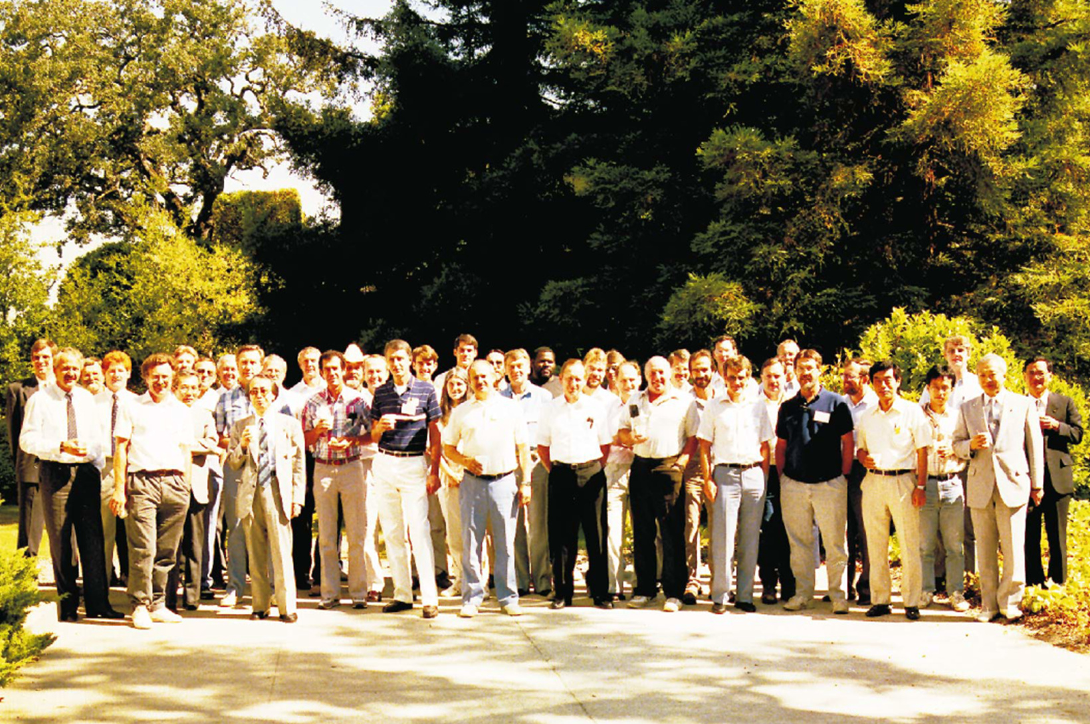
IWAA: A long standing important workshop series
  1st IWAA, SLAC, 1989
1989 Workshop Menu:
Current Alignment Topics
Toolboxes: Instrumentation, Software, and Methods
Fiducialization of Conventional Magnets
Next Generation Linear Colliders
  FNAL, 2018

Slide 4
1989 IWAA chaired by Robert Ruland – Opening remarks
    The idea for this workshop goes back quite a few years when we started aligning the SLC.
    At that time, we knocked at CERN’s and DESY’s doors to ask for help.
    The original one way information street eventually evolved into a relationship where we exchanged mutual experiences and developments.
    One day, we noticed that we had been reinventing the wheel a number of times.
    Then came a time when others started knocking on our door for support and exchange of ideas. We had the same feeling again: a great deal of work had been done over again, not because of competition, but because we were always unaware what our neighbours were doing.
    This is the reason for initiating this workshop. We want to establish lines of communication; we want everyone to share not only their accomplishments, but also their problems.
    …. Tackling the millimetre ‘old’ world to the micrometre current world ….
    …. Fiducialization is a fancy name for relating the effective magnetic axis of a component to some kind of surveying reference marks. The alignment process is one in which we move a component’s reference mark to its called for coordinate. But this is only one part of the story. The beam does not know anything about fiducials, the beam is influenced only by the electromagnetic field of a component. We have, therefore, to relate the magnetic axis to the fiducial marks with the same care as we do the final positioning….
    …. these sessions will give an overview of some of the new approaches of making the fiducialization process more reliable and improving what is now a weak link….

Slide 5

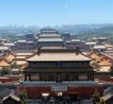


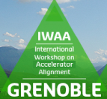

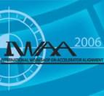
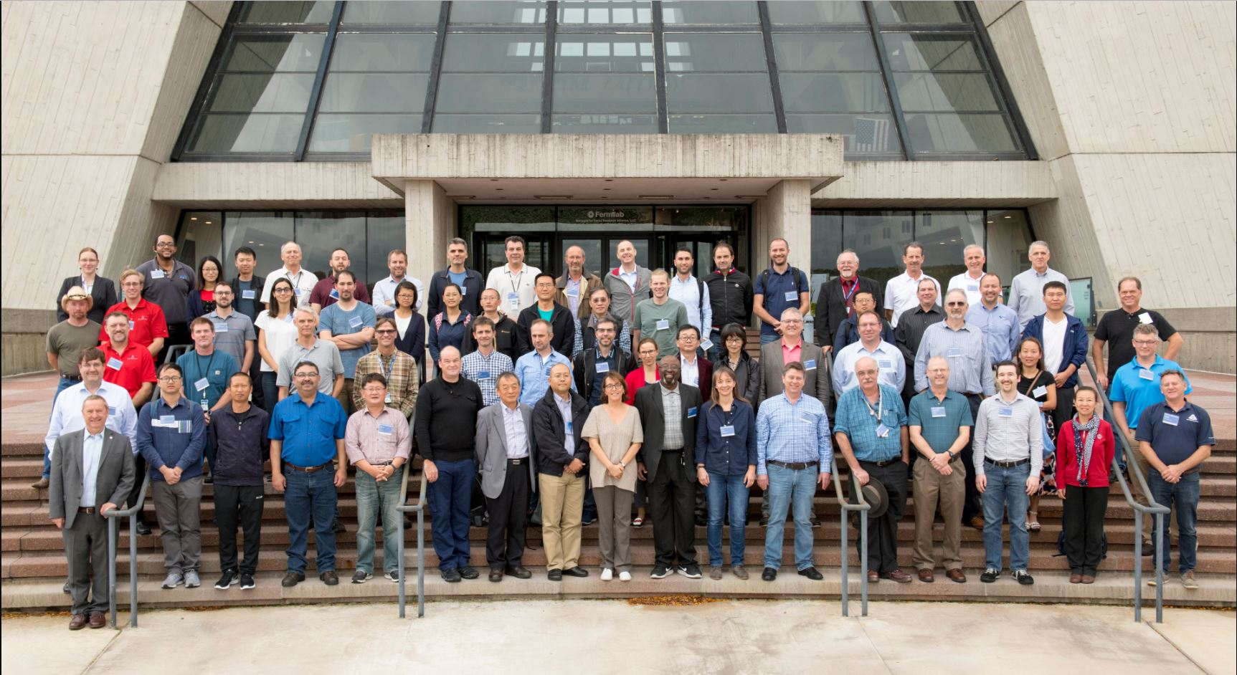
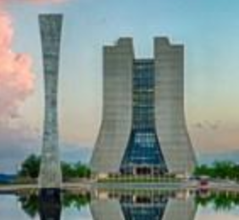






IWAA lifecycle: a long-standing important workshop series
  IHEP, 2014
  1st IWAA, SLAC 1989
  Spring-8, 2022
  DESY, 1990
  ISRF, 2016
  CERN, 2004
  CERN, 1993
  SLAC, 2006
  FNAL, 2018
  KEK, 1995
  KEK, 2008
  ANL, 1997
  DESY, 2010
  ESRF, 1999
  FNAL, 2012

Slide 6
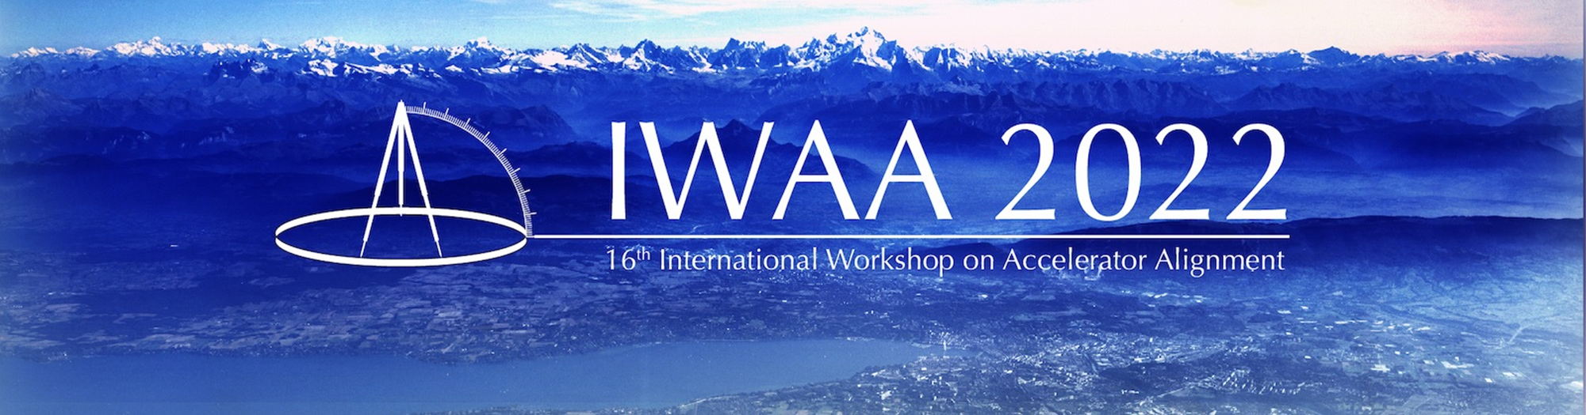
Finally: here we are again in person
Pandemic stopped the numerous attempts to get together and continue the fruitful in-person exchanges
And at last, 2022 IWAA (CERN) taking place in Ferney-Voltaire
Voltaire a French Enlightenment writer, historian and philosopher, advocating freedom of expression and believing above all in the efficacy of reason.
‘Common sense is not so common…’ (Voltaire quote)

Slide 7

16th IWAA
  The International Organizing Committee:
    V. Bocean (FNAL, USA)
    G. Gassner (SLAC, USA)
    W. Jansma (ANL, USA)
    H. Kimura (SPring8, Japan)
    D. Martin (ESRF, France)
    D. Masuzawa (KEK, Japan)
    D. Missiaen (CERN, Switzerland)
    J. Prenting (DESY, Germany)
    X. Wang (IHEP, China)
  The local Organizing Committee:
    Behrens
    P. Bestmann
    J-C. Gayde
    G. Kautzmann
    J. Kotzian
    H. Mainaud Durand
    D. Mergelkuhl
    D. Missiaen
    P. Sainvitu
Thank you to the International and local Organising Committees.
It is a highly interesting programme ahead of us, including the visits.
With an impressive international participation …

Slide 8
16th IWAA participation
1 exhibitor: Hexagon Metrology
125 participants, from 34 companies, laboratories or universities
ALBA Synchrotron (Spain)
Argonne (USA)
BNL (USA)
Canadian Light Source (Canada)
CERN (Switzerland)
DESY (Germany)
Diamond Light Source (UK)
DUKE (USA)
ESRF (France)
ESS (Sweden)
FNAL (USA)
FOGALE Sensors (France)
GANIL (France)
GEOFIT (France)
GEOS3D (Austria)
GSI (Germany)
KEK (Japan)
INFN (Italy)
Institute of High Energy Physics (China)
Institut für Geodäsie (Germany)
ISIS Neutron & Muon Source (UK)
Jefferson Lab (USA)
Korea Atomic Energy Research Institute (South Korea)
LAPP (France)
Liberec Technical University (Czech Republic)
Lund university (Sweden)
MAX IV (Sweden)
NSRRC (Taiwan)
PSI (Switzerland)
SLAC (USA)
SOLARIS Synchrotron (Poland)
Synchrotron Light Research Institute (Thailand)
Synchrotron Soleil (France)
Universitat Politechnica Valencia (Spain)

Slide 9
16th IWAA program
Program at glance:
2 keynotes
34 oral presentations in 12 sessions:
  Surveying and alignment (2) - Instrumentation (3) - Metrology (2)
  Monitoring (2) - Geodesy (1) - Surveying concepts and strategies (2)
30 poster presentations: 2 sessions on Wednesday and Thursday morning
Visits on Wednesday afternoon:
  ATLAS Wire offset measurements for alignment
  From a drone to orthophoto Universal Adjustment Platform
  Structured Laser Beam Alignment sensors for HL-LHC

Slide 10
16th IWAA: Today needs you even more than ever
Acting in meeting today’s accelerator 'requirement while inventing the tools needed to respond to the future accelerators specifications.
More and more demanding specification, entering into ‘never-done before’ world.
Relying on innovation, research and development, and always thinking out of the box.
Our future relies on international collaborations, and indeed we can only be meeting the next challenges together.
As all the other accelerator’ fields, yours is an essential brick to be successful.
Accelerator alignment is an integral part of the first conceptual studies.
This workshop is a fantastic opportunity to share our knowledge, experiences, debate on new ideas, challenge each other.
To contribute to a healthy and exciting future in which the next talented generation will engage and commit to carry on our solid professional engagement journey.

