Slide 1
Ingredients for building our particle accelerator future
Malika Meddahi
Our mission and ‘raison d’être’
From today to the next decades: vision and a strategy
CERN environmental commitments
The next generation
Concluding words

Slide 2
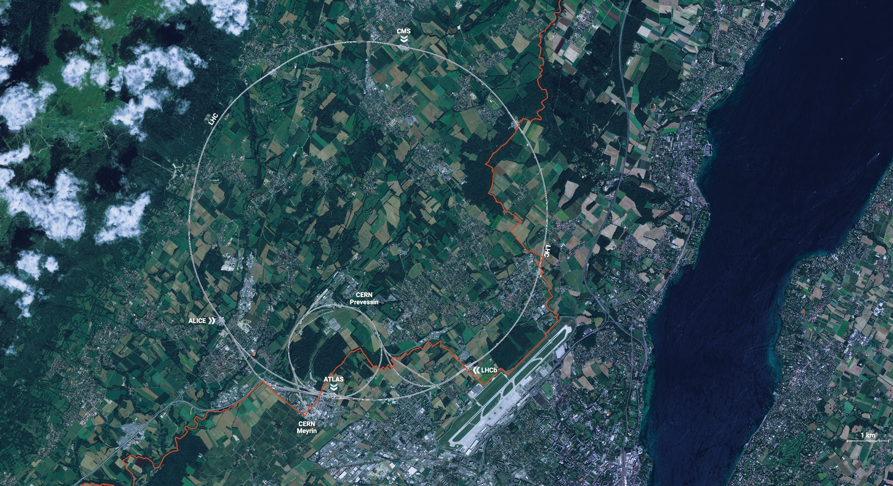
Our mission and ‘raison d’être’
CERN is the world’s biggest laboratory
for particle physics.
Our goal is to understand the most fundamental particles and laws
of the universe.

Slide 3
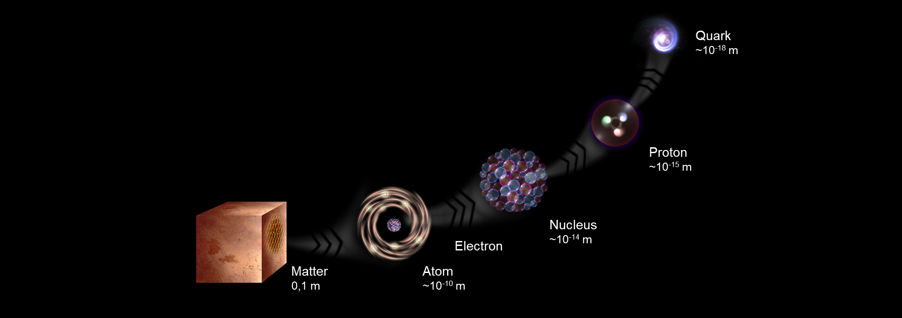
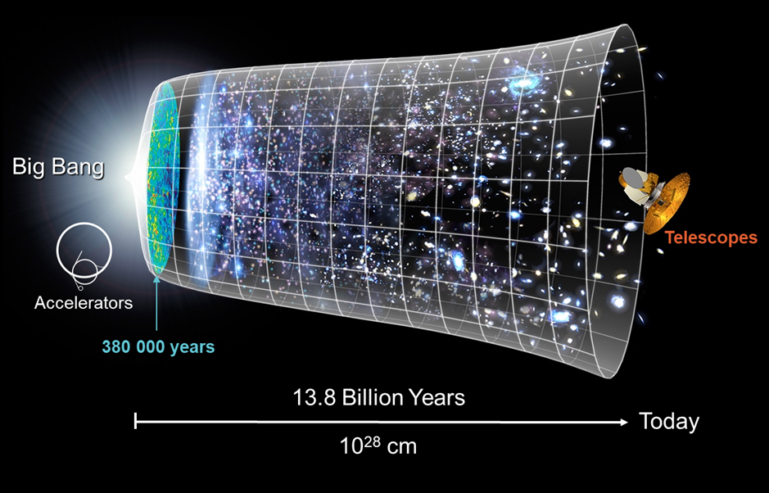
The fundamental questions
What is the universe made of?
We study the elementary building blocks of matter and the forces that control their behavior.
How did the universe begin?
We reproduce the conditions a fraction of a second after the Big Bang, to gain insight into the structure and evolution of the universe.

Slide 4
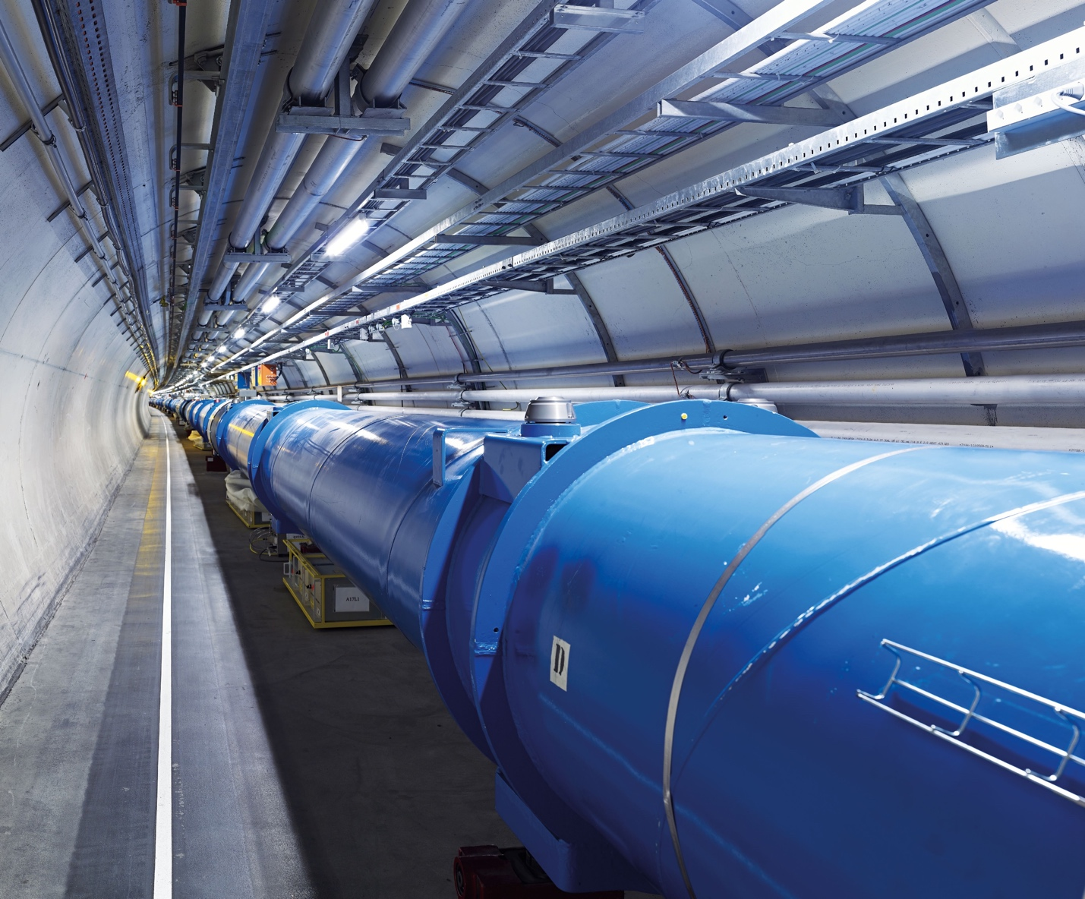
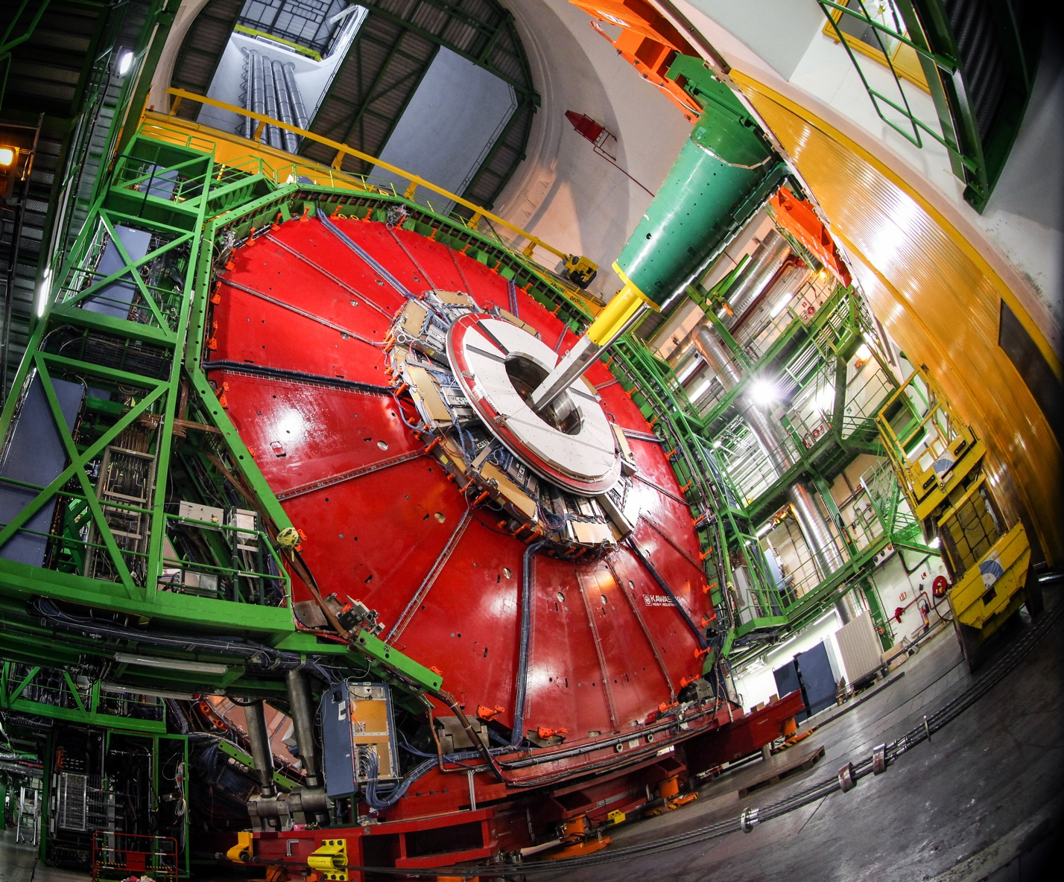
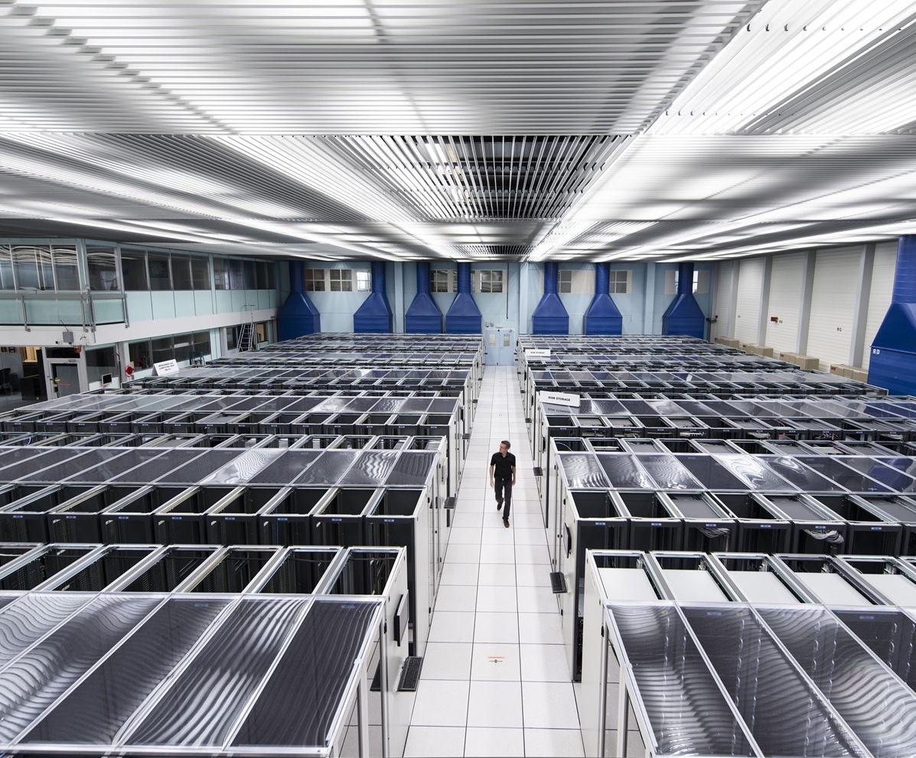
3 main technical ingredients
The largest machines to study the smallest particles in the universe – relying on technology innovation and R&D to advance the limits of what is possible.
Detectors - giant 3D cameras
Computing power - Worldwide Computing Grid
ACCELERATORS
DETECTORS
COMPUTING

Slide 5
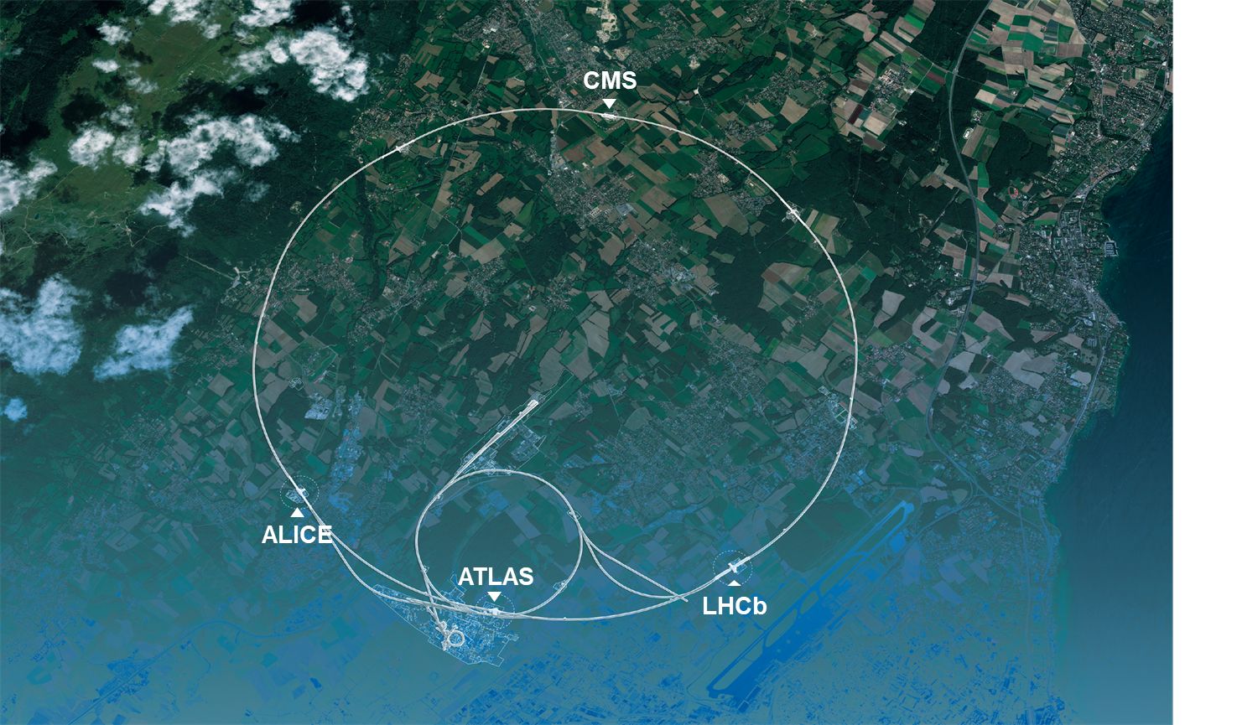
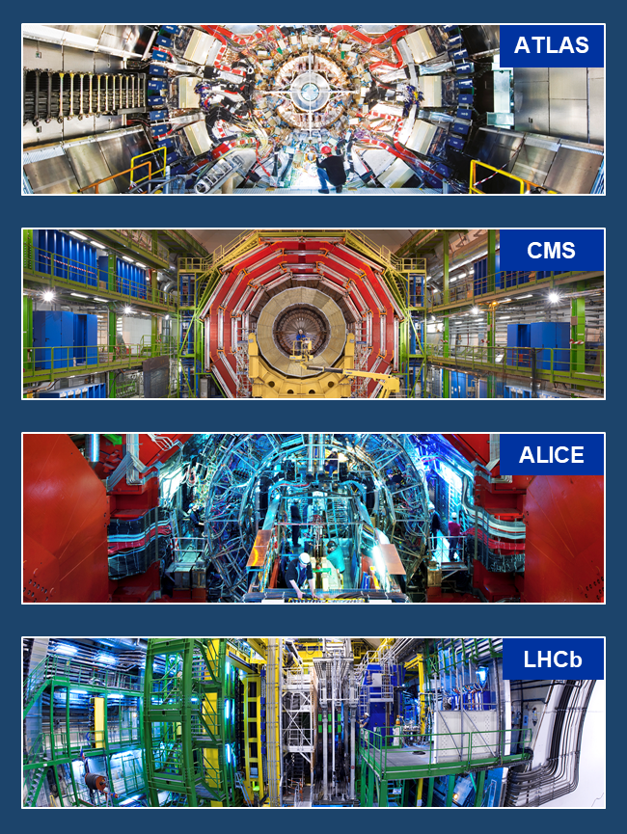
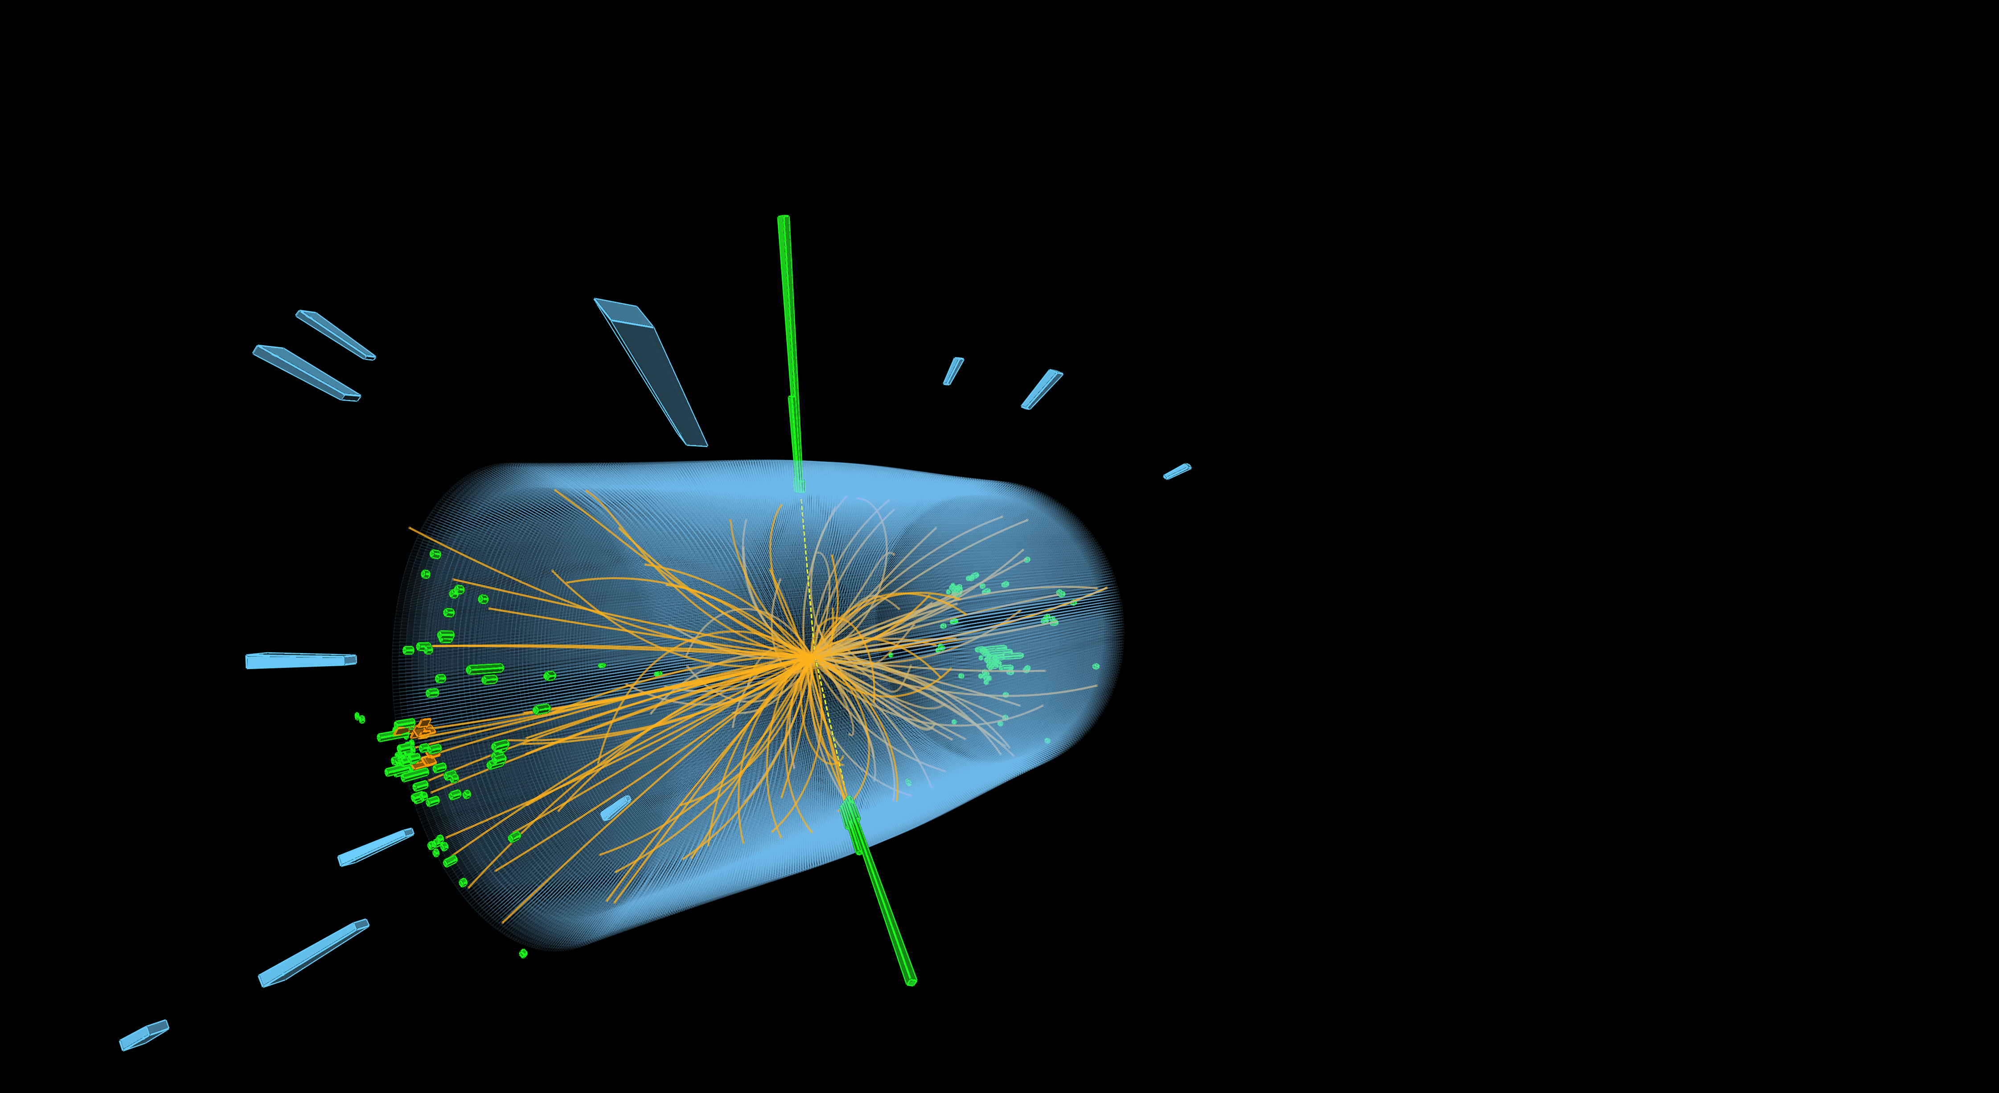



3 main technical ingredients
Accelerate particles to almost the speed of light.
Giant detectors record the product of the beam collisions in the heart of the four experiments.
Worldwide LHC Computing Grid.
The energy of the particles in collision is converted into new particles.

Slide 6
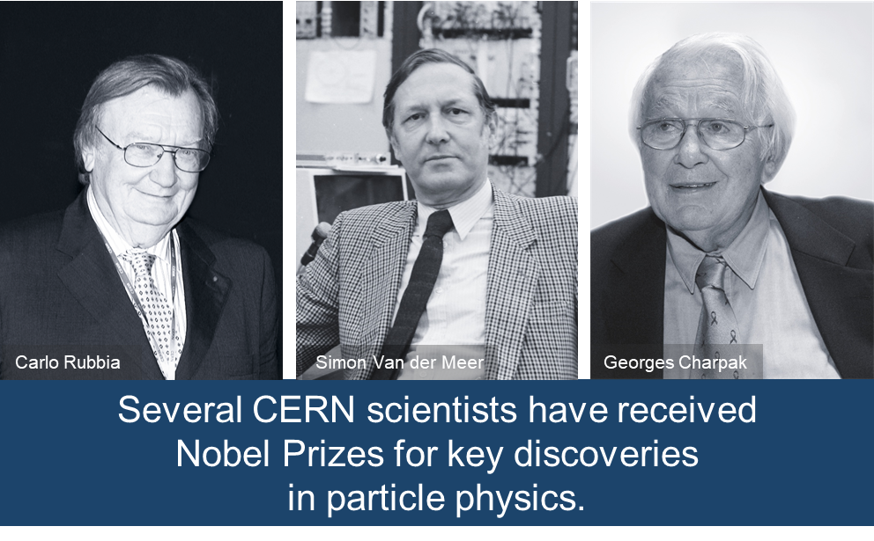
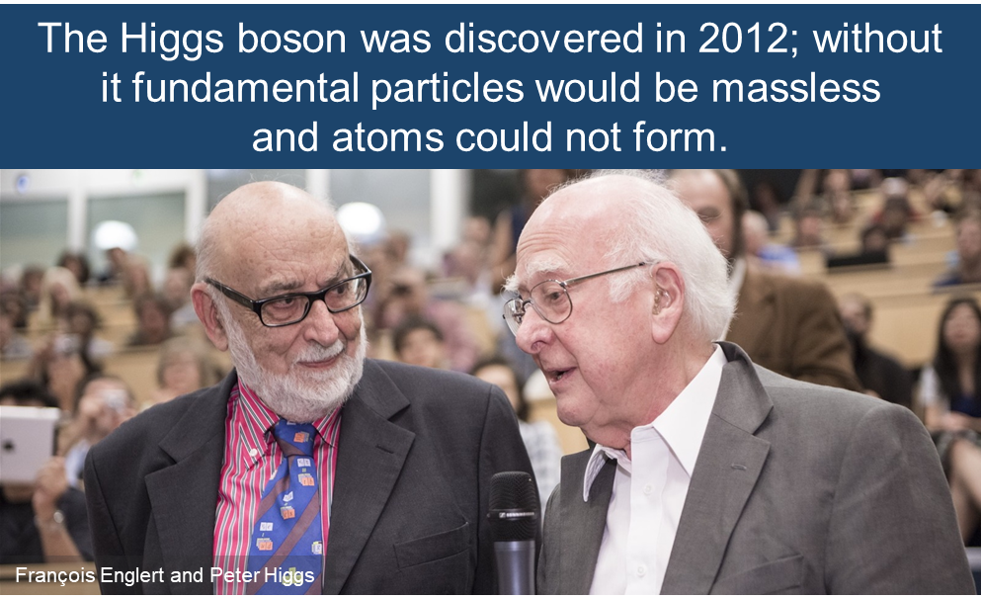
A lot of successes and still many opportunities ahead of us to answer remaining questions
Numerous and giant steps forward …
…. and still many unanswered questions in fundamental physics
Why is the universe made only of matter, with hardly any antimatter?
95% of the mass
and energy
of the universe is unknown.
Why is gravity so weak compared to the other forces?
Is there only one Higgs boson, and does it behave exactly as expected?

Slide 7
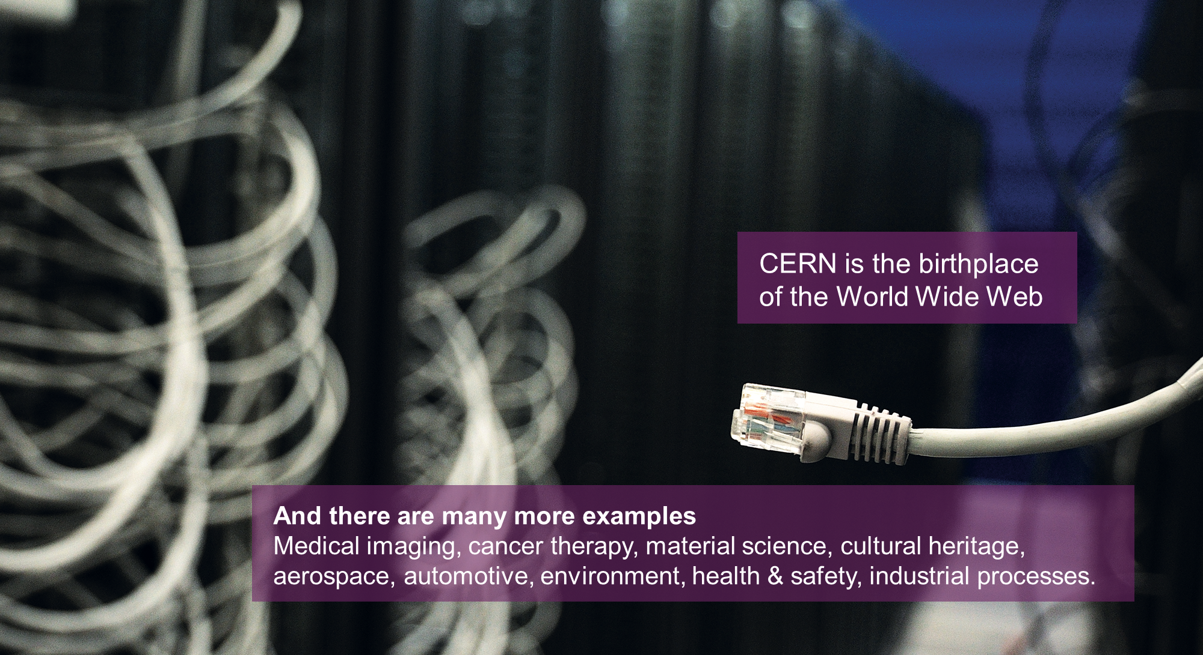
CERN’s technological innovations have applications in many fields

Slide 8
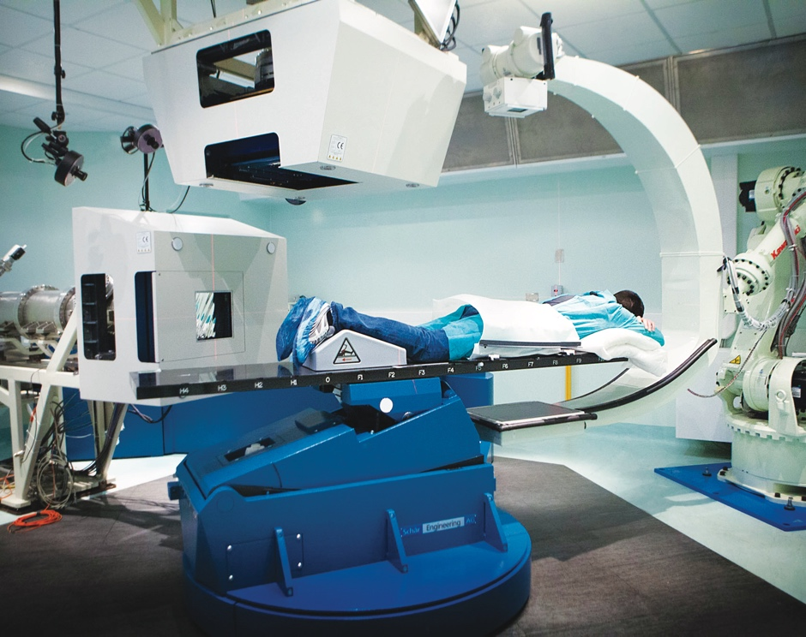
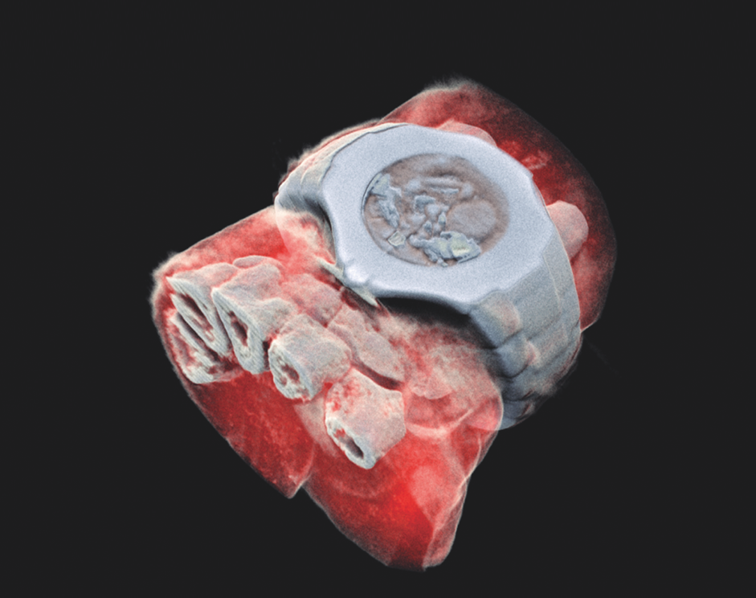
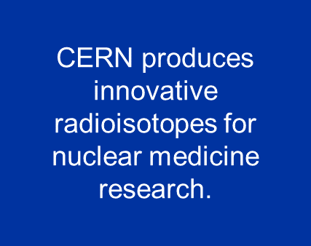
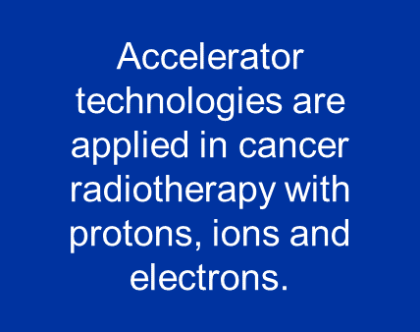
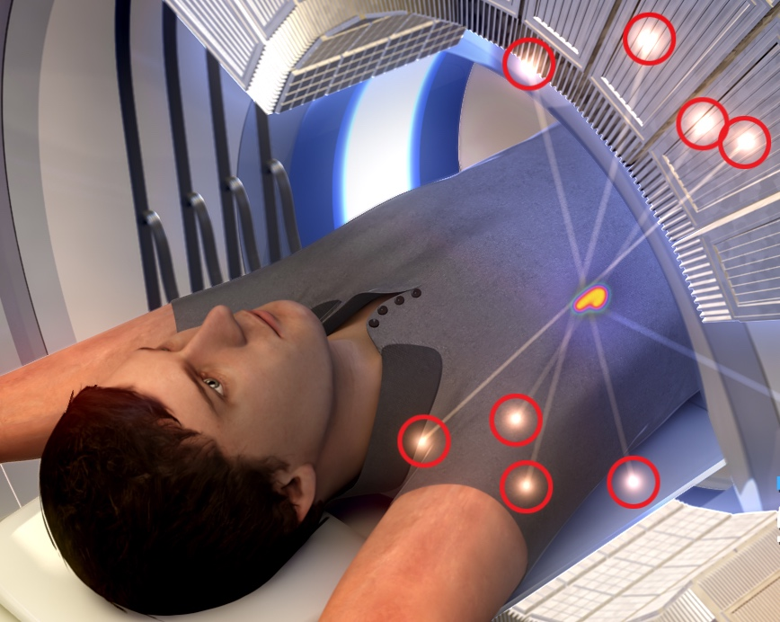
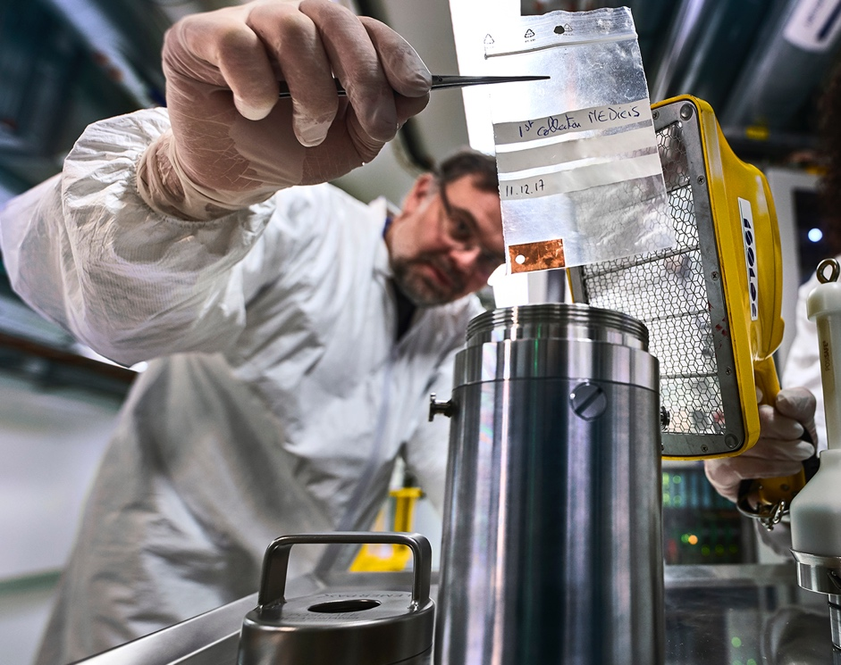
CERN's technological innovations have important applications in the fields of medicine and health
Technologies applied
at CERN are also used in PET, for medical imaging and diagnostics.
© marsbioimaging
© CNAO
© ENVISION / ENLIGHT
Pixel detector technologies are
used for high resolution
3D colour X-ray imaging.

Slide 9
Preparing the future: CERN scientific programme
Based on the 2020 update of the European Strategy for Particle Physics => 3 pillars CERN
1- LHC exploitation: RUN3 & HL-LHC
RUN3: 2022-25; 13.6 TeV c.d.m, 250 fb⁻¹ (ATLAS and CMS), 25-30 fb⁻¹ (LHCb), 7 nb⁻¹ (ALICE, Pb-Pb);
HL-LHC: 2029-2042, ~3000 fb⁻¹ (ATLAS and CMS).
2- Scientific program complementary to the LHC experiments
  Experiments at the Booster, PS, SPS ;
  Participation in accelerator-based neutrino projects (LBNF/DUNE) through the CERN Neutrino Platform;
  Other opportunities discussed as part of the 'Physics Beyond Colliders' working group.
New contributions expected at the end of 2025 for an update of the strategy towards 2026-2027
3- Preparing for the future of CERN
  Intense R&D program for accelerators (incl. high field superconducting magnets, radio frequency, plasma field waves…);
  The Feasibility Study for a Future Circular Collider (FCC) (final report expected Dec. 2025);
  R&D and design studies for other scenarios: e.g. CLIC, Muon colliders.

Slide 10
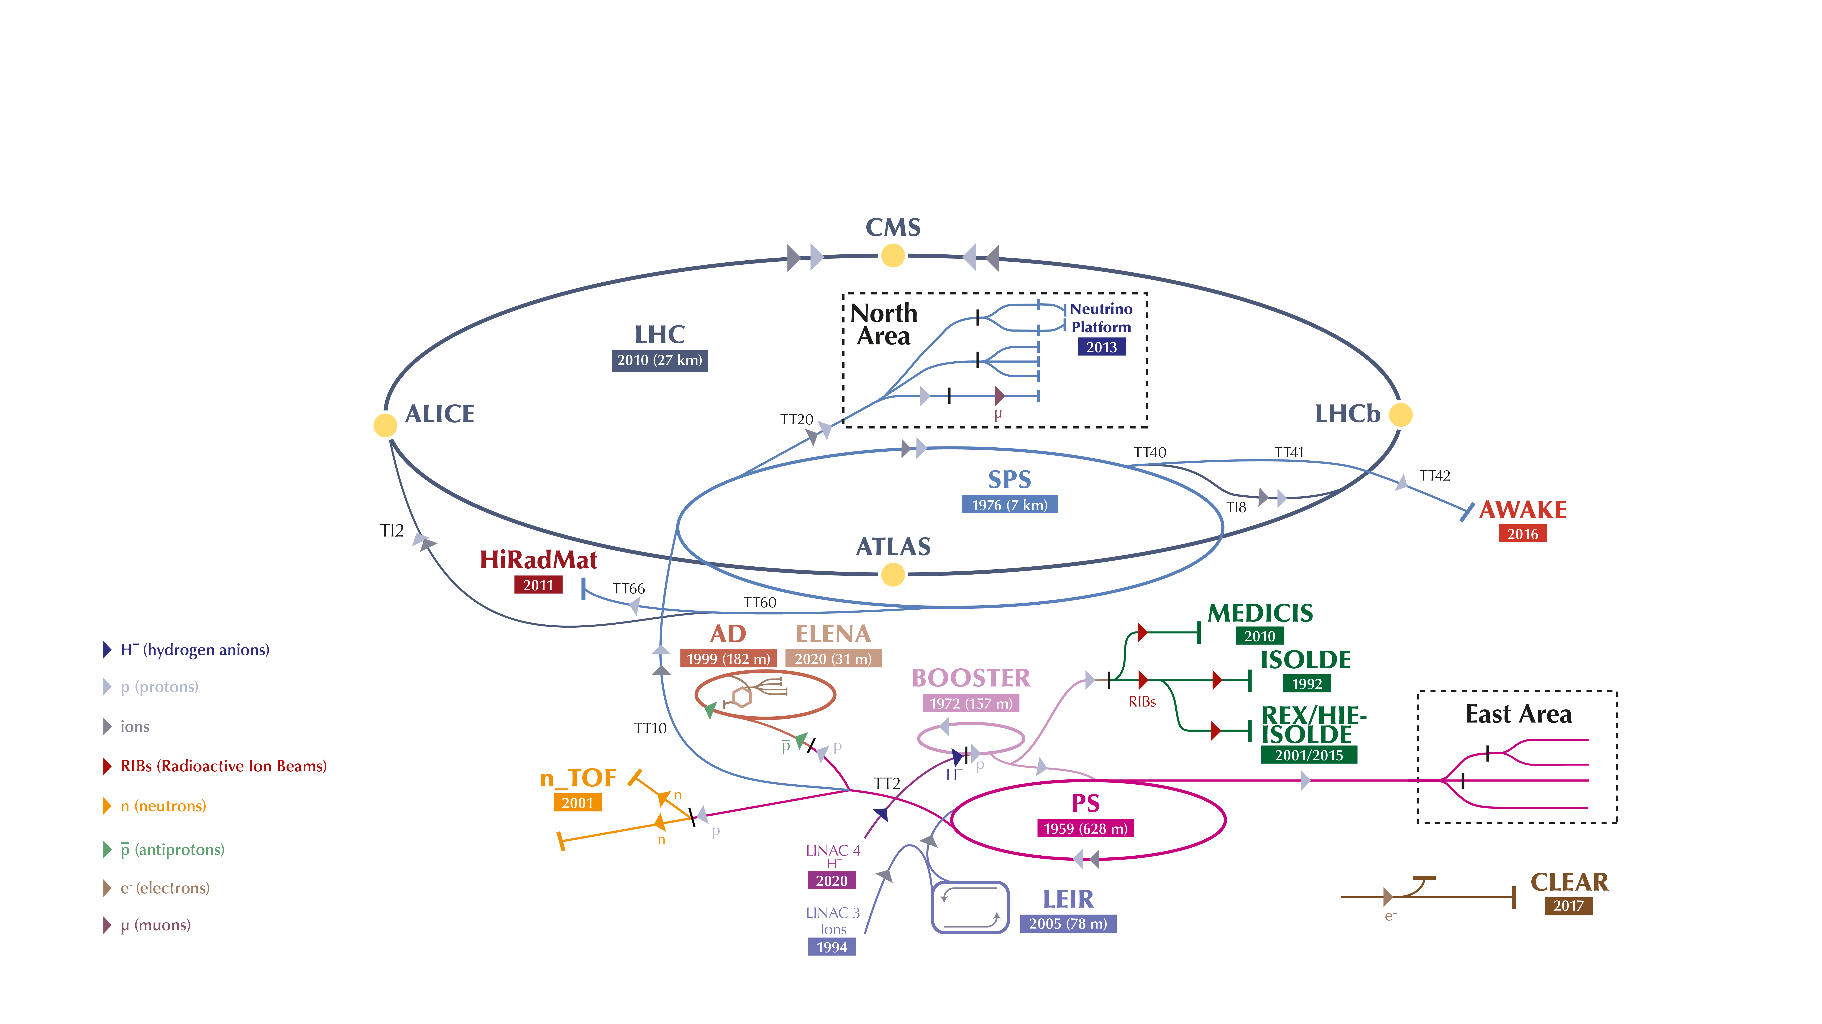
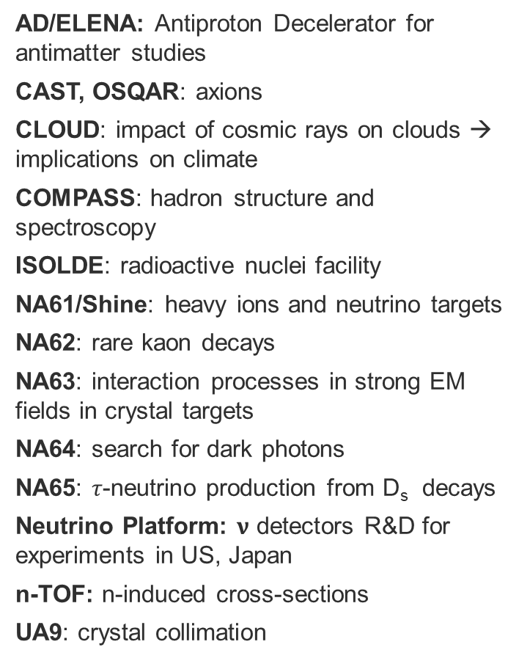
The heritage: a unique accelerators complex

Slide 11
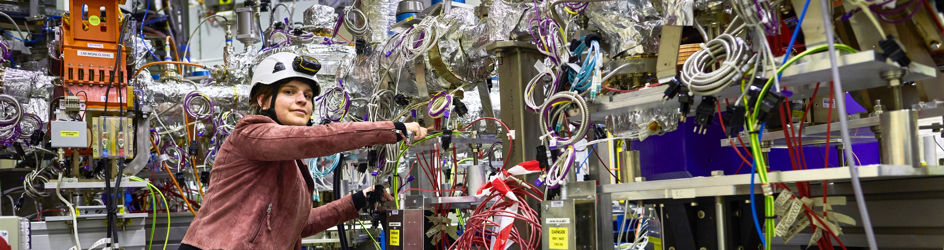
A diverse and rich scientific programme
Theoretical Particle Physics
Nuclear Physics
(ISOLDE)
Antimatter Research
(Antiproton Decelerator)
Cosmic rays and cloud formation
(CLOUD)
Fixed-target experiments, which include searches for rare phenomena
Contribution to the Long Baseline
Neutrino Facility in the USA
(LBNF)

Slide 12
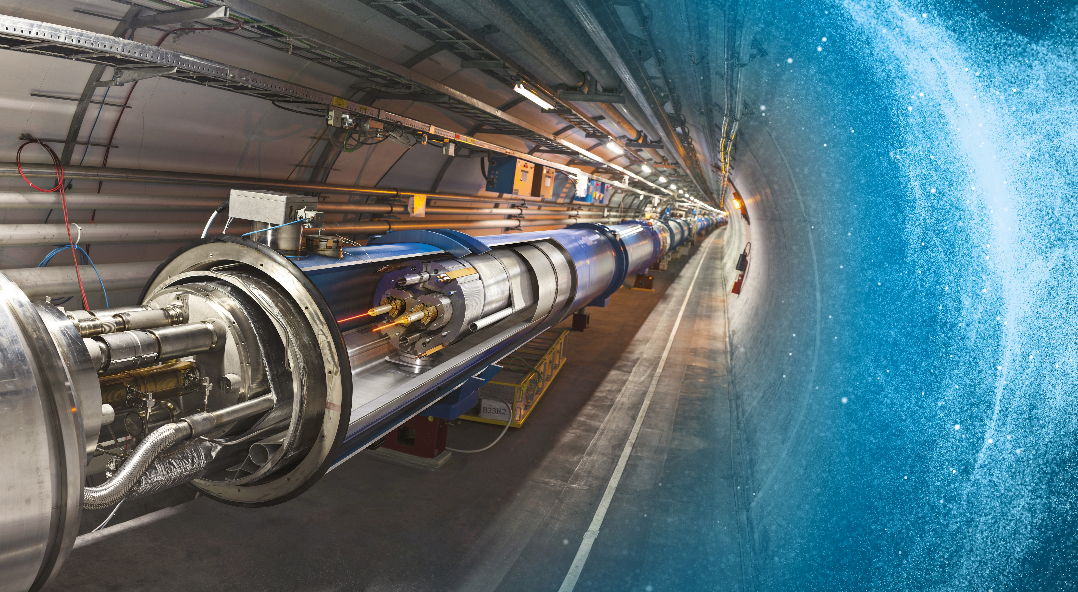
The Large Hadron Collider LHC
27 km in circumference
About 100 m underground
2 beams of trillions of protons travelling at 0.999999991 times the speed of light in opposite directions
Superconducting radiofrequency system to accelerate the beams
NbTi Superconducting magnets operating at - 271.3 °C to bend them in a circle
Largest beam vacuum system worldwide
Advanced powering, machine protection systems, beam diagnostics & control
4 Large experiments

Slide 13
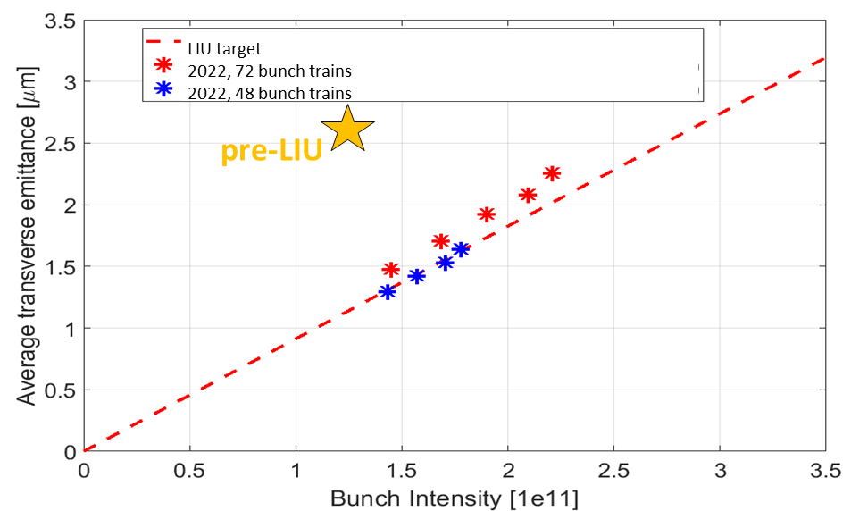
Provide users with the beams of today while preparing those of tomorrow.
Ambitious target values ​​for the beam parameters expected at the gates of the HL-LHC:
Beam parameters @ LHC entrance | N_{b} (x 10¹¹ p/b) | ε_{x,y,} (μm) | Bunch spacing | Bunch number
HL-LHC targets | 2.3 | 2.1 | 25 ns | 4x72 per injection
Pre LS2 targets | 1.3 | 2.7 | 25 ns | 4x72 per injection
LHC Injectors Upgrade project - 2011-2021:
Define the modifications needed to overcome beam performance limitations in all injectors so that the required parameter set can be achieved;
Make the identified changes;
Bring the injectors back into service at pre-LS2 performance then gradually at the ‘LIU’ target values.
In 2022, the SPS extracted 1.8e11 p/b with the required luminosity and packet length, in line with the LIU ramp-up plan.
2.3e11 p/b are now stable on the injection energy plateau.

Slide 14
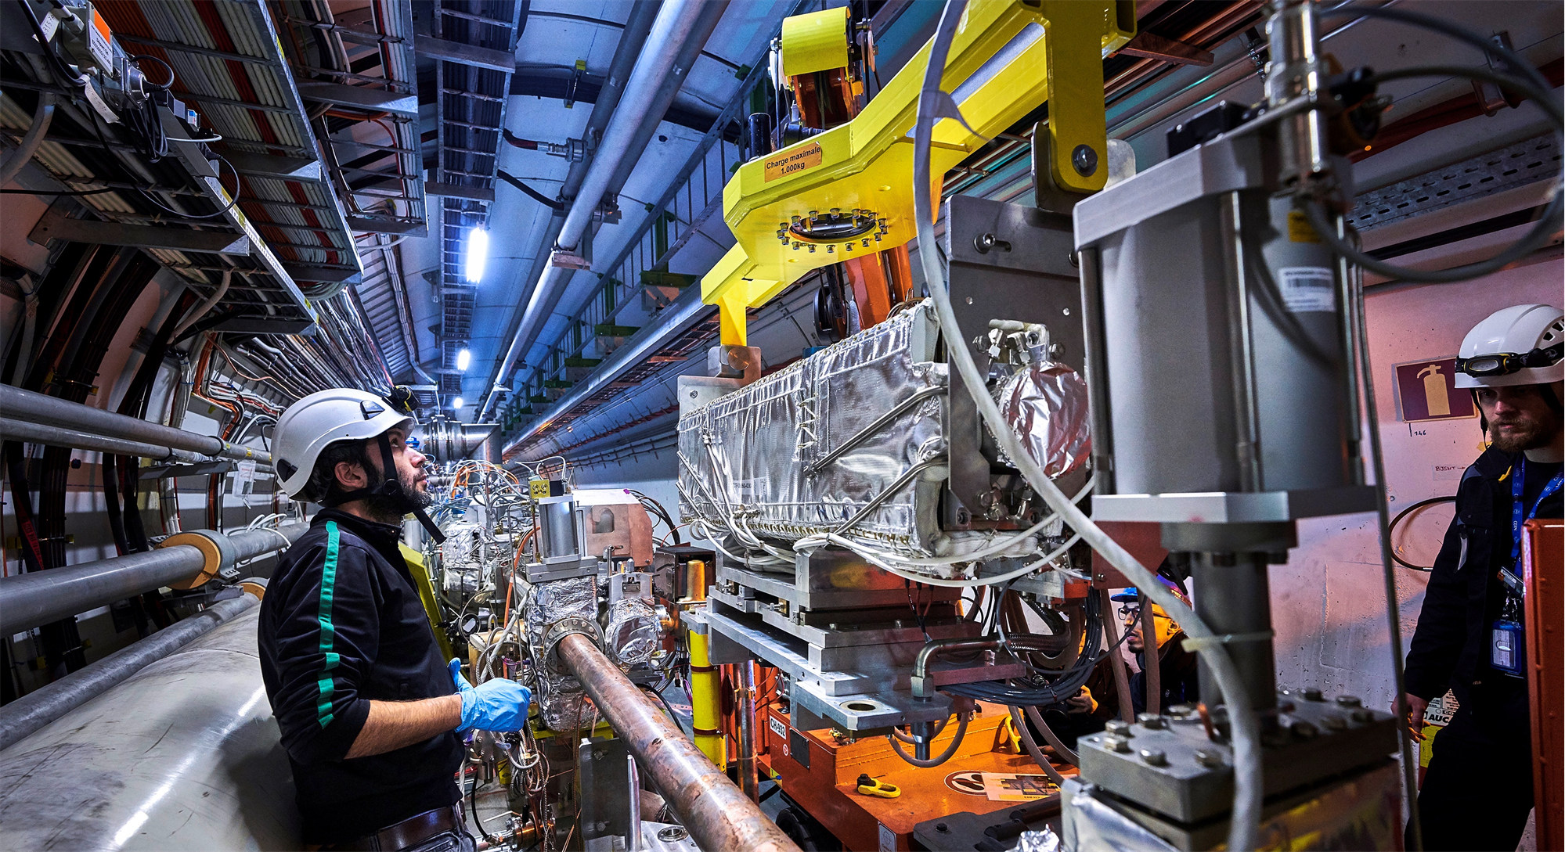
Upgrade to the High-Luminosity LHC under way
The HL-LHC will use new technologies to provide
10 times more collisions
than the LHC.
It will provide greater precision and discovery potential.
It will start operating in 2029, and run until 2042.

Slide 15
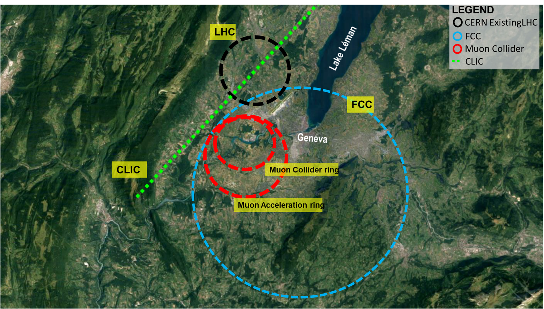
Scientific priorities for the future: a fertile ground of ideas
Implementation of the recommendations
of the 2020 Update of the European Strategy
for Particle Physics:
Fully exploit the HL-LHC
Build a Higgs factory to further understand this unique particle
Investigate the technical and financial feasibility of a future energy-frontier 100 km collider at CERN
Ramp up relevant R&D
Continue supporting other projects around
the world

Slide 16

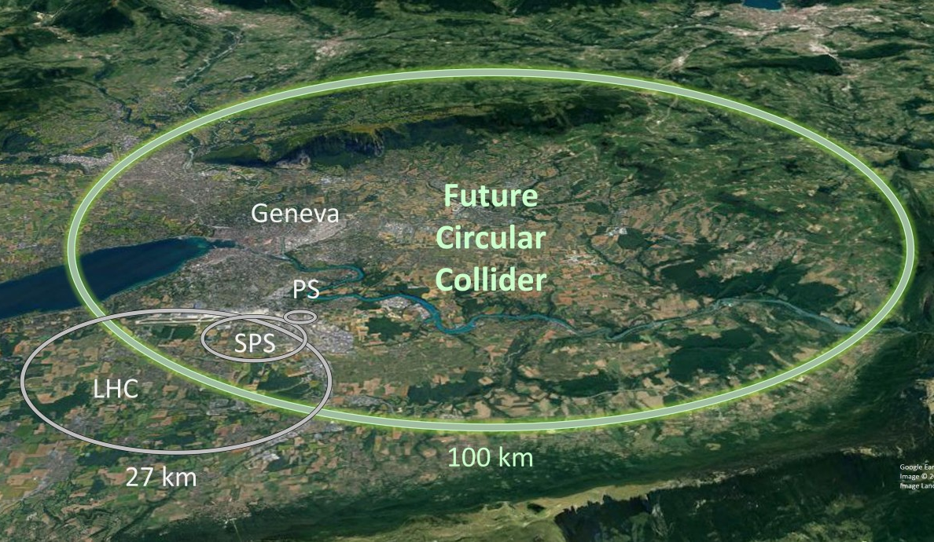
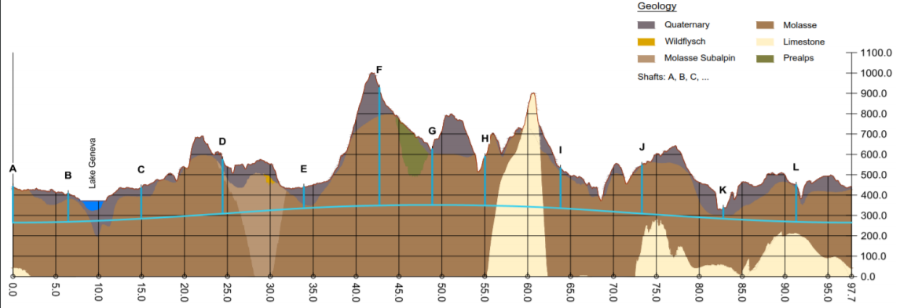
Scientific priorities for the future
Courtesy Rhodri Jones – EUSPEN2022
A Future Circular Collider – feasibility study underway – completed by end 2025
  Goal: to push the energy frontier of particle colliders to reach 100 TeV
  A ~100km ring linking to the existing CERN accelerator complex
  Sustainable operational model being elaborated
  Key engineering challenges include:
    Civil engineering the tunnel & related infrastructure
    Magnet technology to reach much higher field
    Improved superconducting RF

Slide 17

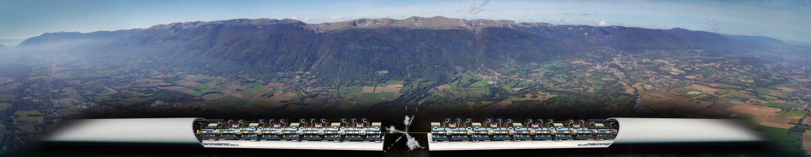
Scientific priorities for the future
Courtesy Rhodri Jones – EUSPEN2022
A Compact Linear Collider – technical design report under preparation
  For the era beyond HL-LHC – horizon of 2040
  Novel two-beam accelerating technique using high-gradient, room temperature, X-band RF cavities
    Proof of principle experiment completed at CERN
  Expandable, staged programme (11 – 50 km) with collision energies up to the energy frontier
  Engineering challenges include:
    Avoiding breakdown in any of the 140000 accelerating structures, high precision alignment & stability, minimising power consumption.

Slide 18

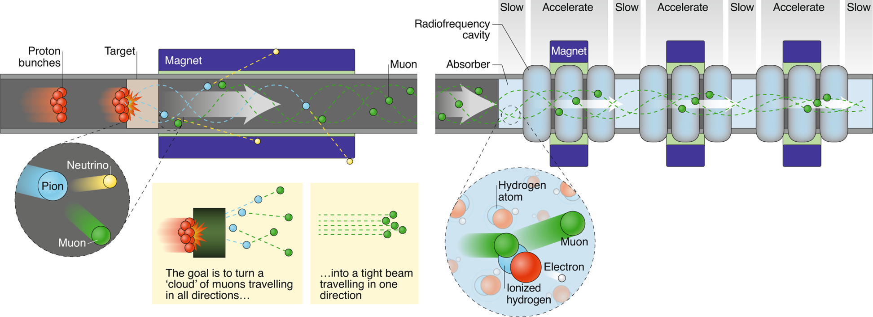
Scientific priorities for the future: R&D Concepts
Courtesy Rhodri Jones – EUSPEN2022
A Muon Collider – Study underway
  Promises to reach higher energy and luminosity than linear colliders
  Global Challenges:
    Muons are not stable (lifetime only 2.2 μs at rest) so acceleration needs to be quick
      At relativistic speeds their lifetime is much longer as time slows down for the muon!
    Muons decay to produce neutrinos leading to radiation issues at the surface
  Engineering challenges
    high-field magnets
    efficient RF
    robust targets

Slide 19

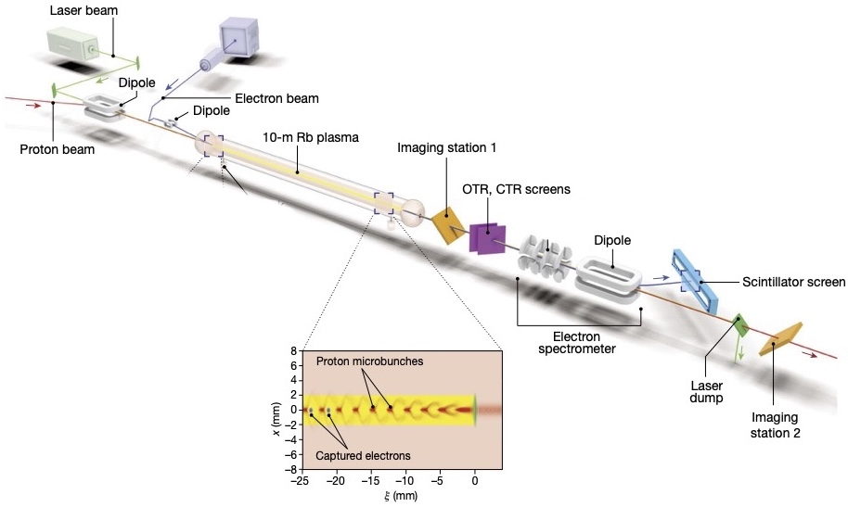
Scientific priorities for the future– R&D Concepts
Plasma Wakefield Acceleration – Experimental studies underway
Courtesy Rhodri Jones – EUSPEN2022
  Novel acceleration concept being studied by the AWAKE experiment at CERN
  Replaces traditional radiofrequency cavities with a plasma cell for acceleration
  Plasma waves generated by an intense proton bunch
  An electron bunch can then be injected onto these waves to be accelerated to high energy
  Capable of generating accelerating gradients an order of magnitude higher than current radiofrequency systems allowing for much more compact accelerators

Slide 20
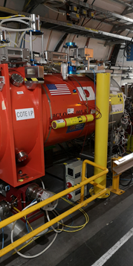
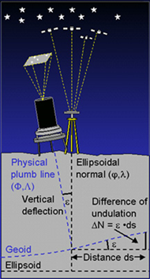
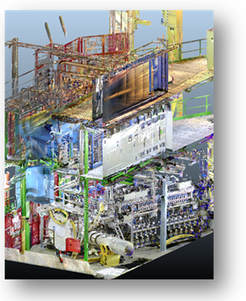

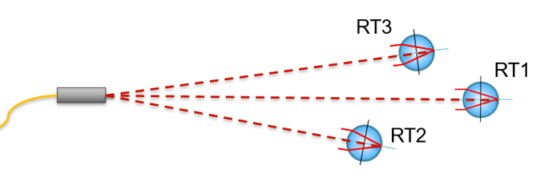
Geodetic Metrology
Courtesy Rhodri Jones – EUSPEN2022
Challenges
  Scale from nm to 100km
  Range in size of components
  Environment - radiation, cryogenic, limited access,..
  Accuracy & Precision required
Position Monitoring & Adjustment
  HL-LHC
    Monitoring of magnet inside cryostat at micrometer level
    Alignment over all components over 200m better than ~250μm
  CLIC
    Component alignment at ~10μm
    Stabilisation of critical components at nanometre level
Structured laser beam
Frequency Scanning Interferometry (FSI)
Permanent monitoring
Geodetic aspects
Georeferenced scans
R&D

Slide 21
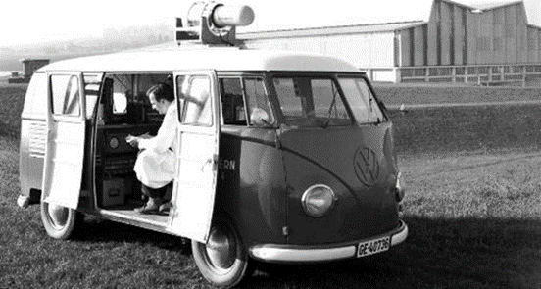
For a research which respects the environment: context
A long-term approach that originates from the creation of the laboratory in 1954
1980-1990: integration of environmental concerns into impact studies of new accelerators
Since then, greater consideration of environmental issues in CERN's activities according to the evolution of the theme in the Host States and on an international scale - breakthrough of key subjects such as energy and greenhouse gas emissions tight
Establishment:
  of the Tripartite Environment Committee in 2007 (CERN – Authorities of the Host States France and Switzerland)
  of a Tripartite Agreement on the protection against ionizing radiation and the safety of the Organization's facilities in 2010
  a CERN committee dedicated to energy in 2015 and creation in 2017 of a CERN committee dedicated to all environmental issues
  an ISO 50001 certification process for energy management, started in 2021 with completion at the end of 2022.
Publication :
  the first 2017-2018 environmental report in September 2020 according to the GRI (Global Reporting Initiative) standard, available to the public, and the second 2019-2020 report in November 2021
  Publication of MASTERPLAN 2040 in December 2021 for the development of CERN sites, integrating framework objectives for the protection of the environment

Slide 22
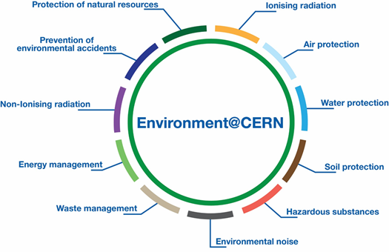
For a research which respects the environment: strategy
Minimize the impact of laboratory activities on the environment through priority actions defined by 2025
Pursue actions and the development of technologies to consume less, improve efficiency and recover more
Continue to identify and develop CERN technologies that would help to mitigate society's impact on the environment

Slide 23
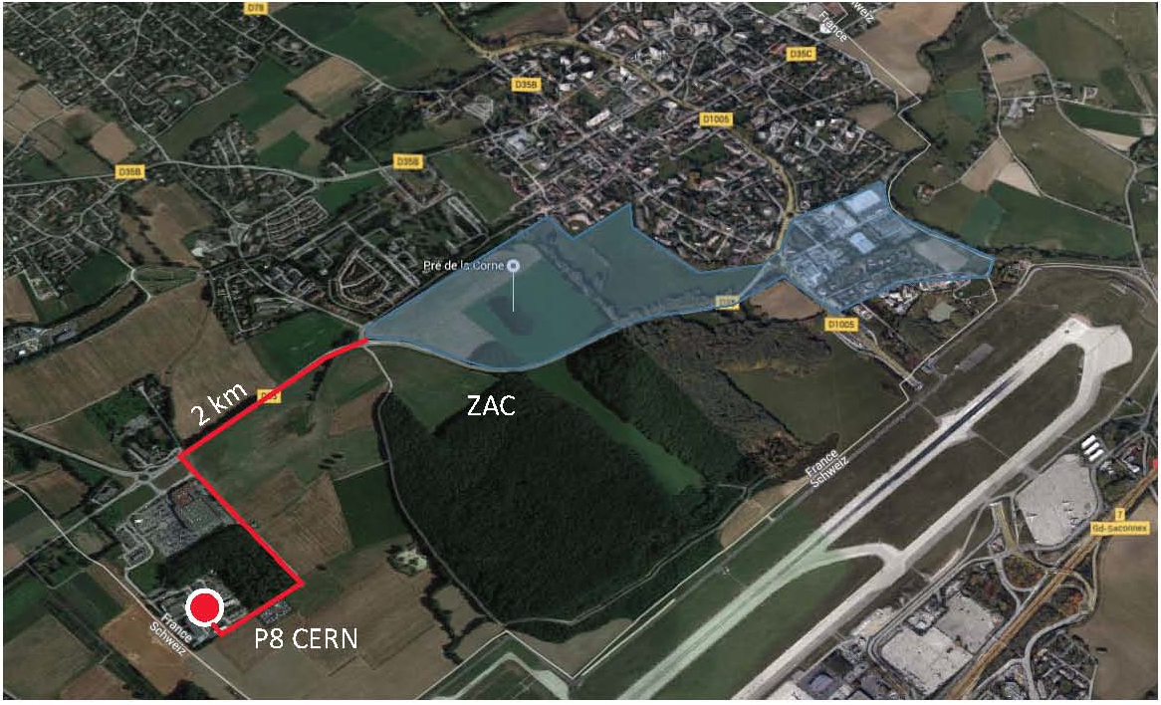
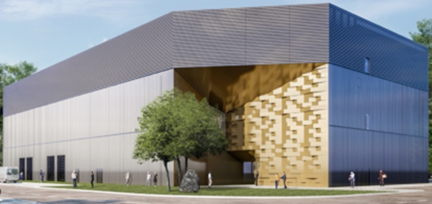
Energy – consume less, improve efficiency and recover more: the numbers
The thermal discharges of some become the resource of others.
Heat recovery from CERN-P8 (Ferney Voltaire) to be injected into an “anergy” local loop (ZAC Zone d’Aménagement Concerté, Ferney-Voltaire innovation) - 20 GWh/year
Renovation of the Prévessin boiler room (F) including heat recovery from the new Computing Center (PCC) planned to heat the buildings on the site from 2024 – reduction of emissions from the gas boiler room located on the site (up to ~1900 tCO2e/year).
Ongoing studies to recover heat from the CERN cooling towers at LHC point 1 to heat the buildings of the Meyrin site (CH) – reduction of emissions from the gas-fired boiler room located on the site (from ~2000 tCO2e/ year).

Slide 24
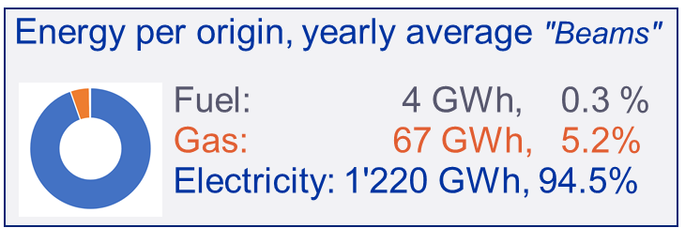
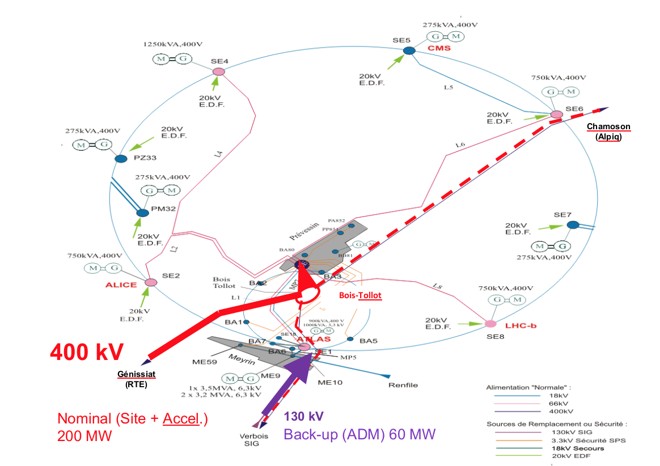
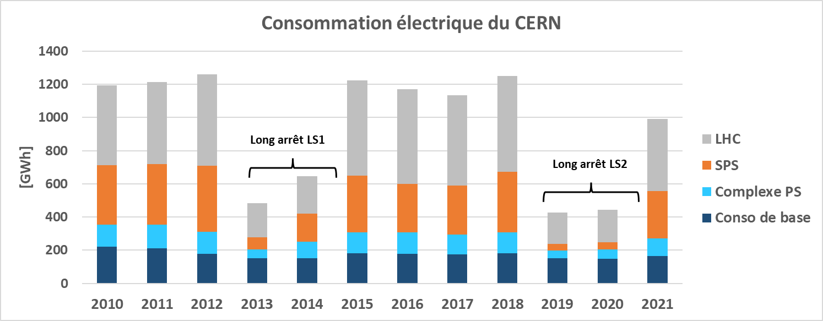
Energy – consume less, improve efficiency and recover more: the numbers
~90% for accelerators, detectors and test facilities
Main feeding point from a 400kV line (interconnection F-CH)
Mandatory for CERN accelerators (capacity and stability)
Back-up from 130kV (limited capacity).

Slide 25
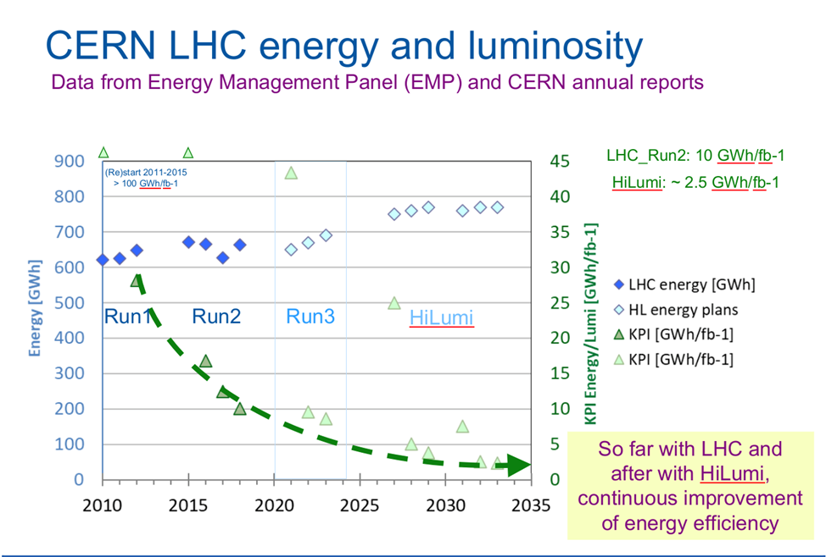
Energy – consume less, improve efficiency and recover more
Energy efficiency and savings related to scientific and technical facilities
  Savings of ~100 GWh/year in place since 2010
  Energy efficiency, energy savings taken into account in each renovation/optimization project of the CERN accelerator infrastructure
  New metric developed for the Large Hadron Collider (LHC) to illustrate the amount of energy used per unit of luminosity delivered
Energy efficiency standards are systematically applied for new constructions at CERN and in the building renovation master plan.
Travail similaire fait pour la chaine des injecteurs du LHC

Slide 26
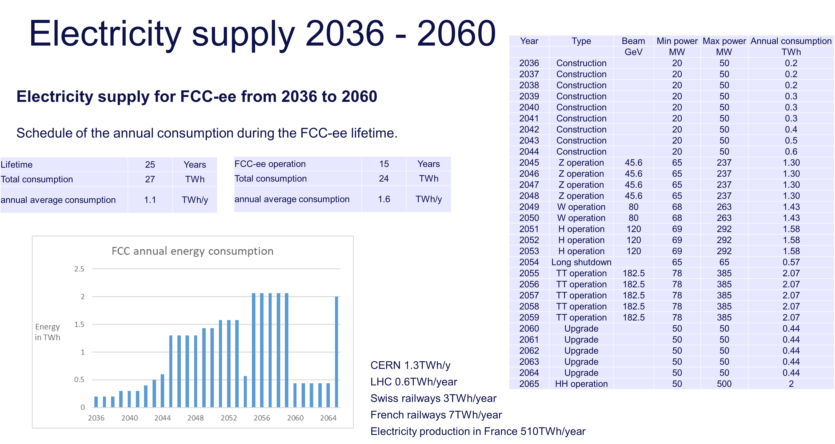

Energy – consume less, improve efficiency and recover more
FCC power being evaluated by machine configuration- Jean-Paul Burnet, ESS WK, 29-30 September 2022, Grenoble
Next steps
Define the electrical infrastructure based on these numbers for the feasibility study
Work on the reduction of the energy consumption
Study energy production, energy recovery and sustainability
Travail similaire fait pour la chaine des injecteurs du LHC

Slide 27
FCC – environmental initial state analysis
Human environment agricultural economic study, transport infrastructures, constructed areas strategic infrastructures of national interest, demography and development, analysis of risks relating to technical infrastructures
Services
public health and emergency services, security, education, housing, industry and commerce
Heritage and landscape
viewpoints and sites of cultural, natural importance and historical importance
Natural environment
flora, fauna, biodiversity, presence and relevance of habitats, presence and conditions of forests, existence and evolution of protection zones
Physical environment
climatic and meteorological conditions, sites topography, geology
Light
artificial light pollution, source, type, intensity, direction, places of occurrence and duration
Noise
level, frequency and places of occurrence
Soil and water
surface water, hydrology, soil profile, land cover and land use and existing soil pollution
Vibration, source, type, level, frequency, places of occurrence and duration
Air
air quality and types of pollutants
  Ionisation and non-ionising radiation
  source, type, level

Slide 28
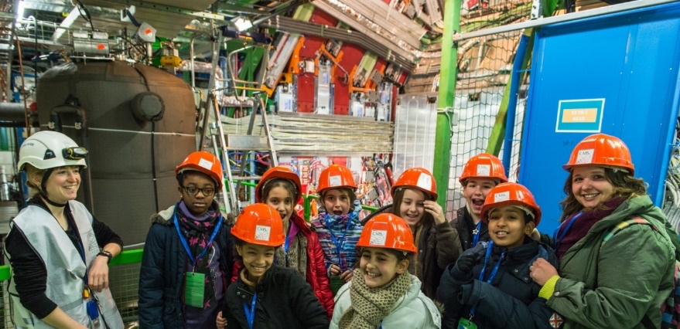
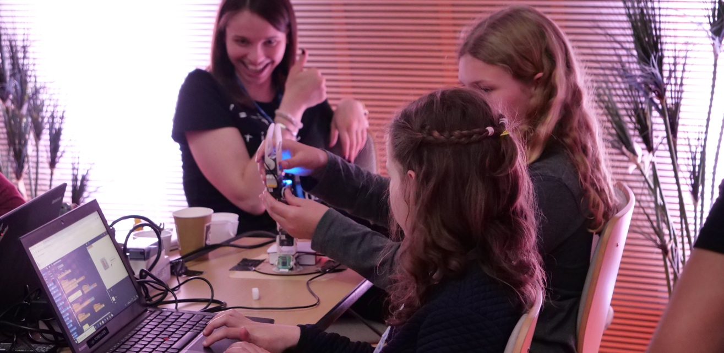
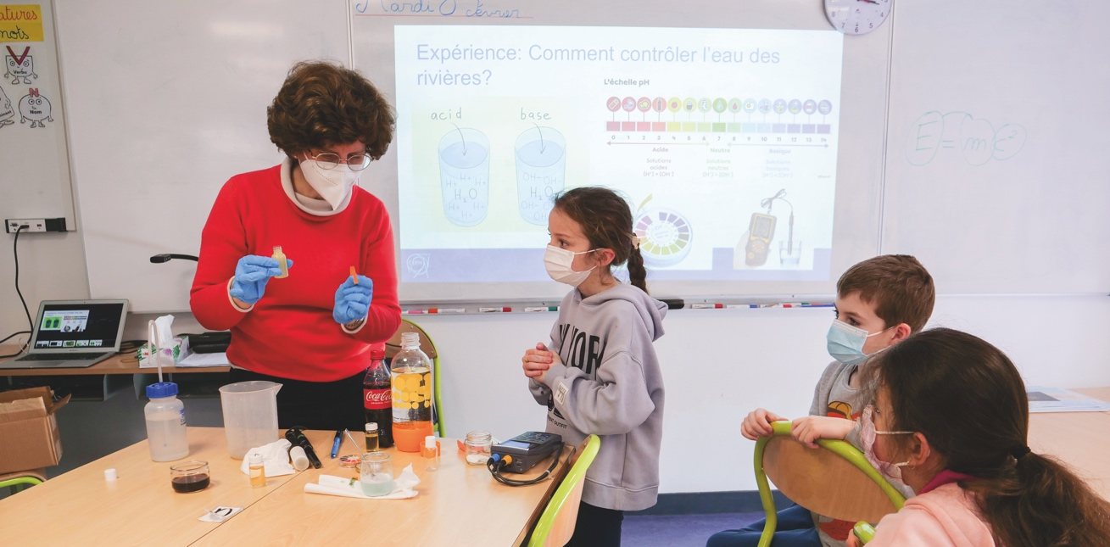
Our future: the next generations, from the early age
Be a scientist
Since 2011
In collaboration with the educational institutions
Discovery of the scientific approach through group activities in class (9-12 years old)
CERN schools visits
https://voisins.cern/en/be-scientist
Django Girls in ICT
In 2018, 2019 and 2021
Computer discovery workshops for girls
 voisins.cern/fr/day-ict-workshops-girls-globe
Women and Girls in Science and Technology
Since 2017
11 February is the International Day of Women and Girls in Science. On this occasion and for the whole of the week, UNIGE Scienscope, EPFL, LAPP and CERN offer local schools the opportunity to welcome a female scientist / engineer to present her work to (mixed) classes.
They are invited to tell their story, reveal some mysteries of science and, if they wish, to conduct some small demonstrations.

Slide 29
Countless training possibilities offered at CERN
Opportunities for students | Field | Duration | Eligibility | Features | Open to applications
Interns (100/an) | Applied Physics, Engineering, Computer Science | Max. 6 months | Full-time undergraduate student | Project with CERN supervisor | 11/2022
Technical students (200/an) | Applied Physics, Engineering, Computer Science | 4 to 12 months | Have completed 18 months of undergraduate studies | Project with CERN supervisor | 08/2022 to 7/11/2022
Summer students (300/an) | Physics, Engineering, Computer Science | 8 to 13 weeks in summer | Have completed 3 years of undergraduate studies | Conferences, visits, workshops | 11/2022 to 01/2023
Doctoral students (80/an) | Applied Physics, Engineering, Computer Science | 6 months to 3 years | Enrolled in a doctoral program | Project leading to a thesis, 2 thesis supervisors (University / School and CERN) | 08/2022 to 7/11/2023

Slide 30
Endless career opportunities at CERN
ORIGIN
Give a real boost to your career.
Continue learning with a job offering support and guidance from the supervisor and a CERN team.
Duration: 6 – 36 months
Selection committee: November – March – May – August
Eligibility:
Candidates from Member States and Associate Member States
Specialized studies/technician's diploma or Bachelor's or Master's degree; less than 2 years of experience
QUEST
Deepen your knowledge and expertise.
Work on a specific proposed project, under expert supervision, within a team.
Development of the professional network in the areas of interest. Ability to supervise a student.
Duration: 6 – 36 months
Selection committee: March – October
Eligibility:
Candidates from Member States and Associated Member States - (exceptionally for candidates from non-Member States)
Master 2 to 6 years of experience
PhD with maximum 3 years of experience
Research Fellows
Build international visibility and develop a network in the scientific community.
Duration: 6 – 36 months
Selection committee: November – May
Eligibility:
Postdoctoral research topic to be submitted (particle physics, applied physics, engineering)
Candidates from Member States and Associated Member States - (exceptionally for candidates from non-Member States)
PhD with up to 6 years of experience
CERN recruits around 250 new graduates every year

Slide 31
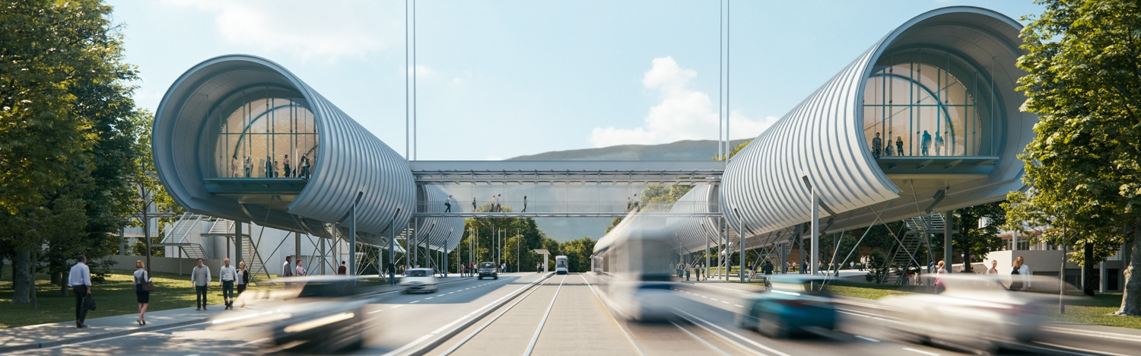
CERN Science Gateway
CERN's new education and communication center for the general public, everyone from 5 years old
Opening scheduled for summer 2023
Immersive exhibitions, educational laboratories, events and shows

Slide 32
Concluding remarks
CERN has a vast and exciting scientific programme:
  With the LHC running until ~2042;
  With the facilities and experiments of the injector complex, complementary to the collider, at the service of a large community;
  Through vigorous R&D and design studies for future installations.
The ESPP 2020 program has identified the Future Circular Collider as the preferred option at CERN for an upcoming post-LHC collider.
  An immense physical potential, but also a very difficult and ambitious project;
  The feasibility study has started and will be completed by the end of 2025;
  The focus is on FCC-ee and magnet R&D;
  Other options are also being studied.
To maintain interest in CERN and motivate the community (especially younger generation), it is crucial to:
  Avoid too much time between the end of the HL-LHC around 2042 and the start of physics in a new installation (around ~2045);
  Build a new facility alongside the operation of the HL-LHC where the next generation can work on HL-LHC data analysis and R&D for the construction of the new facility.
Today's accelerators form our heritage and our foundation for tomorrow.
There will be no future large-scale scientific project without a thoughtful energy management policy, including a strong incentive for energy efficiency and energy recovery among the major objectives.
Any future projects will have challenging ‘alignment and survey’ specification. Your expertise is integrally part of the success of our future programmes.
.

Slide 33
THANK YOU

