Slide 1
Detectors, Metrology, Alignment
CERN, 2.11. 2022
W. Riegler, CERN

Slide 2
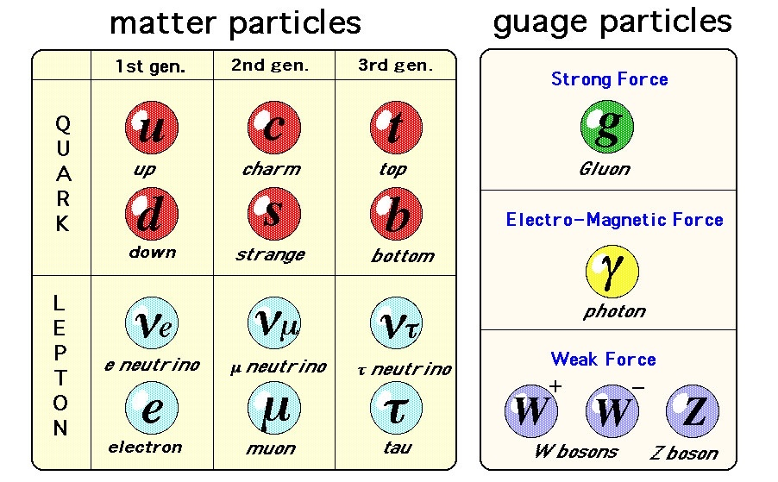
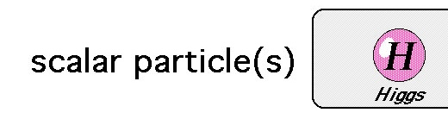

Standard Model
‘Completed’ with the discovery of the Higgs particle.
Verified and confirmed quantitatively with incredible precision.
No hint where to find solutions for unresolved questions like
dark matter, matter-antimatter asymmetry, dark energy …
We need new tricks, new tools, more precision … to make progress !

Slide 3
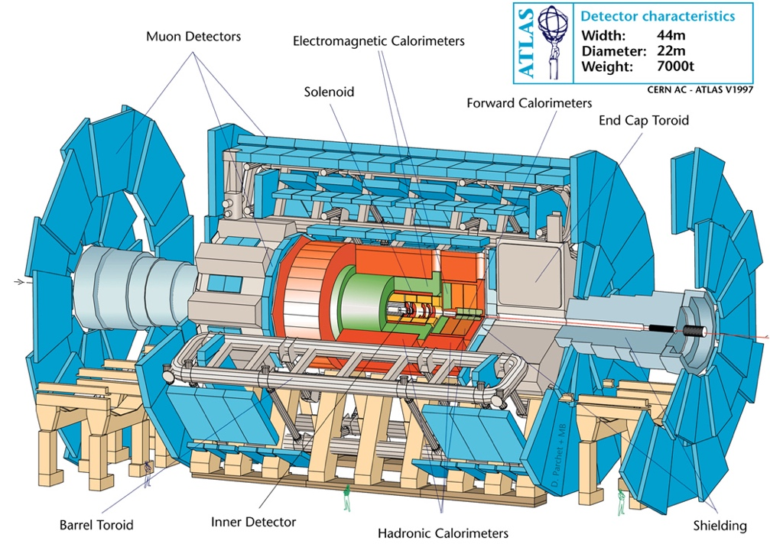
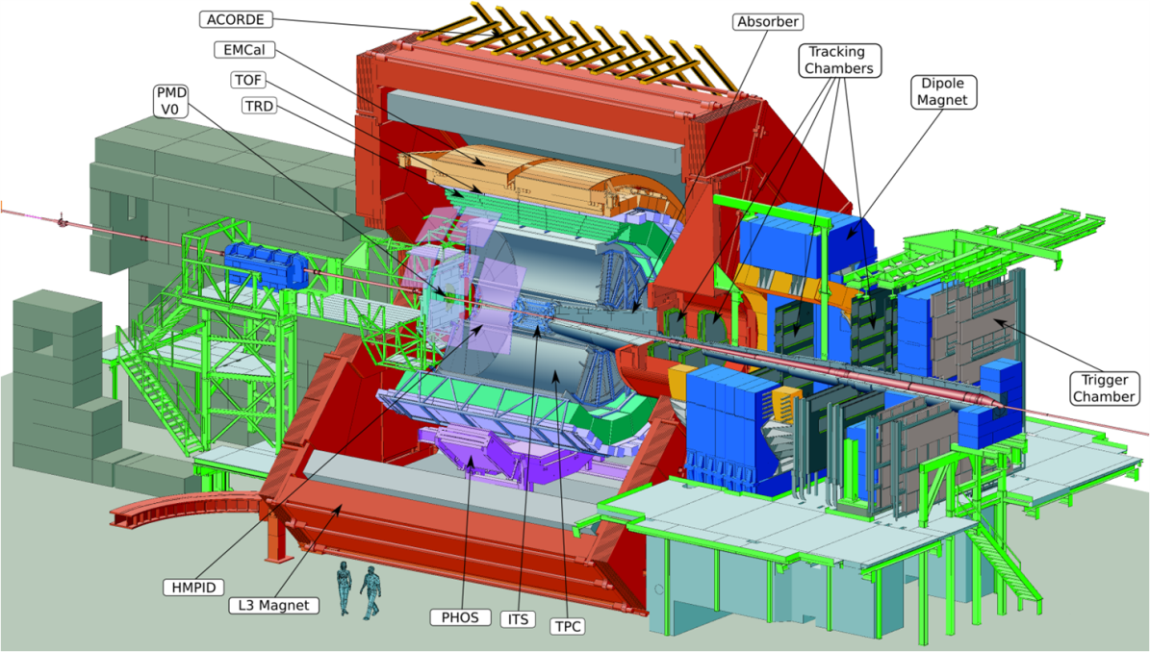
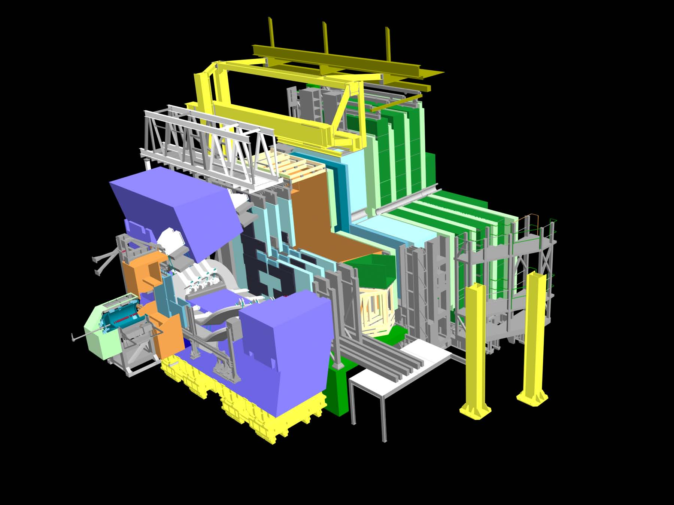
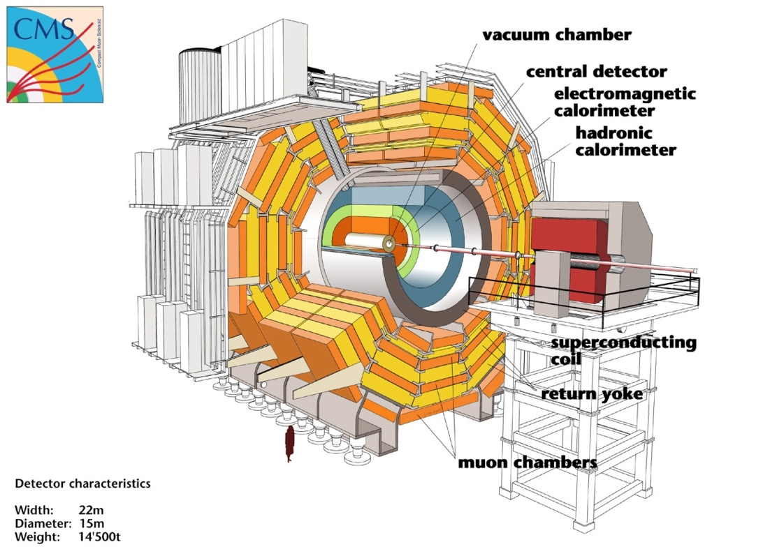

Slide 5
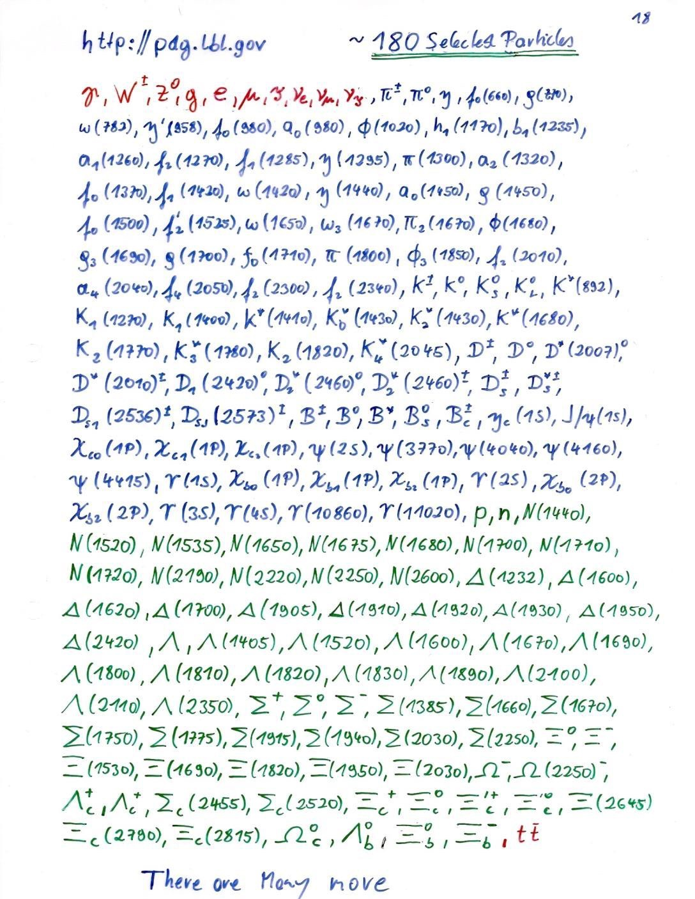
A selection of particles listed by the particle data group.
How can we tell them apart in our detector ?!

Slide 6
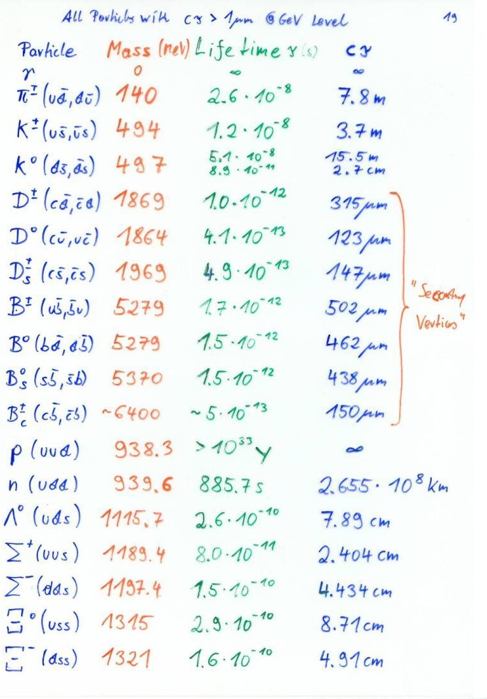
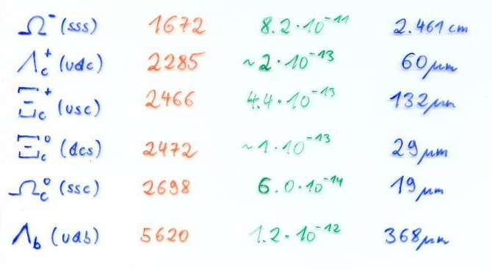
Out of the hundreds of known particles, these are the only ones that have a lifetime long enough to produce a track of >1um before they decay
(at GeV Level).
Some of them decay after flying only a few hundred um.
Others traverse the entire detector.

Slide 7
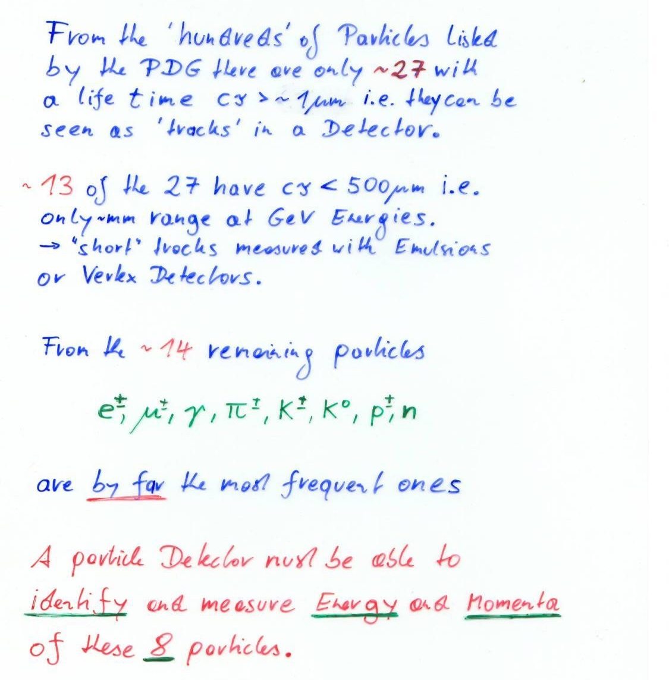
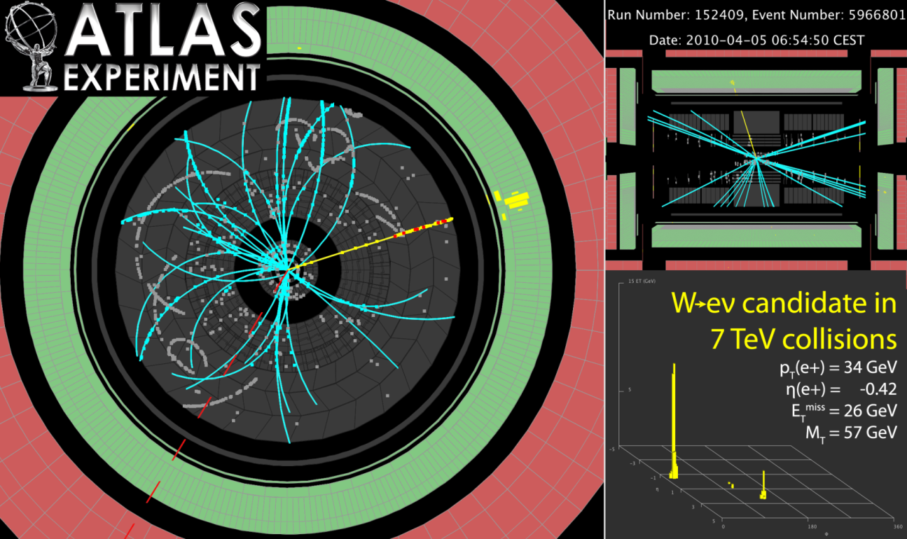

Slide 8
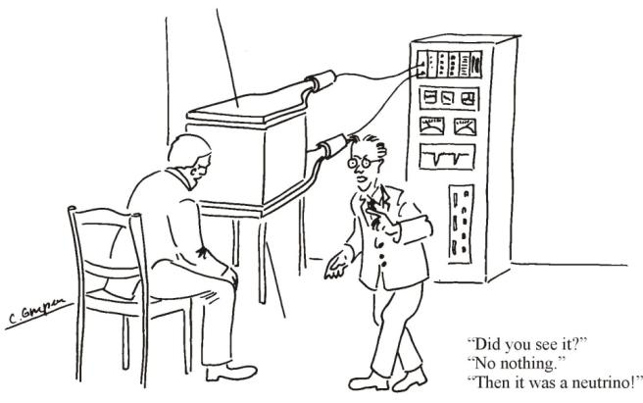

Interaction of Particles with Matter
Any device that is to detect a particle must interact with it in some way → almost …
In many experiments neutrinos are measured by missing transverse momentum.
E.g. e⁺e⁻ collider. P_{tot}=0,
If the Σ p_{i} of all collision products is ≠0 → neutrino escaped.
Claus Grupen, Particle Detectors, Cambridge University Press, Cambridge 1996 (455 pp. ISBN 0-521-55216-8)

Slide 9
2010 ATLAS W candidate

Slide 10
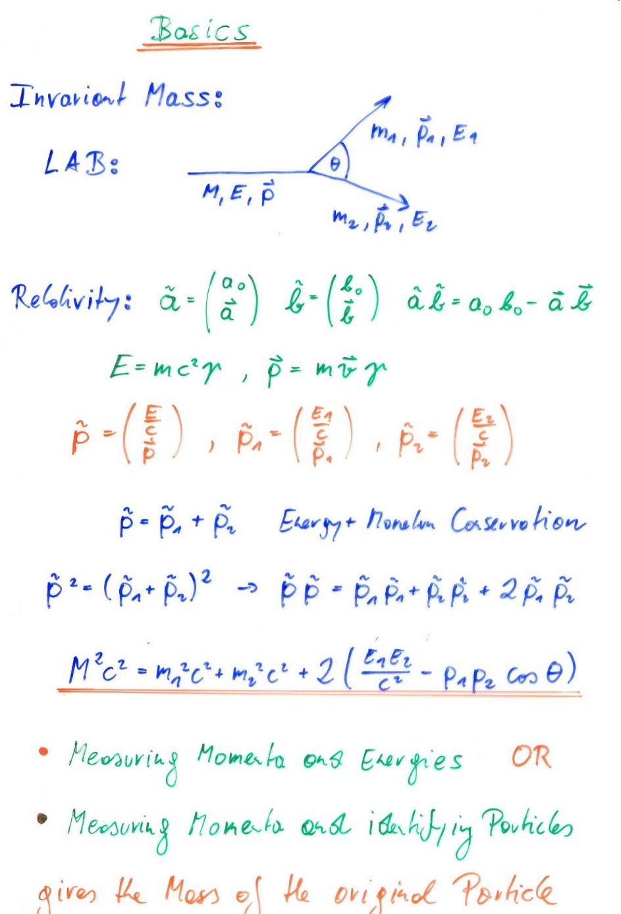
The Mass of the original particle is determined by the decay particle’s 4 momenta through relativistic kinematics.

Slide 11
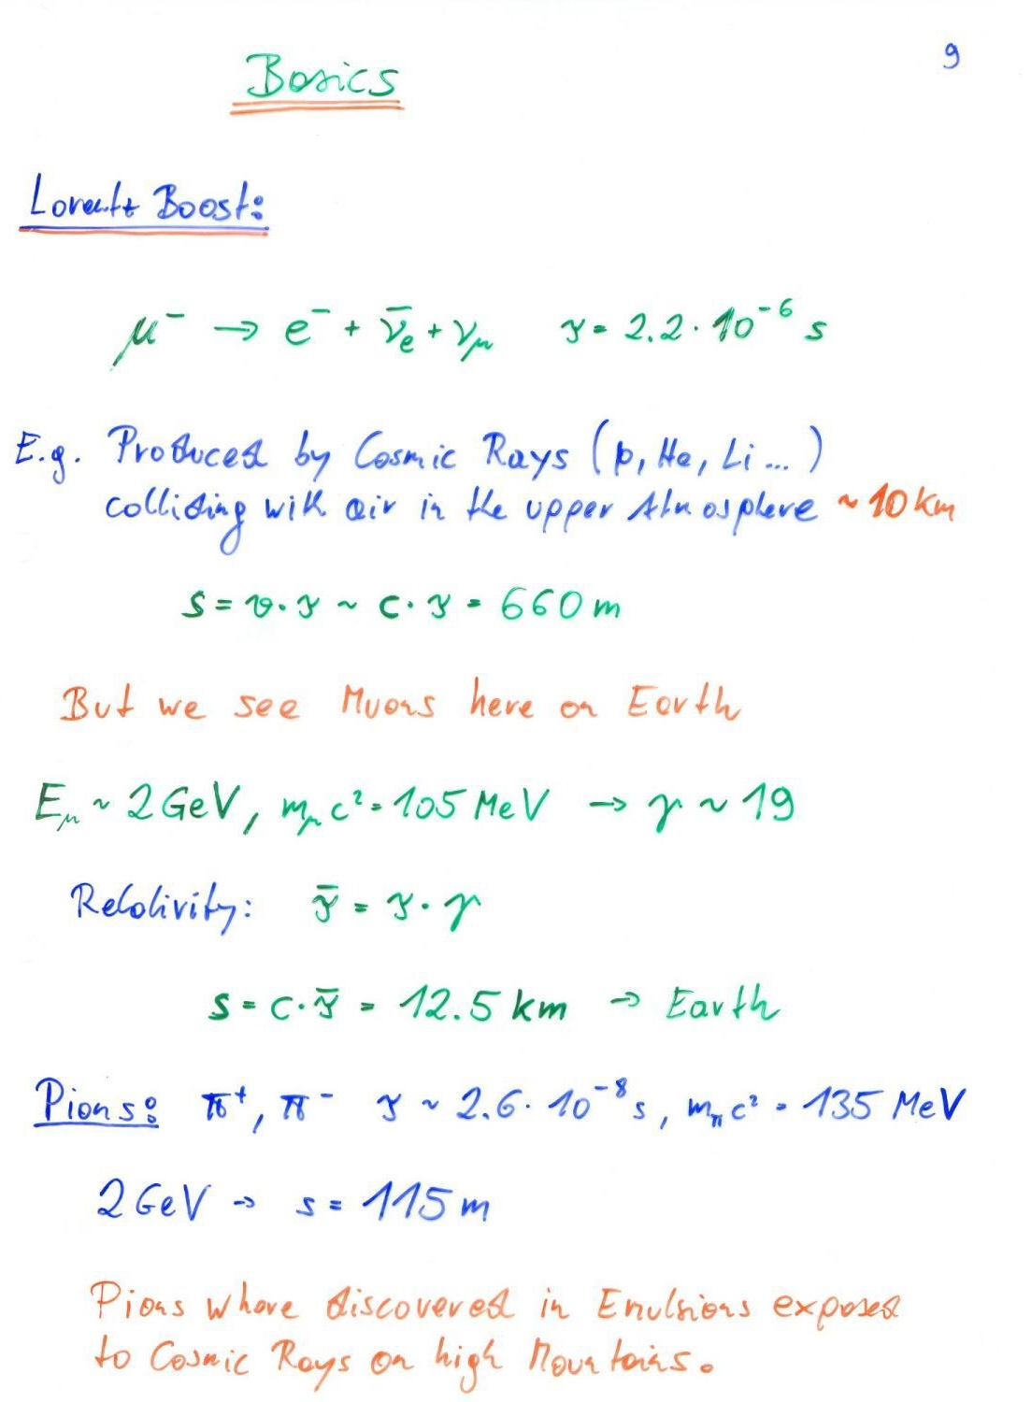
Displaced vertices from short lived particles like tau, B, D mesons are ‘boosted, prolonged’ by the particle’s Lorentz factor.

Slide 12
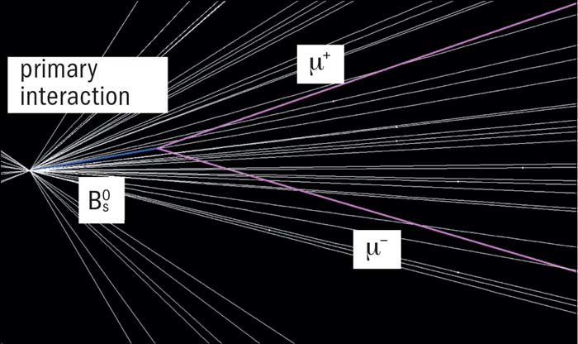
LHCb B decay

Slide 13
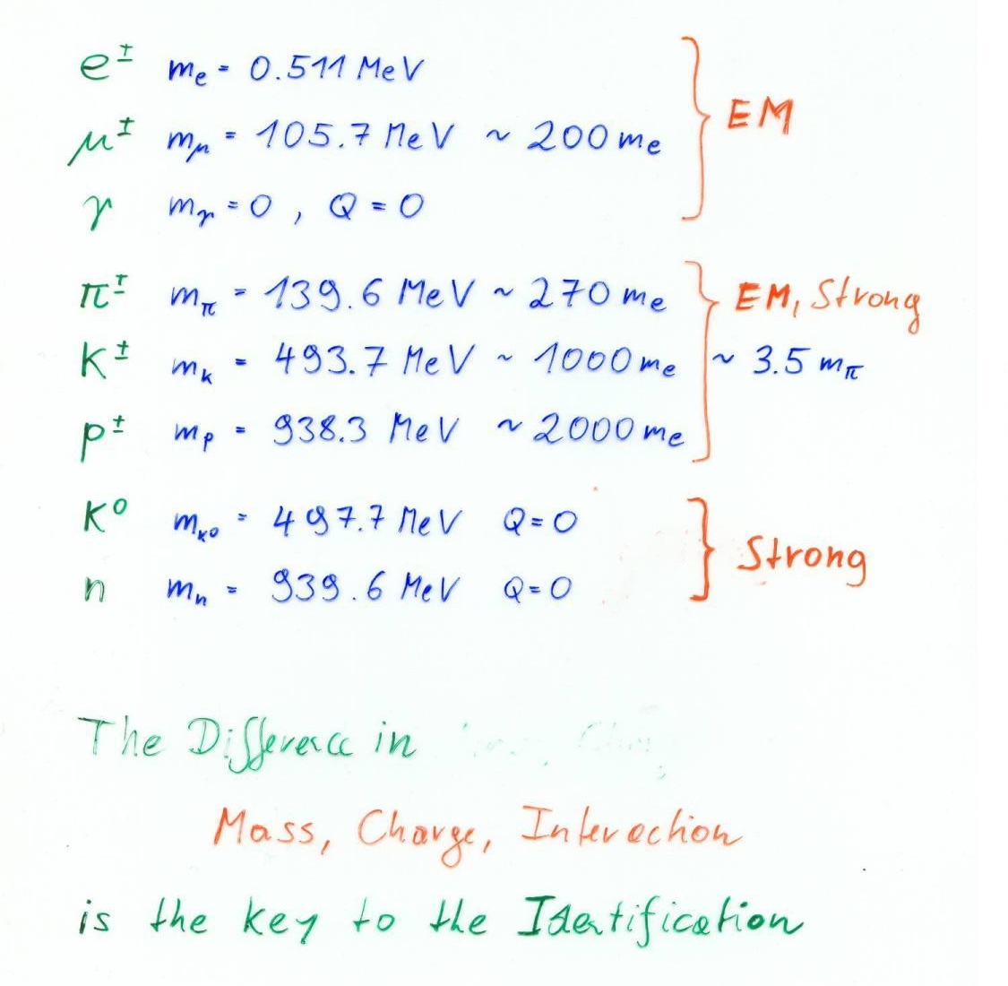
Particles ‘seen’ by a detector:

Slide 14
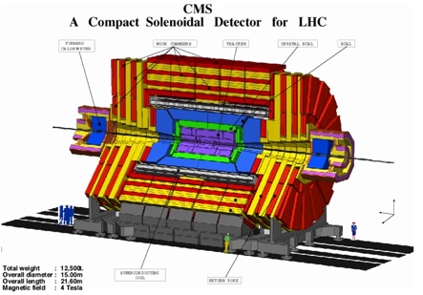
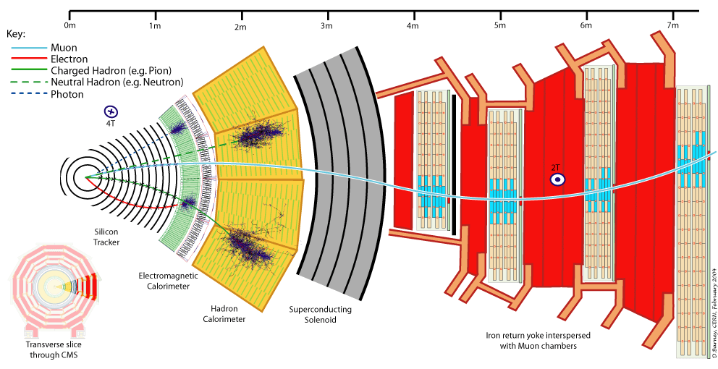
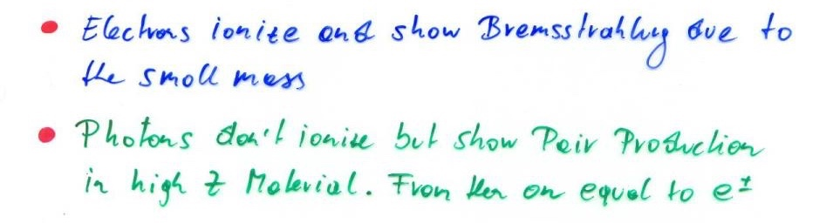
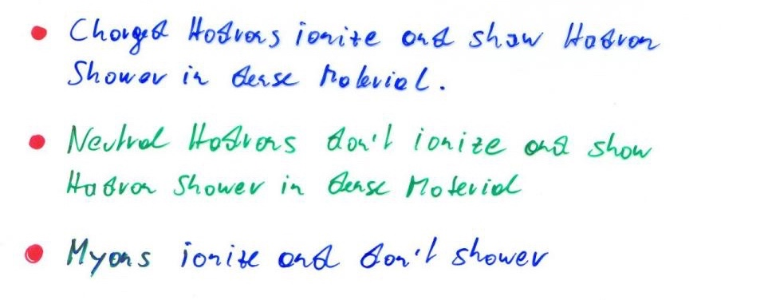

Slide 16
Bubble Chamber versus Silicon Tracker

Slide 17
Candidate Higgs Events
Candidate Higgs → 4e
Candidate Higgs → 4μ
Candidate Higgs → 2μ2e
Candidate Higgs → 2 photons

Slide 18
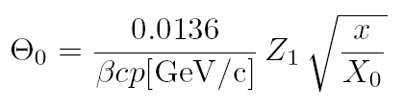
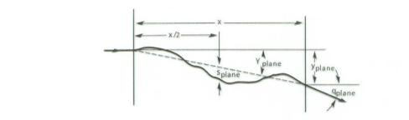

Multiple Scattering
Statistical (quite complex) analysis of multiple coulomb collisions (Rutherford scattering at the nuclei of the detector material) gives:
Probability that a particle is defected by an angle θ after travelling a distance x in the material is given by a Gaussian distribution with sigma of:
X₀ ... Radiation length of the material
Z₁ ... Charge of the particle
p ... Momentum of the particle
For small deflection of the particles by our detector we want:
→ Large Radiation length X₀ – i.e. low Z and low density material (Be, C …)
→ Small x i.e. very thin detector elements.

Slide 19
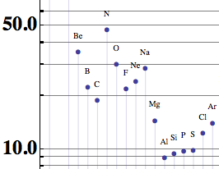
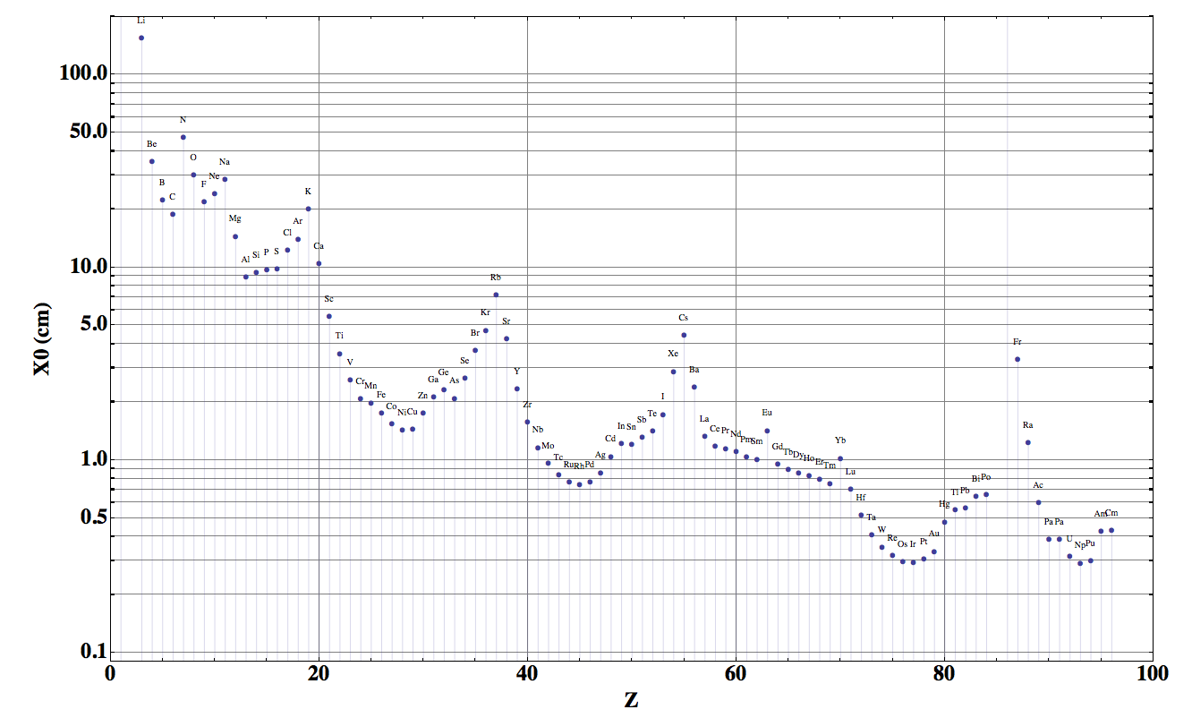
Radiation Length

Slide 20
What determines the impact parameter resolution?
What determines the impact parameter resolution
Vertex projection from two points: a simplified approach (telescope equation)
pointing resolution = ( a ⊕ b ) μm
from
detector
position
error
from
coulomb
scattering
Δx
detector layer 2
θ_{m}
Δx
detector layer 1
r₁
r₂
r₁
r₂
perceived
vertex
perceived
vertex
a
true vertex
b
true vertex
First layer as close as possible to the vertex and First layer with minimal amount of material.
e.g. x/X₀ = 0.0114, r₁= 39mm
→ b= 57um for p=1GeV/c
Detector Granularity, minimize Δx:
e.g. 50um pixel and r₂ very large compared to r₁
→ a=Δx=50/√12 = 15um

Slide 21
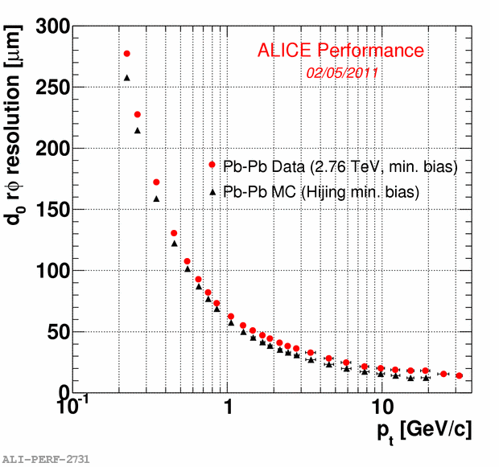
Heavy Flavour – Experimental measurement
Example of ALICE Silicon Tracker
For high particle momenta the resolution is dominated by the detector granularity.
For ‘low’ particle momenta i.e. p < 10GeV/c the impact parameter resolution is dominated by the material and distance of the first layer.
ALICE 1: x/X₀ = 0.014 and r₁= 39mm is already very good !
ALICE 2: x/X₀ = 0.003 and r₁= 22mm !
Future:
ALICE ITS 3: x/X₀ < 0.001 and r₁= 20mm !
ALICE 3: x<X₀ < 0.001 and r₁ = 5mm !
→ Very small beampipe
→ Monolithic silicon sensors <50um
Optimized carbon fiber supports and cooling tubes.
Impact parameter resolution
a = 15um
b = 57um for p=1GeV/c

Slide 22
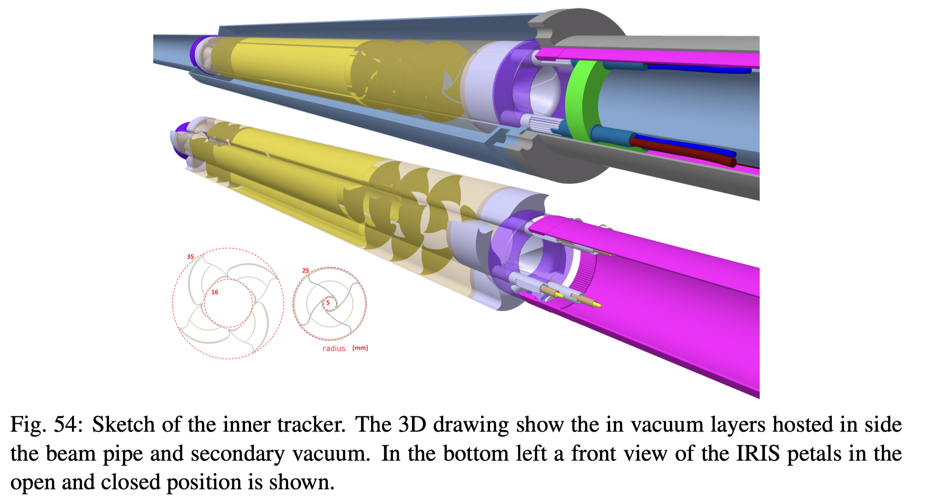
ALICE3 vertex tracker proposal

Slide 23
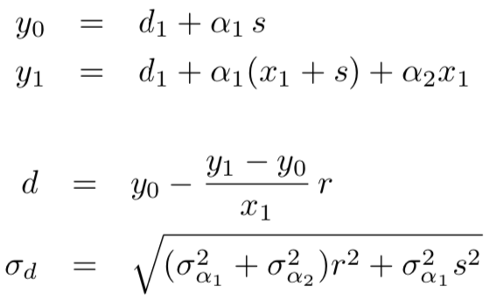
Effect of the beampipe
1st layer
2nd layer
Beampipe
y₁
y₀
α₂
d₁
α₁
d
s
x=0
x₁
x
r
First layer as close as possible to the beampipe – ideally fixed on the beampipe → s=0
No use of first layer being much thinner than the beampipe.
Beryllium X₀= 35.8cm
800um → 0.22% of X₀
500um → 0.14% of X₀

Slide 24
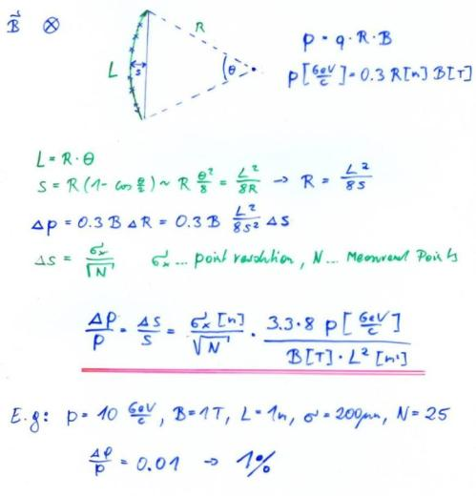
Momentum Measurement
Magnetic Spectrometer: A charged particle describes a circle in a magnetic field:

Slide 25
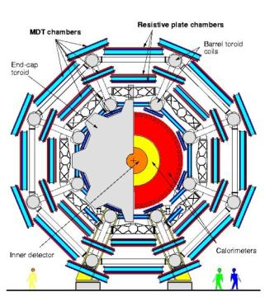
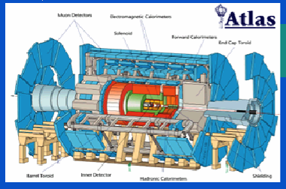
Example: ATLAS Muon Spectrometer
N=3, σ=50um, p=1TeV,
L=5m, B=0.4T
∆p/p ~ 8% for the most energetic muons at LHC

Slide 26
Typical Steps for Alignment of a Detector
The detector elements are built to a given precision. This precision is monitored during the construction by different methods of metrology.
The position of the many detector elements is referred to an external reference.
After installation of the detector, these references are surveyed with an absolute precision +0.5-0.7mm r.m.s. and relative precision that is typically better than that.
Most of the time one tries to adjust the detector elements in order to get them to their nominal position as close as possible.
The position can also be used to then place the detector at it’s true position in the detector simulation, but this is rare and not preferred.
The detectors are typically placed in their nominal position in the track reconstruction software, and the difference (residuals) of the over-constrained tracks then a measure for the displacement.

Slide 27
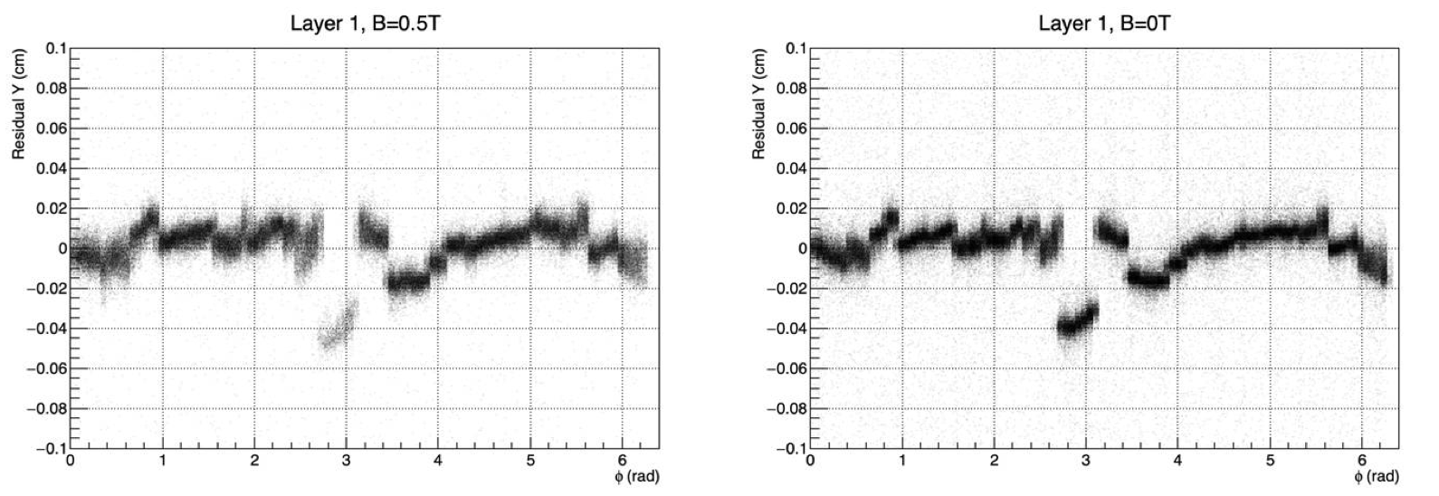
Example of ALICE ITS detector
Different hierarchy of elements can be seen. Staves (ladders) with precise placement of sensors on the ladders, but relative displacement of the ladders. Typically within ±200μm in this example, rms much much better.

Slide 28
Example of ALICE ITS detector
Metrology for verification of construction tolerances.
Construction precision not only for well defined nominal position for measurement, but also for constraints of clearances between detector elements and e.g. between detector and beampipe.
In general, many times the metrology data are not used for the alignment in the software. The nominal position is taken as a starting point and then alignment is done using tracking data. !! Formats, Coordinate Systems !!
Alignment must be better than intrinsic sensor resolution e.g.5um in the case of the ALICE ITS.

Slide 29
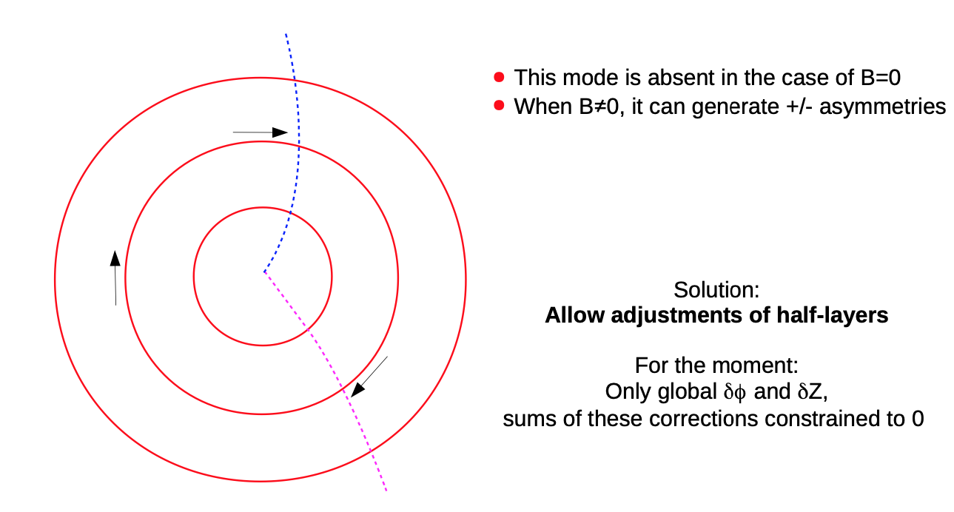
”Weak Modes”, example of clocking
This type of classic alignment is the baseline for all future large scale silicon trackers.

Slide 30
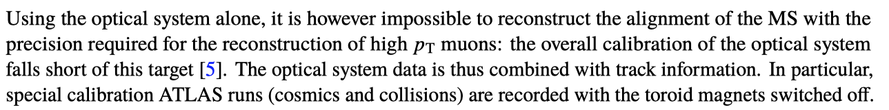

Large scale muon systems, ATLAS
1 TeV muon deviates 0.5mm from a straight line.
Detector position resolution is 70-80um.
Alignment to 50um precision is the goal (over 10m).
5800 optical sensors in the barrel and 6600 sensors in the end-caps (Rasniks, BCAMs, Laser, lens, CCD).
Whether a alignment of a system can be done with tracks alone depends on the
Stability of the system and the track statistics during that time.

Slide 31
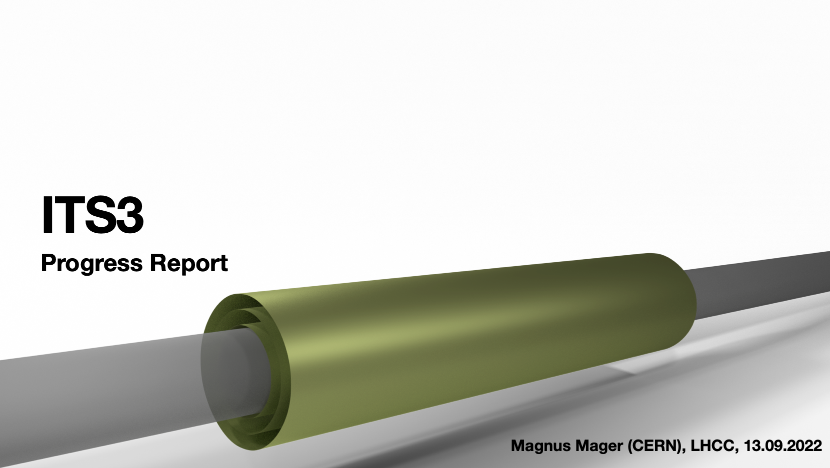
‘Perfect Detector’

Slide 32
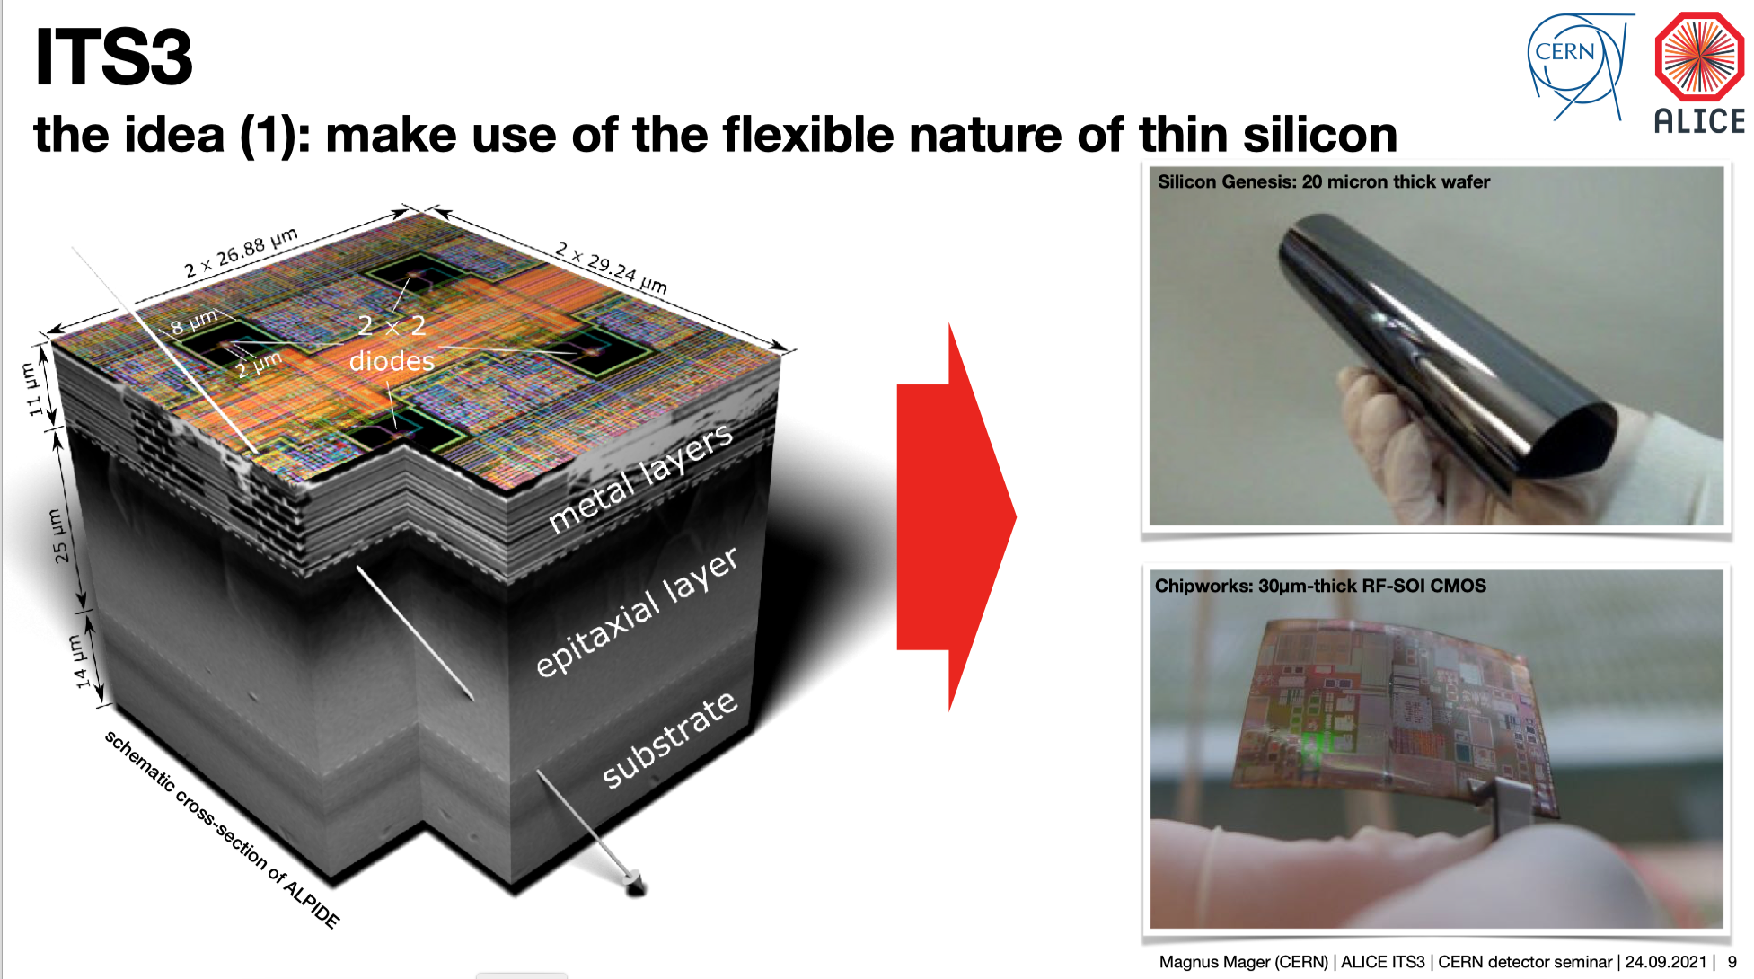

Slide 33
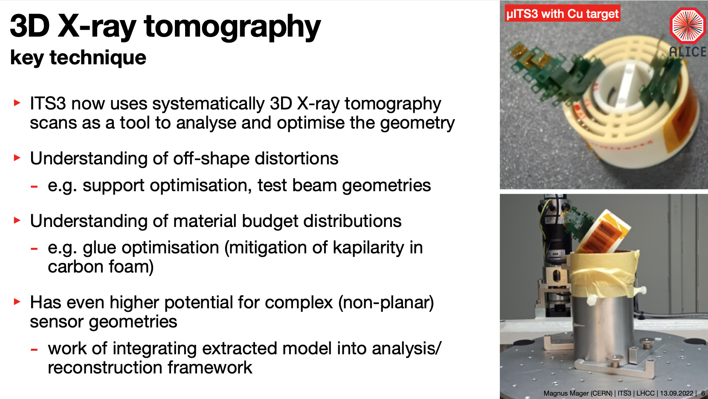

Slide 34
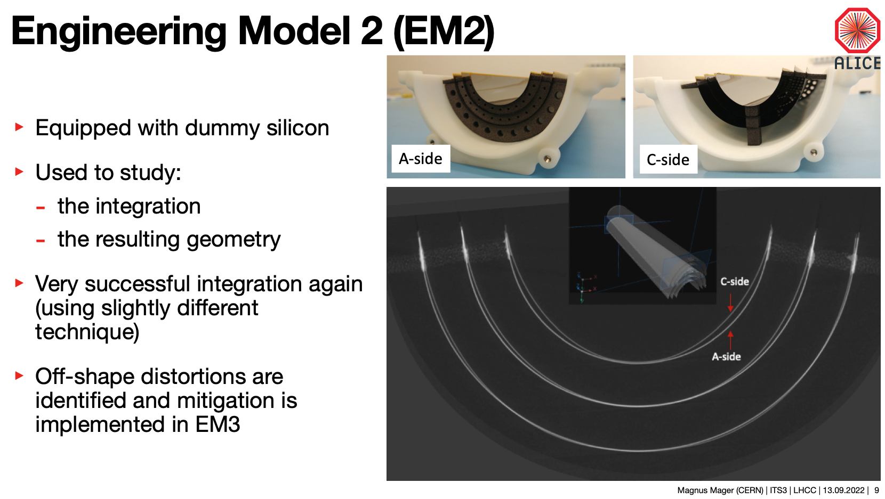

Slide 35
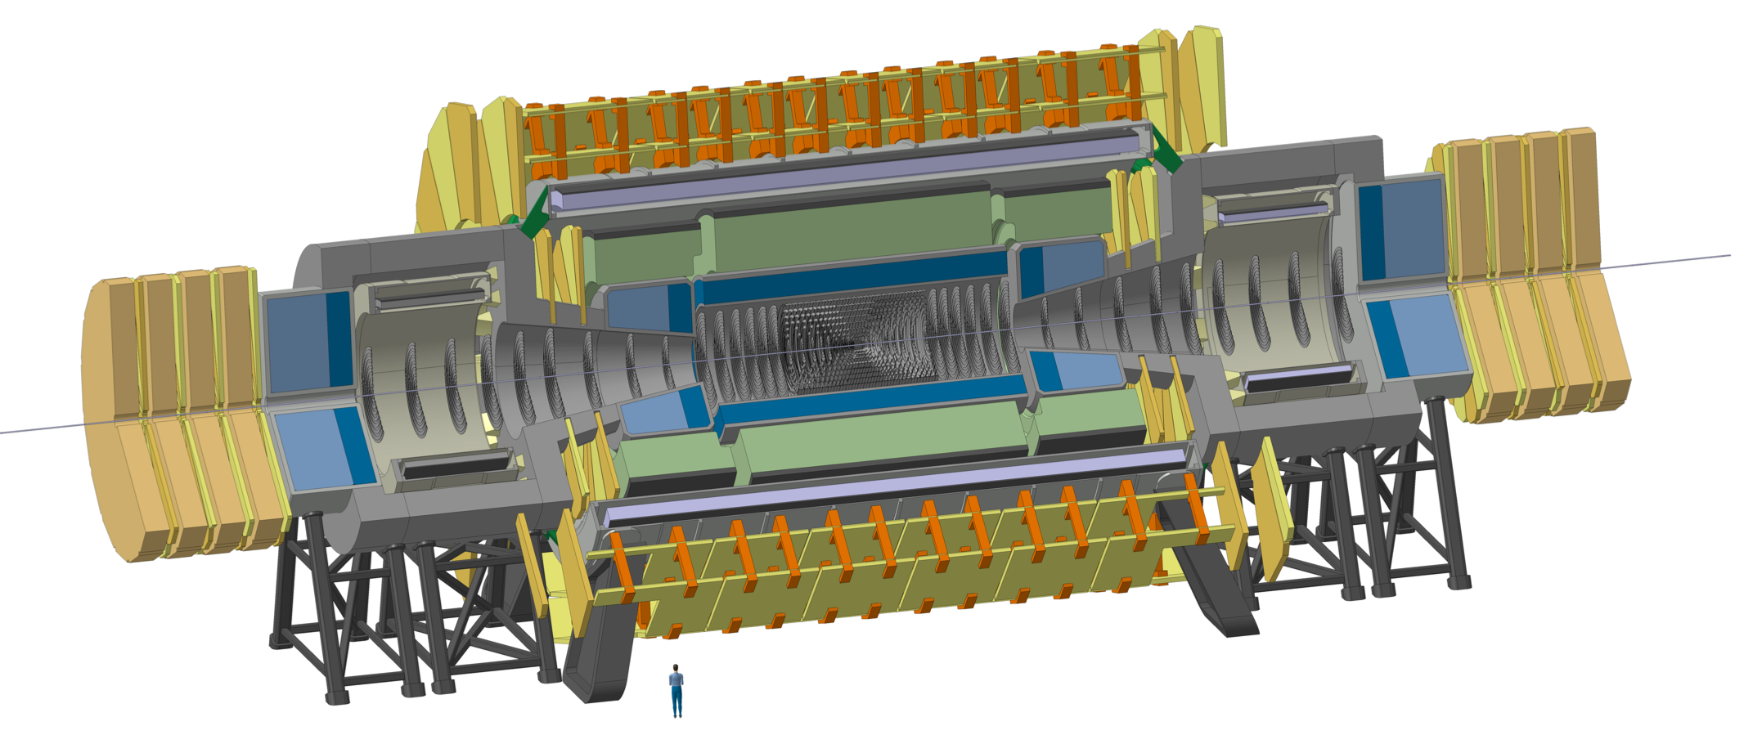
FCC-hh Reference Detector
4T, 10m solenoid, unshielded
Forward solenoids, unshielded
Silicon tracker
Barrel ECAL LAr
Barrel HCAL Fe/Sci
Endcap HCAL/ECAL LAr
Forward HCAL/ECAL LAr
The cost and weight of a yoke that returns the magnetic flux is considered excessive.
50m length, 20m diameter
similar to size of ATLAS

Slide 36
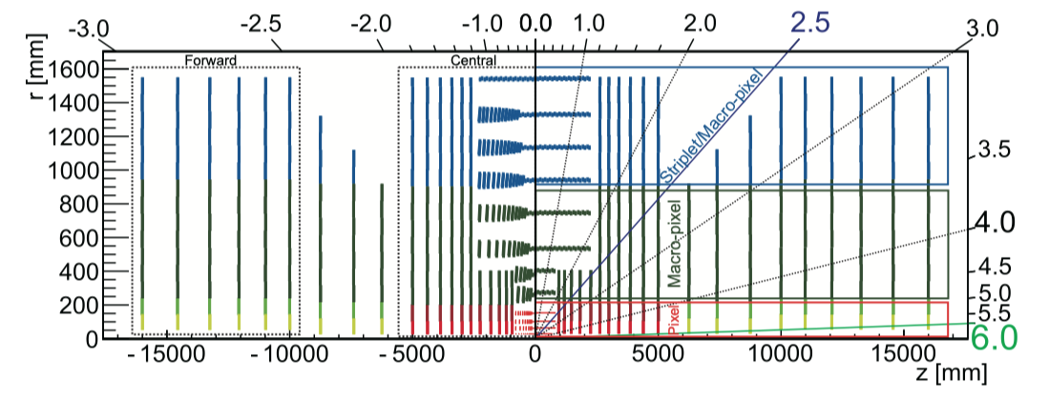
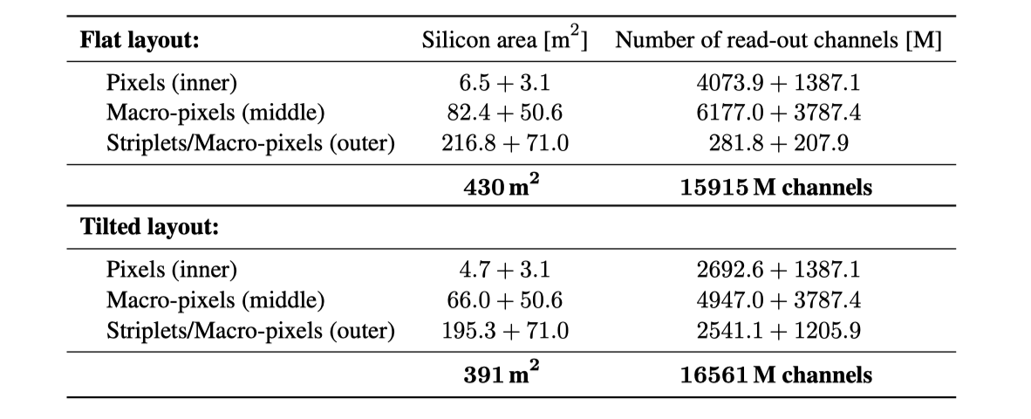
Tracker Numbers

Slide 37
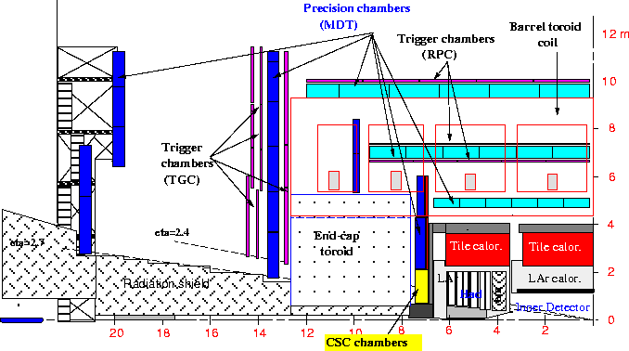
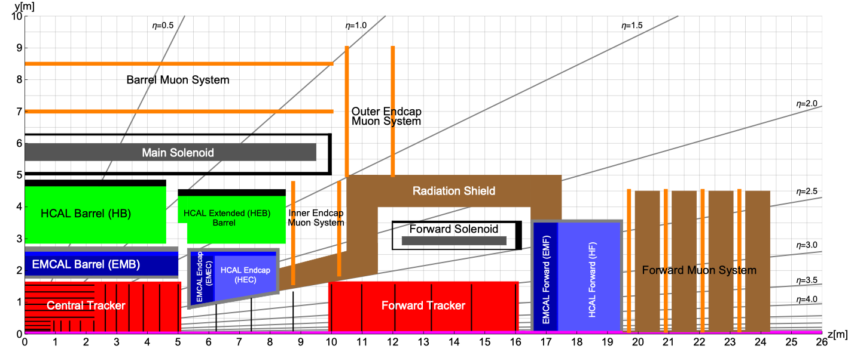
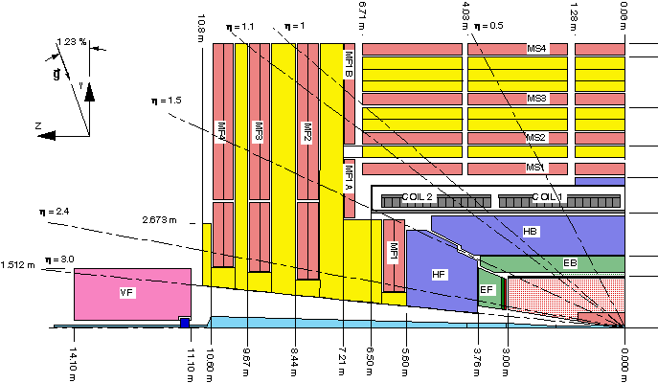
Comparison to ATLAS & CMS
FCC-hh reference detector
similar to size similar to ATLAS

Slide 38
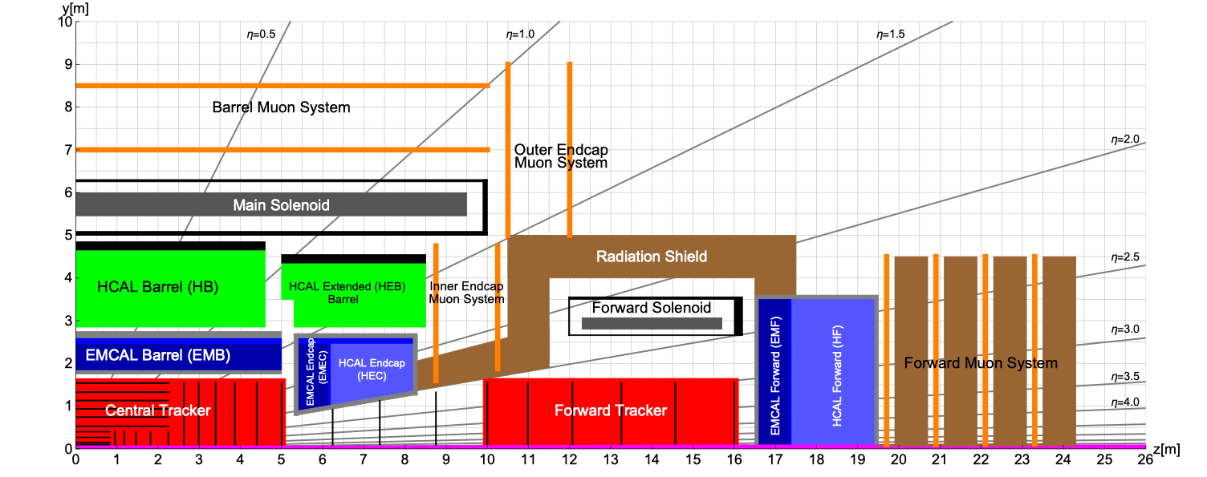
FCC-hh Reference Detector
50m long, 20m diameter
Cavern length 66m
L* of FCC 40m.
90% of ‘heavy‘ physics will take place in η<2.5.
Increase of acceptance for precision spectroscopy and calorimetry from 2.5 at LHC to 3.8-4 for SM physics.
Calorimetry and tracking up to η=6 to have sufficient acceptance for VFB jets

Slide 39
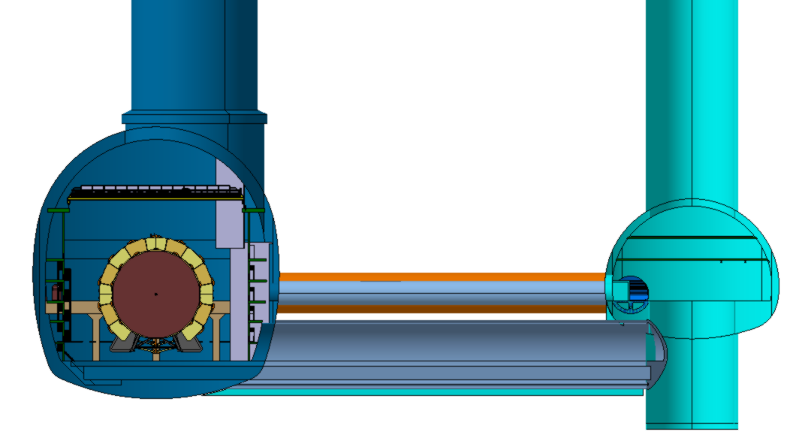
Service Cavern
Distance of 50m
civil engineering (separate object, no pillar)
Radiation shielding (10-15m might be sufficient)
stray field reduction
Detector Cavern
Service Cavern
Trigger Latencies: 100m propagation time = 0.5 us. ATLAS/CMS Phase-II L1 latency is 10us → No issue.

Slide 40
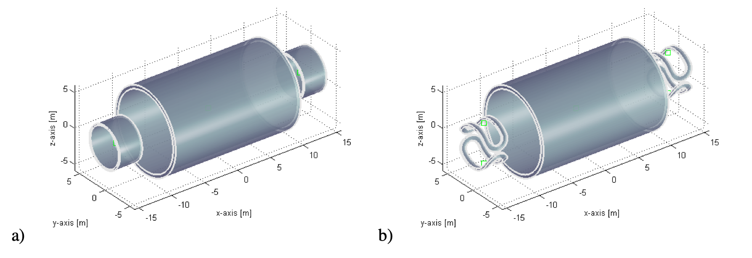
Magnet System
Central Solenoid + 2 Forward Solenoids
Central Solenoid + 2 Forward Dipoles

Slide 41
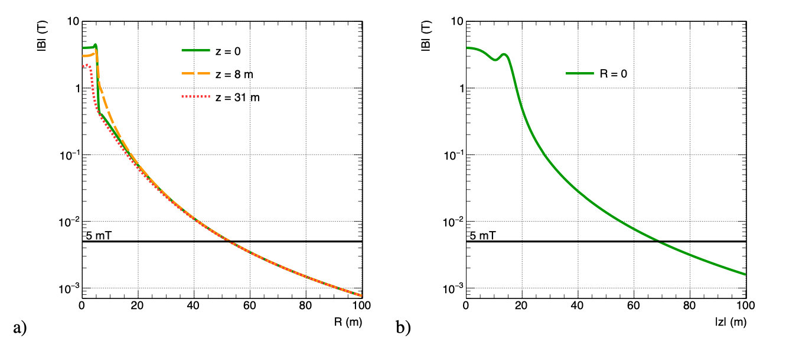
Stray Field
200-300mT outside the detector.
Less than 5mT in the service cavern.
→ This allows the use of standard equipment (pumps, motors, turbines …)

Slide 42
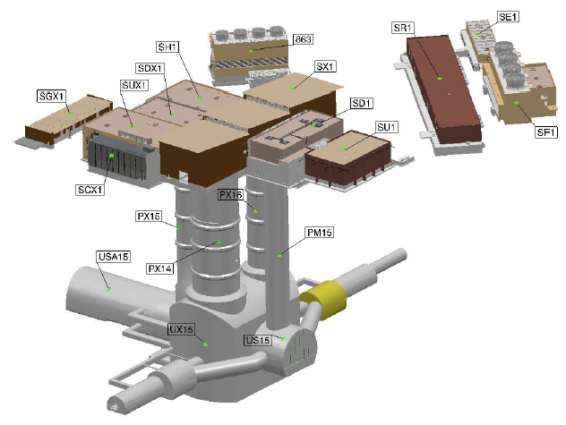
ATLAS
12.6m diameter
18m diameter
35m
50m
30m

Slide 43
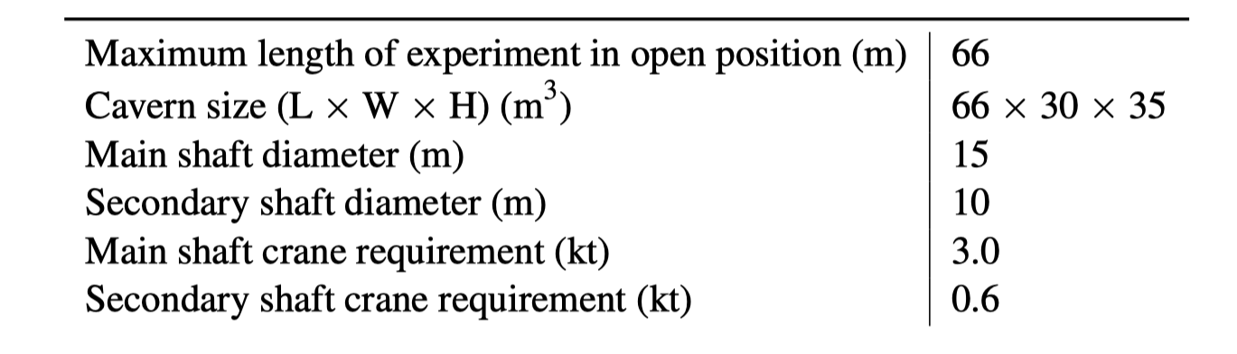

Requirements for FCC-hh (CDR)

Slide 44
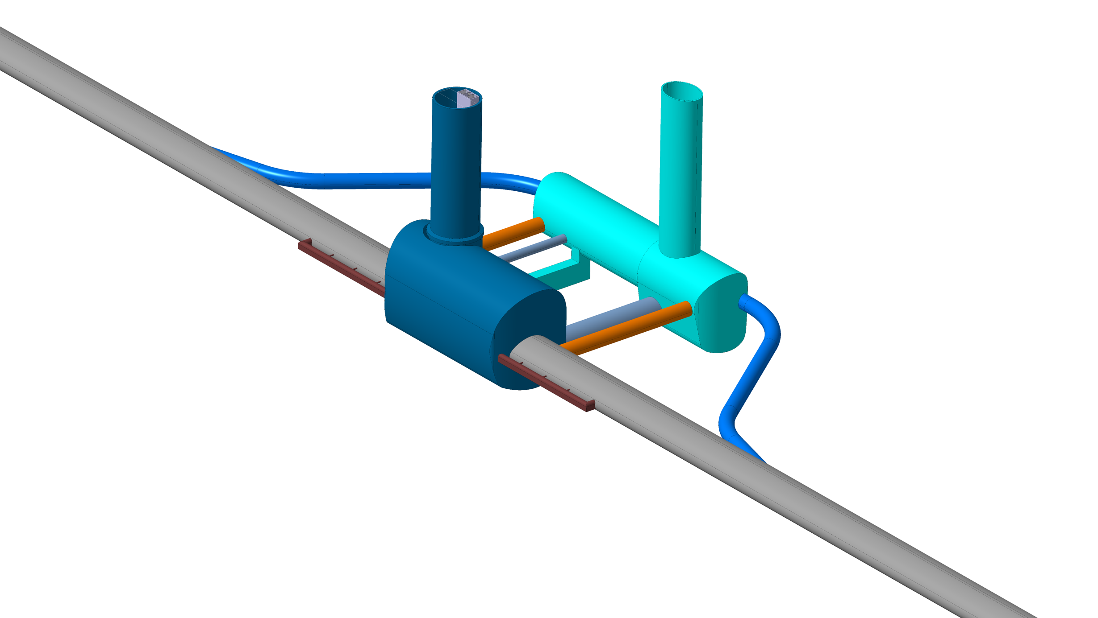

27.09.2022
F. Valchkova-Georgieva
  FCC Experiment Underground Structure version 2022
Experimental Shaft ø18m
Elliptical Service Shaft
Evacuation
connection tunnel
Service Cavern
Connection tunnel ø 5.5m
Experiment Cavern
Machine tunnel
Survey Galleries
Connection tunnel ø 5.5m
Connection tunnel ø 10m

Slide 45
27.09.2022
F. Valchkova-Georgieva
  FCC Experiment Underground Structure version 2022
Experimental Shaft ø18m
Elliptical Service Shaft
Evacuation
connection tunnel
Service Cavern
Connection tunnel ø 5.5m
We consider one shaft (15m clearance) to the experiment cavern to be sufficient.
The largest part on the ‘away’ side is the forward solenoid, which can pass to the shaft side.
CMS installed their detector in the same configuration.
Machine tunnel

Slide 46

27.09.2022
F. Valchkova-Georgieva
  FCC Experiment Underground Structure version 2022
Experimental Shaft ø18m
Elliptical Service Shaft
Evacuation
connection tunnel
Service Cavern
Connection tunnel ø 5.5m
We do not consider the CMS strategy of assembling the the detector on the surface.
It is not an option for the FCC-hh reference detector.
It might be a possibility for other detector types, but it is one of many possibilities, not a priori the preferred one.
Machine tunnel
CMS shaft ø20.5m

Slide 47
Detectors for FCC-ee
CLD
IDEA
Typically similar size to LEP detectors, of course with much more performant sensors.

Slide 48
Conclusion
For detector construction, classical metrology techniques are used in order to control construction tolerances etc.
After installation of the detector elements, the reference points on the detectors are measured w.r.t. the cavern survey network to a precision of 0.5-1mm.
The survey measurements are either used to align the detector to nominal position or to implement the know position in the detector simulation.
Precise alignment of the detector elements is done using tracks B on/B off/ Cosmics.
External reference measurements are typically used for monitoring of the stability or for referring the variations of the positions to given reference alignment.
Making sure that all positioning modes are properly aligned is tedious and depends on the specific geometry and track distribution (weak modes).
Novel detector concepts using e.g. bent silicon wavers differ from the ‘classic’ flat surface elements.
Future detectors at the FCC have a size, layout and cavern infrastructure that does not differ significantly from the LHC detectors and caverns. Channel number, radiation load, data rate are a big challenge.

