Slide 1
ATLAS Cavern Deformation
Nearly 20 years of geodetic monitoring
Presentation: Witold NIEWIEM BE/GM/ESA
Project: Dirk MERGELKUHL, Witold NIEWIEM, Jean-Christophe Gayde
02.11.2022

Slide 2
Subject of the presentation
Cavern shape is dynamic and it is important to monitor its evolution
Why do we monitor the caver?
Methodology of measurements
Floor vertical and horizontal movements
Wall perpendicular movements
What is a lesson for surveyors?

Slide 3
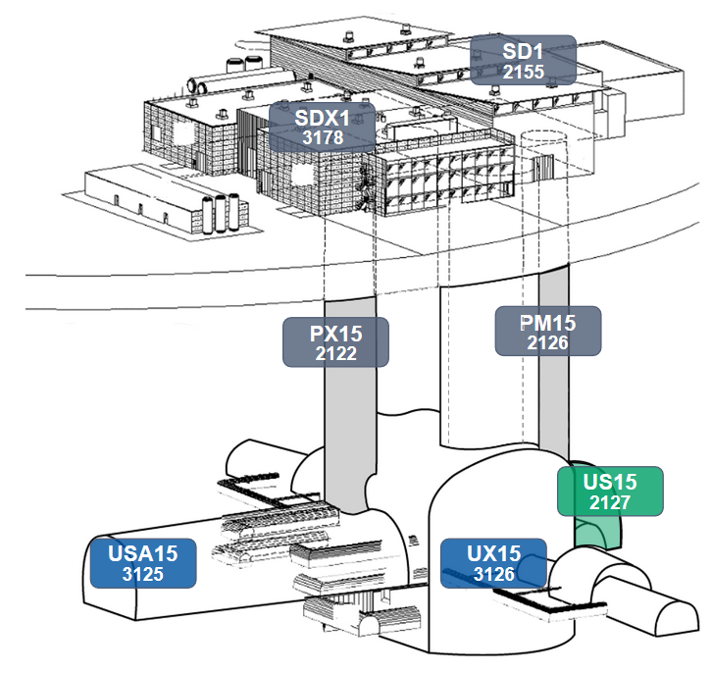
Object of monitoring
  35 m
  7000 t
~100 m
  53 x 30 m
  Earth pressure

Slide 4





Motivation of cavern monitoring
  Accuracy requirements
  Future project and upgrade
  Safety of underground cavern
  Detector ageing
  Mechanical adjustment design

Slide 5
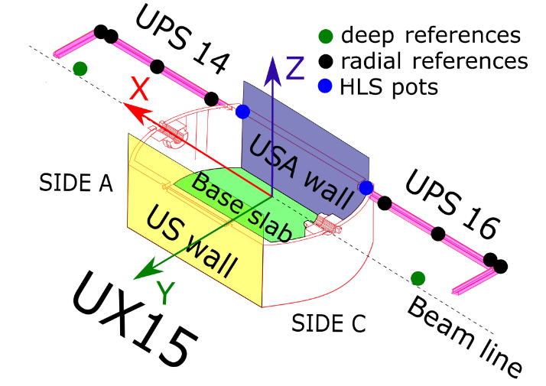
Network and equipment
  Important aspects of measurement methodology:
  Survey monuments
  Coordinates system
  Datum and deep references
  Technique evolution

Slide 6
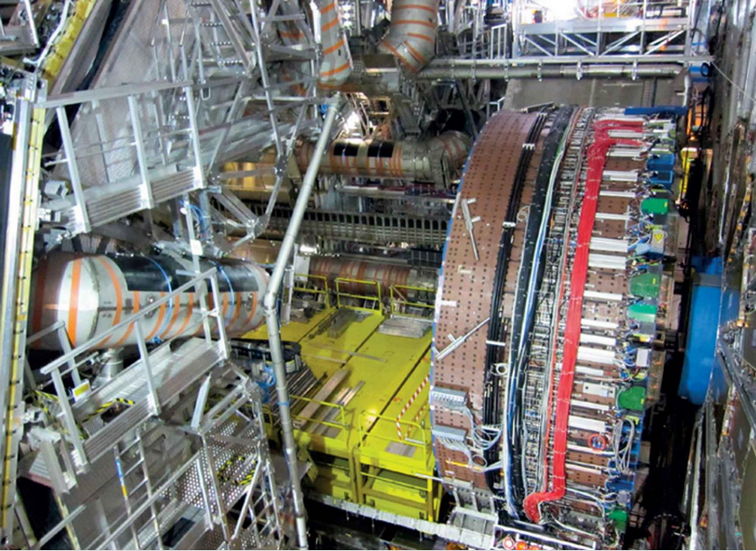
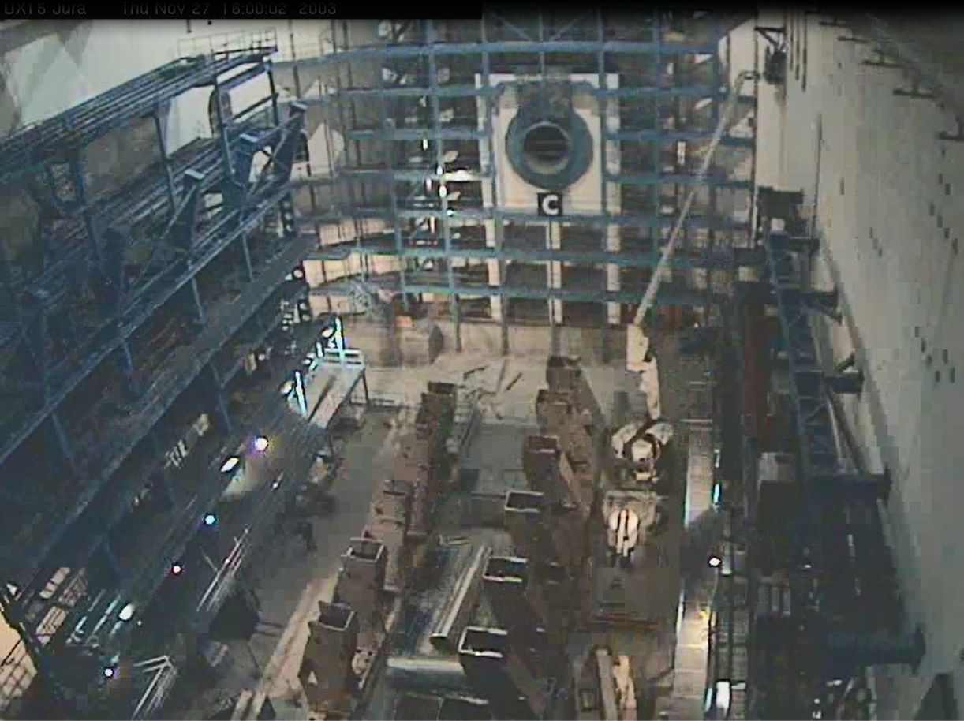
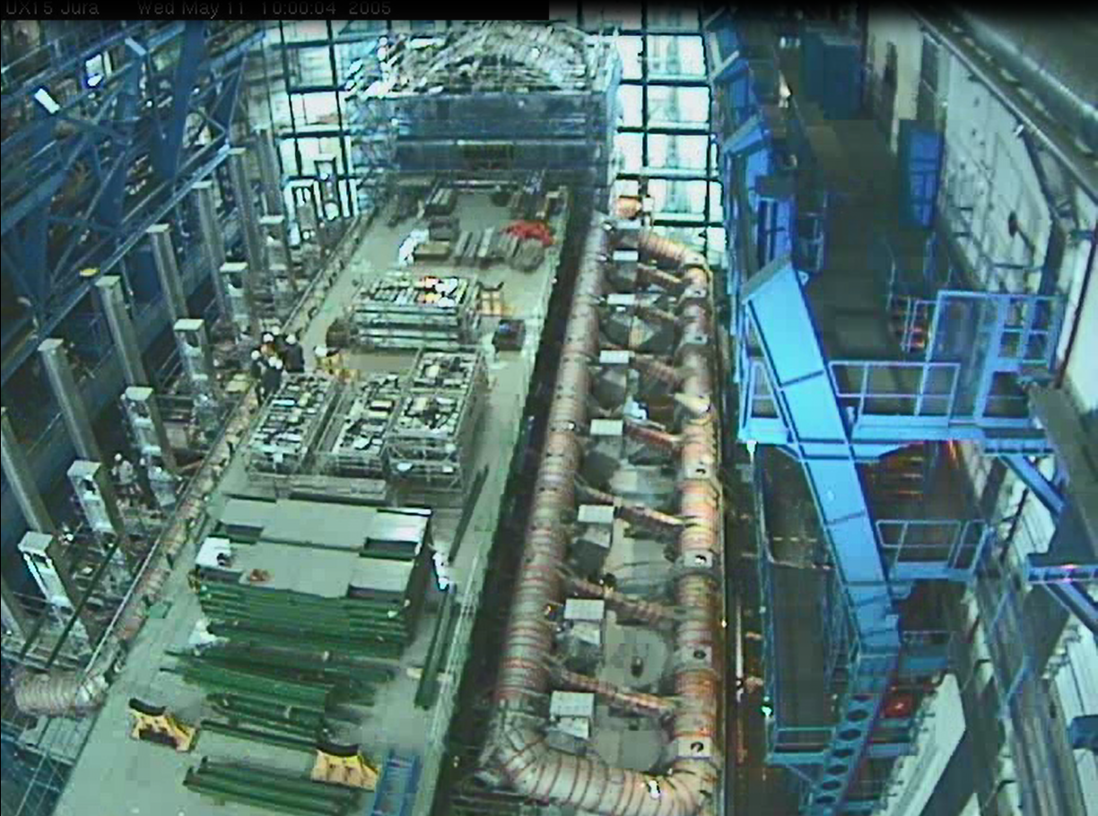
The civil engineering predictions
  ATLAS base slab movements:
  2.0 mm down before ATLAS installation
  5.5 mm down due to ATLAS installation
  1.0 mm/year up caused by ground pressure
  < 1.0 mm/year up to stabilisation period

Slide 7
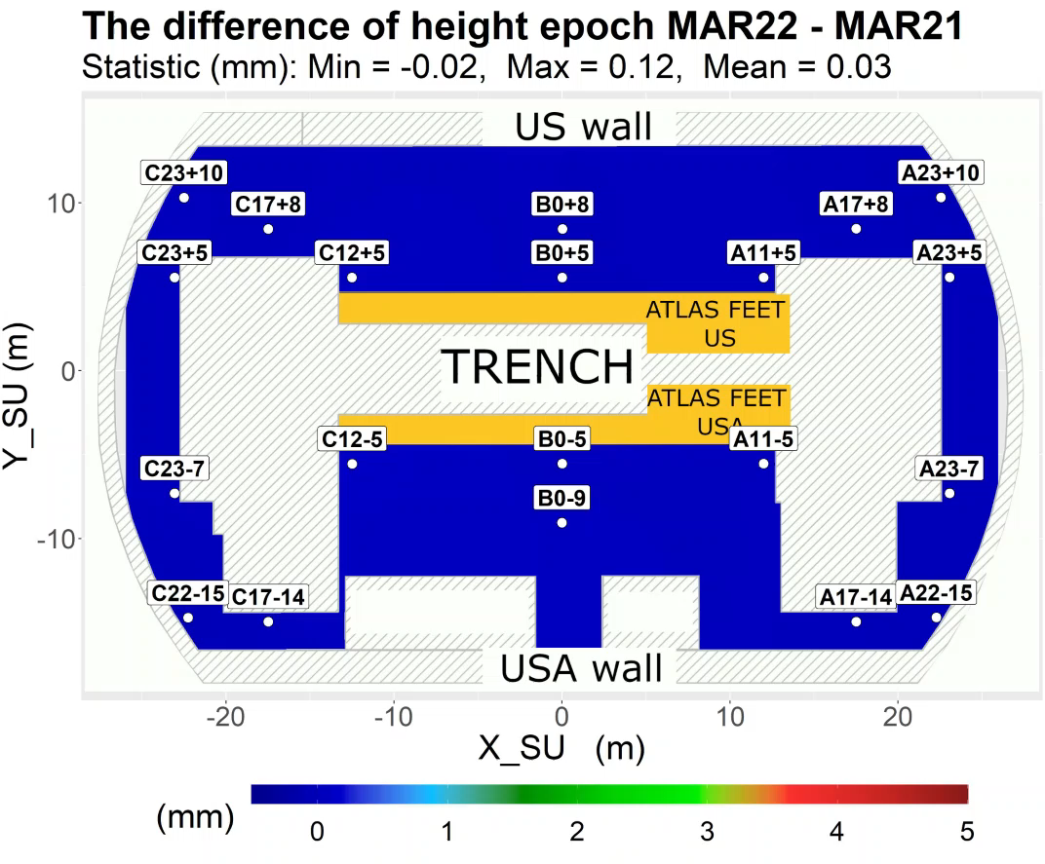
Base slab vertical movement

Slide 8
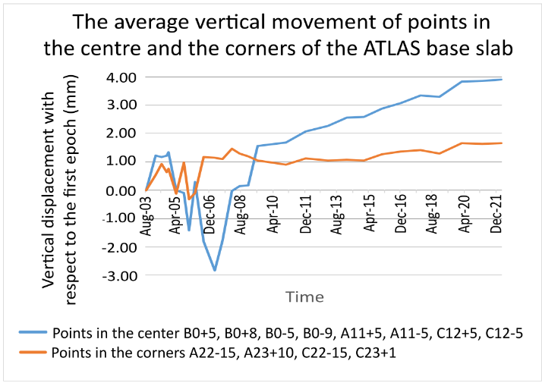
Base slab vertical movement - Centre and corners

Slide 9
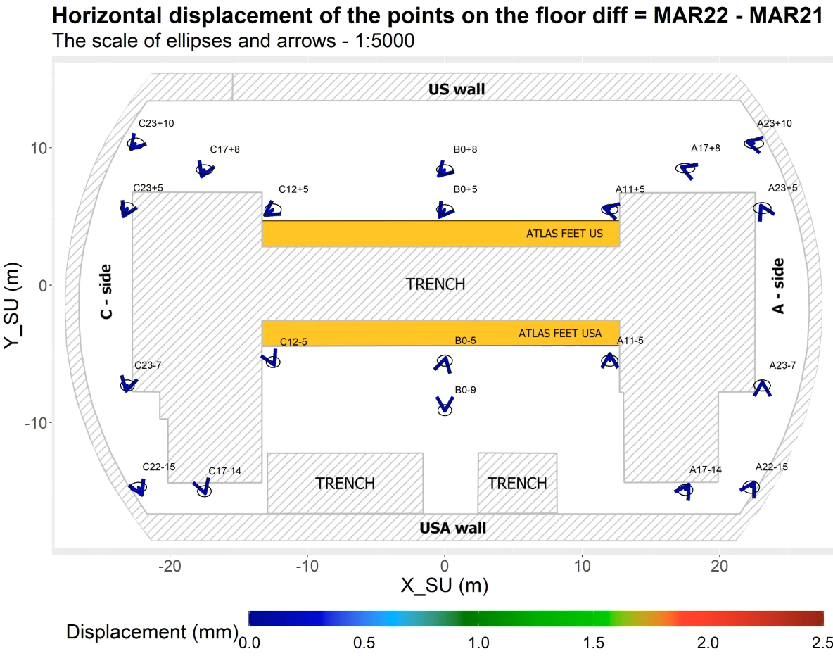
Base slab horizontal movement

Slide 10
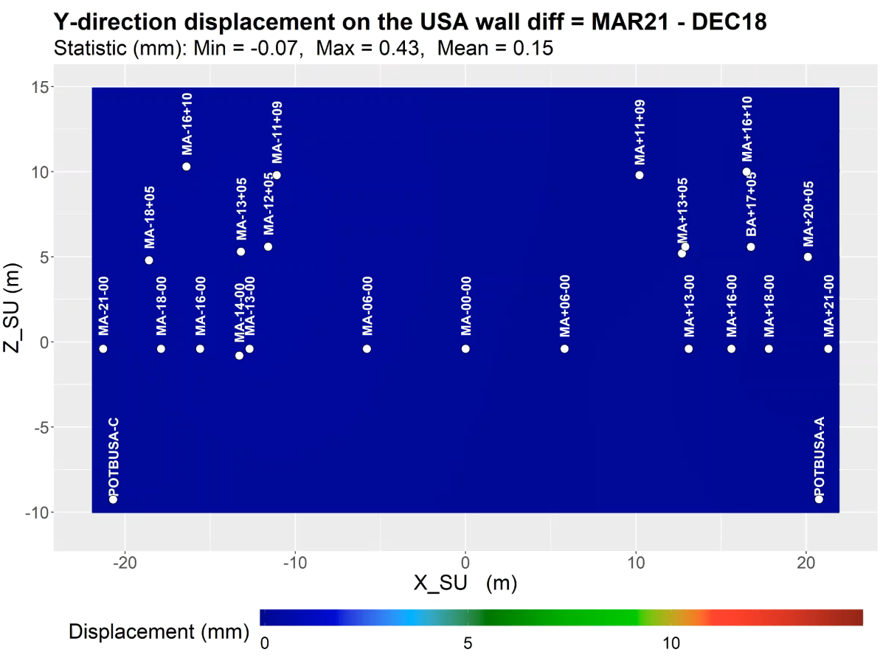
Wall perpendicular movement

Slide 11



Lessons for future measurement
  Unavoidable reference network adaptation
Measurement not only for construction follow-up and adjustment
  No effective absolute reference over 20 years

Slide 12
Conclusion
Why is the monitoring?
Safety and effectiveness of the ATLAS detector
What are the cavern movements?
5.0 mm heave in the center over 20 years
0.15 mm/year heave from 2009 on
14.6 mm max displacement of the wall
What is the lesson learned?
Stability of reference points and conception change

Slide 13
Witold Niewiem | ATLAS Cavern Deformation

