Slide 1
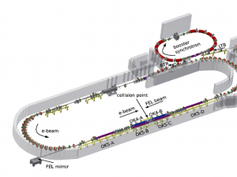
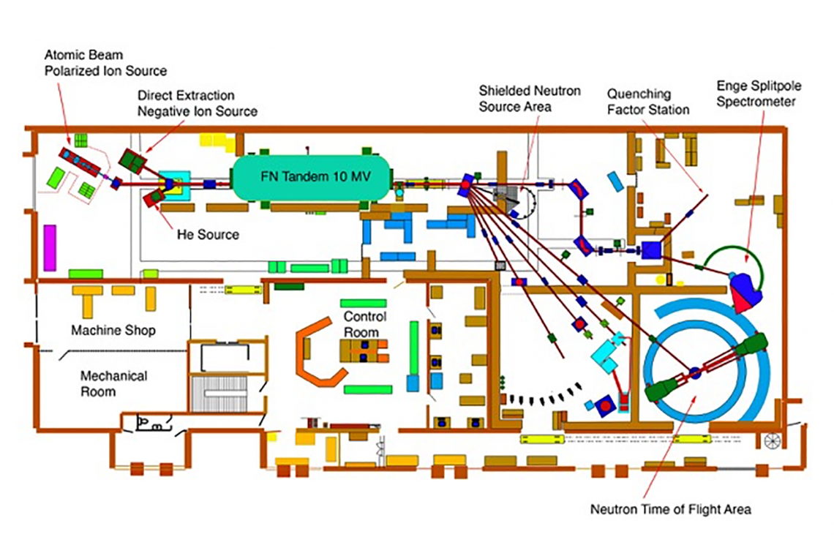
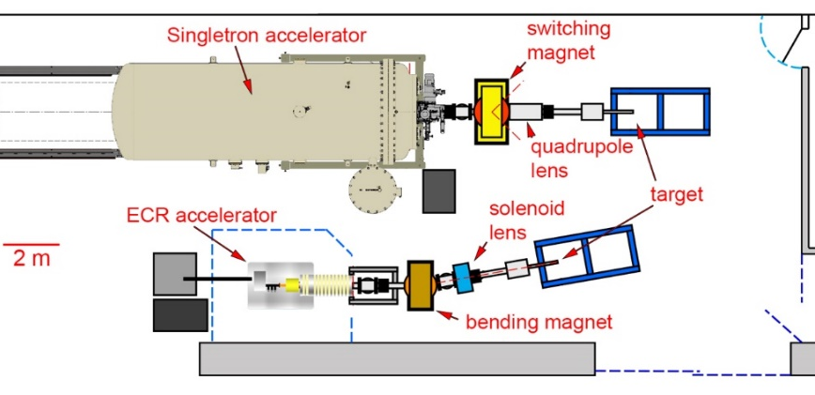
A NEW ALIGNMENT PROVISION FOR LENA’S 240 KeV ECR ACCELERATOR AT DUKE UNIVERSITY
Mark Emamian, Duke Free Electron Laser Laboratory (FELL)
Thomas Chappelo, Laboratory for Experimental Nuclear Astrophysics (LENA)
A Brief Report on Accelerator Facilities at Duke University:
1. Triangle Universities Nuclear Laboratory (TUNL), 10 MeV Tandem Accelerator
2. Duke Free Electron Laser Laboratory (FELL), 1 GeV Electron Storage Ring
3. Laboratory for Experimental Nuclear Astrophysics (LENA)
a. 2 Mev Singletron Accelerator
b. 240 Kev Electron Cyclotron Resonator (ECR) Accelerator
Free Electron Laser Laboratory (FELL)
Laboratory for Experimental Nuclear Astrophysics (LENA)

Slide 2
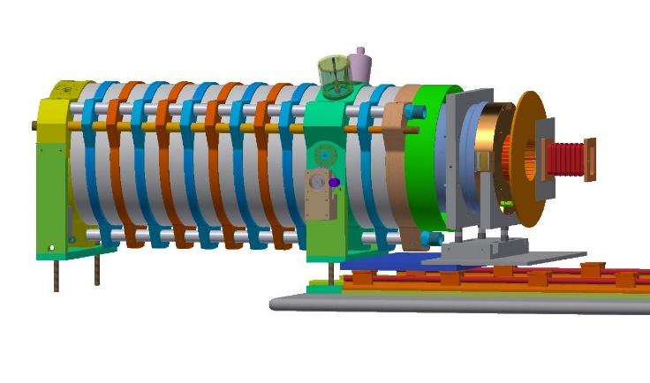
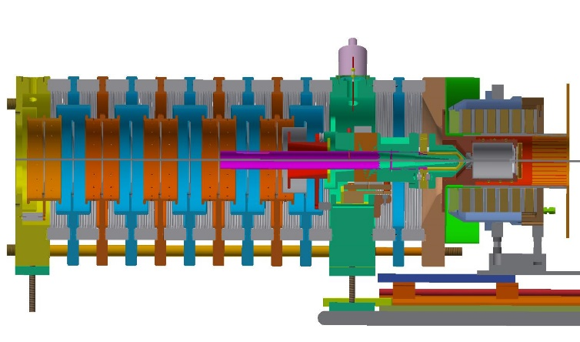

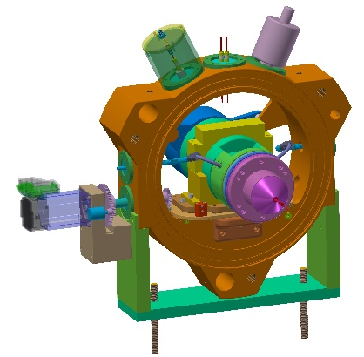
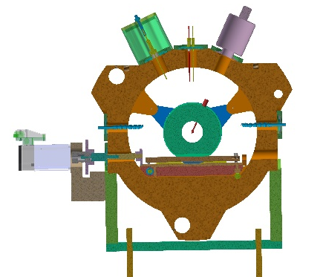
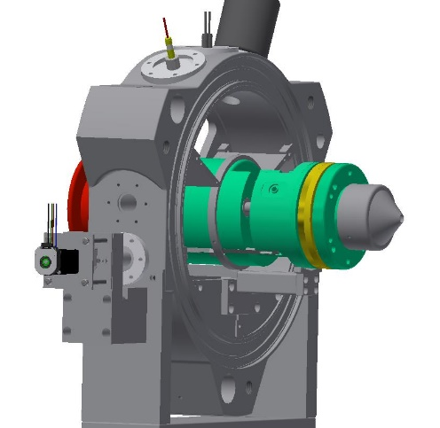
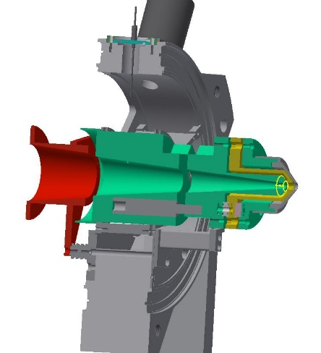
A NEW ALIGNMENT PROVISION FOR LENA’S 240 KeV ECR ACCELERATOR AT DUKE UNIVERSITY
Mark Emamian, Duke Free Electron Laser Laboratory (FELL)
Thomas Chappelo, Laboratory for Experimental Nuclear Astrophysics (LENA)
The Electron Cyclotron Resonator (ECR) ion accelerator is housed at the Duke University’s Laboratory for Experimental Nuclear Astrophysics (LENA) and can produce beam energies of up to 240 keV at the target. Alignment procedure and detailed design of this ECR ion accelerator was presented in the IWAA conference in Grenoble, France. Since then, a new design provision for the beam extraction section of the accelerator was implemented for ease of alignment and operation. In this report, the survey and alignment procedure for this modified beam extraction section will be presented in detail.
Extraction System
Beam Direction
3D Model of ECR Column (left) and the Cross Section View (Right)
ECR consists of a plasma chamber into which 2.45 GHz microwave power is injected through a tapered waveguide, a surrounding solenoidal magnet array, and ion extraction and focusing electrodes, which shape the beam and transport it to the accelerator column.
Laboratory for Experimental Nuclear Astrophysics (LENA)
Stepper Motor to Move the Extraction System in the Beam Direction
Yaw Adjustments Screws
Retaining Ring
Extraction System
Extraction System
Beam Direction
Roll, Pitch & Height Adjustments Screws
Linear Ball Bushing
Rack & Pinon Gear Mechanism
Extraction System’s Alignment Cradle
and its Adjustment Provisions
Isometric View of the Extraction System
and its Kinematic Mount Mechanism
Alignment Mechanism for the ECR Extraction System
3D View of the Extraction System
With its New Kinematic Mount Alignment Mechanism
Cross Section Front View of the Extraction System
With its New Kinematic Mount Mechanism

