Slide 1
Structured Laser Beam In
Non-Homogeneous Environment
Krystof Polak^{1,3}, Jean-Christophe Gayde¹, Miroslav Sulc^{2,3}
2.11.2022
¹CERN – European Organization for Nuclear Research, Switzerland
²IPP – Institute of Plasma Physics of the Czech Academy of Sciences, Czech Republic
³TUL – Technical University of Liberec, Czech Republic

Slide 2
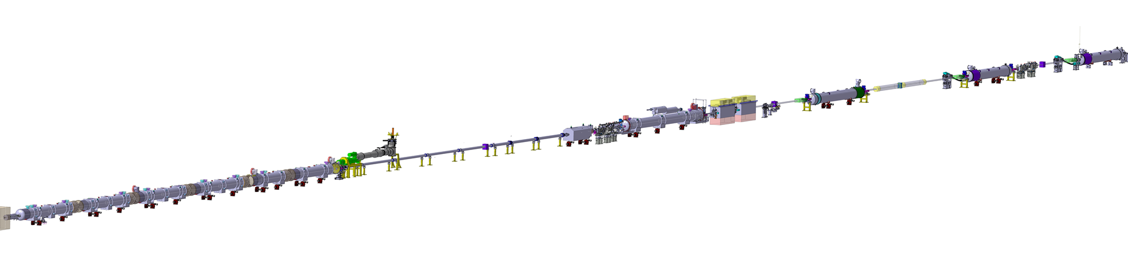
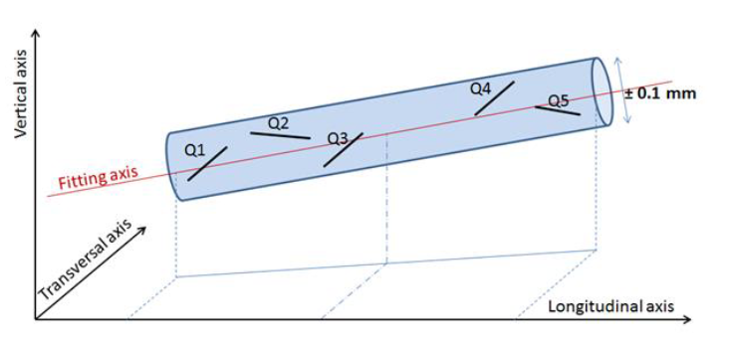
Alignment of Particle Accelerators
SLB offers hope to create a laser beam based optical alternative for long distance alignment systems
Presently Hydrostatic Leveling Systems and stretched Wire Positioning Systems are used for monitoring
In the particle accelerators, high accuracy is required for the alignment of adjacent components
Typical alignment requirements for accelerators at CERN:
  LHC: σ = 150 µm over L = 150 m
  HL-LHC: σ = 150 µm over L = 200 m
  CLIC: σ = 15 µm over L = 200 m
Radius = σ
High Luminosity LHC (~200 m)
Alignment window L

Slide 3
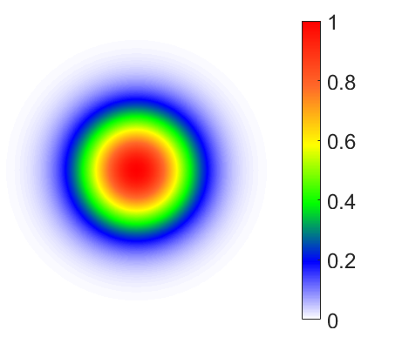
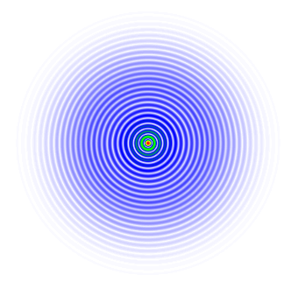
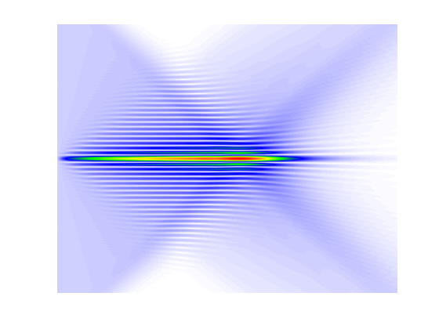
Basics about optical beams
An optical beam is a special bounded form of the light propagating with a small divergence
Gaussian beam
  Small focus
  Significantly divergent
Bessel beam
  Long longitudinal focus
  Limited longitudinal range
  Zero divergence
Thin Lens
Gaussian beam
Focus
Plane wave
Axicon

Slide 4
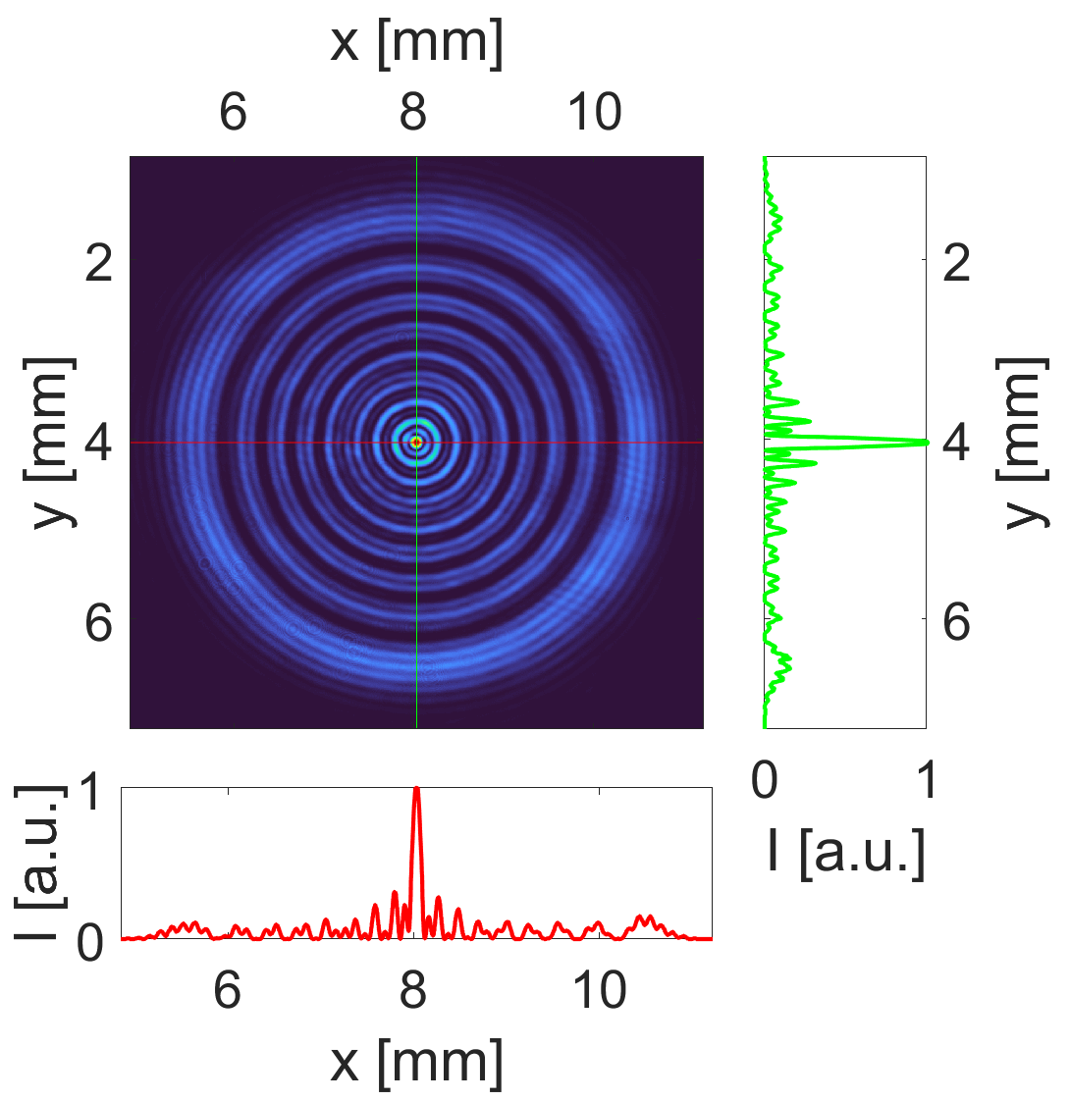
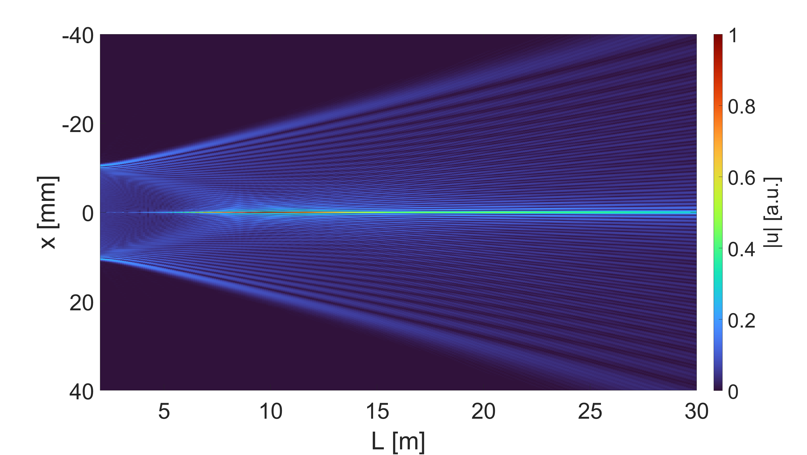
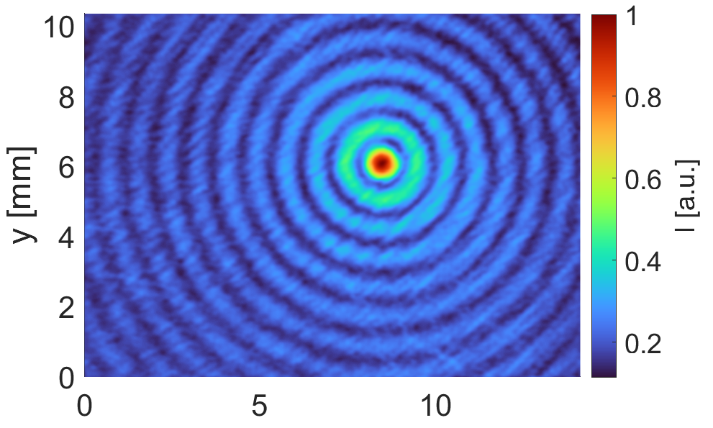
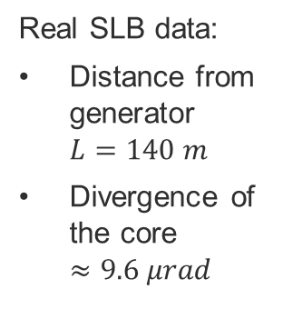
Introduction to SLB
Pseudo non-diffractive optical beam
Combines the properties of a Gaussian beam and a Bessel beam
Very bright central core, sharp boundary of the core, small divergence, propagating theoretically at infinite distance (tested on 900 m), etc.
Real SLB data:
Distance from generator $L=140 m$
Divergence of the core $≈9.6 μrad$

Slide 5
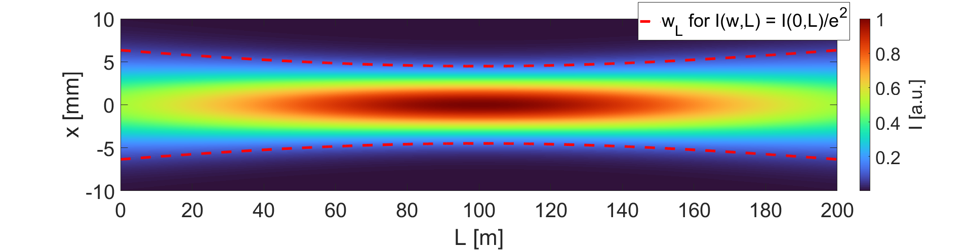
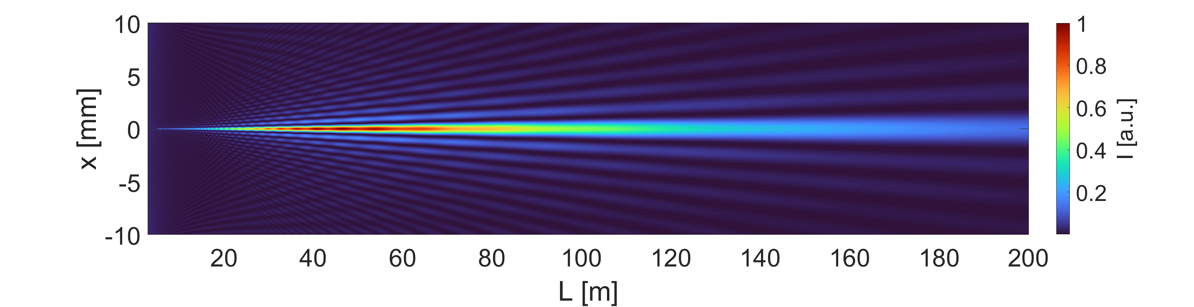
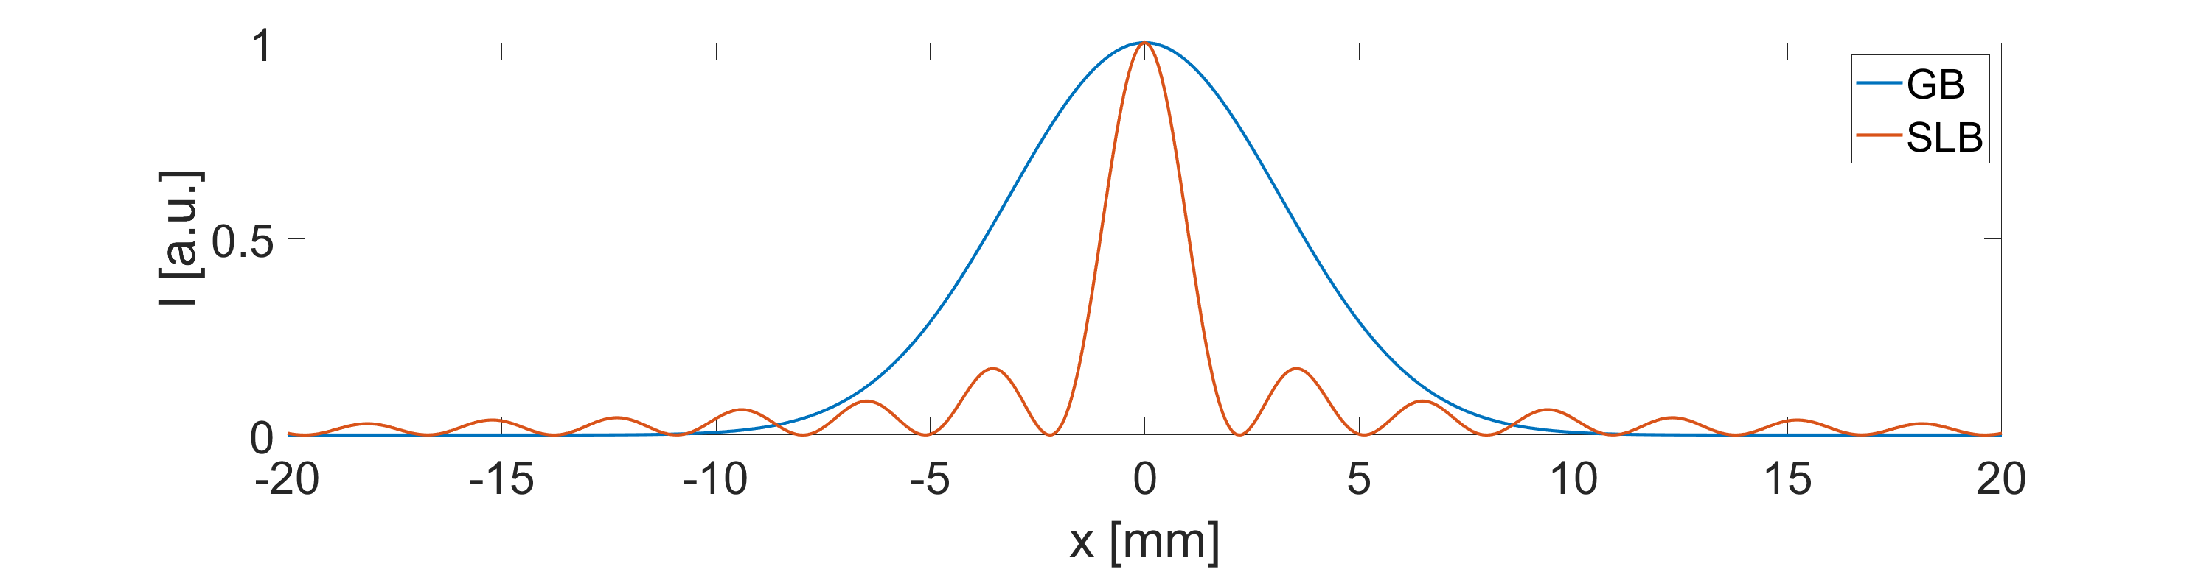

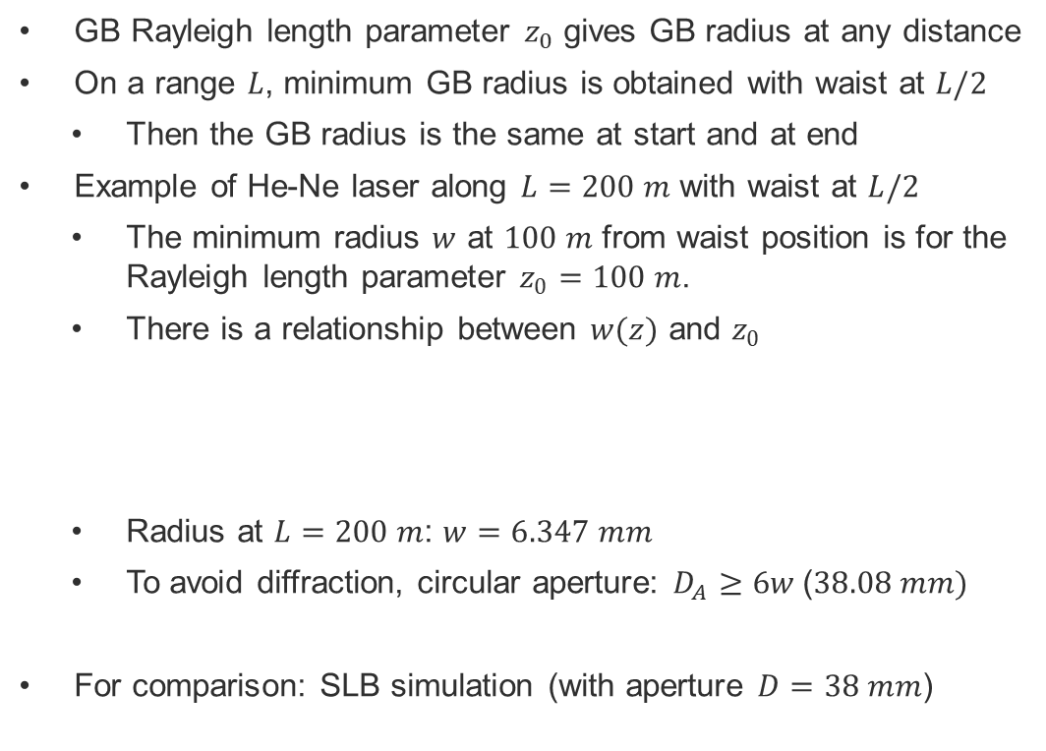
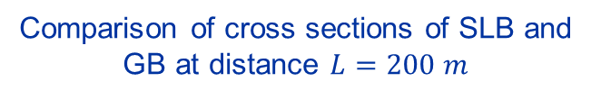
Comparison of SLB and GB
Longitudinal profile of GB
GB Rayleigh length parameter $z_{0}$ gives GB radius at any distance
On a range $L$, minimum GB radius is obtained with waist at $L/2$
  Then the GB radius is the same at start and at end
Example of He-Ne laser along $L=200 m$ with waist at $L/2$
  The minimum radius $w$ at $100 m$ from waist position is for the Rayleigh length parameter $z_{0}=100 m$.
  There is a relationship between $w(z)$ and $z_{0}$
  Radius at $L=200 m$: $w=6.347 mm$
  To avoid diffraction, circular aperture: $D_{A}≥6w$($38.08 mm)$
For comparison: SLB simulation (with aperture $D=38 mm$)
Longitudinal profile of SLB
$$w\left(z\right)=\sqrt{\frac{λ}{π}\left(z_{0}+\frac{z^{2}}{z_{0}}\right)}$$
Comparison of cross sections of SLB and GB at distance $L=200 m$
SLB - long range propagation and low central core divergence - looks well suited for long range alignment systems
However, its straightness must be considered carefully

Slide 6
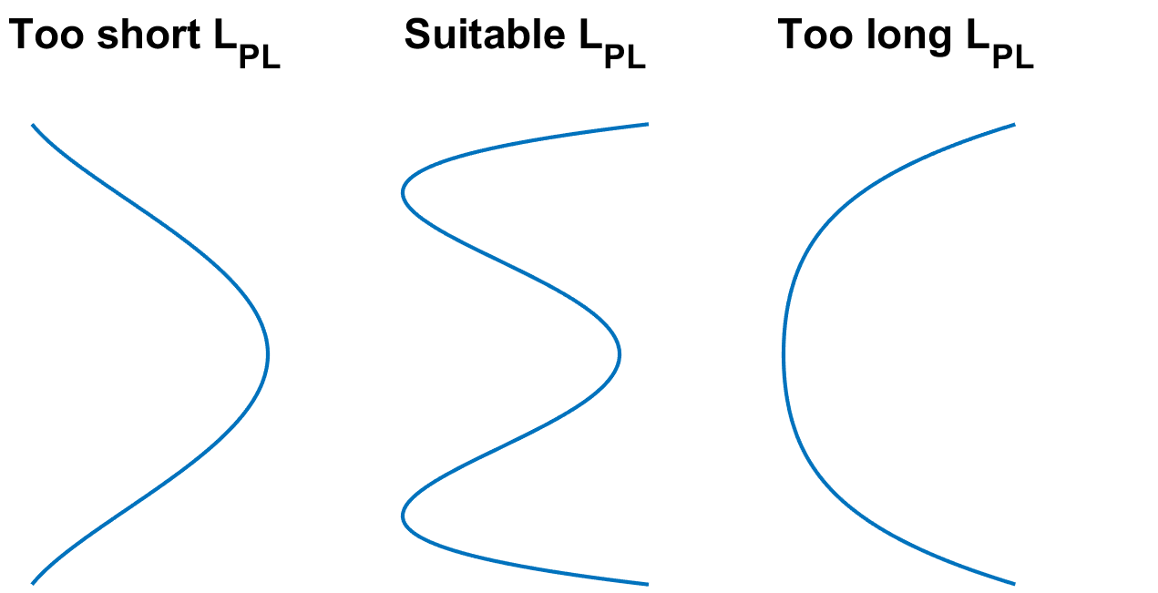
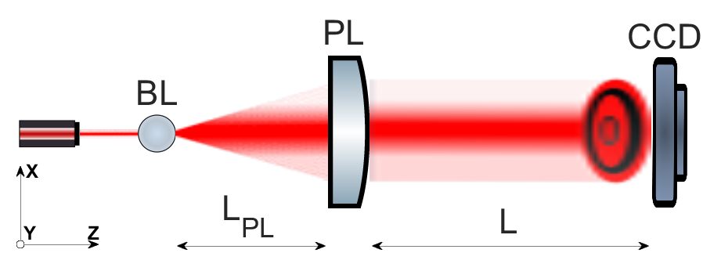
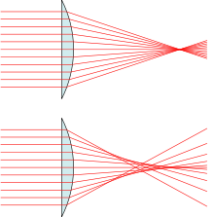
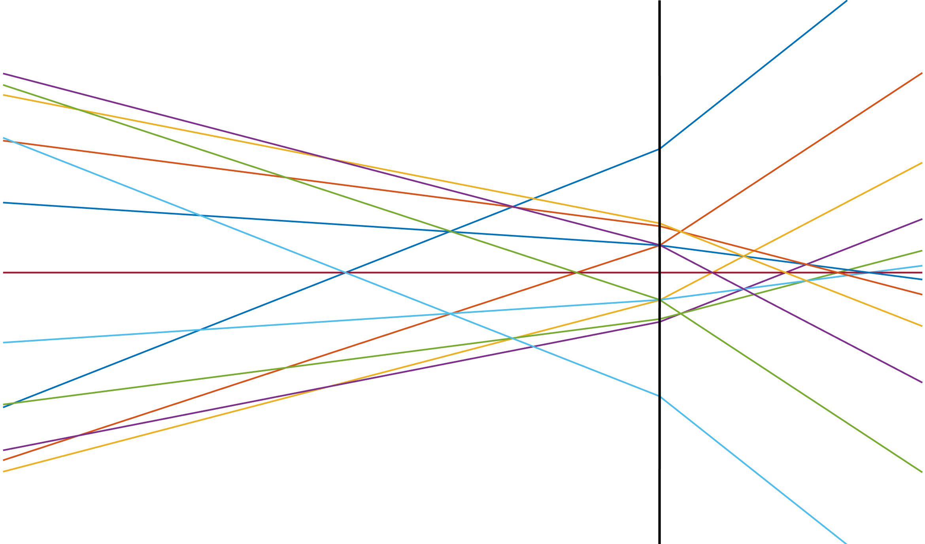



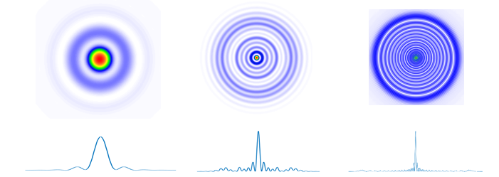
SLB generation principle
Combination of two optical aberrations, namely defocus and spherical aberration.
Wavefront shape condition for infinity range SLBs
Different shapes of SLB in suitable range
source: Wikipedia
Spherical aberration

Slide 7
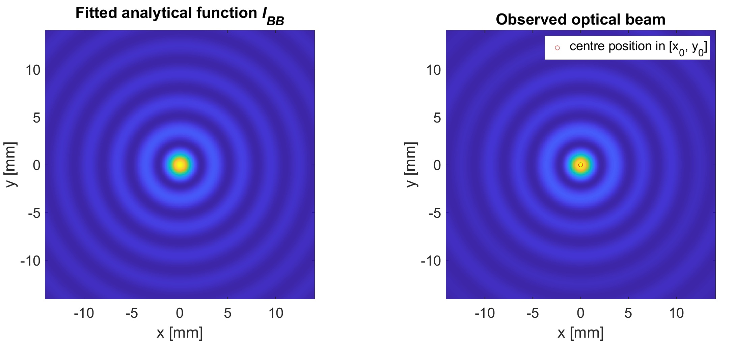
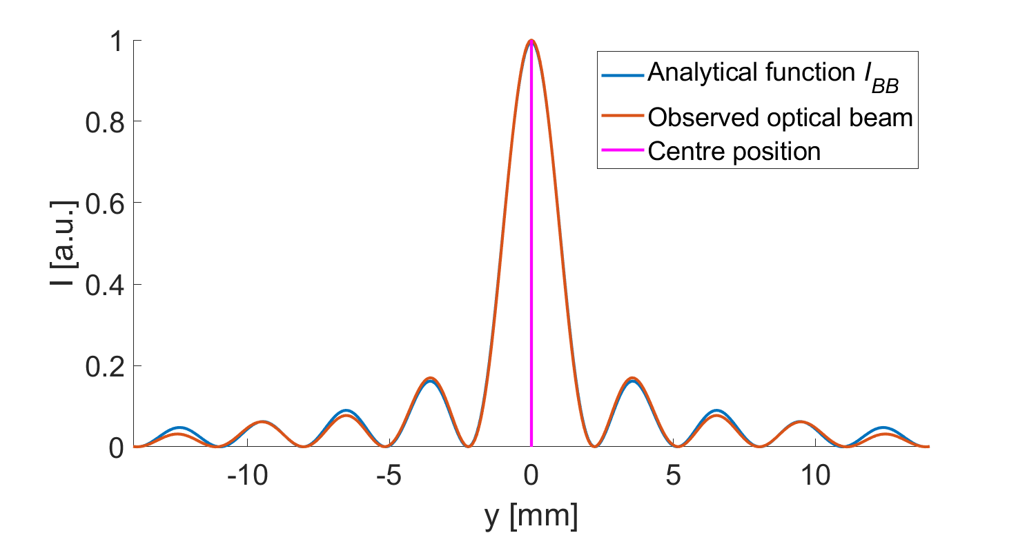
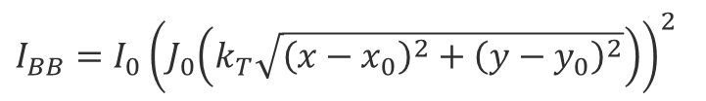

Detection of the SLB centre position
Significant similarity between SLB and BB
Analytical function of BB optical intensity distribution
4 unknown parameters ($I_{0}$, $k_{T}$, $x_{0}$ and $y_{0}$) are calculated for best fitting surface
Parameters $x_{0}$ and $y_{0}$ are the coordinates of the SLB centre position
$I_{BB}=I_{0}{\left(J_{0}\left(k_{T}\sqrt{{\left(x−x_{0}\right)}^{2}+{\left(y−y_{0}\right)}^{2}}\right)\right)}^{2}$

Slide 8


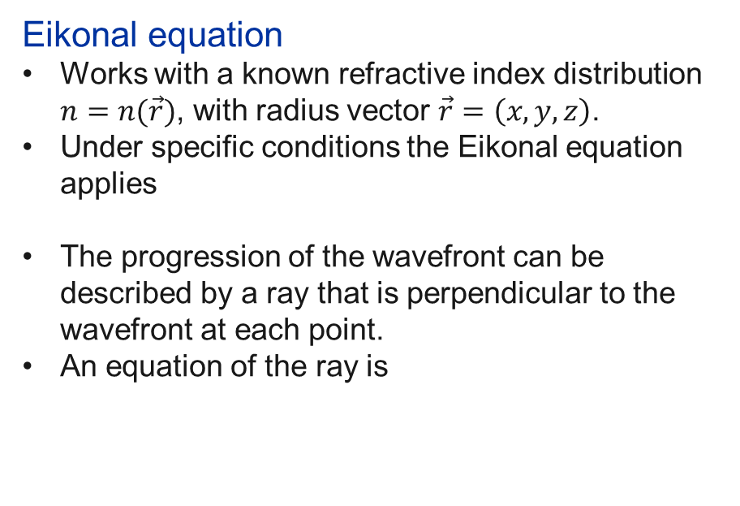






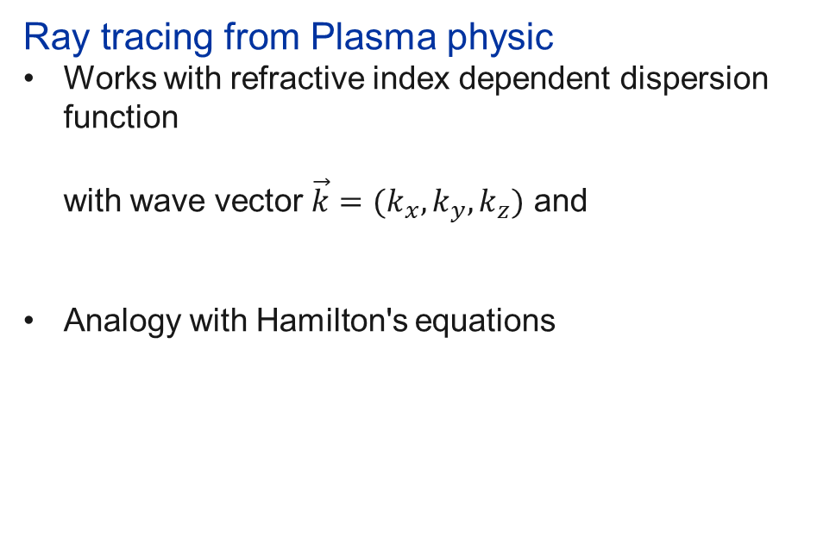

Conventional light tracing methods in non-homogeneous environments
Eikonal equation
Works with a known refractive index distribution $n=n(\vec{r})$, with radius vector $\vec{r}=\left(x,y,z\right)$.
Under specific conditions the Eikonal equation applies
The progression of the wavefront can be described by a ray that is perpendicular to the wavefront at each point.
An equation of the ray is
Ray tracing from Plasma physic
Works with refractive index dependent dispersion function
with wave vector $\vec{k}=(k_{x},k_{y},k_{z})$ and
Analogy with Hamilton's equations
$$Θ\left(\vec{r},\vec{k}\right)=k−k_{0}n(\vec{r})$$
$${\left(∇S\right)}^{2}=n^{2}$$
$$k=\sqrt{k_{x}^{2}+k_{y}^{2}+k_{z}^{2}}$$
$$S\left(\vec{r}\right)=constant$$
$$\vec{k}$$
$$\frac{d\vec{r}}{ds}=\frac{∂Θ}{∂\vec{k}}$$
$$s\left(\vec{r}\right)$$
$$\frac{d}{ds}\left(n\frac{d\vec{r}}{ds}\right)=∇n$$
Path of the wavefront
$$\frac{d\vec{k}}{ds}=−\frac{∂Θ}{∂\vec{r}}$$
Path of the ray
Both approaches provide the same solutions
In both cases, the result is the trajectory of the ray. However, information about the optical intensity distribution is not obtained.

Slide 9
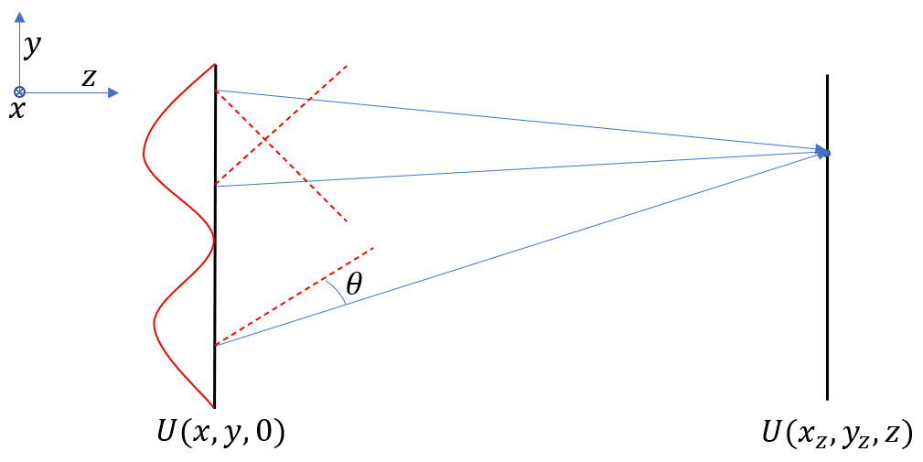



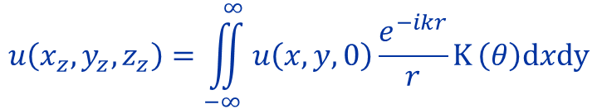
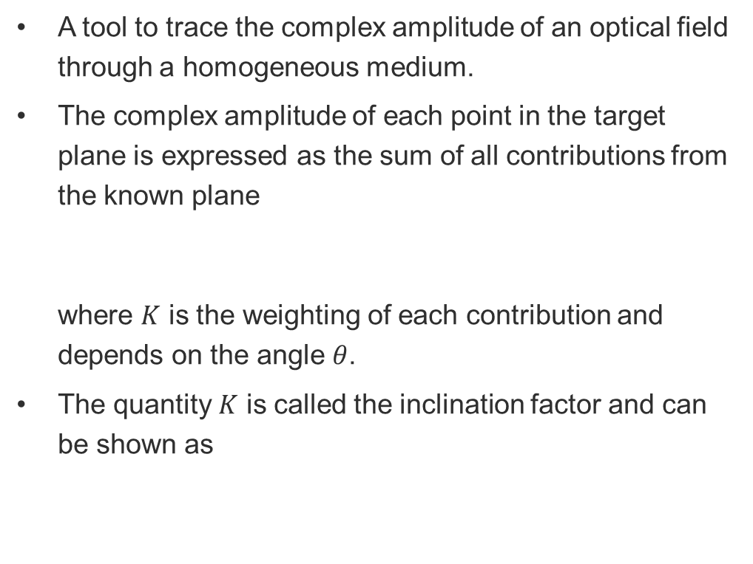






Diffraction integral
$$\tilde{y}$$
$$y$$
A tool to trace the complex amplitude of an optical field through a homogeneous medium.
The complex amplitude of each point in the target plane is expressed as the sum of all contributions from the known plane
where $K$ is the weighting of each contribution and depends on the angle $θ$.
The quantity $K$ is called the inclination factor and can be shown as
$$\tilde{x}$$
$$x$$
$$r$$
$$θ$$
$$u(x,y,0)$$
$$u(x_{z},y_{z},z)$$
General aperture
$$u\left(x_{z},y_{z},z_{z}\right)=\iint_{−∞}^{∞}{u\left(x,y,0\right)\frac{e^{−ikr}}{r}K}\left(θ\right)dxdy$$
$$K\left(θ\right)=\frac{i}{λ}\cos{θ}$$

Slide 10
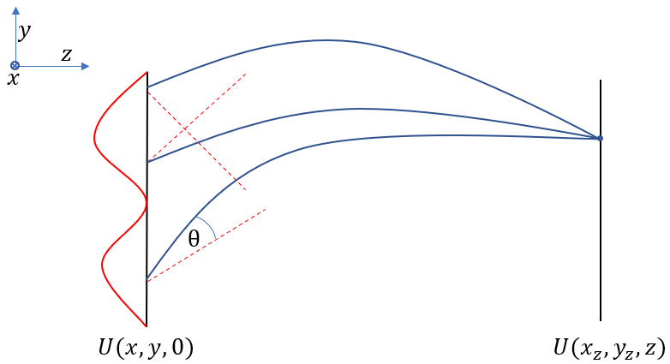
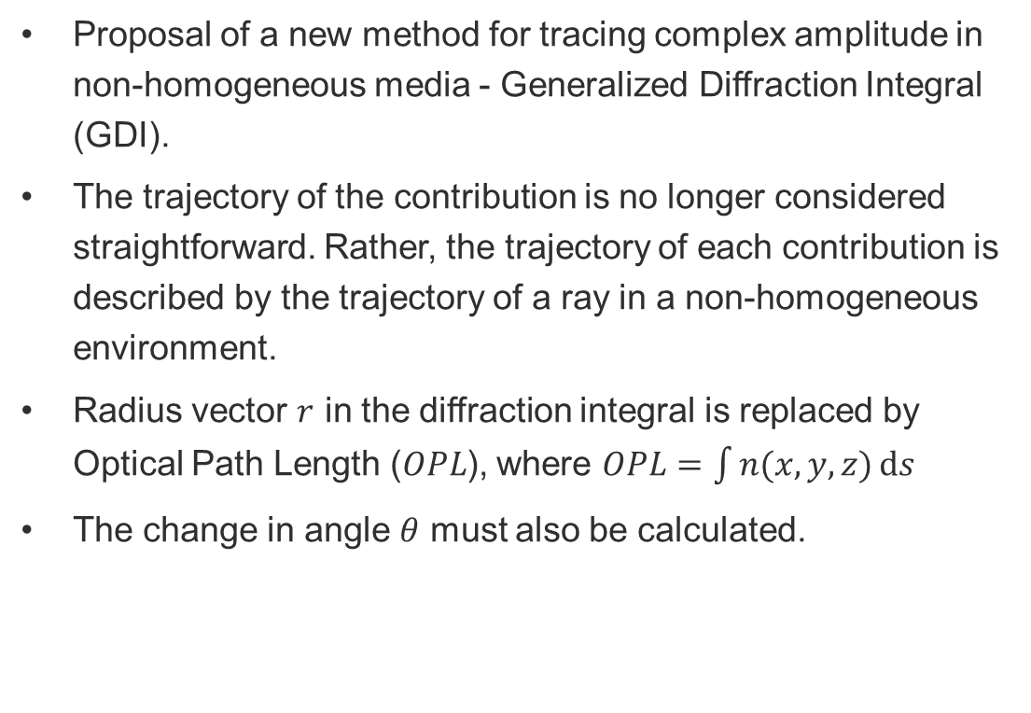
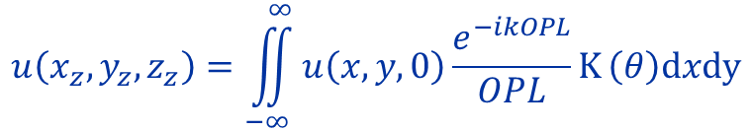
Generalization of the Diffraction integral
Proposal of a new method for tracing complex amplitude in non-homogeneous media - Generalized Diffraction Integral (GDI).
The trajectory of the contribution is no longer considered straightforward. Rather, the trajectory of each contribution is described by the trajectory of a ray in a non-homogeneous environment.
Radius vector $r$ in the diffraction integral is replaced by Optical Path Length ($OPL$), where $OPL=\int{n(x,y,z)ⅆs}$
The change in angle $θ$ must also be calculated.
$$u\left(x_{z},y_{z},z_{z}\right)=\iint_{−∞}^{∞}{u\left(x,y,0\right)\frac{e^{−ikOPL}}{OPL}K}\left(θ\right)dxdy$$

Slide 11
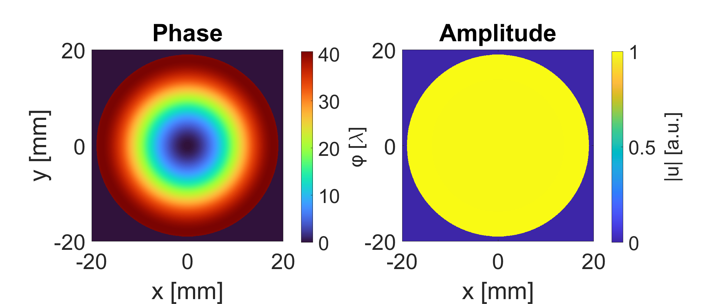
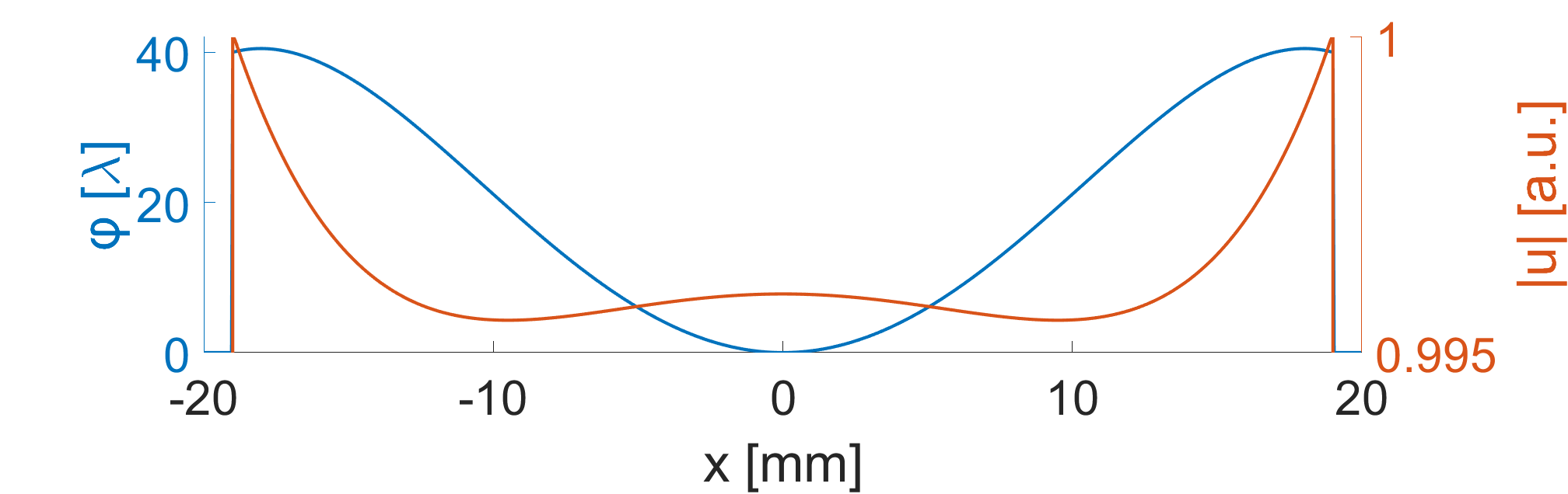
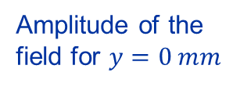


Parameters of SLB generator and models for simulations
For the simulations, the following generator was chosen
  Wavelength: $λ=632.8 nm$
  Radius of the ball lens (BL): $r_{BL}=5 mm$
  Refractive index of the BL: $n=1.98$
  Focal length of the projection lens (PL): $f_{PL}=106.7 mm$
  Diameter of the PL aperture: $A=38 mm$
  Distance between BL and PL: $L_{PL}=100.6 mm$
Generated field in the plane immediately after SLB generator
Phase for $y=0 mm$
Amplitude of the field for $y=0 mm$
  The environmental non-homogeneity is described by the refractive index distribution in the models used.
  For simplicity, the models consider only temperature dependence and not pressure, humidity, etc., which are at least an order of magnitude less sensitive.

Slide 12
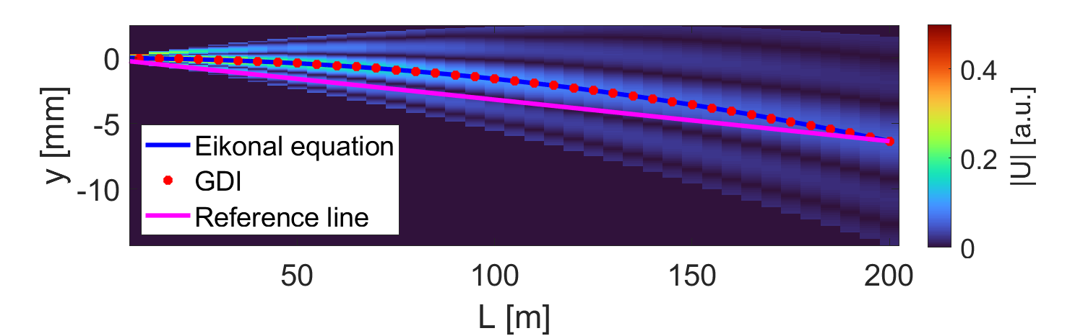
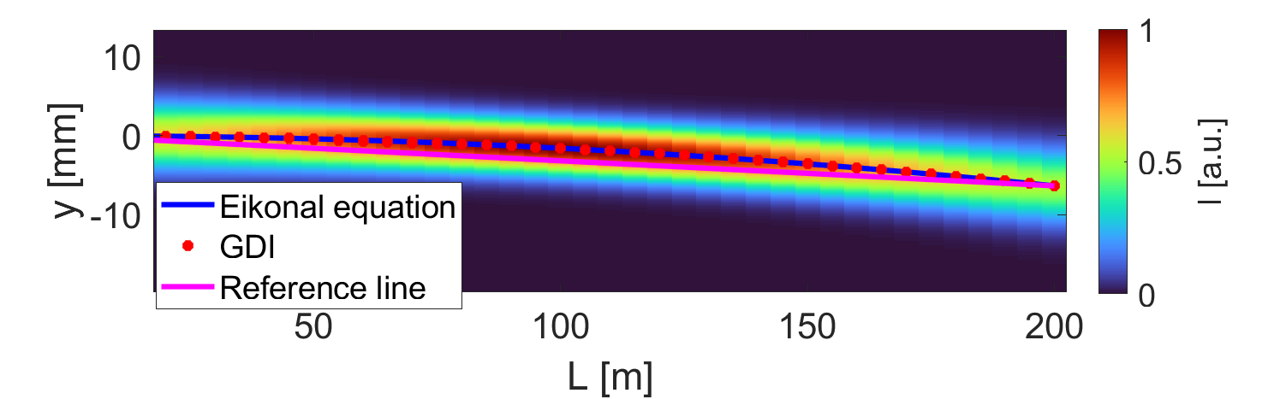
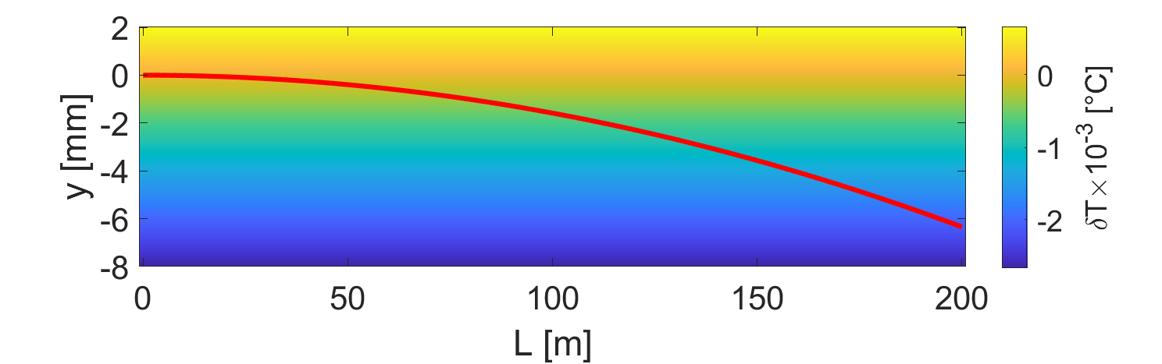
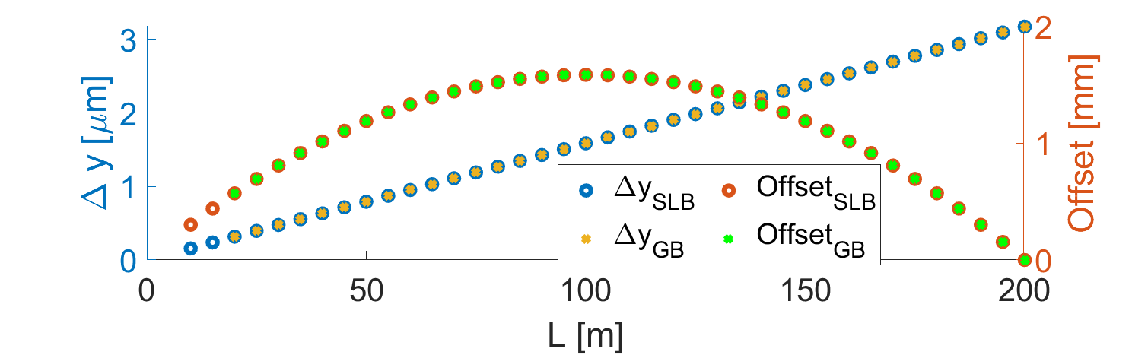

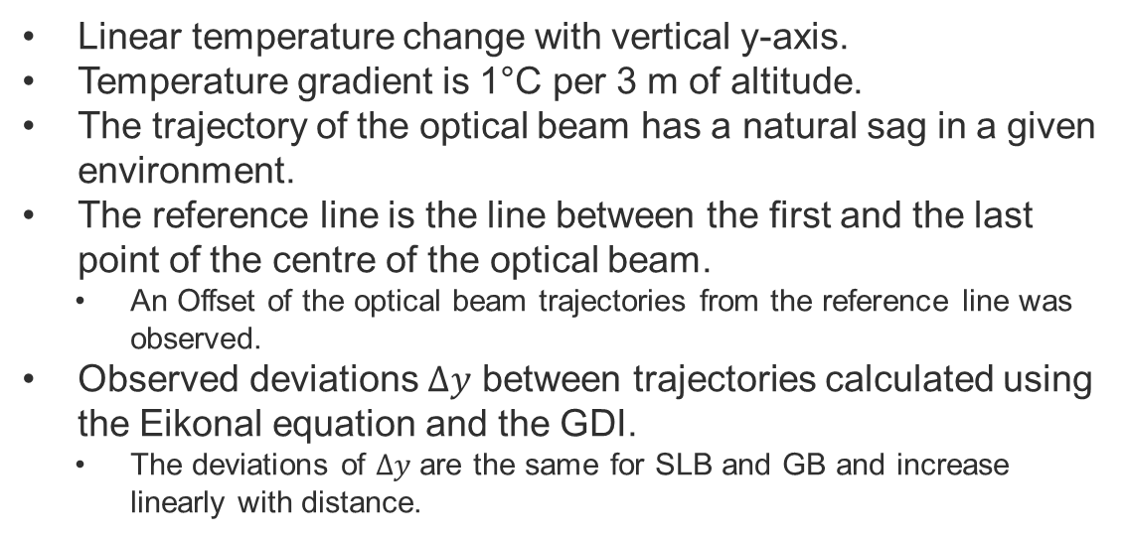
Model case with linear change of temperature
Linear temperature change with vertical y-axis.
Temperature gradient is 1°C per 3 m of altitude.
The trajectory of the optical beam has a natural sag in a given environment.
The reference line is the line between the first and the last point of the centre of the optical beam.
  An Offset of the optical beam trajectories from the reference line was observed.
Observed deviations $Δy$ between trajectories calculated using the Eikonal equation and the GDI.
  The deviations of $Δy$ are the same for SLB and GB and increase linearly with distance.
$$T\left[°C\right]=16+δT$$

Slide 13
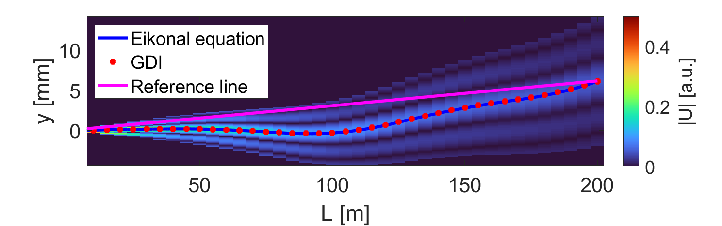
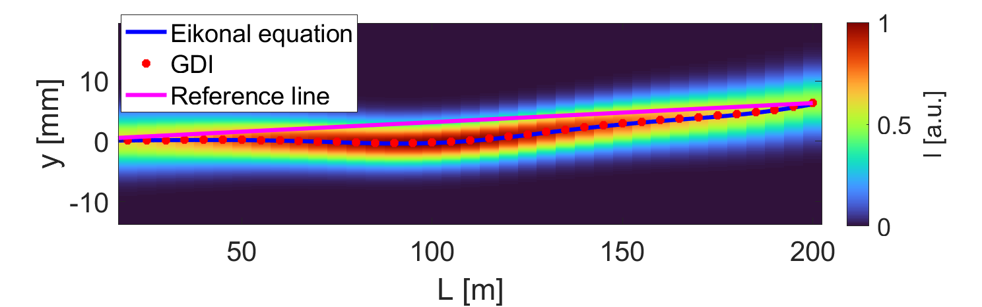
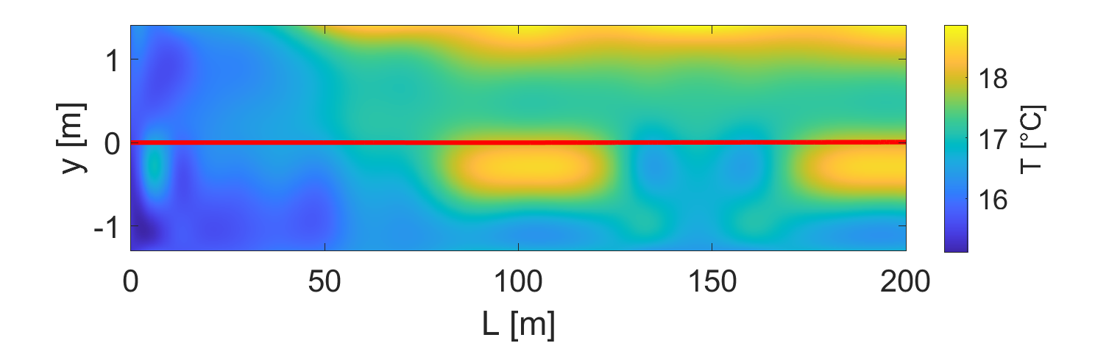
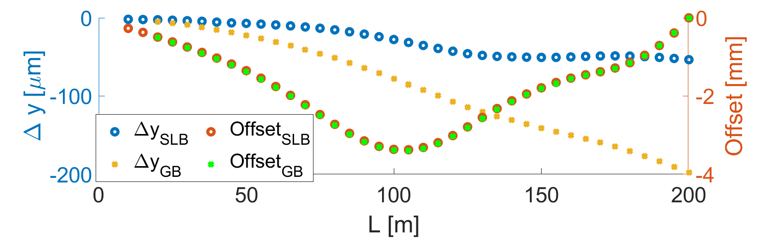
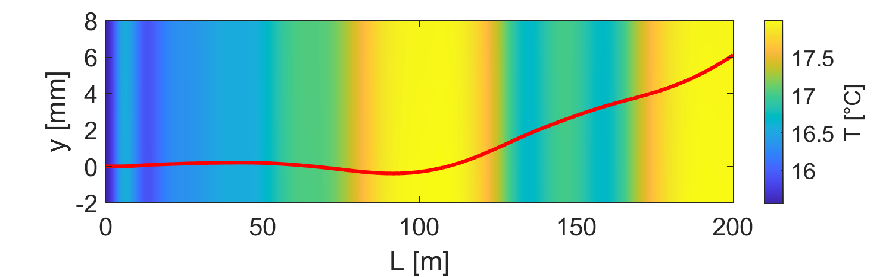
2nd model based on measured TT1 data
The model is based on real temperature measurement data in Transfer Tunnel 1 (TT1) at CERN.
For simplicity, temperature invariance in the horizontal direction was considered.
Different SLB, GB and ray trajectories were observed.

Slide 14
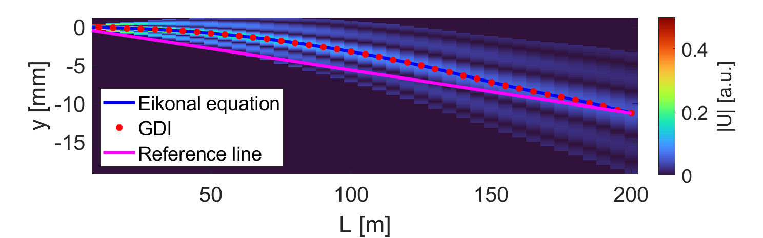
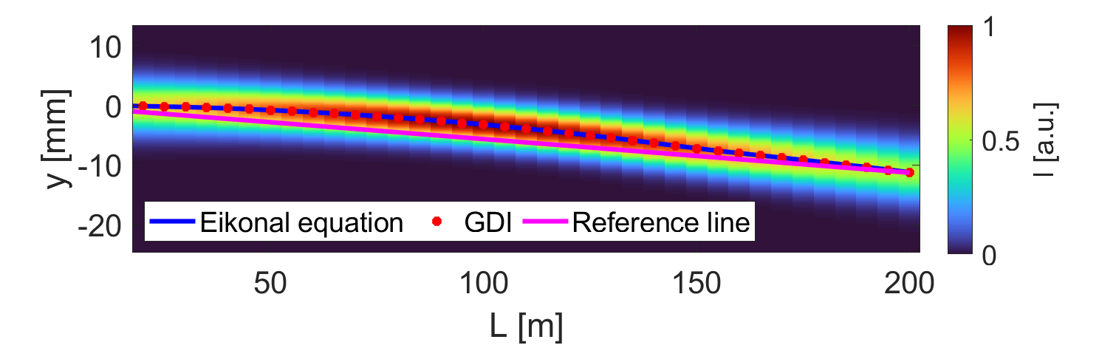



3rd model based on measured LHC data
The model is based on real temperature measurement data in LHC tunnel at CERN.
For simplicity, temperature invariance in the horizontal direction was considered.
Different SLB, GB and ray trajectories were observed.

Slide 15




Comparison of all models
Offset trajectories in a linear model can be described by a parabola.
In general cases the parabola is disturbed by temperature changes in the longitudinal direction (e.g. LHC model in 150 m).
The deviation $Δy$ in the linear model has a linear increase.
In the general case, the progression of the $Δy$ is non-trivial.
There is a strong dependence of the progression of the deviation on the type of optical beam.
 | 1. Linear | 2. TT1 | 3. LHC
max Offset SLB [mm] | 1.59 | 3.37 | 2.45
max Offset GB [mm] | 1.59 | 3.39 | 2.46
max $Δy$ SLB [$μ$m] | 3.18 | 53.5 | 15.6
max $Δy$ GB [$μ$m] | 3.17 | 198 | 59.5

Slide 16
Conclusion
This study examines how the SLB trajectory is affected by environmental non-homogeneity.
Conventional methods for describing the trajectory of light in an non-homogeneous medium do not consider the change in optical intensity distribution, so they are fundamentally inaccurate.
A new GDI method based on the generalization of the diffraction integral was proposed to solve this problem.
Simulations on three cases were performed.
  The simulations demonstrated the deviation of the optical beam trajectory from the beam path.
  Significant deviation of SLB and GB trajectories exceeding 100 μm was observed for non-trivial non-homogeneity.
  The SLB trajectory is closer to the ray trajectory than the GB trajectory.
Sag trajectories of the optical beam cause an offset from the reference line.
  With a linear transverse temperature change, the offset progresses along the parabola.
  The general temperature distribution shows small transverse changes and step changes in the longitudinal direction. Thus, the evolution of the offset can be described locally by parabolas that change parameters with longitudinal temperature changes.

Slide 17
Thank you for your attention!
The SLB generation principle is protected by patent:
J.-C. Gayde and M. Sulc, “An Optical System for Producing a
Structured Beam“. EP3564734, 2019.

Slide 18
References
D. M. Gale, “Visual alignment of mechanical structures using a Bessel beam - datum practical implementation”, in Optical Measurement Systems for Industrial Inspection Vii, Bellingham, 2011, 8082, 80823D.
R. E. Parks, “Aligning reflecting optics with Bessel beams”, in Proc. SPIE 11488, Optical System Alignment, Tolerancing, and Verification XIII, Online Only, United States, 2020, 114880J.
R. E. Parks, “Practical considerations for using grating produced Bessel beams for alignment purposes”, in Optomechanics and Optical Alignment, Bellingham, 2021, 11816, 1181603.
J.-C. Gayde and M. Sulc, “An Optical System for Producing a Structured Beam”, European patent application 3564734 A1. 2019-11-06.
J.-C. Gayde, K. Polak, and M. Sulc, “Introduction to structured laser beam for alignment and status of the R&D,” 2022.
Born, Max; Wolf, Emil (1999), “Principles of optics: electromagnetic theory of propagation, interference and diffraction of light (7th ed.)”, London; New York; Paris: Pergamon Press.
Saleh, B. E. A., & Teich, M. C. (2019). “Fundamentals of Photonics: 2 Volume Set (3rd ed.)”, Wiley-Blackwell. Volume 1.
P. E. Ciddor, “Refractive index of air: new equations for the visible and near infrared,” Appl. Opt., vol. 35, pp. 1566–1573, Mar. 1996.

