Slide 1
Upgrade of the Fermilab Booster Accelerator Tunnel Control Network
Dr. Babatunde O’Sheg Oshinowo, FRICS
Dr. Virgil Bocean, Chuck Wilson, John Kyle, Gary Coppola
Alignment and Metrology Group
Fermi National Accelerator Laboratory
Batavia, Illinois

Slide 2
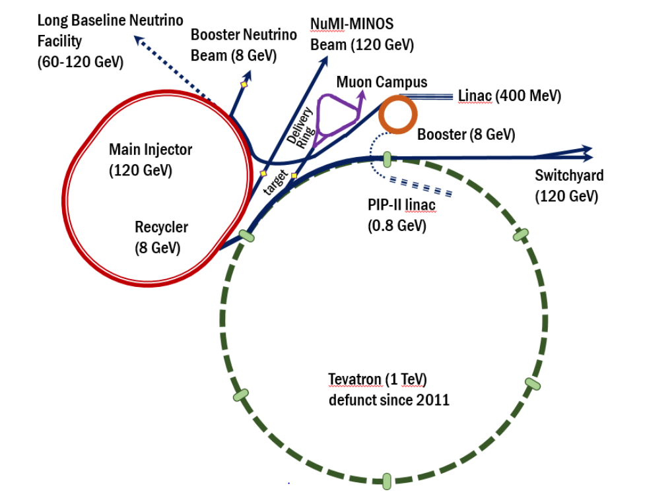
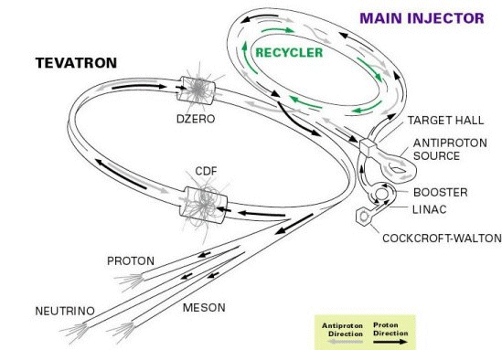
Fermilab Accelerator Complex
Fermilab
Fermilab accelerator complex includes:
400 MeV H- pulsed normal-conducting RF Linac,
8 GeV proton Booster synchrotron,
8 GeV Recycler storage ring that shares a tunnel with the 120 GeV proton Main Injector synchrotron, and
a 3.1 GeV muon Delivery Ring.
A number of beamlines are connected to the accelerators, such as BNB, NuMI and the future LBNF beamline and 0.8 GeV Superconducting Radio-Frequency PIP-II Linac located inside the Tevatron ring and the corresponding beamline for injection into the Booster
8GeV
Transfer Line
CDF
C0
TeVatron
Main Injector

Slide 3
Fermilab Accelerator Complex
Fermilab
Existing Linac is a linear accelerator about 152 meters long that brings proton beams up to energies of about 400 MeV, providing proton beam for the Booster accelerator and the rest of the chain of accelerators
Linac beam originates from a pulsed H- ion source followed by a 750 keV RFQ and a 400 MeV normal-conducting pulsed Linac that injects into an 8 GeV rapid-cycling-synchrotron Booster
8GeV
Transfer Line
CDF
C0
TeVatron
D0

Slide 4
Fermilab Accelerator Complex
Fermilab
Booster ring is a synchrotron accelerator with a circumference of 474 meters. The Booster consists of a 24-fold period lattice with Brass Plugs in each period. The Booster also consists of several combined function magnets, RF cavities, and BPMs
8GeV
Transfer Line
CDF
C0
TeVatron
Main Injector
D0

Slide 5
Fermilab Accelerator Complex
Fermilab
Recycler is a 3.3 km 8 GeV storage ring made from several permanent magnets.
Main Injector is situated directly below the Recycler in the same tunnel. It is 3.3 km in circumference and ramps up proton beam from the Recycler from 8GeV to 120GeV. The world’s highest-intensity neutrino beams are generated from these proton beams. Main Injector consists of several dipoles and quadrupoles magnets and the
8GeV
Transfer Line
CDF
C0
TeVatron
Main Injector
D0

Slide 6
Fermilab Accelerator Complex
Fermilab
8-GeV transfer line from Booster to the Fermilab Main Injector is 764 meters long. The 8GeV tunnel is connected to both Main Injector and Booster tunnels. 8GeV beamline consists of several permanent magnets. conventional dipoles, quadrupoles, Multiwires Profile Monitors and Beam Position Monitors. 8-GeV transfers protons to the Recycler.
8GeV
Transfer Line
CDF
C0
TeVatron
Main Injector
D0

Slide 7
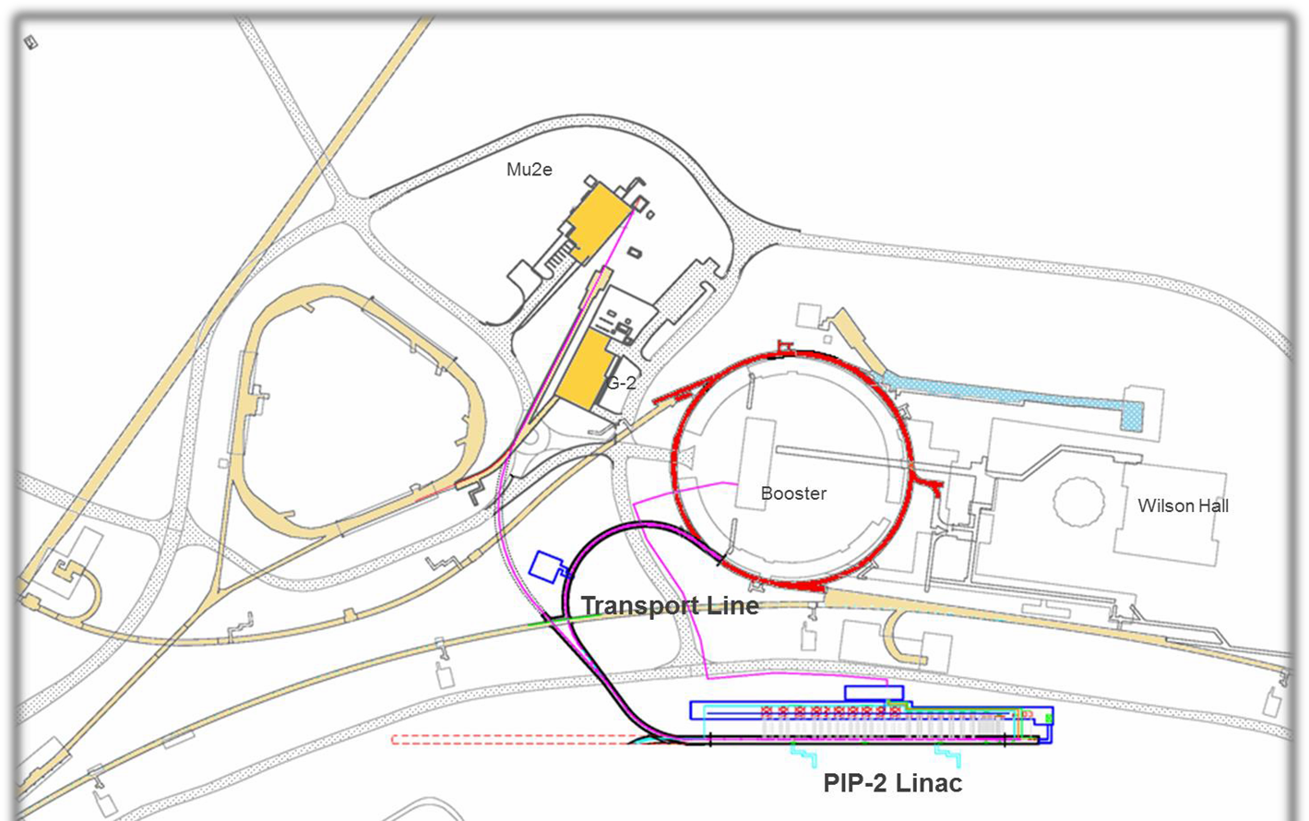
Proton Improvement Plan-II (PIP-II)
Booster
8GeV
Transfer Line
New PIP-II (Proton Improvement Plan II) will replace the existing 400 MeV normal-conducting Linac with a modern 800 MeV superconducting RF based linear accelerator (PIP-II Linac).
The 800 MeV PIP-II Linac will use superconducting RF accelerating cavities at three different frequencies. Beam focusing is provided by quadrupoles and solenoids

Slide 8
PIP-II connection to Booster
Fermilab
Booster
CDF
8GeV
Transfer Line
TeVatron
PIP-II Linac underground tunnel will be 210 m long and will be connected to the present Booster through a new 300 m long transfer line
The PIP-II Linac-to-Booster transfer line will transport the beam from the end of the superconducting Linac to the Injection Girder of the Booster
Main Injector
D0

Slide 9
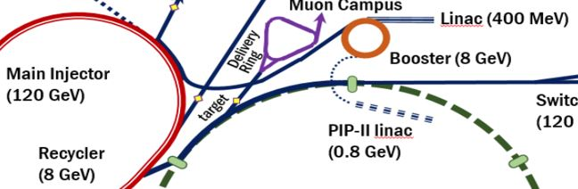
Goals of Booster Network Upgrade
8GeV
Transfer Line
To upgrade of the Booster tunnel control network to be consistent with the PIP-II Linac-to-Booster transfer line tunnel control network that will be tied to the current 2003 Fermilab surface network (epoch 2003)
To connect the upgraded 8GeV, Booster and Tevatron tunnel control networks and ensure that all networks are connected to the same epoch 2003 surface network

Slide 10
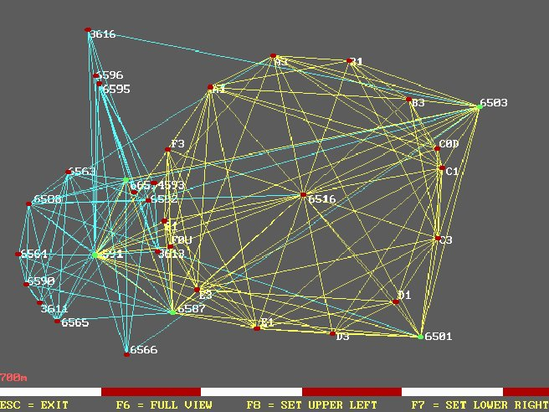
Fermilab Surface Network
1998 and 2003 Main Injector surface networks include 10 sight risers. The 10-sight riser drop points were incorporated into a tunnel network to provide absolute positioning for tunnel control system constraints at the +/- 1mm level.
Fermilab
CDF
2003 Tevatron network includes 14 sight risers. The 14-sight riser drop points were incorporated into a tunnel network
C0
1998 8GeV network includes 4 sight risers. The 4-sight riser drop points were incorporated into a tunnel network
The upgraded 2003 surface network used GPS baselines and Mekometer distance measurements. Vertical measurements were made with digital levels.
Main Injector
D0

Slide 11
Fermilab Tunnel Networks
Fermilab
8GeV
Transfer Line
CDF
C0
Main Injector, Linac and Tevatron tunnel control networks are tied to the epoch 2003 surface network
1998 8GeV tunnel control network was upgraded in 2019 by densifying existing monumentations inside the tunnel using the Laser Tracker. Connection to epoch 2003 surface network was achieved by connecting the Main Injector tunnel network to the 8GeV tunnel network
2004 Booster tunnel control network was NOT connected to the epoch 2003 surface network
TeVatron
Main Injector
D0

Slide 12
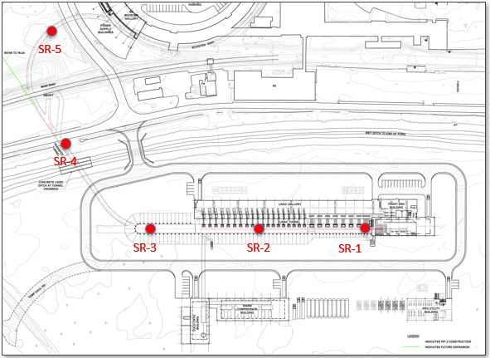
PIP-II Linac-to-Booster Transfer Tunnel Network
Booster
Fermilab
CDF
C0
TeVatron
The new PIP-II Linac-to-Booster transfer line tunnel networks will be tied to the 2003 surface network and connected to the current Booster network. The Laser Tracker will be used for measurements. Tunnel network design is on-going
The PIP-II Linac will have 3 sight risers and PIP-II transfer line will have 2 sight risers
Main Injector
D0

Slide 13
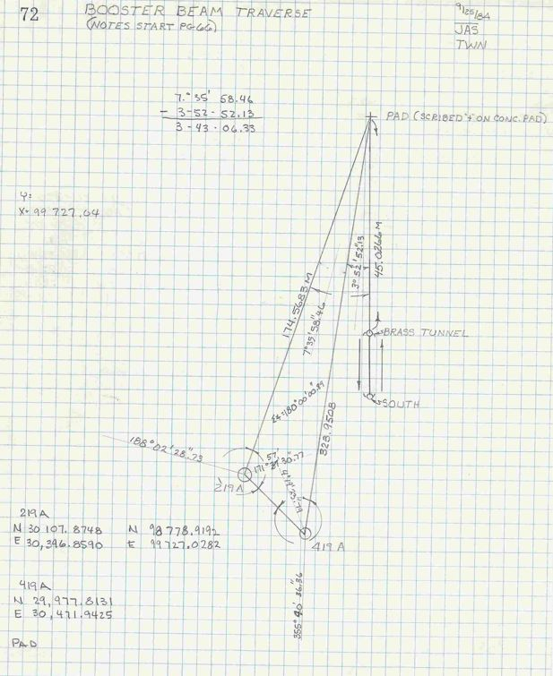
Booster Tunnel Network
The Booster tunnel has NO sight risers
Booster tunnel network was tied to a 1984 surface network different from the current Fermilab surface network
Horizontal network was established by traversing from a line between two Antiproton site riser points (219A, 419A) through a hatch to two points in period 4 in the Booster Ring (BRASS TUNNEL, South)

Slide 14
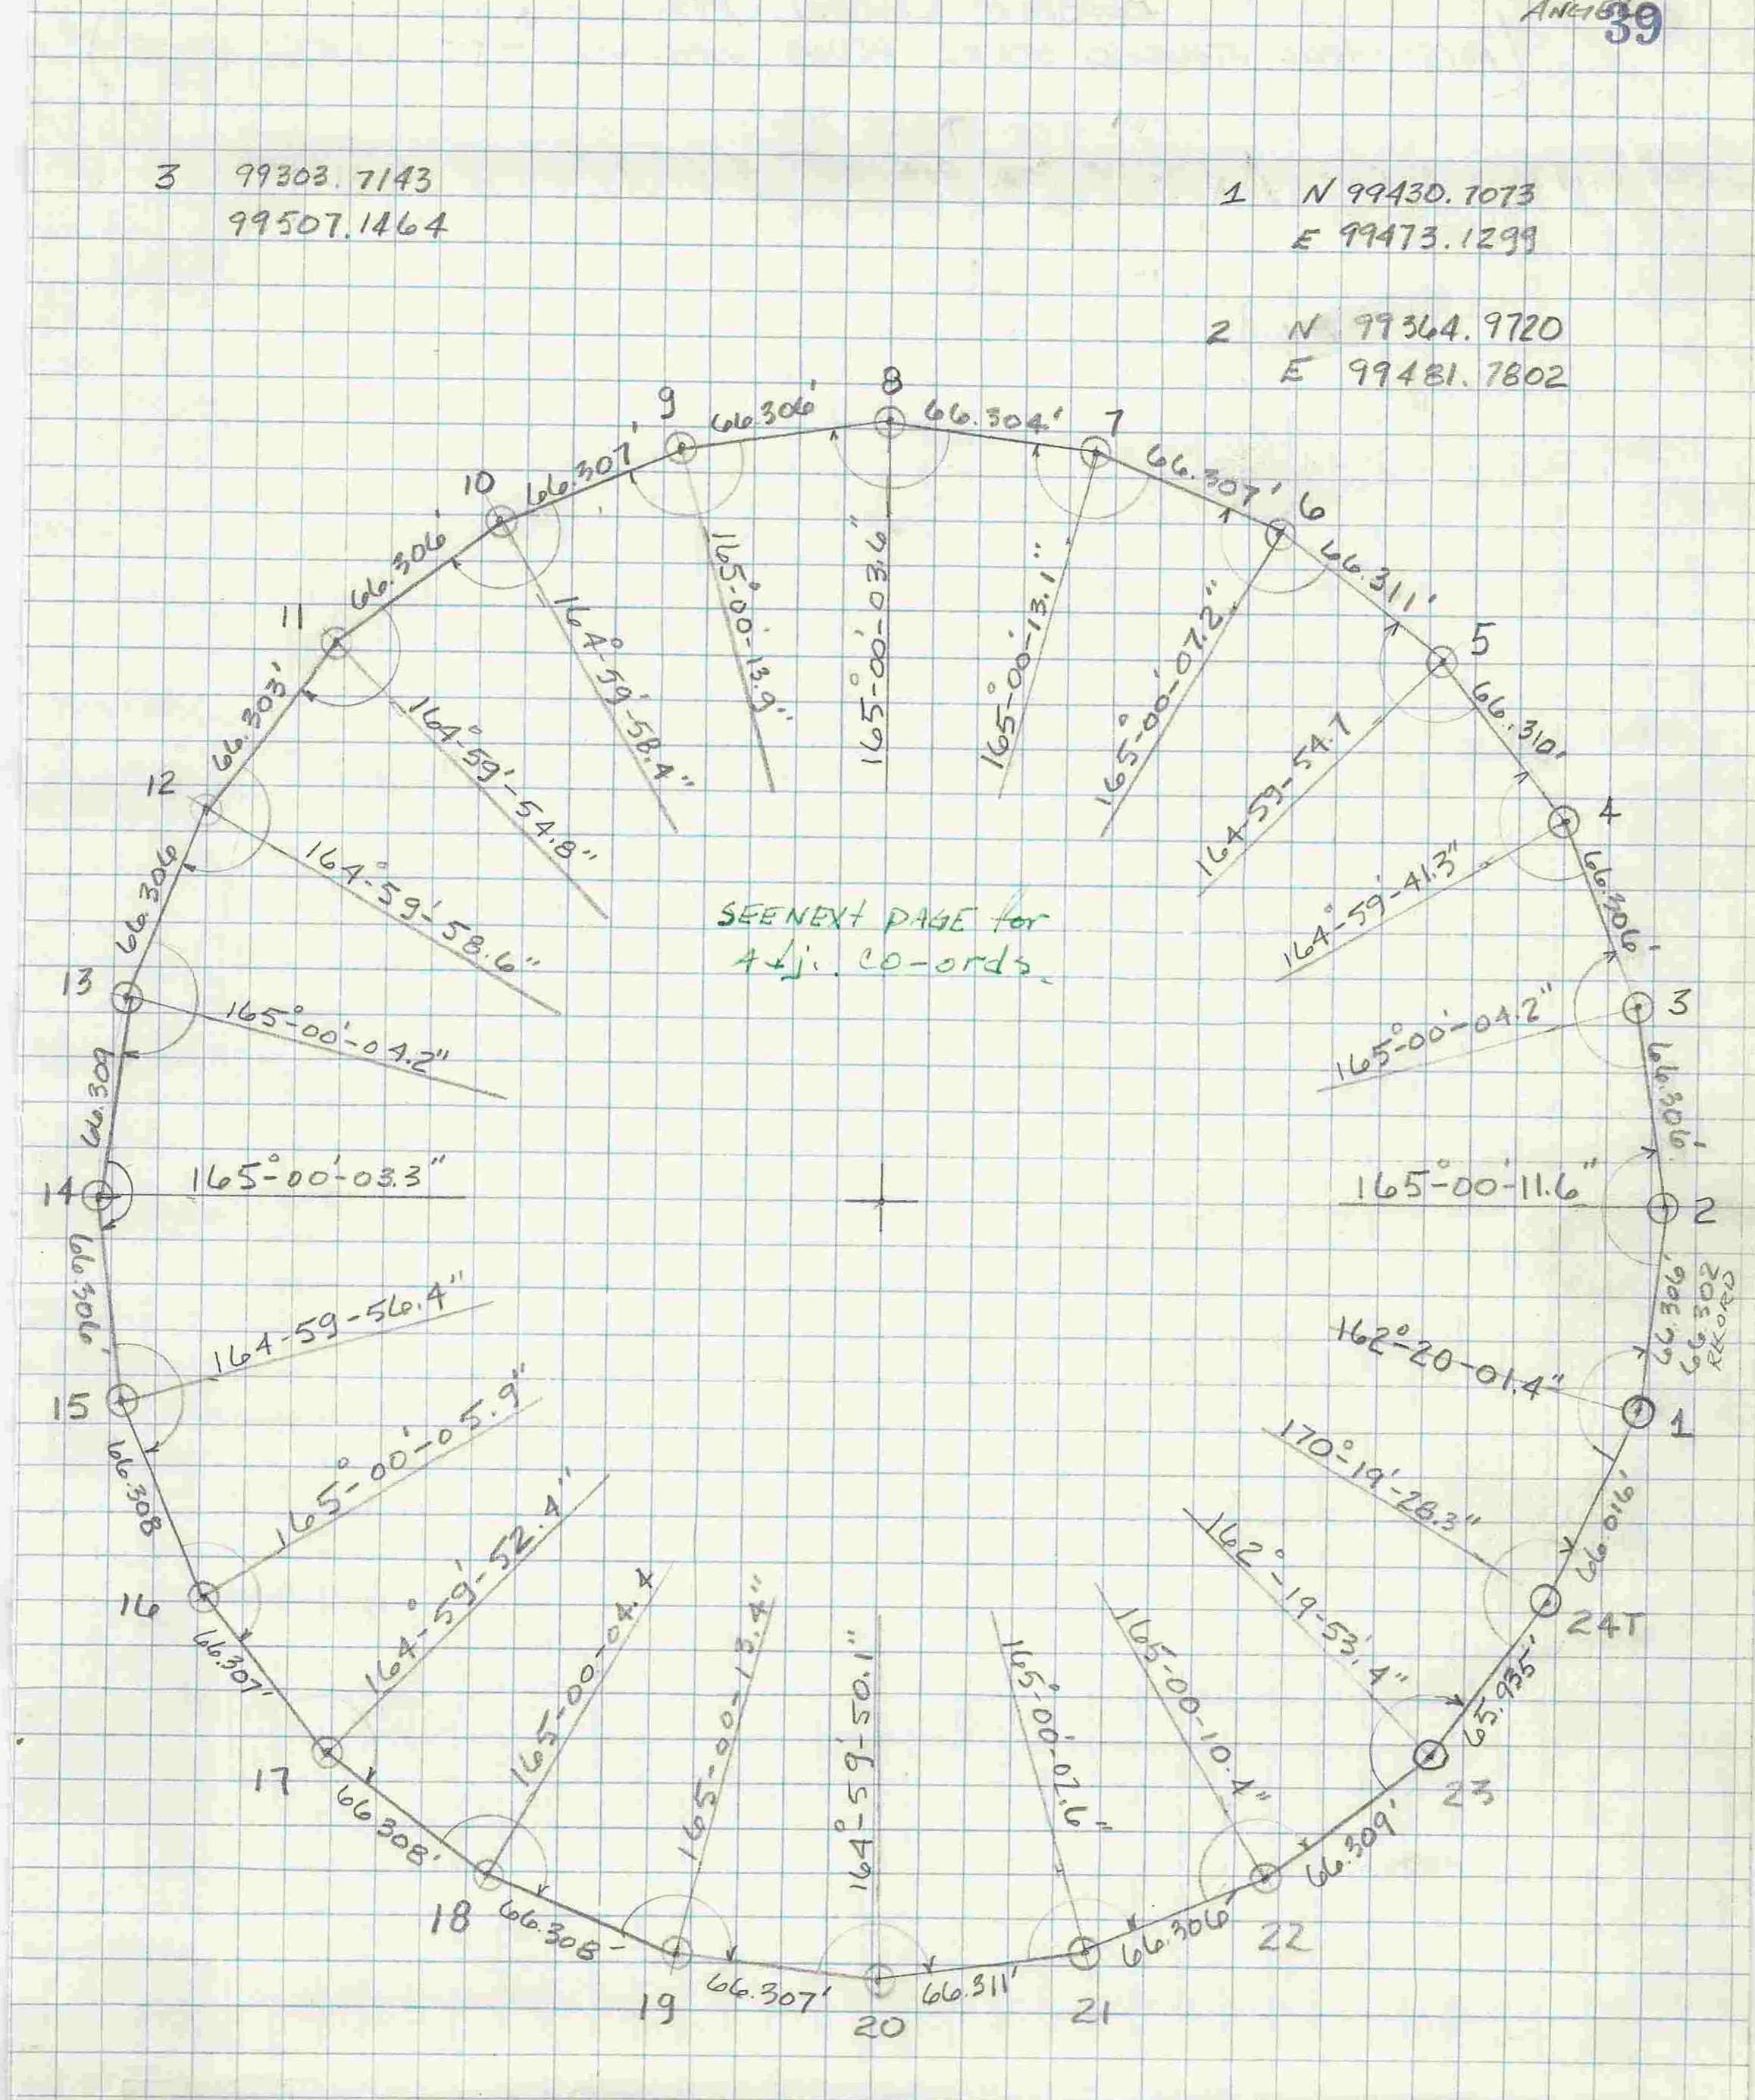
Booster Tunnel Network
Traverse continued from these to two points (BRASS TUNNEL, South) to all 24 brass plugs around the Ring
Booster traverse used Meko 5000 and Kern E2
Magnet alignment was done using offsets to the lines between brass plugs
2004 control network densified existing brass plugs with several floor and wall points and pass points around the Booster Ring. The existing brass plugs were held fixed in the adjustment
Booster tunnel network was NOT connected to the epoch 2003 surface network in 2004
Therefore, the Booster tunnel network needs to be upgraded from epoch 1984 to epoch 2003 surface network

Slide 15
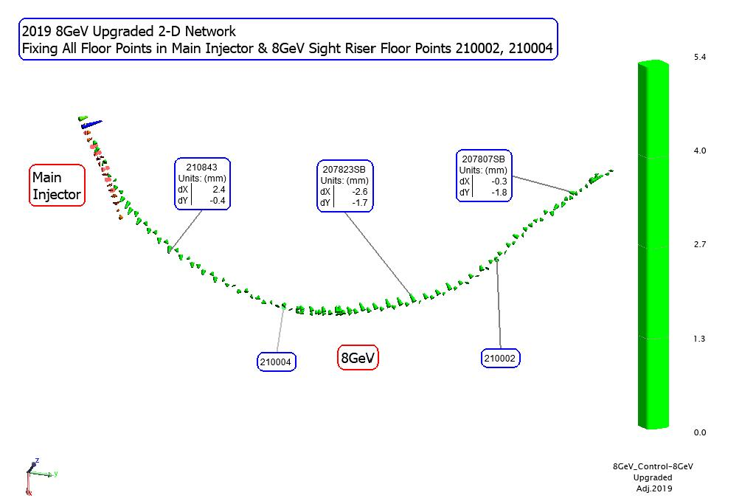
Upgraded 8GeV Network
2019 8GeV horizontal network upgrade included the existing network with densified monumentations using the Laser Tracker. It is connected to the Main Injector network

Slide 16
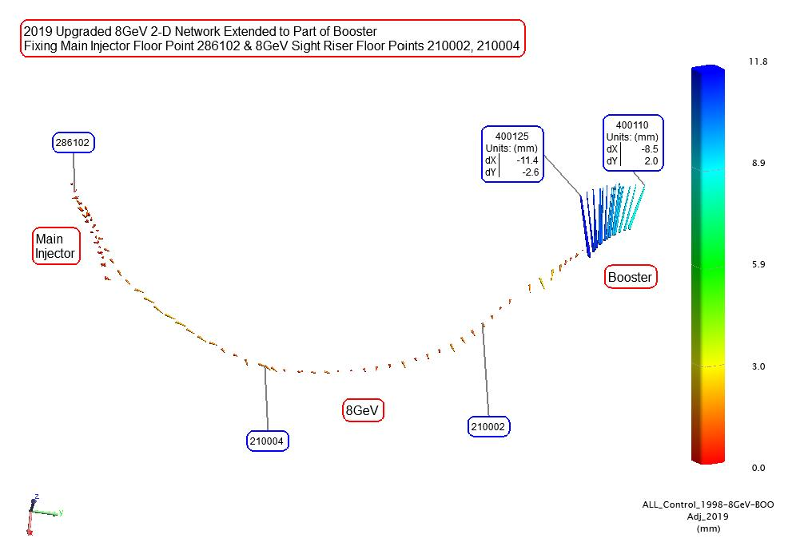
Upgraded 8GeV Network to Booster
2019 8GeV horizontal network upgrade was extended to the Booster Ring (Period 3 through Period 6)
Network adjustment revealed discrepancies between the 2019 8GeV and extended Booster networks
These discrepancies between the 2019 upgraded 8GeV and Booster horizontal networks is attributed to different epochs of surface network used by each network

Slide 17
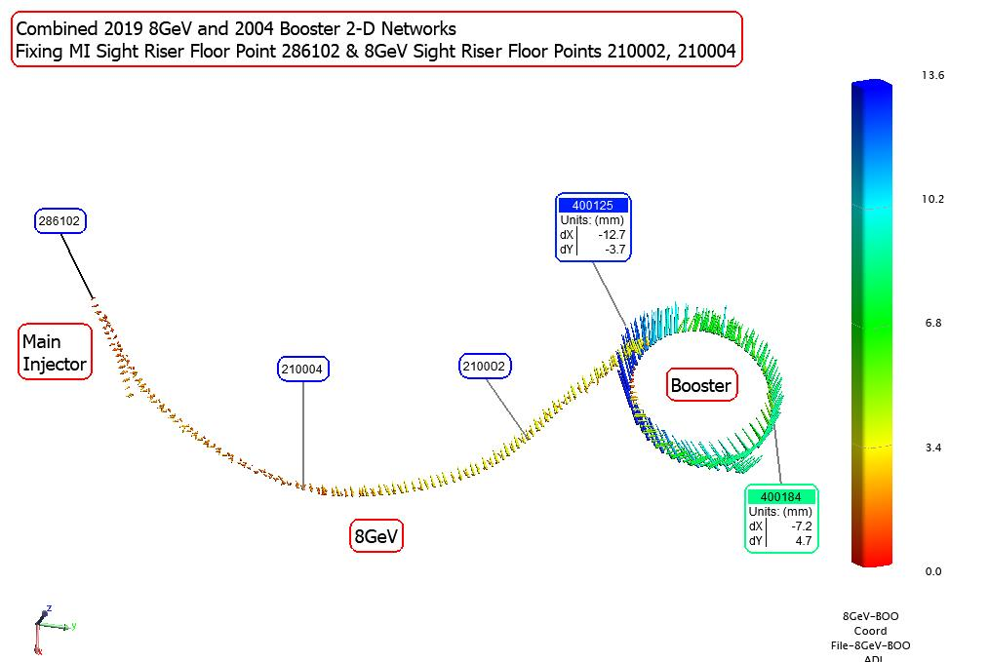
2019 8GeV Network + 2004 Booster Network
2019 8GeV network combined with entire 2004 Booster Laser Tracker measurements
Network adjustment revealed inconsistencies between the 2019 8GeV and 2004 Booster networks.
These discrepancies between the 2019 upgraded 8GeV and Booster horizontal networks is attributed to different epochs of surface network used by each network

Slide 18
PIP-II Booster Injection Survey 20Aug19
Booster
8GeV
Transfer Line
Task: To measure and mark one wall point where designed PIP-II beam crosses the Booster wall
PIP-II Booster Injection point differs from the marked point using the existing controls by 2.7 mm
The difference is attributed to different epochs of surface network used for PIP-II (epoch 2003) and the Booster tunnel networks (epoch 1984)

Slide 19
Connect Booster Network to
Fermilab Surface Network
Steps to connect Booster tunnel network, originally tied to epoch 1984 surface network, to the Tevatron and 8GeV both tied to the epoch 2003 Fermilab surface network:
Run a 2-D closed traverse from Tevatron A0 to Booster Ring. Resulting adjustment is First Traverse adjusted Booster coordinates connected to the epoch 2003 surface network
8GeV to Booster to 2-D network adjustment holding some floor points in the 8Gev network fixed some floor points from the Tevatron Booster traverse coordinates in 1) fixed. Resulting adjustment is the Final Booster 2-D adjusted coordinates connected to the epoch 2003 surface network
Transform the Booster coordinates in 1) to the Final Booster coordinates in 2)
Compute the differences between the Booster coordinates in 2) to the Booster coordinates in 3)

Slide 20
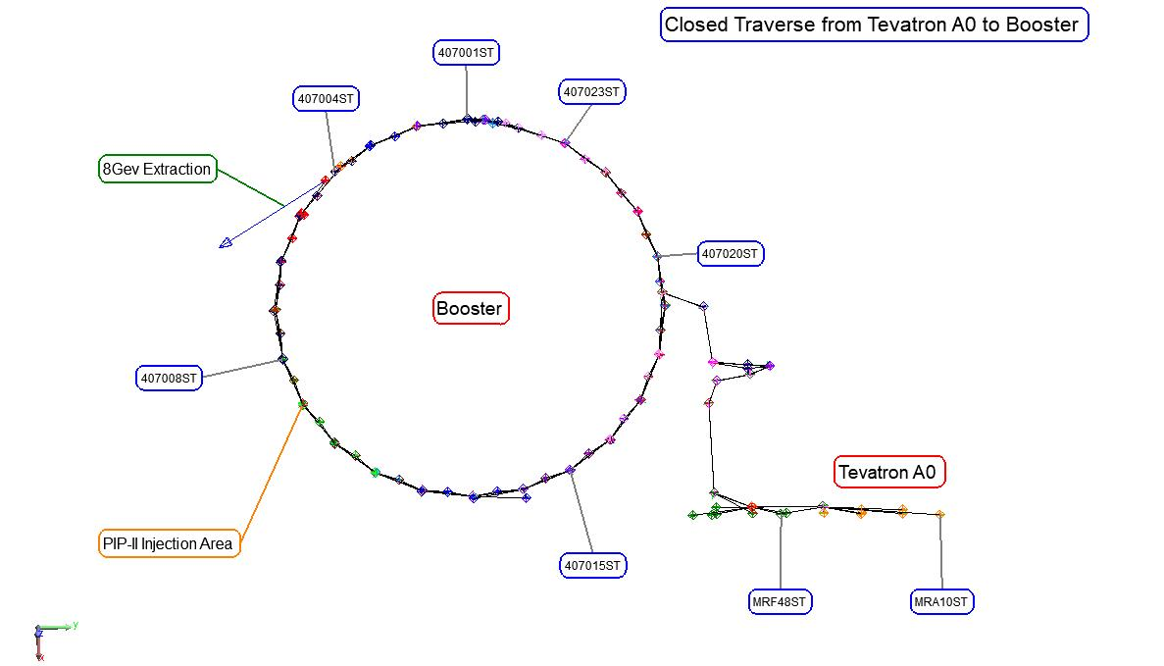
Tevatron to Booster 2-D Traverse
First Traverse Adjustment:
All Tevatron A0 control points held fixed
C0
TeVatron
Main Injector
D0

Slide 21
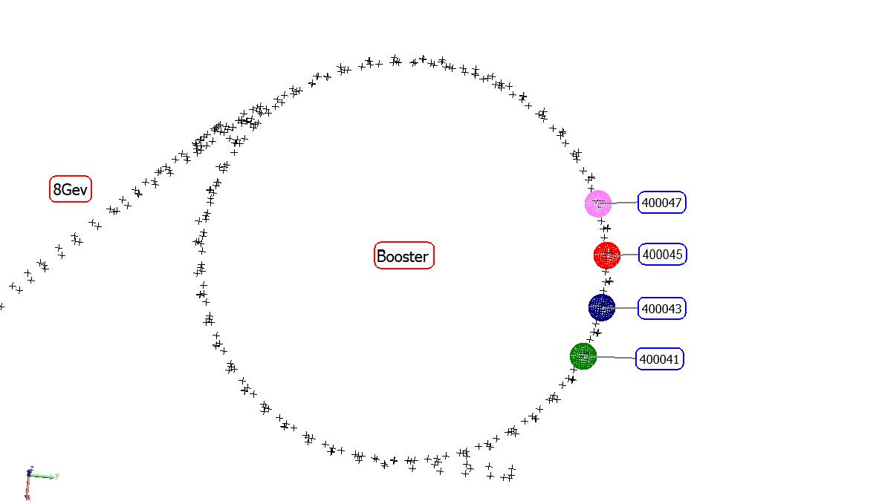
Final Adjustment: 8GeV to Booster 2-D Network
C0
Final Adjustment:
- Four (4) floor points in the First Traverse adjustment held fixed
- Floor points in part of 8GeV held fixed – 4 cell bodies
TeVatron
Main Injector
D0

Slide 22
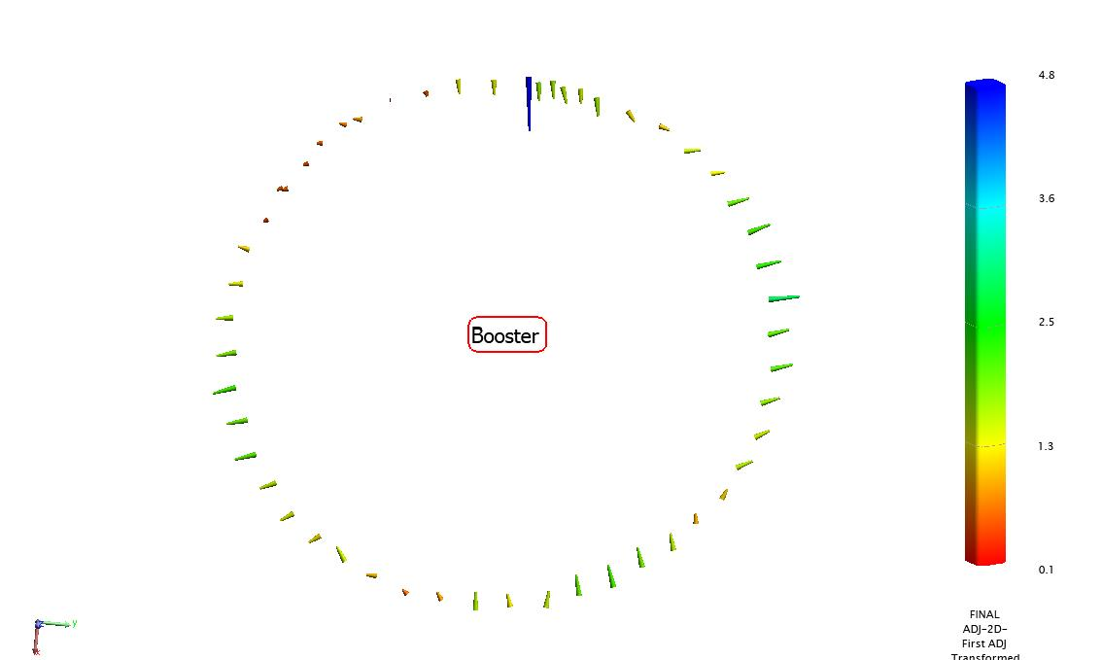
Differences Final Adjusted and First Adjusted Coordinates
C0
TeVatron
Differences Final Adjusted Booster Coordinates and First Adjusted (Traverse) Booster Coordinates Transformed to Final Adjusted Coordinates
Differences of 0.1 mm to 2.5 mm are considered acceptable
Main Injector

Slide 23
Conclusions
Booster
The Booster Tunnel network has been upgraded so that it is compatible to adjacent tunnel networks connected to epoch 2003 Fermilab surface network
The next Booster tunnel network upgrade will happen when PIP-II Linac-to-Booster transfer line tunnel control network breaks into the Booster tunnel

Slide 24
Acknowledgment
I would like to thank:
My colleague Dr. Virgil Bocean for help with computations
Chuck Wilson for Measurement Plans and assembling all the Tracker data
Alignment and Metrology Department members who participated in the Booster and 8GeV upgrades
Questions?

