Slide 1
Measurement and alignment of the TIDVG5 SPS beam dump
C. Vendeuvre, P. Bestmann, F. Barcet
03/11/2022

Slide 2
Outline
SPS within CERN and TIDVG within the SPS
CNGS feedback on hidden point measurement
Network Simulation in the ECX5 cavern
Prototypes and mechanical adaptation
Final results for hidden point measurement
Conclusion

Slide 3
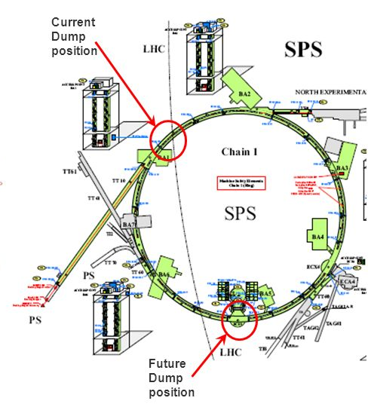
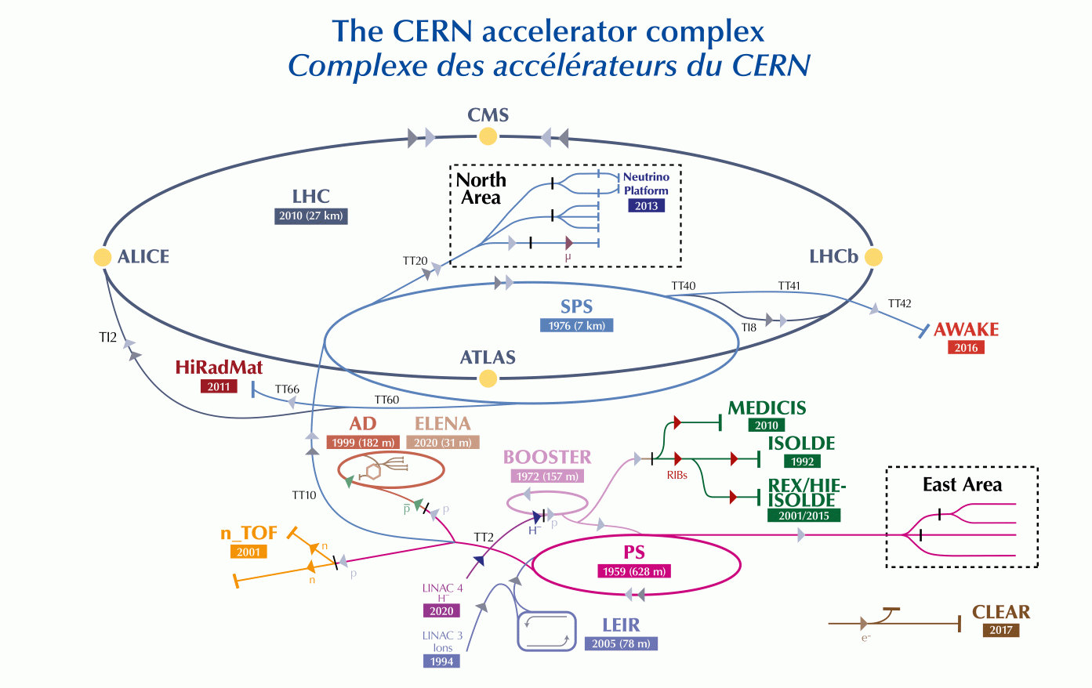
SPS within CERN
Pre-LS2 dump position
Current
dump position

Slide 4
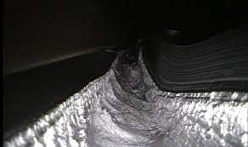
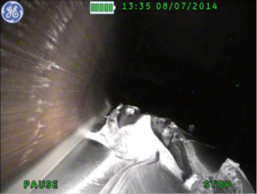
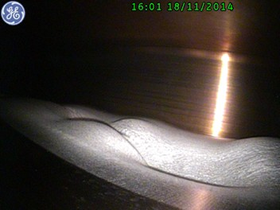
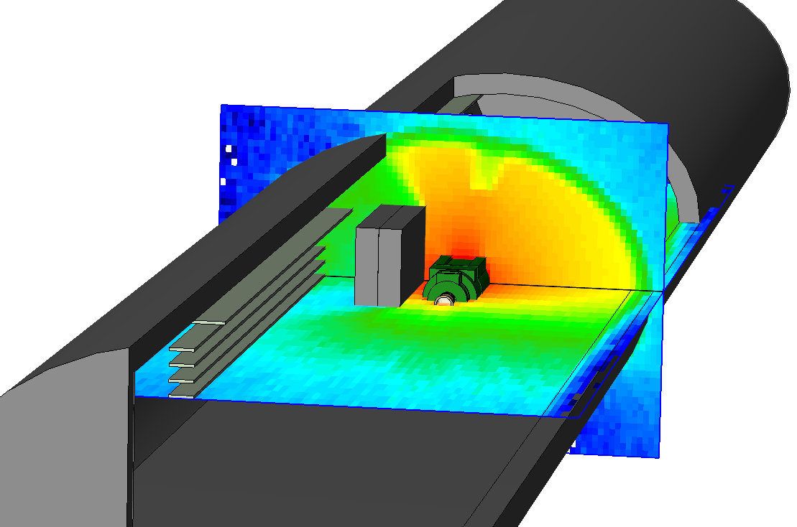
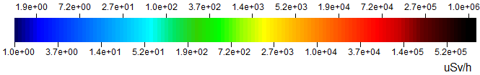
Limitation of previous TIDVG
Previous design built for 300/400 GeV Beams
HL-LHC beam up to 450 GeV
Dose rate after 1 week of cooling

Slide 5
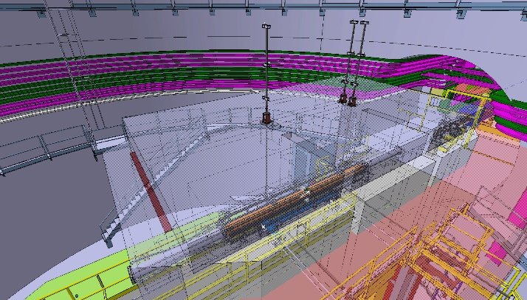
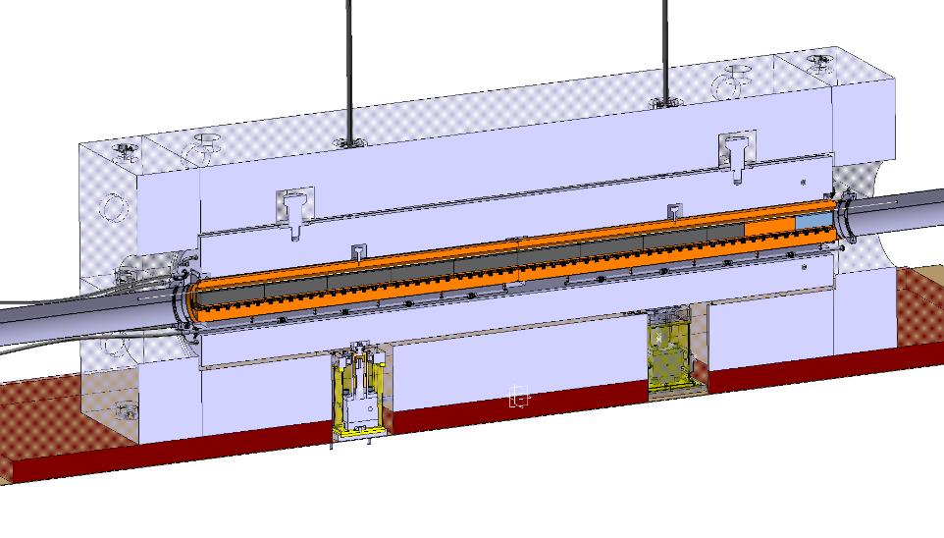
Key point of TIDVG5 Design
Heavy shielded with concrete, iron and marble
Need to measure through the shielding
±0.7 mm transverse alignement tolerance
Will get heavily radioactive with time (1 MGy/year at 35 cm)
20 Years of service without access to the equipment

Slide 6
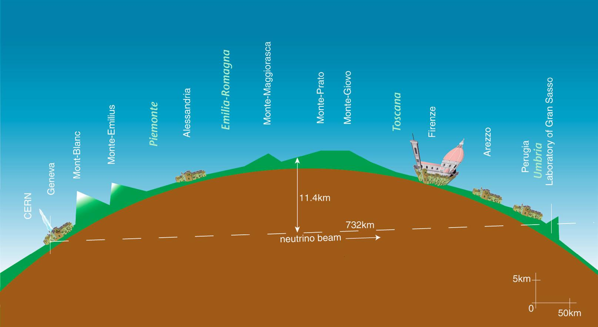
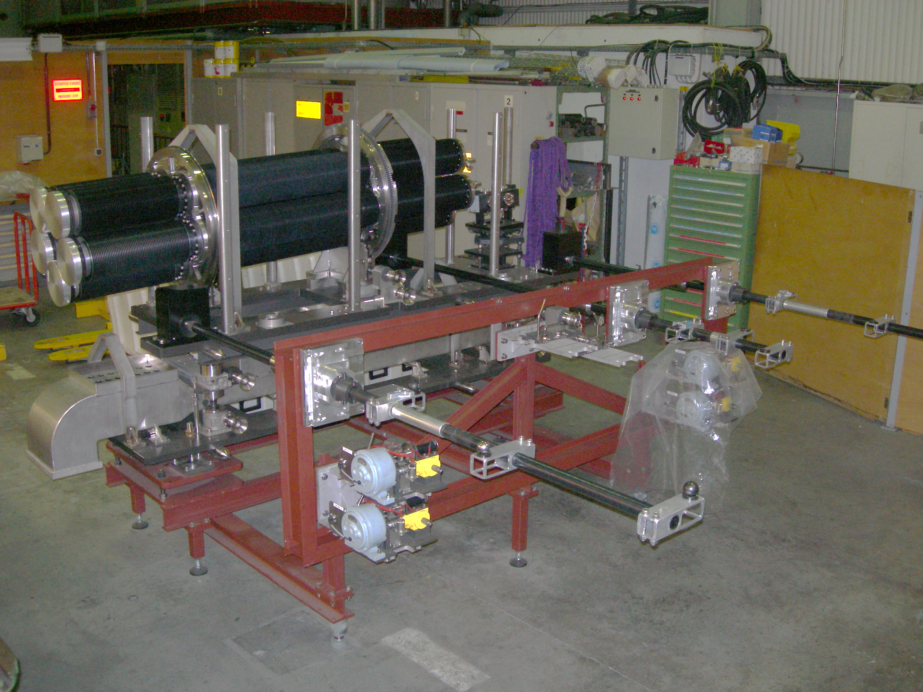
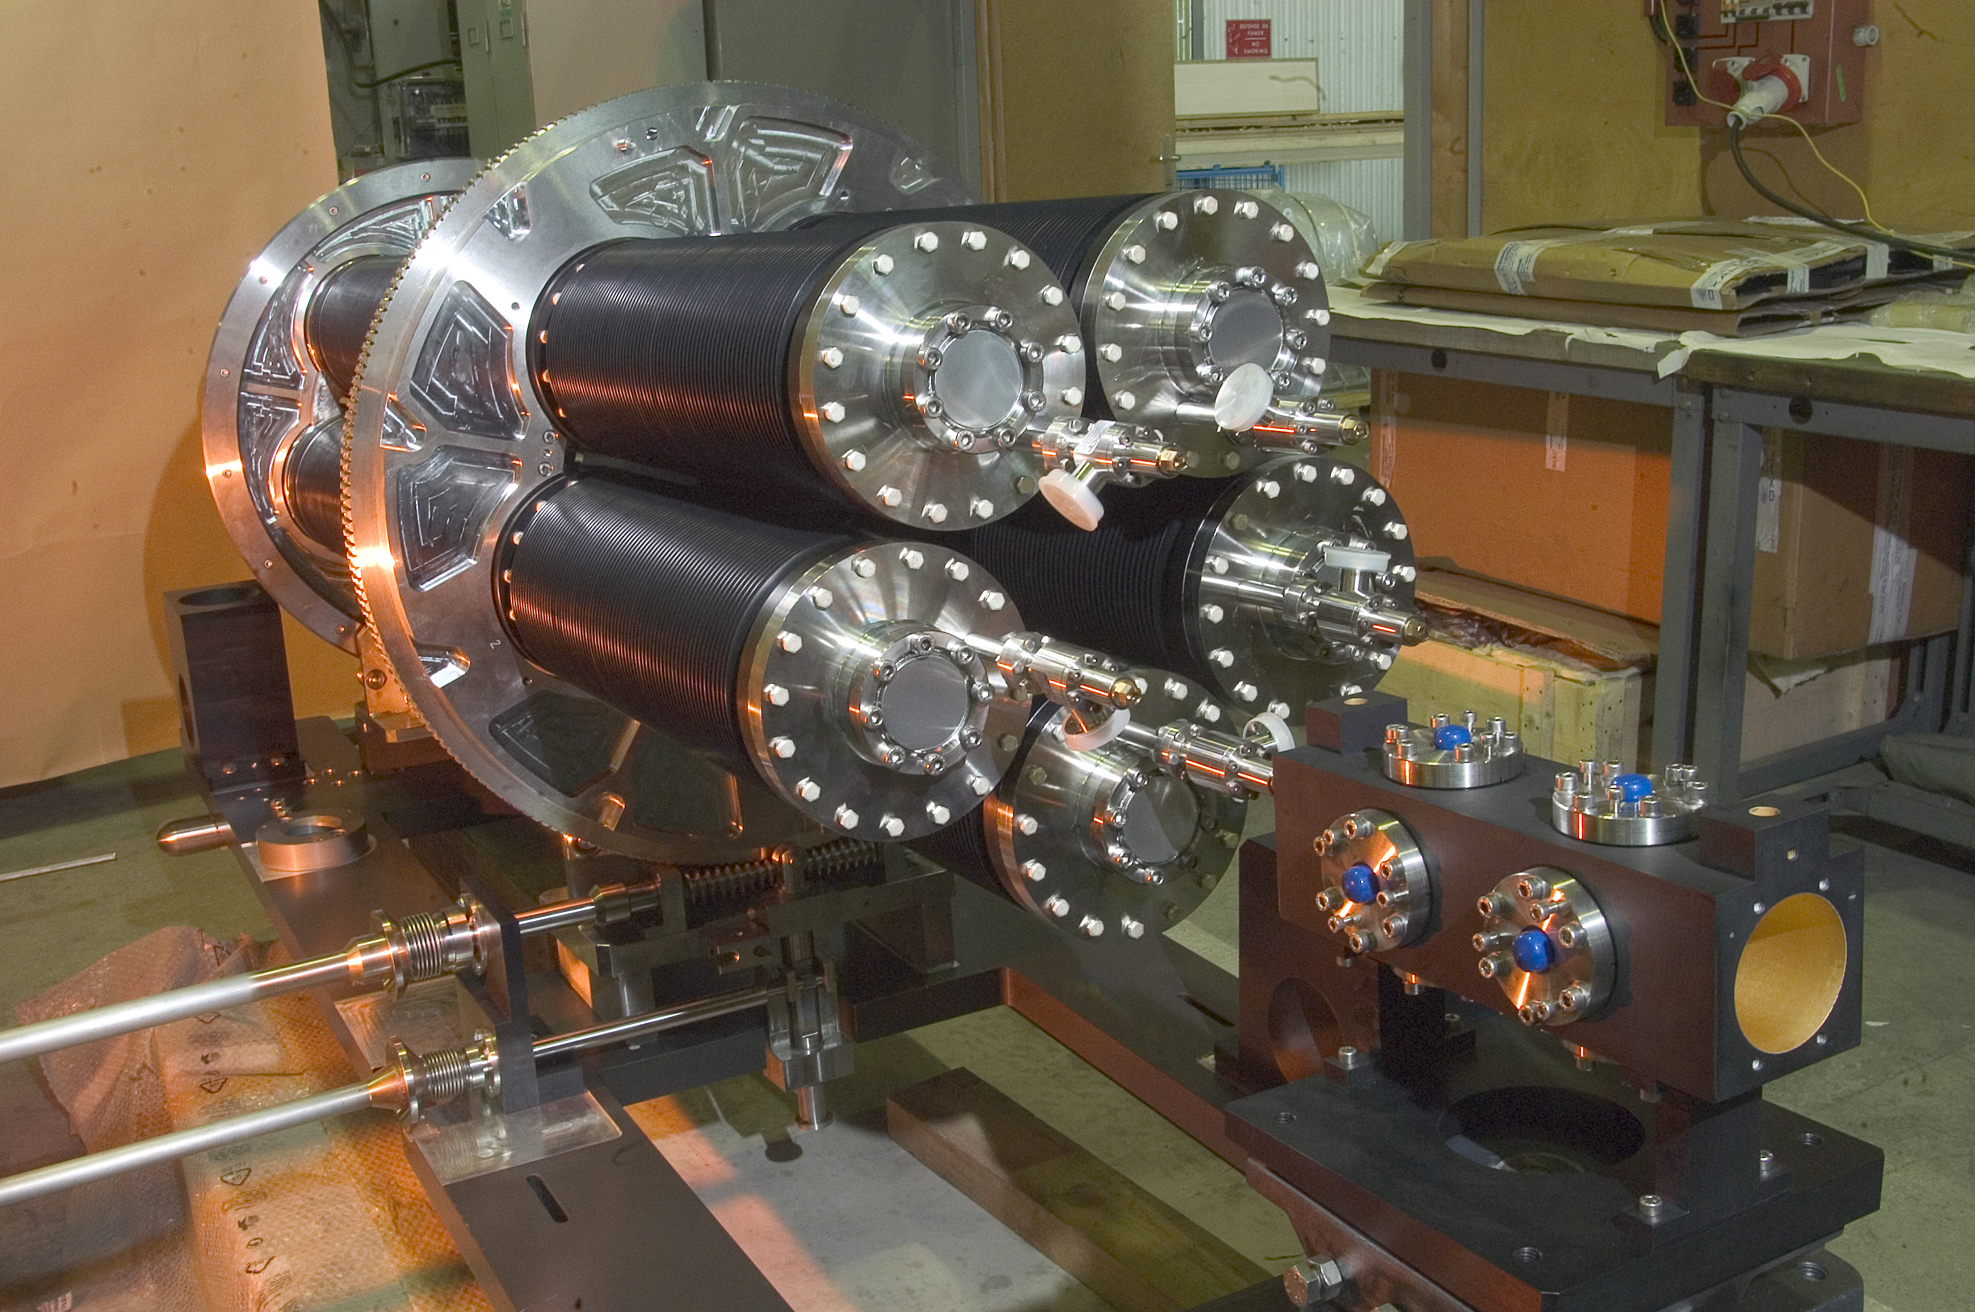
CNGS History
Cern Neutrinos to Gran Sasso
Similarities with SPS beam dump Project :
Protective shielding
Radioactive area
Tight tolerance : +- 0.1 mm transverse

Slide 7
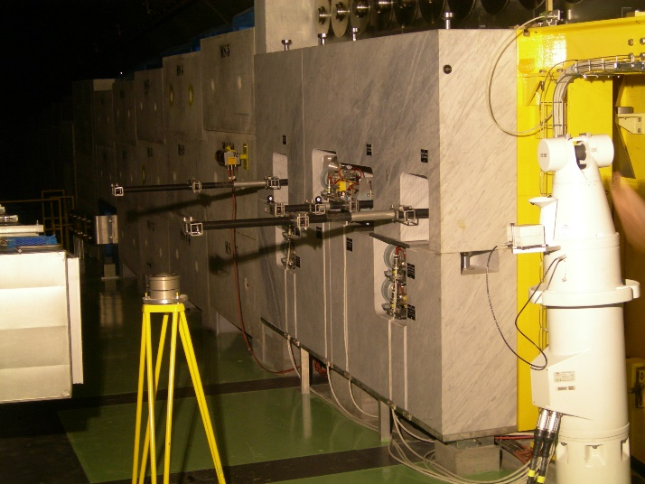
CNGS Measurement
Carbon bar system :
3 vertical for initial alignement
3 horizontal for standard alignement
Lesson learned :
Bars to be used as hidden point device
Weight of the bar to be reduced to a minimum
Extrapolation should not exceed factor of 1

Slide 8
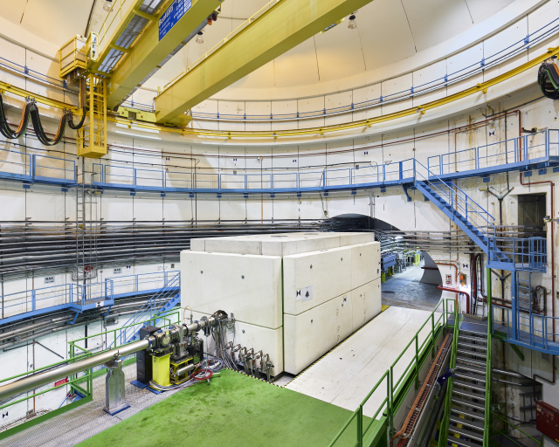
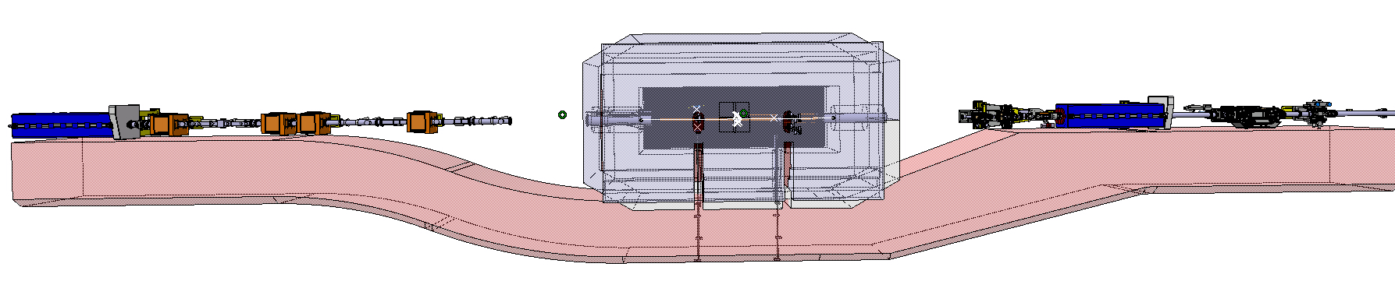
ECX5 Geodetic Network
Regular alignement of the quadrupoles
Transmission of the geometry across the cavern
Alignement of the dump
Transmission of the geometry from reference quads to TIDVG5

Slide 9
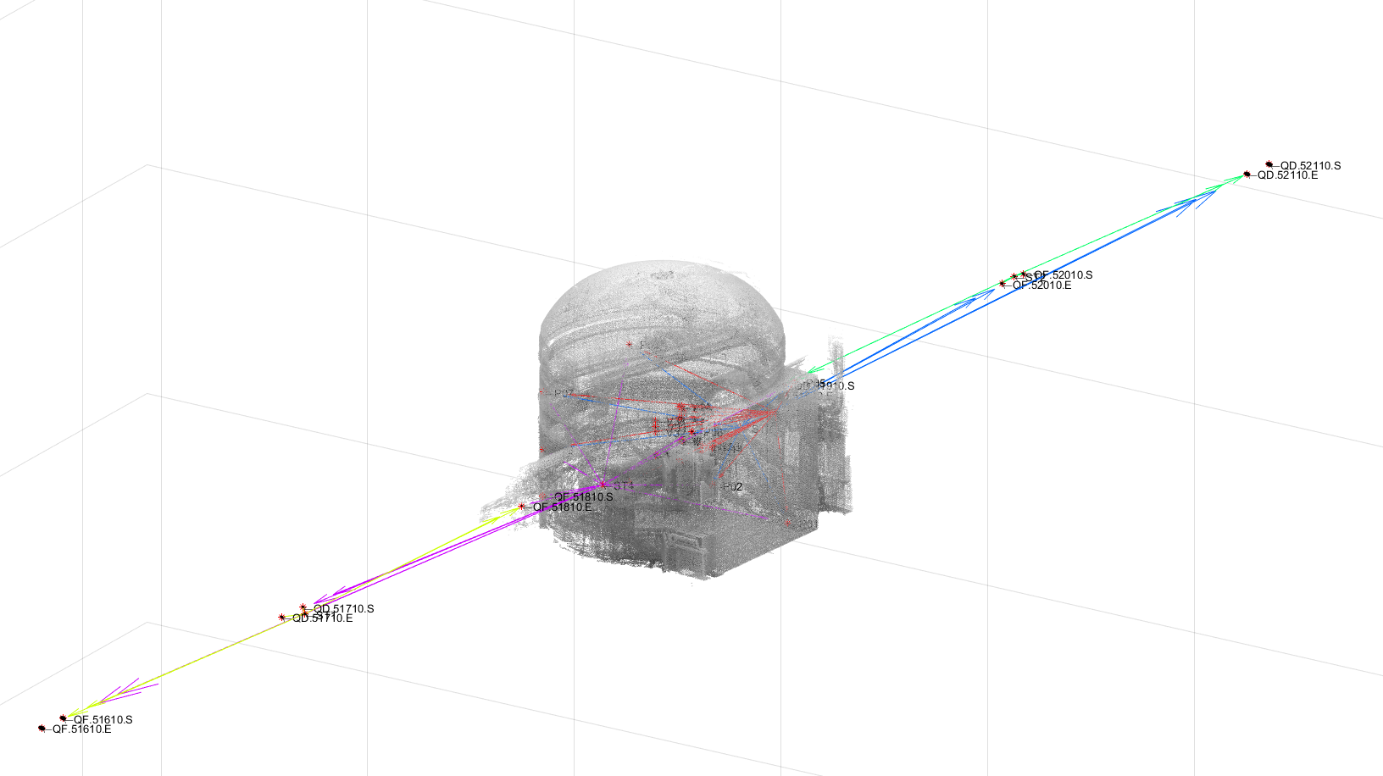
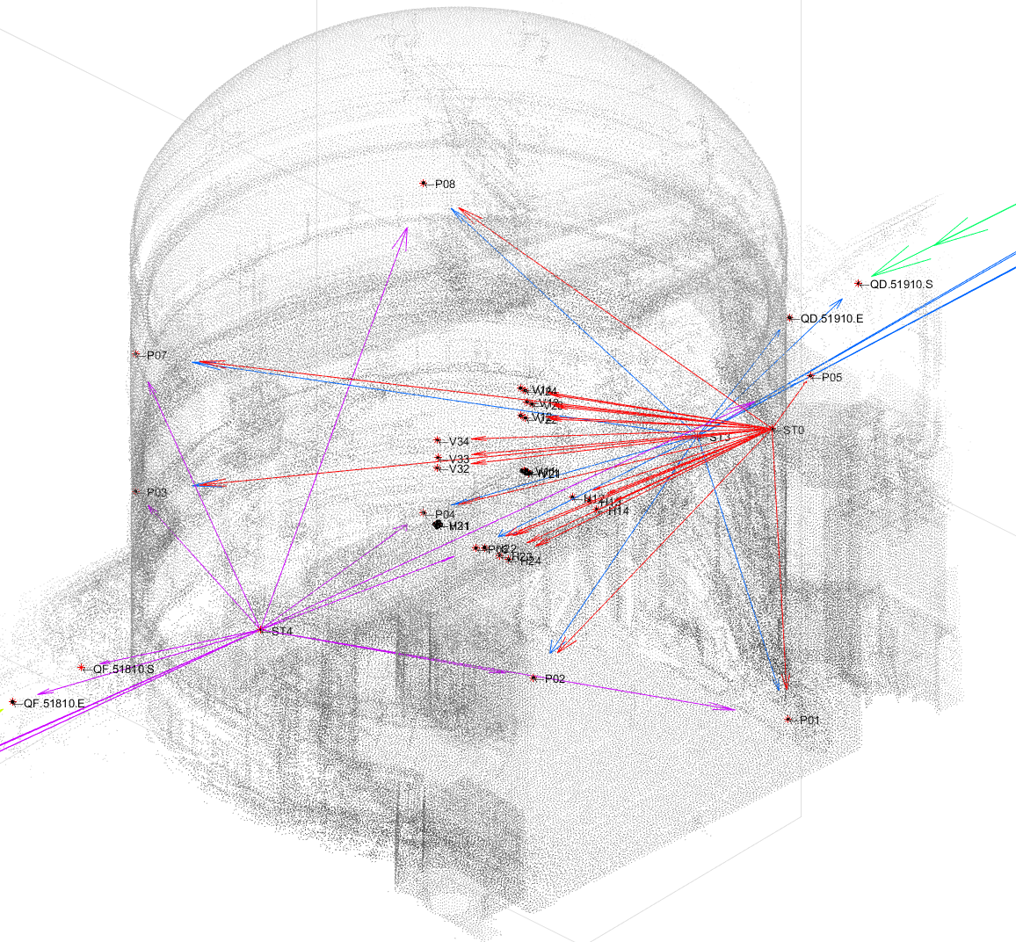
ECX5 Geodetic Network
2 software used for simulations :
Logiciel General de Compensation (LGC2)
SpatialAnalyzer (SA)
Geodetic network materialized with :
Drift nests on 3 floors and all around the cavern
Brackets at strategic positions
Magnets linking machine to the network
Additional drift nests installed along tunnel after first measurement
Name | 3D sigma SA (mm) | 3D sigma LGC (mm)
QF.51610.E | 0.244 | 0.338
QF.51610.S | 0.227 | 0.313
QD.51710.E | 0.017 | 0.169
QD.51710.S | 0.017 | 0.161
QF.51810.E | 0.077 | 0.081
QF.51810.S | 0.047 | Fixed point
QD.51910.E | 0.054 | 0.075
QD.51910.S | 0.077 | 0.071
QF.52010.E | 0.017 | 0.169
QF.52010.S | 0.014 | 0.177
QD.52110.E | 0.220 | 0.313
QD.52110.S | 0.244 | 0.338

Slide 10
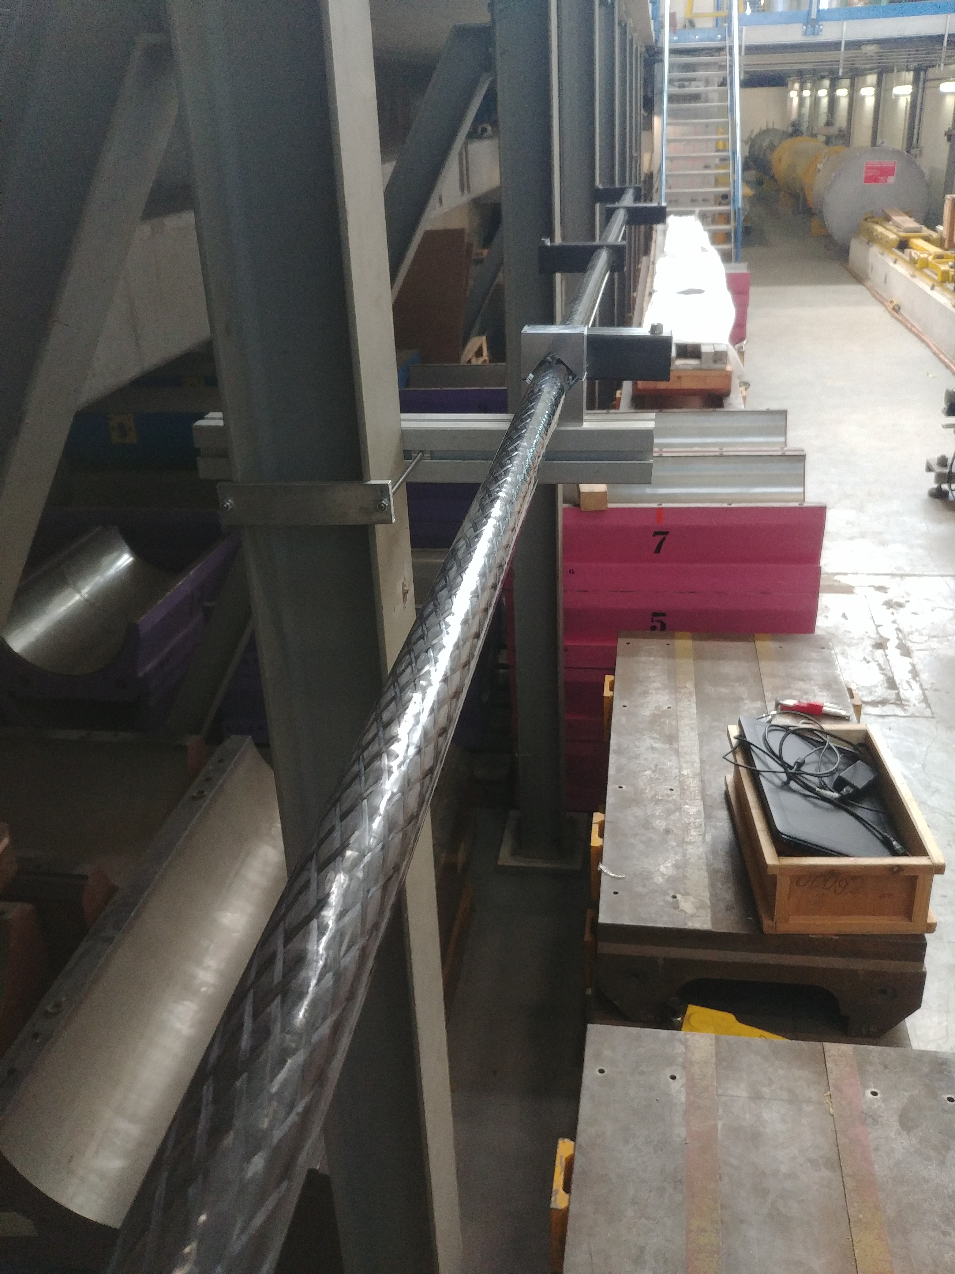
Prototypes :
3-meter long bar testing
Test for effect of deformation of the bar
Precision of best fit transformation for comparison
Z : Vertical, Y : along the bar
Situation | SX (mm) | SY (mm) | SZ (mm)
All positions and dates | 3.785 | 0.066 | 5.972
Same Orientation | 0.059 | 0.007 | 0.597
Same date | 3.363 | 0.067 | 6.233
Same date and orientation | 0.057 | 0.002 | 0.138
Bar to be oriented the same way
weight to be reduced
Precision was promising

Slide 11
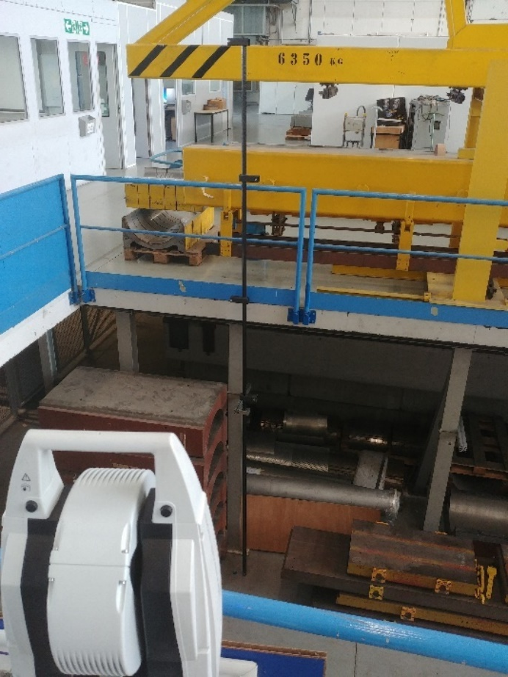
Prototypes :
5-meter long bar testing
Test for accuracy of the system
Comparison of direct laser tracker measurement and indirect (hidden point device) measurement
Z : Vertical, Y : along the bar
Accuracy fits requirement
4-meter long is enough
 | 4 ref point on 5 meter |  |  | 3 ref point equivalent 4 meter
Situation | X RMS (mm) | Y RMS (mm) | Z RMS (mm) | X RMS (mm) | Y RMS (mm) | Z RMS (mm)
Hz | 0.756 | 0.099 | 0.405 | 0.666 | 0.096 | 0.430
Ve | 0.259 | 0.277 | 0.074 | 0.235 | 0.217 | 0.076
Hz same day | 0.624 | 0.071 | 0.239 | 0.556 | 0.069 | 0.222
Ve Same day | 0.083 | 0.07 | 0.042 | 0.076 | 0.059 | 0.041

Slide 12
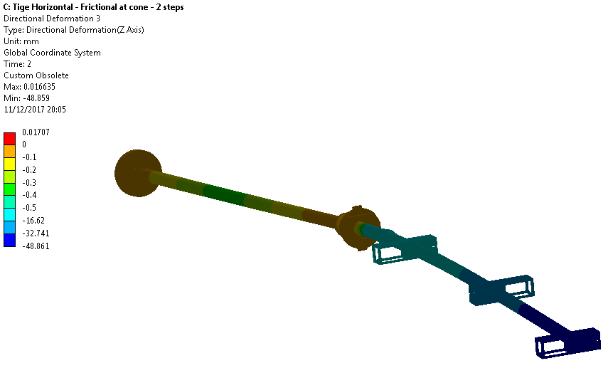
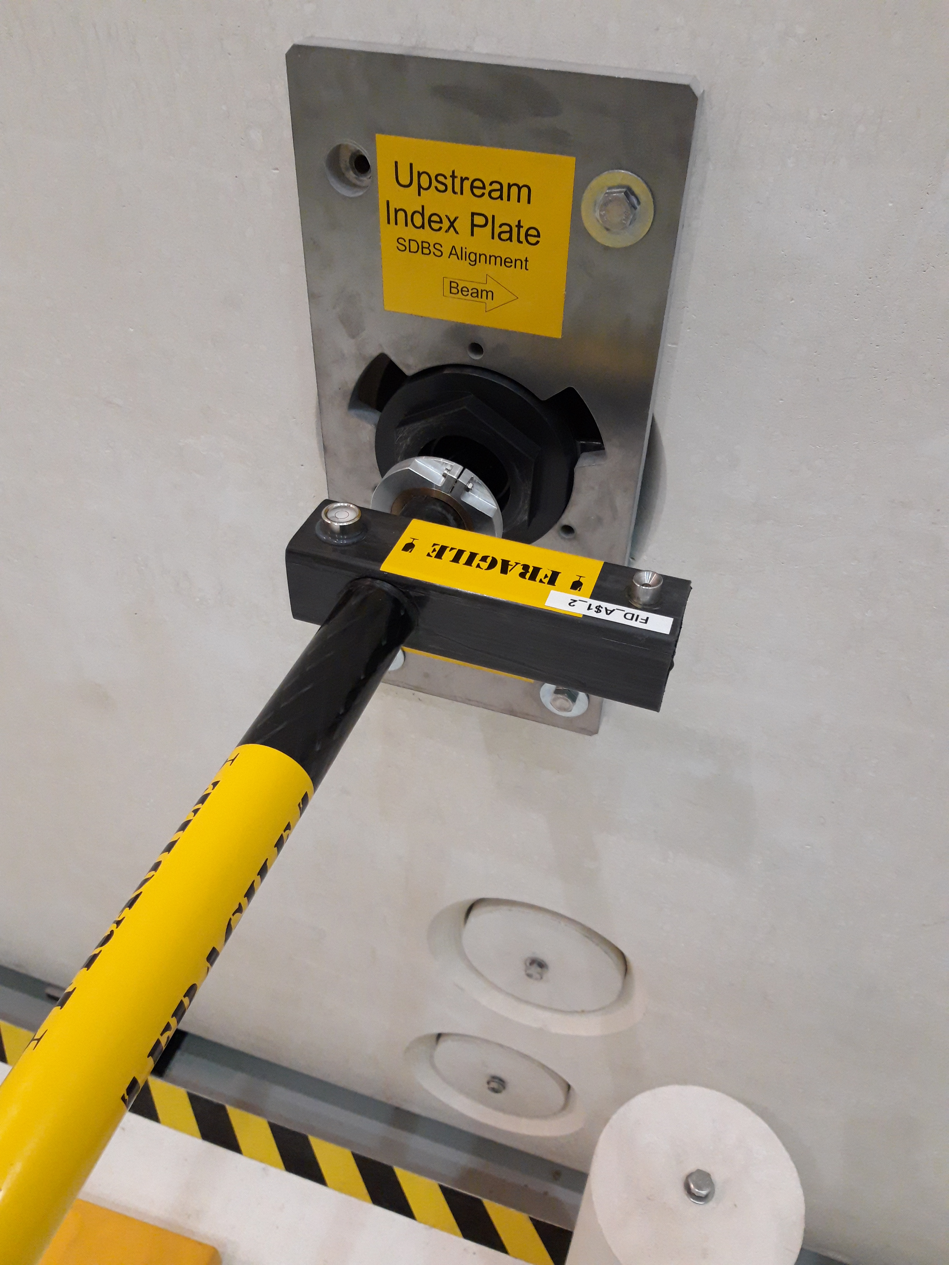
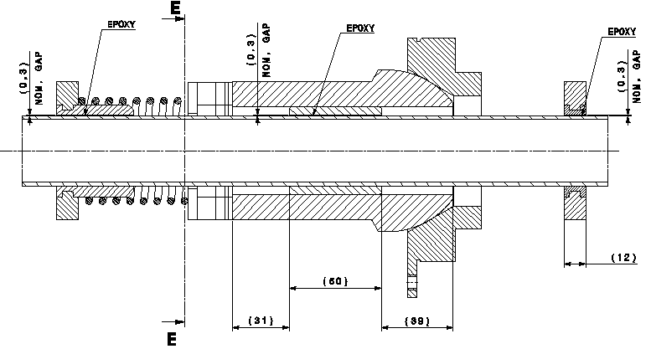
Mechanical design
Check of mechanical deformation under weight
Check of mechanical deformation with supporting system
Determination of the appropriate force for handling

Slide 13
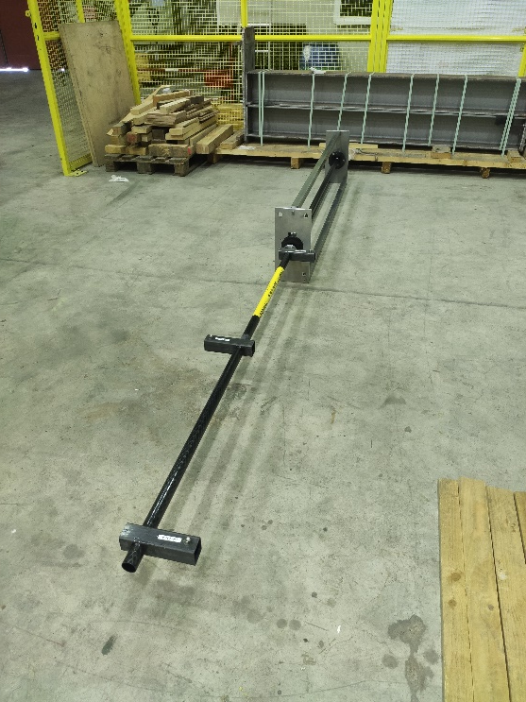
Final 4-meter bars
Tests for final accuracy of the system
Similar constraints on the setup as it would be used on field
3 horizontal bars and 3 vertical
Situation | X (mm) | Y (mm) | Z (mm)
Hz bars RMS | 0.084 | 0.014 | 0.214
Ve bars RMS | 0.114 | 0.093 | 0.013
Hz max error | 0.21 | 0.04 | 0.42
Ve max error | 0.35 | 0.28 | 0.04
Mechanical aspects improved accuracy

Slide 14
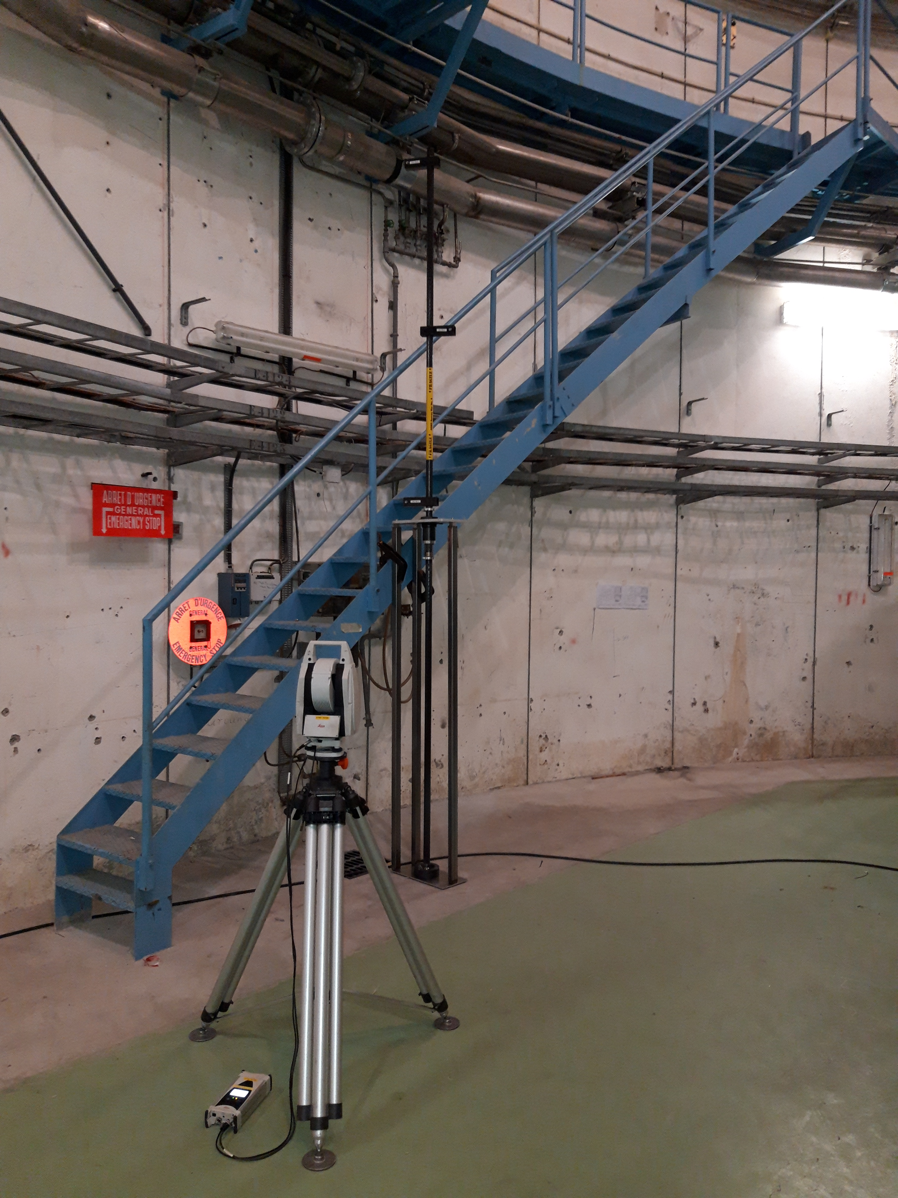
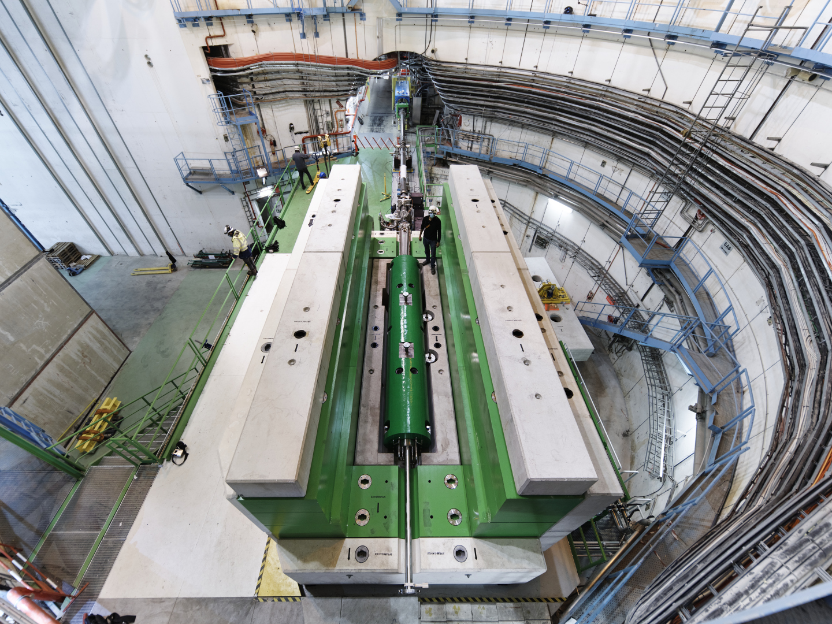
On-site alignement
Pre-alignement with open shielding
On-site Calibration

Slide 15
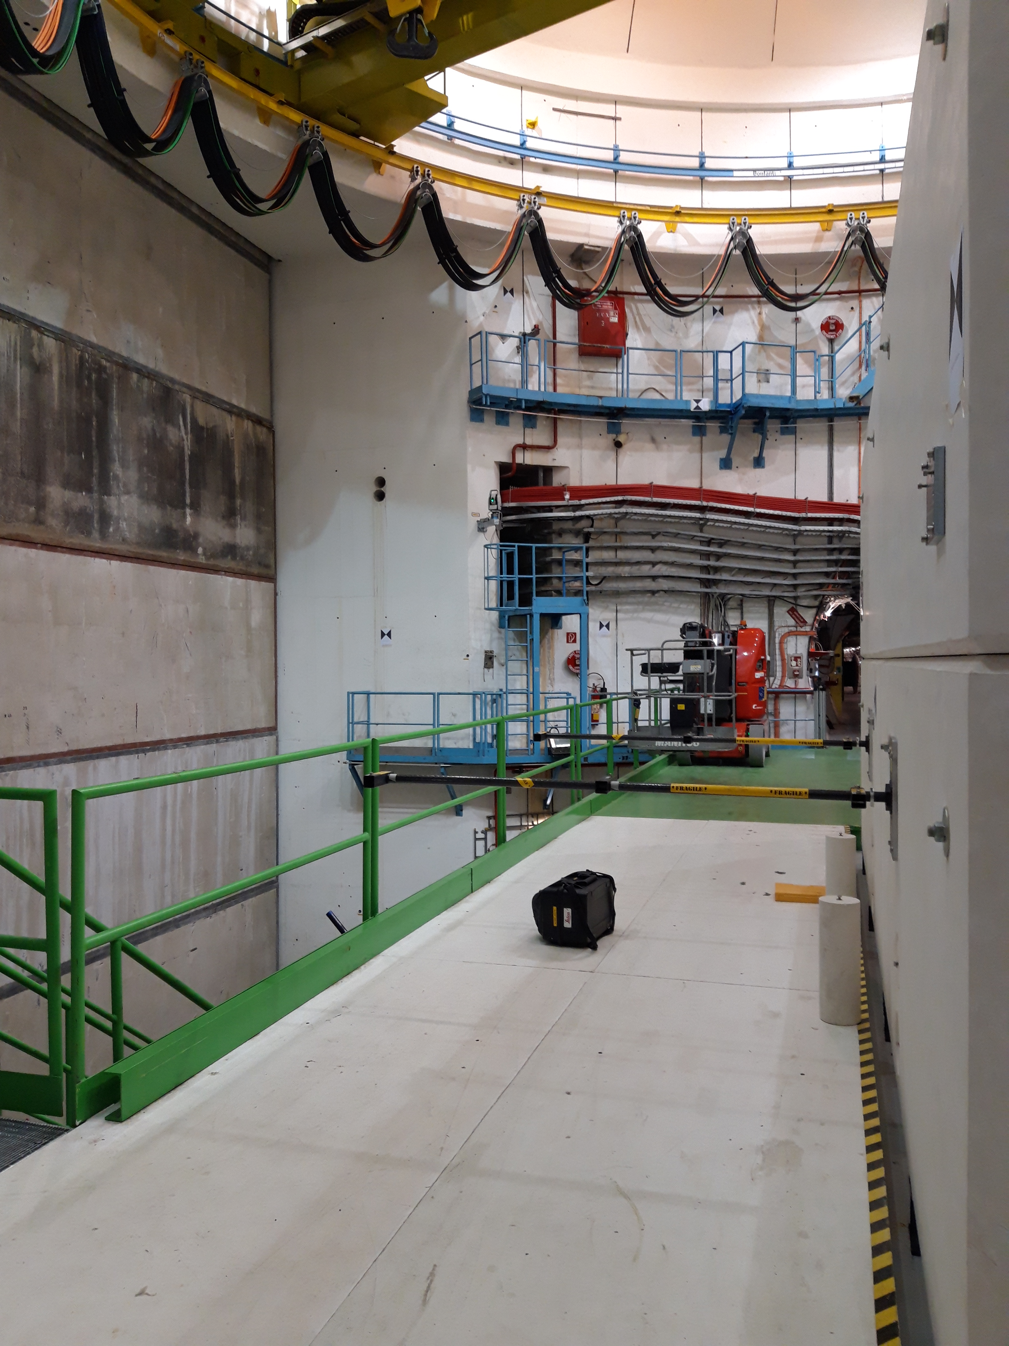
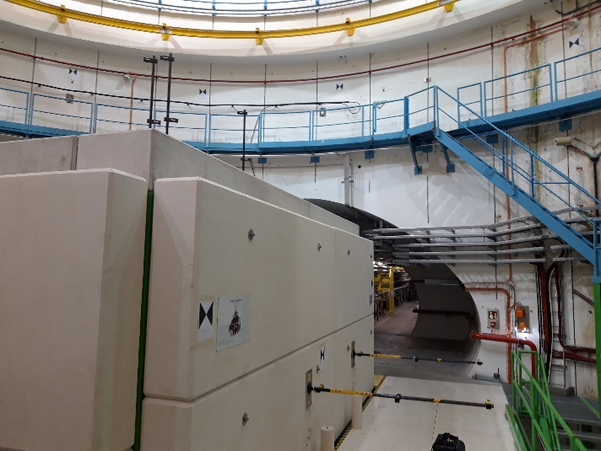
On-site alignement
A posteriori Sigma in CCS :
 | SX (mm) | SY (mm) | SZ (mm)
BEAM_SPS.TIDVG.51872.E | 0.13 | 0.10 | 0.07
BEAM_SPS.TIDVG.51872.S | 0.14 | 0.10 | 0.11
SPS.TIDVG.51872.B | 0.05 | 0.10 | 0.13
SPS.TIDVG.51872.A | 0.04 | 0.10 | 0.12
SPS.TIDVG.51872.T | 0.12 | 0.12 | 0.03
SPS.TIDVG.51872.E | 0.12 | 0.12 | 0.03
SPS.TIDVG.51872.S | 0.13 | 0.13 | 0.04

Slide 16
Conclusion
Experience of the past as a starting point
Laser tracker based solution
Optimisation of the mechanical aspect after first tests.
Accuracy meets the requirement
The system fits to the constraints of radioactive areas
  Simple mechanics
  Maintenance free
  No active part
Robust and failsafe tool to be used for decades

Slide 17
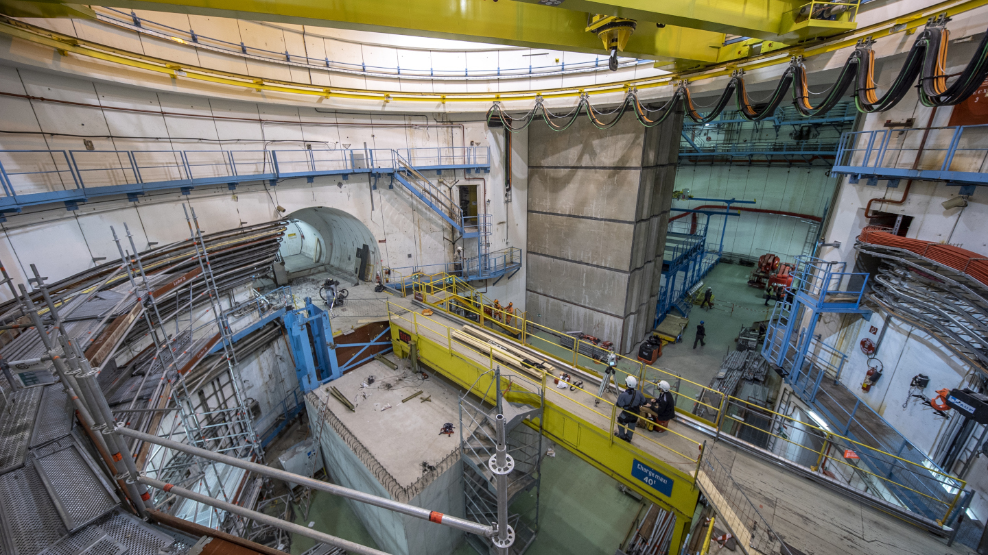
Thank you

