Slide 1
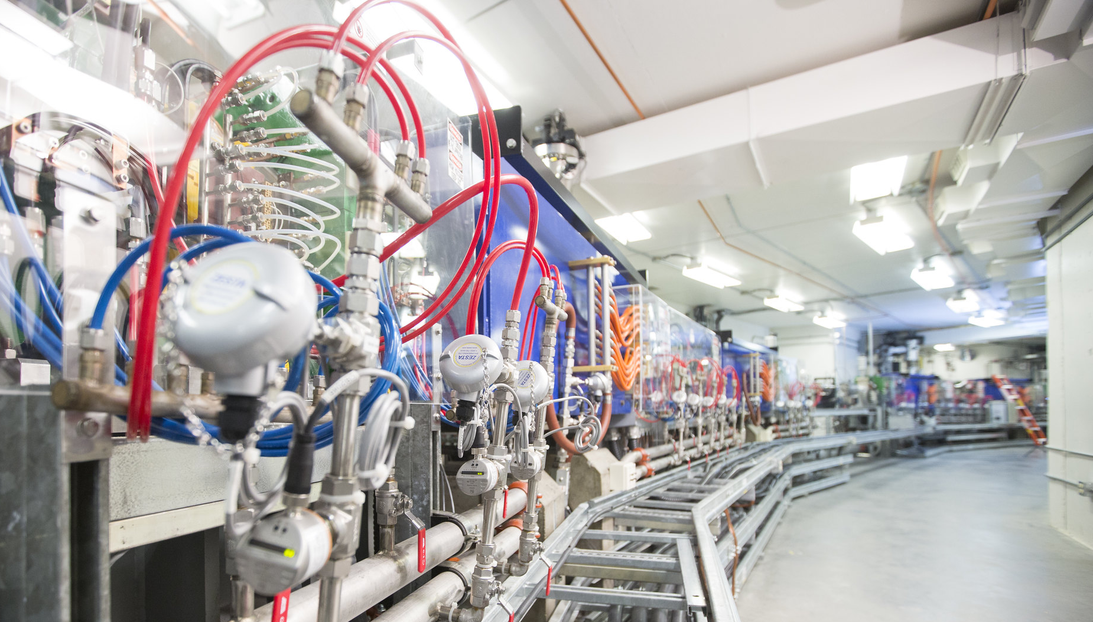
Updating the CLS Storage Ring Reference Network
Presented by David M. Smith
2022-11-03
On behalf of the CLS SA&V Team

Slide 2
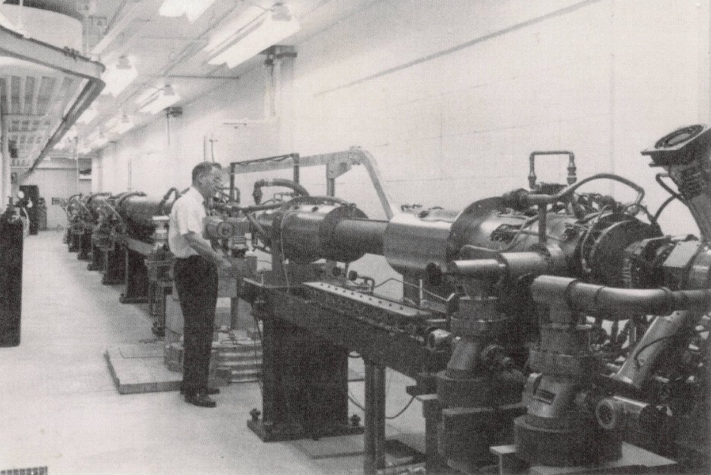
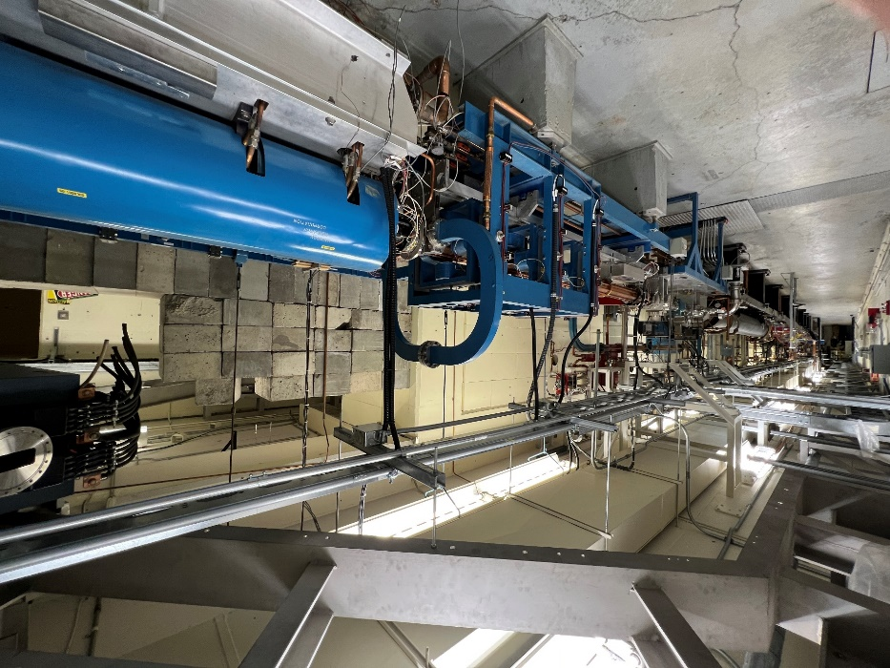
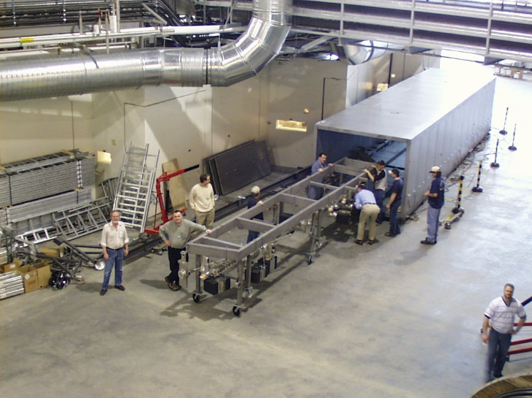
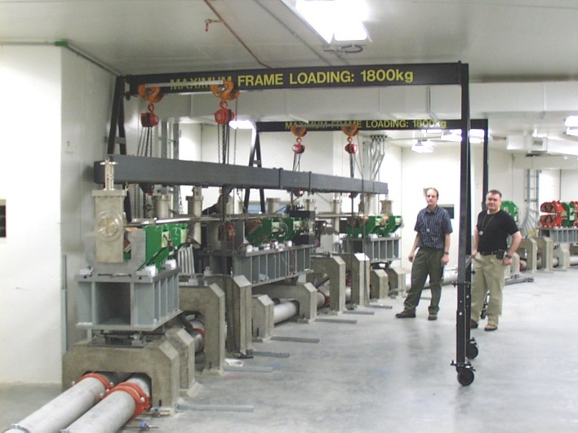
Background
The Canadian Light Source (CLS) is Canada’s only Synchrotron
Storage Ring constructed in 2003, first light December 2003
CLS was built upon the infrastructure of the Saskatchewan Accelerator Laboratory, which was built in the early 1960’s
Vacuum chambers being installed in February 2003
CLS LINAC, the same location, just sixty years apart!

Slide 3
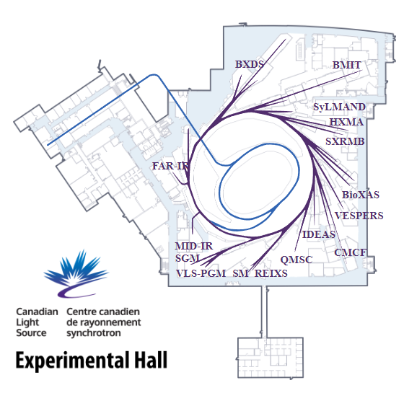
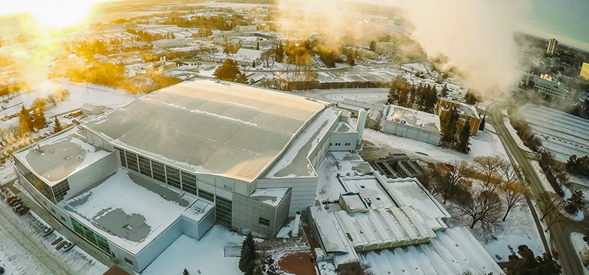
Background
3rd Generation Synchrotron
  171 m circumference
  2.9 GeV, 220 mA top-up
  22 operating beamlines
Recently completed Phase III (2019), completed suite of operational beamlines*
Facility is focusing on the following:
  Renovation of older beamlines,
  New experimental methods and expanding user base, and
  Improving machine performance (2 RF cavities).
Canadians love talking about our weather, typically goes from -30°C to +30°C each year
*there is room for one more insertion device beamline, but no construction plans at this time

Slide 4
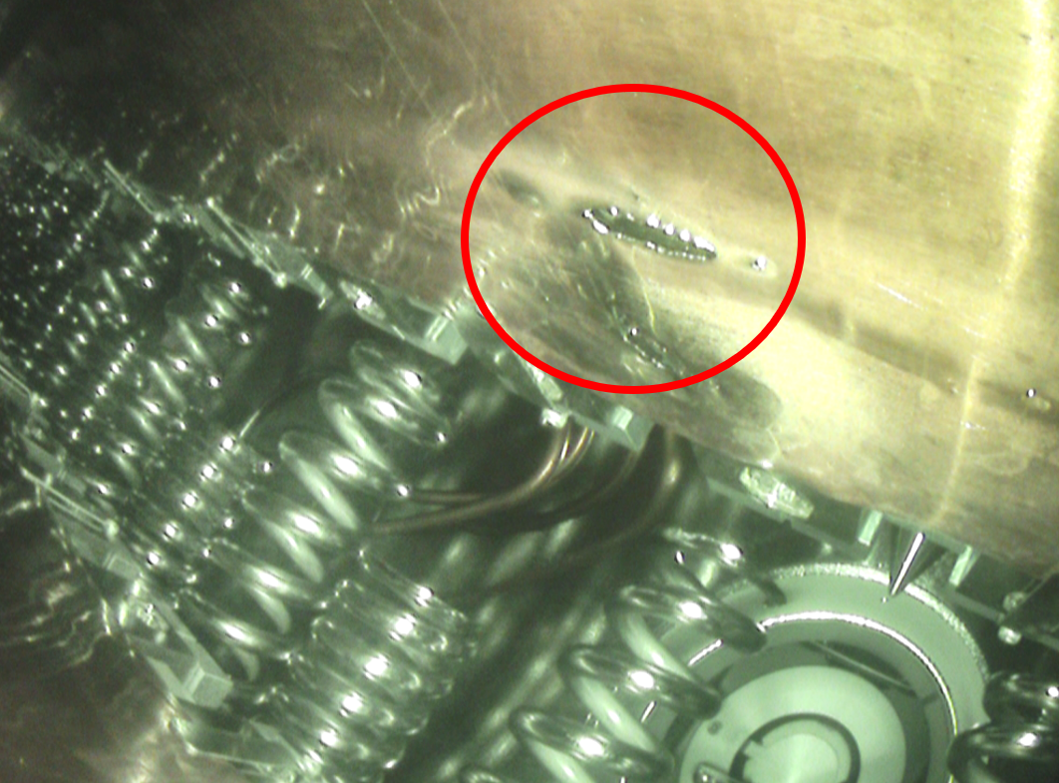
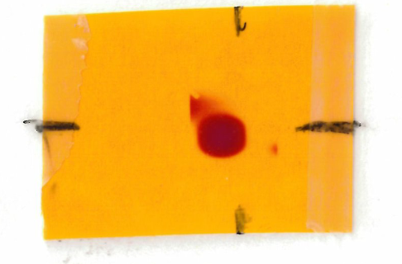
Background
CLS Storage Ring girders remained untouched since installation, considered OK given low alignment demands and high emittance (ε_{x} = 18.1 nm-rad).
Large Beam Position Monitor (BPM) offsets were used to steer the electron beam (150 – 500 µm) to align SR beam.
Machine alignment became a larger concern when 1) an in-vacuum insertion device was damaged, and 2) some BPM offsets seemed to restrict top-up mode from working.
In-vacuum wiggler’s foil damaged due to missteer + orbit correction thresholds, large BPM offset and improper orbit control thresholds
BPM
BPM
e⁻ beam
Q
V
Q
BEND
S
Q
S
Q
S
BEND
Q
V
Q
Straight Section
Radiation indicator result 12 m downstream of insertion device. Dipoles completely misaligned from theory (black tick marks)
CLS double bend achromat layout. Orbit correction steers the beam to BPM centers plus any offsets. Not easy to move or shim individual magnets or BPMs

Slide 5
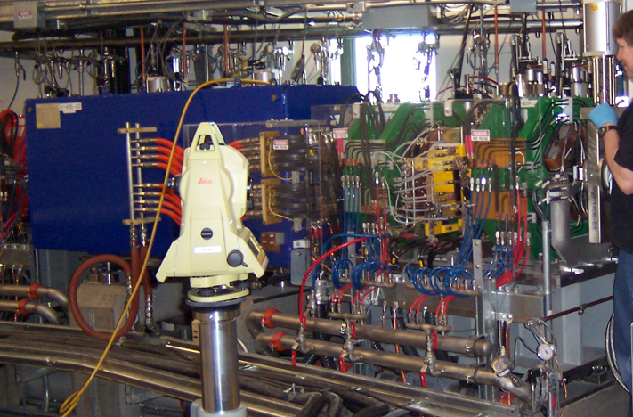
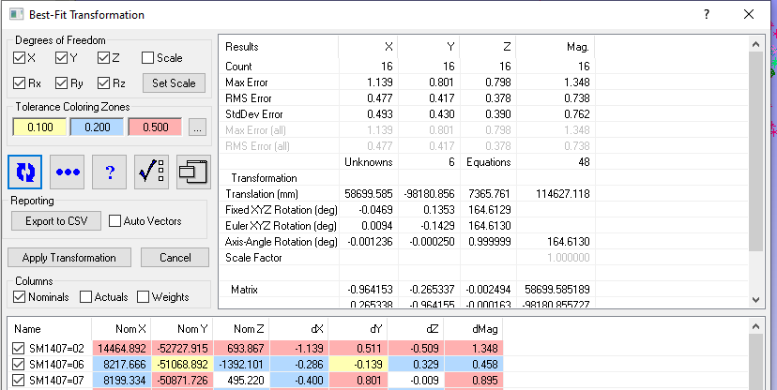
Background
Before considering alignment work in SR, the reference network needs to be addressed
Combination of concrete curing (seen at many new synchrotrons), equipment drift, and original network formation methods has led to a poor network (high error, poor locates)
  Locate to SR Network ≥ 0.50 mm RMS error, ≥ 1.00 mm MAX error typical
  Locate to SR Quads ≥ 0.25 mm RMS error
Locate error dominates any survey or alignment performed in the SR
CLS Survey, Alignment, and Vibration (SA&V) pursued updating the network in the SR in 2021
Leica Wild TC2002 total stations for alignment
Typical locate to reference network in the SR

Slide 6
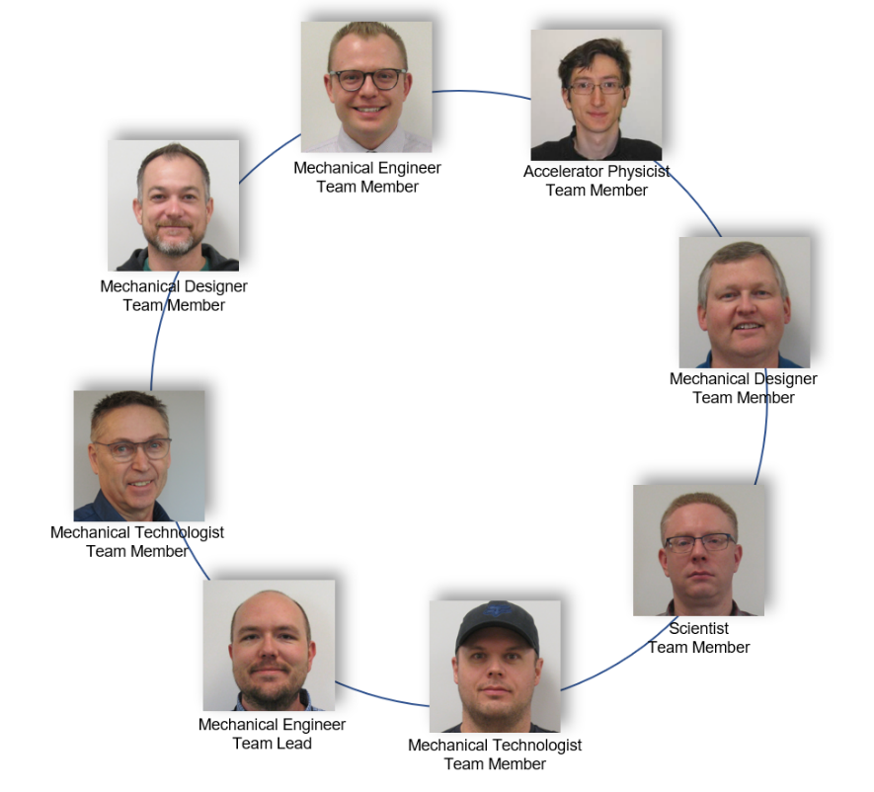
The SA&V Team
The SA&V team was formed in 2019 in anticipation of upcoming alignment work and
Not a “department”, but an inter-departmental task force and research team, spend 10% - 20% of their time on SA&V work
Glad to be back at IWAA!
CLS SA&V Team
2022
Team Mandate
Develop of SA&V protocols
Conduct SA&V tasks
Maintain software, equipment, and methodologies
Advance knowledge
EQUIPMENT MAINT. AND UPGRADES
REFERENCE NETWORK MAINT.
MACHINE ALIGNMENT
VIBRATION

Slide 7
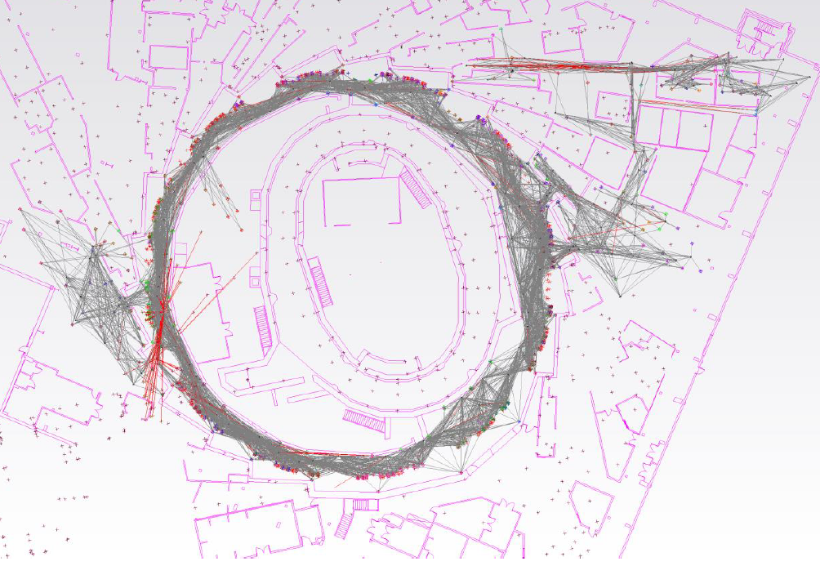
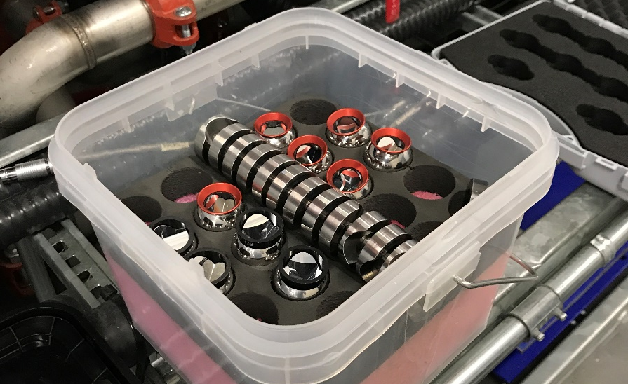
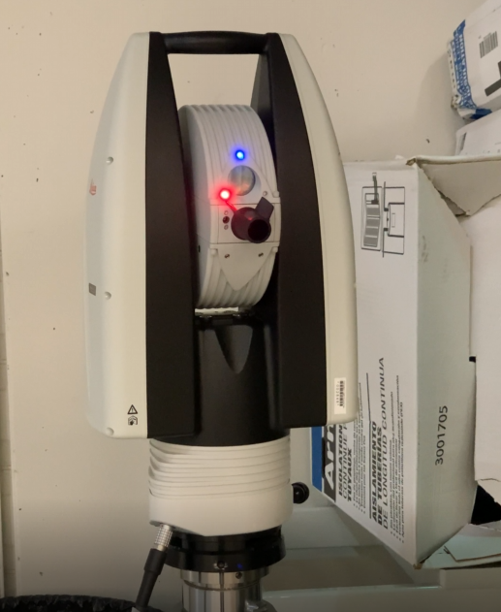
Methodology
During the Spring of 2021, SA&V team did complete resurvey of the SR including monuments and components
Included two beamlines, BXDS and CMCF (monuments only)
642 monuments, took two months due to a COVID-19 outbreak at the facility
Multiple SMR’s allowed for quick capture using auto-measure features of SA
All setups and shots shown for network creation shown in SA
SA&V team uses a Leica AT960-LR for survey measurements

Slide 8
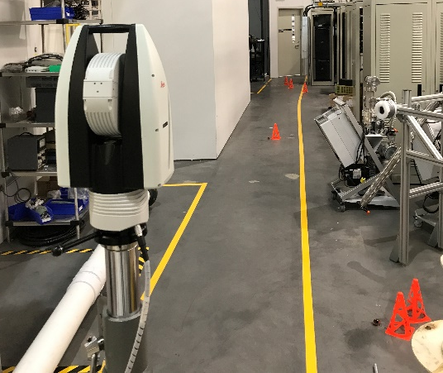
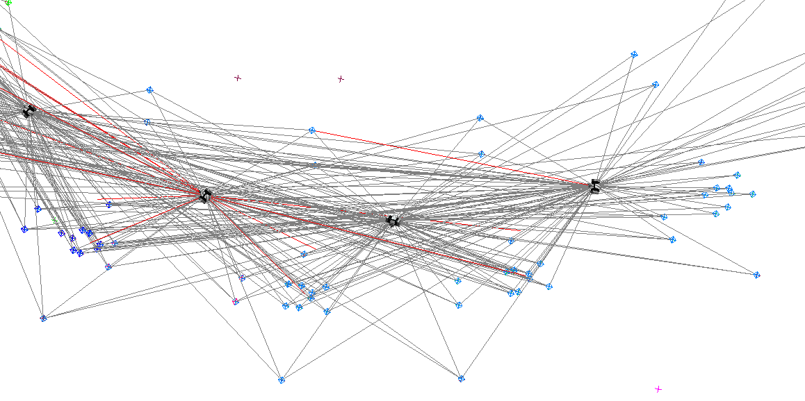
Methodology
General rules for collecting the data
  Each point captured minimum 4 times,
  Minimum one opposed measurement from another viewing angle. The more view angles, the better
Tracker is located to the original network via 3 points (Nominal Points method)
AT960-LR can capture multiple retroreflectors quickly using Auto-Measure
Laser tracker setups chosen to overlap to make sure each point is captured a minimum of four time. Usually each point is captured at least twice from each side.

Slide 9
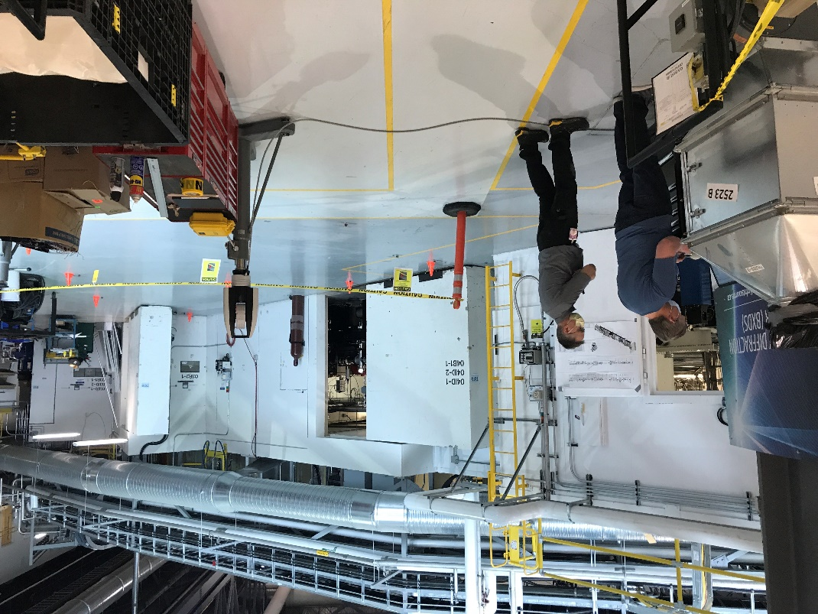
Methodology
First level of trimming outliers (data cleaning) occurred daily either on the floor or afterward when reviewing the data by best fitting shots to the original network.
Test locates were performed through the process (every few days) to temporary USMN’s to ensure consistency
Further trimming done in SpatialAnalyzer’s (SA) Unified Spatial Metrology Network ranking feature (USMN)

Slide 10
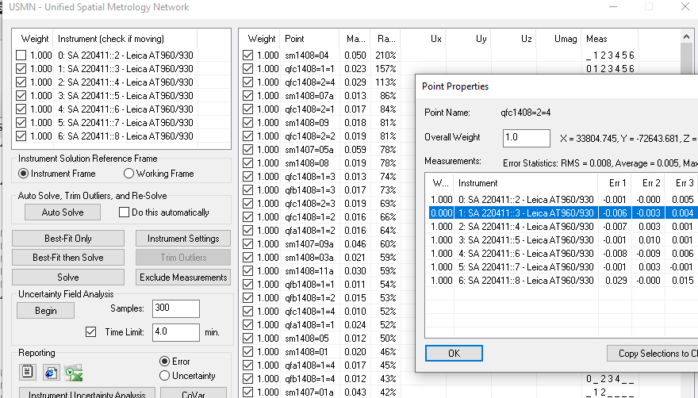
Methodology
Table 1: Ranking analysis guideline for point weighting.
Goal of trimming outliers:
  Maximum ranking of 100% (or as close as reasonably possible), and
  Minimize the number of measurements removed, less than 10%.
“the percentage of the expected 3-sigma envelope consumed by the maximum measurement residual […] points with smaller rankings are more tightly clustered around the optimal value” ^{[1]}.
Max IV Survey, Alignment and Mechanical Stability team provide excellent discussion of how the ranking works for outlier removal ^{[2]}. We followed many of the procedures outlined in their paper.
Situation | Step | Ranking [%] | Weighting | Situation | Step | Ranking [%] | Weighting
≥ 4 measurements for point | 1 | >150 | Single measurement set to 0 | < 4 measurements for point | 1 | >150 | Whole measurement collection set to 0
 | 2 | 100 < x < 150 | Single measurement set to 0.5 |  | 2 | 100 < x < 150 | Whole measurement collection set to 0.5
 | 3 | >100 | Single measurement set to 0.25 |  | 3 | >100 | Whole measurement collection set to 0.25
[1] Hexagon Metrology Inc., SpatialAnalyzer User Manual (2022).
[2] B. Afzali-Far et al., “Data analysis, spatial metrology network, and precision realignment of the entire MAX IV linear accelerator,” Nucl. Instrum. Methods Phys. Res. A. 1003 (2021); https://doi.org/10.1016j.nima.2021.165267

Slide 11
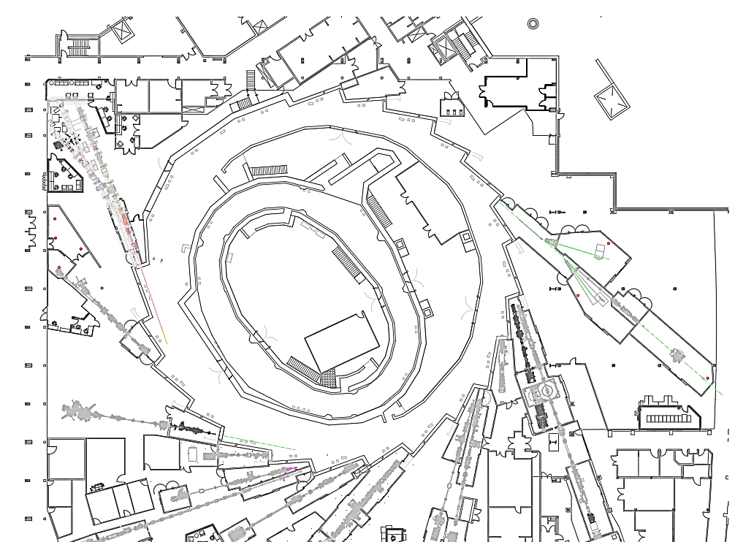
Methodology
Boundary conditions used to minimize alignment at key transition area (sensitive beamlines, Booster Ring to SR interface). Boundary conditions brought in as mini-USMNs (USMN with points)
These areas are perturbed less than the other point groups at the cost of a residual error
Added benefit, helps minimize alignment at sensitive transition areas, where alignment could affect machine performance
CMCF
Storage Ring
BXDS Focusing Region
BTS
BXDS
Table 2: Final weighting of boundary conditions.
CMCF Focusing Region
Boundary Condition | Weight | Notes
Historical Reference Network | 0.1 | Original machine alignment
BXDS Focusing Region | 2.0 | USMN included 4 instruments
CMCF Focusing Region | 2.0 | USMN included 6 instruments
BTS + SR Interface | 3.0 | USMN included 4 instruments
CLS layout showing general location of boundary conditions relative to the SR

Slide 12
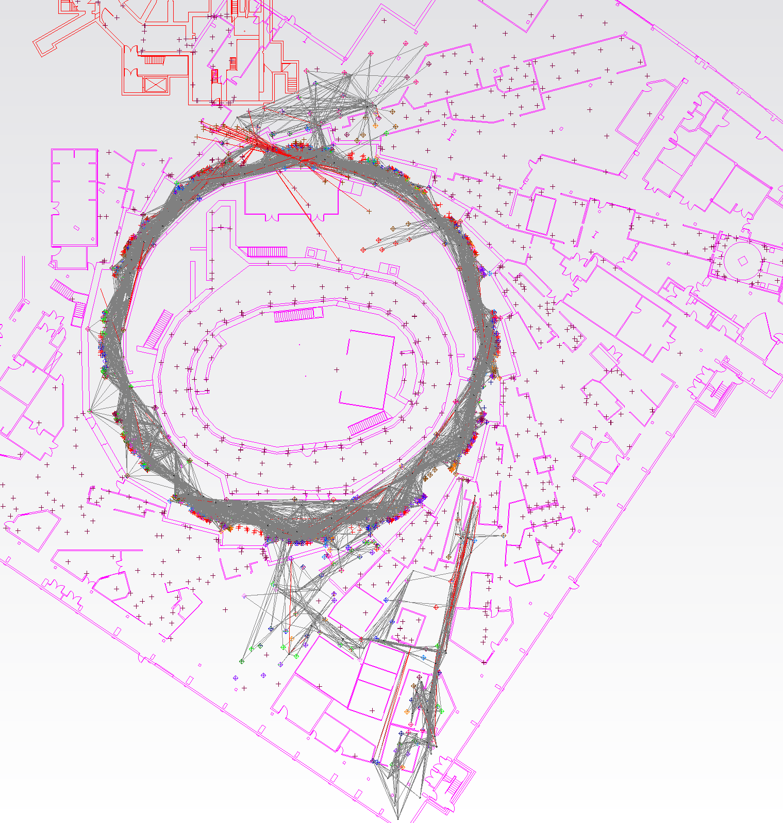
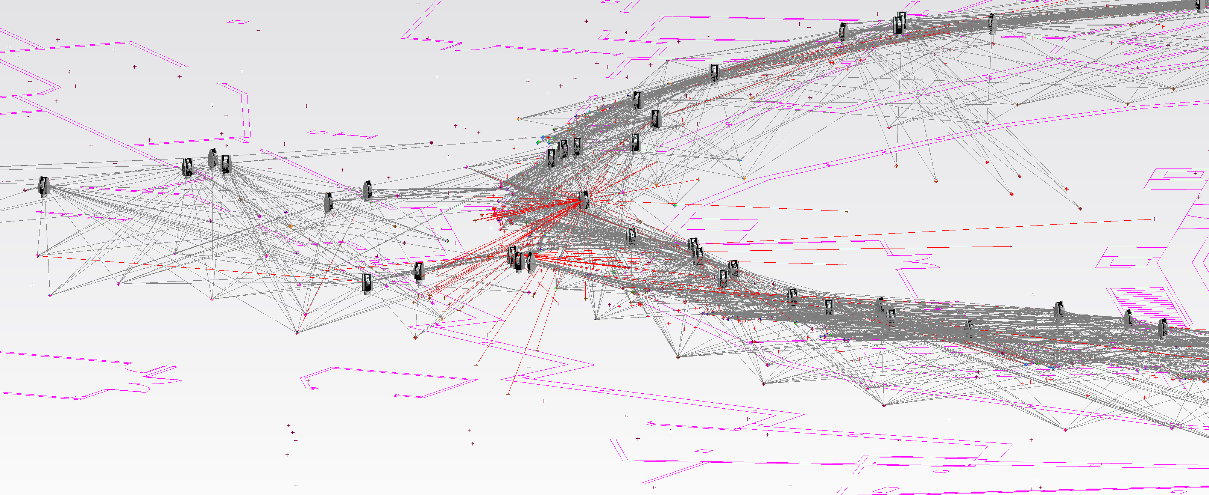
Methodology
Network uncertainty calculated to 99.7% confidence interval (3σ), 500 samples (analysis takes ≈4.5 hours)
End goal for final network:
  Average network error ≤ 0.100 mm,
  Average network uncertainty ≤ 0.050 mm

Slide 13
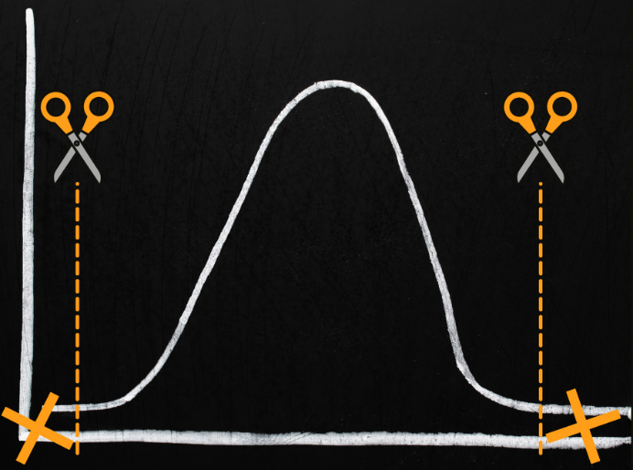
Results
Cleaning guidelines applied to data
After cleaning the data, 8% of original points were removed, mostly control points from the Historical Reference Network
We were able to reach ranking of 100%, but noticed diminishing returns on final network result around 110%
About 14 different USMN iterations were completed
Table 3: Outlier results before and after cleaning
 | Before-Cleaning | After-Cleaning
Number of Stations | 150 | 150
Number of Points | 642 | 642
Number of Measurements | 5469 | 5050
Max Ranking | 733% | 100%
RMSE of network (mm) | 0.34 | 0.13

Slide 14
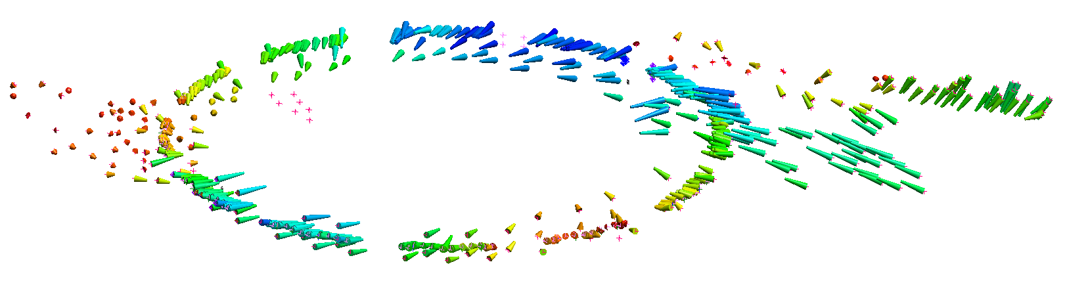
Results
Significant change in some areas from original network
CMCF
BXDS
BTS
Graphical displace showing magnitude change from original network to the new network. Minimum change captured in blue (min = 0.04 mm), max change in red (max = 5.18 mm)
Table 4: Network statistical results
Did not meet uncertainty goal in Z axis, but we did in the X and Y axes (horizontal)
Average error < 0.100 mm
 | Error (mm) | Ux (mm) | Uy (mm) | Uz (mm) | Umag (mm)
Average | 0.094 | 0.045 | 0.048 | 0.131* | 0.148*
RMS | 0.127 | 0.056 | 0.056 | 0.198 | 0.213
* did not meet our goal criterion

Slide 15
Conclusion
Overall the creation of the new network was successful
New locates averaging less than 0.080 mm RMS error
  Not surprising it’s better given the method of capture, but does it describe reality?
  Significant deviation from original network, how much is 20 years of shifting concrete and components, how much from other factors
  Future work reviewing residual error in the boundary condition areas, compare against beamline alignment
  Desire to continue with epochs of measurement once we’re confident in path forward

Slide 16
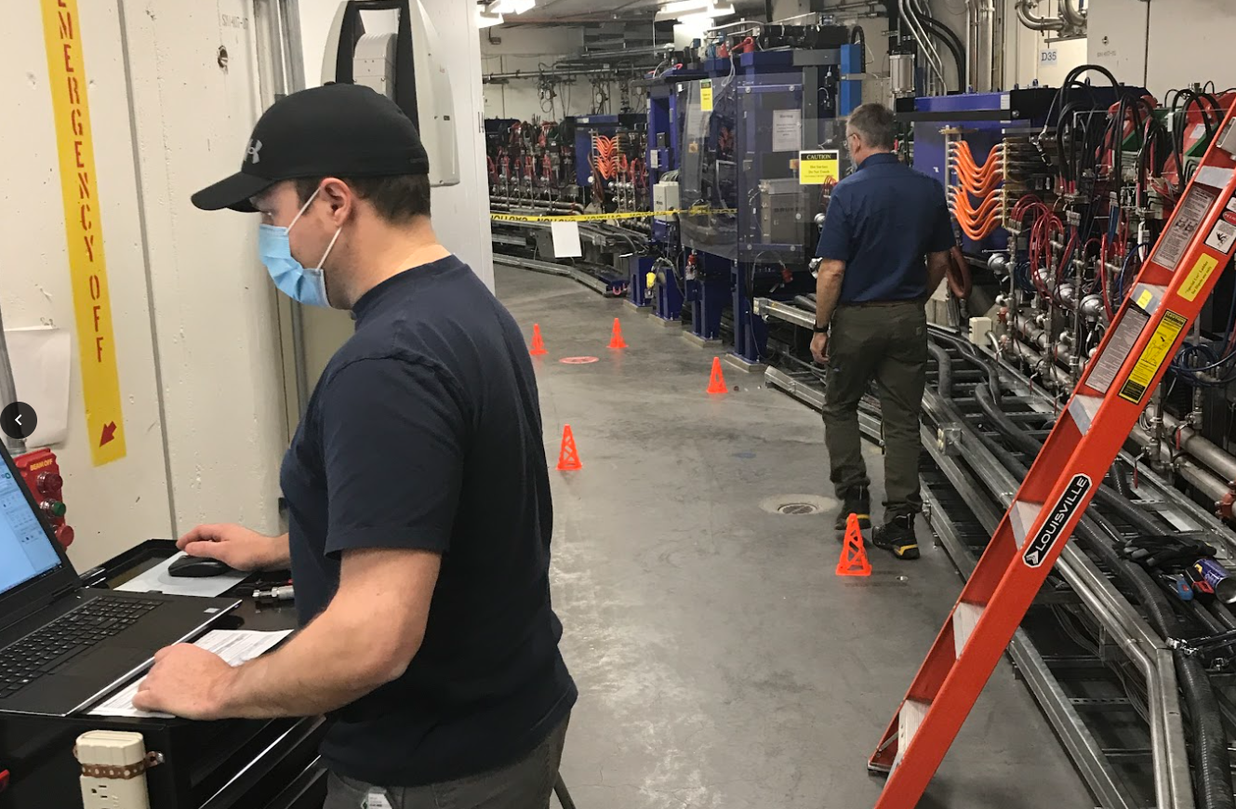
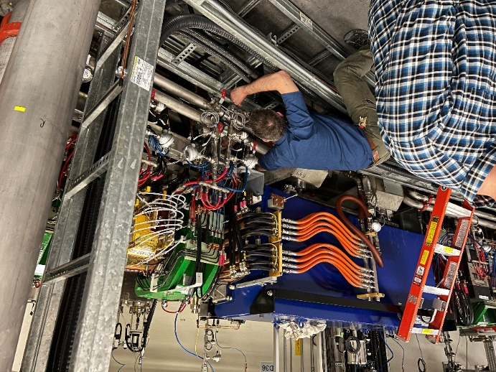
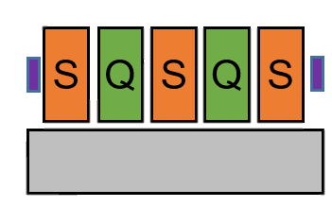
Conclusion
New network has since been used for girder adjustments in the Storage Ring, “quasi-alignment”
Girder moves were to eliminate large BPM offsets, moving girder to BPM position, remove stress on orbit control
Further work, analysis needed before pursuing SR alignment (diagnostic tools, simulations, quad centers)
SA&V team in the CLS Storage Ring
Exaggerated Reality Before Correction
BXDS IVU
e⁻ beam
Q
Q
BEND
V
After Correction, Aligned
BXDS IVU
e⁻ beam
Q
Q
BEND
V
Adjusting a quad girder
Girder moved up

Slide 17
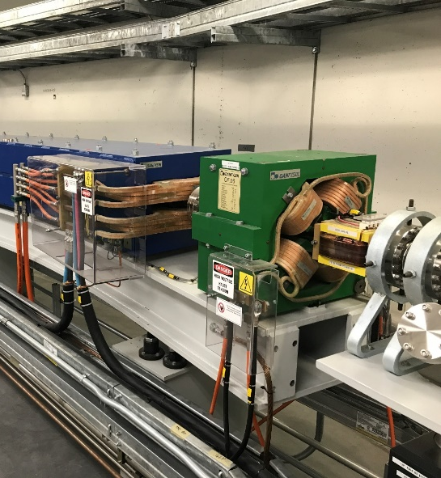
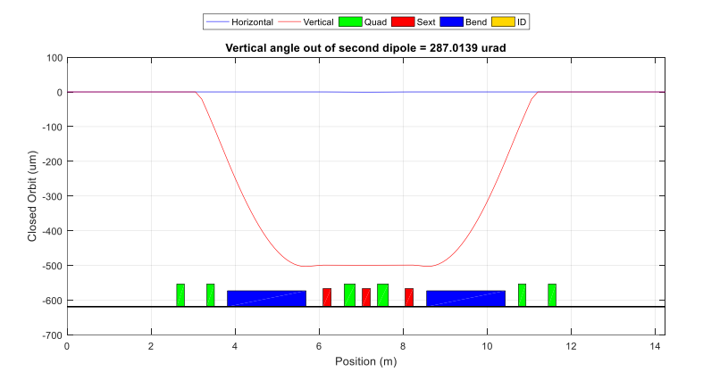
Future Work
Further study of new network ongoing, continuing to survey other machine areas in the meantime
Booster Ring (BR) next area of interest
  BR has always had major alignment issues (poor energy acceptance, high dispersion)
  Goal is to update network in BR, measure components
  Evaluate magnet positions and work with physicists to simulate alignment changes
  Develop our diagnostic tools (magnet fiducialization, corrector current measurements)
Plan is to first develop a methodology to align (smooth) the BR. If successful (proof of concept), this will be applied to further alignment in the Storage Ring.
Typical BR dipole, quad girder
Elegant used for Booster and Storage Ring simulations

Slide 18

Acknowledgments
Only one member of a larger team!
Special thanks to those from other facilities who met with our team for discussions on our alignment work:
  Behrouz Afzali Far and MAX IV SAM team
  Rodrigo Junqueira Leao, GSI Helmholtz Centre for Heavy Ion Research
Special thanks to IWAA International and Local organizing committees
CLS SA&V Team
2022

