Slide 1
Alignment for the ESRF Extremely Brilliant Source
IWAA2022 CERN
David Martin ESRF

Slide 2
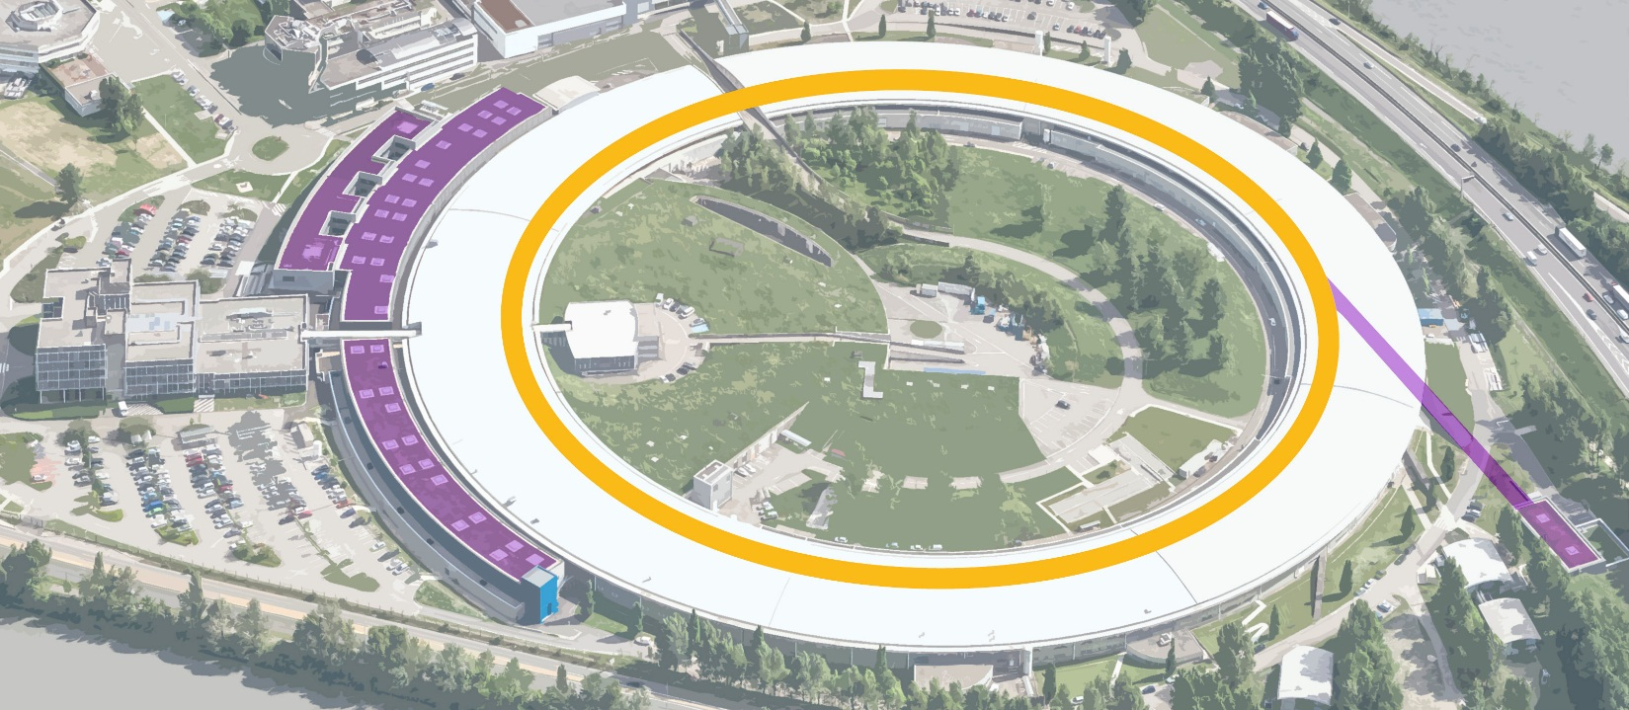
ESRF Upgrade programme
2009
2015
Upgrade PHASE I – 160 M€
In time and within budget
2015
2022
ESRF-EBS – 150 M€
Launched in June 2015
- Construction of 19 new-generation experimental stations to explore the nanoworld
- Creation of a new ultra-stable experimental hall
- Improvement and refurbishment of most of the cutting-edge scientific equipment and accelerator infrastructure
- Construction of a new storage ring –the EBS, inside the existing structure, with performance increased by a factor of 100
- Construction of new state-of-the-art beamlines
- Ambitious instrumentation programme (optics, high-performance detectors)
- Intensified big data strategy

Slide 3
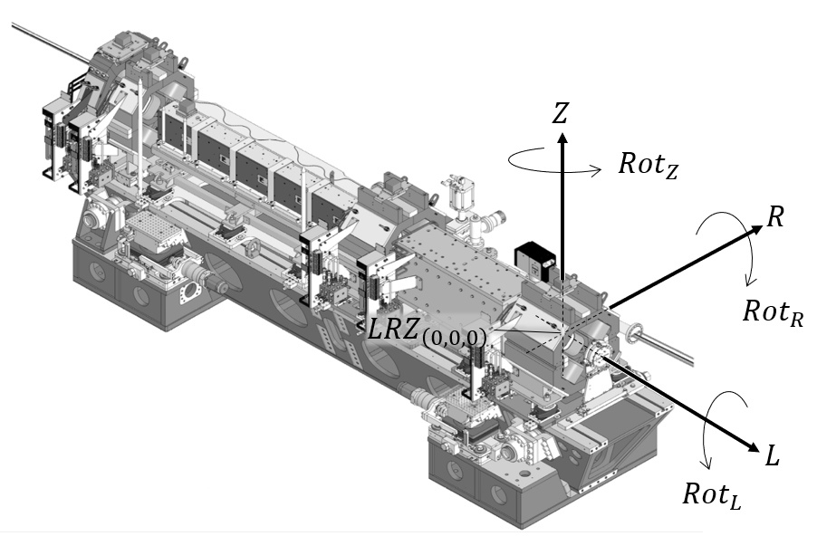
EBS Alignment Constraints
There were two key constraints for EBS
first respect the magnet (and other) alignment tolerances
Machine | U(L) [μm] | U(R) [μm] | U(Z) [μm]
Long. Varying field dipoles | 1000 | >100 | >100
High gradient quadrupoles, Combined function dipoles | 500 | 60 | 60
Medium gradient quads | 500 | 100 | 85
Sextupoles | 500 | 70 | 50
Octupoles | 500 | 100 | 100
Maximum permissible error 2.5σ
… and second ensure the new machine was in the same place as the old machine to minimize disturbance to the functioning beamlines.

Slide 4
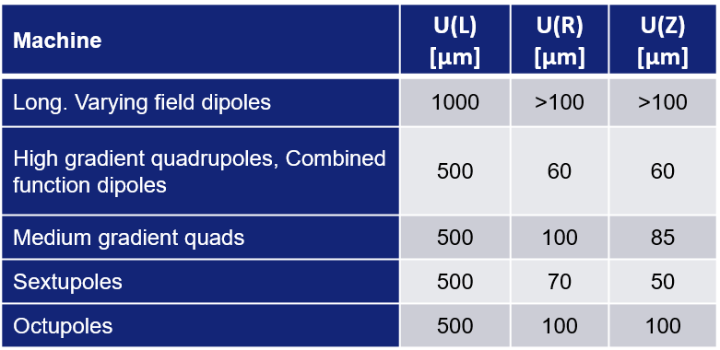
Alignment Tolerances – What do they mean?
Early on it was decided that these tolerances included all possible errors, and notably:
  Fiducialisation,
  Alignment on the girder including:
    opening and closing of magnets,
    girder rectitude,
  Transportation,
  Alignment in the tunnel,
  …
It was also decided the most appropriate way to determine the overall uncertainty was to follow the methodology for an uncertainty calculation outlined in the Guide to the Uncertainty in Measurement – the GUM*.
*available at https://www.bipm.org/en/publications/guides/gum.html

Slide 5
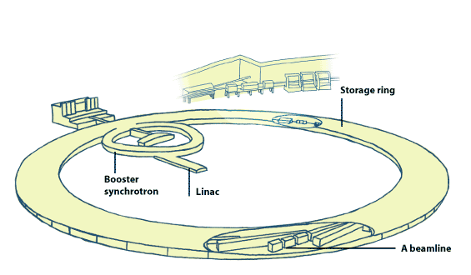
Beamline position constraint
A synchrotron is an extremely powerful source of X-rays. The X-rays are produced by high energy electrons as they circulate around the synchrotron.
The X-ray beams emitted by the electrons are directed toward beamlines that surround the storage ring in the experimental hall. Each beamline is designed for use with a specific technique or for a specific type of research.
The majority of beamlines at the ESRF were installed before EBS. To avoid having to realign these beamlines, which would require an inordinate amount of work; it was decided to align the new machine in the same position as the old one …

Slide 6
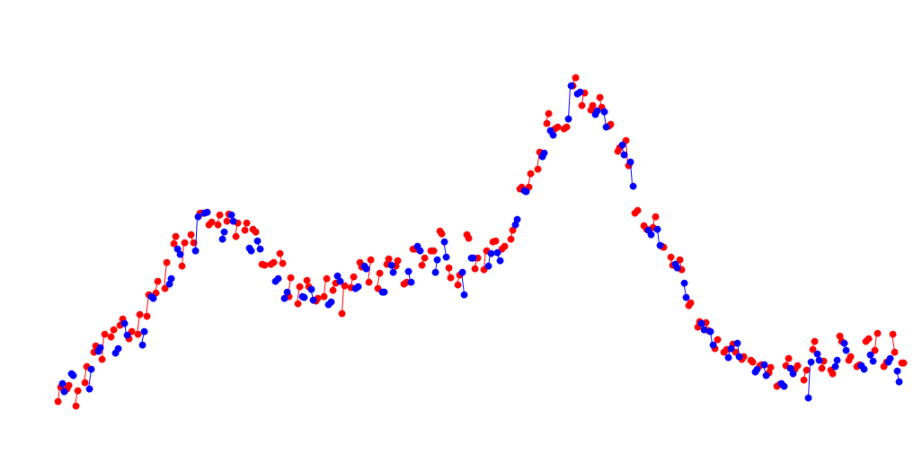
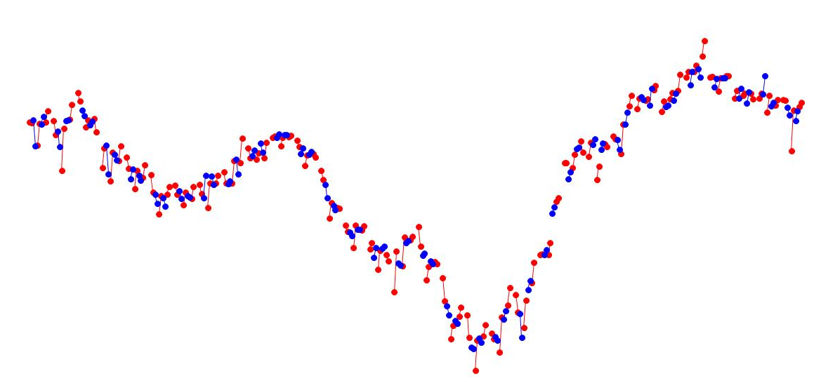
Beamline position constraint
At the end of 2018 when the dismantlement of the old SR and EBS installation began, the old machine was not in its nominal position
Horizontal
Vertical
+1.1 mm
+0.8 mm
Nominal Position
Nominal Position
-2.1mm
-1.2 mm

Slide 7
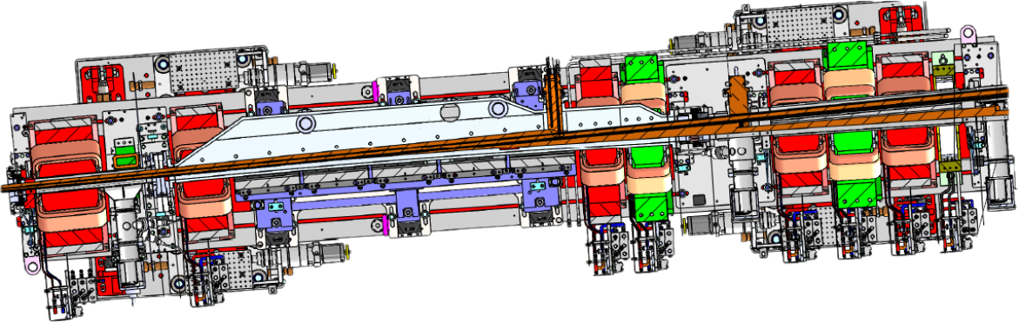
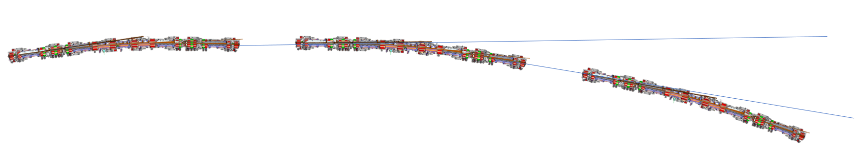
Beamline position constraint
The constraint was to align the beamline source points and directions as they were in the old machine. The beamline direction is determined by the magnet positions on either side of the source point.
G4 girder
Source Point
G1 girder
Beamline

Slide 8
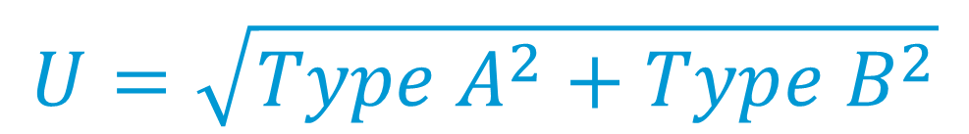
Measurement Uncertainty
Type A Uncertainty
measurement series 1
measurement series 2
⁞
measurement series n
measurement uncertainty
non-negative parameter characterizing the dispersion of the quantity values being attributed to a measurand, based on the information used
ref.
values
calibration
certificates
Type B Uncertainty
manufacturer’s
specifications
experience
$$U=\sqrt{{Type A}^{2}+{Type B}^{2}}$$
An uncertainty calculation is generally done in a characteristic manner

Slide 9
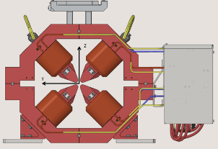
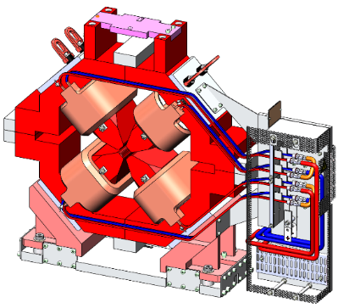
Fiducialisation
For a magnet, we are interested in putting the magnet axis in the right place
But we cannot see the magnet axis
So we have to reference it with respect to something we can see.

Slide 10
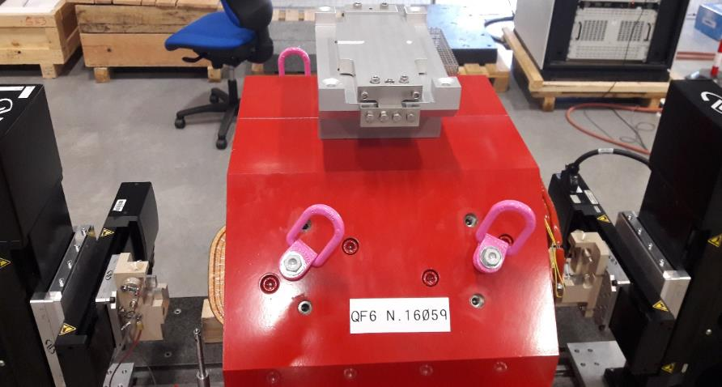
Fiducialisation
The original plan was for the magnet manufacturers to do the fiducialisation and shimming, but It was discovered that there were unacceptably large differences between measurements made at the ESRF* and by the manufacturers …
So the ESRF Survey and Alignment group was asked to fiducialise all of the magnets …
At the ESRF this is done on a magnet measuring bench using a stretched wire.
*The problem was with the manufacturers 3D measuring arm instruments…

Slide 11
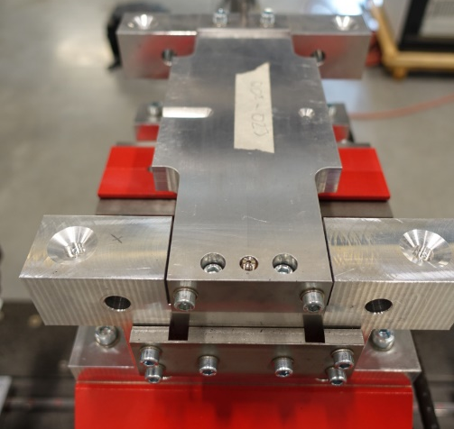
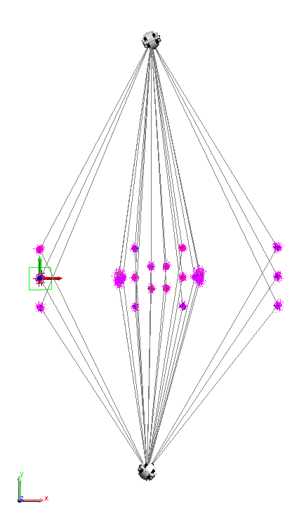
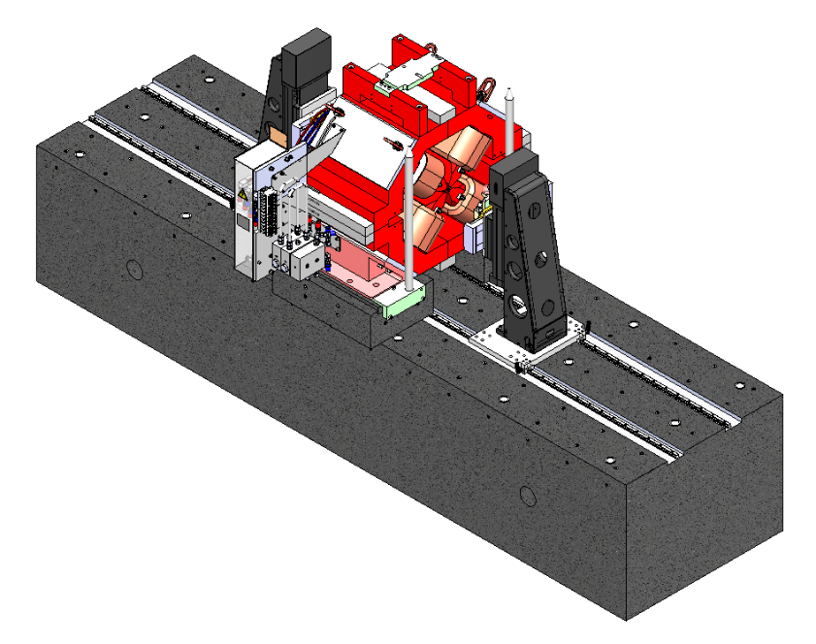
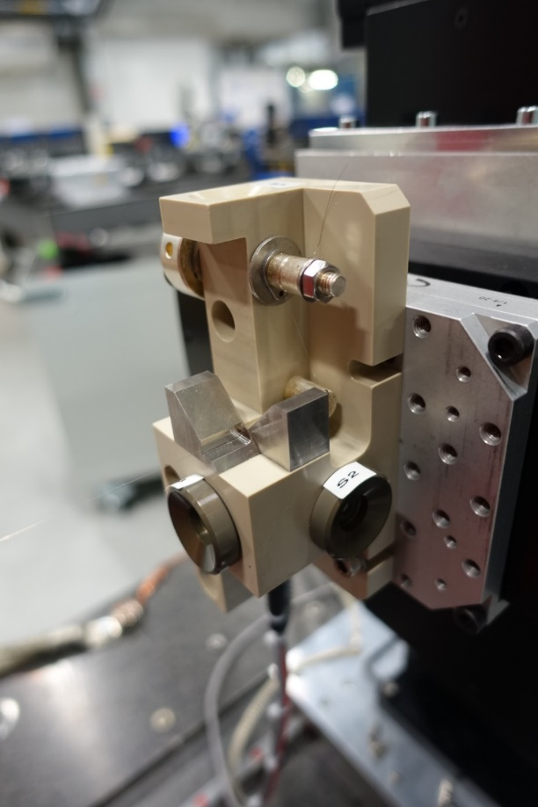
Fiducialisation
The magnet reference points were determined from two laser tracker stations.

Slide 12
Fiducialisation uncertainty
 |  | U(L) [μm] | U(R) [μm] | U(Z)¹ [μm] | U(Z)² [μm]
Laser Tracker
 | Wire position | 13 | 15 | 18 | 18
 | Measurement | 9 | 10 | 9 | 9
 | Repeatability | 3 | 3 | 12 | 12
Magnet measurements |  |  | 4 | 4 | 4
Magnetic Fiducialisation |  |  | 20 | 20 | 20
Magnet Shim Determination |  |  |  |  | 20
Total |  | 16 | 26 | 31 | 37
Shims were used to align certain magnets:
1) High gradient quadrupoles, Combined function dipoles
2) Medium gradient quadrupoles, sextupoles and octupoles
We combine all of these errors/uncertainties to determine the fiducialisation uncertainty contribution.
This is the first of several contributions to the overall alignment uncertainty…
Reference: G. Le Bec, J. Chavanne, L. Lefebvre, D. Martin, and C. Penel, “Magnetic Measurements and Fiducialisation of the ESRF-EBS Magnets”, in Proc. 11th Int. Particle Accelerator Conf. (IPAC'20), Caen, France, May 2020, paper THVIR09, pp. XX-XX

Slide 13
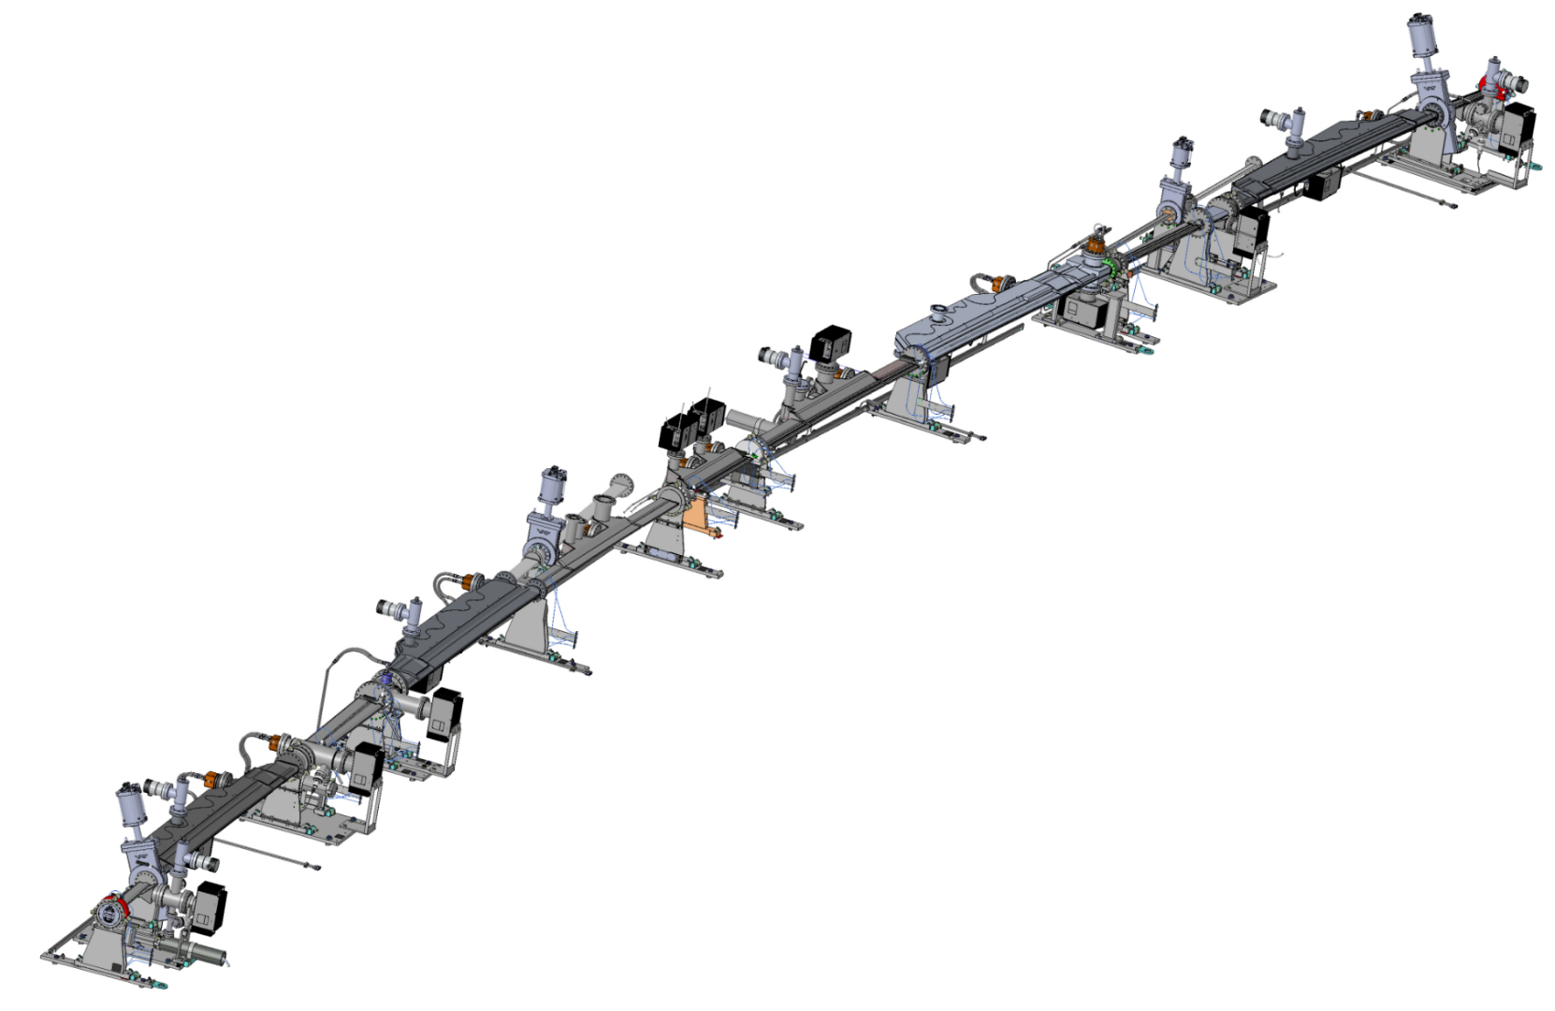
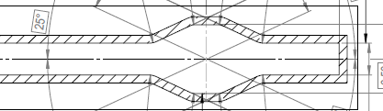
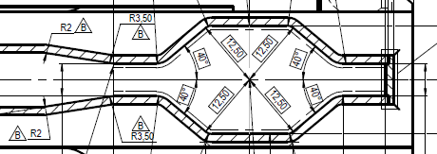
Vacuum Chambers
There are several families of vacuum chambers:
Magnet pole positions impose tight mechanical tolerances …
Low profile cross section
13mm
High profile cross section
BPM tolerances
~150 um…
20mm

Slide 14
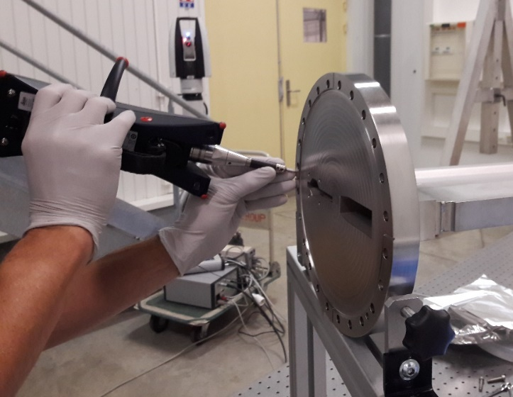
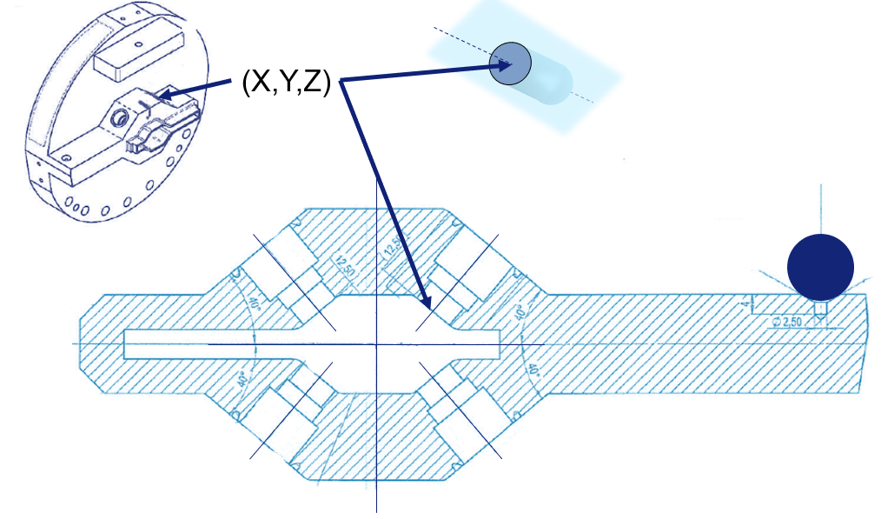
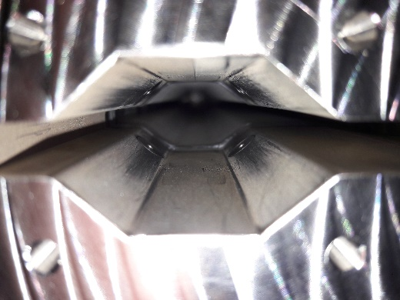
BPM fiducialisation

Slide 15
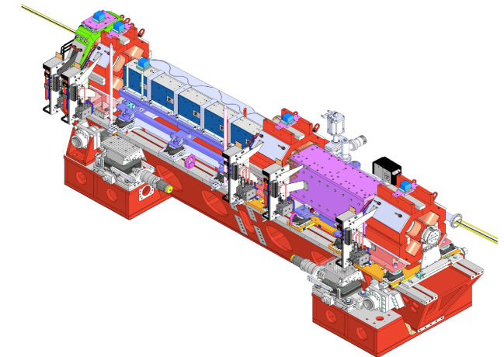
Girder assembly
Girders are installed and aligned in the horizontal plane
Magnets are installed on the girder 0.5 mm
Magnets are fine aligned 0.05 mm
Magnets are opened
Vacuum string is installed
BPMs aligned 0.1 mm
Magnets are closed
Fine magnet alignment check and survey
Assembly was made at ESRF01 – a dedicated building

Slide 16
Summary of High tolerance Magnet ESRF01 assembly errors
Summary statistics for the assembly of the Octupole, Quadrupole, Sextupole and DQ magnets on the girders at ESRF 01…
SD_{R} =14 um
SD_{z} =17 um

Slide 17
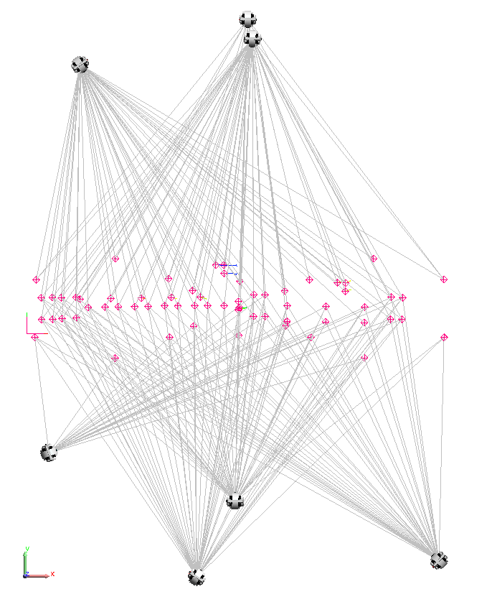
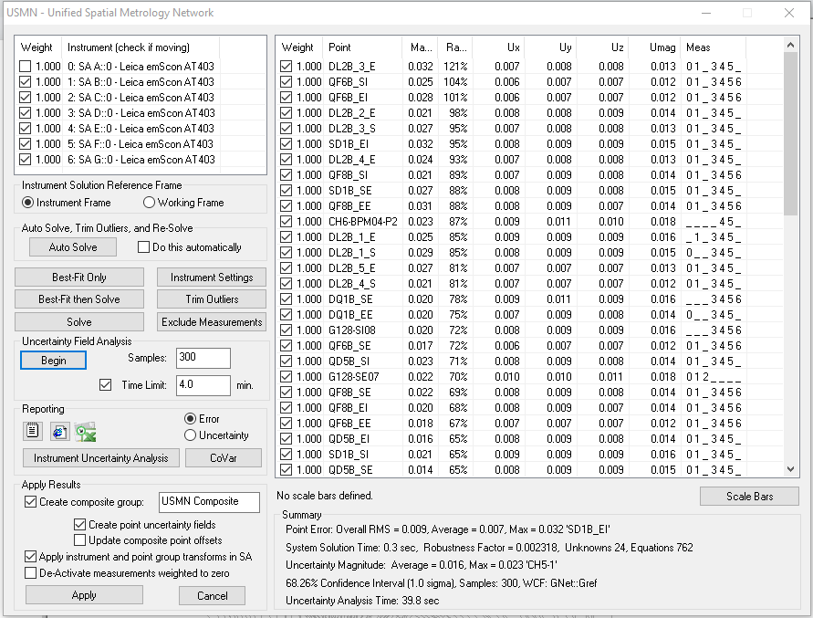
Girder alignment uncertainty
 | U(L) [μm] | U(R) [μm] | U(Z) ¹⁾ [μm] | U(Z) ²⁾ [μm]
Measurements | 6 | 7 | 6 | 6
Difference to nominal | 126 | 24 | 25 | 25
Overall uncertainty |  | 14 | 17 | 17
Magnet Opening/Closing | 8 | 5 | 7 | 7
Girder rectitude |  |  |  | 8
Total | 126 | 29 | 31 | 31
Shims were used to align certain magnets:
1) High gradient quadrupoles, Combined function dipoles
2) Medium gradient quadrupoles, sextupoles and octupoles

Slide 18
EBS installation in the tunnel
Plates Pre-Tracing
Plates Setting Out
Plates Alignment
Plates Control
Girder Pre-Alignment
Girder Fine-Alignment
Girder Control
Girder Touch-ups
Girder Re-control
DQ2 Alignment
DQ2 Control
HLS Installation

Slide 19

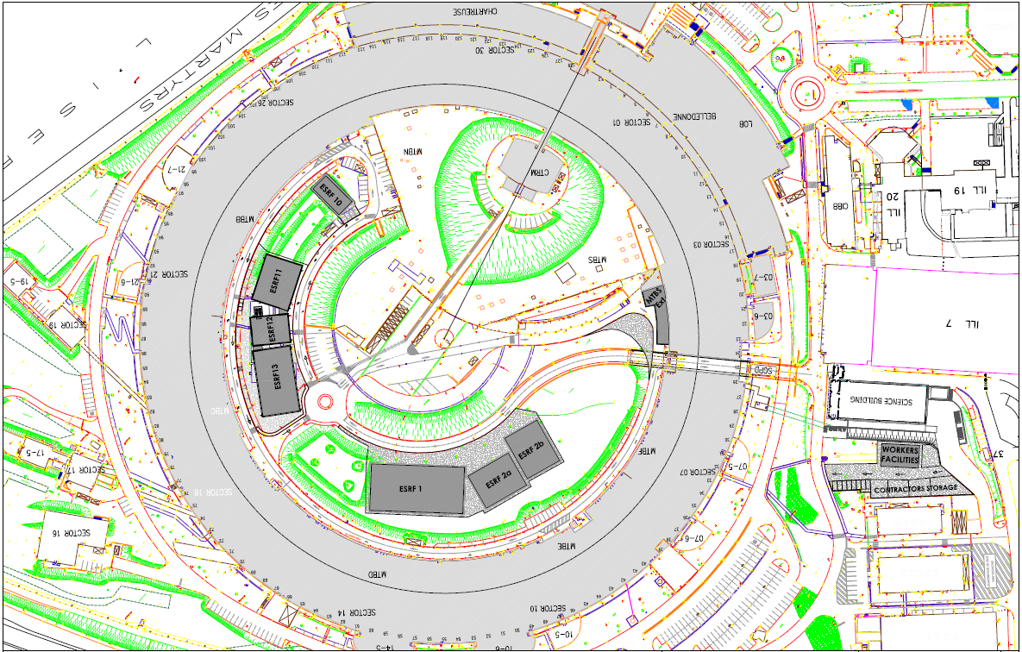
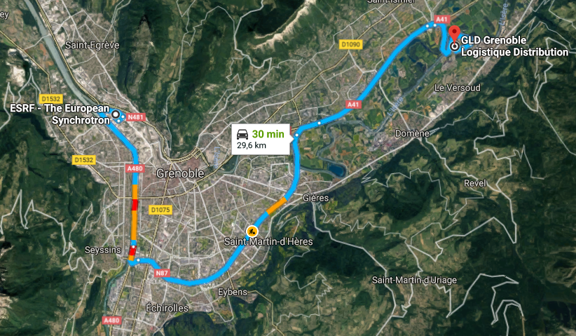
Storage and transport
Storage place | Quantity | Comments
G.L.D. | 90 | Girder direct access with a crane
ESRF 01 | 9 | End of the assembly process
Chartreuse hall | 30 | Non standard girders + ID24 entry point
Source: Mini-Workshop on Girders and Alignment – 10-11 May 2021- Thierry Brochard (ESRF)

Slide 20
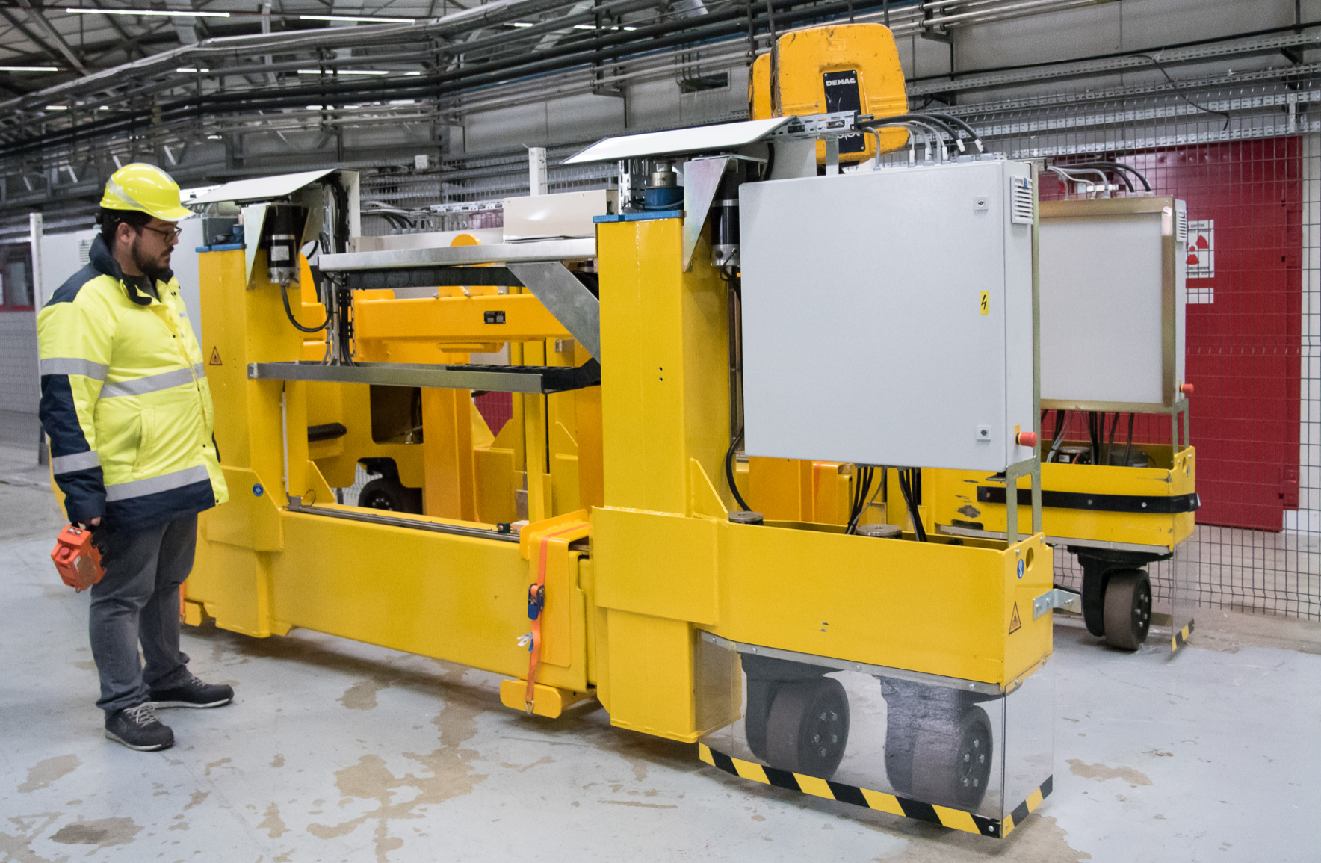
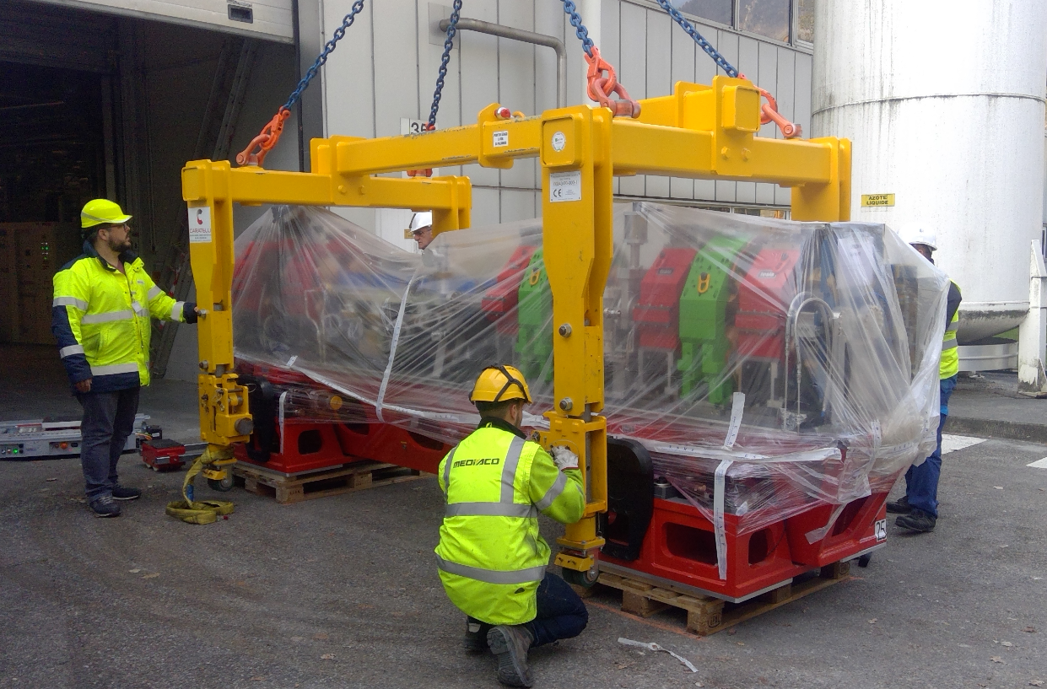
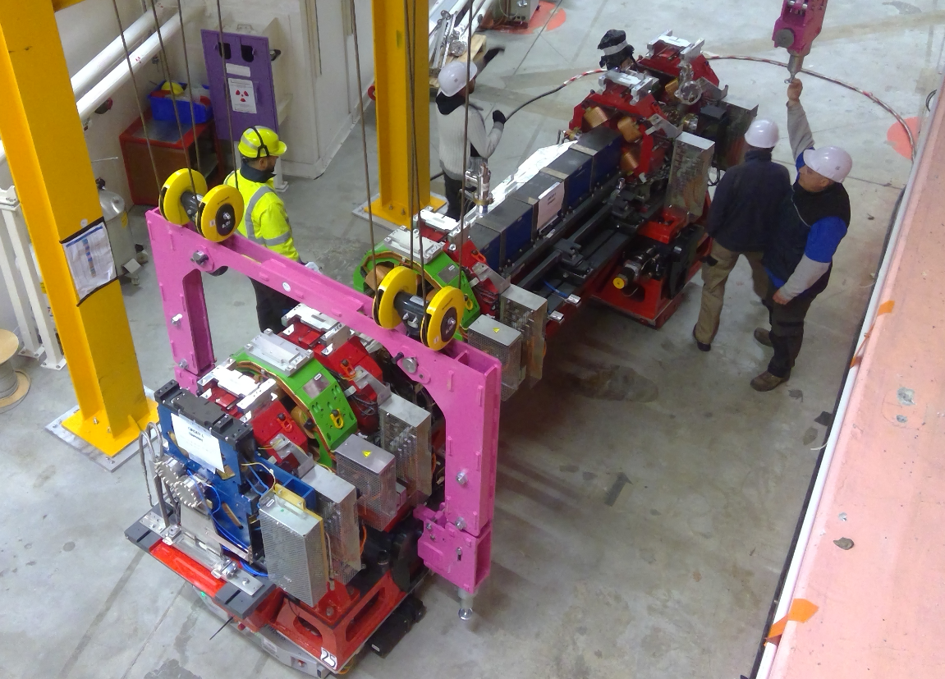
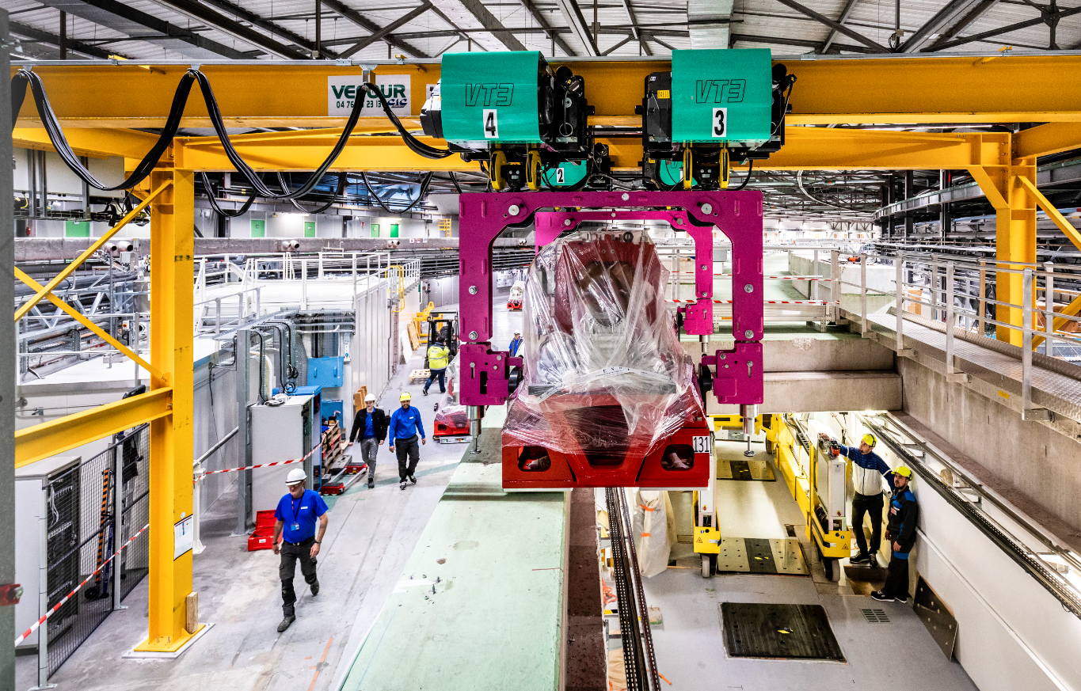
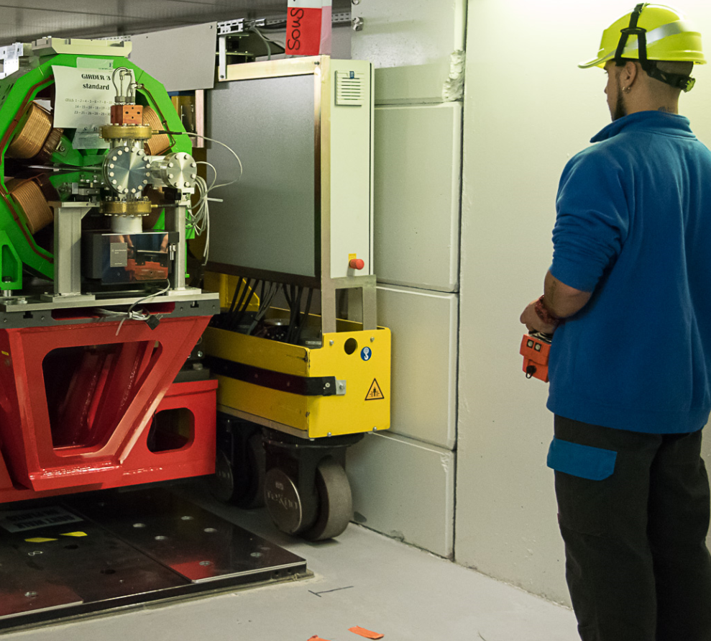
Installation
Girders were:
transported from storage on a truck,
unloaded using a crane,
transported to a gantry,
lifted into the tunnel using the gantry, and
transported to their final position with the transport module.

Slide 21
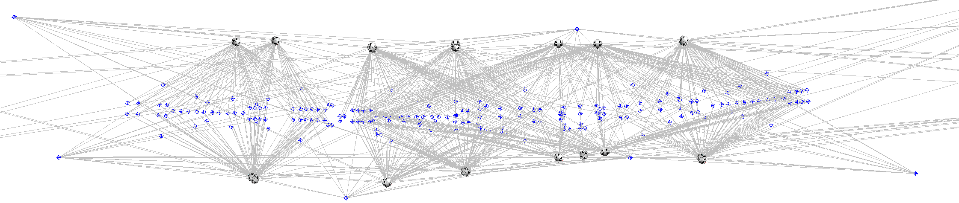
Effect of storage, transportation, installation and bakeout
After the installation and initial alignment in the tunnel all of the girders were remeasured like they were during in ESRF01. This was done again after the bakeout was finished in the tunnel.
The magnet positions were then adjusted onto the magnet positions measured at ESRF01.
Survey | U(R) [μm] | U(Z) [μm]
ESRF01 (see girder alignment uncertainty) | 14 | 17
After transport (3D adjustment on ESRF01) | 17 | 20
After bakeout (3D adjustment on ESRF01) | 19 | 21
These results suggest the effect of transport was ~10 µm – and the effect of bakeout on the alignment less than that …
ESRF01 was the building where the girders were assembled.

Slide 22
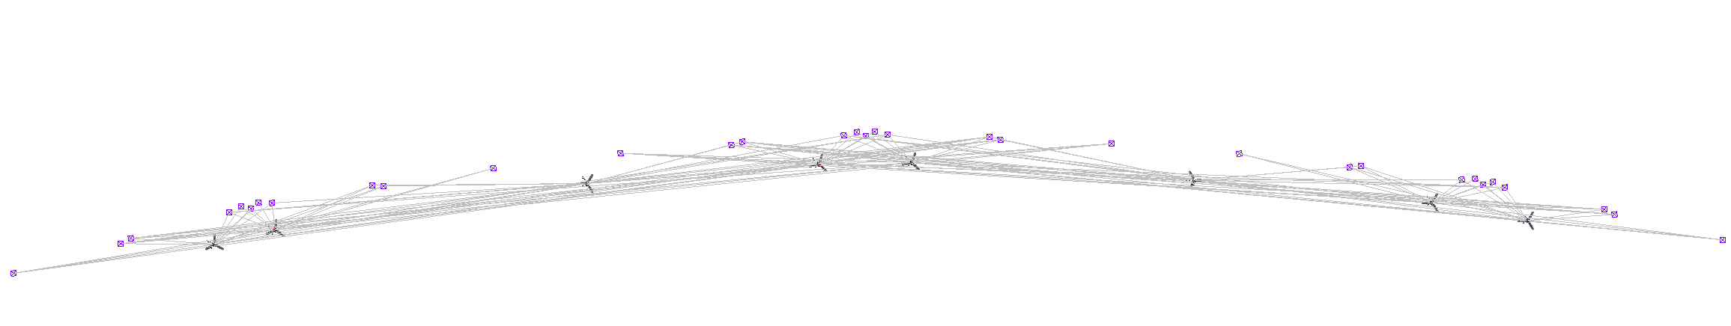
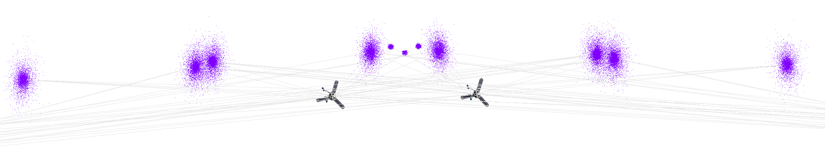
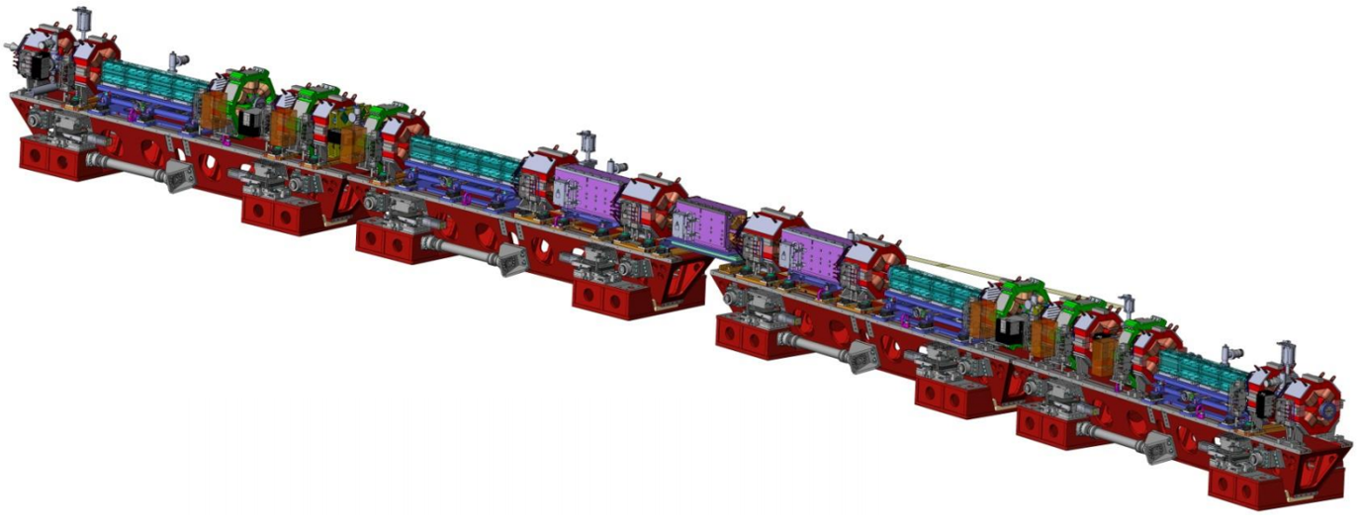
Girders in the tunnel
DQ2
G1
G2
G3
G4

Slide 23
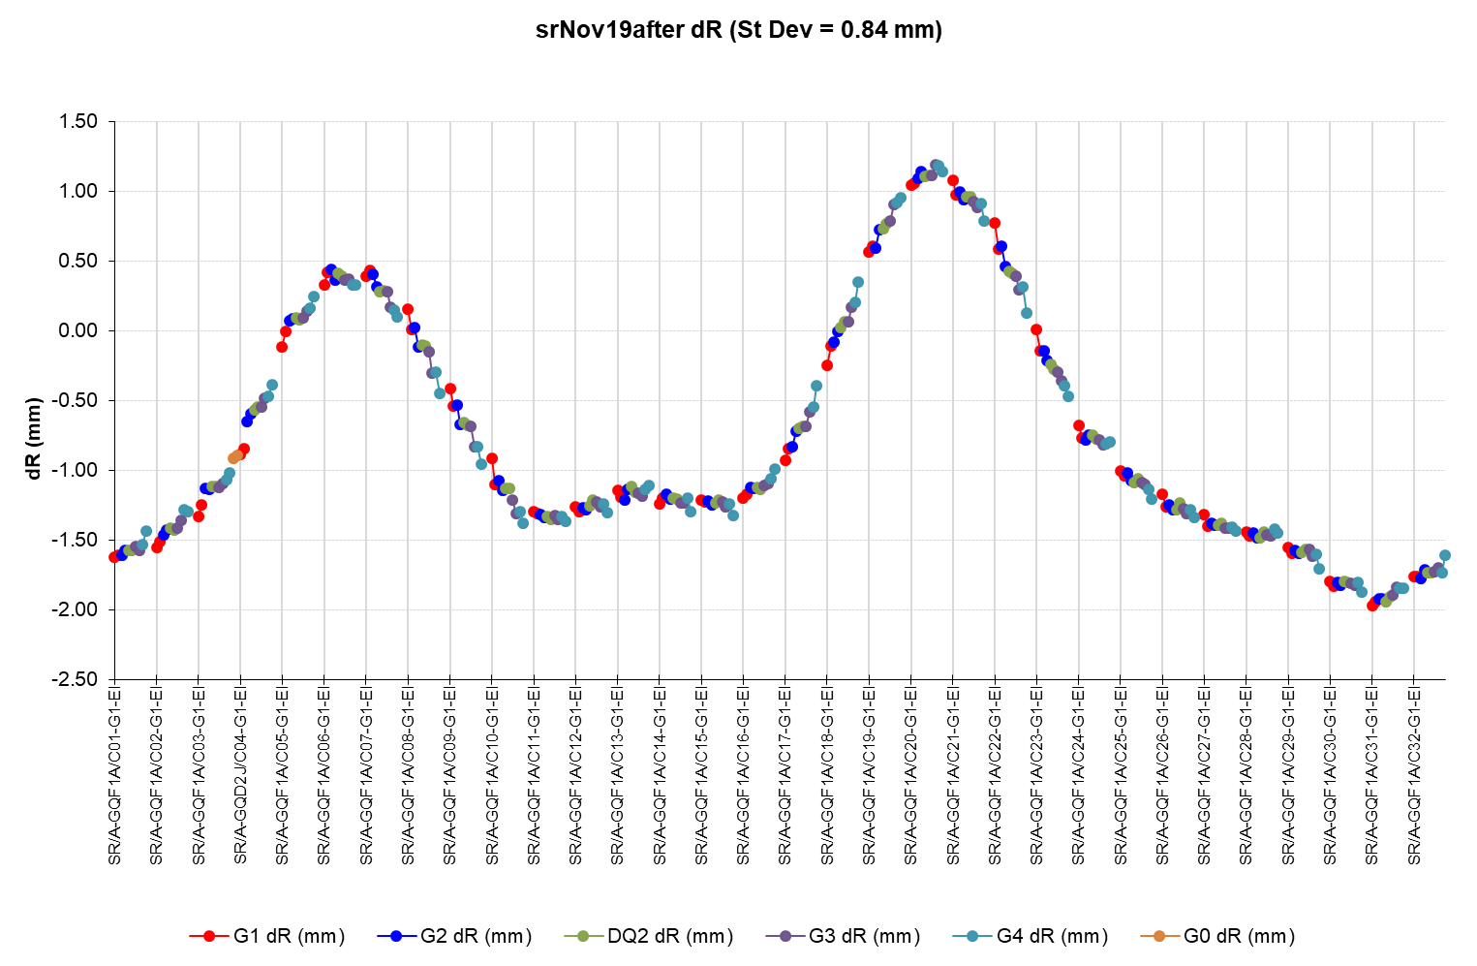
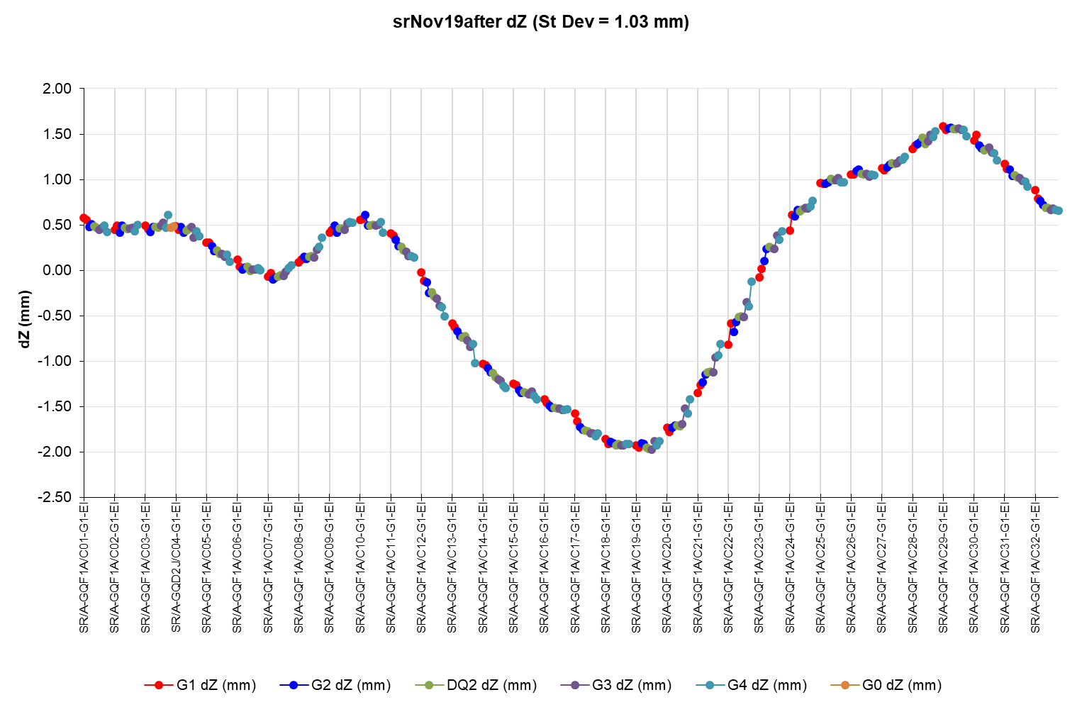
November 2019 – after Final alignment - Error

Slide 24
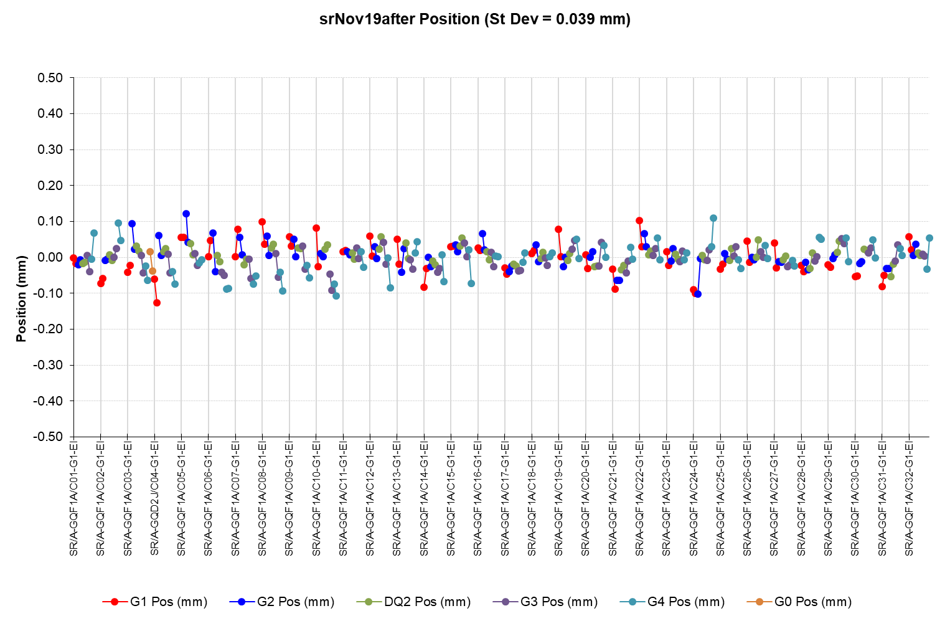
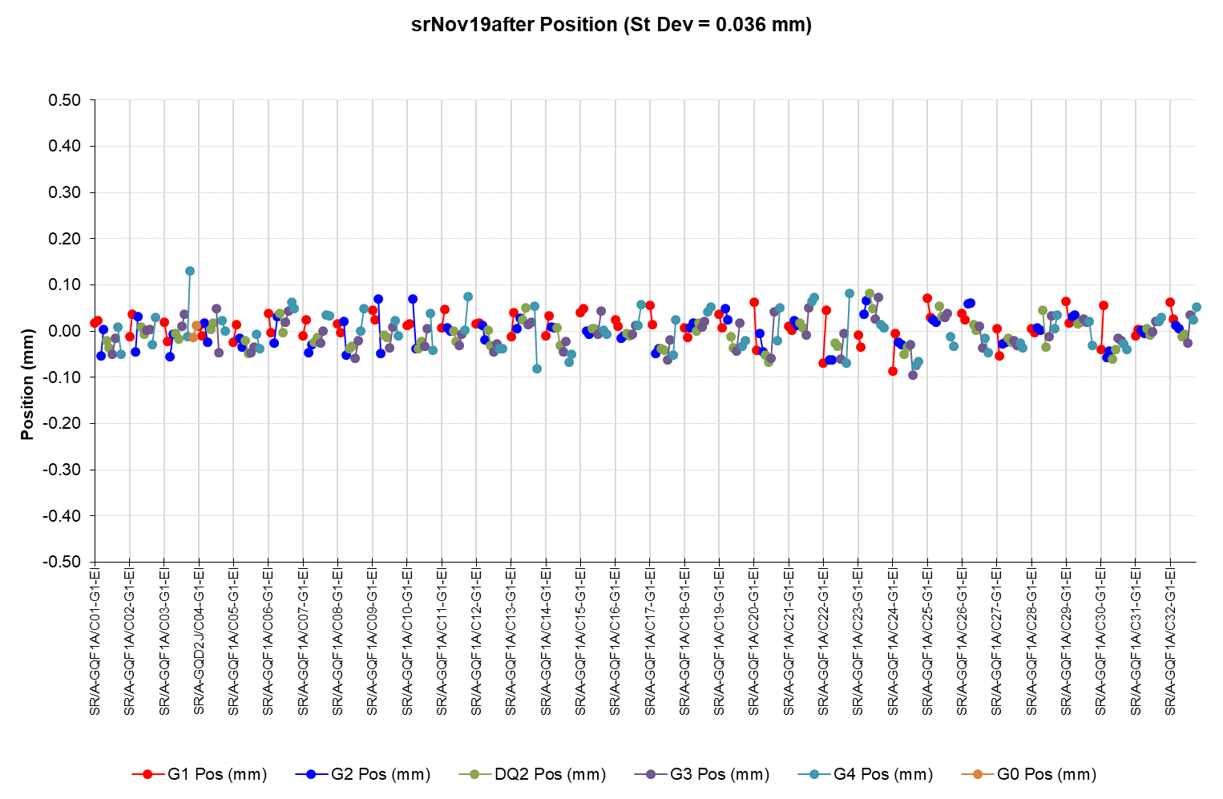
November 2019 – after Final alignment - Error
U_{R}=39 um
U_{Z}=36 um
 | U(R) [μm] | U(Z) [μm]
G1E, G4S | 52 | 42
G1S, G2E, G3S, G4E | 42 | 34
G2S, G3E | 24 | 32
DQ2 | 23 | 30

Slide 25
Alignment uncertainty for ½ cell
Combined alignment uncertainties for the EBS machine using the U_{R} and U_{Z} from the previous slides are estimated to be:
Magnet type |  | Nominal U(R) [μm] | Measured U(R) [μm] | Nominal U(Z) [μm] | Measured U(Z) [μm]
QF1A | Med. Grad. Quad. | 100 | 66 | 85 | 65
QD2A | Med. grad. quad. | 100 | 40 | 85 | 49
QD3A | Med. Grad. Quad. | 100 | 40 | 85 | 49
SD1A | Sextupole | 70 | 40 | 50 | 49
QF4A | Med. Grad. Quad. | 100 | 40 | 85 | 49
SF2A | Sextupole | 70 | 40 | 50 | 49
QF4B | Med. Grad. Quad. | 100 | 40 | 85 | 49
OF1B | Octupole | 100 | 58 | 100 | 60
SD1B | Sextupole | 70 | 58 | 50 | 60
QD3A | Med. Grad. Quad. | 100 | 40 | 85 | 49
QF6B | High Grad. Quad. | 60 | 40 | 60 | 45
DQ1B | Dipole-Quadrupole | 60 | 40 | 60 | 45
QF8B | High Grad. Quad. | 60 | 47 | 60 | 55
DQ2C | Dipole-Quadrupole | 60 | 46 | 60 | 54
…Symmetric …
Note U(L) = 453 µm for a nominal value of 500m

Slide 26
Alignment uncertainty
QF1A U(R)=66; U(Z) =65
QD2A U(R)=40; U(Z)=49
OF1B U(R)=58; U(Z) =60
QF4B U(R)=40; U(Z) =49
SF2A U(R)=40; U(Z)=49
DQ2C U(R) = 46; U(Z)=54
QF4A U(R)=40; U(Z)=49
QF8B U(R) = 47; U(Z)=55
DQ1B U(R) = 40; U(Z)=45
QF6B U(R) = 40; U(Z)=45
QD3A U(R)=40; U(Z)=49
SD1A U(R)=40; U(Z)=49
SD1B U(R) = 58; U(Z)=60
QD3A U(R)=40; U(Z)=49
…Symmetric…

Slide 27
Alignment uncertainty
Machine simulations estimate the alignment uncertainties to be less than these values. The SR alignment estimates were:
  rms quadrupole horizontal orbit → 22 to 42 µm
  rms quadrupole vertical orbit → 22 to 53 µm
  P. Raimondi,et al., “Commissioning of the Hybrid Multi-Bend Achromat lattice at the European Synchrotron Radiation Facility” Phys. Rev. Accel. Beams 24, 110701 – Published 1 November 2021
Our estimates for alignment uncertainties are:
Medium gradient magnets
  U(R) = 40 to 66 um for a nominal value of 100 um
  U(Z) = 49 to 69 um for a nominal value of 85 um
Sextupole magnets
  U(R) = 40 to 58 um for a nominal value of 70 um
  U(Z) = 49 to 60 um for a nominal value of 50 um
High gradient and combined function magnets
  U(R) = 40 to 47 um for a nominal value of 60 um
  U(Z) = 45 to 54 um for a nominal value of 60 um

Slide 28
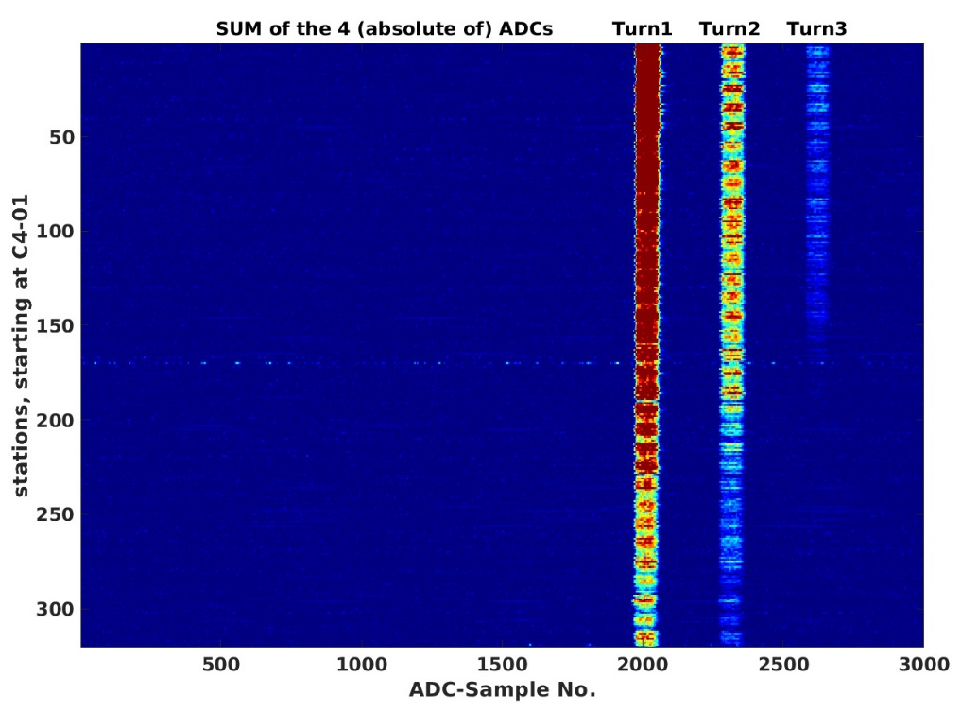
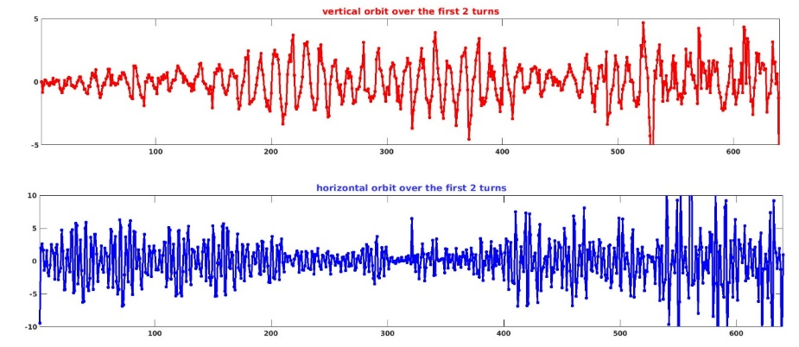
28 November 2019 at 19hrs FIRST TURNS IN EBS-SR
In any event the machine worked – and in no small part due to the alignment…
First turn losses in C23
First 2.5 turns

Slide 29
Beamlines
Recall the second major constraint – put the machine back where the old machine was…
ID10
ID15
ID21
ID16
ID28
ID17
ID01
RMS R [mm] | RMS Z [mm] | RMS Direction [urad]
0.32 | 0.22 | 8

Slide 30
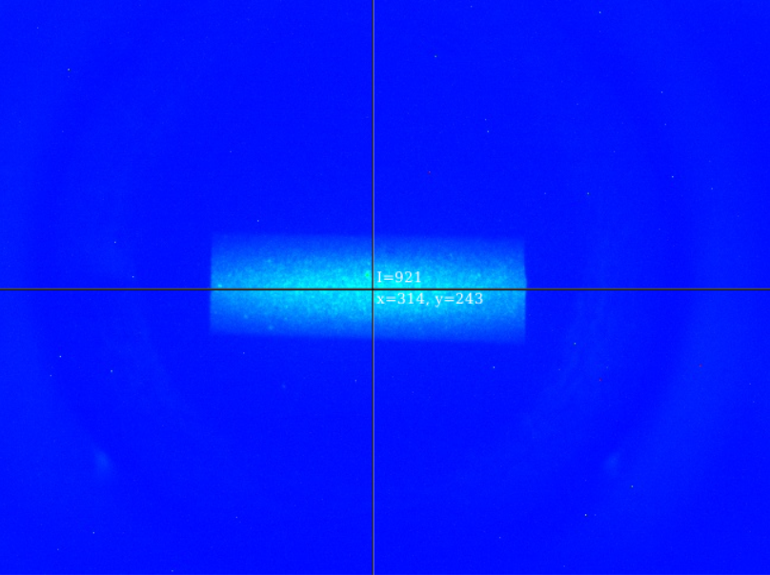
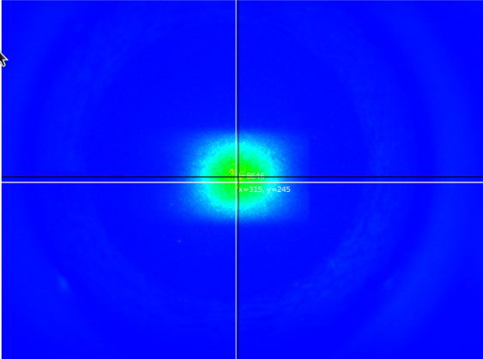
Image of Photon beam on ID09 January 30 2020
Old SR
26 November 2018
EBS
30 January 2020
…The EBS X-ray beam at distances varying from 45 to 160m was found within fractions of millimetres from its position in December 2018…
E-mail Francesco Sette to all staff on 31/01/2020

