Slide 1


From Engineering to Alignment
How functional geometrical requirements on equipment are handled and transferred into installation drawings
Dr Bertrand Nicquevert
Fabien Rey

Slide 2
A use case: the ESS Target Monolith Systems assembly
    An Integration challenge
    What space do we need?
    A communication problem
Systematic approach through Technical Drawings and ISO GPS language
    Deployment at ESS
    Acceptance and Verification
Developing tools applicable from Design to Commissioning
    Positioning requirements = Tolerance zones?
    Introduction to Datum System
    Datum System vs Coordinate System
    A generic tool
Geodetic application with installation drawings
    Multiples Target Coordinate Systems
    Geodetical Network and [TCSsam]
    Examples
Conclusion

Slide 3
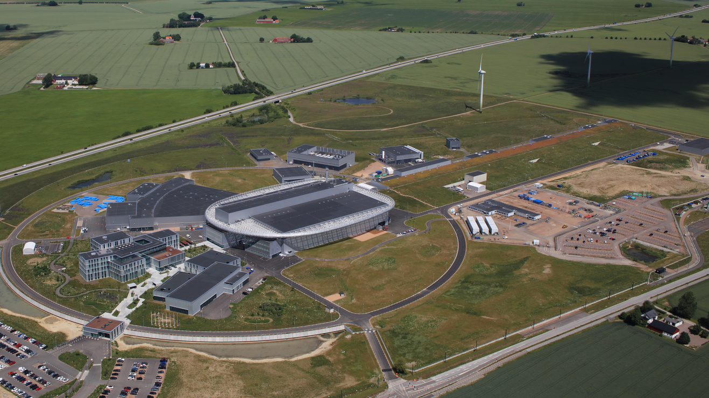
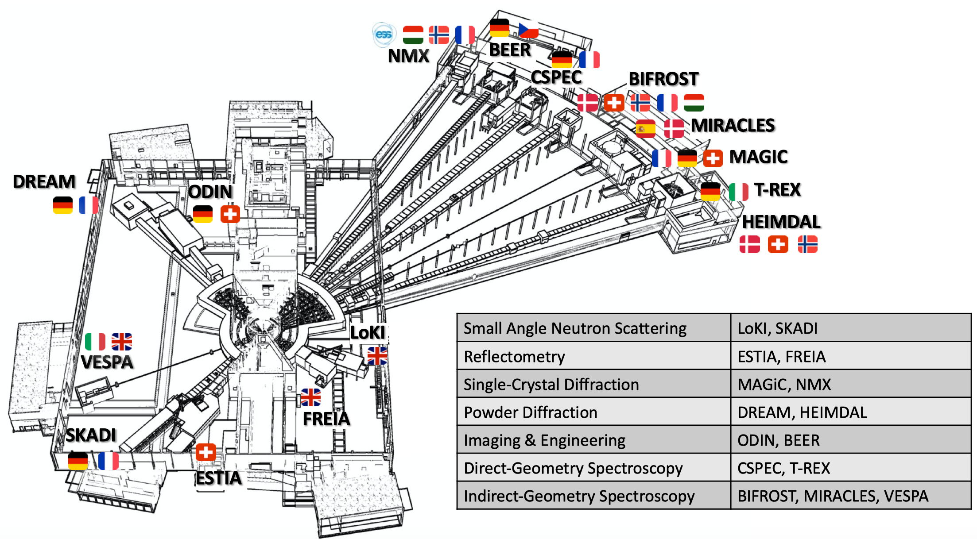
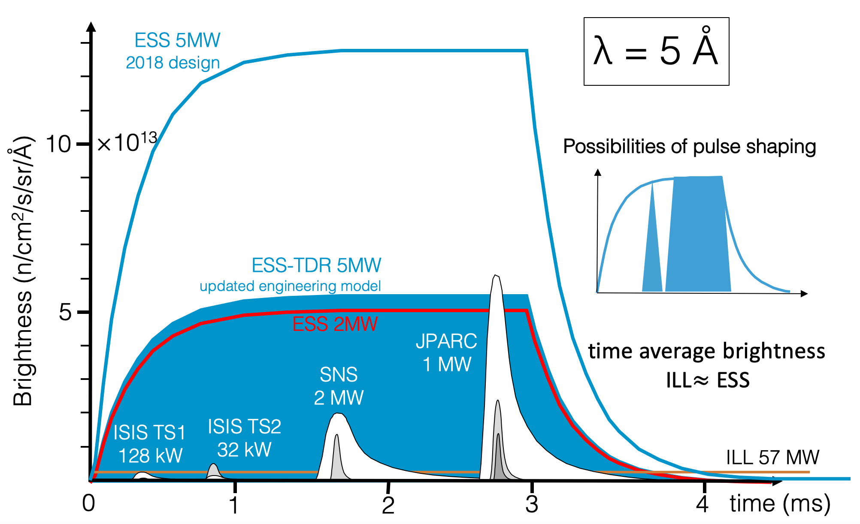
European Spallation Source
European Research Infrastructure Consortium (ERIC)
Build and operate the world’s most powerful neutron source
Host countries: Sweden & Denmark
+11 partner countries
15 instruments under construction
User Operation starting 2027
22 instruments complete after 2030
In – Kind Contribution

Slide 4
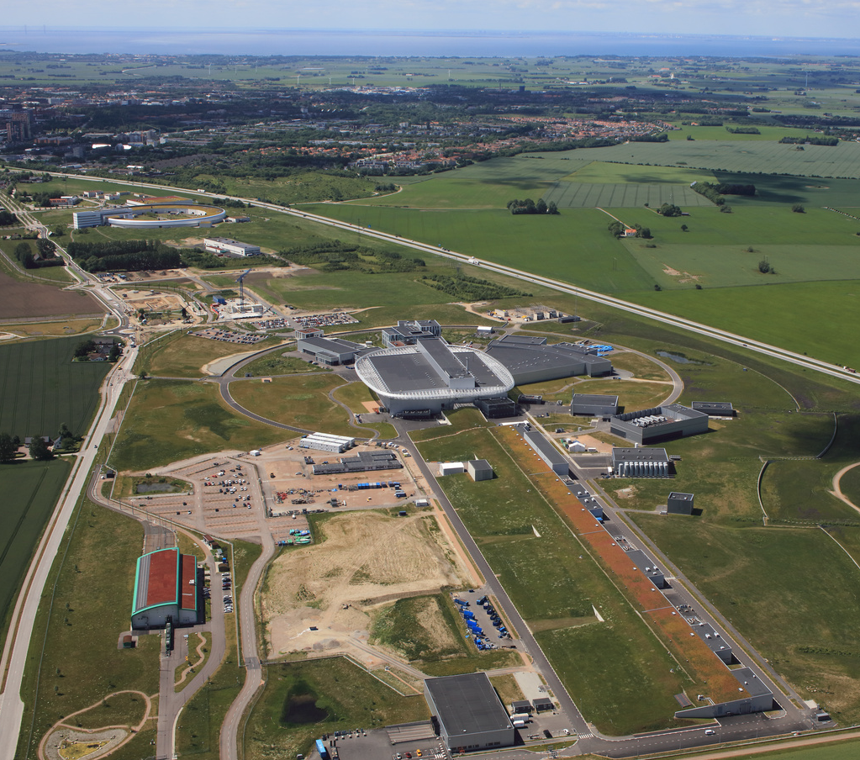
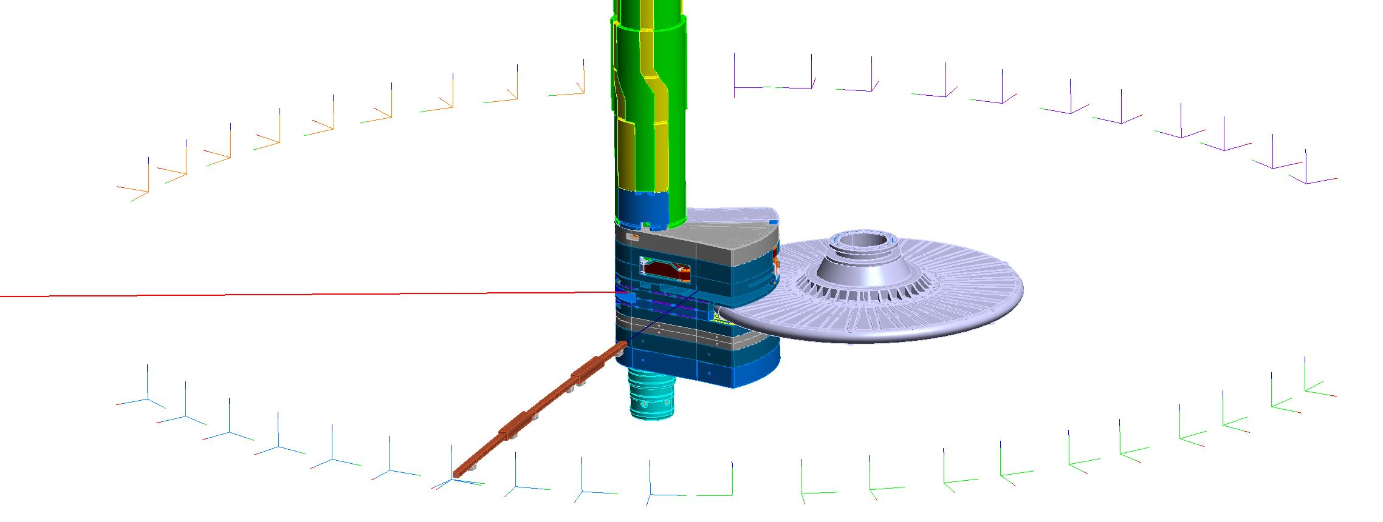
Neutrons with Spallation at ESS
Process in which a heavy nucleus emits a large number of nucleons as a result of being hit by a high-energy particle.
Target
Instruments
Moderator Reflector
Neutrons
Linear proton accelerator
Energy: 2 GeV
Rep. Rate: 14 Hz Current: 62.5 mA PeakPulse length: 2.86 ms
Wheel
Neutron Optics
Proton Beam
Neutrons
Ion Source

Slide 5
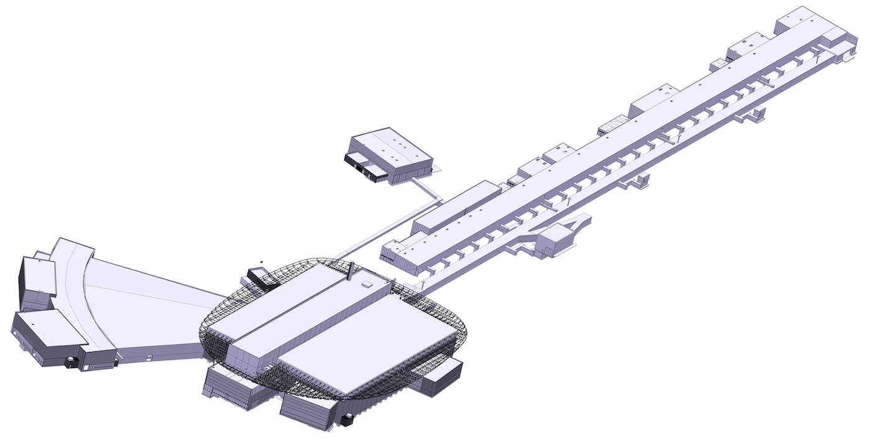
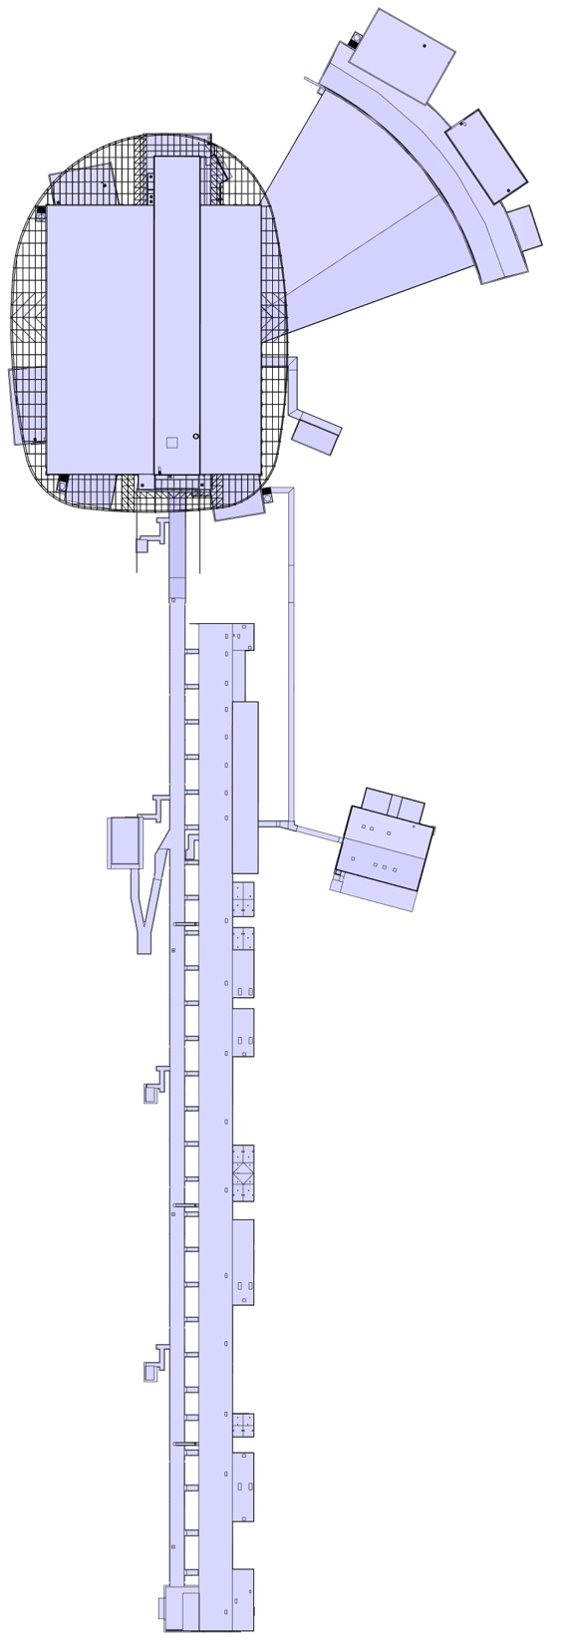
ESS Technical Buildings
Cryo Compressor Building
Gallery Building
LINAC Tunnel
Experimental Halls
250 m
750m
Target Building

Slide 6
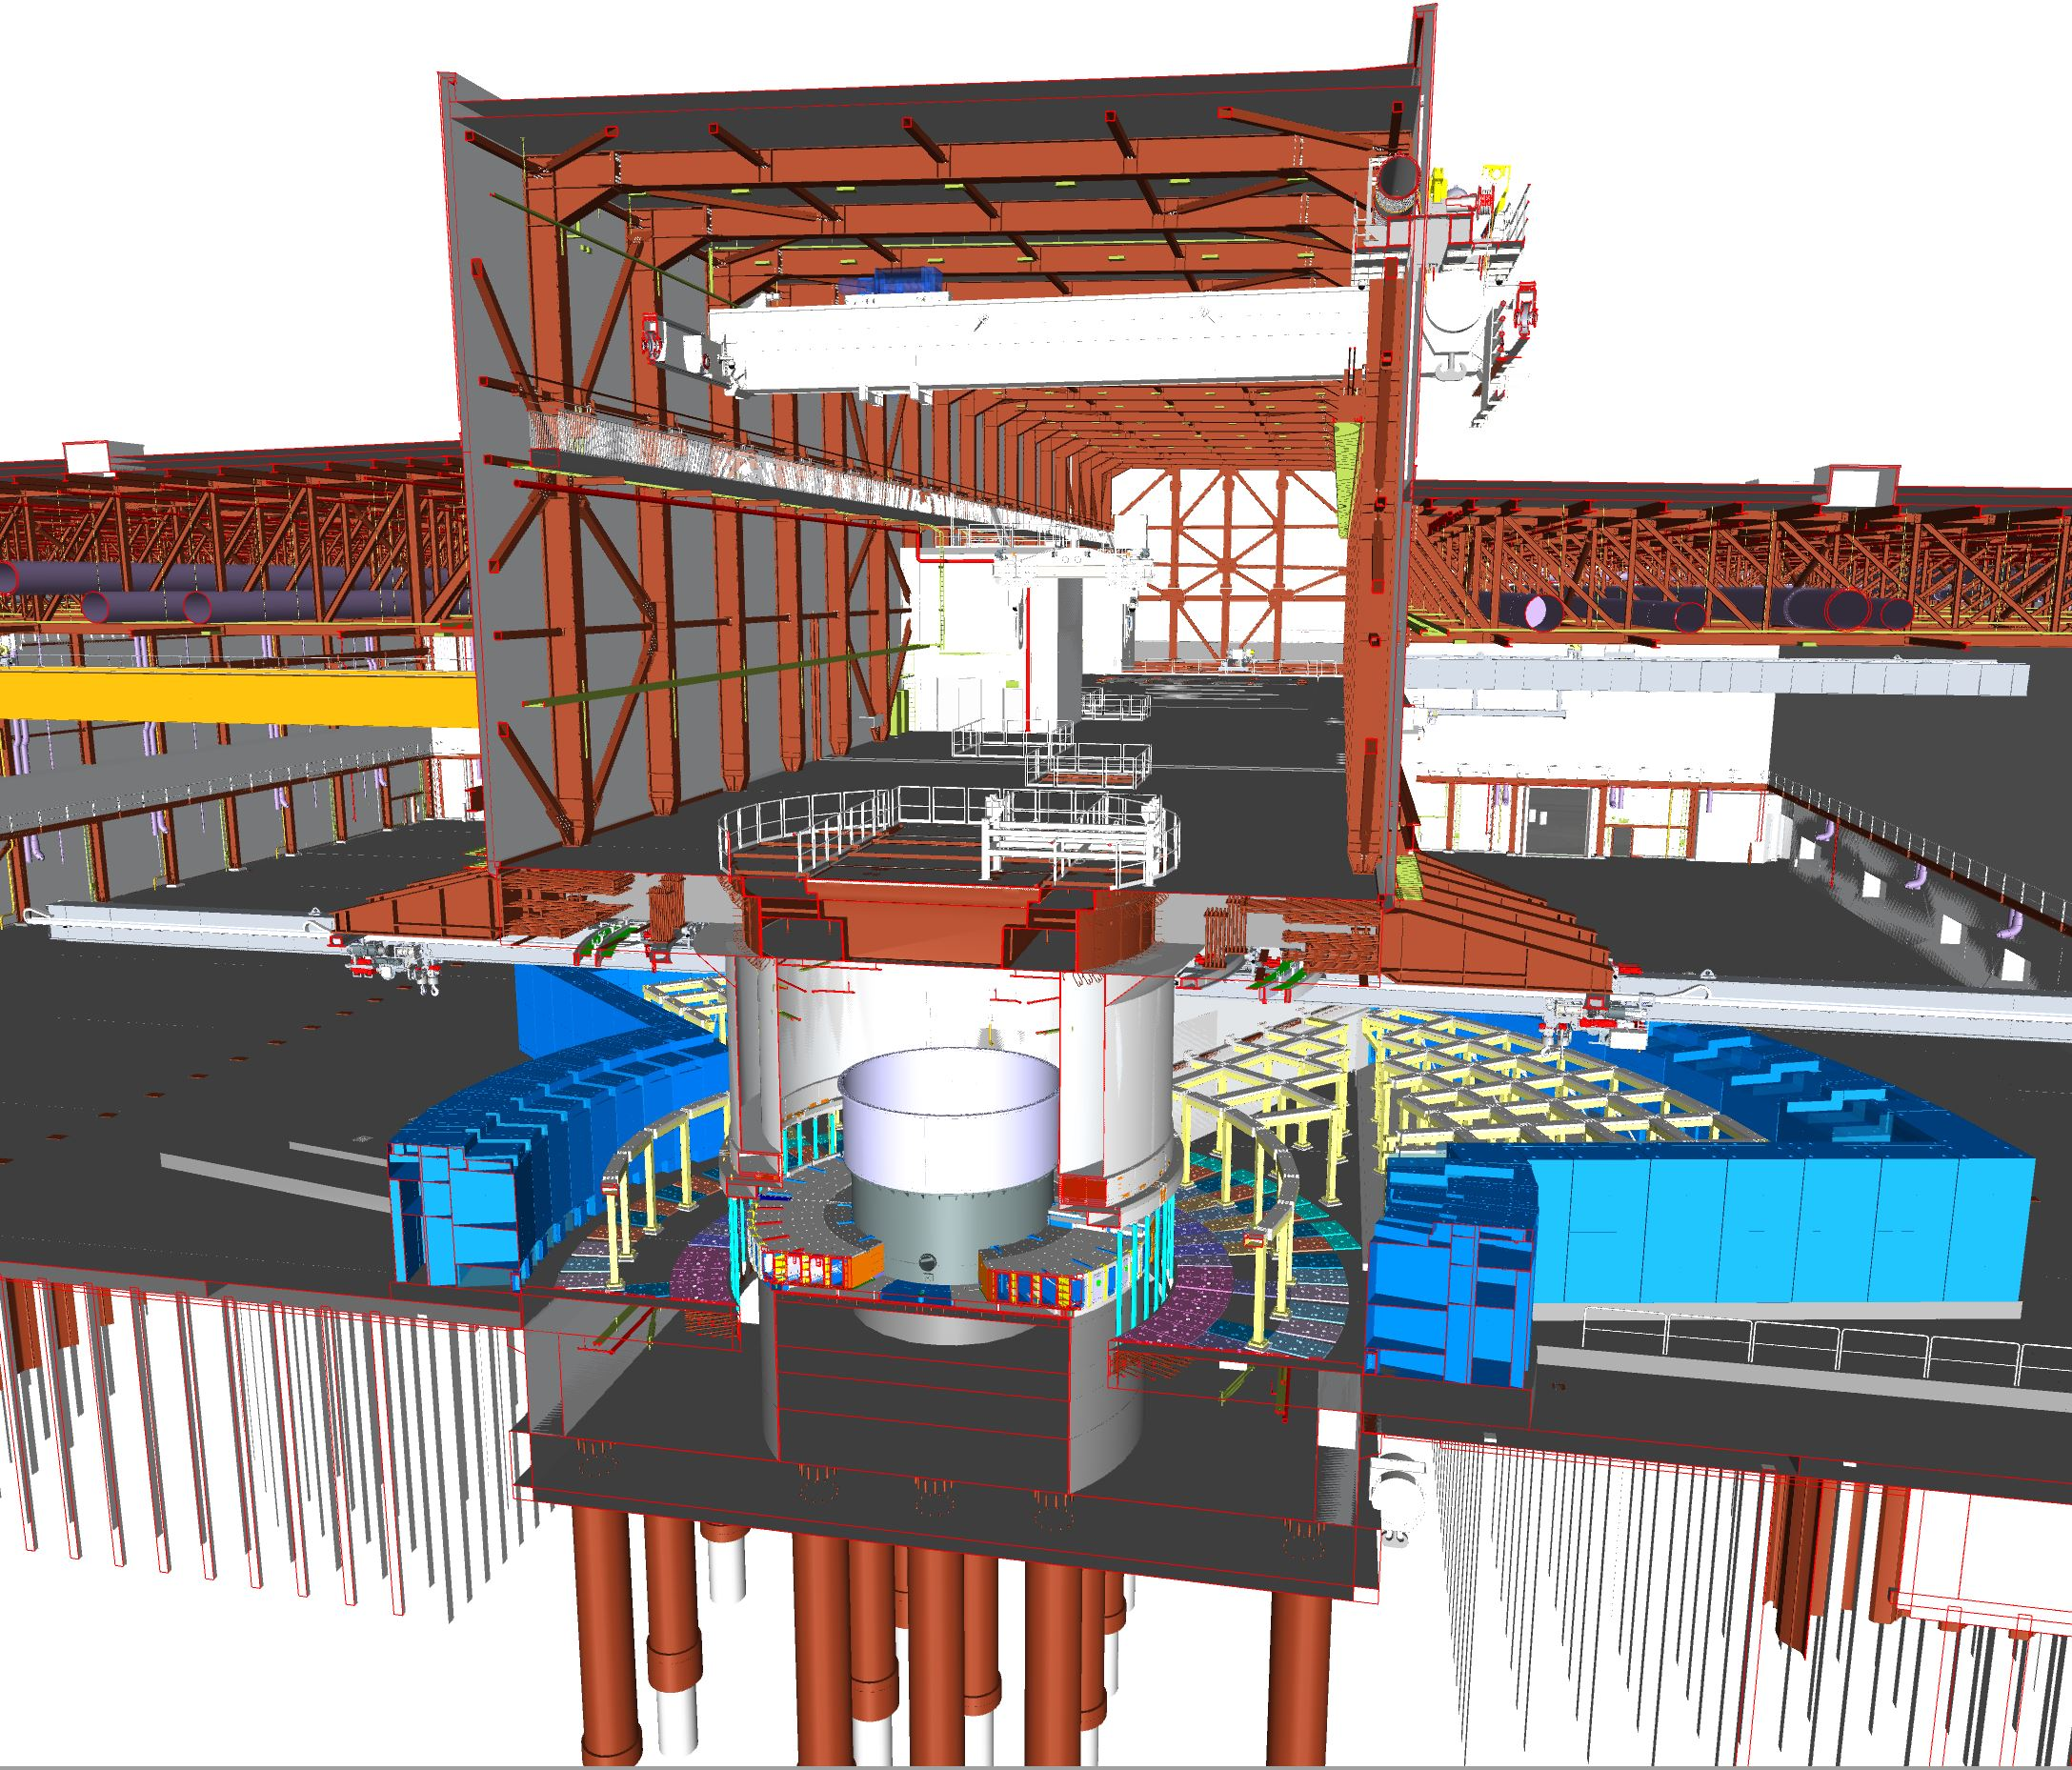
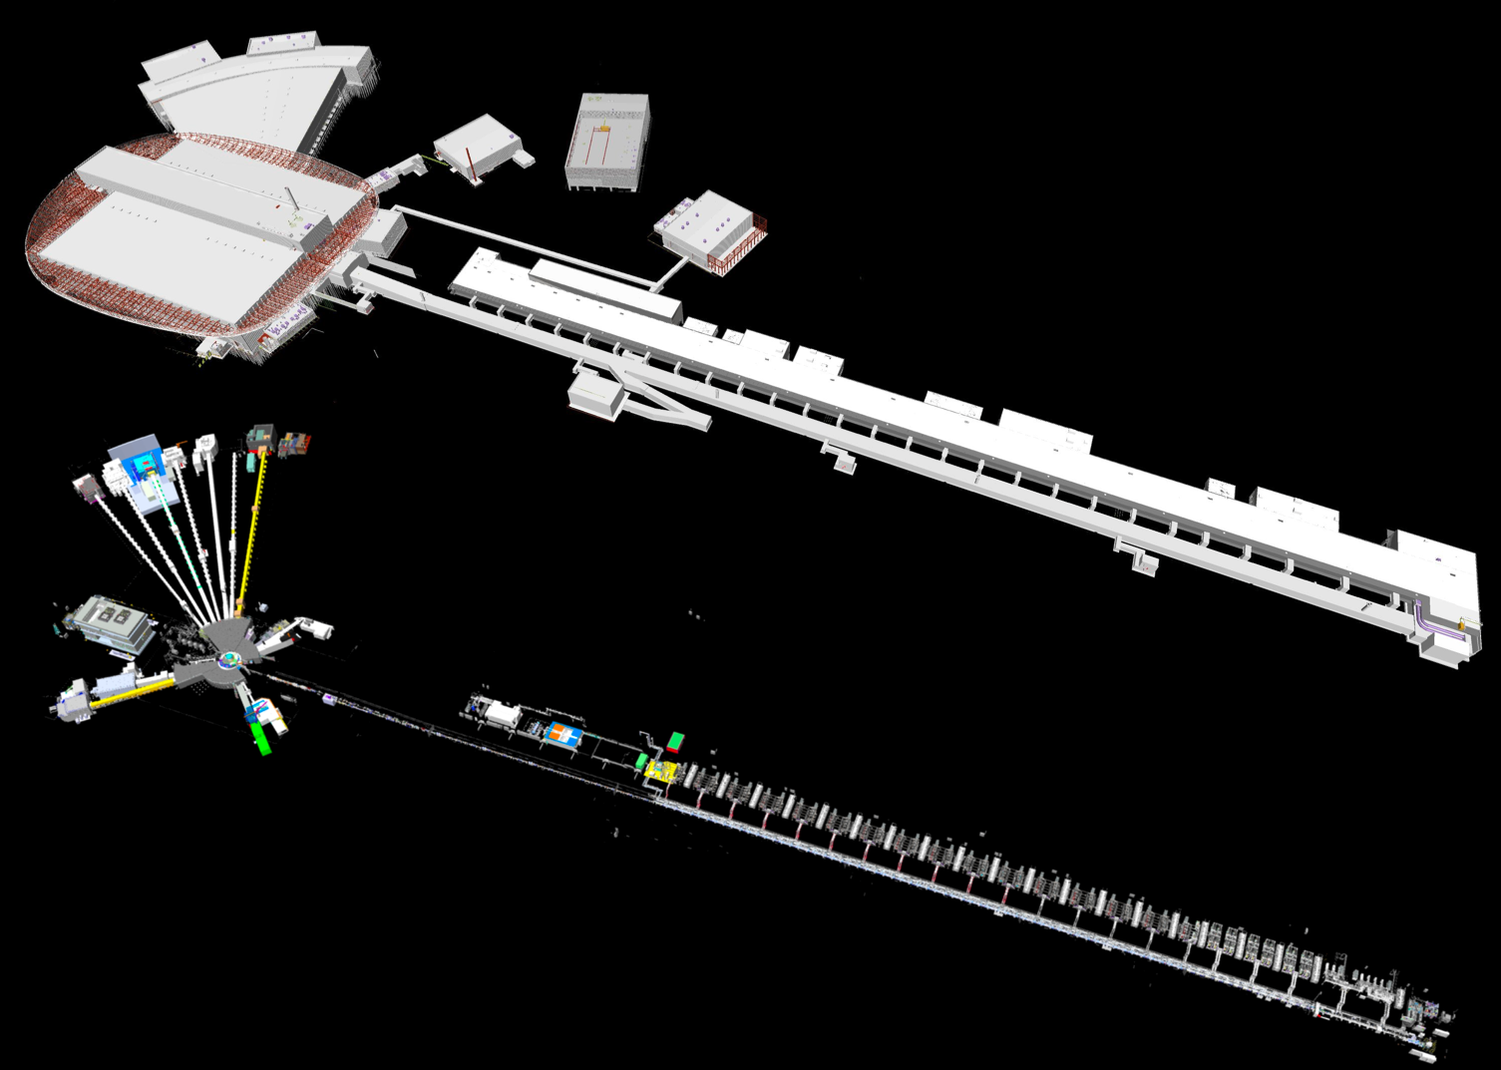
A use case: the ESS Target Monolith Systems assembly
    An integration challenge
SECTION VIEW OF TARGET BUILDING
ESS TECHNICAL BUILDINGS
ESS MACHINE
Proton Beam

Slide 7
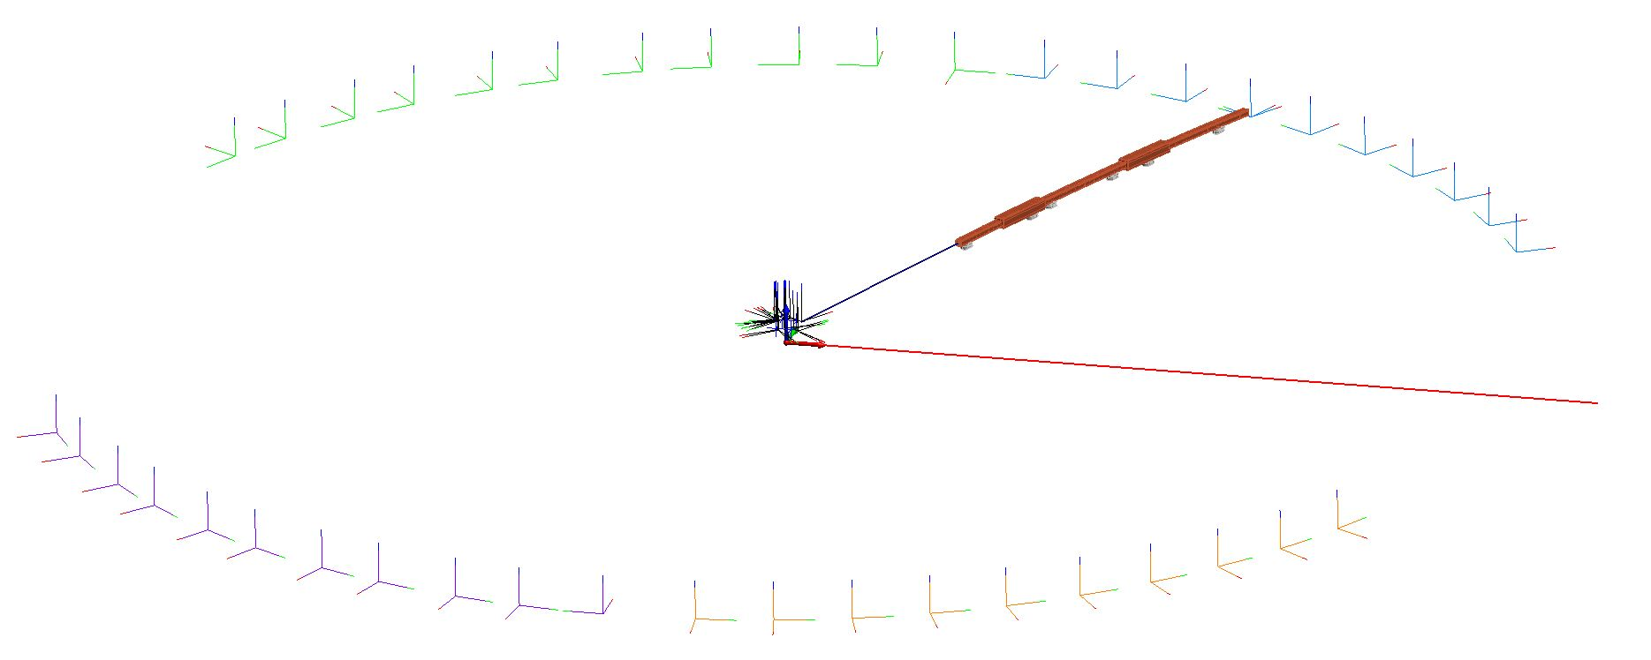
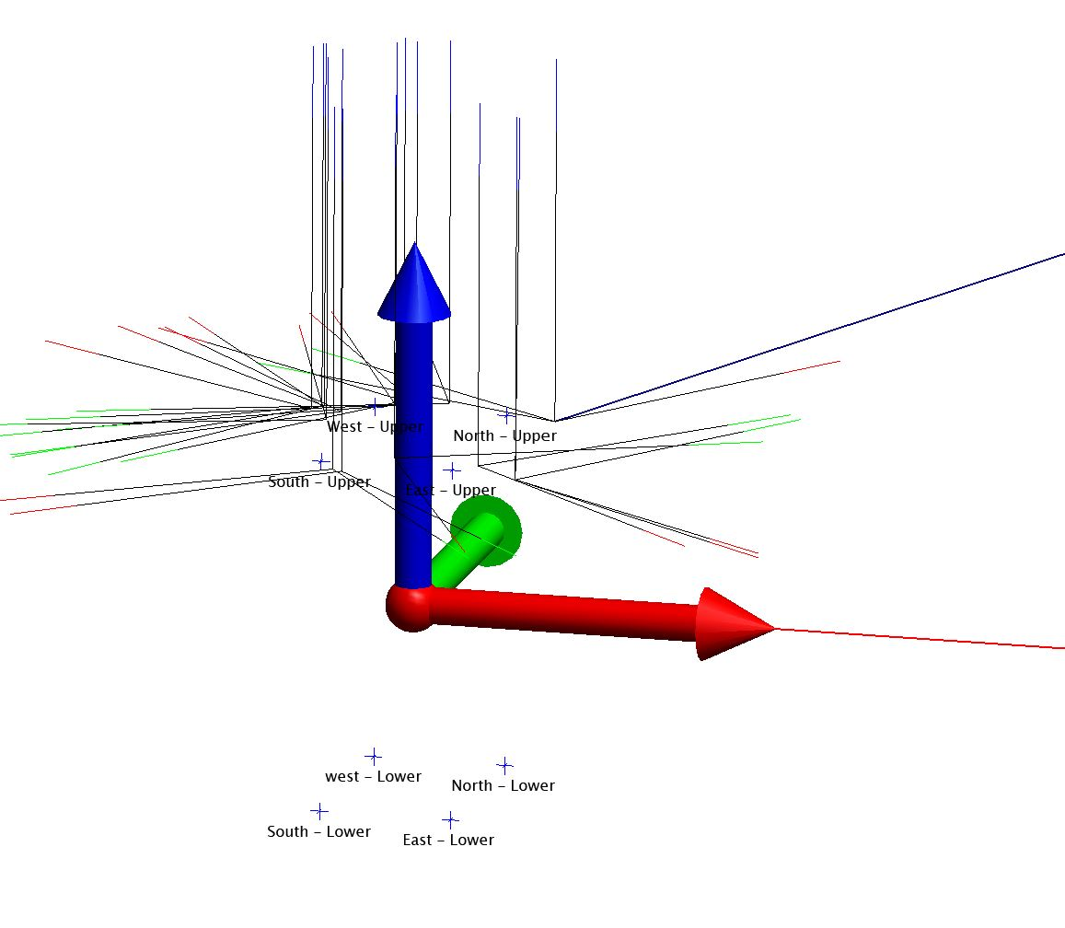
A use case: the ESS Target Monolith Systems assembly
    An integration challenge
West Sector
Beam Port Coordinate System
North Sector
Neutron Beam
NEUTRON OPTICS
Proton Beam
Target Coordinate System
Instrument Source Coordinate System
Z
South Sector
Y
Focal Points
East Sector
TCS
X
4 Upper
4 Lower

Slide 8
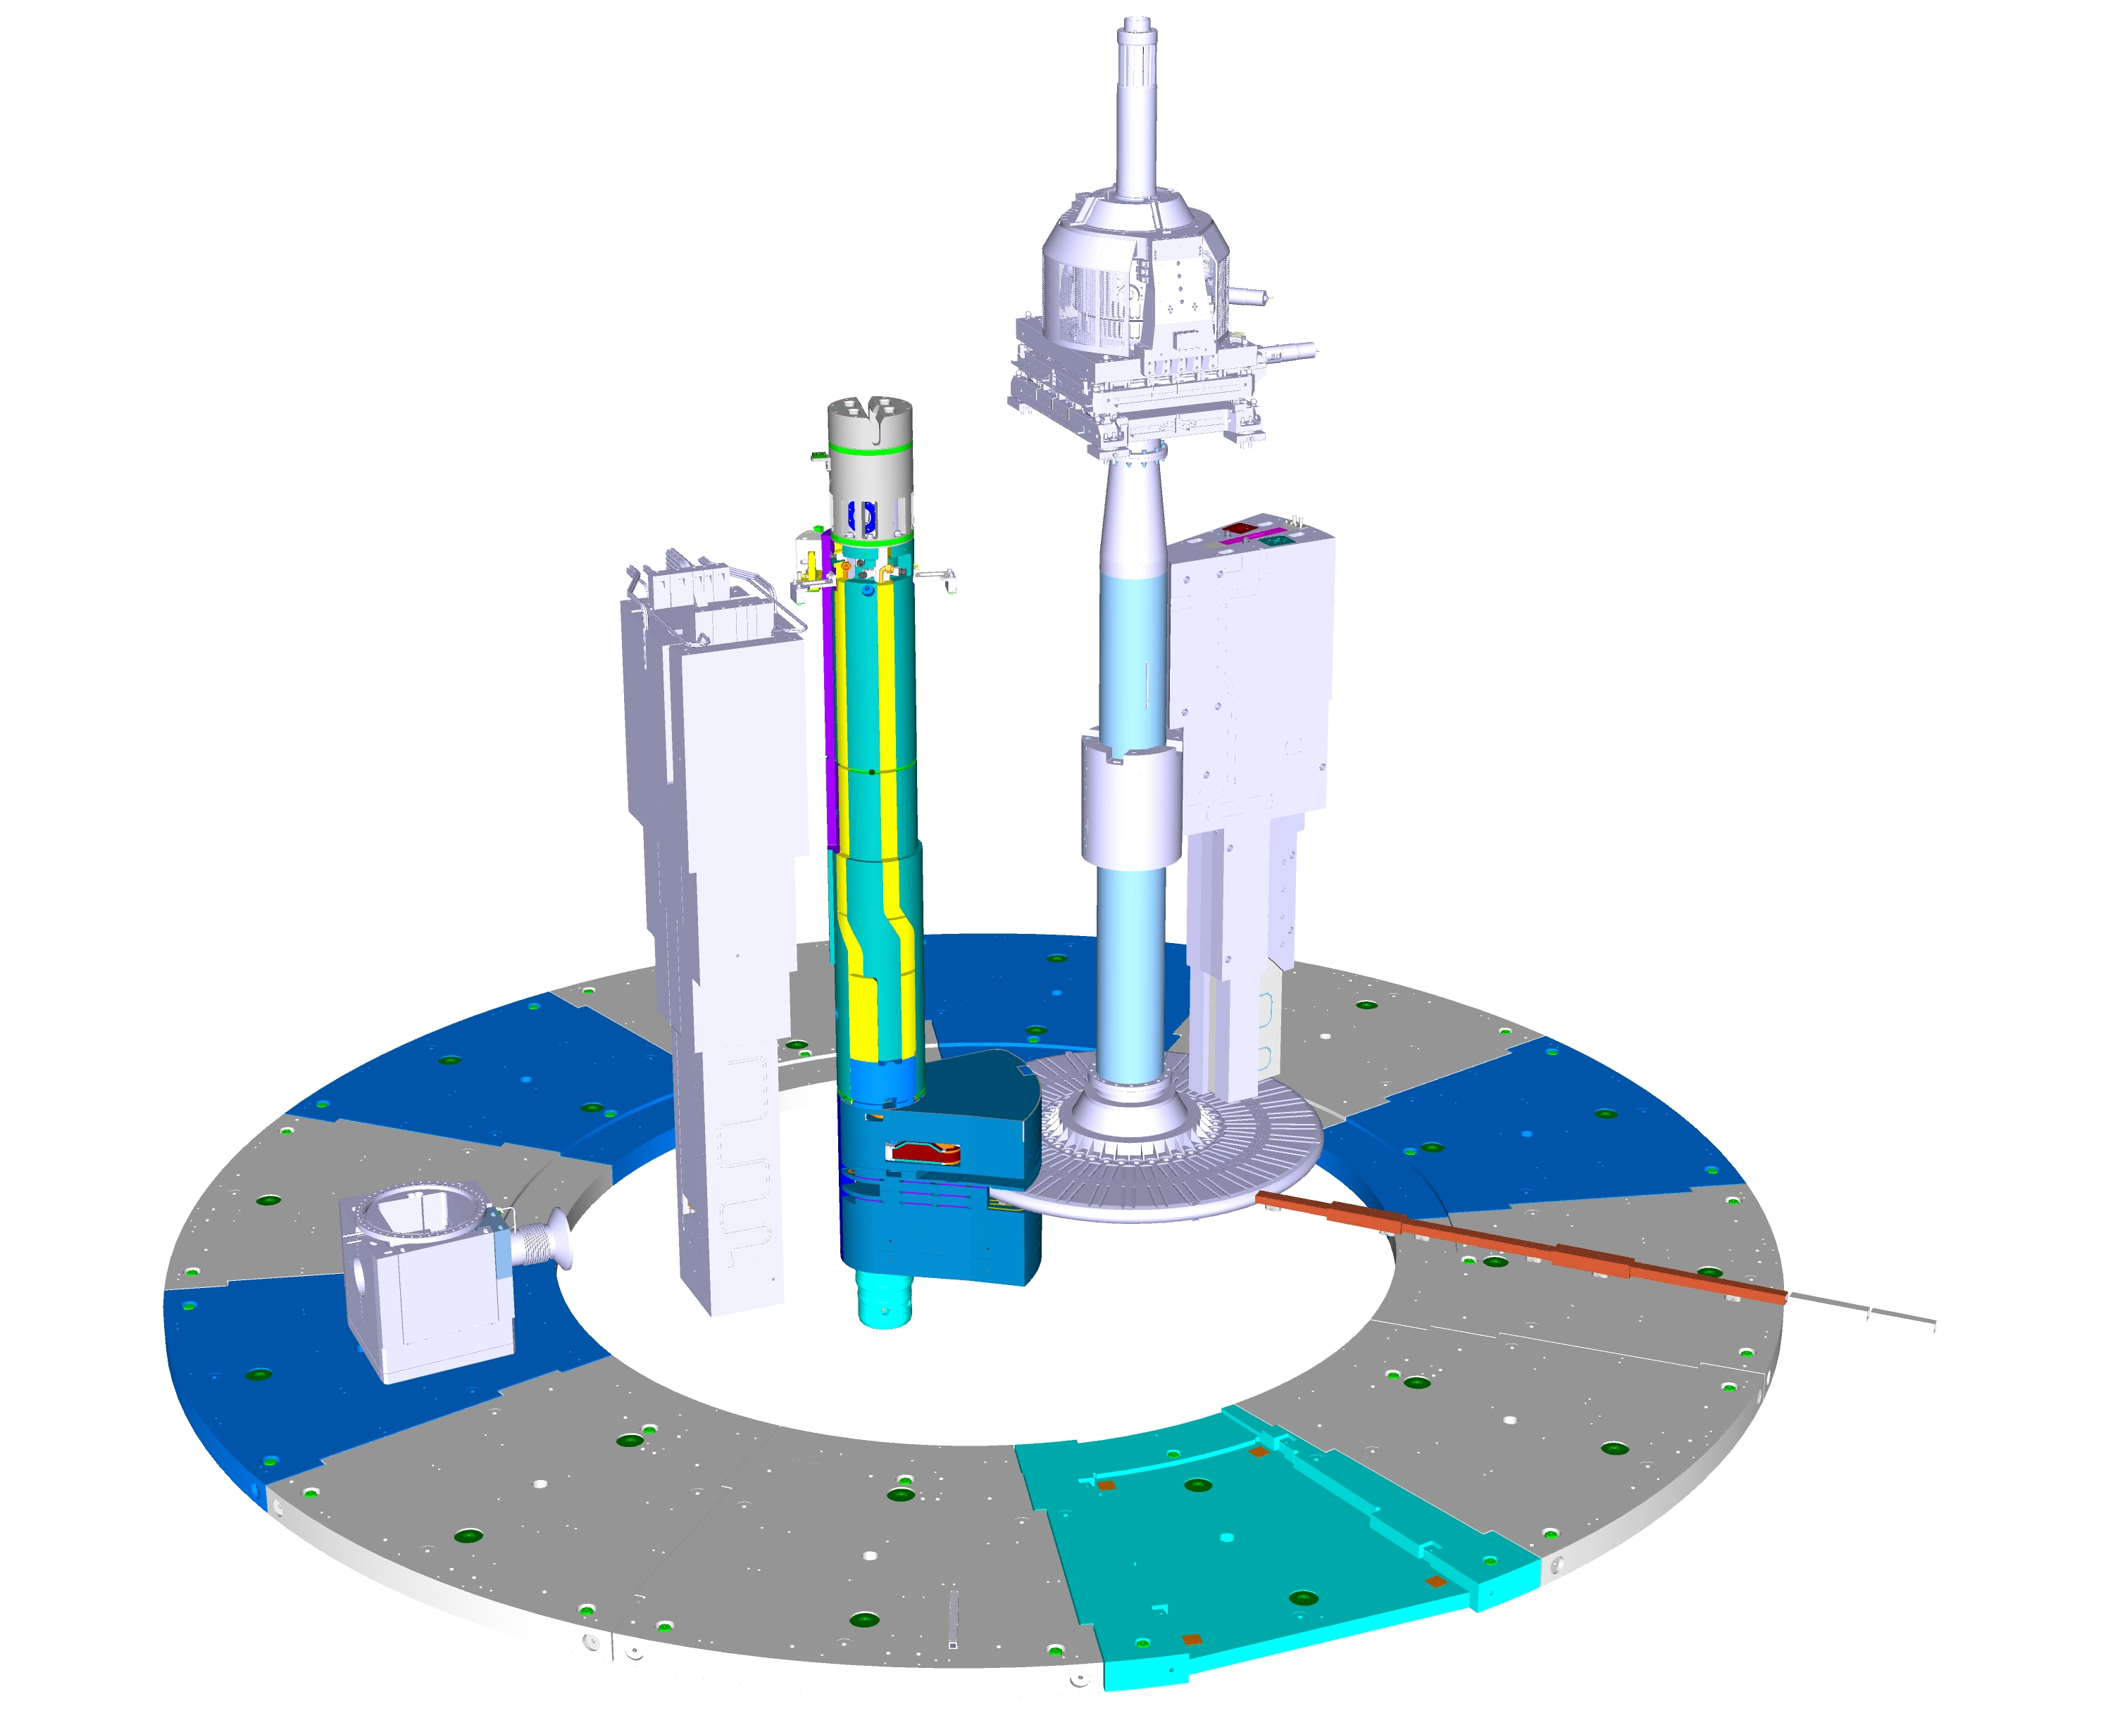
A use case: the ESS Target Monolith Systems assembly
    An integration challenge
TARGET DRIVE UNIT
TARGET MONITORING
PROTON BEAM INSTRUMENTATION
PROTON BEAM
WINDOW
NEUTRON OPTICS
WHEEL
PROTON BEAM
MODERATOR REFLECTOR
NEUTRON BEAM
BASE PLATES

Slide 9
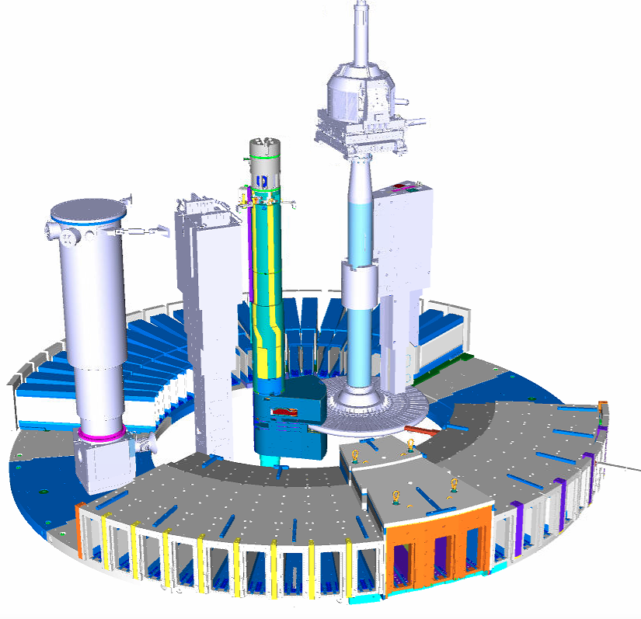
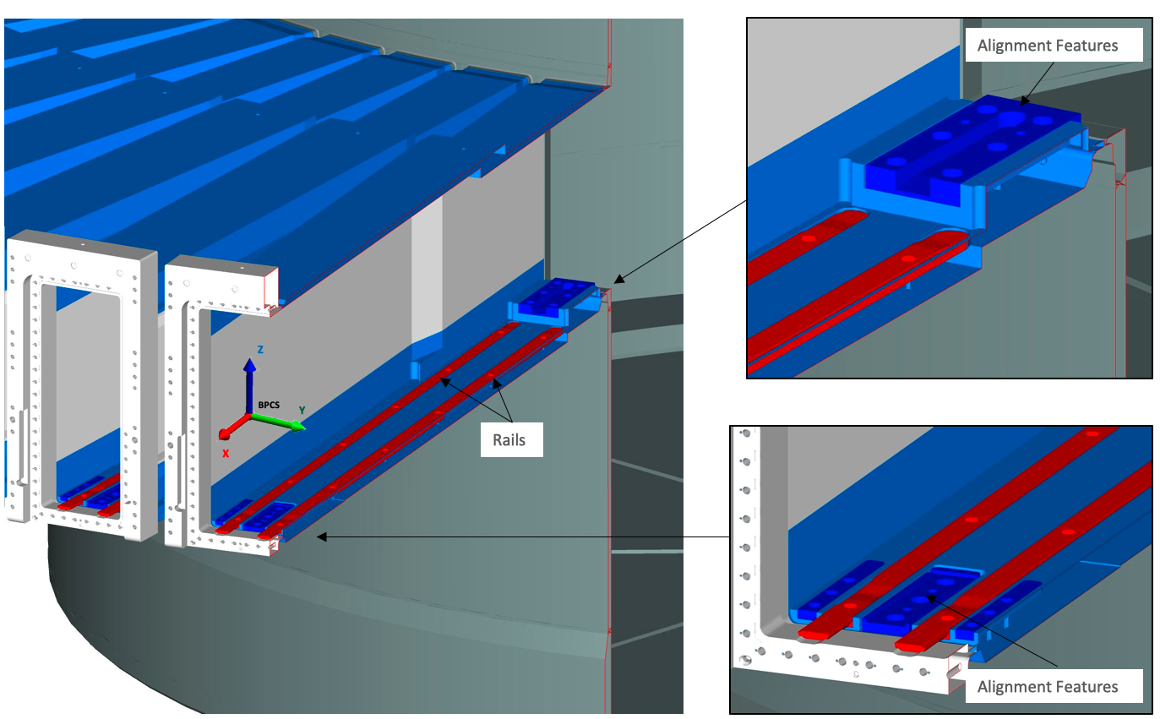
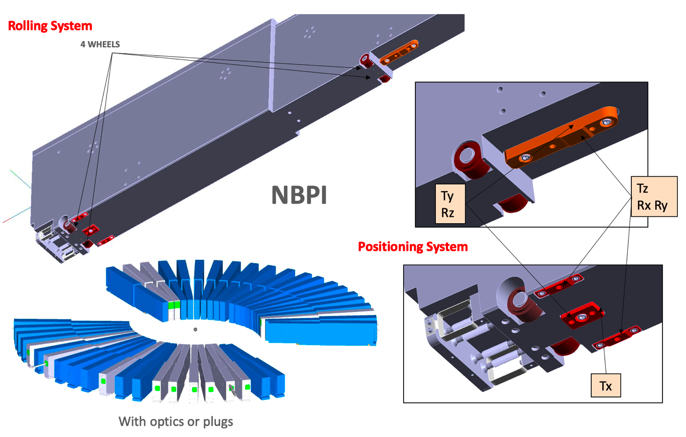
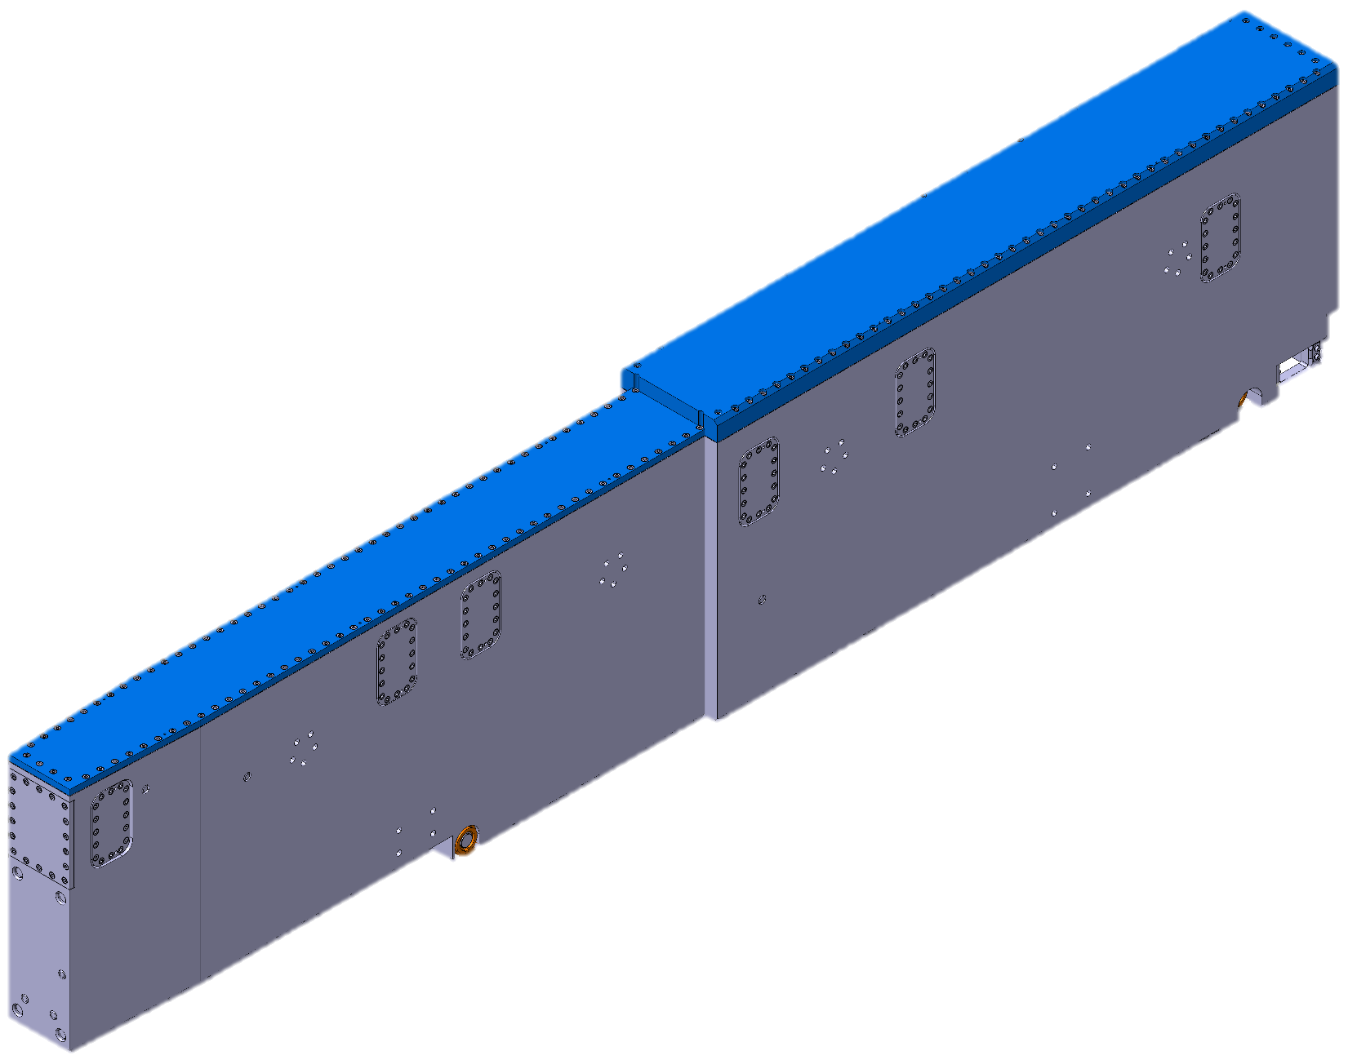
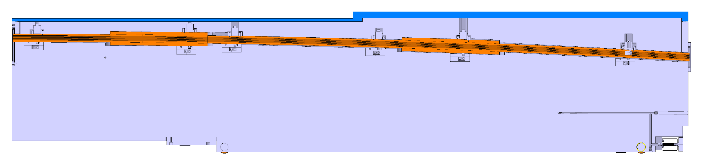
A use case: the ESS Target Monolith Systems assembly
    An integration challenge
PORT TUBES
NEUTRON BEAM PORT INSERT
NEUTRON BEAM PORT INSERT WITH OPTICS

Slide 10
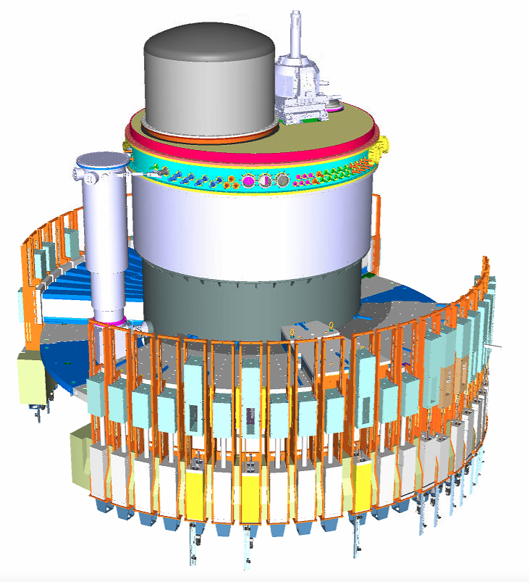
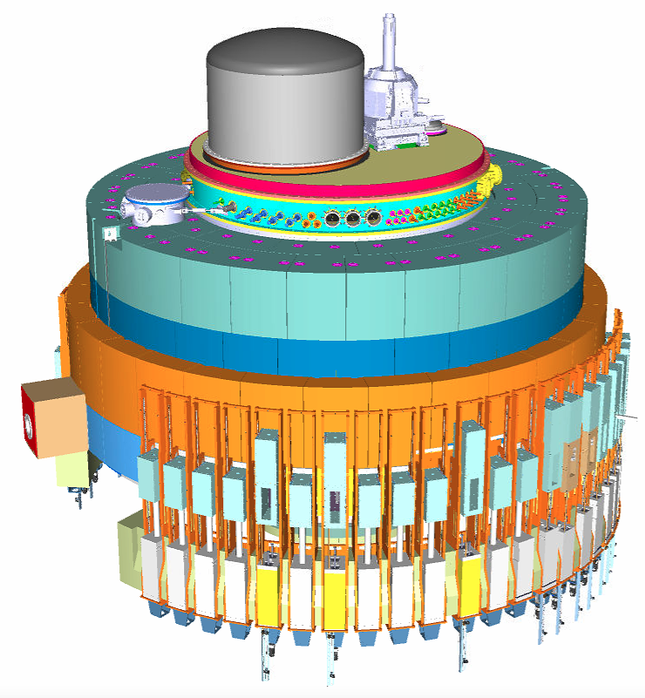
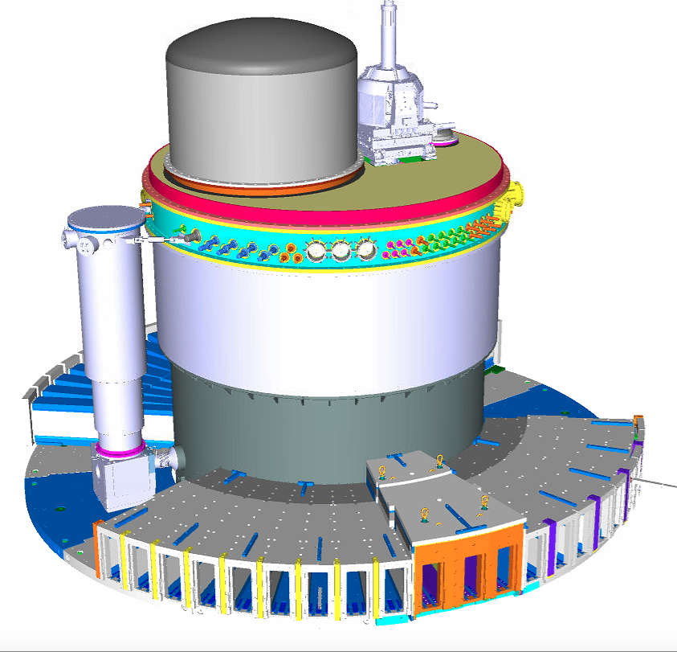
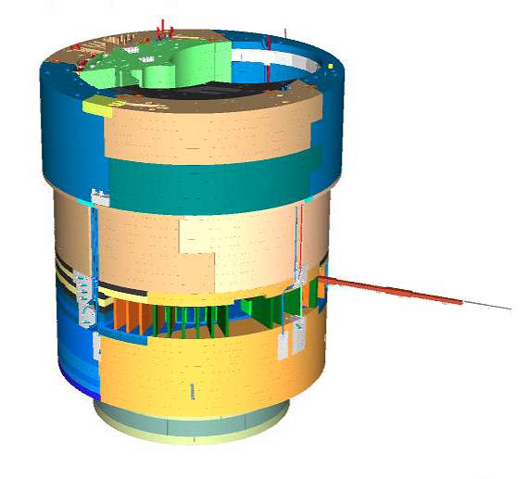
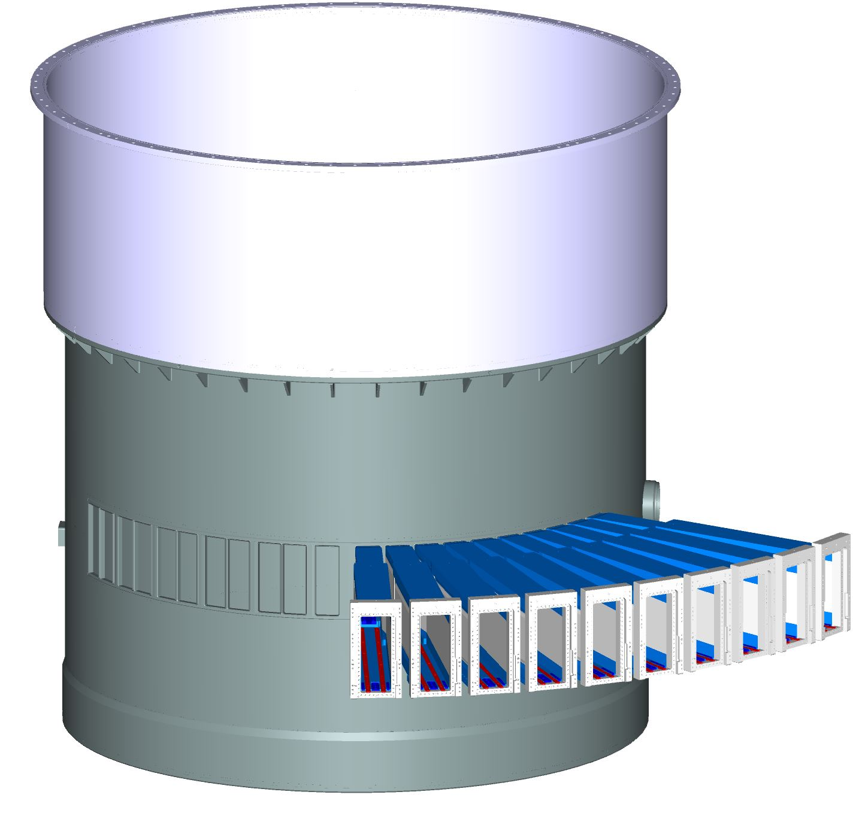
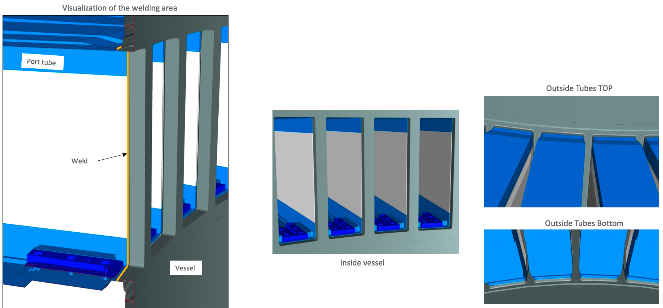
A use case: the ESS Target Monolith Systems assembly
    An integration challenge
OUTER SHIELDING
Monolith Vessels
LIGHT SHUTTERS
Welding Vessel – Port Tubes
INNER SHIELDING
PORT TUBES

Slide 11
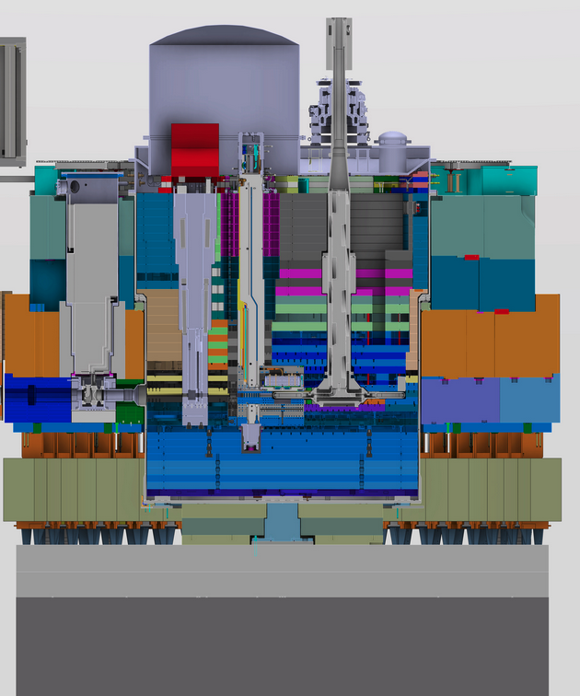
A use case: the ESS Target Monolith Systems assembly
    An integration challenge
Many systems designed by ESS teams and In-Kind partners
Nominal CAD model with tight nominal clearances
Mobility of systems : wheel, plugs and insert , installation, operation and maintenance
Additional constraints:
  Vacuum vessel - pressurized equipment
  Thermal effects
  Radiation
  Differential settlement
Numerous meetings and workshops to talk about geometrical tolerances
Section view of the
Target Monolith Systems
Each teams try to express their needs as they can:
Interface documents
Technical Drawings
Excels files
PowerPoints
Whiteboards sketch
2019
Try to establish:
Manufacturing Tolerances
Installation Tolerances
Operation Tolerances
Clash analysis
Assembly simulations

Slide 12
A use case: the ESS Target Monolith Systems assembly
    What space do we need?
All good !!!! until we have a problem :
    large geometrical deviations observed during manufacturing of the monolith vessel
Can we accept this component apparently out of manufacturing tolerances?
March 2020
Are we sure that we expressed without ambiguity our needs?
ESS Engineering Handbook
Interface documents
Geometrical requirements
Manufacturing
drawings
Verification
and Acceptance ?

Slide 13
A use case: the ESS Target Monolith Systems assembly
    An communication problem
During Verification , ESS teams and in-kind partners realize :
too much ambiguities in the way of expressing geometrical requirements
various teams were not using all the same “ language “ to express their needs
Our functional analysis was not consistent and reliable
We have a communication problem
We must change our way of working !

Slide 14
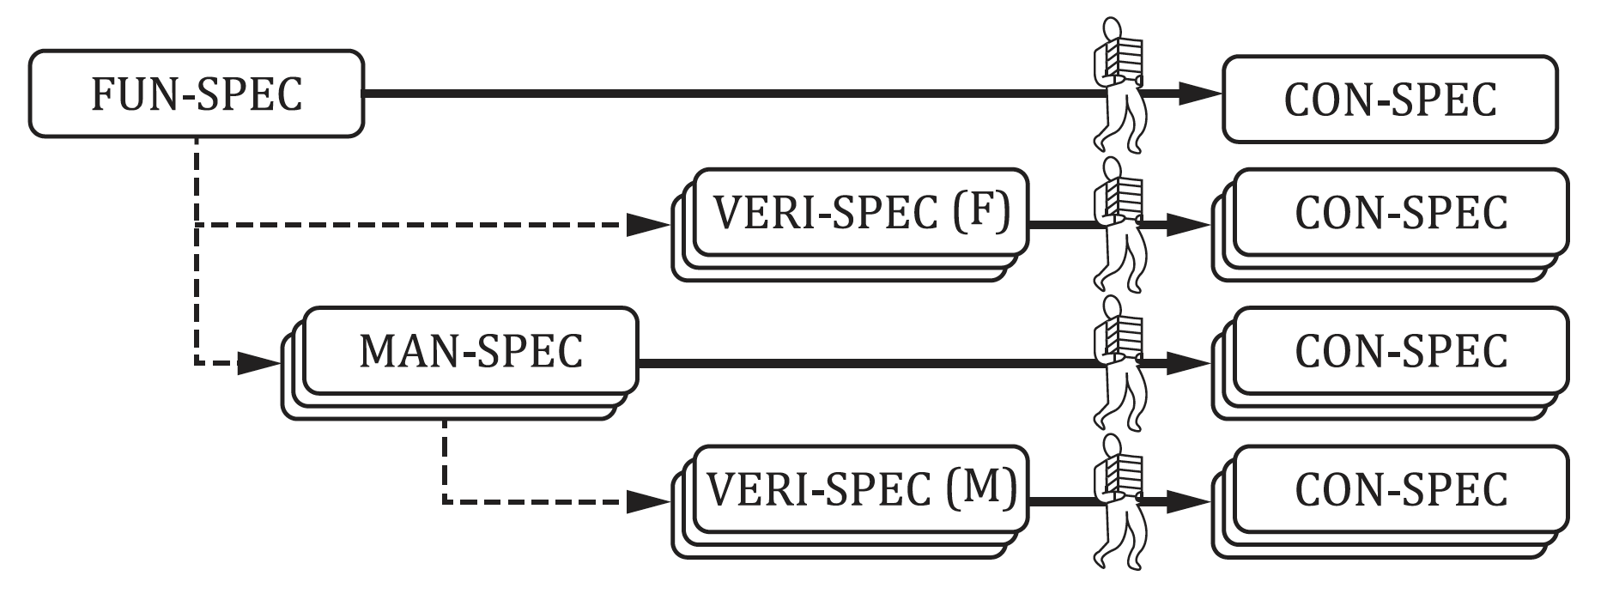
Systematic approach through technical drawings and ISO GPS language
    Deployment at ESS
Strategy: rely on International Standards (ISO)
Technical Drawings
ISO GPS language
Technical Product Documentation - ISO 128
Geometrical Product Specification
(ISO GPS) is the system used to define the geometrical requirements of workpieces in engineering specifications, and the requirements for their verification.
ISO 14638:2015
Type of documents with GPS- ISO/TS 21619:2018
GPS- ISO 8015:2011
Convince Top management!
ISO-GPS Training organized for many teams
Not only designers but also mechanical workshop , Installation teams, managers …
Make distinction between three types of specifications
Functional specification: FUN-SPEC
Manufacturing specification: MAN-SPEC
Verification specification: VERI-SPEC (F) ou (M)
WHAT
HOW
WHETHER

Slide 15
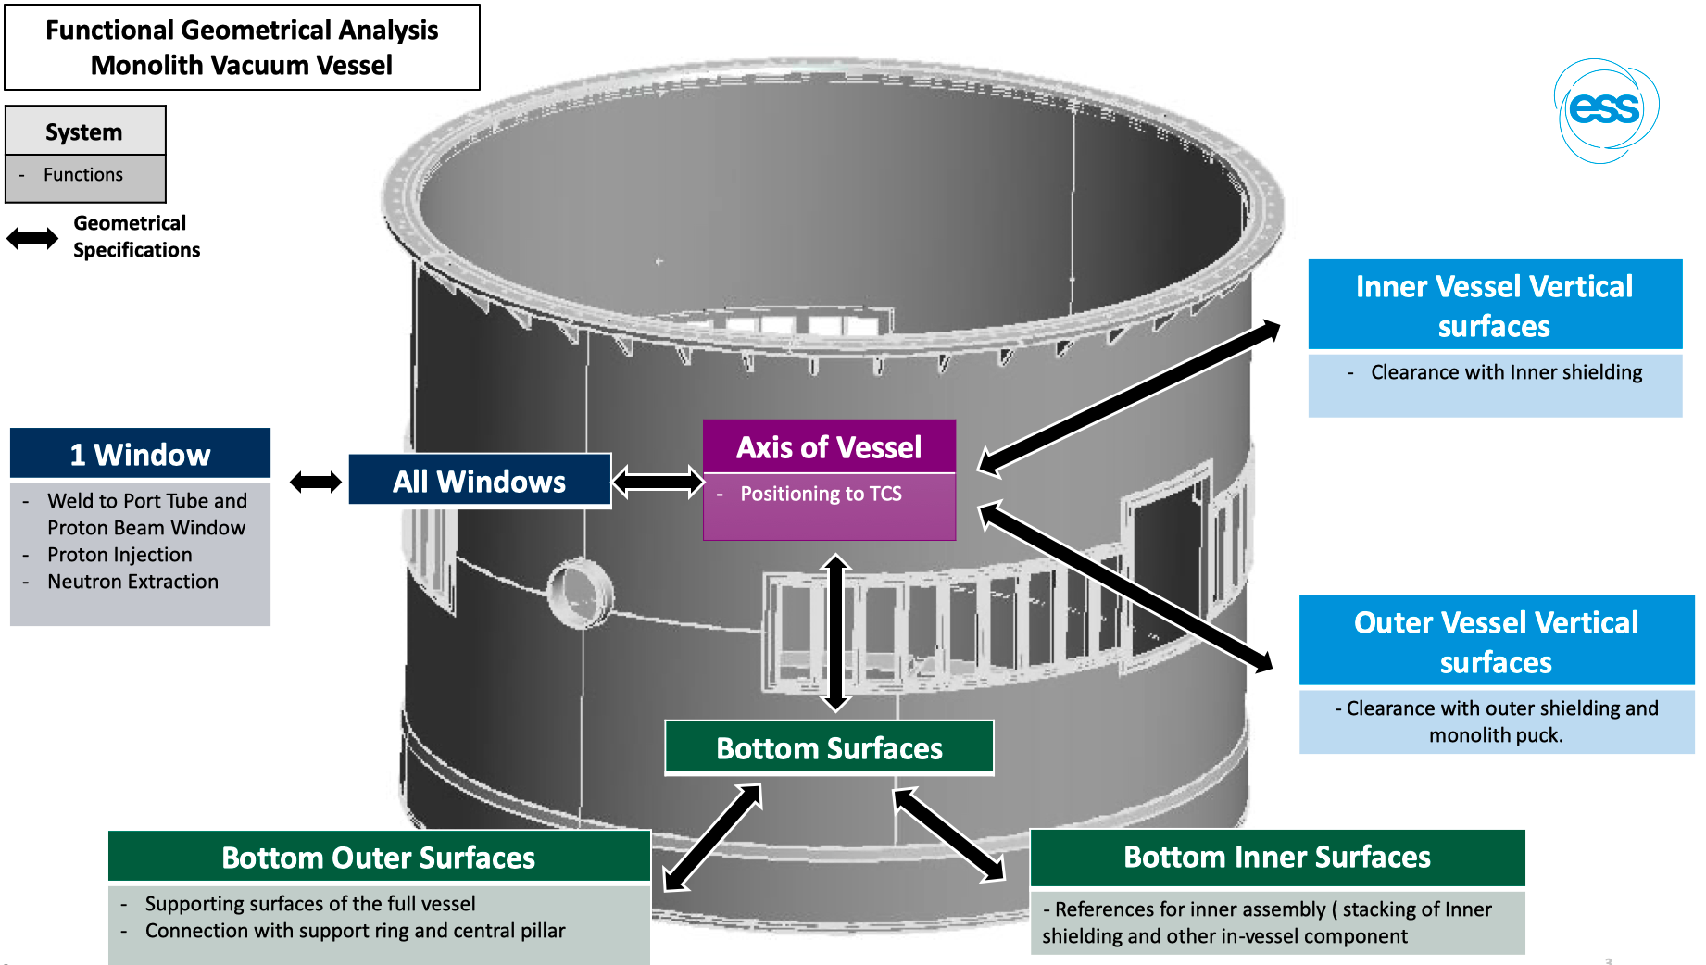
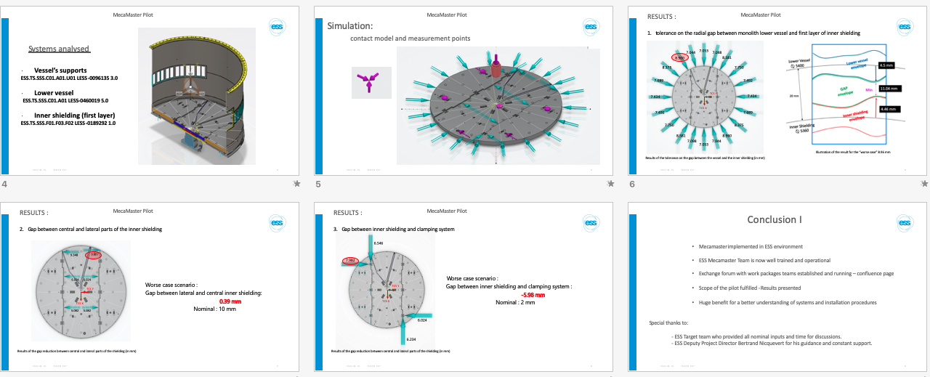
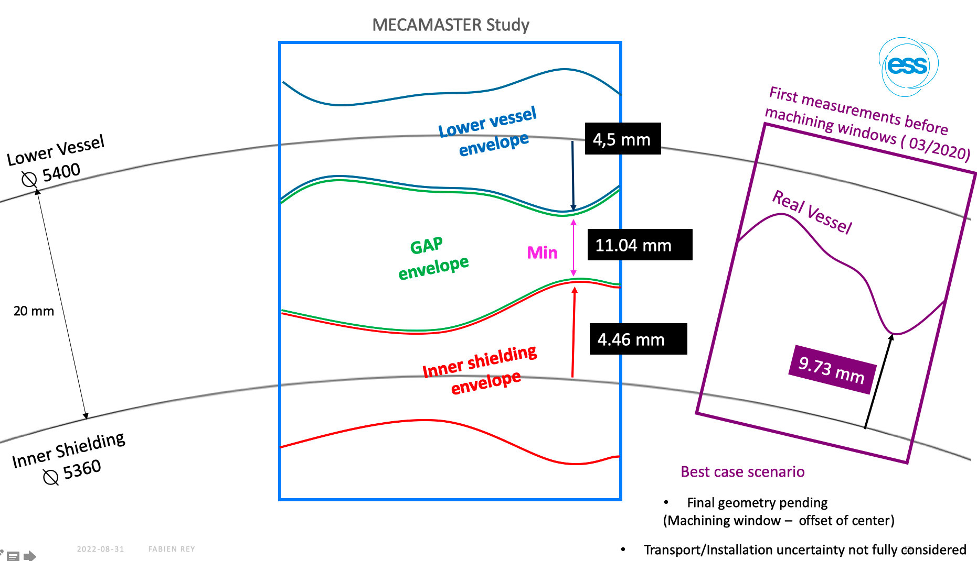
Systematic approach through technical drawings and ISO GPS language
    Acceptance and Verification
All teams started talking the same language ISO GPS
Functional analysis fully revisited
3D tolerance stack-up analysis carried out
Functionals and Verifications Drawings – ISO GPS compliant
Immediate benefit :
we can express the geometrical needs of each stakeholders in an unambiguous and common way
Better understanding of 3D interfaces between systems
Clarification of objectives for :
Manufacturing
Installation
Operation

Slide 16
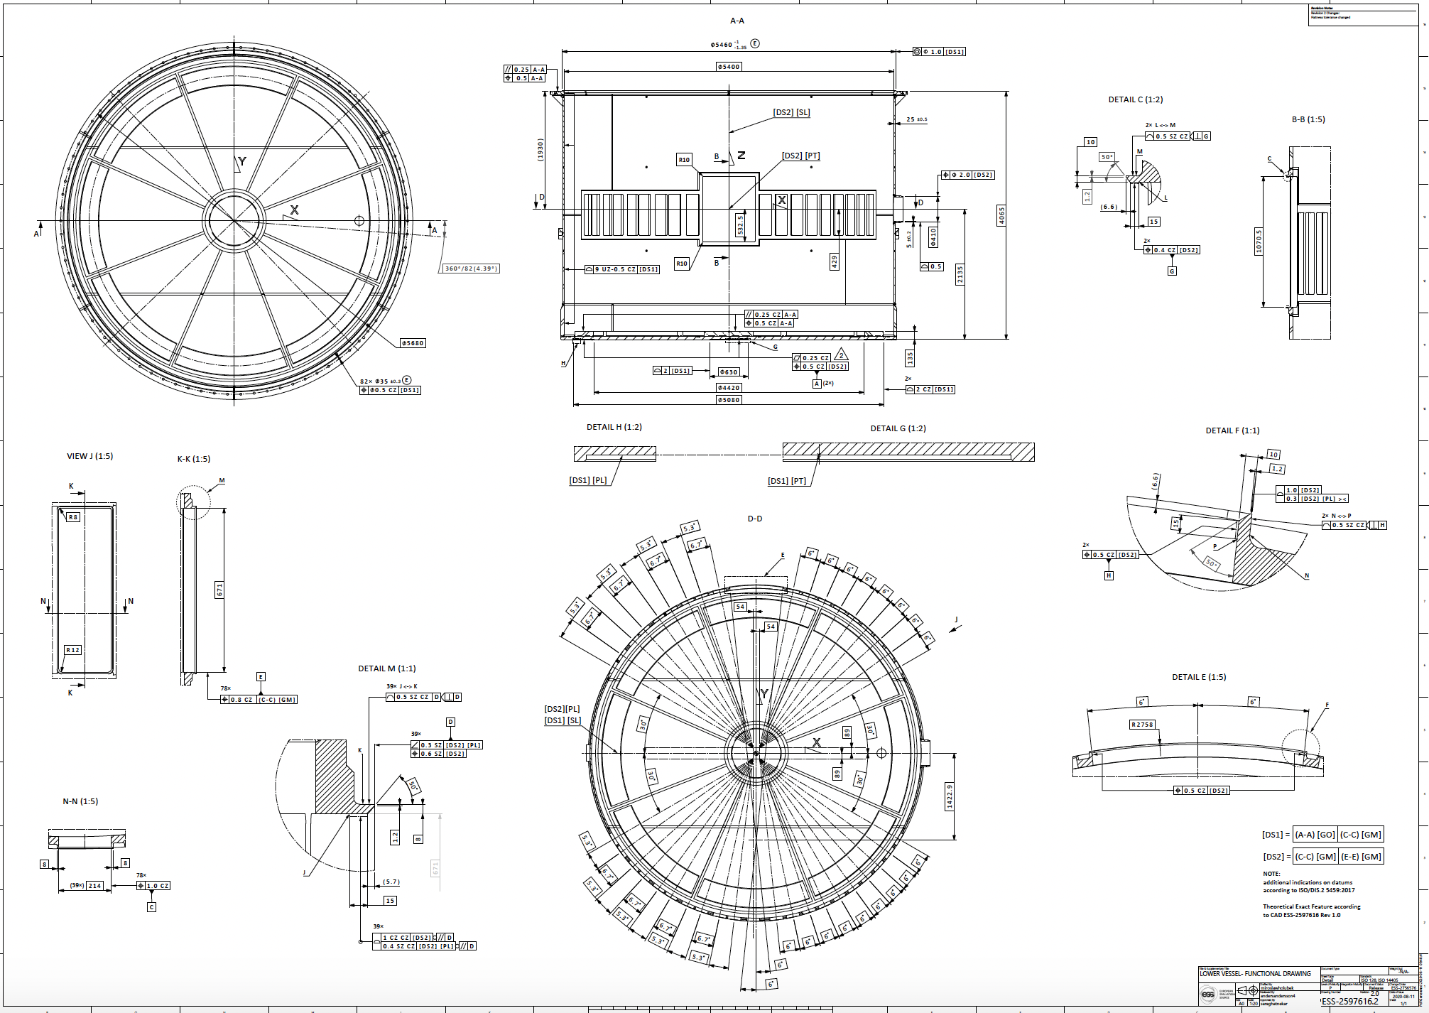
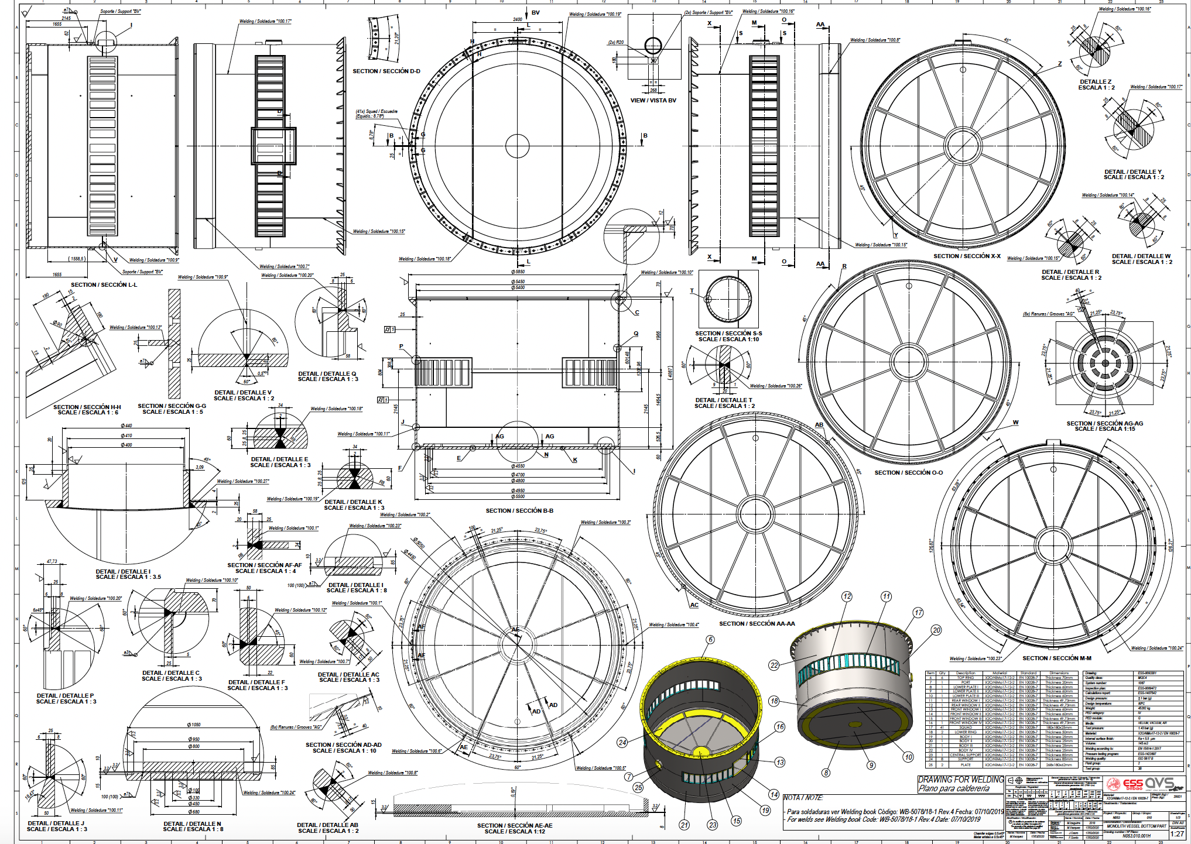
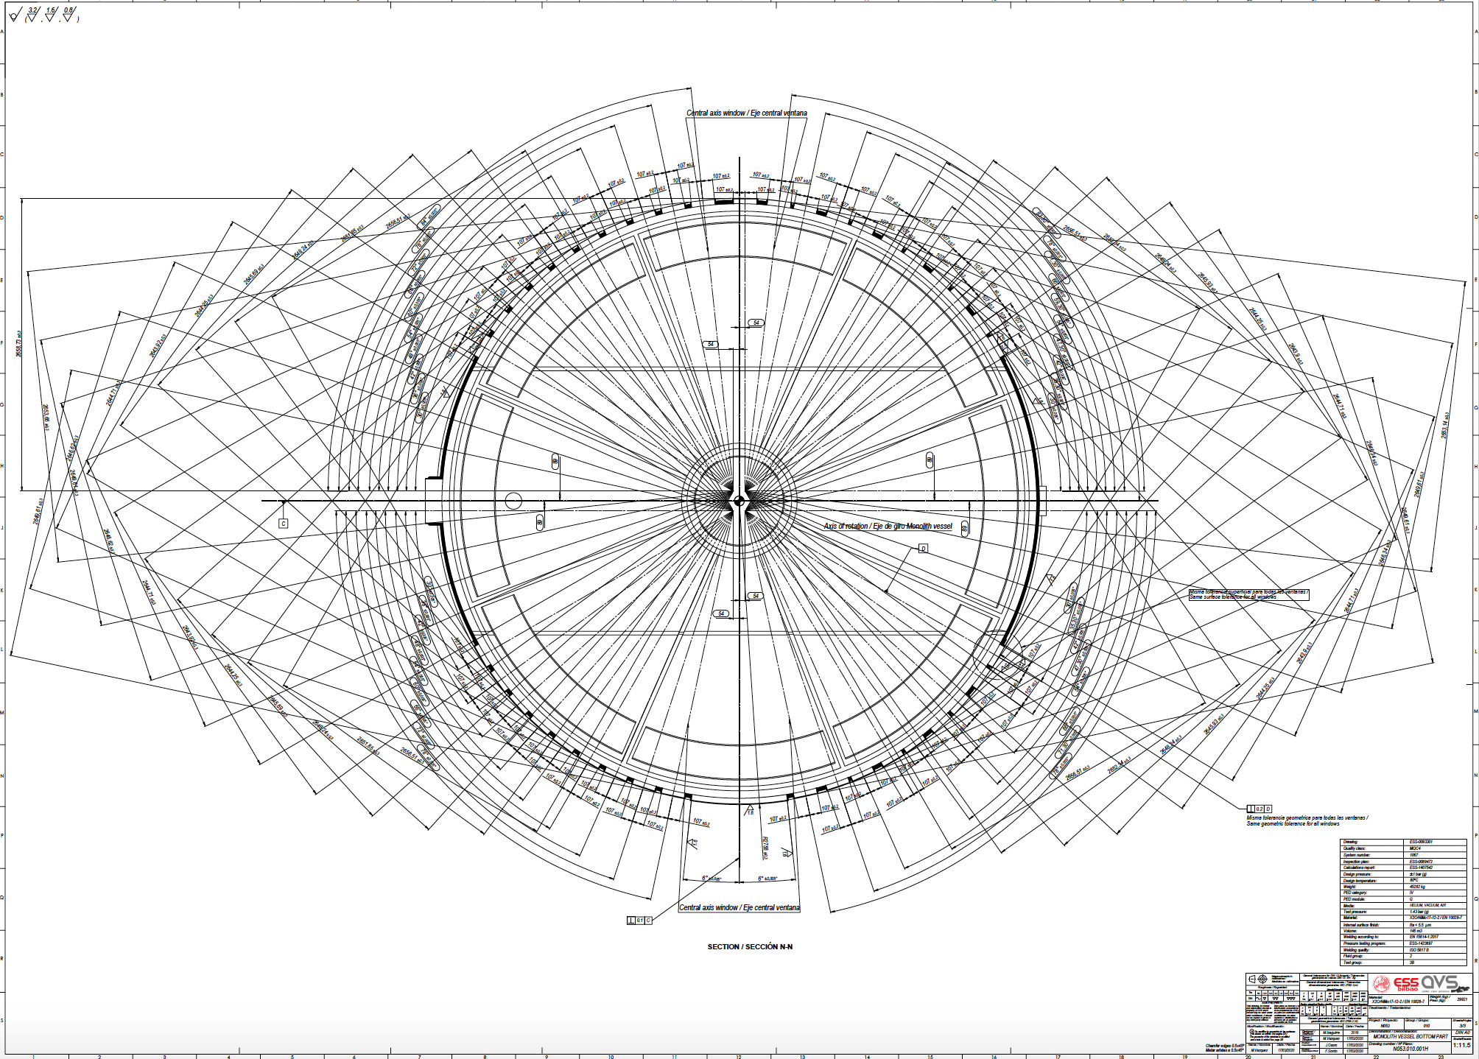
Systematic approach through technical drawings and ISO GPS language
    Acceptance and Verification
We go from :
TO

Slide 17
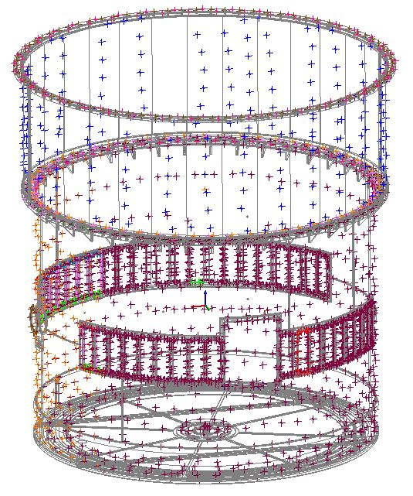
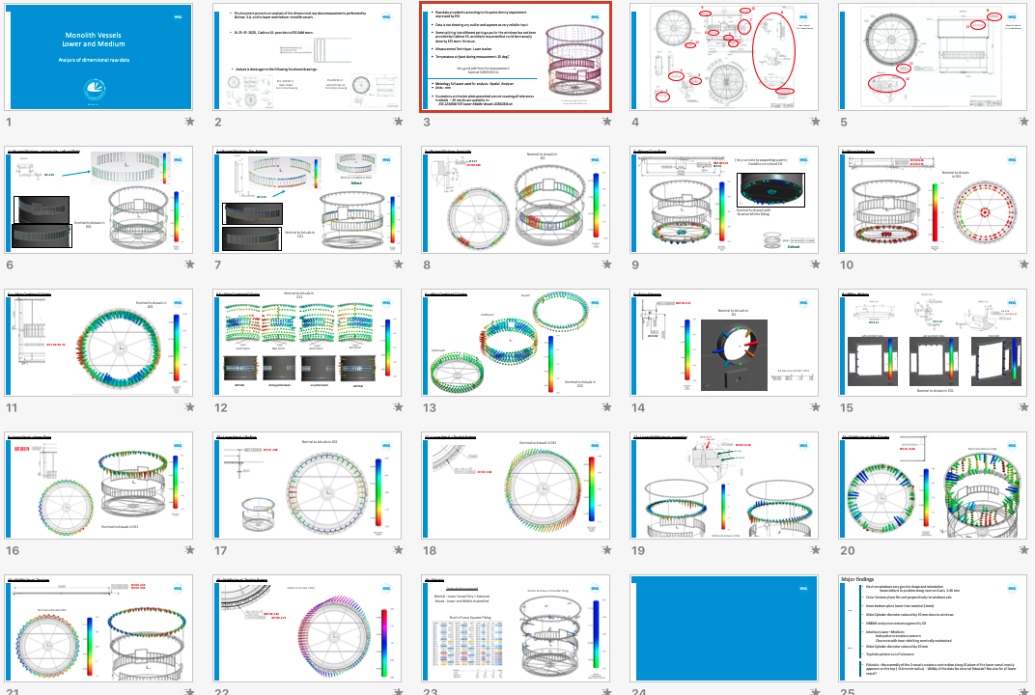
Systematic approach through technical drawings and ISO GPS language
    Acceptance and Verification
Raw measurement data
(extracted integral features)
Verification Report
VERI-Spec derived from FUN-Spec

Slide 18
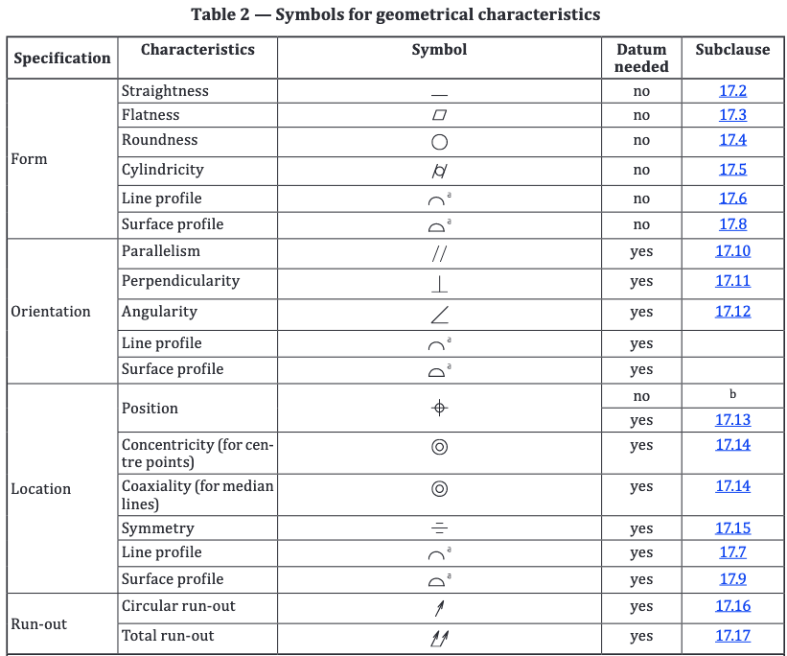
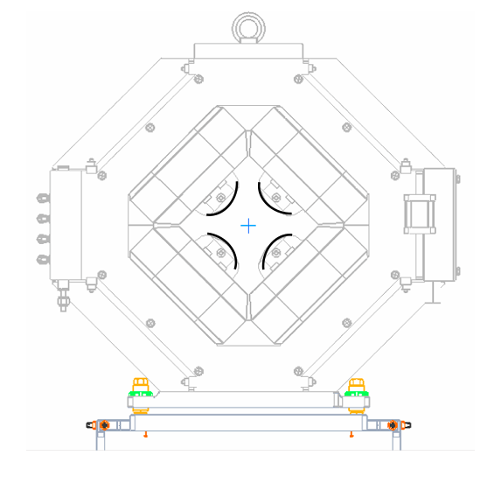
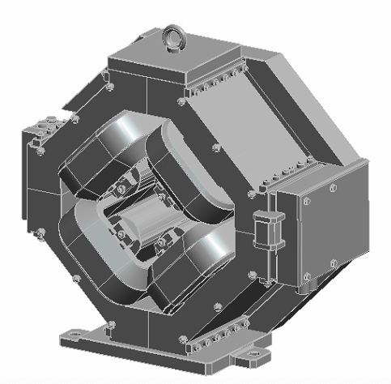
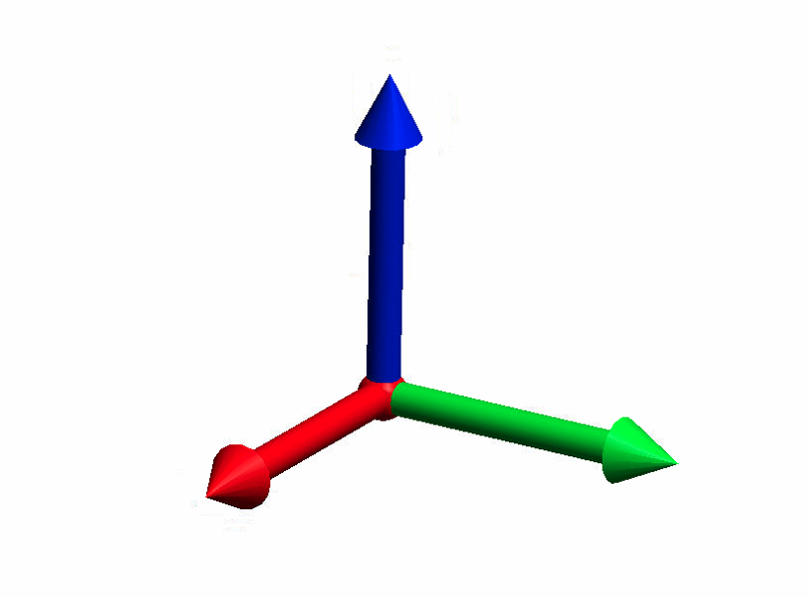




Developing tools applicable from Design to Commissioning
    Positioning requirements = Tolerance zones ?
ESS Engineering Handbook
Functional
drawings
Manufacturing
drawings
Verification
drawings
Installation
drawings
What is an installation drawing?
Express geometrical specifications on functional features of the part with respect to situation features of type :
Provide information for positioning and orientation of a part or assembly with respect to a local or global reference frame
Translation in
ISO GPS language:
Frame usage not normalized
point
Line
plane
[PT]
Or a combination of them
[SL]
ISO 1101:2017
[PL]
Geometrical product specifications (GPS)
Geometrical tolerancing – Tolerances of form, orientation, location and run- out
Identify functional surfaces and
express geometrical specifications
Positioning requirements
“I want this component to be within ± 1 mm
with respect to this reference frame”
4x
$$∅ t4 CZ$$
A
X
Y
Z
$$±∆X$$
$$± ∆Y$$
$$± ∆Z$$
In this case not locking all degrees of freedoms !
Z
A
$$α$$
$$β$$
$$γ$$
$$±∆α$$
$$± ∆β$$
$$± ∆γ$$
TED
$$γ$$
$$β$$
X
$$α$$
Y
TED: Theoretical Exact Dimension (can be a distance or an angle)

Slide 19
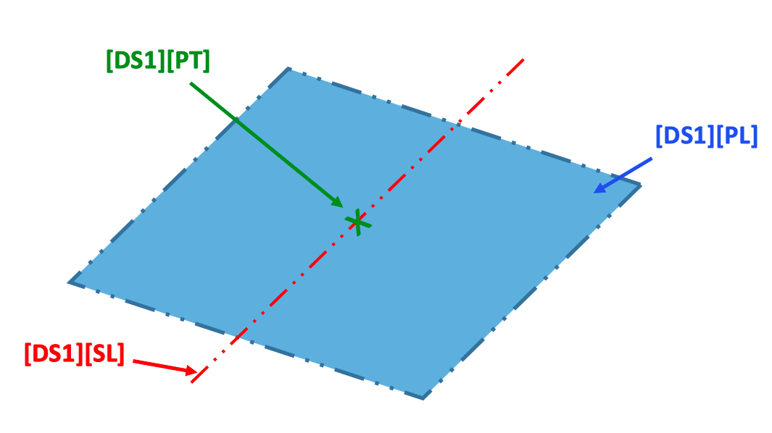
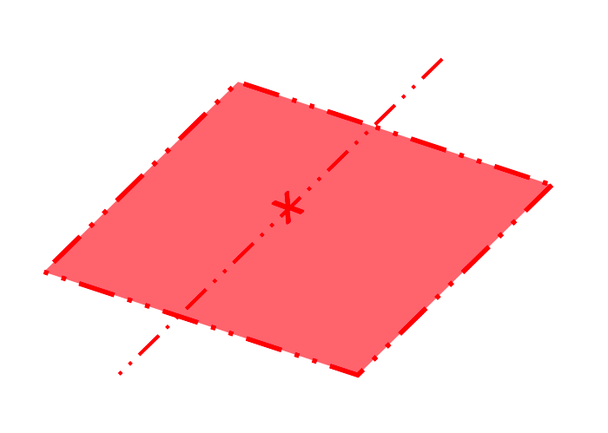




Developing tools applicable from Design to Commissioning
    Introduction to Datum System
A datum system can always be reduced to a resulting minimal set, made of :
ISO 5459:2011 Geometrical product specifications (GPS) – Geometrical
tolerancing – Datums and datum systems
- A theoretically exact plane [PL]
- A straight line [SL] in this plane
with respect to which geometrical specifications are referenced.
This is the “resulting datum system”.
- A point [PT] on this straight line
locking all degrees of freedom !
or a subset of those (locking three to five degrees of freedom)
This resulting datum system may be called a “ToLiP”: PoinT On Line In Plane.
We have now the tools to fully express positioning requirements using tolerances zones with respect to ToLiP’s
X
Y
Z
$$±∆X$$
$$± ∆Y$$
$$± ∆Z$$
DS1
TED
$$α$$
$$β$$
$$γ$$
$$±∆α$$
$$± ∆β$$
$$± ∆γ$$
TED
TED
4x
$$∅ t4 CZ$$
DS1
Example of geometrical specification

Slide 20
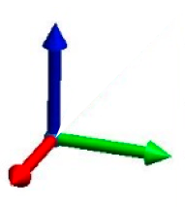
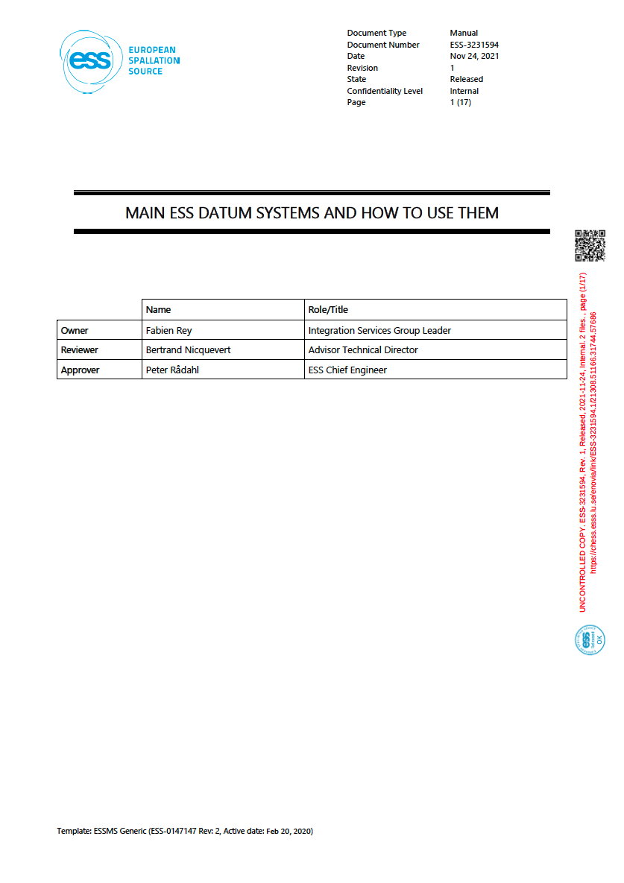
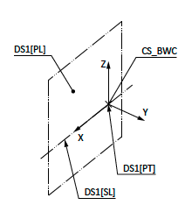
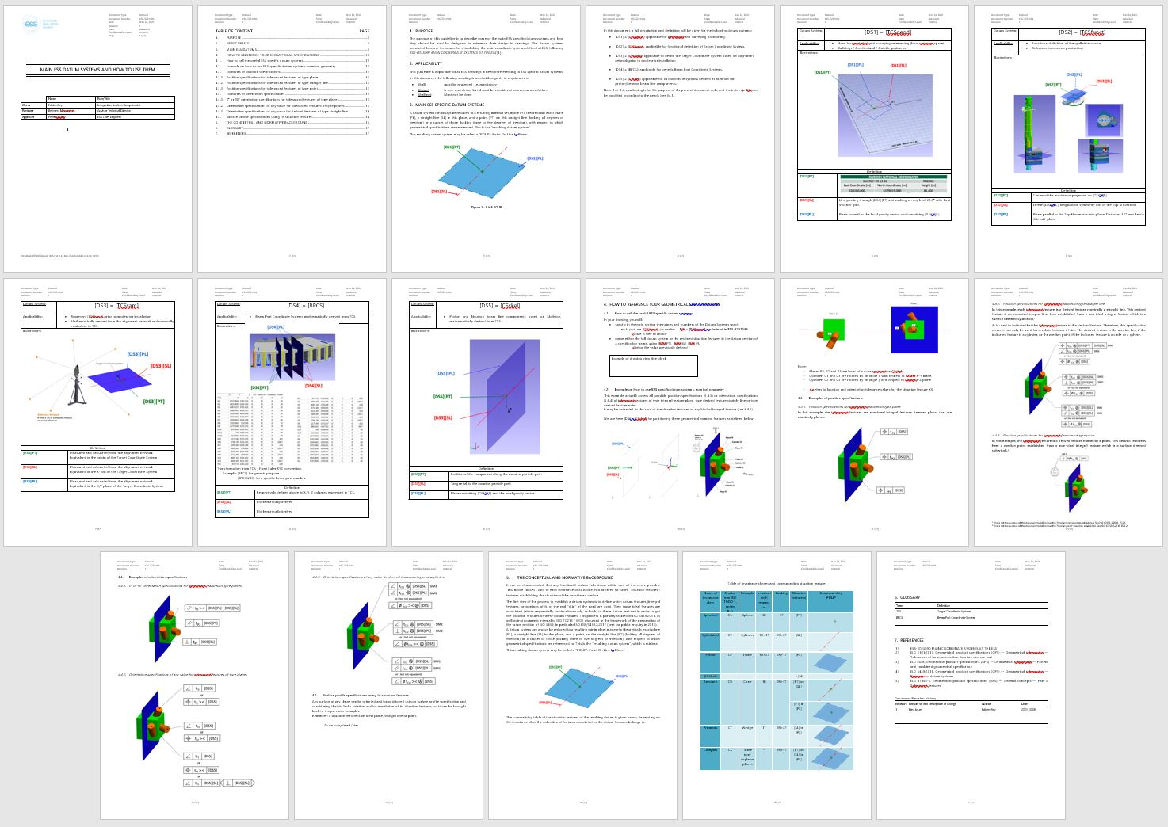
Developing tools applicable from Design to Commissioning
    Datum System vs Coordinate System
The idea came to specifically declare Datums Systems and attach them to Coordinate Systems contained in our CAD skeleton
Z
To help designers to reference their design, we defined some specific
ESS Datums Systems
attached to
ESS main Coordinates Systems
Y
X
[DS]
(CS)
and also to instruct designers on how to use them and establish their own ones.
Example of association DS to CS
Note: Not fully equivalent (no direction)
Rarely an issue.

Slide 21
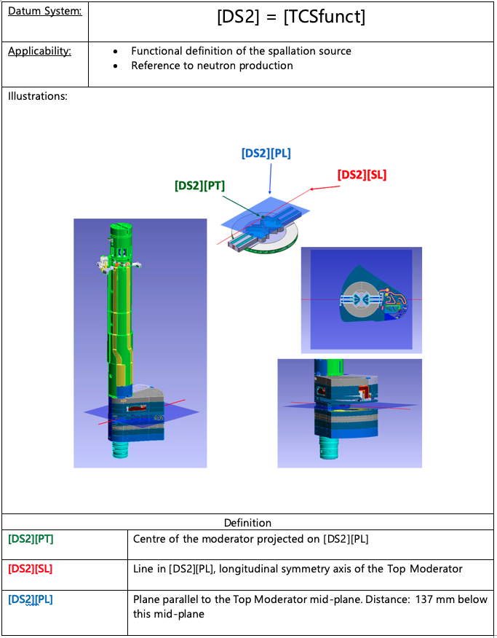
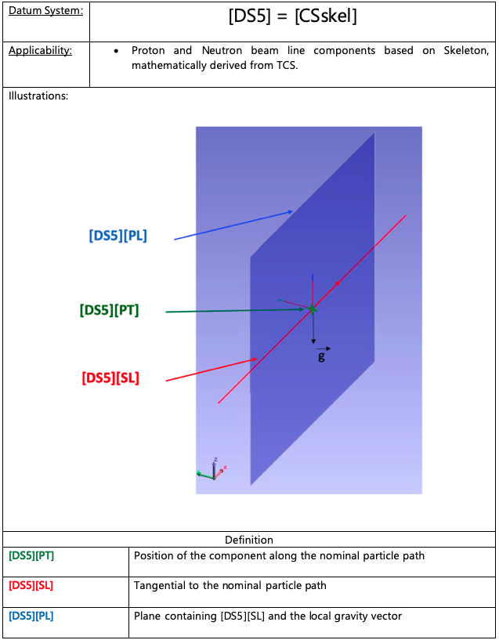
Developing tools applicable from Design to Commissioning
    Datum System vs Coordinate System
Examples of ESS Datum Systems
Establishing a real functional definition of the neutron source
For a generic beam skeleton

Slide 22
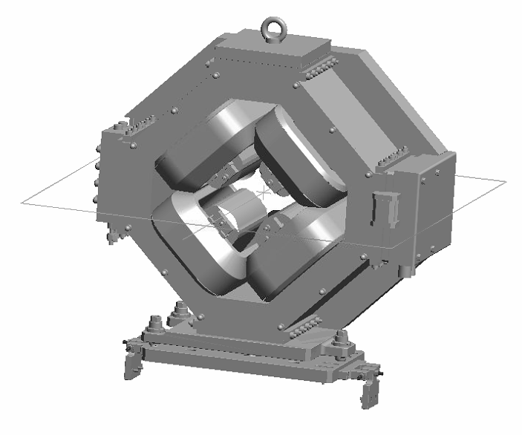
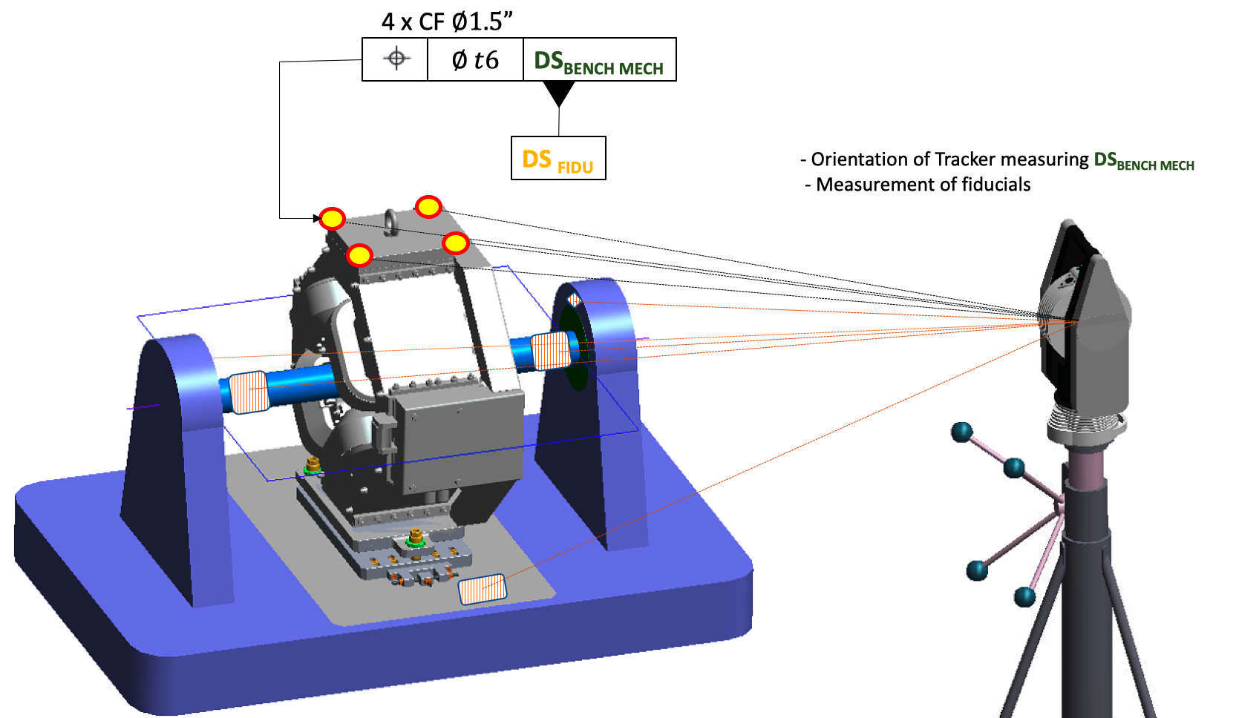
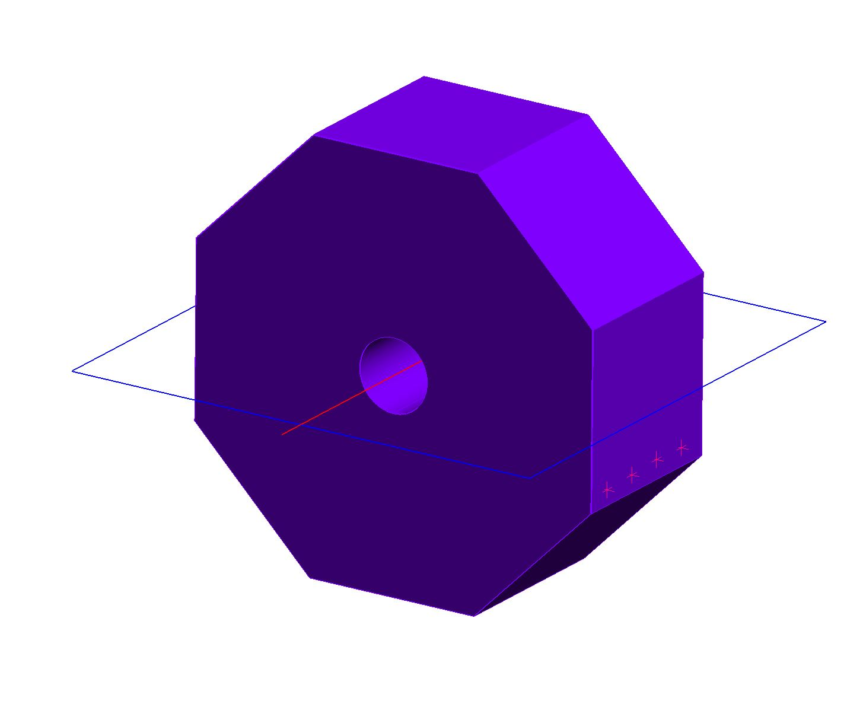
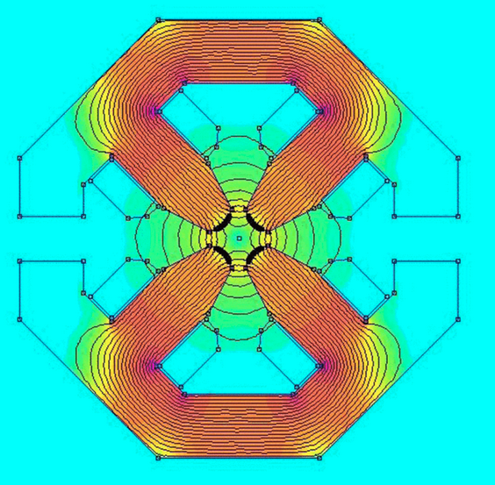
Developing tools applicable from Design to Commissioning
    A generic tool
A generic tool applicable to express geometrical specifications for positioning different concepts
Theoretical beam physic lattice DS
Multi physic DS
(magnetic axis-optical axis- electrical axis…)
Mechanical DS
Fiducialization DS
Geodetic DS
Spatial Integration Envelope DS
DS _{Nominal}
DS _{Magnetic}
DS _{Mechanical}
DS _{Fiducialization}
DS _{Geodetic}
DS _{Integration}
Nominal definition
Multi Physic properties
Mechanical references
Multi physic properties to external references
Final position in Global Reference
External envelope and 3D interfaces

Slide 23
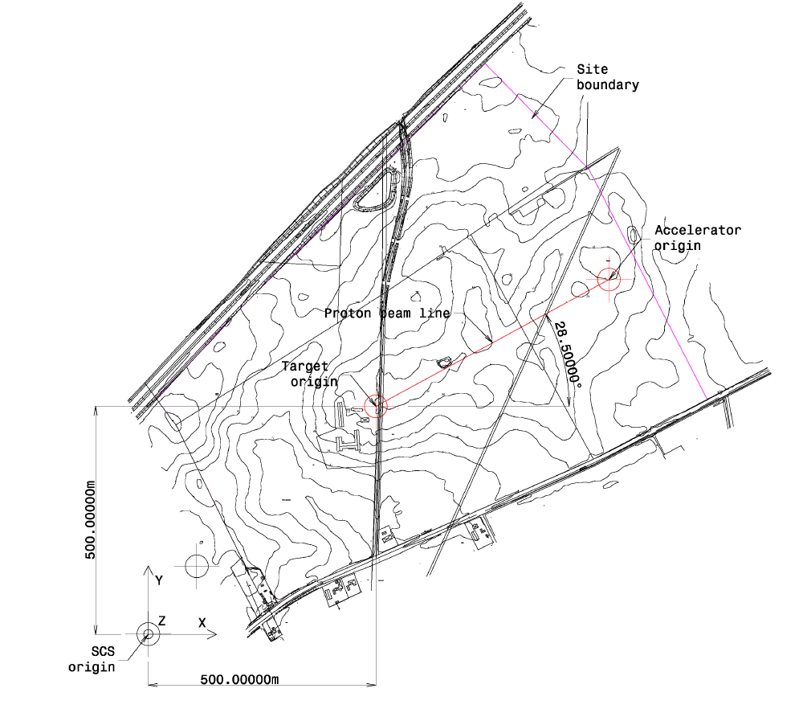


Geodetical applications with installation drawings
    Multiples Target Coordinate Systems
The passage from CAD to Reality imposes some geodetical considerations:
Another definition of TCS
Y
X
Z
Absolute orientation of the TCS axis is defined as follow:
Z-axis: Collinear to local gravity in opposite direction
X-axis: Oriented positive in East direction, making an angle of 28.5 degrees with the East SWEREF 99 13 30 grid
Y-axis: right hand rule.

Slide 24






Geodetical applications with installation drawings
    Multiples Target Coordinate Systems
2013
2019
2023
Civil Engineering - Building Construction
Machine Installation
3D Laser Scanning
Target and NSS systems installation
Alignment Network
Dense SAM references
Accuracy - bellow ±0.1 mm close to TCS
- network error propagation
- Environmental conditions
- Differential settlement
Geodetic Network
External pillars
Accuracy : mm
Functioning position of TCS
Neutron source defined by moderator position
Not directly accessible once installed
TCS _{Geod}
???
TCS _{Funct}

Slide 25
Geodetical applications with installation drawings
    Geodetical Network and [TCS_{SAM}]
Generally , our daily geodetical positioning problem could be expressed as follow:
+
+
+
+
+
+
+
+
+
+
+
+
+
+
+
+
+
+
+
+
+
Local Accuracy and Precision
quantify and describe our capacity to repeatedly position ourselves with respect to the local network
+
+
+
+
+
+
+
+
+
Local Uncertainty
+
+
+
+
+
+
+
+
+
+
+
+
+
+
+
+
+
Global Accuracy and Precision
quantify and describe our capacity to repeatedly position ourselves with respect to the global reference
+
+
+
+
+
+
+
+
+
+
+
+
+
+
+
+
+
+
+
+
+
Global Uncertainty
Y
+
+
+
+
+
+
+
+
+
+
+
+
+
+
+
+
+
+
+
+
+
+
Z
X
Geodetical network – true value expressed in global reference CS
Geodetical network – Measured and calculated -
Local Positioning of an Measuring Instrument (Laser Tracker)
Global Reference

Slide 26

Geodetical applications with installation drawings
    Geodetical Network and [TCS_{SAM}]
Local Positioning at ESS
Estimated Local Accuracy
Inside all technical buildings
within a spherical volume R=10m
Less than ± 100 microns at 3 sigma
Global Positioning at ESS
Global accuracy toward TCS
< ± 100 microns at 3 sigma
< ± 200 microns at 3 sigma
TCS
< ± 300 microns at 3 sigma
< ± 500 microns at 3 sigma

Slide 27


Geodetical applications with installation drawings
    Geodetical Network and [TCS_{SAM}]
[TCS_{SAM}]
Express our capability to define the Global Reference (TCS) using a local geodetic network
Very dependent on the quality of geodetic network !
n x CF $∅1.5”$
TCS_{SAM}
+
Network reference
CF: Contacting Feature

Slide 28

Geodetical applications with installation drawings
    Examples
Installation drawing
Expression
of a
Local Positioning
Geometrical Specifications
Explicit representation of the nominal position of the situation features
illustration and association CS to DS
Reference to skeleton CS number
CAD number

Slide 29

Geodetical applications with installation drawings
    Examples
Installation drawing
Same local positioning requirements over multiple similar systems using skeleton CS .
one unique drawing !

Slide 30
CONCLUSION
Benefit of relying on international standard : Technical Drawings and ISO GPS
Introduction of TOLIP as fully constrained datum system
Versality of the tool to address different concepts and remove ambiguities
Traceability of requirements from Engineering to Alignment
Functional
drawings
Manufacturing
drawings
Verification
drawings
Installation
drawings
Verification
drawings

Slide 31






Thank you
$$∆PT$$
$$∆SL$$
$$∆PL$$
Dr Bertrand Nicquevert
Fabien Rey

