Slide 1

Engineering survey and alignment network design for Siam Photon Source II
S. Srichan, M. Phanak, K. Sittisard, K. Rittaprom,
S. Suphachiaraphan, O. Utke
Synchrotron Light Research Institute
THAILAND
16th International Workshop on Accelerator Alignment, CERN, Geneva 31 Oct-4 Nov 2022

Slide 2
Outline
Introduction to Siam Photon Source
New Synchrotron Facility in Thailand-Siam Photon Source II Project
Siam Photon Source II reference network design (Conceptual)
Conclusion and future work

Slide 3
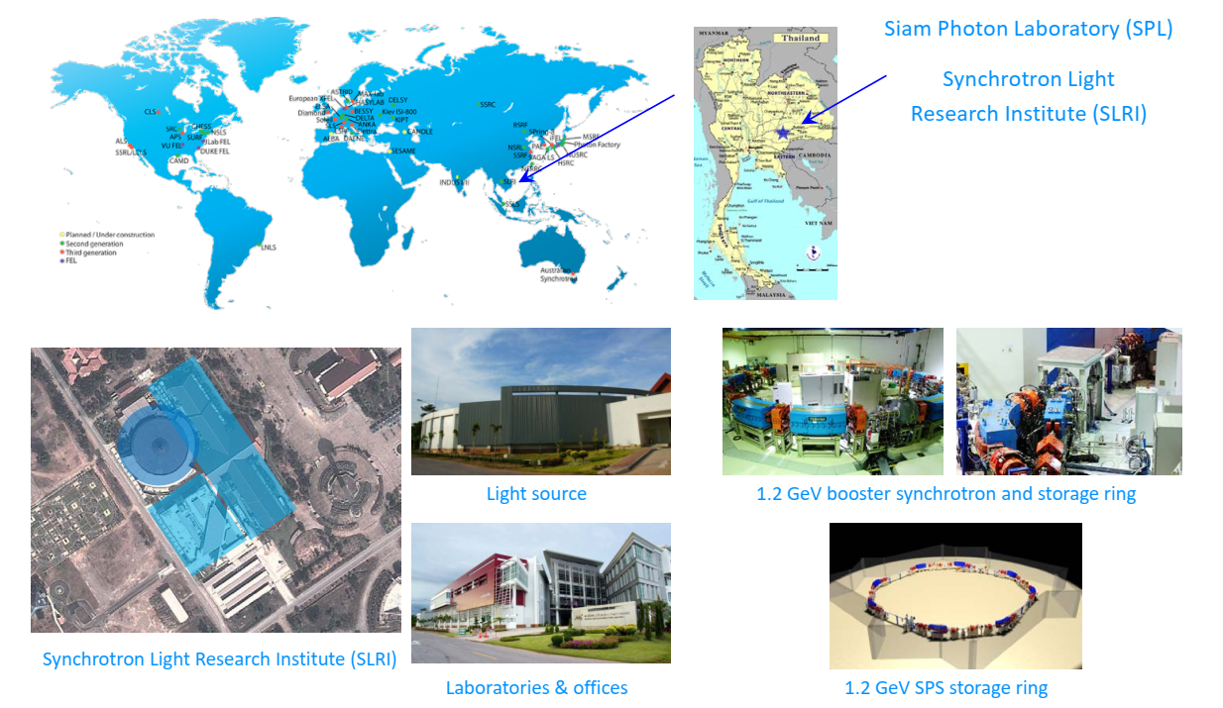
Siam Photon Source

Slide 4


Siam Photon Source: Nakhon Ratchasima, Thailand
Things to do in Nakhon Ratchasima
PIMAI Historical Park
KHAO YAI National Park

Slide 5
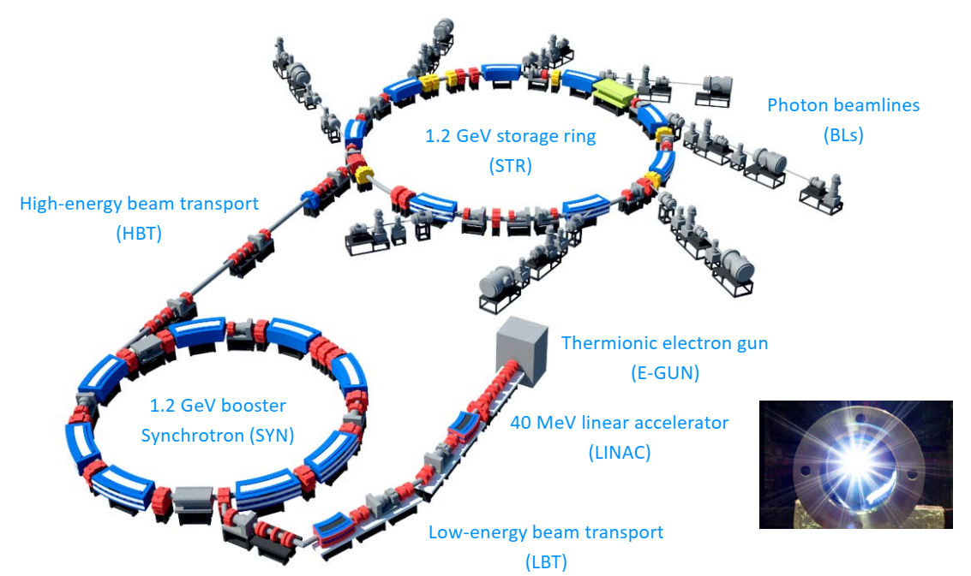
Siam Photon Source

Slide 6
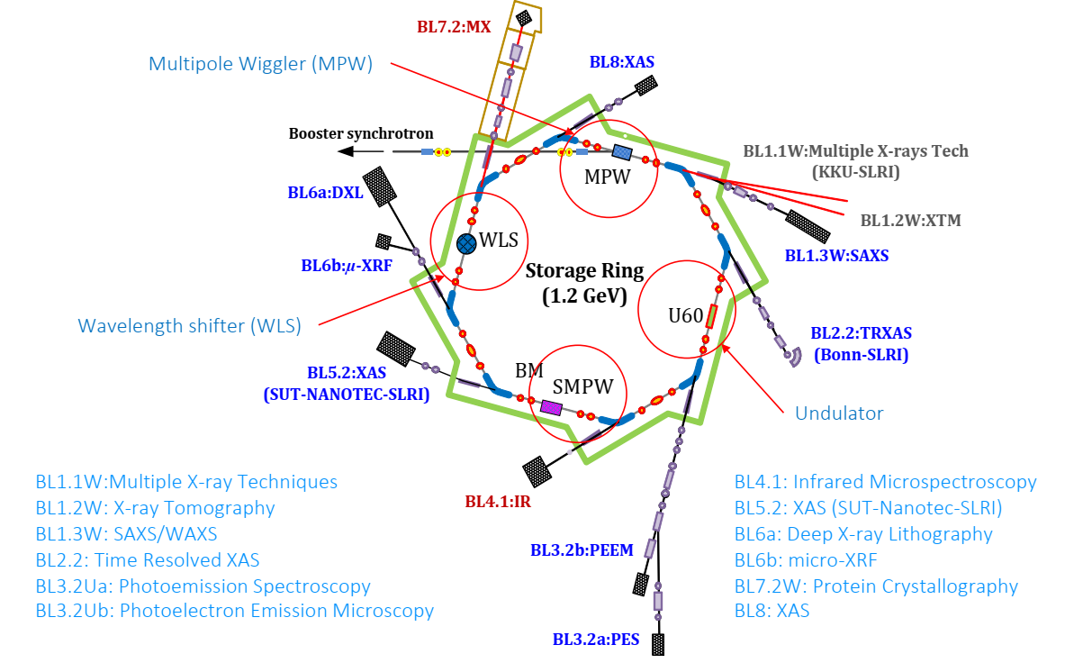
Siam Photon Source

Slide 7
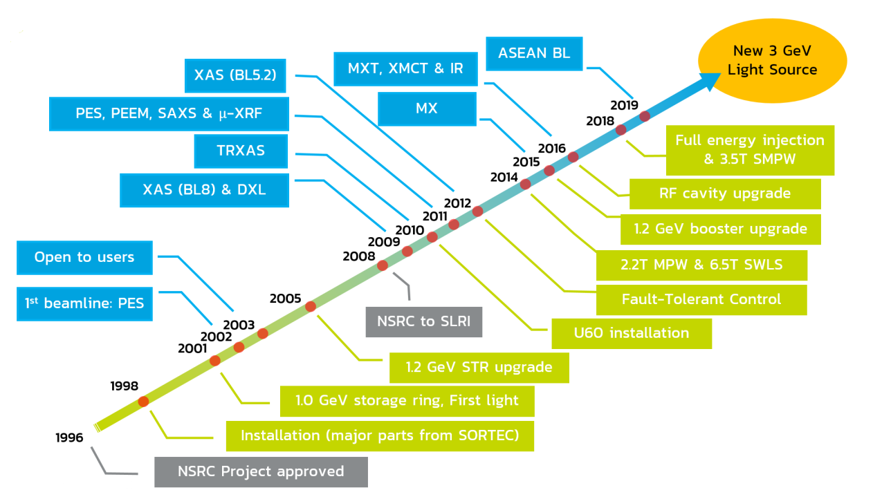
Time to go Forward

Slide 8
Siam Photon Source II (SPS-II)
Parameters SPS-I and SPS-II
Parameters | SPS | SPS-II
Circumference (m) | 81.3 | 327.502
Energy (GeV) | 1.2 | 3.0
Relativistic factor γ | 2348.34 | 5870.85
Emittance ε_{x0} (nm·rad) | 41.0 | 0.96
Beam current (mA) | 150 | 300
Nat. energy spread σ_{E} (%) | 0.066 | 0.077
Nat. chromaticity ξ_{x}/ξ_{y} | -8.7/-6.4 | -65.6/-76.7
Tune Q_{x}/ Q_{y} | 4.75/ 2.82 | 34.24/12.31
Momentum compaction α_{c} | 1.70e-2 | 3.33e-4
Damping times hor./ver./long. (ms) | 10.7/9.8/4.7 | 9.7/11.3/6.2
Straight/circumference | 0.33 | 0.35
Energy loss per turn U₀ (MeV) | 0.066 | 0.577
RF frequency (MHz) | 118.00 | 119.00
RF voltage (MV) | 0.3 | 1.5
Harmonic number | 32 | 130
Overvoltage V/U₀ | 4.5 | 2.6
Synchronous phase (degree) | 167.29 | 157.34
Synchrotron tune | 0.00460 | 0.00178
Nat. bunch length (mm) | 29.03 | 7.48
Nat. bunch duration (ps) | 96.8 | 24.9
Larger ring -> More Beamlines
Higher beam energy -> Higher photon energy
Lower emittance
-> Higher flux, brightness
Higher current
More space availability -> More Beamlines

Slide 9

Siam Photon Source II: Rayong, Thailand
Eastern Economic Corridor of Innovation (EECi)
Rayong Province
160 km (99 mi) from Bangkok
90 km (55 mi) from U-tapao International Airport
90 km(55 mi) from Pattaya

Slide 10
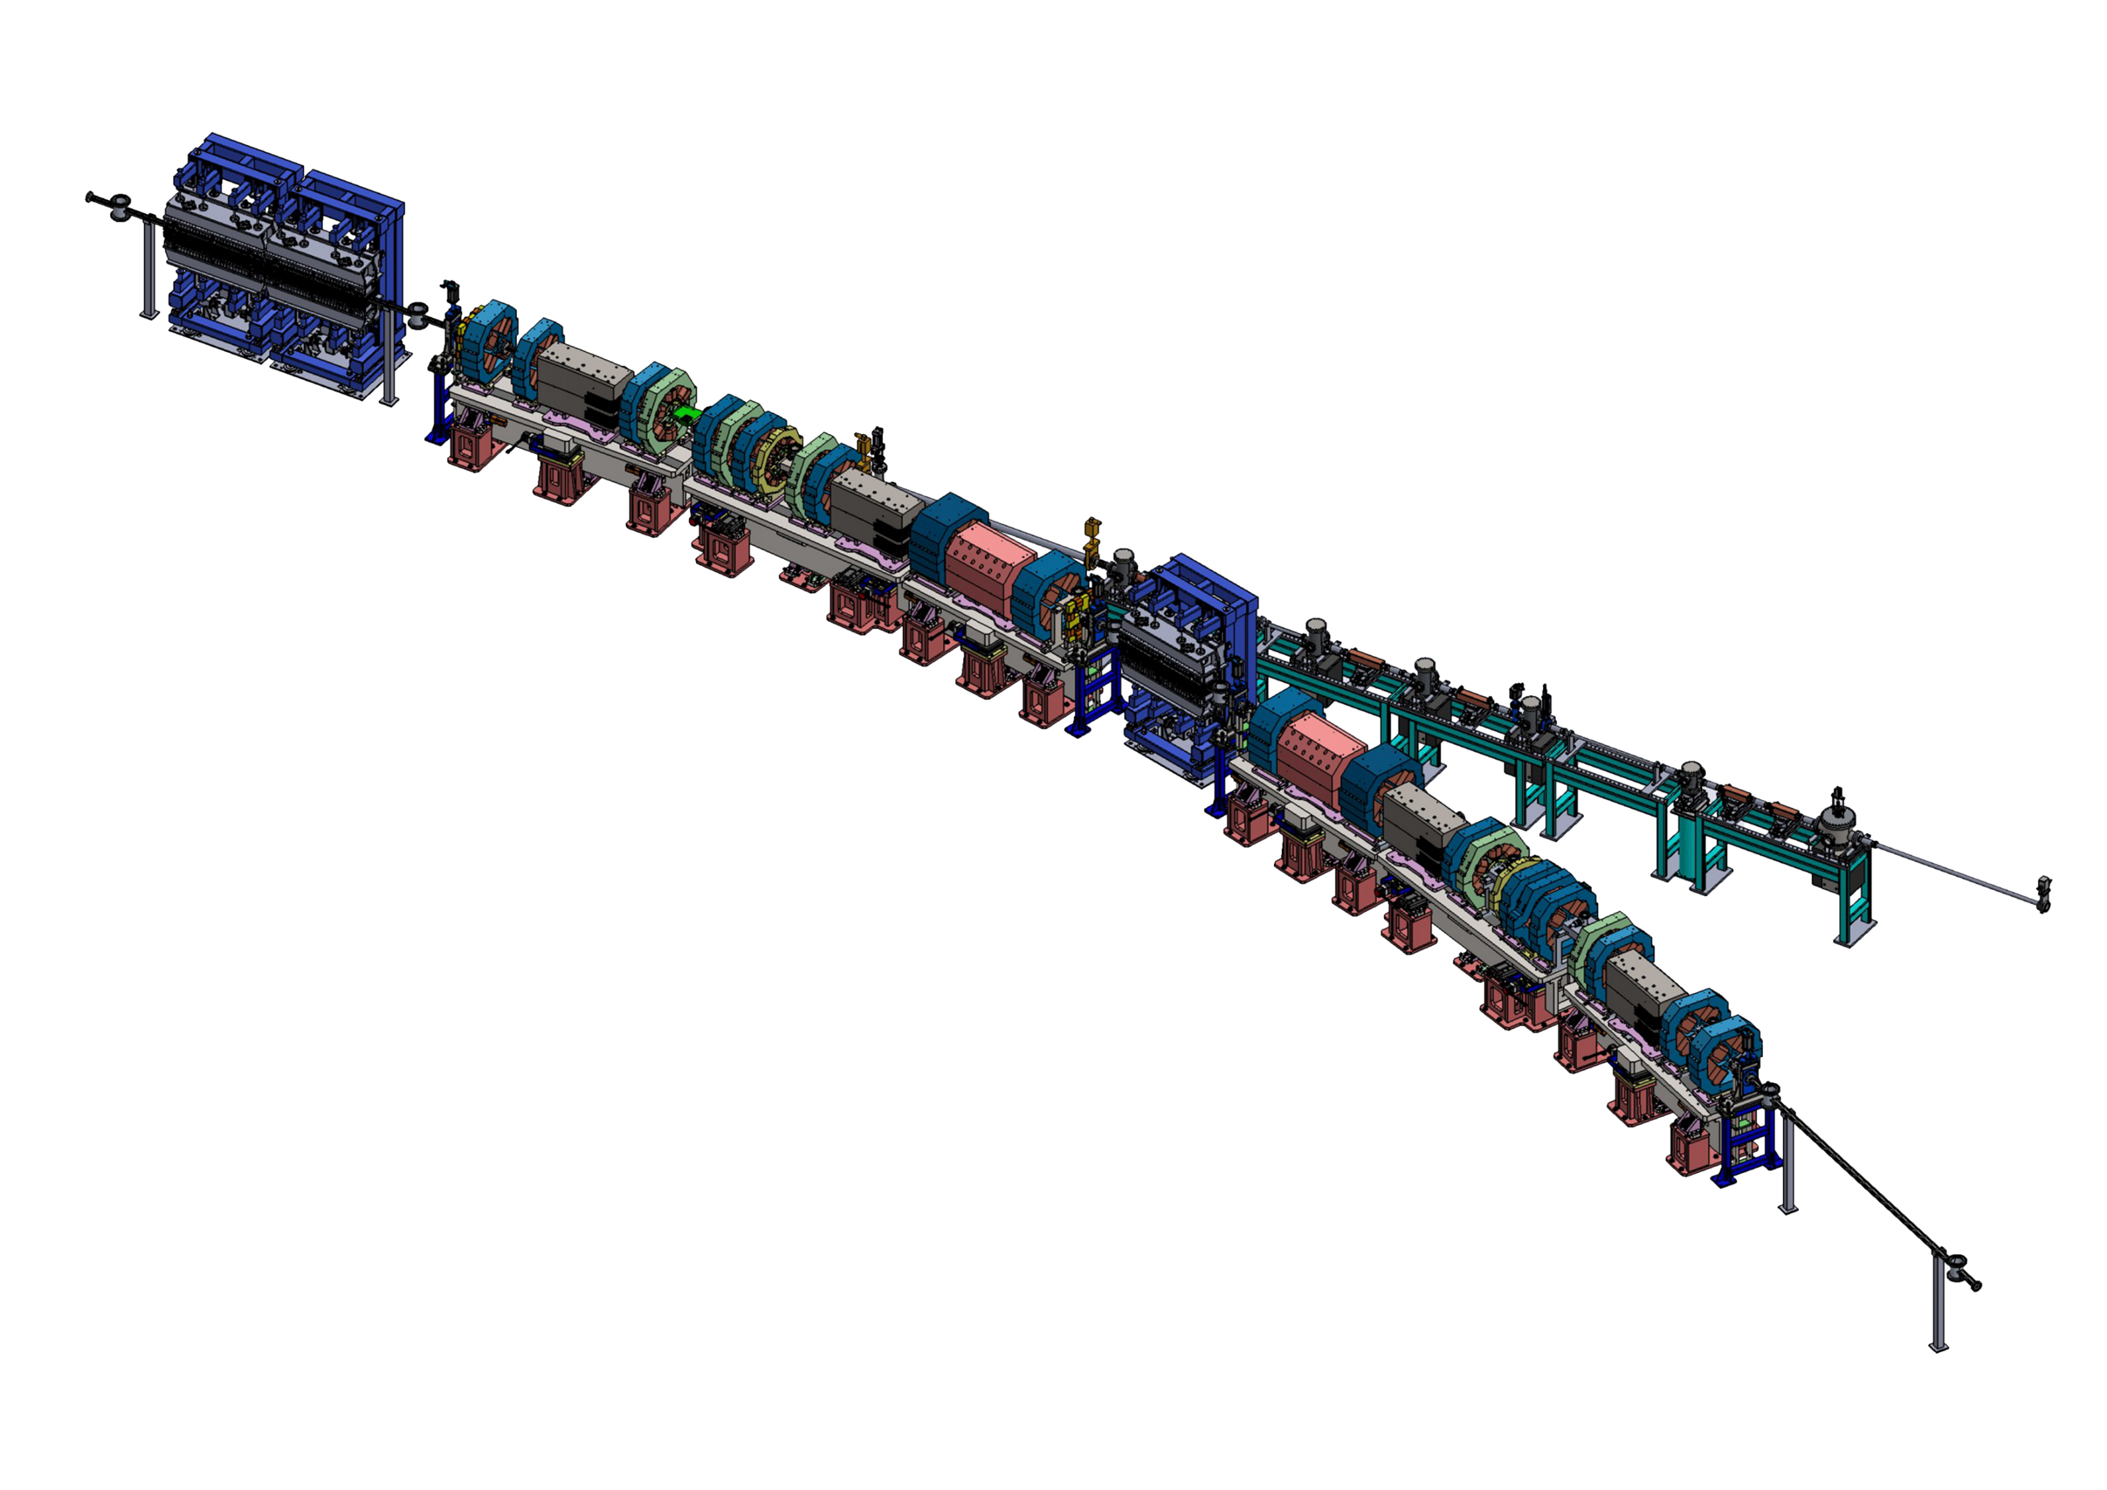
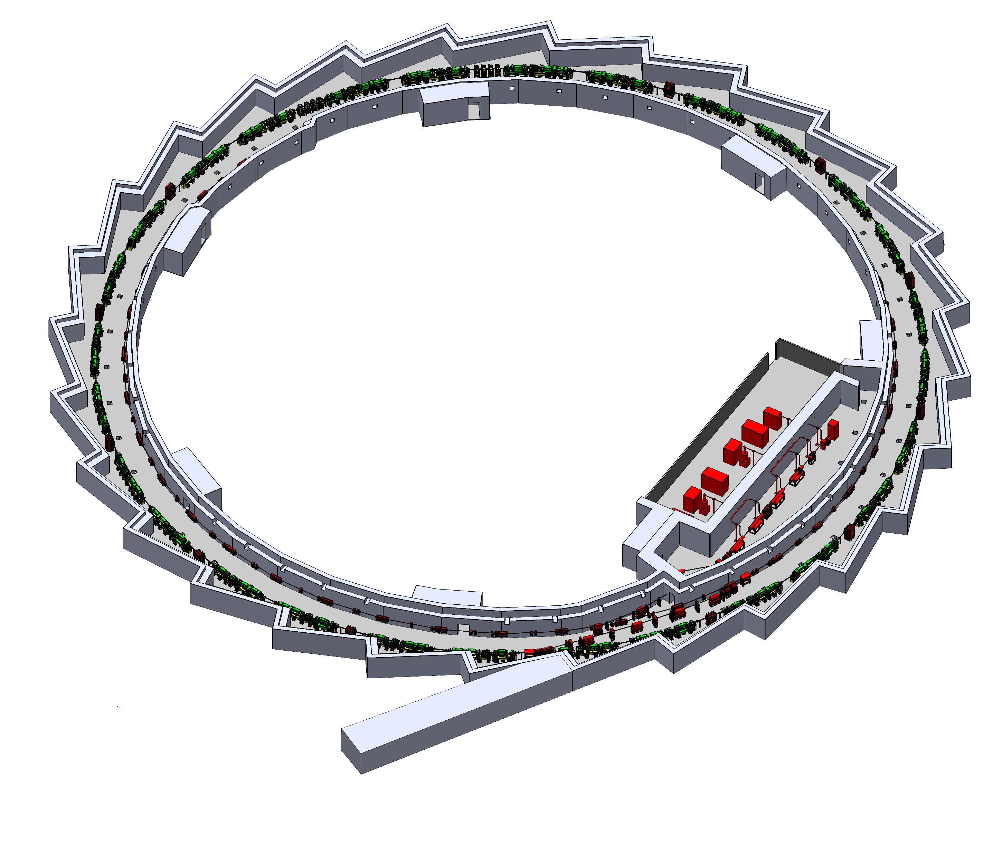
SPS-II Machine
SPS-II Main Components
Electron gun
150 MeV linear accelerator
3.0 GeV booster synchrotron - (Circumference 304.8 m)
Low and high energy transfer line
3.0 GeV storage ring - (Circumference 327.1 m)
Beamlines*
21 Insertion Device (ID) beamlines
2 infrared beamlines
2 diagnostic beamlines
Insertion device
Front-end
DTBA Cell
Double Triple Bend Achromat (DTBA) cell
with insertion device & front-end
5. Storage ring
3. Booster synchrotron
1. Electron gun
2. Linear accelerator
4. Low-energy beam transfer line
6. Beamline
4. High-energy beam transfer line

Slide 11
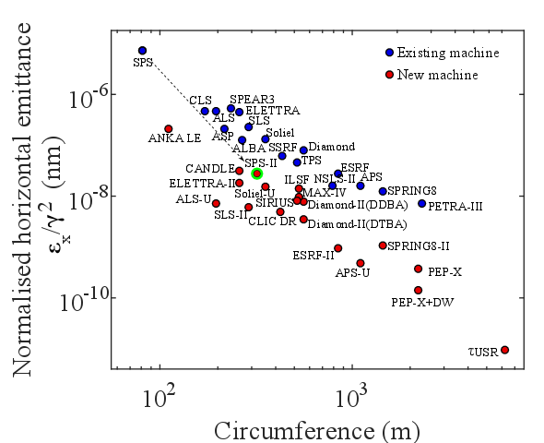
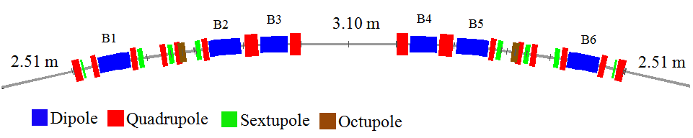
Beam Dynamics: Storage Ring
Design concept:
Performance --> MBA cell, low emittance (<1nmrad)
Feasibility --> Moderate magnets requirement
Productivity --> Space usage (>35%)
Originated from Diamond Light Source upgrade study
DTBA (Double Triple Bend Achromat )
Circumference (m) : 327.5
Emittance (nm.rad): 0.96
14 Cell -> RING
28 straights in total

Slide 12
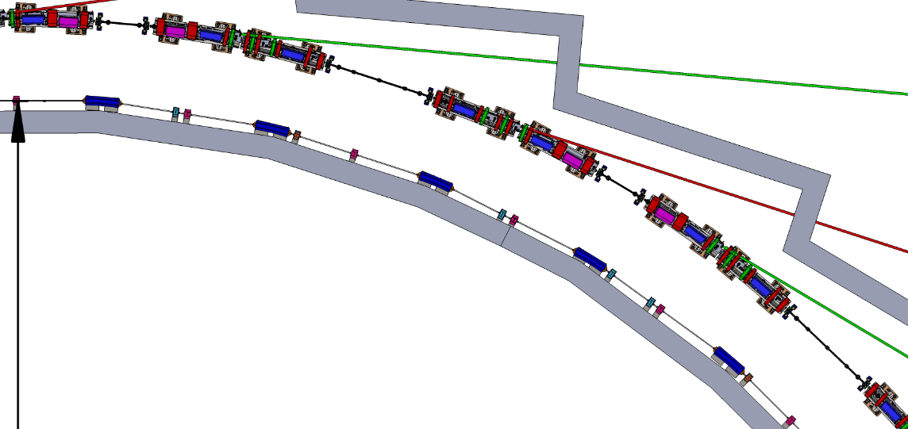
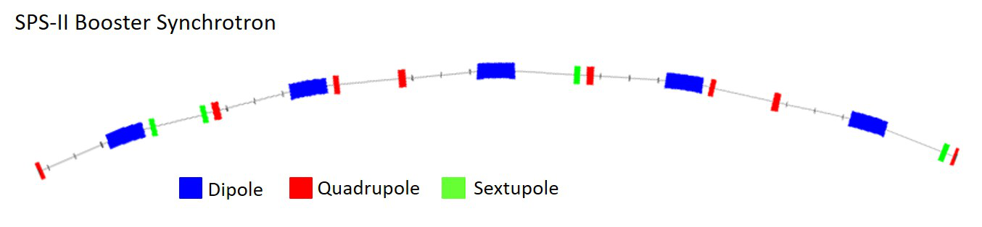
Beam Dynamics: Booster
Circumference (m) : 304.8288
Emittance (nm.rad) 5.87
Distance between BS and STR: 3.64 m
Storage ring
Booster
8 Cell -> RING
Concentric booster
low emittance for providing a clean injection into the storage ring
Minimize the building construction cost (substantial saving of building space and shielding)
Minimize magnet manufacturing cost (small lattice elements, low power consumption)
Simple transfer line between booster and ring

Slide 13
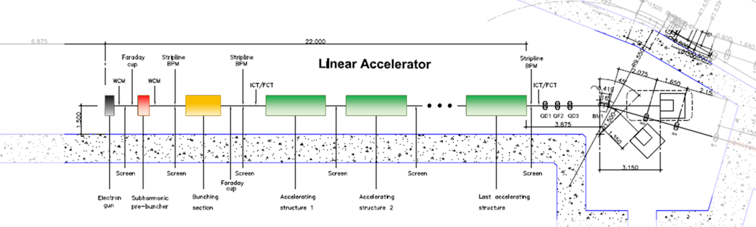
150-MeV Linear Accelerator
Triode
gun
Subharmonic
prebuncher
S-band accelerating structure
S-band accelerating structure
The last
S-band accelerating structure
Buncher
Design considerations:
Target beam energy of 150 MeV
Total linac length < 25 m
Compatible with 119-MHz RF system of booster and storage ring
Proposed Components:
Triode gun with 119-MHz voltage modulation at the grid level to produce a chopped beam
Subharmonic pre-buncher operating at 476 MHz
S-band buncher operating at 2856 MHz
S-band accelerating structures
Main Parameters of the SPS-II Linac
Parameter | Value
Beam energy | 150 MeV
Normalized emittance | ≤ 50 mm∙mrad
RMS energy spread | ≤ 0.5 %
Bunch train charge (MBM) | > 6 nC
Bunch charge (SBM) | ≥ 1.5 nC
Bunch train duration (MBM) | 150-600 ns
Bunch duration (SBM) | < 1 ns
Repetition rate range | 1-5 Hz
Nominal repetition rate | 2 Hz

Slide 14
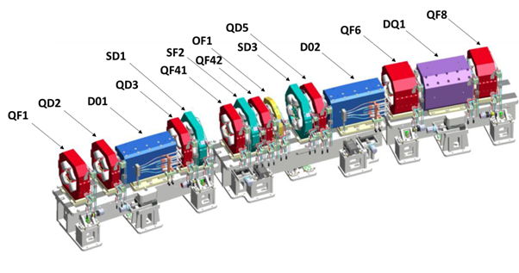
Magnet System
Moderate requirements
Offset quadrupole design (ESRF) for combined dipole-quadrupole magnet
Manufacturing tolerance ± 0.02 mm
Static deformation of magnet structure < 0.005 mm
Pulsed multipole magnet (nonlinear kicker) for injection into storage ring
Magnets for storage ring (solid steel) and booster synchrotron (laminated steel) to be manufactured in Thailand
Pulsed magnets (septum, kicker) to be purchased as a turnkey system
Half-cell of SPS-II storage ring DTBA lattice

Slide 15
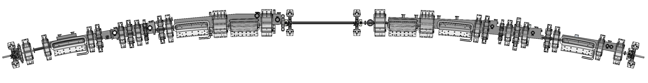
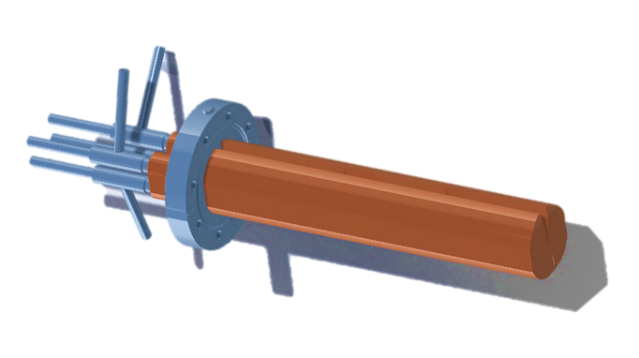
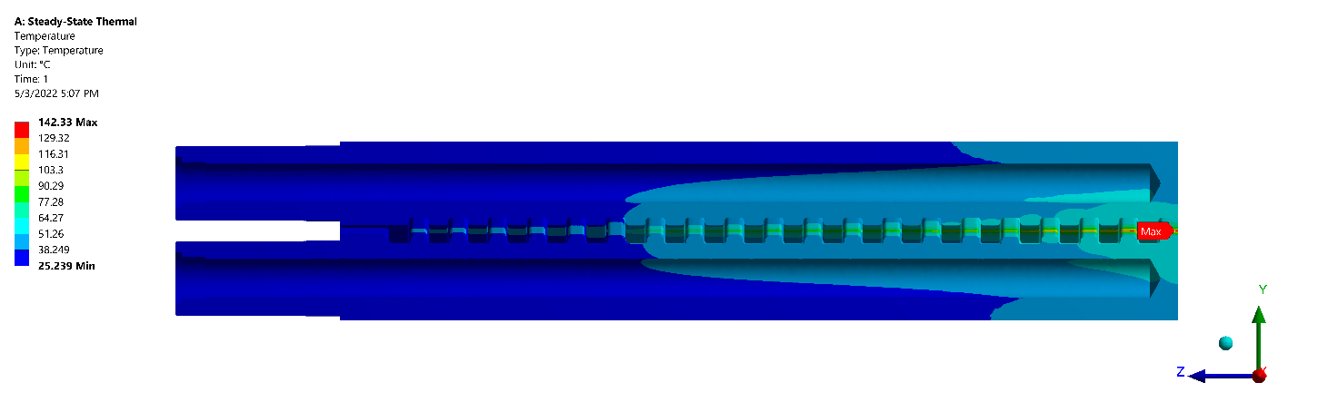
Vacuum System
Vacuum chamber
Considering local manufacture technology (especially welding technology) and a limitation of the chamber thickness located between the magnet poles, stainless steel has been selected as chamber material due to its excellent strength
Fabrication tolerances | < 1 mm/m
Taper inclination | < 1/10
The step height | < 1 mm
High power tolerance absorber
Domestical manufacturing
To enhance production potential of Thai industrial sector, the knowledge of vacuum part fabrication has been transferred to Thai local company for producing chamber parts with ultrahigh vacuum and high precision requirements.
Photon absorbers have been designed to tolerate SR power with the beam current up to 500mA + 20% margin

Slide 16
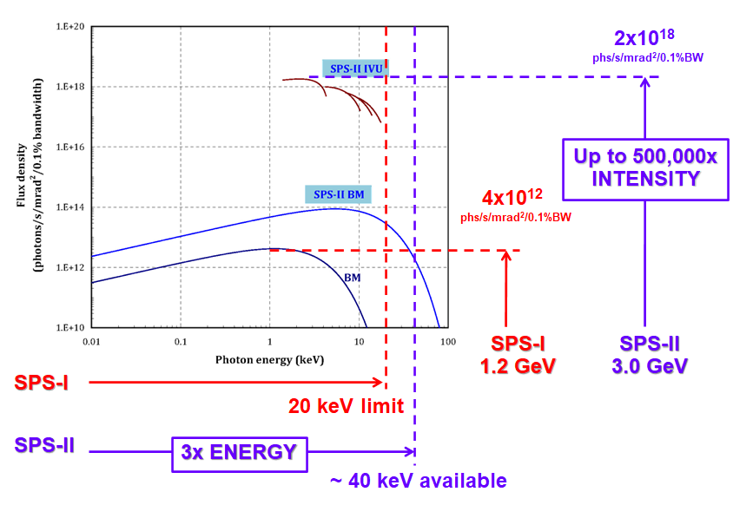
Photon Beamlines
1st phase beamlines
High resolution soft X-ray spectroscopy (HRSXS)
Tender X-ray absorption spectroscopy (TXAS)
Hard X-ray absorption spectroscopy (HXAS)
Small and wide angles X-ray scattering (SWAXS)
High-resolution X-ray diffraction (HRXRD)
X-ray micro computed tomography (XMCT)
Macromolecular X-ray crystallography (MX)
Beamline | Techniques
HRSXS | PES, ARPES, XPS, PEEM, NEXAFS, XMCD
TXAS | XANES, EXAFS, XRF
HXAS | XANES and QEXAFS, XRF, XES
SWAXS | SAXS, WAXS USAXS, GISAXS
HRXRD | XRD, High Resolution XRD, XRD imaging
XMCT | micro-tomography
MX | micro-focused MX MAD and SAD
7. MX: 5.0 – 20 keV
6. XMCT: 8.0 – 60 keV
5. HRXRD: 8.0 – 25 keV
4. SWAXS: 4.0 – 23 keV
3. HXAS: 4.0 – 35 keV
2. TXAS: 1.0 – 1.3 keV
1. HRSXS: 0.08 – 2.5 keV
far IR and IR
VIS
UV
VUV/soft X-ray
hard X-ray
1 eV
10 eV
100 eV
1 keV
10 keV
100 keV

Slide 17
Project Schedule
Building Construction
Installation and Commissioning
Prototype R&D
Design of the 3 GeV Synchrotron Light Source
2025
2029
2020
2022
Completion of SPS-II buildings
User beam service (phase 1).
2021
2030
2023
2028
Operational SPS-II
Development of Prototypes
Procurement and Construction of SPS-II
Installation and Commissioning

Slide 18
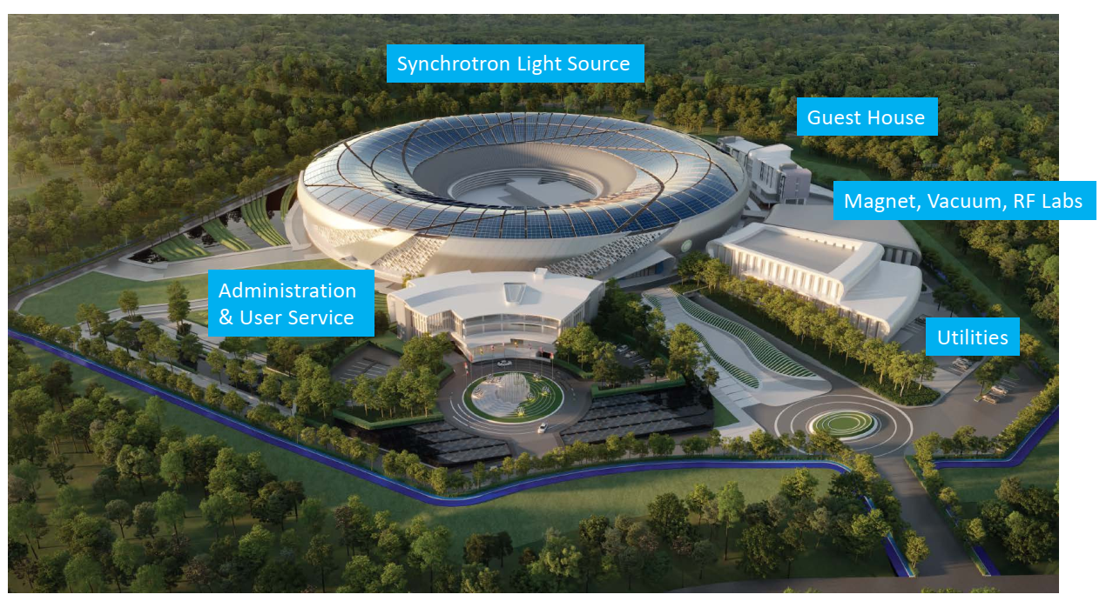
Buildings and Facilities

Slide 19
The budget tolerance
According to beam dynamic requirements, the accelerator physicist give the maximum alignment error as described:
Table: Storage ring magnet alignment tolerance
Error type | RMS
Element misalignment
Horizontal for quad,sext,dipole | 100 µm
Vertical for quad,sext,dipole | 100 µm
Longitudinal for dipole | 100 µm
Tilt for all | 200 µrad

Slide 20
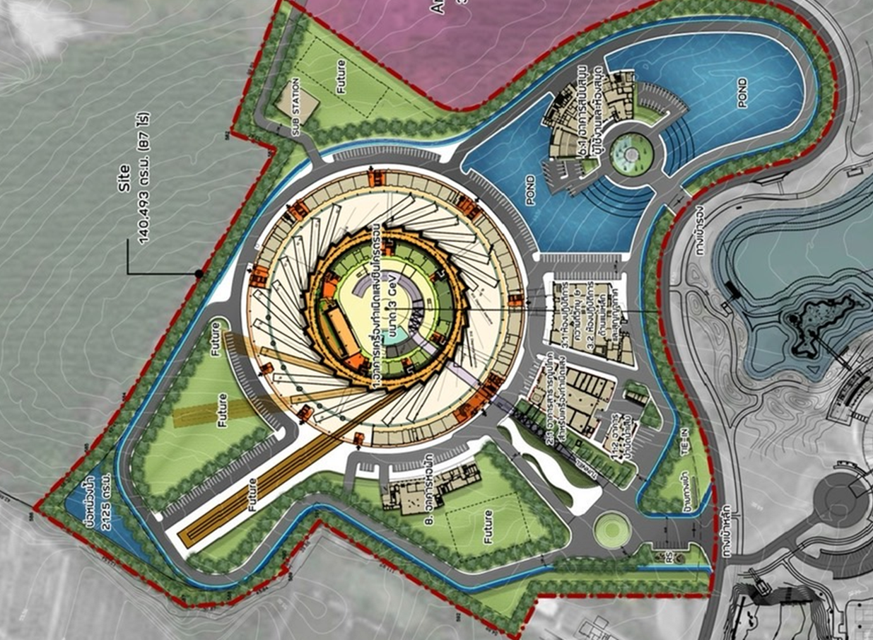
Reference network design
Area 140,493 sq.m
GNSS
GNSS
GNSS
GNSS

Slide 21
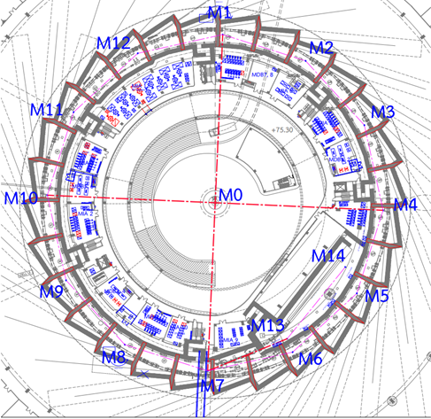
Primary survey network
We classify our control network to two steps;
The primary survey network is used as the global control of the whole synchrotron that consists of 14 primary control points for accelerator part included M0. These are a central monument (M0), for M13 and M14 located in Linac tunnel and M1-M12 located around the storage ring tunnel. M0 or central control point will be established on the concrete pile embedded in bedrock. It will be used for an absolute displacement measurement.
The secondary survey network or alignment network

Slide 22
Conclusion and future work
The survey network of SPS-II will be constructed by using GPS, total station, digital level, laser tracker and the metrology software. Our existing instruments are FARO laser tracker and CAM2 software, theodolite and optical level. We will assemble the team for surveying, focused on development of survey and alignment strategy for SPS-II installation. We are planning to visit and participate in alignment activities on accelerator laboratory around the world while we are also getting a good cooperation. In the future, we have to do a lot of work.

Slide 23
Instrumentation

Slide 24
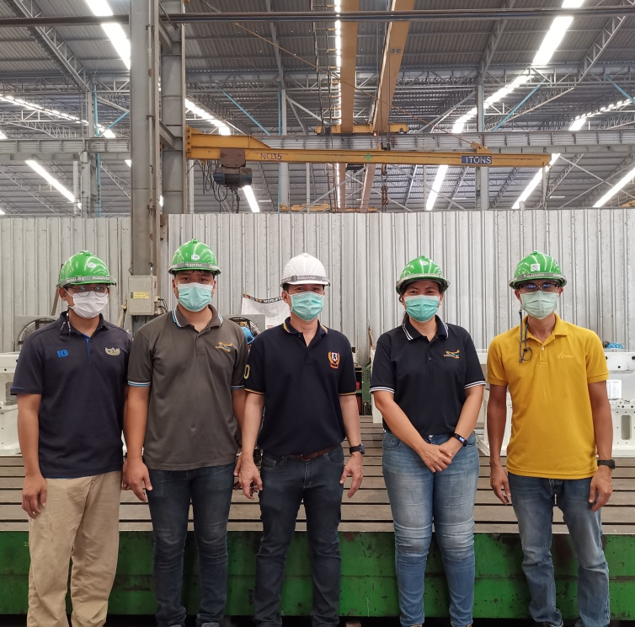
Survey and Alignment Group
The organization of our Synchrotron Light Research Institute currently consists of 200 staffs which are 100 researchers, 30 engineers and 70 administrative officers.
Currently, we do not have survey and alignment group. We have supporting team consists of 1 civil engineer and 4 mechanical engineers.

Slide 25

Thank you for your attention
Welcome to Thailand
Welcome all suggestions and recommendations.

