Slide 1
Application of GNSS Length Metrology to CERN Geodetic Network
Luis García-Asenjo, Sergio Baselga, Pascual Garrigues, Raquel Luján
Universitat Politècnica de València (UPV), Spain
Damien Pesce
Institut national de l’information géographique et forestière (IGN), France
Benjamin Weyer, Jean Frederic Fuchs, Dominique Missiaen
European Organization for Nuclear Research (CERN), Switzerland

Slide 2
Outline
Introduction
Length metrology
GeoMetre Project
GBDM+ (our GNSS approach to length metrology)
Observation campaign at CERN geodetic network
GDBM+ results
Comparison with Kern Mekometer ME5000
Conclusions, limitations and future work

Slide 3
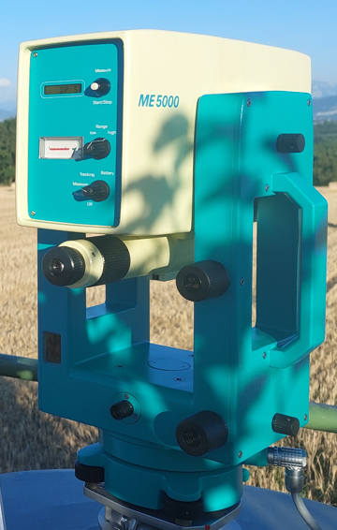
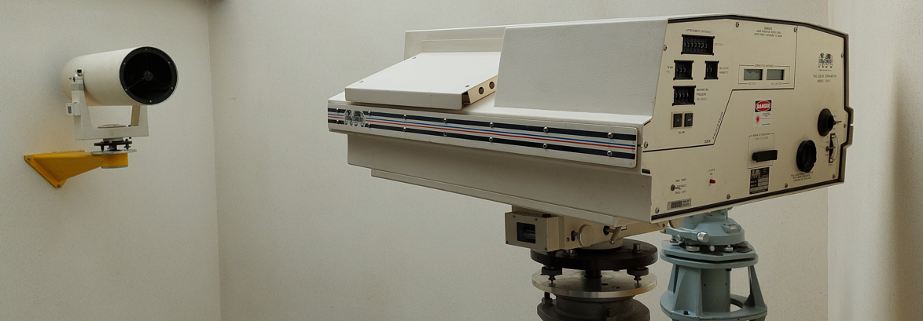
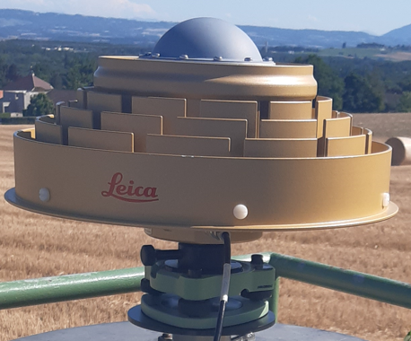
Introduction
Length metrology Realization, maintenance and dissemination of the SI meter
In the open air, the level of accuracy 10⁻⁷ (0.5 mm @ 5 km) is a major challenge
High-precision EDMs (e.g. Kern Mekometer ME5000)
Limited by the accurate determination of n = f(T,p,h%)
e.g. 10⁻⁷ in the distance requires ∼0.1ºC in T for the entire path!
Refractivity-compensated (i.e. two-color) EDMs (e.g. Terrameter, Arpent Absolute Distance Meter, TeleYAG)
Costly and not easily accesible
GNSS ? “Not traceable”
We’ll try to remedy this lack of traceability
Good practice guide for high accuracy global navigation satellite system based distance metrology (JRP SIB60 Surveying Consortium 2013-2016)
Concludes that the uncertainties of ionospheric and tropospheric delays, multipath effect and antenna phase centre variations are mostly unknown, as is their propagation to the final results, which prevents a rigorous uncertainty analysis of the GNSS-based distance determination.

Slide 4

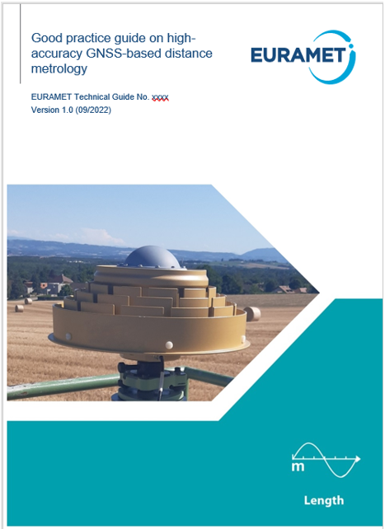
Introduction
EMPIR 18SIB01 Large-scale dimensional measurements for geodesy (‘ ’) 2019-2022
A joint attempt to develop enhanced large-scale dimensional metrology for geodesy:
environmental compensation: acoustic and spectroscopic temperature measurement, two-color compensation
development of novel prototypes: Arpent and TeleYAG (two-color EDM, 5 km range with 1 mm uncertainty, k = 2), DistriMetre (outdoor multilateration system, 200 m range with 200 µm uncertainty, k = 2)
earth-bound verification of SLR and GNSS over 5 km with 1 mm uncertainty, k = 2
establishment of a 5 km geodetic reference baseline (EURO5000)
local tie metrology
Outcome:
Dedicated strategy for GNSS-based length determination with full uncertainty characterization
Sergio Baselga, Luis García-Asenjo,
Pascual Garrigues, Raquel Luján
UPV, Spain
Florian Pollinger
PTB, Germany
Ulla Kallio, Hannu Koivula
NLS, Finland
Kinga Wezka, Dominik Próchniewicz
WUT, Poland
Damien Pesce
IGN, France
Sten Bergstrand
RISE, Sweden
Currently under discussion to be (hopefully) adopted!

Slide 5
Introduction
EMPIR 18SIB01 Large-scale dimensional measurements for geodesy (‘ ’) 2019-2022
GNSS-based length determination with full uncertainty characterization
Relatively simple strategy
Use of standard GNSS files and products (RINEX, ANTEX, SP3), and software solutions (CSRS-PPP)
Dedicated procedure based on GNSS carrier-phase double differences
(improved GNSS-Based Distance Meter, GBDM+)
TO
Obtain an accurate distance (azimuth and elevation are unimportant)
Study the impact of GNSS sources of error (multipath, antenna calibration, tropospheric delay, antenna height determination) on the GNSS-based distance determination:
estimation of sources of error in zero differences (ZD)
propagation to double differences (DD)
propagation to distance determination (GBDM+ functional model)
Application and verification in EURO5000 baseline and CERN geodetic network

Slide 6
GBDM+ Motivation
The use of GNSS is appealing:
1) GNSS scale is worldwide stable at the level of 0.001 ppm and traceable to the SI definition of the metre by its maintenance by means of atomic clocks
2) GNSS instrumentation is readily available, its use can be easily adopted
3) lack of direct intervisibility between baseline ends is not a problem
Is it the same as the traditional GNSS geodetic processing?
No
1) the baseline length (not coordinates) is a direct output
2) the corresponding uncertainty is rigorously obtained
Minimum equipment
2 receivers + 2 individually calibrated antennas + auxiliary equipment (tribrachs, cables…)

Slide 7
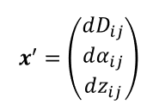




GBDM+ Ingredients
Initial data:
• GNSS observation files (RINEX format)
• Precise satellite ephemerides and clocks files (SP3 format, obtained from IGS)
• Satellite antenna phase center offsets and variations (ANTEX format, obtained from IGS)
• Individual antenna calibrations (at least by one method) for each of the antennas in use (ANTEX format)
PPP processing for each station, which provides (estimated values and corresponding uncertainties):
• Approximate coordinates
• Receiver clock offsets
• Tropospheric delays
• Carrier phase residuals
Dedicated model for GNSS-based distance determination
where the uncertainties of the error sources are first estimated in zero differences and then rigorously propagated to the solution of the system of double difference equations by which the distance is obtained

Slide 8
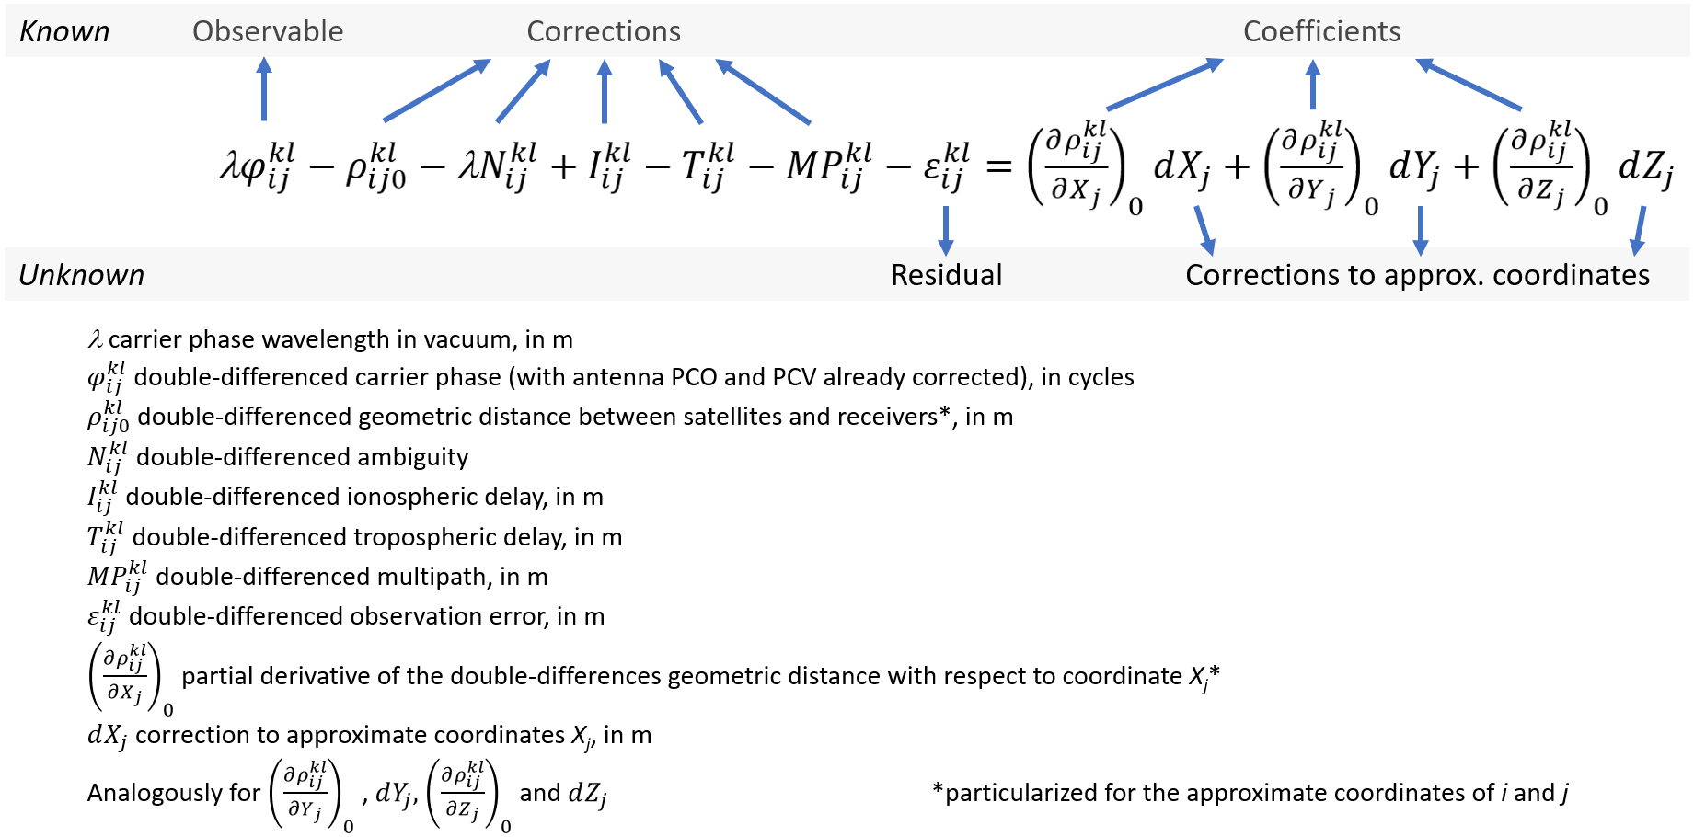
GBDM+ Functional Model (1/2)

Slide 9

GBDM+ Functional Model (2/2)
In matrix form the system of equations is $k+r=Ax$
By using a Jacobian and a rotation matrix it is transformed to $k+r=ARJ^{−1}x′$
where $x^{′}=\left(\begin{matrix}dD_{ij} \\ dα_{ij} \\ dz_{ij}\end{matrix}\right)$
$x′(1,1)$ directly gives the correction to the approx. baseline
distance, so that $D_{ij}={D_{ij}}_{0}+dD_{ij}$
The corresponding uncertainty can also be directly obtained
from the $(1,1)$ element of the covariance matrix $σ_{D_{ij}}=\sqrt{σ_{xx}(1,1)}$
Additional details in:
Baselga, S., García-Asenjo, L., Garrigues, P., Luján, R. (2022) GBDM+: an improved methodology for a GNSS-Based Distance Meter. Meas. Sci. Technol., 33, 085020
García-Asenjo, L., Baselga, S., Atkins, C., Garrigues, P. (2021) Development of a Submillimetric GNSS-Based Distance Meter for Length Metrology. Sensors, 21, 1145

Slide 10
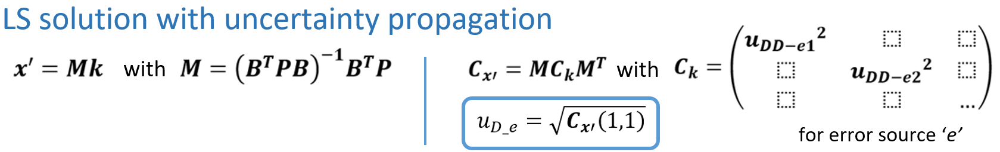
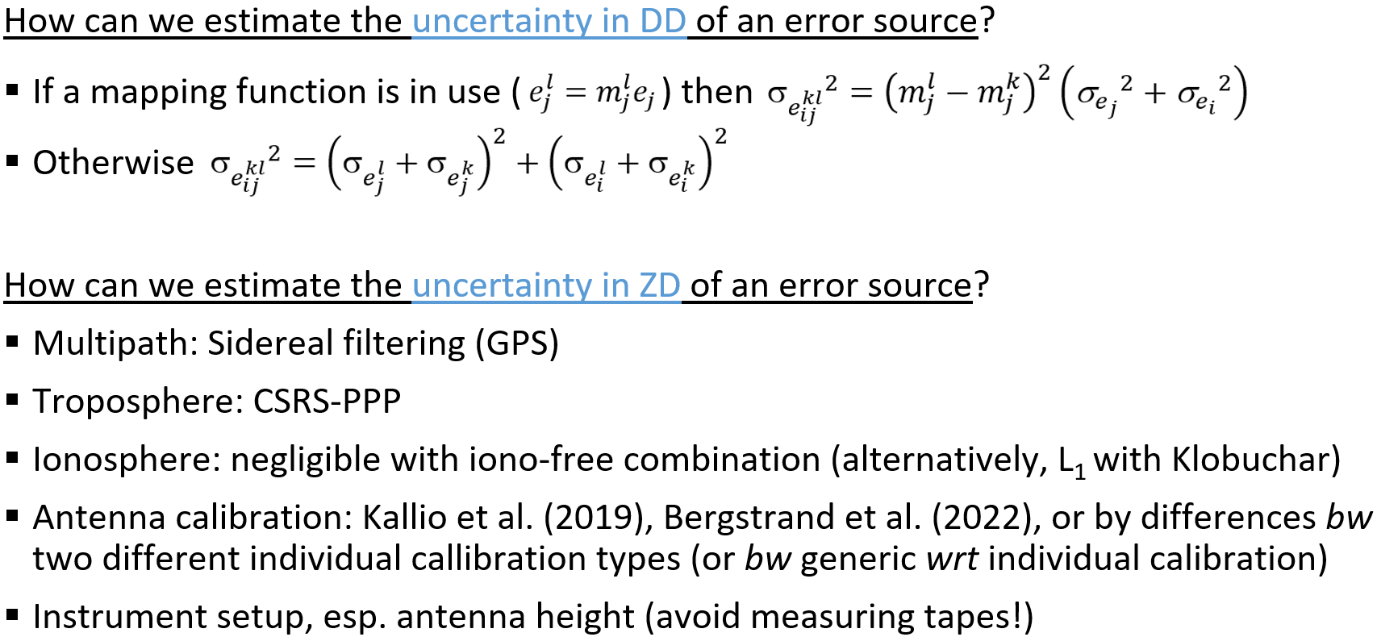
GBDM+ Uncertainty

Slide 11
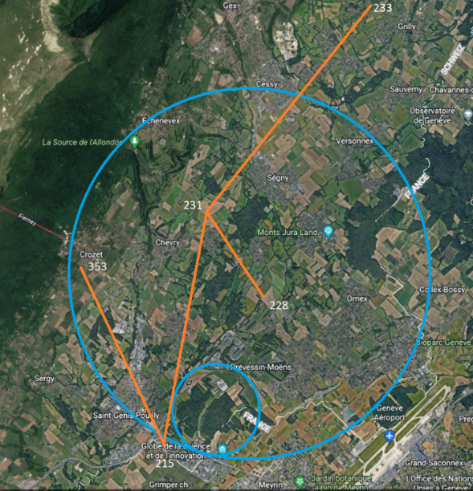
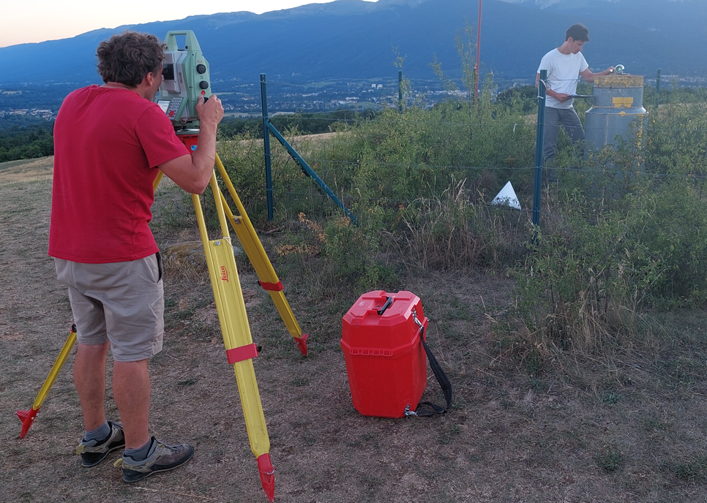
CERN geodetic network observation campaign
A subset of 5 pillars, 4 baselines:
231-228 (∼2.2 km)
215-353 (∼4.7 km)
231-215 (∼6.0 km)
233-231 (∼6.5 km)
Measured by GNSS:
3 days (July 11, 2022, 9:57GMT to July 14, 2022, 19:05GMT)
5 LEICA GR25 receivers
5 LEICA AR25 individually calibrated choke ring antennas
4 global constellations (GPS, Galileo, GLONASS, BDS)
Observation rate 1 s⁻¹
Antenna height accurately measured by Total Station
Measured by Arpent Absolute Distance Meter:
Same baselines were measured the week before
Results still to be released

Slide 12
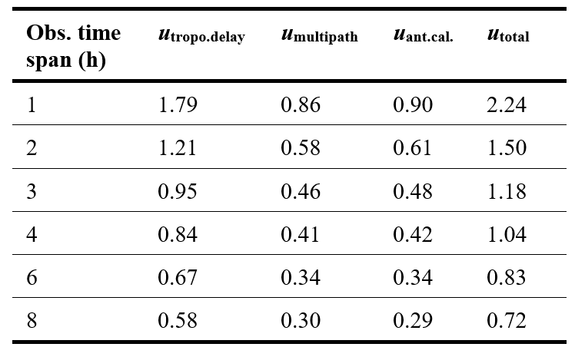
GBDM+ results: Uncertainty propagation
Uncertainties in double differences
Some plots of uncertainties (k = 2) for baseline 231-228
Total uncertainty budget
For baseline distance 231-228 after propagation of all relevant sources*, values in mm (k = 2). Average values for each of the different time blocks
*The propagated uncertainty in antenna heights resulted below 0.01 mm in this case, so it is not displayed in the table

Slide 13
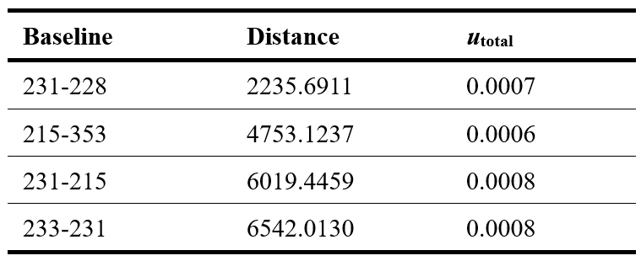
GBDM+ results: distances
Baseline distances and uncertainties
Summary of baseline distances and corresponding uncertainties, values in m, k = 2

Slide 14
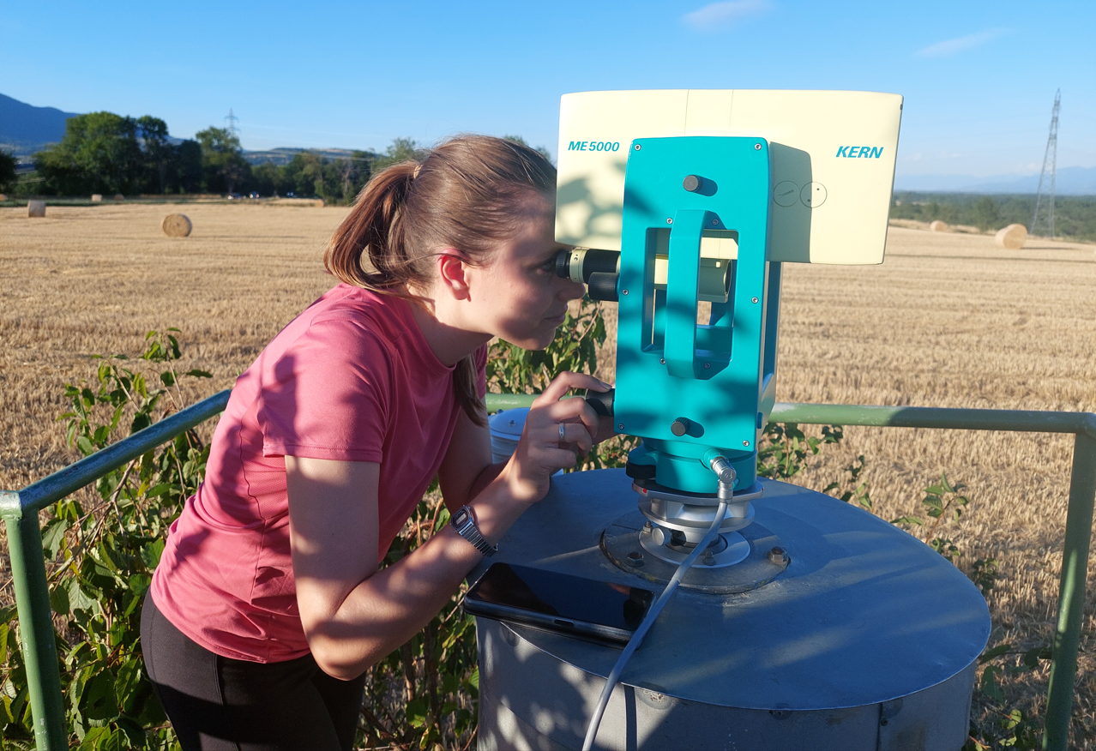
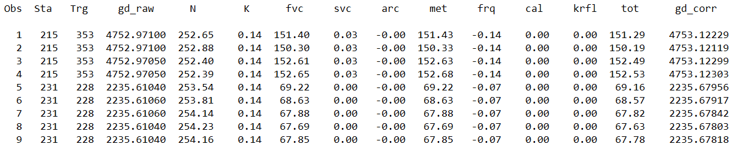
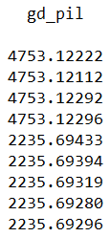
Mekometer results (1/2)
The baselines <5km were measured with Kern Mekometer ME5000 (231-228 and 215-353)
The index of refraction was determined at baseline ends after measurements with Testo 176P1 meteorological sensors, using Ciddor & Hill (1999) formula
The average value was used to compute the first and second velocity corrections as well as the arch-to-chord correction.
As expected, the second velocity and the arch-to-chord corrections resulted negligible.
First velocity correction 7 to 15 cm!
The Mekometer frequency was calibrated at the UPV calibration lab resulting in a virtually zero scale correction (-0.030 ± 0.015 ppm, k = 2)
Distances were then reduced to head of pillars

Slide 15
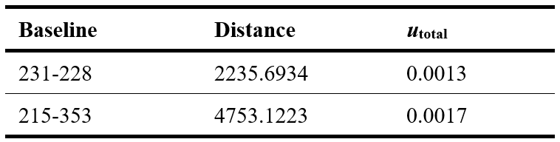
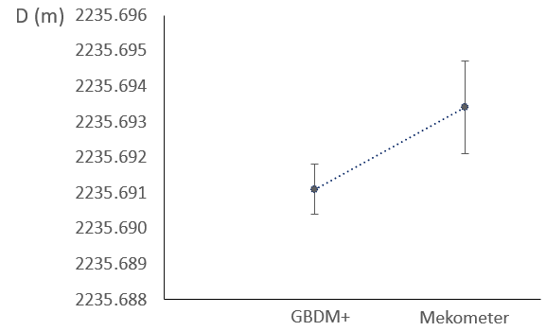
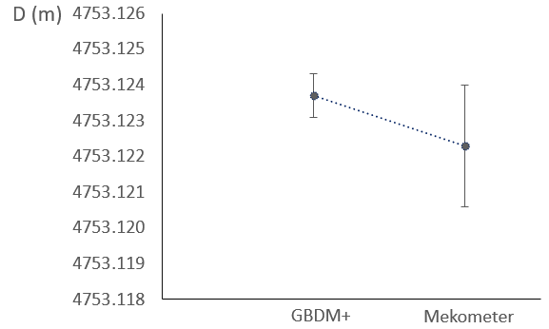
Mekometer results (2/2)
Mekometer results
Mekometer vs GBDM+ results
u_{total} is experimental deviation (k = 2)
Limitations:
Meteorological parameters measured only at the baseline endpoints
No calibration available for the reflector (offset = 0?)
(CO₂ content assumed as 421 ppm)

Slide 16
Conclusions, limitations and future work
Satisfactory results for the GBDM+ approach: ∼10⁻⁷
Satisfactory results for comparisons with Mekometer (also with historical data)
Limitations
CSRS-PPP v.3 estimates ionospheric delays but does not distribute them to the users. The CSRS-PPP may possibly add this output as part of its forthcoming v.4 (Banville 2021, personal communication). For the moment, no uncertainty included in the uncertainty budget.
CSRS-PPP v.3 truncates all input files to a sampling rate of 30 s, so no corrections and corresponding uncertainty values are available for shorter rates.
The sidereal filtering approach to determine a multipath model (correction + uncertainty) is only possible for the GPS constellation due to the corresponding repeat periods of the different GNSS constellations. A complete uncertainty analysis for satellites from constellations other than GPS is not possible.
The possibility of eliminating DD eqns with large uncertainties, or those whose uncertainties have a large impact on the resulting distance, still remains unexplored.

Slide 17
References
Banville, S., Hassen, E., Lamothe, P., Farinaccio, J., Donahue, B., Mireault, Y., Goudarzi, M.A., Collins, P., Ghoddousi-Fard, R., Kamali, O. (2021) Enabling ambiguity resolution in CSRS-PPP. Navigation 68(2) 433-451
Baselga, S., García-Asenjo, L., Garrigues, P., Luján, R. (2022) GBDM+: an improved methodology for a GNSS-Based Distance Meter. Measurement Science and Technology, 33: 085020 (16 pp.) DOI: 10.1088/1361-6501/ac6f45
Baselga, S., García-Asenjo, L., Garrigues, P., Luján, R., Pollinger, F., Kallio, U., Koivula, H., Wezka, K., Próchniewicz, D., Pesce, D., Bergstrand, S. (2022, in preparation) Good practice guide on high-accuracy GNSS-based distance metrology. EURAMET Technical Guide
Bauch, A., Eusébio, L., Kallio, U., Koivula, H., Lahtinen, S., Marques, F., Pellegrino, O., Pires, C., Pollinger, F., Poutanen, M., Saraiva, F., Schön, S. and Zimmermann, F. (2017) Good practice guide for high accuracy global navigation satellite system based distance metrology. Revised Version 2. (Braunschweig: JRP SIB60 Surveying Consortium).
Bergstrand, S., Jarlemark, P. and Herbertsson, M. (2020) Quantifying errors in GNSS antenna calibrations: Towards in situ phase center corrections Journal of Geodesy 94 105 (15 pp).
Ciddor, P.E., and Hill, R.J. (1999) Refractive Index of Air. 2. Group Index. Applied Optics 38, 1663–1667
García-Asenjo, L., Baselga, S., Atkins, C., Garrigues, P. (2021) Development of a Submillimetric GNSS-Based Distance Meter for Length Metrology. Sensors 21, 1145.
Kallio, U., Koivula, H., Lahtinen, S., Nikkonen, V., Poutanen, M. (2019) Validating and comparing GNSS antenna calibrations. Journal of Geodesy 93, 1–18.

Slide 18
Thanks for your attention!

