Slide 1
11T Dipole short model coil metrology at cold and measurement of thermal contraction
Dirk Mergelkuhl, Konstantinos NIKOLITSAS – CERN
03.11.2022

Slide 2
Table of content
HL-LHC dipole construction
Application
  Measurement demand
  Preparation of photogrammetric setup
  Measurement configuration and data
Deformation analysis of short model coil
Estimation of the CTE
Conclusion

Slide 3
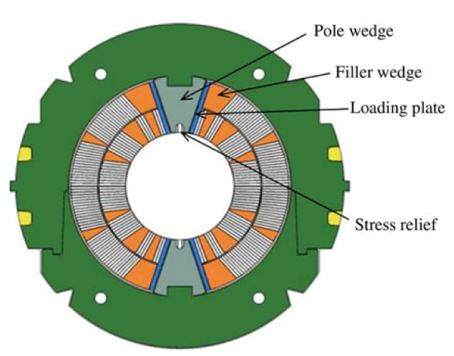
11T Dipole measurement demand
Demand from the HL-LHC Work Package 11
  Second task force on 11 T dipole magnet following a CERN Machine Advisory Committee review
Deformation measurement of 11 T short model dipole to define the coefficient of thermal contraction (CTE)
  warm measurement at room temperature
  cold in nitrogen gas just above liquid (> 77 K)
Measurement precision < 100 micron
Preparation time 6 weeks

Slide 4
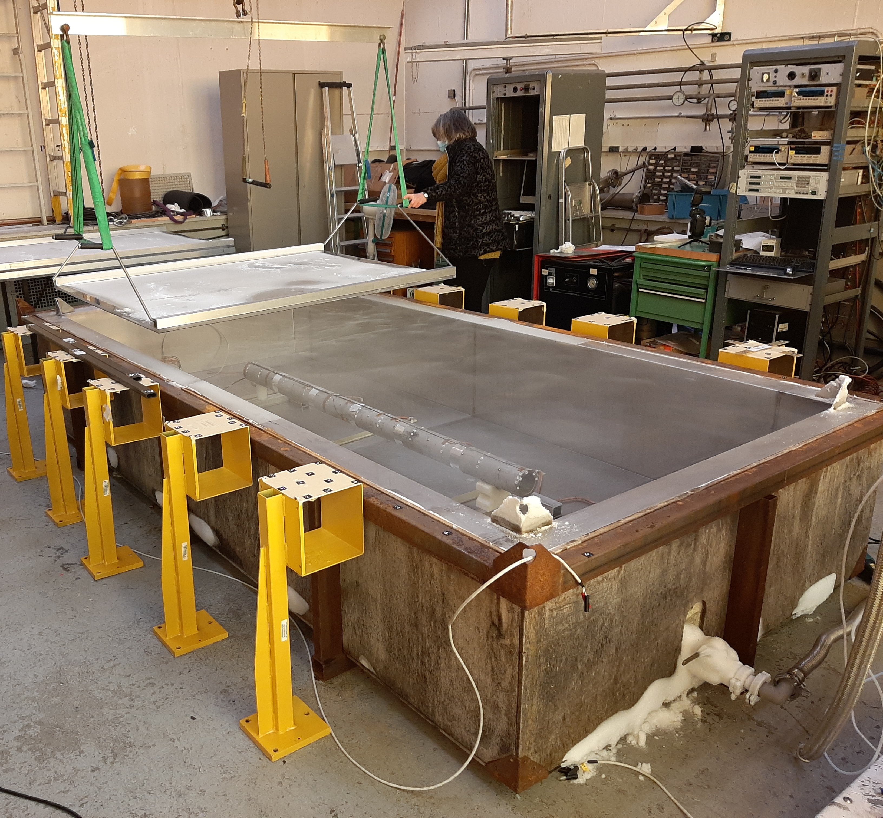
Test set-up of Cryolab
Installation with dummy load
Test occasion for survey team:
  Isostatic support
  Target type and target size
  Influence of vapour cloud
  Cool down and warm-up time and achievable temperature difference
  Sensible to air humidity
Validation of procedure, equipment, precision and useable time slot

Slide 5
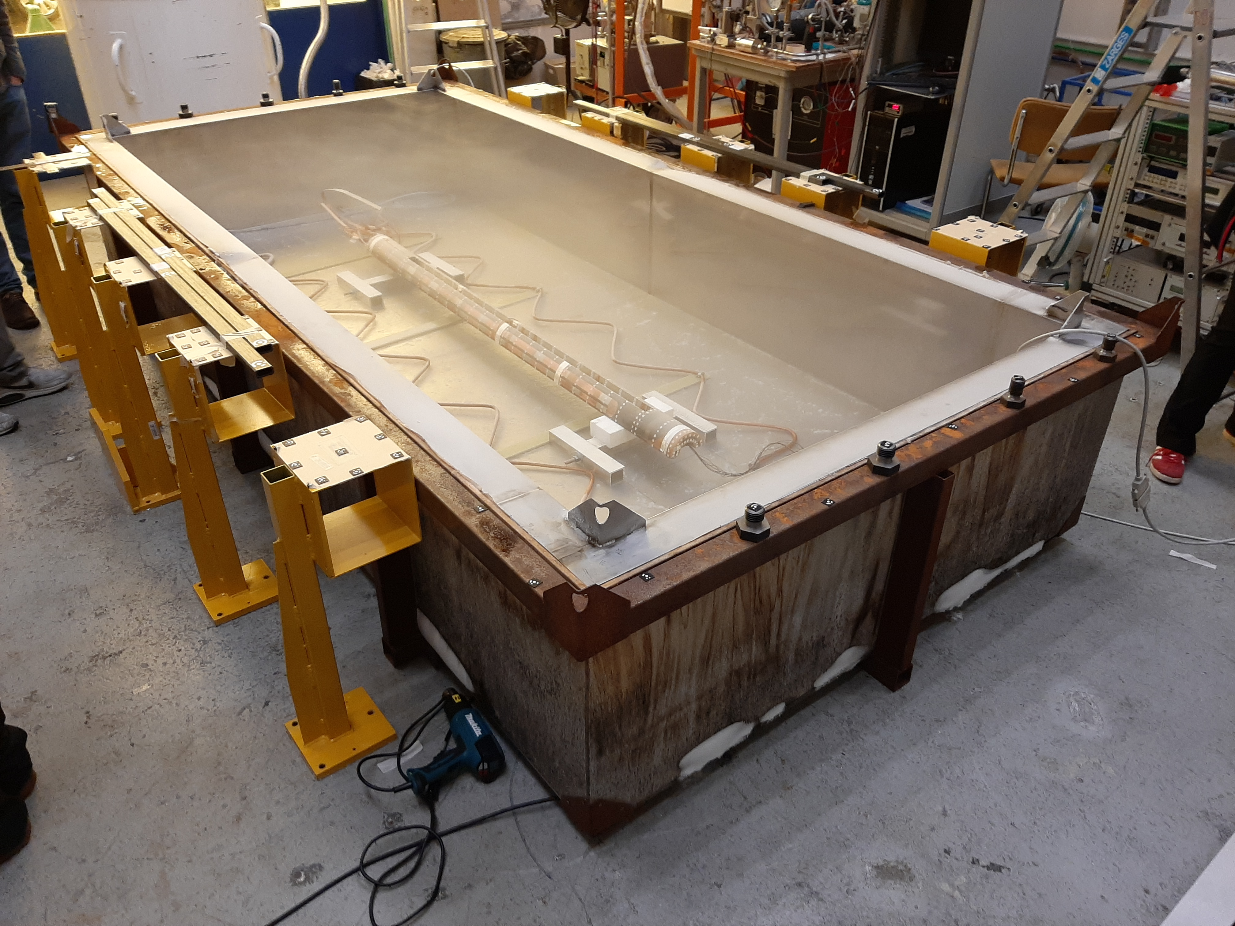
Photogrammetric set-up
Setup prepared by TE-CRG-CI
11 T model coil on isostatic supports
Cool-down with liquid nitrogen bath
Covered during cool-down/warm-up
Temporarily opened for the photogrammetric measurement
Scale bars and photogrammetric coded targets outside the cold bath

Slide 6
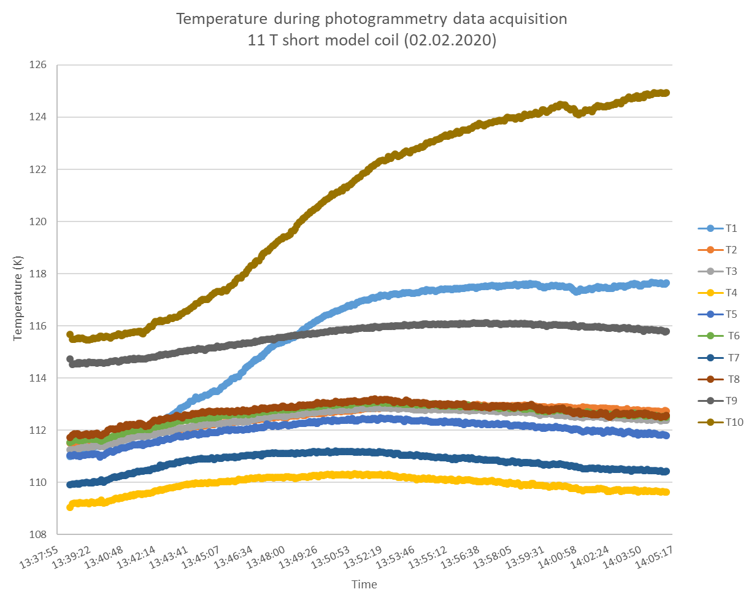
Temperature data
Detailed data for cold measurement
Inhomogeneous temperature distribution for cold measurement

Slide 7
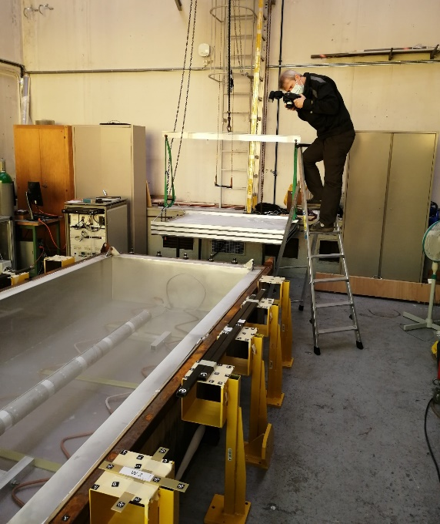
Photogrammetric equipment
AICON DPA-Pro (Hexagon) for analysis
2 cameras
  1x Canon 5DS, 28 mm lens
  1x Nikon D3X, 28 mm lens
10-12 reference scales (carbon fibre)
Non-coded targets
  Self-adhesive foil stickers on loading plates, thickness 70 µm, Ø 3 mm
  Self-adhesive paper stickers on coil, thickness 100 µm, Ø 2 mm

Slide 8
Measurement constraints
Constraints
Consequences
Thin vapour cloud on top of “swimming pool”
After few minutes a small ice layer forms on the targets and coil
High temperature gradient for measurements rays
Points distributed on multiple surfaces
Reduced visibility for target measurement
Limited time for data acquisition
Small number of missing points in individual measurements
Decreased precision of measurement in cold
Increase of measurement time

Slide 9
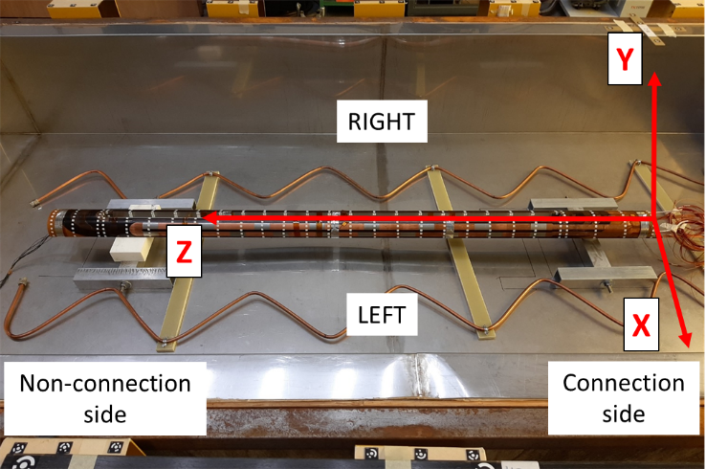
Coordinate system definition
Origin: intersection of the cylinder axis and the mean plane of targets on the connection side end.
X-axis: perpendicular to the two others in a right handed Cartesian Coordinate System.
Y-axis: in direction of the loading plates.
  The average angle of the calculated mean planes for the two loading plates is defined as 0°.
Z-axis: calculated best-fit cylinder axis
Only for the 1st warm measurement!

Slide 10
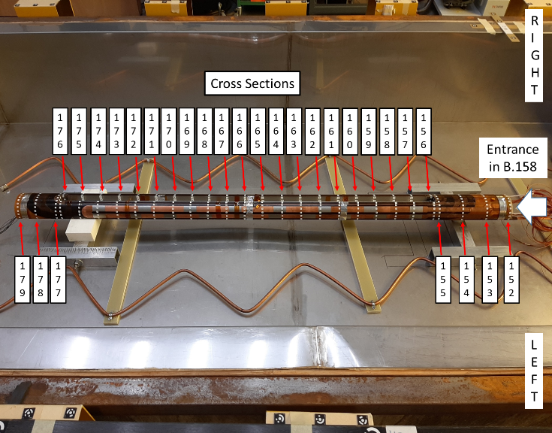
Point distribution on 11T model coil (I)
List of measured surface
2 layers of 10 targets per end face
12 targets per section and 4 additional in loading plate area
4x sections on connection end
3x sections on short end
21x sections (every 75 mm) in the area of the loading plates
If possible, targets on the key surface

Slide 11
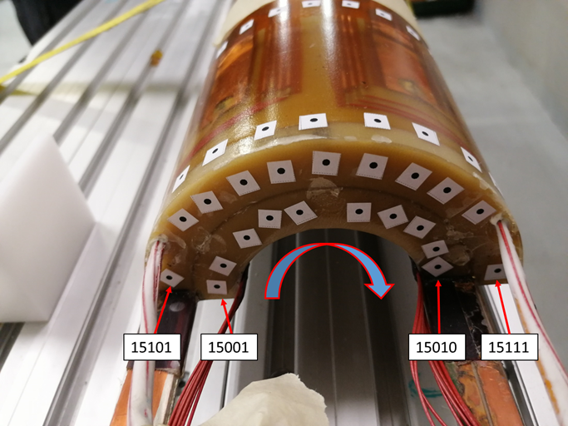
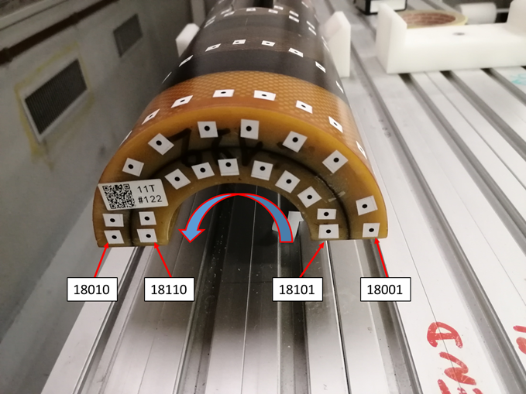
Point distribution on 11 model coil (II)
End surface of the coil
(View side from connection end)
End surface of the coil
(View side from non-connection end)

Slide 12
Measurement configuration
At least ~400 photos
~600 measured points
> 70000 observations
~4100 unknowns
Average RMS of 3D coordinates ~5-15 µm
RMS of scale residuals ~5-15 µm

Slide 13
Preparation Deformation Analysis
Analysis based on 7- parameter least-square transformation
(3 translations, 3 rotations, 1 scale factor)
Reference measurement 01.02.2021 (warm)
  7-DOF transformation for cold 02.02.2021
  7-DOF transformation for warm 03.02.2021
  7-DOF transformation for warm 11.02.2021
Outputs:
  Residual deformations after application of global scaling factor (slides 14-18)

Slide 14
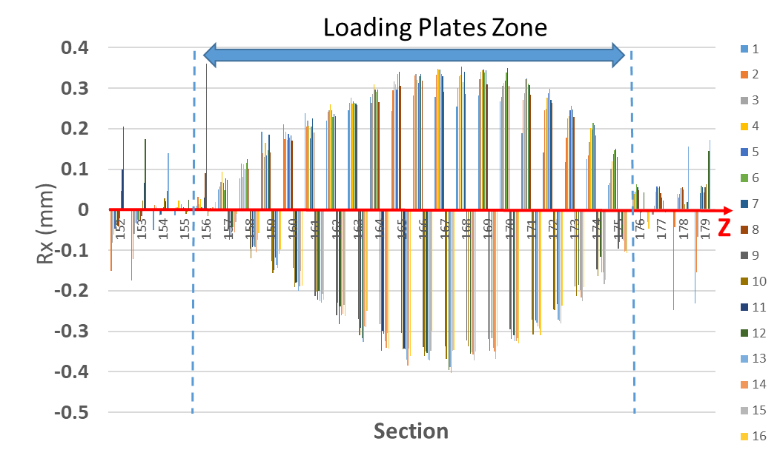
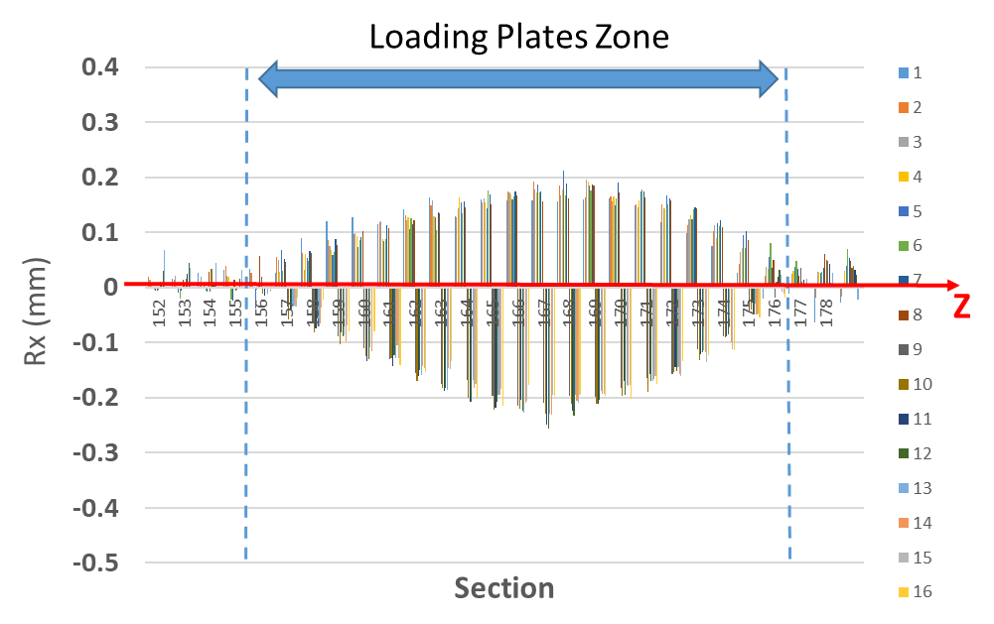
Deformation Analysis X-direction (I)
Cold To Reference
Warm After To Reference
The loading plates open by +-0.40 mm
The loading plates open by +-0.25 mm
Analysis of residuals after application of global scale factor!

Slide 15
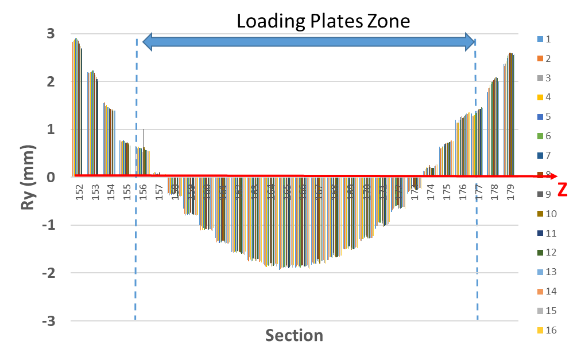
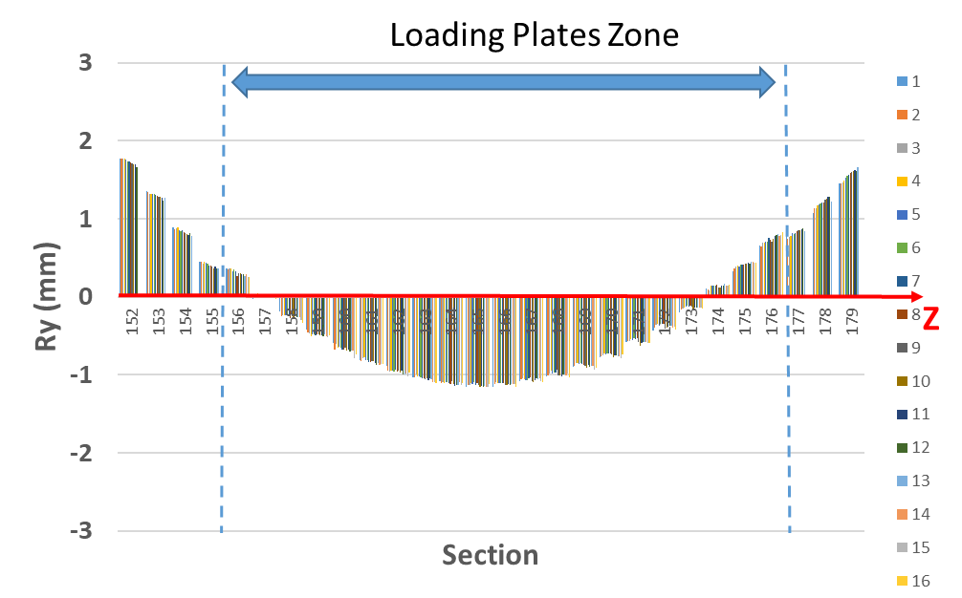
Deformation Analysis Y-direction (II)
Cold To Reference
Warm After To Reference
The coil is bended by +2.9/-1.9 mm
The coil is bended by +1.8/-1.2 mm
Analysis of residuals after application of global scale factor!

Slide 16
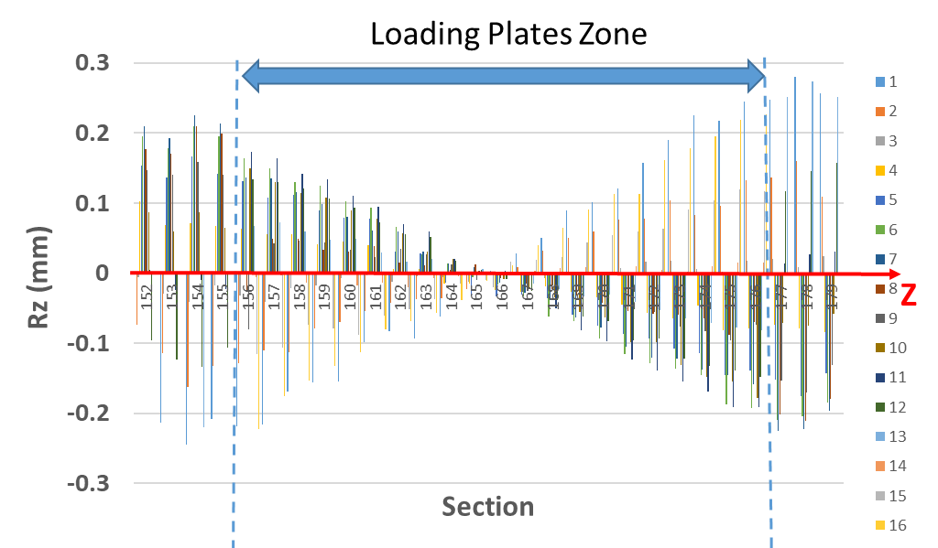
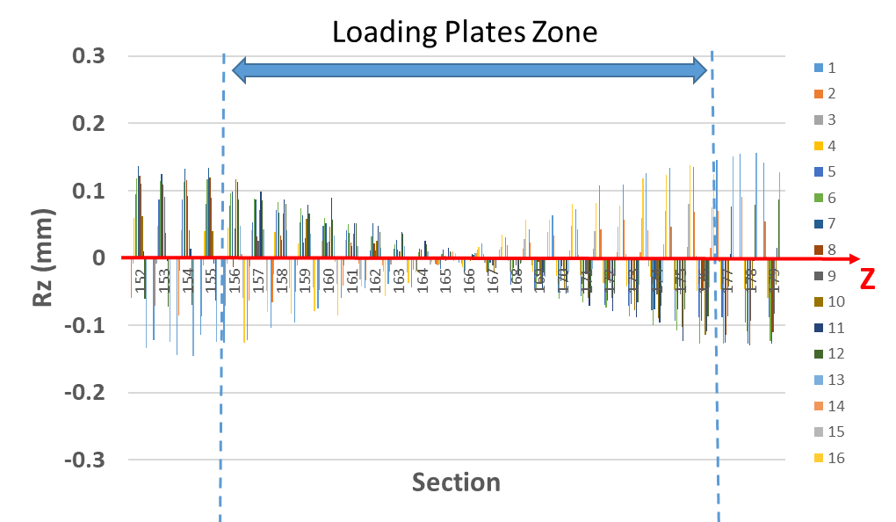
Deformation Analysis Z-direction (III)
Cold To Reference
Warm After To Reference
The coil is twisted by +-0.26 mm
The coil is twisted by +-0.15 mm
Analysis of residuals after application of scale factor!

Slide 17
Estimation of thermal contraction
Procedure to get best estimated scale factor of “bended” coil
Bending of nearly 5 mm could influence the global scale factor in the least square 7-parameter transformation
The following procedure has been used instead:
  Transformation 6 DOF (3 translations, 3 rotations, scale fixed to 1.0) to get in the coordinate system of the reference measurement.
  Transformation 4 DOF to get the scale factor (translation XZ, rotation Y, scale factor in XZ plane)
  Correction for bending (difference of arc to straight line)

Slide 18
Estimation of thermal contraction
Reference to Cold
Reference to Warm (after test)
Result using XZ coordinates of all points on coil surfaces:
  Cold to reference (no correction)
    2.285 mm/m (1σ = 13 µm)
    12.86 µm/m/K
  Final contraction after bending correction:
    2.269 mm/m
    12.77 µm/m/K
Even after warm-up the 11 T model coil stays bended/twisted
The form is significantly different from the zero measurement before the test
Warm (2nd) to reference measurement
  -0.099 mm/m
  The coil is longer than before

Slide 19
Conclusion (deformation and CTE)
The 11T model coil contracts but also bends (4.85 mm), twists (0.26 mm) and the pole opens during the cold test (±0.4 mm)
The form of the 11T dipole short model coil changes significantly after cooling cycle. The residual bend after the cold test is permanent and significant.
The best estimate of a global CTE is 12.8 ± 0.3 μm/m/K for the difference from room temperature and a ΔΤ ≈ 177.68 K but probably more than a single coefficient needs to be taken into account to characterize the coil as a composite structure.

Slide 20
Conclusion (photogrammetry)
The photogrammetric measurements in cryogenic condition has been successfully completed despite the harsh environmental conditions and the 3D measurement precision has been close one of the room temperature measurement.
Statistical data for image measurement precision and scale bar residuals have been at the same level for warm and cold measurements.
The homogeneous temperature of the coil and the corresponding measurement is crucial for the setup. Modification of setup for MQXF with immerged coil.

