Slide 1
Detection of Structured Laser Beam centroid and its use for alignment
IWAA 2022 – CERN
Martin Dusek ^{1,2}, Krystof Polak ^{1,2}, Jean-Christophe Gayde ¹, Miroslav Sulc ², Dirk Mergelkuh ¹, Witold Niewiem ^{1,3}
CERN – European Organization for Nuclear Research, Switzerland ¹,
Technical University of Liberec, Czech Republic ²
ETH Zurych, Zurych ³
11/2/2022

Slide 2
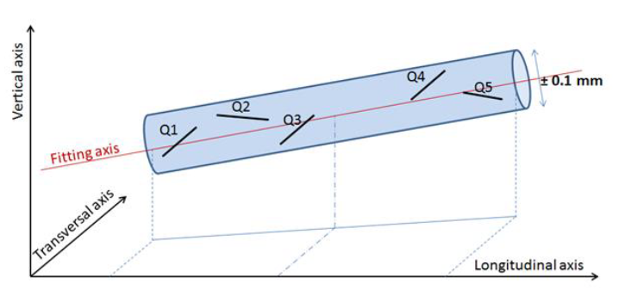
Alignment of Particle Accelerators
Fitting aligned objects with respect to a straight reference line
Typical alignment requirements for accelerators at CERN:
  LHC: σ = 150 µm over L = 150 m
  HL-LHC: σ = 150 µm over L = 200 m
  CLIC: σ = 15 µm over L = 200 m
  FCC: To be announced
  (Preliminary σ = 50 - 100 µm over L = 200 m)
Raduis = σ
Alignment window L
Presently Hydrostatic Leveling Systems and stretched Wire Positioning Systems are used for monitoring
Structured laser beam (SLB) has potential to create a laser beam-based alternative for long-distance alignment system

Slide 3
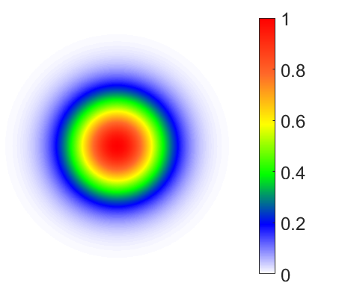
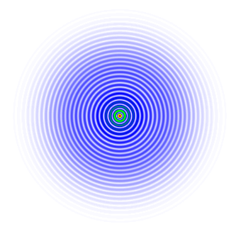



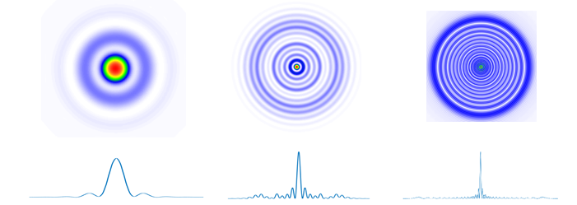
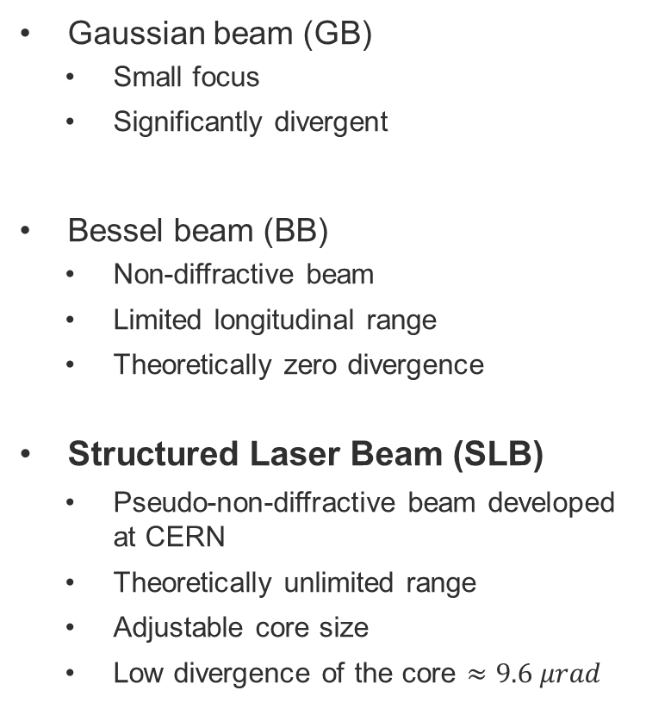
Optical beams
Gaussian beam
Thin Lens
Gaussian beam (GB)
  Small focus
  Significantly divergent
Bessel beam (BB)
  Non-diffractive beam
  Limited longitudinal range
  Theoretically zero divergence
Structured Laser Beam (SLB)
  Pseudo-non-diffractive beam developed at CERN
  Theoretically unlimited range
  Adjustable core size
  Low divergence of the core $≈9.6 μrad$
Focus
Plane wave
Axicon
Generated wavefronts
Plano-convex Lens
3
Ball Lens

Slide 4
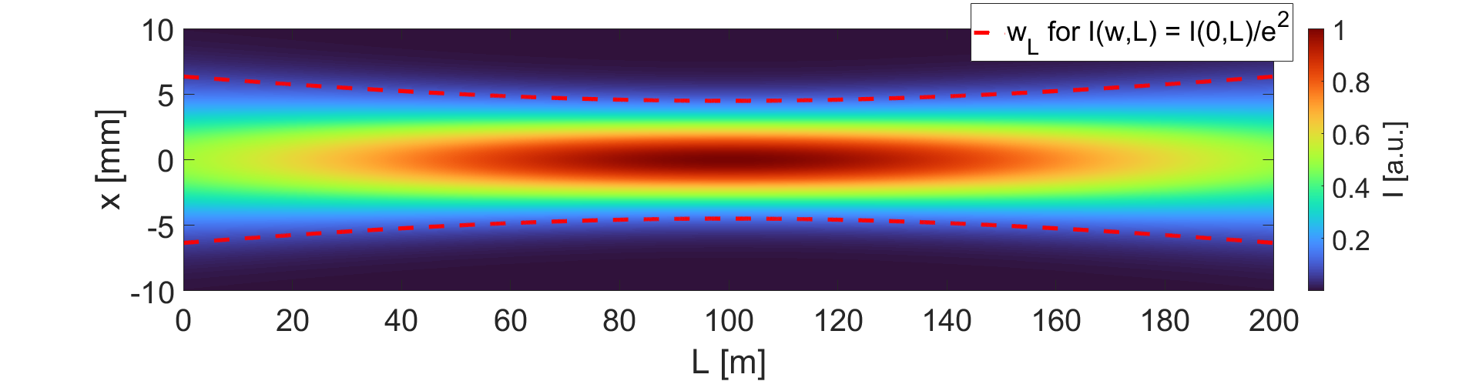
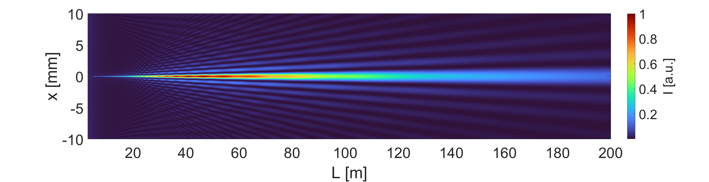
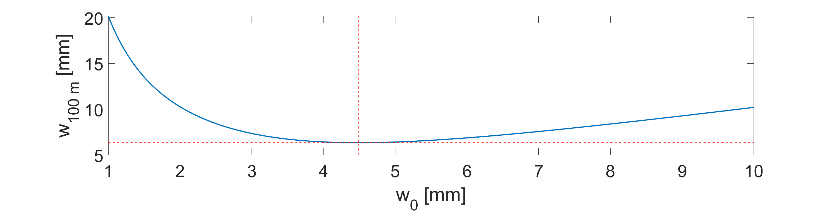
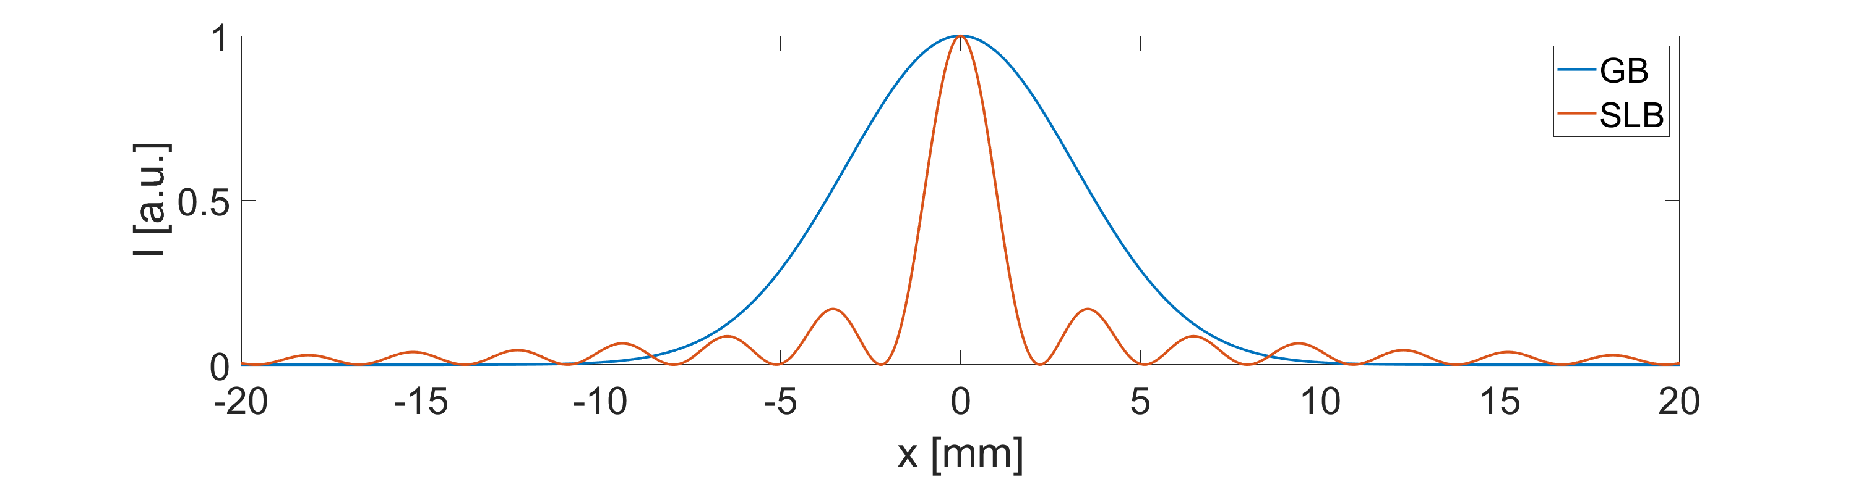
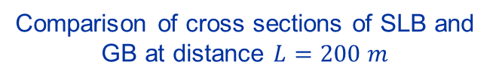
Comparison of SLB and GB
Longitudinal profile of GB
GB parameters must be tuned carefully in order to be used for alignment
There can be a problem with the intensity of the GB
SLB has sharp, well-defined, intensive core, that can be easily detected
Longitudinal profile of SLB
Comparison of cross sections of SLB and GB at distance $L=200 m$
GB optimization

Slide 5
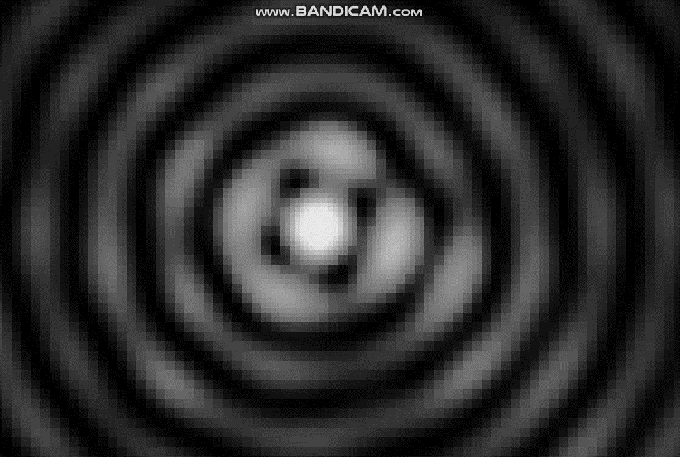
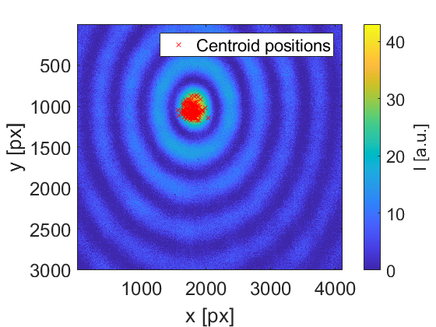
SLB as straight-line reference
Is the SLB really a straight line?
How to detect the beam at multiple points?
Can we use the system without vacuum?
How to precisely detect the centroid?
Beam is oscillating due to the air fluctuations of the atmosphere
In the short term, without huge temperature spikes, the beam is oscillating around one point
  Possibility to average data in time
Need for a precise, fast, and easy-to-use algorithm for detection of the centroid
1 mm
Oscillations of a SLB measured
2 m away from a generator
Real image of a SLB –
120 m away from a generator. Projected on a CMOS chip
14x10 mm² without any imaging optics.
Centroid positions measured for
1 hour. Pixel size 3.45 μm.

Slide 6
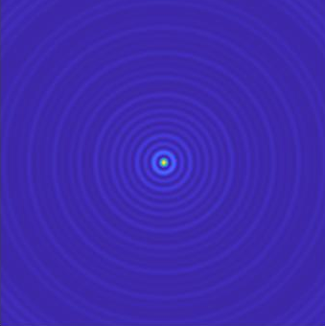
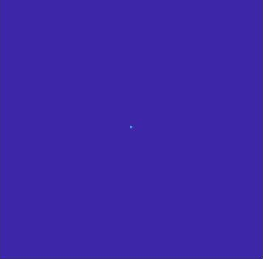
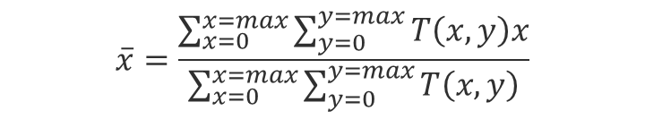
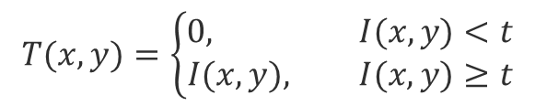
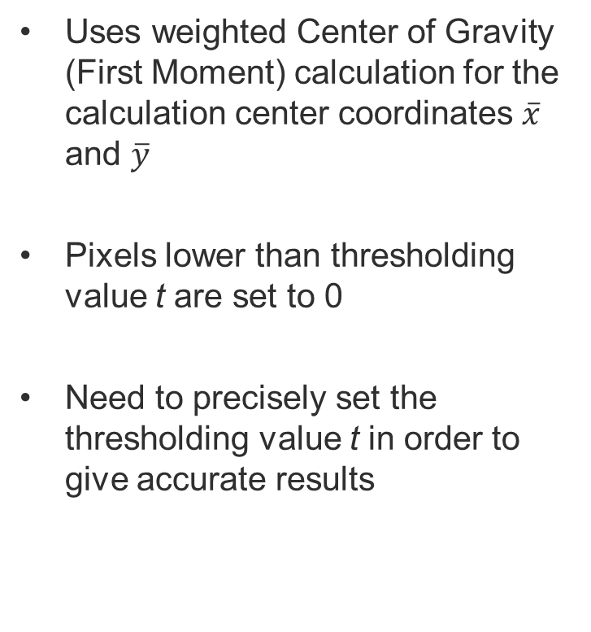
Thresholding Center of Gravity (TCoG)
Uses weighted Center of Gravity (First Moment) calculation for the calculation center coordinates $\overline{x}$ and $\overline{y}$
Pixels lower than thresholding value t are set to 0
Need to precisely set the thresholding value t in order to give accurate results
$$T(x,y)=\left\{\begin{aligned}0, I(x,y)<t \\ &I(x,y), I(x,y)≥t\end{aligned}\right.$$
$$\overline{x}=\frac{\sum_{x=0}^{x=max}{\sum_{y=0}^{y=max}{T\left(x,y\right)x}}}{\sum_{x=0}^{x=max}{\sum_{y=0}^{y=max}{T\left(x,y\right)}}}$$

Slide 7
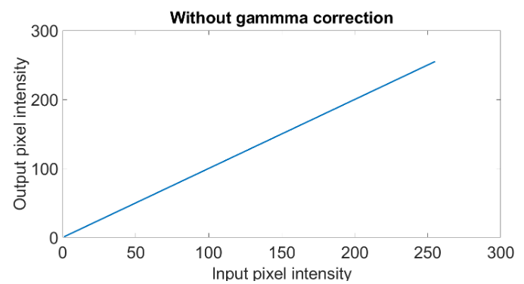
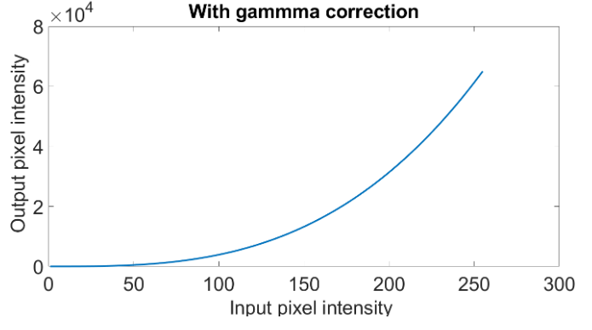
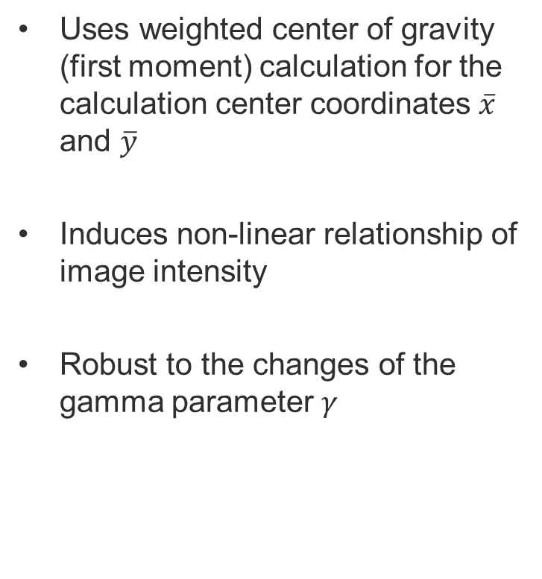
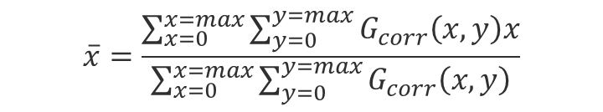

Gamma corrected Center of Gravity (GCoG)
Uses weighted center of gravity (first moment) calculation for the calculation center coordinates $\overline{x}$ and $\overline{y}$
Induces non-linear relationship of image intensity
Robust to the changes of the gamma parameter $γ$
$$G_{corr}(x,y)=I_{max} {(\frac{I\left(x,y\right)}{I_{max}})}^{γ}$$
$$\overline{x}=\frac{\sum_{x=0}^{x=max}{\sum_{y=0}^{y=max}{G_{corr}\left(x,y\right)x}}}{\sum_{x=0}^{x=max}{\sum_{y=0}^{y=max}{G_{corr}\left(x,y\right)}}}$$

Slide 8
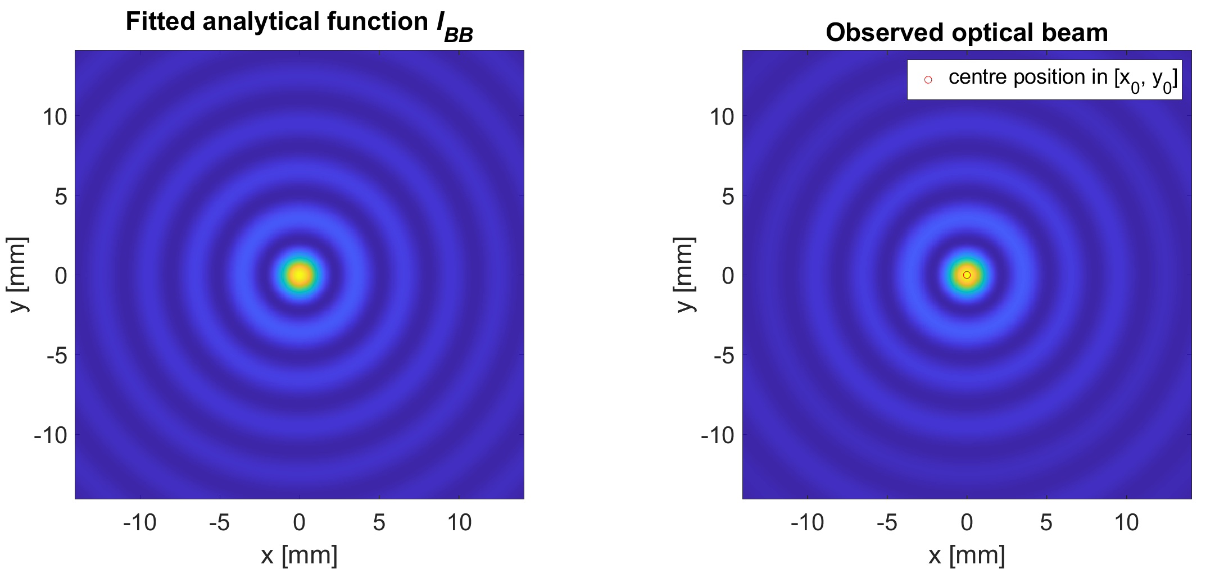
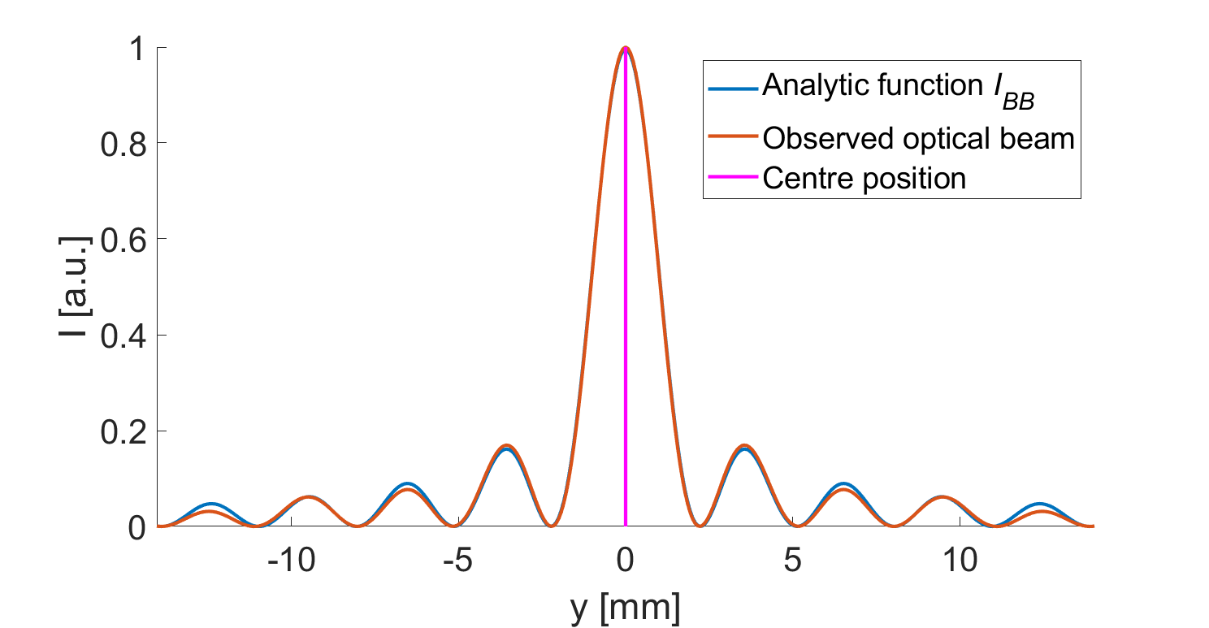
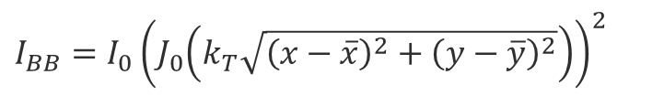
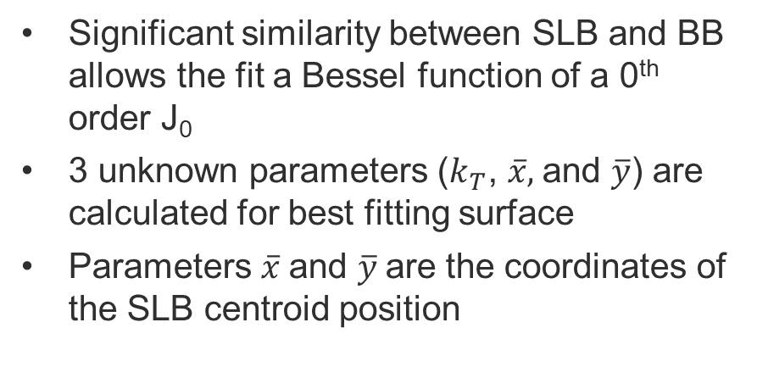
Bessel Fitting Algorithm (BFA)
Significant similarity between SLB and BB allows the fit a Bessel function of a 0th order J₀
3 unknown parameters ($k_{T}$, $\overline{x},$and $\overline{y}$) are calculated for best fitting surface
Parameters $\overline{x}$and $\overline{y}$are the coordinates of the SLB centroid position
$I_{BB}=I_{0}{\left(J_{0}\left(k_{T}\sqrt{{\left(x−\overline{x}\right)}^{2}+{\left(y−\overline{y}\right)}^{2}}\right)\right)}^{2}$

Slide 9
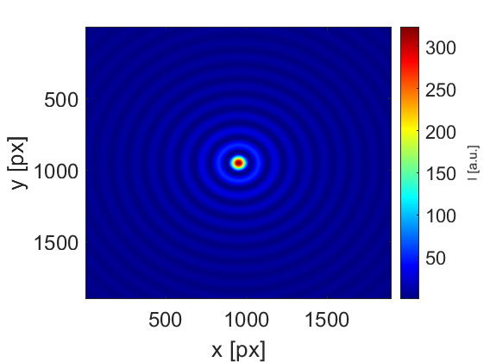
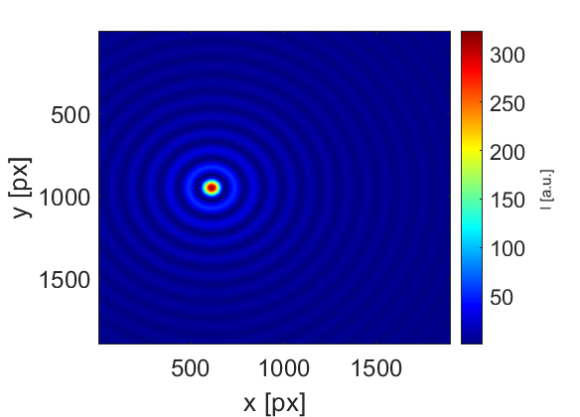
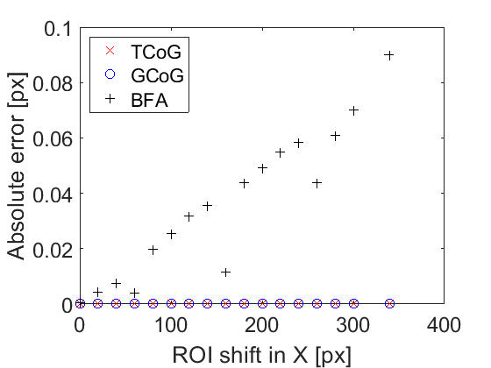
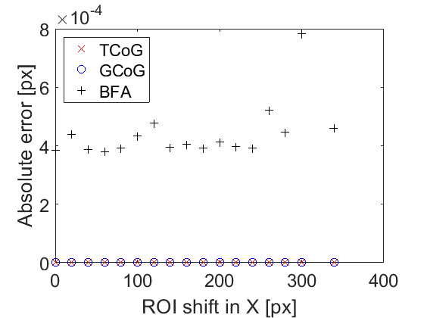
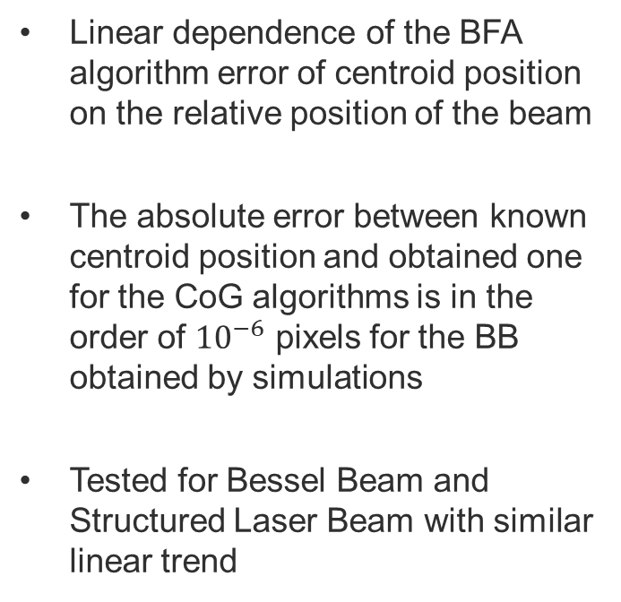
Detection of BB and SLB centroid
Shift of 320 px
Linear dependence of the BFA algorithm error of centroid position on the relative position of the beam
The absolute error between known centroid position and obtained one for the CoG algorithms is in the order of ${10}^{−6}$ pixels for the BB obtained by simulations
Tested for Bessel Beam and Structured Laser Beam with similar linear trend
X-coordinates
Y-coordinates

Slide 10
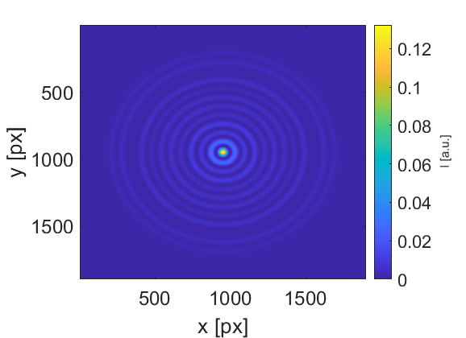
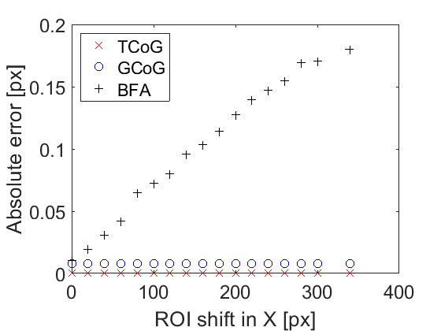
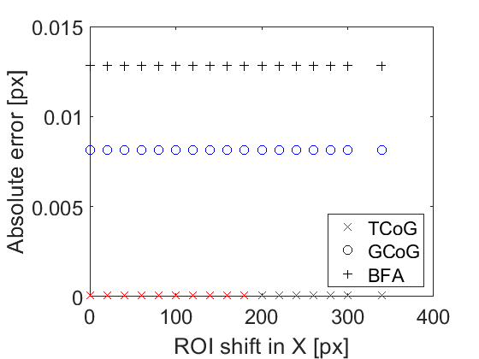
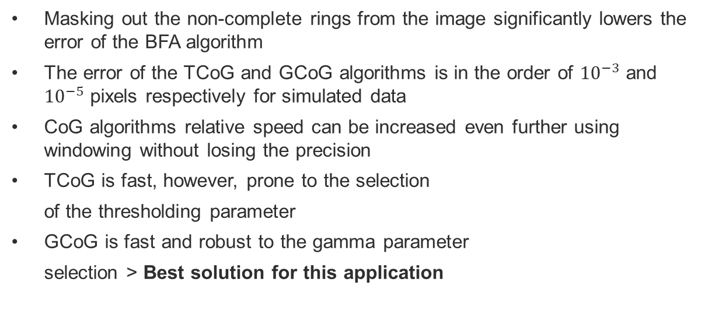
Detection of SLB centroid
Masked SLB
Masking out the non-complete rings from the image significantly lowers the error of the BFA algorithm
The error of the TCoG and GCoG algorithms is in the order of ${10}^{−3}$ and ${10}^{−5}$ pixels respectively for simulated data
CoG algorithms relative speed can be increased even further using windowing without losing the precision
TCoG is fast, however, prone to the selection
of the thresholding parameter
GCoG is fast and robust to the gamma parameter
selection > Best solution for this application
X-coordinate without a mask
X-coordinate with a mask
Algorithm | Relative computational time
BFA | 40.3 s
GCoG | 0.17 s
TCoG | 0.16 s

Slide 11
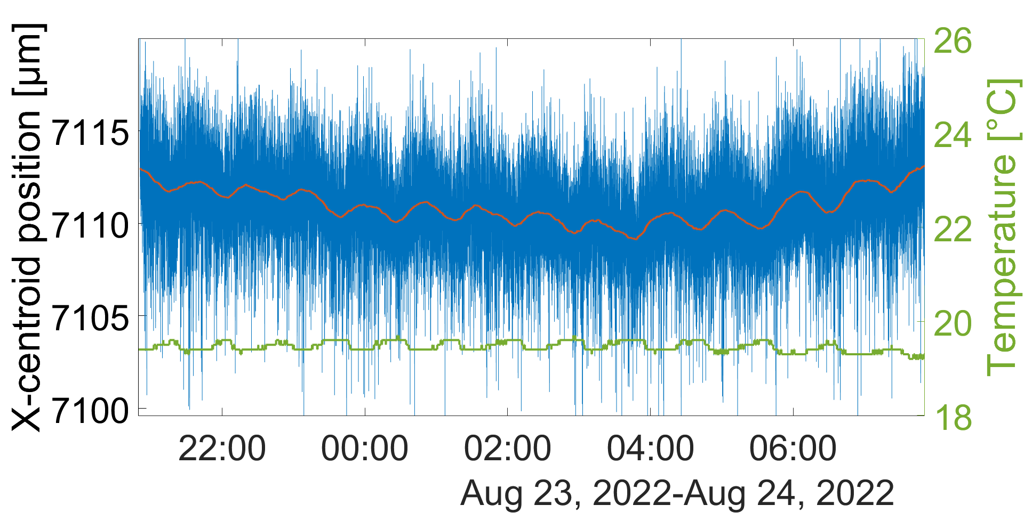
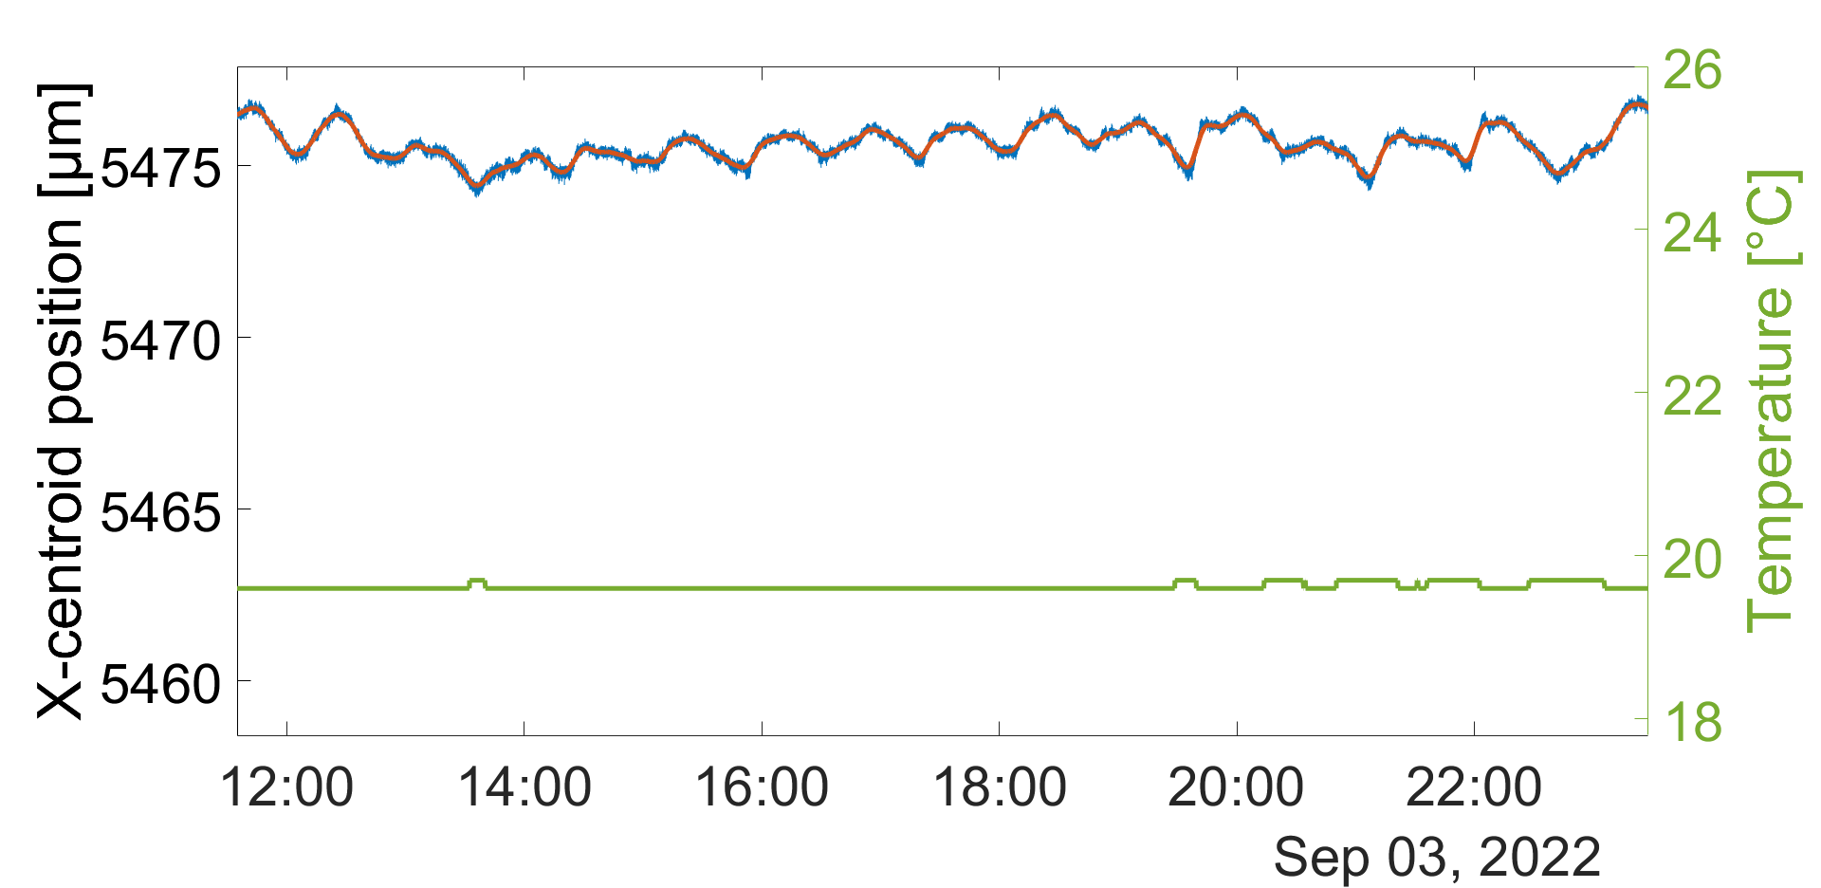
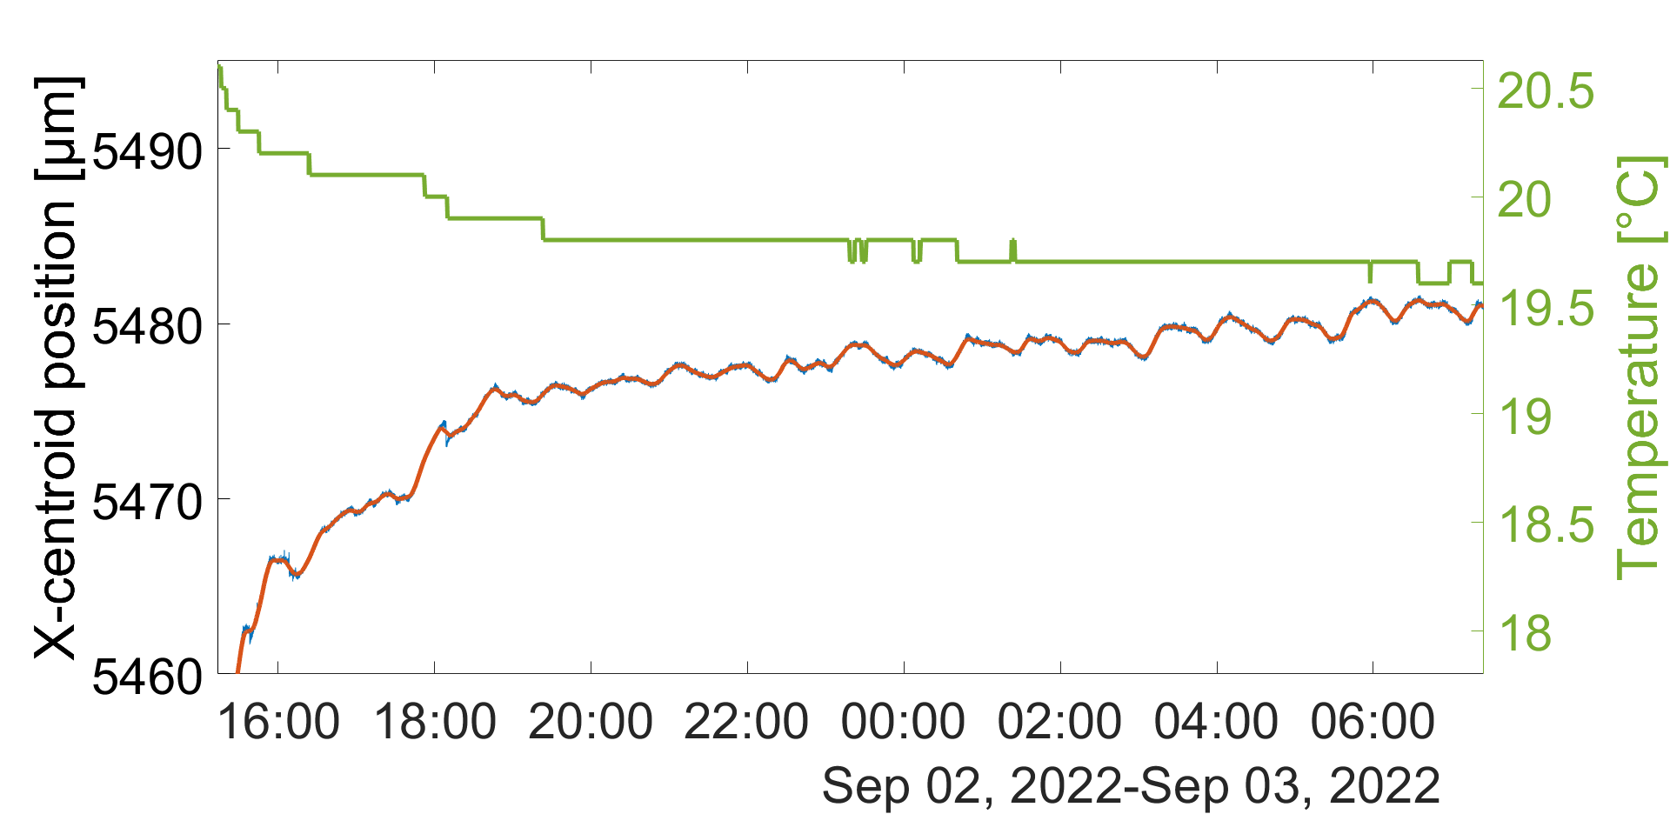
Stability of a SLB
Free-space propagation
Correlation with temperature
Dependence of the oscillation on the tube gap position
Temperature probe
Movable tube gap
Glass window
Insulated tube propagation
2 m
SLB generator inside the tube
CMOS chip
Results from the laboratory | STD X [μm] | STD Y [μm]
Free-space | 1.53 | 1.3
Tube with a gap in front of the laser | 0.65 | 0.66
Tube with a gap in front of the camera | 0.28 | 0.27
Tube closed by window | 0.11 | 0.11
Tube closed and thermally insulated | 0.06 | 0.07

Slide 12
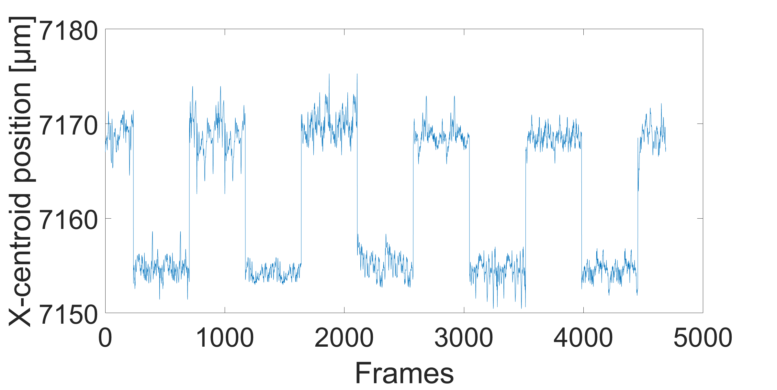
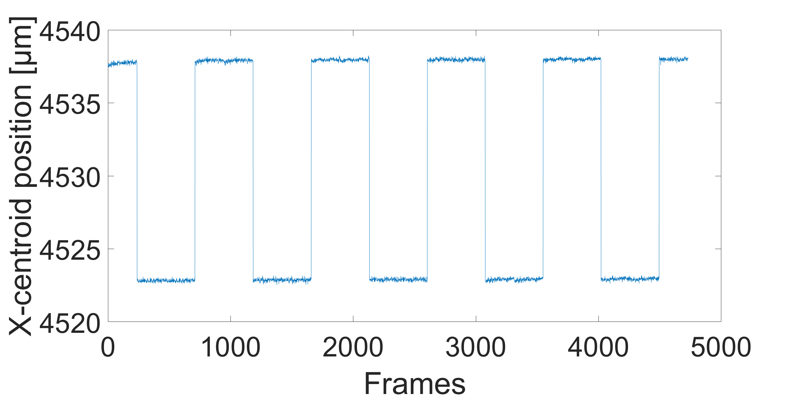
Detection of the relative miss-alignment
Free-space propagation
Setup aligned using laser tracker
Relative misalignment of 15 μm induced by moving camera on a highly precise linear stage
Averaged over 20 seconds
Free-space
  Error of ±1.3 μm
Insulated tube
  Error of ±0.05 μm
Insulated tube propagation
Glass window
Movement direction
2 m
SLB generator inside the tube
CMOS chip
High precision linear stage

Slide 13
Conclusion
All of the algorithms are suitable for the detection of a SLB or BB
Best-fit algorithm needs preprocessing of the image with a circular mask, to avoid using the non-full circles
CoG algorithms exceed BFA when a high speed of detection is needed
TCoG algorithm is the most precise one, however, the precision of GCoG is comparable and it is much more robust to the parameter selection in real measurements
The standard deviation of the beam propagating inside a thermally insulated tube over 2 meters is 0.06 μm
It was possible to reconstruct the relative misalignment with an error of ±0.05 μm
Propagating the beam inside the vacuum will further improve the performance
Measurements over 60 and 120 meters will be performed

Slide 14
Thank you for your attention!
The SLB generation principle is protected by patent:
J.-C. Gayde and M. Sulc, “An Optical System for Producing a
Structured Beam“. EP3564734, 2019.

